Slide 1
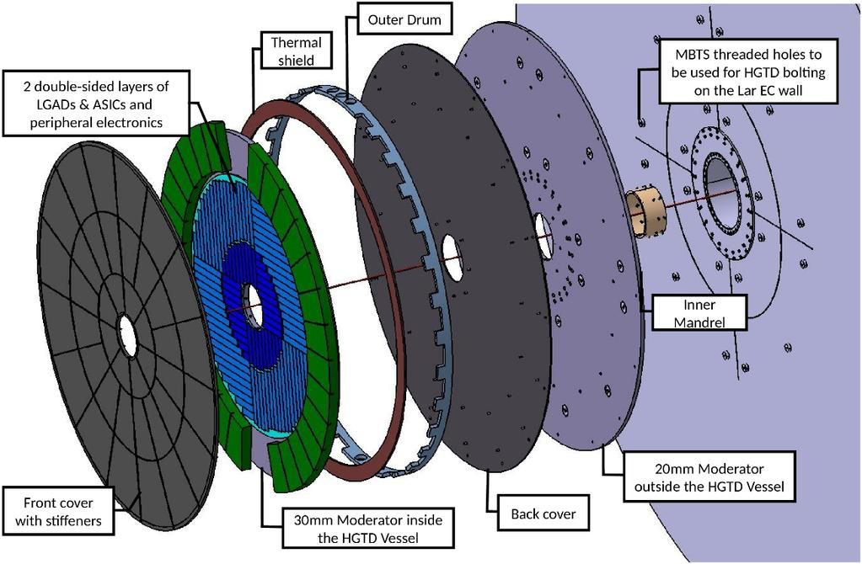
High Granularity Timing Detector A new ATLAS tool for the HL-LHC
Ricardo Gonçalo

Slide 2
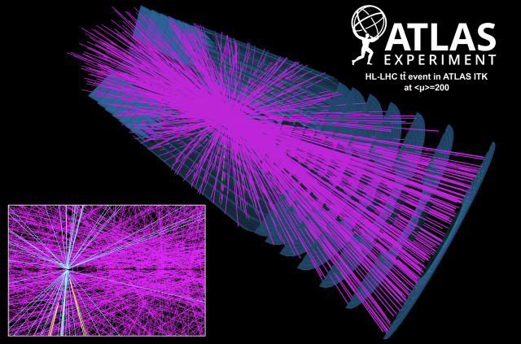
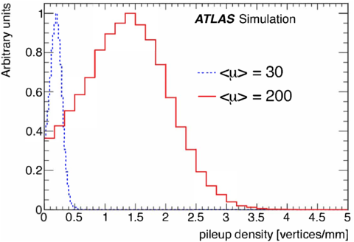
High-Luminosity LHC
The price of high luminosity →high pileup
At the HL-LHC we expect a maximum <μ> of around 200
Average collision density of 1.8 vertices / mm
How to deal with these extreme conditions?

Slide 3
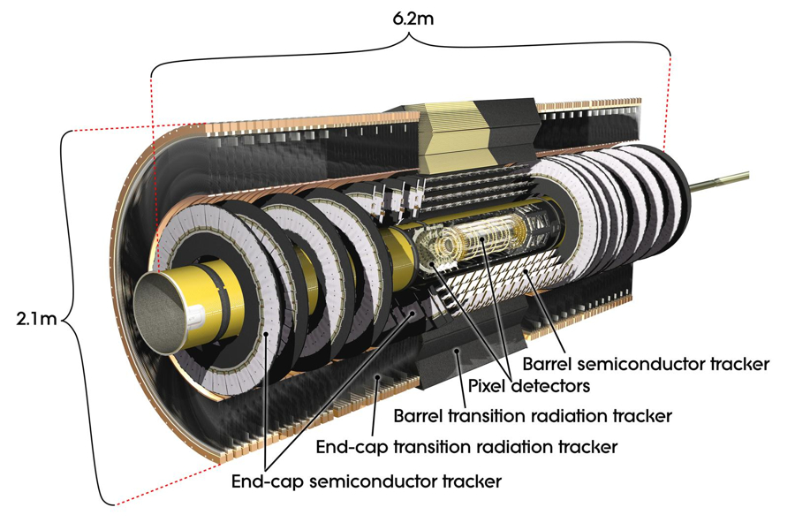
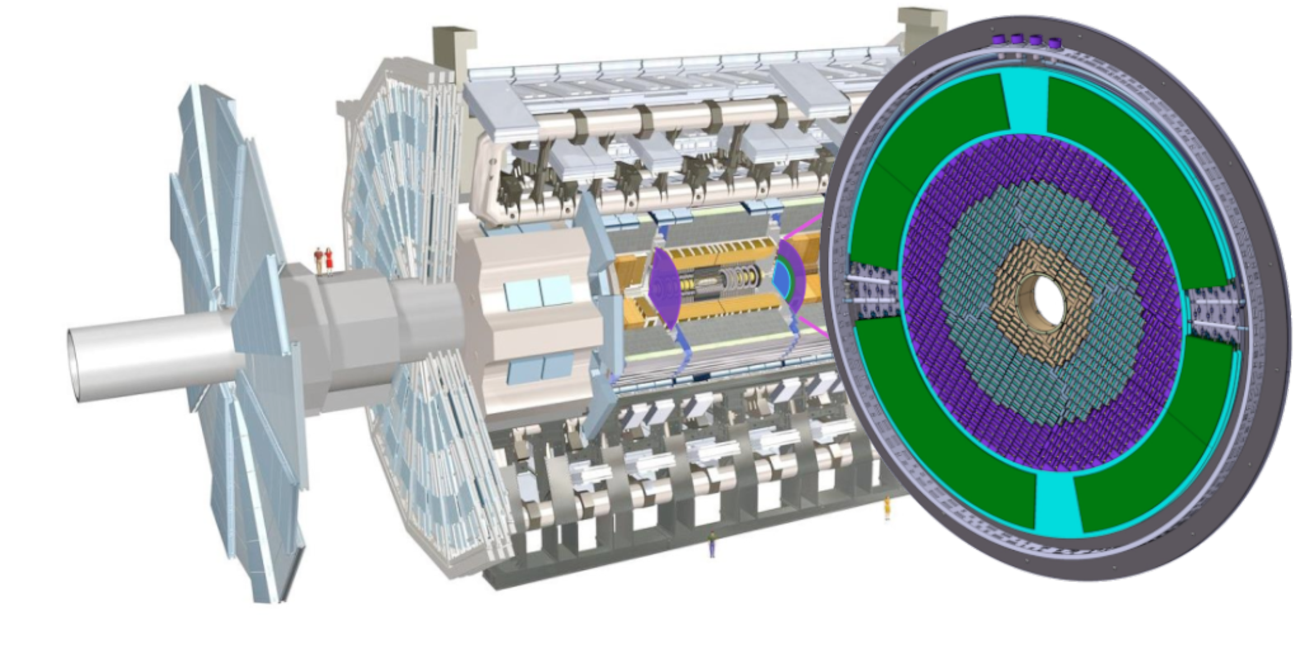
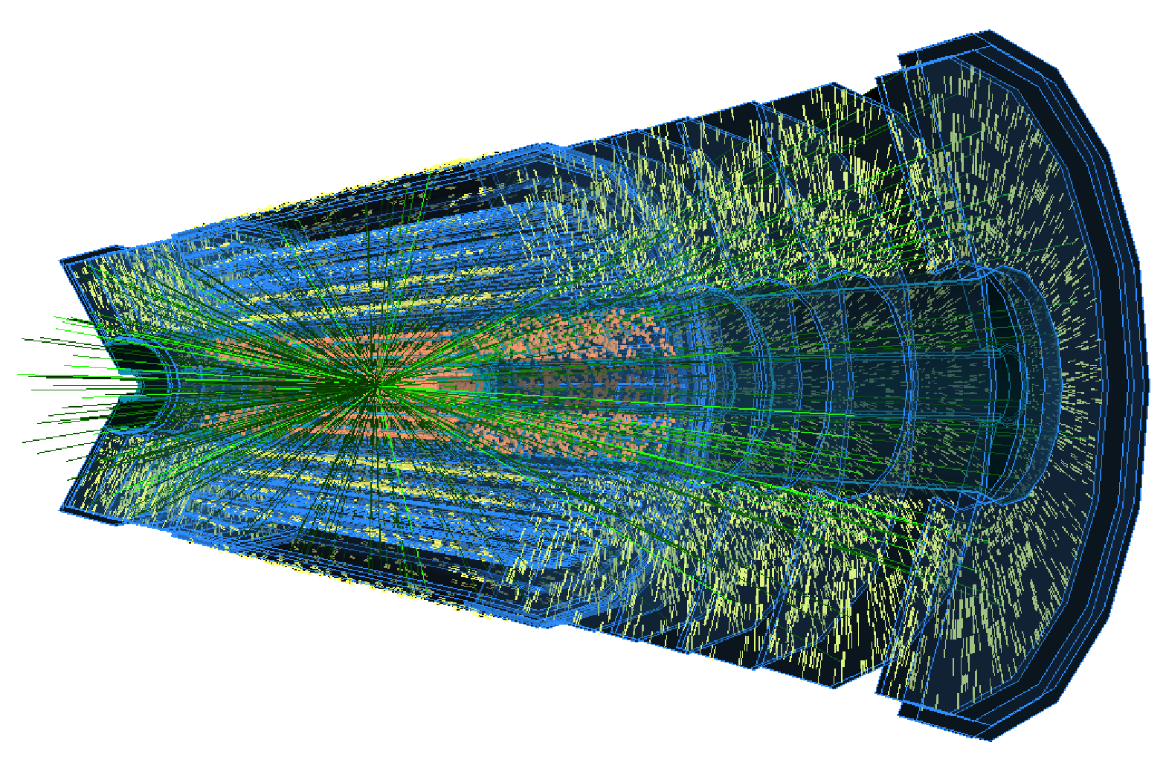
Tracking and the HGTD
The Inner Tracker (Itk) will replace current ID
Coverage extended from |η|<2.5 to |η|<4
The HGTD will add timing information to tracks
Upgrade ATLAS tracking from 3-D to 4-D tracking system (ITK+HGTD)

Slide 4
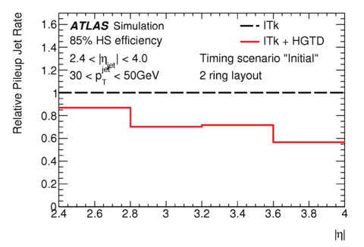
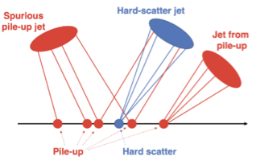
Pileup mitigation and luminosity
ITk has good σ_{Z} resolution for central rapidity
Allow good separation between vertices
Timing information will be important for large |η| where σ_{Z} is worse
Will also greatly improve luminosity measurement with hit rate cunting

Slide 5
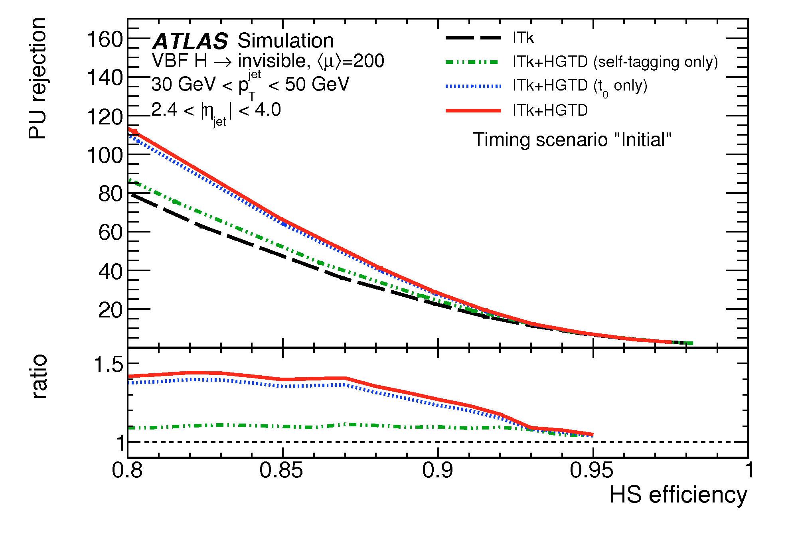
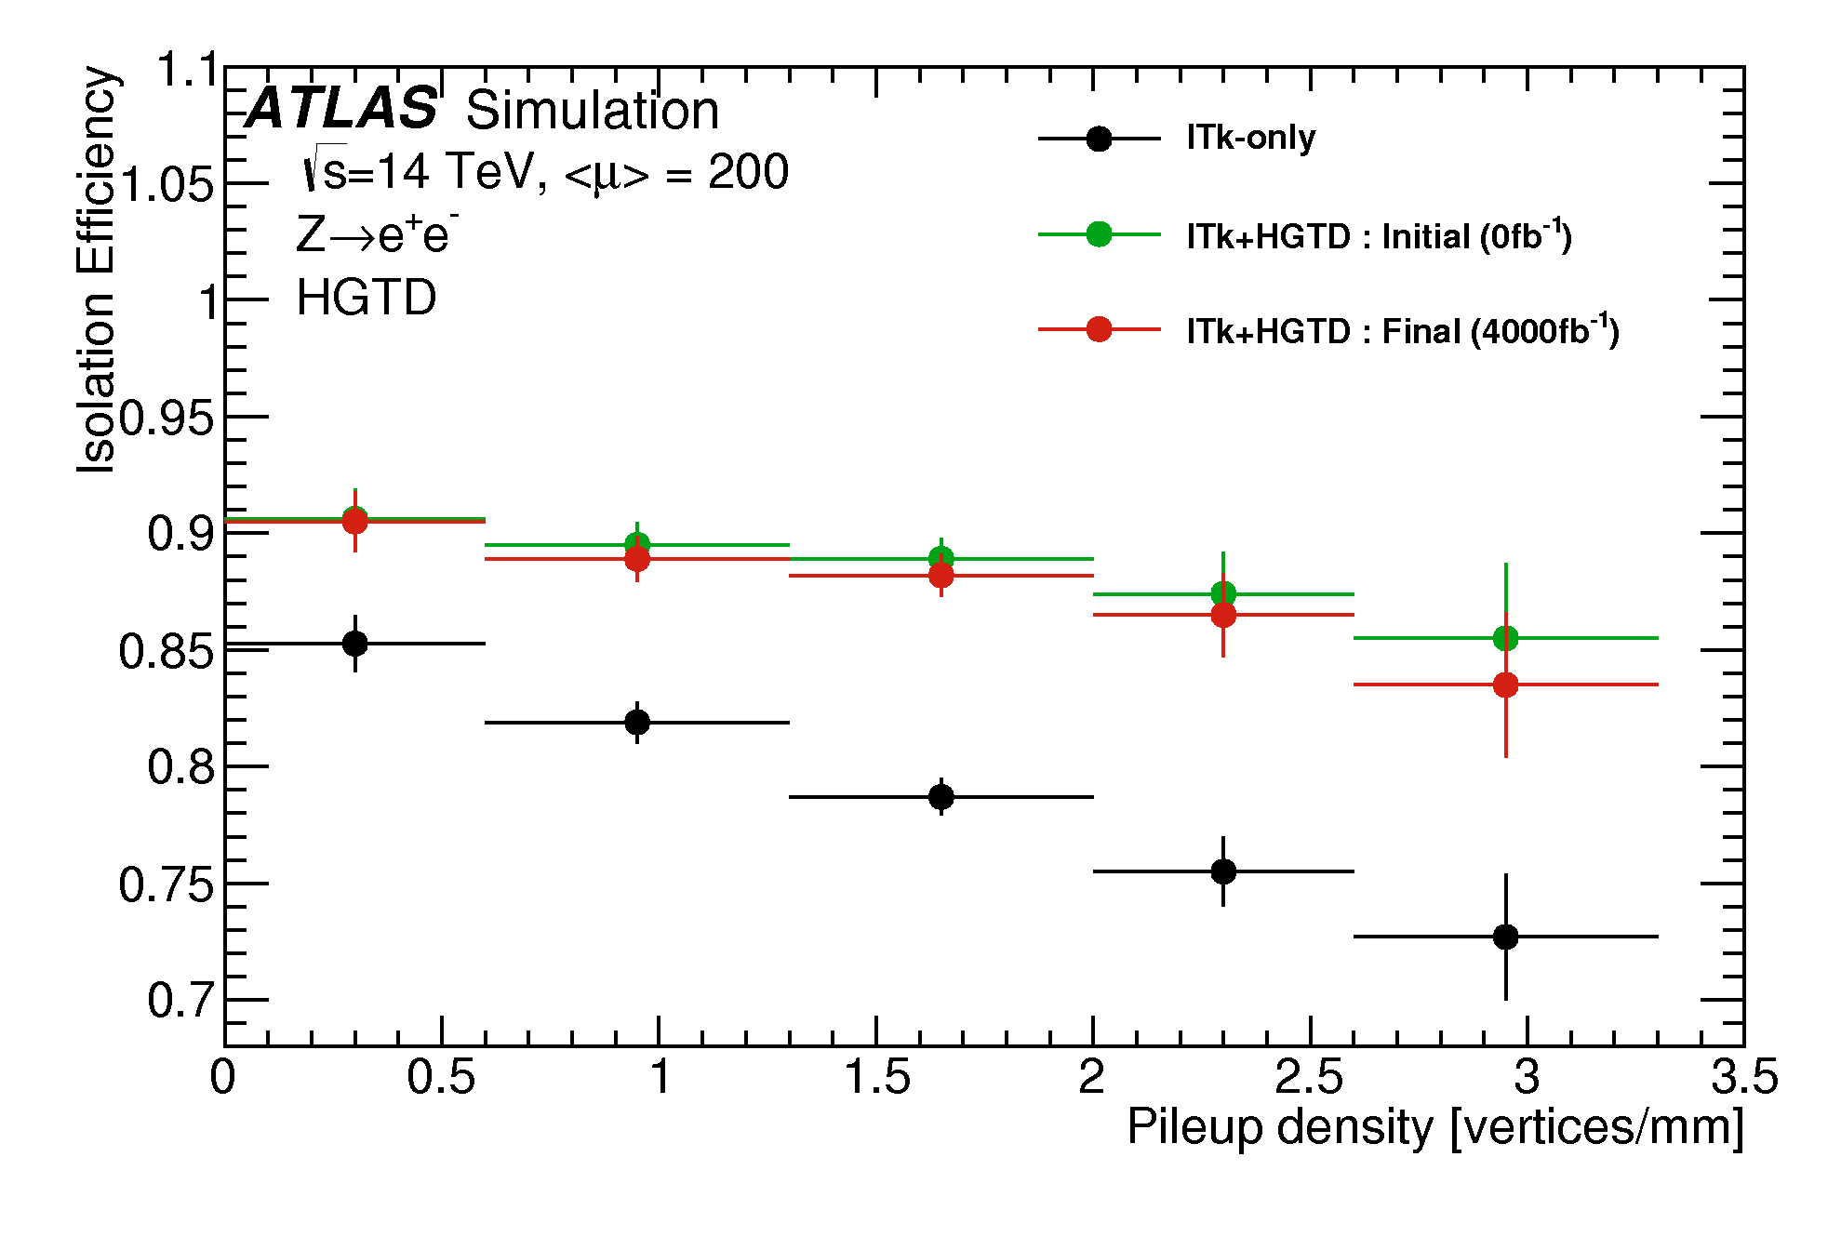
Impact on reconstruction
Pileup-jet rejection increases by a factor of 1.4 (for 85% efficiency)
Lepton isolation efficiency increases up to 25 %
HGTD removes majority of pileup deterioration

Slide 6
High Granularity Timing Detector
Two instrumented double-sided layers
7.5 mm-thick, three rings mounted in two cooling disks
Gap region between the barrel and the end-cap calorimeter at z=3.5m from interaction point
High-precision time measurement: 30 - 50 ps resolution per track
Assign time to tracks in the forward region: 2.4 < η < 4.0
Improve pileup rejection by a factor of 6 and correct track-to-vertex association

Slide 7
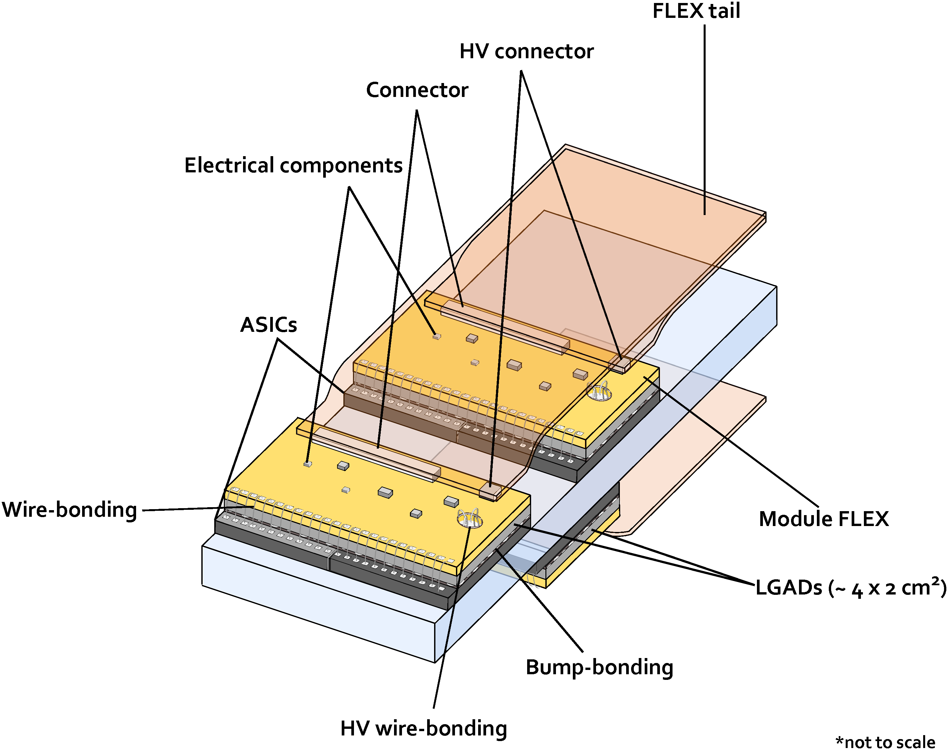
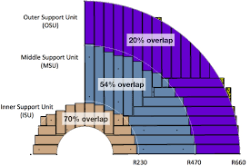
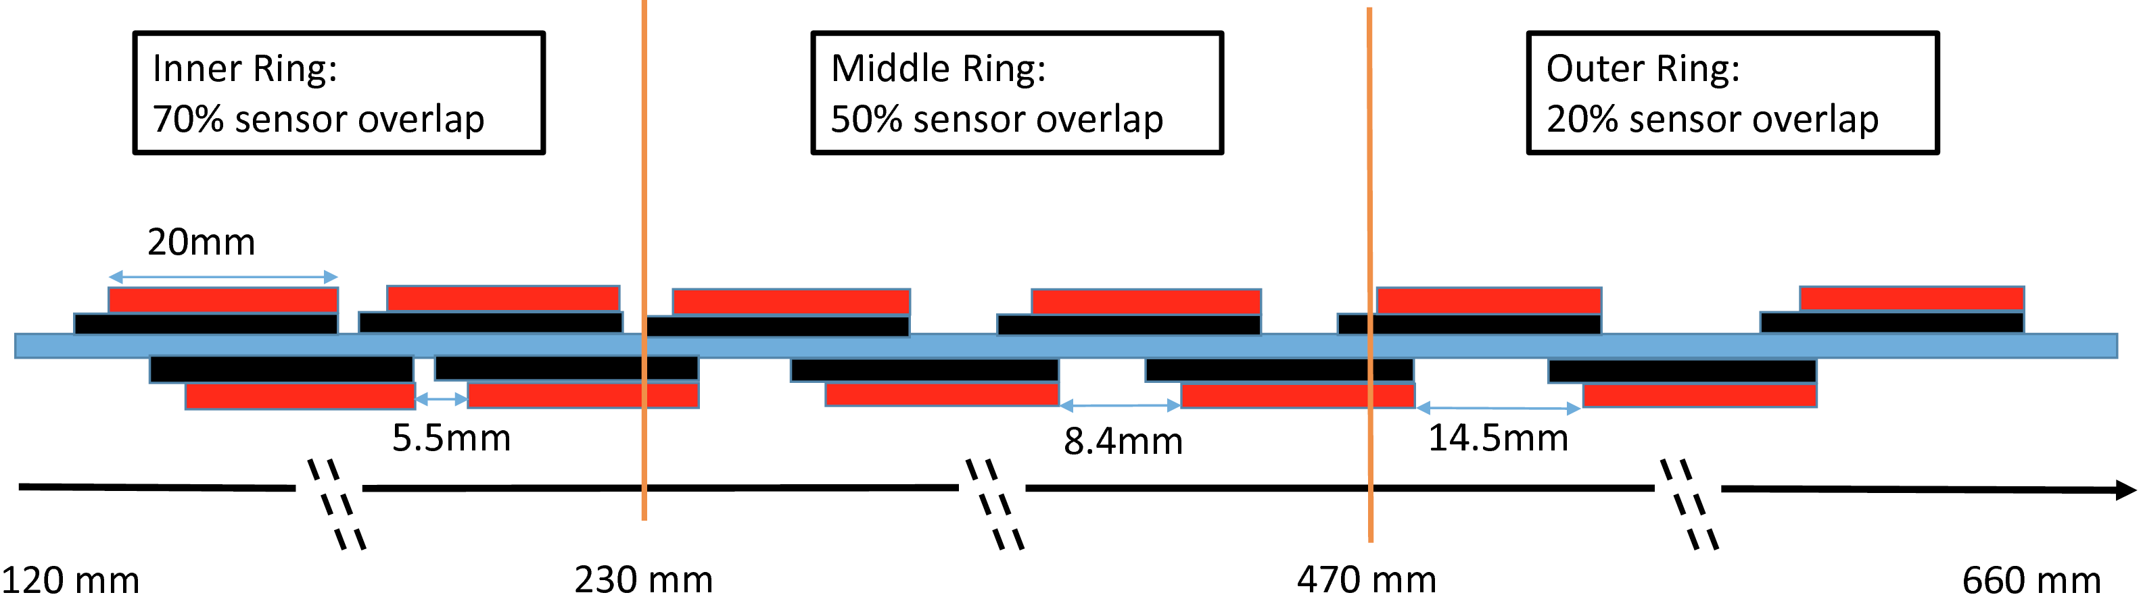

Slide 8
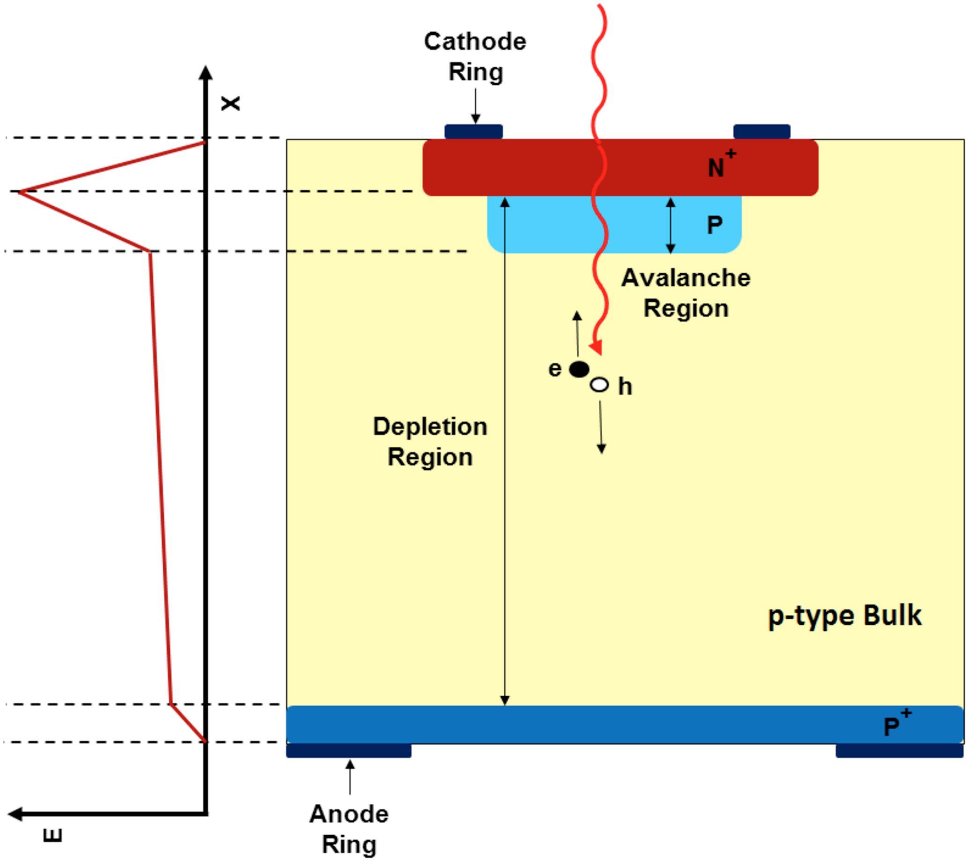
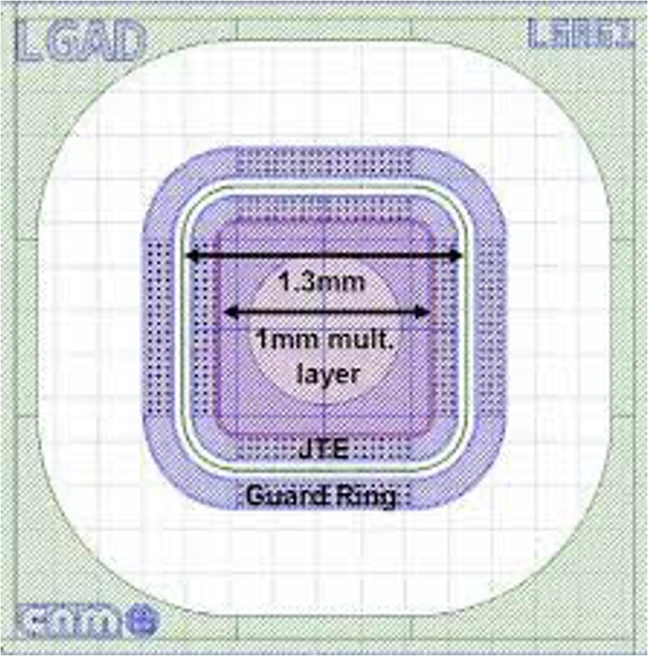
Low-Gain Avalanche Diodes (LGAD)
Pad size of 1.3×1.3 , 5 μm thick
Occupancy <10% at lowest HGTD radius (120 mm).
Small dead areas between pads
15×15 pads, for 1.95×1.95 cm² total area
Notes:
Originally developed by CNM and RD50.• n-p Si detector with an additional thin (<5 μm) and highly doped p-type multiplication layer with a high E field.• Internal gain > 20 (8) before (after) irradiation ( <800 V).• Hit efficiency > 95 % at the end of lifetime.• Excellent time resolution: <30 ps before irradiation.• HGTD prototypes are produced by CNM

Slide 9
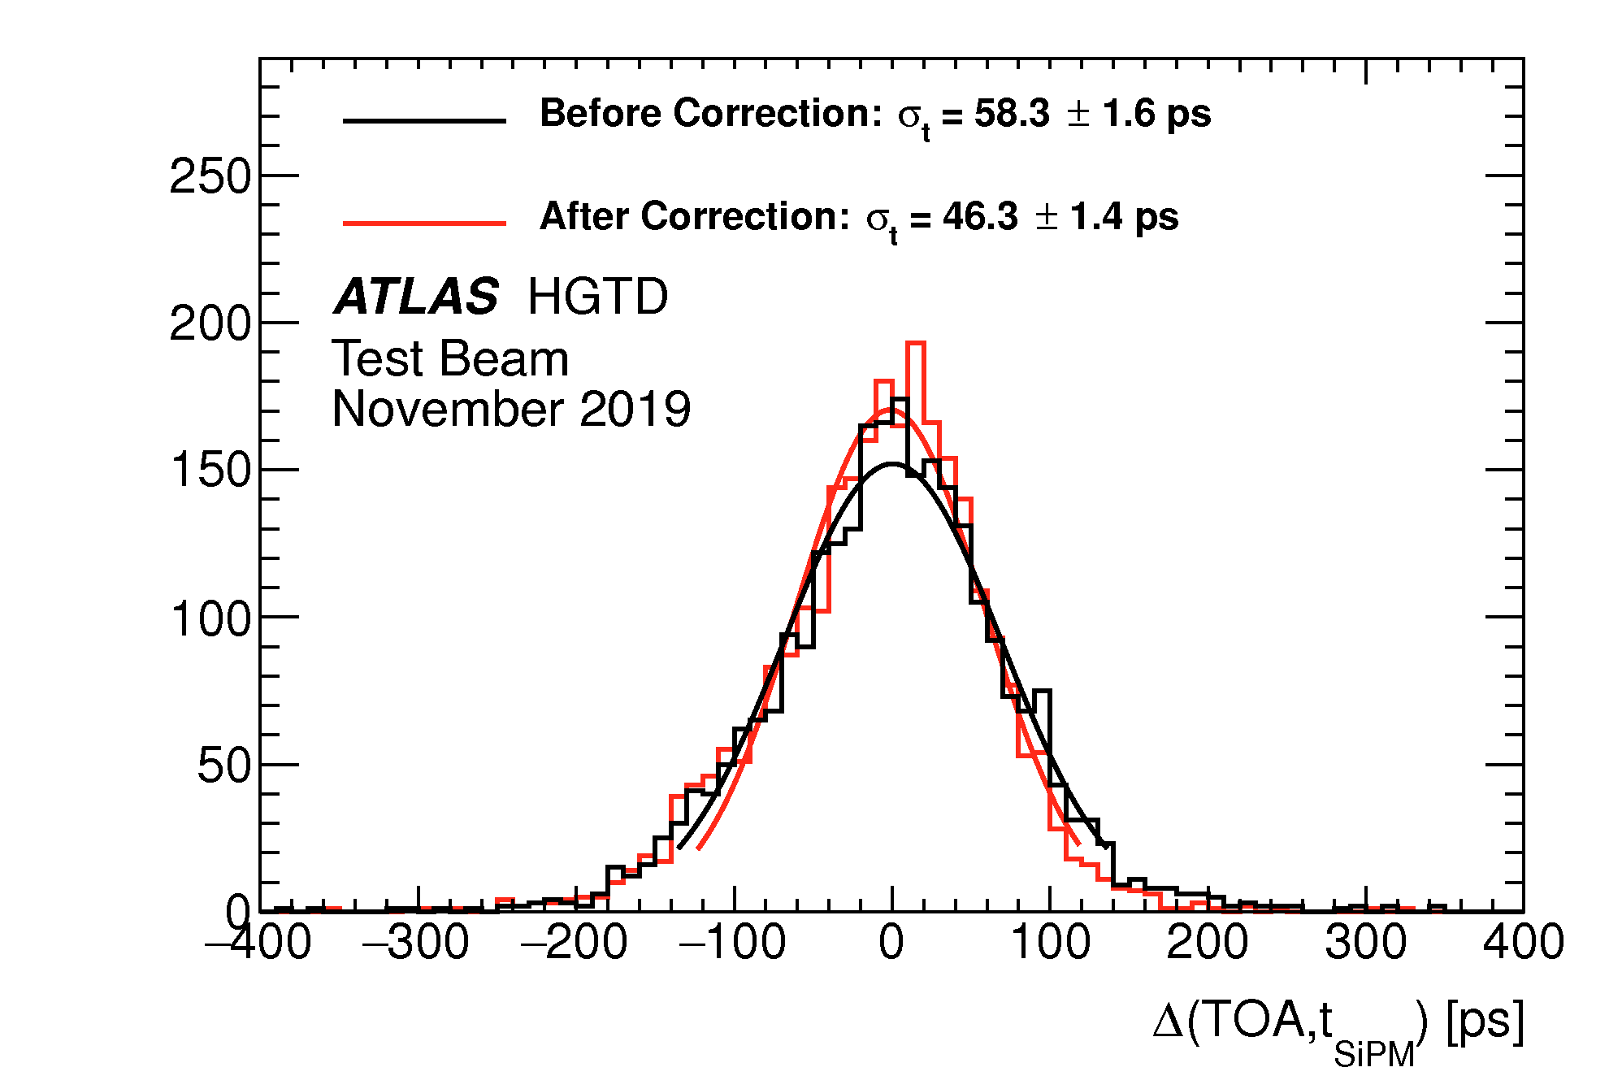
Front-end electronics: ALTIROC
Signal from each LGAD read out using the ATLAS LGAD Timing Readout Chip (ALTIROC)
Bump-bonded to LGAD module
15x15 = 225 readout channels
Channel= Analogue( Preampli fiers, Time Of Arrival TOA, Time Over Threshold TOT, CFD) + Digital data transmission
Time resolution of 58 ps before corrections

Slide 10
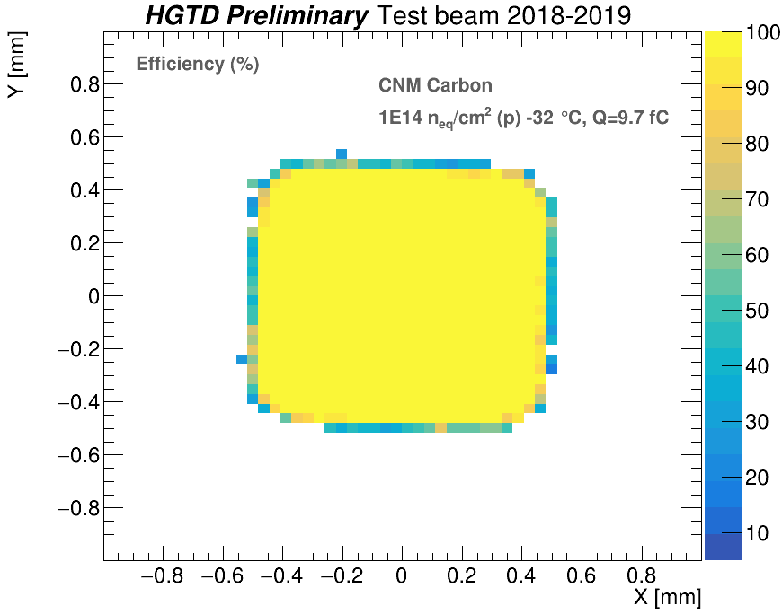
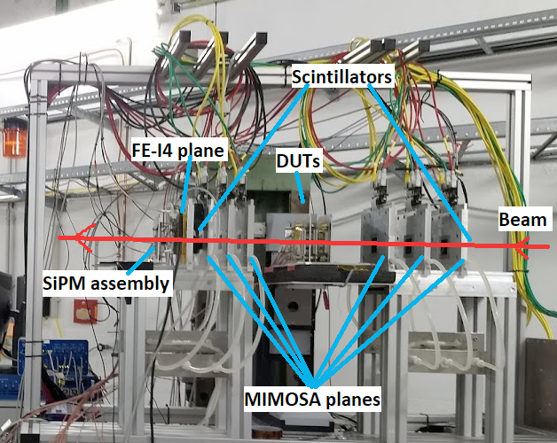
Test beam
Data collected in 2018-2019 with 120 GeV pion beam (CERN SPS) and 5 GeV electron beam (DESY).
Hit efficiency defined as hits on sensor with > 2 fC
Response is ≈100% in the active area

Slide 11
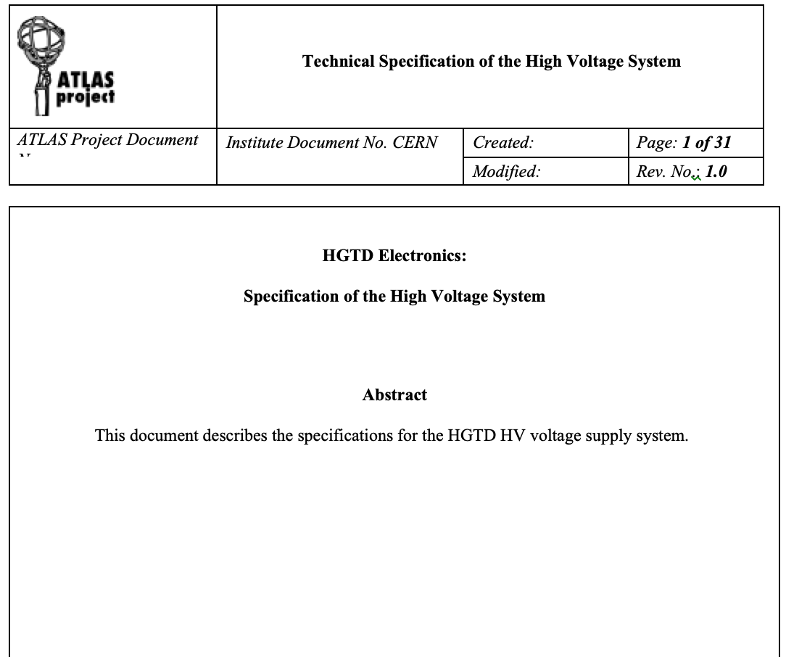
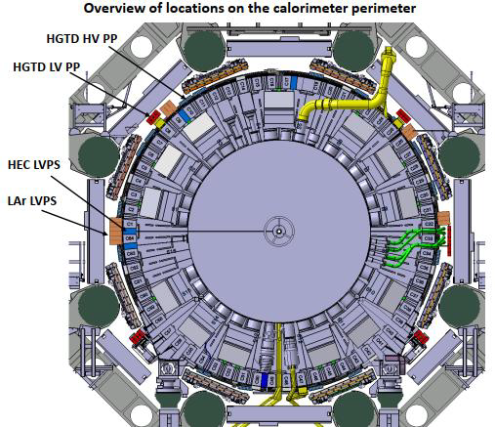
HGTD Involvement: HV Patch Panels
Producing HV patch panels CERN group:
16 patch panel boxes located around the calorimeter perimeter
Routing of High Voltage to HGTD detector
Filtering out AC noise
Preliminary layout done and prototype tested
Contributing to Specifications Review (SPR) document
Notes:
Possibilities: TDAQ and DCS

Slide 12
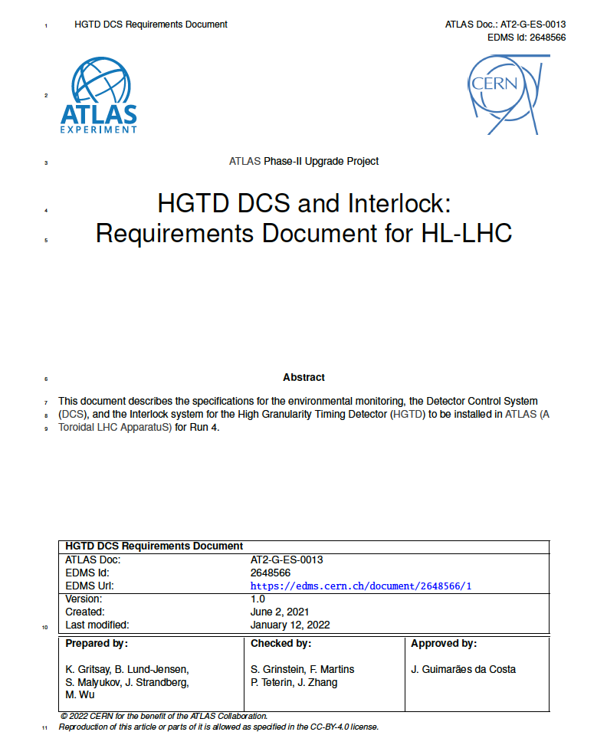
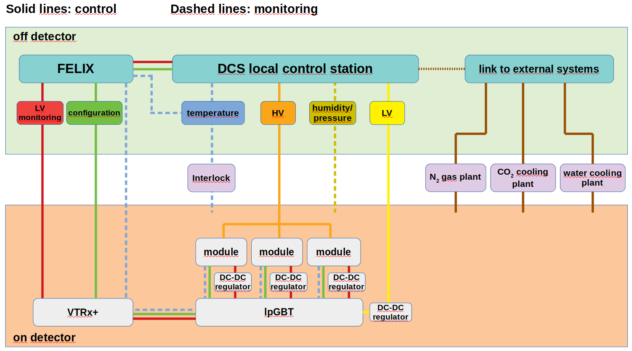
DCS and Interlocks
HGTD DCS – ongoing work (Filipe):
Contributed to DCS Specifications Review document
Following SPR panel recommendations working on alternative for data transfer path separate from FELIX
Working on High Voltage DCS
DCS and Interlocks – plans (Rui, Helena):
Plan to develop monitoring data transfer through FELIX or alternative solution – Rui
Plan to develop design for Interlocks – Helena
Helena’s commitments imply a small re-scheduling

Slide 13
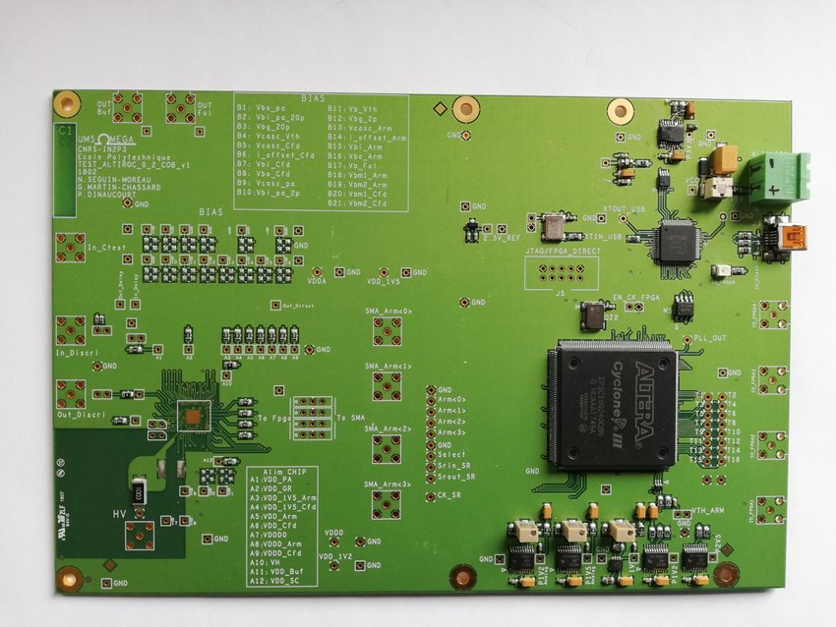
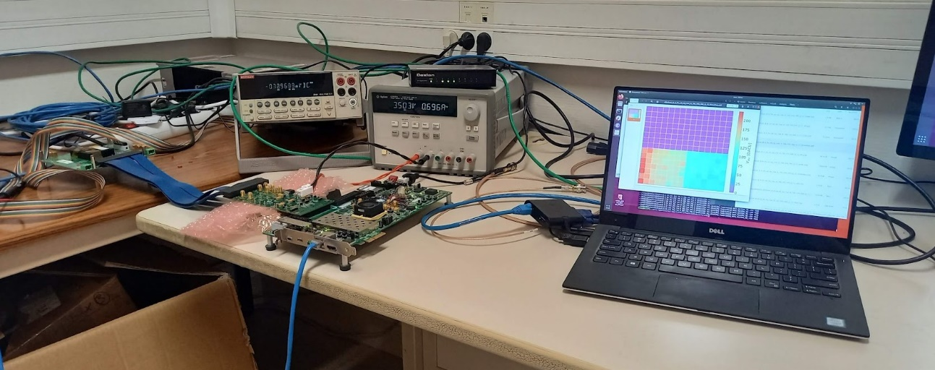
Electronics: Altiroc
Becoming involved in Altiroc testing:
In contact with Omega laboratory to install a test setup at LIP
Previous experience with Omega ASICs and frontend electronic design & production
Serious immediate problem in obtaining a Xilinx board (20 weeks delivery time… changed to 1 month)

Slide 14
Conclusions
HGTD is expected to start data taking in 2028 and will be the first large-scale application of LGAD technology
Will reduce pileup in the forward region and improve luminosity measurement
LGADs and their readout ALTIROCs are optimised to reach a 30-50 ps per track up to the end of lifetime
We are joining this project in several areas within our expertise
References:
A High-Granularity Timing Detector for the ATLAS Phase-II upgrade, 30th Lepton-Photon, Jan 2022, Manchester, UK, ATL-HGTD-SLIDE-2021-745
LHCATLAS Collaboration. Technical design report: A high-granularity timing detector for the ATLAS phase-II upgrade. Technical report, 2020. https://cds.cern.ch/record/2719855Reference

