Slide 1
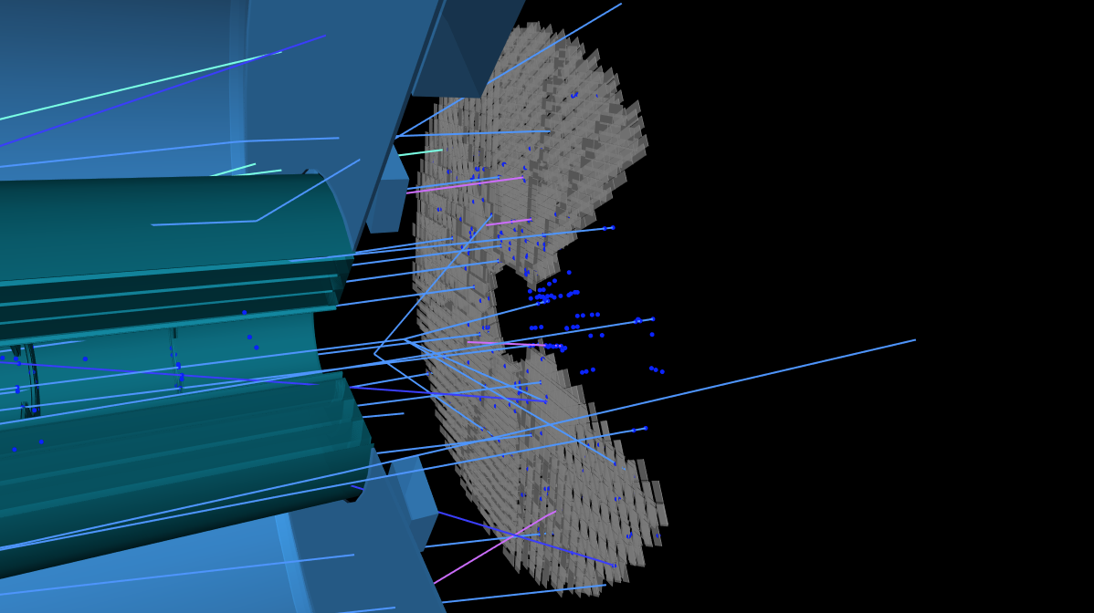
High Granularity Timing Detector
Ricardo Gonçalo (U. Coimbra, LIP)
on behalf of the HGTD Group
ATLAS Week, Lisbon, October 2022

Slide 2
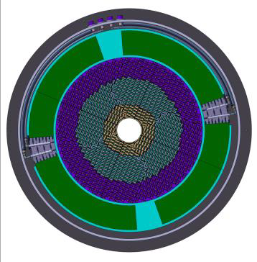
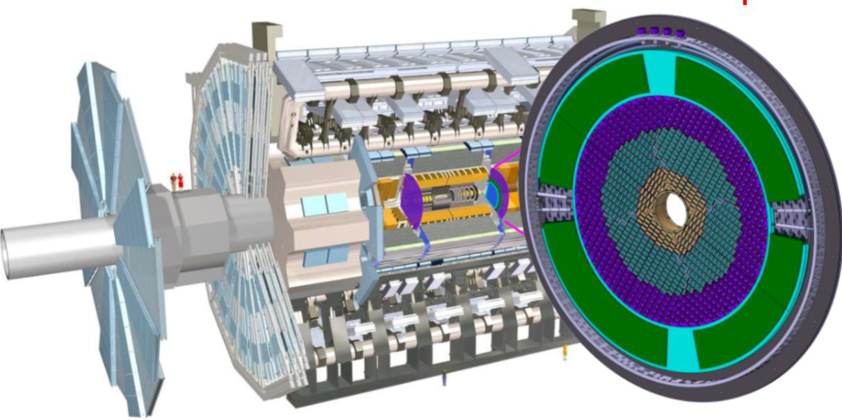
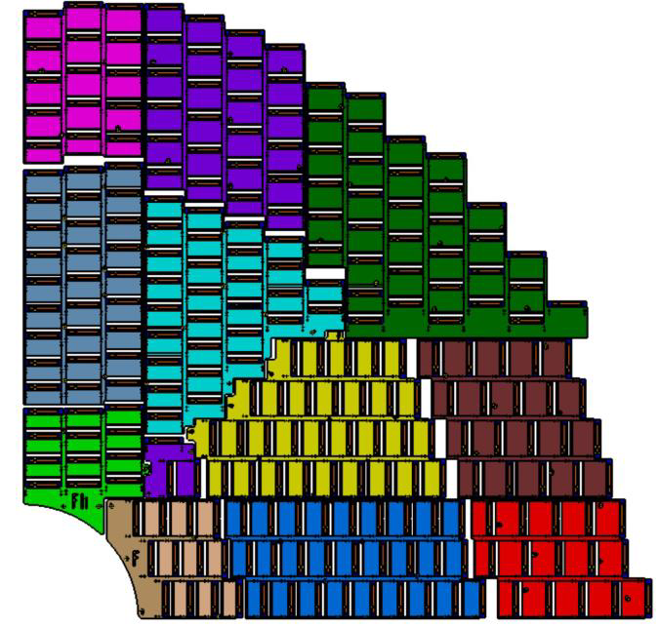
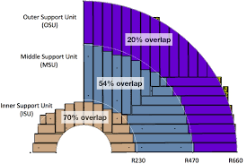
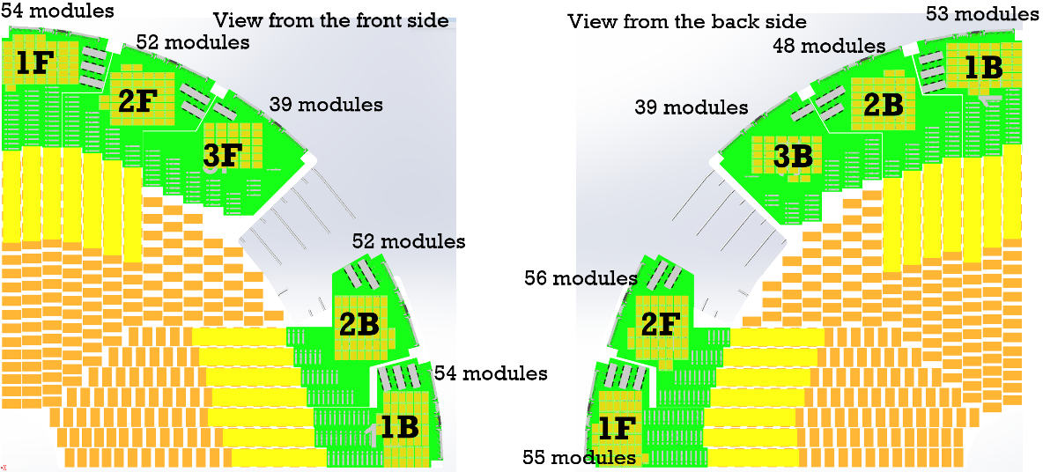
The High Granularity Timing Detector
Two detector wheels between ITk and endcap:
z = ±3.5 m; 7.5 cm thick (+5 cm neutron moderator)
Active detector region: 2.4 < |η| < 4.0
8032 modules with 2 hybrids each (sensor + readout ASIC)
3.6 M channels; 1.3×1.3 mm² pixels; 6.4 m² active area
Radiation hardness: up to 2.5x10¹⁵ Neq /cm², 2 MGy
Pileup rejection:
Identify track vertex in forward region (poor ITk z_{VTX} resolution)
30-50 ps/track, 35-70 ps/hit resolution
Luminosity measurement:
Count number of hits at 40 MHz to get bunch-by-bunch luminosity
Goal is 1% luminosity uncertainty

Slide 3
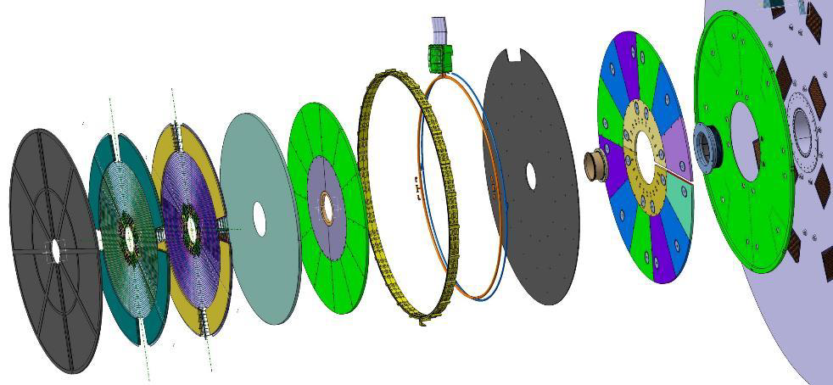
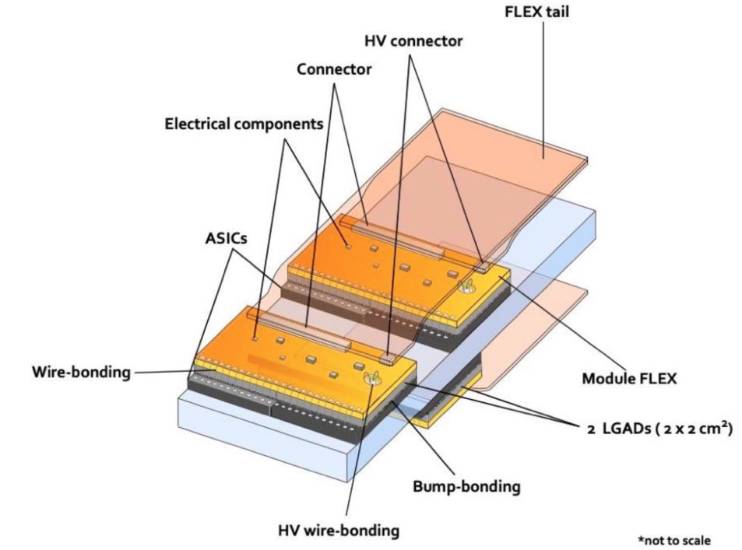
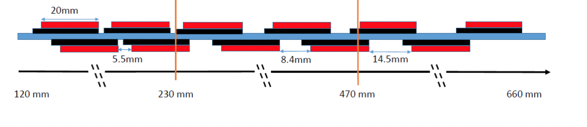
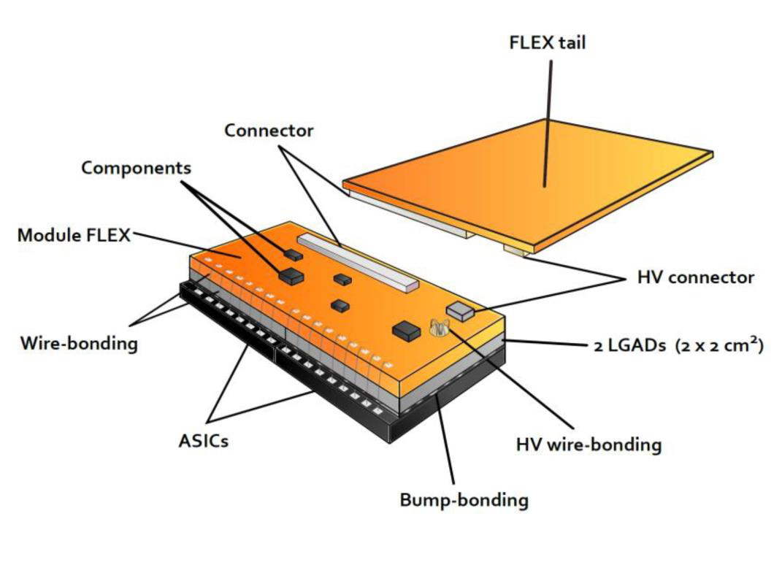
Outer ring and CO₂ lines
Internal moderator
External moderator
HGTD Modules:
LGADs bump-bonded to two ALTIROC ASICs: 2×2 cm²
15×15 pads of 1.3×1.3 mm²
Operated at -30 °C (CO₂ cooling) to cope with radiation damage
Low Gain Avalanche Detector (LGAD) sensors:
Mounted on both sides of cooling disks
Active region: 12 cm < r < 64 cm
Peripheral electronics: 64 cm < r < 100 cm
Three regions with different sensor overlap
Neutron moderator (5cm) to shield detector from backscattered neutrons

Slide 4
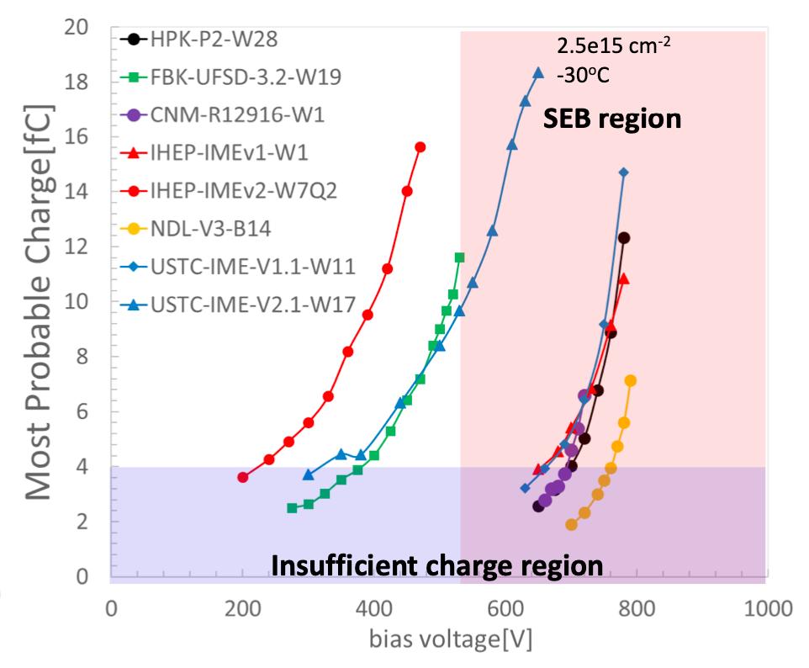
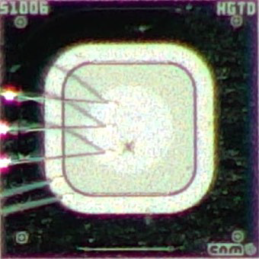
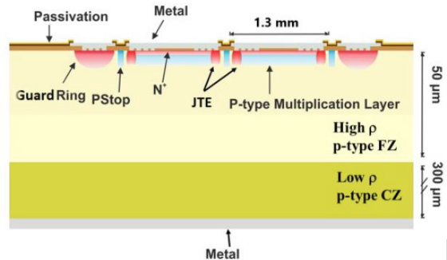
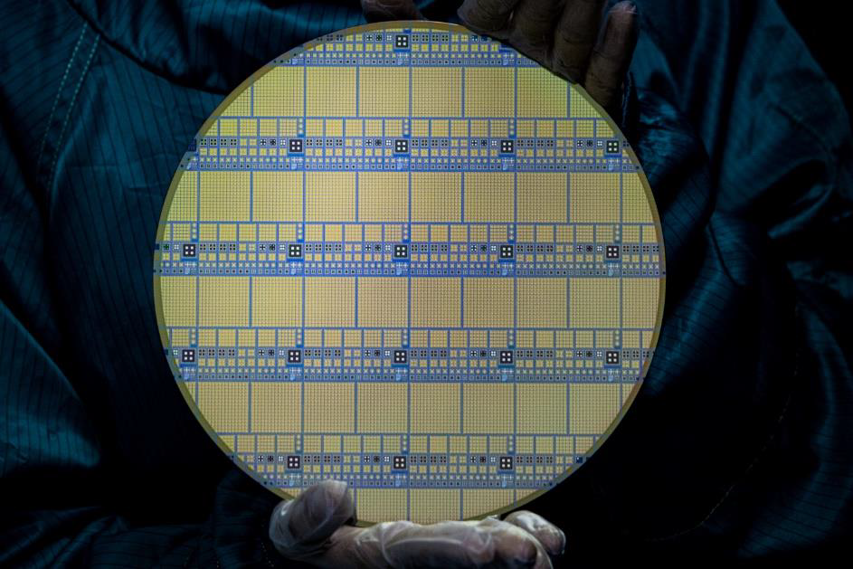
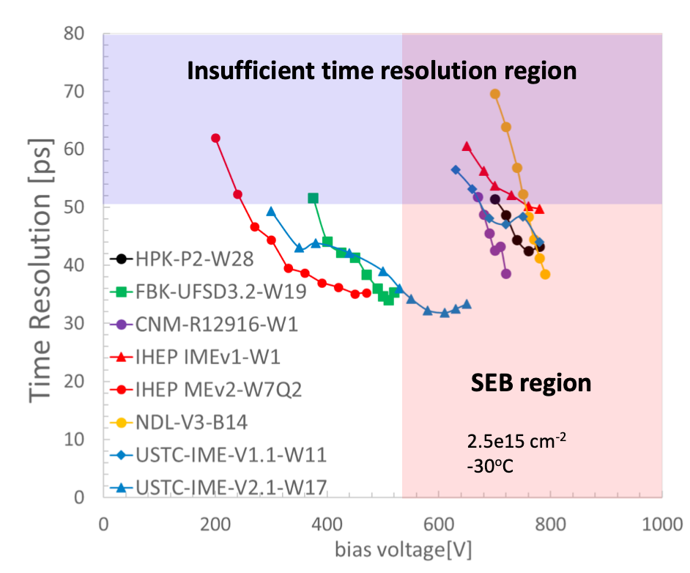
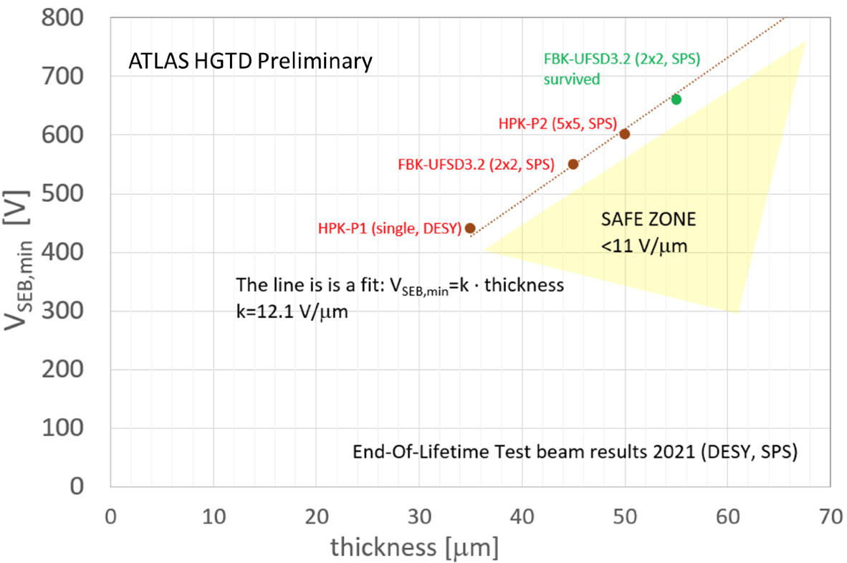
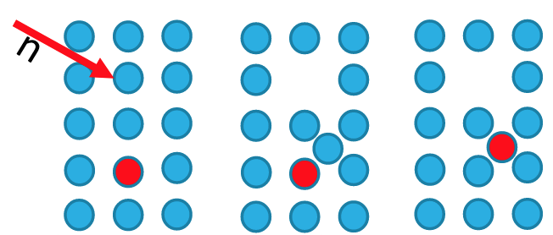
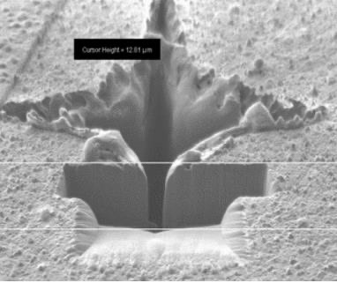
Low Gain Avalanche Detector Sensors
Aim for 70 ps/hit timing resolution after full irradiation
Thin ≈50 μm active layer on thick ≈300 μm substrate
Multiplication layer
Affected by irradiation originated defects (acceptor removal)
Compensated by higher bias voltage up to a point
Single Event Burnout (SEB) in irradiated sensors at high HV
Above 12 V/μm or ≈600 V/50 μm wafers
Robustness improved by carbon-enriched gain layer
Only carbon-enriched gain layer modules viable for operation

Slide 5
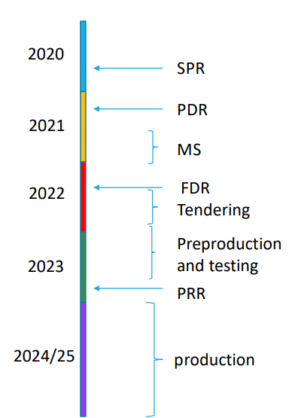
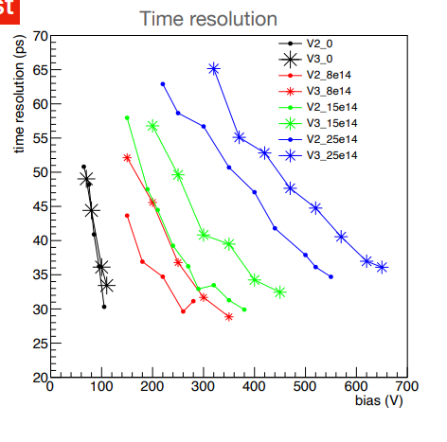
Testing sensors from 4 different vendors – with carbon-enriched gain layer
Test program for sensors and sensor+ALTIROC assemblies
Sensors from at least 3 vendors satisfy the requirements to be used in HGTD
Tendering process in preparation
Expect contracts awarded in December – 1.5 month delay
Will accelerate procedure and stagger production to avoid delays

Slide 6
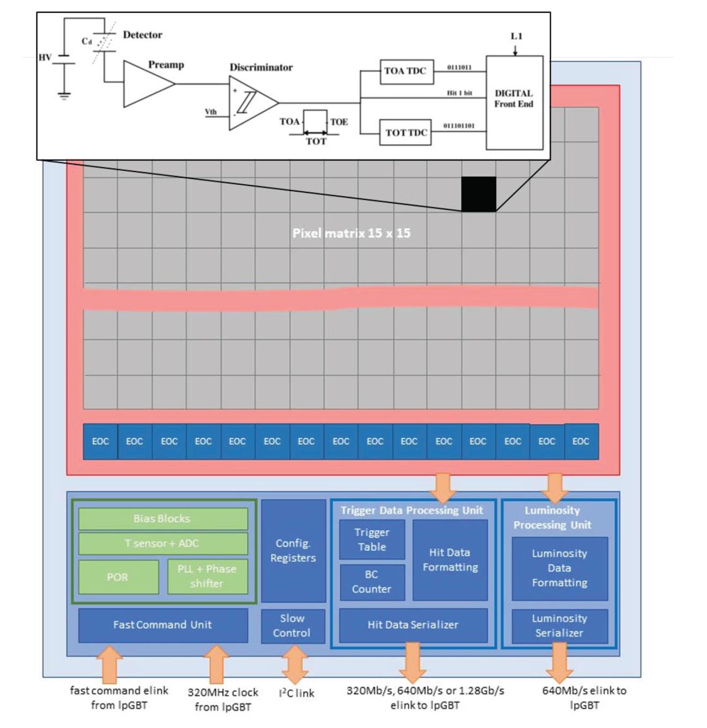
ALTIROC frontend ASIC
Readout of 15×15 LGAD pixels
2×2 cm² bump-bonded to sensors
Specifications:
Jitter < 25ps @ 10 fC; <65ps @ 4 fC
Minimum threshold: 2 fC
Outputs:
Time Of Arrival (TOA)
Time Over Threshold (TOT)
Luminosity (No. of pixels hit)
ALTIROC 2: first full size prototype; tests being finalized at several institutes
ALTIROC 3: to be submitted in November

Slide 7
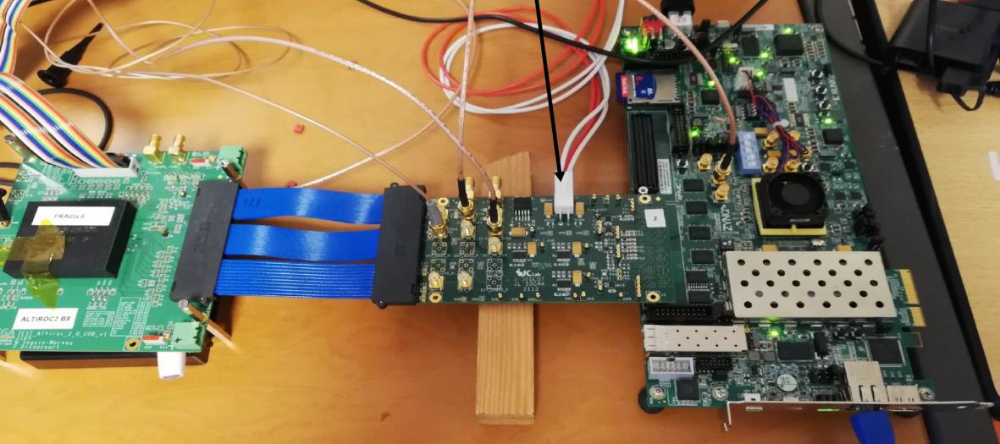
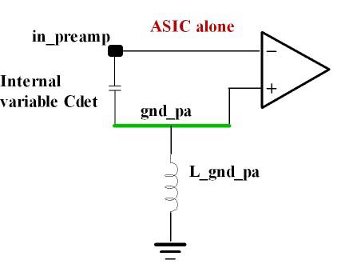
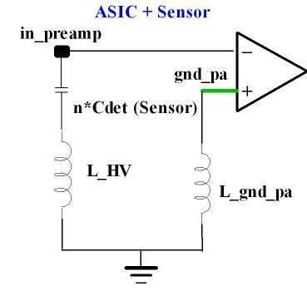
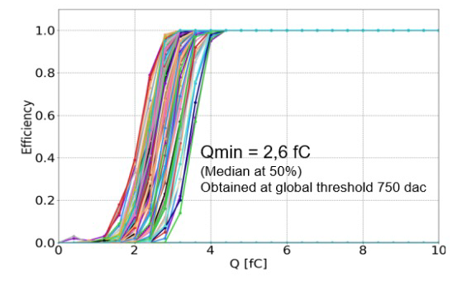
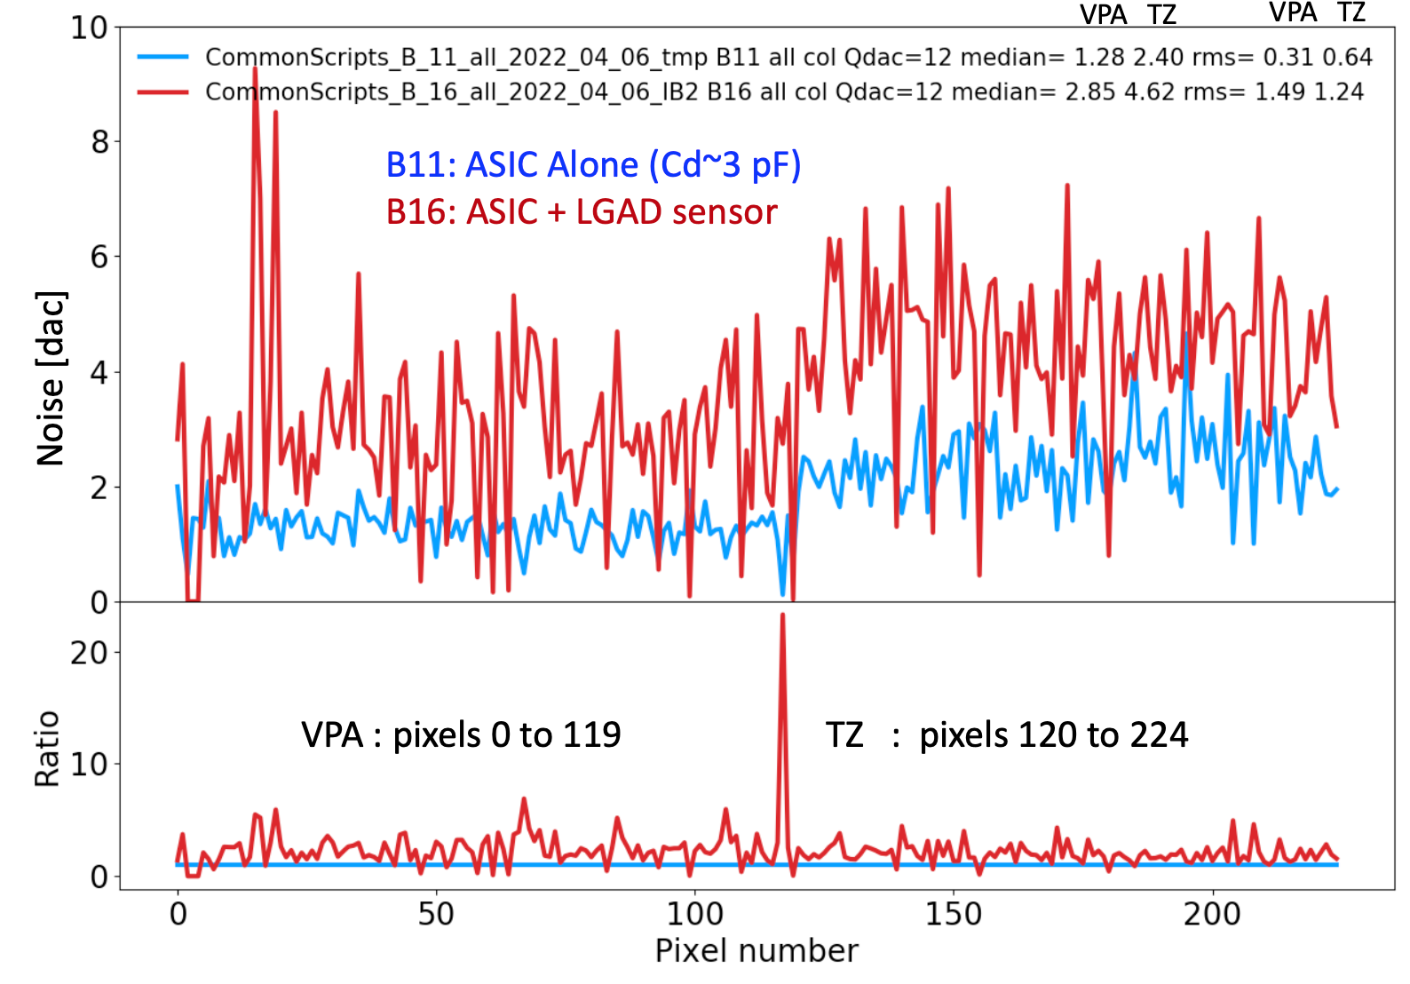
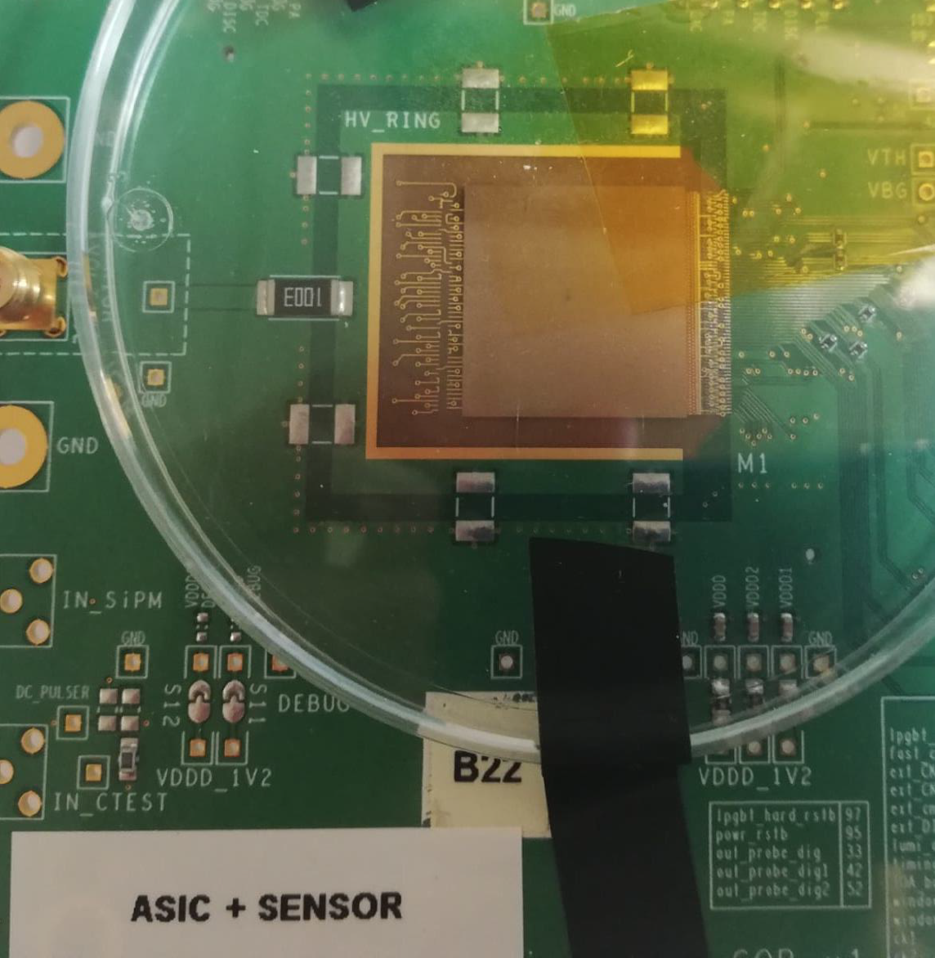
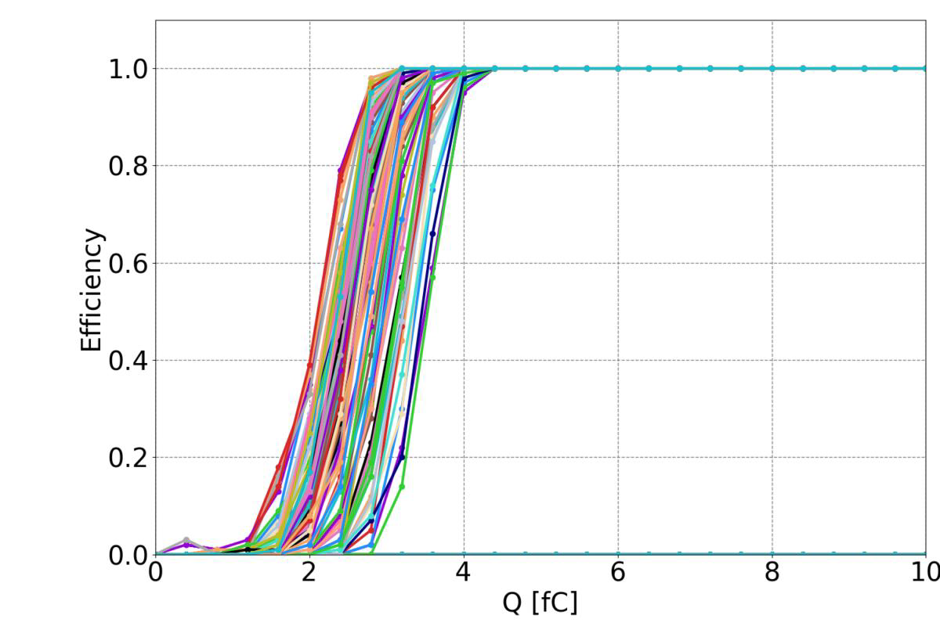
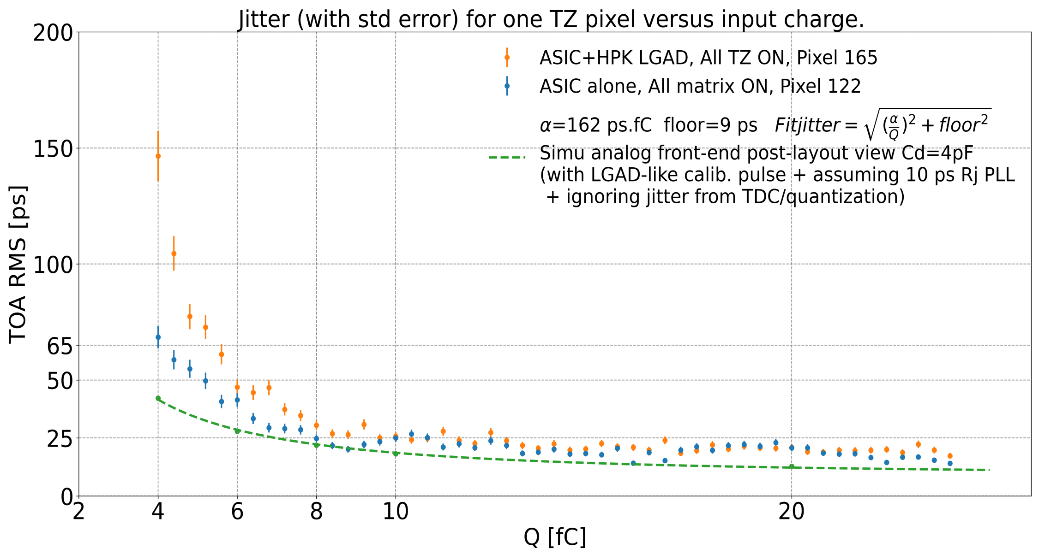
Intensive ALTIROC 2 testing program:
ASIC alone found to be close to specifications
But additional noise found in ASIC + LGAD sensor assembly
Due to parasitic inductances separating sensor/preamp grounds
Effect amplified due to 10 nF HV decoupling capacitor
Removing capacitor gave lower noise and so Q_{min} = 2.6 fC instead of 4 fC with capacitor
Removing 10 nF capacitor
Q_{min} = 2.6 fC

Slide 8
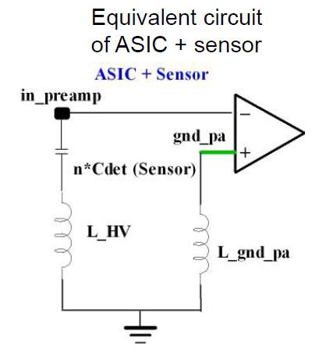
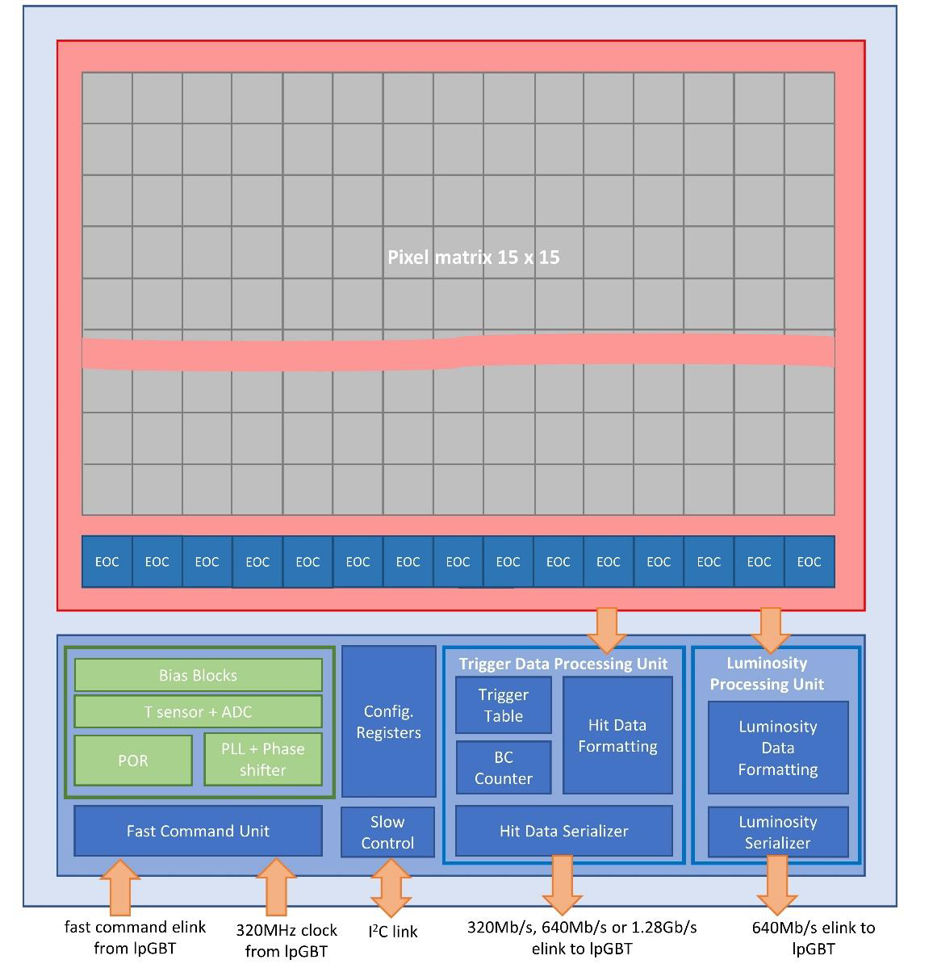
ALTIROC 3
Improvements with respect to ALTIROC 2:
Identified bottleneck for trigger rates > 1 MHz giving high FIFO occupancy
Modifications for smaller Q_{min} and jitter to address:
Voltage drops between grounds solved in ALTIROC 3
Digital noise injected through preamplifier ground
Higher redundancy to improve robustness against Single Event Effects
40 MHz clocks in ALTIROC 3 matrix de-skewed along the columns and between columns to avoid high digital current spikes
Power consumption slightly higher : 1.4 mW/ch vs 1.2 mW/ch
ALTIROC plans: PDR set to October 18
Design of ALTIROC 3 version is now ready – verifications in coming month
Submit to foundry in early November – to arrive at CERN early Feb. 2023
HGTD-ALTIROC-A – pre-production ASIC
Design to start in April 2023 and FDR in October 2023

Slide 9
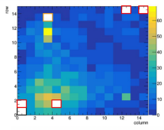
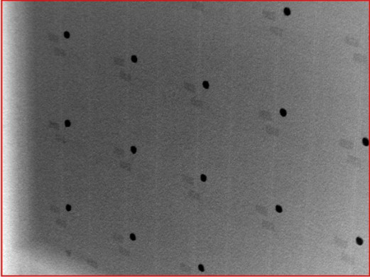
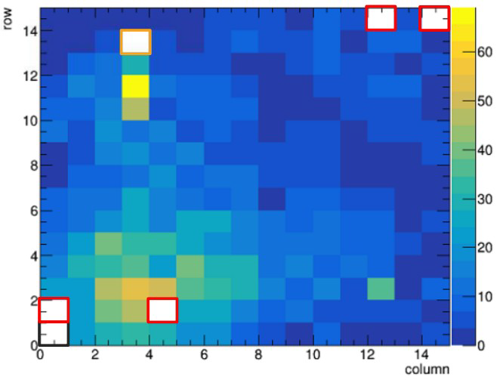
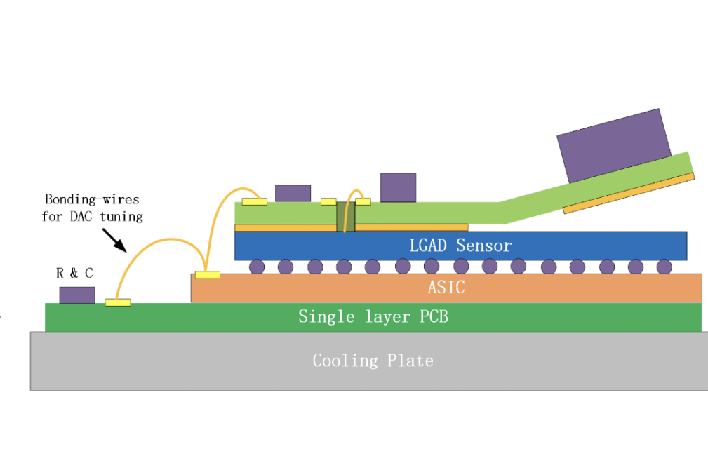
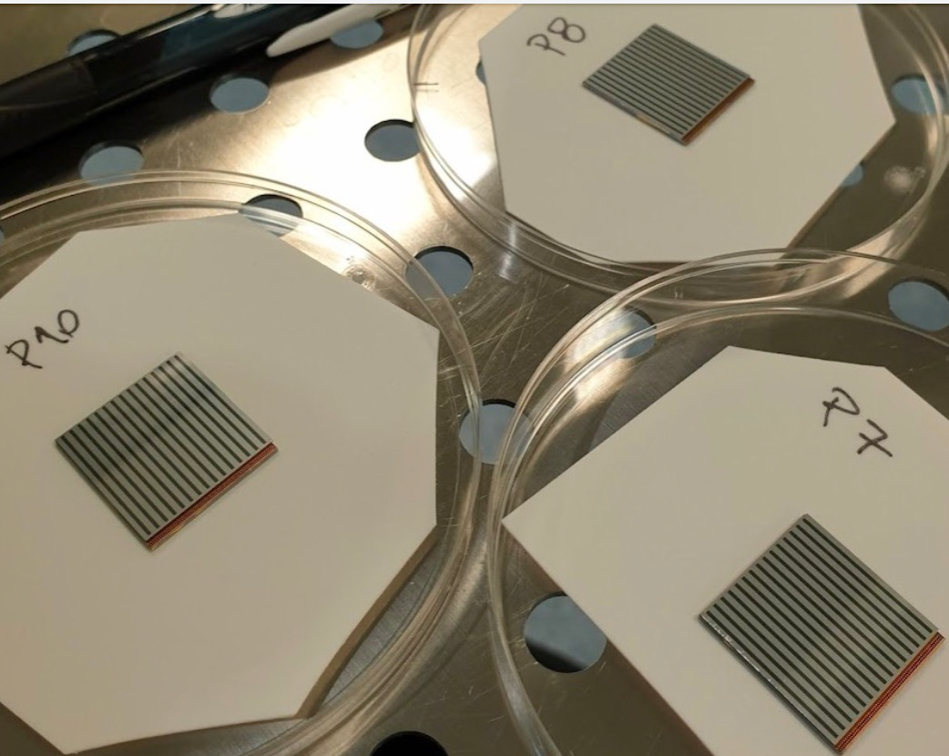
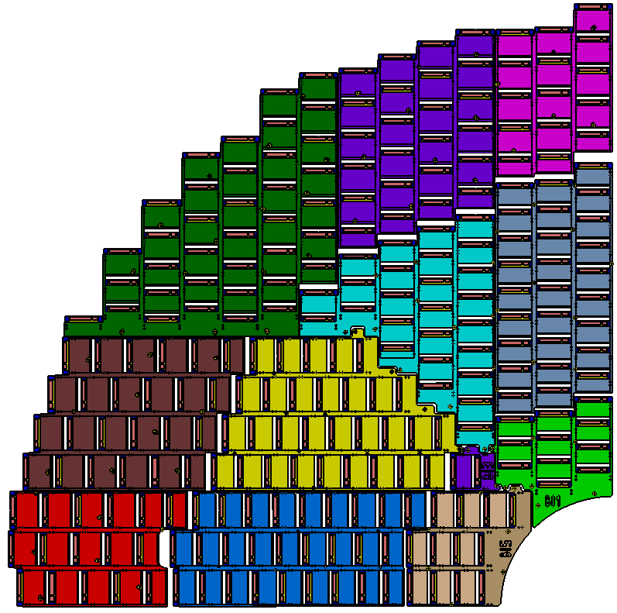
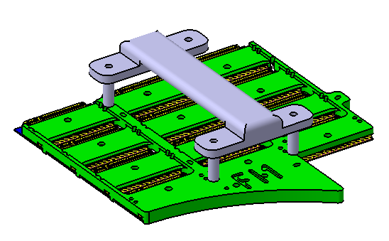
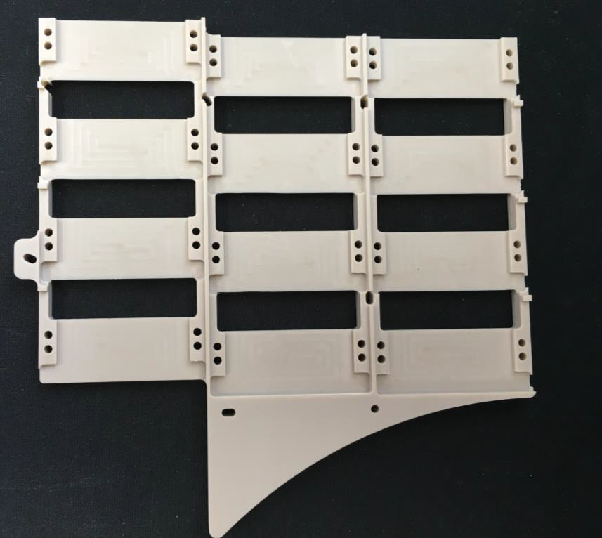
HGTD Modules
Hybridization: Sensor bump-bonded to ASIC
Technique established at several sites
Detailed tests (shear test, X-ray examination) have shown good bonding results achieved
Beam tests at CERN in July and September; next one in 19/10 – 02/11
Five full modules produced and more without sensor
Load to be spread between several institutes
Dedicated tools developed:
Bending the flex, aligning and placing the bare module on the flex, and glueing the assembly
Support units developed and prototypes tested

Slide 10
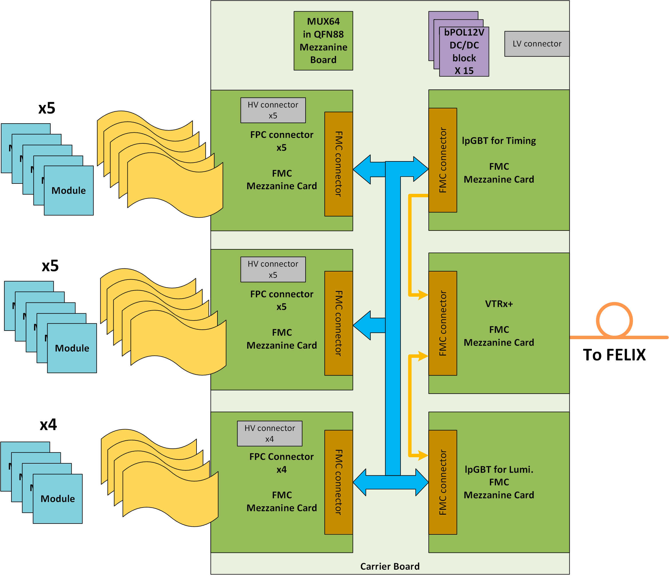
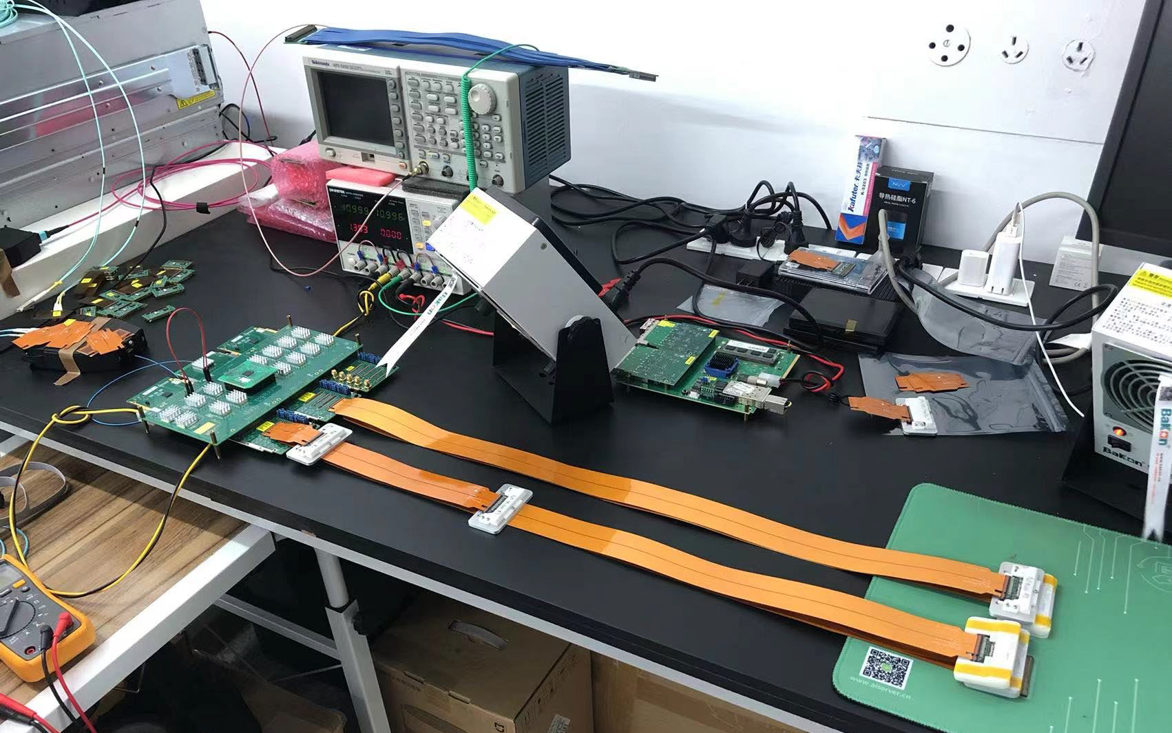
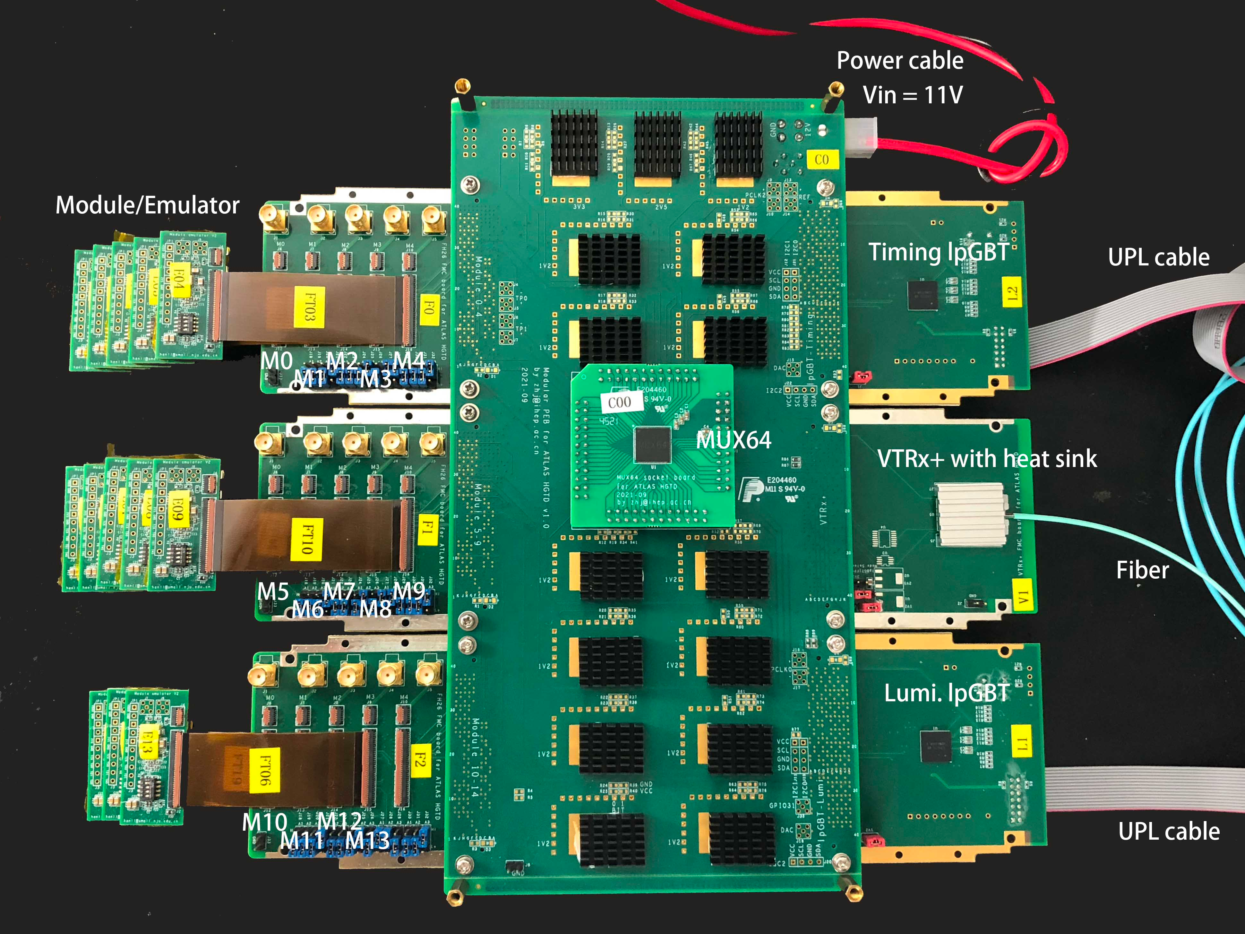
Peripheral Electronics Boards
Prototype (PEB 1F) design to finish soon – some delays to understand communication with FELIX and to simplify PEB design, to save time/complexity later on:
Space limitations on rigid PCB for connectors and components required flex tails integrated into rigid PCB
A lot of individual testing of components (lpGBT, VTRX+) already done
PDR in Nov 2022; PEB 1F Production: Dec 2022-Jan 2023
PEBs
Modular PEB
Timing lpGBT
To FELIX
Flex tails
Module emulators
Lumi lpGBT

Slide 11
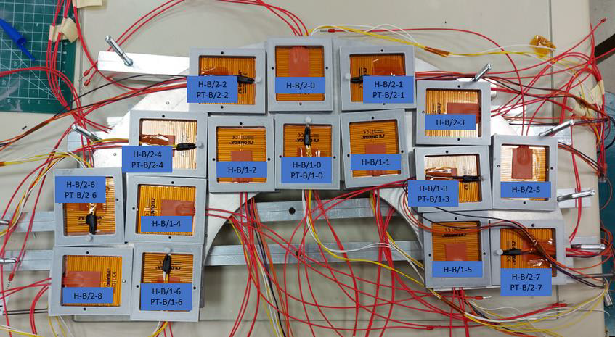
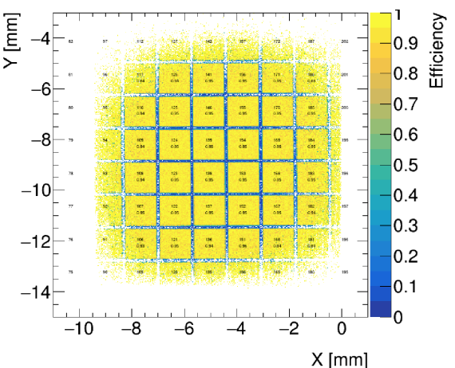
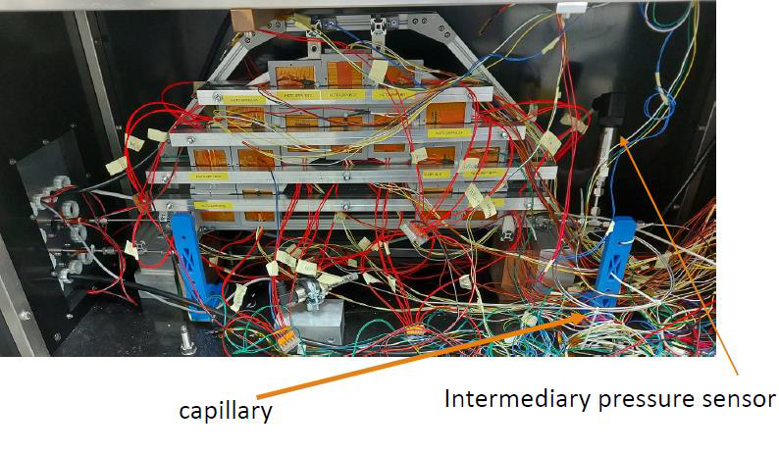
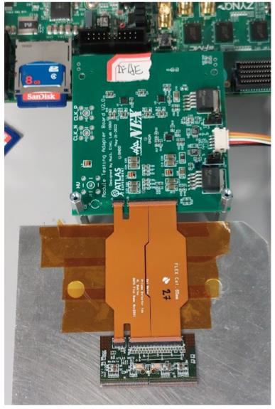
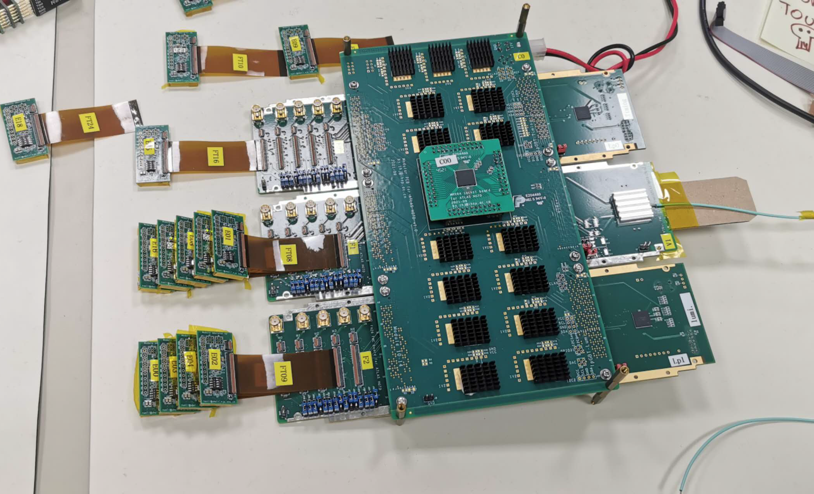
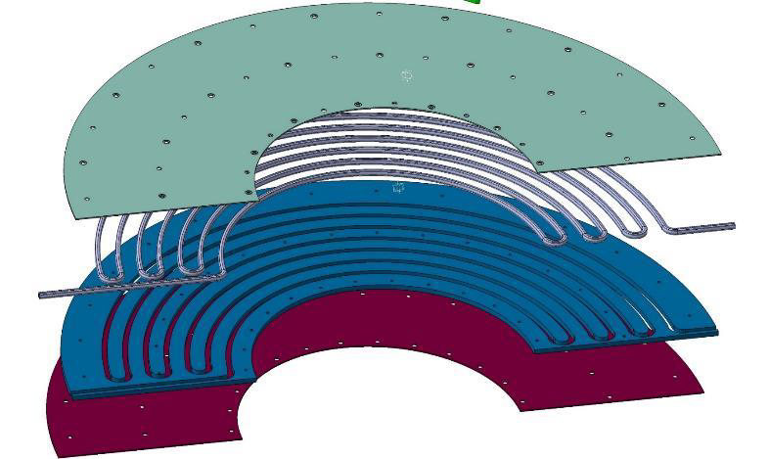
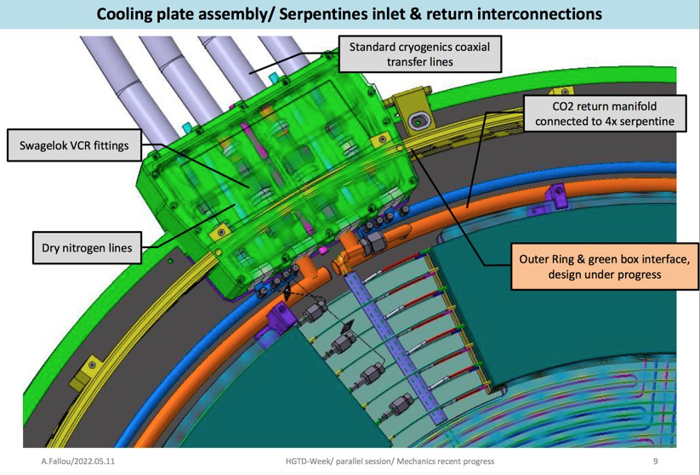
And Much Much More!...
Heater and DAQ demonstrators
And a mockup for cable routing
Test beams and sensor irradiation
Full update of mechanics vessel design, ready for PDR
DCS and Interlocks development
Grounding and shielding
Beamtest paper accepted: link
Etc, etc...

Slide 12
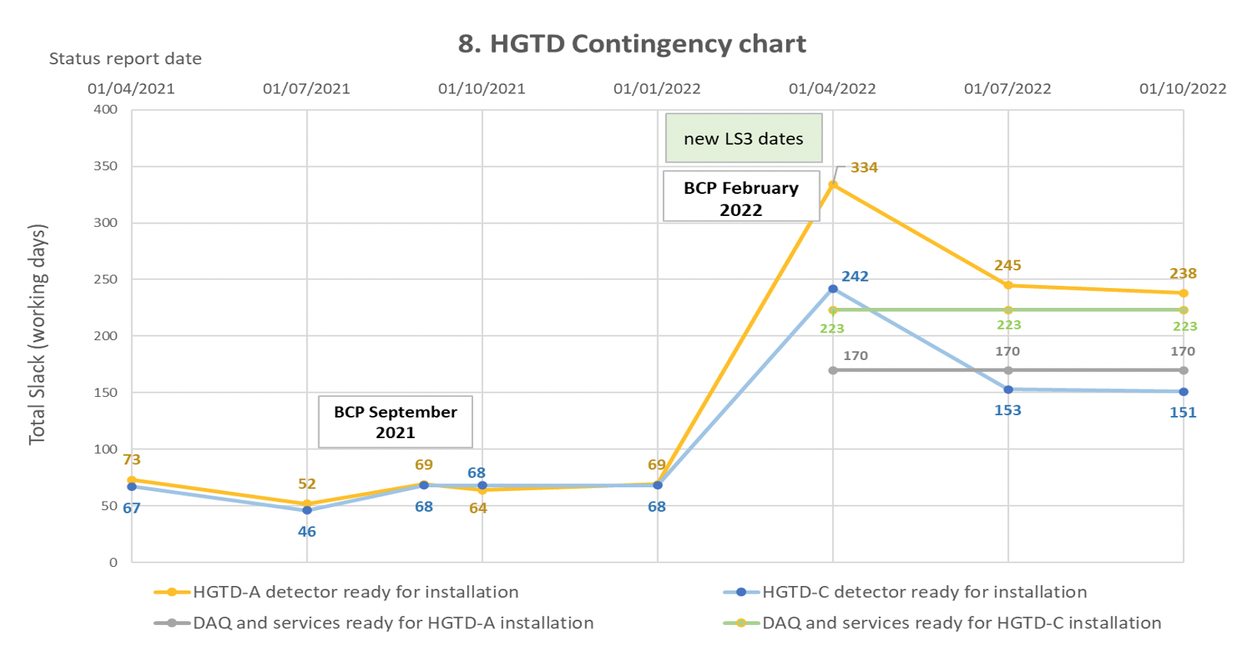
Project Overview
LGAD Sensor production: Tendering ongoing
Pre-production to start in December, followed by tests
ALTIROC ASIC: Critical, FDR October 2023
ALTIROC3 to be submitted early November
Pre-production (ALTIROC A) design starts April 2023
Peripheral electronics boards: PDR (PEB 1F) November 2022
Complex large boards with 6 versions – design slightly behind
Design of other versions to start in January 2023
HV Power Supplies: PDR passed in September 2022
Ordering full-size prototypes for evaluation
PDR raised questions on gounding scheme (single-point vs mesh)
LV Power Supplies: FDR planned for December 2022
Pre-production expected in March 2023
Modules, Flex cables, Detector units: PDR planned for Dec 2022
Production of 50 modules for full demonstrator by February 2023
Mechanics and on-detector cooling: PDR in November 2022
Services, CO2 cooling, N2, Cables, Fibres: PDR in November 2022
Lost around 2 months due to delay in ASIC submission
But delays now stabilized – only 1 week lost in last quarter
Project contingency:
HGTD-A: 238 working days
HGTD-C: 151 working days

Slide 13
Thanks for listening!

