Slide 1

ATLAS Week Lisbon 2022

Slide 2
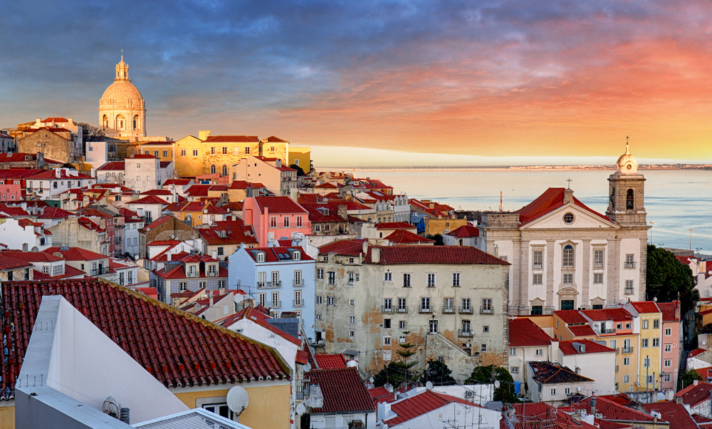
Welcome to Lisbon!

Slide 3
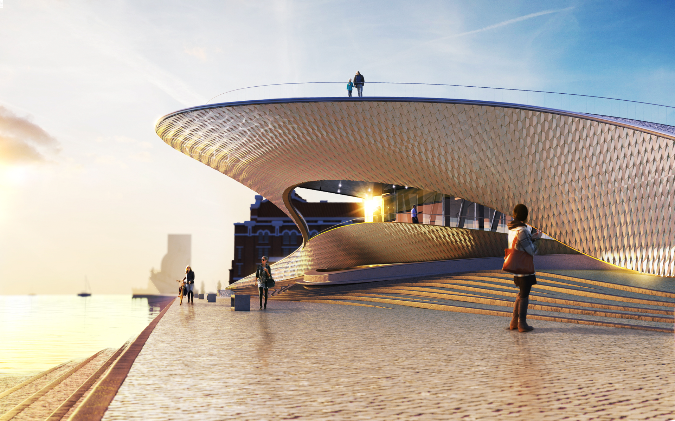
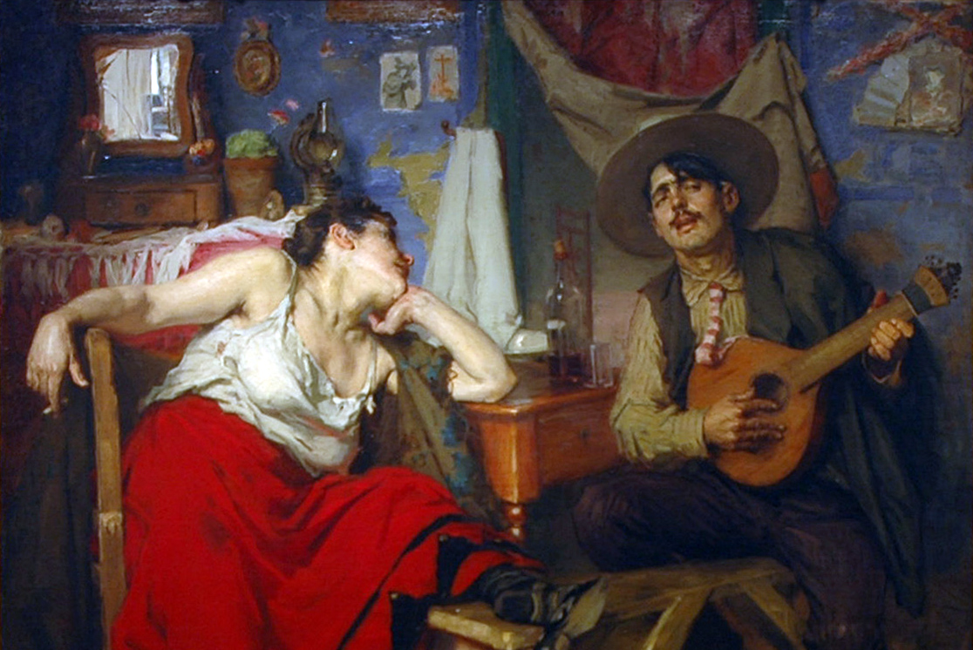
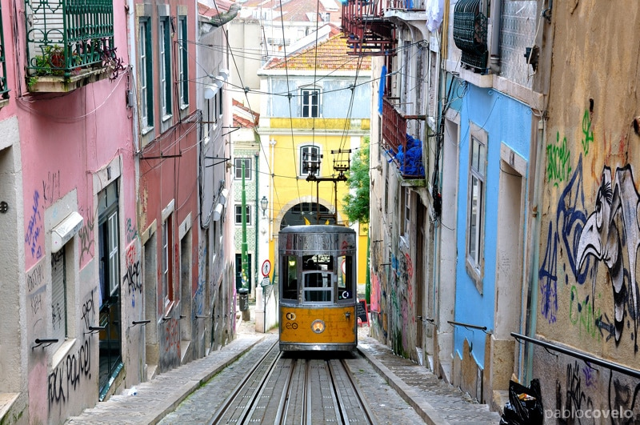
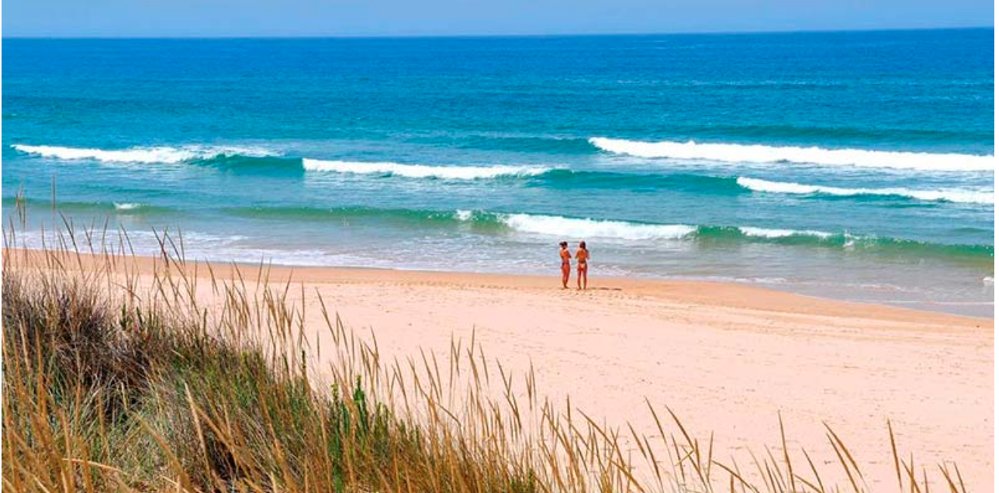
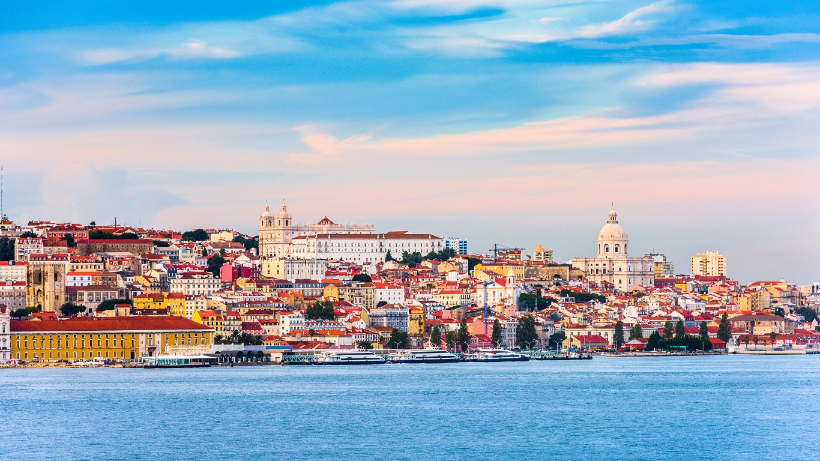
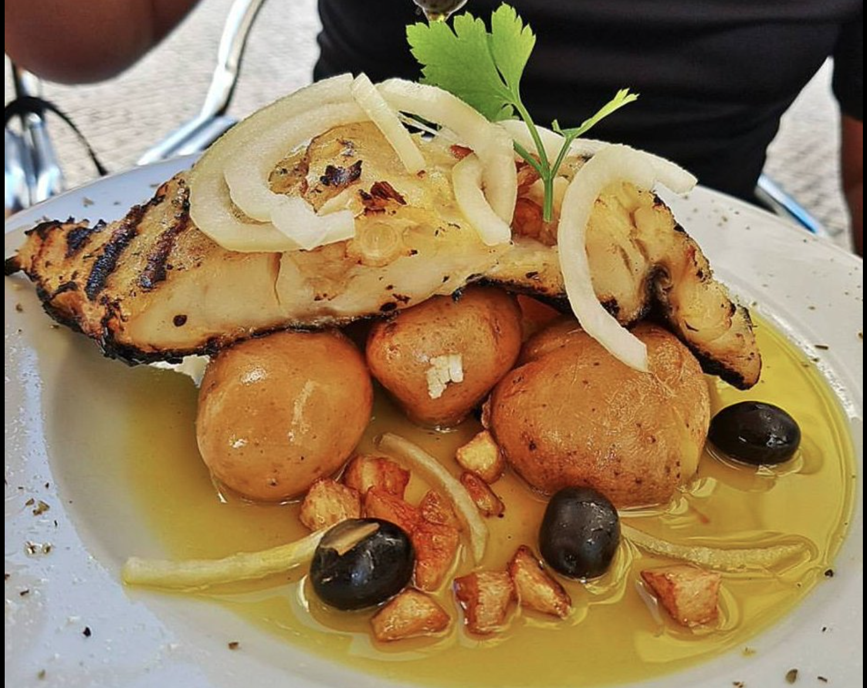
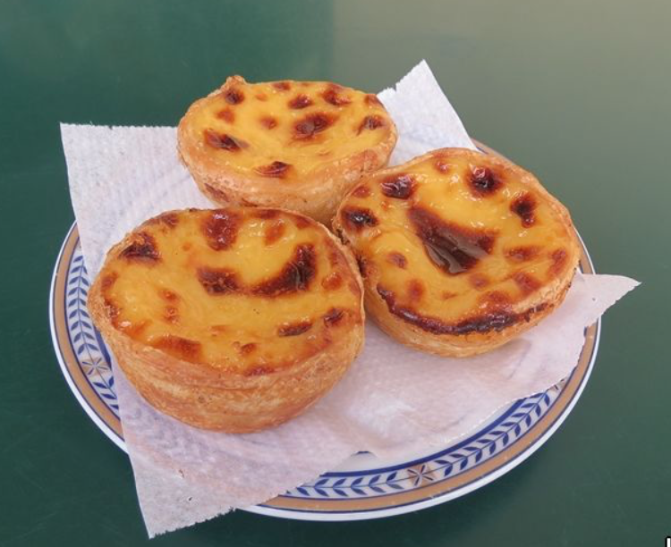
Lisbon
By the Tagus river
Vibrant city, home of traditions, culture and fine cuisine
Close to beautiful beaches
Mild weather in October (average 23º/15º)
  Mostly sunny

Slide 4
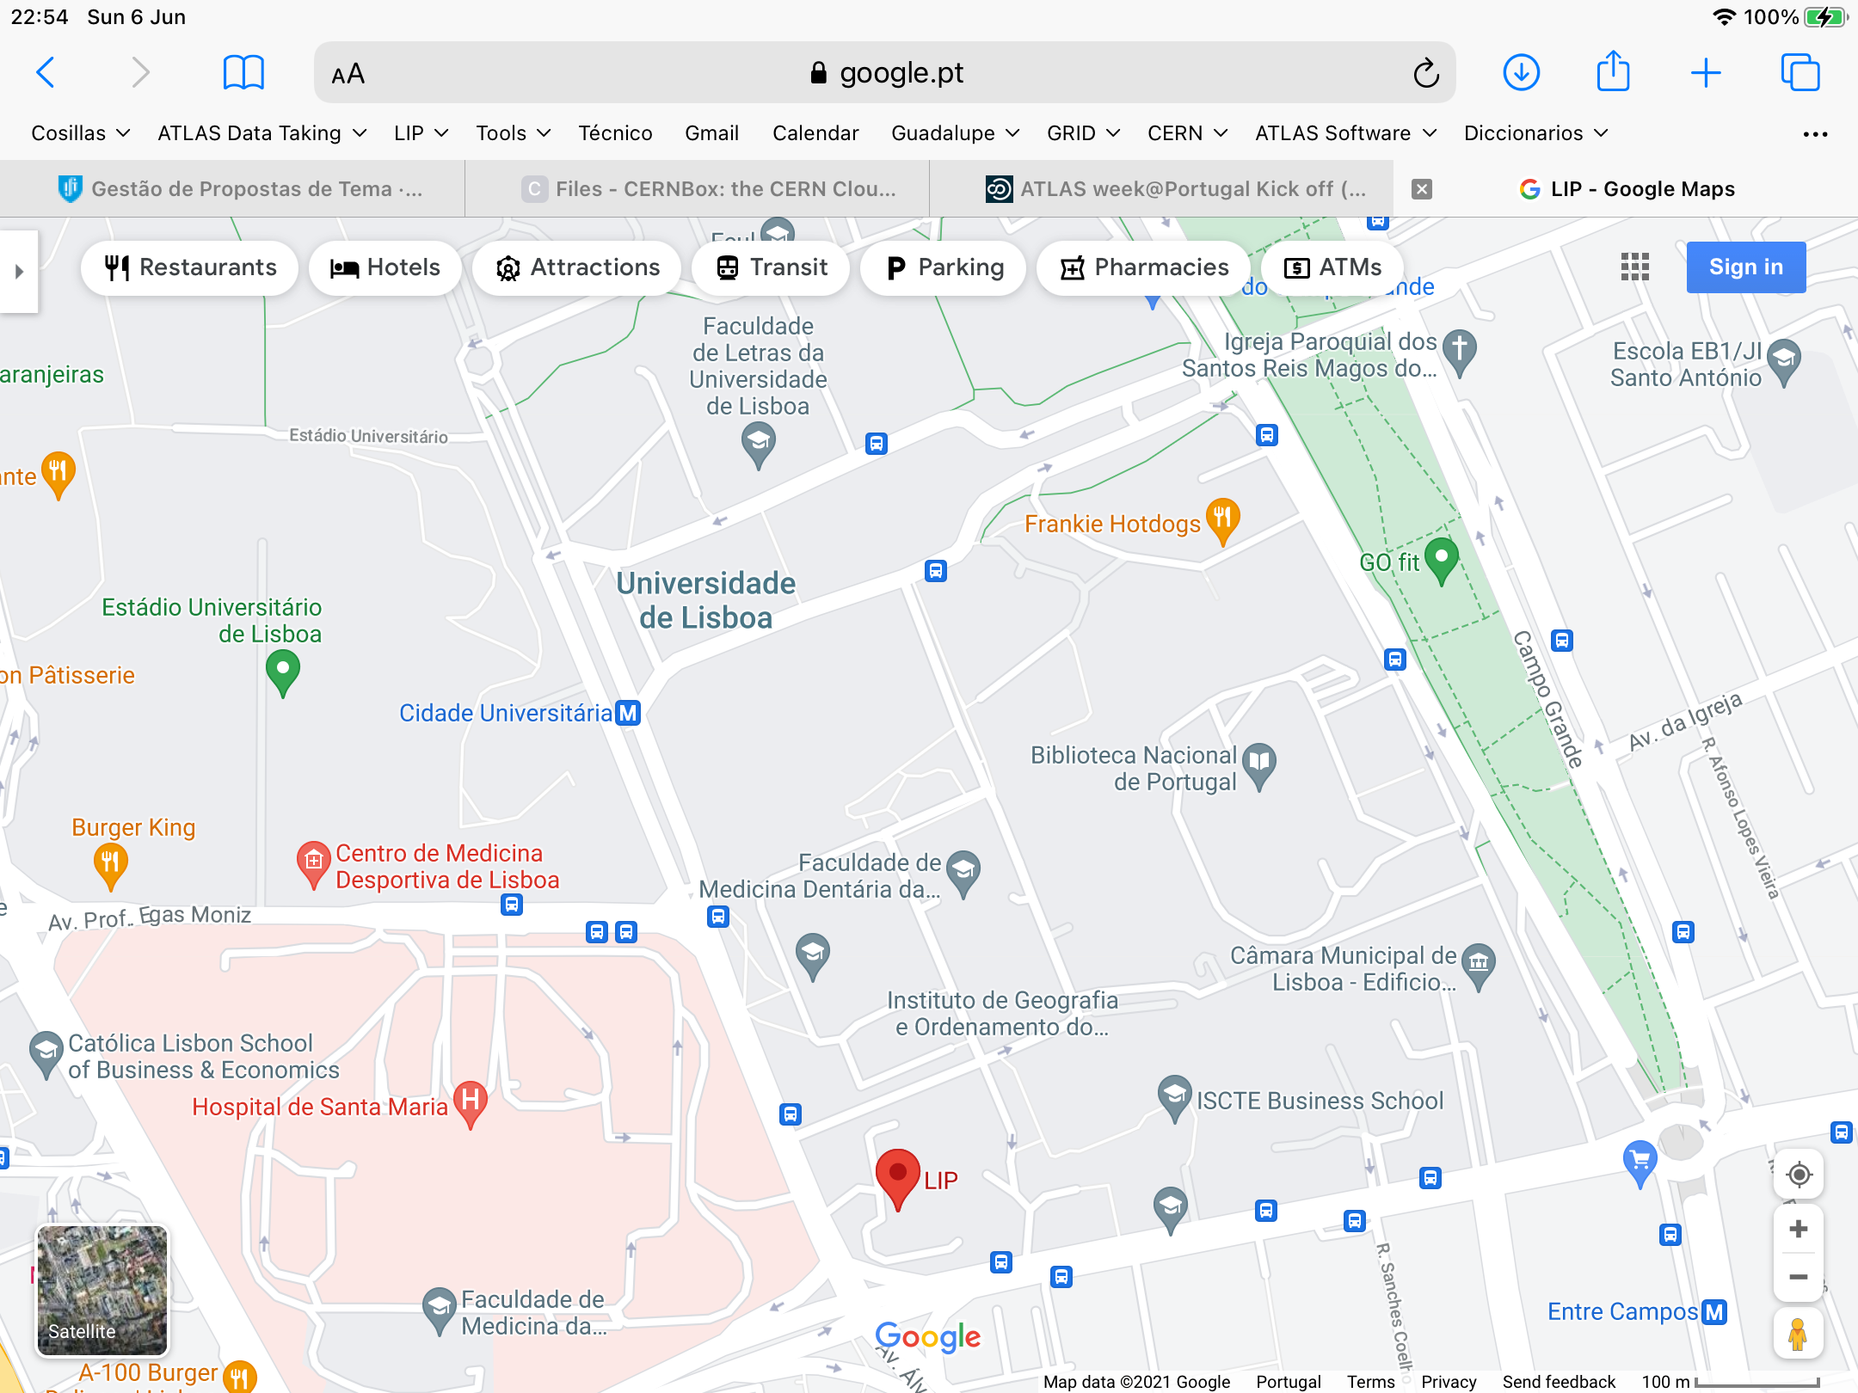
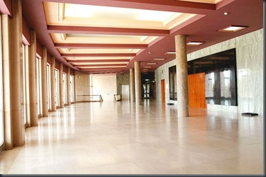
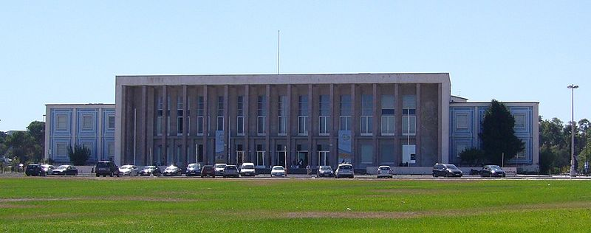
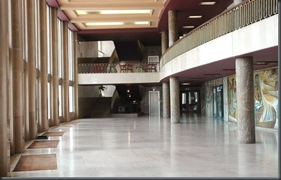
Venue location
Aula Magna
Central location
  Well communicated by public transport
    Subway: 50 m, bus: 50 m
  Within walking distance from several hotels
  Close to LIP (5 mins)
Buffet lunch will be provided every day
  Not too many restaurants close by
  Easier/faster
Large space available for coffe breaks and lunches
Large green area outside
LIP
LIP

Slide 5
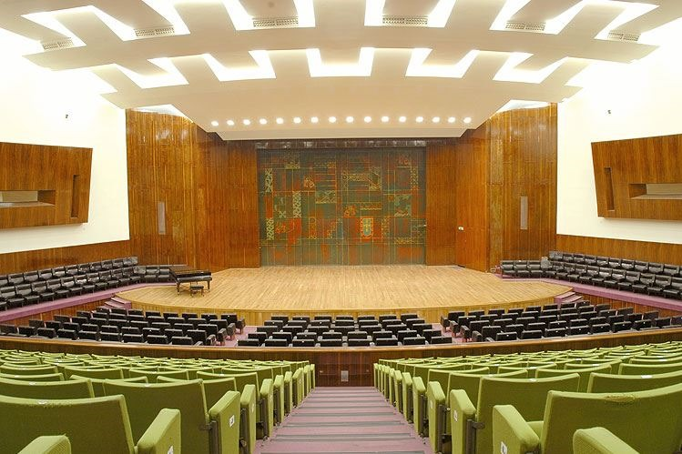
Venue — Aula Magna
Main room:
Aula Magna of the University of Lisbon
Satellite rooms for meetings on site or at LIP (5 mins away)
Wifi:
  Eduroam, University service
  Provides
    sufficient number of connections
    support during the event
Ethernet connection for presentations

Slide 6
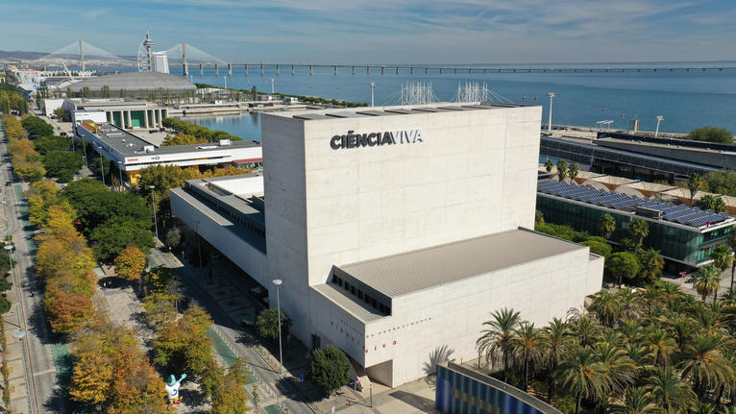
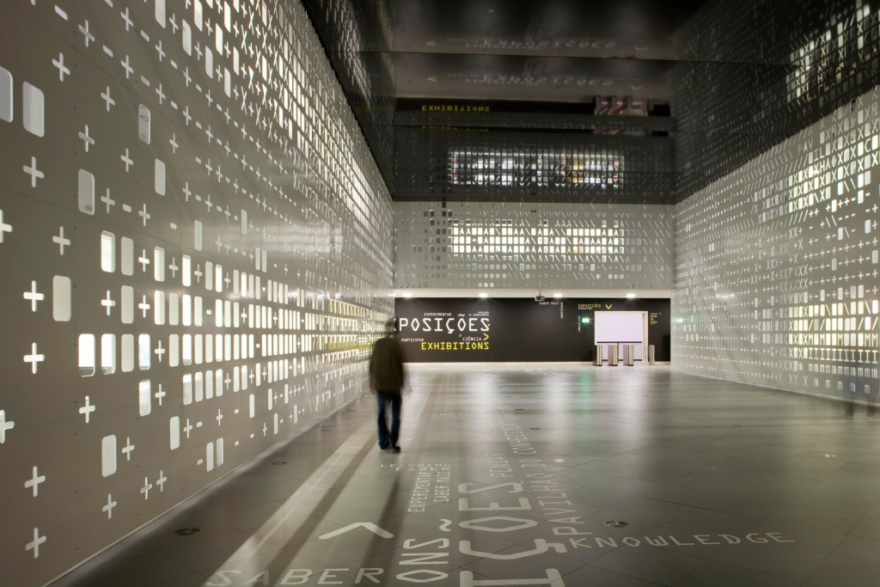
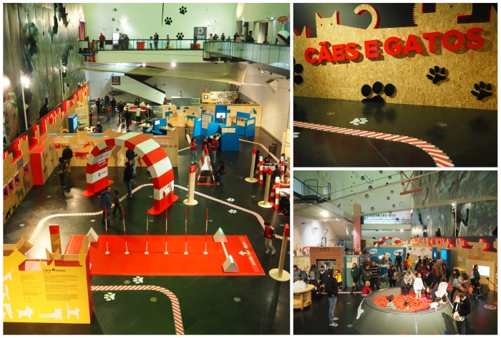
Social events: welcome drink
Ciência Viva museum
  Dedicated to explaining science for kids
Placed in Parque das Nações
  Ideal for a nice evening walk and dinner around
  Very touristic area

Slide 7
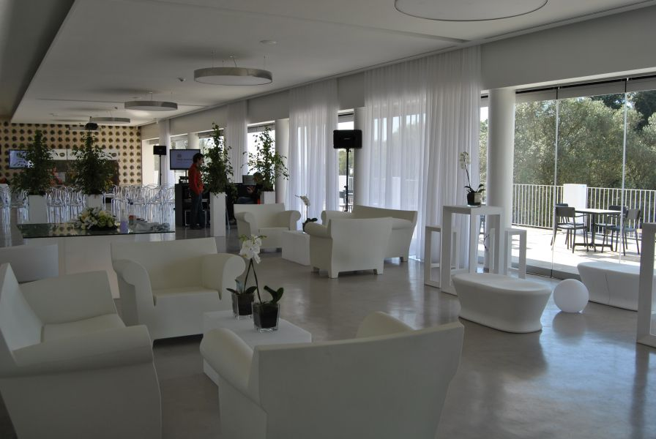
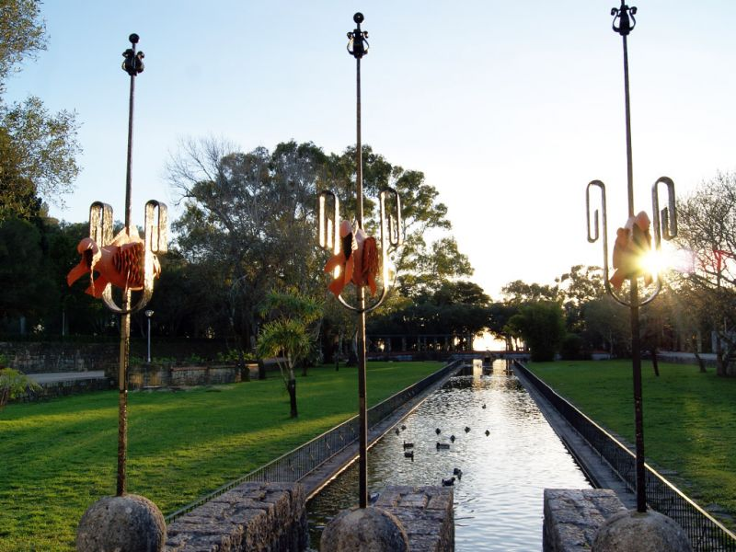
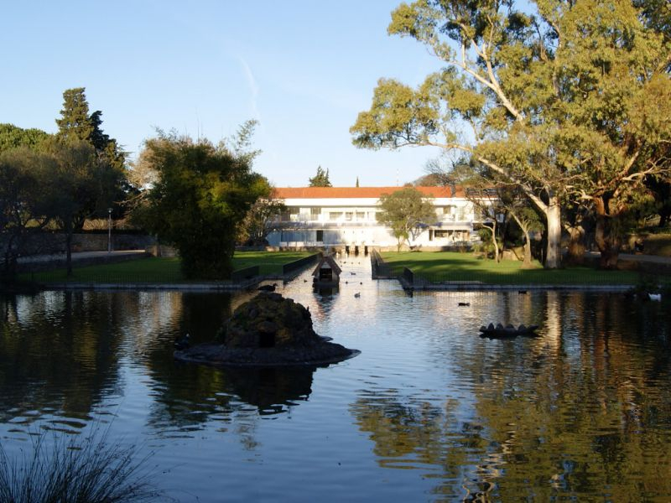
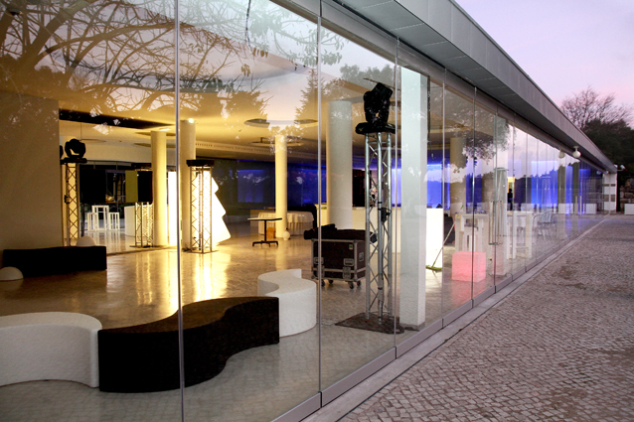
Social events: conference dinner
Thursday evening
Montes Claros restaurant
  In Monsanto, the largest green area in Lisbon
  Transportation by bus provided

Slide 8
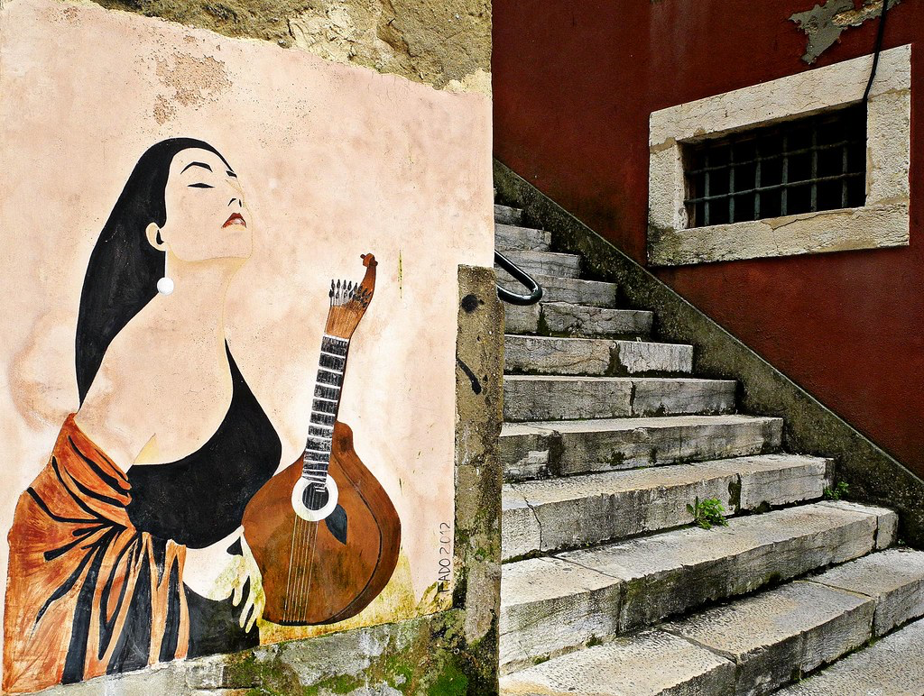
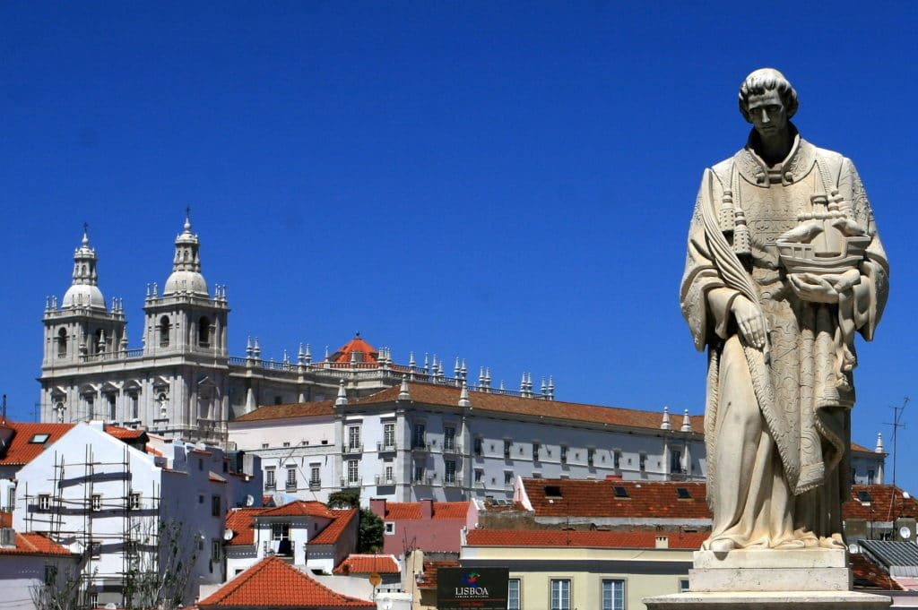
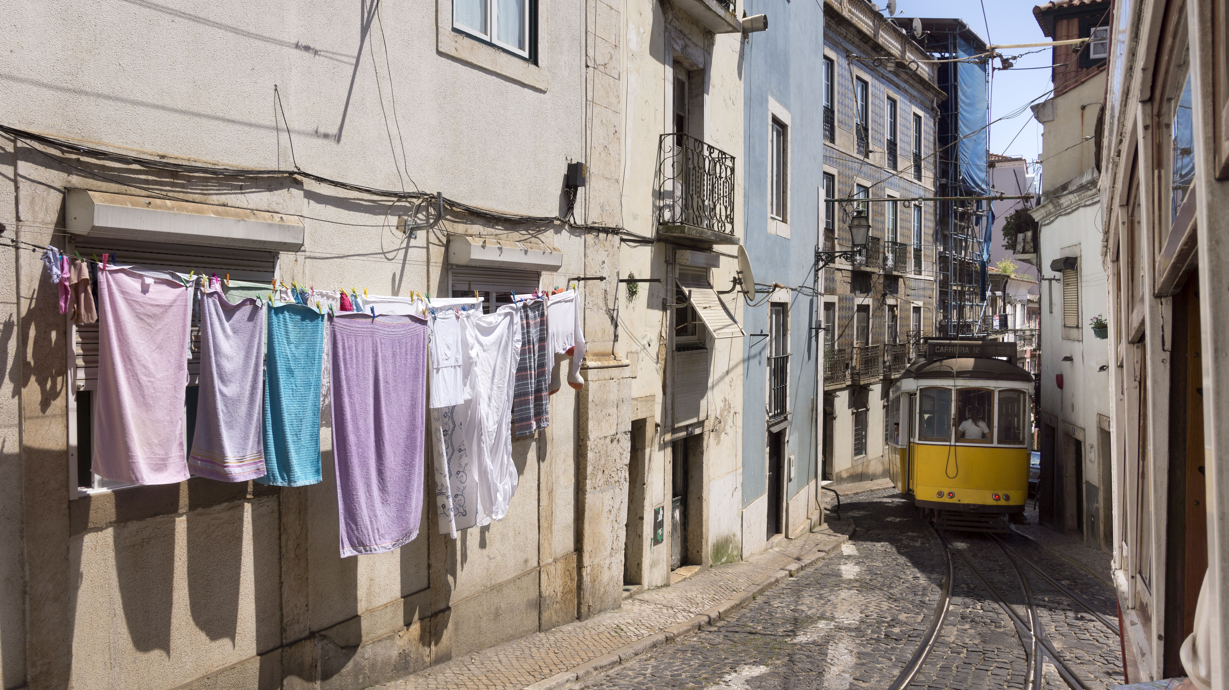
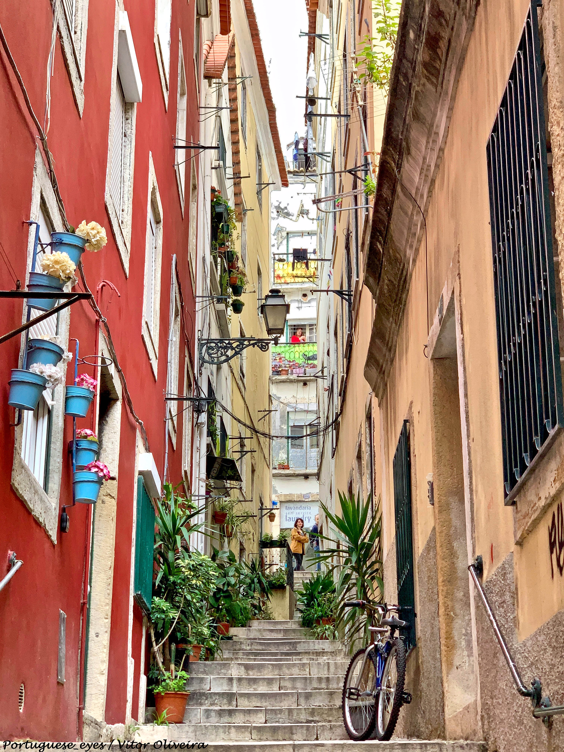
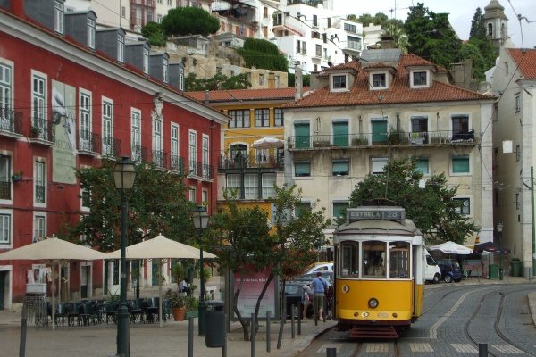
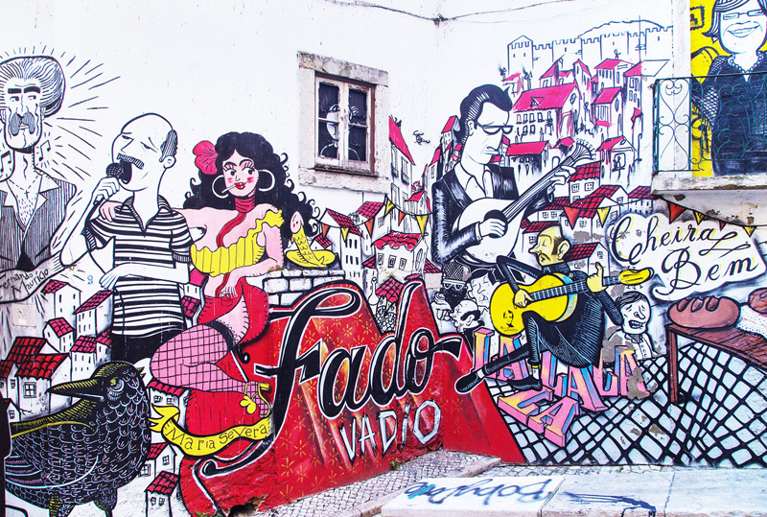
Optional social event:
Excursion
Half-day guided tour of old town
  The popular districts: Mouraria and Alfama
  The original Lisbon since Roman times – home of artisans, merchants, fishwives and sailors
  Home of Fado and its traditions
  Wednesday 12th
  Price: 30 euros
  More info on web page

Slide 9
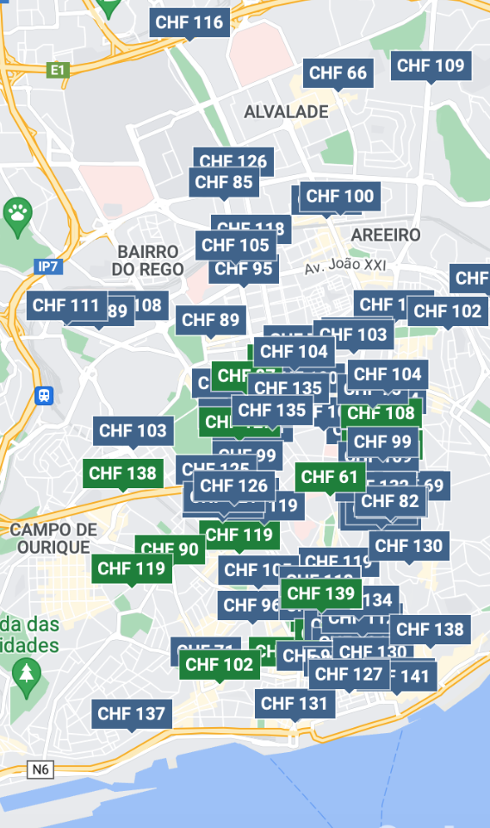
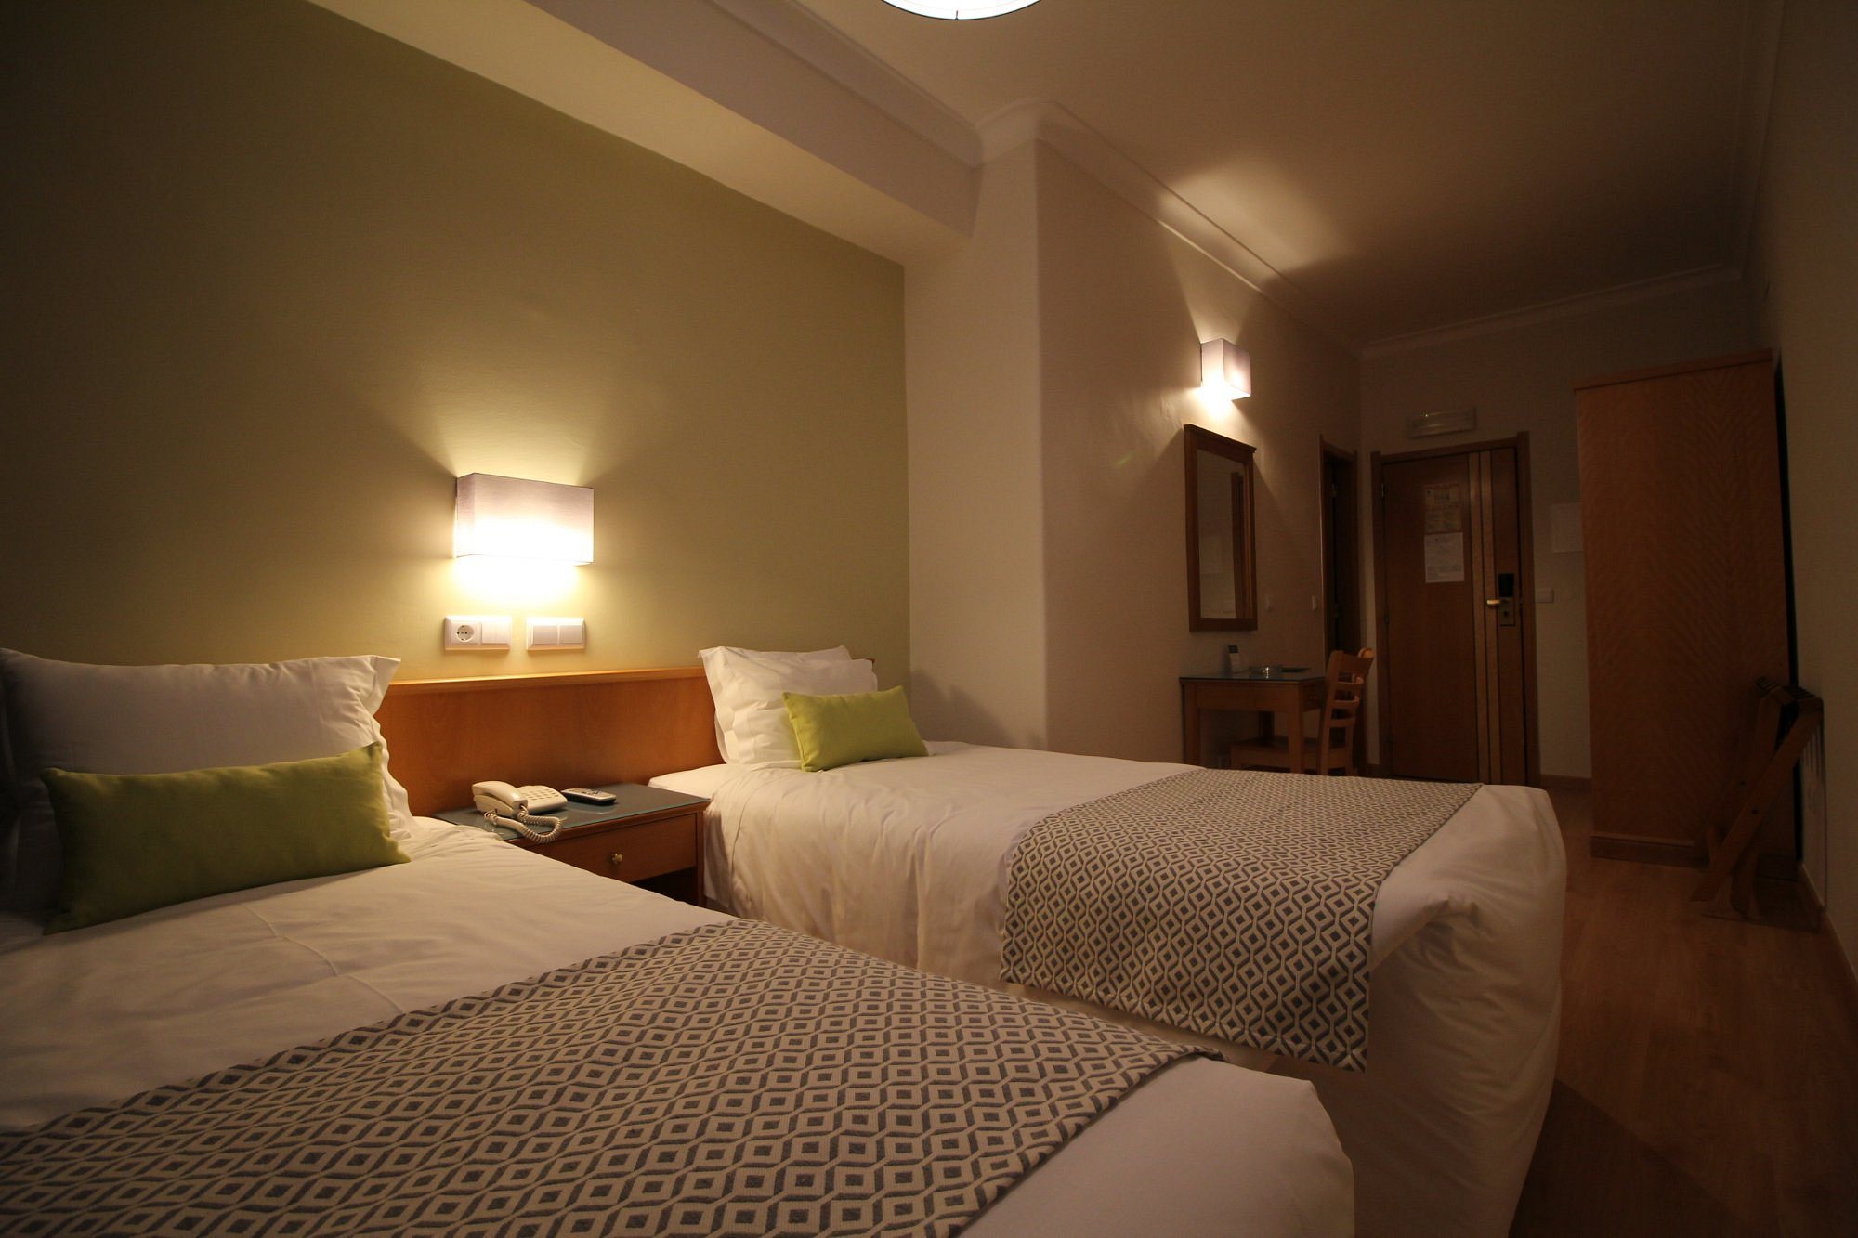
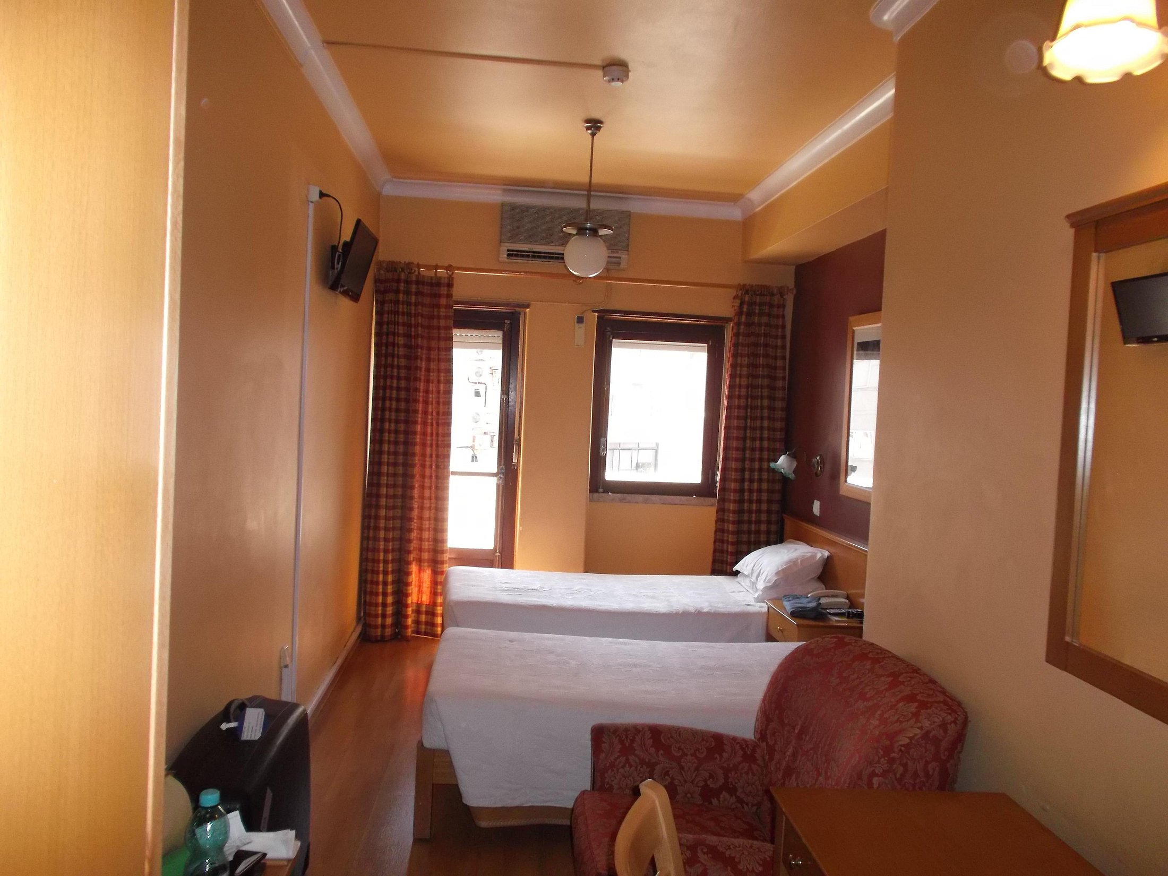
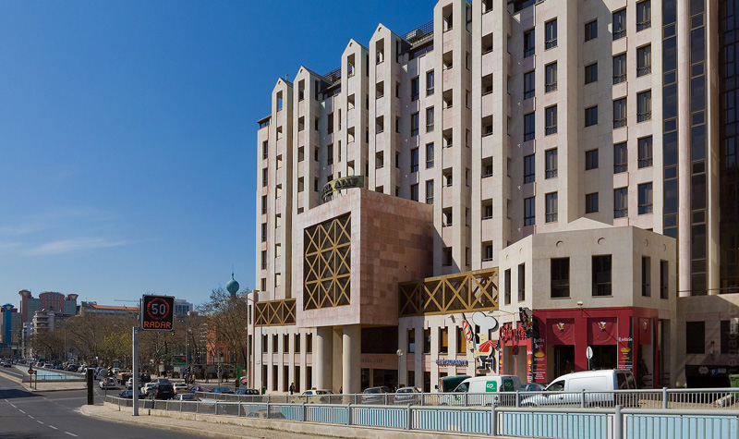
    Logistics: fees and accommodation
Fees:
  Regular fee: 380 Eur – 280 Eur for students
  Late fee (15 August): 430 Eur
Fee payment:
  Bank transfer – easiest
  Payment also possible through EventBrite
  Instructions on web page
Accommodation:
  Lots of hotels available – easily reachable by subway
    Easy to find good accommodation at reasonable price
  Group bookings made for 45 rooms (single and double) in 3 hotels – prices from 50 to 75 Euro
    All within reasonable walking distance of venue

Slide 10
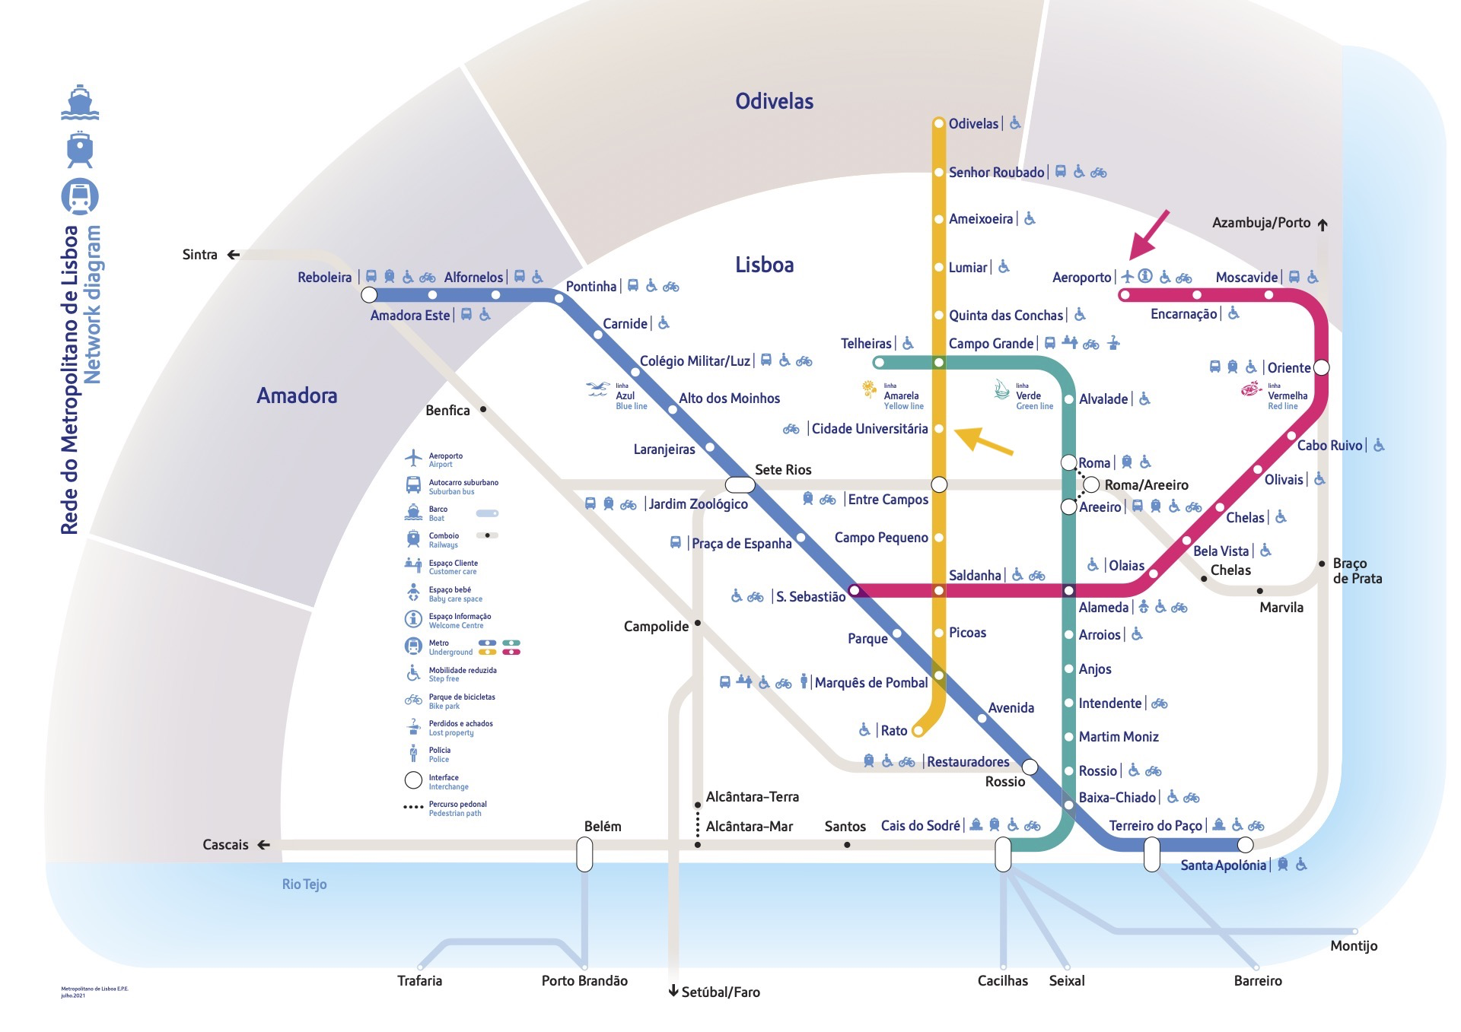
Logistics: getting to and around Lisbon
Flying to Lisbon:
  Lisbon airport well connected to many capitals in the world
  Typical flight duration from Geneva to Lisbon: 2h 20 min
  Airport very close to the city center and well connected by public transport (bus, subway, taxi)
Easiest is by subway (Metro):
Conference venue is near a subway access (Cidade Universitaria – Yellow line)
  Accommodation near the Yellow line is easily found
  Subway fee: 1.5 Euro / 1 hour
  24 h ticket for 6.45 Euro
  Valid for metro and buses
Information on the ATLAS Week page
Taxis are easy and cheap:
  E.g. Airport to centre ~15 - 20 Euro
But: please make sure taxi meter is running!
https://www.metrolisboa.pt/en/

Slide 11
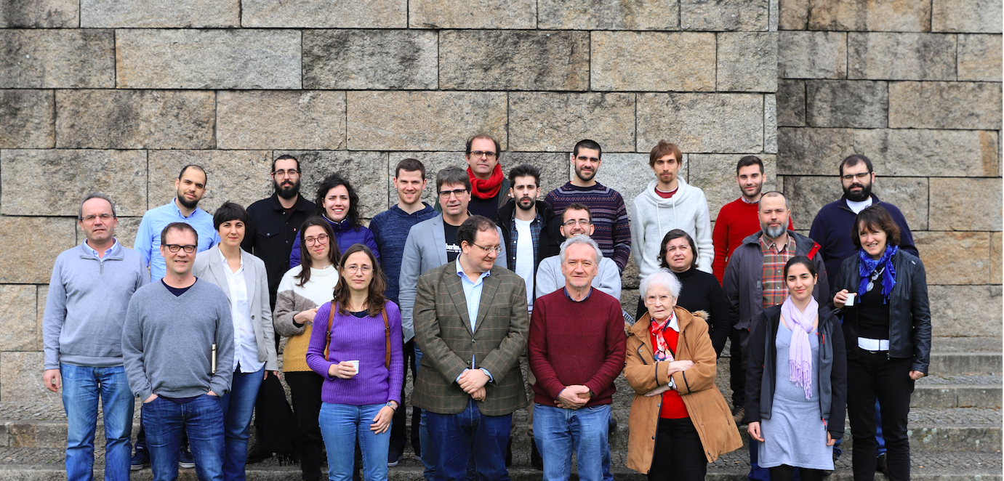

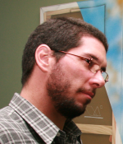
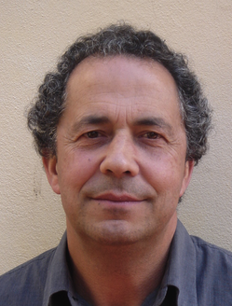
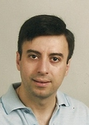
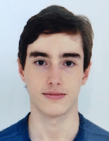
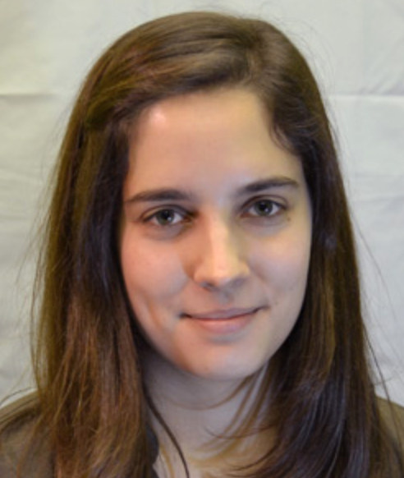
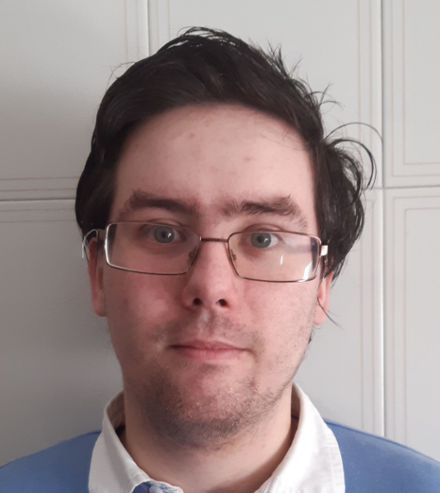
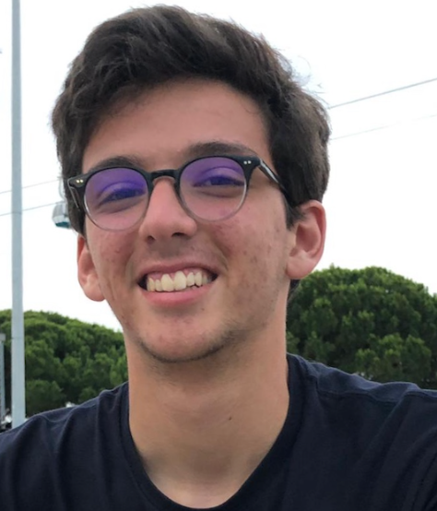
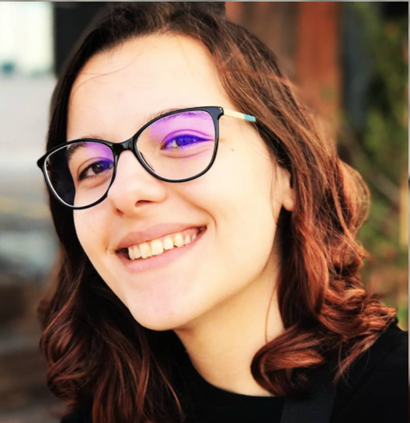
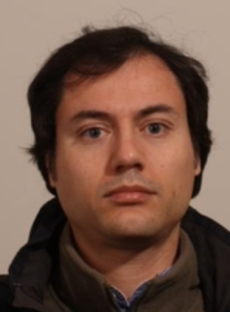


Your hosts: the Portuguese ATLAS Team
National group:
LIP (Lisbon, Coimbra, Minho), FCUL, FCTUC, U. Minho, CFNUL
CEFITEC/UNL, INESC, CFMC, AdI engineers training program

Slide 12
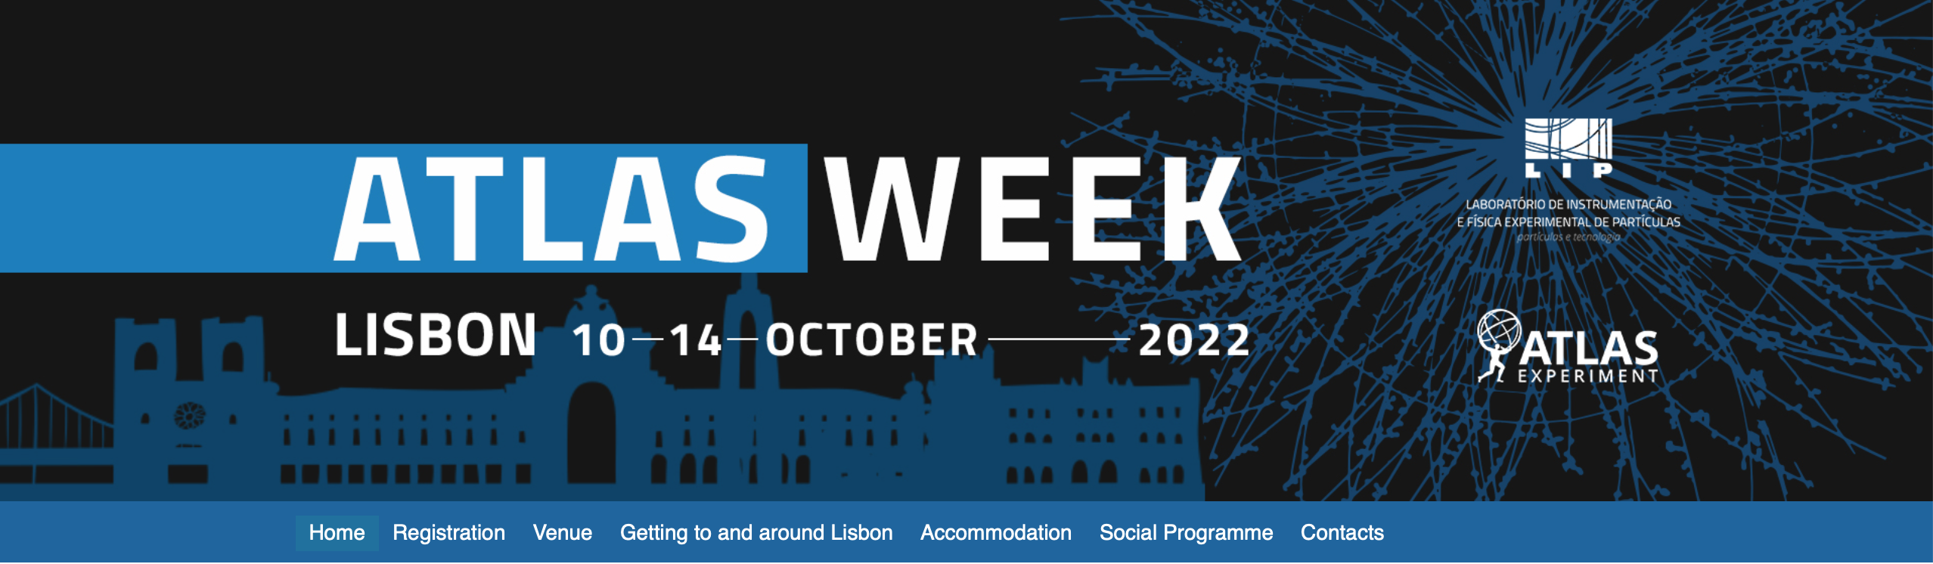
More information:
Web page:
  https://indico.cern.ch/event/1161009/
Any questions?
  Contact us at atlasweek.2022@lip.pt

Slide 13
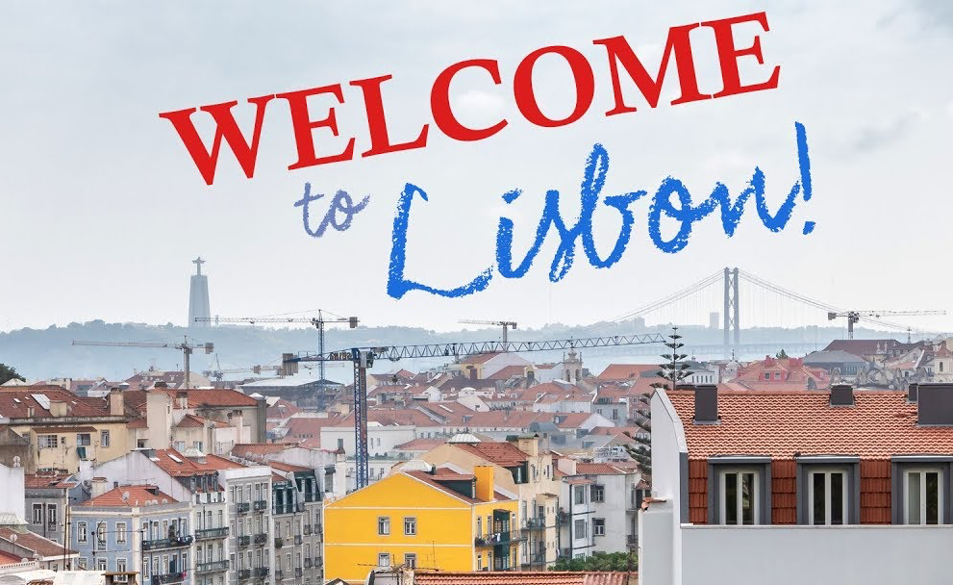




Thanks and...
Acknowledgments:

