Slide 1
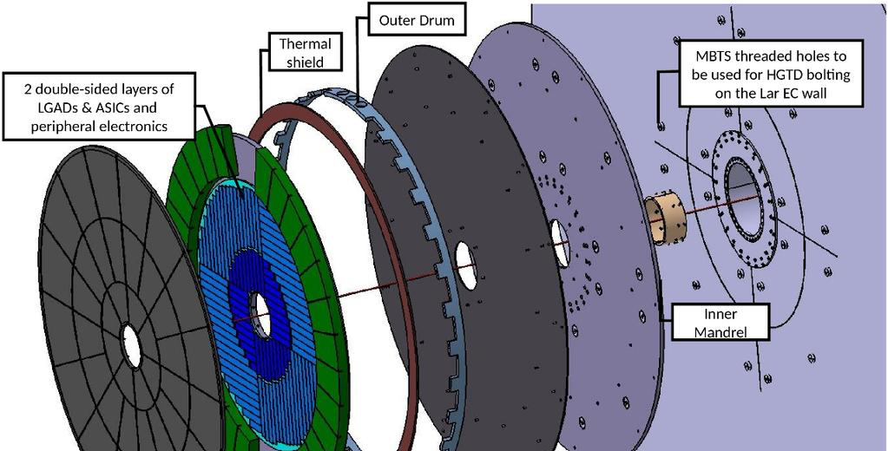
High Granularity Timing Detector
Project planning

Slide 2
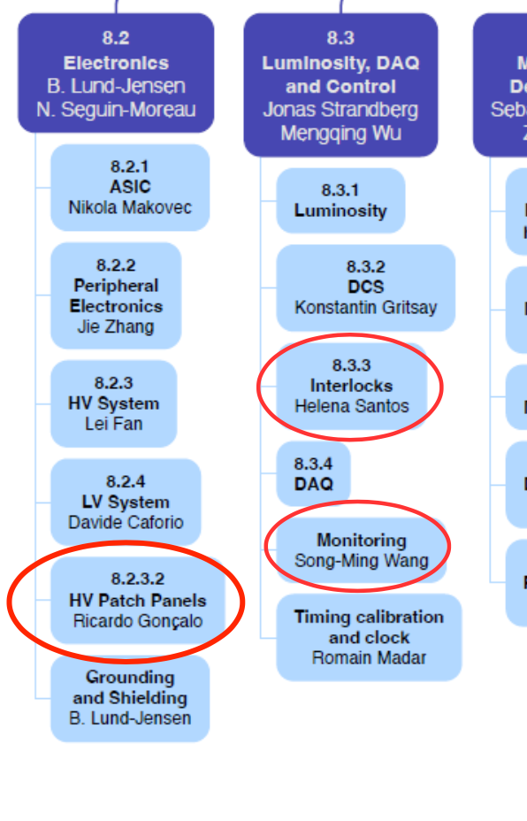
HGTD @ LIP
Tasks at LIP:
Electronics Work Package:
High Voltage patch panels
ALTIROC ASIC development
Luminosity, DAQ & Control:
DCS
Interlocks
Infrastructure:
Long HV cables
Pigtails
Possibly: Mechanical design and production at LIP

Slide 3
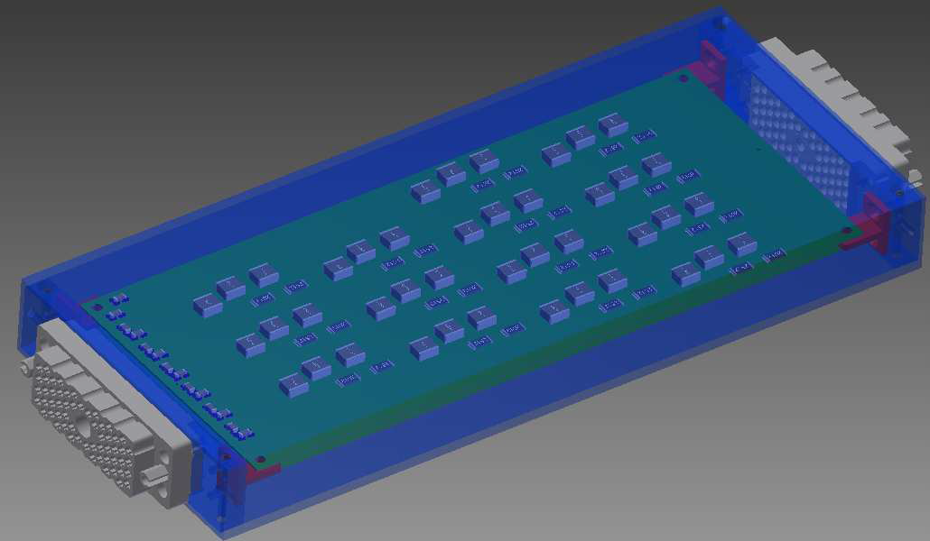
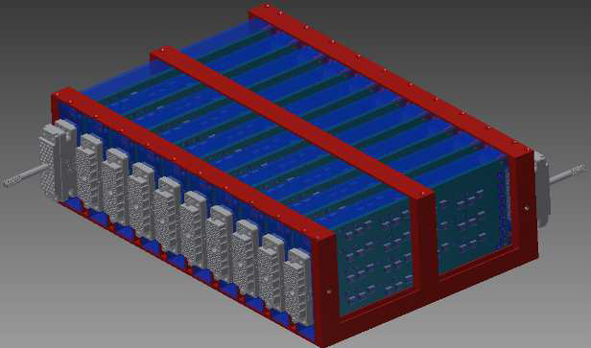
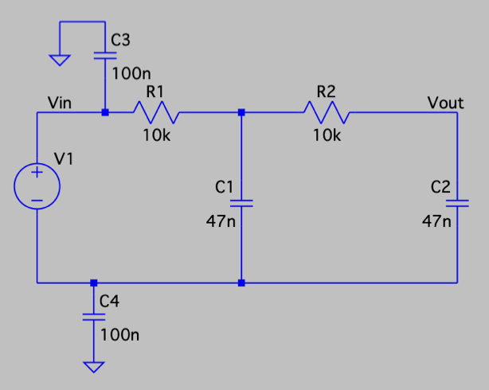
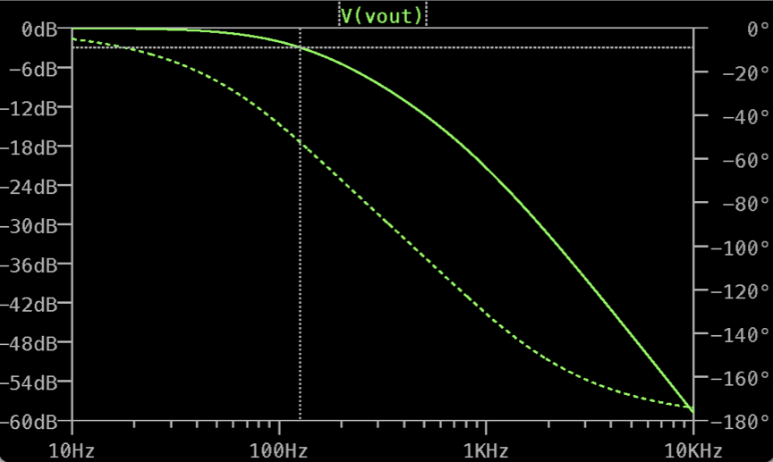
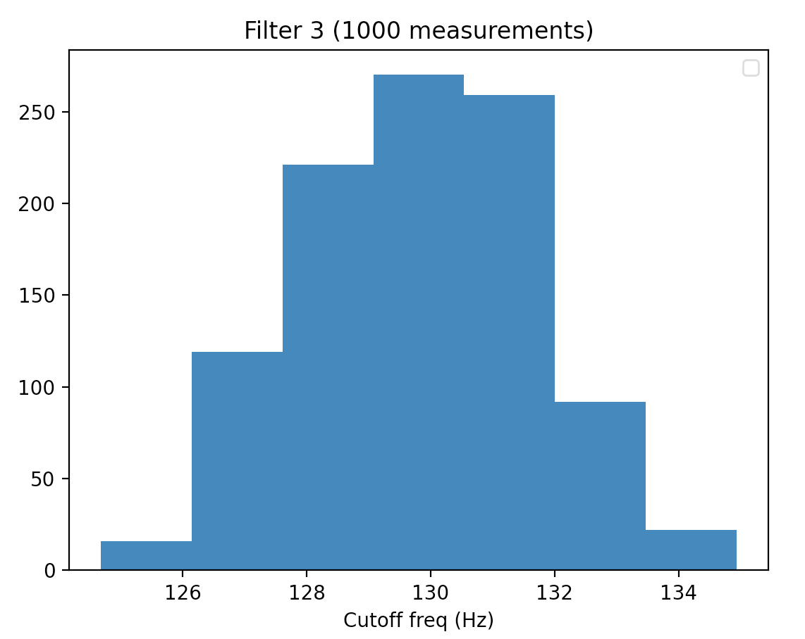
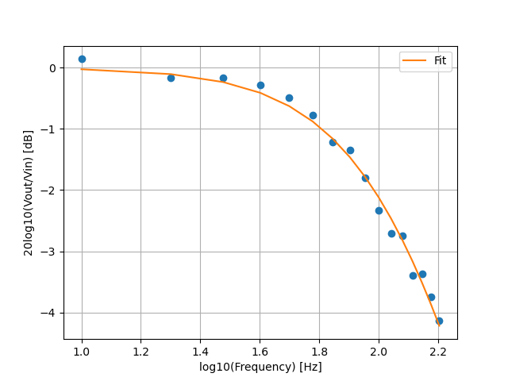
Electronics and High-Voltage
HV patch panels (António Caramelo):
Responsible for producing HV patch panels
Routing and filtering High Voltage to HGTD detector
Preliminary layout done and prototype tested
Design being updated after review
Cables:
Complicated situation: quotes > 2x original price – cannot pay for this
Still interested in fabrication and sharing part of price
Also interested in Pigtails

Slide 4
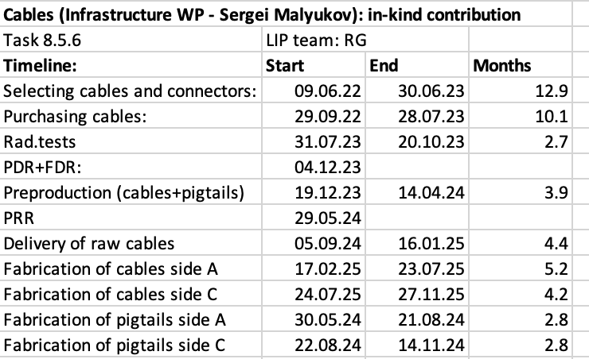

Slide 6
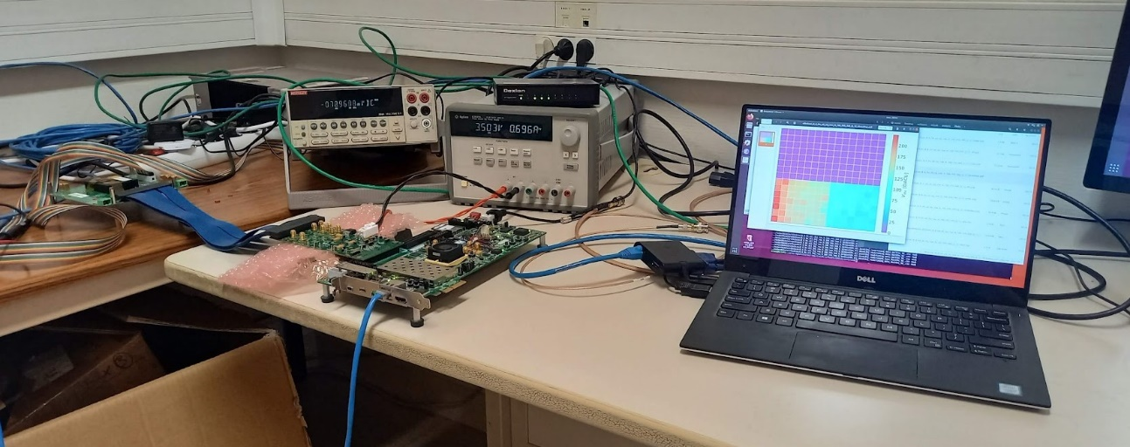
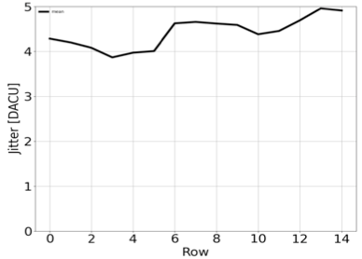
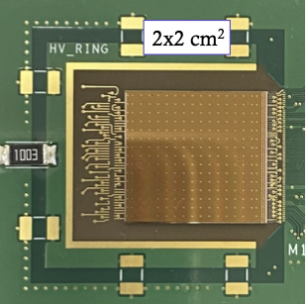
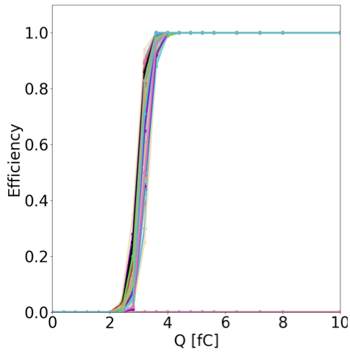
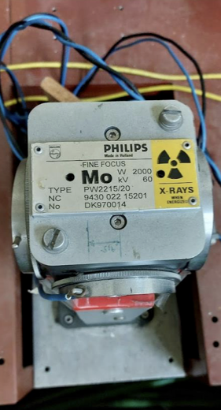
ALTIROC ASIC
ALTIROC: (Rui Fernandez, Pedro Assis)
ASIC under development for LGAD readout
Taking part in ASIC development tests
TID: irradiating at -35ºC – making tests now...

Slide 8
DCS and Interlocks
Detector Control System (Rui Fernandez, Filipe Martins):
Contributing to DCS architecture definition
Readout of DCS environment data through ELMB2 communication board
Interlocks (Helena, Maria Cruz):
Responsability for HGTD Interlocks – mostly will re-use ITk design
Likely to produce an interlock module ourselves (HV-Present)

