Slide 1
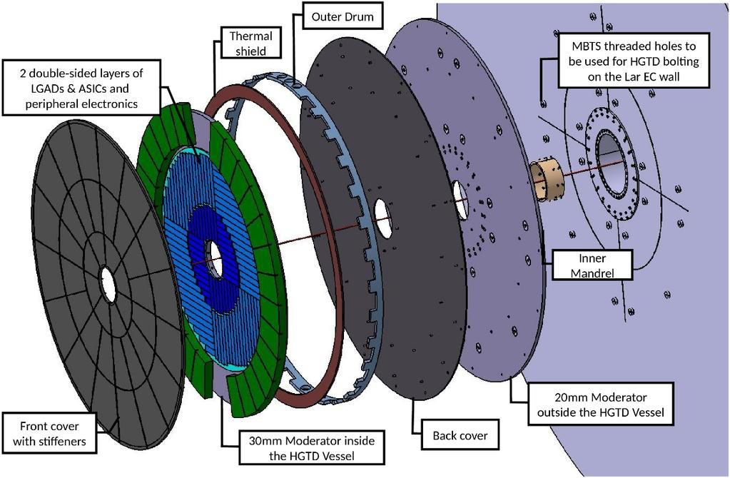
ATLAS Upgrade: HGTD

Slide 2
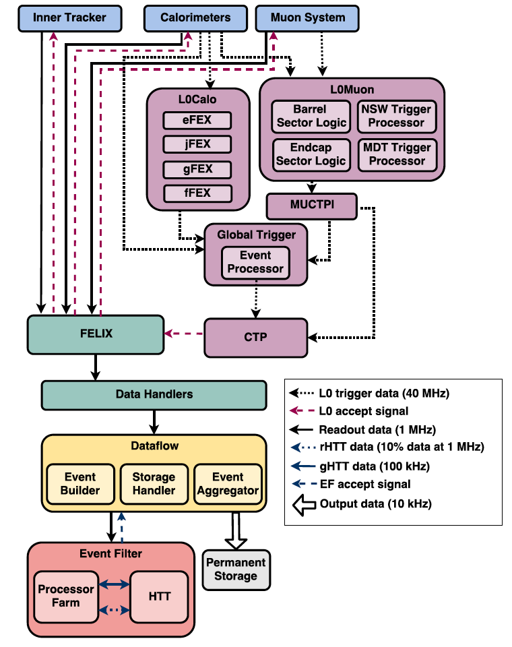
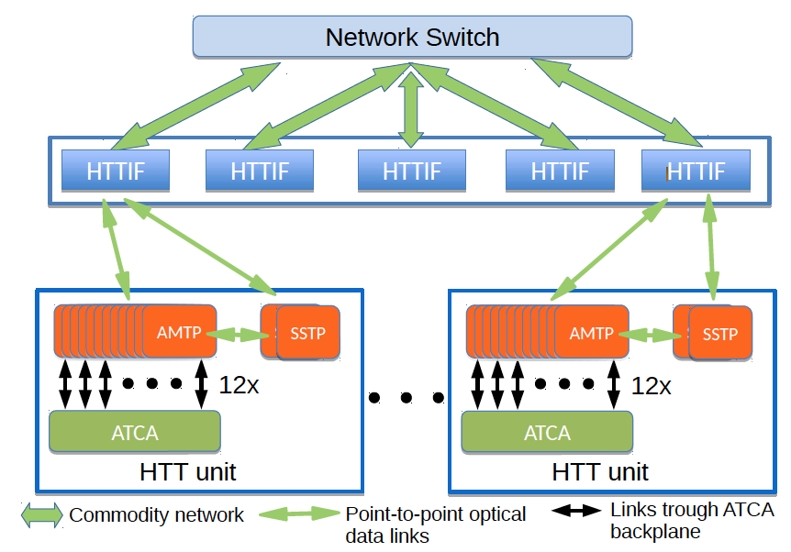
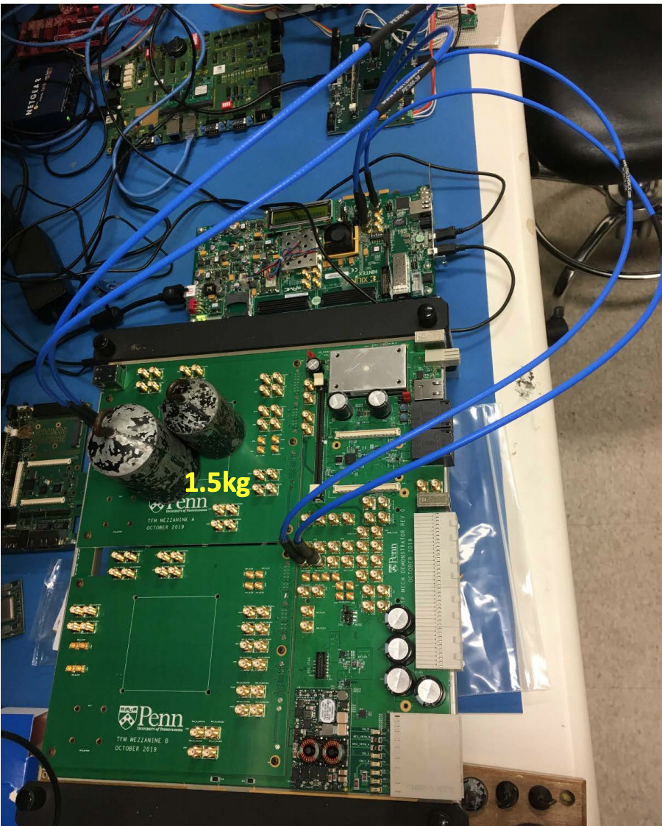
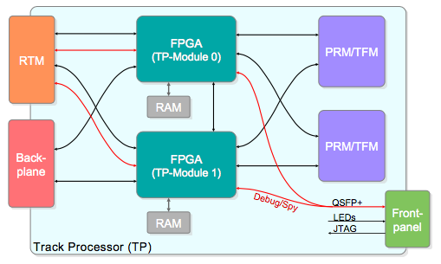
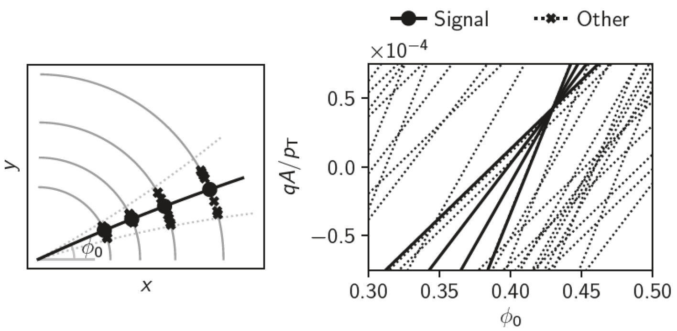
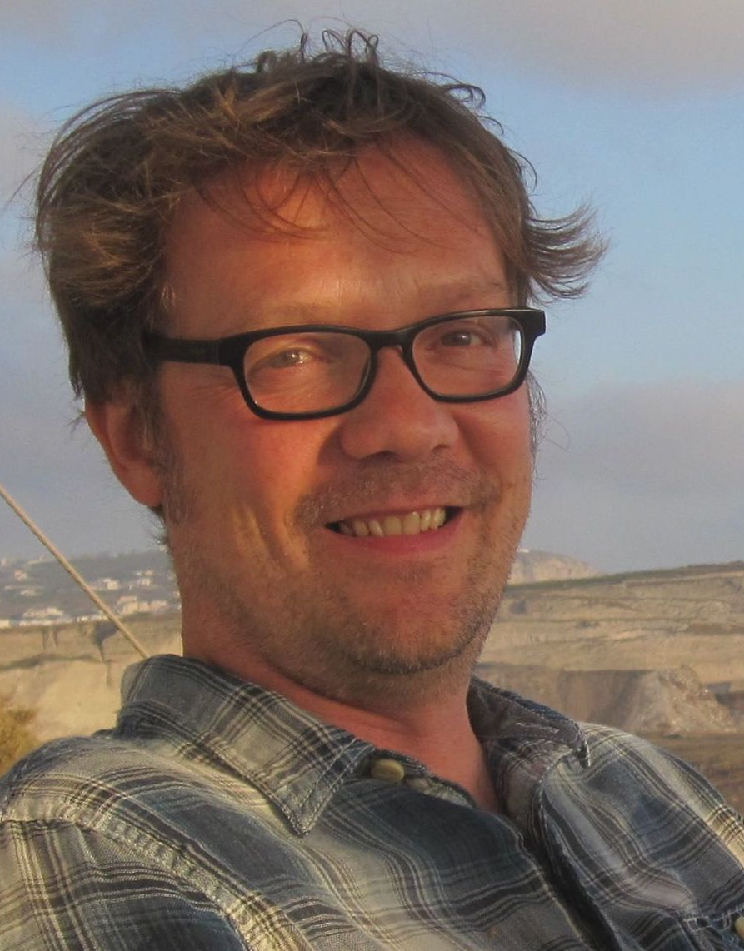
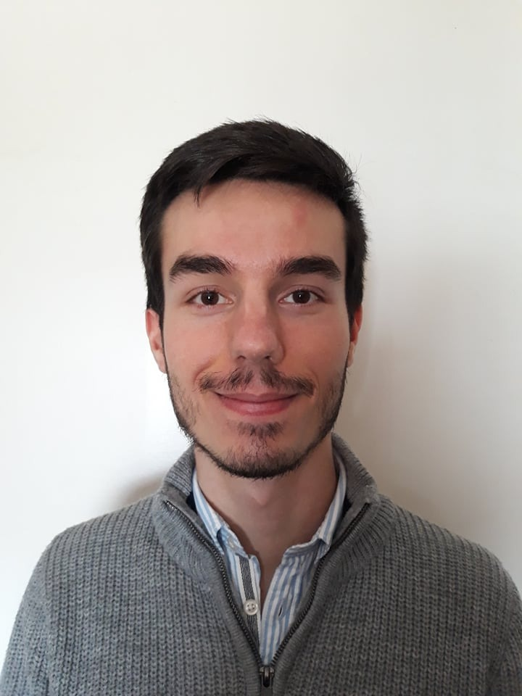
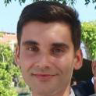
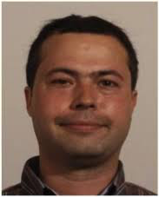
HTT electronics and software
Hardware tracking co-processor for the trigger:
Abandoned by ATLAS in favour of a solution based on software+commodity hardware
Contributions from LIP:
HTT fast simulation; studies of tracking performance – PHD Qualif. Task
Alternative tracking algorithm (Hough transform) – MSc thesis
Development of TP network interface – only started; TP prototype received late
Didn’t get here: production of RTM board and DCS
Team: 1 academic, 2 engineers, 1 PhD student, 1 MSc student

Slide 3
High Granularity Timing Detector
Two detector wheels at ±3.5 m from IP
7 m² area, covering region of 2.4<|η|<4
8032 LGAD modules of 20×20 mm²
Pixel pitch of 1.3×1.3mm²
Time resolution 30 – 50 ps / track
Aims to improve pileup rejection and luminosity measurement

Slide 4
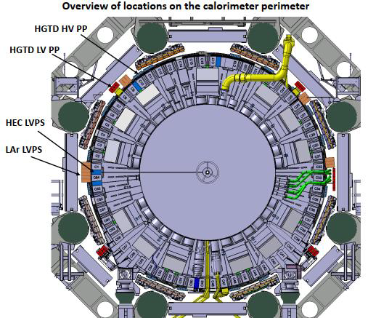
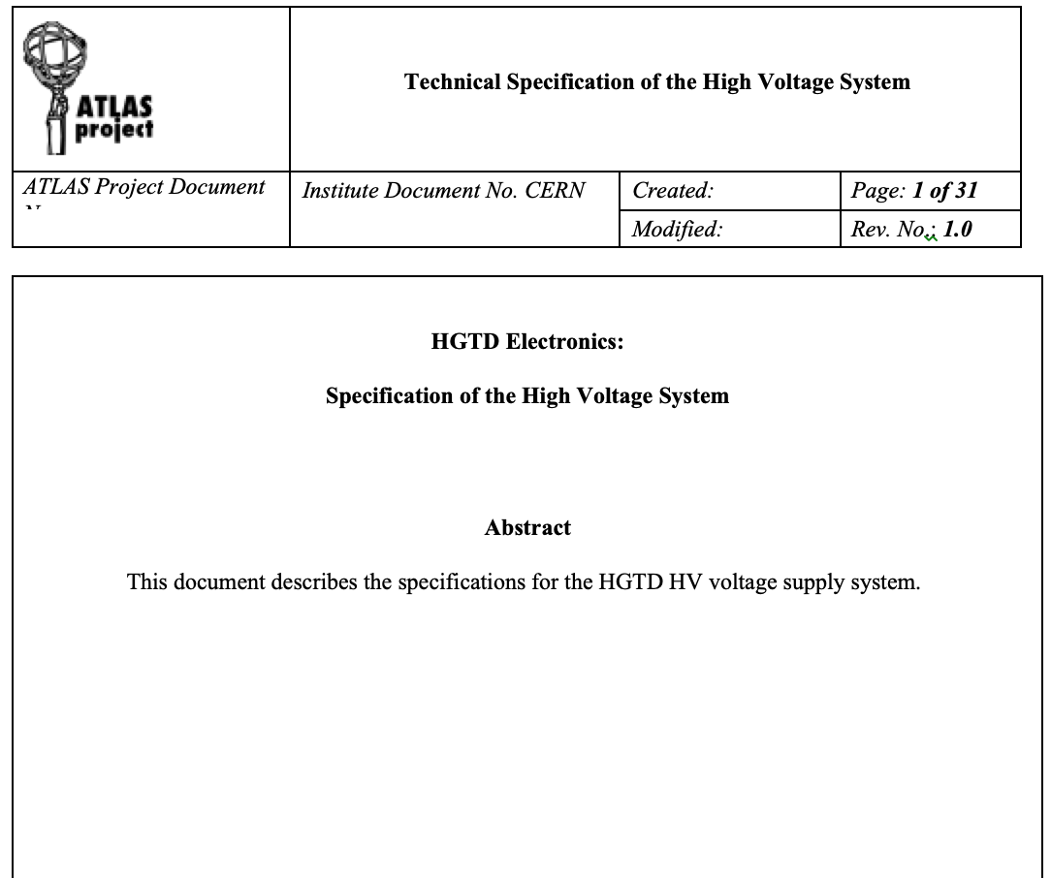
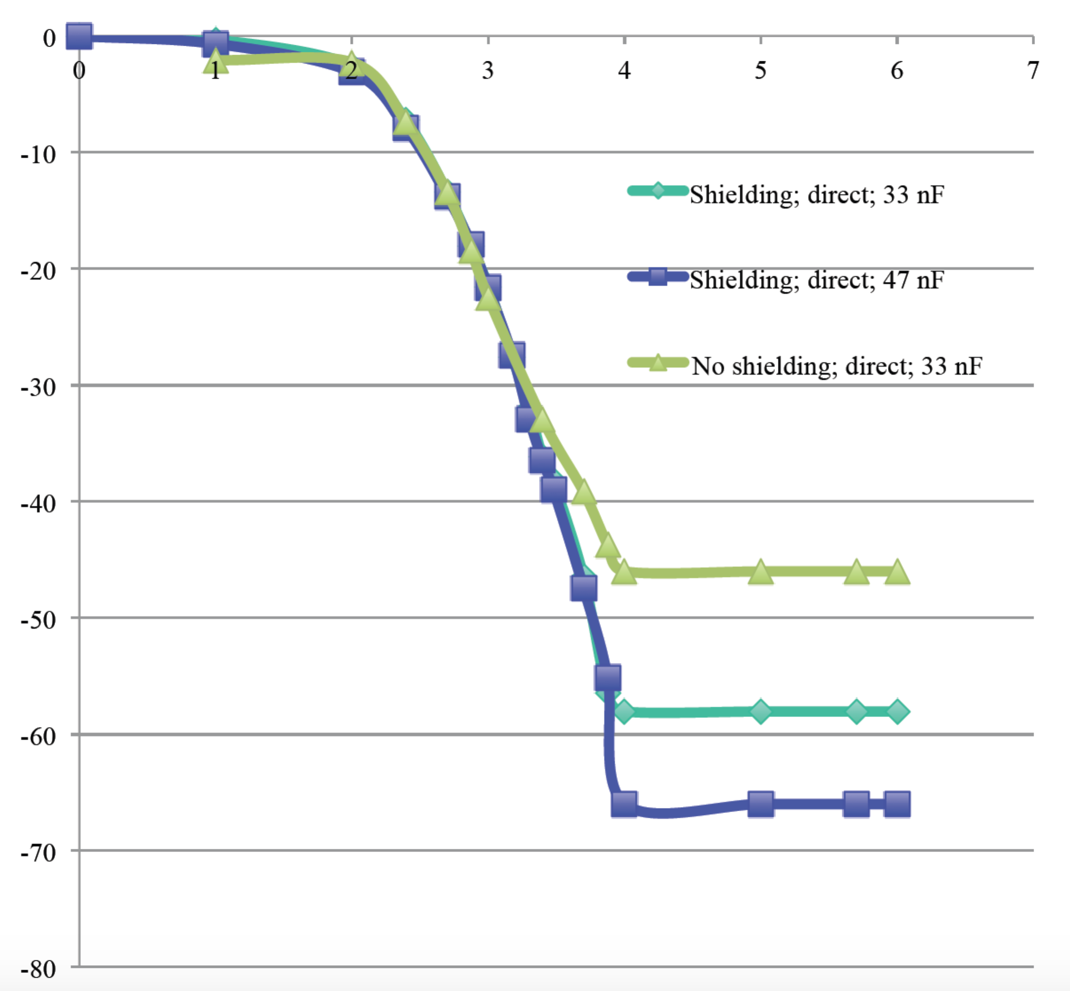
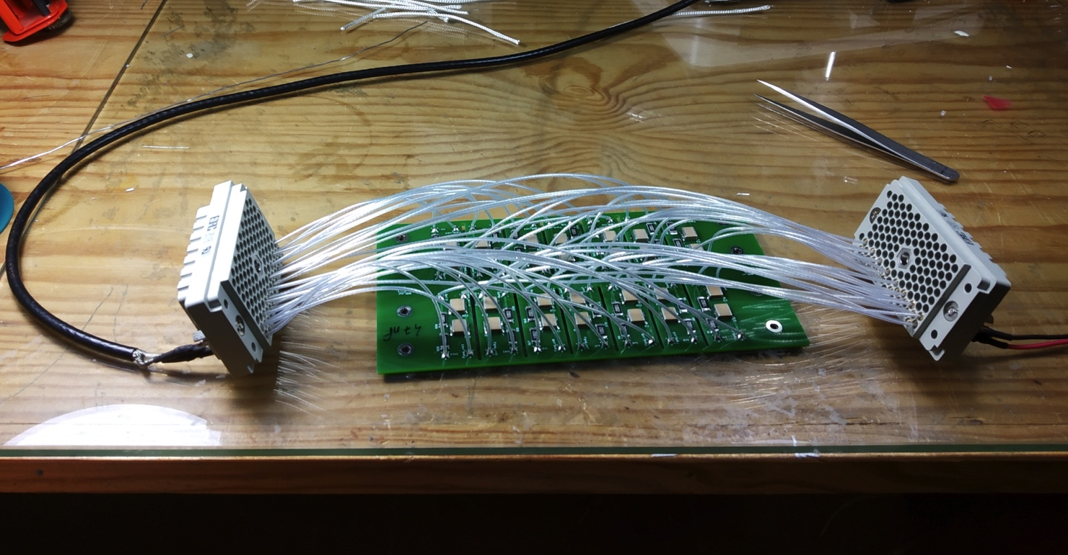
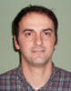
HGTD High Voltage Patch Panels
Aim was developing HV patch panels for CERN group:
16 patch panel boxes located around the calorimeter
Routing of High Voltage to HGTD detector and filtering out AC noise
Collaborating with Detector Lab. (Coimbra)
Luis Lopes; Orlando Cunha
Proposed design and presented in Electronics meetings
Built and tested prototype
Now contributing to Specifications Review (SPR) document
Proposal to HGTD: produce patch panels ourselves at LIP as in-kind contribution – 85 kEUR
Notes:
Possibilities: TDAQ and DCS

Slide 5
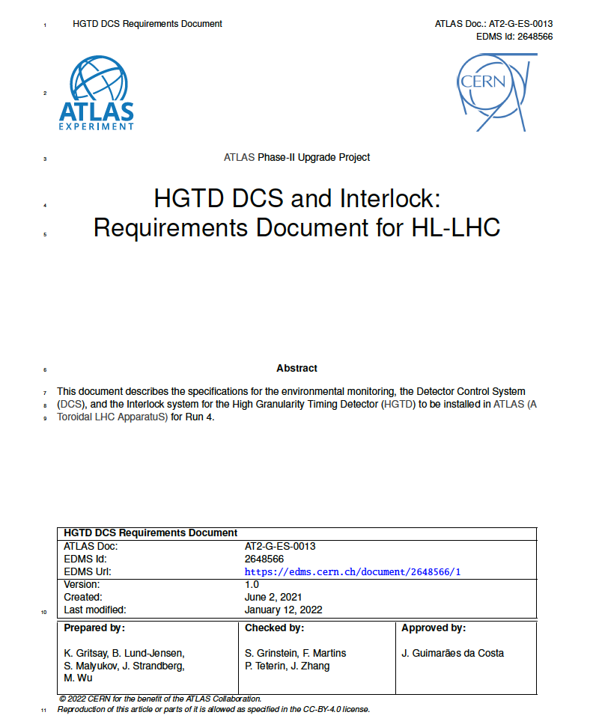
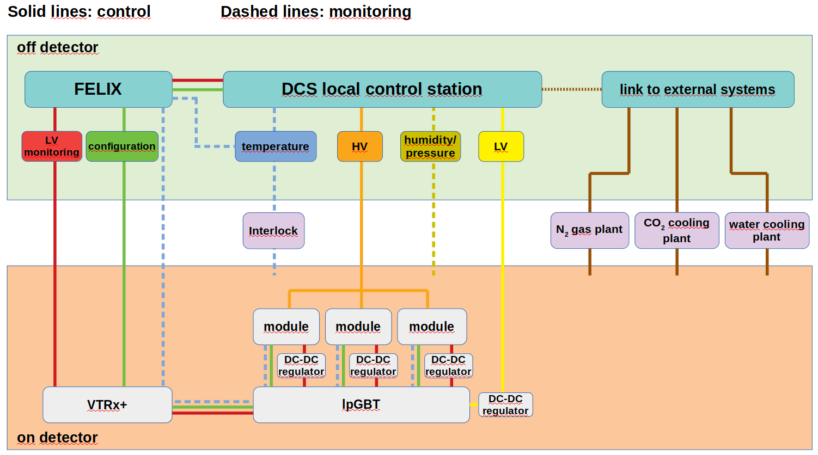
Detector Control System
HGTD DCS design
Filipe Martins contributed to DCS Specifications Review
Helena interested in taking part – tbd how
Filipe working on alternative data transfer scheme following panel recommendations – data path separate from FELIX
FELIX firmware in collaboration with eCRLab:
Part of DCS data to be transferred through FELIX
Rui Fernandez to start contributing to firmware
Next steps depend on investigation by Filipe and on system decision – alternative means possible MoU contribution
Proposal to HGTD: involvement in HV DCS with person power

Slide 7
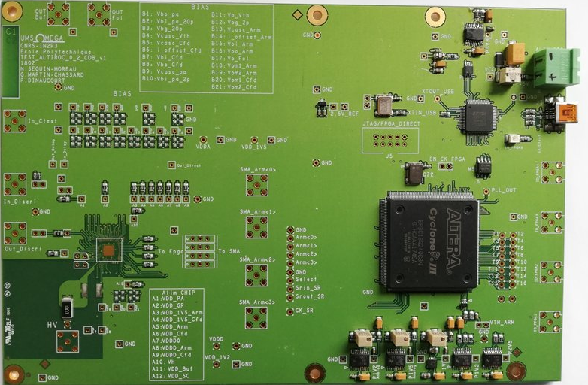
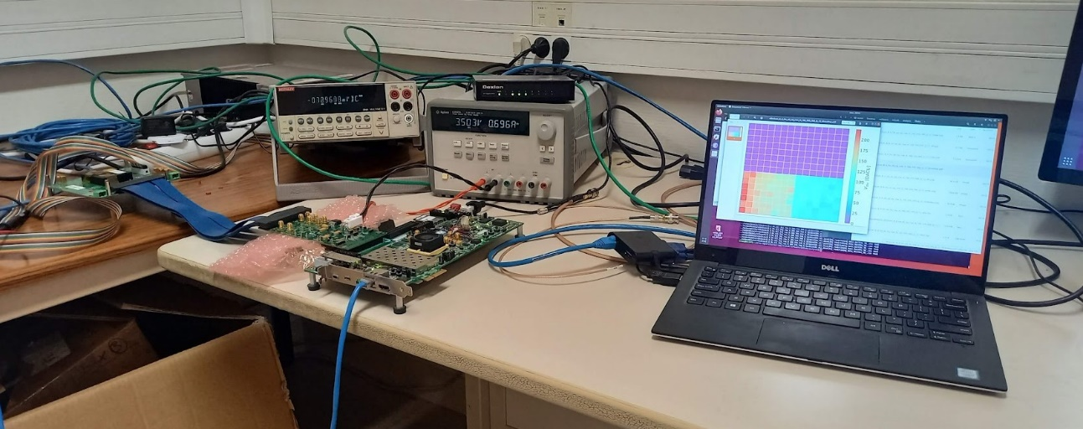
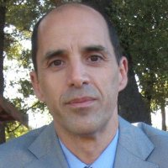
Altiroc ASIC
Getting involved with testing Altiroc v.2
In collaboration with eCRLab
6 institutes already involved – but interest in gaining experience with this
Rui Fernandez involved, with support from Miguel Ferreira and Pedro Assis
In contact with Omega lab. to obtain material, to install a test setup at LIP
Proposal to HGTD: involvement in Atiroc development with person power (little cost)

Slide 8
Impact and Upgrade MoU
HTT: MoU share of ~600 kEUR
HGTD project:
Only ~112 kEUR CORE funds missing, in HGTD DAQ (some 6 months ago)
Little existing experience in DCS – possible important impact from group
Developing challenging Altiroc front-end ASIC – technological interest
Patch panels – way into project and possible group responsability – 85 kEUR
Ideal: pay people from MoU – maybe easier on TDAQ tasks
Other areas:
Interlocks:
Mostly temperature sensors connected to Interlock Matrix Crate (IMC) located in USA15, similarly to Itk
Possible LIP involvement: interface to ATLAS interlock system (15 kEUR)
Performance studies:
Suitable for student qualification tasks

Slide 9
Thanks!
Acknowledgments

Slide 10
Possible areas of involvement
DCS:
Software involvement – much expertise in the group
Interlocks:
Mostly temperature sensors connected to Interlock Matrix Crate (IMC) located in USA15, similarly to ITk
DAQ, Lumi, timing?:
Firmware (& hardware?) – opportunity for collaboration with eCRLab and João Varela/CMS
Performance studies:
Suitable for student qualification tasks
112 kCHF CORE funds missing (TDAQ)

Slide 11
Backup

