Slide 1
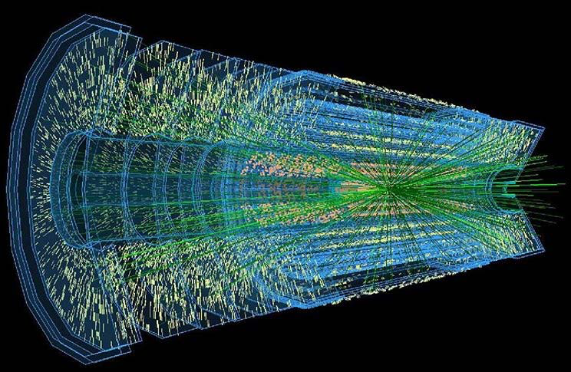
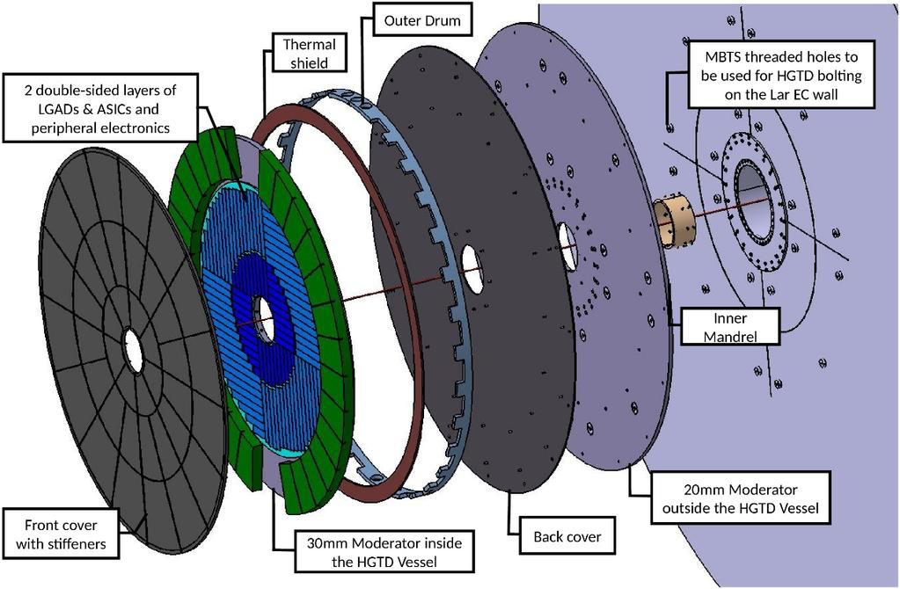
ATLAS Upgrade

Slide 2
ATLAS Upgrade Project Tasks
TileCal High Voltage upgrade
Progressing steadily – recent beam test with latest board prototypes
What is the plan for the next 2.5 years?
Any incoming students? Grants?
Technical contracts? Who?
Material needs? How are TileCal funds?
TDAQ Hardware Accellerators
Developed more in the last project in partnership with Técnico; now needs to consolidate
Nuno Fernandez to apply for PhD grant; incoming students?
Grants? Hardware?

Slide 3
ATLAS Upgrade Project Tasks
High-Granularity Timing Detector
Must join project formally: working since March on Patch Panels with no formal link
Areas of contribution:
Electronics: patch panels - ongoing with Detector Lab; development work for ~2 months more; production later?
Lumi / DAQ / DCS: Filipe Martins, Helena; possibility for Filipe to coordinate in future?
Possible areas for collaboration witrh eCRLab (Rui Fernandez):
Interlock crates
DAQ Firmware – Felix readout
Timing calibration & clock – also link to João Varela?
Physics studies for upgrade
Do we need this? Who would contribute?

Slide 4
Thanks!

