Slide 1

Jet Trigger and changes for Run II
Ricardo Gonçalo (LIP), David Miller (Chicago)
On behalf of the Jet Signature Group people who did the hard work
ATLAS Weekly Meeting - 2 December 2014

Slide 2

Outline
Introduction
Jet Trigger in Run I
  Level 1, Level 2, Event Filter
Jet Trigger for Run II
  Partial Scan
  Faster clustering and Full Scan
  Calibration options
Jet Trigger Menu

Slide 3
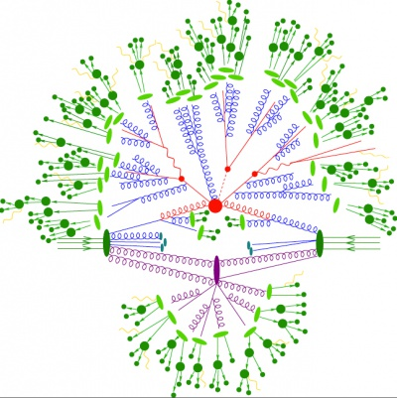
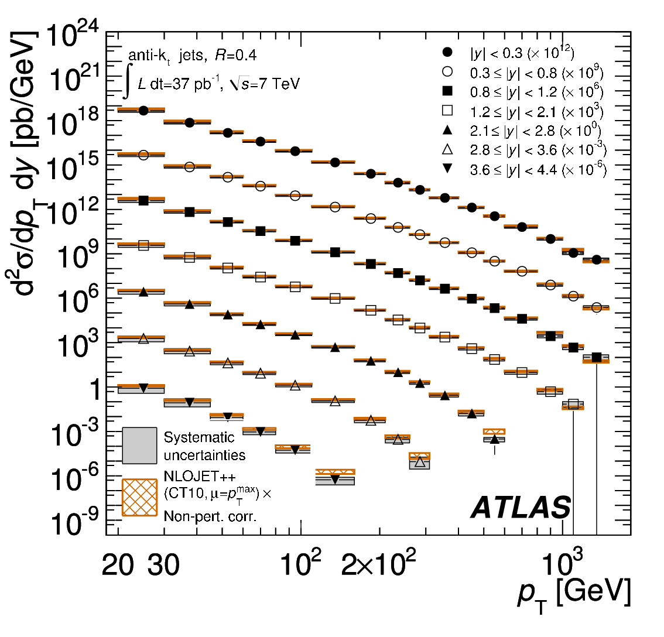

Unusual trigger…
  Jets defined by jet algorithm
  Jets have non-negligible size in detector
  Nearby jets influence reconstruction
  Signal is same as background
  Just selecting phase space (i.e. physics!)
  Very steeply falling spectrum
  Jet p_{T} resolution determines “background” rate
Region of Interest (RoI) approach not really suitable
Reproduce offline reconstruction as much as possible
All jets are connected

Slide 4
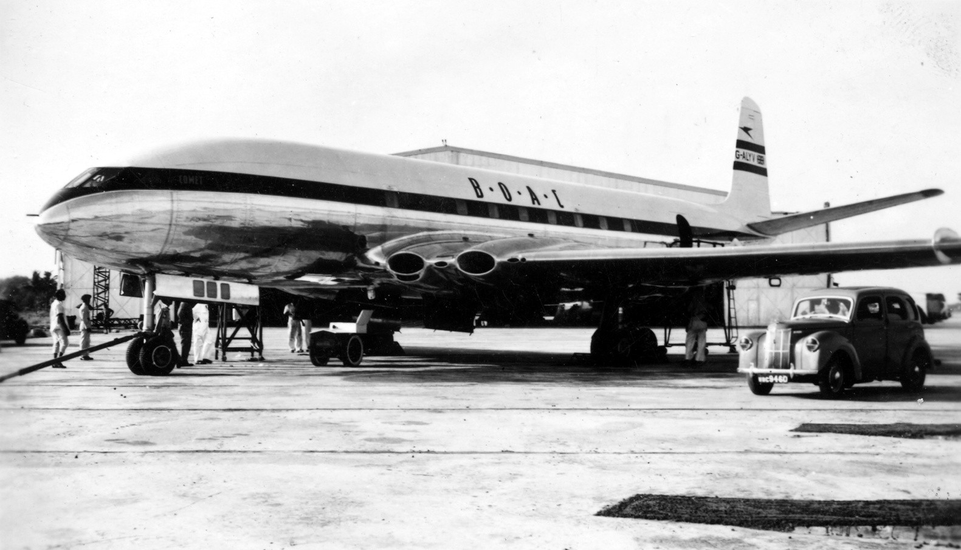
Jet Trigger in Run-I

Slide 5
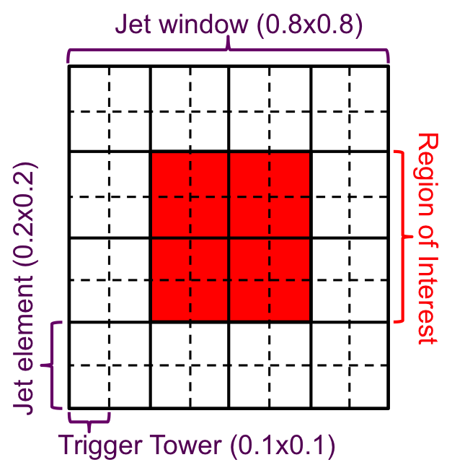
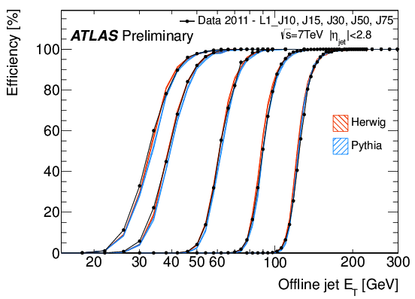
Level 1 Jet Trigger
Jet Elements built from 2x2 Trigger Towers
Sliding Window jet algorithm
Identifies L1 jet RoI if local E_{T} maximum found and above threshold
Trigger Tower ET resolution around 1GeV (digital)
Very slow turn-on due to poor resolution (J15 reaches 100% efficiency at ≈50GeV)
NOTE: expect significant improvements for Run II from nMCM calibration

Slide 6
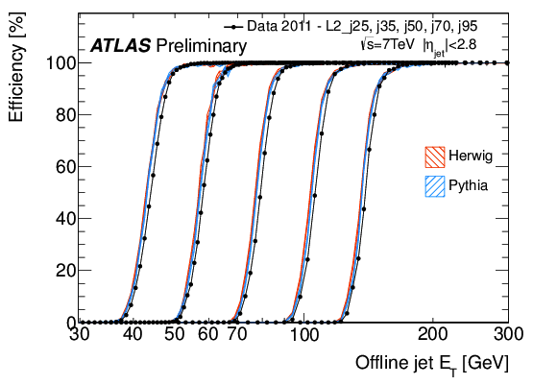
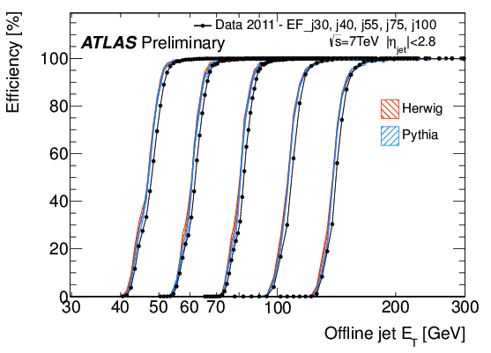
Jet trigger in Run 1
Level 2:
Cone algorithm in RoI’s
Anti-kt jets from Trigger Towers (Level 1.5)
  ≈L1 granularity and resolution but full calo scan
  Partially recover close-by jet/jet splitting bias from L1 sliding window
Much faster turn-on than L1
Event Filter:
Offline-like jet reconstruction
  Anti-kt jets starting from TopoClusters
Offline-like performance (on surviving events)

Slide 7
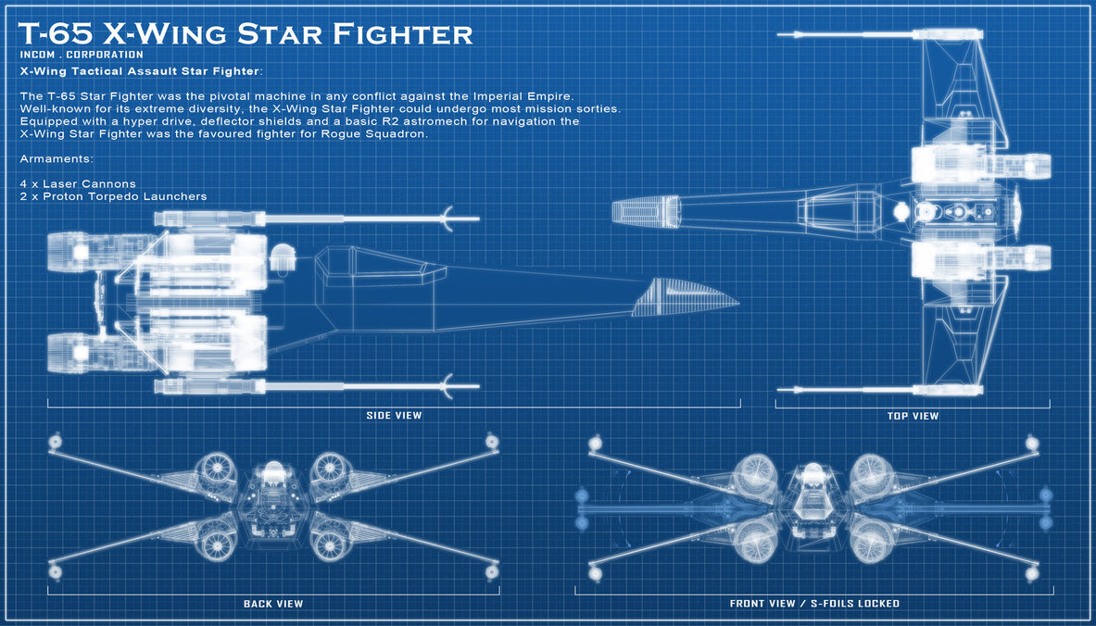
Jet Trigger plans and difficulties

Slide 8
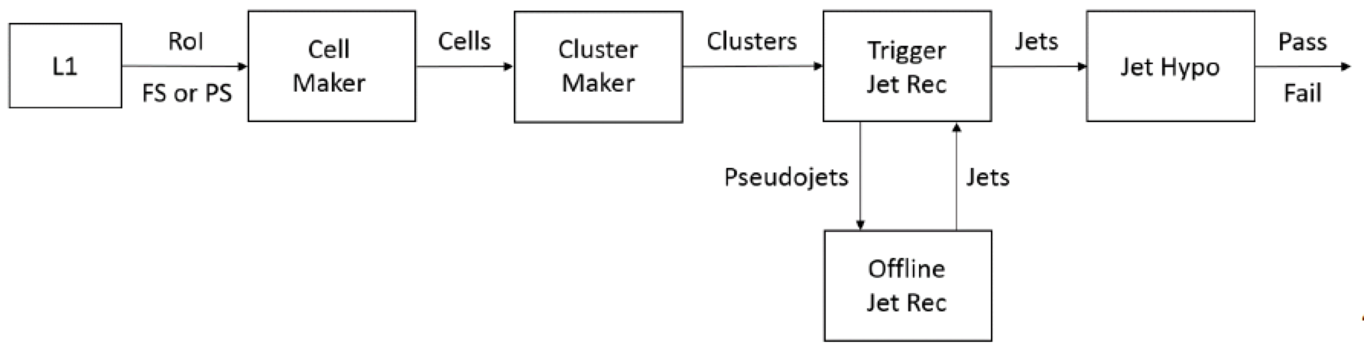
Architecture & SW changes for Run II
Merged High Level Trigger instead of separate L2 & Event Filter
L1Topo topological processor at Level 1 (see later slides)
Migration to xAOD led to major software changes
Peter Sherwood
Valentinos Christodolou
Challenging!
  Re-writing of jet trigger software and config, updated monitoring, etc
Opportunities!
  Improve on RoI-based jet reconstruction in Level 2
  Greater re-use of offline jet reconstruction and calibration
  Good collaboration with HLTCalo and offline jet groups (thanks!)
Main obstacle: CPU time, mainly clustering

Slide 9
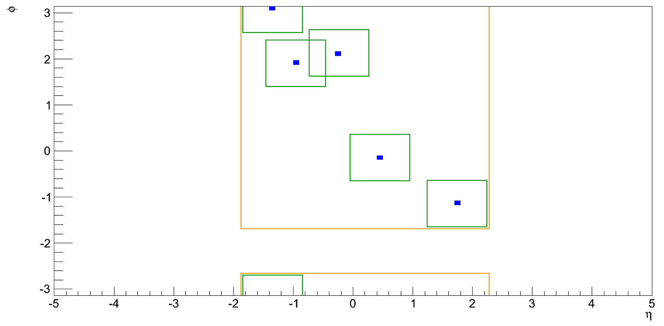
Partial solution: Partial Scan
Ademar Delgado, Mark Sutton
David Freeborn
Partial vs Full scan
E_{T} of 3rd jet in 3j50
sRoI size 1x1
HLT jet finding on Super RoI built from union of all L1 RoIs
  Or better alternative: start from Trigger Tower full scan (L1.5)
  Tuneable parameters: L1_Jx (or L1.5 seed), size of RoIs making sRoI
  Good jet reconstruction performance and costs
  Efficiency: (L1_J20) ≈ 99.5% wrt Full Scan (j110)
Major downside: no jet area subtraction of pileup

Slide 10
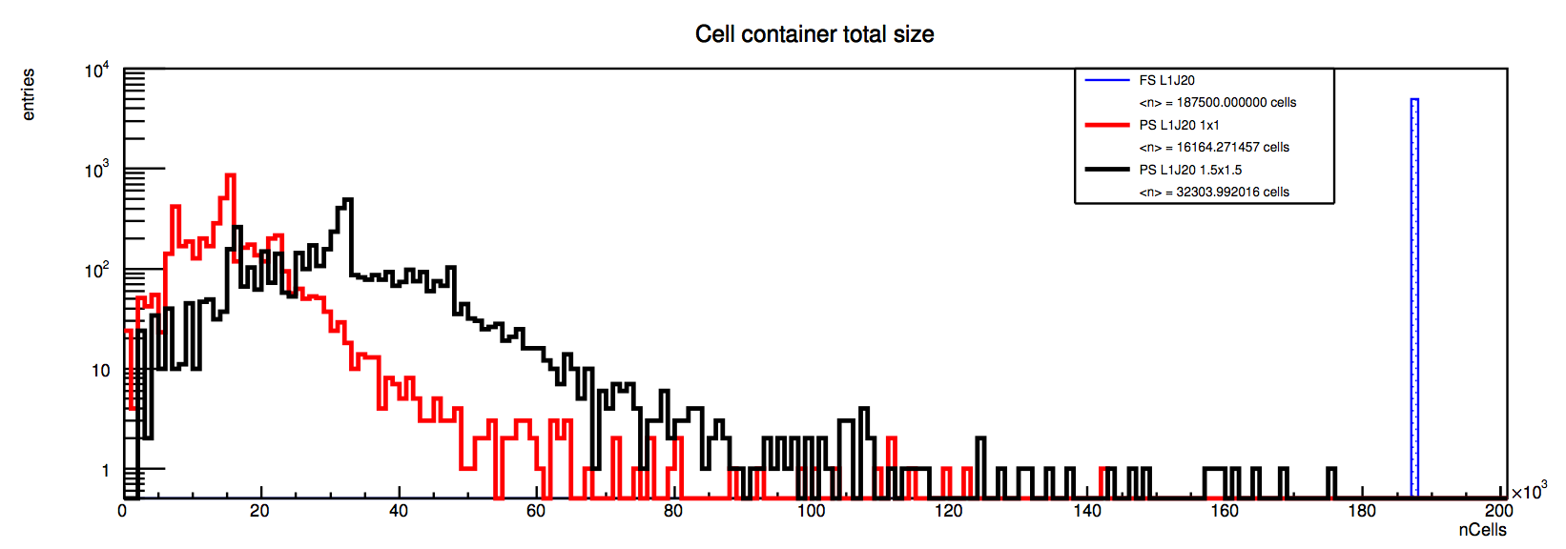
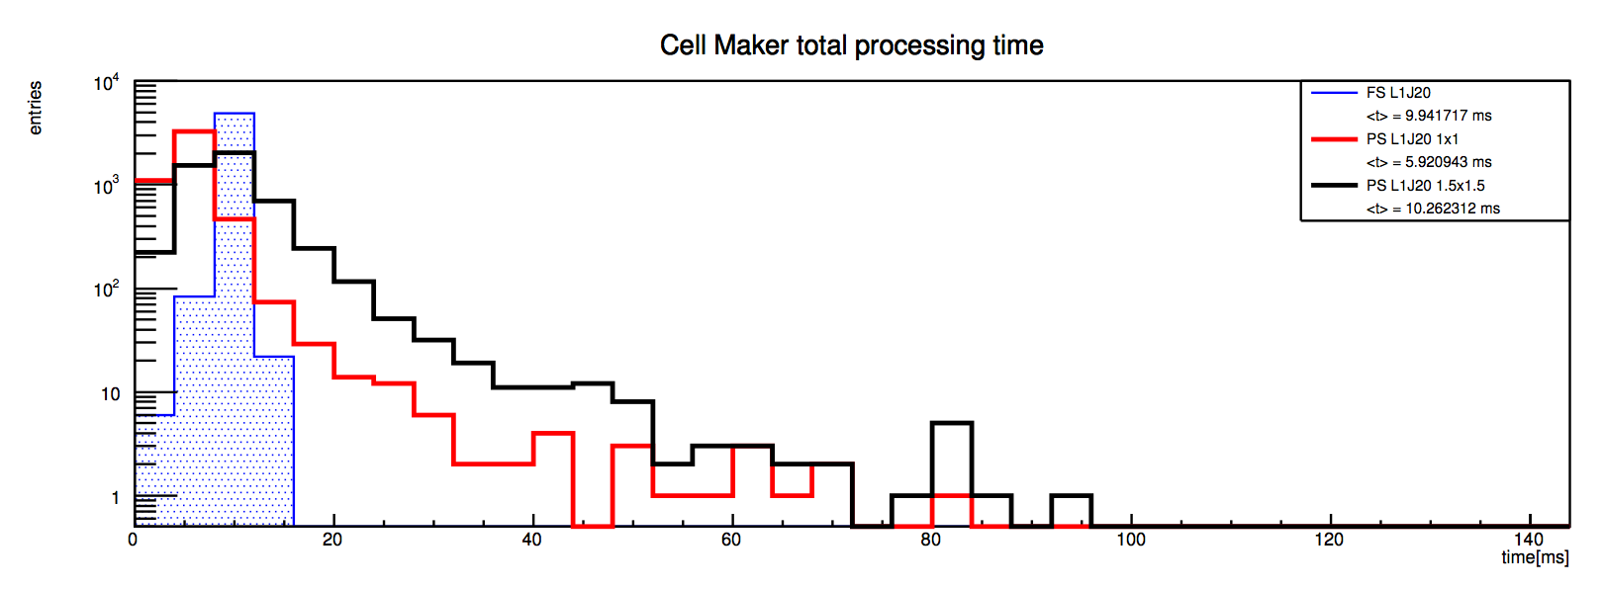
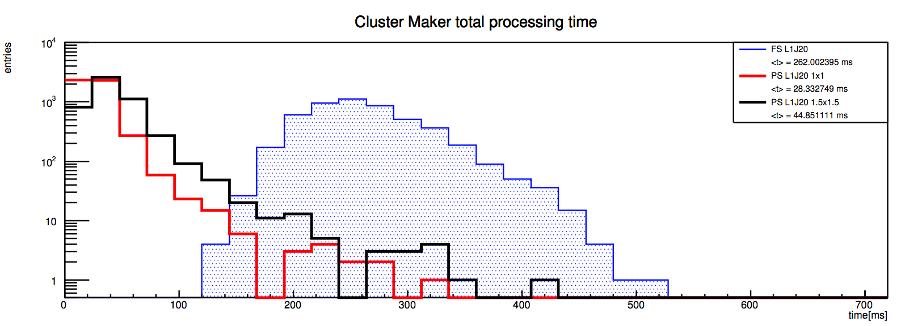
Cost…
Ademar Delgado
JZ2W (80-200GeV)
Full Scan : <n> ≈ 190k cells
Partial Scan: L1_J20 1x1 :
<n> ≈ 16k cells
Partial Scan: L1_J20 1.5x1.5 :
<n> ≈32k cells
Nr of cells
JZ2W (80-200GeV)
Full Scan : <t> ≈ 10ms
Partial Scan: L1_J20 1x1:
<t> ≈ 6ms
Partial Scan: L1_J20 1.5x1.5 :
<t> ≈ 10ms
CellMaker time
JZ2W (80-200GeV)
Full Scan : <t> ≈ 260ms (actually… this was a glitch)
Partial Scan: L1_J20 1x1:
<t> ≈ 30ms
Partial Scan: L1_J20 1.5x1.5 :
<t> ≈ 45ms
ClusterMaker time

Slide 11
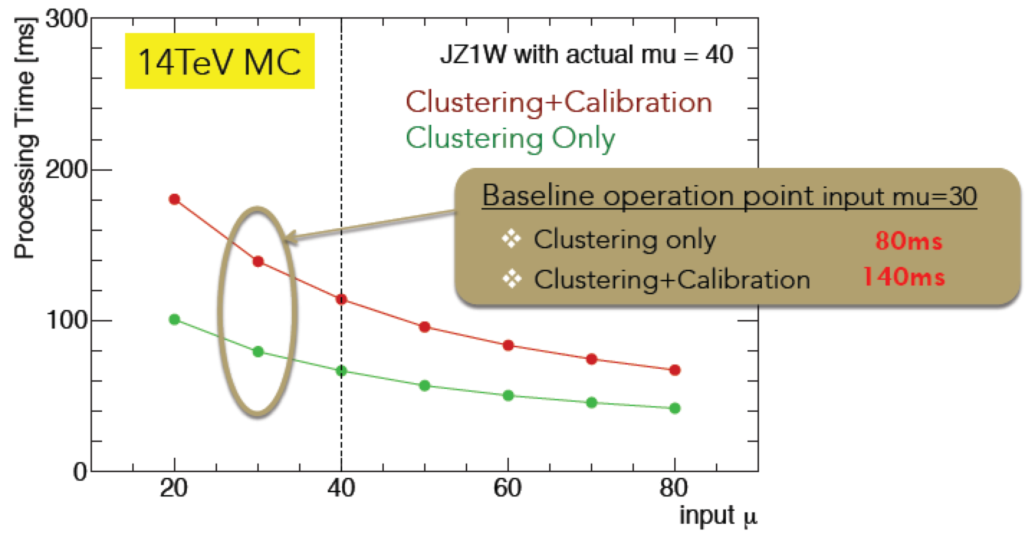
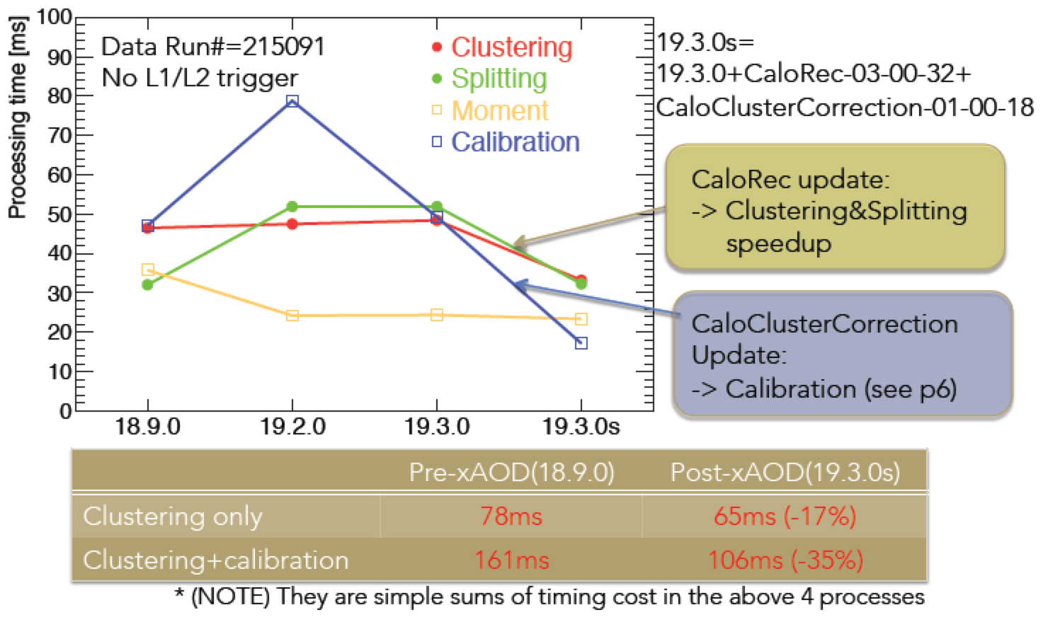
Improvements in clustering time
Updates to TopoCluster lead to much improved CPU time
TopoCluster:
Clustering
Splitting
Moment calculation
Calibration
Full calorimeter scan in HLT
Cluster making:
  80ms/evt
Cluster+Calibration (LCW):
  140ms/evt
New baseline plan:
Full calorimeter scan
Keep Partial Scan: plan B
Plan to use L1.5 to reduce rate for TopoCluster scan (in progress)
Naoko Kanaya, Craig Wigglesworth, Walter Lampl

Slide 12

The road ahead

Slide 13
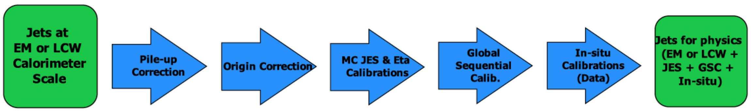
Jet Calibration in HLT
Apply as much as possible of offline jet calibration
Concentrate on steps leading to larger improvements
Essential:
  Pileup (jet area) subtraction and Jet Energy Scale: working
In progress/plans:
  Global Sequential Calibration: some factorizable steps possible
  Tracking-based steps may be possible but not yet addressed
Requires full event scan for energy density calculation
Requires full event tracking and pr. vertex
Calibration parametrized vs p_{T} & η
Requires full tracking & calo details(*)
Calibration parametrized vs p_{T} & η
Peter Sherwood, Nuno Anjos

Slide 14
Key
Jet Algorithm:
  a4 = anti-kt jet finding algorithm with R parameter of 0.4
  a10 = anti-kt jet finding algorithm with R parameter of 1.0
Input objects used for jet finding:
  tc = TopoClusters reconstructed from calorimeter cells
  TT = Level 1 TriggerTowers read out in HLT to allow fast but coarse full calo scan (a.k.a. Level 1.5)
Calorimeter scan:
  PS = partial calorimeter scan seeded by L1 RoI or L1.5
  FS = full calorimeter scan (default)
Pseudorapidity range:
  xxETAyy = jets in interval xx < |η| < yy – default is 0eta32 (old central jets)
Cluster Energy Scale correction:
  em = no weights applied
  lcw = local cluster weighting
Jet Energy Scale correction:
  jes = JES calibration factors without pileup subtraction
  sub = pileup subtraction applied but no JES factors
  subjes = both pileup subtraction and JES factors
Some possible combinations:
  a4tcem = jets built from EM-scale clusters with no jet level calibration
  a10tcemsubjes = jets built from EM-scale clusters with pile-up subtraction and jet-level calibration
  a10TTem = jets built from TriggerTowers with no jet level calibration
  a4tclcwsub = jets built from LC-scale clusters with only a pile-up subtraction applied at the jet level
  a10tclcw_PS = jets built from LC-scale clusters found in a SuperRoI seeded by all L1_Jx items

Slide 15
Primary Jet Menu Items at low & high lumi
Menu for MC15 under final discussion right now
  5x10³³ menu: j360, fatjet360, 4j85, 5j60, 6j50.0ETA24, ht800
  2x10³⁴ menu: j400, fatjet450, 4j100, 5j85, 6j50.0ETA24, ht1000
Default calibration: emsubjes
  Calibrated + pileup subtract jets EM-scale clusters
“Cross-check” chains with alternative calibrations for a few strategic thresholds
  E.g.: j360_a4tcemjes/j380_a4tcemsubjes/j380_a4tcemjes/j380_a4tclcwsubjes
Chain Type | L1 Seed at 0.5x10³⁴ | HLT Item at 0.5x10³⁴ | L1 Seed at 2x10³⁴ | HLT Item at 2x10³⁴
Single jet | J75 | j360 | j100 | j400
Single fat jet | HT150 | j360_a10 | HT190 | j450_a10
4 jets | 3J40 | 4j85 | 3J50 | 4j100
5 jets | 4J15 | 5j60 | 4J20 | 5j85
6 jets | 5J15.0ETA24 | 6j50.0ETA24 | 5J15.0ETA24 | 6j50.0ETA24
HT trigger | HT190 | ht800 | HT190 | ht1000

Slide 16
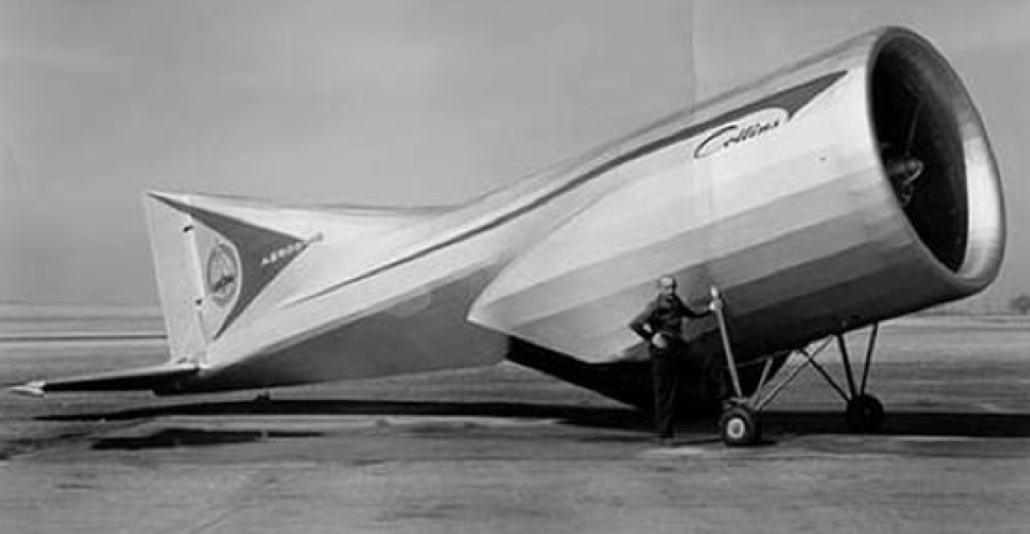
L1Topo, Fat Jets, et al.
L1Topo allows to cut on complex quantities using L1 objects
Example here:
  Optimization of fat-jet L1 seed
  HTC: E_{T} sum of all jets with E_{T}>20GeV within |η|<2.5
Several other studies, like:
  HT trigger for stop searches
  Fat-jet trigger for VV->jj
  Razor triggers for resonances decaying to jets+invisible particles
UBA (Devesa, Reisin, Otero, Piegaia)

Slide 17
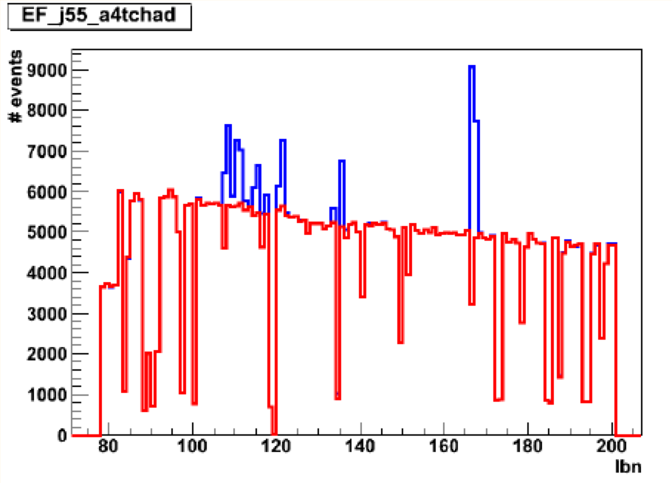
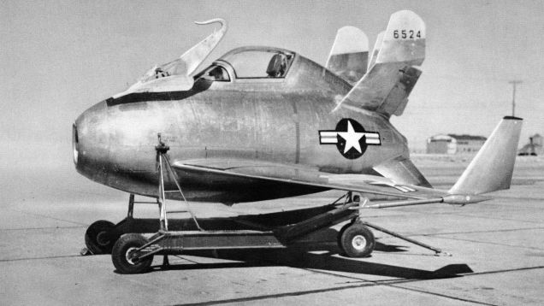
Other loose ends…
Several other studies/improvements not mentioned here time:
Impact of pileup subtraction (Erich Varnes)
Impact of pileup in resolution and bias (Annabelle Chuinard)
Jet offline analysis framework (Rob Cantrill, Lourenço Lopes)
Lots of work in Monitoring and validation (Lee Sawyer, Sebastien Prince, Aparajita Dattagupta, et al)
Jet menu studies in SUSY, SM, Higgs, Exotics, etc
Jet cleaning (Nuno Anjos, liaising with Caterina Doglioni)
Etc…

Slide 18

Conclusions
Big changes in Jet Trigger for Run II
Baseline plan:
  Trigger Tower full scan to reduce input rate
  Full calorimeter scan – Partial Scan as plan B
  Jet area subtraction and as much as possible of offline calibration
Long road to get here – but main features working
  Much room for improvement! Volunteers (very) gladly accepted!
We’re (almost) ready for new run!

Slide 19

Bonus slides

Slide 20
Inclusive single jet chains
Level 1 seed | Rate @ 0.5 & 2x10³⁴ | HLT chain | Rate @ 0.5 & 2x10³⁴ | Prescale@2x10³⁴ | Clients
L1_RD0 |  | j55_a4tcemsubjes | O(Hz) | ? | bootstrap
 |  | j60_a4tcemsubjes | O(Hz) | ? | bootstrap
J12 | 0.95 / 3.8 MHz | j55_a4tcemsubjes | 150 / 600 kHz | 600,000 – 1 Hz | taus
J15 | 0.53 / 2.1 MHz | j60_a4tcemsubjes | 100 / 400 kHz | 400,000 – 1 Hz | taus, btag
J20 | 240 / 970 kHz | j85_a4tcemsubjes | 21 / 85 kHz | 85,000 – 1 Hz | taus, multi-j
 |  | j85_a4tcemjes
 |  | j85_a4tclcwsubjes
 |  | j85_a4tclcwjes
J25 | 130 / 510 kHz | j100_a4tcemsubjes | 10 / 41 kHz | 41,000 – 1 Hz | taus
J30 | 75 / 300 kHz | j110_a4tcemsubjes | 6.5 / 26 kHz | 26,000 – 1 Hz | LAr calib
J40 | 32 / 130 kHz | j150_a4tcemsubjes | 1.6 / 6.5 kHz | 6500 – 1 Hz | J+MET
J50 | 15 / 60 kHz | j175_a4tcemsubjes | 0.75 / 3 kHz | 3000 – 1 Hz | multijet
 |  | j175_a4tcemjes
 |  | j175_a4tclcwsubjes
 |  | j175_a4tclcwjes

Slide 21
Inclusive single jet chains
Level 1 seed | Rate @ 0.5 & 2x10³⁴ | HLT chain | Rate @ 0.5 & 2x10³⁴ | Prescale@2x10³⁴ | Clients
J60 | 7.5 / 30 kHz | j200_a4tcemsubjes | 0.4 / 1.6 kHz | 1600 – 1 Hz | btag
J75 | 4 / 17 kHz | j260_a4tcemsubjes | 140 / 400 Hz | 400 – 1 Hz | btag, low Lumi
J85 | 2.5 / 10 kHz | j300_a4tcemsubjes | 67 / 270Hz | 200 – ≈1 Hz | multijet, medium Lumi
 |  | j320_a4tcemsubjes | 43 / 170 Hz | 150 – ≈1 Hz | multijet, medium Lumi
J100 | 1.3 / 5 kHz | j360_a4tcemjes | 22 / 90 Hz | 100 – ≈1 Hz | unprescaled at 1x10³² or lower: aim for 1-2 points during year to change lowest unprescaled chain Also re-think set of cross-check chains with different calibrations if needed
 |  | j380_a4tcemsubjes | 16 / 65 Hz | 50 – ≈1 Hz
 |  | j380_a4tcemjes
 |  | j380_a4tclcwsubjes
 |  | j380_a4tclcwjes
 |  | j400_a4tcemsubjes | 9 / 35 Hz | unprescaled
 |  | j400_a4tcemjes
 |  | j400_a4tclcwsubjes
 |  | j400_a4tclcwjes
J120 | 1.3 / 2.7 kHz | j460_a4tcemjes + cross-check chains | <1 / 2.8 Hz | unprescaled | High Lumi
J400 | 0 / 0 Hz | noAlg | 5.5 Hz | unprescaled | Passthrough

Slide 22
Multi-jet and fat jet chains
Level 1 seed | @ 0.5 & 2x10³⁴ | HLT chain | @ 0.5 & 2x10³⁴ | Prescale@2x10³⁴ | Clients
3J40 | 0.4 / 1.6 kHz | 4j85_a4tcemsubjes | 45 / 180 Hz | 180 – 1 Hz
3J50 | 0.3 / 1.0 kHz | 4j100_a4tcemsubjes | 12 / 50 Hz | unprescaled | SUSY, SM, top, jets
4J15 | 2.4 / 9.5 kHz | 5j55_a4tcemsubjes | 65 / 260 Hz | 260 – 1 Hz
4J20 | 0.5 / 1.9 kHz | 5j60_a4tcemsubjes | 40 / 170 Hz | 170 – 1 Hz
4J20 | 0.5 / 1.9 kHz | 5j85_a4tcemsubjes | 4 / 15 Hz | unprescaled | SUSY, SM, top, jets
 |  | 5j85_a4tcemjes
 |  | 5j85_a4tclcwsubjes
 |  | 5j85_a4tclcwjes
5J15.0ETA24 | 0.1 / 0.3 kHz | 6j45.0eta24_a4tcemsubjes | 25 / 100 Hz | 100 – 1 Hz | SUSY, SM (*)
5J15.0ETA24 | 0.1 / 0.3 kHz | 6j50.0eta24_a4tcemsubjes | 10 / 40 Hz | unprescaled | SUSY, SM (*)
5J15.0ETA24 | 0.1 / 0.3 kHz | 6j55.0eta24_a4tcemsubjes | 8 / 30 Hz | 30 – 1 Hz | SUSY, SM (*)
HT150 | 3 / 12 kHz | j360_a10tcemsubjes | 14 / 60 Hz | 60 – 1 Hz | exotics, jets
HT190 | 1.2 / 5 kHz | j450_a10tcemsubjes | 2 / 8 Hz | unprescaled | exotics, jets
(*) A new study from SUSY indicates that 6j chains can/should start from 4J20 to save bandwidth – need to understand if this is also ok for SM

Slide 23
Forward jet and HT chains
Level 1 seed | Rate @ 0.5 & 2x10³⁴ | HLT chain | Rate @ 0.5 & 2x10³⁴ | Prescale@2x10³⁴ | Clients
J15.24ETA49 | ? | j60.24eta49 | ? | ? – 1 Hz | egamma
J15.28ETA32 | ? | j60.28eta32 | ? | ? – 1 Hz | SUSY, SM, top, jets
J20.28ETA32 | ? | j85.28eta32 | ? | ? – 1 Hz | jets
J15.32ETA49 | ? | j60.32eta49 | ? | ? – 1 Hz | jets
J20.32ETA49 | ? | j85.32eta49 | ? | ? – 1 Hz | jets
J30.32ETA49 | ? | j110.32eta49 | ? | ? – 1 Hz | jets
J50.32ETA49 | ? | j175.32eta49 | 0 | unprescaled | Jets, SM
J75.32ETA49 | ? | j260.32eta49 | 0 | unprescaled | SM
J100.32ETA49 | ? | j360.32eta49 | 0 | unprescaled | SM
Default R parameter and calibration is a4tcemsubjes
Add cross-check chains (a4tcemjes, a4tclcwsubjes, a4tclcwjes) for:
  j85.28eta32, j85.32eta49, j175.32eta49, j260.32eta49, j360.32eta49
Level 1 seed | Rate @ 0.5 & 2x10³⁴ | HLT chain | Rate @ 0.5 & 2x10³⁴ | Prescale@2x10³⁴ | Clients
HT190 | 1.2 / 5 kHz | ht1000 | 3.5/14 Hz (0 unique) | unprescaled
HT150 |  | Ht500(?) |  | prescaled

Slide 24
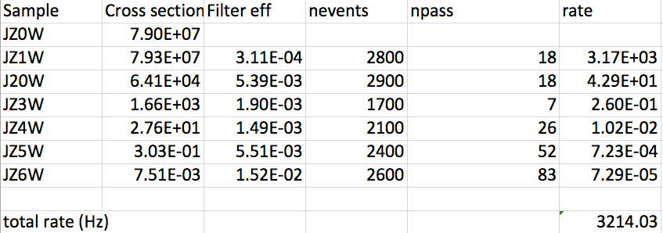
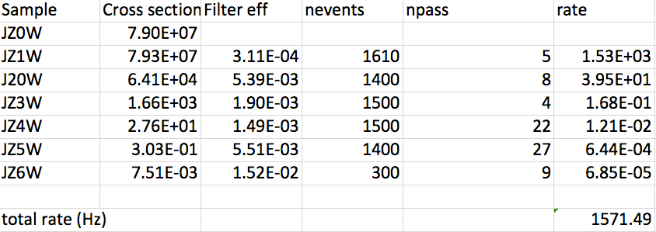
Bonus: rates with pileup correction
Erich Varnes
Conditions:
  L=2x10³⁴
  4j45 rate
  No event weighting
Only fixed ρ=6 here
ρ calculation works in private code so far
Top: no areas subtraction
Bottom: with ρ=6 area subtraction

Slide 25
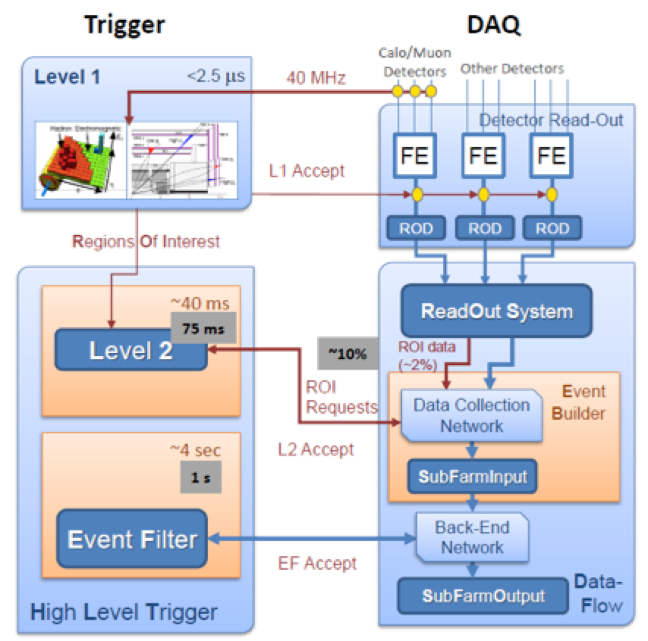
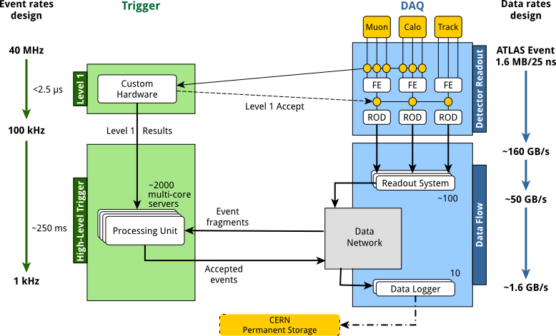
Architecture Changes in Run-II
Main change is merged HLT instead of separate L2 & EF
Run I
Run II

Slide 26
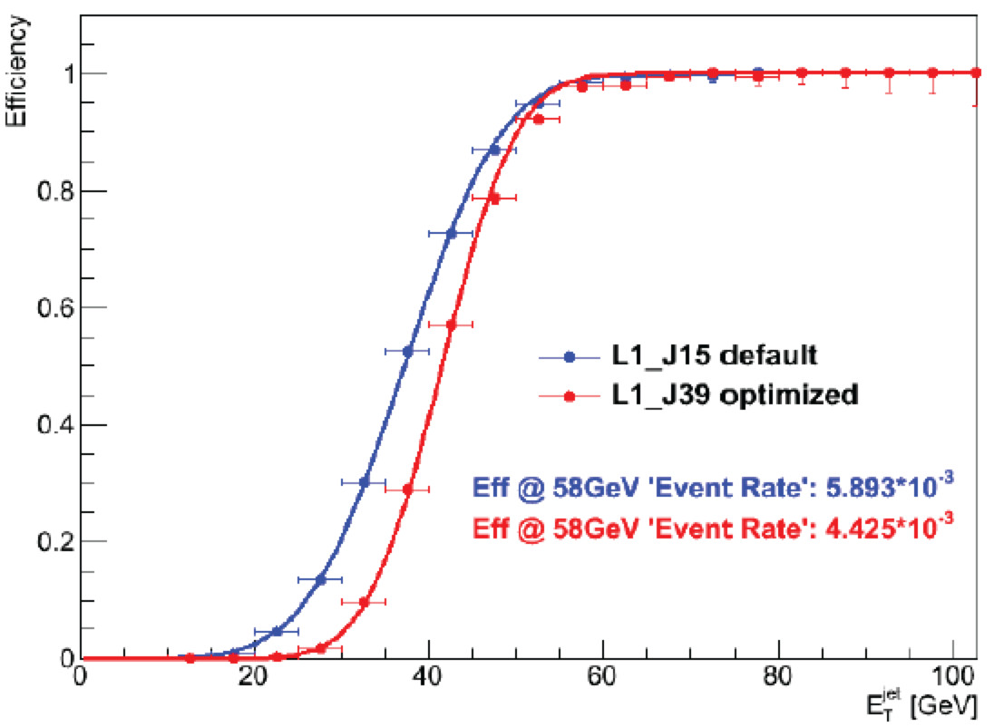
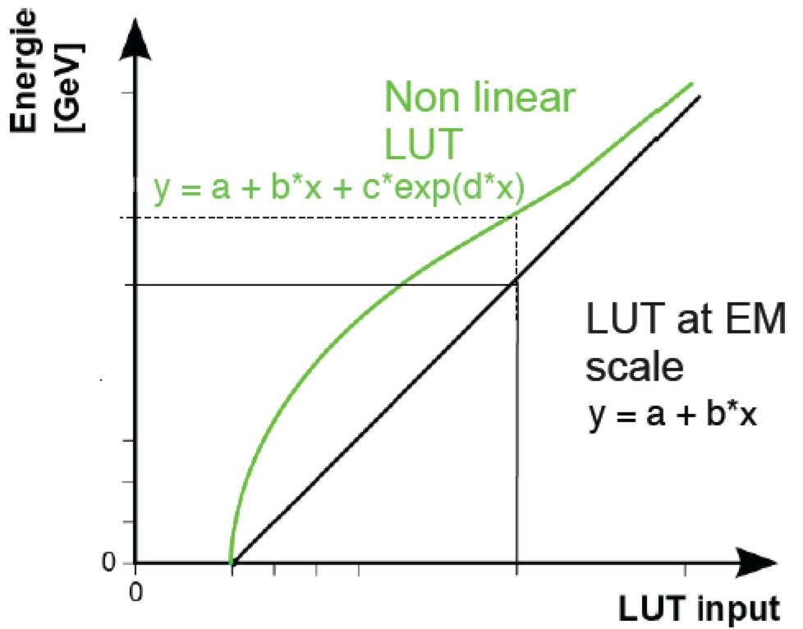
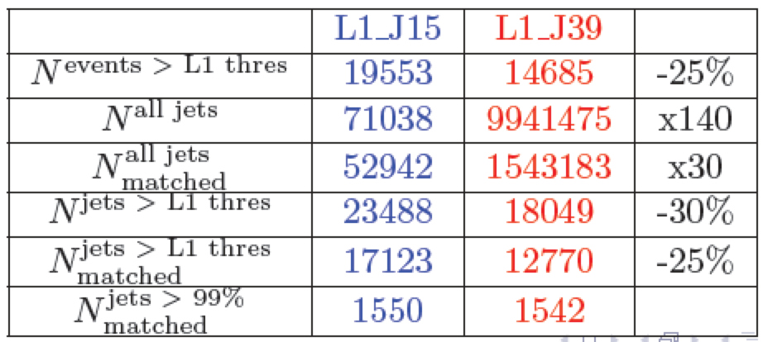
New L1 LUT calibration
Alessandra Baas, Stanislav Suchek
Improved jet calibration in Level 1 Look Up Table
Applied in new nMCM L1Calo boards
Add small non-linear term to optimize resolution

Slide 27
L1 HT triggers for fat jets: signal
UBA (Devesa, Reisin, Otero, Piegaia)

Slide 28
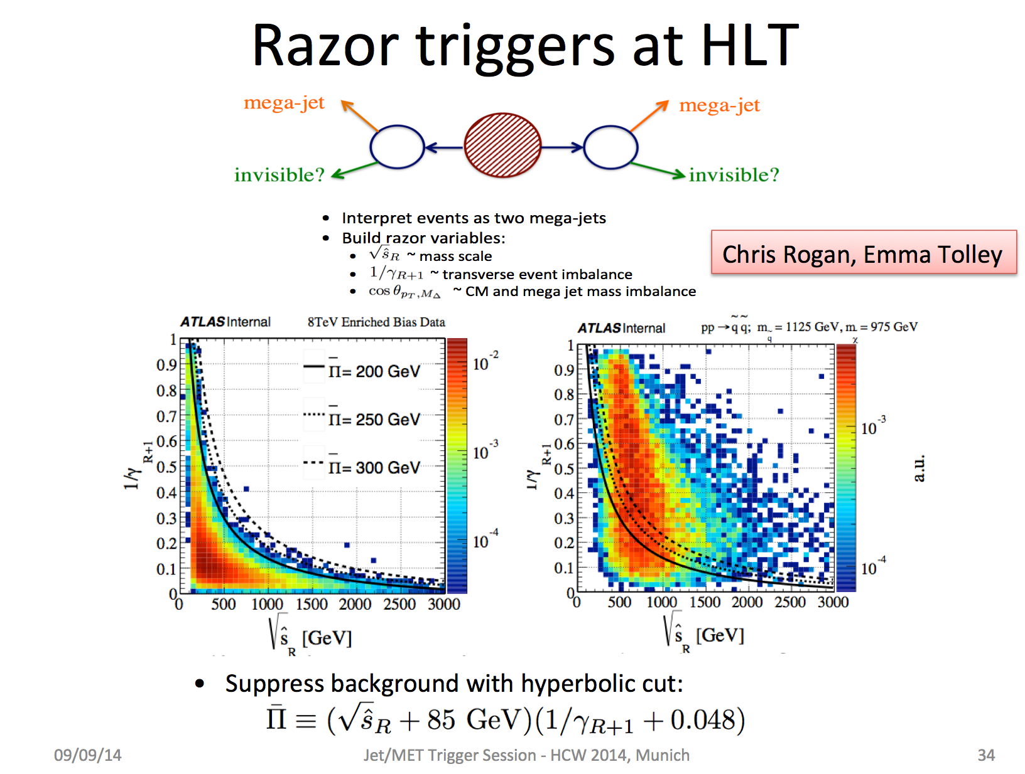

Slide 29
Razor trigger implementation
Larry Lee

Slide 30
Pile-up subtraction: rho
Requires full event topoclusters for rho calculation

Slide 31
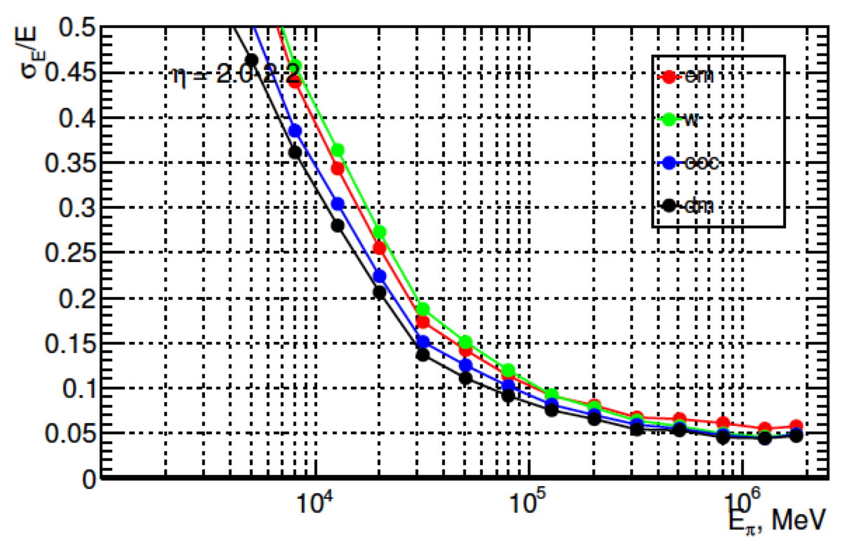
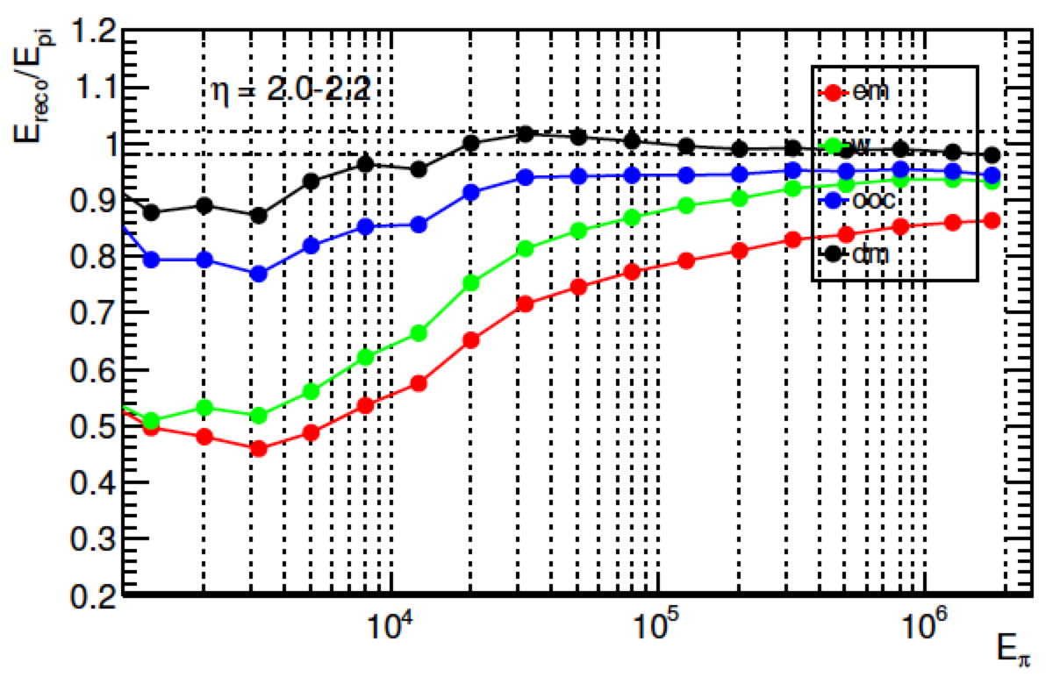
Cluster Calibration
Sven Menke
Resolution and linearity improvement for charged pions after each correction:
  EM
  LCW
  Out of cluster
  Dead material
Conditions:
  <μ>=0
  IBL geometry
  2<|η|<2.2
  4 samplings

Slide 32
Unique efficiencies of the razor triggers
Read the
Y-axis for a
given trigger
and then look
at the value
for any trigger
on the X-axis to
see the benefit
Razor triggers with
Different L1 seeds
(HT and multijet)
Chris Rogan, Emma Tolley

