Slide 1
Update on the
Outstanding Achievement Award Process
R. Gonçalo and S. Demers
for the AOAA preparatory group
CBCAG meeting - February 14, 2024

Slide 2
Context
Reminder of the timeline
Some statistics from our nominations
Current status/next steps
CBCAG preparatory group:
Sarah Demers (Yale) Co-Chair Ricardo Gonçalo (LIP) Co-Chair Attilio Andreazza (Milano) Henri Bachacou (Saclay CEA) Andrei Kazarov (Johannesburg) Borut Kersevan (Ljubljana)

Slide 3
Schedule
11 December: Call for nominations
12 February: Deadline for nominations (9 weeks for nominations)
14 February: Send all nominations to reviewers You are here
11 March: Replies from all reviewers with ratings and comments (more than 3 weeks for the reviewers to review)
22 March: First preparatory group meeting (short-list)
5 April: Second preparatory group meeting (final)
11 April: CBCAG meeting – report – approval
15 April: Presentation to and approval by ATLAS management
19 April: Notification of the winners, order of plaques
20 June: Award ceremony at ATLAS week: 20 June → 2 months to prepare plaques

Slide 4
Some numbers
Categories | Nominations | Individual | Groups
Technical Coordination | 3 | 2 | 1
ITk | 23 | 12 | 11
HGTD | 0 | 0 | 0
Inner Detector | 3 | 2 | 1
Liquid Argon | 3 | 1 | 2
TileCal | 0 | 0 | 0
Muon Spectrometer | 17 | 7 | 10
Forward Detectors | 4 | 1 | 3
TDAQ | 14 | 11 | 3
Combined Performance | 11 | 7 | 4
Run Coordination | 3 | 3 | ?
Computing and Software | 11 | 8 | 4
Trigger | 11 | 4 | 7
Data Preparation | 5 | 4 | 1
Outreach | 7 | 7 | 0
We received 116 nominations
from 79 members of the collaboration

Slide 5
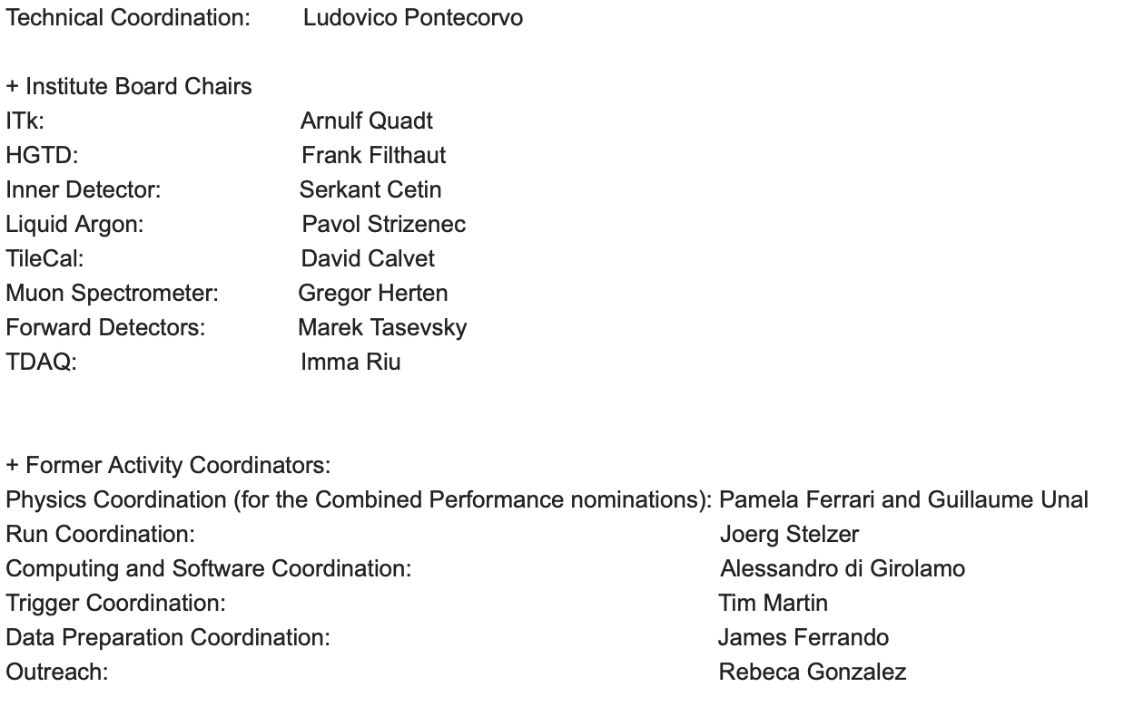
Team of Reviewers

Slide 6
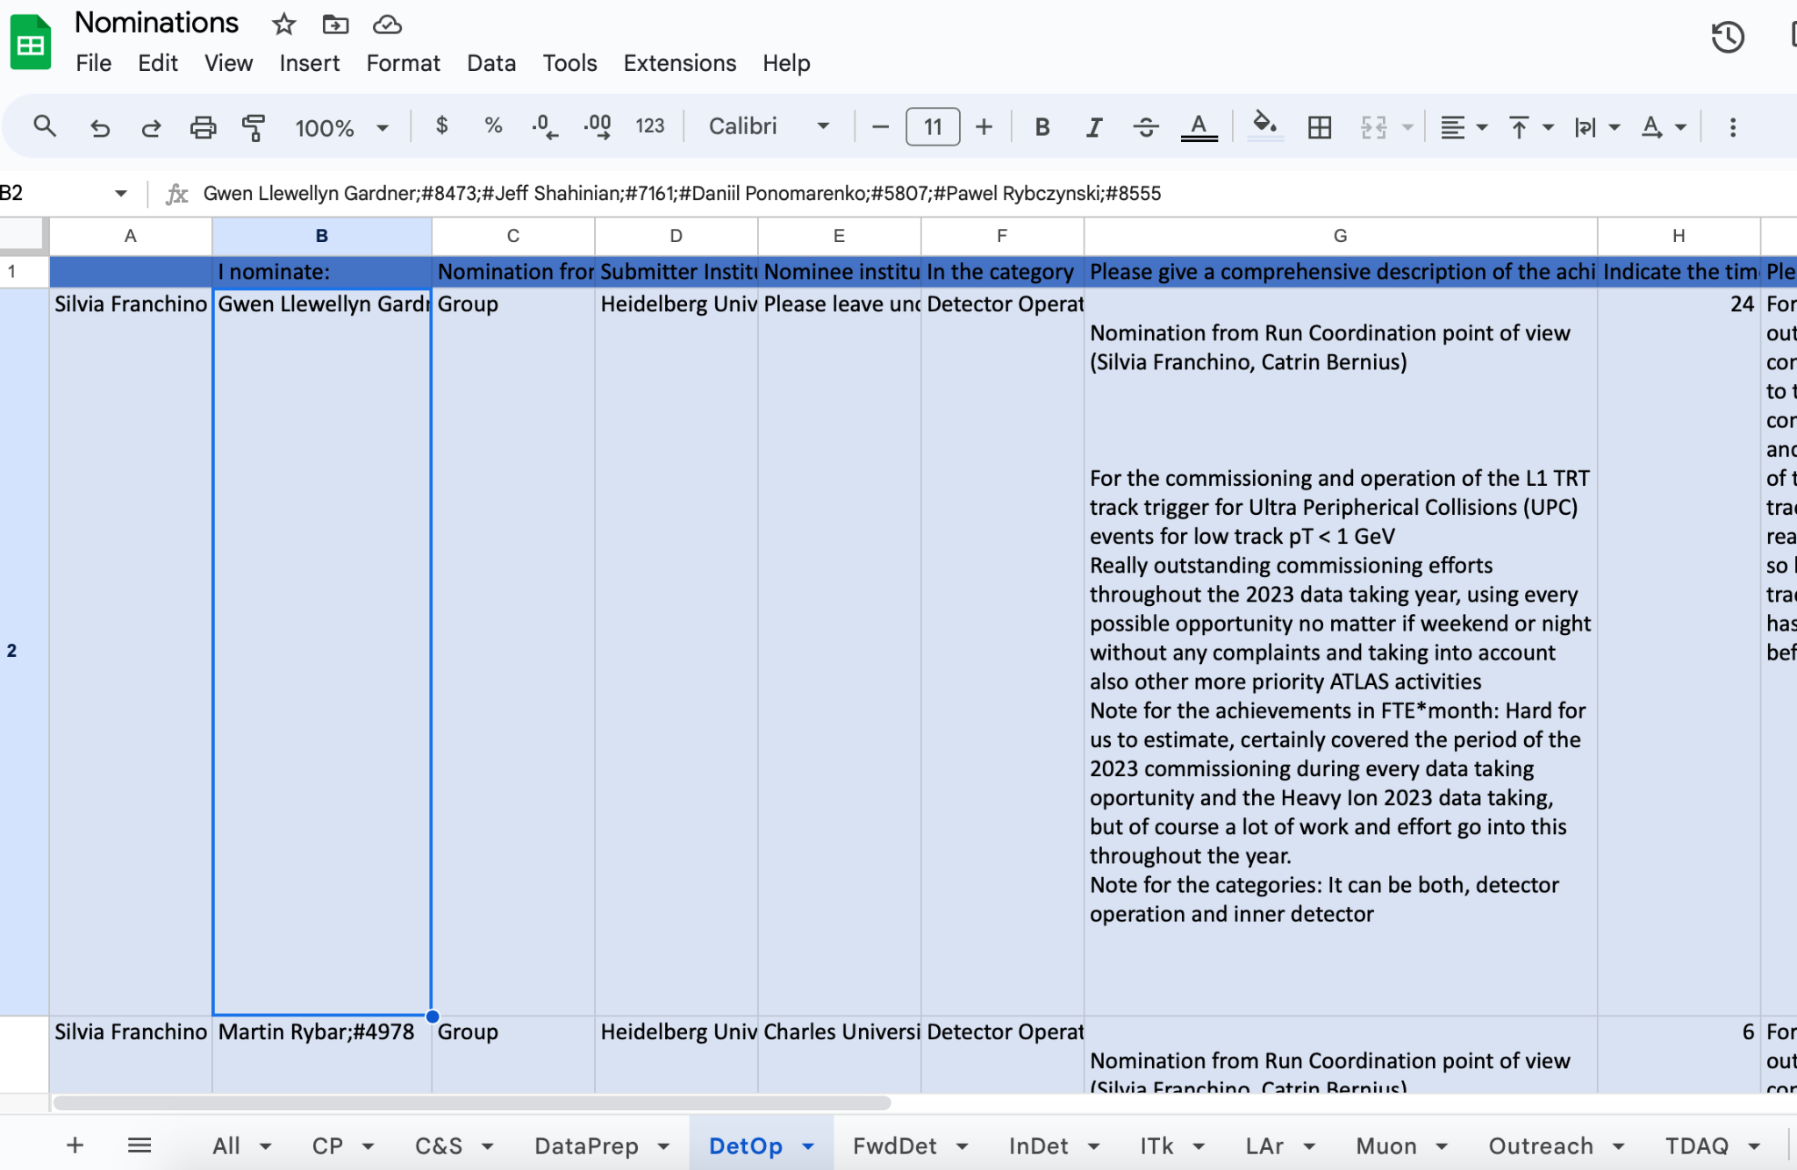
Status (1)
We have created a “google sheets” nominations spreadsheet with all reviews available, broken out by nomination area.
Each reviewer has been given a column for a numerical rating and a column for comments.

Slide 7
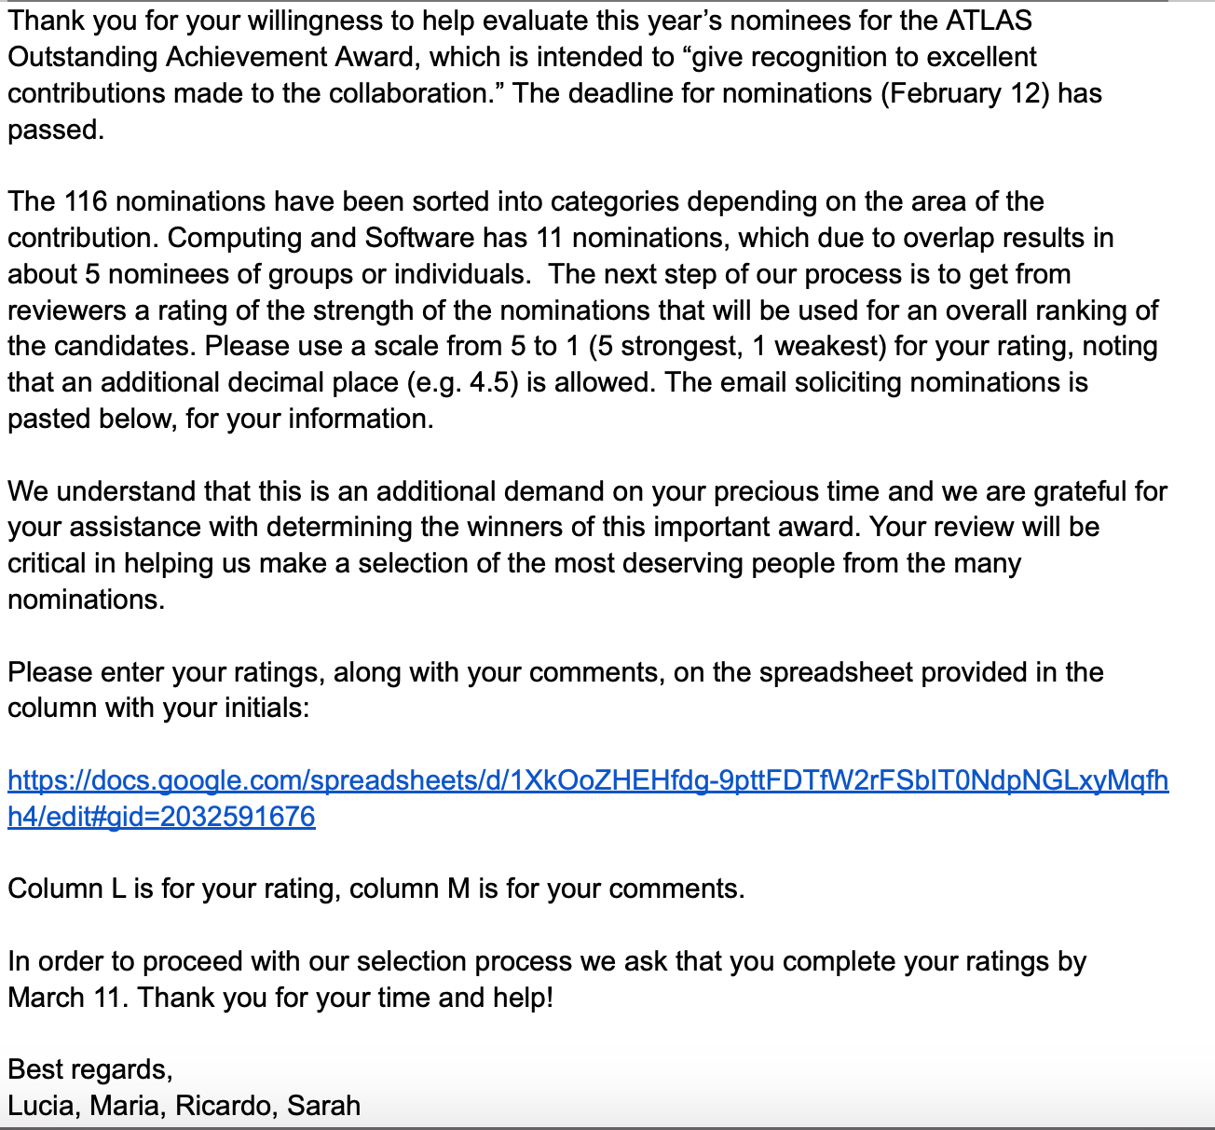
Status (2)
We have created a google document with all drafts available and ready to send to nominees. The letter includes instructions, a timeline, and a link to their respective area nominations tab.
We are ready to send out these emails later today, in order to stay on schedule. Please let us know if you have comments regarding this letter or the process!

