Slide 1
YCC Azores Cruise 2015
Preparation meeting
Port Choiseul – 21 May 2015

Slide 2
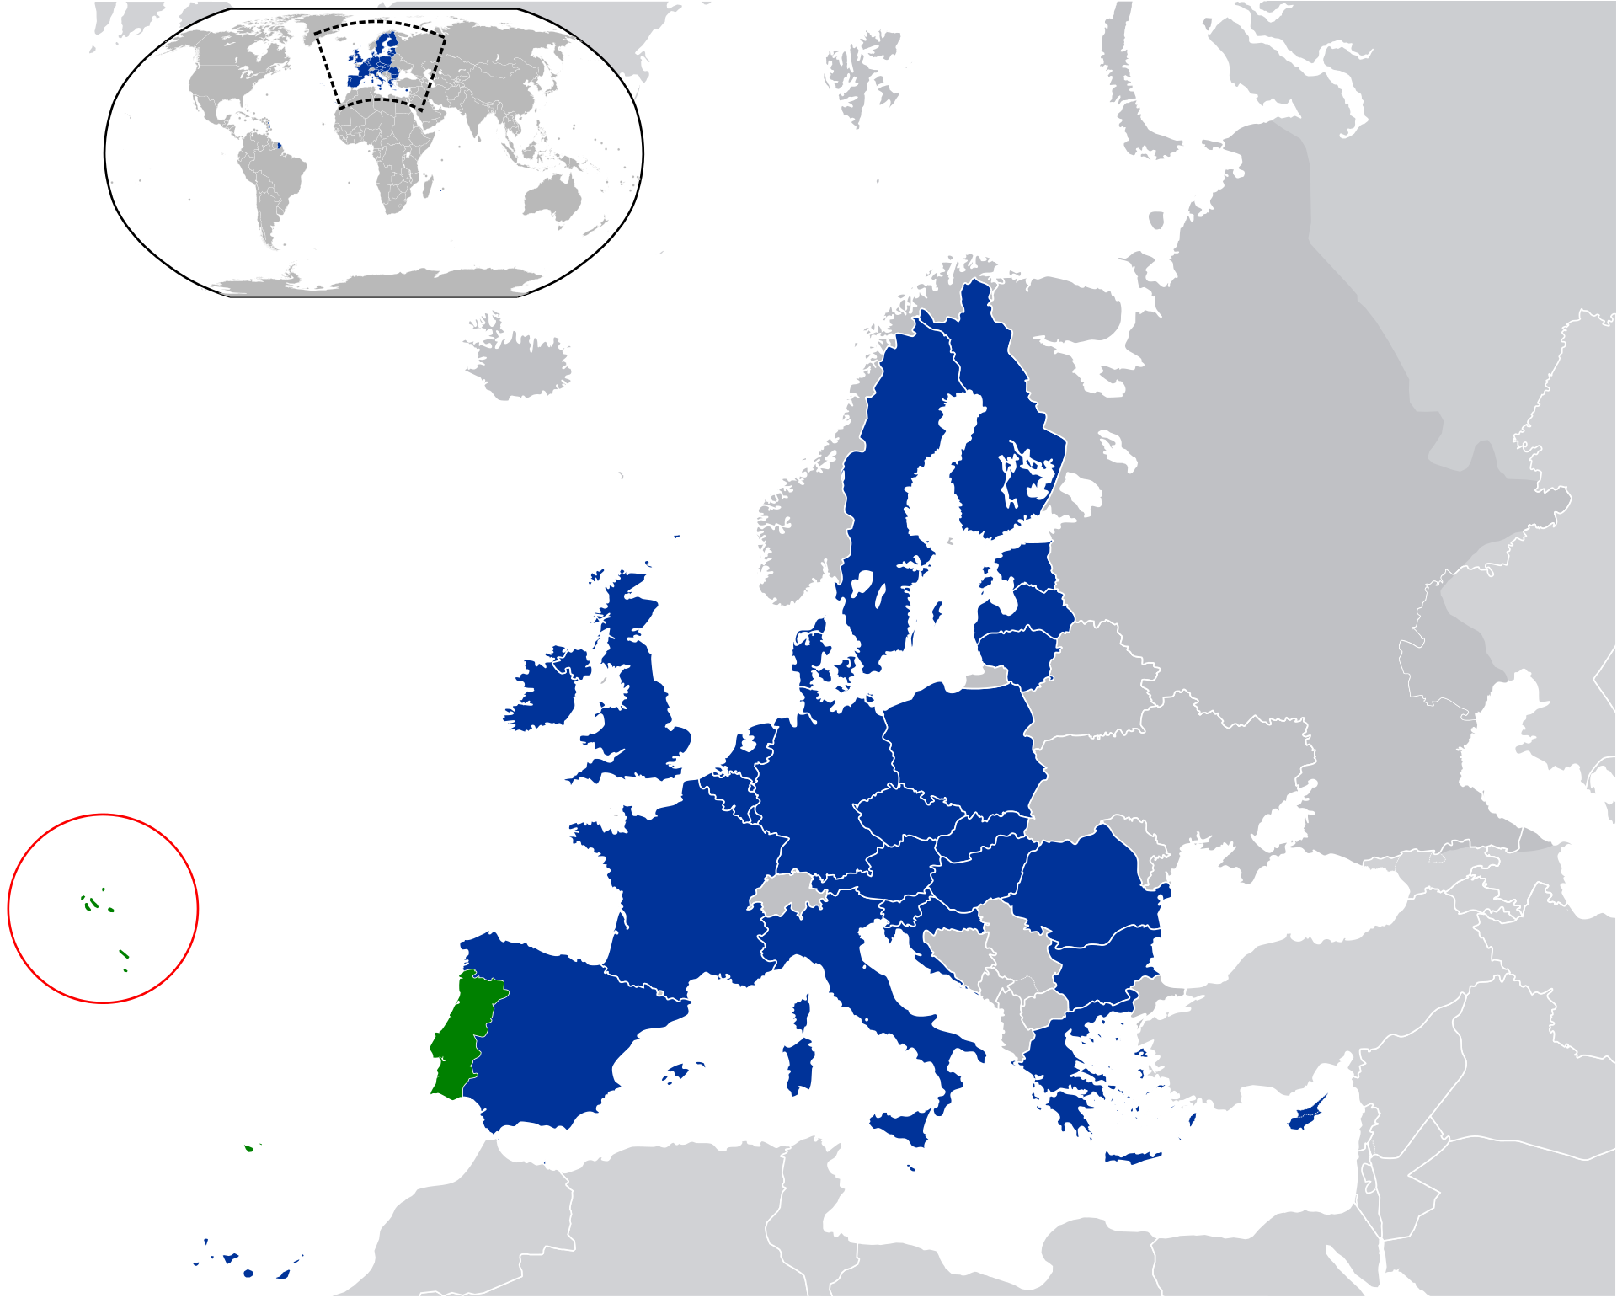
Overview
The Azores
Night out in Lisbon
Weather & Tides
Recommendations
Harbours
Possible routes

Slide 3
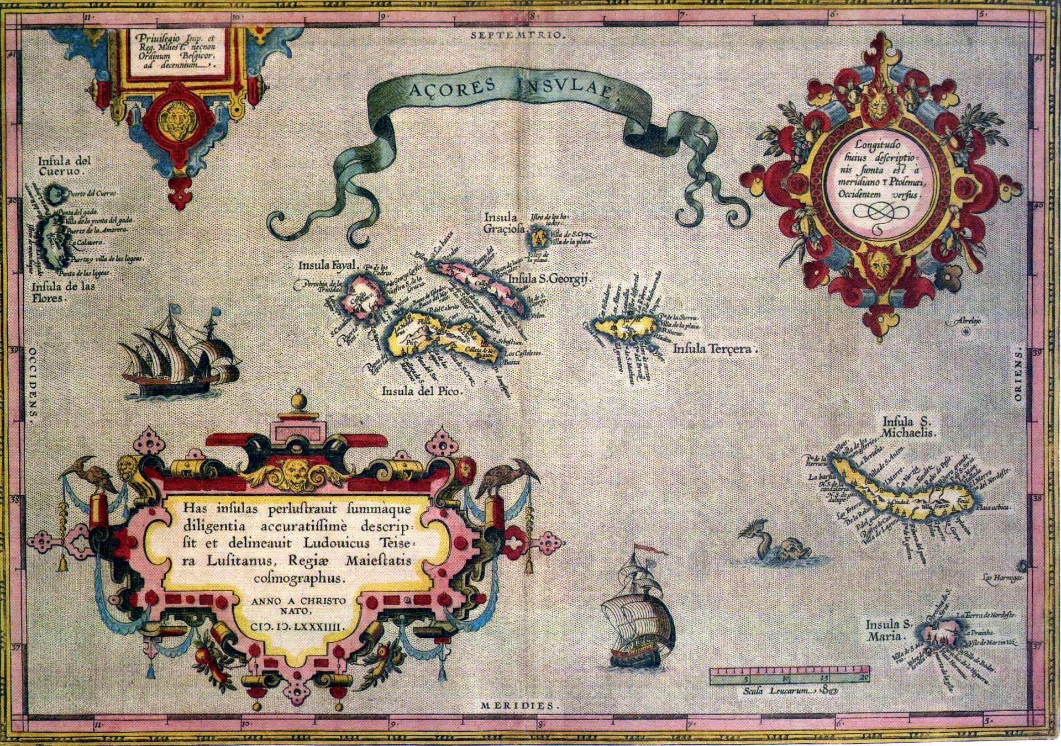
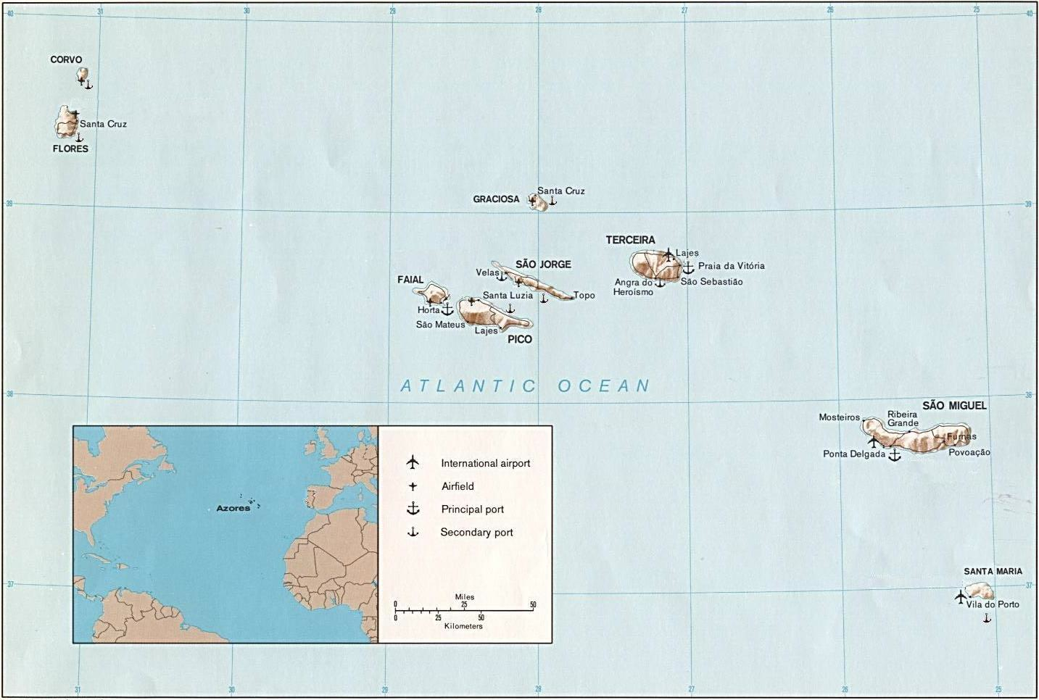
A bit of history
Possibly known by the Phoenicians and the Carthaginian since VI century b.c.
Reference to nine islands NW from the Canaries by Sherif Mohamed al Edrisi in 1154
Unpopulated when (re-)discovered by the Portuguese in 1432
Captain Gonçalo Velho Cabral just missed it one year before, when discovering the “Formigas” rocks, a mere 20nm from Santa Maria
São Miguel known by 1439
The “central group” – Terceira, Graciosa, São Jorge, Pico and Faial – in 1450
Flores and Corvo discovered in 1452
Colonised by emigrants from Portugal but also Flanders, Brittany, Scotland, Ireland and Italy
Economy based on agriculture but also on artisanal whaling until 1981 when it became forbidden
Christopher Columbus stopped in Santa Maria in 1493 returning from America
In 1498 João Fernandes Labrador left Terceira to map out the Labrador
Vasco da Gama stopped in Terceira on his way back from India in 1499
A frequent port of call since then
Herman Melville writes in 1851 about whalers from Nantucket stopping in the Azores in search of provisions and crewmen
In 1976 became a portuguese Autonomous Region with its Regional Government

Slide 4
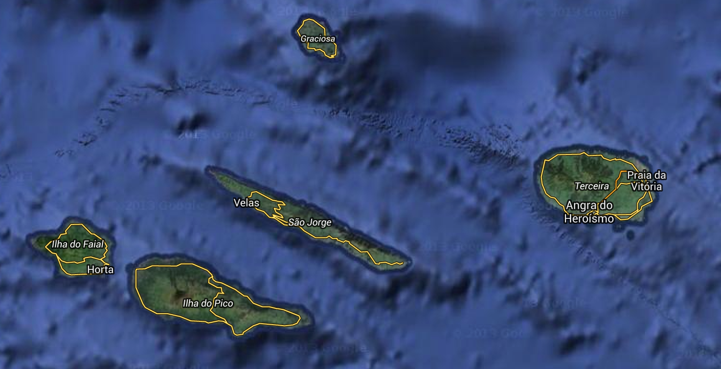
Geography and geology
Nine volcanoes formed at the junction between the eurasian and the african tectonic plates
Age between 8 million years (Sta.Maria) and 270 thousand years (Pico)
Many interesting geological curiosities: lava tubes, volcano craters
Lava rock is a traditional construction material here
Being a set of volcanic islands, there are only few places to drop the anchor, all unprotected, also quite some distance between islands
Advice from Sailazores is to spend nights in a marina
In second week we are likely to stay in the “central group”:
Graciosa
Terceira
São Jorge
Pico
Faial

Slide 5
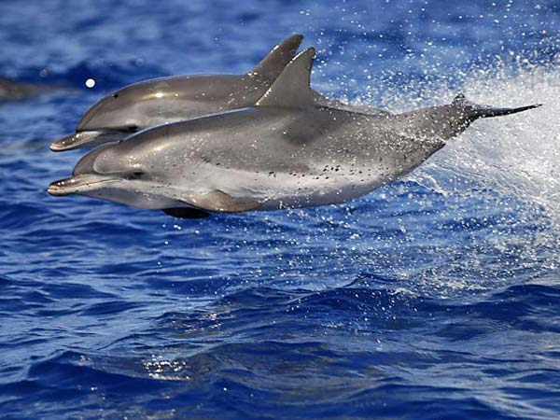
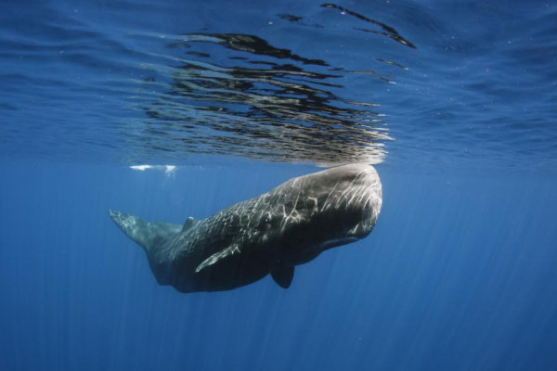
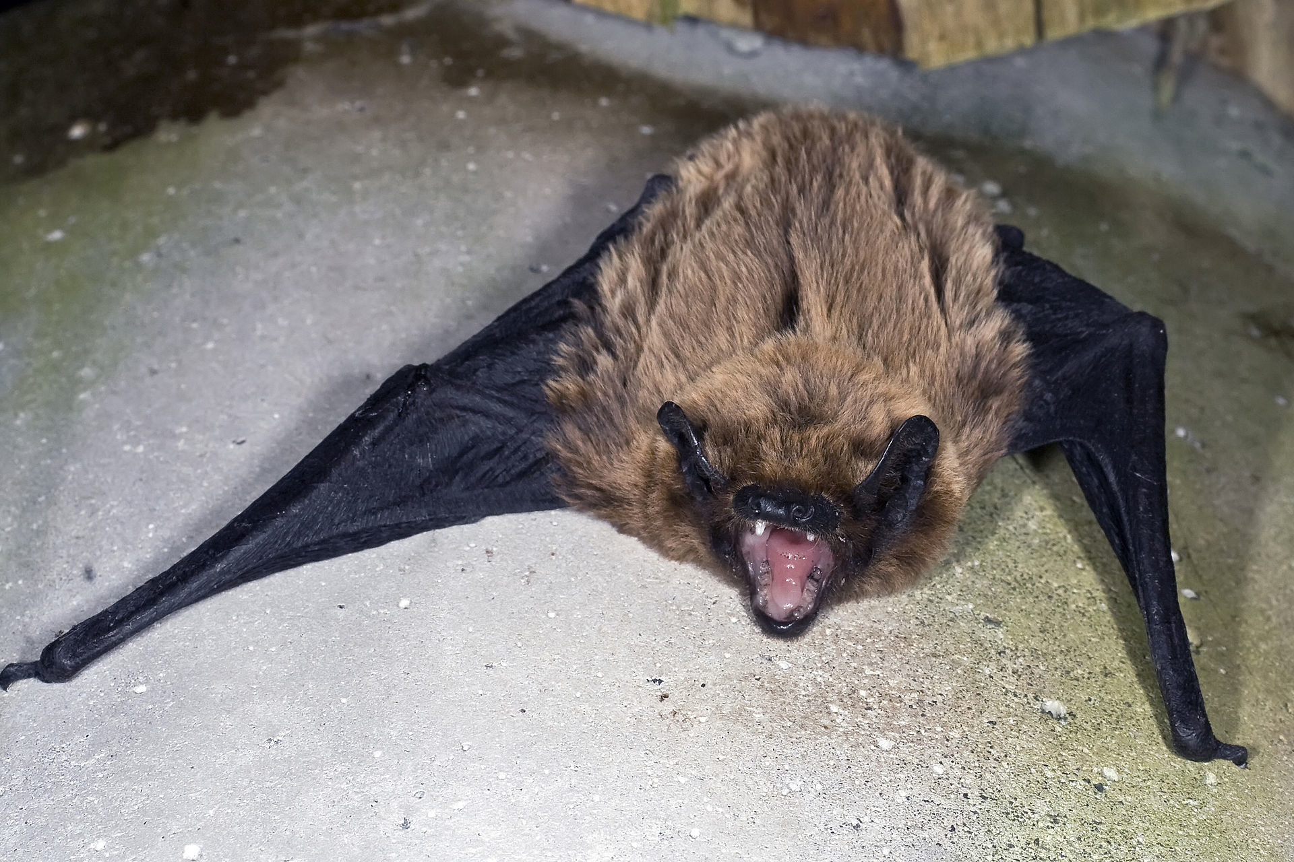
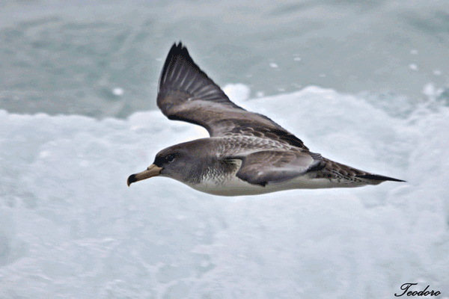
Fauna and flora
Whales and dolphins!
Several species: roaz, comum, pintado, etc – can be seen in family groups
Sperm whales (yes… Moby Dick!) – usually females with youngsters and old males stay around the islands while young males go travel the world
Birds:
Cagarra, ou Pardela (Calonectris, Procellariidae family) – migratory sea birds; spend most of life at sea, coming always to the same island to hatch; largest world concentration in the Azores
Azores bat (Nyctalus azoreum) endemic from the Azores islands – only bat species which hunts by day
Flora:
More than 60 endemic species originating from the Terciary (20M years) and isolated from outside world
Laurissilva forest includes trees and bushes, some are living fossils

Slide 6
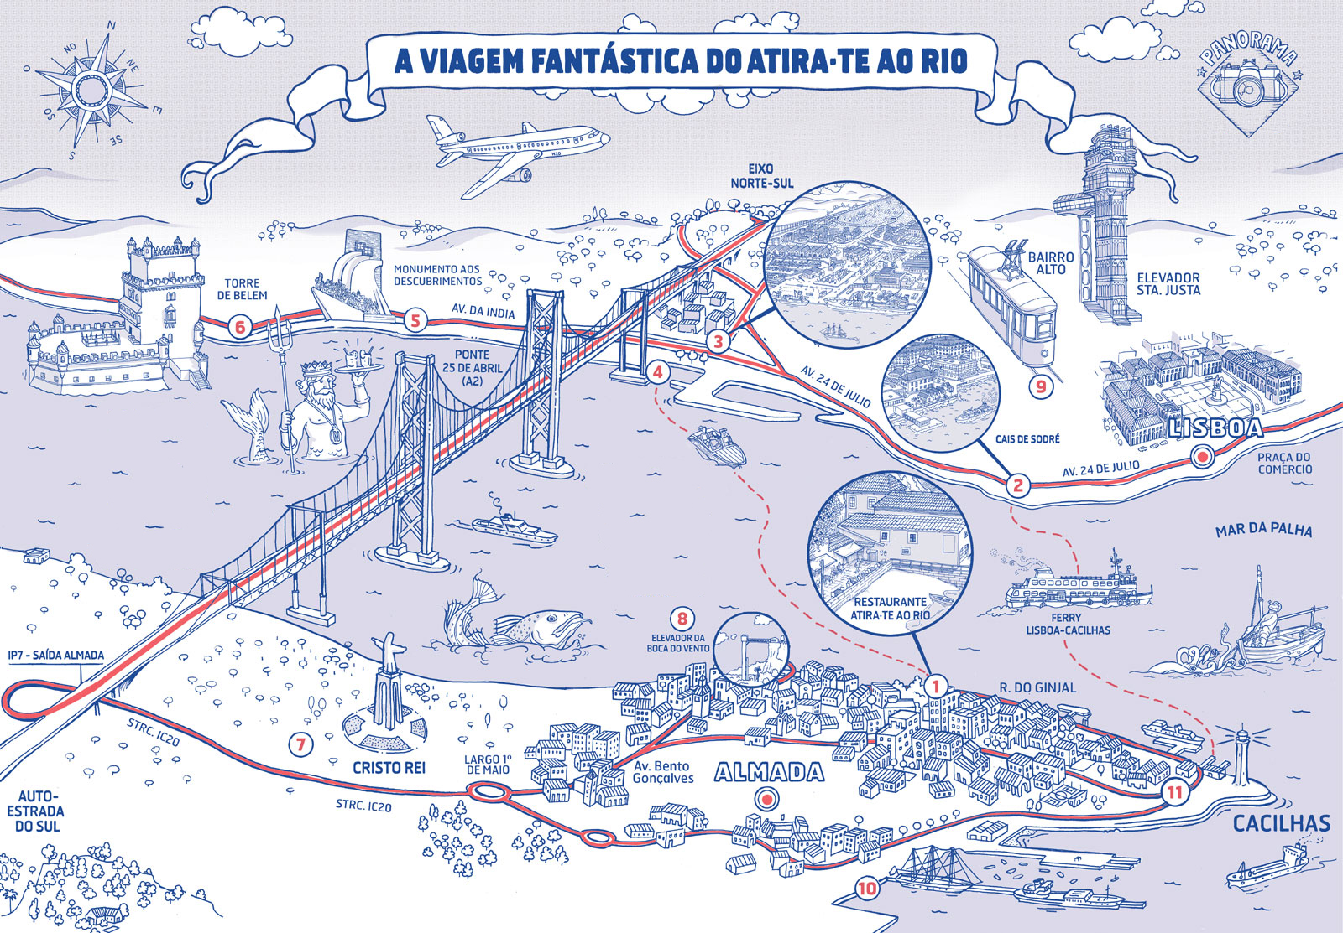
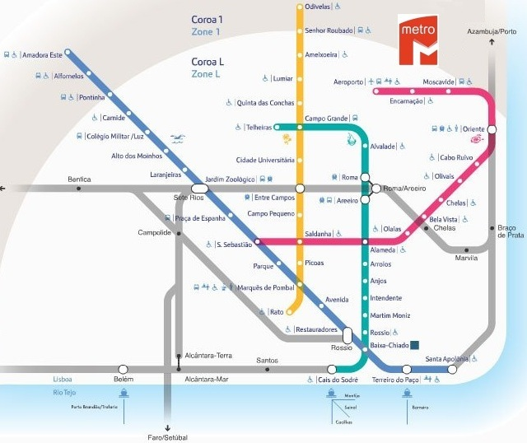
Travel to the Azores
Spirito’s crew spending one night in Lisbon:
TP0953 GVA 04 Sep 18h15 to LIS 04 Sep 19h45
TP1843 LIS 05 Sep 08h00 to HOR 05 Sep 09h40
Propose to go out in Lisbon:
Dinner suggestions:
Atira-te ao Rio (http://www.atirateaorio.pt) in Cacilhas across the Tagus
A bit expensive for Lisbon (not Geneva…) but glorious view and good food
Cross by ferry from Cais do Sodré, walk 500m along pier towards river mouth
Casa do Alentejo (http://www.casadoalentejo.pt)
Traditional food from southern Portugal
In a small 17th century palace hidden in Baixa’s popular historical district
Followed by a visit to lively Bairro Alto bar area and Tasca do Chico for Fado
Or go to a restaurant where Fado is sung (wide selection), e.g. http://www.clube-de-fado.com (a bit expensive, but seems nice)
From airport to city:
Lisbon airport very close to city
Taxis are cheap but make sure counter is running! 10-15 euros to city centre
Aerobus: €3.50 (10% discount when bought online and printed)not valid for other public transport
Line 1 (every 20min) to the city center (Rossio, Praça do Comércio, and railway/ferry terminal at Cais do Sodré). First trip from Cais do Sodré to airport at 7:45 am
Line 2 (every 30min) to the Oriente bus/railway terminals with 30min intervals
Line 3 (every 30min) to the central bus station at Sete Rios via Entrecampos train station
Metro (subway): from airport
€1.90 single trip to any place in the centre; daily pass €6.00 (plus €0.50 for the reusable card) valid for 24 hours after first activation; good on all public transportation (metro, bus, electrico); count 30mins to centre

Slide 7
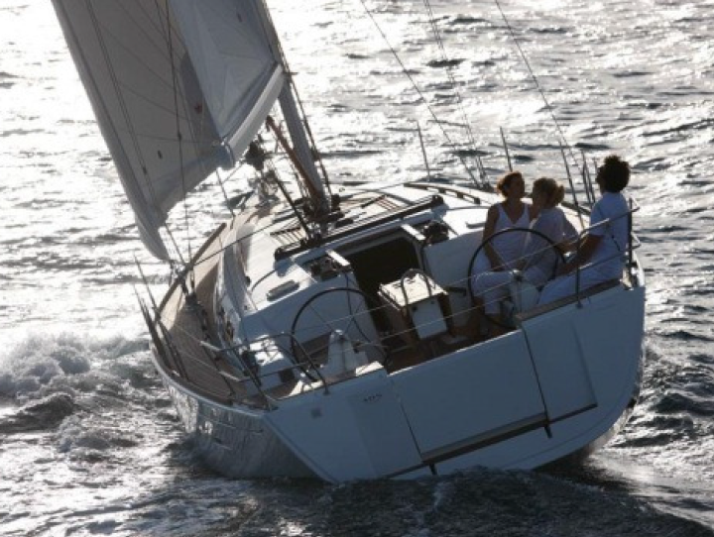
Our boats
Three yachts rented from Sailazores: http://www.sailazores.pt
One week (Horta, Faial; 5 – 12 September):
Trevi: Dufour Grand’Large 450 (2011)
Skipper: Michel Chevallier
Spirito: Dufour Grand’Large 405 (2013)
Skipper: Manfred Willenbrock
Two weeks (29 August to 12 September):
From Ponta Delgada, S.Miguel to Horta, Faial
Primo: Dufour Grand’Large 450 (2014)
Skipper: Michel Cornevin
Boats are practically new and seem well equipped
Marina fees at departure port are included
Sailazores do a briefing on the first day to explain routes, ports, etc
Standard equipment:
Furling genoa; Bimini; Sprayhood; Electric windlass; Autopilot; GPS; VHF; AIS;
Hotwater; Head and cockpit shower; Oven; Microwave; Electric fridge; Ice box; LCD w/ DVD and/or USB, CD, radio and iPod plug, 4 speakers; Binoculars (100 euros deposit, fully refundable)
Linen and towels provided; kitchen equipment (including corkscrew!)
Snorkeling gear (4 x); Inflatable dingy with outboard engine; Liferaft

Slide 8
Weather in September
Average air temperature: 23 (high) 19 (low)
Average precipitation: 80mm (Geneva 100mm)
Average days with rain: 17 (4 seasons each day…)
Wind:
Average speed/direction: 9kts from NE
Probability of >= 4Bft: 30%
Route choice may depend on actual wind direction (island shadow)
Catabatic winds possible near island cliffs
http://www.windfinder.com/ http://www.weatherbase.com

Slide 9
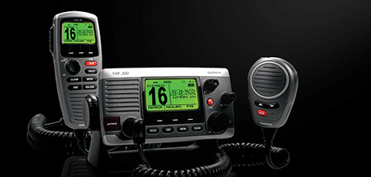
Weather forecasts
Sea area “Azores” (Pt area 5)
Coastal radio: Ch. 16, 25, 26, 28 (24h/24)
VHF – coastal waters:
Weather report, forecasts, navigation warnings
Within 20nm of Faial, Graciosa, Pico, São Jorge, Terceira: Ch. 11 at 09:00 and 21:00
Within 20nm of Flores: Ch. 11 at 10:00 and 19:00
In english and portuguese
Radio (LW):
Horta (518kHz): every 4h from 00:50 in english
Las Palmas (518kHz): every 4h from 01:20 in english; weather reports at 09:20, 13:20, 17:20
BBC4 (198kHz): 05:20, 12:01, 17:54 (UTC+1)
NAVTEX:
Identification letters F (518kHz, english) and J (490kHz, portuguese)
Horta station (NAVAREA 11)
http://weather.gmdss.org/
NAVTEX:
WEATHER BULLETIN FOR
SHIPPING FOR THE ATLANTIC
ZONES
LIMITED BY MERIDIANS 40W-22W
AND BY PARALLELS 30N-45N.
NO WARNINGS.
WEATHER SUMMARY AT
251200UTC:
…
5 - ACORES:
NW 3 TO 4 SOMETIMES 5, VEER
S QUAD AND INCR TO 5 TO 6 IN
W.
GOOD VIS, BECMG MOD TO POOR
IN W.
NW WAVES 2 TO 3 M, BECMG S
AND INCR TO 2.5 TO 4 M IN
FAR W.

Slide 10
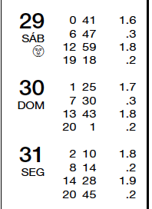
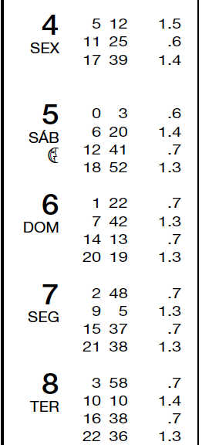
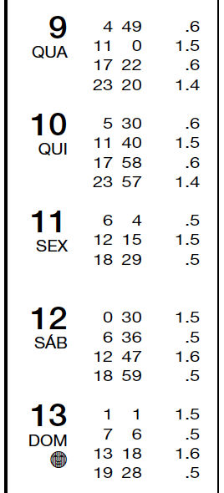
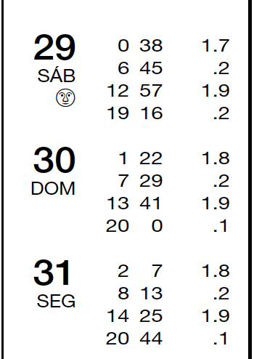
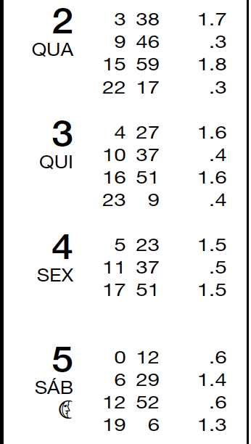
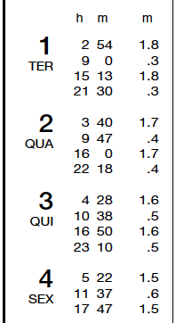
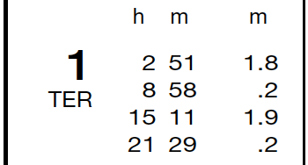
Tides & Navigation
Information from portuguese Instituto Hidrográfico (navy): http://www.hidrografico.pt
Tidal current runs to N, NE or E during rising tide and reverse direction in falling tide
Strongest tidal currents in Faial channel in front of Horta – up to 2 knts
Declination: average 11º33’W 2014 (9’ E) – changes by 2º40’ between east- and west-most islands
Angra do Heroísmo (Terceira)
August
Horta (Faial) - September
Ponta Delgada (S.Miguel)
August September
September

Slide 11
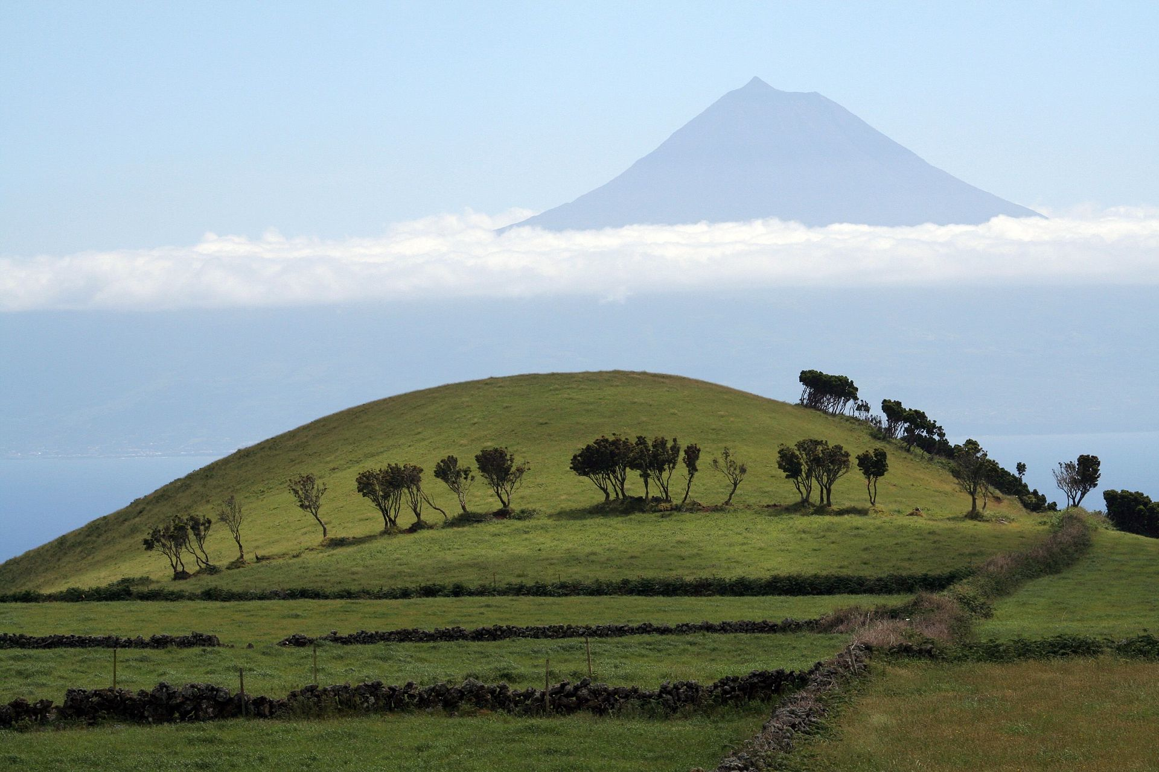
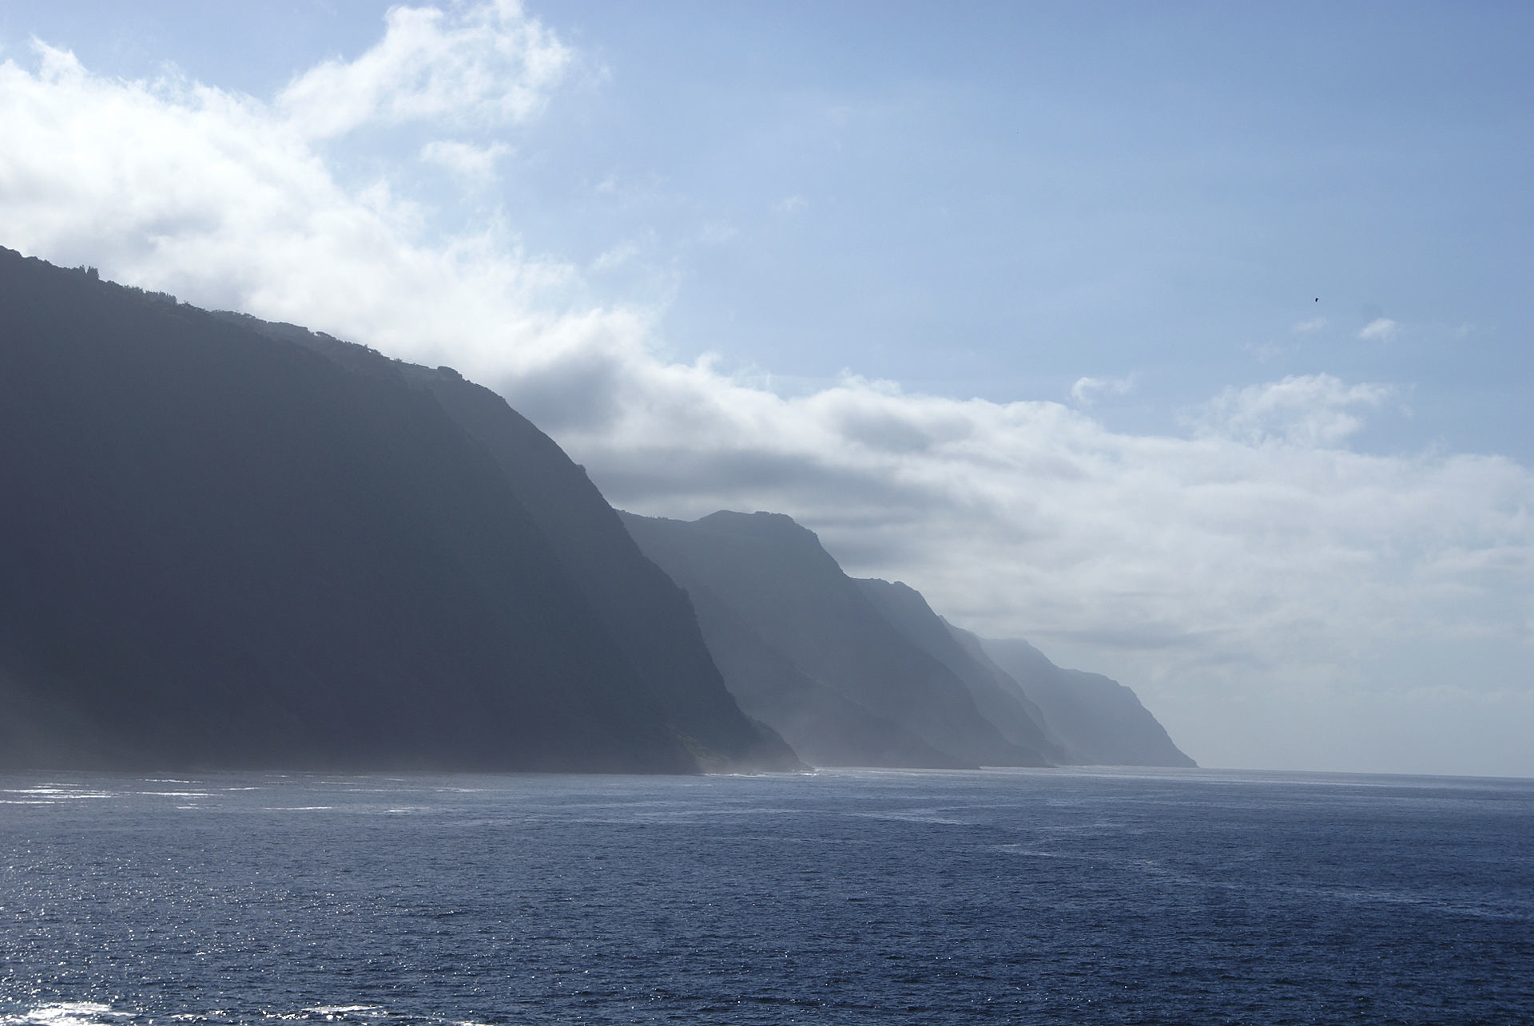
Customs and procedures
Marinas between 10 and 20 euros/night depending on boat length
Azores are European port of entry, so expect some customs bureaucracy
May need to go to immigration (SEF, Serviço de Estrangeiros e Froonteiras) or the police (GNR, Guarda Nacional Republicana) each time we go into port – and when we leave!
But probably no need since the boats have portuguese pavillion
In any case, keep papers filled in Horta to help with formalities later
And of course don’t forget passports…
Briefing from Sailazores should make procedures clear

Slide 12
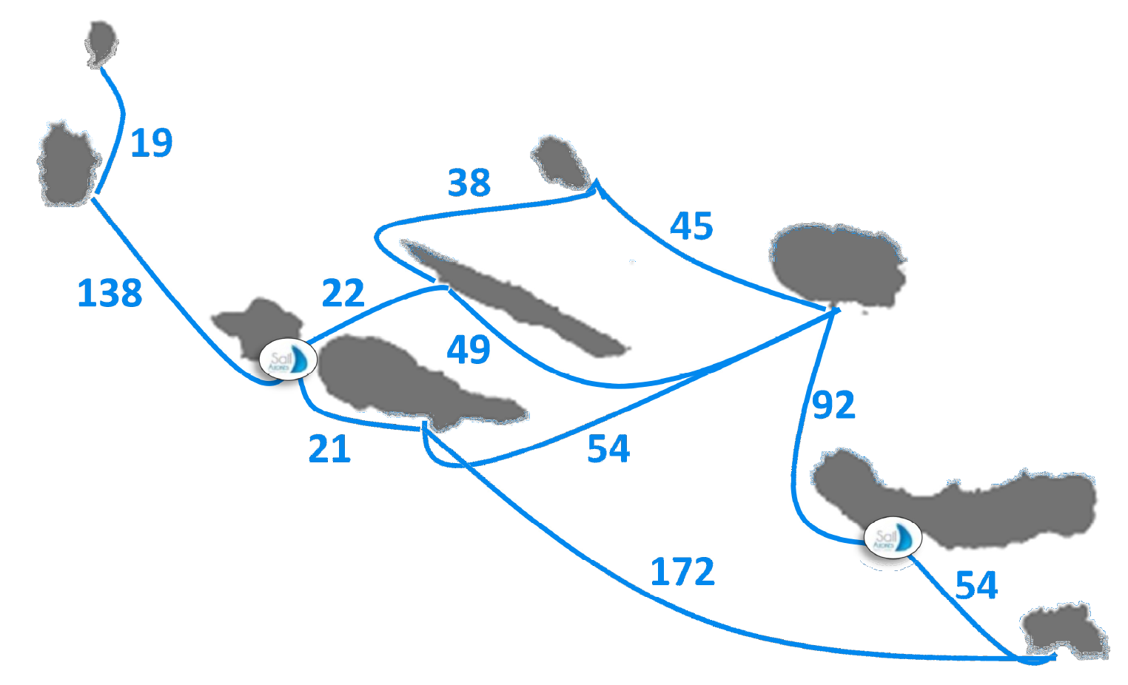
Possible routes
Focusing on second week (5 – 12 September)
Trevi will depart from S.Miguel to join others in Horta on the 5th September – proposed routes for second week in following slides
Distances and sailing times considering a poor 4 knts boat speed
5h
10h
11h
5h
35h
12h
23h
5h
14h
43h
14h

Slide 13
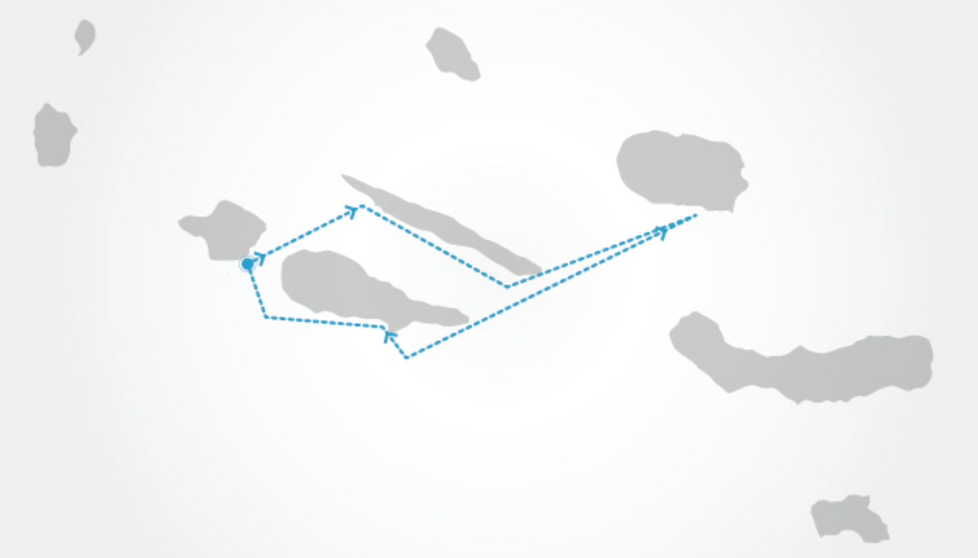
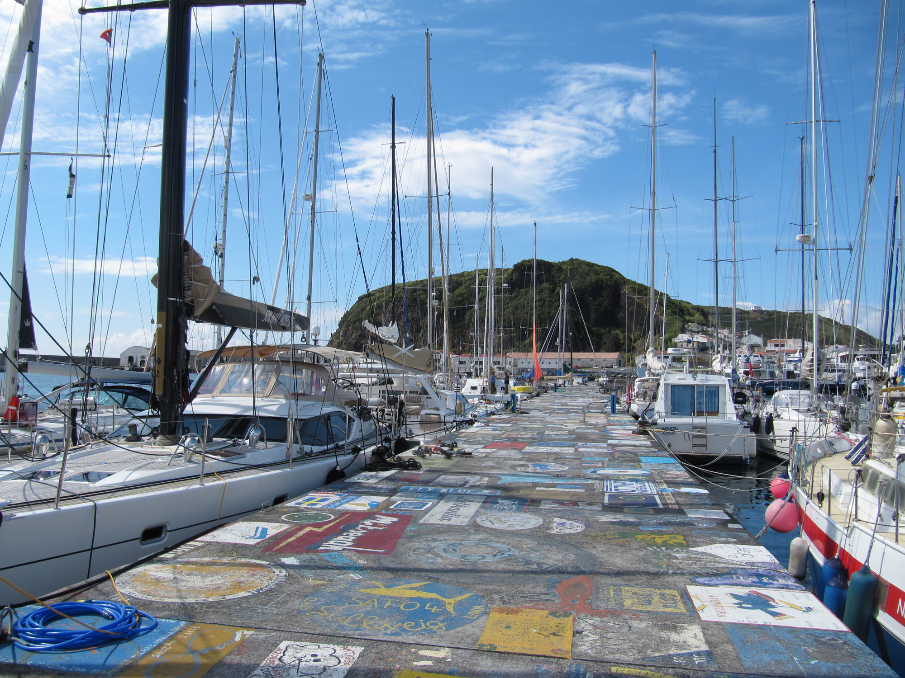
Suggested Itinerary - I
Company website suggests:
5/9: Arrival in Horta (Faial)
6/9: Horta to Velas (S.Jorge) – 22nm
7/9: Velas to Angra (Terceira) – 49nm
Whalespotting
8/9: visit Angra do Heroísmo
UNESCO heritage city centre
Algar do Carvão volcanic caves
9/9: Angra to Lajes (Pico) – 54nm
10/9: visit Pico
Whalemen museum
Climb Pico mountain
Scuba diving
11/9: Lajes to Horta – 21nm
Gin at Peter’s Café Sport
12/9: departure from Horta
http://www.sailazores.pt/charter/itineraries

Slide 14
More advice from Sailazores (phone)
Usual route for 1 week:
Horta to either Lajes (Pico) or Velas (S.Jorge)
Lajes has a small marina with a difficult entrance – ok for the 40ft but difficult for the 45ft – only port where a tide table is needed
Velas has a very nice marina – north coast of S.Jorge is beautiful and worth visiting
Graciosa – nice small island with particular architecture
Terceira – must see Angra – marina in the town centre
Return via Pico (Lajes) or S.Jorge (Velas) depending on option taken above
Other advice:
Flores some 24h from Horta (i.e. >=2 days return trip) and small marina – not worth it for a 1-week cruise
Weather – good temperature with occasional light rain – T-shirt and shorts weather but bring a sweater for the evening and rain gear
Wind – May-June great; July-August calm; September variable but good, generally < 20 knts
North coast of S.Jorge is quite exposed to the weather – surfers’ paradise…
Briefing by Sailazores before we take the boat on the 5th September

Slide 15
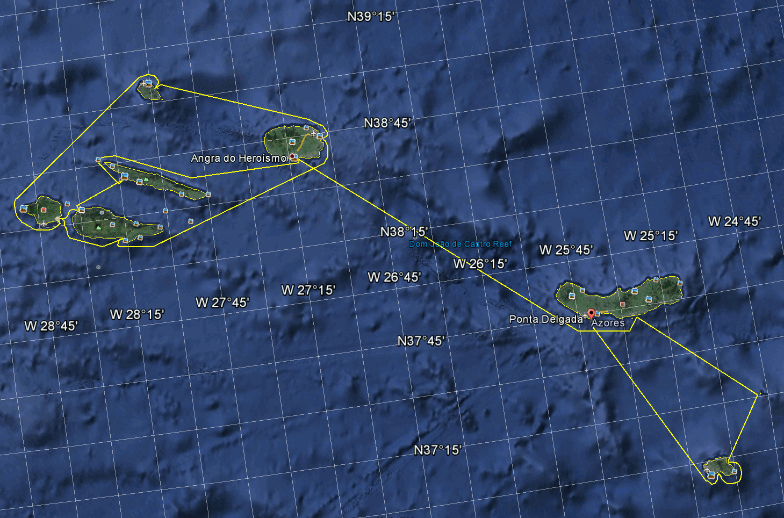
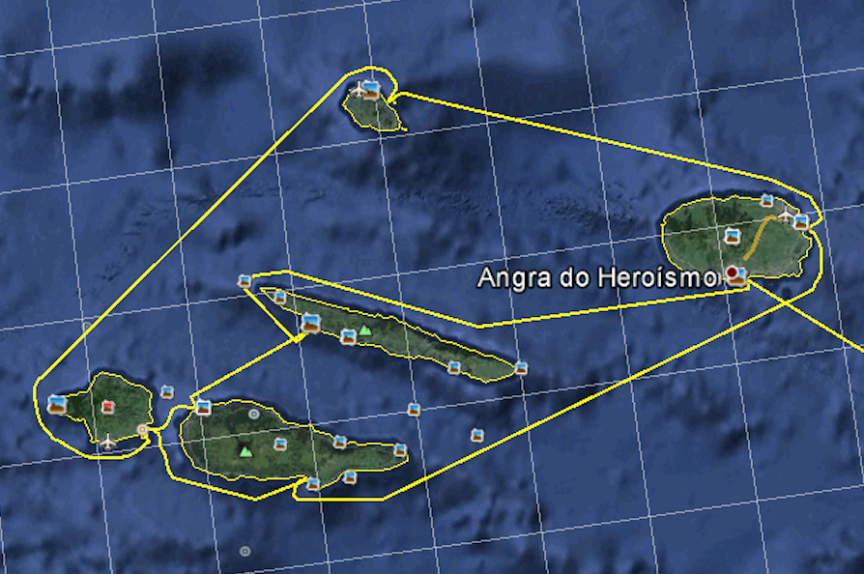
Suggested Itinerary - II
Adjusting slightly Jens’s proposed route:
5/9: Arrival in Horta (Faial)
6/9: Horta to Lajes do Pico – 21nm (take receding tide)
7/9 Lajes to Angra do Heroísmo (Terceira) – 54nm
8/9 Angra to Graciosa
9/9 Graciosa to Velas (S. Jorge)
10/9 Velas to Horta – 22nm
11/9 Free for tourism
Climb Pico from Madalena (1nm)
Visit recent volcano – Capelinhos (taxi)
Gin at Peter’s Café Sport
12/9: departure from Horta
Adjustment to Jens’s proposal so we could all visit Angra (and Graciosa?)

Slide 16
Week 1: Trevi coming from Sta. Maria to Horta
Suggested changes to allow other boats to visit Angra, Velas and Graciosa
Allows short last day from S. Roque (Pico) – similar distances to Jens’ plan
Week 2: all together from Horta and back to Horta
S.Roque

Slide 17
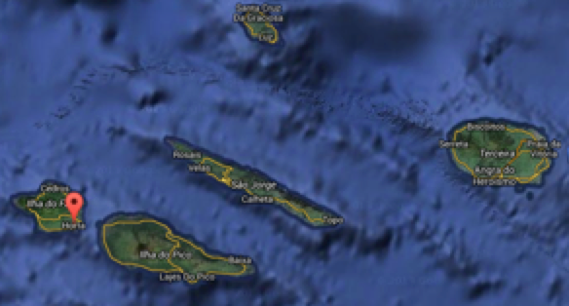
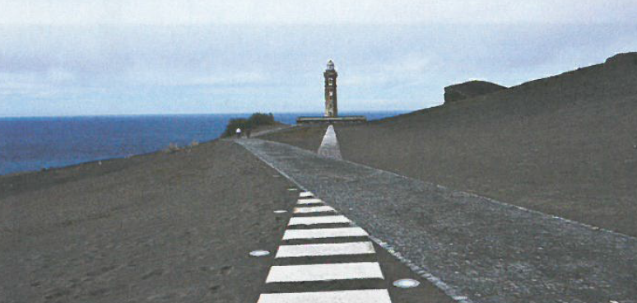
Faial
Ports:
Horta – well protected Marina and popular crossroads of the Atlantic
Approach fine by day or night
A must: make painting on marina wall to signal YCC cruise!
Anchorages:
Almoxarife beach – 2nm north of Horta; exposed to the east
Places to see:
By taxi:
Lunar landscape of Capelinhos volcano and visitor centre – the latest Azores volcano (1957)
Caldeira – the volcan’s crater in the center of the island
By the port:
Several companies at the port offer diving and whale watching trips
Porto Pim and Monte da Guia – a lovely beach and a little old volcano crater
Peter’s Café Sport – a gin at Peter’s as the Sun sets is indispensible
Restaurants:
Areínha Velha, owned by Genuíno Madruga, fisherman and solo round-the-world sailor – Porto Pim

Slide 18
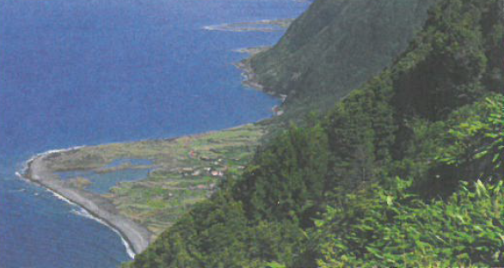
São Jorge
Ports:
Velas – main town
Small but very good Marina according to Sailazores
Approach: ok by day or night
Calheta – small quiet port half way the S coast
Protected from NW to E
Anchorages:
Urzelina – good weather anchorage; protected from NW to SE
half-way between Velas and Calheta
Fajã do Ouvidor – only anchorage in north coast; good for weak S wind
Places to see:
By taxi:
Fajãs (do Santo Cristo and do Ouvidor) – villages by the sea; access on foot from top of cliffs
By the port:
Try the local cheese!
Sta Catarina cannery in Velas – good canned fish to take home
Restaurants:
Fornos de Lava – fish cataplana or veal with cheese crust
Café Gambão – try the traditional espécie cake

Slide 19
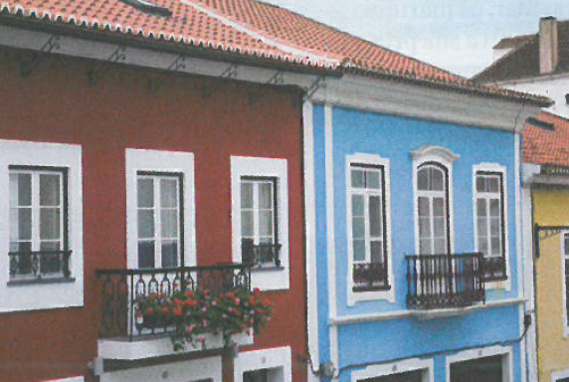
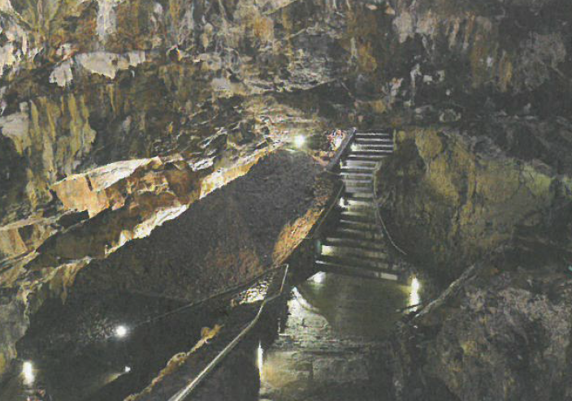
Terceira
Ports:
Angra do Heroísmo – good marina in a beautiful town
Approach: ok by day or night
Praia da Vitoria – good marina
Approach ok by day or night
São Mateus da Calheta – fishing port a few miles W of Angra
Anchor by day
Anchorages:
Cais do castelo – by Angra, good for East wind
Places to see:
By taxi:
Algar do Carvão volcanic caves – essentially the inside of an inactive volcano
By the port:
Marinas in Angra do Heroísmo and Praia da Vitória are in the town centre
Angra: visit old town centre, Cathedral, forts of St. John the Baptist and St. Sebastian, Alto da Memória (Memory Hill) viewpoint
Restaurants & food:
Angra: alcatra (beef) Terceira fashion; Dona Amélia cake (O Forno pâtisserie)
Praia da Vitória: O Pescador (fish dishes)

Slide 20
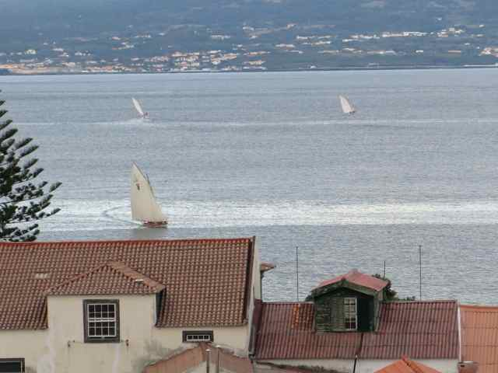
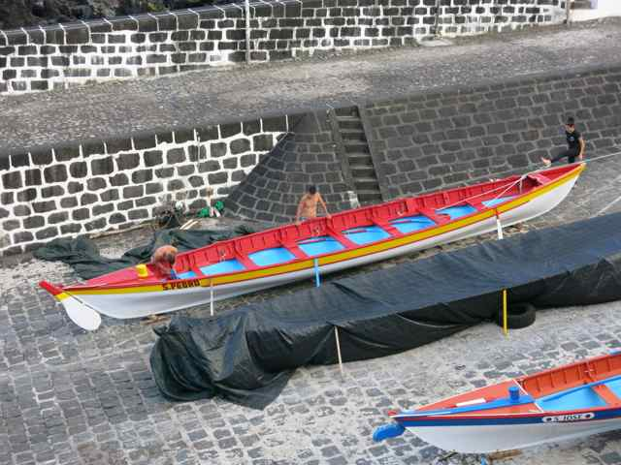
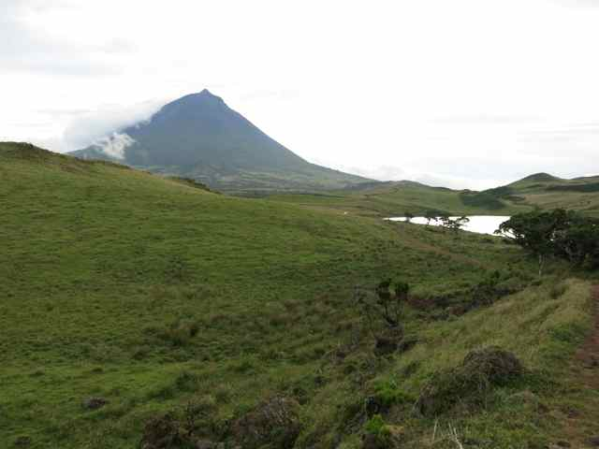
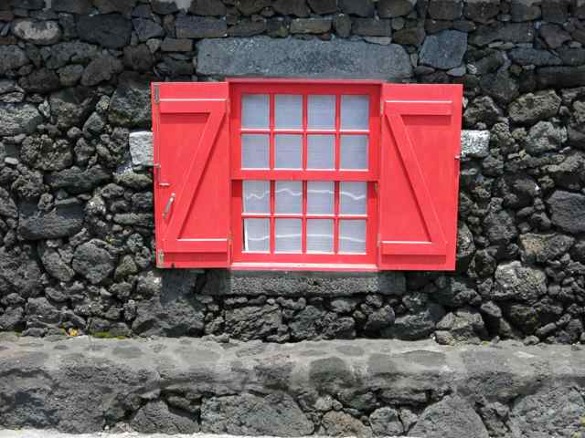
Pico
Ports:
Lajes – South coast – small marina, a bit shallow; narrow channel partially obstructed by rocks
Approach: ok by day but difficult by night – marina entrance partially obstructed by rocks after a recent storm
Madalena – West, facing Horta in Faial (15mins away by ferry) – ferry port and small commercial harbour
Approach good from N or NW: if approaching from south of the (very obvious) Madalena rocks, make sure to stay close to them to avoid a sandbank; anchor on sand in south part of the harbour; watch out for the ferry
São Roque – north coast; fishing and commercial port on the north side of Pico
Approach stay 200m clear of Baixo do Cais rocks; by night approach between 130º and 295o from the light at end of pier (Fl.G.3s) and stay at least 50m away from pier; moor to buoy or anchor (11-15m depth, rocky bottom) inside port
Anchorages:
Calheta dos Nesquim – south coast – small day anchorage but open to south; watch for some rocks as approaching
Santa Cruz das Ribeiras – south coast – small port; seems open to swell from East; anchor by 5m on sand and rocks
Places to see:
By car/taxi:
Vineyards enclosed in lava walls (Lagido de Santa Luzia)
Gruta das Torres – Lava tunnel which carried lava down from the Pico volcano – 450m open of a total 5km explored length!
By the port:
Wine museum in Madalena – 15mins from the port – closed mondays and holidays
Whalemen museum in Lajes – very good museum documenting whaling in small boats done here until the 70’s
Restaurants & food:
Ancoradouro – fish and seafood – a reference in Pico – 15mins from port in Madalena

Slide 21
Graciosa
Ports:
Vila da Praia (S.Mateus) – small town with a fishing and commercial port on the eastern coast; seems to be the only well-sheltered harbour in the island; not a marina!
Approach – the port is just in front of the small (500m long) Ilha da Praia island; leave coast and little island clear by 300-500m and avoid the Baixa dos Remedios bank if approaching from S; by night follow alignment lights at 307º until the pier is at the beam
Anchorages:
Santa Cruz – anchor at Cais do Freire or at Cais da Barra – both seem little better than bays open to E with poor rocky bottoms – better leave the boat in Vila da Praia and visit by taxi
Places to see:
By car/taxi:
Furna do enxofre – rare geological phenomena in a crater at the islands SW end with bubbling
Visit Santa Cruz – the town seems pretty; the main church is partly from the XVI and partly from the XVIII centuries
Restaurants & food:
Could not find much information; better ask Sailazores people upon arrival

