Slide 1

Higgs Physics
IST – 29 November 2023
Topics in Particle Physics, Astrophysics and Cosmology
Ricardo Gonçalo – UC/LIP

Slide 2

Outlook
What is the Higgs boson and what is it good for?
How did we find it?
Why do we care?
And what comes next?
Notes:
What we thought we knew – teoria e pre-LHC data
How we know what we know – experimental aspects
What we know – we found a Higgs boson
All we have found out in the meantime – mass, spin, parity, cross sections
What we know we don’t know...
What we think we know – teoria e o BSM Higgs

Slide 3
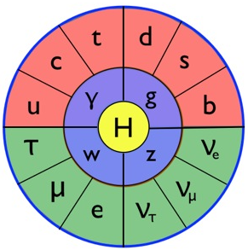
Introduction
The Standard Model particles and interactions, and some theory to set the scene…

Slide 4
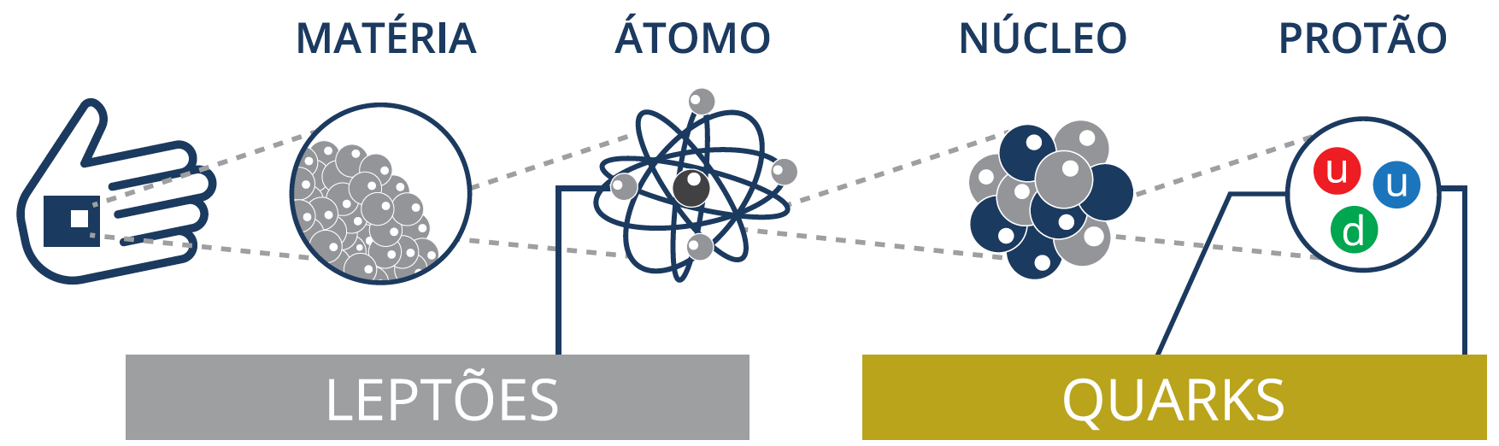
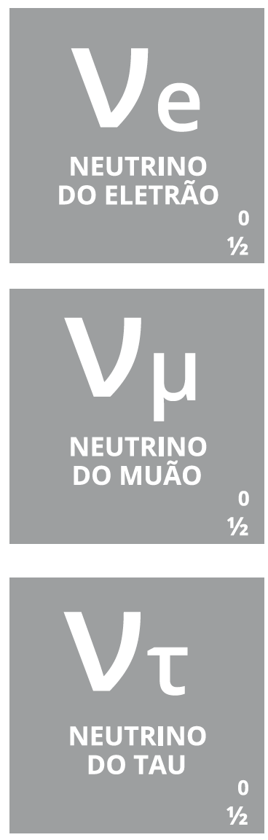

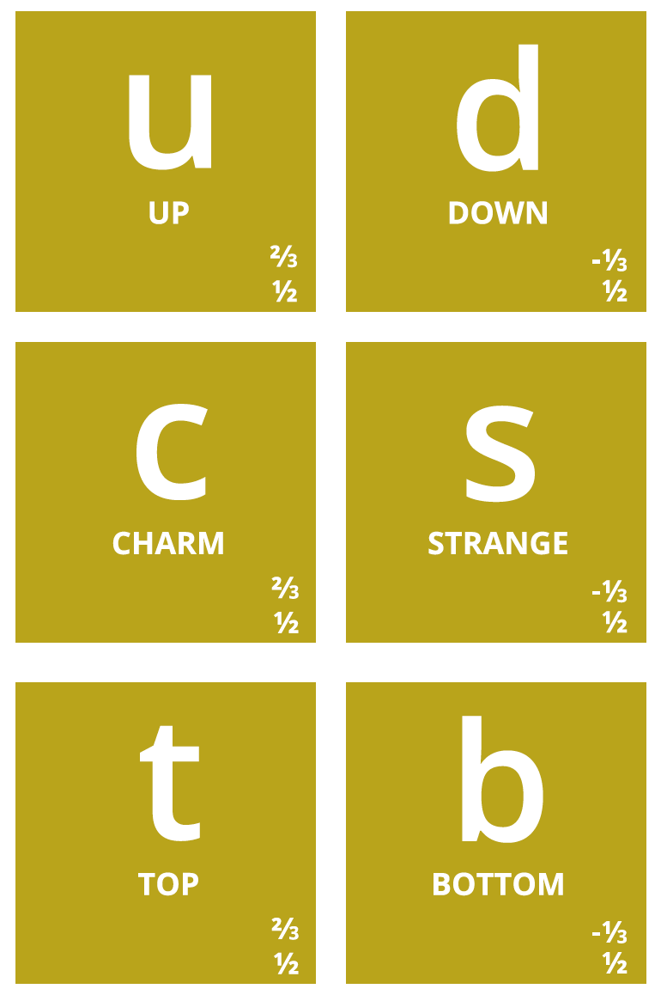
Notes:
Então, quais são afinal as partículas elementares? Temos os quarks, que dão as diferentes propriedades da nova tabela periódica
Também temos o electrão (já conhecíamos), e os seus primos mais pesados: muão e tau. Para cada um destes temos os neutrinos (não são feitos de quarks), que são produzidos em reações no Sol, por exemplo.
Por alguma razão (que desconhecemos) há 3 gerações de partículas elementares, cada uma mais pesada que a anterior → mistério!

Slide 5
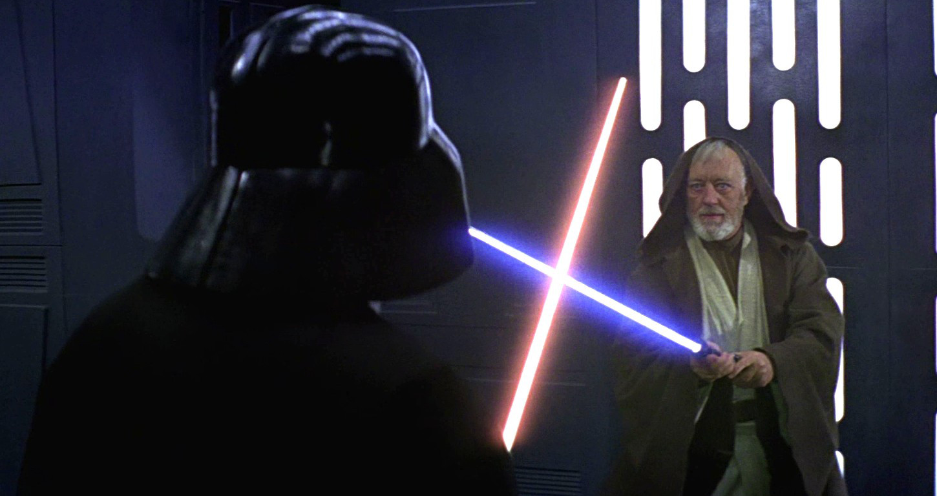
Fundamental Forces

Slide 6
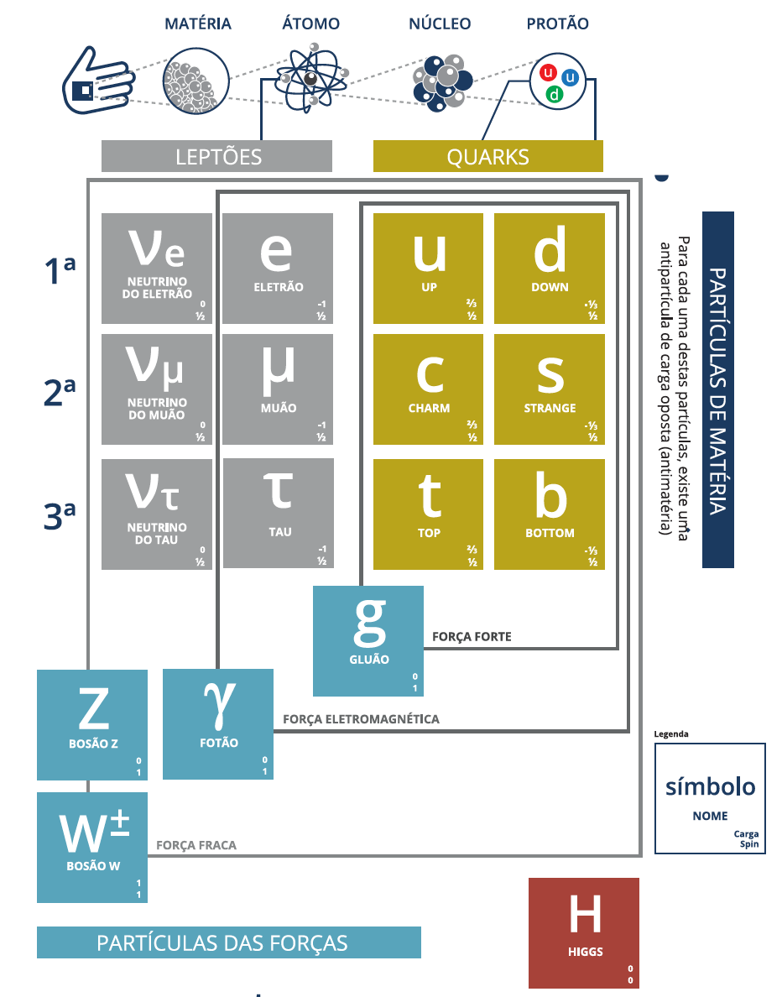
Fundamental forces
Electromagnetic:
  Carried by photons
  Acts on electrical charge
Weak:
  Carried by:
    W± (charged current)
    Z⁰ (neutral current)
  Acts on weak isospin
Strong:
  Carried by 8 gluons
  Acts on colour

Slide 7
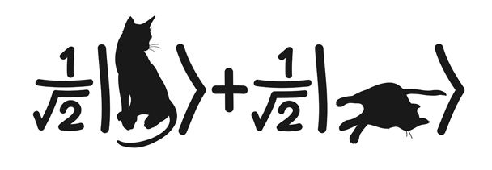
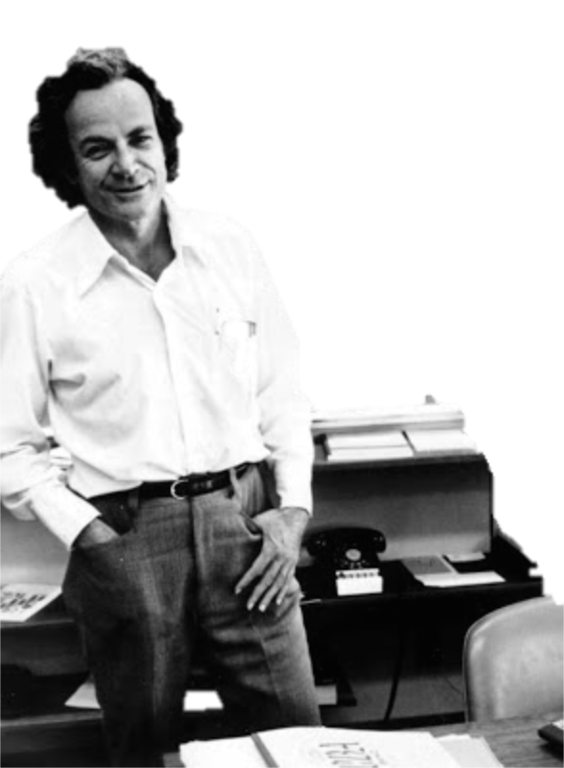
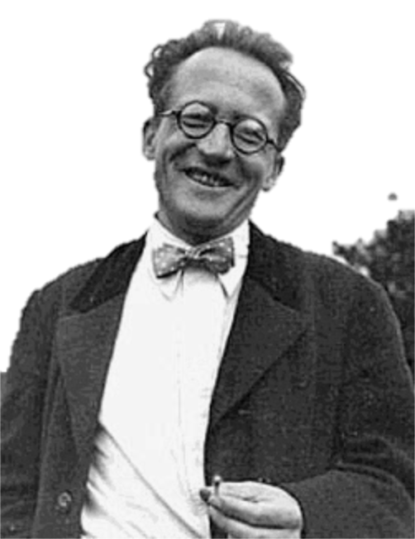

Let’s go to quantum fields...
Erwin Schrödinger (1887 - 1961)
Richard Feynman (1918 - 1988)
Fluffy (?-?)
Notes:
Erwin Rudolf Josef Alexander Schrödinger (1887 –1961), sometimes written as Erwin Schrodinger or Erwin Schroedinger, was a Nobel Prize-winning Austrian physicist who developed a number of fundamental results in the field of quantum theory, which formed the basis of wave mechanics: he formulated the wave equation (stationary and time-dependent Schrödinger equation) and revealed the identity of his development of the formalism and matrix mechanics. Schrödinger proposed an original interpretation of the physical meaning of the wave function.
Richard Phillips Feynman (1918 – 1988) was an American theoretical physicist known for his work in the path integral formulation of quantum mechanics, the theory of quantum electrodynamics, and the physics of the superfluidity of supercooled liquid helium, as well as in particle physics for which he proposed the parton model. For his contributions to the development of quantum electrodynamics, Feynman, jointly with Julian Schwinger and Sin-Itiro Tomonaga, received the Nobel Prize in Physics in 1965.

Slide 8
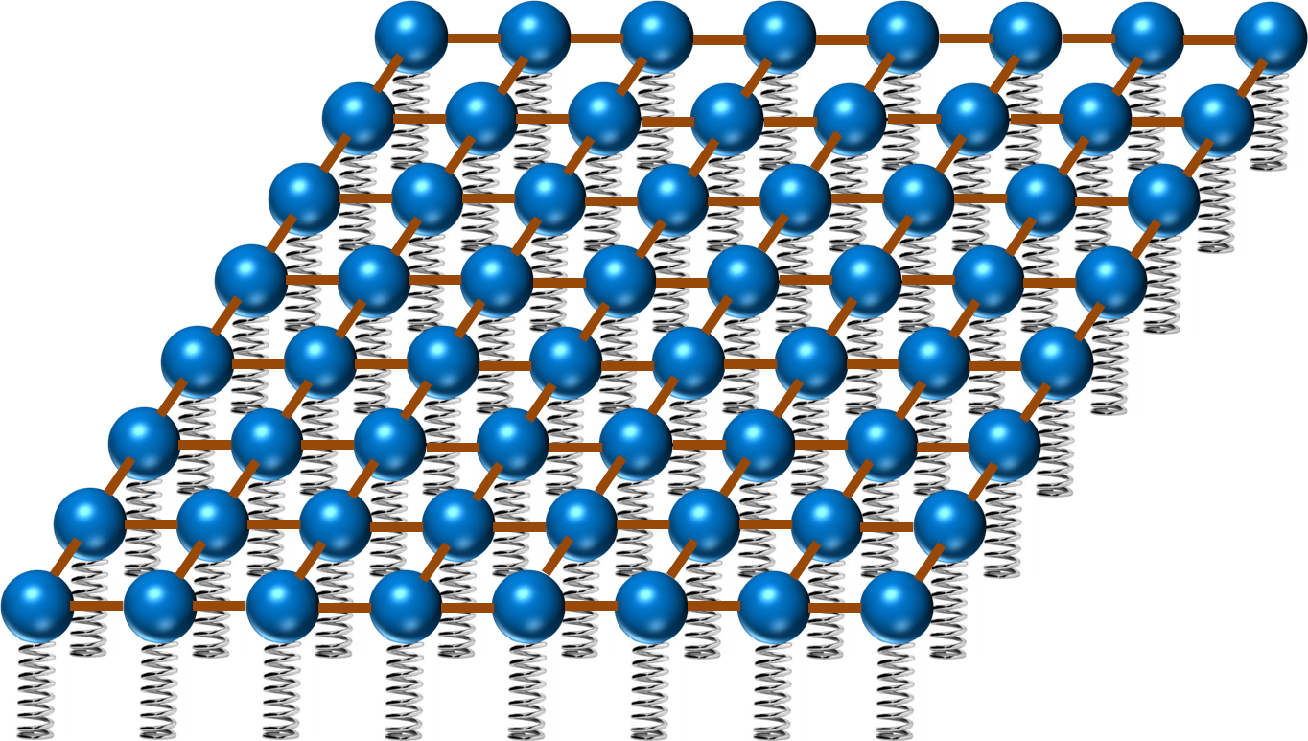
Quantum field theory…
Imagine space as an infinite continuum of balls and springs, where each ball is connected to its neighbours by elastic bands. Particles are perturbations of this field
y
ϕ(x,y)
x

Slide 9
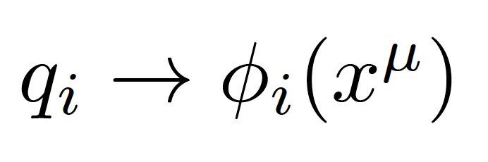
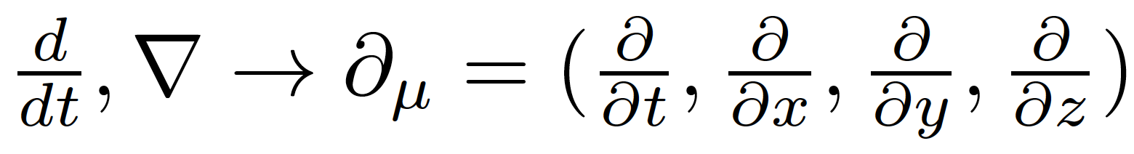
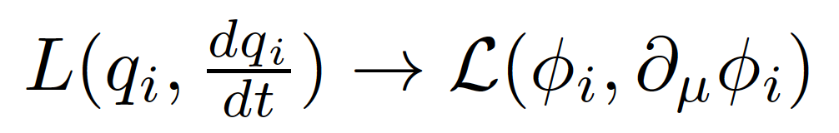
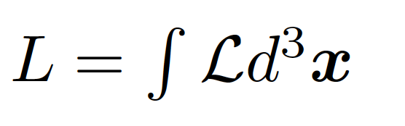
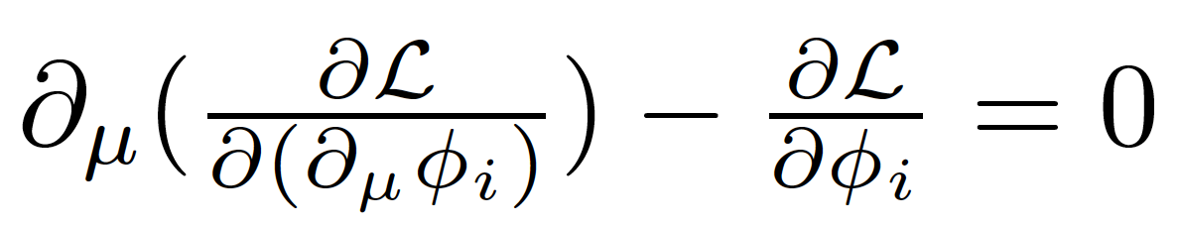
Generalized coordinates are fields (dislocation of each spring)
In a relativistic theory we must treat space and time coordinates on an equal footing, so the derivatives in the classical equations are now
In place of a Lagrangian we have a Lagrangian density (we call it Lagrangian anyway, just to be confusing)
with:
Get dynamics from the Euler-Lagrange equation:

Slide 10
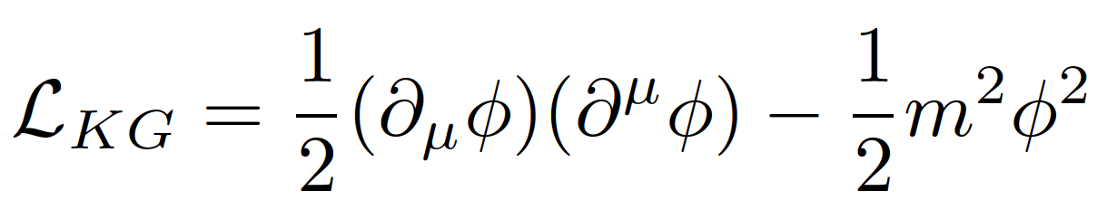
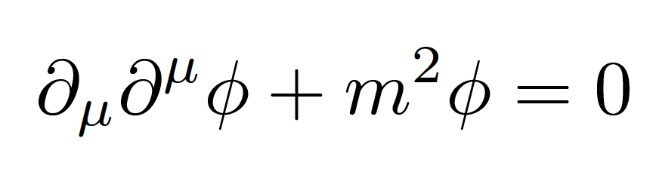
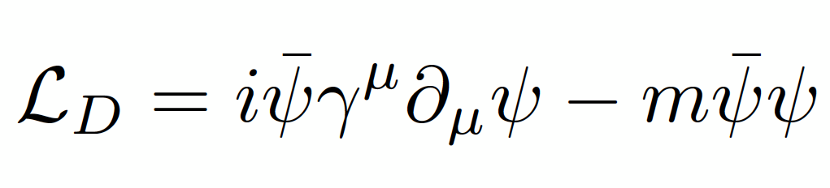
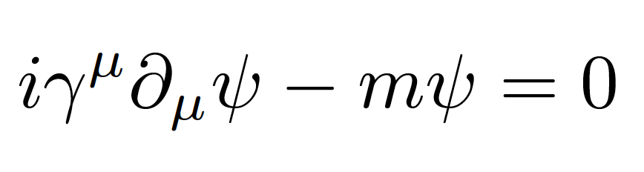
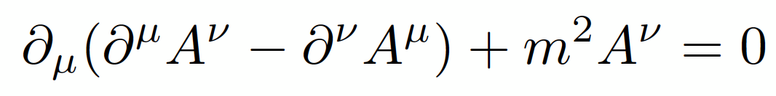
Example Lagrangians and equations of motion:
Klein-Gordon Lagrangian for spin 0 particles (scalars):
Dirac Lagrangian for spin ½ particles (fermions):
Proca Lagrangian for spin 1 (vector) particles:
Important:
  Mass terms in Lagrangian are quadratic in the fields

Slide 11
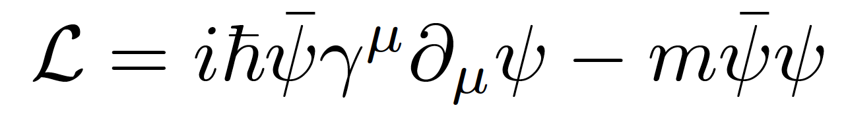
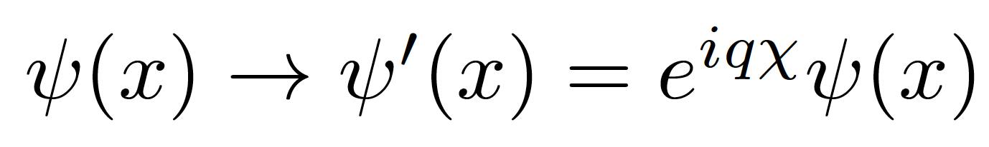
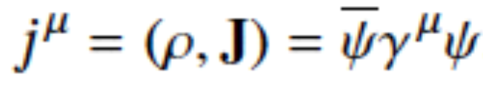
Global gauge invariance
Take the Dirac Lagrangian for a spinor field ψ representing a spin-½ particle, for example an electron:
It is invariant under a global U(1) phase transformation like:
Where χ is a constant
Note: gauge invariance of the Dirac equation can be demonstrated to lead to conservation of probability current j^{μ}
Notes:
By the way: this is related to the conservation of electric charge!

Slide 12
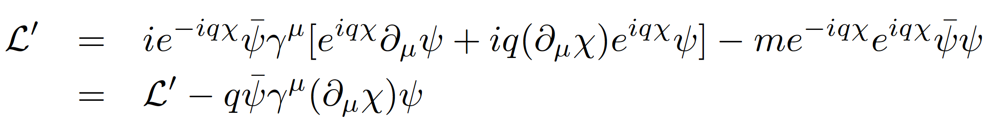
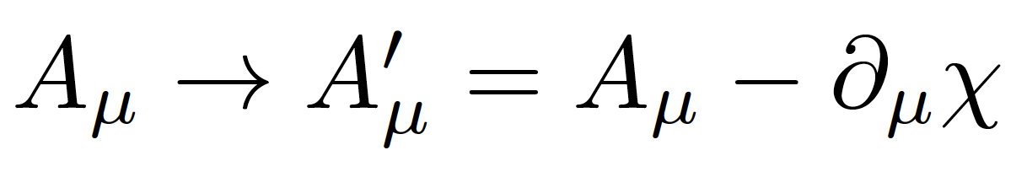
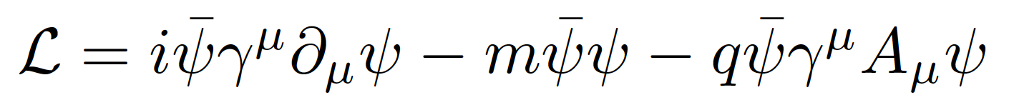
Local gauge invariance and interactions
If χ = χ (x) then we get extra terms in the Lagrangian:
But we can now make the Lagrangian invariant by adding an interaction term with a new gauge field A_{μ} which transforms as:
We get:
Note:
The new gauge field A_{μ} is the photon in QED
The mass of the fermion is the coefficient of the term on ψψ
There is no term in A_{μ}A^{μ} (the photon has zero mass)
Notes:
Demanding local gauge conservation resulted in obtaining a new field (the photon) and its interactions with the fermion fields. This is the blueprint of all Standard Model theories (called “Gauge theories”).
Gauge theories are automatically renormalizable (‘t Hooft & Veltman’s Nobel prize) i.e. don’t produce nonsense.

Slide 13
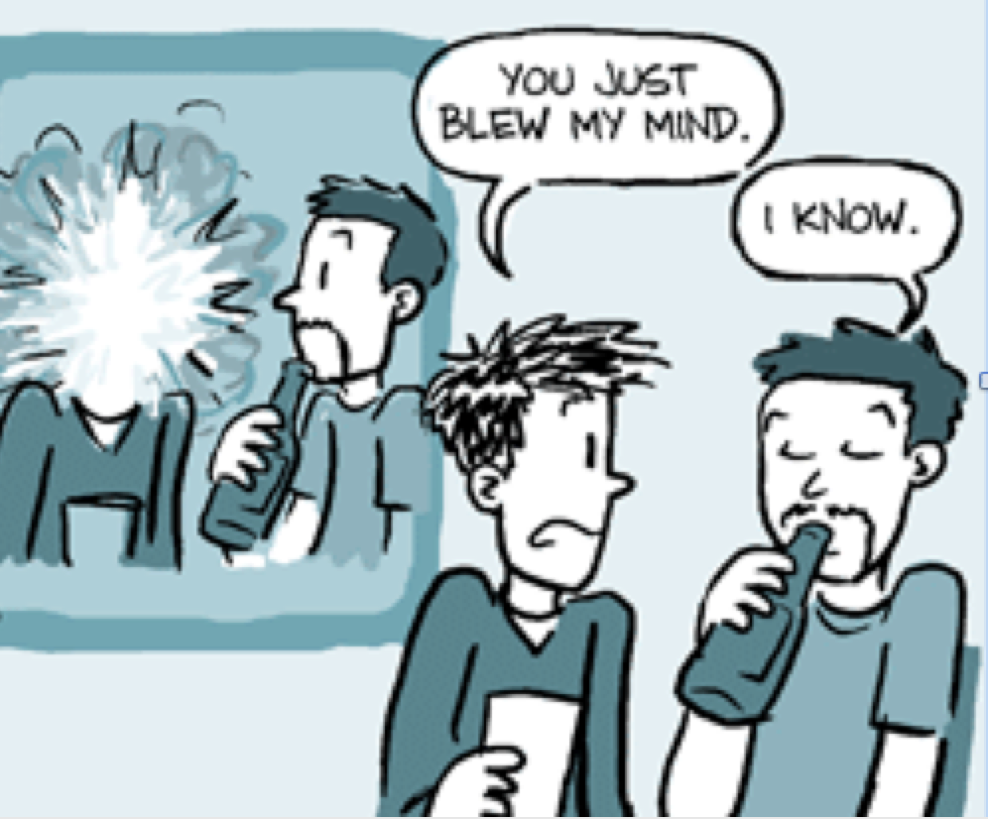
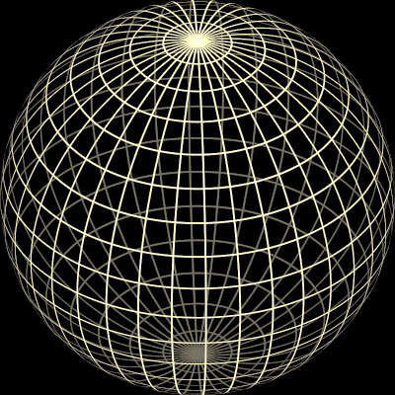
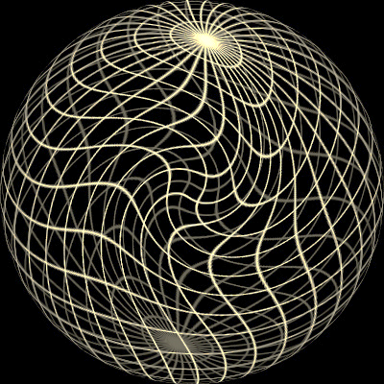
Original sphere
Global transformation
Local transformação
χ = constant
χ = χ (x)

Slide 14
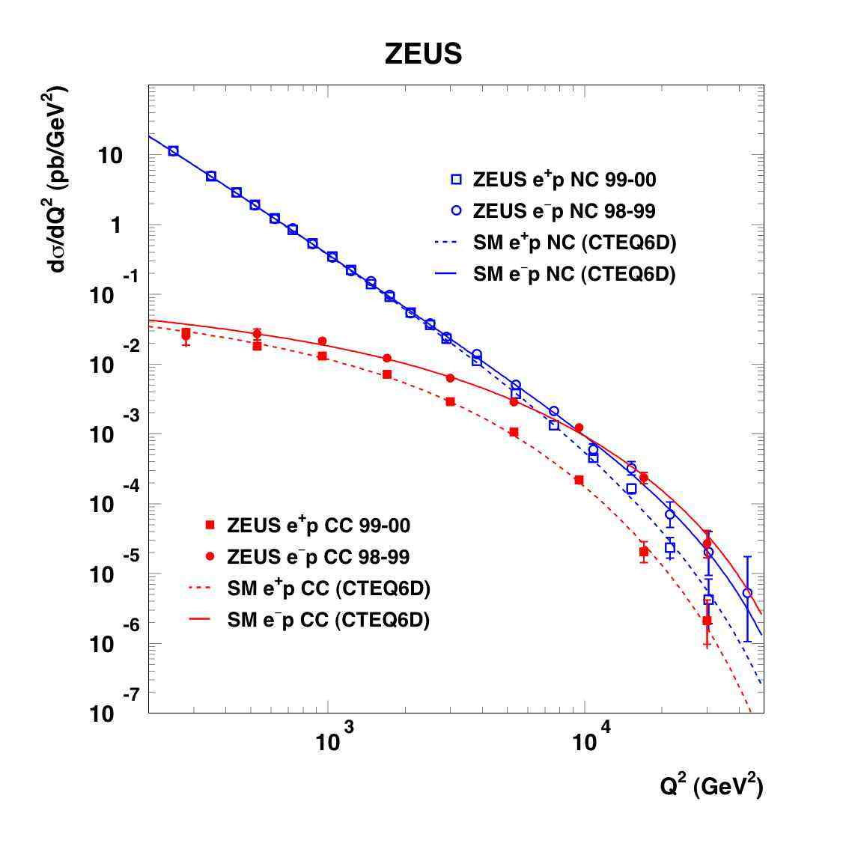
Weak Neutral Currents and Electroweak Unification
Notes:
Como é que sabíamos disto? Ou só estávamos só a adivinhar?
Vemos isto em medidas experimentais!! Neste gráfico vemos a probabilidade de um certo tipo de reação entre partículas.
Há duas possibilidades: uma reação governada pela força fraca e outra reação pela força eletromagnética.
A altas energias, vemos que as duas forças se tornam numa só força: a força electrofraca.
É a quebra de simetria ao contrário, como se andássemos para trás no tempo, em direção ao Big Bang

Slide 15
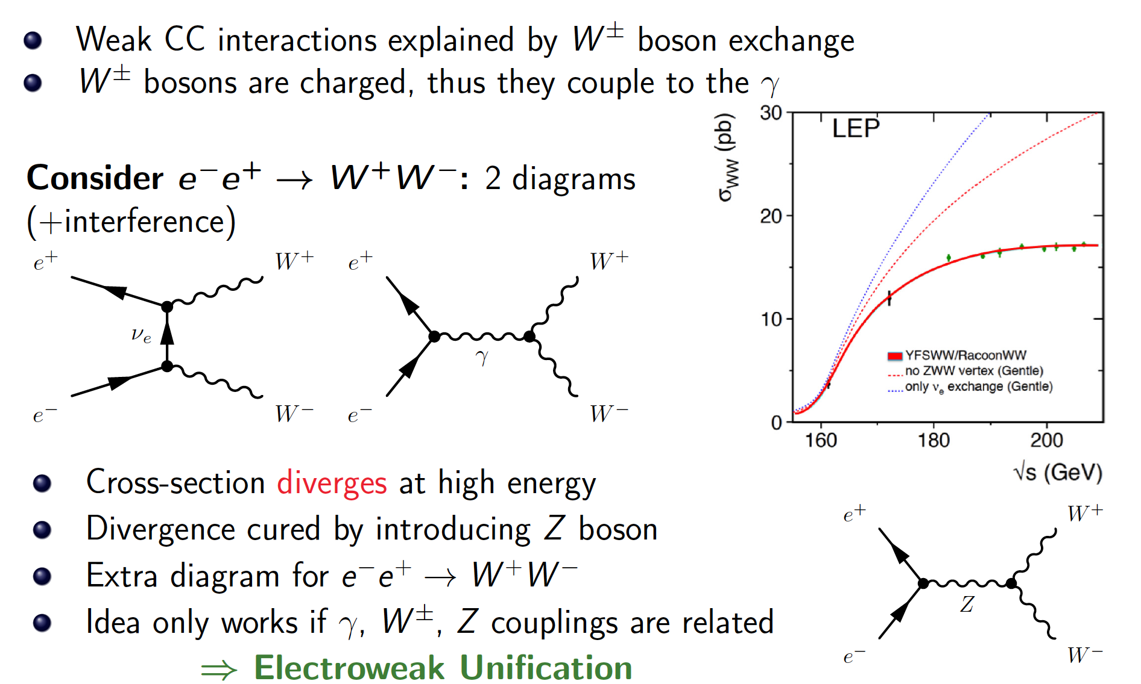
Weak Charged and Neutral Currents

Slide 16
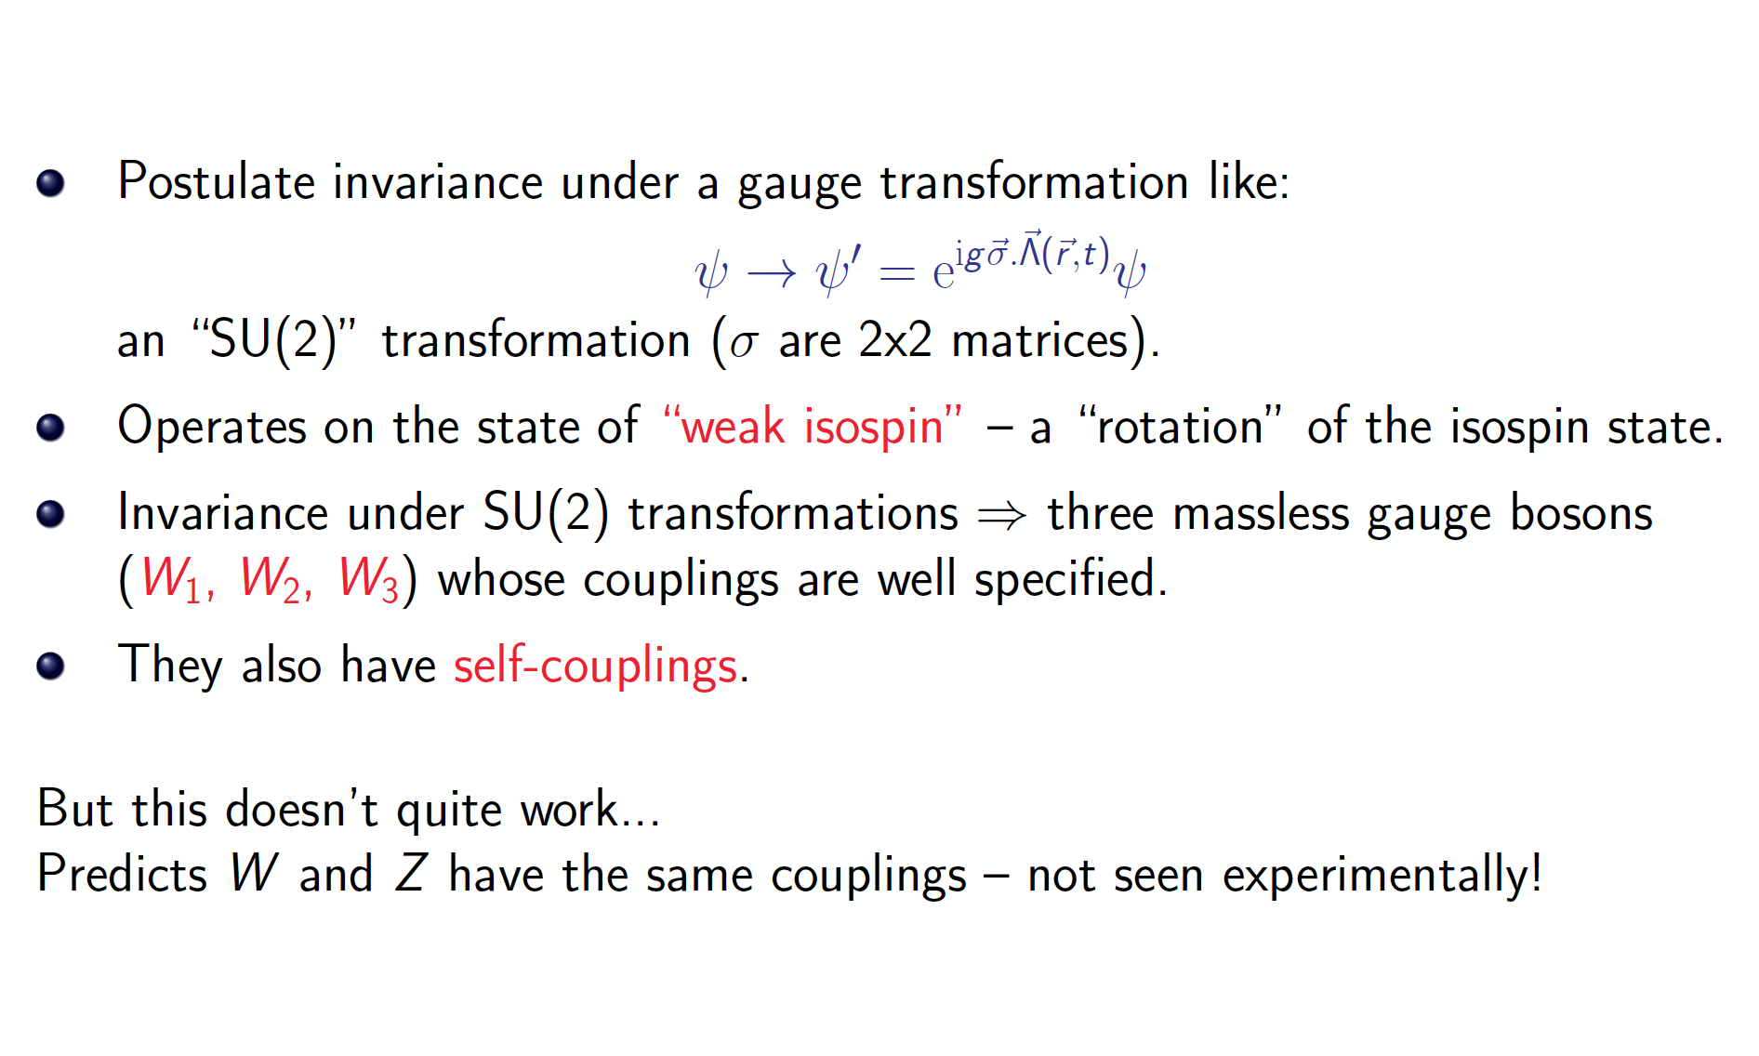
Weak Gauge Theory

Slide 17
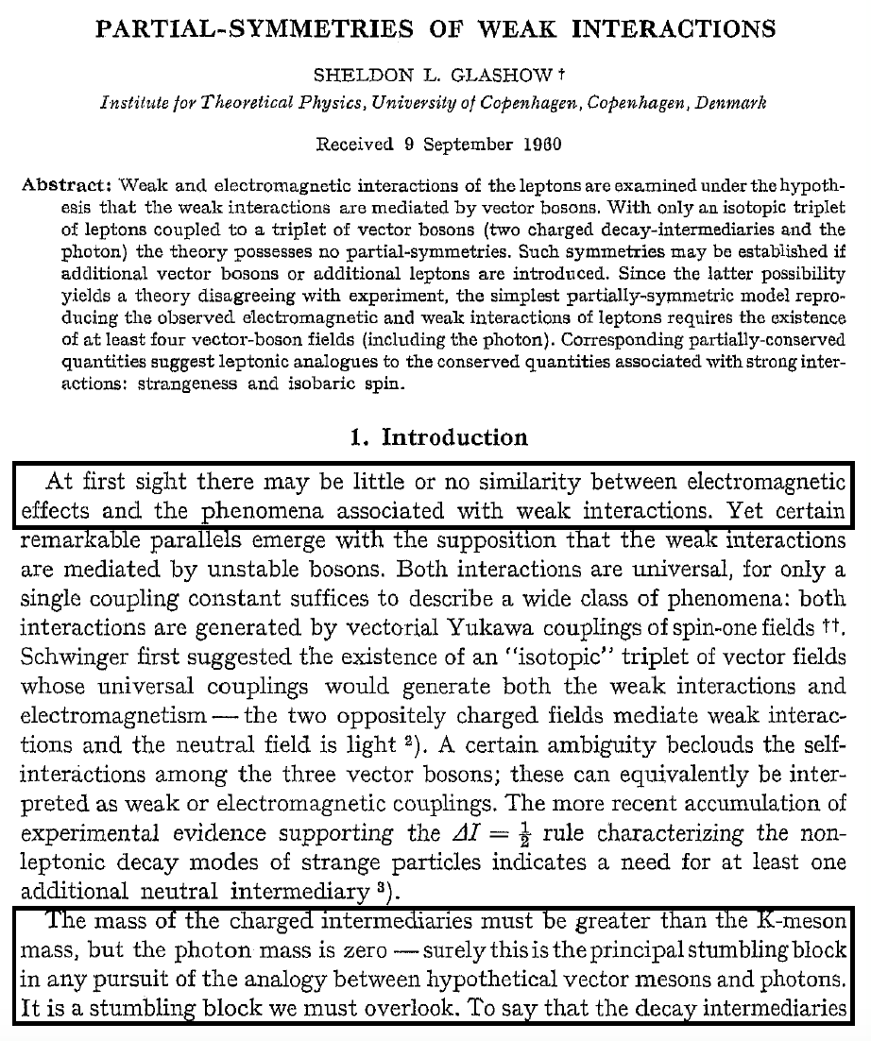
Sheldon Glashow’s “stumbling block”
There are hints that EM and weak interactions have a common origin
  Similar gauge structure
  W± couples to charge
But there are obvious differences:
  Different masses of W±, Z and photon
  Structure of the vertex is different

Slide 18
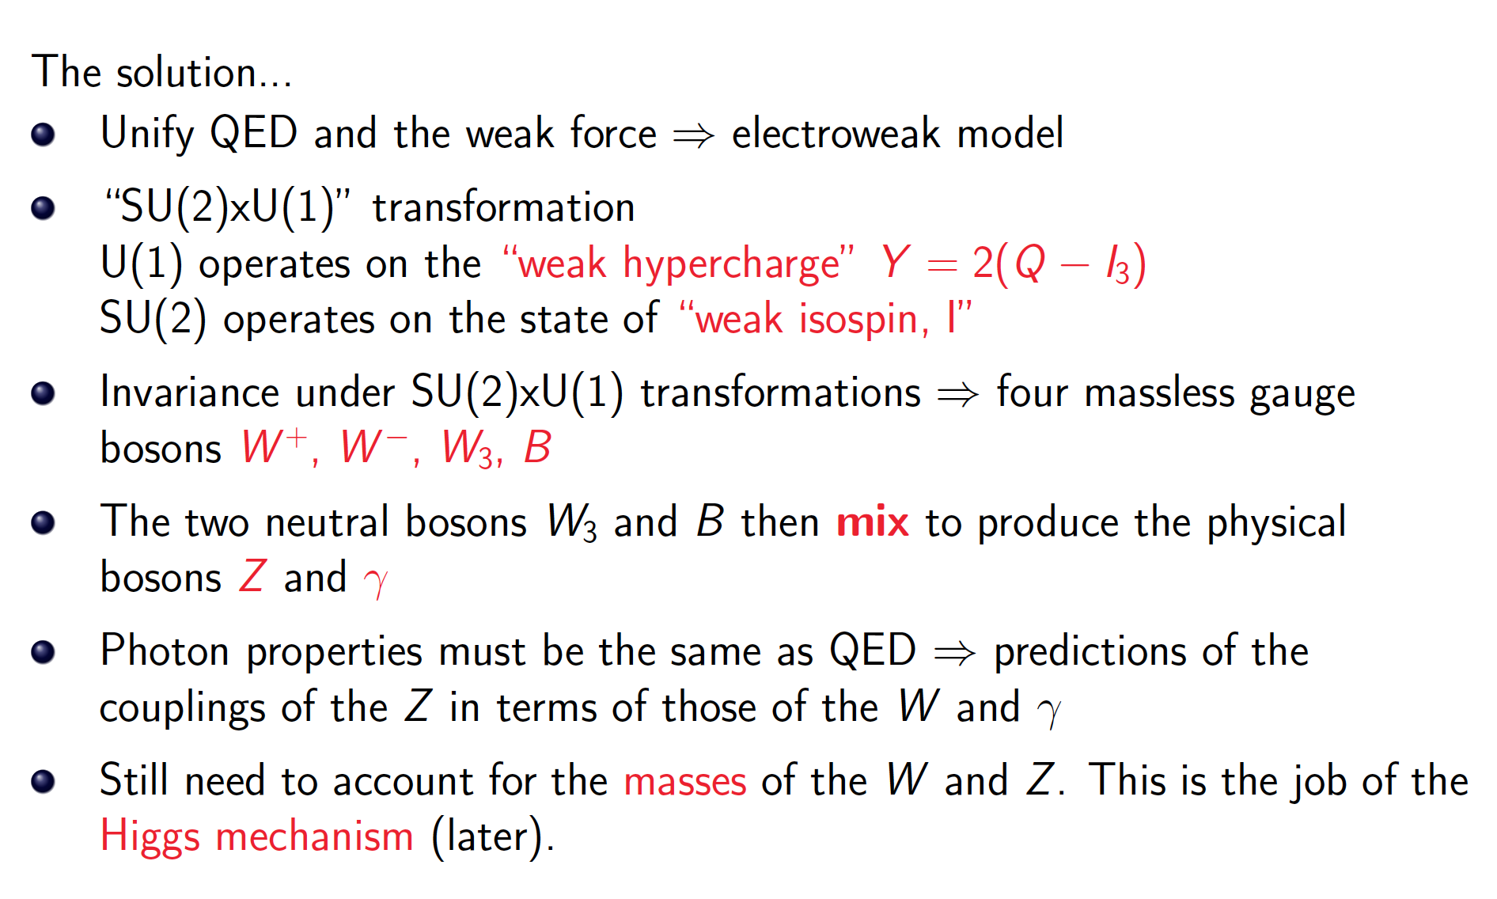
Electroweak Gauge Theory

Slide 19
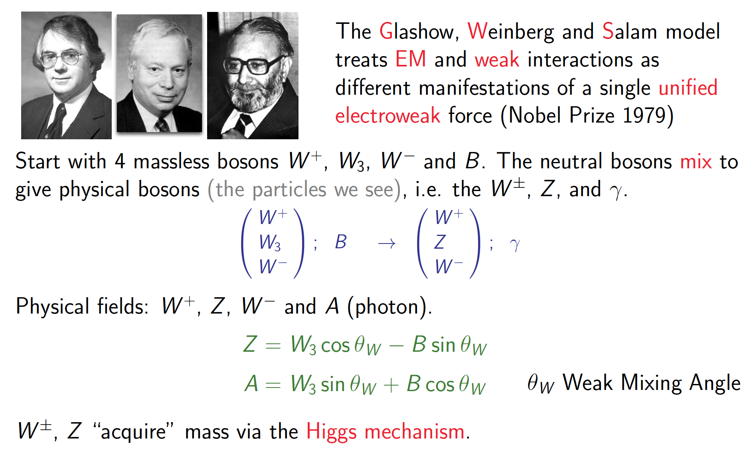
The GWS Model

Slide 20
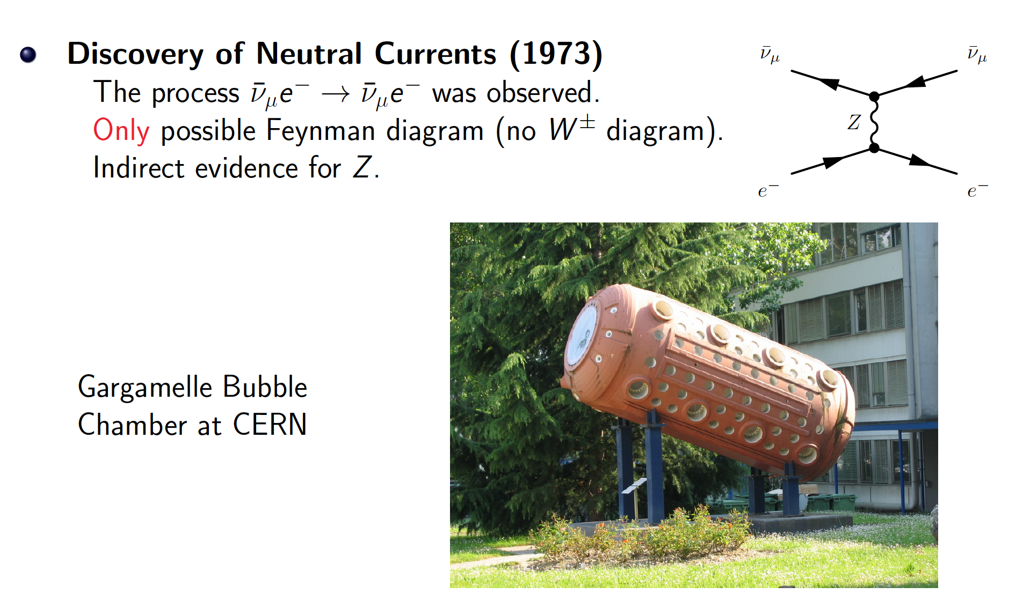
Evidence for the GWS model

Slide 21
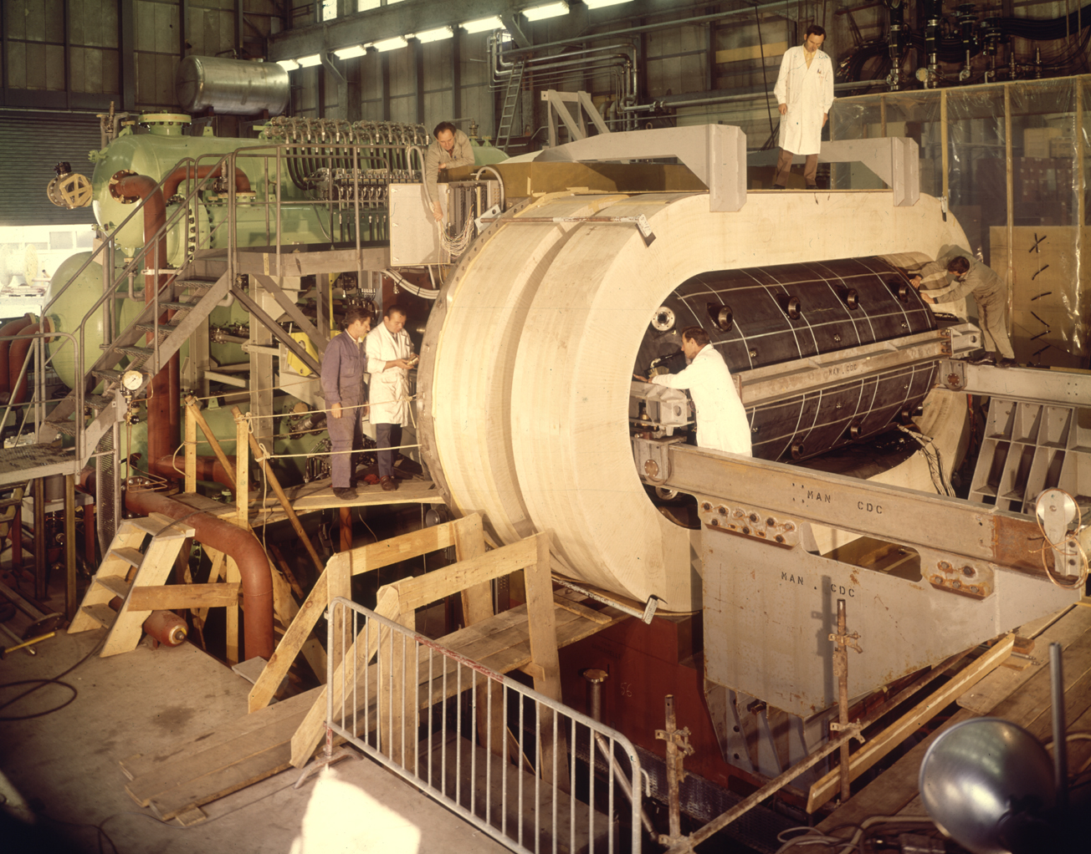

Slide 22
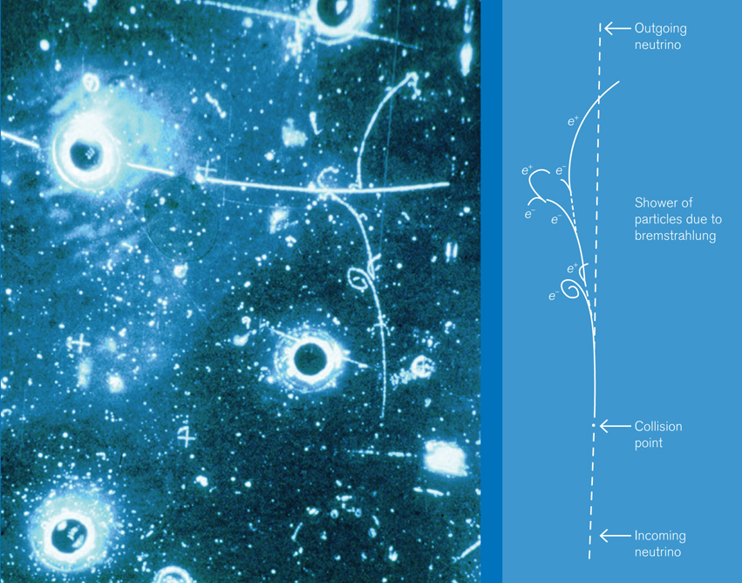
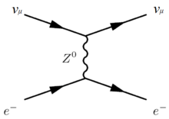

Slide 23
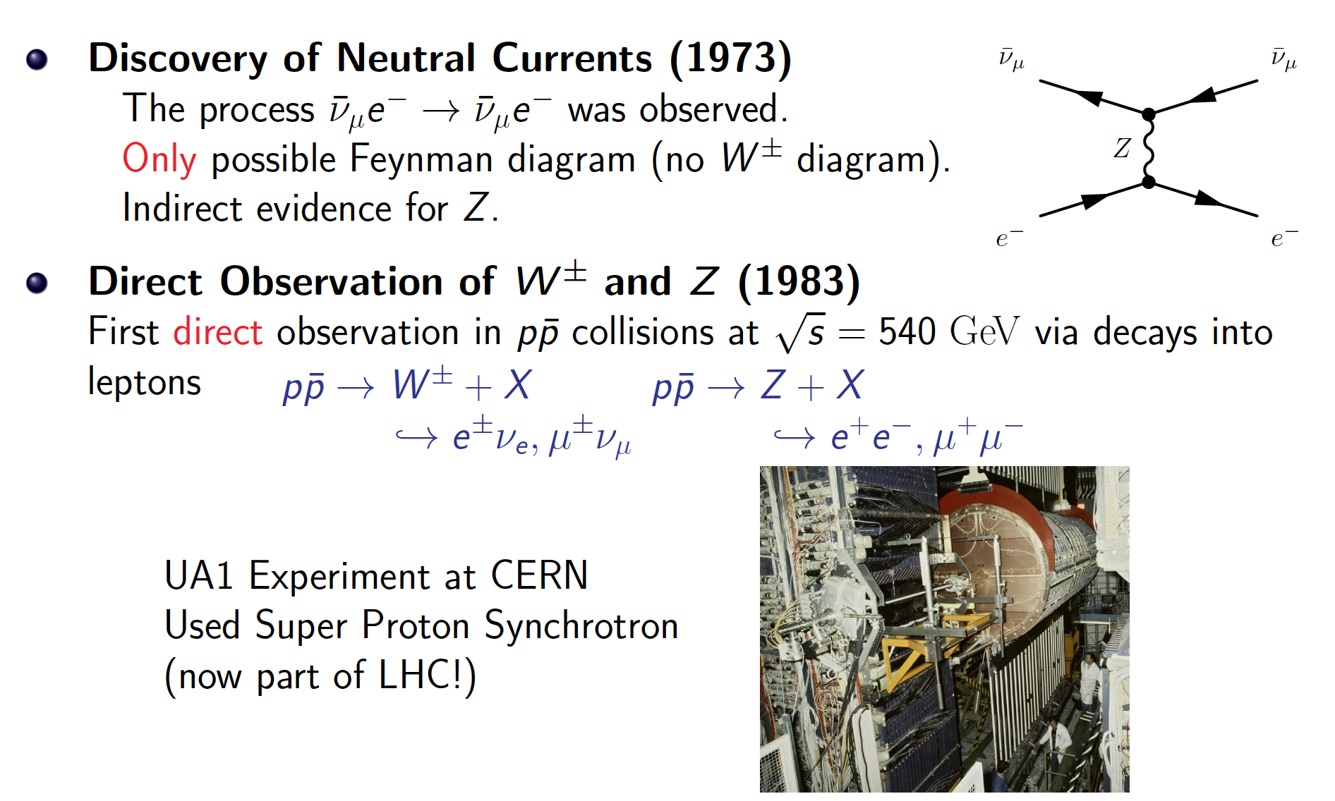
Evidence for the GWS model

Slide 24
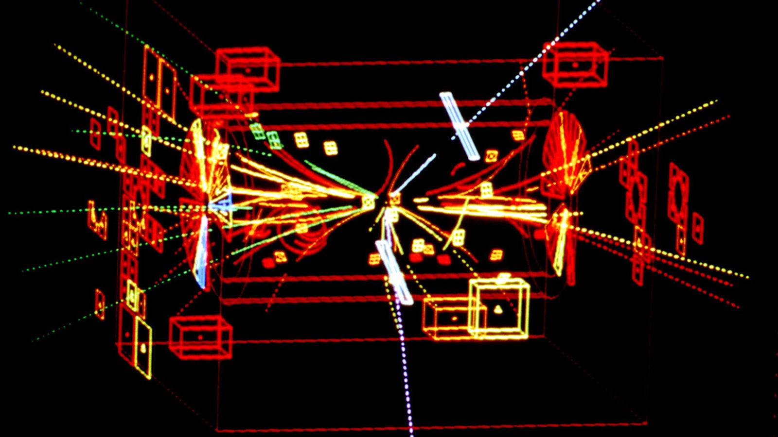

Slide 25
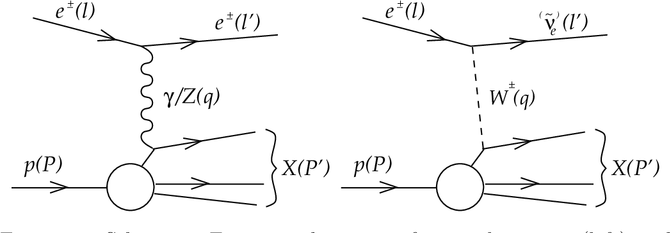
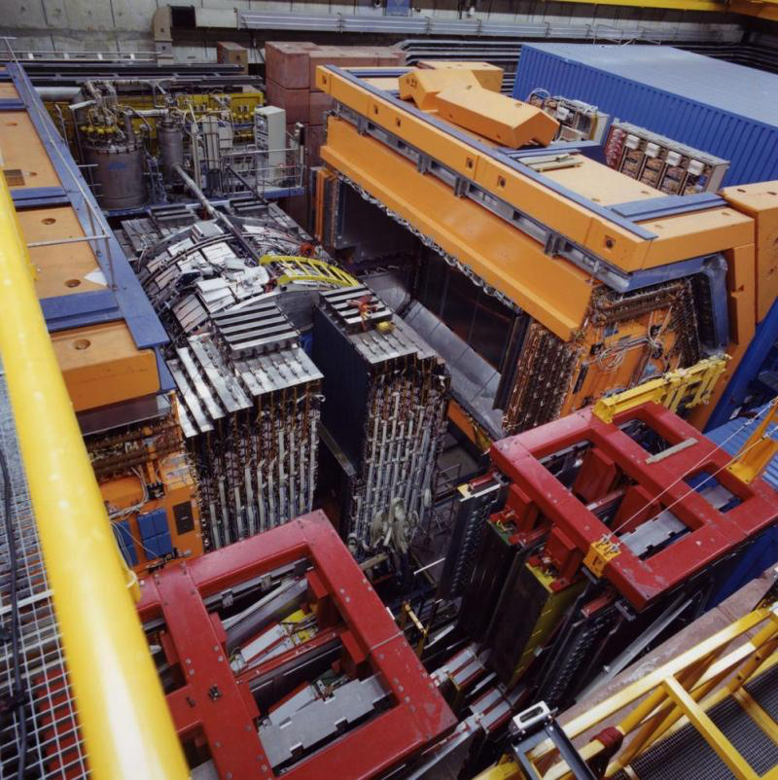
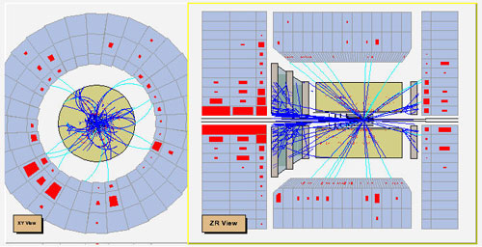
Electromagnetic interaction
Weak interaction
Notes:
Como é que sabíamos disto? Ou só estávamos só a adivinhar?
Vemos isto em medidas experimentais!! Neste gráfico vemos a probabilidade de um certo tipo de reação entre partículas.
Há duas possibilidades: uma reação governada pela força fraca e outra reação pela força eletromagnética.
A altas energias, vemos que as duas forças se tornam numa só força: a força electrofraca.
É a quebra de simetria ao contrário, como se andássemos para trás no tempo, em direção ao Big Bang

Slide 26

Now for the problems...

Slide 27

Problem 1: Mass of elementary particles and gauge bosons
What if we add a photon mass term to the QED Lagrangian?
To keep the Lagrangian gauge invariant (against a local U(1) local phase transformation) the photon field transforms as:
But the A^{μ} mass term breaks the Lagrangian invariance:
For the SU(2)_{L} gauge symmetry transformations of the weak interaction the fermion mass term m_{e}ψψ also breaks invariance!

Slide 28
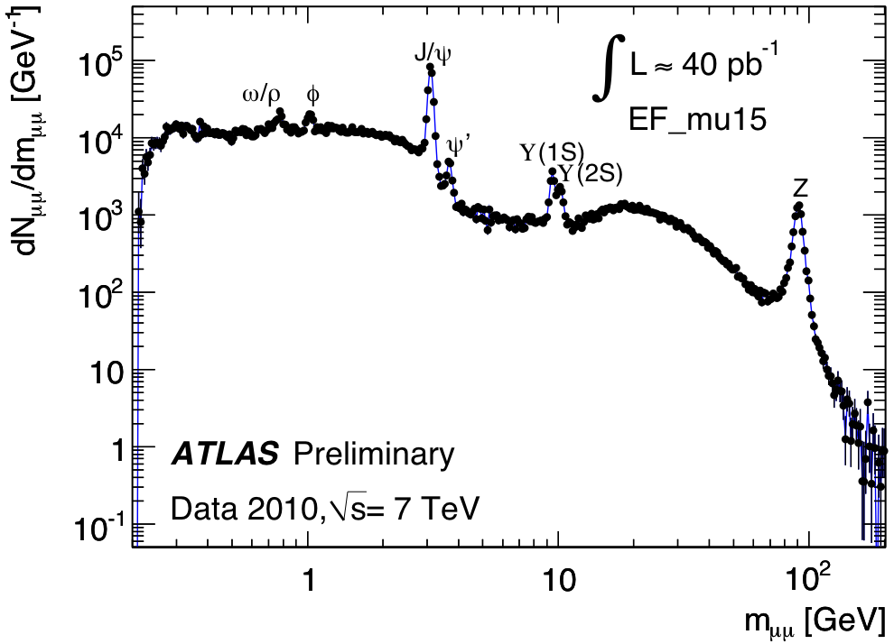
It should not work…
MASS
p
n
e
μ
γ
W±
Z
u
d
t
Notes:
1: mass of elementary bosons and fermions

Slide 29
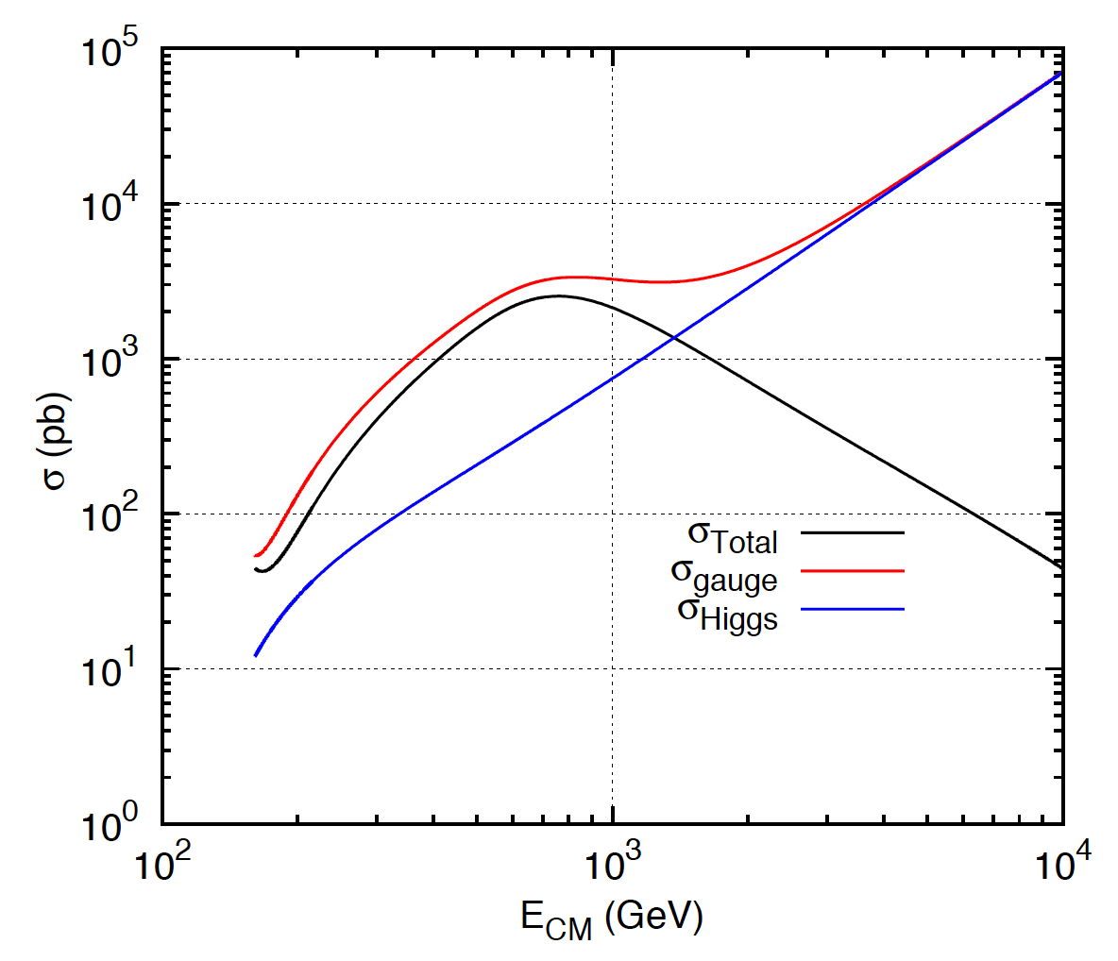
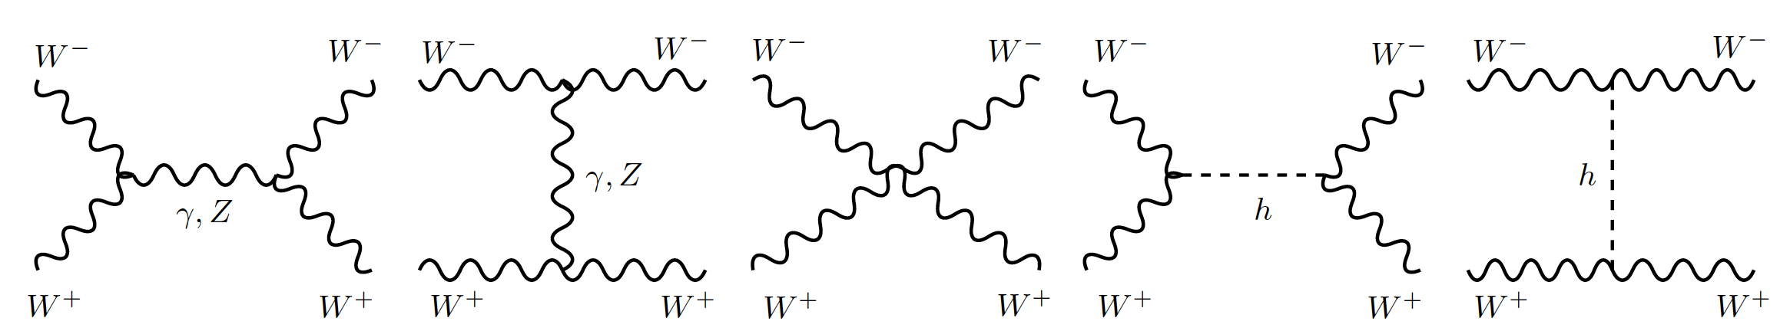
Problem 2:
Longitudinal gauge-boson scattering
In the absence of the Higgs, some processes have cross sections that grow with the centre of mass energy of the collision… i.e. breaks unitarity!
The Higgs regulates the cross section through negative interference
J.C.Romão [5]
Bottom line: the SM (without the Higgs mechanism) results in wrong calculations and breaks down for massive particles
Feynman diagrams contributing to longitudinal WW scattering

Slide 30
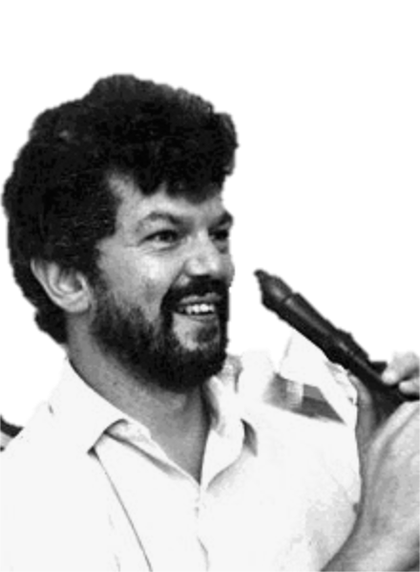
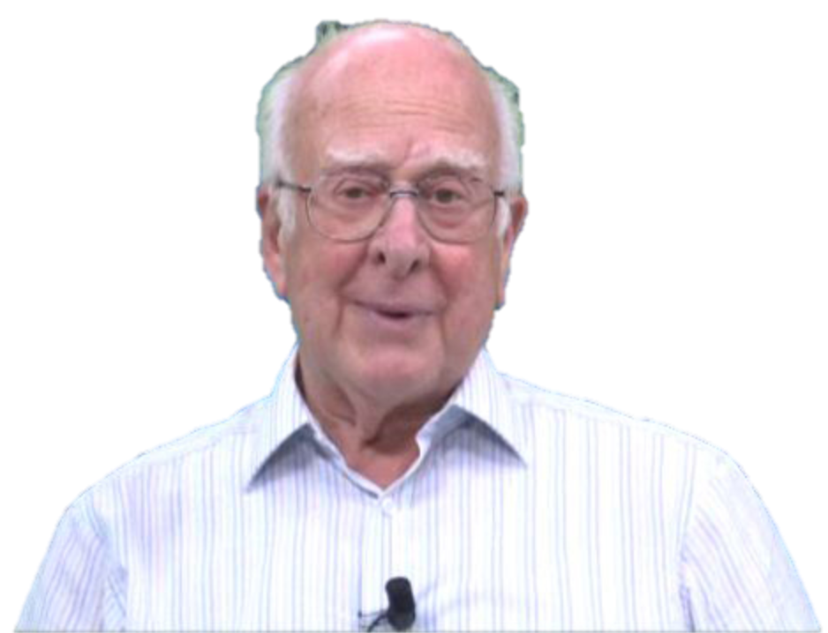
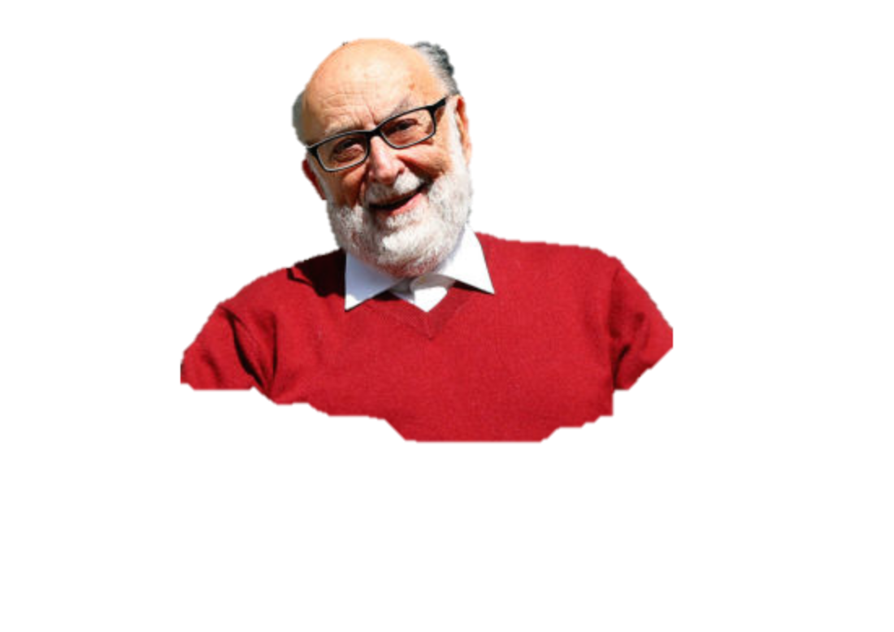
The Higgs Mechanism
Robert Brout (1928 – 2011)
François Englert (b. 1932)
Peter Higgs (b. 1929)
Notes:
Peter Ware Higgs (born 29 May 1929) is a British theoretical physicist, emeritus professor at the University of Edinburgh. In the 1960s, he proposed that broken symmetry in electroweak theory could explain the origin of mass of elementary particles in general and of the W and Z bosons in particular. This so-called Higgs mechanism, which was proposed by several physicists besides Higgs at about the same time, predicts the existence of a new particle, the Higgs boson, the detection of which became one of the great goals of physics.
Robert Brout (1928 –2011) was a Belgian theoretical physicist who made significant contributions in elementary particle physics. He was a Professor of Physics at Université Libre de Bruxelles where he had created, together with François Englert, the Service de Physique Théorique.
François Baron Englert (born 1932) is a Belgian theoretical physicist and 2013 Nobel prize laureate (shared with Peter Higgs). He is Professor emeritus at the Université libre de Bruxelles (ULB) where he is member of the Service de Physique Théorique. He is also a Sackler Professor by Special Appointment in the School of Physics and Astronomy at Tel Aviv University and a member of the Institute for Quantum Studies at Chapman University in California.

Slide 31





Introduce a SU(2) doublet of spin-0 complex fields
New Lagrangian term:
With a potential
For λ>0, μ²>0 the potential has a
minimum at the origin
For λ>0, μ²<0 the potential has an
infinite number of minima at:
The choice of vacuum (lowest
energy state of the field) breaks the
symmetry of the Lagrangian

Slide 32




Notes:
Quebra da simetria electrofraca após o Big Bang: quando a densidade de energia baixou, as próprias forças fundamentais mudaram
No fim ficamos com W e Z com massa, fotão na mesma sem massa, e resta-nos um bosão de Higgs; mas as proprias forças mudam!
In the Standard Model with no Higgs mechanism, interactions are symmetric and particles do not have mass
Electroweak symmetry is broken: Photon does not have mass W, Z have a large mass
Higgs mechanism: mass of W and Z results from the Higgs mechanism; Masses of fermions come from a direct interaction with the Higgs field

Slide 33


EWK Symmetry Breaking in Pictures

Slide 34


Slide 35










Higgs Properties
Mass
Spin: 1 degree of freedom => 0
Couplings:
To gauge bosons
Yukawa couplings to fermions
Self-couplings

Slide 36


The Long Way to Discovery

Slide 37






Slide 38

Searches at LEP

Slide 39

Low-mass searches at LEP

Slide 40

Higher-mass Higgs production at LEP

Slide 41


Slide 42

Searches at the Tevatron

Slide 43

Higgs production at the Tevatron

Slide 44


The final stand of the Tevatron
By the end of its lifetime, the Tevatron had very sophisticated analyses of a huge number of channels
By that time the LHC was collecting data and analysing it very fast
The CDF and D0 experiments obtained an excess of around 3 standard deviations in the mass range 115<M_{H}<140 GeV
Not enough to claim discovery, but consistent with the LHC results

Slide 45

LEP and Tevatron: the Blue Band Plot
Decades of searches in several experiments...
By July 2010:
  LEP+Tevatron+SLD limits
  Higgs excluded for m_{h}<114.4 GeV at 95% CL
  Plus between 158 and 175 GeV
CERN-PH-EP-2010-05

Slide 46



Discovery at the LHC
Design (p-p run):
√s = 14 TeV (design)
N_{p} = 1.2 x 10¹¹ p/bunch
2780 bunches
Peak L = 1 x 10³⁴ cm⁻²s⁻¹ (design)
β* = 55 cm
Run 1: 2009 – 2013 √s = 7/8 TeV
Run 2: 2015 – 2018 √s = 13 TeV
Mont Blanc
ATLAS
CMS
Notes:
LHC Running at 2x design luminosity
Expect 150/pb by end of this year

Slide 47
ATLAS
3000 colaboradores
175 institutos de 38 países
L = 44 m, ∅ ≈ 25 m, 7 000 t
CMS
3800 colaboradores
199 institutos de 43 países
L = 22 m, ∅ ≈ 15 m, 14 000 t
R. Gonçalo - LIP
Ciência 2018
47
Notes:
15 years to develop and build; ≈10⁸ electronic channels / experiência; developed worldwide computing grid to treat data
Cerca de 1000 estudantes de pós-graduação por experiência - training of next generation of researchers;
Development of computing Grid, data analysis techniques, etc; training of engineers and tech. transfer;

Slide 48

48
Notes:
Alignment to ~30 micron
Beams cross every 25 ns (7m)

Slide 49
Muon Spectrometer: |η| < 2.7
Air-core toroid + gas-based muon chambers
σ/p_{T} = 2% @ 50GeV to 10% @ 1TeV (ID+MS)
EM calorimeter: |η| < 2.5 (3.2)
Pb-LAr accordion sampling
σ/E = 10%/√E ⊕ 0.7%
L = 44 m, ∅ ≈ 25 m
7000 tonnes
≈10⁸ electronic channels
2-level trigger reducing 40 MHz collision rate to 1 kHz of events to tape
Hadronic calorimeter:
Fe/scintillator / Cu/W-LAr
σ/E_{jet}= 50%/√E ⊕ 3%
Solenoid: B = 2 T
Inner Tracker: |η| < 2.5
Si pixels/strips and Trans. Rad. Det.
σ/p_{T} = 0.05% p_{T} (GeV) ⊕ 1%

Slide 50


Slide 51

Higgs @ the LHC
Many different production and decay mechanisms
  Span 3 orders of magnitude in cross section and branching ratio
  Some very clean decays with low BR (γγ, 4l)
  Other very difficult with higher rates (bb, WW, ττ,...)
Access Higgs properties through combination of different channels
Notes:
https://twiki.cern.ch/twiki/bin/view/LHCPhysics/LHCHXSWG#Latest_plots

Slide 52





Higgs @ the LHC
Many different production and decay mechanisms
  Span 3 orders of magnitude in cross section and branching ratio
  Some very clean decays with low BR (γγ, 4l)
  Other very difficult with higher rates (bb, WW, ττ,...)
Access Higgs properties through combination of different channels
Notes:
https://twiki.cern.ch/twiki/bin/view/LHCPhysics/LHCHXSWG#Latest_plots

Slide 53



It takes time to get it right
EPS-HEP 2011 conference [6]

Slide 54

2012: Descoberta do bosão de Higgs: H->γγ
Notes:
The weighting of events is similar to what is used in the final significance extraction

Slide 55


Discovery channels
Discovery was made in ATLAS and CMS with about 5 fb⁻¹ of 7 TeV data and 20 fb⁻¹ of 8 TeV data per experiment; several channels combined
This means about 400 000 Higgs bosons produced in about 8 000 000 000 000 000 (8x10¹⁵) proton collisions
  Only about 4000 events with Higgs bosons contributed to the discovery

Slide 56




The Standard Model of particle physics completed
2013
Notes:
Particulas fundamentais conhecidas; forças a que elas reagem; Z tem massa alta ao contrario de gamma e gluoes; Higgs pedra basilar do edificio; dá massa mas só pequena fração nos hadroes;

Slide 57


A Descoberta do bosão de Higgs

Slide 58



Slide 59


The Story So Far...
What now?!
Notes:
Como é que sabíamos disto? Ou só estávamos só a adivinhar?
Vemos isto em medidas experimentais!! Neste gráfico vemos a probabilidade de um certo tipo de reação entre partículas.
Há duas possibilidades: uma reação governada pela força fraca e outra reação pela força eletromagnética.
A altas energias, vemos que as duas forças se tornam numa só força: a força electrofraca.
É a quebra de simetria ao contrário, como se andássemos para trás no tempo, em direção ao Big Bang

Slide 60



Probing the 125 GeV Higgs
2HDM
Triple coupling λ₃
Clavicle
Aorta
Ribs
Yukawa
couplings
BSM

Slide 61


















Production
Decay
FIT
H->γγ
×
H->ZZ
t
H->WW
t
Backgrounds +
t

Slide 62


Signal strength measurements

Slide 63



Higgs boson mass
  ATLAS: arXiv:1307.1427
Mass: around 125GeV
  Was the only unknown
  SM parameter ☺
For a while, different mass values were being measured in ATLAS and CMS, and in different channels
Numbers evolved with accumulated statistics
Phys. Rev. Lett. 114, 191803

Slide 64

Higgs boson mass
Mass measurement from
  H→ZZ*→4l
  H→ γγ
Precision at the permille level achieved
Notes:
https://atlas.web.cern.ch/Atlas/GROUPS/PHYSICS/PAPERS/HIGG-2016-33/ → 1 June 2018
http://cms-results.web.cern.ch/cms-results/public-results/publications/HIG-16-040/index.html → 8 April 2018
Both use 36.1 fb⁻¹ from 2015+2016

Slide 65


Exploring the electroweak scale
Precision measurements of m_{W}, m_{t}, m_{H} are stringent tests of the SM at the EW scale
  E.g. excluding measured m_{H}, global EW fit gives m_{H} = 90 ± 21 GeV (1.7 σ tension) driven in part by m_{top}
arXiv:1803.01853

Slide 66







Higgs boson width
arXiv:1808.01191 [hep-ex]/HIGG-2017-06
SM Higgs width Γ_{H}~4.1 MeV
  Too small to be measured directly
  Best direct limit from CMS:
    Γ_{H} < 1.1GeV @ 95% CL
Off-shell Higgs production sensitive(*) to Γ_{H}
ATLAS measurement:
  pp→H→ZZ→4l and ZZ→2l2ν
  m(H) > 2 m(Z)
  36.1 fb⁻¹ of 13 TeV data
  Observed (expected) limit:
    Γ_{H} < 14.4 (15.2) MeV
(*) Assume interference term with proportional to
Notes:
https://atlas.web.cern.ch/Atlas/GROUPS/PHYSICS/PAPERS/HIGG-2017-06/ → 2 Aug.2018
above 125 GeV off-shell production of the Higgs boson has a substantial cross section at the LHC [13–16], due to the increased phase space as the vector bosons (V = W; Z) and
top quark decay products become on-shell with the increasing energy scale

Slide 67




Measuring the Higgs Spin
Polar angle θ in the rest frame of the diphoton system (Collins-Soper frame)

Slide 68

Casting a wider net

Slide 69




Higgs + Dark Matter
ATLAS-CONF-2018-039
Used 79.8 fb⁻¹ of 13 TeV data
  High E_{T}^{miss} (>150GeV) and b-tagging to suppress backgrounds
  Reconstruct b-jets as 2 small jets or merged variable-radius (VR) track jets
Signal benchmark: Type-II 2HDM + U(1)_{Z’} symmetry (Z’-2HDM)
Main backgrounds: tt, W/Z+jets
Excluded region in m_{A} – m_{Z’} plane
Notes:
https://atlas.web.cern.ch/Atlas/GROUPS/PHYSICS/CONFNOTES/ATLAS-CONF-2018-039/ → 25 July 2018
VR jets: track jets reconstructed with an algorithm in which the radius parameter decreases with increasing jet transverse momentum (pT)
large missing transverse momentum and either two b-tagged small radius jets or a single large radius jet containing two b-tagged subjets

Slide 70








Triple Higgs coupling
arXiv:1808.00336 [hep-ex]; ATLAS-CONF-2018-043
The triple Higgs coupling λ_{HHH} can be probed through di-Higgs production
Very suppressed in SM!
  Negative interference between LO diagrams
  Cross section 1500x less than ggF
Wide range of decay BR and channel purity
bbττ analysis:
  Used 36 fb⁻¹ of 13 TeV data
  Final state BR(bbττ)=7%
  Non-Resonant 95% CL limit:
    μ < 12.7 observed (14.8 expexcted)
Combination: at ≈10 x SM sensitivity – with 3% of the HL-LHC luminosity analyzed
Di-Higgs combination plot here
Notes:
https://atlas.web.cern.ch/Atlas/GROUPS/PHYSICS/CONFNOTES/ATLAS-CONF-2018-026/ → 2 Jul 2018
https://atlas.web.cern.ch/Atlas/GROUPS/PHYSICS/CombinedSummaryPlots/HIGGS/ATLAS_HIGGS6100_HH_Summary/ATLAS_HIGGS6100_HH_Summary.png
https://atlas.web.cern.ch/Atlas/GROUPS/PHYSICS/CONFNOTES/ATLAS-CONF-2018-043/

Slide 71




A bit of fun…
1-loop effective potential
RG-improved potential
What if…
  At higher orders, Higgs potential doesn’t have to be stable
  Depending on m_{t} and m_{H} second minimum can be lower than EW minimum ⇒ tunneling between EW vacuum and true vacuum?!
“For a narrow band of values of the top quark and Higgs boson masses, the Standard Model Higgs potential develops a shallow local minimum at energies of about 10¹⁶ GeV, where primordial inflation could have started in a cold metastable state”, I. Masina, arXiv:1403.5244 [astro-ph.CO]
  See also: V. Brachina, Moriond 2014 (Phys.Rev.Lett.111, 241801 (2013)), G. Degrassi et al, arXiv:1205.6497v2; R.Contino, Workshop sulla fisica p-p a LHC, 2013

Slide 72



The universe seems to live near a critical condition
JHEP 1208 (2012) 098
Why?!
Explained by underlying theory?
Anthropic principle?

Slide 73


Higgs @ LIP ATLAS Group
Exploring Higgs couplings to heavy quarks
Less well known... Much more space for surprises!
New physics effects may show up already at leading order
2018: Hbb and Htt couplings demonstrated
2020: CP of ttH coupling in ttH, H->γγ
2022: ttH, H->bb fiducial cross section
2022: Preliminary results for CP of ttH coupling studied in ttH, H->bb
Notes:
Porque é que interessa?
O Higgs desintegra-se sobretudo em quarks bottom. Se vemos isto há menos espaço para nova física!

Slide 74


ttH CP measurement
Sakharov conditions for a matter-dominated universe require CP violation
Known CP-violating processes:
  From complex phases in CKM-matrix - quark mixing
  Maybe in PNMS-matrix as well - neutrino mixing
BUT: insufficient, by orders of magnitude
CP violation in Higgs sector?
    Possible in some models with extended Higgs sector (e.g. some 2HDMs)
    Need mixing of scalar (CP-even) and pseudo-scalar (CP-odd) Higgs states
What do we know about Higgs CP properties?
  In the SM, Higgs scalar is a CP eigenstate with J^{CP} = 0⁺⁺
  Pure J^{P} = 0⁻ hypothesis for observed Higgs boson was ruled out in Run 1
  But a large CP-odd admixture is not ruled out

Slide 75

How to search for a CP-odd admixture?
Effect of CP-odd components on bosonic couplings parametrized as expansion with higher order terms suppressed by powers of scale of new physics Λ
Could explain why a CP-odd admixture has not been seen
Fermionic couplings are affected at tree level
Mixing angle α between CP-even and CP-odd coupling components
More notable for heavier fermions due to enhanced coupling
Notes:
2nd term is interference between CP-even and CP-odd – is zero for CP-even effective operators
3rd term is CP-even but affects rates – cannot be distinguished from other BSM rate enhancements
MadGraph: , arXiv:1405.0301 [hep-ph]

Slide 76






H-top Coupling in ttH/tH production
ATLAS-CONF-2022-016 (16 March 2022)
Calculate CP-sensitive observables b₂ and b₄ from top-quark 3-momenta
Use different observables in combined fit depending on region
Notes:
Reco BDT trained with ttH signal
Lep: target 1 or 2 semi-leptonic top decays
2 leptons: no top reconstruction
1 lepton: build W candidate (lep+E_{T}^{miss})and then top candidate from W + BDT-favoured jet
Had: target hadronic top decays
reconstruct 1 or 2 tops from jets
CP BDT:

Slide 77

H-top Coupling in ttH/tH production
ATLAS-CONF-2022-016 (16 March 2022)
Simultaneous fit in all regions
μ = 0.83^{+0.30}_{-0.46}
α = 11° ⁺⁵⁵₋₇₇
Expected:
μ = 1.0^{+0.25}_{-0.27}
α = 0° ⁺⁴⁹₋₅₀
Pure CP-odd (α = 90°) disfavoured at 1.2 σ
Complementary to previous ttH(H→γγ) analysis:
Phys. Rev. Lett. 125 (2020) 061802
Pure CP-odd (α = 90°) excluded at 3.9 σ
Limit on |α| < 43° at 95% C.L.
α
Notes:
Reco BDT trained with ttH signal
Lep: target 1 or 2 semi-leptonic top decays
2 leptons: no top reconstruction
1 lepton: build W candidate (lep+E_{T}^{miss})and then top candidate from W + BDT-favoured jet
Had: target hadronic top decays
reconstruct 1 or 2 tops from jets
CP BDT:

Slide 78


Summary
Higgs sector measurements look SM-like so far
But there is new physics out there!
The Higgs is:
  The only fundamental scalar
  Connected to EW symmetry breaking
  A great window to look beyond the Standard Model
And we have only collected ≈5% of all HL-LHC data!
Watch this space!
Notes:
Gavin Salam (LHCP’18) “The >5σ observations of ttH and H → ττ, independently by ATLAS and CMS, firmly establish the existence of a new kind of fundamental interaction,
Yukawa interactions.”
(Hbb, Htt, etc.): not a gauge interaction, and unlike anything we’ve probed before

Slide 79





Slide 80

Questions?
Thank you for your interest!
jgoncalo@lip.pt

Slide 81








