Slide 1
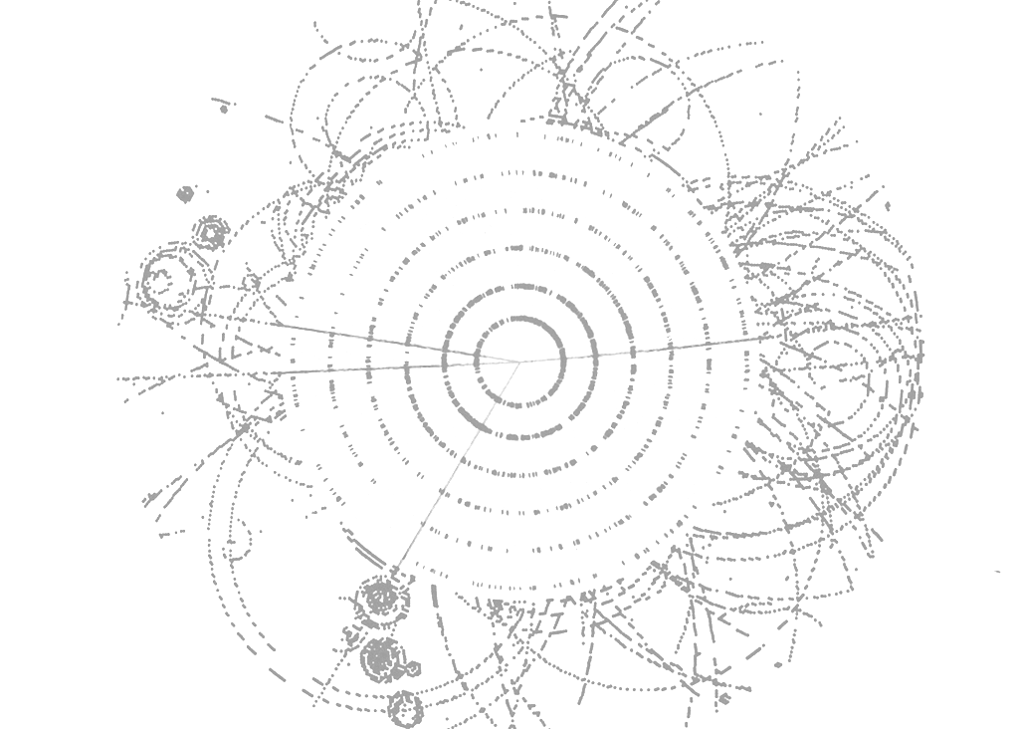


H➝τ⁺τ⁻ and H±➝τ±ν_{τ} with the ATLAS Detector at the LHC
International Workshop on Tau Lepton Physics, Manchester, 13-17 September 2010
Ricardo Gonçalo
Royal Holloway
on behalf of the ATLAS Collaboration

Slide 2
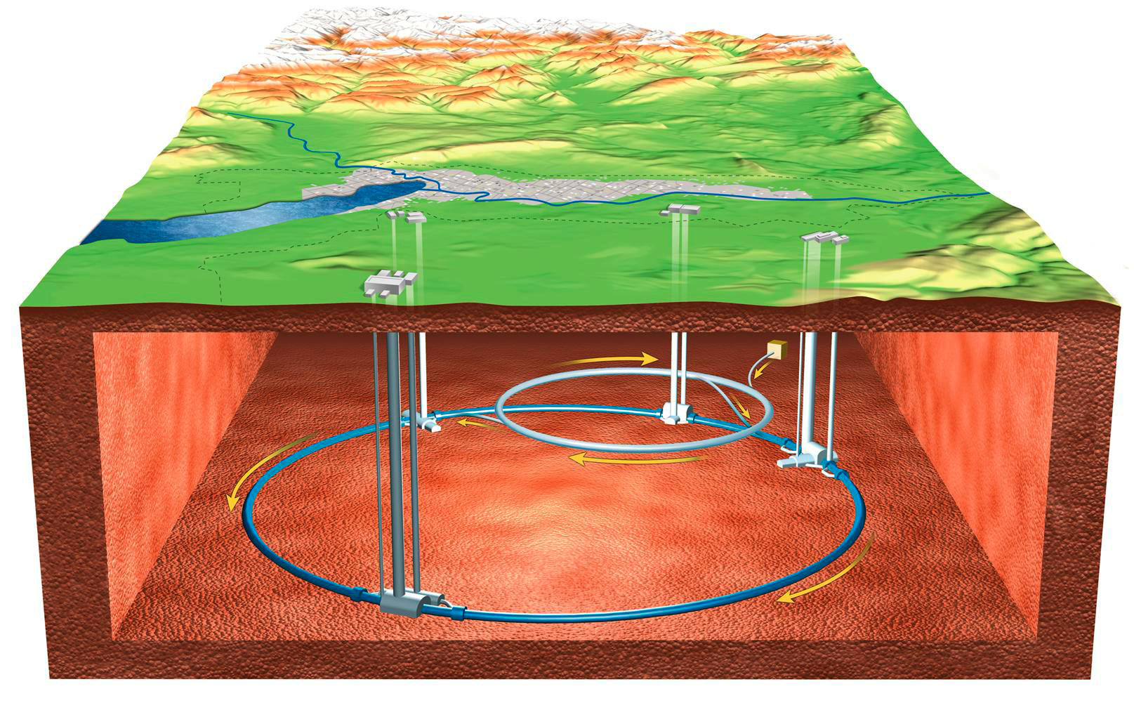
Outline
ATLAS and LHC Status and Plans
Higgs Physics at the LHC
Recent ATLAS Results
  H➝τ⁺τ⁻ in the Standard Model
  h/H/A➝τ⁺τ⁻ in the MSSM
  Charged Higgs: H±➝τ±ν_{τ}
Summary and Outlook

Slide 3
ATLAS and LHC Status and Plans

Slide 4
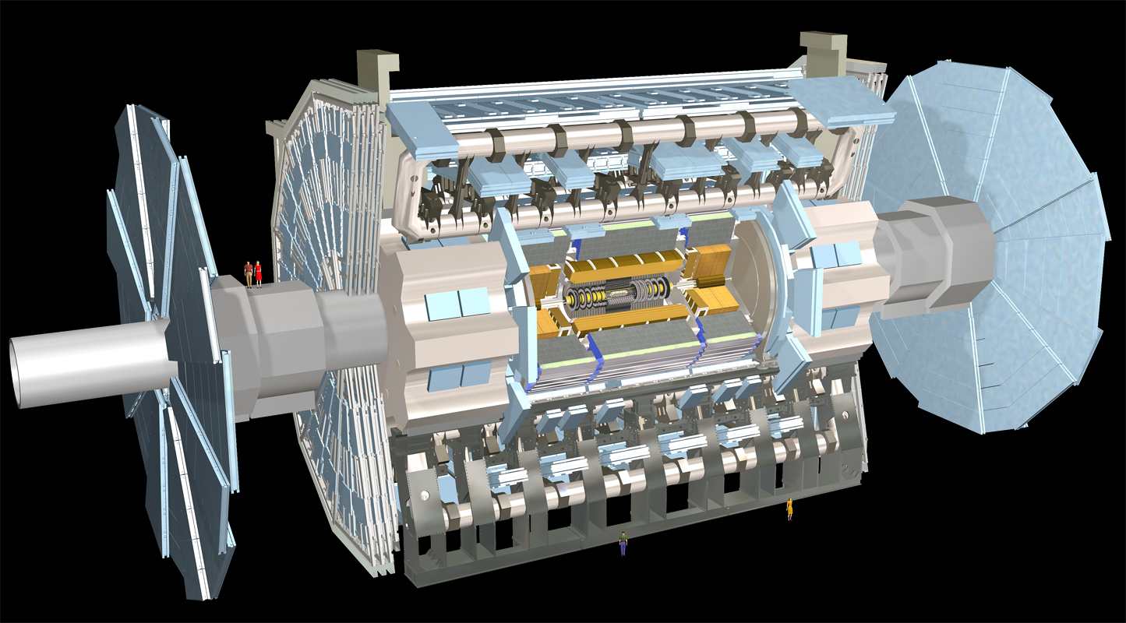
Muon Spectrometer: |η|<2.7
Air-core toroids and gas-based muon chambers
σ/p_{T} = 2% @ 50GeV to 10% @ 1TeV (ID+MS)
EM calorimeter: |η|<3.2
Pb-LAr Accordion
σ/E = 10%/√E ⊕ 0.7%
Hadronic calorimeter:
|η|<1.7 Fe/scintillator
1.3<|η|<4.9 Cu/W-Lar
σ/E_{jet}= 50%/√E ⊕ 3%
JINST (2008) 3 S08003
L = 44 m, ∅ ≈ 25 m
7000 tonnes
≈10⁸ electronic channels
3-level trigger reducing 40 MHz collision rate to 200 Hz of events to tape
Inner Tracker: |η|<2.5, B=2T
Si pixels/strips and Trans. Rad. Det.
σ/p_{T} = 0.05% p_{T} (GeV) ⊕ 1%

Slide 5
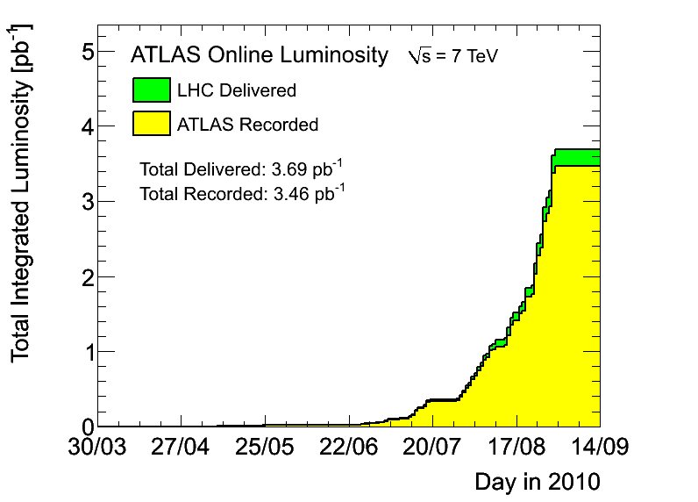
LHC running smoothly at √s = 7 TeV
  Crossed L = 10³¹cm⁻²s⁻¹ milestone in August
  Aim to achieve L = 10³² cm⁻²s⁻¹ in 2010
  p-p run until 1 Nov., followed by heavy-ion run
  Go to √s = 14 TeV in 2013 after shutdown
ATLAS collected ∫Ldt ≈ 3.46 pb⁻¹ (±11%)
  At ≈ 94% efficiency and improving
  First W and Z cross section measurements
  Handful of top candidates seen
  Expect to collect 1 fb⁻¹ until end 2011
7 TeV

Slide 6
Higgs Physics at the LHC

Slide 7
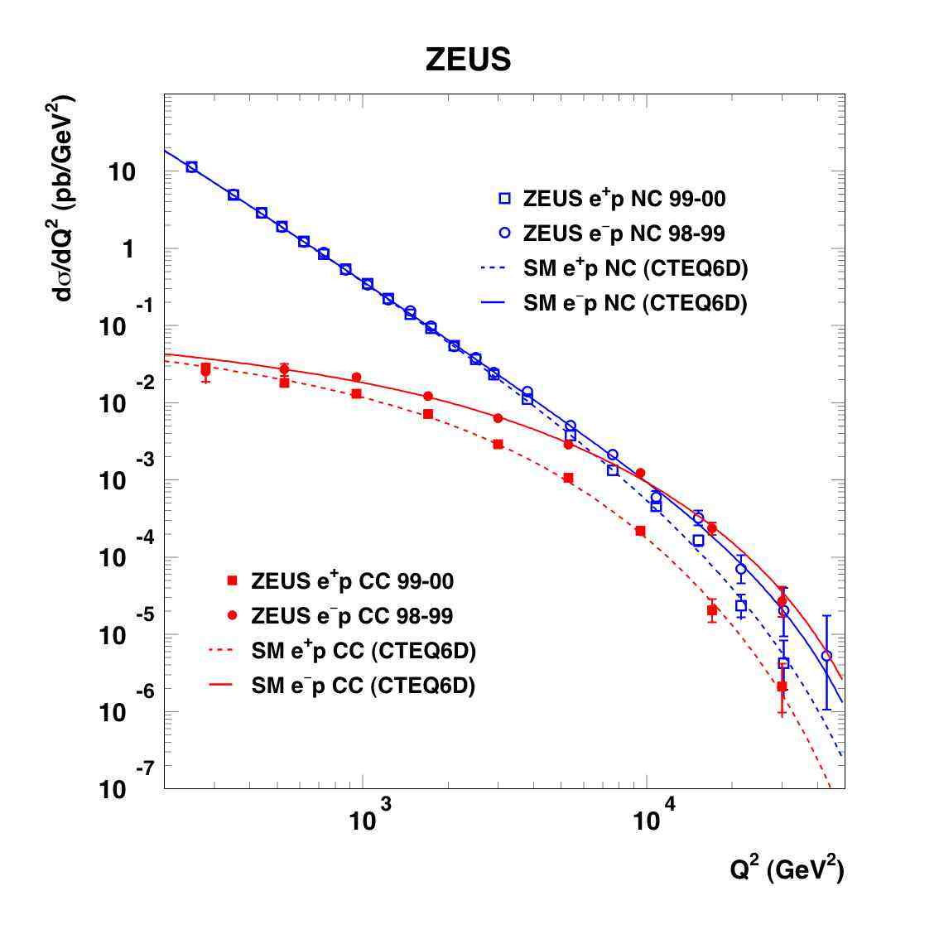
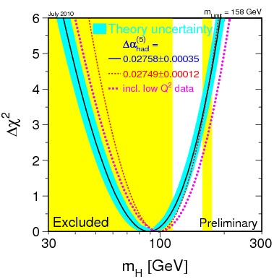
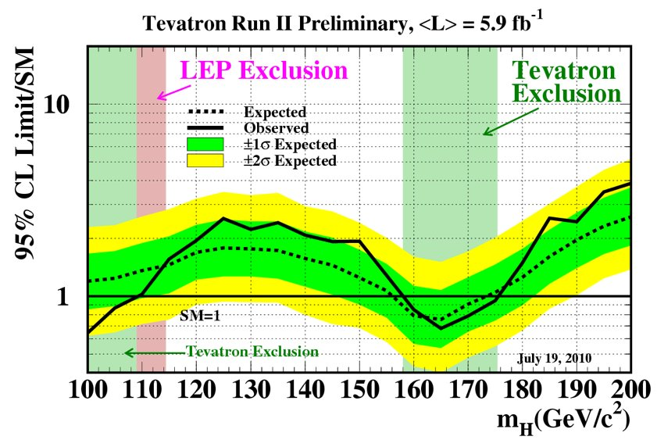
Electroweak symmetry breaking/unification and the need to account for massive particles is clear from experimental data
The simplest model of electroweak symmetry breaking predicts the existence of one Higgs scalar
  The Higgs boson mass is the only free parameter
Current mass limits as of July 2010:
  LEP excluded mass range below 114.4 GeV/c²
  EW fit: m_{H} = 89⁺³⁵₋₂₆ GeV/c²; including LEP: m_{H} < 185 GeV/c²
  Tevatron excluded mass range of 158 – 175 GeV/c²
Z⁰/γ*
W±
http://www-zeus.desy.de/physics/sfew/PUBLIC/sfew_results/preliminary/dis04/
http://lepewwg.web.cern.ch/LEPEWWG/
http://tevnphwg.fnal.gov/results/SM_Higgs_Winter_08hepex/

Slide 8
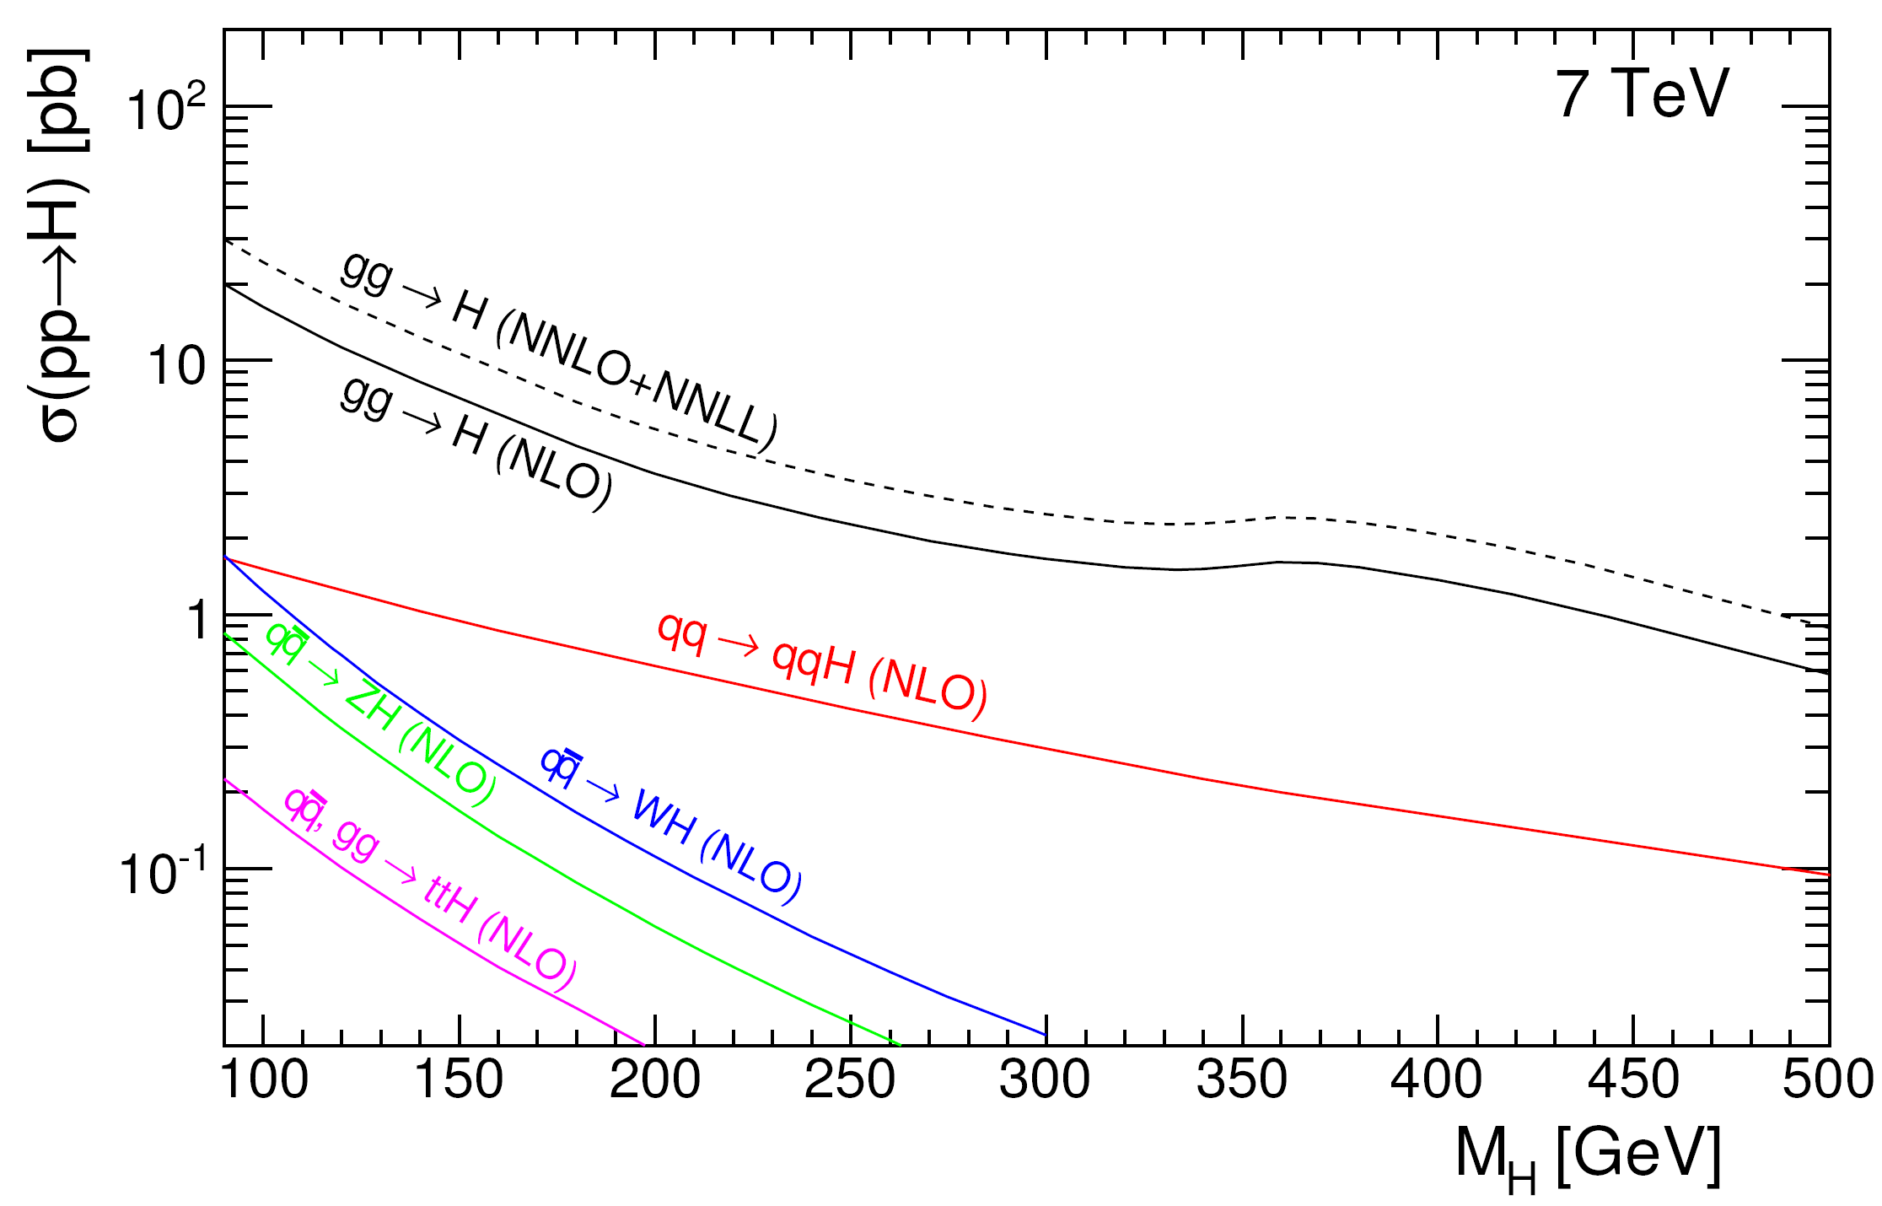
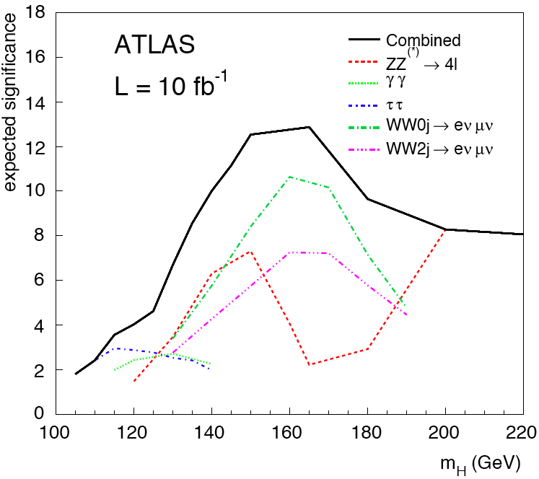
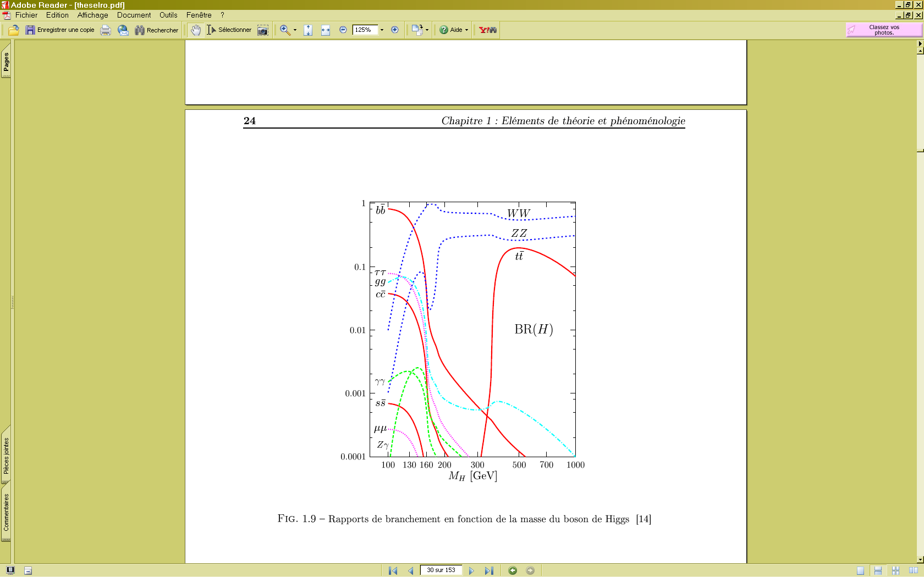
Standard Model Higgs:
Main production modes at the LHC:
  Gluon fusion (gg➝H)
  ≈10x smaller: Vector boson fusion (qq->qqH)
Main decay modes:
  At low mass, H->bb is dominant (BR ≈ 90%), followed by H➝ττ (BR ≈ 10%)
  Above m_{H} ≈ 135 GeV/c² H➝WW and H➝ ZZ are the dominant decays
At low m_{H}, H➝ττ makes large contribution to ATLAS sensitivity
ATL-PHYS-PUB-2010-009
√s = 14 TeV
CERN-OPEN-2008-020

Slide 9
In the MSSM, 2 Higgs doublets give 5 particles
  Three neutral: h, H (CP-even), A (CP-odd); two charged: H±
At tree level m_{h} < m_{Z} – after radiative corrections m_{h} < 135 GeV/c²
Important parameters: m_{A}, tan β = v₁/v₂
  As tan β increases, Higgs decays to b quarks and tau leptons enhanced over vector bosons
Branching ratio to taus is O(10%) of one to bb in both SM and MSSM
  But tau identification and triggering can be very advantageous over b-initiated jets
  In case of charged Higgs bosons the dominant decay may involve a tau lepton
Need the best possible tau trigger, ID and reconstruction that ATLAS can provide!
  See talks by Stefania Xella and Anna Kaczmarska in previous session
BR(h)
BR(A)
BR(H±)
M.Spira, Higgs Hunting workshop, Orsay, July 2010

Slide 10
ATLAS results in SM and MSSM
The following slides summarize ATLAS results for H➝τ⁺τ⁻ (SM) and h/H/A➝τ⁺τ⁻ and H±➝τν_{τ} (MSSM)
All results shown (calculated at √s = 14 TeV and √s = 7 TeV) are based on Monte Carlo simulation
Work currently focuses on understanding backgrounds to search channels
  Particularly on establishing data-driven methods to determine these backgrounds

Slide 11
H➝τ⁺τ⁻ in the Standard Model

Slide 12
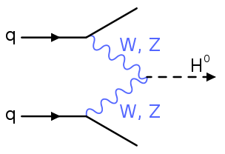
Studied Vector Boson Fusion (VBF) production channel
  Use discrimination power from 2 tag jets and clean inter-jet gap (tree level)
Three channels (ll, lh, hh) for leptonic or hadronic τ decays
  Trigger for hadron-hadron channel proved to be feasible
  Background for this channel needs to be measured from data (in progress)
M_{ττ} can be reconstructed in the collinear approximation with good resolution (δm ≈ 8 – 10 GeV/c²)
  Assume τ decays to be only source of E_{t}^{miss}
  Assume massles τ’s
Dominant background is Z/γ*➝ττ
τ_{l}
l
ν
Collinear approx.
ν
E_{T}^{miss}
π
ν
π
τ_{h}
π

Slide 13
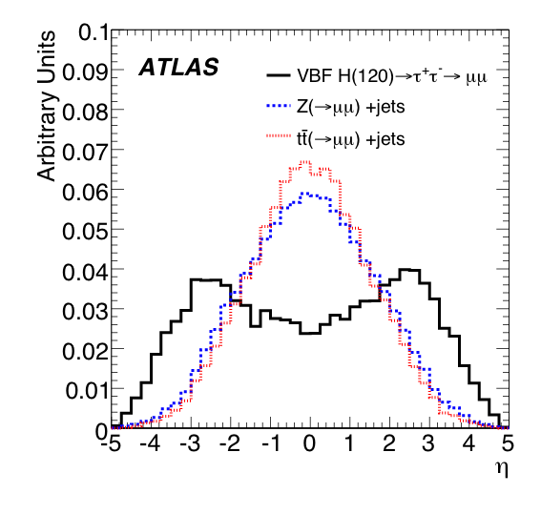
Studied Vector Boson Fusion (VBF) production channel
  Use discrimination power from 2 tag jets and clean inter-jet gap (tree level)
Three channels (ll, lh, hh) for leptonic or hadronic τ decays
  Trigger for hadron-hadron channel proved to be feasible
  Background for this channel needs to be measured from data (in progress)
m_{ττ} can be reconstructed in the collinear approximation with good resolution (δm ≈ 8 – 10 GeV/c²)
  Assume τ decays to be only source of E_{t}^{miss}
  Assume massles τ’s
Dominant background is Z/γ*➝ττ
CERN-OPEN-2008-020
τ_{l}
l
ν
Collinear approx.
ν
E_{T}^{miss}
π
ν
π
τ_{h}
π

Slide 14
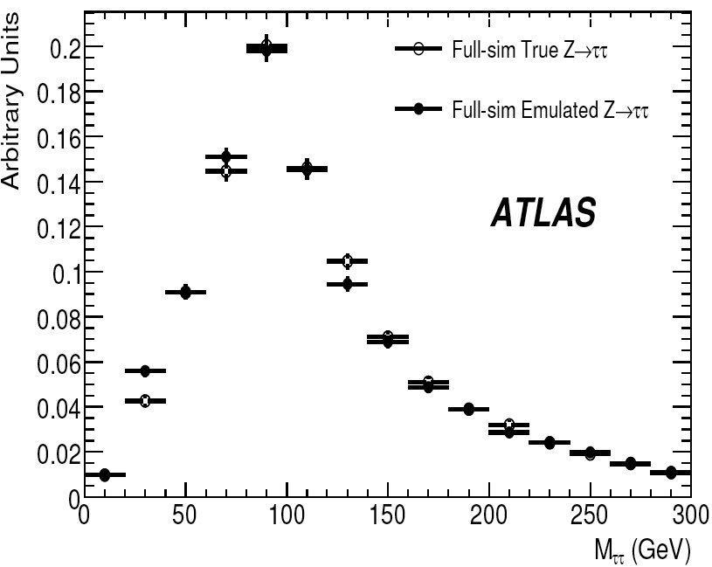
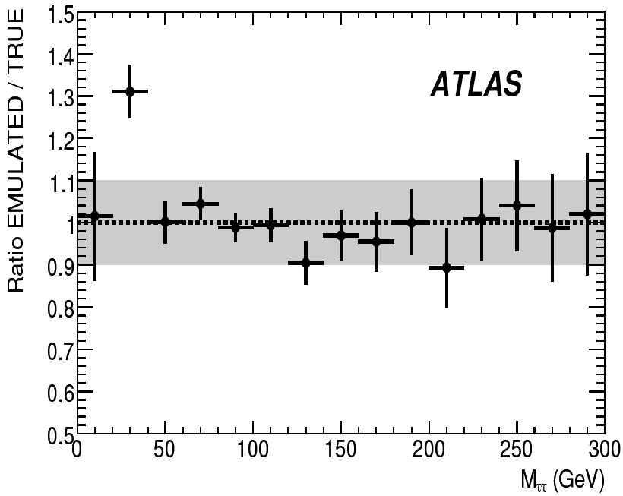
High tail of the Z➝ττ mass distribution extends into signal region
Simulation shortcomings would impact on signal extraction – needs to be estimated from collision data:
  Select Z➝μμ
  Take μ 4-momenta and decay as a τ in Tauola
  Run through detector simulation and merge back into event
CERN-OPEN-2008-020
μ
Ζ➝μμ
Ζ➝ττ➝lh
ν
ν
μ
μ
π
π
ν
π

Slide 15
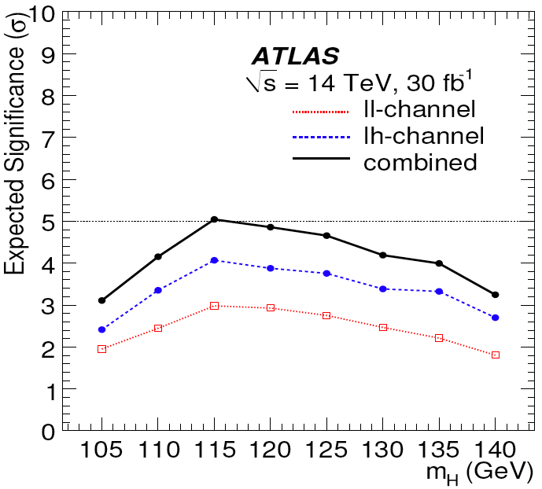
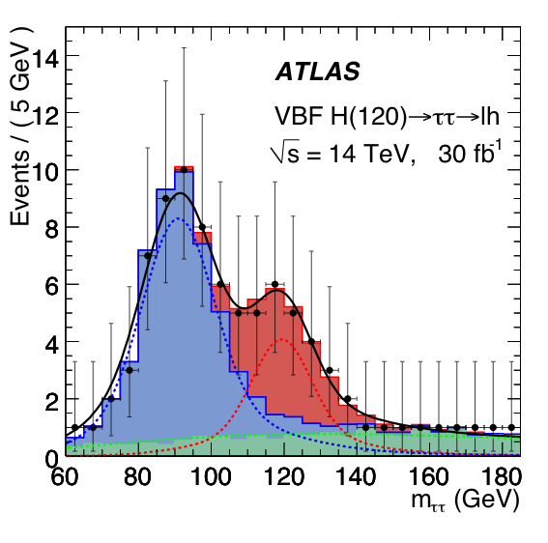
ll event selection: 2 leptons + tag jets + E_{T}^{miss}
  Two leptons (e or μ) with opposite charge
  Leptons not back to back and 0 < x_{l1}, x_{l2} < 0.75 (for collinear approximation to work)
  Two “tag” jets with E_{T} > 40 and 20 GeV in opposite hemispheres with Δη_{jj} > 4.4 and di-jet mass > 700 GeV/c²
  E_{T}^{miss} > 40 GeV
lh event selection: e/μ + τ_{h} + tag jets + E_{t}^{miss}
  Exactly one lepton (e or μ) with p_{T} > 22 GeV
  One reconstructed hadronic tau (τ_{h})
  Lepton and τ_{h} not back to back and 0 < x_{l1}, x_{l2} < 0.75 (for collinear approximation to work)
  Transverse mass (lepton, E_{T}^{miss}) < 30 GeV
  Two “tag” jets with E_{T} > 40 and 20 GeV in opposite hemispheres with Δη_{jj} > 4.4 and di-jet mass > 700 GeV/c²
  E_{T}^{miss} > 30 GeV
Combination of ll and lh:
  5σ discovery with 30 fb⁻¹ at 14 TeV for m_{H} ≈ 115 GeV/c²
  Systematic uncertainties of ≈20% in signal efficiency , dominated by jet energy scale
H➝ττ
CERN-OPEN-2008-020
Z➝ττ
QCD

Slide 16
h/H/A➝τ⁺τ⁻ in the MSSM

Slide 17
Previously studied h/H/A➝τ⁺τ⁻➝l⁺l⁻+4ν – lepton-lepton final state
  m_{h}^{max} scenario and mass range 110 GeV/c² < m_{A} < 800 GeV/c² (CERN-OPEN-2008-020)
New studies include lepton-hadron final state (ATL-PHYS-PUB-2010-011)
  Similar analysis; focused on 150 GeV/c² < m_{A} < 800 GeV/c² (h ignored since m_{h} ≲ 135 GeV/c²)
Event selection: e/μ + τ_{h} + E_{t}^{miss}
  At least one e or μ with p_{T} > 24 GeV
  Exactly one hadronic τ_{h} with opposite charge to e/μ
  E_{T}^{miss} > 20 GeV; transverse mass: M_{T}(lepton, E_{T}^{miss}) < 25 GeV/c²
  m_{ττ} > 0 from collinear approximation and 0 < x_{l1}, x_{l2} < 1
  Separate sample into b-tagged and non b-tagged events to optimize separately using variables: Δφ_{lτ}, E_{T}^{miss}, E_{T}^{τ} and m_{ττ}
Re-do analyses for several masses between m_{H} = 150 GeV/c² and 800 GeV/c²
Backgrounds: Z+jets and W+jets (non-b tagged) , ttbar (b-tag), QCD, single top
ATL-PHYS-PUB-2010-011

Slide 18
Define strategies to determine backgrounds from collision data
Example: ttbar background
  Select control sample with high E_{T}^{miss} and no M_{ττ} cut
  Other cuts similar to signal region
  Bin events in number of reconstructed jets
  Estimate ttbar in signal region through:
Control
Signal

Slide 19
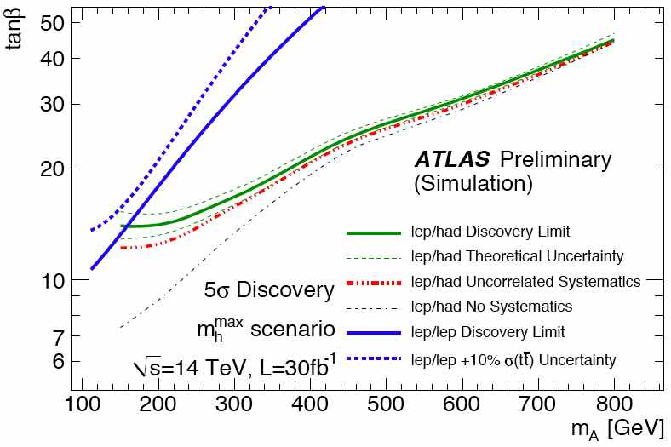
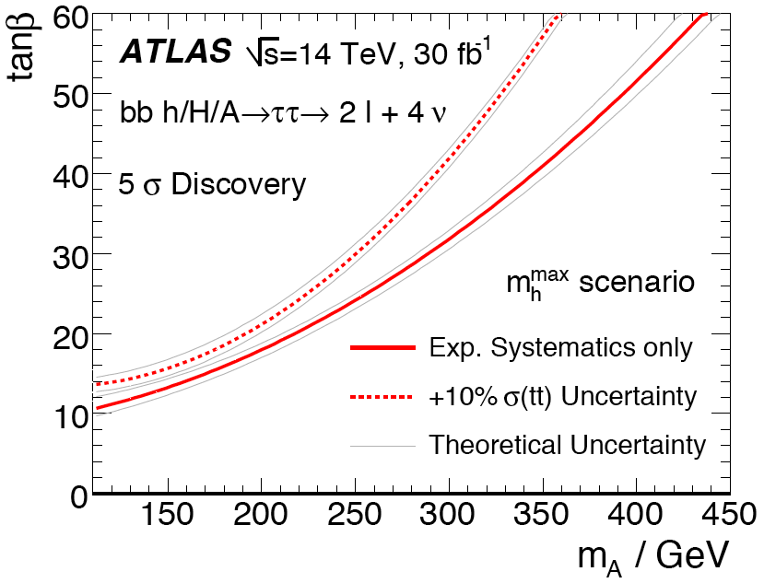
Combined b-tagged and non b-tagged analyses
Improvement for M_{A} > 150 GeV/c² over older ATLAS analysis of di-lepton final state τ_{l}τ_{l} (CERN-OPEN-2008-020)
Compares well with combined Tevatron results at 2.96 TeV obtained with 1.8 fb⁻¹ (CDF) and 2.2 fb⁻¹ (D0)
lepton/lepton
ATL-PHYS-PUB-2010-011
CERN-OPEN-2008-020
arXiv:1003.3363v3 [hep-ex]
95% exclusion limit vs tanβ and m_{A}

Slide 20
Charged Higgs: H±➝τ±ν_{τ}

Slide 21
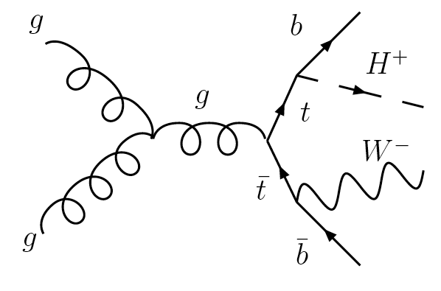
Full simulation study done at √s = 10 TeV and extrapolated to √s = 7 TeV, 1 fb⁻¹
  Cross sections scaled down and corrected for different acceptance when necessary
Only light charged Higgs study being shown here: m_{H+} < m_{t}
  For tan β > 1 BR(H⁺➝τν) dominant; for tan β > 3 BR(H⁺➝τν) > 90%
Event Selection: 2 leptons + E_{T}^{miss} + 2 jets + kinematic cuts
  Two leptons (e/μ) with opposite charge and with p_{T}^{l1} > 20 GeV and p_{T}^{l2} > 10 GeV
  At least 2 jets with E_{T} > 15 GeV
  Two jets with the highest b-jet probability assigned to be daughters of top and anti-top
  E_{T}^{miss} > 50 GeV
  Transverse mass of charge Higgs candidate
  Lepton helicity angle θ_{l}*: cos θ_{l}* < -0.6 (on H⁺ side)
l⁺
ν
ν
τ⁺
ν
l⁻
ν

Slide 22
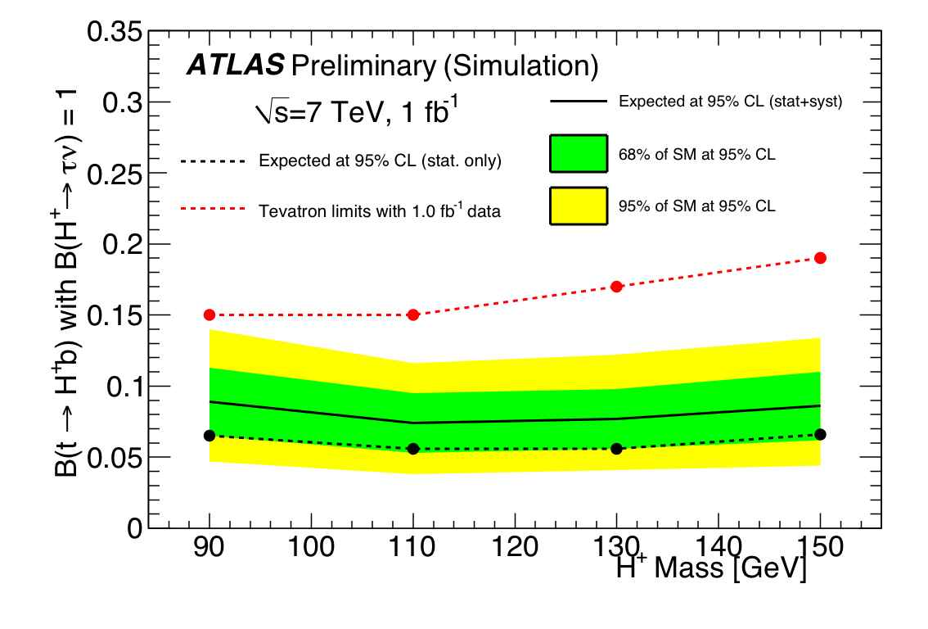
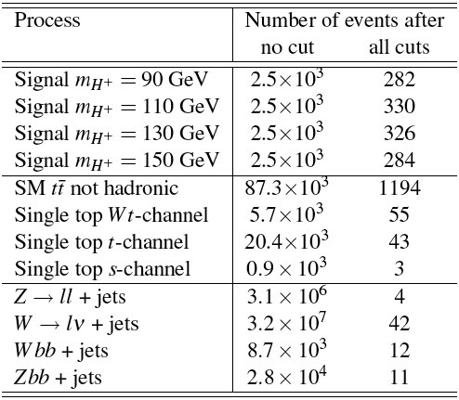
Results for √s = 7 TeV, 1 fb⁻¹:
Upper limit on BR(t➝bH⁺) assuming BR(H⁺➝τν) = 1 versus m_{H+}
Main background: ttbar (≈90%)
Sensitivity evaluated separately for each mass point (m_{H+} = 90 – 150 GeV/c²)
Expected exclusion: BR(H⁺➝τν) > 10% for mass range ≈90 – 150 GeV with 1 fb⁻¹
Significant improvement on current Tevatron limits for this channel
ATL-PHYS-PUB-2010-006
ATL-PHYS-PUB-2010-009

Slide 23
Conclusions and Outlook

Slide 24
Low Higgs mass region is difficult experimentally – taus will be an essential tool to achieve good sensitivity in this region
An excellent, identification and reconstruction of tau leptons is essential
Currently focusing on methods to determine backgrounds and estimate performance from collision data
Charged Higgs search proved to be competitive with 1 fb⁻¹ of data at √s = 7 TeV which we will collect by the end of 2011!
ATLAS will be able to exclude the Higgs in a wide region in both the SM and the MSSM with data from the current run.
Note: WW + ϒϒ + ZZ results only
ATL-PHYS-PUB-2010-009
We’ve got a very exciting year ahead! Stay tuned!
Notes:
Latest significance drops from 7 to 3 at M_{H} ≈ 120 GeV/c₂. This comes both from the addition of H->ττ and (perhaps even more) from gluon-fusion cross section enhancement going from NLO to NNLO+NNLL.

Slide 25
Backup

Slide 26
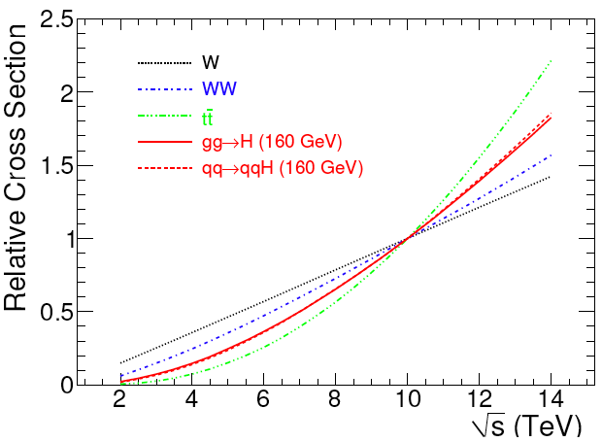
Calculated at NLO (MCFM)
ATL-PHYS-PUB-2010-009

Slide 27
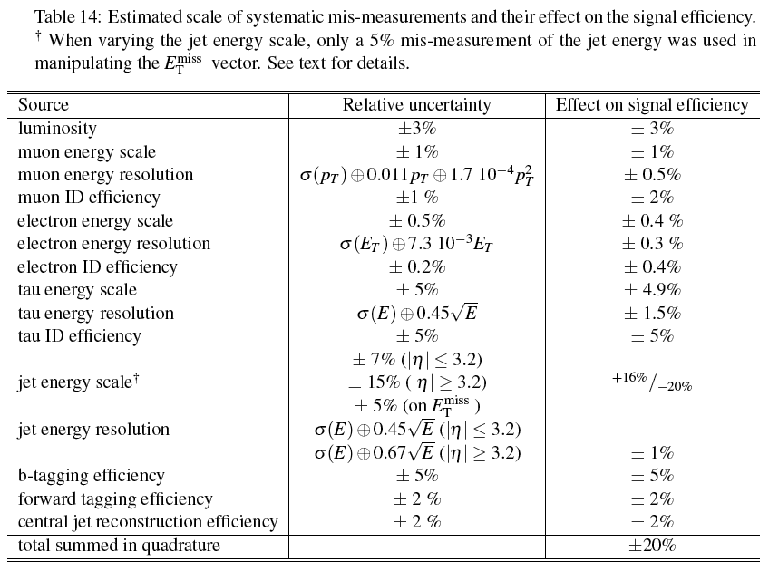
VBF H➝τ⁺τ⁻

Slide 28
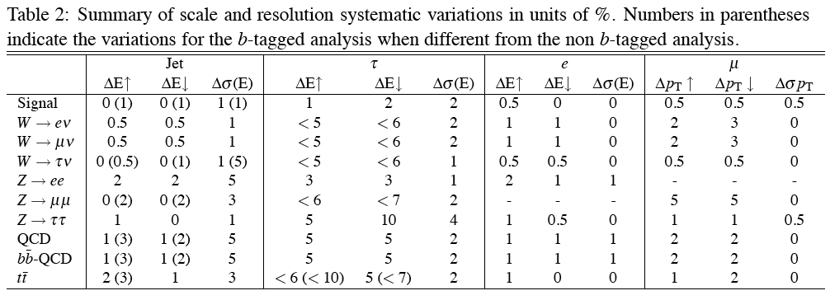
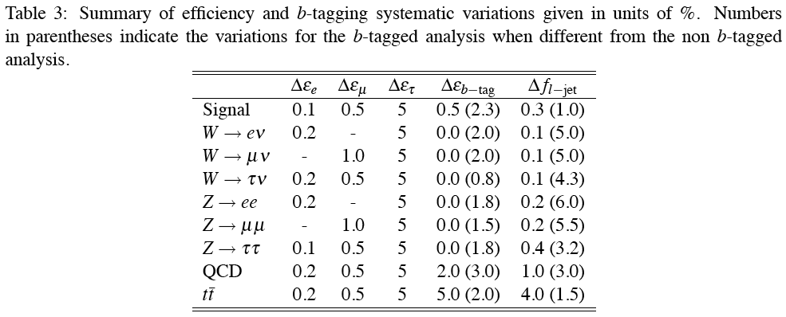
h/H/A➝τ⁺τ⁻ in the MSSM

Slide 29
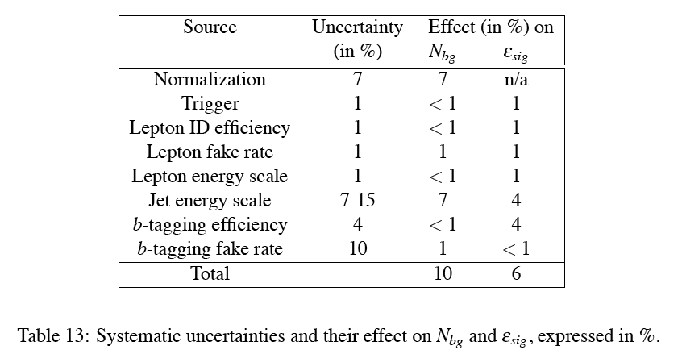
H±➝τ±ν_{τ}

