Slide 1
HH→4b benchmark for the HTT
Ana Luísa Carvalho, Ricardo Gonçalo

Slide 2
Outline
Why HH→4b
Parameterization of b-tagging performance
MC samples
Some control plots
Initial rate estimation

Slide 4
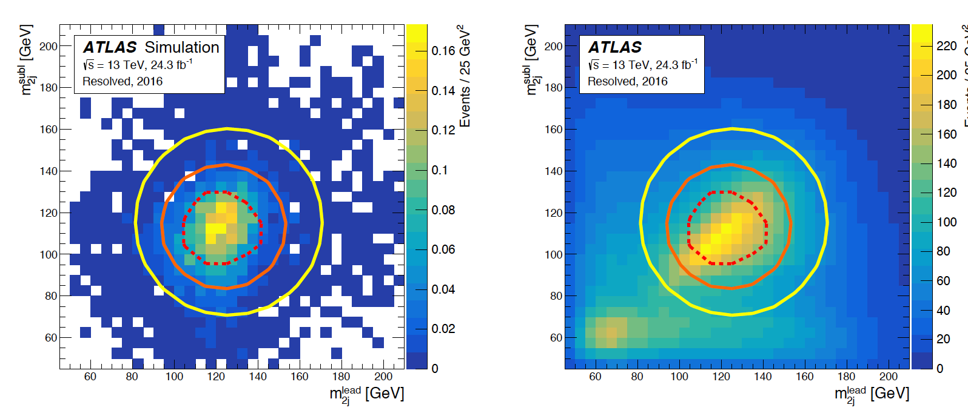
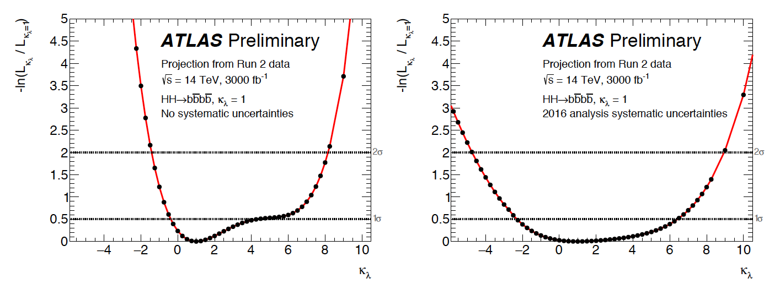
Current estimates
Current prospects for di-Higgs at HL-LHC (ATL-PHYS-PUB-2018-053)
bbγγ, bbττ, bbbb for 3000 /fb
3.0 σ significance
Uncertainty on μ_{HH} ≈ 30 - 40%
λ_{HHH} / λ_{SM} expected 1±0.7

Slide 9
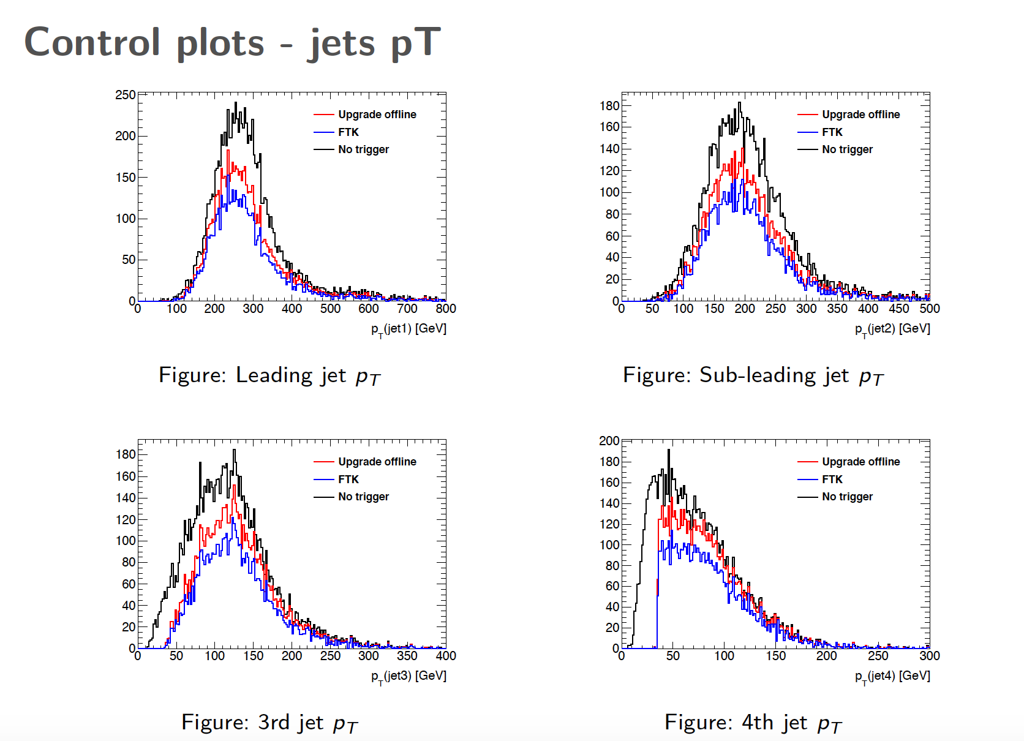

Slide 12
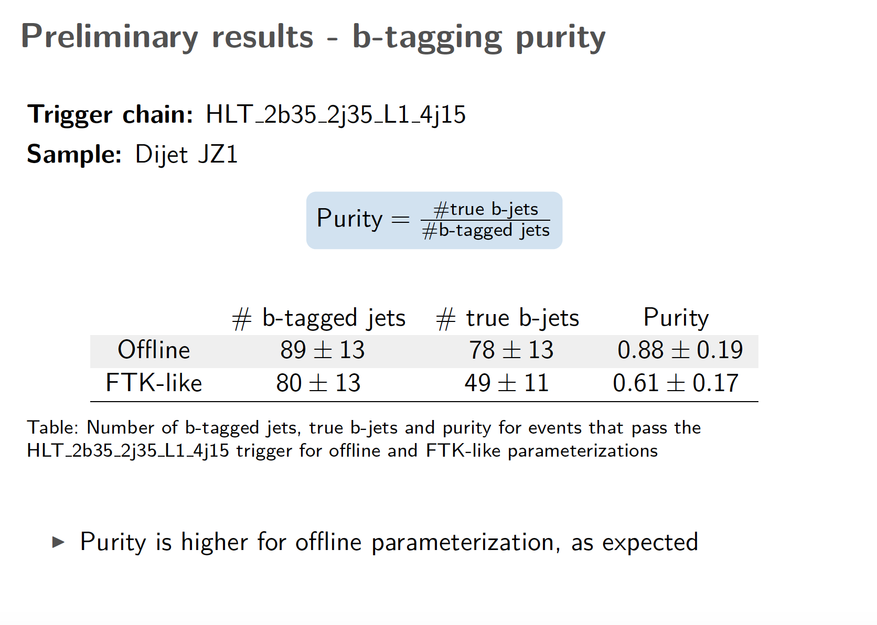

Slide 13
Next steps
Working on first version of HTT fast simulation
Based on easy to change parameterization
Re-do analysis with non-resonant signal sample
Significance estimate will be useful as HTT benchmark

