Slide 1
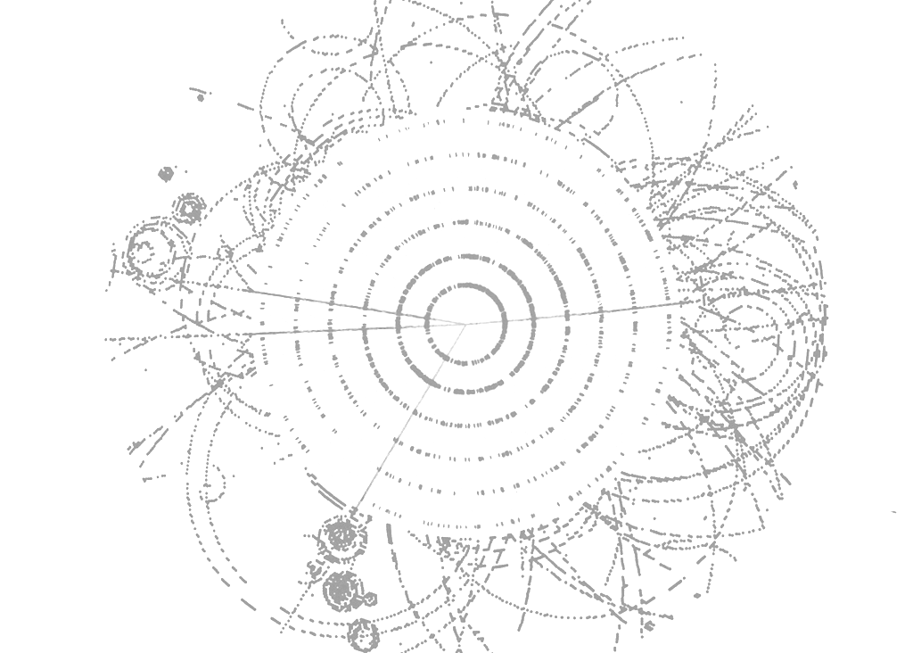



ATLAS Trigger Performance
Ricardo Gonçalo
Royal Holloway University of London
On behalf of the ATLAS Collaboration
LHC Days at Split, 4-8 October, 2010

Slide 2
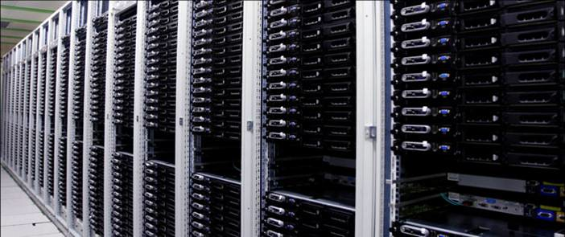
Outline
Introduction
The ATLAS Trigger
  Architecture of the ATLAS Trigger
  Trigger Menu and Configuration
Trigger Performance
  Event selection and its performance
The Road Ahead
  Heavy Ion Run
  Conclusions

Slide 3
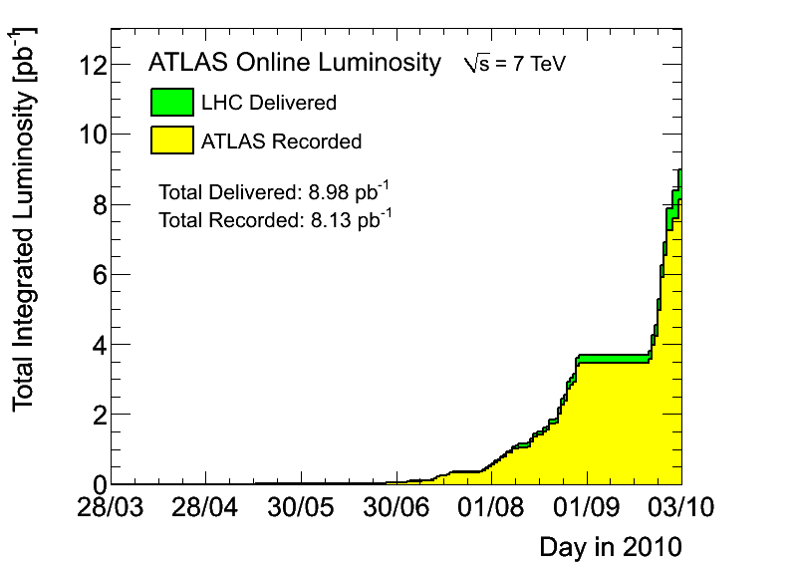
ATLAS collected ∫ L dt > 8 pb⁻¹ (±11%)
  At ≈ 94% efficiency and improving
  First W and Z cross section measurements
  Handful of top candidates seen
LHC running smoothly at √s = 7 TeV
  Started 30 March 2010 with L≈10²⁷cm⁻²s⁻¹
  Crossed L = 10³¹cm⁻²s⁻¹ milestone in August
  Aim to achieve L = 10³² cm⁻²s⁻¹ in October
  p-p run until early November, followed by heavy-ion run
  Plan for √s = 14 TeV in 2013 after shutdown
Trigger coping with ≈10⁵ increase in LHC luminosity over 7 months
See also previous talk by Daniel Fournier
7 TeV

Slide 4
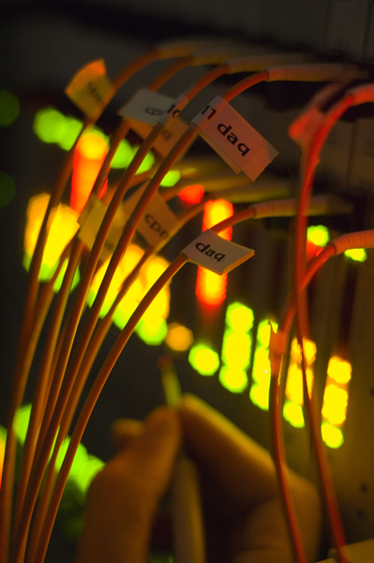
The ATLAS Trigger

Slide 5
Architecture
Calo, Muon, Min. Bias
Tracking
Level 1 (L1): < 75 kHz
  Fast Custom-built electronics
  Input mainly from Calorimeter and Muon spectrometer
  Inputs combined in Central Trigger Processor
High Level Trigger (HLT):
  Level 2 & Event Filter (third level)
  Software based running on large PC farm
Level 2 (L2): ≈ 3 kHz
  Fast custom algorithms
  reconstruction mainly in Regions of Interest (RoI) ➔ limited data access
Event Filter (EF): ≈ 200 Hz
  Third trigger level
  Offline tools inside custom wrappers,
  Access to full event information
40 MHz
Level-1
Fast Custom Electronics
t < 2.5μs
Front End Pipelines
L1 Accept
< 75 kHz
Requested Data in RoI
Readout Buffers
Level-2
500 PCs
<t> ≈ 40ms
≈ 3kHz
Event Builder
Access to full event
Event Filter
1800 PCs
<t> ≈ 4s
Full Event Buffers
≈ 300 MB/s
≈ 200 Hz
Storage & offline processing
Notes:
Level 1 (LVL1)
Fast custom‐built electronics
Latency: <2.5μs
High Level Trigger – Level-2 & 3 (Event Filter)
Software based running on large PC farm:
Level-2:
Fast custom algorithms
Request data in Regions of Interest (RoI) from Read out Buffers
Mean Processing Time ~ 40 ms,
Level 3 = Event Filter (EF)
Offline tools inside custom wrappers,
Access to full built event
Mean Processing Time ~4s
Output to storage average of 300Hz, but can be and has been considerably higher for shorter periods.

Slide 6
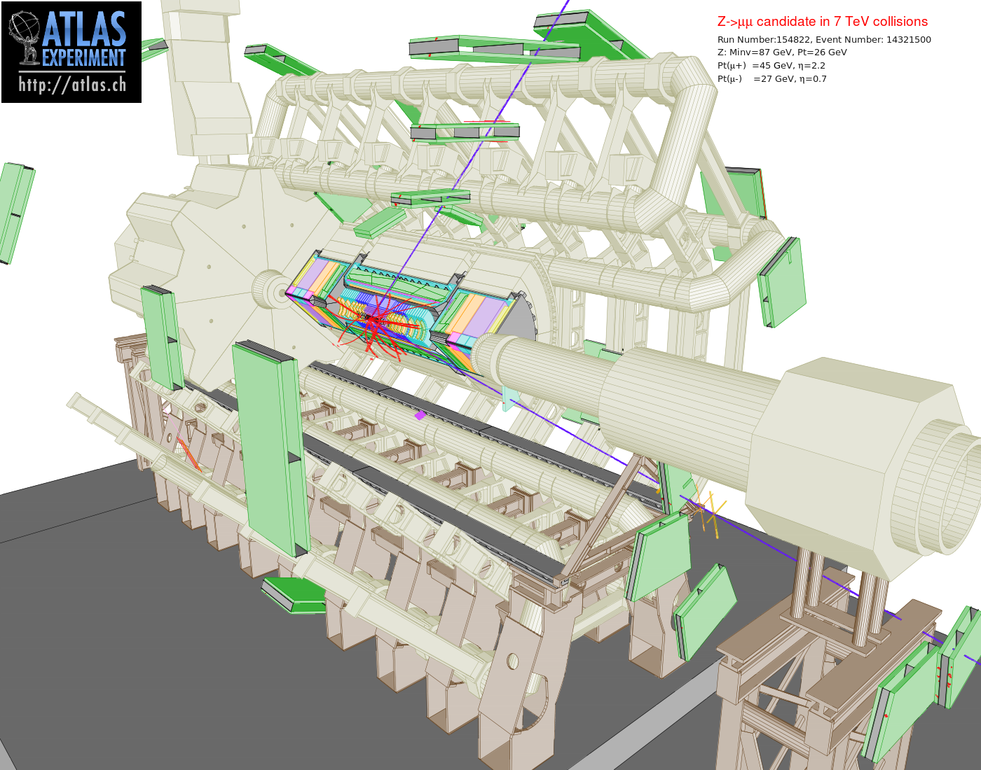
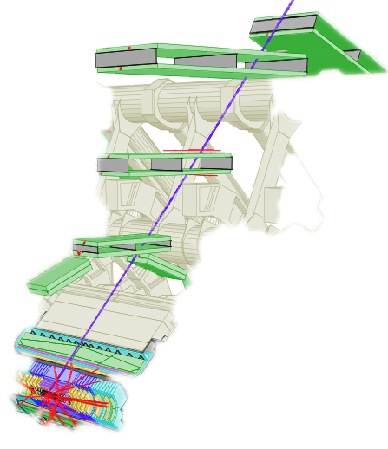

Slide 7
L1 muon candidate (RoI) fires 2 thresholds
Each seeds one or more L2 algorithm chains
Algorithm result cached: only run heavy algorithms once
If signature not confirmed, de-activate chain
Active chains seed other chains in next level
L1_MU20
L1_MU10
L1_MU6
L2_mu10
L2_mu6
algorithms
algorithms
Algorithm chains process event or just Region of Interest (RoI) for speed – to reconstruct physical objects: electrons, photons, muons, jets, etc
Event accepted if at least one chain active at end of Event Filter (EF)
All chains executed – since trigger result used to stream events (inclusive data streams)
p_{T}^{μ}>10 GeV?
p_{T}^{μ} > 6 GeV?
EF_mu6
…
Notes:
Caching if same algorithm and data

Slide 8
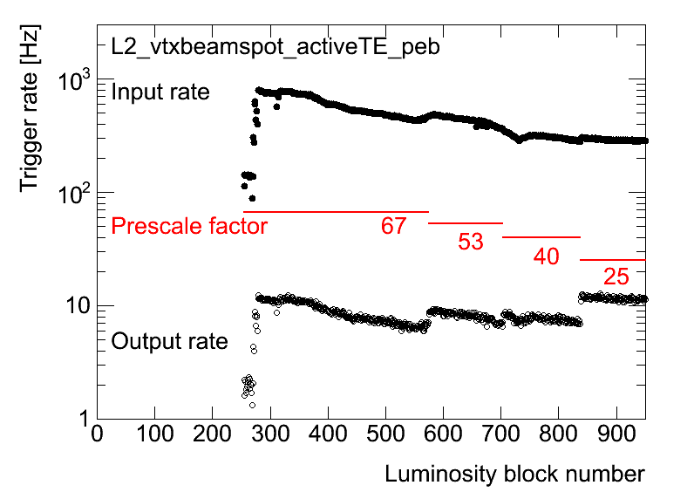
Trigger menu:
Collection of trigger signatures
≈200 – 500 algorithm chains in current menus
Algorithms re-used in many chains
Selections dictated by ATLAS physics programme
Also calibration & monitoring chains
Trigger physics objects | Lowest unprescaled E_{T} thresholds (GeV) at L ≈ 1x10³² cm⁻²s⁻¹
 | L1 | HLT | Rate (Hz)
Electron | 10 | 15 | 21
Photon | 14 | 40 | 7.3
Tau | 20 | 50 | 3.7
Muon | 4 | 13 | 18
Missing E_{T} | 20 | 35 | 3.2
Jet | 75 | 115 | 2.0
ΣE_{T} | 200 | 350 | 1.6
Configuration infrastructure
Very flexible!
Pre-scale factors employed to change menu while running
Adapt to changing LHC luminosity
Also chains for B-tagged jets & B-physics signatures

Slide 9
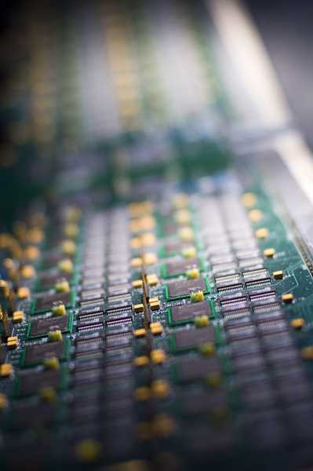
Performance

Slide 10
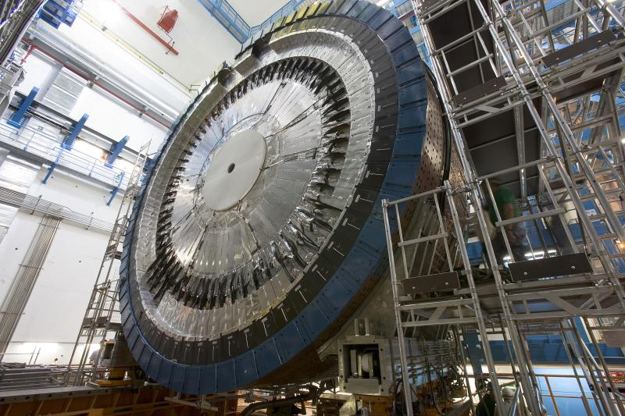
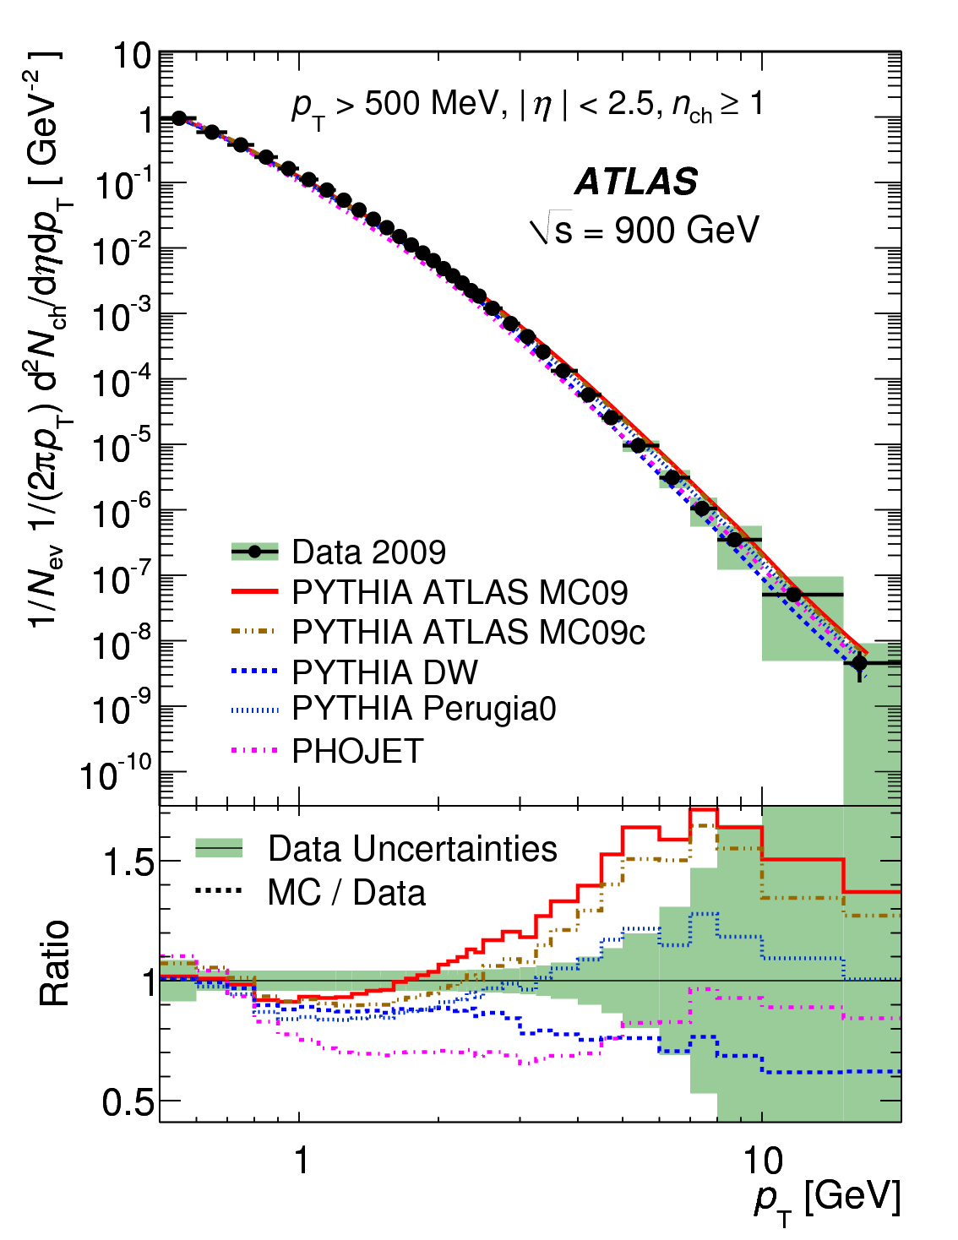
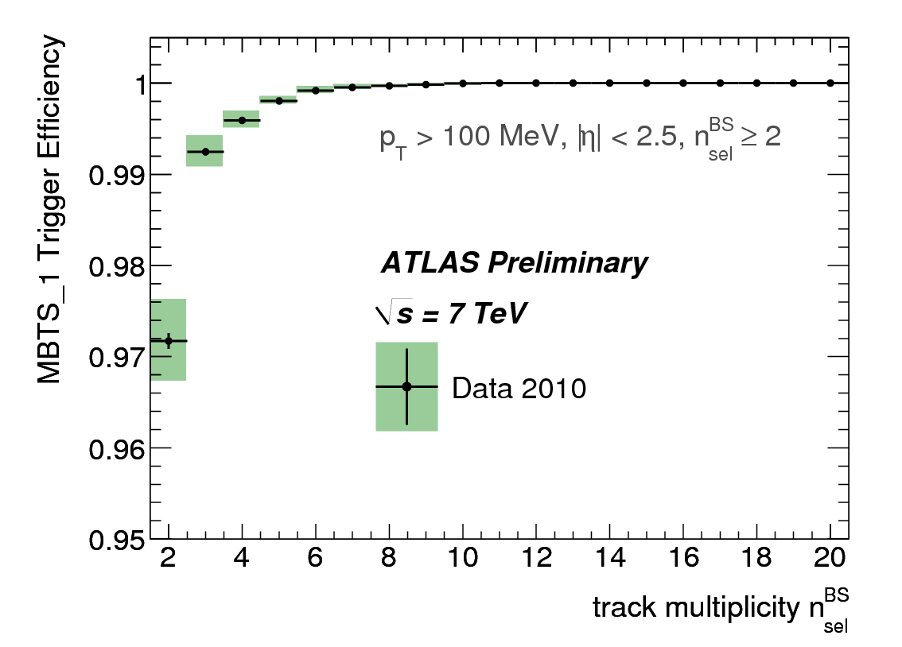
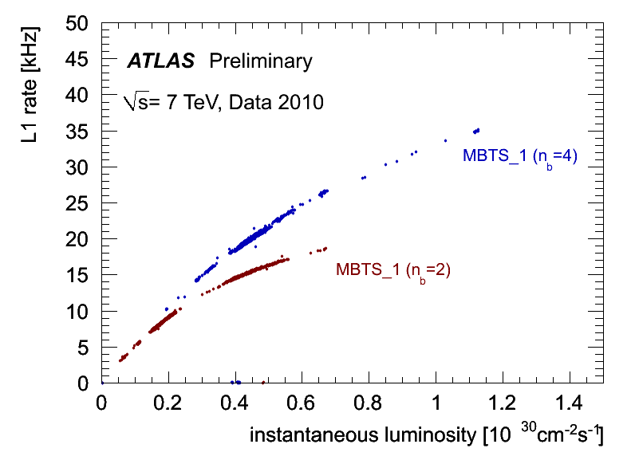
Minimum Bias Trigger
Phys.Lett.B 688, Issue 1, 2010
Soft QCD studies
Provide control trigger on p-p collisions; discriminate against beam-related backgrounds (using signal time)
Minimum Bias Scintillators (MBTS) installed in each end-cap;
  Example: MBTS_1 – at least 1 hit in MBTS
Also nr. of hits its in Inner Detector
Minbias Trigger Scintillator:
32 sectors on LAr cryostat
Main trigger for initial running
η coverage 2.1 to 3.8
LHC collision rate (n_{b}=4)
LHC collision rate (n_{b}=2)
Notes:
MBTS_1 efficiency = N(MBTS_1 && offline track && mbSpTrack) / N(offline track && mbSpTrack) – systematics from use of control trigger mbSpTrack and from track d0 cut
MBTS_1 rate v. Inst. Lumi for 2 and 4 pairs of colliding bunches in ATLAS - the MBTS rate saturates as it approaches nb times the LHC revolution frequency (nb*fLHC~22 kHz)
rate of colliding bunches - 2 b : 22.5kHz ; 4b : 45 kHz

Slide 11
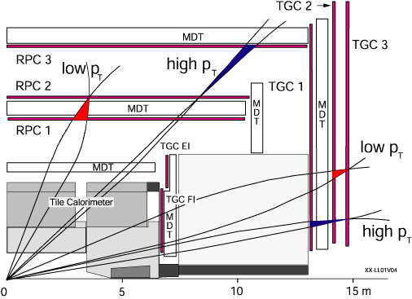
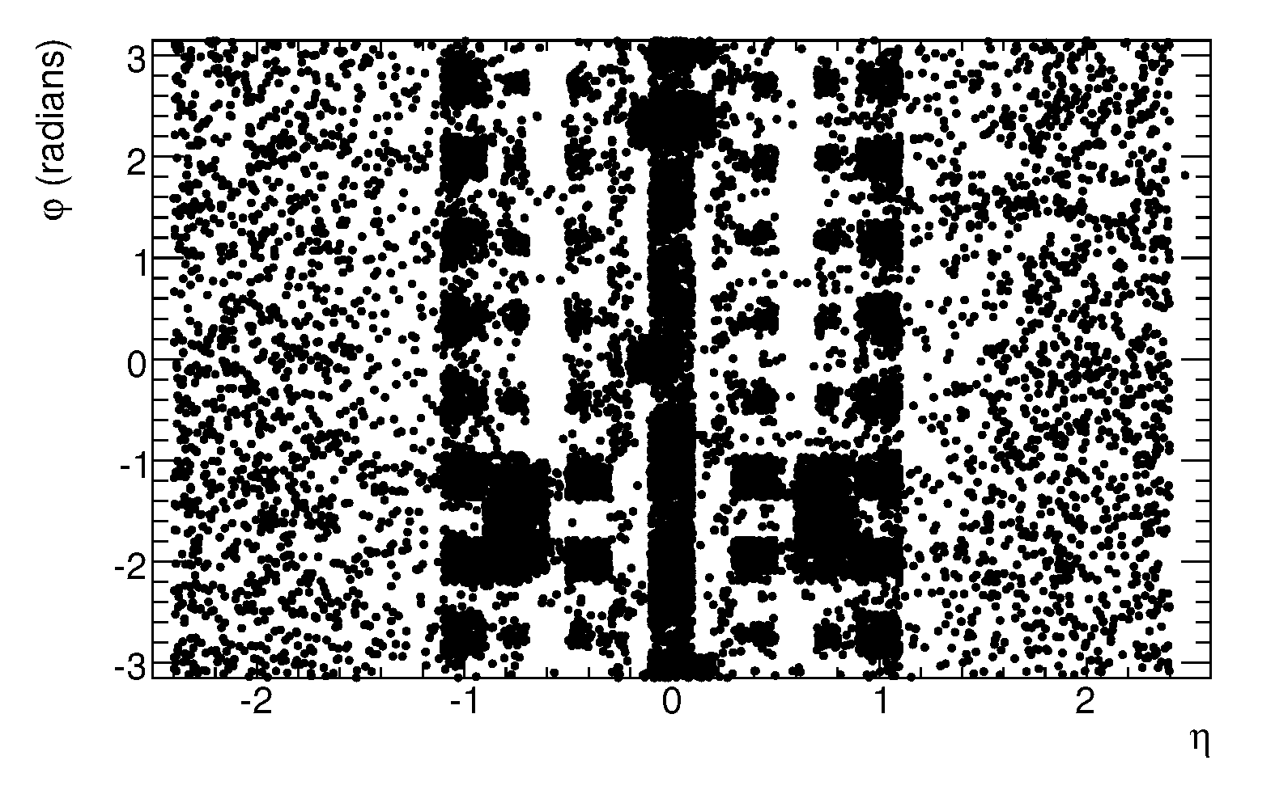
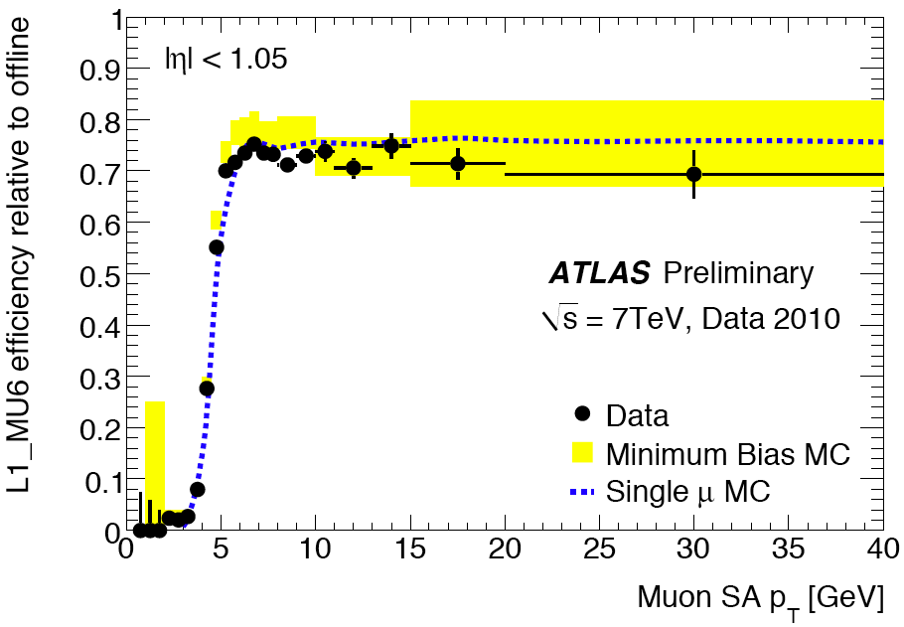
Muon Trigger
Low P_{T}: J/Ψ, Υ and B-physics
High P_{T}: H/Z/W/τ➝μ, SUSY, exotics
Level 1: look for coincidence hits in muon trigger chambers
  Resistive Plate Chambers (barrel) and Thin Gap Chambers (endcap)
  p_{T} resolved from coincidence hits in look-up table
Level 2: refine Level 1 candidate with precision hits from Muon Drift Tubes (MDT) and combine with inner detector track
Event Filter: use offline algorithms and precision; complementary algorithm does inside-out tracking and muon reconstruction
INST 3 (2008) S08003
80% acceptance due to support structures etc.

Slide 12
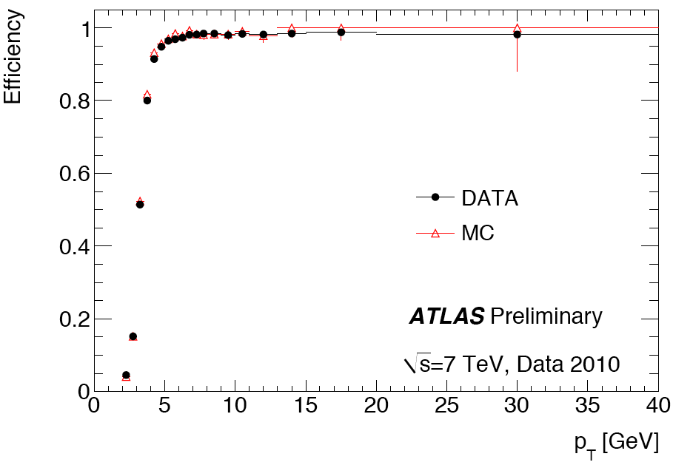
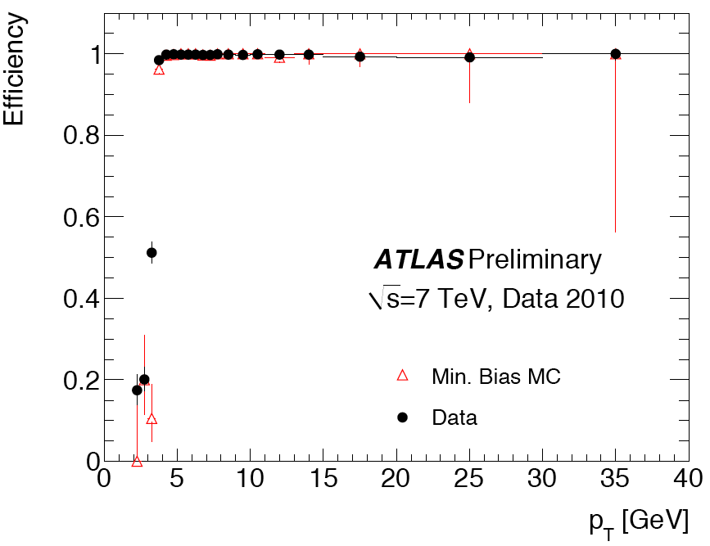
Stand-alone: muons reconstructed from Muon Spectrometer information only
  L2 efficiency > 98% w.r.t. L1 for muons with p_{T} > 4 GeV
  Good agreement with simulation
Combined: muons reconstructed from Muon Spectrometer segment combined with Inner Detector track
  Sharp turn-on and high efficiency
  Good agreement with simulation
Alternative inside-out algorithm also used in Event Filter
Standalone
Level 2 effic. wrt Level 1
p_{T} > 4GeV
Combined
Ev. Filter effic. wrt Level 2
p_{T} > 4GeV
More details in talk by Alexander Oh this afternoon

Slide 13
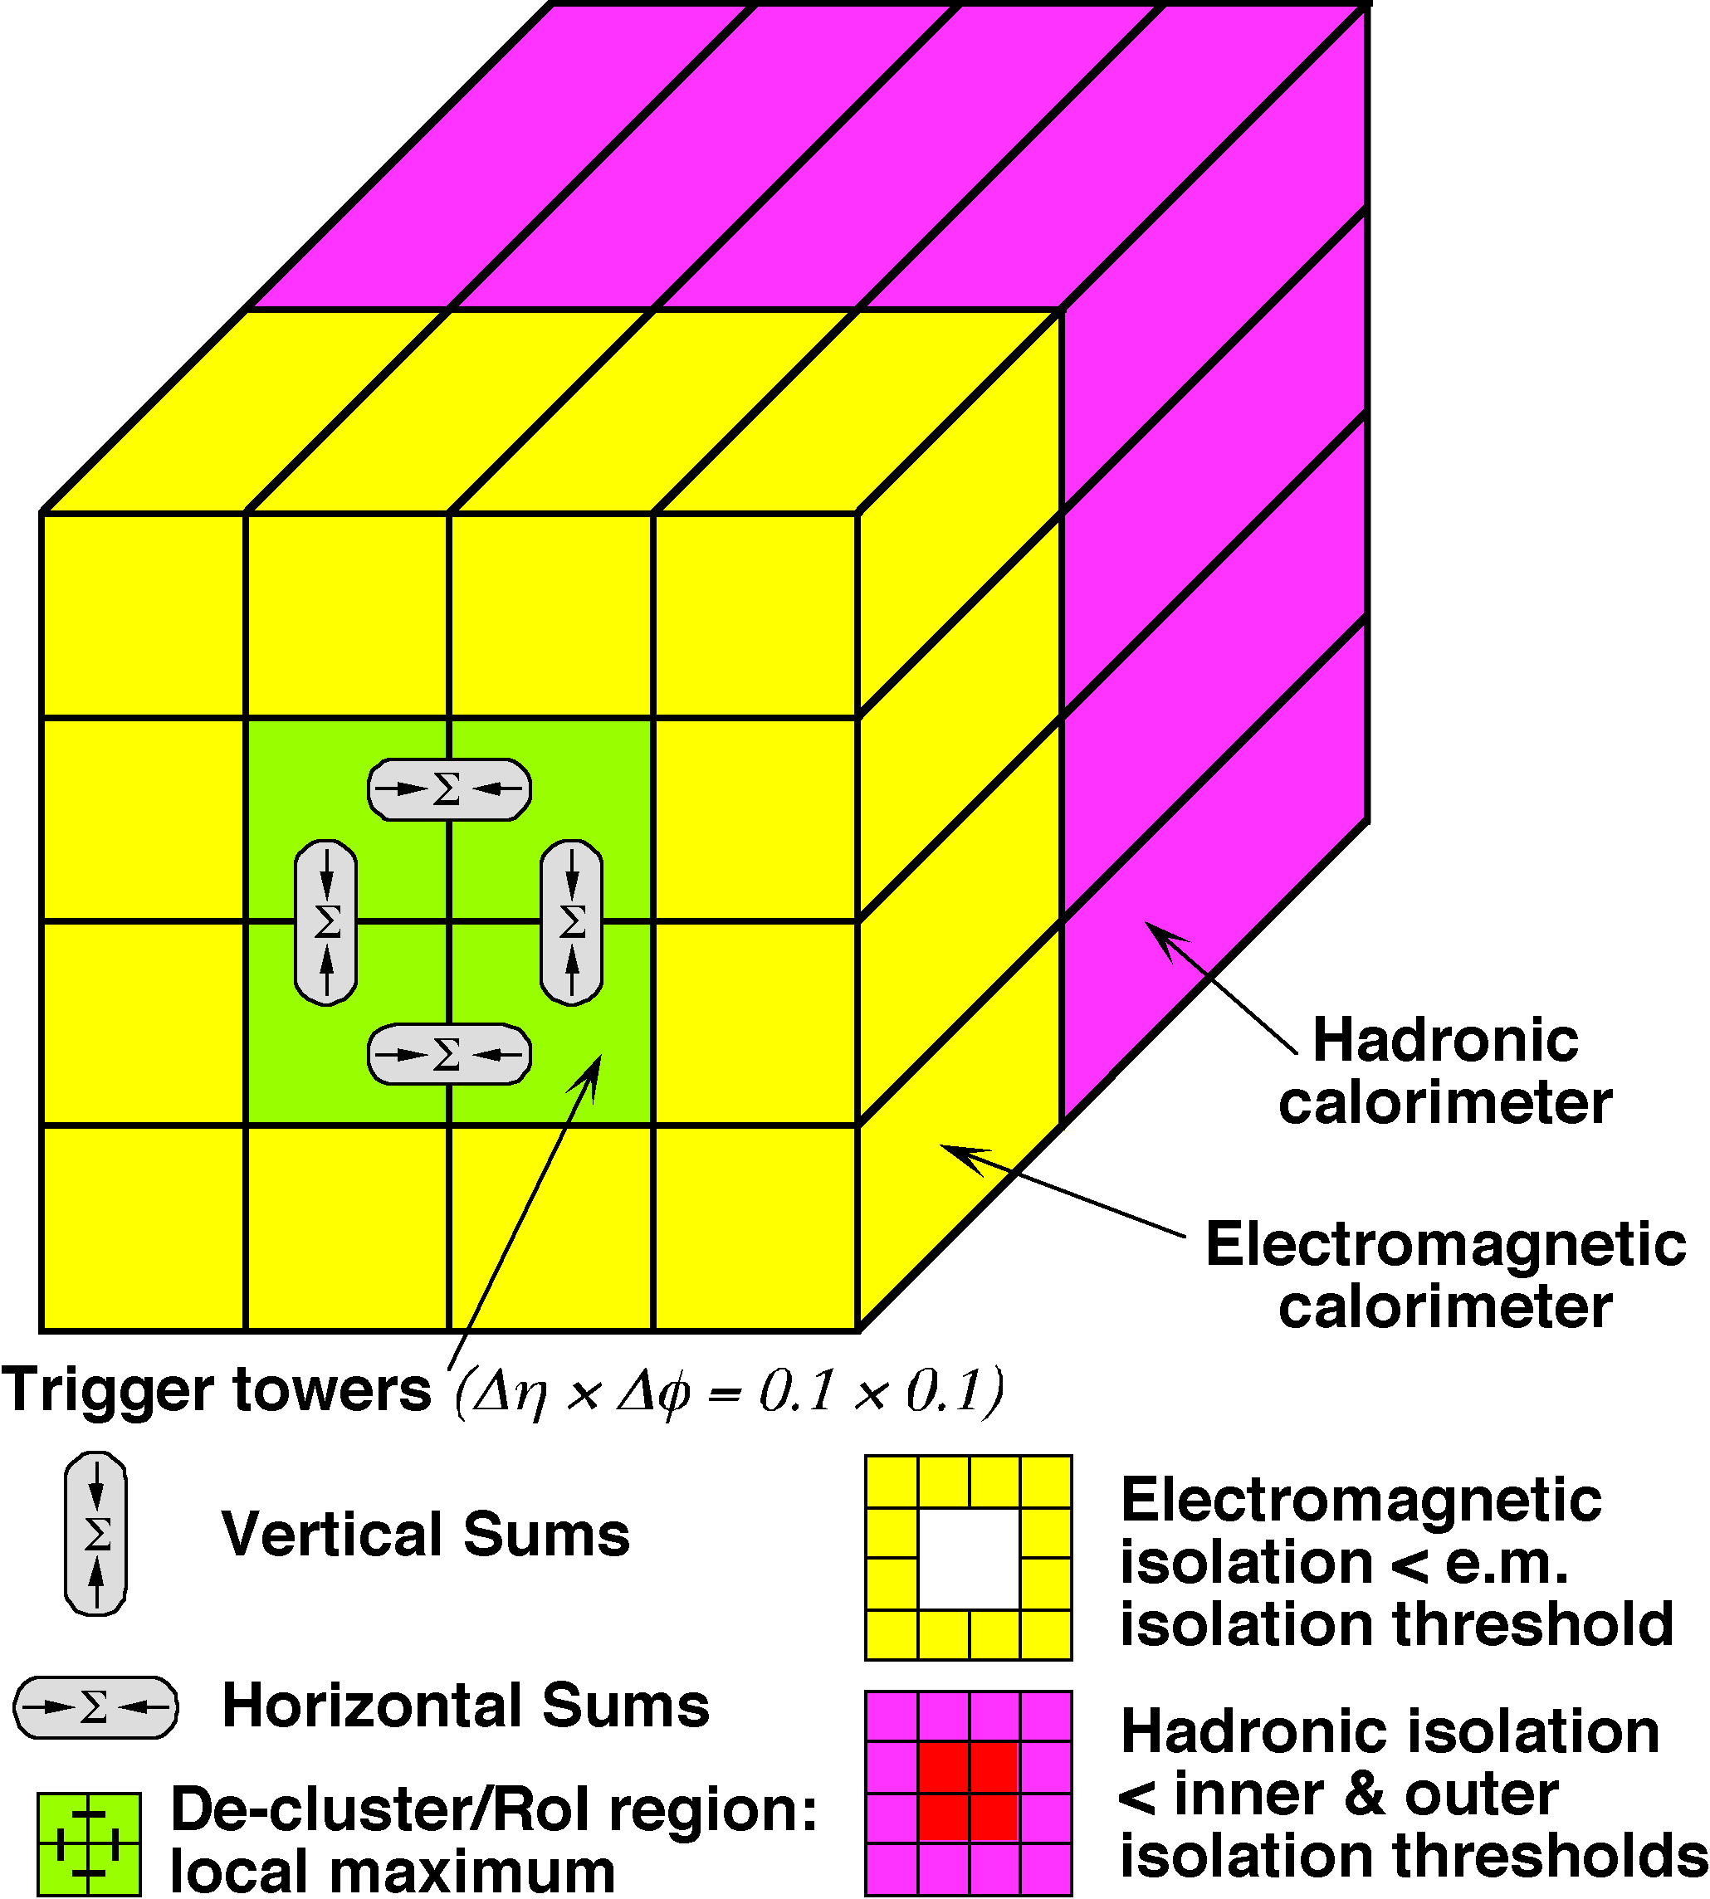
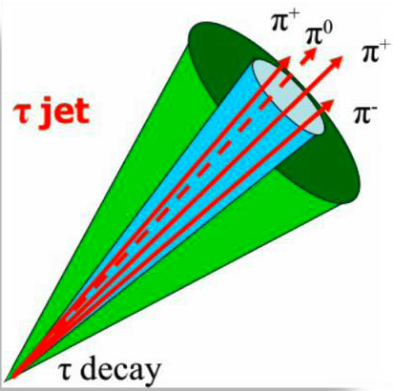
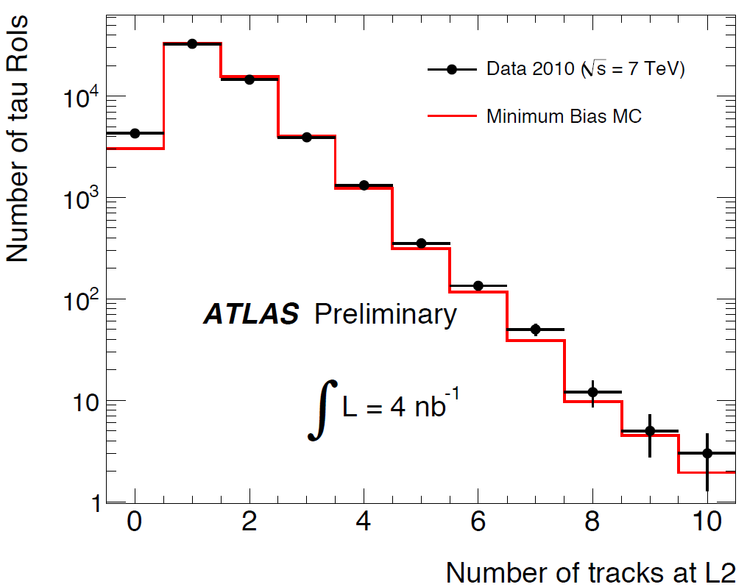
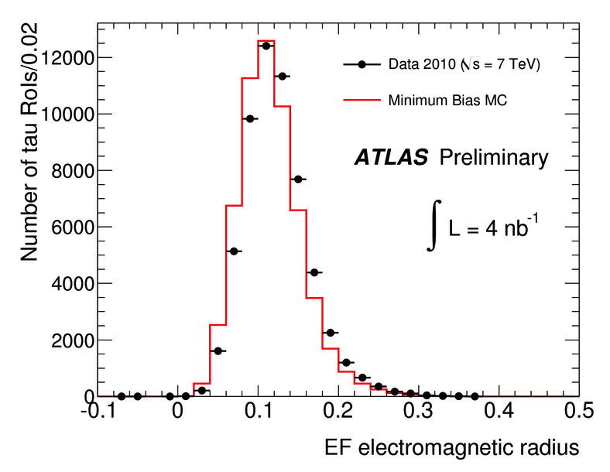
Hadronic Tau Trigger
W/Z ➝ τ, SM &MSSM Higgs, SUSY, Exotics
Level 1: start from hadronic cluster – local maximum in ΔηxΔφ = 0.2x0.2 – possible to apply isolation
Level 2: track and calorimeter information are combined – narrow cluster with few matching tracks
Event Filter: 3D cluster reconstruction suppresses noise; offline ID algorithms and calibration are used
ATLAS-CONF-2010-090

Slide 14
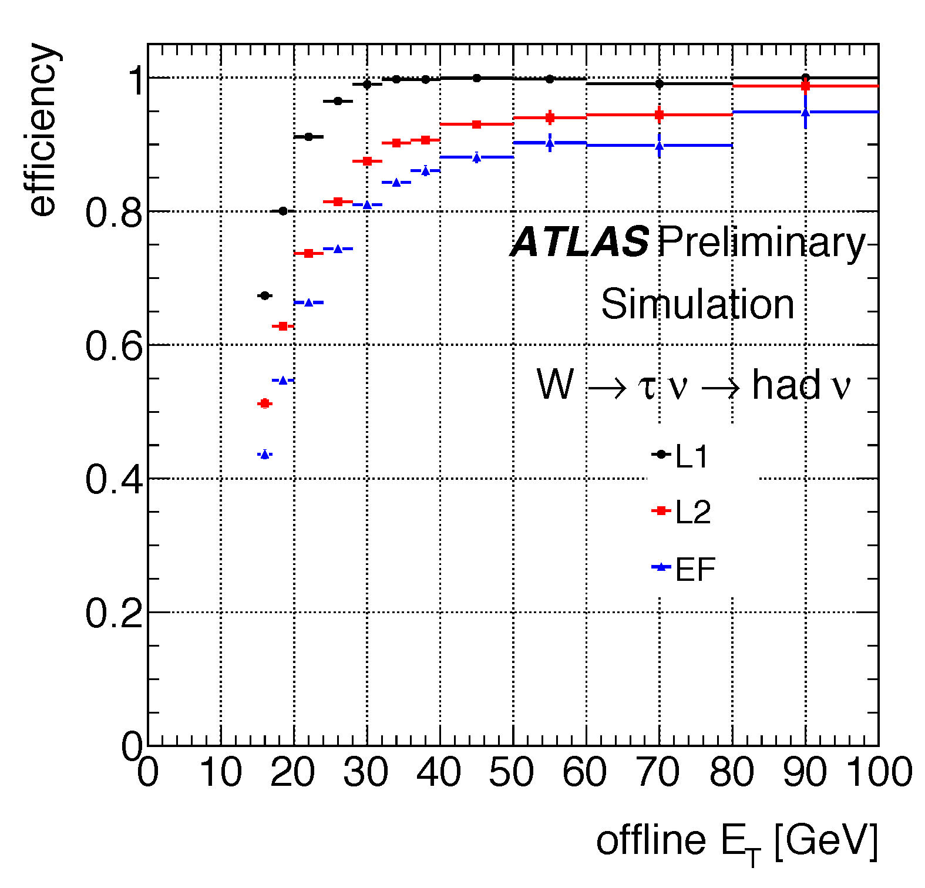
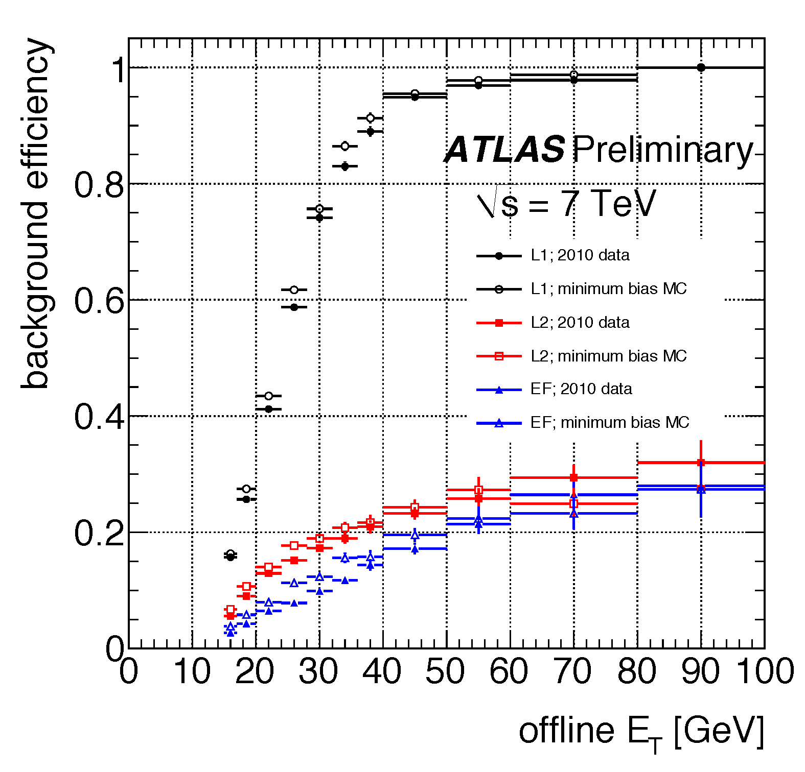
Typical background rejection factor of ≈5-10 from Level 2+Event Filter
  Right: fake rate for loose tau trigger with p_{T} > 12 GeV – aka tau12_loose
  MC is Pythia with no LHC-specific tuning
    Better agreement is expected after underlying-event tuning
Left: EF efficiency ≈80% above threshold for true taus (simulation_
  Obtained for true taus, with respect to taus from offline reconstruction
  Thresholds (tau12_loose): 5GeV (Level 1), 7GeV (Level 2), 12GeV (Ev. Filter)

Slide 15
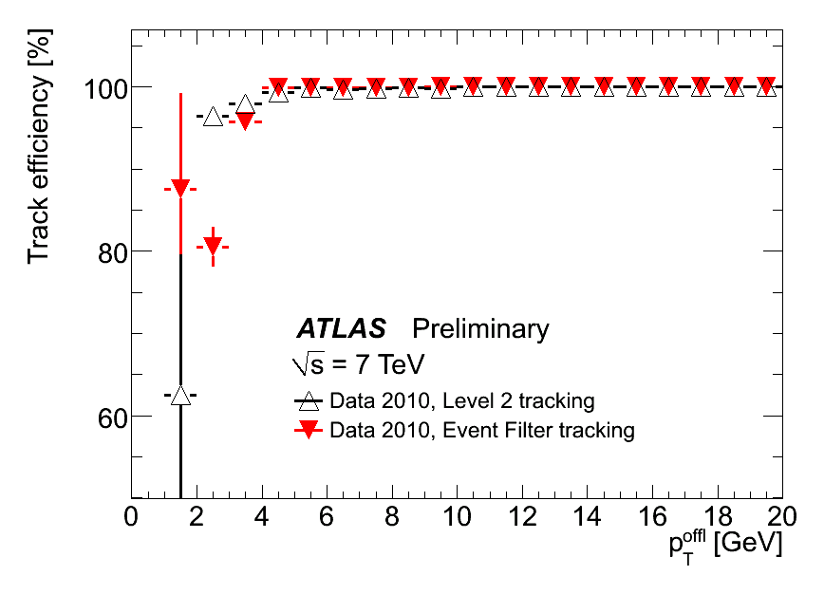
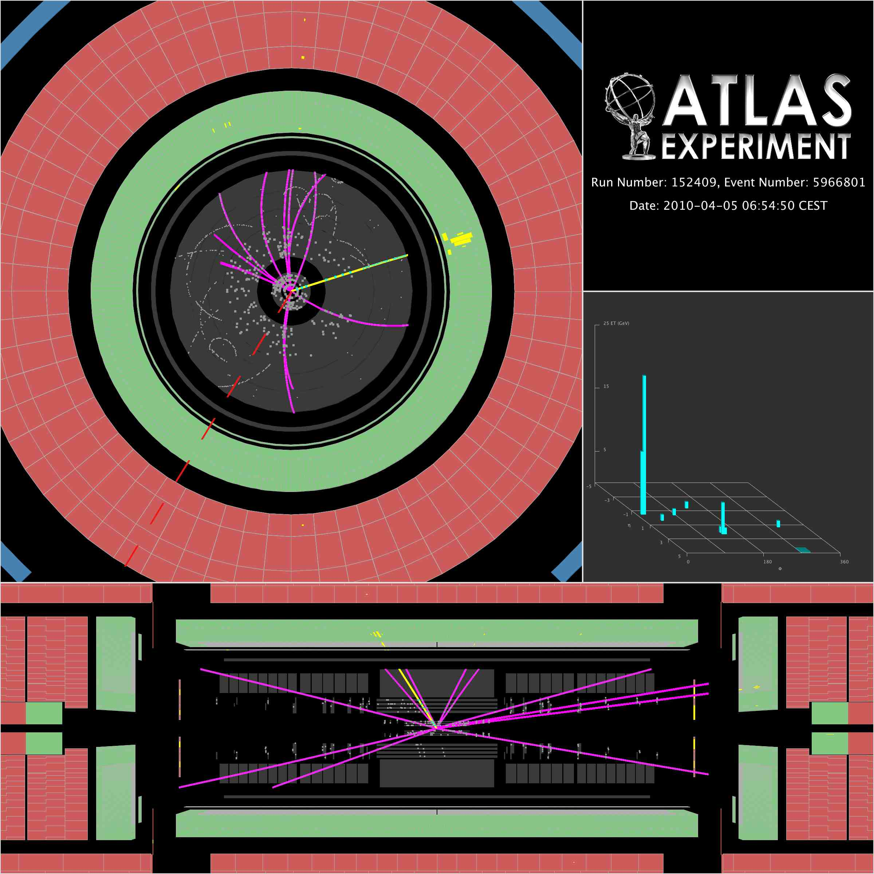
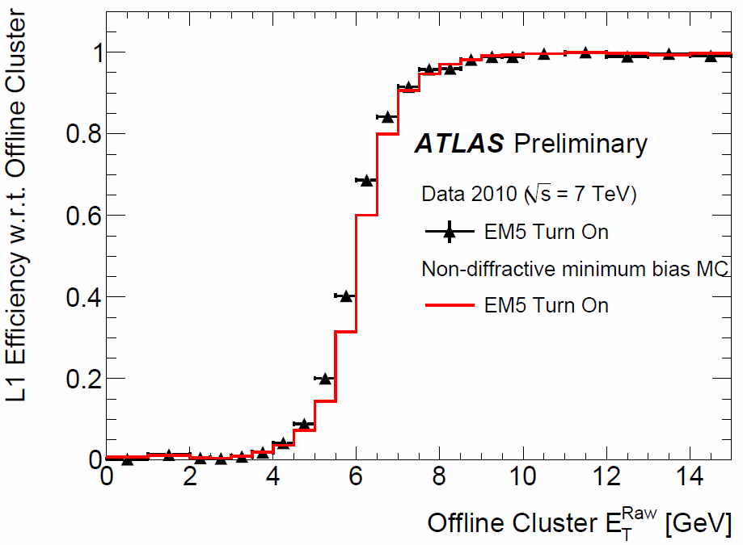
e/γ Trigger
W➝eν
p_{T}≈3-20 GeV: b/c/tau decays, SUSY
p_{T}≈20-100 GeV: W/Z/top/Higgs
p_{T}>100 GeV: exotics
Level 1: local E_{T} maximum in ΔηxΔφ = 0.2x0.2 with possible isolation cut
Level 2: fast tracking and calorimeter clustering – use shower shape variables plus track-cluster matching
Event Filter: high precision offline algorithms wrapped for online running
L1 EM trigger
p_{T} >= 6 GeV

Slide 16
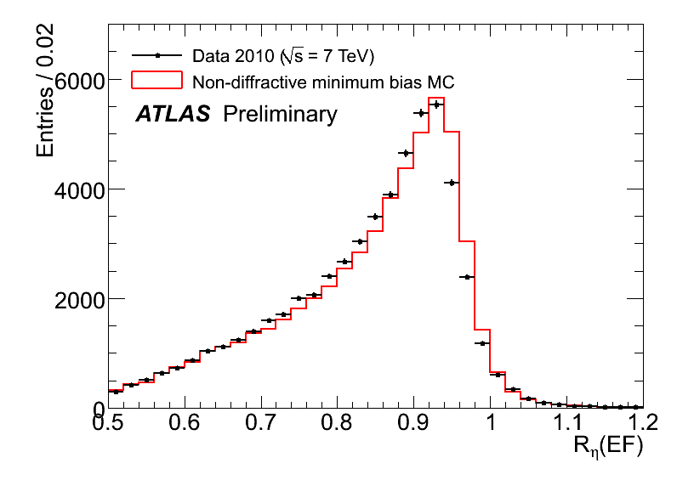
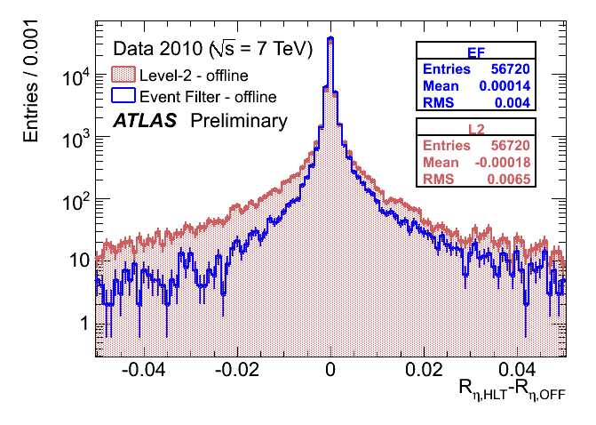
Discriminate against hadronic showers based on shower shape variables
Use fine granularity of LAr calorimeter
Remaining differences between real data and simulation consistent with expected precision of the simulation
Resolution improves in Event Filter with respect to Level 2

Slide 17
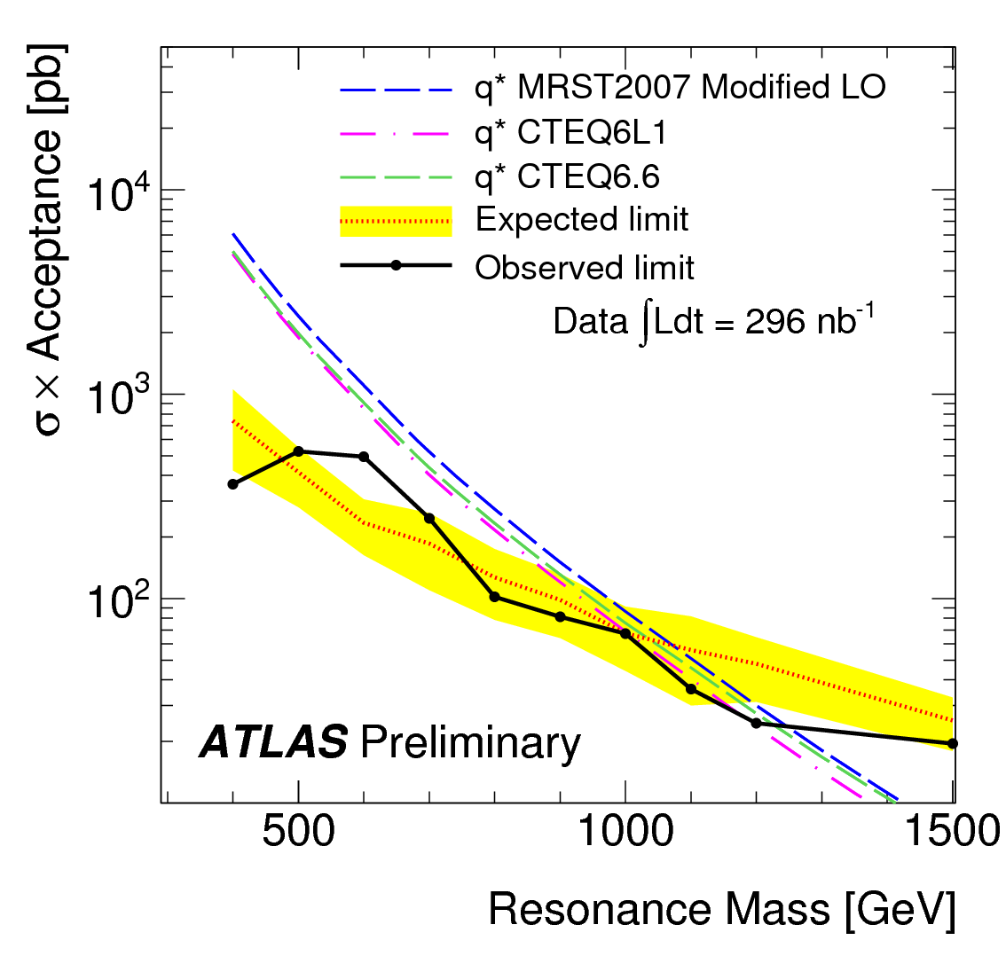
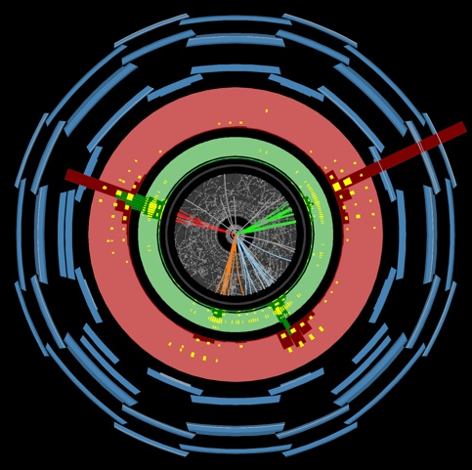
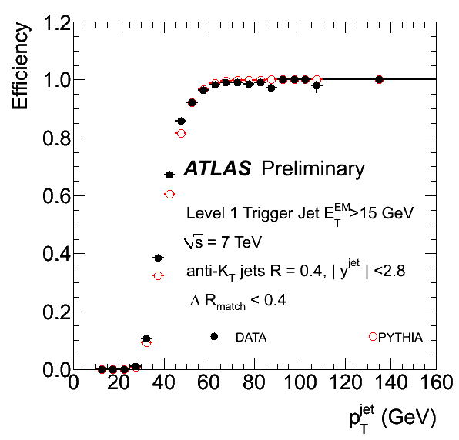
Jet Trigger
QCD multijet production, top, SUSY, generic BSM searches
Level 1: look for local maximum in E_{T} in calorimeter towers of ΔηxΔφ = 0.4x0.4 to 0.8x0.8
Level 2: simplified cone clustering algorithm (3 iterations max) on calorimeter cells
Event Filter: anti-k_{T} algorithm on calorimeter cells; currently running in transparent mode (no rejection)
High Level Trigger running at EM scale plus jet energy scale corrections at the moment
ATLAS-CONF-2010-065
arXiv:1008.2461v1 [hep-ex]
Note in preparation

Slide 18
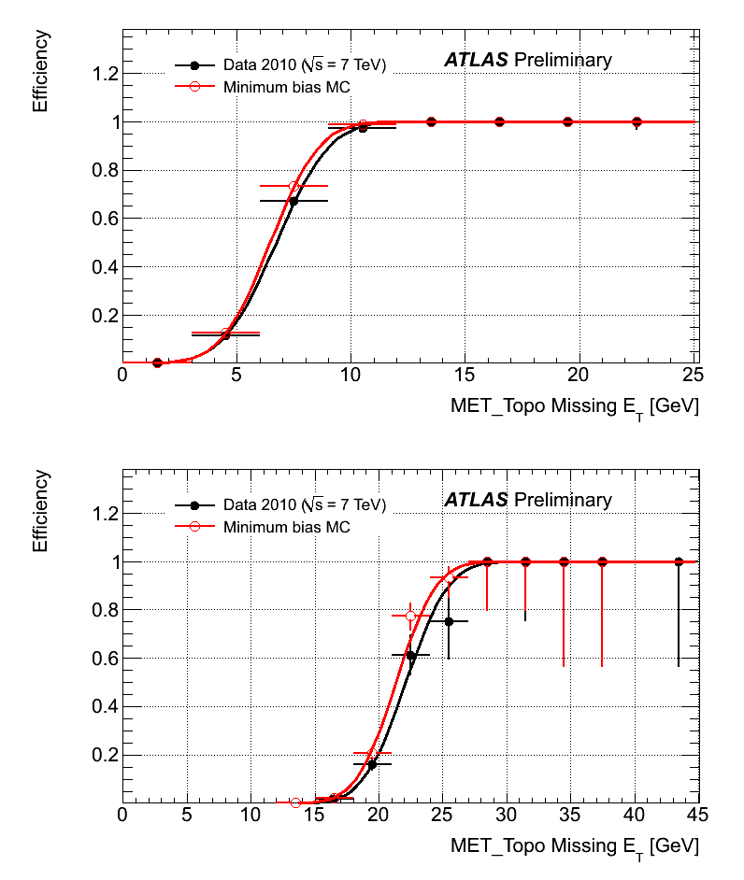
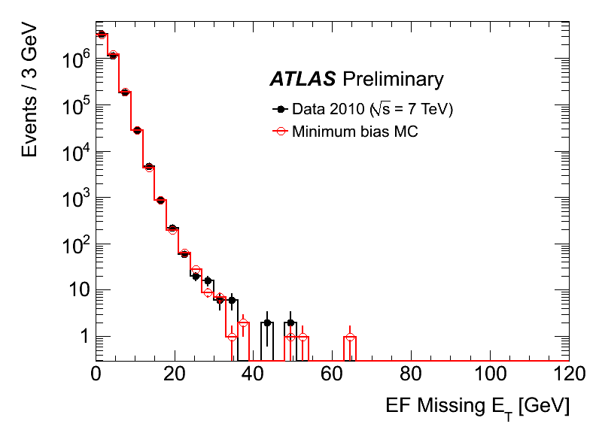
Missing E_{T} Trigger
SUSY, Higgs
Level 1: E_{T}^{miss} and E_{T} calculated from all calorimeter towers
Level 2: only muon corrections possible
Event Filter: re-calculate from calorimeter cells and reconstructed muons
Level 1
5 GeV threshold
Level 1
20 GeV threshold

Slide 19

The Road Ahead

Slide 20
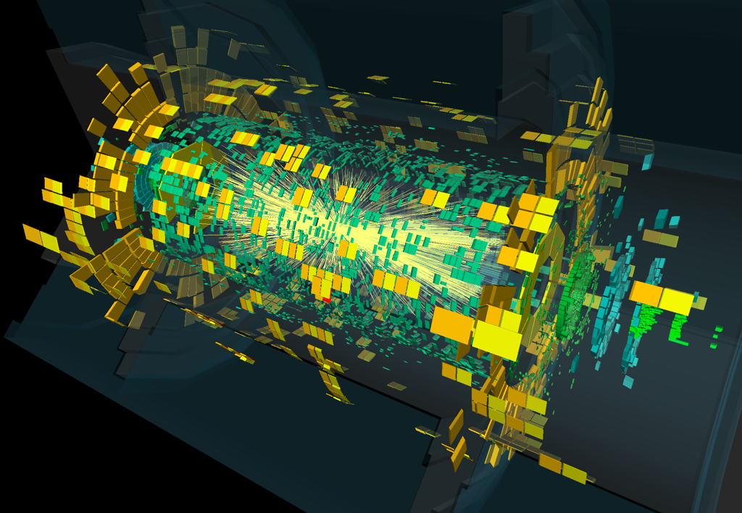
Plans for Heavy Ion Run
Collect ≈3μb⁻¹ of Pb-Pb collisions at 2.76 TeV/nucleon during 4 weeks in November
Take advantage of ATLAS capabilities
  Good angular coverage
  Good particle ID
  Forward scintillators and Zero Degree Calorimeters
Trigger rate ≈ 140 Hz
  σ_{Pb+Pb}≈ 7.6 barn
  L ≈ 1x10²⁵cm⁻²s⁻¹ (1% of design)
  I.e. around 100Hz of collisions
Use modified L1 menu only
  Use as little High Level Trigger as possible
  Avoid tracking if possible (1000s of tracks for central collisions)
Trigger | Triggers, thresholds, etc
Minimum bias | Hits in forward scintillators, zero-degree calorimeter, luminosity detectors etc for wide eta coverage Primary triggers for heavy ion run
Σ E_{T} | 50, 500, 1000, 2000 GeV Centrality trigger and centrality veto to enhance peripheral collisions
Jets | Single and di-jet triggers, scalar sum of jet energy for centrality veto
EM | Single photon and electron triggers
Muons | Single muon and di-muon triggers
Tau | Single tau and di-tau triggers

Slide 21
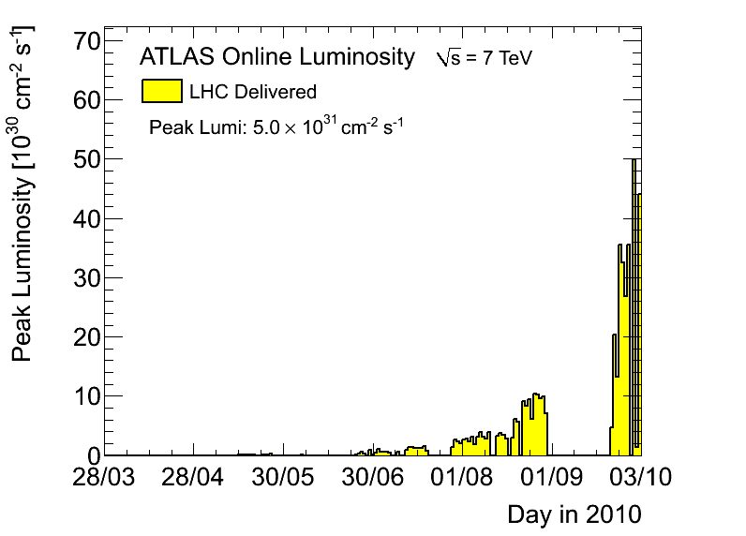
Conclusions
The ATLAS Trigger has successfully coped with a LHC luminosity spanning almost 5 orders of magnitude
It is a flexible and robust system thanks to years of planning, prototyping, commissioning and lots of dedicated work by many people
More sophisticated triggers will be actively used as needed: jets with b-tagging, B physics, jet algorithms at the Event Filter, use of isolation requirements, etc
There is space to evolve! The current selections will continue to be optimized to cope with even higher luminosities
The heavy-ion run will test the ATLAS trigger in a new environment
The ATLAS trigger was instrumental in delivering data for first ATLAS physics measurements and will continue to do so!
L =5x 10³¹ cm⁻²s⁻¹
L = 10³¹ cm⁻²s⁻¹

Slide 22
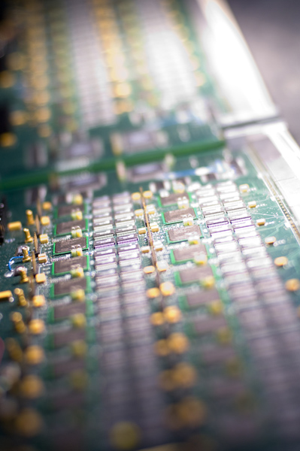
Backup Slides

Slide 23
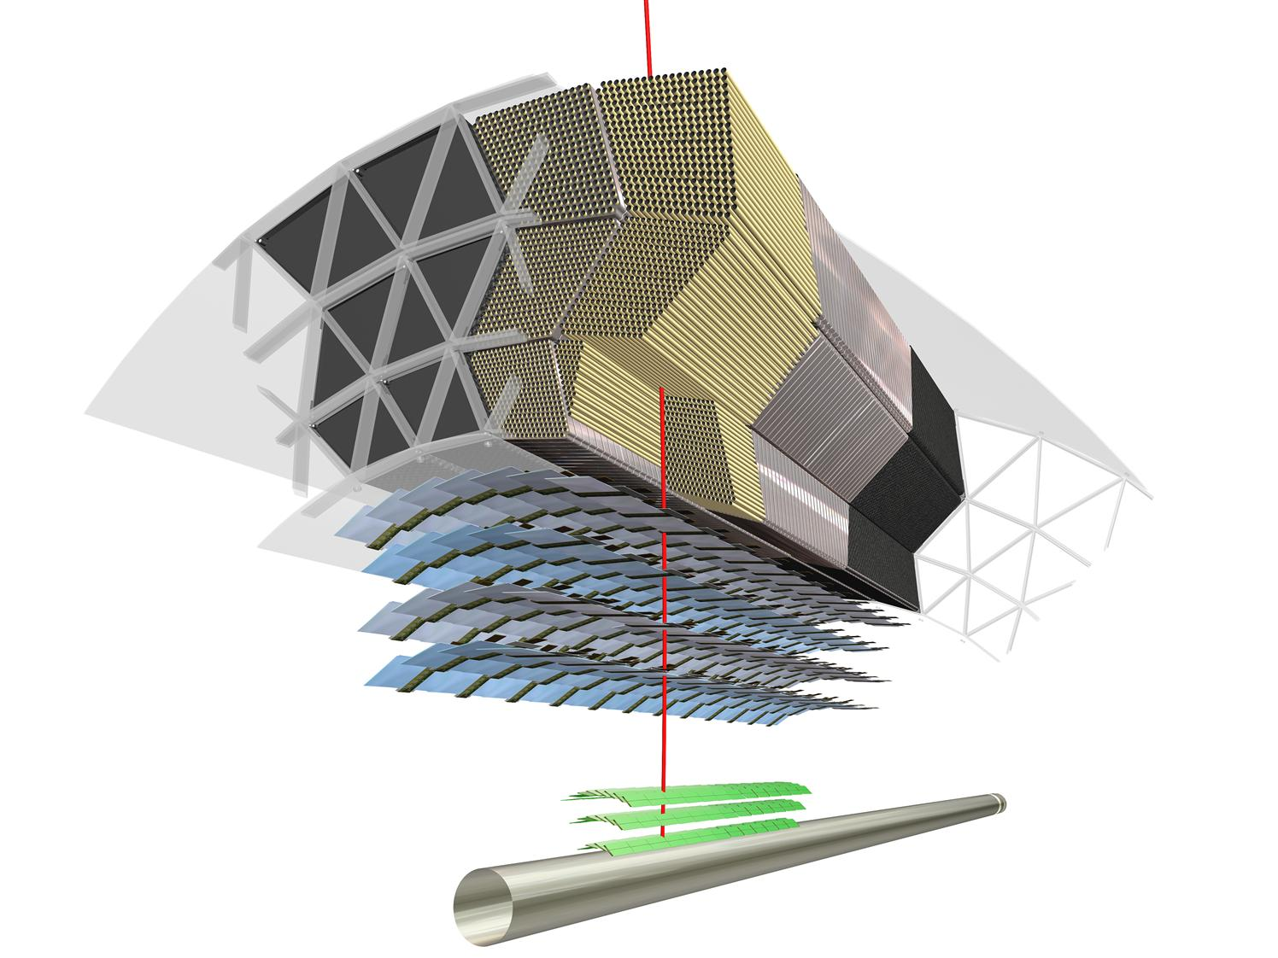

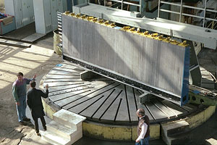
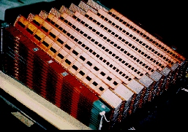
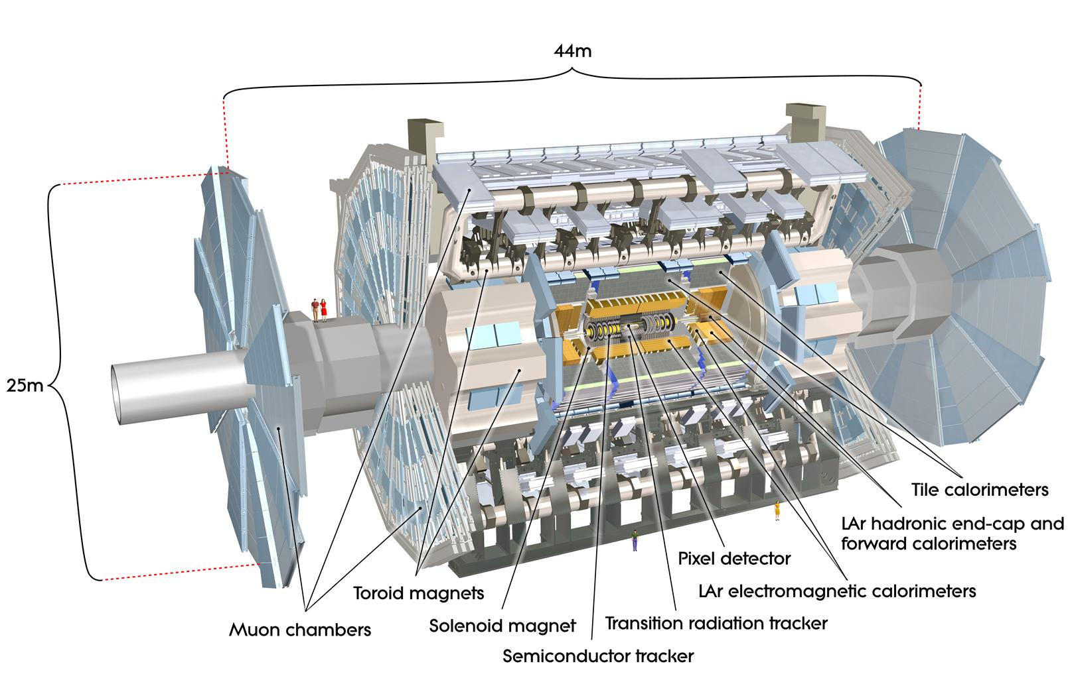
The ATLAS Detector
Large angular coverage:
|η|<4.9; tracking in|η|<2.5
Inner detector: pixels, Si-strips and transition Radiation Tracker in for particle identification
Liquid Argon electromagnetic calorimeter with accordion geometry
Iron-scintillating tile hadronic calorimeter; tiles placed radially and staggered in depth
Toroidal magnetic field (peak 4T) in air-core toroids; 2T in solenoid around Inner Detector

Slide 24
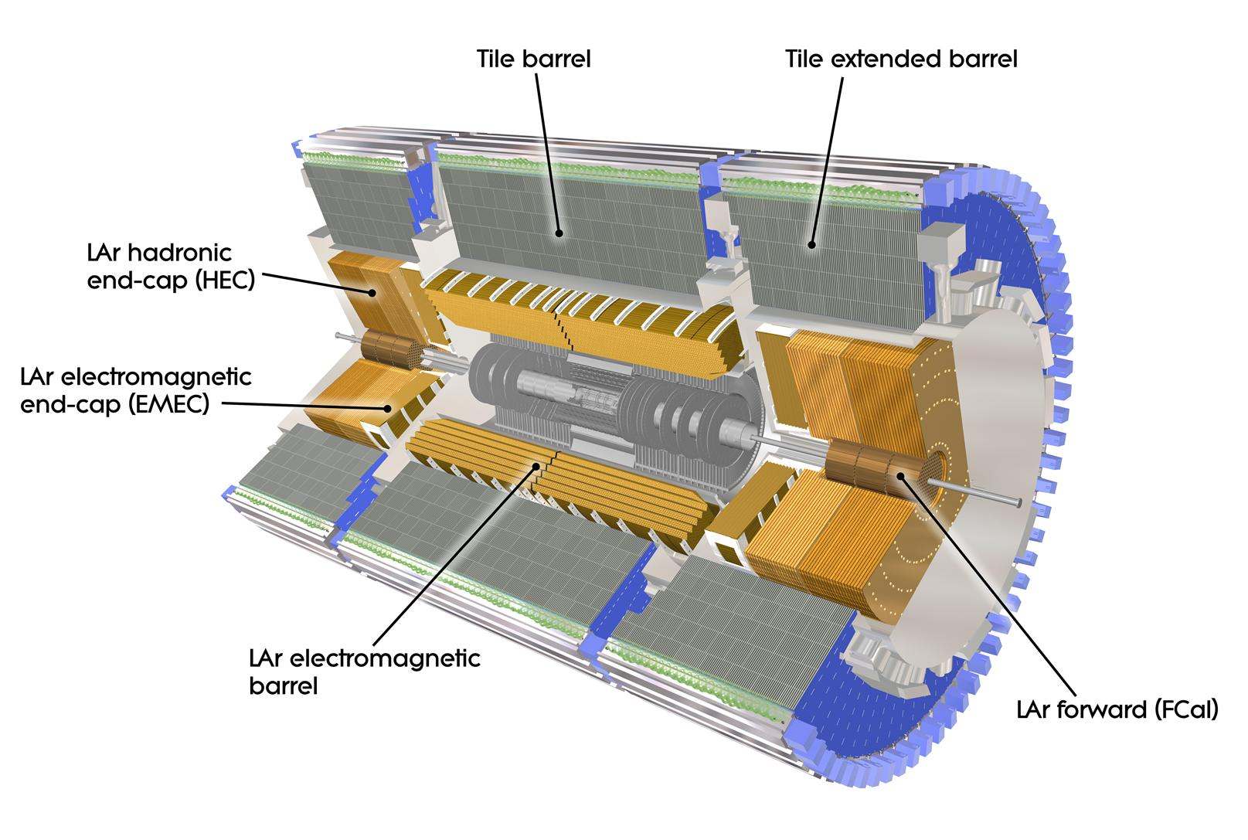
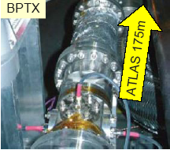
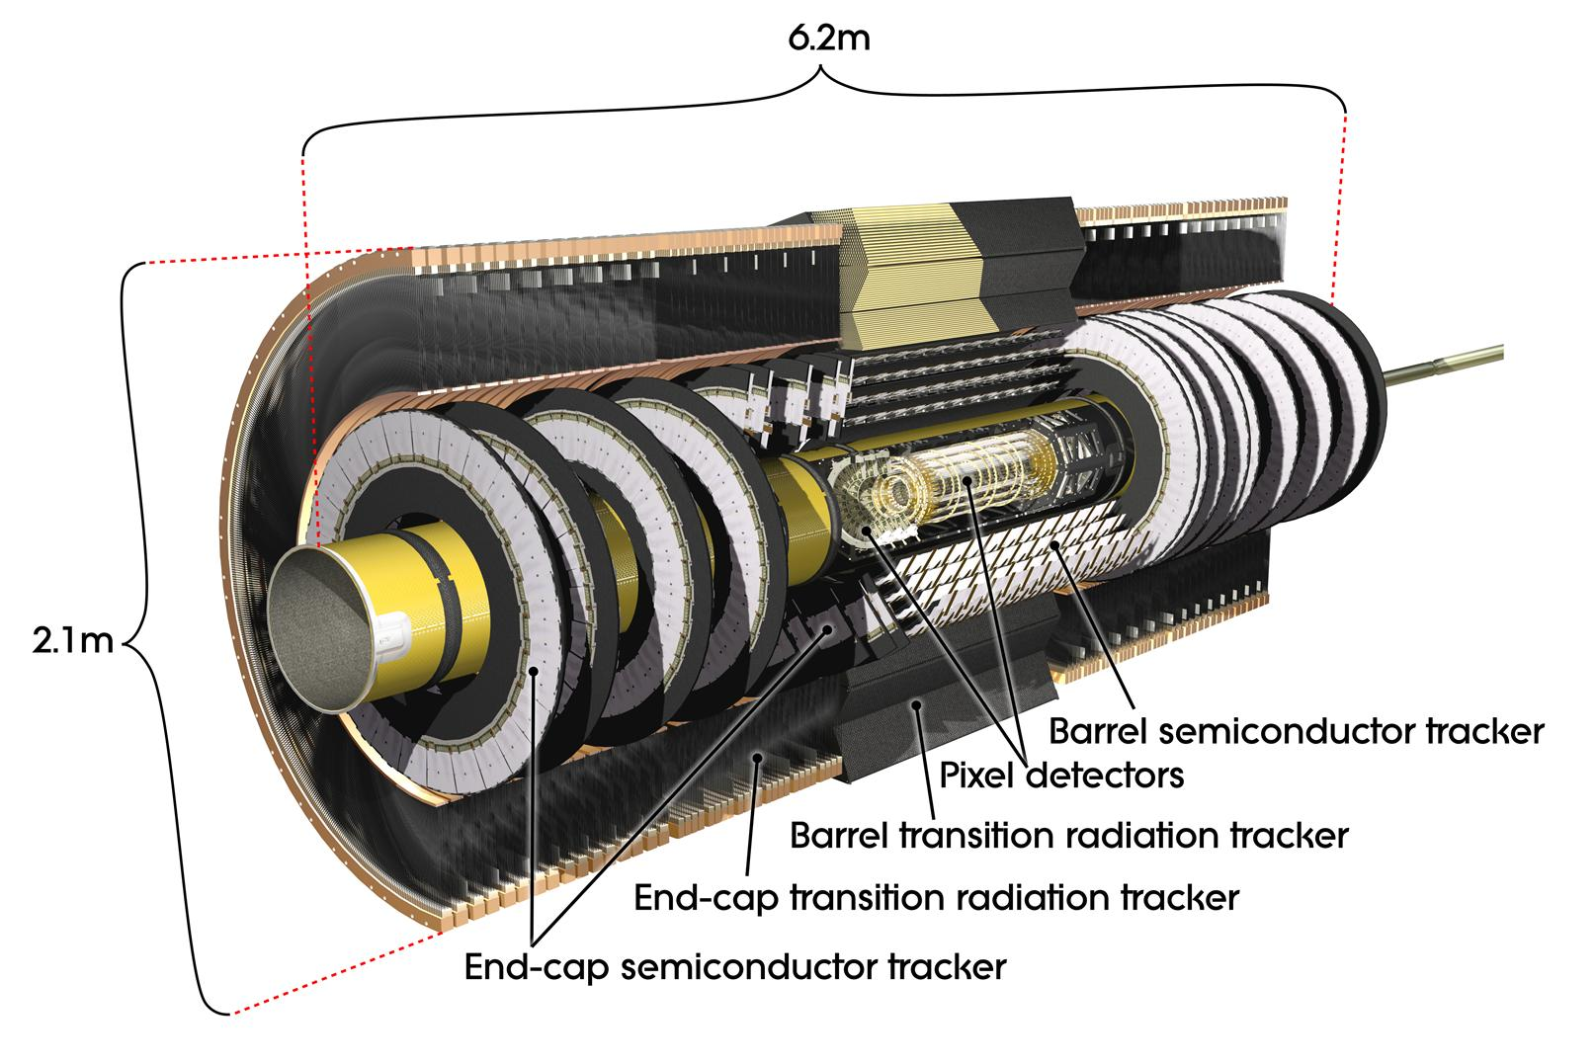
160000 channels
Beam Pickup: at ± 175m from ATLAS
Trigger on filled bunch
Provide the reference timing
Minbias Trigger Scintillator:
32 sectors on LAr cryostat
Main trigger for initial running
η coverage 2.1 to 3.8
Pixel: 10x100μm; 80 M channels
Strips: 80μm; 6 M channels

Slide 25
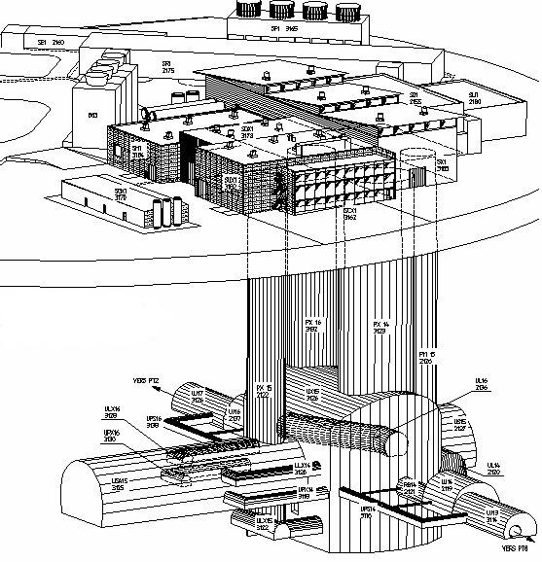
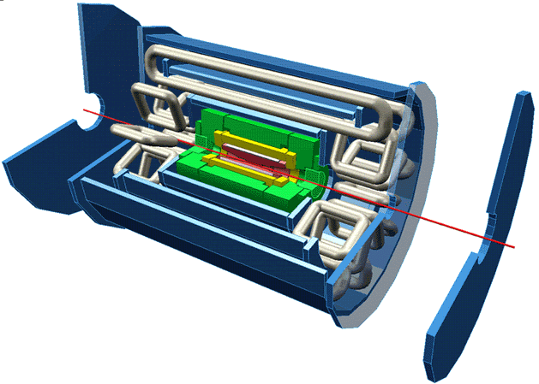
Trigger / DAQ architecture
CERN
computer
centre
4-code dual-socket nodes
6
~1600
~100
~ 500
Event rate
~ 200 Hz
Local
Storage
SubFarm
Outputs
(SFOs)
Event
Filter
(EF)
Event
Builder
SubFarm
Inputs
(SFIs)
LVL2
farm
Second-
level
trigger
Data
storage
DataFlow
Manager
Network
switches
pROS
stores
LVL2
output
Network switches
LVL2
Super-
visor
Gigabit Ethernet
Event data requests
Delete commands
Event data
pulled:
partial events
@ ≤ 100 kHz,
full events
@ ~ 3 kHz
Event size
~1.5MB
Requested event data
Regions Of Interest
Data of events accepted
by first-level trigger
~150
PCs
1600
Read-
Out
Links
VME
Dedicated links
Read-Out
Subsystems
(ROSs)
Read-
Out
Drivers
(RODs)
RoI
Builder
First-
level
trigger
Timing Trigger Control (TTC)
Event data pushed @ ≤ 100 kHz,
1600 fragments of ~ 1 kByte each

Slide 26
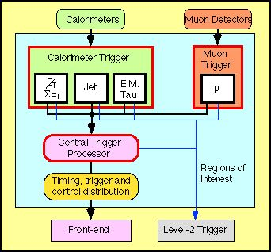
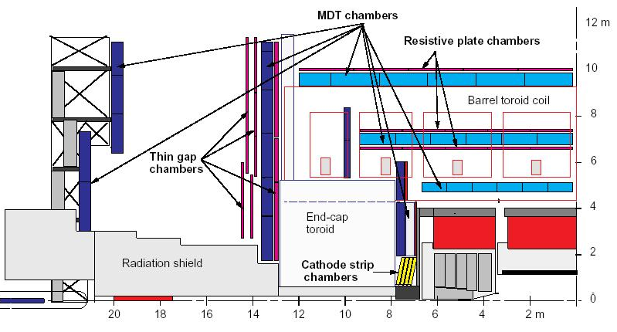
Level 1 architecture
Level 1 uses calorimeter and muon systems only
Muon spectrometer:
  Dedicated trigger chambers
    Thin Gap Chambers – TGC
    Cathode Strip Chambers – CSC
Calorimeter:
  Trigger towers group calorimeter cells in coarse granularity: Δη×Δϕ = 0.1×0.1 (EM/Tau); Δη×Δϕ = 0.2×0.2 (Jets)
Identify regions of interest (RoI) and classify them as MU, EM/Tau, Jet
Information passed to level 2:
  RoI type
  E_{T} threshold passed
  Multiplicity
  Location

Slide 27

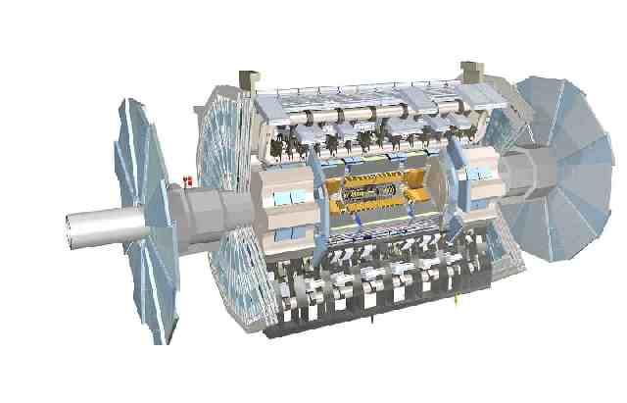
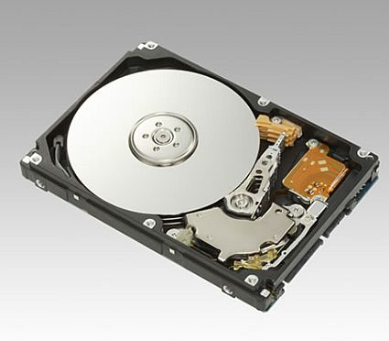
Trigger Configuration
Trigger Database .
configures
saved in
Conditions .
event data
configuration
Analysis .
Data .

Slide 28
Trigger Commissioning
Commissioning with cosmics, single-beam 2008 & 2009:
  Initial timing in of Level-1 signals, ready for first collisions
First Collisions : Dec 2009 : 900 GeV; Mar 2010 : 2.36 TeV; 30 March 2010 : 7 TeV
  Level-1 active
  HLT running online in monitoring mode - no HLT rejection*:
Luminosity cm⁻²s⁻¹
10²⁷ 2x10²⁷ 5x10²⁷ 10²⁸ 2x10²⁸ 5x10²⁸ 10²⁹ 2x10²⁹ 5x10²⁹ 10³⁰ 2x10³⁰ 5x10³⁰ 10³¹ …10³²
2010
April
May
June
July
August onwards
Level-1 Active
HLT Monitoring Mode
Progressively
activate HLT
HLT active
Min. Bias trigger records all collisions
Min. Bias pre-scaled
e, γ, Jet, τ, μ and MET not pre-scaled
1.5 x 10²⁹ : e & γ 4x10²⁹ : τ
6x10²⁹ : forward μ
1x10³⁰ : MET
Physics menu deployed: Shift focus from commissioning to physics
Progressive activation of HLT :
  Prescale sets pre-generated covering fixed luminosity ranges:
    Can be updated before or during the run to match machine conditions.
* Control Trigger: Random Bunch crossing + Inner Detector Hits at HLT – 1st trigger actively rejecting - already in 2009.
Notes:
Commissioning with cosmics, single-beam 2008 & 2009:
initial timing in of Level-1 signals, ready for first collisions
First Collisions L<2x10²⁹cm⁻²s⁻¹ : Dec 2009 : 900 GeV; Mar 2010 : 2.36 TeV; April 2010 : 7 TeV
Event selection for first Physics using Level-1
HLT running online in monitoring mode - no HLT rejection (except Min. Bias control trigger)
Allows detailed validation of HLT triggers ready to activate selection when needed
Provides online beam-spot measurement based on Level-2 Tracking
Up to L~2x10²⁷ cm⁻²s⁻¹ Minimum Bias trigger used to record all collisions
When rate exceeded ~300Hz, Minimum Bias trigger pre-scaled
Level-1 electron/photon, Jet, Tau, Muon and Missing E_{T} triggers un-pre-scaled
7 TeV Collisions 2x10²⁹cm⁻²s⁻¹ < L < 2x10³⁰cm⁻²s⁻¹ June/July 2010:
Progressive enabling of HLT
1.5 x 10²⁹ : e & γ 4x10²⁹ : τ 6x10²⁹ : μ in end-caps 1x10³⁰ : Missing E_{T}
Prescale sets pre-generated covering fixed luminosity ranges.
Can be updated during the run to match machine conditions.
Physics menu: being deployed now for running L> 2x10³⁰cm⁻²s⁻¹:
Shift of emphasis from commissioning to physics

Slide 29
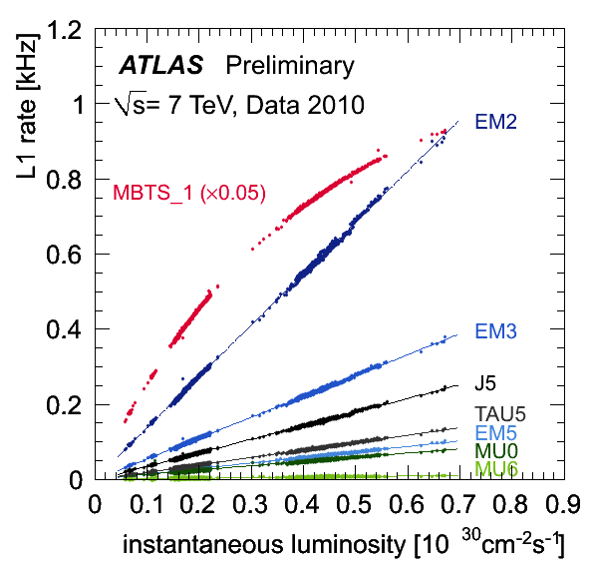
Level 1 trigger rate for various trigger selections up to L = 7x10²⁹cm⁻²s⁻¹

Slide 30

Time Difference between forward and backward counters signal collisions events:

Slide 31

1 pb⁻¹/day

Slide 32

Example: level 2 e/γ calorimeter reconstruction
Full granularity but short time and only rough calibration
Reconstruction steps:
  LAr sample 2; cluster position and size (E in 3x3 cells/E in 7x7 cells)
  LAr sample 1; look for second maxima in strip couples (most likely from π⁰→γγ, etc)
  Total cluster energy measured in all samplings; include calibration
  Longitudinal isolation (leakage into hadronic calorimeter)
Produce a level 2 EM cluster object
π⁰
γ

Slide 33


Example: level 2 tracking algorithm
Form pairs of hits in Pixel and SCT in thin φ slices;
  extrapolate inwards to find Z_{vtx} from a 1D histogram
Using Z_{vtx}, make 2D histogram of hits in η-φ plane;
  remove bins with hits in too few layers
Do 2D histogram using space point triplets in 1/p_{T}-φ plane;
  Form tracks from bins with hits in >4 layers
Use Kalman technique on the space points obtained in previous steps
  Start from already estimated parameters: Z_{vtx}, 1/p_{T}, η, φ
Full granularity but short time
Algorithms optimised for execution speed, including data access time
Produce level 2 tracks
ρ
Z
Z
Y
Y
ρ
X
X
Z

