Slide 1
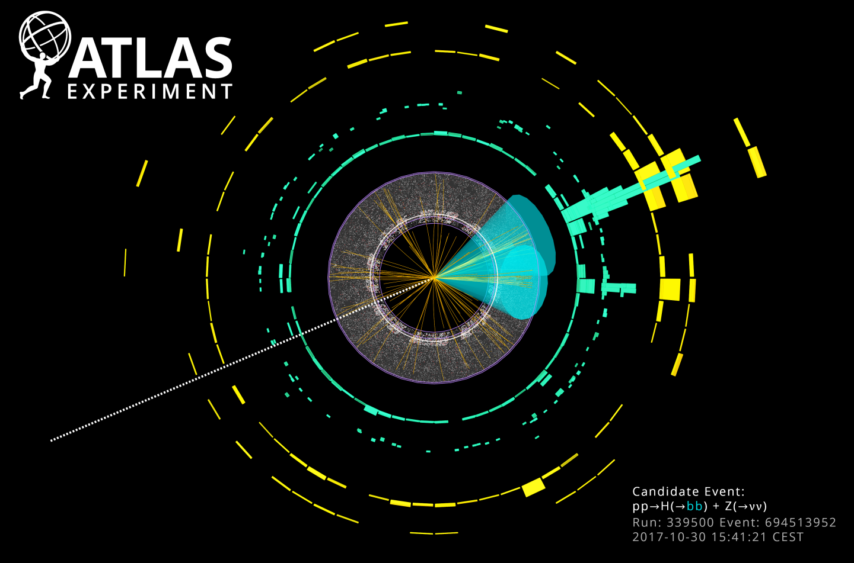





News from the Higgs front
Ricardo Gonçalo
LIP - Laboratório de Instrumentação e Física Experimental de Partículas
Faculdade de Ciências da Universidade de Lisboa

Slide 2
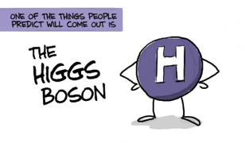
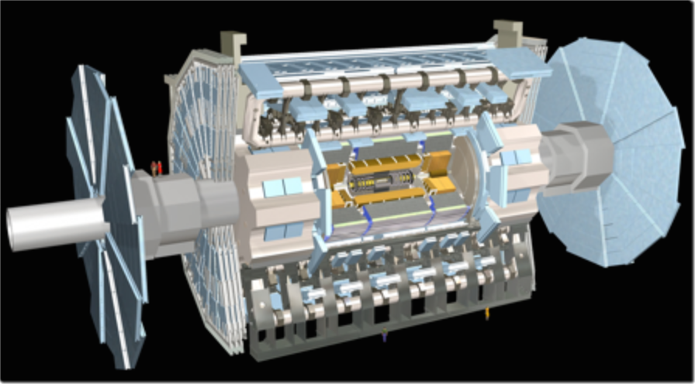
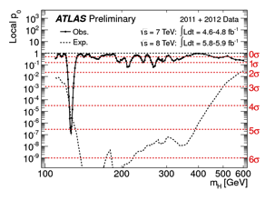




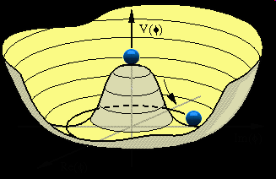
Outlook
The Standard Model and the Higgs
The LHC and experiments
The Run 1 legacy
Probing the 125 GeV Higgs
Probing the Yukawa sector
Searching wider
The long run

Slide 3
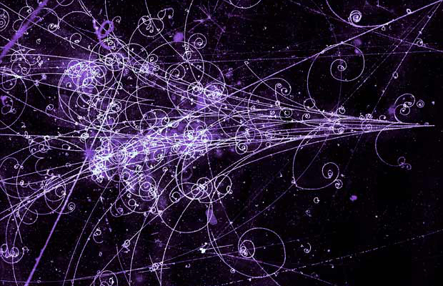
The Standard Model of Particle Physics

Slide 4
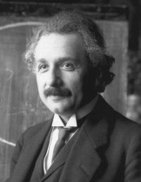
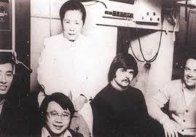
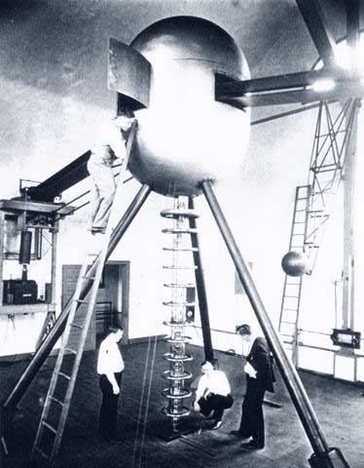
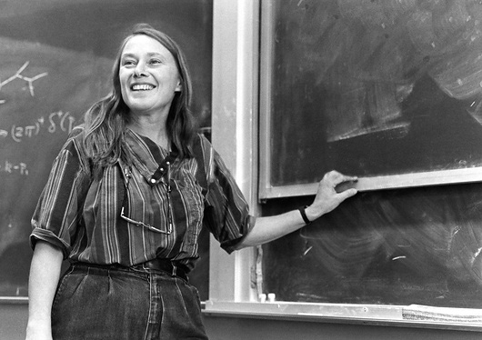
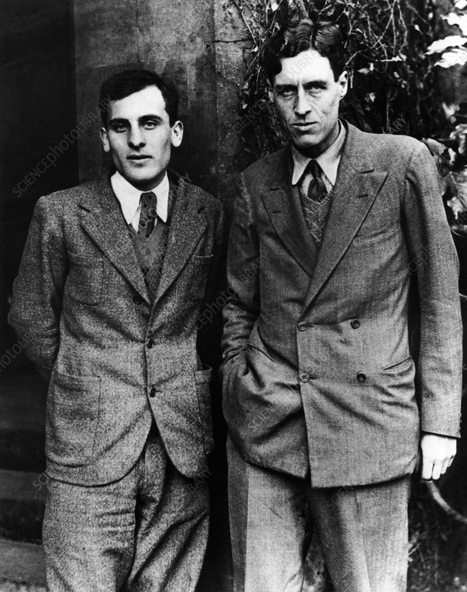
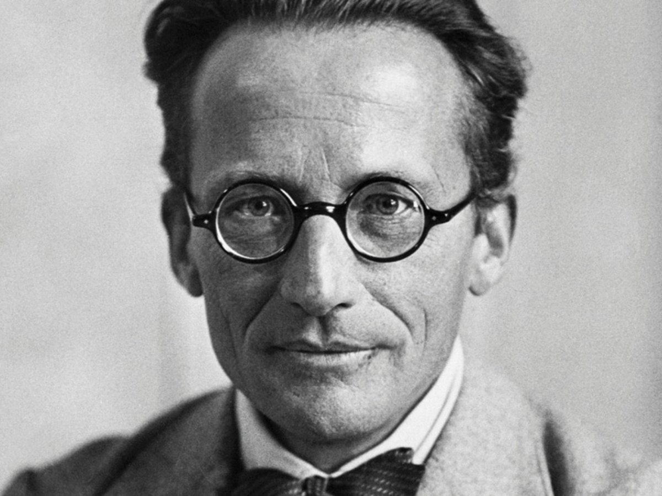
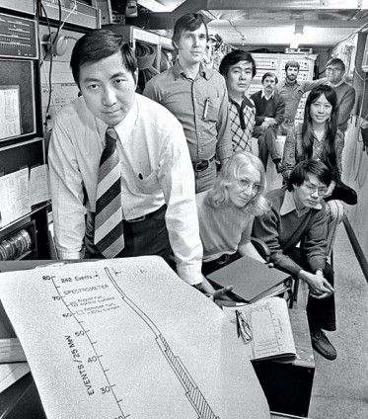
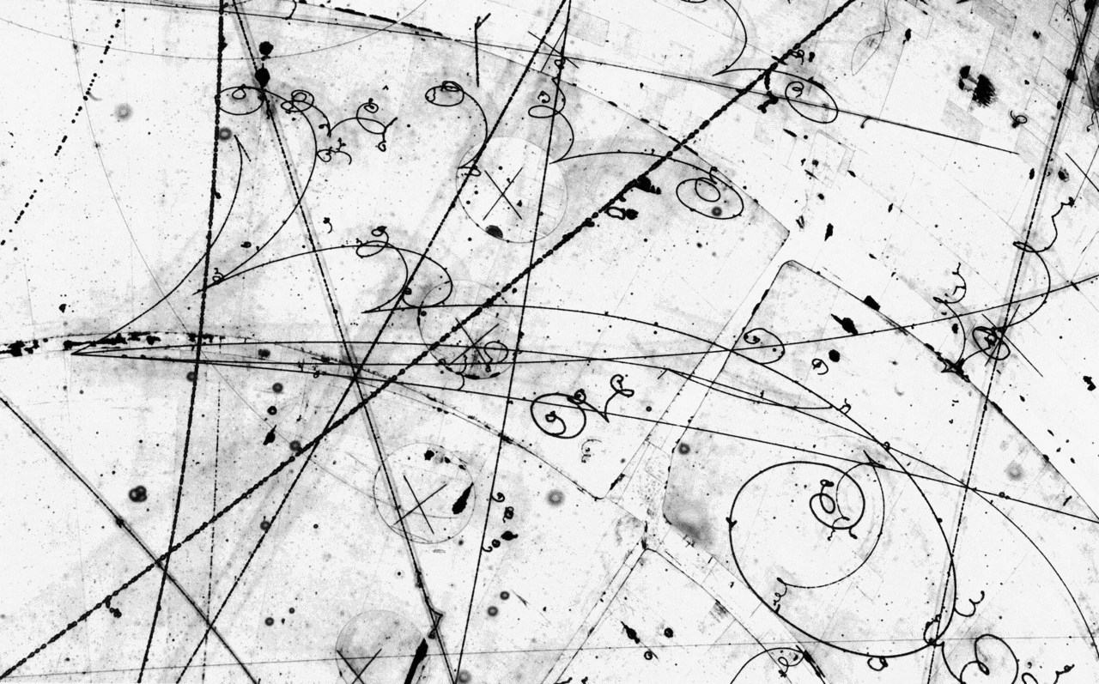
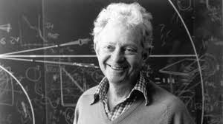
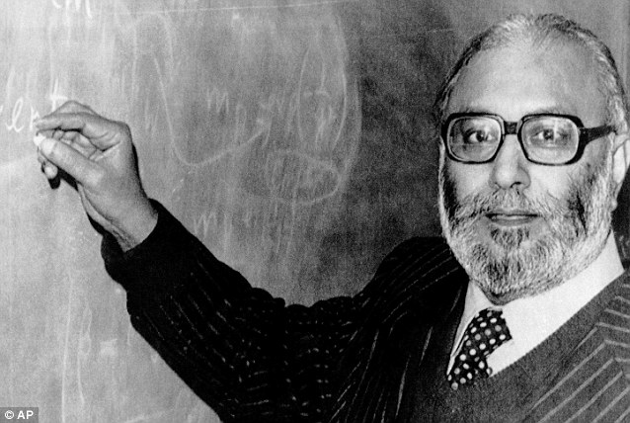

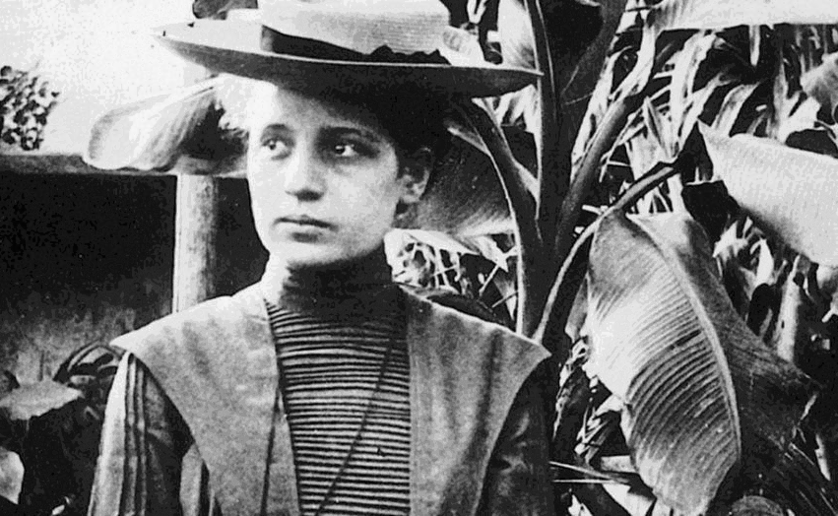
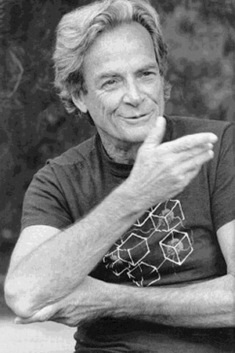
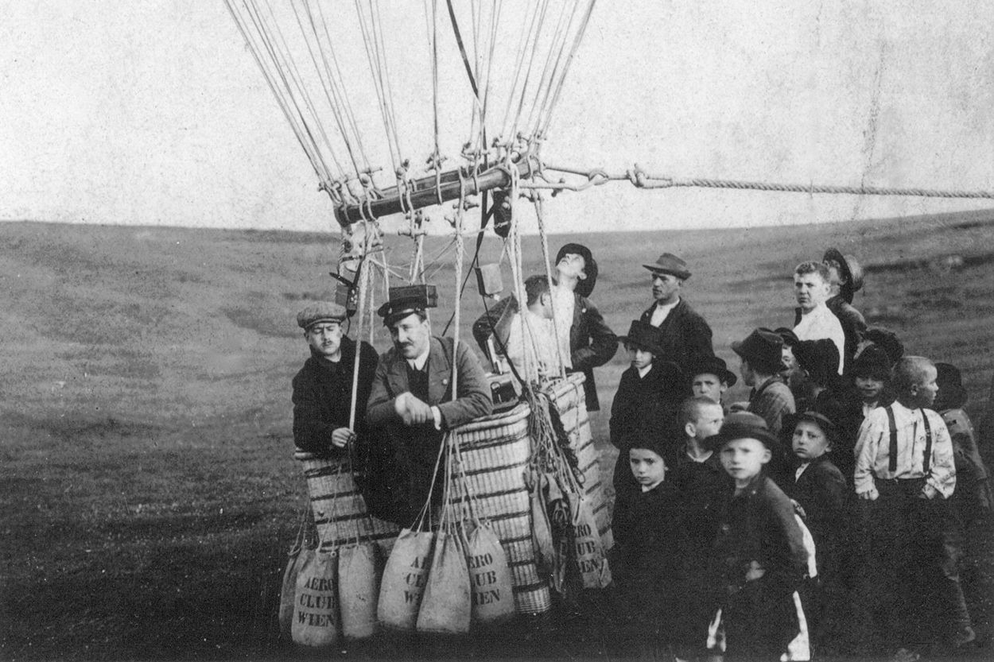
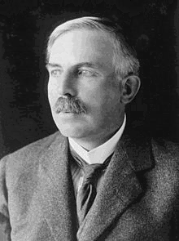
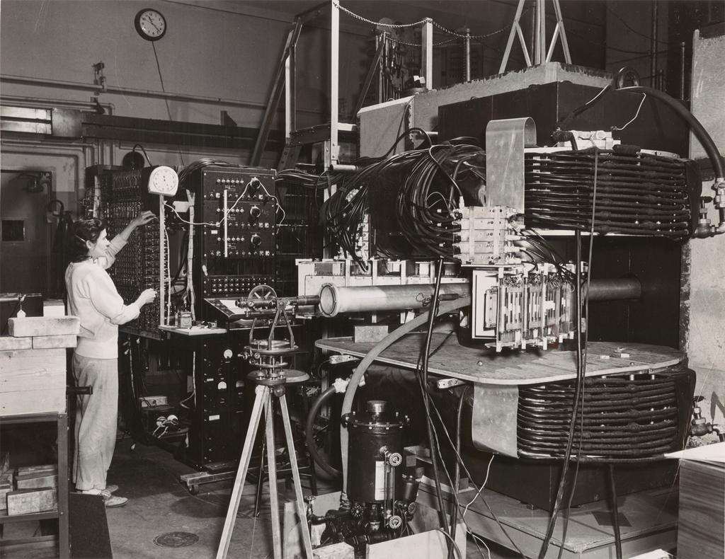
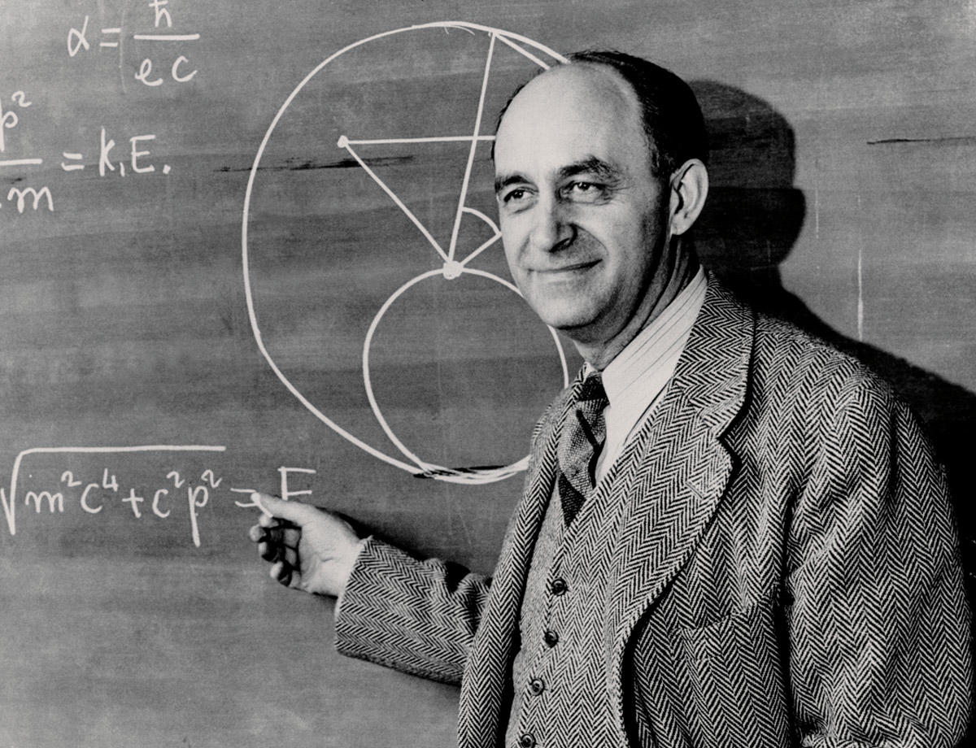
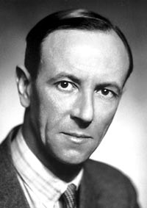
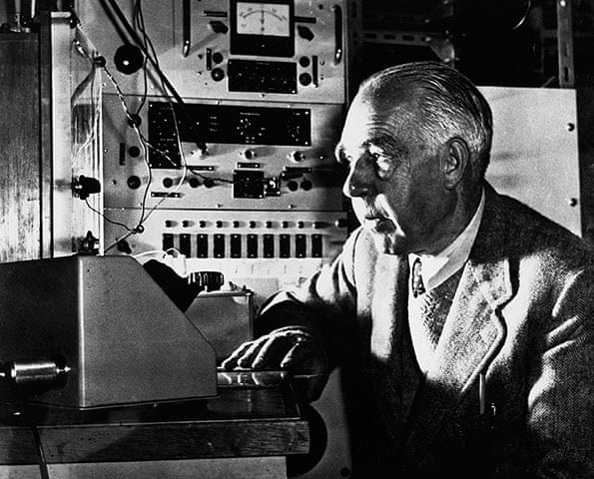

Slide 5
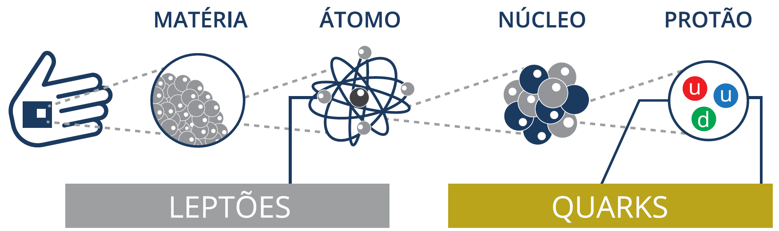
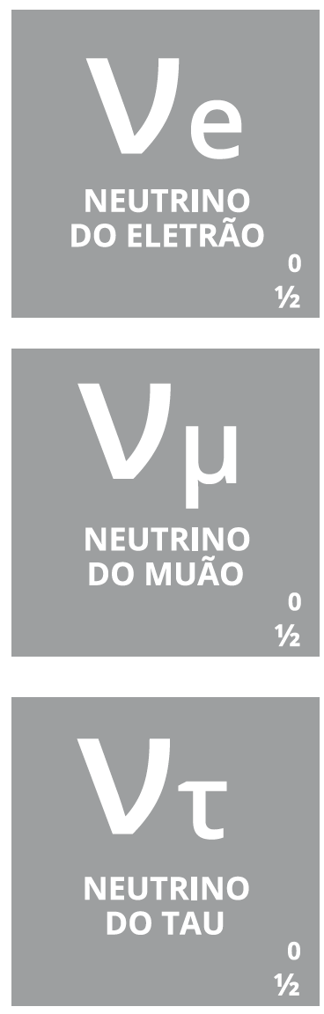

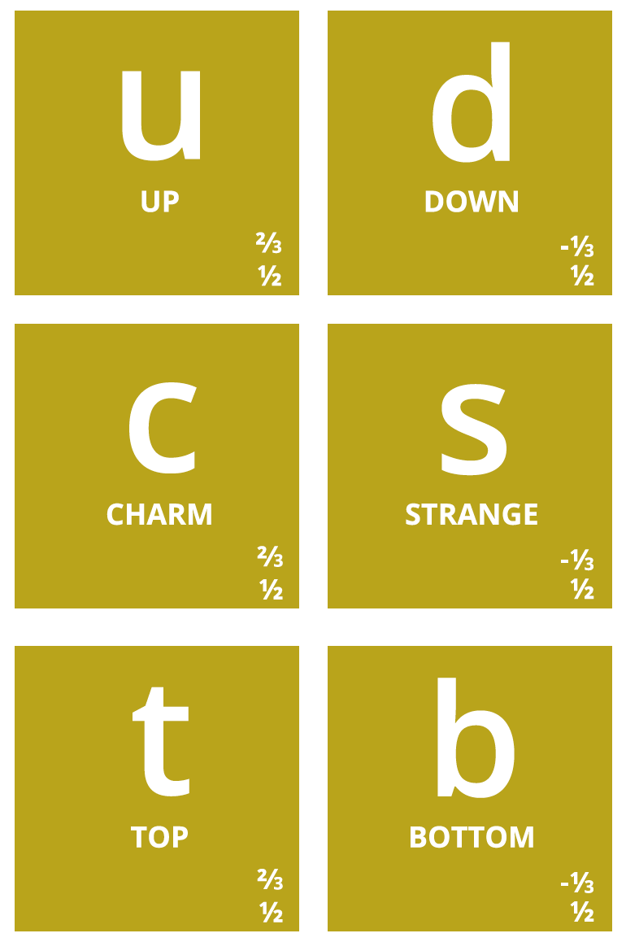
Notes:
Então, quais são afinal as partículas elementares? Temos os quarks, que dão as diferentes propriedades da nova tabela periódica
Também temos o electrão (já conhecíamos), e os seus primos mais pesados: muão e tau. Para cada um destes temos os neutrinos (não são feitos de quarks), que são produzidos em reações no Sol, por exemplo.
Por alguma razão (que desconhecemos) há 3 gerações de partículas elementares, cada uma mais pesada que a anterior → mistério!

Slide 6
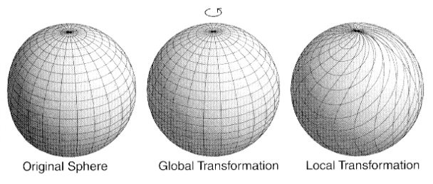
Symmetries in field theory
Symmetries → Interactions!
Equations locally invariant for certain symmetries
Standard Model Symmetry Group
Generalisation of SU(2)
Phase
3D rotation
U(1) × SU(2) × SU(3)
Photon
Electromagnetism
Week interactions
Bosons W⁺,W⁻,Z
Strong interaction
Gluons

Slide 7
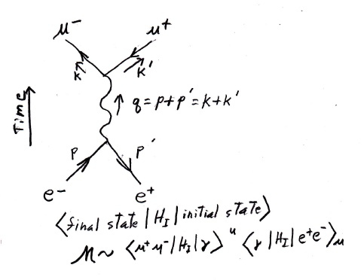
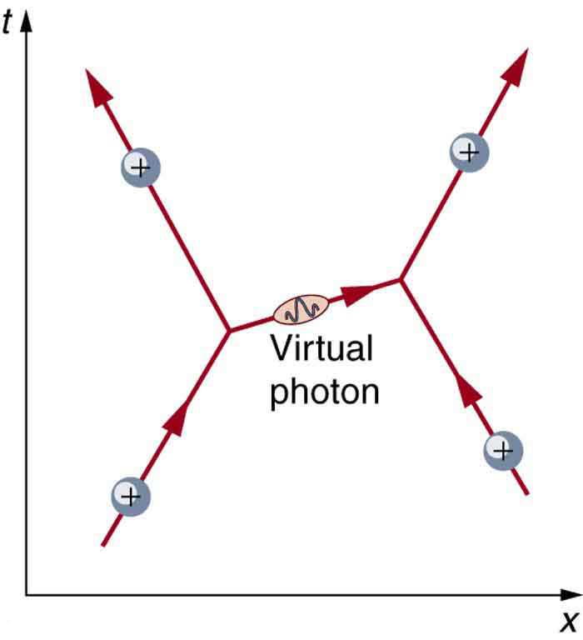
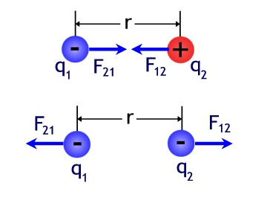
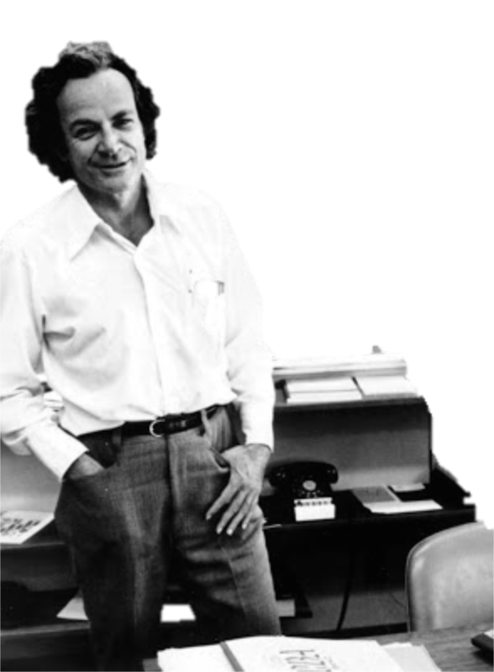
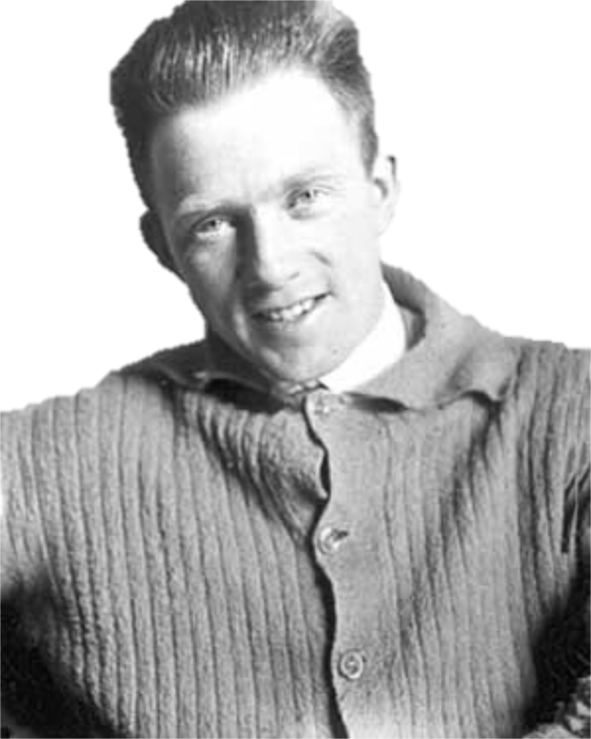
Werner Heisenberg (1901 – 1976)
Richard Feynman (1918 - 1988)
Notes:
A força que nos é mais familiar é a força gravítica (que atrai maçãs para a terra e a cabeça dos cientistas) – neste caso a força age sobre tudo que tem massa e é sempre atrativa
É a força que nos mantém sobre a terra – porque puxa a nossa massa para a massa muito grande da terra – na verdade é a força mais fraca que conhecemos!
A seguir foi descoberta a força electromagnética, que em vez da massa actua sobre a carga elétrica. Agora temos uma força repulsiva se a carga elétrica tiver o mesmo sinal
Mas hoje sabemos que as forças actuam entre partículas com cargas de certo tipo (por exemplo carga elétrica) porque trocam outras partículas (transmissoras dessa força). Por exemplo 2 partículas com carga positiva repelem-se porque trocam fotões entre elas: explicar o diagrama
Isto funciona porque podemos pedir energia emprestada ao universo para criar um fotão (a partícula transmissora) que vive durante muito pouco tempo. Quanto mais energia pedirmos ao universo, menos tempo temos para existir o fotão. Isto é uma das maneiras de ler esta equação: o princípio da incerteza, descoberto pelo Werner Heisenberg, que tem um ar muito pouco incerto!

Slide 8
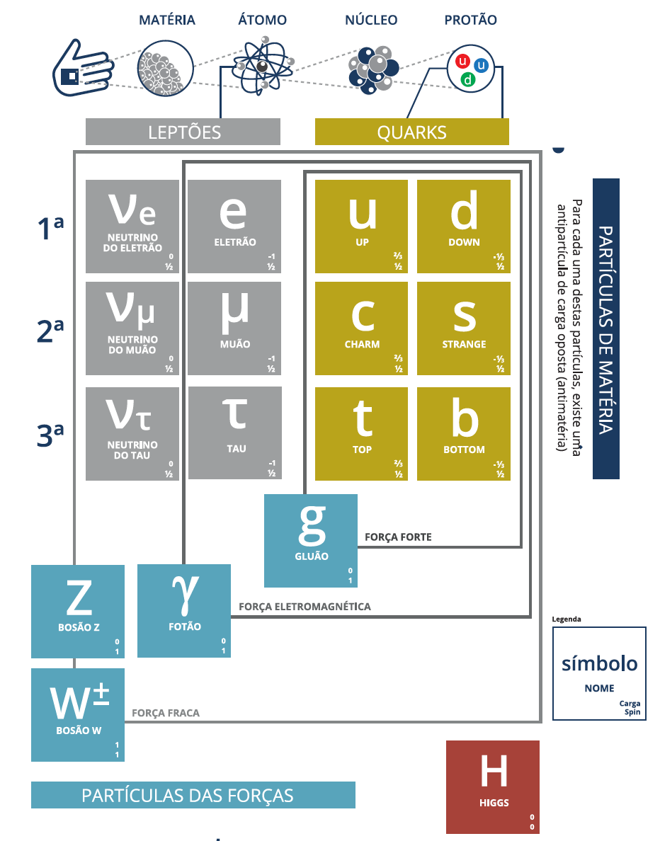

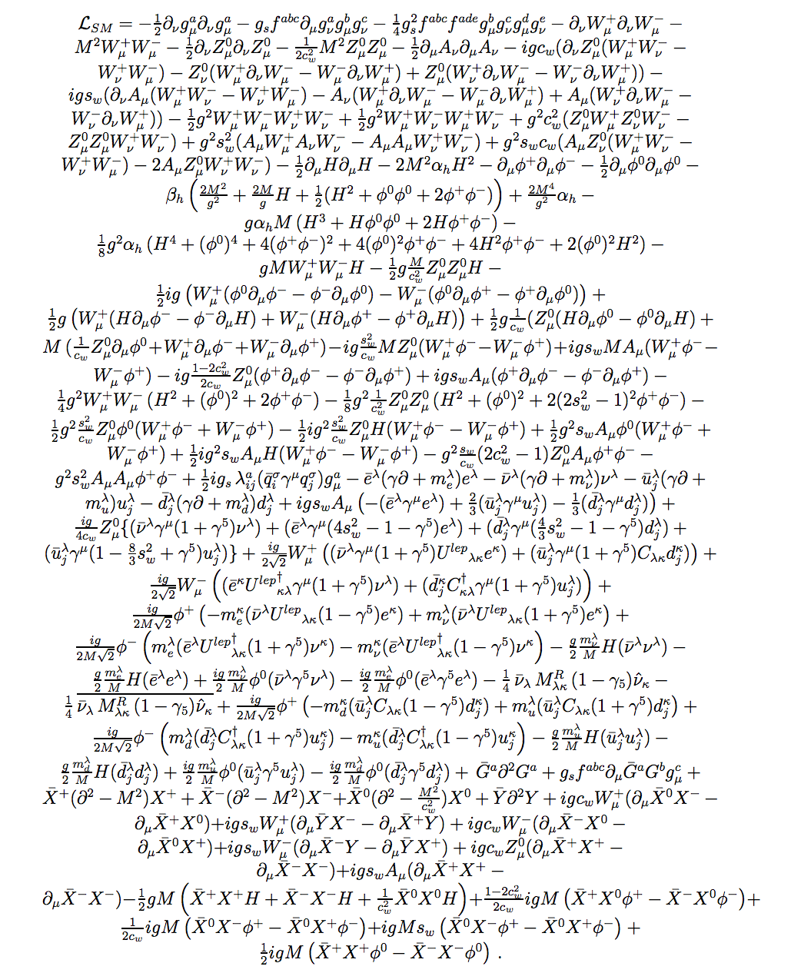
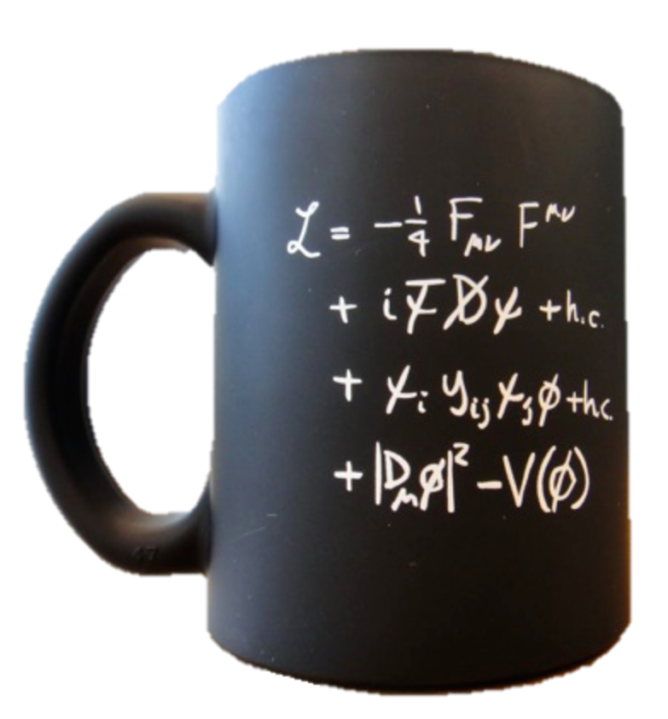
The Standard Model of Particle Physics
2015
2013
Notes:
Particulas fundamentais conhecidas; forças a que elas reagem → Um Triunfo da física do último século!!
Eletromagnética de alcance infinito; Z tem massa alta ao contrario de gamma e gluoes, por isso a força nuclear fraca tem alcance muito curto; força forte também, mas porque é tão forte que quando tentamos afastar duas partículas, a energia dispendida é suficiente para criar mais partículas
E o Higgs? É uma pedra basilar do edificio de que falamos mais à frente

Slide 9
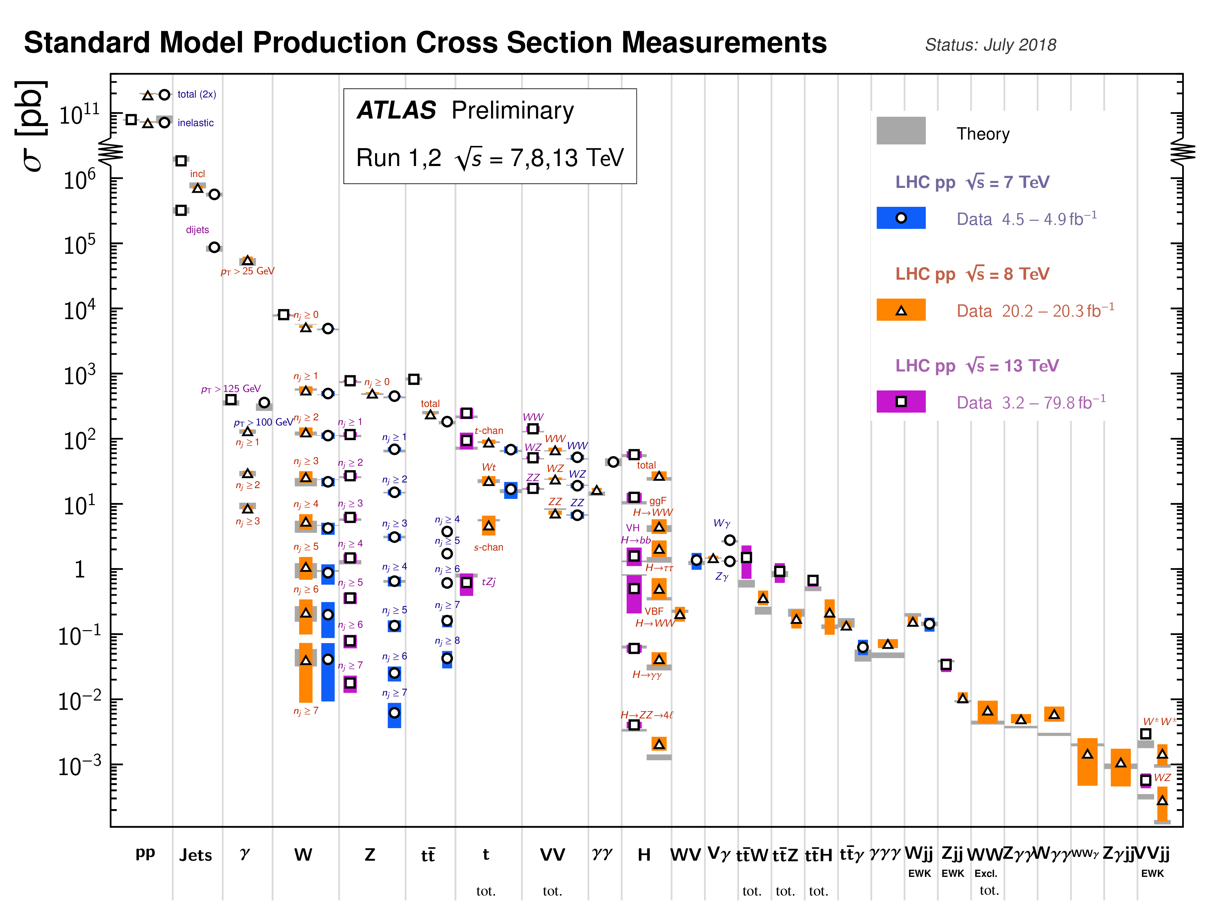
Notes:
SM expectations match measurements at the LHC over a huge range (12 orders of magnitude)! Clearly we do know something....

Slide 10
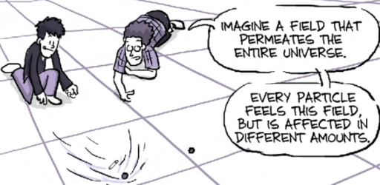
Why the Higgs?

Slide 11
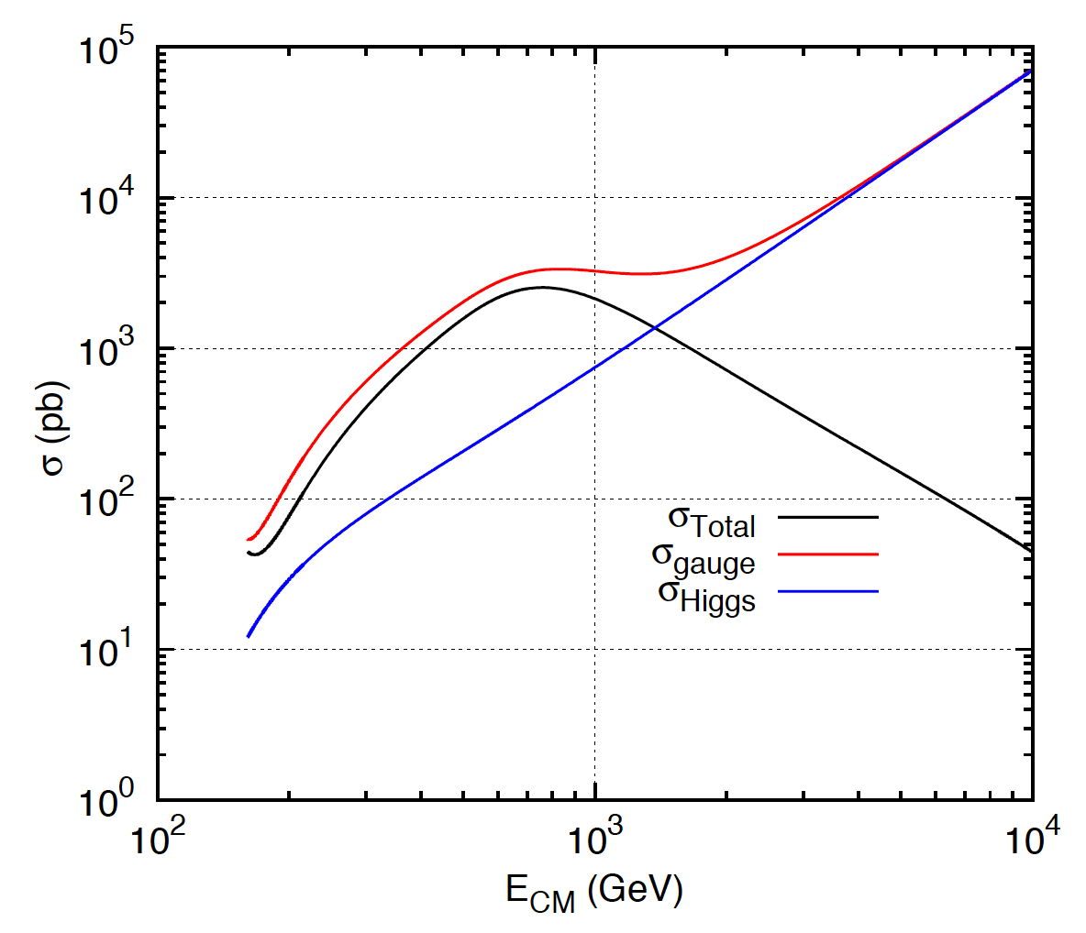
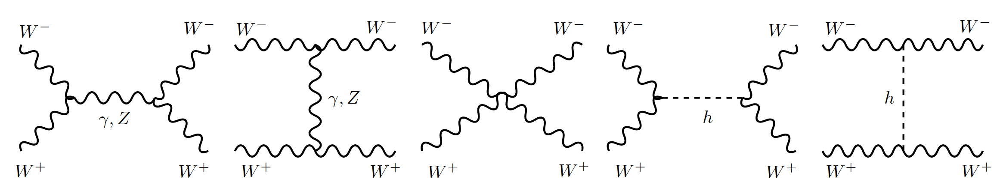
1
Longitudinal gauge-boson scattering
In the absence of the Higgs, some processes have cross sections that grow with the centre of mass energy of the collision…
Breaks unitarity!
J.C.Romão [5]
Feynman diagrams contributing to longitudinal WW scattering

Slide 12
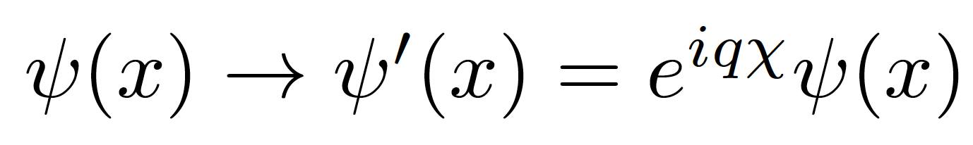
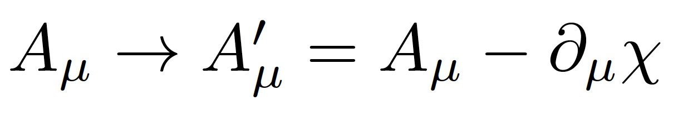
2
Mass of elementary particles and gauge bosons
To keep the Lagrangian gauge invariant against a U(1) local phase transformation:
with χ = χ (x). The photon field transforms as:
But the A^{μ} mass term breaks the invariance of the Lagrangian:
For the SU(2)_{L} gauge symmetry transformations of the weak interaction the fermion mass term m_{e}ψψ also breaks invariance!
Bottom line: the SM (without the Higgs mechanism) results in wrong calculations and gauge invariance breaks down for massive particles
Notes:
Tomando os termos do Lagrangeano da QED mas juntando m(gamma) à mão:

Slide 13
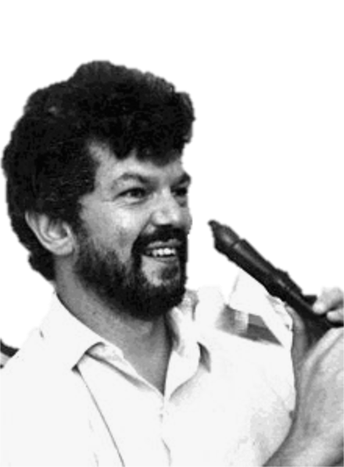
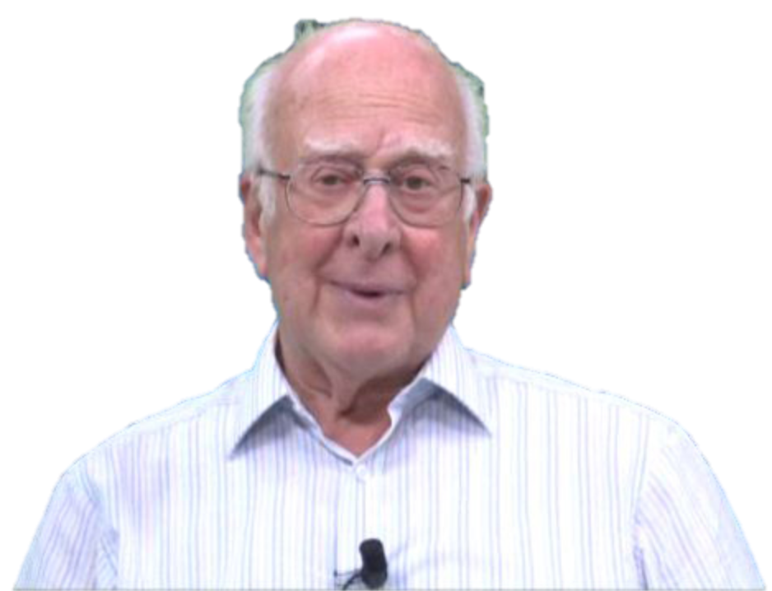
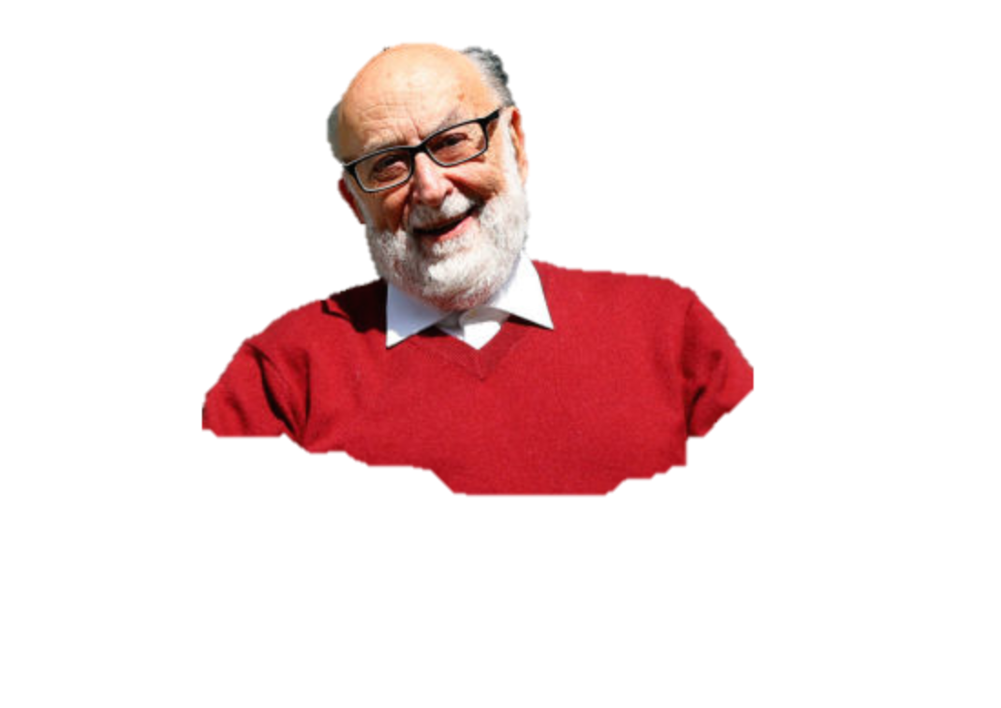
The Higgs Mechanism
Robert Brout
(1928 – 2011)
François Englert (b. 1932)
Peter Higgs (b. 1929)
Notes:
Peter Ware Higgs (born 29 May 1929) is a British theoretical physicist, emeritus professor at the University of Edinburgh. In the 1960s, he proposed that broken symmetry in electroweak theory could explain the origin of mass of elementary particles in general and of the W and Z bosons in particular. This so-called Higgs mechanism, which was proposed by several physicists besides Higgs at about the same time, predicts the existence of a new particle, the Higgs boson, the detection of which became one of the great goals of physics.
Robert Brout (1928 –2011) was a Belgian theoretical physicist who made significant contributions in elementary particle physics. He was a Professor of Physics at Université Libre de Bruxelles where he had created, together with François Englert, the Service de Physique Théorique.
François Baron Englert (born 1932) is a Belgian theoretical physicist and 2013 Nobel prize laureate (shared with Peter Higgs). He is Professor emeritus at the Université libre de Bruxelles (ULB) where he is member of the Service de Physique Théorique. He is also a Sackler Professor by Special Appointment in the School of Physics and Astronomy at Tel Aviv University and a member of the Institute for Quantum Studies at Chapman University in California.

Slide 14
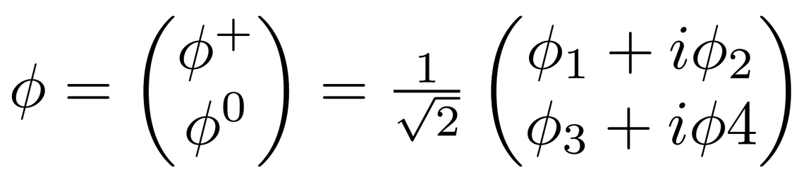
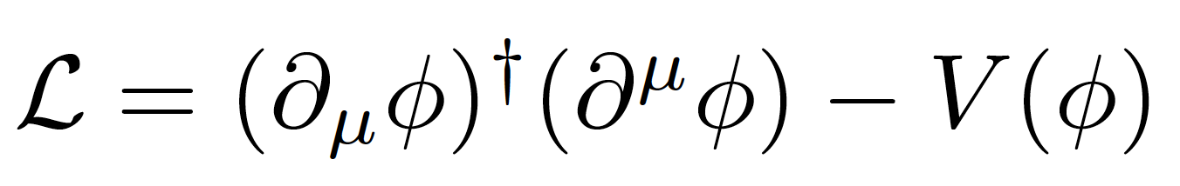
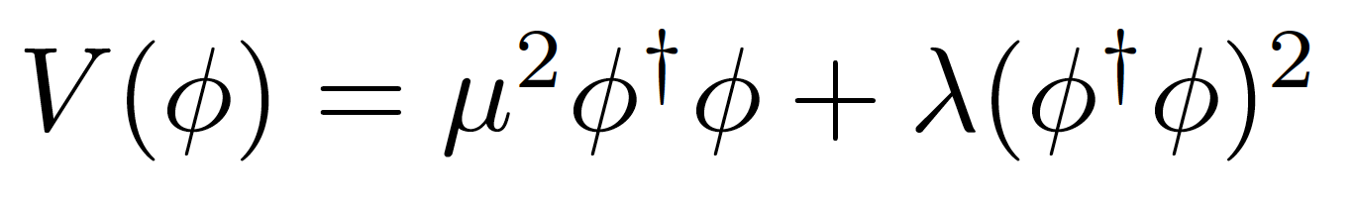
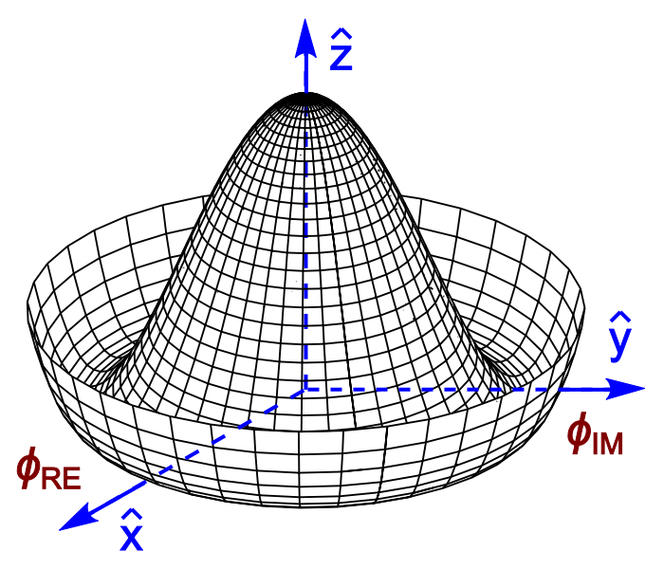
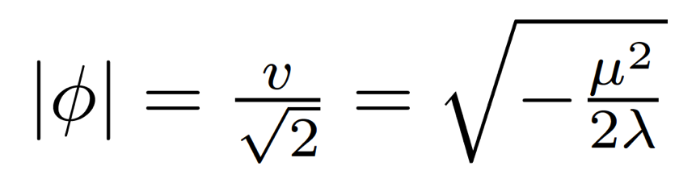
Introduce a SU(2) doublet of spin-0 complex fields
The Lagrangian term is
With a potential
For λ>0, μ²>0 the potential has a
minimum at the origin
For λ>0, μ²<0 the potential has an
infinite number of minima at:
The choice of vacuum (lowest
energy state of the field) breaks the symmetry of the Lagrangian

Slide 15





Electroweak symmetry breaking
In the Standard Model with no Higgs mechanism, interactions are symmetric and particles do not have mass
Electroweak symmetry is broken:
  Photon does not have mass
  W, Z have a large mass
Higgs mechanism: mass of W and Z results from the Higgs mechanism
Masses of fermions come from a direct interaction with the Higgs field

Slide 16


EWK Symmetry Breaking in Pictures
Notes:
Higgs field has 4 degrees of freedom
Mass of W+, W- and Z absorb 3 – 1 left (the Higgs)
Higgs boson is evidence for mechanism

Slide 17






What (we think) we know:
Higgs mass was(!) the only unknown parameter of the SM
We can give mass to W± and Z and keep the photon massless
Higgs couples to W and Z proportionally to their masses
Higgs couples to fermions proportionally to their mass

Slide 18


Exploring the electroweak scale
Precision measurements of m_{W}, m_{t}, m_{H} are stringent tests of the SM at the EW scale
  E.g. excluding measured m_{H}, global EW fit gives m_{H} = 90 ± 21 GeV (1.7 σ tension)
arXiv:1803.01853

Slide 19

Tools of the Trade
The LHC and its experiments

Slide 20

Design (p-p run):
√s = 14 TeV (design)
N_{p} = 1.2 x 10¹¹ p/bunch
2780 bunches
Peak L = 1 x 10³⁴ cm⁻²s⁻¹ (design)
β* = 55 cm
Run 1: 2009 – 2013 √s = 7/8 TeV
Run 2: 2015 – 2018 √s = 13 TeV
Mont Blanc
ATLAS
CMS
Notes:
LHC Running at 2x design luminosity
Expect 150/pb by end of this year

Slide 21

Muon Spectrometer: |η| < 2.7
Air-core toroid + gas-based muon chambers
σ/p_{T} = 2% @ 50GeV to 10% @ 1TeV (ID+MS)
EM calorimeter: |η| < 2.5 (3.2)
Pb-LAr accordion sampling
σ/E = 10%/√E ⊕ 0.7%
L = 44 m, ∅ ≈ 25 m
7000 tonnes
≈10⁸ electronic channels
2-level trigger reducing 40 MHz collision rate to 1 kHz of events to tape
Hadronic calorimeter:
Fe/scintillator / Cu/W-LAr
σ/E_{jet}= 50%/√E ⊕ 3%
Solenoid: B = 2 T
Inner Tracker: |η| < 2.5
Si pixels/strips and Trans. Rad. Det.
σ/p_{T} = 0.05% p_{T} (GeV) ⊕ 1%

Slide 22

Muon Spectrometer:
Steel return yoke and gas-based muon chambers
σ/p_{T} = 1% @ 50GeV to 5% @ 1TeV (ID+MS)
EM calorimeter:
PbWO₄ crystals homogen.
σ/E = 2-5%/√E ⊕ 0.005
Hadronic calorimeter:
Brass+scint./Steel+quartz
σ/E_{jet}= 100%/√E ⊕ 0.05
Solenoid: B = 4 T
Inner Tracker:
Si pixels/strips
σ/p_{T} = 0.02% p_{T} (GeV) ⊕ 0.005

Slide 23


Slide 24


Slide 25


Slide 26


ATLAS, CMS and the LHC
R. Steerenberg (CERN), LHCC 30 May 2018
Run 1: 2009 – 2013; ≈ 5 fb⁻¹ at √s = 7 and ≈ 20 fb⁻¹ at 8 TeV per experiment
Run 2: 2013 – 2018; 149 fb⁻¹ recorded at √s = 13 TeV by the end of pp run
Instantaneous luminosity of 2 x 10³⁴ cm⁻²s⁻¹ in 2017 (2x design!)
  Downside is pileup => experimental challenge!
  Multiple vertices, large occupancy, degraded reconstruction resolution, etc
  LHC breaking new ground to go around this: leveling!

Slide 27


Leveling by beam offset
Anti-leveling: crossing angle
Anti-leveling: β* reduction
Eckhard Elsen, LHCP’18
β* reduction
crossing angle reduction steps
Notes:
Leveling and anti-leveling already in action

Slide 28

Higgs at the LHC

Slide 29

Higgs @ the LHC
Many different production and decay mechanisms
  Span 3 orders of magnitude in cross section and branching ratio
  Some very clean decays with low BR (γγ, 4l)
  Other very difficult with higher rates (bb, WW, ττ,...)
Access Higgs properties through combination of different channels
Enormous amount of progress since discovery 6 years ago!
Notes:
https://twiki.cern.ch/twiki/bin/view/LHCPhysics/LHCHXSWG#Latest_plots

Slide 30





Higgs @ the LHC
Many different production and decay mechanisms
  Span 3 orders of magnitude in cross section and branching ratio
  Some very clean decays with low BR (γγ, 4l)
  Other very difficult with higher rates (bb, WW, ττ,...)
Access Higgs properties through combination of different channels
Enormous amount of progress since discovery 6 years ago!
Notes:
https://twiki.cern.ch/twiki/bin/view/LHCPhysics/LHCHXSWG#Latest_plots

Slide 31


The Run 1 legacy

Slide 32








Slide 33



It takes time to get it right
EPS-HEP 2011 conference

Slide 34


















Production
Decay
FIT
H->γγ
×
H->ZZ
t
H->WW
t
Backgrounds +
t

Slide 35


The Run 1 legacy
Phys. Rev. Lett. 114 (2015) 191803
JHEP 08 (2016) 045
Mass – Higgs mass measured with 0.2% accuracy:
  m_{H} = 125.09 ± 0.21 (stat.) ± 0.11 (scale) ± 0.02 (other) ± 0.01 (theory) GeV
Couplings:
  ggF with H → ZZ,,WW observed by individual experiments
  VBF and H →  observed with >5σ significance by ATLAS+CMS combination
  ttH, VH production and H → bb not observed during Run1
Couplings compatible with SM:
  Signal strength: μ_{VBF+VH}/μ_{ggF+ttH} = 1.06 ^{+0.35} _{-0.27}
  Coupling modifiers broadly consistent with SM but large uncertainty
μ = (σ ×BR)_{Obs}/ (σ×BR)_{SM}
Significance (σ)
Prod. | Obs. | Expect.
VBF | 5.4 | 4.7
VH | 3.5 | 4.2
ttH | 4.4 | 2.0
Decay | Obs. | Expect.
H→ττ | 5.5 | 5.0
H→bb | 2.6 | 3.7
Notes:
https://atlas.web.cern.ch/Atlas/GROUPS/PHYSICS/PAPERS/HIGG-2015-07/
https://atlas.web.cern.ch/Atlas/GROUPS/PHYSICS/PAPERS/HIGG-2014-14/

Slide 36


The Run 1 legacy
Phys. Rev. Lett. 114 (2015) 191803
JHEP 08 (2016) 045
Mass – Higgs mass measured with 0.2% accuracy:
  m_{H} = 125.09 ± 0.21 (stat.) ± 0.11 (scale) ± 0.02 (other) ± 0.01 (theory) GeV
Couplings:
  ggF with H → ZZ,,WW observed by individual experiments
  VBF and H →  observed with >5σ significance by ATLAS+CMS combination
  ttH, VH production and H → bb not observed during Run1
Couplings compatible with SM:
  Signal strength: μ_{VBF+VH}/μ_{ggF+ttH} = 1.06 ^{+0.35} _{-0.27}
  Coupling modifiers broadly consistent with SM but still large uncertainty
μ = (σ ×BR)_{Obs}/ (σ×BR)_{SM}
Significance (σ)
Prod. | Obs. | Expect.
VBF | 5.4 | 4.7
VH | 3.5 | 4.2
ttH | 4.4 | 2.0
Decay | Obs. | Expect.
H→ττ | 5.5 | 5.0
H→bb | 2.6 | 3.7
Notes:
https://atlas.web.cern.ch/Atlas/GROUPS/PHYSICS/PAPERS/HIGG-2015-07/
https://atlas.web.cern.ch/Atlas/GROUPS/PHYSICS/PAPERS/HIGG-2014-14/

Slide 37



Probing the 125 GeV Higgs in Run 2
Two Higgs Doublet Model
Triple coupling λ₃
Clavicle
Aorta
Ribs
Yukawa
couplings
New Physics

Slide 38







Higgs boson mass
arXiv:1804.02716 [hep-ex]; arXiv:1706.09936 [hep-ex]; arXiv:1806.00242 [hep-ex]
Mass measurement from CMS H→ZZ*→4l:
m_{H}^{ZZ*}= 125.26 ± 0.20 (stat) ± 0.08 (syst) GeV
New Measurements from ATLAS
  H→ γγ: m_{H}^{γγ} = 124.93 ± 0.40 GeV
  H→ZZ*→4l: m_{H}^{ZZ∗} = 124.79 ± 0.37 GeV
Run 1+2 combination from ATLAS:
  m_{H} = 124.97 ± 0.19 (stat) ± 0.13 (syst.) GeV
1 June 2018
8 April 2018
Notes:
https://atlas.web.cern.ch/Atlas/GROUPS/PHYSICS/PAPERS/HIGG-2016-33/ → 1 June 2018
http://cms-results.web.cern.ch/cms-results/public-results/publications/HIG-16-040/index.html → 8 April 2018
Both use 36.1 fb⁻¹ from 2015+2016

Slide 39




Differential Higgs boson cross sections
JHEP 11 (2017) 047; CMS-HIG-17-015; ATLAS-CONF-2018-002; ATLAS-CONF-2018-018
Reached a new phase in the exploration of the Higgs sector!
Differential cross sections:
  Higgs p_{T} sensitive to new physics in gluon-fusion loop
  Number of jets sensitive to modeling of radiation and different production modes
May - July 2018
Notes:
https://atlas.web.cern.ch/Atlas/GROUPS/PHYSICS/PAPERS/HIGG-2017-11/ → 24 May 2018
https://atlas.web.cern.ch/Atlas/GROUPS/PHYSICS/CONFNOTES/ATLAS-CONF-2018-018/ → 04 Jun 2018
http://cms-results.web.cern.ch/cms-results/public-results/publications/HIG-16-041/ → 30 June 2017
http://cms-results.web.cern.ch/cms-results/public-results/preliminary-results/HIG-17-015/index.html → March 2017
http://cms-results.web.cern.ch/cms-results/public-results/publications/HIG-17-025/ → 11 July 2018(after the conference)

Slide 40







Higgs boson width
arXiv:1808.01191 [hep-ex]/HIGG-2017-06
2 Aug 2018
SM Higgs width Γ_{H}~4.1 MeV
  Too small to be measured directly
  Best direct limit from CMS:
    Γ_{H} < 1.1GeV @ 95% CL
Off-shell Higgs production sensitive(*) to Γ_{H}
ATLAS measurement:
  pp→H→ZZ→4l and ZZ→2l2ν
  m(H) > 2 m(Z)
  36.1 fb⁻¹ of 13 TeV data
  Observed (expected) limit:
    Γ_{H} < 14.4 (15.2) MeV
(*) Assume interference term with proportional to
Notes:
https://atlas.web.cern.ch/Atlas/GROUPS/PHYSICS/PAPERS/HIGG-2017-06/ → 2 Aug.2018
above 125 GeV off-shell production of the Higgs boson has a substantial cross section at the LHC [13–16], due to the increased phase space as the vector bosons (V = W; Z) and
top quark decay products become on-shell with the increasing energy scale

Slide 41


Exploring the Yukawa sector

Slide 42



Observation of H→ττ
Phys. Lett. B 779 (2018) 283
Combine all final: 𝝉_{had}𝝉_{had}, 𝝉_{lep}𝝉_{had}, 𝝉_{lep}𝝉_{lep}
3 categories: 0-jet, VBF and boosted (mostly ggF)
35.9 fb-1 of 13 TeV data
2D likelihood fit using m_{𝜏𝜏}, m_{jj} or p_{T}^{𝜏𝜏}
Observed (expected) significance of 4.9𝝈 (4.7𝝈)
Combining with Run 1:
  36 fb-1 of 13 TeV data: 4.9 𝝈 observed; 4.7 𝝈 expected
  Combining with Run 1: 5.9 𝝈 observed; 5.9 𝝈 expected
  𝝁 = 0.98 ± 0.18
Notes:
http://cms-results.web.cern.ch/cms-results/public-results/publications/HIG-16-043/index.html → 1 August 2017

Slide 43



Observation of H→ττ
ATLAS-CONF-2018-021
Combine all final: 𝝉_{had}𝝉_{had}, 𝝉_{lep}𝝉_{had}, 𝝉_{lep}𝝉_{lep}
Categories targeting boosted Higgs (mostly ggF) and VBF (additional jets)
Dominant backgrounds from Z→𝝉𝝉 and jets faking taus
Cut-based analysis using fit to m𝜏𝜏 distribution in 13 signal regions
Largest uncertainties: data and MC statistics, signal modelling and jets
Cross section measurement (13 TeV):
𝝈^{ggF} = 3.0 ± 1.0 (stat.) ^{+1.6}_{-1.2} (syst.) pb; 𝝈^{VBF} = 0.28 ± 0.09 (stat.) ± 0.10 (syst.) pb
Significance:
  36 fb⁻¹ of 13 TeV data: 4.4 𝝈 observed; 4.1 𝝈 expected
  Combining with 7 and 8 TeV data: 6.4 𝝈 observed; 5.4 𝝈 expected
3 June 2018
Notes:
https://atlas.web.cern.ch/Atlas/GROUPS/PHYSICS/CONFNOTES/ATLAS-CONF-2018-021/ → 3 June 2018

Slide 44







Observation of ttH production
arXiv:1804.02610 [hep-ex]; arXiv:1806.00425 [hep-ex];
Direct access to top Yukawa coupling
Experimental tour-de-force!
  Complex final states
  Large irreducible backgrounds
  Small cross sections: O(0.5)pb @ 13 TeV
Use all available final states:
  H→bb: high stats but low purity BR≈58%, S/B≈1-6%
  Multileptons: H→𝜏𝜏, H→WW*, H→ZZ* BR = 30%, S/B=4-34%
  H→𝛾𝛾: clean but low stats BR = 0.23%, S/B=5-200%
  H→ZZ*→4lep: clean but very low stats BR = 0.01%, S/B=50-500%
April - June 2018
Notes:
https://atlas.web.cern.ch/Atlas/GROUPS/PHYSICS/PAPERS/HIGG-2018-13/ → 1 June 2018
24/12/2017 – Evidence from ATLAS: 36.1 fb-1 in ttH(ττ, γγ, bb, VV): 4.2 σ observed, 3.8 σ expected
08/04/2018 – Observation in CMS: 5.1 (7 TeV), 19.7 (8TeV), and 35.9 (13 TeV) fb-1: 5.2 σ observed, 4.2 σ expected
01/06/2018 – Observation in ATLAS: 79.8 fb⁻¹ for ttH(γγ, ZZ→4l) and with 36.1 fb-1 in ttH(bb) (13 TeV): 5.2 σ observed, 4.9 σ expected
Adding 4.5 fb-1 (7 TeV) and 20.3 fb-1 (8 TeV): 6.3 σ observed, 5.1 σ expected

Slide 45









ttH observation: bb and Multileptons
ttH(ML) Phys. Rev. D 97 (2018) 072003; arXiv:1803.05485 [hep-ex]
ttH(bb) Phys. Rev. D 97 (2018) 072016; JHEP 01 (2018) 054
ttH(H→leptons)
Sensitive to: H→𝜏𝜏, H→WW* and H→ZZ*
Backgrounds: ttW/ttZ, non-prompt leptons and fake taus
Main uncertainties: signal modelling, jet energy scale and non-prompt lepton estimate
ATLAS: 4.1𝝈 observed; 2.8𝝈 expected
CMS: 3.2𝝈 observed; 2.8𝝈 expected
ttH(H→bb):
Profit from large H→bb branching ratio (58.4%)
But challenging final state: large ttbb irreducible background, theory uncertainties, combinatorics...
Main uncertainties: tt+heavy flavours, b tagging, jet calib.
ATLAS: 1.2𝝈 observed; 1.6𝝈 expected
CMS: 1.6𝝈 observed; 2.2𝝈 expected
For both channels:
Intensive use of dedicated machine learning (NN, BDT) and matrix element methods: suppress fake leptons, reconstruct events, flavour tagging, and enhance S/B
Notes:
ttH(ML) →https://atlas.web.cern.ch/Atlas/GROUPS/PHYSICS/PAPERS/HIGG-2017-02/ → 24 December 2017
ttH(bb) → http://atlas.web.cern.ch/Atlas/GROUPS/PHYSICS/PAPERS/HIGG-2017-03/ → 24 December 2017
http://cms-results.web.cern.ch/cms-results/public-results/publications/HIG-17-006/index.htm → 14 August 2017

Slide 46






ttH observation
arXiv:1806.00425 [hep-ex]; arXiv:1804.02610 [hep-ex]
CMS:
Combined Run 1 + 36.1 fb⁻¹ Run 2:
5.2 σ observed, 4.2 σ expected
ATLAS:
ttH(H→𝛾𝛾):
  New signal categories from BDT discriminant
  Sensitivity increased by 50%
Run 2 data from 2015+2016+2017 (𝛾𝛾/ZZ): 79.8 fb⁻¹
  5.2 σ observed, 4.9 σ expected
Adding Run 1: 6.3 σ observed, 5.1 σ expected
Measured production cross section at 13 TeV:
  670 ± 90 (stat.) +110−100 (syst.) fb
Notes:
http://cms-results.web.cern.ch/cms-results/public-results/publications/HIG-17-035/index.html → 8 Abril 2018
http://atlas.web.cern.ch/Atlas/GROUPS/PHYSICS/PAPERS/HIGG-2018-13/ → 1 Jun 2018

Slide 47

Notes:
http://atlas.web.cern.ch/Atlas/GROUPS/PHYSICS/PAPERS/HIGG-2018-13/
data event from the tt̄H(γγ) Had BDT bin with the largest signal over background ratio. The event contains two photon candidates, with a diphoton mass of 125.4 GeV. In addition, six jets are reconstructed using the anti-k_{t} algorithm and R=0.4, including one jet that is b-tagged using a 77% efficiency working point. The photons correspond to the green towers in the electromagnetic calorimeter, while the jets (b-jets) are shown as yellow (blue) cones.

Slide 48






Next steps in ttH(→bb) @ LIP
In BSM scenarios could have mixed-CP structure of top Yukawa coupling
  e.g. 2HDM
  α = 0 recovers SM
Study done with fast simulation so far
See e.g.:
Phys. Rev. D 96, 013004 2017
Phys. Rev. D 98, 033004 2018

Slide 49






Observation of H→bb
arXiv:1808.08238; arXiv:1808.08242 [hep-ex]
See CERN seminar: observation in ATLAS and CMS
  https://indico.cern.ch/event/750541/
Largest branching fraction (58.4%) but huge background from heavy flavour production
Must use associated production: WH/ZH
  Require 2 b jets + 0 (Z→𝜈𝜈), 1 (W→ℓ𝜈) or 2 (Z→ℓℓ) leptons
Largest backgrounds:
  Z+heavy flavour (0- and 2-lepton) and tt (1-lepton)
  Irreducible background from VZ with Z→bb
9 July 2018
Notes:
http://cms-results.web.cern.ch/cms-results/public-results/publications/HIG-16-044/index.html → 21 September 2017
https://atlas.web.cern.ch/Atlas/GROUPS/PHYSICS/PAPERS/HIGG-2016-29/ → 10 August 2017
https://atlas.web.cern.ch/Atlas/GROUPS/PHYSICS/CONFNOTES/ATLAS-CONF-2018-036/ → 9 July 2018
http://cms-results.web.cern.ch/cms-results/public-results/publications/HIG-18-016/ → 24 August 2018

Slide 50





Observation of H→bb
arXiv:1808.08238
Harder p_{T} spectrum for signal than backgrounds
  Go to high p_{T} to improve S/B
Use for event categories:
  75 < p_{T}^{V} < 150 GeV (2ℓ only)
  150 < p_{T}^{V} < 200 GeV
  p_{T}^{V} > 200 GeV
Main discriminant variables m_{bb}, p_{T}^{V} and ΔR_{bb}
  m_{bb} resolution extremely important!
Notes:
Evidence: https://atlas.web.cern.ch/Atlas/GROUPS/PHYSICS/PAPERS/HIGG-2016-29/fig_01.png→ 10 August 2017
Observation: https://atlas.web.cern.ch/Atlas/GROUPS/PHYSICS/PAPERS/HIGG-2018-04/fig_03.png→ 9 July 2018

Slide 51










Observation of H→bb
arXiv:1808.08238
Run 2:
  Observed (expected) of 4.9𝝈 (4.3𝝈)
Adding Run 1:
  Observed (expected) of 4.9𝝈 (5.1𝝈)
Adding ttH and VBF:
  Observed (expected) of 5.4𝝈 (5.5𝝈)
  Observation of H→bb decays
Adding H→ZZ and H→γγ:
  Observed (expected) of 5.3𝝈 (4.8𝝈)
  Observation of VH production
Notes:
Evidence: https://atlas.web.cern.ch/Atlas/GROUPS/PHYSICS/PAPERS/HIGG-2016-29/fig_01.png→ 10 August 2017
Observation: https://atlas.web.cern.ch/Atlas/GROUPS/PHYSICS/PAPERS/HIGG-2018-04/fig_03.png→ 9 July 2018

Slide 52


Slide 53


H→bb @ LIP
Boosted decision tree (BDT)
Combine many different variables
Trained in 8 categories: 3 lepton, 2/3 jets, low/high p_{T}^{V} bin (2 lepton channel)
Most discrimination from m_{bb} and DR(b₁,b₂)
New in run 2:
m_{Top}, |DY(V,H)| → +7% in sensitivity

Slide 54


2nd generation Yukawa: H→μμ
ATLAS-CONF-2018-026
2 July 2018
Easy to trigger on, but very rare
Used 80 fb⁻¹ of 13 TeV data
Event categories based on muon η, p_{T}^{μμ}, and VBF (BDT)
Search peak in m_{μμ}
Background from sidebands à la H→γγ analysis
95% CL limits:
  2.1 (obs), 2.0 (exp)
Getting close to SM sensitivity!
Notes:
https://atlas.web.cern.ch/Atlas/GROUPS/PHYSICS/CONFNOTES/ATLAS-CONF-2018-026/ → 2 Jul 2018

Slide 55



Combination
ATLAS-CONF-2018-031
Combined γγ, ZZ, WW,ττ, μμ and bb (incl. ttH+tH modes)
  Up to 79.8 fb⁻¹ of √s = 13 TeV data
Combination yields VBF significance 6.5σ (5.3σ expected) from ATLAS alone
Main production modes (ggF, VBF, VH, ttH) have all been observed!!
Good agreement with SM predictions
  Overall signal strength:
  μ = 1.13 ^{+0.09} _{-0.08}
Quantified space for undetectable decays or modified BR (e.g. BSM H→cc)
  B_{BSM} < 0.13 at 95% CL.(*)
7 July 2018
(*) In determination of κ_{g} and κ_{γ} - assumption dependent
Notes:
https://atlas.web.cern.ch/Atlas/GROUPS/PHYSICS/CONFNOTES/ATLAS-CONF-2018-031/fig_05.png→ 7 July 2018

Slide 56

Casting a wider net

Slide 57

Trevor Vickey
IoP HEP Conf.2019

Slide 58





Higgs + Dark Matter
ATLAS-CONF-2018-039
25 July 2018
Used 79.8 fb⁻¹ of 13 TeV data
  High E_{T}^{miss} (>150GeV) and b-tagging to suppress backgrounds
  Reconstruct b-jets as 2 small jets or merged variable-radius (VR) track jets
Signal benchmark: Type-II 2HDM + U(1)_{Z’} symmetry (Z’-2HDM)
Main backgrounds: tt, W/Z+jets
Excluded region in m_{A} – m_{Z’} plane
Notes:
https://atlas.web.cern.ch/Atlas/GROUPS/PHYSICS/CONFNOTES/ATLAS-CONF-2018-039/ → 25 July 2018
VR jets: track jets reconstructed with an algorithm in which the radius parameter decreases with increasing jet transverse momentum (pT)
large missing transverse momentum and either two b-tagged small radius jets or a single large radius jet containing two b-tagged subjets

Slide 59








Triple Higgs coupling
arXiv:1808.00336 [hep-ex]; ATLAS-CONF-2018-043
7 July 2018
4 Sep 2018
The triple Higgs coupling λ_{HHH} can be probed through di-Higgs production
Very suppressed in SM!
  Negative interference between LO diagrams
  Cross section 1500x less than ggF
Wide range of decay BR and channel purity
bbττ analysis:
  Used 36 fb⁻¹ of 13 TeV data
  Final state BR(bbττ)=7%
  Non-Resonant 95% CL limit:
    μ < 12.7 observed (14.8 expexcted)
Combination: at ≈10 x SM sensitivity – with 3% of the HL-LHC luminosity analyzed
Di-Higgs combination plot here
Notes:
https://atlas.web.cern.ch/Atlas/GROUPS/PHYSICS/CONFNOTES/ATLAS-CONF-2018-026/ → 2 Jul 2018
https://atlas.web.cern.ch/Atlas/GROUPS/PHYSICS/CombinedSummaryPlots/HIGGS/ATLAS_HIGGS6100_HH_Summary/ATLAS_HIGGS6100_HH_Summary.png
https://atlas.web.cern.ch/Atlas/GROUPS/PHYSICS/CONFNOTES/ATLAS-CONF-2018-043/

Slide 60


The future

Slide 61

LHC and HL-LHC timeline

Slide 62




LHC Upgrades
Development of a new generation of superconducting magnets with higher critical field (Nb₃Sn):
  13.5 T instead of 8 T (LHC, NbTi)
Development of “crab cavities” to increase bunch overlap
Colimators, connectors, civil eng., etc
R. Gonçalo - LIP
Ciência 2018
62
Notes:
High-Luminosity LHC (HL-LHC) (and challenges: 5x10^34 cm-2s-1 levelled; i.e. factor 5 over design
3 ab-1 by ~2035; requires focussing β*=15 cm; crab crossing
COST: 1300 MCHF; 100 MCHF/year operation
(NbTi) used in the LHC magnets can only bear magnetic fields of up to 9-10 Tesla

Slide 63





Calorimeter: new DAQ electronics, HV sources and gap scintillators
Gap scintillators
New tracking detector
New muon detector “Small Wheel”
New dedicated hardware tracking processor for trigger
High Granualrity Timing Detector
(30ps/track)
Notes:
Add spacial granularity to separate close tracks and add tracking solid angle (b-tagging, vertex ident. Etc)
Add timing information to reject pileup: need O(mm) resolution => ~O(10ps) ; 30ps = 9mm
Replace damaged detectors with more rad.hard technologies
HGTD radius 120 – 640 mm ; • Completely replace Inner Detector with all-silicon

Slide 64


Future of Higgs: HL-LHC
H→cc
Limit of μ = 6.3 at 95% CL
A lot can be done with 3000fb⁻¹ !!!
H→μμ
9σ expected
Notes:
https://atlas.web.cern.ch/Atlas/GROUPS/PHYSICS/PUBNOTES/ATL-PHYS-PUB-2018-016/
https://atlas.web.cern.ch/Atlas/GROUPS/PHYSICS/PUBNOTES/ATL-PHYS-PUB-2018-006/

Slide 65



Summary
Important milestones crossed last year with ttH and H→bb observations!
Main production modes (ggF, VBF, VH, ttH) have all been observed!!
The Higgs sector continues to look SM-like
But!
We know there is new physics out there!
≈ 3000 fb⁻¹ of data expected at the HL-LHC
We have a strong programme of precision measurements and searches for new Higgs states and decays
Overall highlight from the past year (very personal bias!):
“The >5σ observations of ttH and H → ττ, independently by ATLAS and CMS, firmly establish the existence of a new kind of fundamental interaction, Yukawa interactions.”
Gavin Salam (LHCP’18)
Notes:
Gavin Salam (LHCP’18) “The >5σ observations of ttH and H → ττ, independently by ATLAS and CMS, firmly establish the existence of a new kind of fundamental interaction,
Yukawa interactions.”
(Hbb, Htt, etc.): not a gauge interaction, and unlike anything we’ve probed before

Slide 66




In conclusion
See here for more: ATLAS Public results page

Slide 67
Free
Bonus Slides

Slide 68


Slide 69

Two Higgs Doublet Model (2HDM)
Two Higgs doublets: Φ₁ and Φ₂ → 5 Higgs bosons incl. 2 charged
Free parameters:
  4 masses (Do we know one? Assume it’s m_{h})
  tan β = v₁/v₂ ratio of v.e.v.’s of Φ₁ and Φ₂
  Mixing angle of h and H: α
4 possible Yukawa coupling arrangements (“types”) with no FCNC
Most common SUSY benchmark (MSSM) is based on Type II
If cos(β-α) = 0, h = Standard Model H⁰

Slide 70




Implications for 2HDM
ATLAS-CONF-2018-031
H(125) assumed to be light CP-even neutral scalar h in 2HDM
h production and decay same as for SM Higgs boson
Notes:
https://atlas.web.cern.ch/Atlas/GROUPS/PHYSICS/CONFNOTES/ATLAS-CONF-2018-031/ → 7 July 2018
• Type I: one Higgs doublet couples to vector bosons, while the other one couples to fermions. The first doublet is ‘fermiophobic’ in the limit where the two Higgs doublets do not mix.
• Type II: one Higgs doublet couples to up-type quarks and the other one to down-type quarks and charged leptons.
• Lepton-specific: the Higgs bosons have the same couplings to quarks as in the Type I model and to charged leptons as in Type II.
• Flipped: the Higgs bosons have the same couplings to quarks as in the Type II model and to charged leptons as in Type I.

Slide 71






ATLAS-CONF-2017-047; ATLAS-CONF-2018-028
5 July 2018
Simplified template cross sections (STXS):
  Independent, simple fiducial region definition for each production mode
  Common for ATLAS, CMS and theory
  Good balance between experimental precision and theory uncertainty
Notes:
http://atlas.web.cern.ch/Atlas/GROUPS/PHYSICS/PAPERS/HIGG-2016-21/ → 13 February 2018
https://atlas.web.cern.ch/Atlas/GROUPS/PHYSICS/CONFNOTES/ATLAS-CONF-2017-047/ → combination 5 July 2017
ATLAS: H→γγ and H→ZZ→4l cross section in 31 fiducial regions 36.1 fb⁻¹, 13 TeV used to measure
https://atlas.web.cern.ch/Atlas/GROUPS/PHYSICS/CONFNOTES/ATLAS-CONF-2018-028/ → 5 July 2018

Slide 72


M_{W} and M_{t}:
The Story So Far...
Eur. Phys. J. C 78 (2018) 110
https://twiki.cern.ch/twiki/bin/view/LHCPhysics/LHCTopWGSummaryPlots
Per mille precision!
Notes:
http://cms-results.web.cern.ch/cms-results/public-results/preliminary-results/TOP-15-012/index.html
https://atlas.web.cern.ch/Atlas/GROUPS/PHYSICS/CONFNOTES/ATLAS-CONF-2017-071/

Slide 73



Lagrangians, symmetries and all that
Leonhard Euler(1707–1783)
Emmy Noether (1882 – 1935)
Joseph-Louis Lagrange (1736–1813)
Notes:
Italian-French mathematician and astronomer Joseph-Louis Lagrange in 1788 (born Giuseppe Lodovico Lagrangia to a french father and italian mother) lived in Turin, Berlin and Paris, and was one of the most a renowned mathematicians of his age, teaching . He was president of the commission which defined the metre and kilogram as units. Fourier, who attended his lectures in 1795, wrote: “his voice is very feeble, at least in that he does not become heated; he has a very marked Italian accent and pronounces the s like z [...] The students, of whom the majority are incapable of appreciating him, give him little welcome, but the professeurs make amends for it.” https://en.wikipedia.org/wiki/Joseph-Louis_Lagrange
Amalie Emmy Noether was a German mathematician known for her landmark contributions to abstract algebra and theoretical physics. In physics, Noether's theorem explains the connection between symmetry and conservation laws. Noether was born to a Jewish family in Germany; her father was a mathematician, Max Noether. She studied mathematics at the University of Erlangen. She was invited by David Hilbert and Felix Klein to join the mathematics department at the University of Göttingen, a world-renowned center of mathematical research. But the philologists and historians among the philosophical faculty blocked her: women, they insisted, should not become privatdozent. One faculty member protested: "What will our soldiers think when they return to the university and find that they are required to learn at the feet of a woman? She spent four years lecturing under Hilbert's name. Her habilitation was approved in 1919. Noether remained a leading member of the Göttingen mathematics department until 1933, when Germany's Nazi government dismissed Jews from university positions, and Noether moved to the United States to take up a position at Bryn Mawr College in Pennsylvania. In 1935 she underwent surgery for an ovarian cyst and, despite signs of a recovery, died four days later at the age of 53.
Leonhard Euler (1707 - 1783) was a Swiss mathematician, physicist, astronomer, logician and engineer who made important and influential discoveries in many branches of mathematics like infinitesimal calculus and graph theory while also making pioneering contributions to several branches such as topology and analytic number theory. He also introduced much of the modern mathematical terminology and notation, particularly for mathematical analysis, such as the notion of a mathematical function. He is also known for his work in mechanics, fluid dynamics, optics, astronomy, and music theory. Euler was one of the most eminent mathematicians of the 18th century, and is held to be one of the greatest in history. He is also widely considered to be the most prolific mathematician of all time. He spent most of his adult life in St. Petersburg, Russia, and in Berlin, then the capital of Prussia.

Slide 74


Reminder: Lagrangians in classical mechanics
The equations of motion of a system are derived from a scalar Lagrangian function of generalized coordinates and velocities (time derivatives)
and from the Euler-Lagrange’s equations:

Slide 75


Example
Particle in a conservative potential V. The Lagrangian
has derivatives (e.g. for x)
and Euler-Lagrange’s equations
finally give us Newton’s familiar 2nd law!

Slide 76

Symmetries and conservation laws
Noether’s theorem:
  If a system has a continuous symmetry property, then there are corresponding quantities whose values are conserved in time.
Simplest case: Coordinates not explicitly appearing in the Lagrangian
Lagrangian invariant over a continuous transformation of the coordinates
Example: mass m orbiting in the field of a fixed mass M
Since the lagrangian doesn’t depend explicitly on φ (symmetry with respect to rotations in space), the Euler-Lagrange equation gives
Where the angular momentum J is a constant of motion!

Slide 77



Let’s go to quantum fields...
Erwin Schrödinger (1887 - 1961)
Richard Feynman (1918 - 1988)
Schrödinger’s cat (?-?)
Notes:
Erwin Rudolf Josef Alexander Schrödinger (1887 –1961), sometimes written as Erwin Schrodinger or Erwin Schroedinger, was a Nobel Prize-winning Austrian physicist who developed a number of fundamental results in the field of quantum theory, which formed the basis of wave mechanics: he formulated the wave equation (stationary and time-dependent Schrödinger equation) and revealed the identity of his development of the formalism and matrix mechanics. Schrödinger proposed an original interpretation of the physical meaning of the wave function.
Richard Phillips Feynman (1918 – 1988) was an American theoretical physicist known for his work in the path integral formulation of quantum mechanics, the theory of quantum electrodynamics, and the physics of the superfluidity of supercooled liquid helium, as well as in particle physics for which he proposed the parton model. For his contributions to the development of quantum electrodynamics, Feynman, jointly with Julian Schwinger and Sin-Itiro Tomonaga, received the Nobel Prize in Physics in 1965.

Slide 78

Now in quantum field theory…
Imagine space as an infinite continuum of balls and springs, where each ball is connected to its neighbours by elastic bands. Particles are perturbations of this field
y
ϕ(x,y)
x

Slide 79





Generalized coordinates are now fields (dislocation of each spring)
In a relativistic theory we must treat space and time coordinates on an equal footing, so the derivatives in the classical equations are now
In place of a Lagrangian we have a Lagrangian density (we call it Lagrangian anyway, just to be confusing)
with:
The new Euler-Lagrange equation now becomes

Slide 80

Gauge invariance
Take the Dirac Lagrangian for a field ψ representing a spin-½ particle, for example an electron:
It is invariant under a global U(1) phase transformation like:
Where χ is a constant
Notes:
By the way: this is related to the conservation of electric charge!

Slide 81


Local gauge invariance and interactions
If χ = χ (x) then we get extra terms in the Lagrangian:
But we can now make the Lagrangian invariant by adding an interaction term with a new gauge field A_{μ} which transforms as:
We get:
A few things to note:
Gauge theories are renormalizable, i.e. calculable without infinities popping up everywhere (Nobel prize of t’Hooft and Veltman)
The new gauge field A_{μ} is the photon in QED
The mass of the fermion is the coefficient of the term on ψψ
There is no term in A_{μ}A^{μ} (the photon has zero mass) → this is the beginning of the Higgs story…
Notes:
Demanding local gauge conservation resulted in obtaining a new field (the photon) and its interactions with the fermion fields. This is the blueprint of all Standard Model theories (called “Gauge theories”).
Gauge theories are automatically renormalizable (‘t Hooft & Veltman’s Nobel prize) i.e. don’t produce nonsense.

Slide 82

Now for the problems...

Slide 83
1: Mass of elementary particles and gauge bosons
To keep the Lagrangian gauge invariant against a U(1) local phase transformation:
with χ = χ (x). The photon field transforms as:
But the A^{μ} mass term breaks the invariance of the Lagrangian:
For the SU(2)_{L} gauge symmetry transformations of the weak interaction the fermion mass term m_{e}ψψ also breaks invariance!
Bottom line: the SM (without the Higgs mechanism) results in wrong calculations and breaks down for massive particles
Notes:
SÓ ILUSTRAÇÃO

Slide 84
2: Longitudinal gauge-boson scattering
In the absence of the Higgs, some processes have cross sections that grow with the centre of mass energy of the collision… i.e. breaks unitarity!
The Higgs regulates the cross section through negative interference
J.C.Romão
Feynman diagrams contributing to longitudinal WW scattering

Slide 85



Charged Higgs: H⁺→tb
arXiv:1808.03599
10 Aug 2018
Explored single-lepton and dilepton tt final states
  In range m_{H+}: 200 – 2000 GeV
36.1 fb⁻¹ of 13 TeV data
Events categories: N_{jets} and N_{b-tags}
  Allow to constrain backgrounds in simultaneous fit
BDTs trained in signal regions
  Separate signal and background for 18 mass points
  Matrix method used in single-lepton channel
Extracted limits on σ x BR and on m_{H+} - tan β plane for two MSSM scenarios
Notes:
https://atlas.web.cern.ch/Atlas/GROUPS/PHYSICS/PAPERS/HIGG-2017-04/ → 10 August 2018

