Slide 1



Higgs
don’t
What we know...

Slide 2
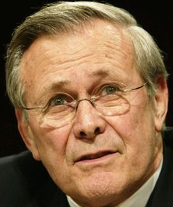

Outlook
What we think we know
  Higgs boson: what it is and where it comes from
How we know what we know
  The LHC machine, the experiments
What we found in 2012
  Discovery of the Higgs boson at the LHC
What we found out since then and
what we know we don’t know
  The unknown unknowns!!
Notes:
What we thought we knew – teoria e pre-LHC data
How we know what we know – experimental aspects
What we know – we found a Higgs boson
All we have found out in the meantime – mass, spin, parity, cross sections
What we know we don’t know...
What we think we know – teoria e o BSM Higgs

Slide 3
What we think we know
Standard Model particles, interactions, and hard-core theory to set the scene…

Slide 4
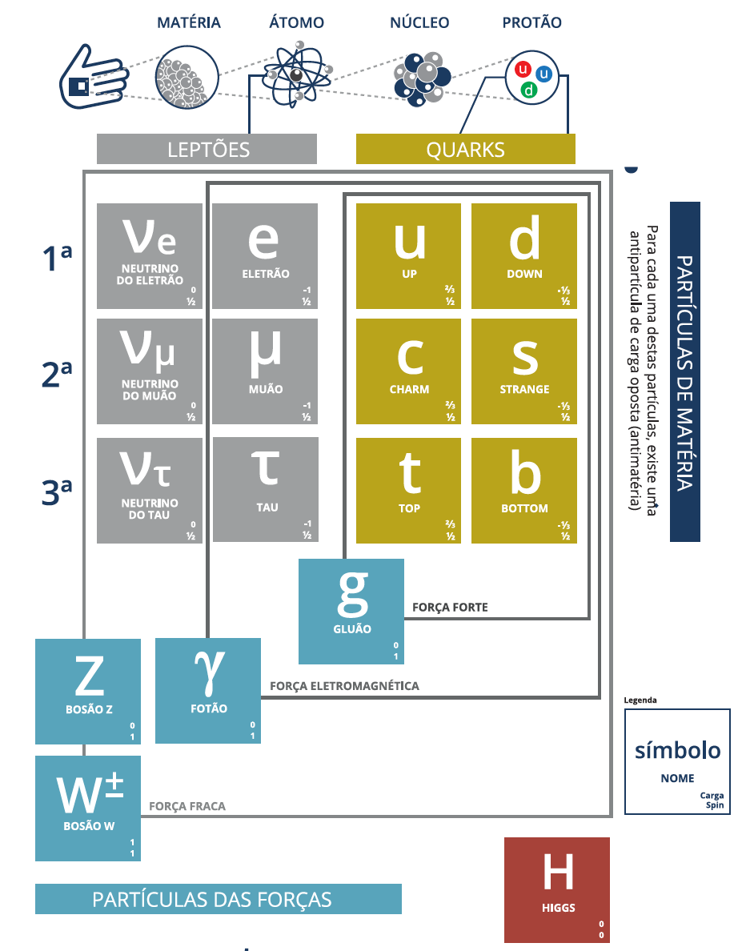
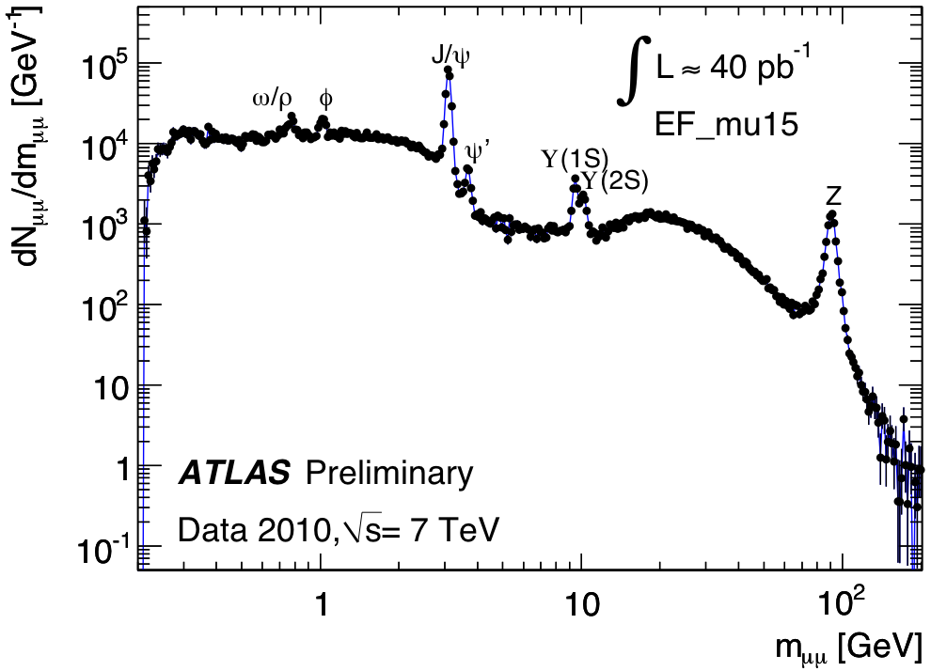
The Standard Model of particle physics
Notes:
Particulas fundamentais conhecidas; forças a que elas reagem; Z tem massa alta ao contrario de gamma e gluoes; Higgs pedra basilar do edificio; dá massa mas só pequena fração nos hadroes;

Slide 5
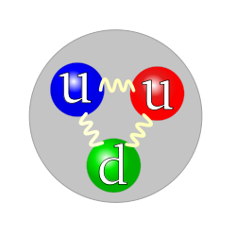

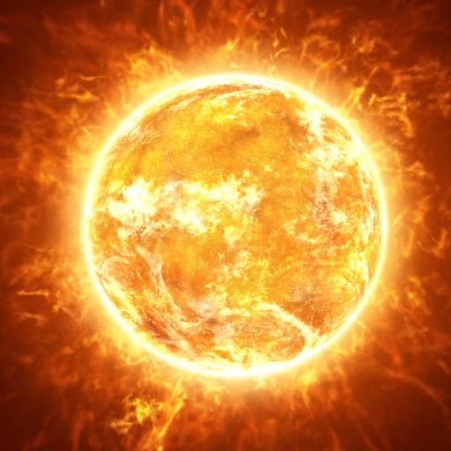

Fundamental interactions
Four known interactions
Carried by messenger particles (gauge bosons)
  As far as we know... We don’t know about gravity (too weak)
Interaction | Gravitation | Weak | Electromagnetic | Strong
Carrier | Graviton?? | W⁺, W⁻, Z | photon | 8 gluons
Acts on | Mass - energy | Weak isospin | Electric charge | Colour
Strength at quark scale | 10⁻⁴¹ | 10⁻⁴ | 10⁰ | 10²
Characteristic range | ∞ | 10⁻¹⁸ m | ∞ | 10⁻¹⁵ m
Characteristic system | Apples, galaxies, etc | Beta decay, nuclear fusion | Light, atoms, chemistry | Hadrons (protons etc)
Notes:
Forças conhecidas transportadas por partículas mensageiras; g afeta maçãs e galáxias; WZ dão processos de alcance mais pequeno que o núcleo; forte cola quarks dentro de protões

Slide 6
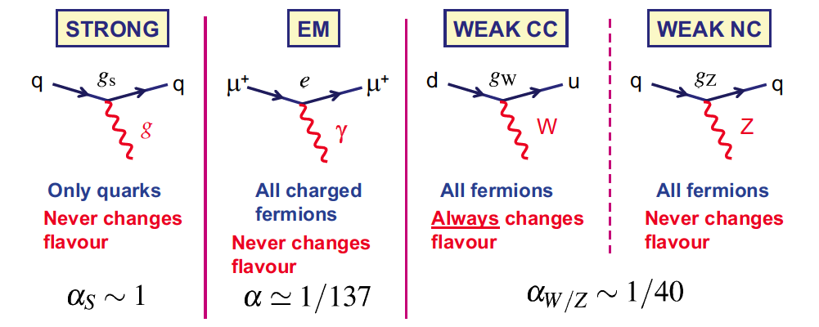
Standard model interactions
The interaction of gauge bosons with fermions is (very) well described by the Standard Model
Gluons
massless
Photon
massless
W+, W-
very massive
Z⁰
very massive
Notes:
Acoplamento (e intensidade do acoplamento) para cada força

Slide 7
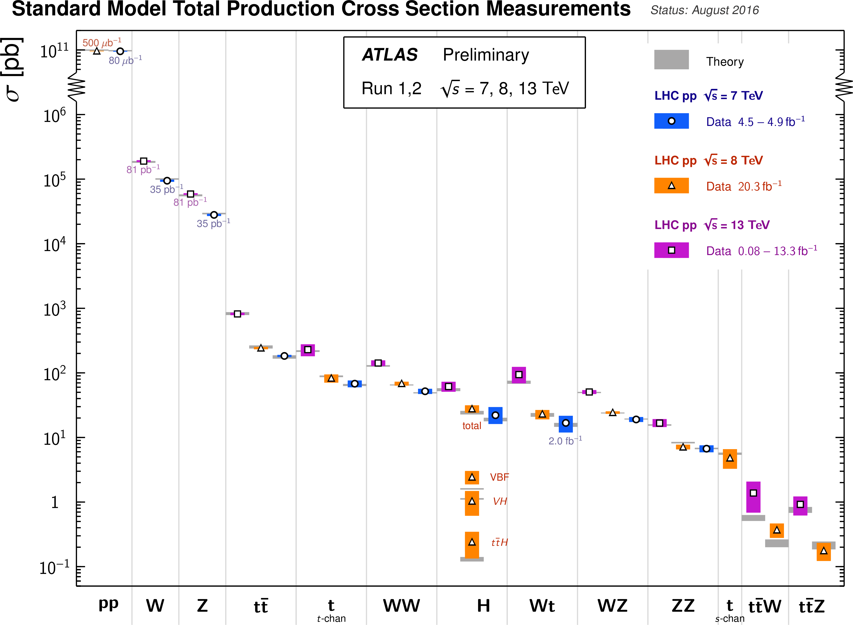
Notes:
SM expectations match measurements at the LHC over a huge range (12 orders of magnitude)! Clearly we do know something....

Slide 8
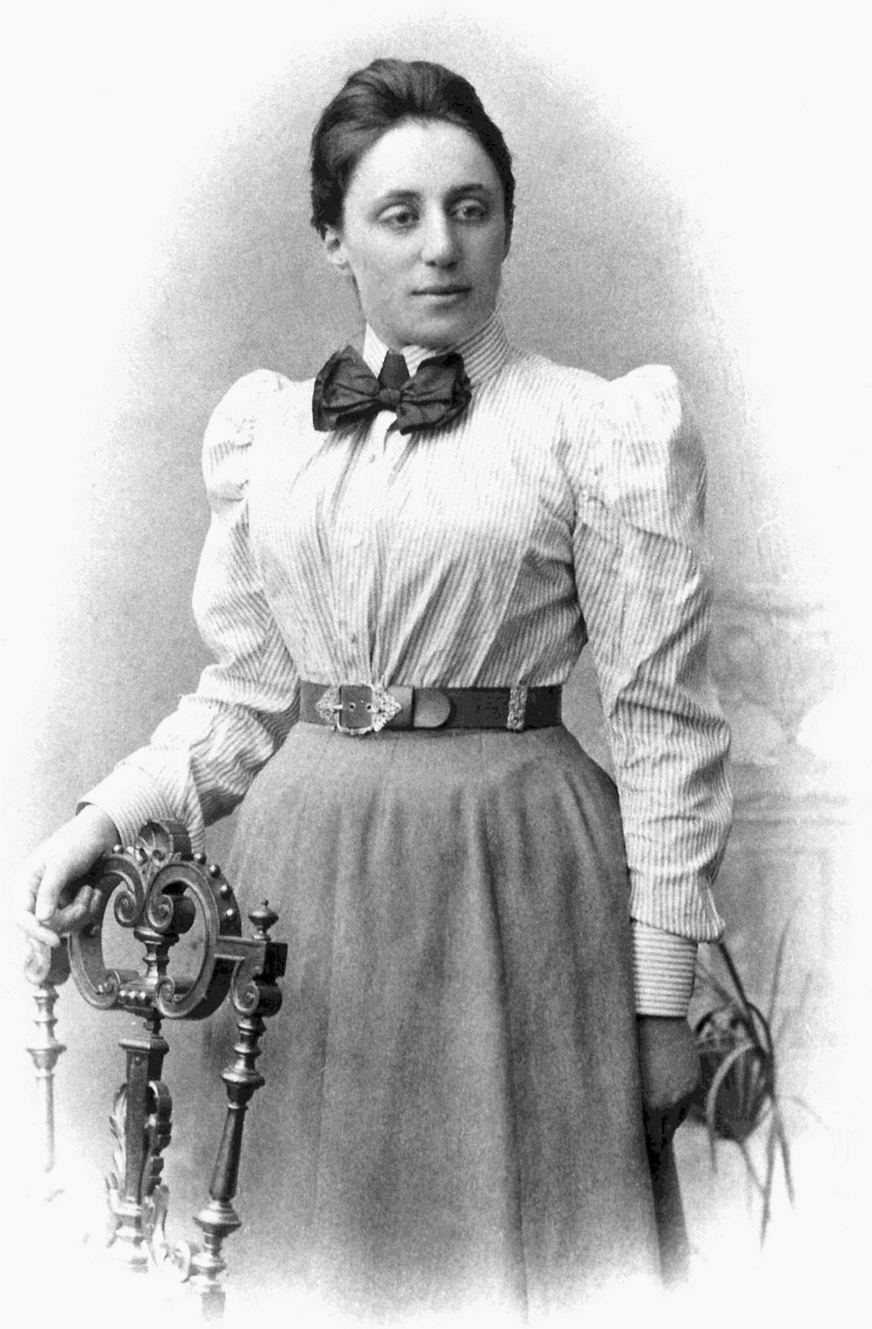
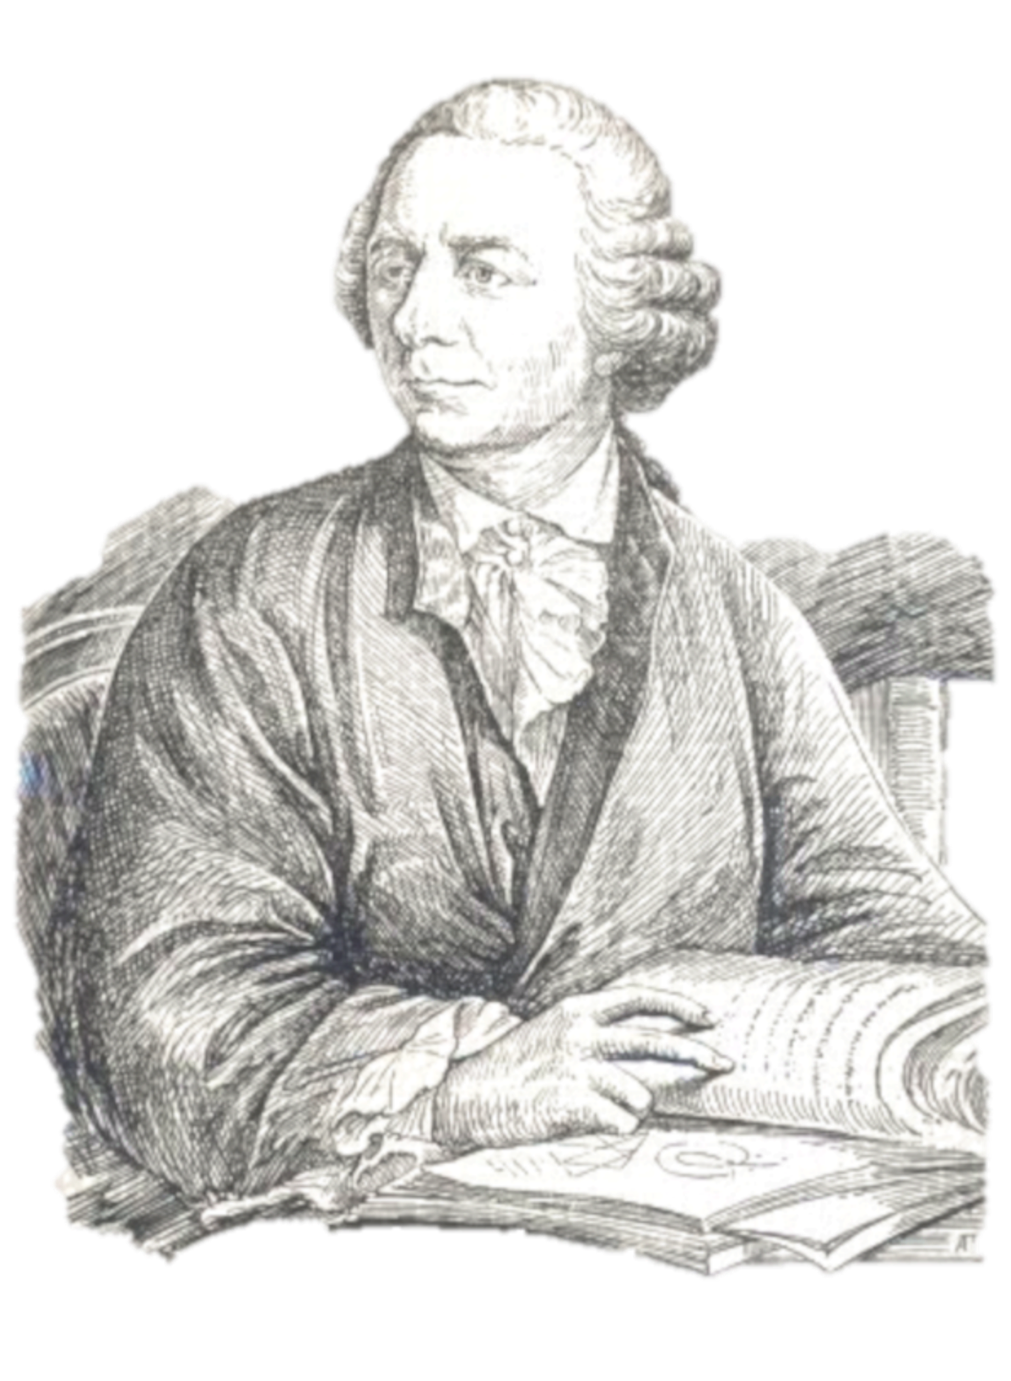
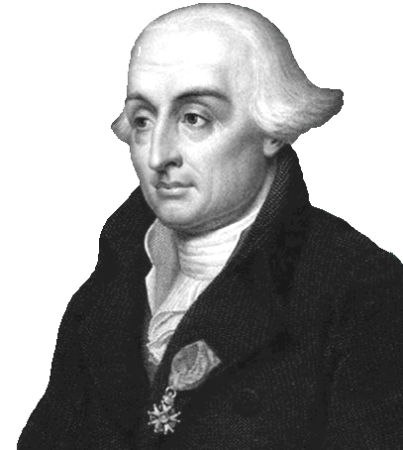
Lagrangians, symmetries and all that
Leonhard Euler(1707–1783)
Emmy Noether (1882 – 1935)
Joseph-Louis Lagrange (1736–1813)
Notes:
Italian-French mathematician and astronomer Joseph-Louis Lagrange in 1788 (born Giuseppe Lodovico Lagrangia to a french father and italian mother) lived in Turin, Berlin and Paris, and was one of the most a renowned mathematicians of his age, teaching . He was president of the commission which defined the metre and kilogram as units. Fourier, who attended his lectures in 1795, wrote: “his voice is very feeble, at least in that he does not become heated; he has a very marked Italian accent and pronounces the s like z [...] The students, of whom the majority are incapable of appreciating him, give him little welcome, but the professeurs make amends for it.” https://en.wikipedia.org/wiki/Joseph-Louis_Lagrange
Amalie Emmy Noether was a German mathematician known for her landmark contributions to abstract algebra and theoretical physics. In physics, Noether's theorem explains the connection between symmetry and conservation laws. Noether was born to a Jewish family in Germany; her father was a mathematician, Max Noether. She studied mathematics at the University of Erlangen. She was invited by David Hilbert and Felix Klein to join the mathematics department at the University of Göttingen, a world-renowned center of mathematical research. But the philologists and historians among the philosophical faculty blocked her: women, they insisted, should not become privatdozent. One faculty member protested: "What will our soldiers think when they return to the university and find that they are required to learn at the feet of a woman? She spent four years lecturing under Hilbert's name. Her habilitation was approved in 1919. Noether remained a leading member of the Göttingen mathematics department until 1933, when Germany's Nazi government dismissed Jews from university positions, and Noether moved to the United States to take up a position at Bryn Mawr College in Pennsylvania. In 1935 she underwent surgery for an ovarian cyst and, despite signs of a recovery, died four days later at the age of 53.
Leonhard Euler (1707 - 1783) was a Swiss mathematician, physicist, astronomer, logician and engineer who made important and influential discoveries in many branches of mathematics like infinitesimal calculus and graph theory while also making pioneering contributions to several branches such as topology and analytic number theory. He also introduced much of the modern mathematical terminology and notation, particularly for mathematical analysis, such as the notion of a mathematical function. He is also known for his work in mechanics, fluid dynamics, optics, astronomy, and music theory. Euler was one of the most eminent mathematicians of the 18th century, and is held to be one of the greatest in history. He is also widely considered to be the most prolific mathematician of all time. He spent most of his adult life in St. Petersburg, Russia, and in Berlin, then the capital of Prussia.

Slide 9
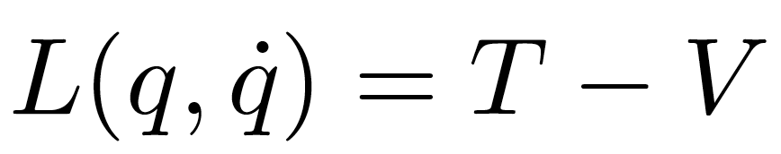
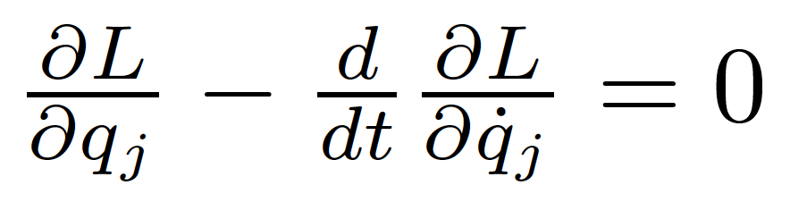
Reminder: Lagrangians in classical mechanics
The equations of motion of a system are derived from a scalar Lagrangian function of generalized coordinates and velocities (time derivatives)
and from the Euler-Lagrange’s equations:

Slide 10
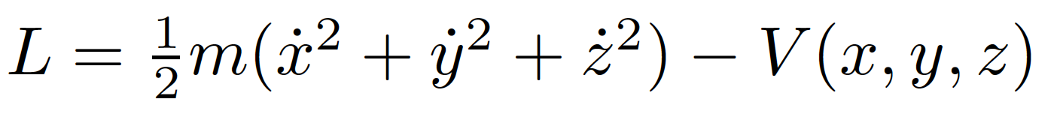
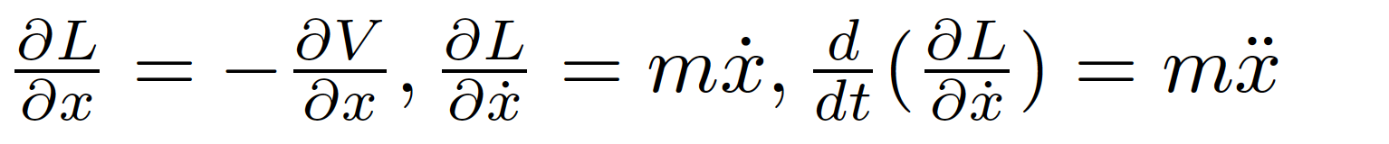
Example
Particle in a conservative potential V. The Lagrangian
has derivatives (e.g. for x)
and Euler-Lagrange’s equations
finally give us Newton’s familiar 2nd law!

Slide 11
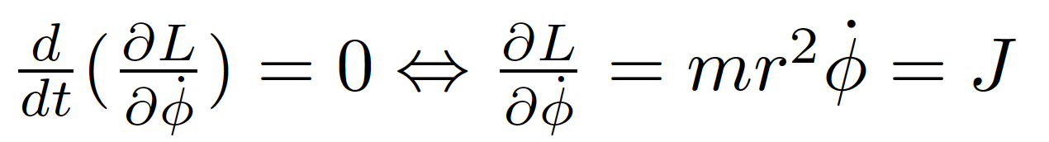
Symmetries and conservation laws
Noether’s theorem:
  If a system has a continuous symmetry property, then there are corresponding quantities whose values are conserved in time.
Simplest case: Coordinates not explicitly appearing in the Lagrangian
Lagrangian invariant over a continuous transformation of the coordinates
Example: mass m orbiting in the field of a fixed mass M
Since the lagrangian doesn’t depend explicitly on φ (symmetry with respect to rotations in space), the Euler-Lagrange equation gives
Where the angular momentum J is a constant of motion!

Slide 12

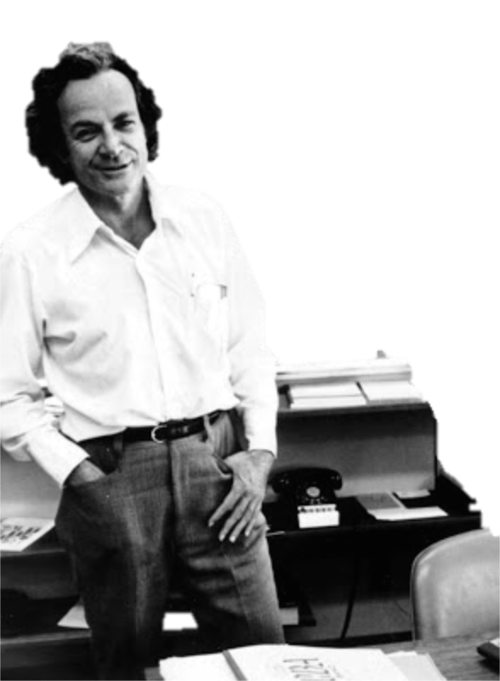
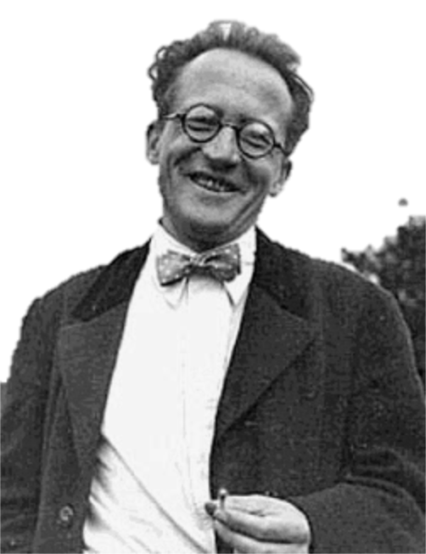

Let’s go to quantum fields...
Erwin Schrödinger (1887 - 1961)
Richard Feynman (1918 - 1988)
Schrödinger’s cat (?-?)
Notes:
Erwin Rudolf Josef Alexander Schrödinger (1887 –1961), sometimes written as Erwin Schrodinger or Erwin Schroedinger, was a Nobel Prize-winning Austrian physicist who developed a number of fundamental results in the field of quantum theory, which formed the basis of wave mechanics: he formulated the wave equation (stationary and time-dependent Schrödinger equation) and revealed the identity of his development of the formalism and matrix mechanics. Schrödinger proposed an original interpretation of the physical meaning of the wave function.
Richard Phillips Feynman (1918 – 1988) was an American theoretical physicist known for his work in the path integral formulation of quantum mechanics, the theory of quantum electrodynamics, and the physics of the superfluidity of supercooled liquid helium, as well as in particle physics for which he proposed the parton model. For his contributions to the development of quantum electrodynamics, Feynman, jointly with Julian Schwinger and Sin-Itiro Tomonaga, received the Nobel Prize in Physics in 1965.

Slide 13
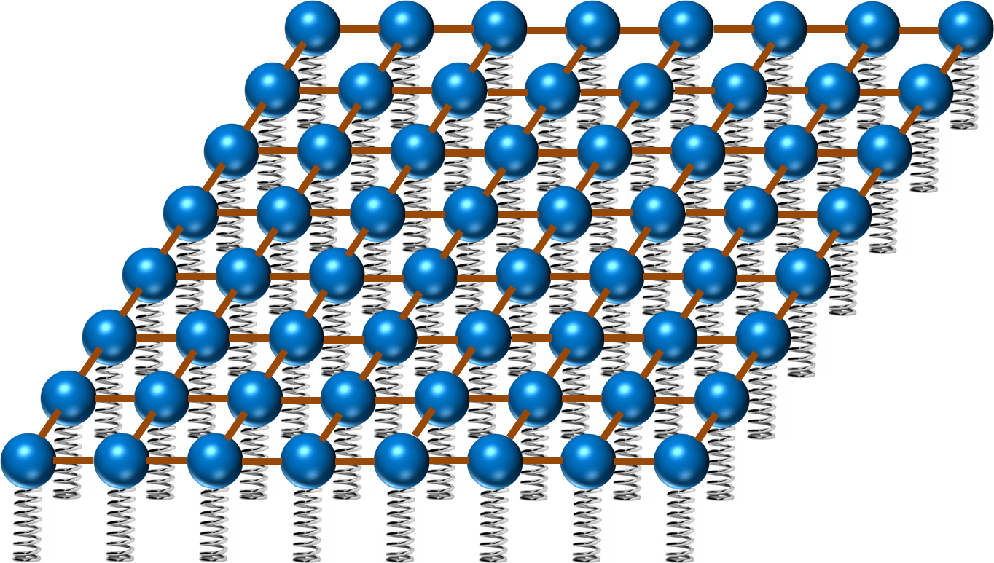
Now in quantum field theory…
Imagine space as an infinite continuum of balls and springs, where each ball is connected to its neighbours by elastic bands. Particles are perturbations of this field
y
ϕ(x,y)
x

Slide 14
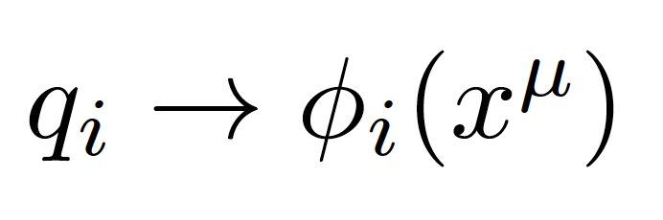
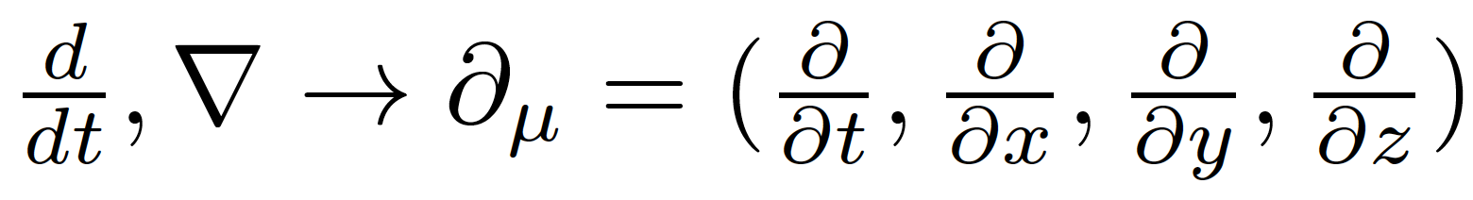
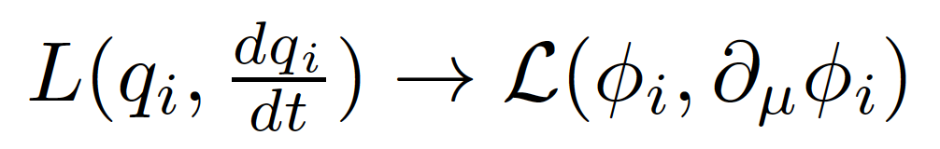
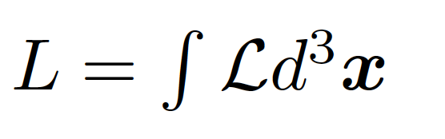
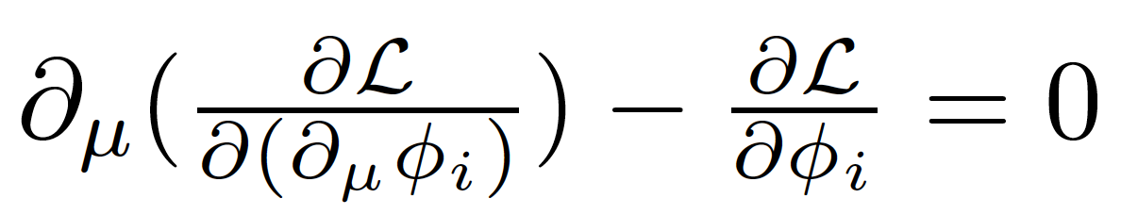
Generalized coordinates are now fields (dislocation of each spring)
In a relativistic theory we must treat space and time coordinates on an equal footing, so the derivatives in the classical equations are now
In place of a Lagrangian we have a Lagrangian density (we call it Lagrangian anyway, just to be confusing)
with:
The new Euler-Lagrange equation now becomes

Slide 15
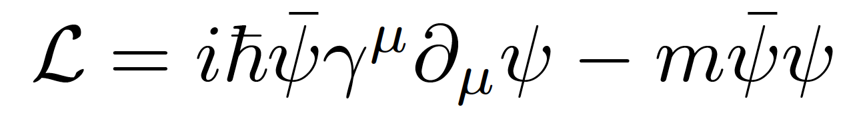
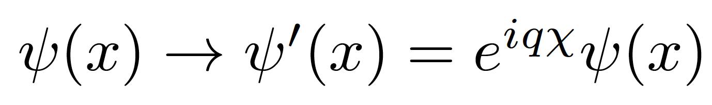
Gauge invariance
Take the Dirac Lagrangian for a field ψ representing a spin-½ particle, for example an electron:
It is invariant under a global U(1) phase transformation like:
Where χ is a constant
Notes:
By the way: this is related to the conservation of electric charge!

Slide 16
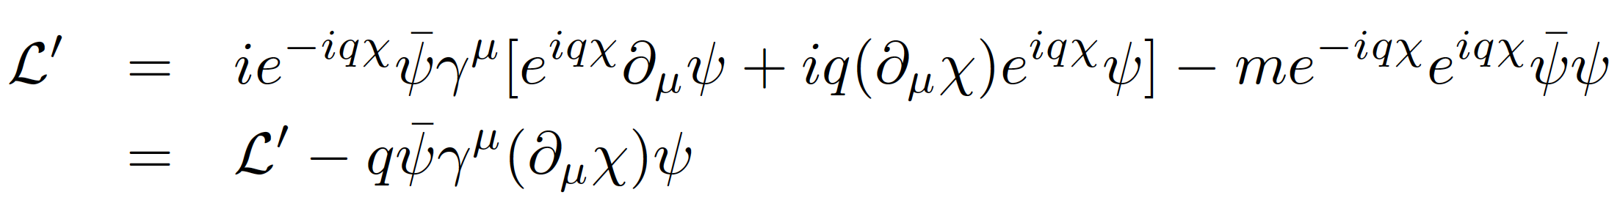
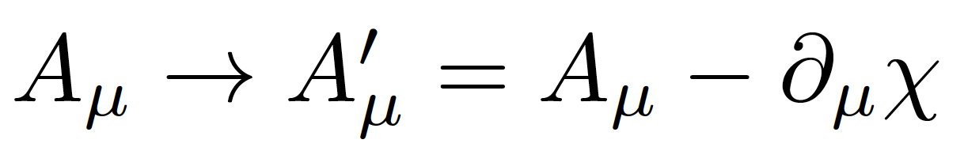
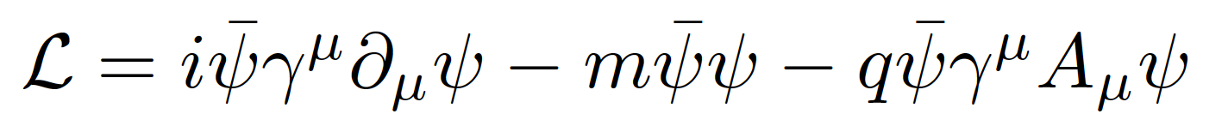
Local gauge invariance and interactions
If χ = χ (x) then we get extra terms in the Lagrangian:
But we can now make the Lagrangian invariant by adding an interaction term with a new gauge field A_{μ} which transforms as:
We get:
A few things to note:
Gauge theories are renormalizable, i.e. calculable without infinities popping up everywhere (Nobel prize of t’Hooft and Veltman)
The new gauge field A_{μ} is the photon in QED
The mass of the fermion is the coefficient of the term on ψψ
There is no term in A_{μ}A^{μ} (the photon has zero mass) → this is the beginning of the Higgs story…
Notes:
Demanding local gauge conservation resulted in obtaining a new field (the photon) and its interactions with the fermion fields. This is the blueprint of all Standard Model theories (called “Gauge theories”).
Gauge theories are automatically renormalizable (‘t Hooft & Veltman’s Nobel prize) i.e. don’t produce nonsense.

Slide 17

Now for the problems...

Slide 18
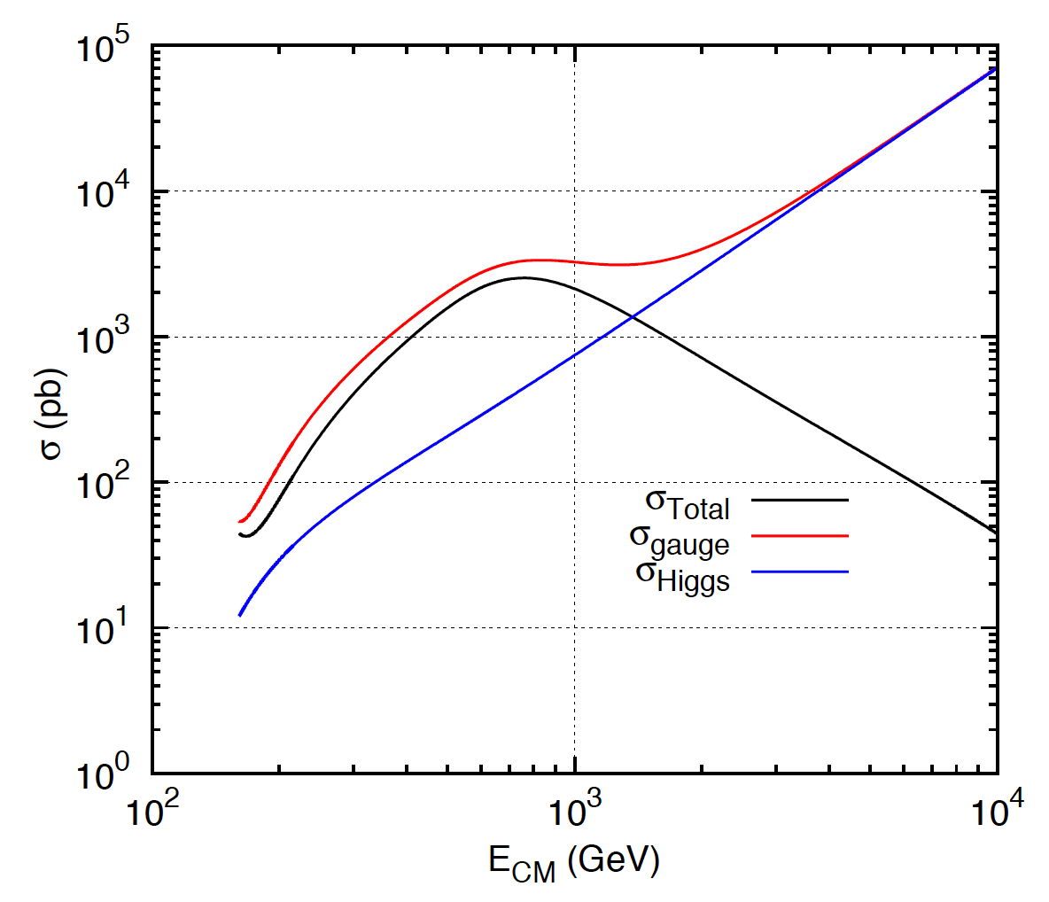
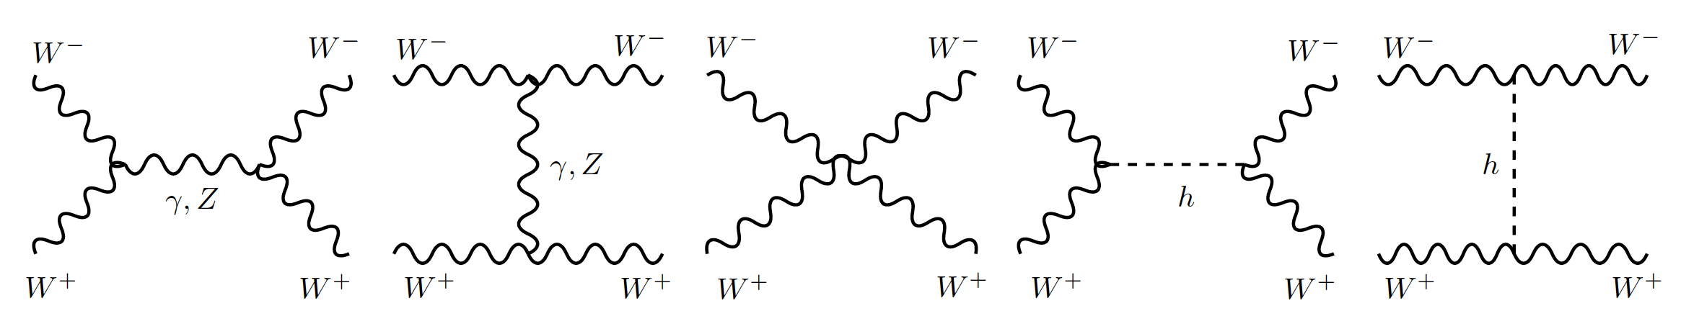
1: Longitudinal gauge-boson scattering
The cross section of a process quantifies the probability that this process occurs in a collision
In the absence of the Higgs, some processes have cross sections that grow with the centre of mass energy of the collision… i.e. breaks unitarity!
The Higgs regulates the cross section through negative interference
J.C.Romão [5]
Feynman diagrams contributing to longitudinal WW scattering

Slide 19
2: Mass of elementary particles and gauge bosons
To keep the Lagrangian gauge invariant (against a U(1) local phase transformation) the photon field transforms as:
But the A^{μ} mass term breaks the invariance of the Lagrangian:
For the SU(2)_{L} gauge symmetry transformations of the weak interaction the fermion mass term m_{e}ψψ also breaks invariance!
Bottom line: the SM (without the Higgs mechanism) results in wrong calculations and breaks down for massive particles

Slide 20
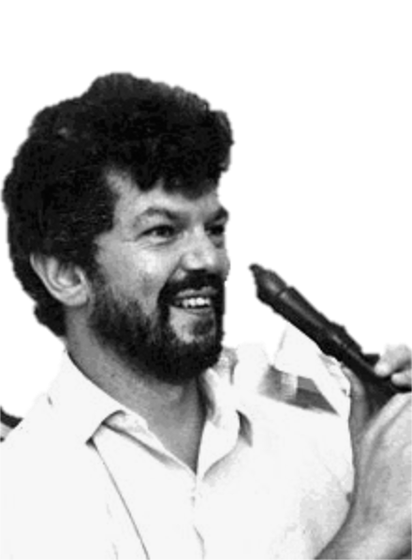
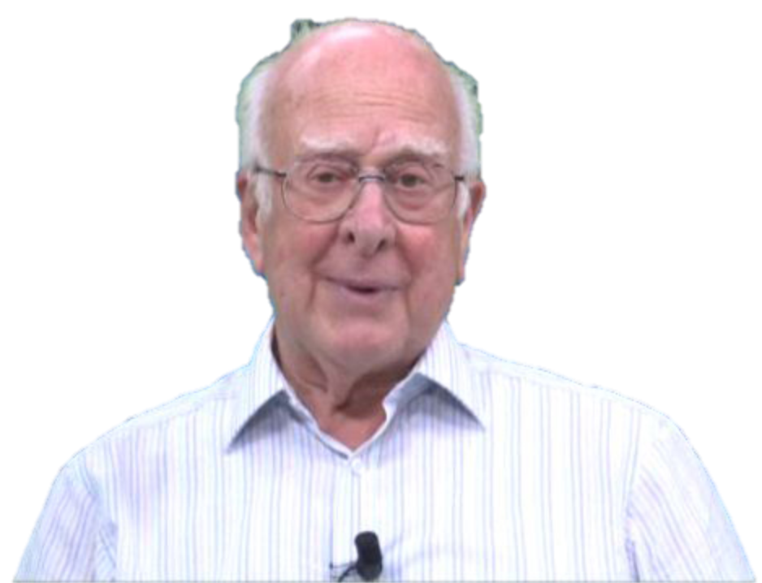
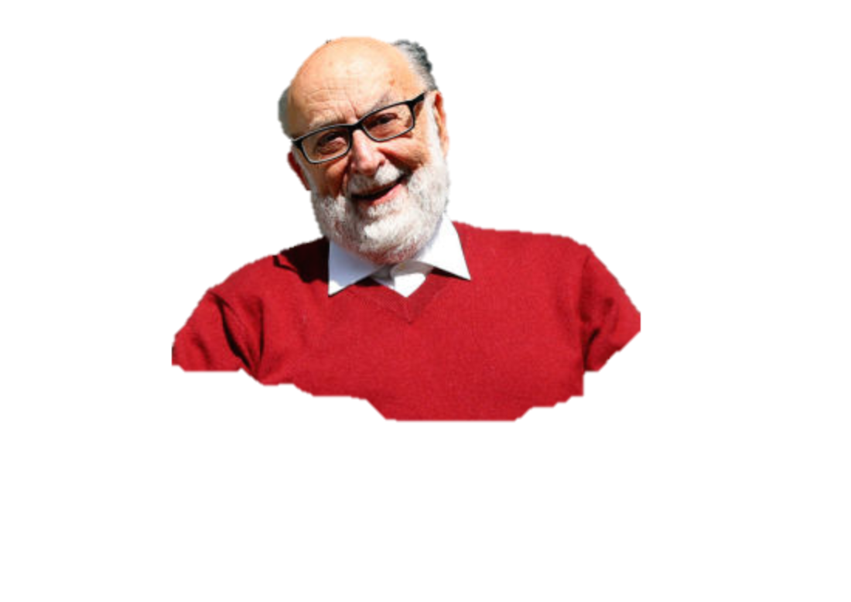
The Higgs Mechanism
Robert Brout (1928 – 2011)
François Englert (b. 1932)
Peter Higgs (b. 1929)
Notes:
Peter Ware Higgs (born 29 May 1929) is a British theoretical physicist, emeritus professor at the University of Edinburgh. In the 1960s, he proposed that broken symmetry in electroweak theory could explain the origin of mass of elementary particles in general and of the W and Z bosons in particular. This so-called Higgs mechanism, which was proposed by several physicists besides Higgs at about the same time, predicts the existence of a new particle, the Higgs boson, the detection of which became one of the great goals of physics.
Robert Brout (1928 –2011) was a Belgian theoretical physicist who made significant contributions in elementary particle physics. He was a Professor of Physics at Université Libre de Bruxelles where he had created, together with François Englert, the Service de Physique Théorique.
François Baron Englert (born 1932) is a Belgian theoretical physicist and 2013 Nobel prize laureate (shared with Peter Higgs). He is Professor emeritus at the Université libre de Bruxelles (ULB) where he is member of the Service de Physique Théorique. He is also a Sackler Professor by Special Appointment in the School of Physics and Astronomy at Tel Aviv University and a member of the Institute for Quantum Studies at Chapman University in California.

Slide 21
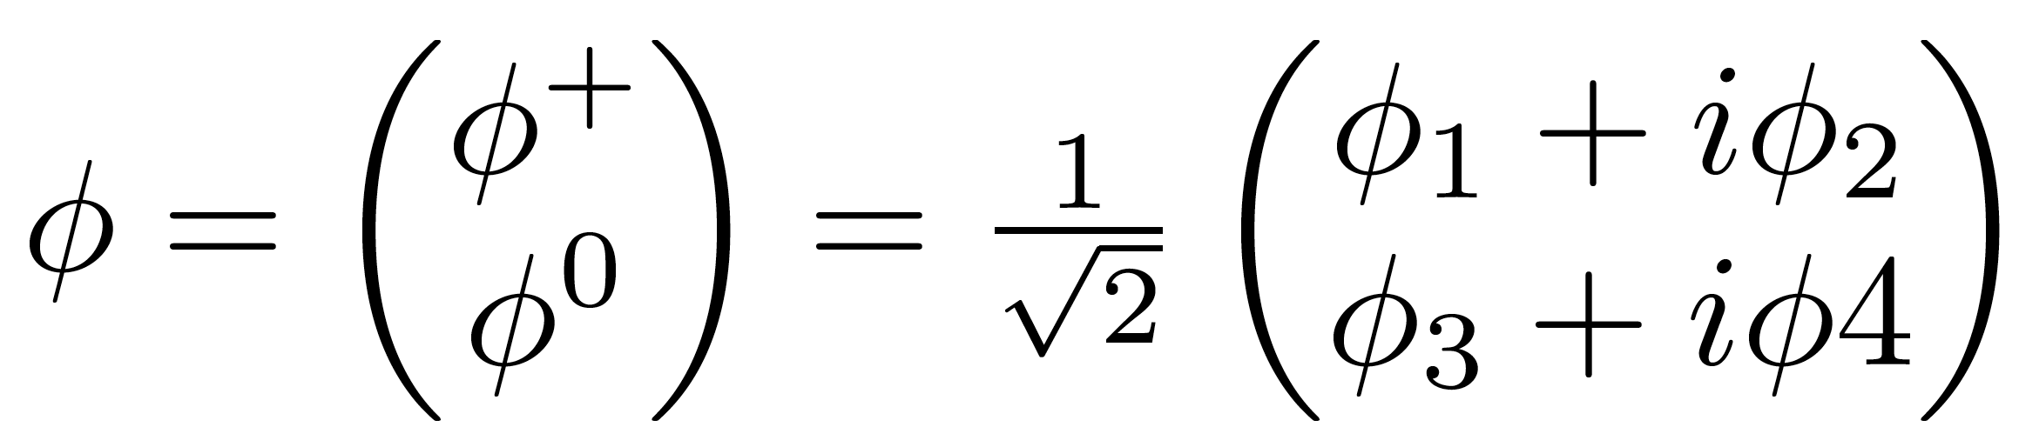
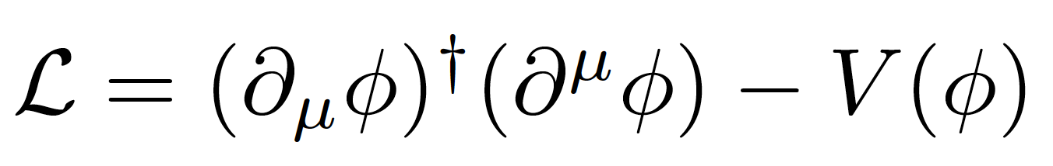
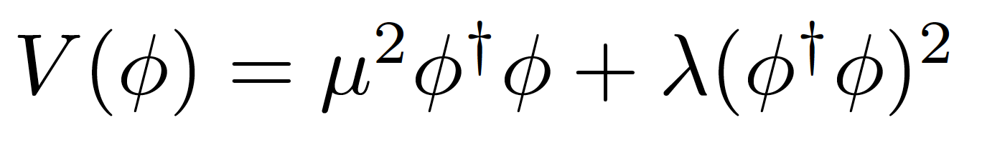
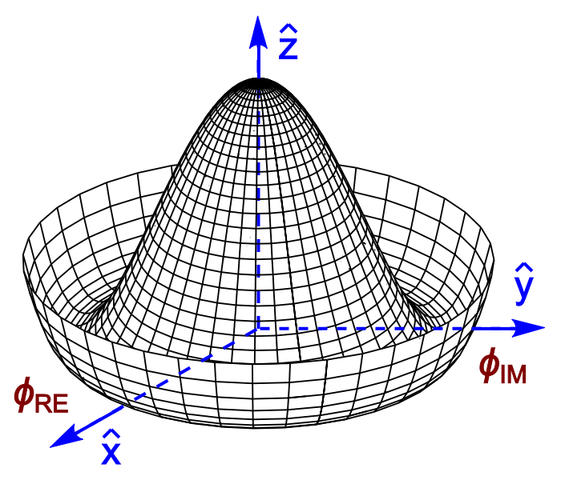
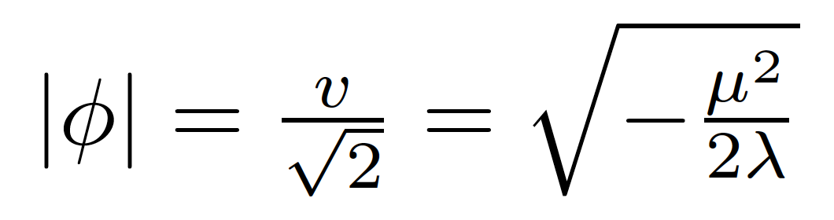
Introduce a SU(2) doublet of spin-0 complex fields
The Lagrangian is
With a potential
For λ>0, μ²<0 the potential has a
minimum at the origin
For λ>0, μ²<0 the potential has an
infinite number of minima at:
The choice of vacuum (lowest
energy state of the field) breaks the symmetry of the Lagrangian

Slide 22
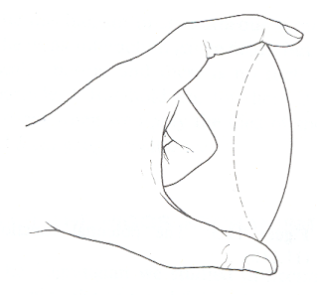
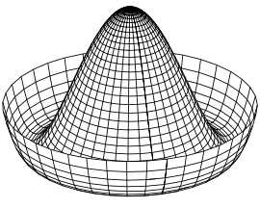
Electroweak symmetry breaking
In the Standard Model with no Higgs mechanism, interactions are symmetric and particles do not have mass
Electroweak symmetry is broken:
  Photon does not have mass
  W, Z have a large mass
Higgs mechanism: mass of W and Z results from the Higgs mechanism
Masses of fermions come from a direct interaction with the Higgs field
see J.Varela’s lecture

Slide 23
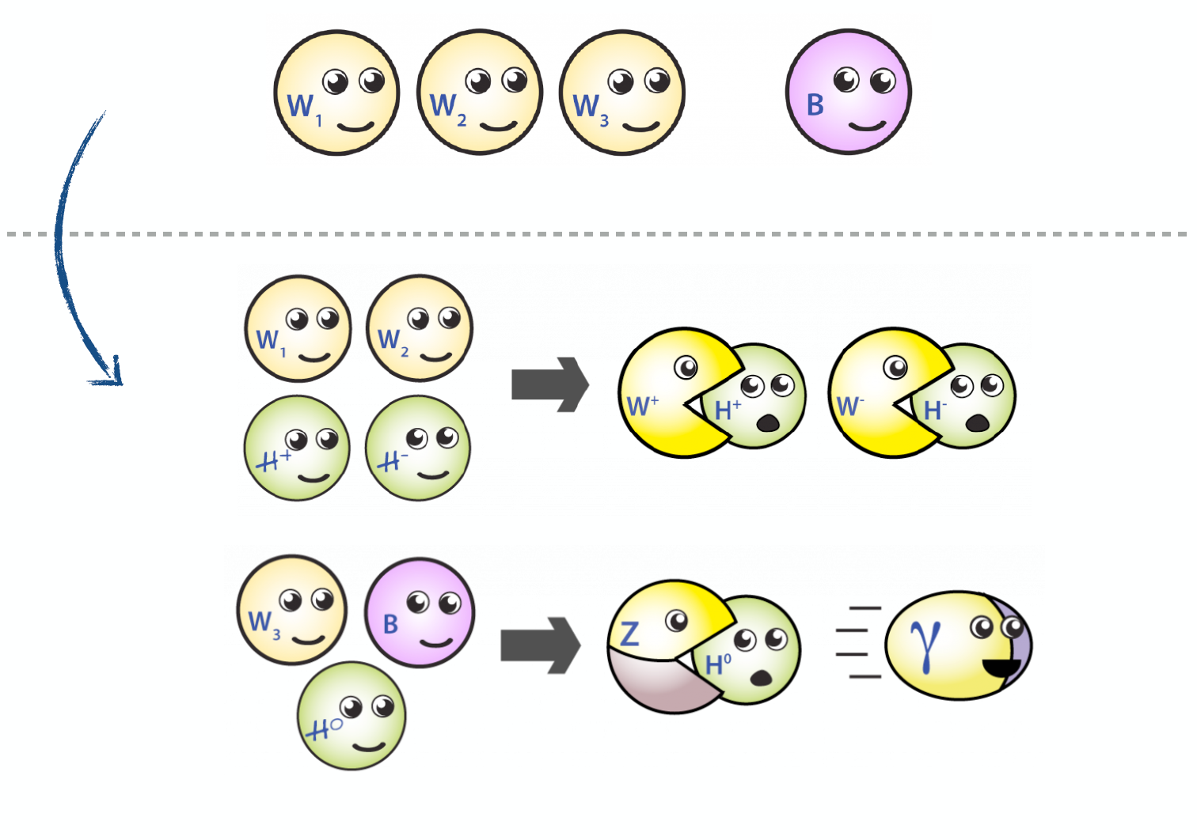
EWK Symmetry Breaking in Pictures

Slide 24
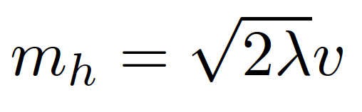
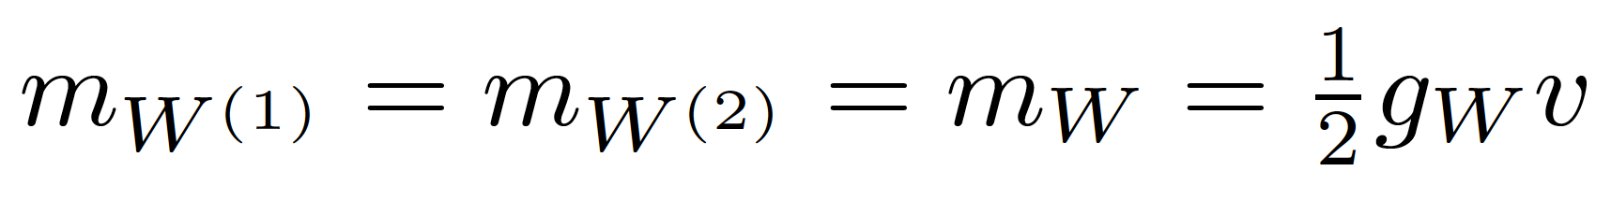
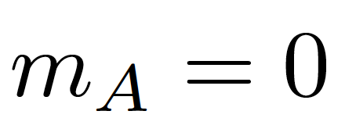

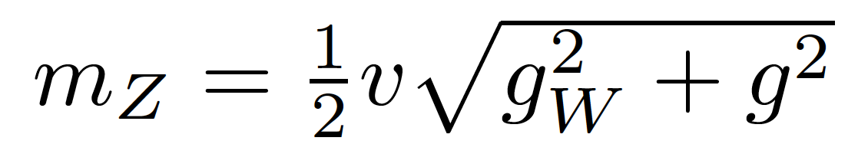
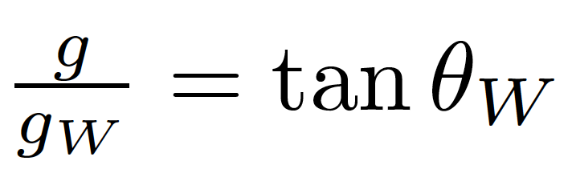
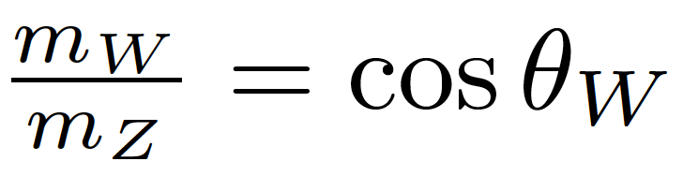
We have at this point a massive scalar field with vacuum expectation value v and mass
4 gauge fields: W⁽¹⁾, W⁽²⁾, W⁽³⁾, and B⁽¹⁾ which transform to give the massive W⁺, W⁻ and Z, and massless A (the photon)
with g, g_{W} the couplings of electromagnetic and weak forces
Defining the Weinberg angle as
we also get the relation between
the masses of W and Z
Fermions get their masses from interaction terms with the Higgs field (Yukawa coupling)

Slide 25
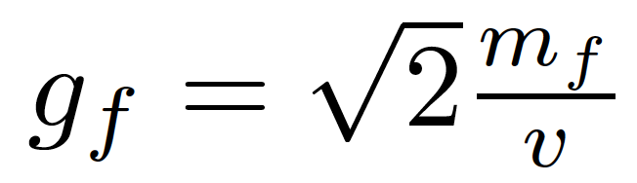
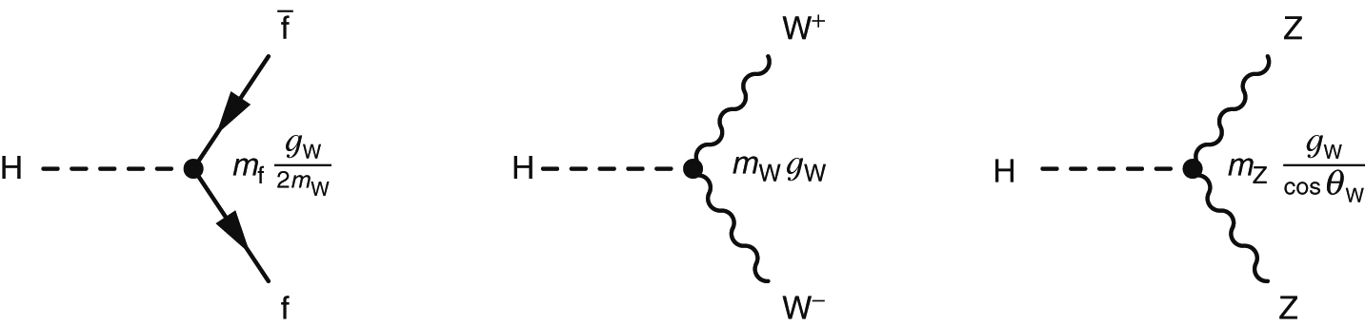
Finally! What we think we know:
Higgs mass (was) the only unknown parameter
We can give mass to W± and Z while keeping the photon massless
Relation between masses of W and Z
Higgs couples to W and Z with strengths proportional to their masses
Higgs couples to all fermions with a strength proportional to their mass

Slide 26
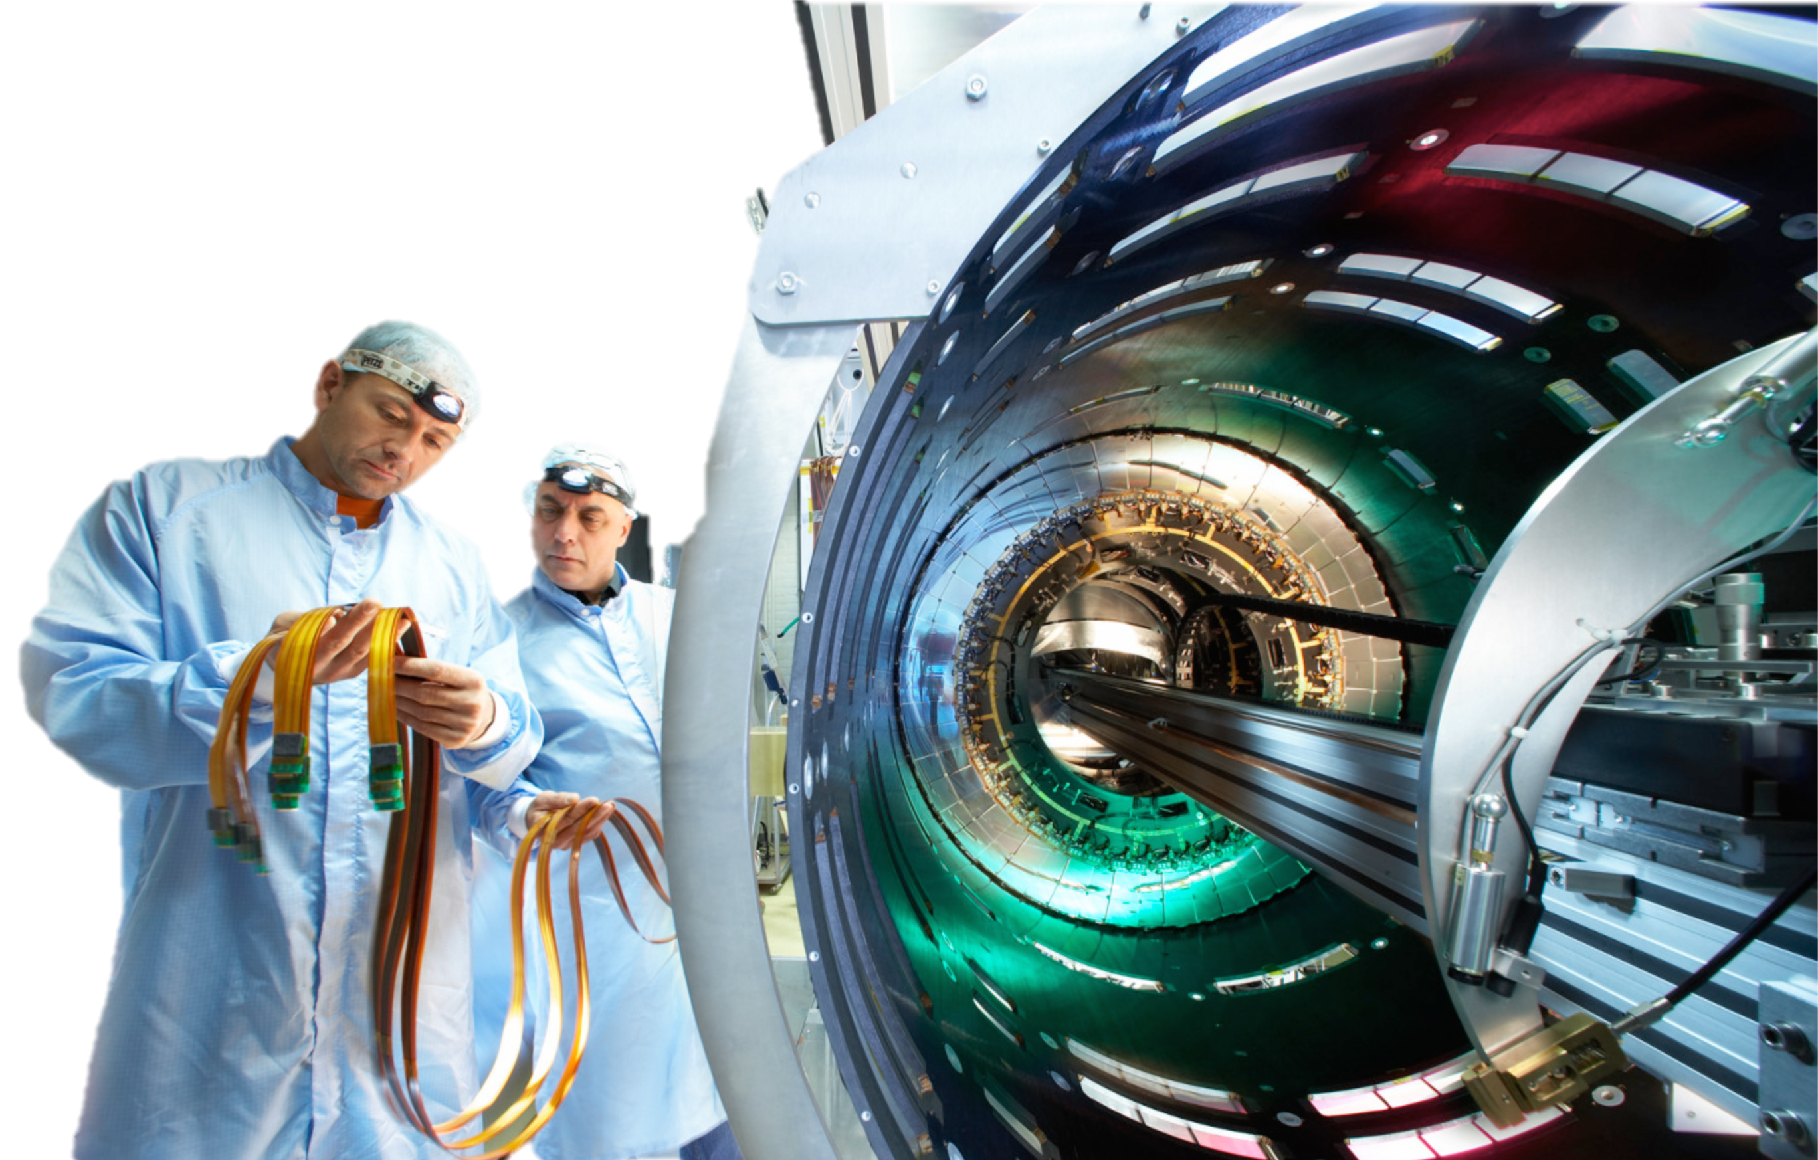
How we know what we know?
The LHC and its experiments

Slide 27



The Large Hadron Collider
Four main experiments:
  ATLAS and CMS general-purpose
  LHCb – B physics
  ALICE – heavy-ion physics
CM energy | 14 TeV (design)
Luminosity (cm⁻²s⁻¹) | Low: 2x10³³ High: 10³⁴
Bunch crossing | 24.95 ns
Overlaid events | 23 @ 10³⁴cm⁻²s⁻¹
Beam radius | 16.7 μm
Particles/bunch | 1.15x10¹¹
Bunches/beam | 2808 (design)
Stored energy | 362 MJ/beam
20,000 tonne aircraft carrier at 21.6km/h (13.4mph)
400 tonne TGV travelling at 150km/h (94mph)

Slide 28


LINAC2 → 50 MeV
Booster → 1.4 GeV
Proton Synchroton (PS) → 25 GeV
Super Proton Synchrotron (SPS) → 450 GeV
Large Hadron Collider (LHC)→ 7 TeV

Slide 29



What do we talk about when we talk about colliding protons?
The LHC collides the beams at the centre of the experiments
Quarks or gluons from colliding protons carry a fraction of the proton’s energy
LHC centre of mass energy:
  7TeV in 2011
  8 TeV in 2012 (2013-2015 shutdown)
  13 TeV from 2015
Both beam energy and luminosity are important
Number of events
Process cross section
Collider luminosity

Slide 30


Slide 31

Muon Spectrometer: |η|<2.7
Air-core toroids and gas-based muon chambers
σ/p_{T} = 2% @ 50GeV to 10% @ 1TeV (ID+MS)
EM calorimeter: |η|<3.2
Pb-LAr Accordion
σ/E = 10%/√E ⊕ 0.7%
Hadronic calorimeter:
|η|<1.7 Fe/scintillator
1.3<|η|<4.9 Cu/W-Lar
σ/E_{jet}= 50%/√E ⊕ 3%
L = 44 m, ∅ ≈ 25 m
7000 tonnes
≈10⁸ electronic channels
3-level trigger reducing 40 MHz collision rate to 200 Hz of events to tape
Inner Tracker: |η|<2.5, B=2T
Si pixels/strips and Trans. Rad. Det.
σ/p_{T} = 0.05% p_{T} (GeV) ⊕ 1%

Slide 32

Particle identification

Slide 33

Portugal at the LHC
Experimental groups from LIP in ATLAS and CMS
20-30 researchers, students, engineers per group, from universities of Lisboa, Coimbra, Minho
Dedicated to tasks from detector operation and upgrade to physics analysis
Both groups made major contributions to the detector development, construction and exploitation over more than 20 years.
Current interests :
ATLAS: detector control; calorimeter calibration and upgrade; jet trigger operation and upgrade; Physics analysis: Higgs; top quark; Exotic; Heavy ions
CMS: calorimeter electronics; trigger/DAQ; Physics analysis: SUSY; top quark; Higgs.

Slide 34

What we found at the LHC in 2012

Slide 35



Slide 36

Setting the scene
Decades of searches in many experiments...
By July 2010:
  LEP+Tevatron+SLD limits
  Higgs excluded m_{h}<114.4 GeV at 95% CL
  Plus between 158 and 175 GeV
CERN-PH-EP-2010-05

Slide 37






Production and decay at the LHC

Slide 38





At the LHC
https://twiki.cern.ch/twiki/bin/view/LHCPhysics/LHCHXSWG
gluon-fusion
VBF
WH
ZH
ttH
Notes:
Main production channels: gluon fusion, Vector Boson Fusion, associated production with vector bosons, associated production with ttbar pair
Animation

Slide 39





Slide 40



It takes time to get it right
EPS-HEP 2011 conference [6]

Slide 41

Discovery time!
Notes:
Em 2008 eu era um jovem postdoc e fui à maior conferência anual de HEP mostrar o que esperávamos ver em Atlas e CMS. Todas as apresentações experimentais sobre o Higgs nas décadas anteriores acabavam a dizer: “não vimos nada e estabelecemos onde o Higgs não está”
Em 2011 fui à conferência de HEP da sociedade europeia de física e pela primeira vez o ambiente mudou: as apresentações de Atlas e CMS mostraram que havia um pequeno sinal nas duas experiências. Pensámos logo que a descoberta do Higgs estava iminente. Fizémos uma festa entre as pessoas do Higgs de ATLAS e CMS para celebrar o Higgs com uma massa de 140 GeV....

Slide 42



Discovery channels
Discovery was made in ATLAS and CMS with about 5 fb⁻¹ of 7TeV data and 20 fb⁻¹ of 8TeV data per experiment; several channels combined
This means about 400 000 Higgs bosons produced in about 8 000 000 000 000 000 proton collisions
  Only about 4000 events with Higgs bosons contributed to the discovery

Slide 43










Combining Higgs Channels
Production
Decay
H->γγ
FIT
×
H->ZZ
H->WW
t
t
t
Backgrounds +

Slide 44

The p₀ Discovery Plot
p₀ is the combined probability that the background fluctuates to look like signal
Translated into the one-sided Gaussian probability
This corresponds to a probability of 1 in 7 million that this was a false positive from fluctuating backgrounds

Slide 45
What we have found out since
And what we still don’t know...

Slide 46



Spin and Parity
First concern after observation!
Some observable quantities sensitive to J^{P}: for example angle between leptons from W decay in H->WW
Pure J^{P} = 0⁻, 1⁺, 1⁻, and 2⁺ excluded with 97.8, 99.97, 99.7, and 99.9% Confidence Level (ATLAS arXiv 1307.1432; CMS Phys. Rev. D 92, 012004)
H->γγ – ATLAS arXiv 1307.1432
H
W⁺
W⁺
μ⁺
W⁻
ν_{μ}
W⁻
e⁻
ν_{e}

Slide 47



Higgs boson mass
Mass: around 125GeV
  Used to be the only unknown
  SM-Higgs parameter, remember? ☺
For a while, different mass values were being measured in ATLAS and CMS, and in different channels
Numbers evolved with accumulated statistics
Current most precise value from ATLAS+CMS has 0.2% precision!
  ATLAS: arXiv:1307.1427
Phys. Rev. Lett. 114, 191803
m_{H}=125.09±0.21 (stat)±0.11 (syst) GeV

Slide 48

Cross section compared to SM expectation

Slide 49


Fermion and Boson couplings from fit
Set one scale factor for all fermions (κ_{F} = κ_{t} = κ_{b}= κ_{τ} =…) and one for all vector bosons (κ_{V} = κ_{Z} = κ_{W})
Assume no new physics
Strongest constraint to κ_{F} comes from loops and interference effects
Note several couplings can still be negative!

Slide 50



Direct Evidence of Fermion Couplings
Challenging channels at the LHC!
  Huge backgrounds (H->bb,H->ττ)
  Or low rate: H->μμ
ATLAS:
  4.1σ evidence of H->ττ decay 3.2σ exp.
  μ = σ_{obs.}/σ_{SM} = 1.4 ±0.3(stat) ±0.4(sys)
CMS:
  Combination of H->bb and H->ττ:
  3.8σ evidence (obs.) 4.4σ (expected)
  μ = σ_{obs.}/σ_{SM} = 0.83 ±0.24
ATLAS-CONF-2013-108
CMS 1401.6527
CMS 1401.6527

Slide 51

New Physics in the Loops?
W
New heavy particles may show up in loops
  Dominant gluon-fusion through a (mostly) top loop production for H->ZZ, H->WW and H->γγ
  H->γγ decay through top and W loops (and interference)
Assume no change in Higgs width and SM couplings to known particles
Introduce effective coupling scale factors:
  κ_{g} and κ_{γ} for ggH and Hγγ loops
W
t
t
t

Slide 52

Couplings versus mass
Reduced coupling modifiers as a function of the particle mass:
For weak vector bosons:
y_{V,i} = √ κ_{V,i} g_{V/i}/2v = √κ_{V,i}m_{V/i}/v
For fermions:
y_{F,i} = κ_{F,i}g_{F/i}/ √2 = κ_{F,i}m_{F/i}/v
Line indicates the predicted dependence on the particle mass for the SM Higgs boson

Slide 53



Higgs differential cross sections
Get access to the loop structure where there may be new physics
ATLAS H→γγ and ZZ and more coming
W
W
W

Slide 54









Anything new on the m_{γγ} = 750 front?
≈750GeV
Notes:
Most fun we had since 2012!

Slide 55




Coupling to quarks: our pet channels at LIP
Important channels and still poorly known!
  ttH – direct coupling to top quarks
  VH->bb – coupling with b quarks
  Can tell us about CP-violation in Higgs sector? Time will tell.
ttH: μ_{ttH} = 1.7 ± 0.8
  ttH(γγ) low – large statistical uncertainty
  tth(ML) high – driven by 2lep0τ and 2lep1τ
  tth(bb) high - driven by dilepton
VH(bb): μ_{VH} = 0.21 ± 0.51
  Low in all channels (WH, ZH)
But nothing to get excited about
  …YET!

Slide 56
Going beyond the standard model
But the Standard Model is not complete; there are still many unanswered questions.
Why do we observe matter and almost no antimatter if we believe there is a symmetry between the two in the universe?
What is this "dark matter" that we can't see but has visible gravitational effects in the cosmos?
Are quarks and leptons actually fundamental, or made up of even more fundamental particles?
Why are there exactly three generations of quarks and leptons? What is the explanation for the observed pattern for particle masses?
How does gravity fit into all of this?

Slide 57
Many possible theories
There are a large number of models which predict new physics at the TeV scale accessible at the LHC:
Supersymmetry (SUSY)
Extra dimensions
Extended Higgs Sector e.g. in SUSY Models
Grand Unified Theories (SU(5), O(10), E6, …)
Leptoquarks
New Heavy Gauge Bosons
Technicolour
Compositeness
Any of this could still be found at the LHC and most have a connection to the Higgs boson

Slide 58



Invisible Higgs
Direct searches for Dark Matter usually hidden in deep caverns for low noise. But there is another way…
  Dark matter has mass! Should couple to the Higgs. Do we see it?
  Weakly interacting particles would leave no trace in detector – “Invisible” Higgs decays
  Could be e.g. neutralinos in SUSY scenario
  Would contribute to total Higgs width – we can search it at the LHC

Slide 59


Invisible Higgs
Require dileptons from Z
Back to back with Missing E_{T} and p_{T}(ll)
No jets
Main backgrounds ZZ, WZ
Claire Shepherd-Themistocleous - 26th Rencontres de Blois 2014

Slide 60




A bit of fun…
1-loop effective potential
RG-improved potential
What if…
  At higher orders, Higgs potential doesn’t have to be stable
  Depending on m_{t} and m_{H} second minimum can be lower than EW minimum ⇒ tunneling between EW vacuum and true vacuum?!
“For a narrow band of values of the top quark and Higgs boson masses, the Standard Model Higgs potential develops a shallow local minimum at energies of about 10¹⁶ GeV, where primordial inflation could have started in a cold metastable state”, I. Masina, arXiv:1403.5244 [astro-ph.CO]
  See also: V. Brachina, Moriond 2014 (Phys.Rev.Lett.111, 241801 (2013)), G. Degrassi et al, arXiv:1205.6497v2; R.Contino, Workshop sulla fisica p-p a LHC, 2013

Slide 61



The universe seems to live near a critical condition
JHEP 1208 (2012) 098
Why?!
Explained by underlying theory?
Anthropic principle?

Slide 62

Where we stand now?
The Higgs may very well be a window into the new physics which we know must exist
We now have very precise results from the Higgs sector
And no surprises (yet?)
But the truth is out there! Must keep looking!

Slide 63

The End
Goldstein, ‘Classical Mechanics’, ‪Addison-Wesley Publishing Company (1980‬)
D. Griffiths, ‘Introduction to Elementary Particles ', John Wiley and Sons (1987)
Exposição “Partículas – do Bosão de Higgs à Matéria Escura”: http://www.lip.pt/particulas/
Wikipedia: https://en.wikipedia.org/
M. Thompson, Modern Particle Physics, Cambridge University Press, 2013
J. Butterworth, Smashing Physics – inside the world’s biggest experiment, Headline Publishing Group, 2014
J.C. Romão, The need for the Higgs boson in the Standard Model, private note, http://porthos.ist.utl.pt/CTQFT/
W.Murray on behalf of the ATLAS and CMS Collaborations, proceedings of the 2011 Europhysics Conference on High Energy Physics, EPS-HEP 2011, July 21-27, 2011 Grenoble, Rhône-Alpes, France, PoS (EPS-HEP2011) 031
LEP Electroweak Working Group, Precision Electroweak Measurements and Constraints on the Standard Model, CERN-PH-EP-2010-095, July 2010
LHC Higgs Cross Section Working Group: https://twiki.cern.ch/twiki/bin/view/LHCPhysics/LHCHXSWG
CMS Collaboration, Constraints on the spin-parity and anomalous HVV couplings of the Higgs boson in proton collisions at 7 and 8 TeV, Phys. Rev. D 92, 012004, 2015
ATLAS and CMS Collaborations, Combined Measurement of the Higgs Boson Mass in pp Collisions at s√=7 and 8 TeV with the ATLAS and CMS Experiments, Phys. Rev. Lett. 114, 191803
I. Masina, arXiv:1403.5244 [astro-ph.CO], V. Brachina, Moriond 2014 (Phys.Rev.Lett.111, 241801 (2013)), G. Degrassi et al, arXiv:1205.6497v2; R.Contino, Workshop sulla fisica p-p a LHC, 2013

Slide 64



Slide 65
Channel combination with gory details
Assumptions:
  Single resonance (at m_{H} = 125.5GeV)
  No modification of tensor structure of SM Lagrangian:
    i.e. H has J^{P} = 0⁺
  Narrow width approximation holds
    i.e. rate for process i ➔ H ➔ f is:
Free parameters in framework:
  Coupling scale factors: κ_{j}²
  Total Higgs width: κ_{H}²
  Or ratios of coupling scale factors: λ_{ij} = κ_{i} / κ_{j}
Tree-level motivated framework
  Useful for studying deviations in data with respect to expectations
    E.g. extract coupling scale factor to weak bosons κ_{V} by setting κ_{W} = κ_{Z} = κ_{V}
  Not same thing as fitting a new model to the data

Slide 66

Forces and expansion of the Universe
E=k. T
k=8.62 10⁻⁵ eV K⁻¹
LHC

Slide 67

Two Higgs Doublet Model (2HDM)
No reason for simplest Higgs sector scenario to be true!
One of the simplest alternatives: 2 Higgs doublets
Leads to 5 different Higgs bosons:
  CP even (scalar): h, H
  CP odd (pseudoscalar): A
  charged: H⁺, H⁻
  Two doublets => two vacuum expectation values (mean field strength in the vacuum) – v₁ and v₂

Slide 68

Two Higgs Doublet Model (2HDM)
Free parameters:
  4 masses (Do we know one? Assume it’s m_{h})
  tan β = v₁/v₂ ratio of v.e.v.’s
  Mixing angle of h and H: α
4 possible Yukawa coupling arrangements (“types”)
Most common SUSY benchmark (MSSM) is based on Type II
If cos(β-α) = 0, h = Standard Model H⁰

Slide 69

Constraints from SM channels
What can our data already say about the 2HDM?
  If it exists in Nature, then some of the measured rates (signal strength) are modified
  Existing measurements can already rule out many possibilities
  Used final states γγ, ZZ, WW, bb, ττ
ATLAS-CONF-2014-010

Slide 70

Rare decays
Only way to probe Higgs decays to charm – charm Yukawa coupling – at LHC
Deviations in coupling from SM value can lead to increase in branching fraction
Analysis also probes Z decays to J/Ψ or ϒ(nS) plus γ – improved LEP limits by 2

Slide 71

Future LHC Running

Slide 72



Not only more luminosity
Higher centre of mass energy gives access to higher masses
Hugely improves potential for discovery of heavy particles
Increases cross sections limited by phase space
  E.g. ttH increases faster than background (factor 4)
But may make life harder for light states
  E.g. only factor 2 increase for WH/ZH, H➞bb and more pileup
  Could be compensated by use of boosted jet techniques (jet substructure)
http://www.hep.ph.ic.ac.uk/~wstirlin/plots/plots.html

Slide 73

Run II/High-Lumi LHC Programme
Precision AND searches!
Precision:
  Continue to look for deviations wrt Standard Model
Differential cross sections:
  New physics in loops could modify event kinematics
Complete measurement of properties:
  E.g. CP quantum numbers:
  Sensitivity in H➞ZZ and VBF
  Search for CP violation in Higgs sector
Search for rare decay modes:
  H➞HH to access self coupling (long term!)
Search for additional Higgs bosons:
  E.g. 2-Higgs Doublet Model is a natural extension and predicted in SUSY

Slide 74






Another example: ttH
Indirect constraints on top-Higgs Yukawa coupling from loops in ggH and ttH vertices
  Assumes no new particles contribute to loops
Top-Higgs Yukawa coupling can be measured directly
  Allows probing for New Physics contributions in the ggH and γγH vertices
Top Yukawa coupling Y_{t} = √2M_{t}/vev = 0.996±0.005
  Does this mean top plays a special role in EWSB?

Slide 75


Sensitivity to New Physics
Degrande et al. arXiv:1205.1065
Effective top-Higgs Yukawa coupling may deviate from SM due to new higher-dimension operators
  Change event kinematics – go differential!
ttH sensitive new physics: little Higgs, composite Higgs, Extra Dimensions,…
In the presence of CP violation, Higgs-top coupling have scalar (κ_{t})and pseudoscalar (˜κ_{t})components
  Strong dependence on ttH cross section
  Note: Indirect constraints from electron electric dipole moment not taken into account (give |˜κ_{t}| < 0.01)
Ellis et al. arXiv:1312.5736

Slide 76
Summary
Recapitulation:
  Electroweak symmetry breaking
  Higgs boson in Electroweak Lagrangian
  Higgs boson production and decay at the LHC
  The landscape at the end of LHC run I
The Higgs sector beyond the Standard Model
  Constraints from current data
  Examples of rare and exotic channels
Future Higgs measurements at LHC and beyond
  Fundamental questions at the end of run I
  Future LHC running – luminosity, energy, and physics reach
  Higgs physics in future LHC analyses – Precision and Searches
  An example: associated production with top-quark pair – SM and BSM

Slide 77

Introduction
Why should we care about ttH?
  Measure largest SM Yukawa coupling (y_{top} ≈ 1)
  Direct measurement of y_{top} – unlike gluon-fusion!
  y_{top} connected to the scale of new physics (arXiv:1411.1923 [hep-ph])
  Complementary channel to extract Higgs CP (arXiv:1501.03157 [hep-ph], arXiv:hep-ph/9602226, arXiv:1312.5736 [hep-ph])
But :
  Small cross section:
    0.506pb @ 13 TeV, 0.136pb @ 8 TeV
    ≈ 0.7% – 1.1% of gluon-fusion Higgs production
  Complicated final states: many possible Higgs and top decay combinations
  Draws on all detector capabilities
  Problematic combinatorial issues in event reconstruction for most channels
So:
  Favour high branching ratio decays: bb, WW, ττ
  Or H->γγ (low BR but no comb. issues there)
  Make analyses orthogonal to ease combination
b
W⁺
W⁻
b
Notes:
Direct access to top yukawa coupling
Gluon fusion loop may be contaminated by BSM particles
Complementary channel to measure CP quantum numbers – route to BSM in case H(125) is not a CP eigenstate
But small xsection (1% of ggF) and complicated final state
Go for high-BR channels and look at ttH->gamma gamma (high purity)

Slide 78






ttH, H→γγ analysis
Phys.Lett. B 740 (2015) 222-242
Analysis targets ttH and tH production (tHqb, tHW)
Data: 4.5 fb⁻¹ at √s = 7 TeV and 20 fb⁻¹ at √s = 8 TeV
Very small BR(H → γγ) = 0.0023
  Event yields: ≈0.2 at 7 TeV; ≈1 at 8 TeV
  But good di-photon mass resolution and small backgrounds
Analysis driven by ttH, but cuts loose enough to accommodate tH
  Efficiency ≈15% for ttH, ≈6% to 12% for tH
Selection:
2 photons with 105 GeV < m_{γγ} < 160 GeV
  Diphoton vertex reconstructed from longitudinal shower profile (un-converted) or tracks (converted photons)
  Leading (subleading) photon: E_{T} > 0.35 x m_{γγ} (0.25 x m_{γγ})
2 event categories:
  Leptonic: ≥ 1 e/μ + ≥ 1 b-tagged jet + E_{T}^{miss} > 20 GeV; m_{le} ≠ m_{Z}
  Hadronic: no e or μ; high jet and b-tag multiplicity
% of signal

Slide 79




Analysis & Results
Phys.Lett. B 740 (2015) 222-242
μ_{ttH} = σ_{obs.}/σ_{SM}
Discriminant parameter: m_{γγ}
  Search excess around 125.4 GeV using S + B likelihood fit
  Signal modelling: Crystal Ball + Gaussian (from simulation)
  Continuum background: exponential fit to sideband
  Fit function validated in loose photon-ID control regions dominated by jets
Signal strength (μ_{ttH} = σ_{obs.}/σ_{SM}) best fit:
  Overall (H → γγ):
  ttH only:
Combined limits on signal strength
μ < 6.7 (4.9 expected)
Interpreting the data as 95% CL interval of a constant κ_{t} multiplying the top Yukawa coupling (y_{t} = κ_{t} y_{t}SM):
  Observed: -1.3 < κ_{t} < 8.0
  Expected: -1.2 < κ_{t} < 7.8

Slide 80



Results
Phys.Lett. B 749 (2015) 519-541
Signal strength μ_{ttH} = σ_{obs.}/σ_{SM} from maximum-likelihood fit to yields in all categories
  Systematic uncertainties are nuisance parameters in fit
  μ_{ttH}=1 assumes SM x-sections and BR, and m_{H} = 125 GeV
  Fit constrains statistically-limited non-prompt leptons
Small excess in combined signal strength from 2l0τ_{had}, 3l categories – compatible with SM
Combined 95% CL exclusion limit on is μ_{ttH} < 4.7 (μ_{ttH} < 2.4 expected)
Single top tH production was set to SM value
  Setting it to zero gives a variation Δμ of 0.04
μ_{ttH} = σ_{obs.}/σ_{SM}
Combination of all categories

Slide 81


Results
Eur. Phys. J. C (2015) 75:349
Signal strength from combined H→bb single-lepton and dilepton channels: μ_{ttH} = σ_{obs.}/σ_{SM} = 1.5 ± 1.1
Exclusion limits at 95% CL: μ < 3.4 (2.2 expected)
Most important uncertainties:
  tt + Heavy Flavour modeling
  Jet energy scale
  ttV cross section

Slide 82


ttH combination
JHEP 05 (2016) 160
Representative/best analysis category
ATLAS combined all above analyses to get final LHC Run 1 sensitivity
LHC Run 1 ATLAS best fit: μ_{ttH} = 1.7 ± 0.8
Compatible with SM signal (μ_{ttH} = 1) within 1σ
2σ above μ_{ttH} = 0 (background-only hypothesis)
95% CL limit: μ_{ttH} < 3.1 × SM (obs) / 1.4 × SM (exp)
ttH channel | S/B | S/√B
H→γγ | 64% | 0.6
multilepton | 20% | 0.69
H→bb 1l | 4% | 0.8
H→bb 2l | 6% | 0.4
H→bb all-had. | 1% | 0.4

Slide 83


Conclusions and outlook
ttH production provides unique, direct access to top Yukawa coupling and Higgs properties
  Covered H→γγ, H→WW, H→ττ, H→ZZ, H→bb decay channels
Combined signal strength 2σ above background-only hypothesis and compatible with SM expectations
μ_{ttH} = 1.7 ± 0.8
Better sensitivity expected soon :
  Higher luminosity (ramping up quickly!)
  Better S/B ratio(*) with respect to some backgrounds
(*) Before cuts and for inclusive tt+jets; not necessarily true after cuts for all channels and jet flavours

Slide 84
How much have we learned since then?
Mass: around 125GeV
  Used to be the only unknown
  SM-Higgs parameter, remember? ☺
ATLAS: arXiv:1307.1427
  m_{H}^{H->4l} = 124.3 ±0.6(stat) ±0.5(sys)
  m_{H}^{H->γγ} = 126.8 ±0.2(stat) ±0.7(sys)
  Assuming single resonance:
  m_{H} = 125.5 ±0.2(stat) ^{+0.5}_{-0.6}(sys)
Tension between channels!
  Compatibility P=1.5% (2.4σ)
  Rises to 8% with square syst.prior
CMS: arXiv:1312.5353
  m_{H}^{H->4l} = 125.6 ±0.4(stat) ±0.6(sys)
Doesn’t look like two different resonances!...
  ATLAS: arXiv:1307.1427
CMS (H->4l)

Slide 85
Spin and Parity
Pure J^{P} = 0⁻, 1⁺, 1⁻, and 2⁺ excluded with 97.8, 99.97, 99.7, and 99.9% Confidence Level (ATLAS arXiv 1307.1432)
But note: Higgs could have CP-violating component!
H->γγ – ATLAS arXiv 1307.1432

Slide 86




So, where do we stand?
LUX 1310.8214
We have found the missing piece of the Standard Model puzzle
The current data show us a SM-like Higgs boson
  Each channel not so well measured
  But combination fits well with expectations
Is this the end of the story?
DAMA 0804.2741
New Physics ➔ Modified Higgs sector(?)
Discovery ➔ Precision! (& a few more channels)

Slide 87


New Physics in the Loops?
W
New heavy particles may show up in loops
  Dominant gluon-fusion through a (mostly) top loop production for H->ZZ, H->WW and H->γγ
  H->γγ decay through top and W loops (and interference)
Assume no change in Higgs width and SM couplings to known particles
Introduce effective coupling scale factors:
  κ_{g} and κ_{γ} for ggH and Hγγ loops
W
t
t
t
ATLAS 1307.1427
Best fit values: κ_{g} = 1.04 ± 0.14, κ_{γ} = 1.20 ± 0.15
Fit within 2σ of SM (compatibility P=14%)

Slide 88


Fermion and Boson couplings from fit
Set one scale factor for all fermions (κ_{F} = κ_{t} = κ_{b}= κ_{τ} =…) and one for all vector bosons (κ_{V} = κ_{Z} = κ_{W})
Assume no new physics
Strongest constraint to κ_{F} comes form gg->H loop
ATLAS and CMS fits within 1-2σ of SM expectation (compatibility P=12%)
Note ATLAS and CMS κ_{V} different – see signal strength below
ATLAS 1307.1427
CMS public page

Slide 89
Direct Evidence of Fermion Couplings
Challenging channels at the LHC!
  Huge backgrounds (H->bb,H->ττ)
  Or low rate: H->μμ
New results!
ATLAS:
  4.1σ evidence of H->ττ decay 3.2σ exp.
  μ = σ_{obs.}/σ_{SM} = 1.4 ±0.3(stat) ±0.4(sys)
CMS: hot off the press!
  Combination of H->bb and H->ττ:
  3.8σ evidence (obs.) 4.4σ (expected)
  μ = σ_{obs.}/σ_{SM} = 0.83 ±0.24
ATLAS-CONF-2013-108
CMS 1401.6527
CMS 1401.6527

Slide 90


Signal Strength
Signal strength: μ = σ_{obs.}/σ_{SM}
ATLAS: global excess in H->γγ and H->ZZ
  μ = 1.33 ±0.14(stat) ±0.15(sys)
  Largest deviation in H->γγ (1.9σ)
  When H->bb and (old) H->ττ added:
  μ = 1.33 ±0.14(stat) ±0.15(sys)
CMS: under-fluctuation in H->WW/γγ
ATLAS-CONF-2013-079
CMS public page
Update: μ = 1.4 ^{+0.5}_{-0.4}
ATLAS-CONF-2013-108

Slide 91
A favourite of mine: ttH
Indirect constraints on top-Higgs Yukawa coupling from loops in ggH and ttH vertices
  Assumes no new particles contribute to loops
Top-Higgs Yukawa coupling can be measured directly
  Allows probing for New Physics contributions in the ggH and γγH vertices
Top Yukawa coupling Y_{t} = √2M_{t}/vev = 0.996±0.005
  Does this mean top plays a special role in EWSB?

Slide 92
Sensitivity to New Physics
Degrande et al. arXiv:1205.1065
Effective top-Higgs Yukawa coupling may deviate from SM due to new higher-dimension operators
  Change event kinematics – go differential!
ttH sensitive new physics: little Higgs, composite Higgs, Extra Dimensions,…
In the presence of CP violation, Higgs-top coupling have scalar (κ_{t})and pseudoscalar (˜κ_{t})components
  Strong dependence on ttH cross section
  Note: Indirect constraints from electron electric dipole moment not taken into account (give |˜κ_{t}| < 0.01)
Ellis et al. arXiv:1312.5736

Slide 93

Status: latest ttH results from CMS
Combination of H -> bb, H -> ττ, H -> γγ and multilepton (H->WW/ZZ)
  HIG-12-035, HIG-13-015, HIG-13-019, CMS public page
No statistically significant excess over background predictions
  Need LHC run II data!

Slide 94


The Far Future
High-Luminosity LHC plus Linear Collider are “dream team” for Higgs properties!
LHC (√s=14TeV and L=3000fb⁻¹) systematics limited
Total width only at Linear Collider (√s=250GeV, L=250fb⁻¹: ≈10% accuracy)
2nd generation couplings (Δ_{c}, Δ_{μ}) challenging at LHC but possible at LC
Δ_{top} opens up for LC500 (√s=500GeV, L=500fb⁻¹): ≈3-7% from HL-LHC + LC500
Precision of HL-LHC + LC limited by LC statistical uncertainty, not systematics!
Klute et al, arXiv: 1301.1322

Slide 95
Conclusions & Outlook
Milestone discovery (finally!) opened field of Higgs properties
  Measurement precision increasing but still limited
  So far it looks like it says in the SM book… but we like surprises!
  New results from challenging fermion channels
  Will benefit enormously from future LHC data!
New Physics is out there!
  Aim for precision analyses: can constrain a lot of model space
  Look at more difficult SM channels: ttH, VH->Vbb, H->ττ, H->μμ
  Keep looking for Beyond SM Higgs signals
  Will benefit enormously from future LHC data! (did I mention this?)
Don’t forget longer term
  HL-LHC + Linear Collider are our dream team

Slide 96




arXiv:1406.3827, CERN-PH-EP-2014-153
Muons
Electrons vs pileup
= Photons from Z➞eeγ
Radiative
Z decays test sample
Photons

Slide 97


H➞γγ Analysis
γγ, 105<m_{γγ}<160GeV
1 e/μ and b-jets
No e/μ,
5-6 jets incl. b-jets
2 e/μ, m_{ee/μμ} ≈ m_{Z}
1 e/μ, E_{t}^{miss}
High E_{t}^{miss}
2 jets, m_{jj} ≈ m_{Z/W}
|Δη(lead jets)|>2, BDT tight
|Δη(lead jets)|>2, BDT loose
Untagged: 4 categories
Dominated by ggF
Analysis categories optimized for measuring signal strength
m_{H} set to 125.4 GeV, as determined in arXiv:1406.3827
20% reduction in total uncertainty with respect to an inclusive analysis

Slide 98




H➞γγ Analysis (cont.)
m_{H} fixed at 125.4 GeV
μ_{γγ} = σ/σ_{SM} = 1.17 ± 0.27 =
1.17 ± 0.23 (stat) ^{+0.10}_{-0.08} (syst) ^{+0.12}_{-0.08} (theory)
Increased statistical uncertainty due to:
  Lower signal rate
  Fluctuation – expected uncertainty 0.35 GeV

Slide 99



H➞ZZ Analysis
Also benefits from improved:
  Electron identification and energy measurement
  Muon momentum scale
Plus:
  New VH category
  Multivariate method to discriminate ZZ* (BDT_{ZZ*})
  Improved treatment of FSR photons
  2D fit to m(4l) and BDT_{ZZ*}
Signal strength: μ = σ/σ_{SM}
Inclusive:
  μ_{ZZ} = 1.44 ^{+0.34}_{-0.21} (stat) ^{+0.21}_{-0.11} (syst)
ggF and VBF categories:
  μ_{ggF} = 1.66 ^{+0.45}_{-0.41} (stat) ^{+0.26}_{-0.16} (syst)
  μ_{VBF} = 0.26 ^{+1.60}_{-0.91} (stat) ^{+0.38}_{-0.23} (syst)

Slide 100
Run II – Not only more luminosity
Higher centre of mass energy gives access to higher masses
Hugely improves potential for discovery of heavy particles
Increases cross sections limited by phase space
  E.g. ttH increases faster than background (factor 4)
But may make life harder for light states
  E.g. only factor 2 increase for WH/ZH, H➞bb and more pileup
  Could be compensated by use of boosted jet techniques (jet substructure)
http://www.hep.ph.ic.ac.uk/~wstirlin/plots/plots.html

Slide 101

Como se distribui a energia dentro dos protões
Partões: quarks e gluões constituintes dos hadrões
x = fracção da energia
do protão levada
por cada partão

Slide 102


Em detalhe: funções de distribuição dos partões
A energias maiores, como as do LHC, a contribuição dos gluões e
dos quarks de “mar” aumenta – o LHC colide quarks e gluões!

Slide 103

Energia efetiva das colisões
quark-gluão
gluão-gluão
quark-quark
Energia de colisão no centro de massa dos protões é 14TeV (8TeV em 2012)
Colisões entre os constituintes elementares (quarks e gluões) são a energias mais baixas
LHC
Tevatrão

Slide 104

Challenges faced by the ATLAS trigger
Much of ATLAS physics means cross sections at least ~10⁶ times smaller than total cross section
25ns bunch crossing interval (40 MHz)
Event size 1.5 MB (x 40 MHz = 60 TB/s)
Offline storing/processing: ~200 Hz
  ~5 events per million crossings!
In one second at design luminosity:
  40 000 000 bunch crossings
  ~2000 W events
  ~500 Z events
  ~10 top events
  ~0.1 Higgs events?
  200 events written out
We’d like the right 200 events to be written out!...

Slide 105


Ok, so we reject background and take only signal events
Maybe not so simple:
  Bunch spacing is 25ns: not much time to decide! (25ns x c = 7.5m)
  Put event fragments in memory pipeline to buy time for Level 1 decision
  Pileup of minimum-bias events means longer reconstruction time and higher occupancy
  Not only pileup from same bunch crossing! ATLAS sub-detector response varies from a few ns to about 700 ns (= 28 bunch crossings!)
  Try to rely mostly on high-pT particles
H->4μ

Slide 106
The ATLAS trigger
Three trigger levels:
Level 1:
  Hardware based (FPGA/ASIC)
  Coarse granularity detector data
  Calorimeter and muon spectrometer only
  Latency 2.5 μs (buffer length)
  Output rate ~75 kHz (limit ~100 kHz)
Level 2:
  Software based
  Only detector sub-regions processed (Regions of Interest) seeded by level 1
  Full detector granularity in RoIs
  Fast tracking and calorimetry
  Average execution time ~40 ms
  Output rate ~1 kHz
Event Filter (EF):
  Seeded by level 2
  Full detector granularity
  Potential full event access
  Offline algorithms
  Average execution time ~1 s
  Output rate ~200 Hz
High-Level Trigger

Slide 107



X-ray of the ATLAS cavern with cosmic muons
Elevators
Access shafts
Very good correlation between
RPC (trigger chambers) and
MDT (precision chambers) hits

Slide 108



Feixes de protões

Slide 109

Energia do feixe:
2802 bunches de 1.15x10¹¹ protões
7TeV / protão (2015) = 7x10¹² x 1.602x10⁻¹⁹ J
Dá 362 MJ por feixe…
Igual à energia cinética de um porta-aviões de 20,000t a viajar a 11,7 nós (21.7 km/h)
Tudo contido num feixe de ≈16μm
Runs típicos duram cerca de 8 horas
Intensidade diminui devido a perdas
Depois voltamos a injectar novos feixes

Slide 110


 | ATLAS | CMS
Magnetic field | 2 T solenoid + toroid (0.5 T barrel 1 T endcap) | 4 T solenoid + return yoke
Tracker | Si pixels, strips + TRT σ/p_{T} ≈ 5x10⁻⁴p_{T} + 0.01 | Si pixels, strips σ/p_{T} ≈ 1.5x10⁻⁴p_{T} + 0.005
EM calorimeter | Pb+LAr σ/E ≈ 10%/√E + 0.007 | PbWO4 crystals σ/E ≈ 2-5%/√E + 0.005
Hadronic calorimeter | Fe+scint. / Cu+LAr (10λ) σ/E ≈ 50%/√E + 0.03 GeV | Cu+scintillator (5.8λ + catcher) σ/E ≈ 100%/√E + 0.05 GeV
Muon | σ/p_{T} ≈ 2% @ 50GeV to 10% @ 1TeV (ID+MS) | σ/p_{T} ≈ 1% @ 50GeV to 5% @ 1TeV (ID+MS)
Trigger | L1 + RoI-based HLT (L2+EF) | L1+HLT (L2 + L3)

Slide 111

The Brazil Plot
Expected:
Upper limit on σ(S+B)/σ(B) at 95% CL in Monte Carlo assuming B-only hypothesis
Observed:
Upper limit on σ(S+B)/σ(B) at 95% CL seen in data assuming B-only hypothesis

Slide 112

The Cyan Band Plot – signal strength
Best fit of μ=σ(S+B)/σ(B) to data
Error bands important…. As usual!

Slide 113
Blind Analysis
To avoid unintended experimenter’s bias in search for the Higgs boson
The analysis strategy, event selection & optimization criteria for each Higgs search channel were fixed by looking at data control samples before looking at the signal sensitive region
  Logistically quite painful
  But the right thing to do !

