Slide 1




Search for the 125 GeV Higgs boson in ttH production with ATLAS
Ricardo Gonçalo (LIP), on behalf of the ATLAS Collaboration

Slide 2
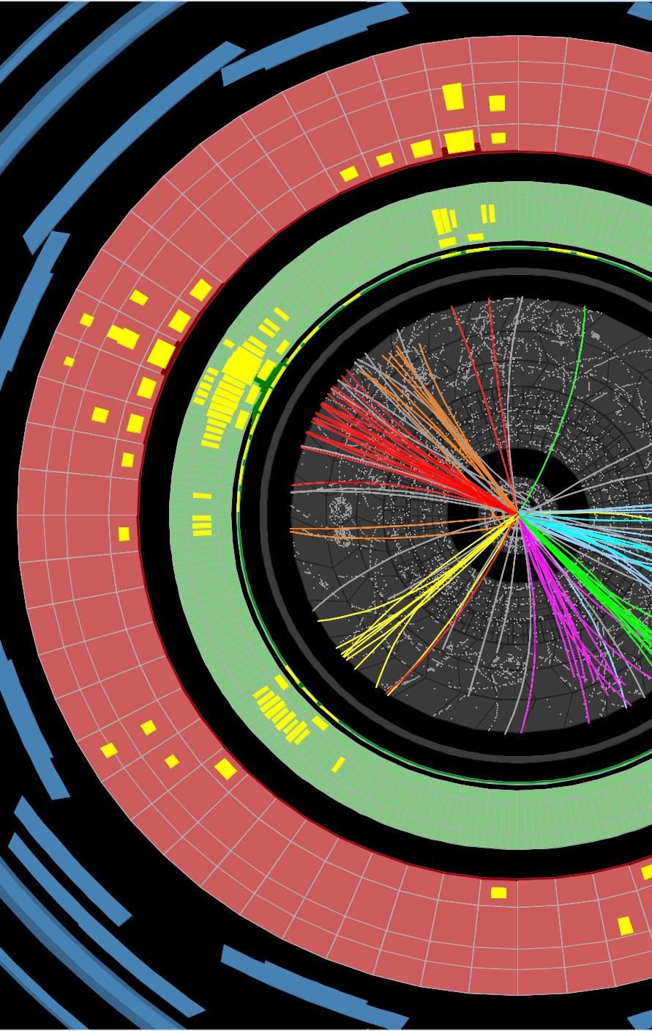
Outline
No LHC Run 2 results yet. But soon!
Introduction
Final LHC Run 1 results
  H → γγ
  Multilepton final states
  H → bb:
    di-leptonic
    lepton+jets
    all-hadronic
Looking forward
Notes:
No LHC run 2 results yet

Slide 3
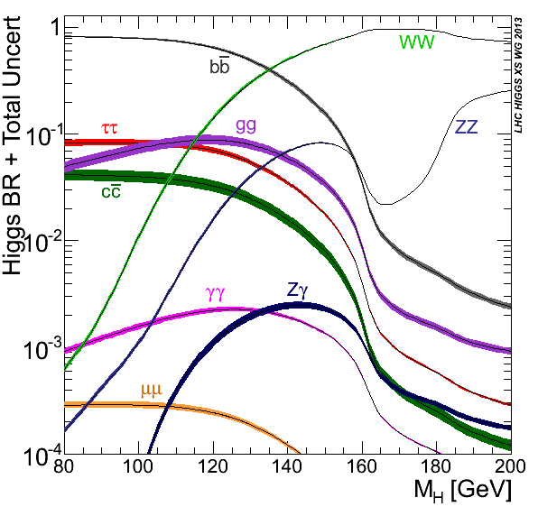
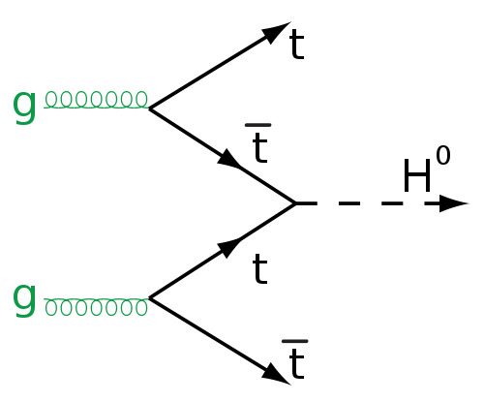
Introduction
Why should we care about ttH?
  Measure largest SM Yukawa coupling (y_{top} ≈ 1)
  Direct measurement of y_{top} – unlike gluon-fusion!
  y_{top} connected to the scale of new physics (arXiv:1411.1923 [hep-ph])
  Complementary channel to extract Higgs CP (arXiv:1501.03157 [hep-ph], arXiv:hep-ph/9602226, arXiv:1312.5736 [hep-ph])
But :
  Small cross section:
    0.506pb @ 13 TeV, 0.136pb @ 8 TeV
    ≈ 0.7% – 1.1% of gluon-fusion Higgs production
  Complicated final states: many possible Higgs and top decay combinations
  Draws on all detector capabilities
  Problematic combinatorial issues in event reconstruction for most channels
So:
  Favour high branching ratio decays: bb, WW, ττ
  Or H->γγ (low BR but no comb. issues there)
  Make analyses orthogonal to ease combination
b
W⁺
W⁻
b
Notes:
Direct access to top yukawa coupling
Gluon fusion loop may be contaminated by BSM particles
Complementary channel to measure CP quantum numbers – route to BSM in case H(125) is not a CP eigenstate
But small xsection (1% of ggF) and complicated final state
Go for high-BR channels and look at ttH->gamma gamma (high purity)

Slide 4
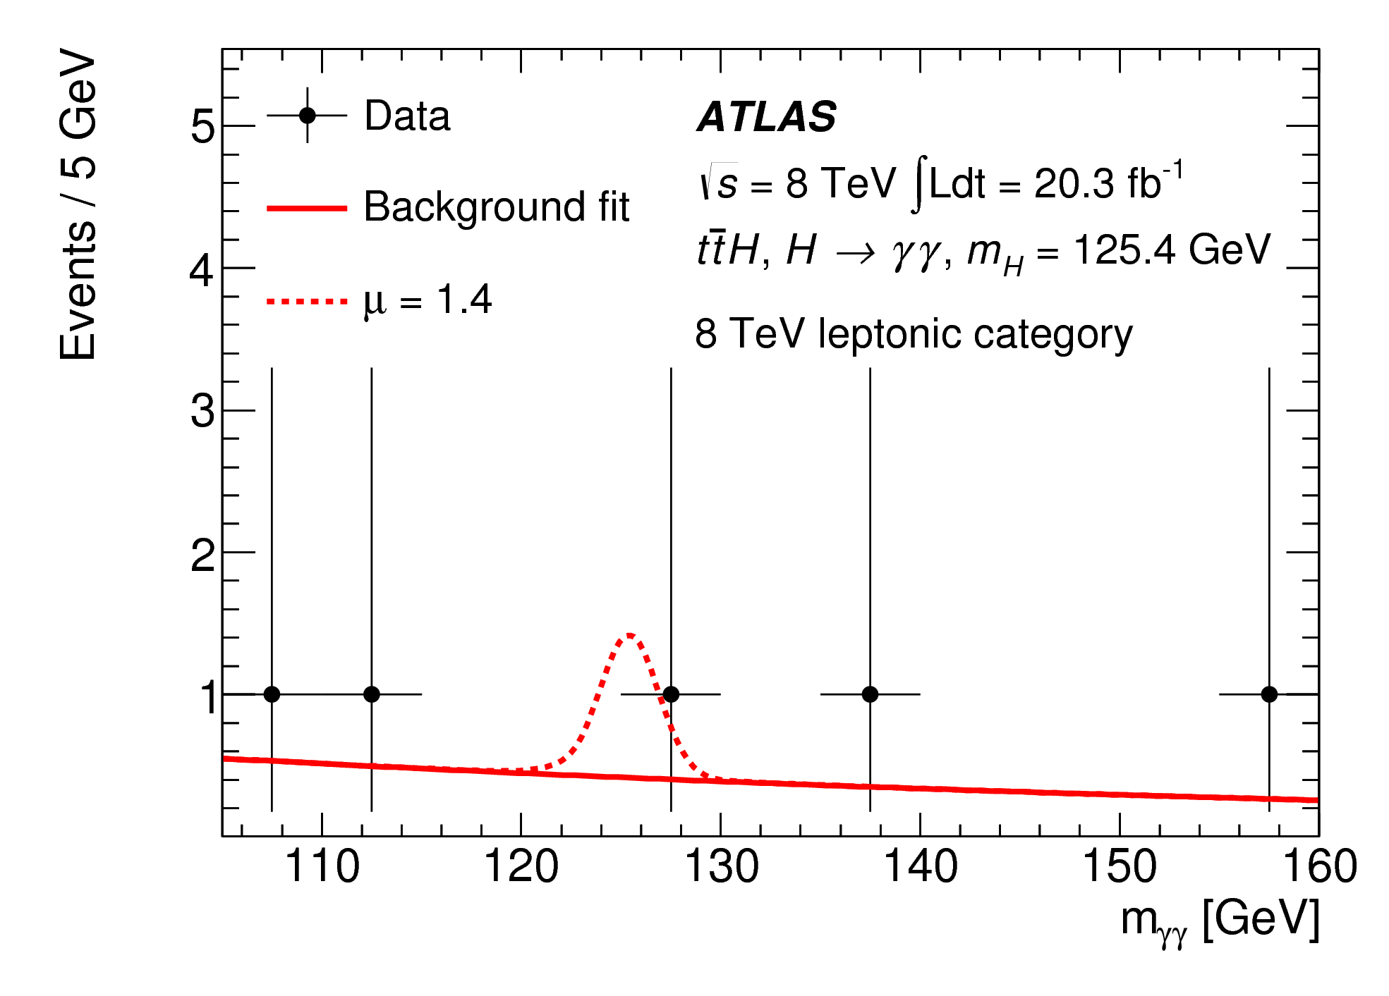
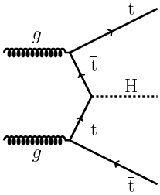
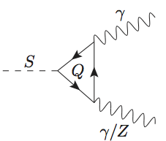
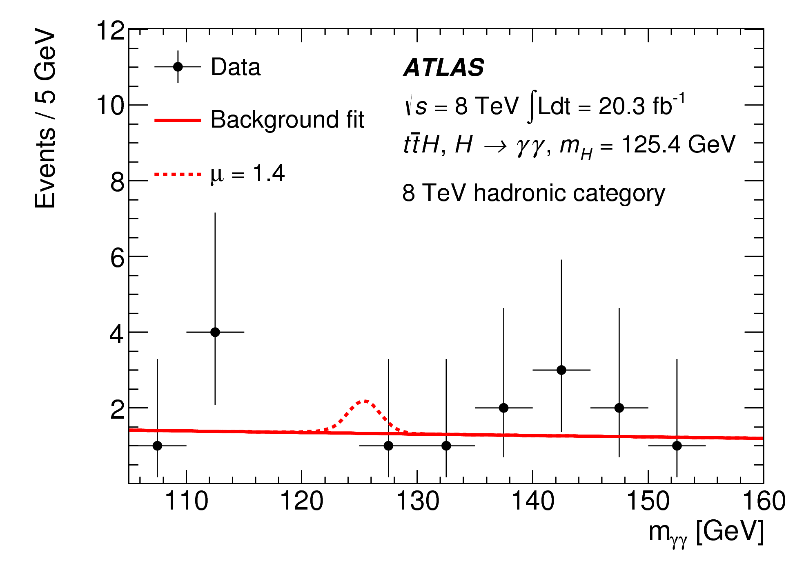
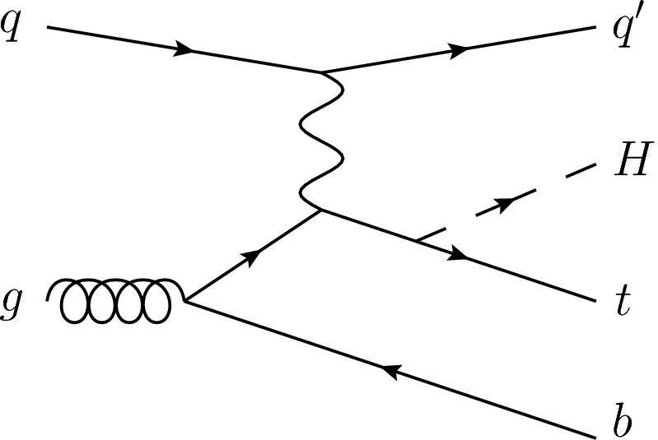
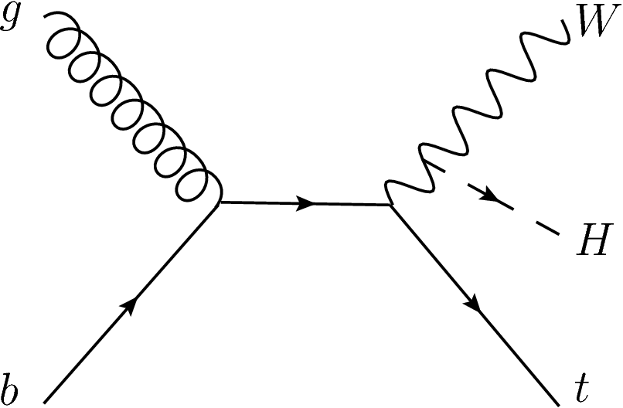
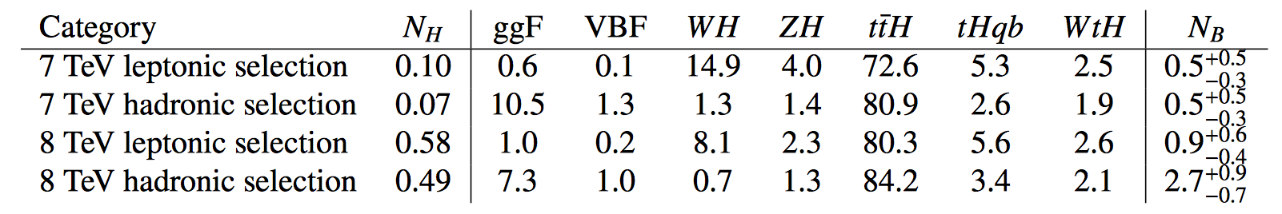
ttH, H→γγ analysis
Phys.Lett. B 740 (2015) 222-242
Analysis targets ttH and tH production (tHqb, tHW)
Data: 4.5 fb⁻¹ at √s = 7 TeV and 20 fb⁻¹ at √s = 8 TeV
Very small BR(H → γγ) = 0.0023
  Event yields: ≈0.2 at 7 TeV; ≈1 at 8 TeV
  But good di-photon mass resolution and small backgrounds
Analysis driven by ttH, but cuts loose enough to accommodate tH
  Efficiency ≈15% for ttH, ≈6% to 12% for tH
Selection:
2 photons with 105 GeV < m_{γγ} < 160 GeV
  Diphoton vertex reconstructed from longitudinal shower profile (un-converted) or tracks (converted photons)
  Leading (subleading) photon: E_{T} > 0.35 x m_{γγ} (0.25 x m_{γγ})
2 event categories:
  Leptonic: ≥ 1 e/μ + ≥ 1 b-tagged jet + E_{T}^{miss} > 20 GeV; m_{le} ≠ m_{Z}
  Hadronic: no e or μ; high jet and b-tag multiplicity
% of signal

Slide 5
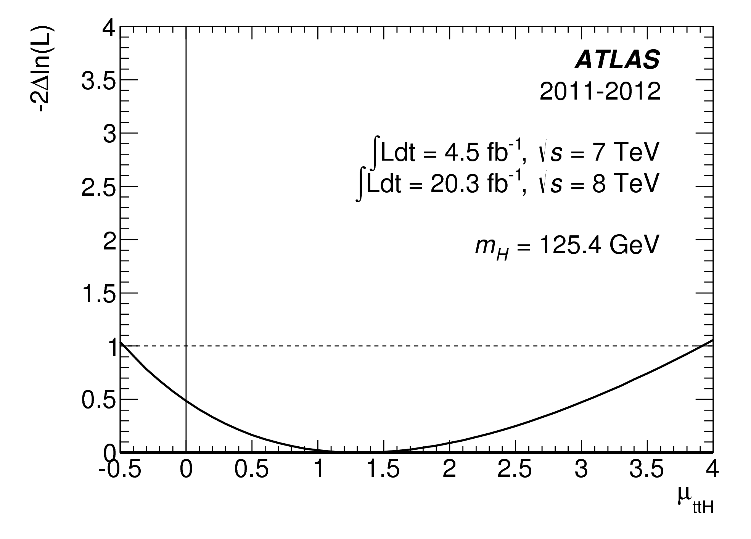


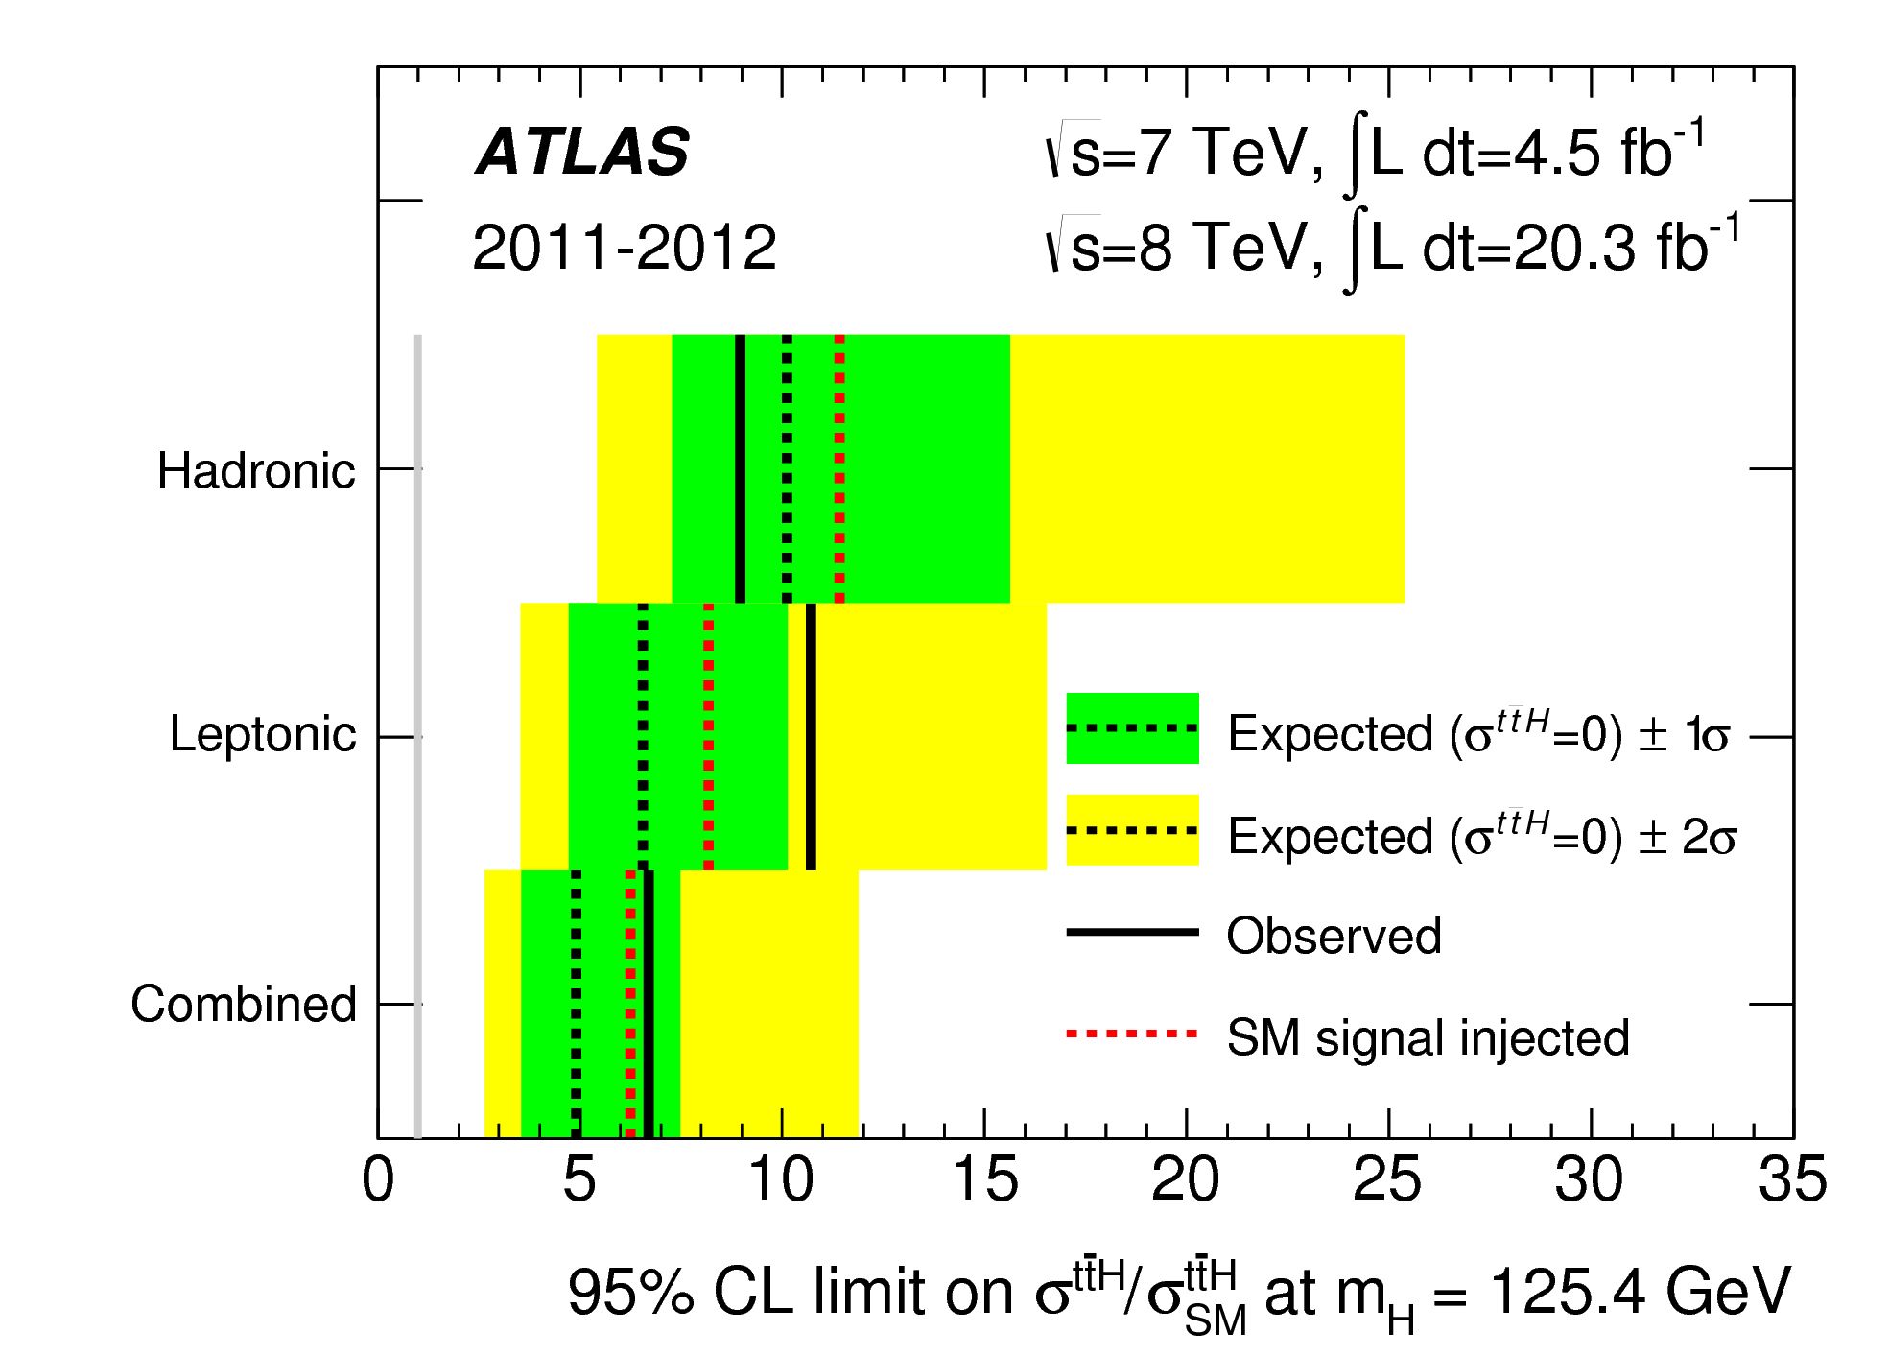
Analysis & Results
Phys.Lett. B 740 (2015) 222-242
μ_{ttH} = σ_{obs.}/σ_{SM}
Discriminant parameter: m_{γγ}
  Search excess around 125.4 GeV using S + B likelihood fit
  Signal modelling: Crystal Ball + Gaussian (from simulation)
  Continuum background: exponential fit to sideband
  Fit function validated in loose photon-ID control regions dominated by jets
Signal strength (μ_{ttH} = σ_{obs.}/σ_{SM}) best fit:
  Overall (H → γγ):
  ttH only:
Combined limits on signal strength
μ < 6.7 (4.9 expected)
Interpreting the data as 95% CL interval of a constant κ_{t} multiplying the top Yukawa coupling (y_{t} = κ_{t} y_{t}SM):
  Observed: -1.3 < κ_{t} < 8.0
  Expected: -1.2 < κ_{t} < 7.8

Slide 6
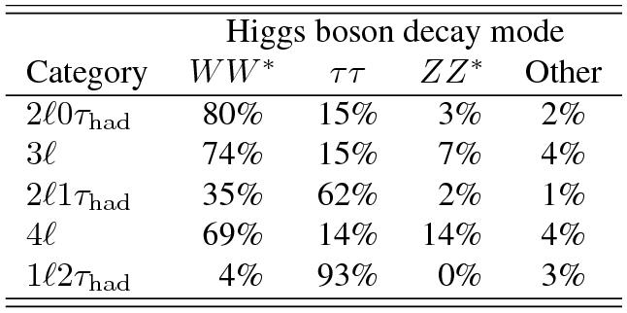
ttH multilepton analysis
Phys.Lett. B 749 (2015) 519-541
Targets mostly H→WW and H→ττ decays (medium BR); also H→ZZ
5 orthogonal event categories: 2l0τ_{had}, 3l, 2l1τ_{had}, 4l, 1l2τ_{had}
Analyzed 20 fb⁻¹ of data at √s = 8 TeV
Low-stats counting analysis:
  Total ≈10 signal events expected (0.4% eff.) but also low backgrounds
Selection designed to suppress tt background
  2l0τ_{had} : 2 same-sign e±/μ±; no τ_{had}
  3l : 3 e± or μ± (total charge ±1)
  2l1τ_{had} : 2 same-sign e/μ and 1 τ_{had}
  4l : 4 e± or μ± (zero total charge)
  1l2τ_{had} : 1 e± or μ± and 2 τ_{had}
  Variable number of jets depending on category => suppress specific backgrounds

Slide 7
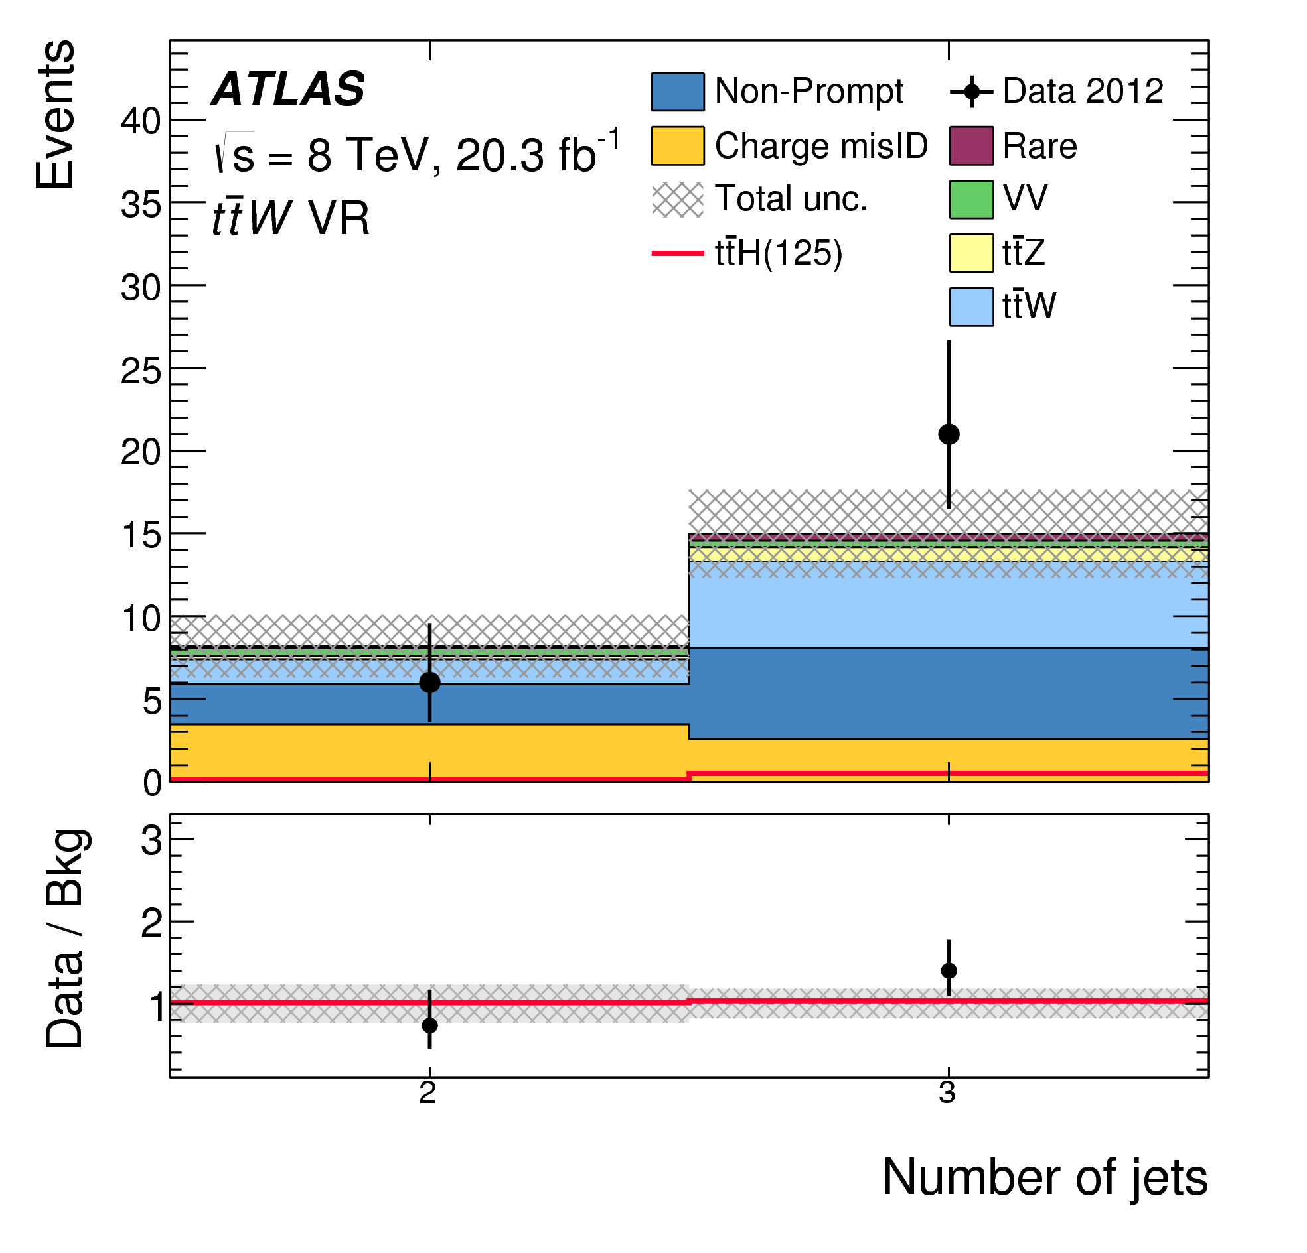
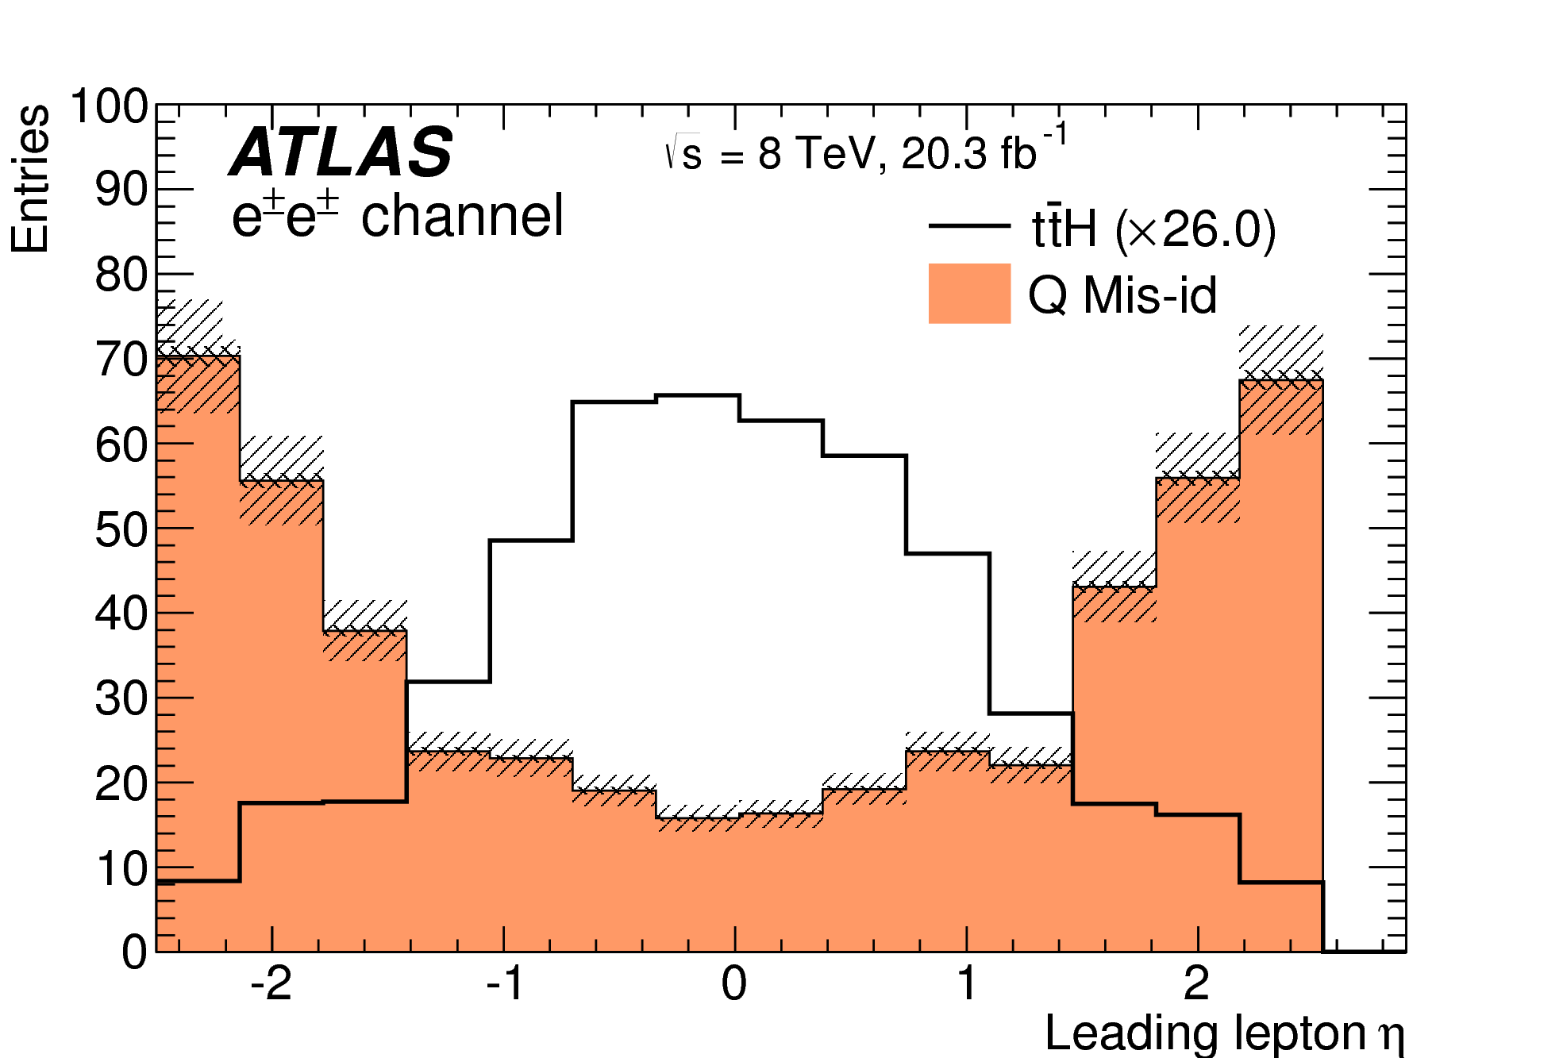
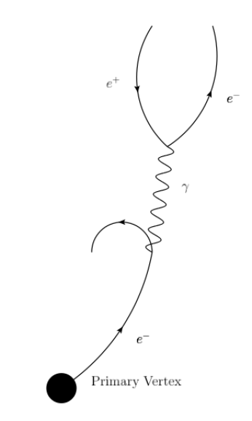
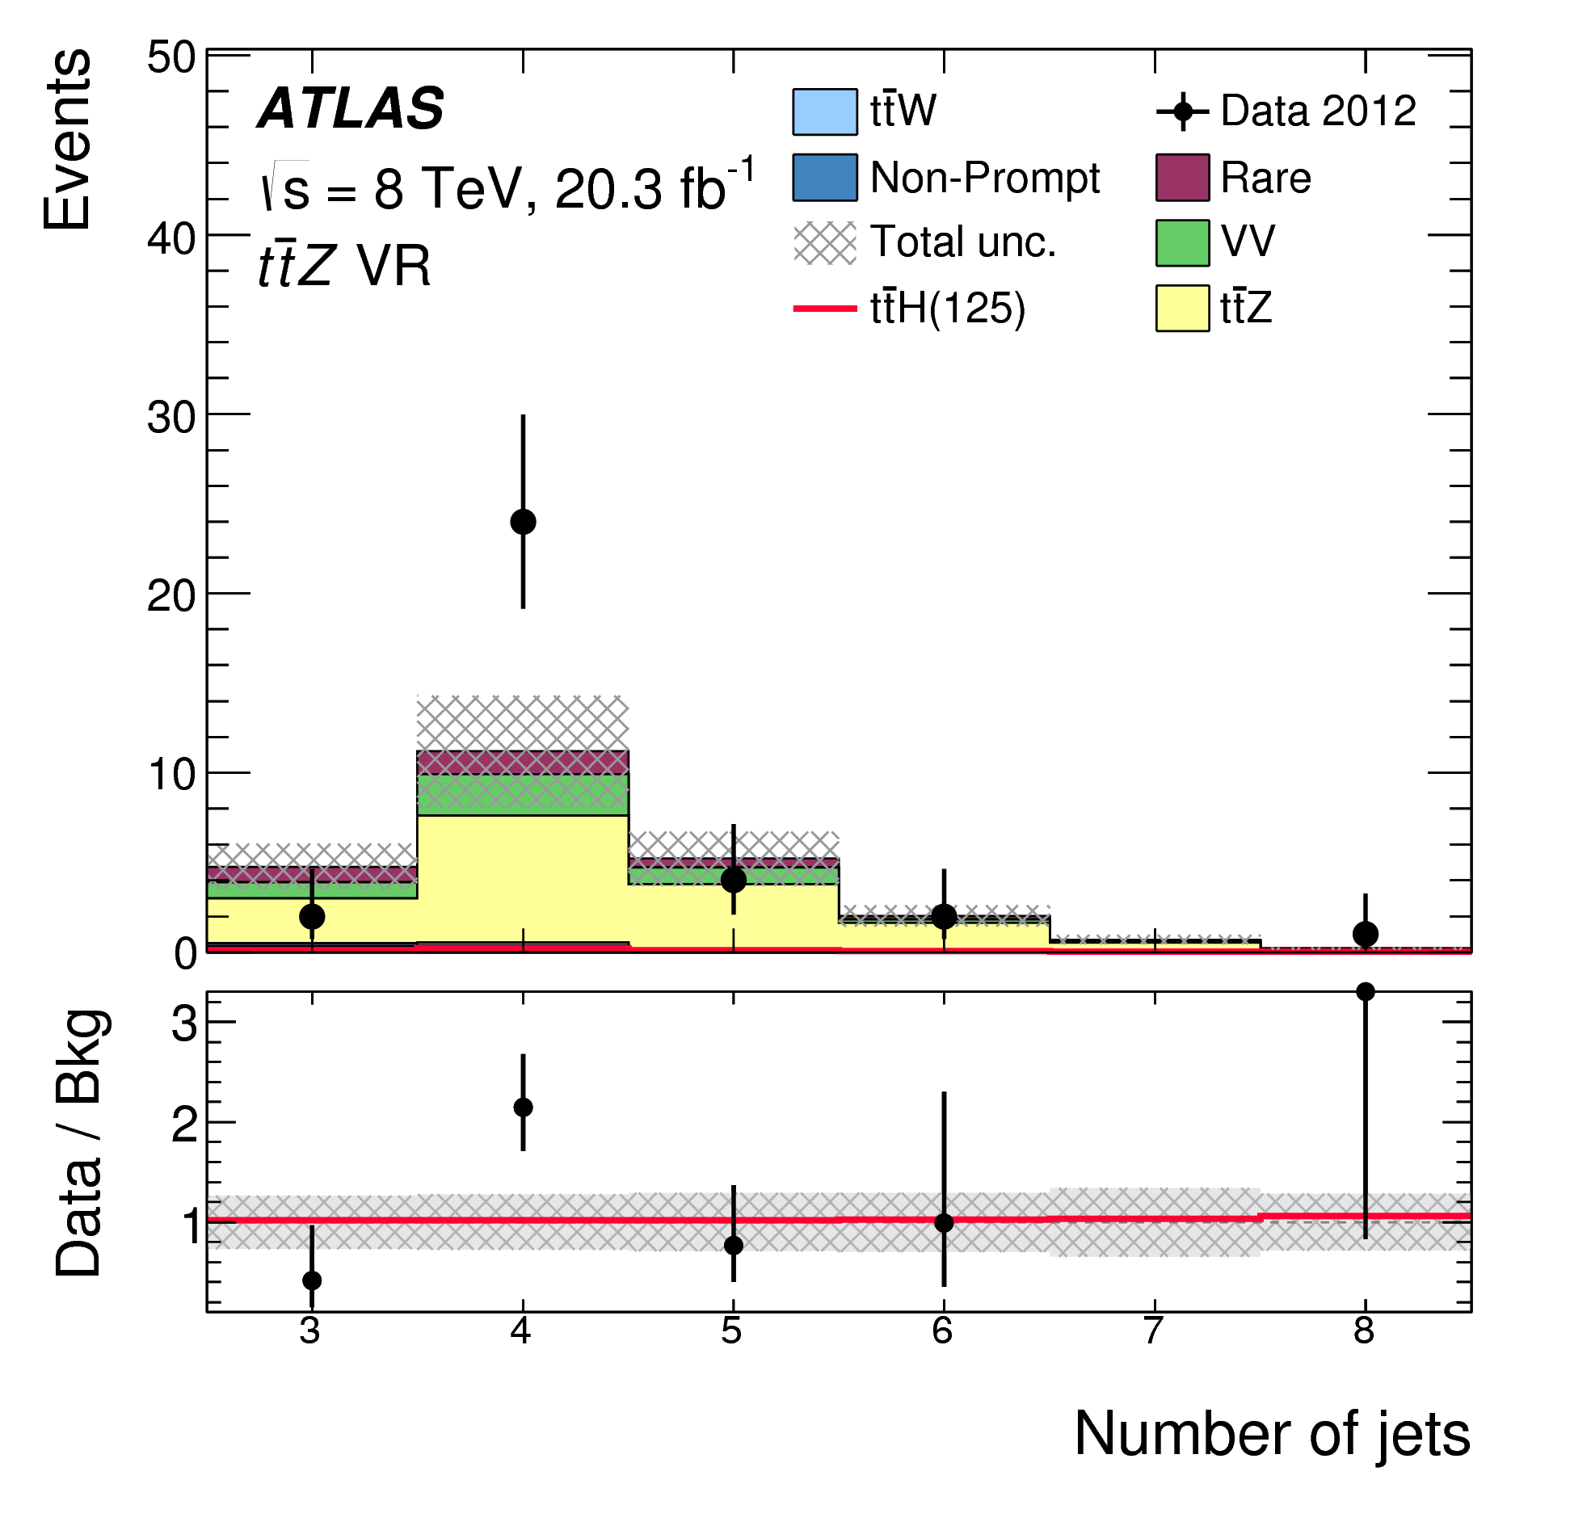
Backgrounds and uncertainties
Phys.Lett. B 749 (2015) 519-541
  Signal final states: WWWWbb, ττWWbb, ZZWWbb
  Backgrounds:
  ttW and ttZ (WWWbb, ZWWbb):
    Estimated from simulation and verified in validation regions
    ttW in 2l0τ_{had}: same as 2l0τ_{had} signal but only ≤ 3 jets
    ttZ in 3l, 2l1τ_{had}, 4l, 1l2τ_{had}: validate in Z→ll region
    Uncertainties up to ≈30% in signal regions
  Dibosons, especially WZ + jets:
    Estimated from simulation and verified in validation regions (e.g. Z + b-jets for 3l)
    Main uncertainty from WZ + b x-section (100% assigned)
    Uncertainties up to ≈50% in signal regions
  Electron charge mis-identification:
    Mainly from e± → e±γ → e±e⁺e⁻ and grows with η (material)
    Estimated from Z→ll data and extrapolated using simulation
    Negligible for muons and track curvature (instrumental)
    Uncertainties up to ≈40% in signal regions
  Non-prompt leptons:
    Can e.g. promote tt events to 2l0τ_{had} or 3l categories
    Estimated from data control regions – inverting lepton cuts
    Uncertainties of ≈20 - 50% in signal regions
  Fake τ_{had} identification (important in 1l2τ_{had})
    3 data control regions with loose τ_{had} identification

Slide 8
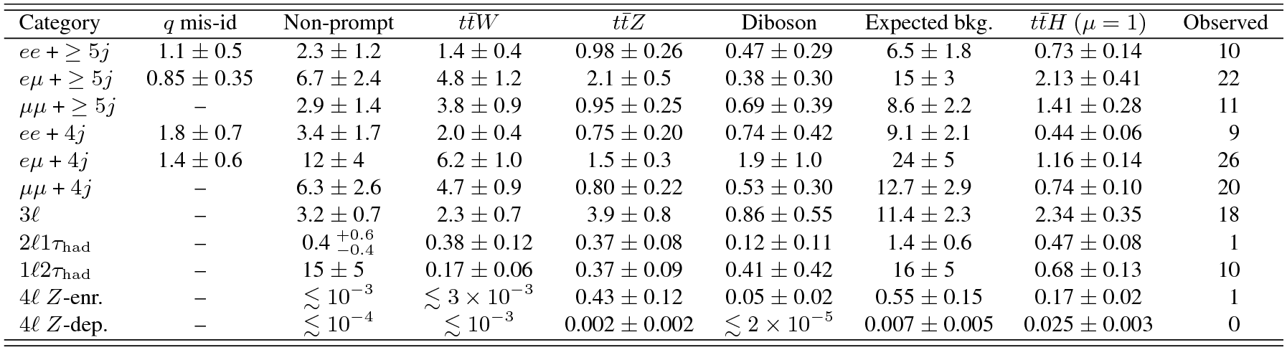
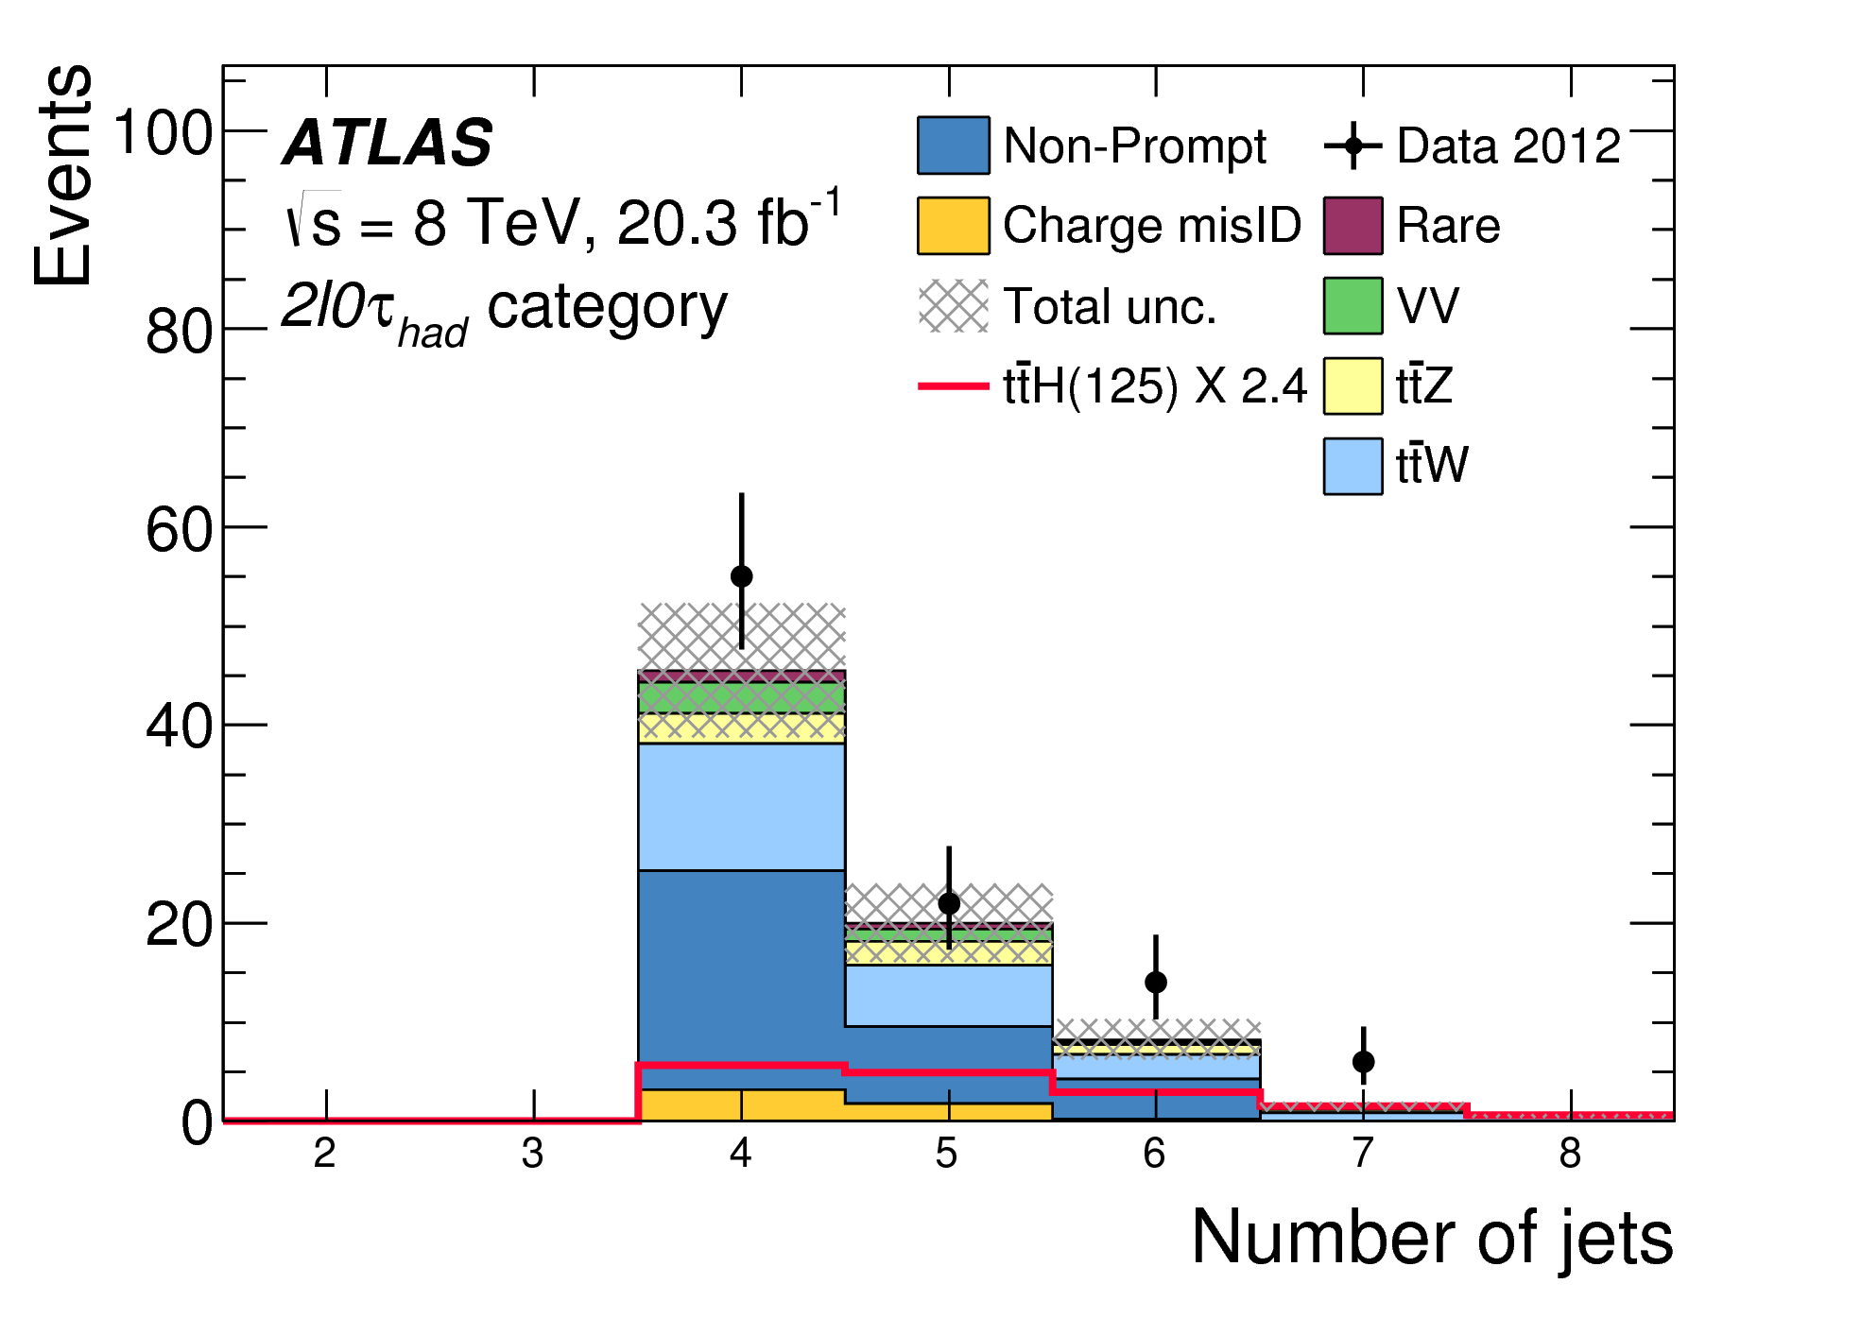
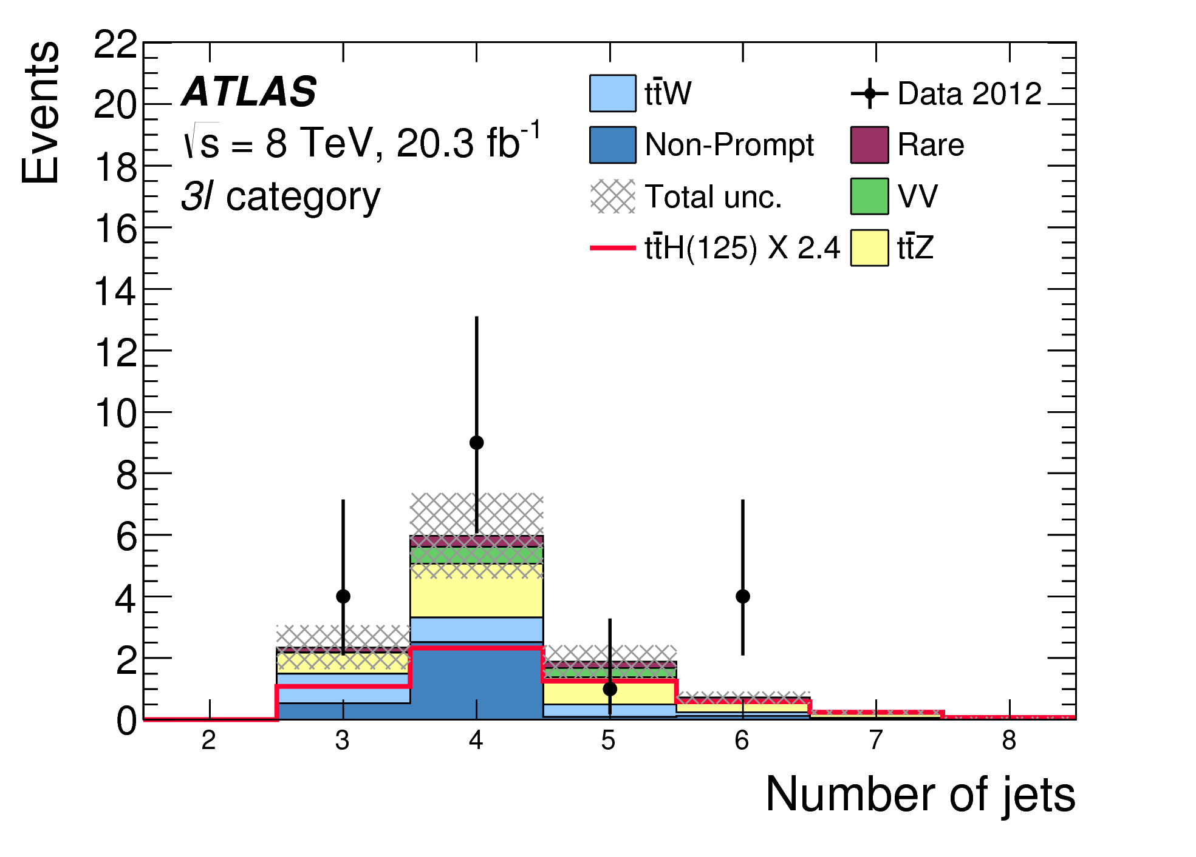
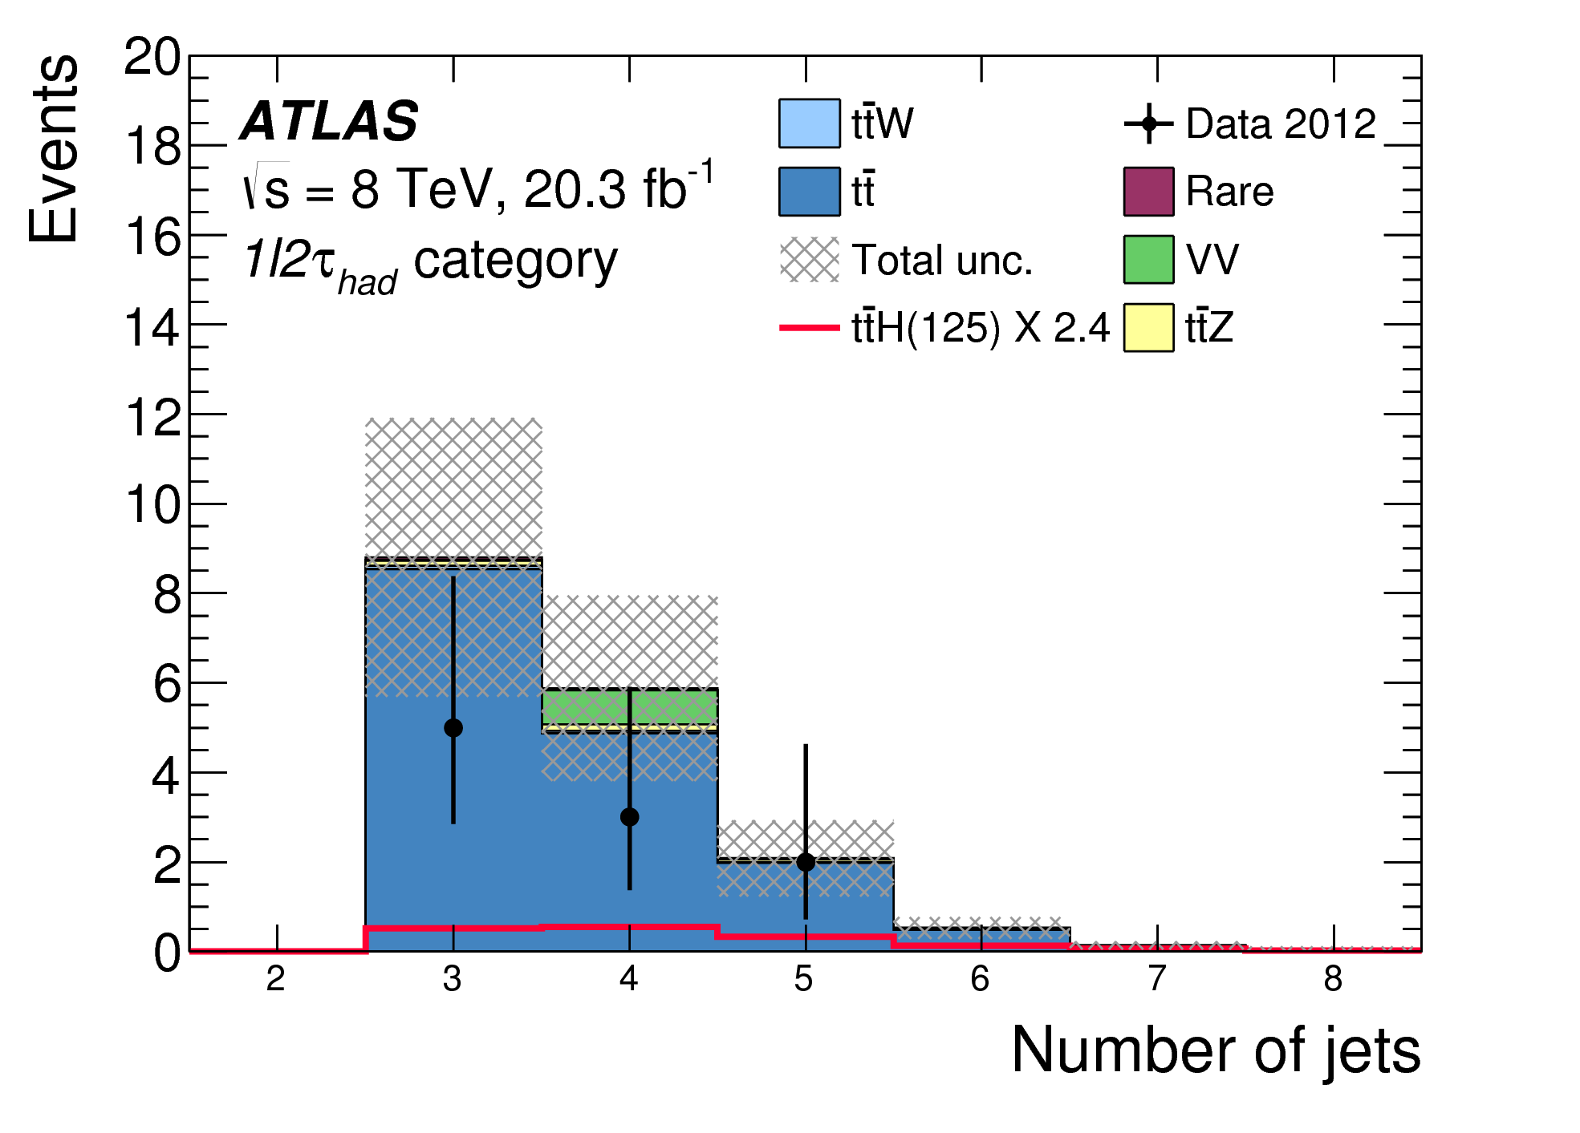
Signal regions
Phys.Lett. B 749 (2015) 519-541
Most sensitive: 2l0τ_{had}, 3l – dominated by H→WW
Followed by 2l1τ_{had} – dominated by H→ττ and H→WW
2l0τ_{had}
3l
2l1τ_{had}
1l2τ_{had}
4l

Slide 9
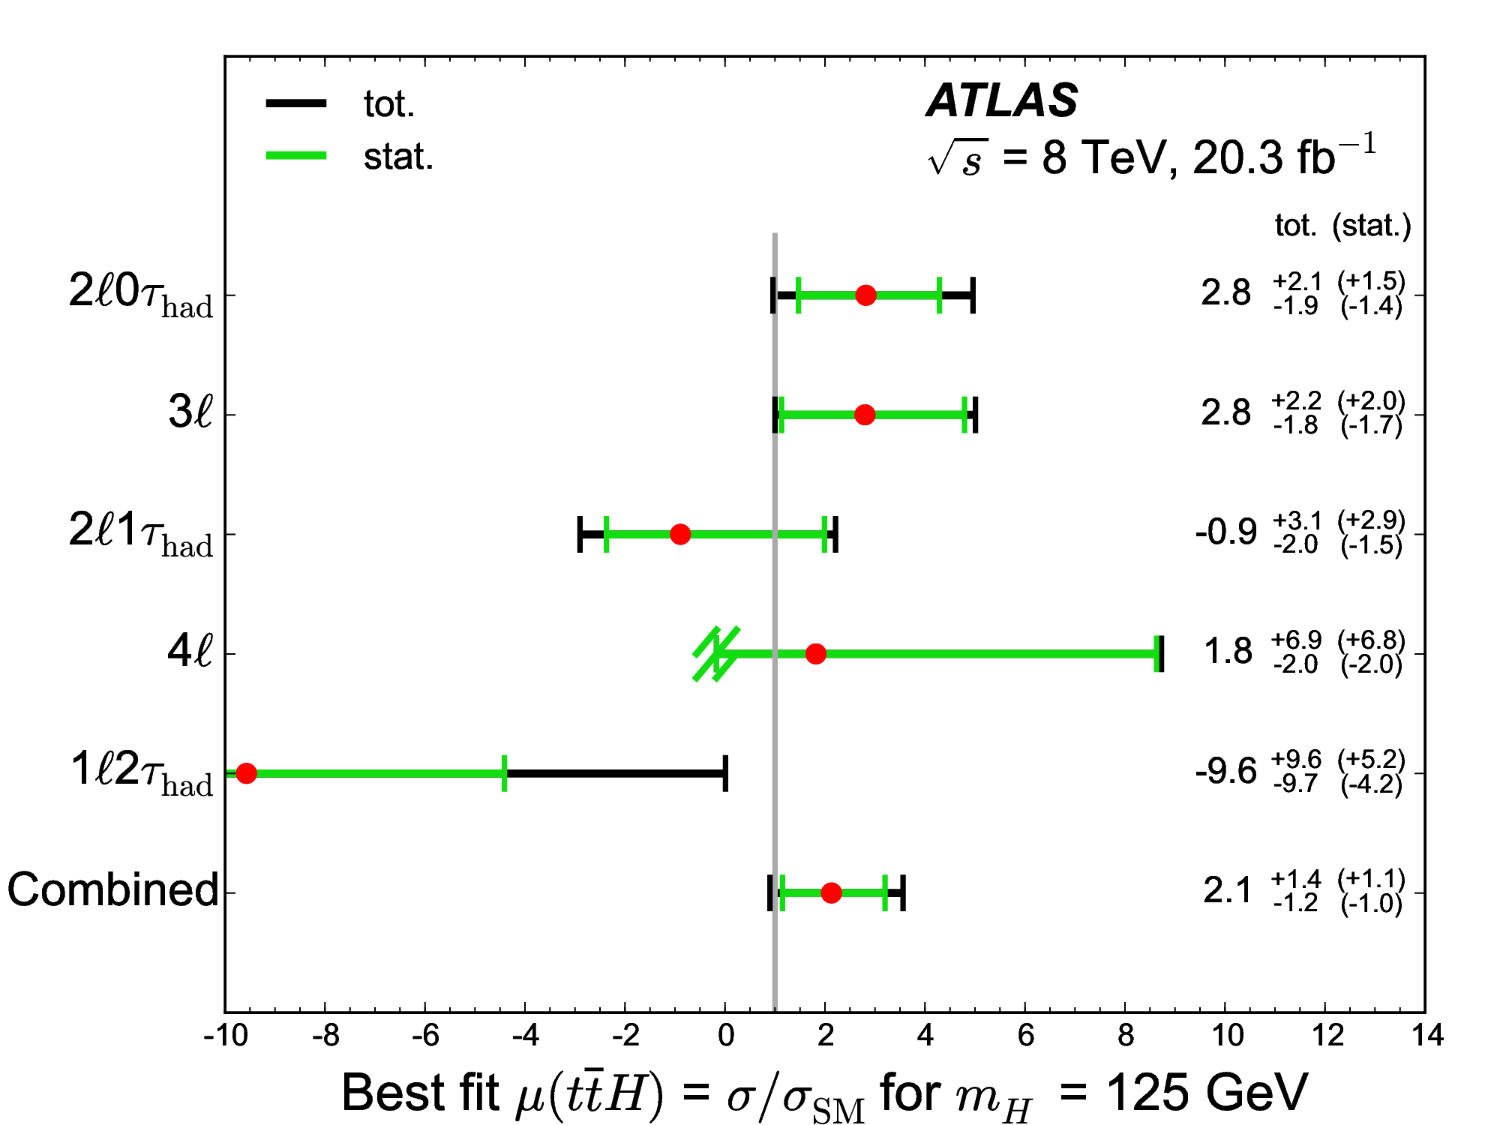
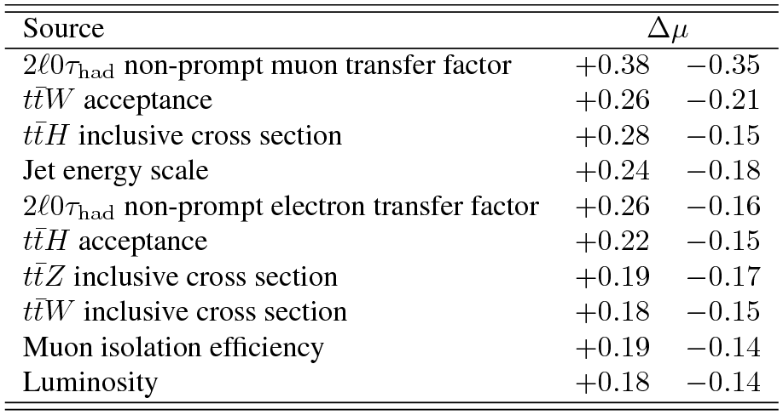
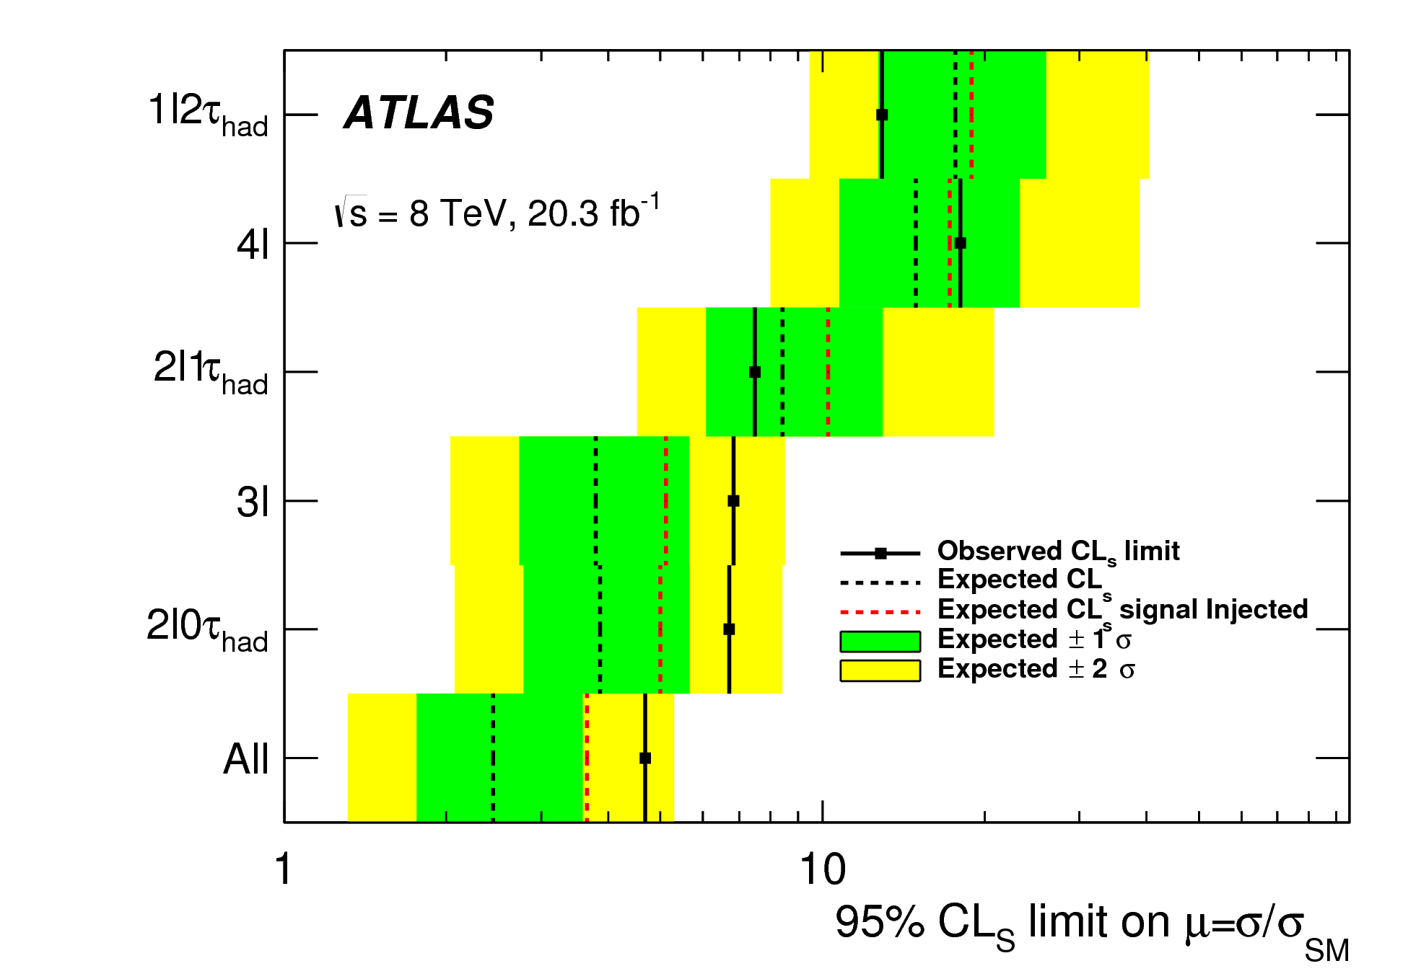
Results
Phys.Lett. B 749 (2015) 519-541
Signal strength μ_{ttH} = σ_{obs.}/σ_{SM} from maximum-likelihood fit to yields in all categories
  Systematic uncertainties are nuisance parameters in fit
  μ_{ttH}=1 assumes SM x-sections and BR, and m_{H} = 125 GeV
  Fit constrains statistically-limited non-prompt leptons
Small excess in combined signal strength from 2l0τ_{had}, 3l categories – compatible with SM
Combined 95% CL exclusion limit on is μ_{ttH} < 4.7 (μ_{ttH} < 2.4 expected)
Single top tH production was set to SM value
  Setting it to zero gives a variation Δμ of 0.04
μ_{ttH} = σ_{obs.}/σ_{SM}
Combination of all categories

Slide 10
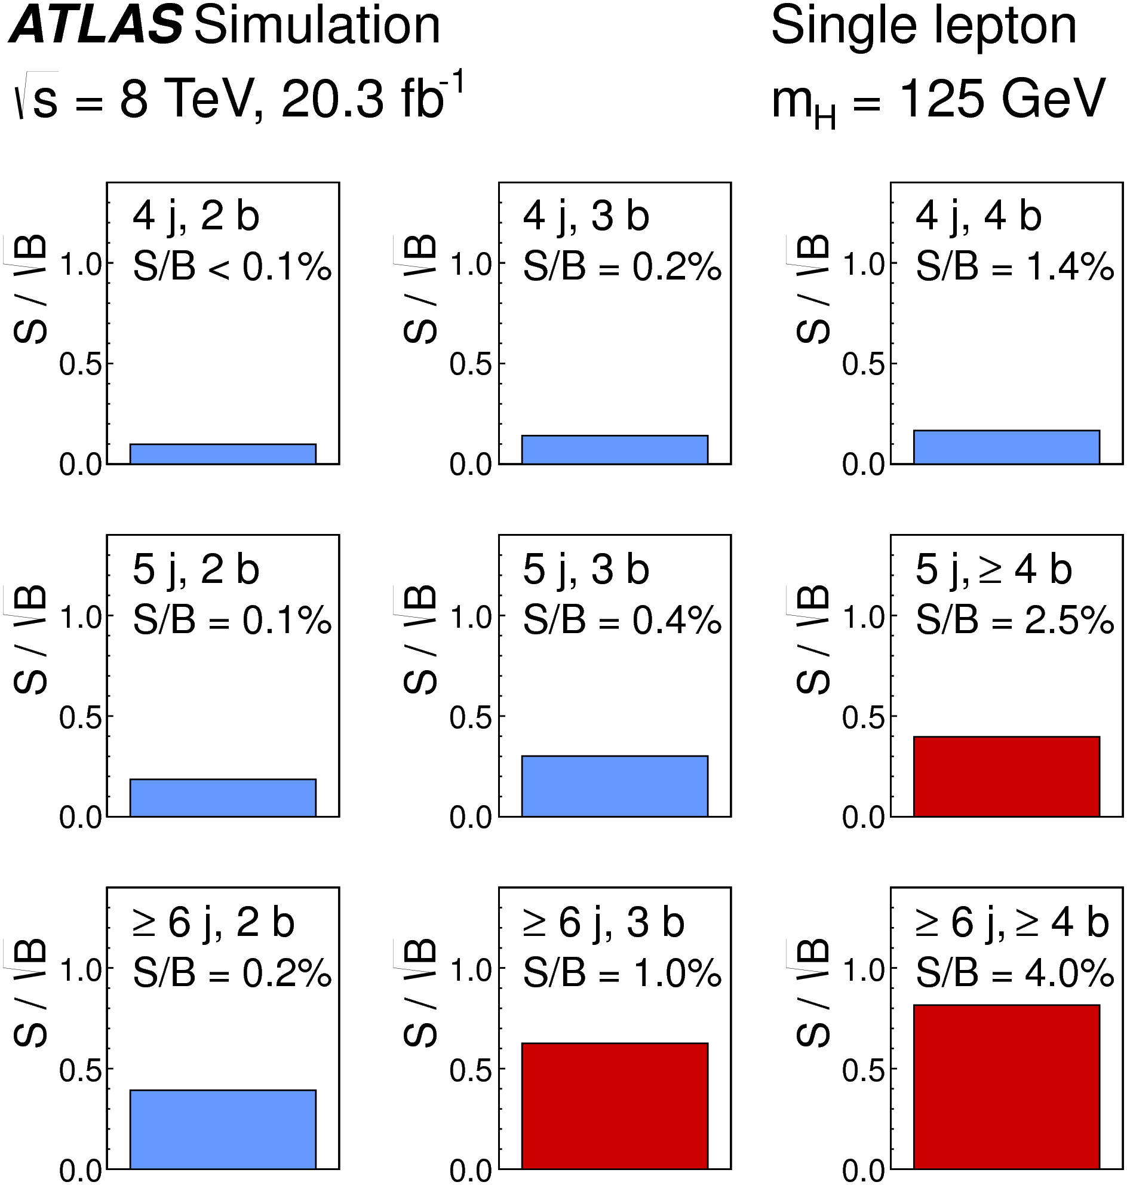
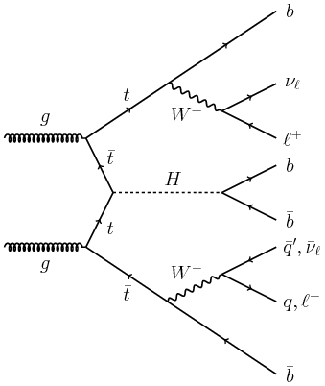
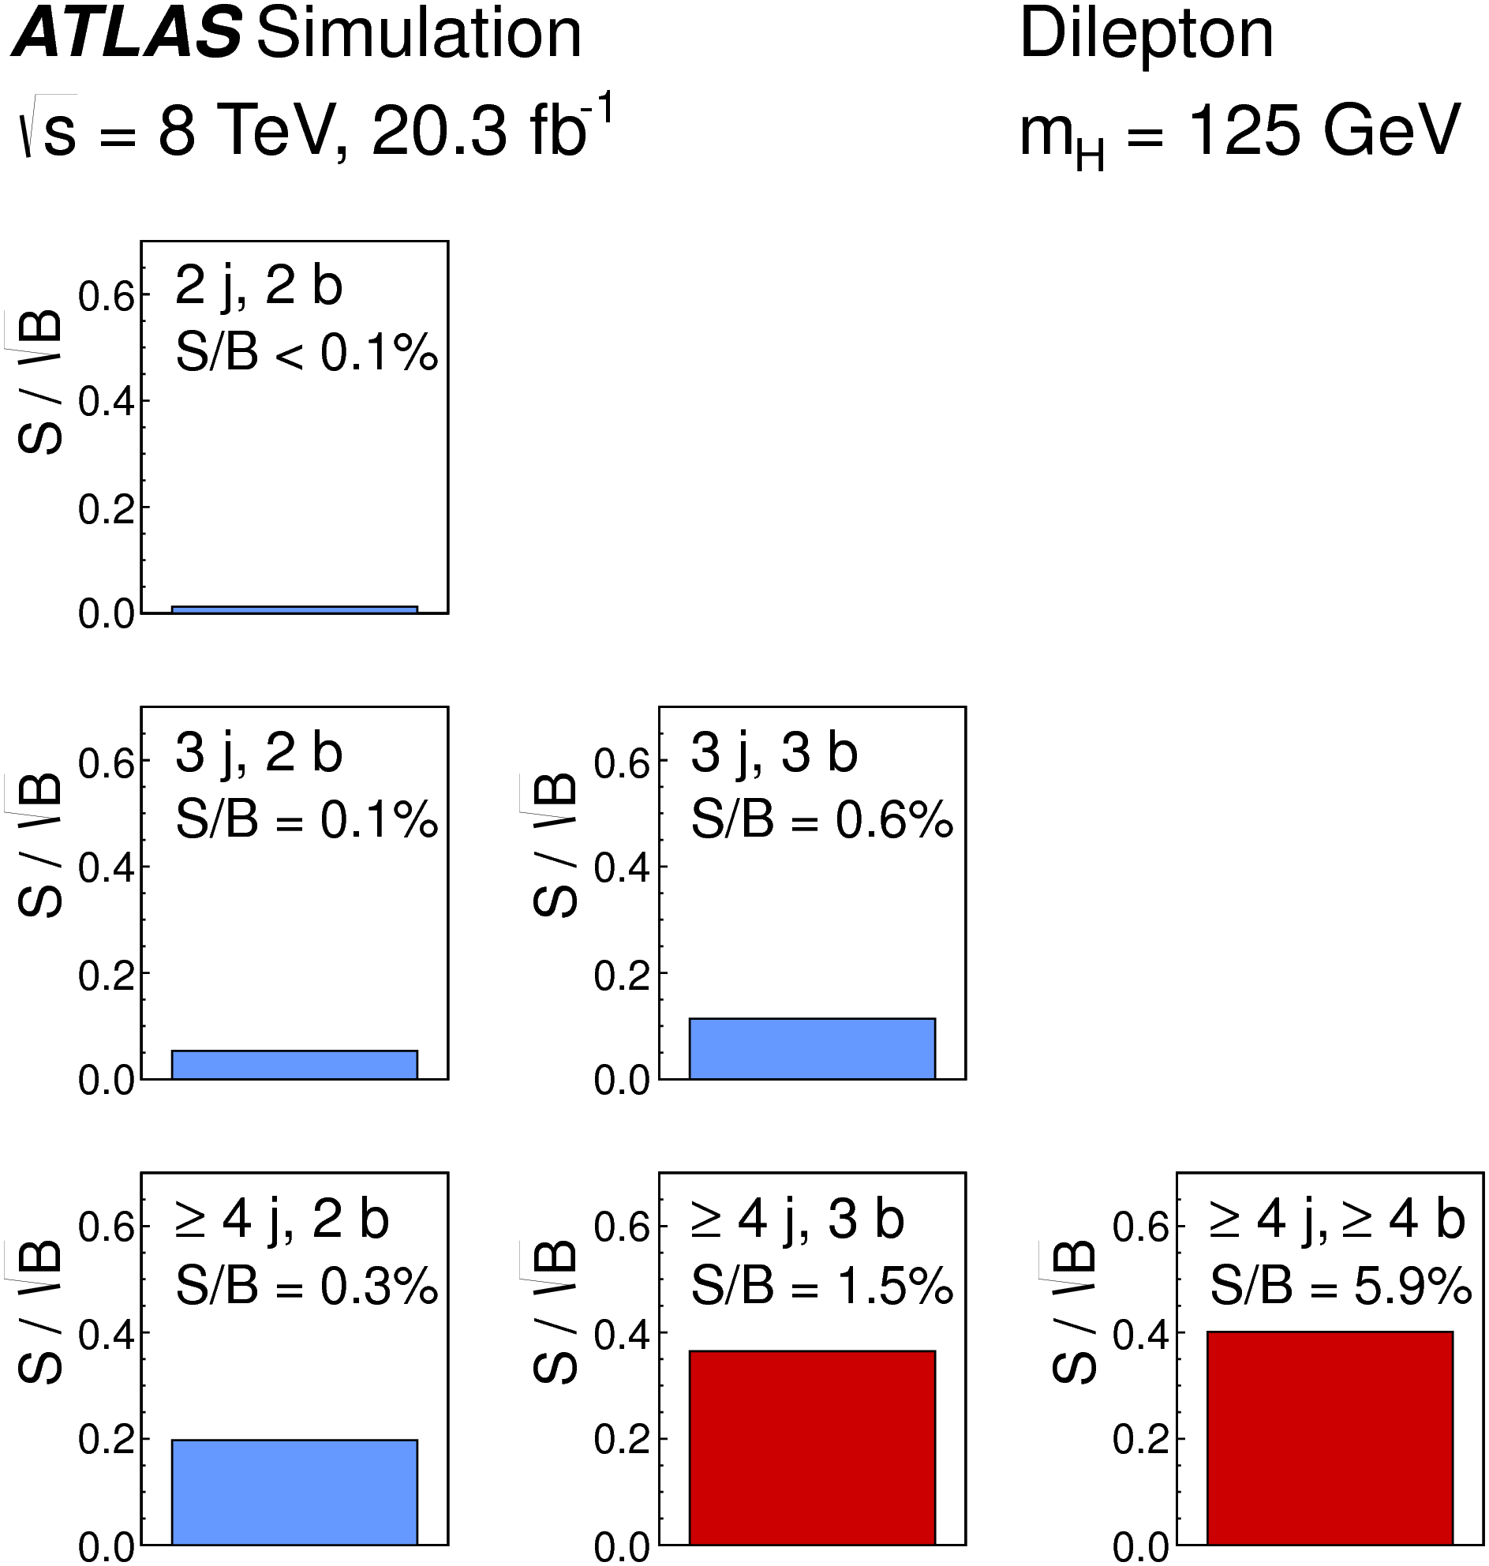
ttH(H→bb) with ≥1 lepton
Eur. Phys. J. C (2015) 75:349
Analyzed 20.3 fb⁻¹ of data at √s = 8 TeV
Benefit from high BR(H→bb) = 58%
Avoid full event reconstruction – plagued by combinatorial errors
Main difficulty: accurate modeling of large or poorly-known backgrounds
Two channels: “single-lepton” and “dilepton” (lepton = e± or μ±)
  Single-lepton channel: 1 good e± or μ± + ≥ 4 jets, ≥ 2 are b-tagged
  Dilepton channel: 2 e± or μ± (opposite charge) + ≥ 4 jets, ≥ 2 are b-tagged
  Several categories according to nr. of jets and b-tags – to enhance sensitivity and constrain backgrounds!

Slide 11
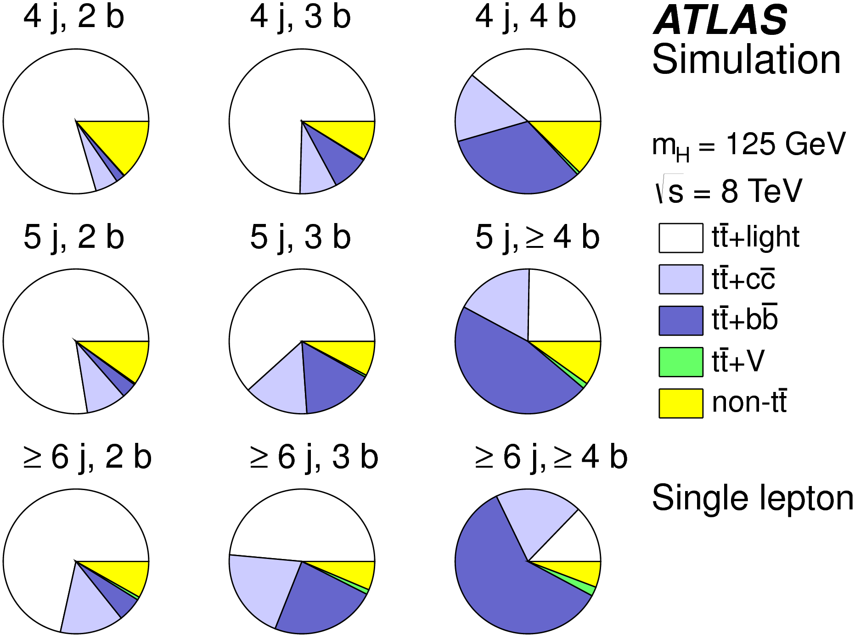
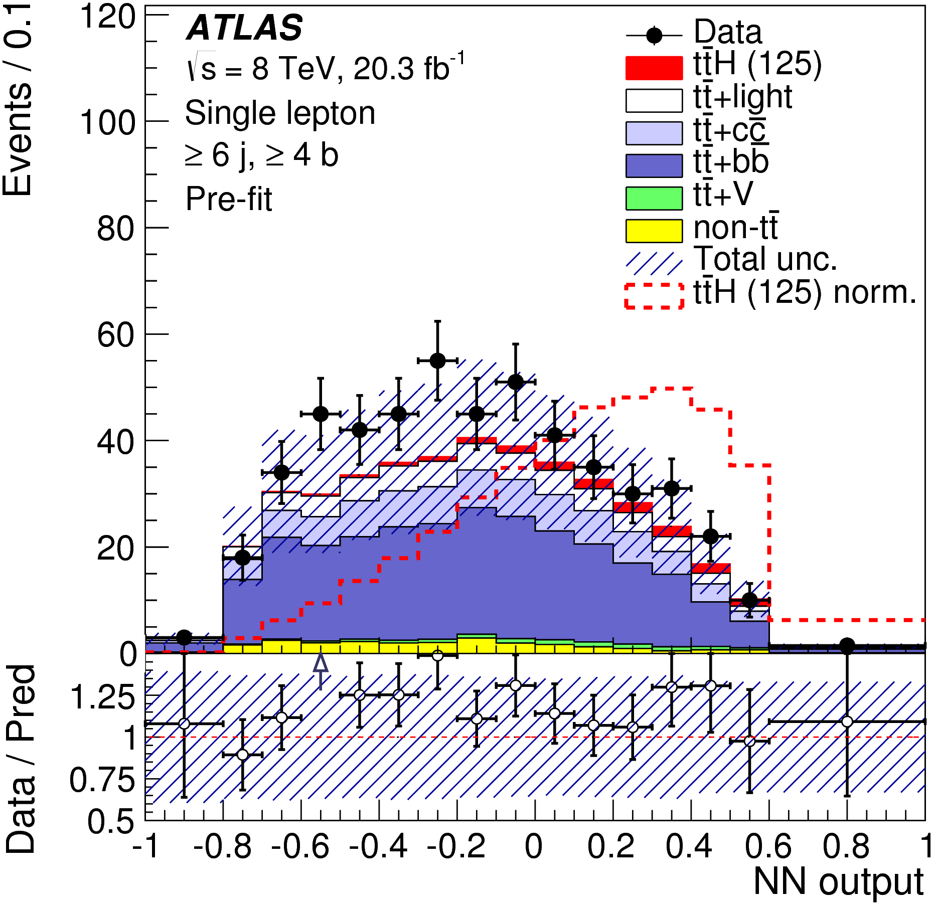
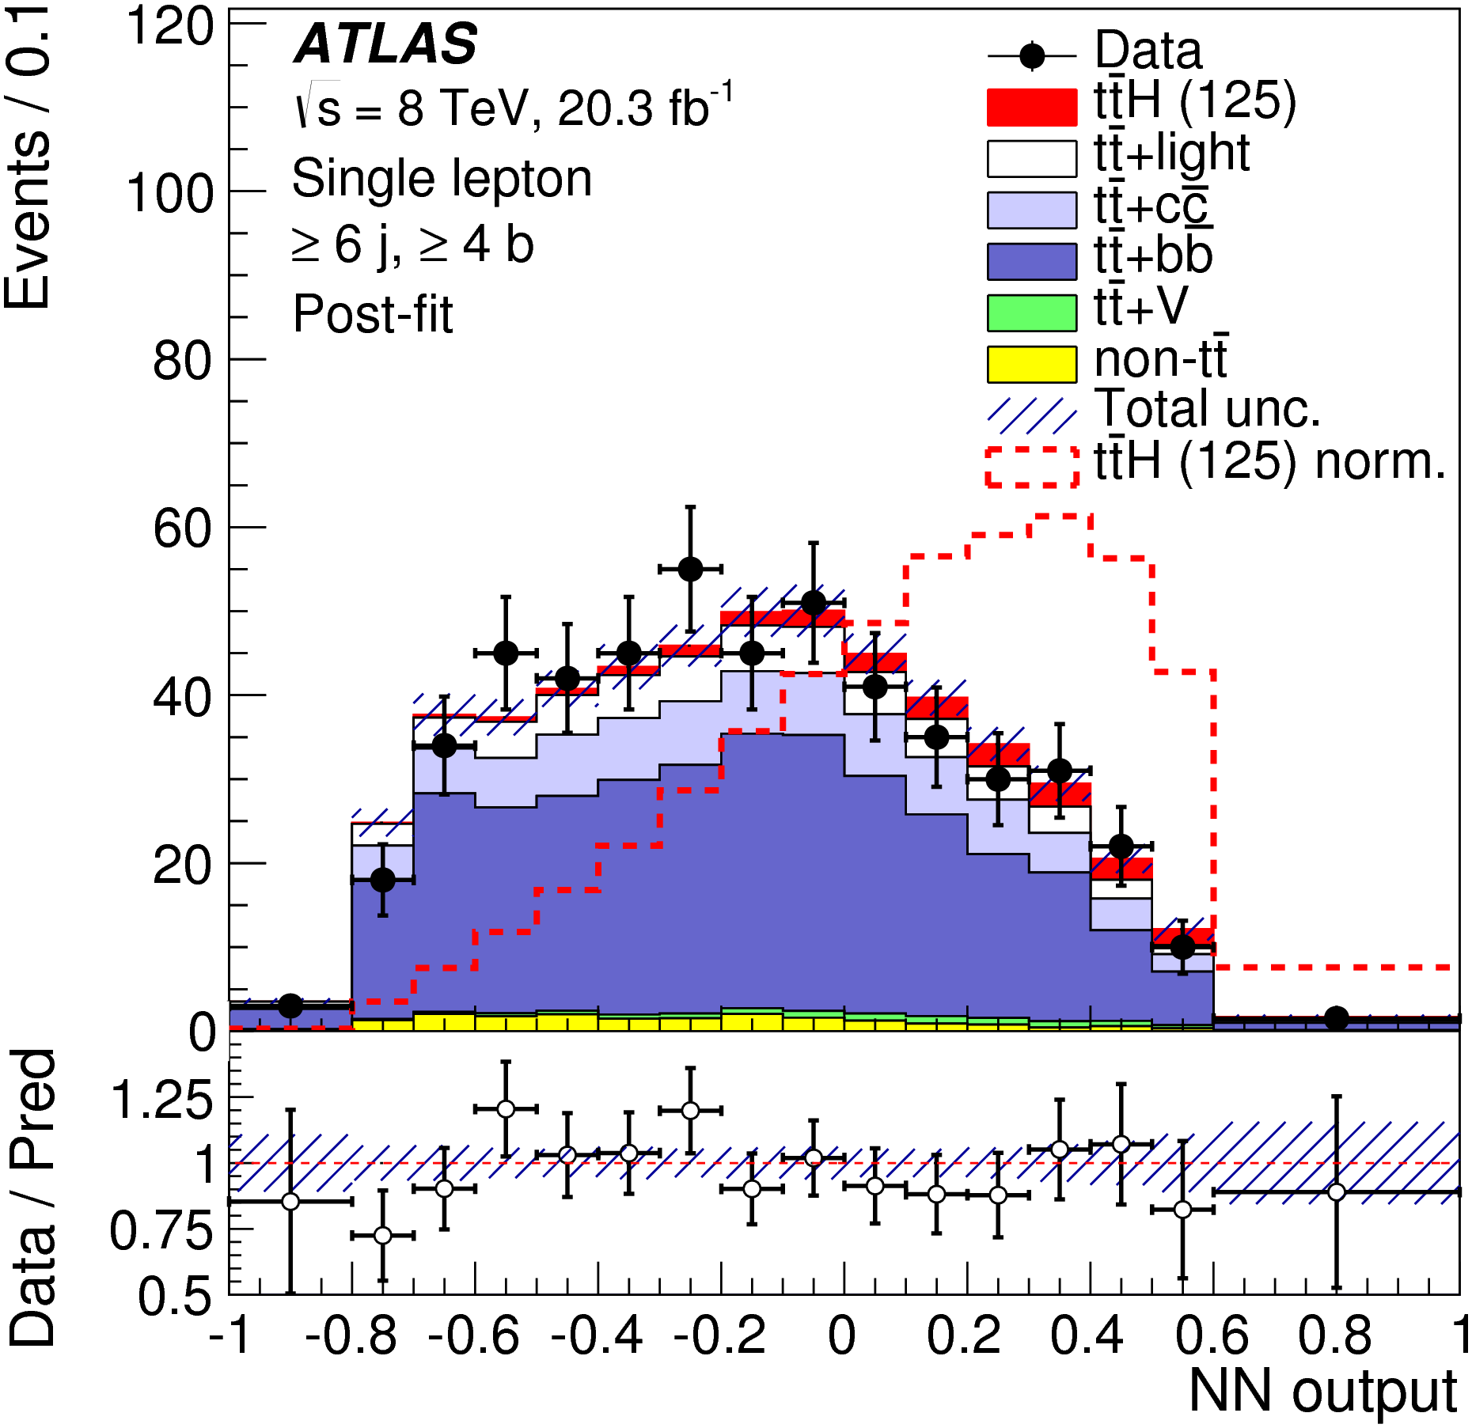
Analysis
Eur. Phys. J. C (2015) 75:349
Use H_{T}^{had} in low S/B regions to constrain various backgrounds in simultaneous fit
Neural Network (NN) in signal-rich regions
  In single-lepton channel: two Matrix Element Method variables used as input to NN – most discriminating NN input!
Much attention paid to modeling of important backgrounds: tt + jets, ttW/Z, W/Z + jets
  tt + bb is irreducible background in both channels
In single-lepton channel: NN to separate tt + light jets from tt + Heavy Flavours in 5j,3b category
  Target tt+c (from W→cs) through 3rd b-tagged jet
 | 2 b-tags | 3 b-tags | 4 b-tags
4 jets | H_{T}^{had} | H_{T}^{had} | H_{T}^{had}
5 jets | H_{T}^{had} | NN (tt+j vs H.F.) | NN
≥6 jets | H_{T}^{had} | NN | NN

Slide 12
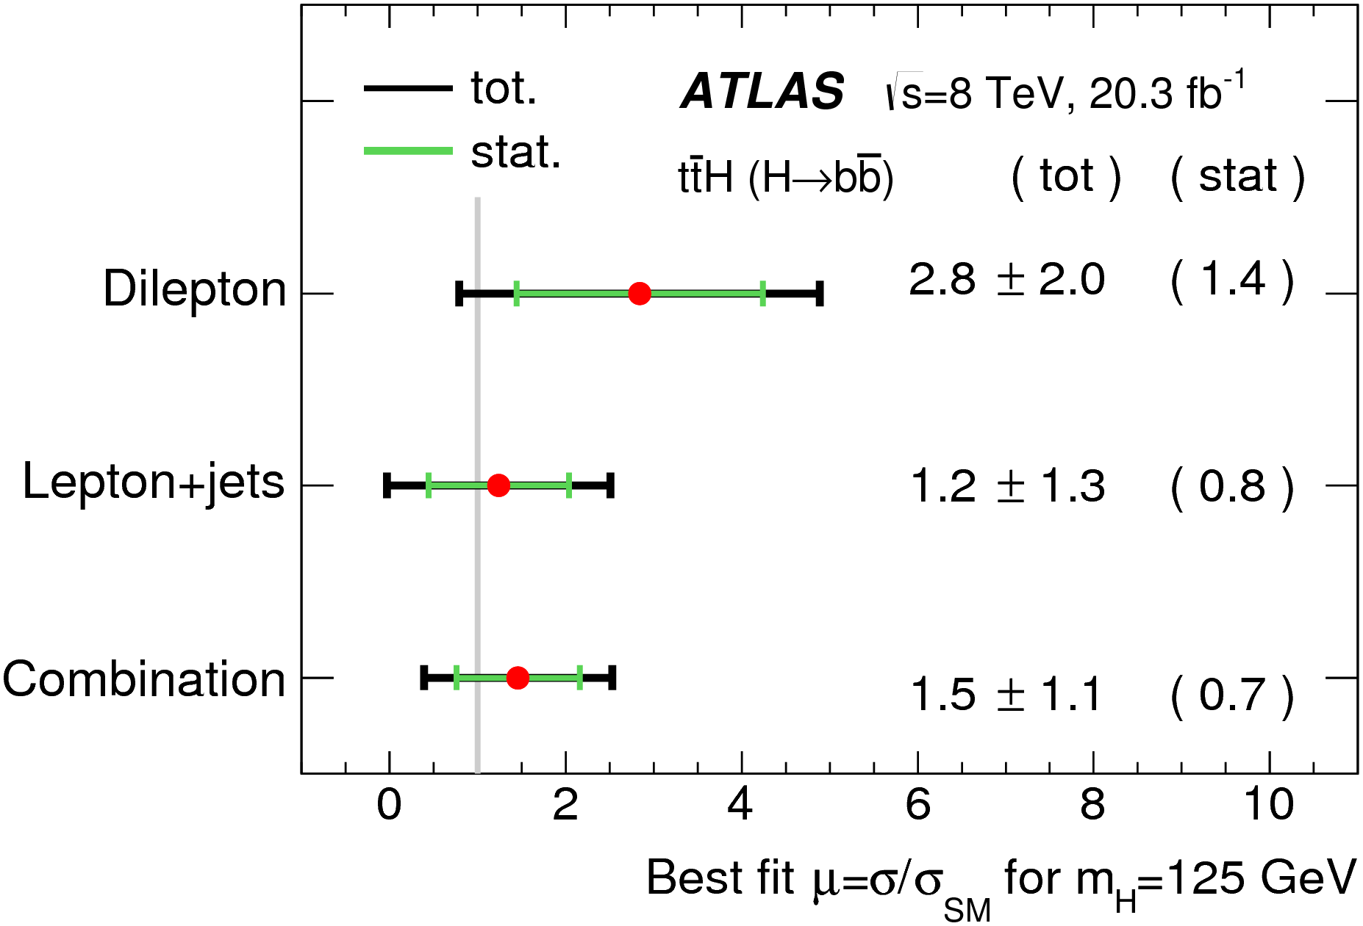
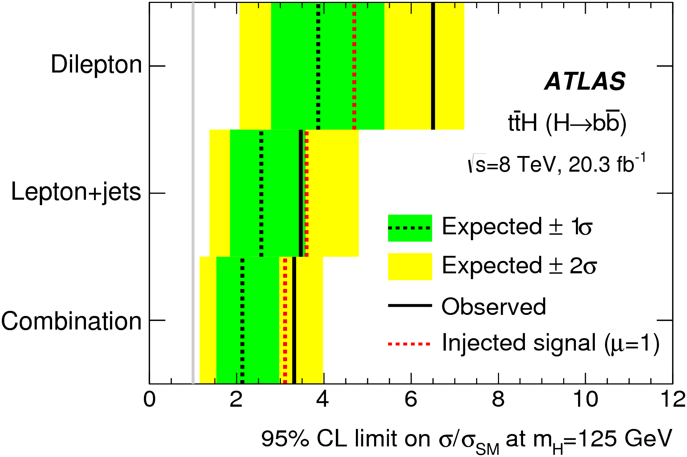
Results
Eur. Phys. J. C (2015) 75:349
Signal strength from combined H→bb single-lepton and dilepton channels: μ_{ttH} = σ_{obs.}/σ_{SM} = 1.5 ± 1.1
Exclusion limits at 95% CL: μ < 3.4 (2.2 expected)
Most important uncertainties:
  tt + Heavy Flavour modeling
  Jet energy scale
  ttV cross section

Slide 13
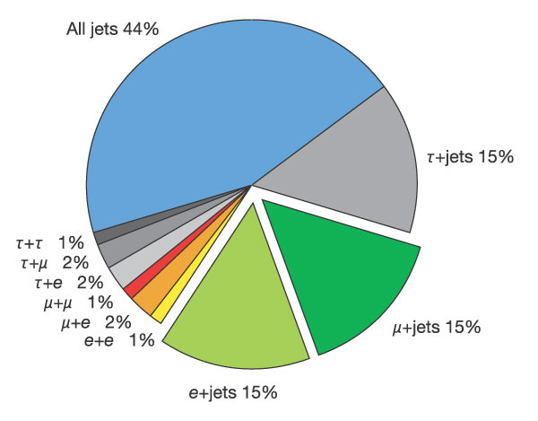
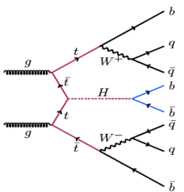
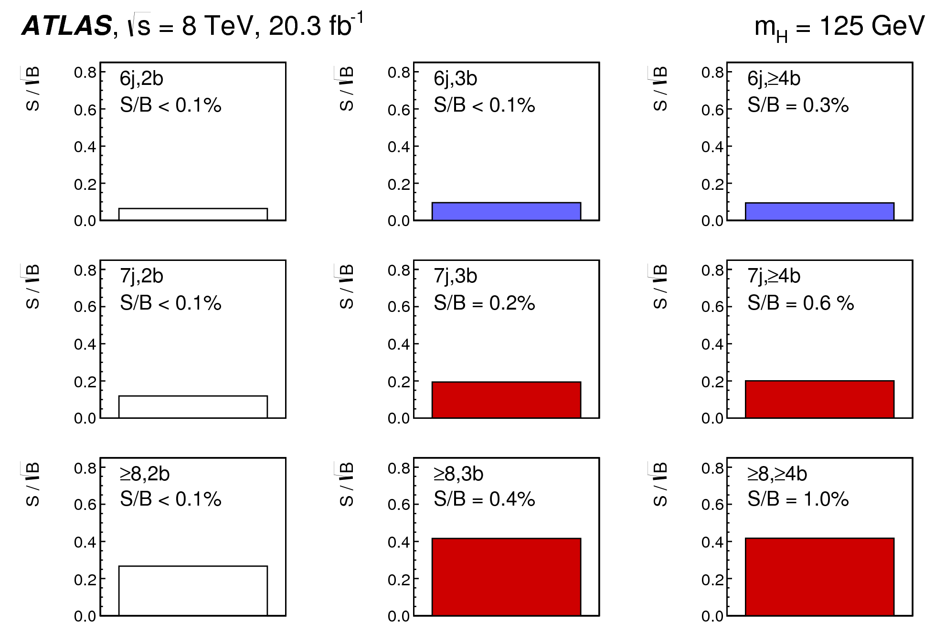
ttH(H→bb) all-hadronic
JHEP 05 (2016) 160
Analyzed 20.3 fb⁻¹ of data at √s = 8 TeV
Benefit from high BR(H→bb) = 58% AND high tt BR to jets = 44%
Main difficulty: large multijet background
Selection:
  5-jet trigger with p_{T} > 55 GeV, |η| < 2.5
  No good electrons or muons with p_{T} > 25 GeV – orthogonality with other H→bb analyses
  ≥ 6 jets ; ≥ 2 jets b-tagged
  5 leading jets with p_{T} > 55 GeV, |η| < 2.5; other jets p_{T} > 55 GeV, |η| < 2.5

Slide 14
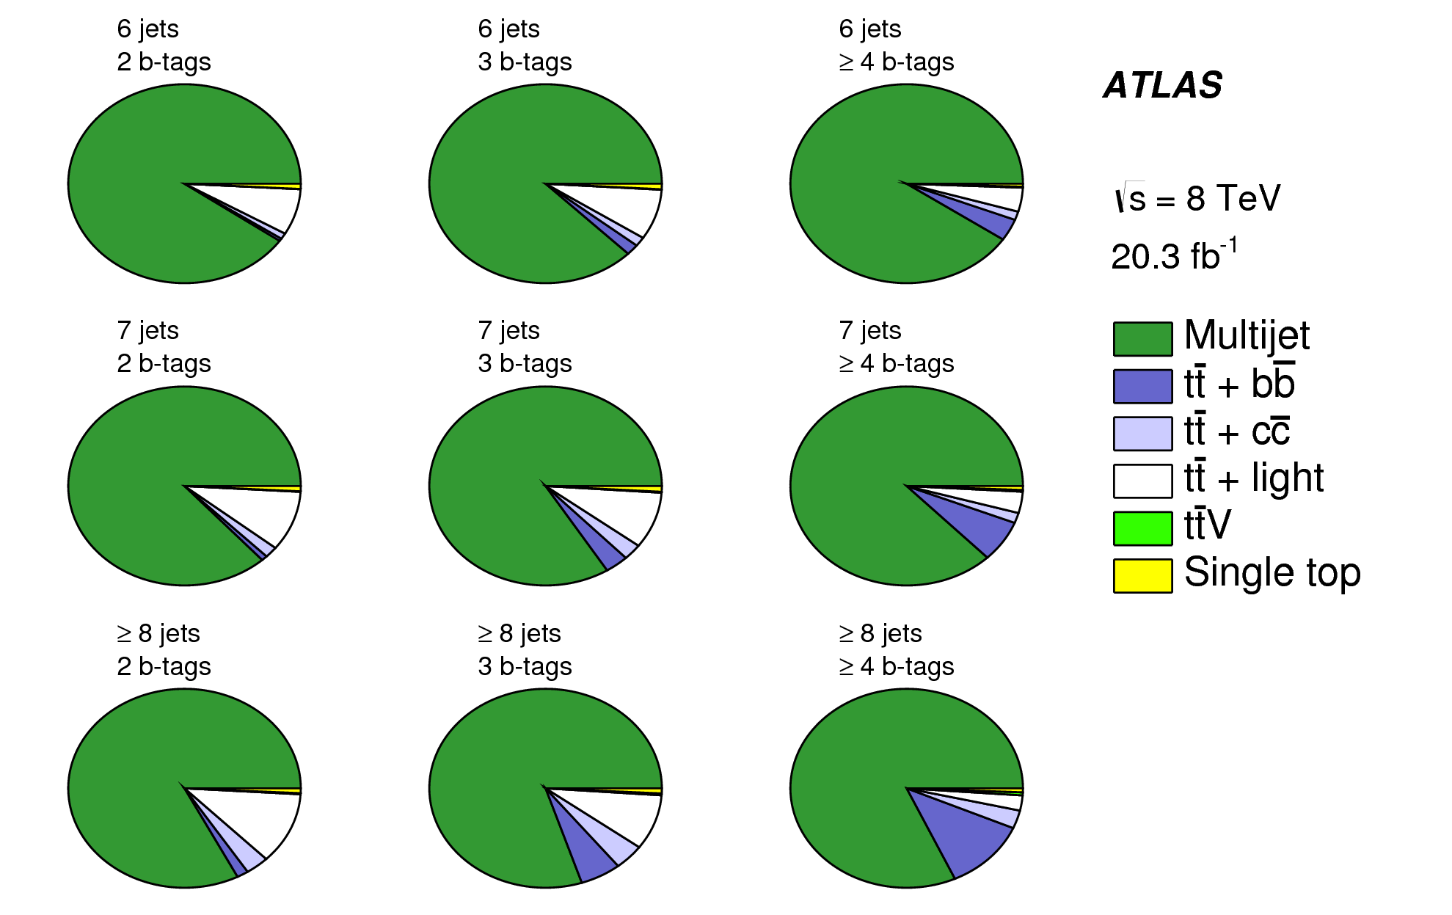
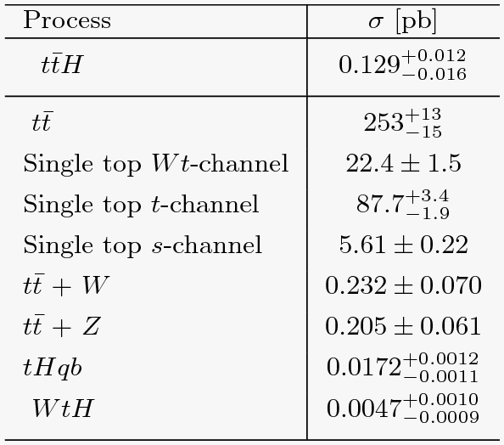
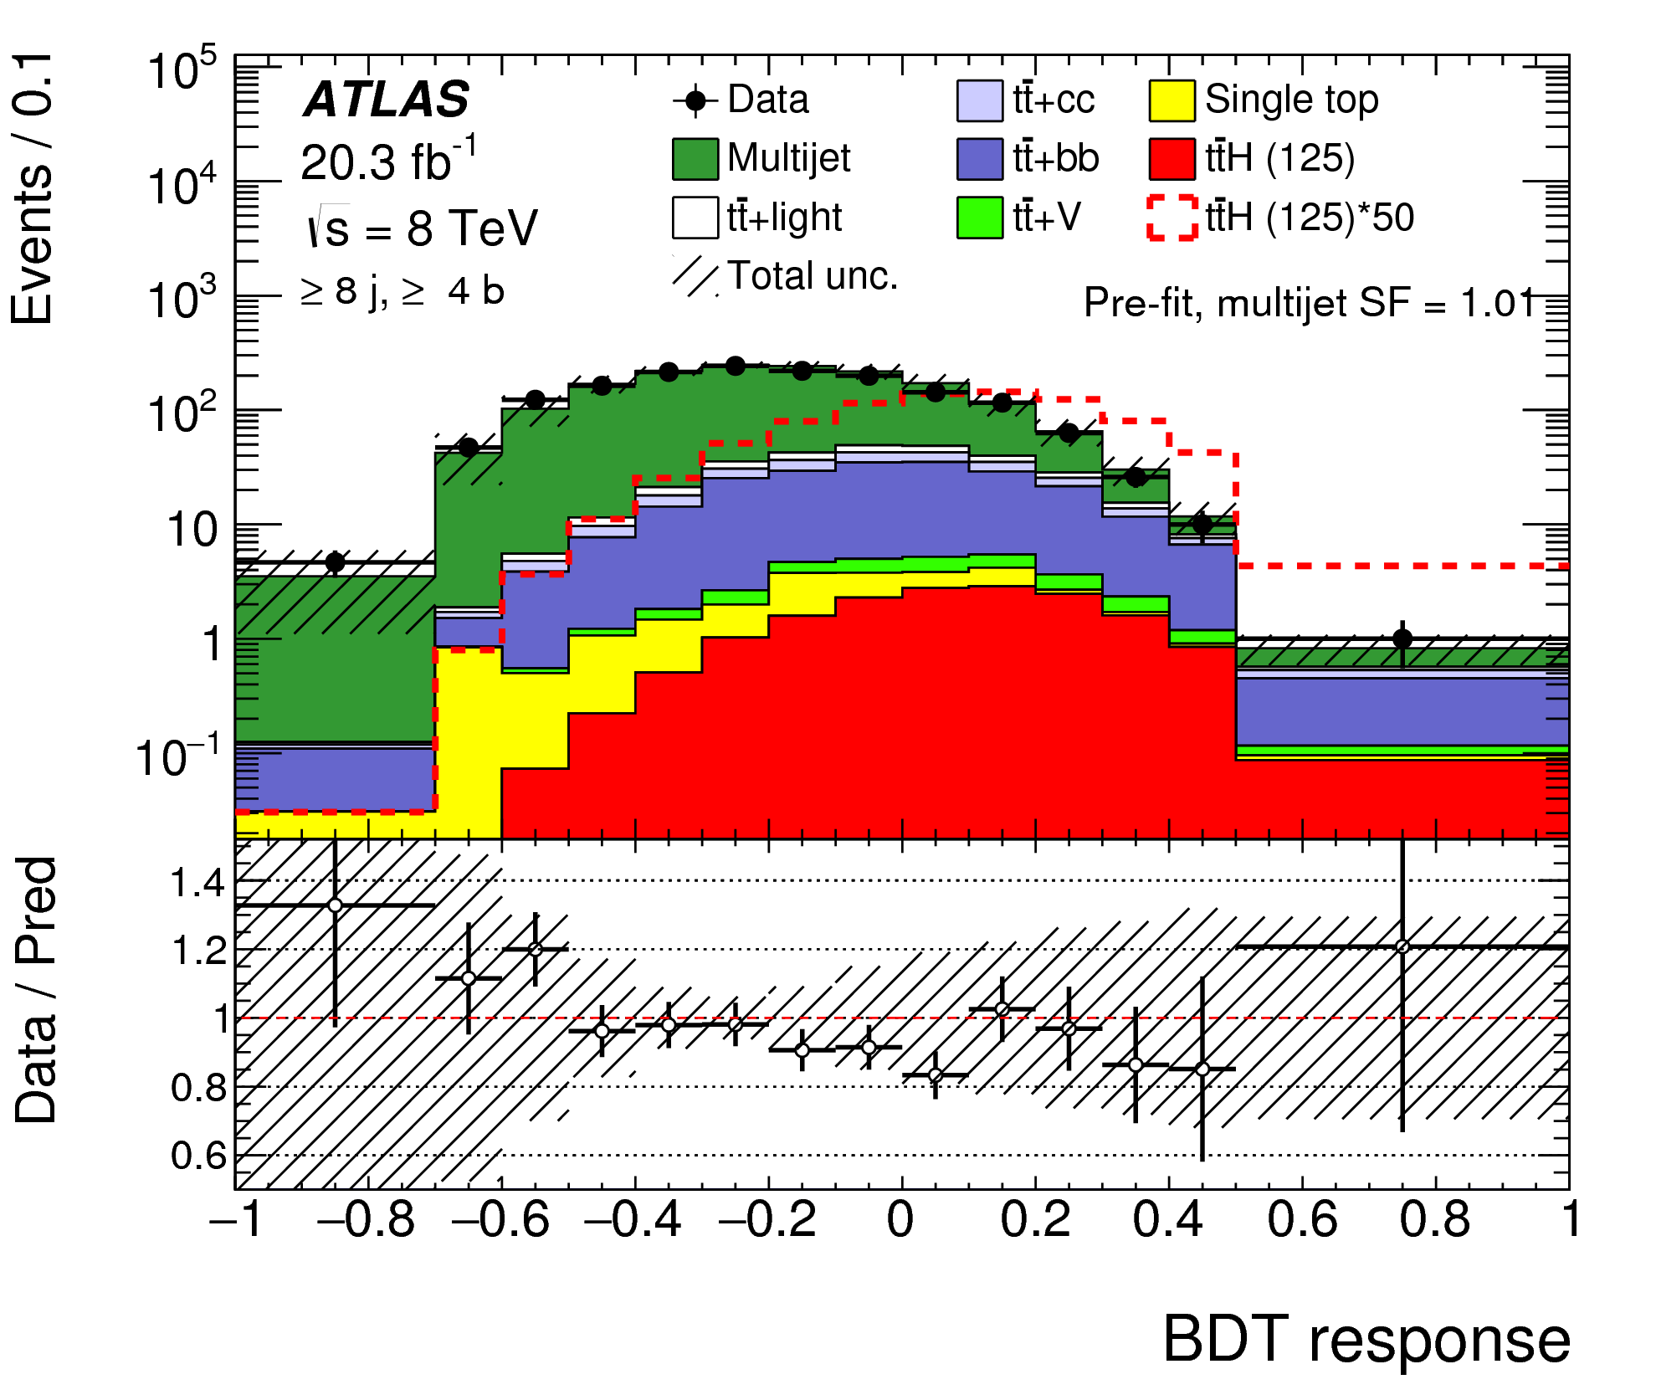
Analysis
JHEP 05 (2016) 160
Categories according to nr. of jets and b-tags
  2 b-tag events used to extract multijet backgr.
Backgrounds:
  Multijet production is dominant background;
  Followed by tt + jets
  Smaller contributions from ttV and tH
Data-driven multijet estimation:
  Tag rate function TRF_{MJ} extracted in 2b-tag region
  Allows to emulate multijet backgr. versus nr. of b-tags
  Validated with closure test in data and MC
Employs BDT discriminants in each category
 | 2 b-tags | 3 b-tags | 4 b-tags
6 jets | Used to extract multijet backg. | BDT control | BDT control
7 jets |  | BDT signal | BDT signal
≥8 jets |  | BDT signal | BDT signal

Slide 15
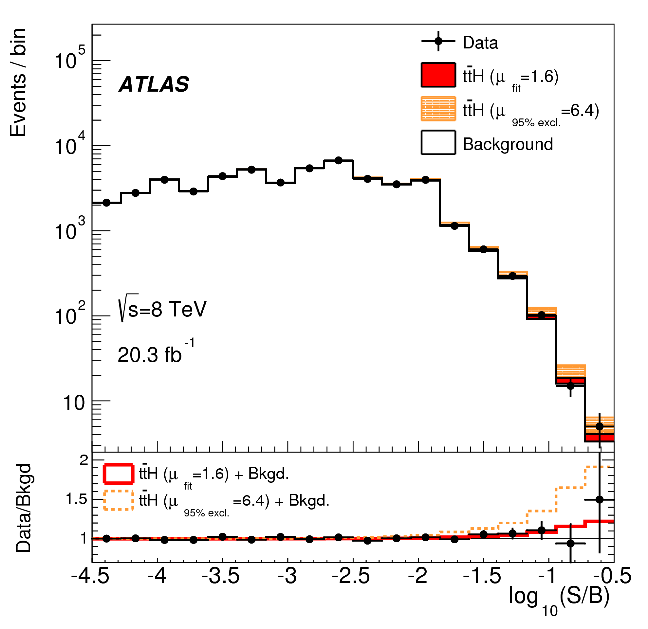
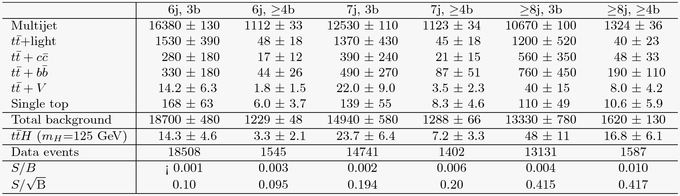
Results
JHEP 05 (2016) 160
Profile likelihood fit to BDT output in 6 regions
  Determine signal strength μ = σ_{obs.}/σ_{SM}
  Constrains normalization of each background as nuisance parameter
  Multijet background free parameter (like μ but unlike simulated backgrounds)
Fit results:
  Best fit μ = 1.6 ± 2.6
  Limits at 95% CL: μ < 6.4 (expected 5.4)

Slide 16
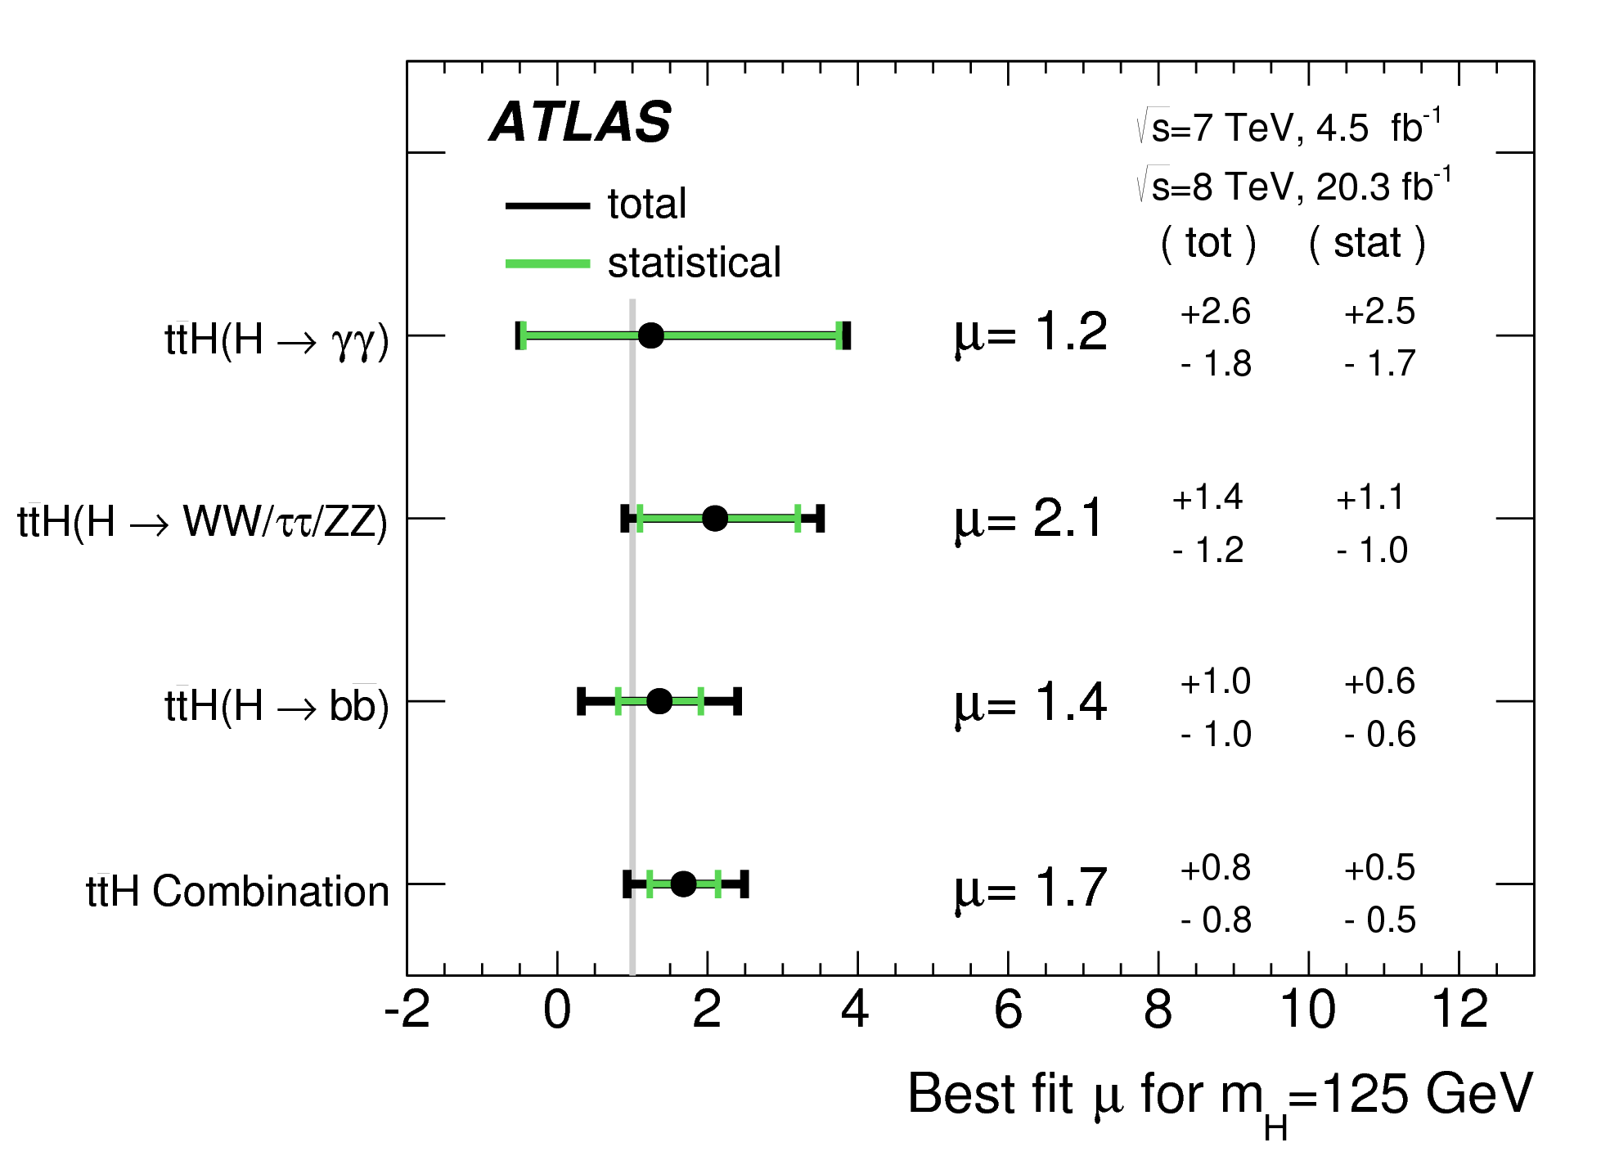
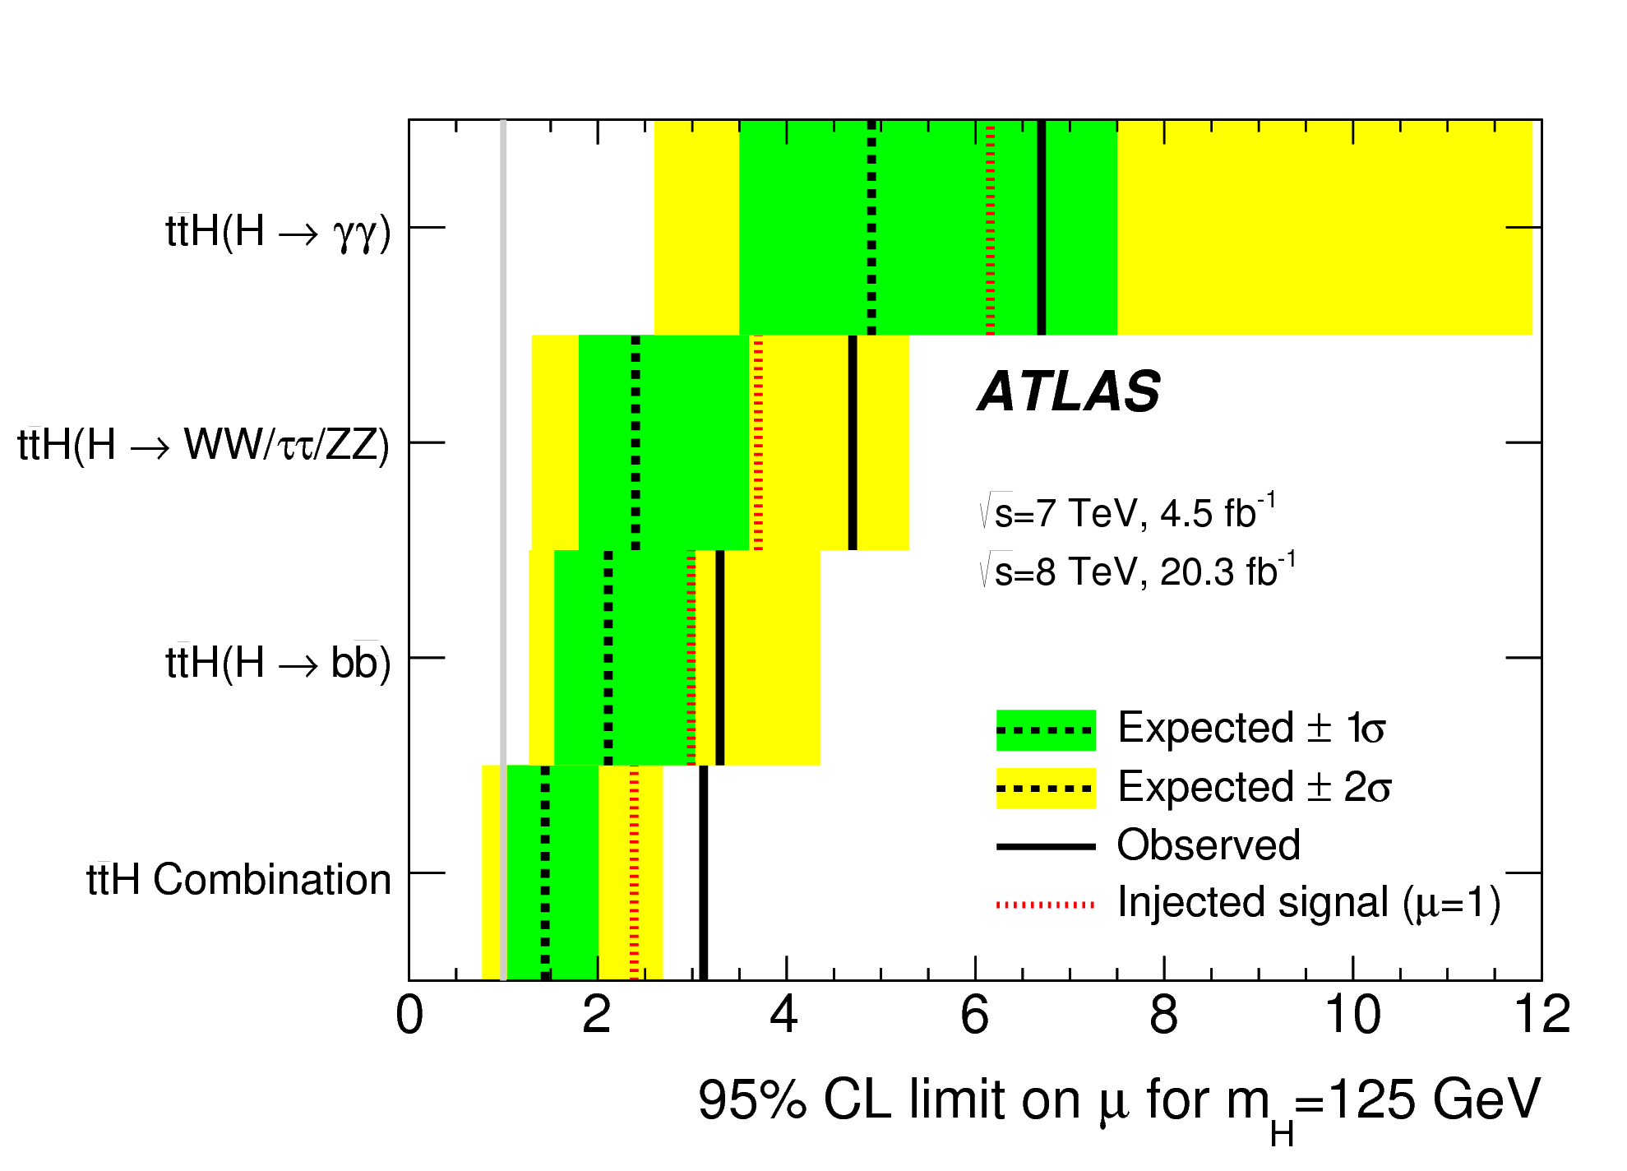
ttH combination
JHEP 05 (2016) 160
Representative/best analysis category
ATLAS combined all above analyses to get final LHC Run 1 sensitivity
LHC Run 1 ATLAS best fit: μ_{ttH} = 1.7 ± 0.8
Compatible with SM signal (μ_{ttH} = 1) within 1σ
2σ above μ_{ttH} = 0 (background-only hypothesis)
95% CL limit: μ_{ttH} < 3.1 × SM (obs) / 1.4 × SM (exp)
ttH channel | S/B | S/√B
H→γγ | 64% | 0.6
multilepton | 20% | 0.69
H→bb 1l | 4% | 0.8
H→bb 2l | 6% | 0.4
H→bb all-had. | 1% | 0.4

Slide 17
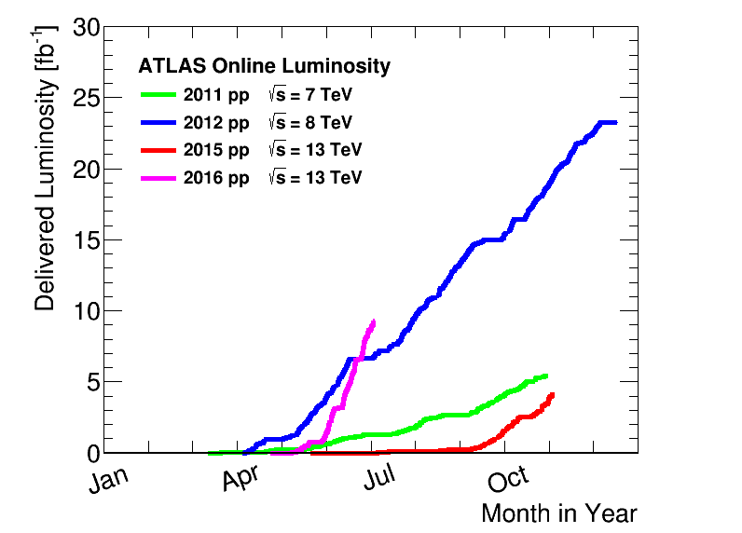

Conclusions and outlook
ttH production provides unique, direct access to top Yukawa coupling and Higgs properties
  Covered H→γγ, H→WW, H→ττ, H→ZZ, H→bb decay channels
Combined signal strength 2σ above background-only hypothesis and compatible with SM expectations
μ_{ttH} = 1.7 ± 0.8
Better sensitivity expected soon :
  Higher luminosity (ramping up quickly!)
  Better S/B ratio(*) with respect to some backgrounds
(*) Before cuts and for inclusive tt+jets; not necessarily true after cuts for all channels and jet flavours

Slide 18
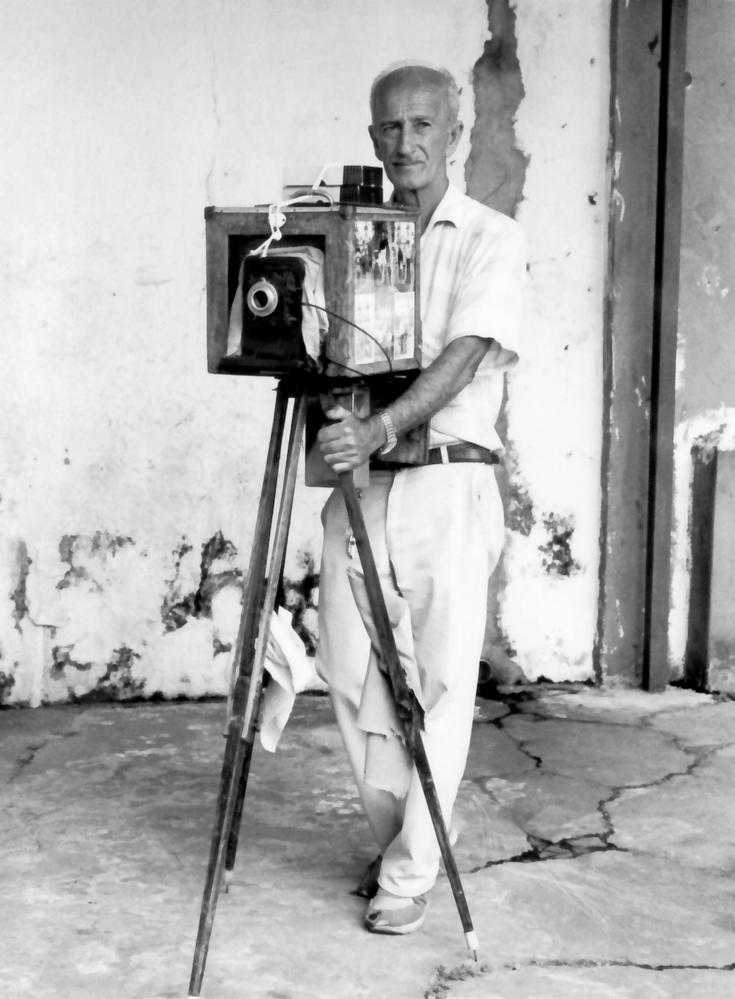


Bonus slides

Slide 19
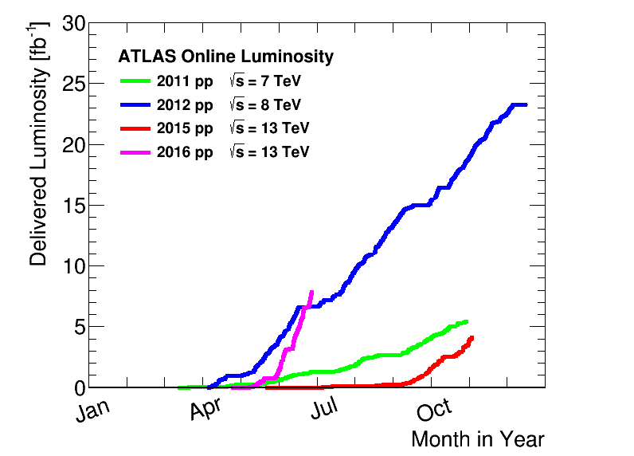
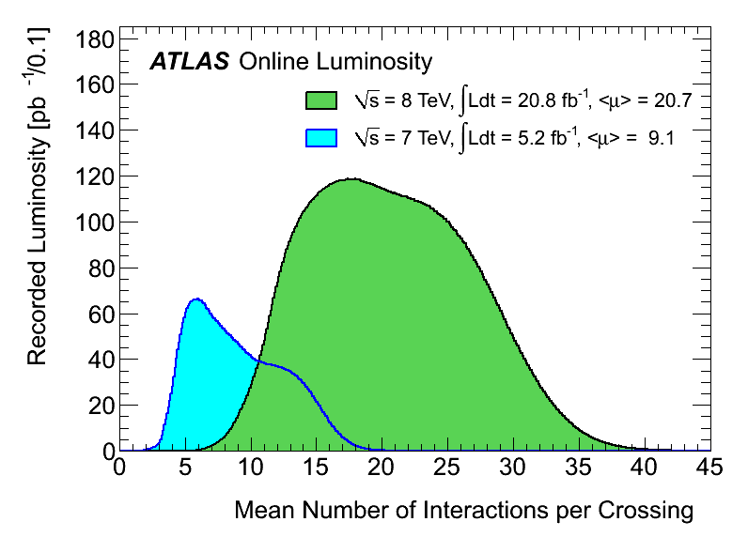
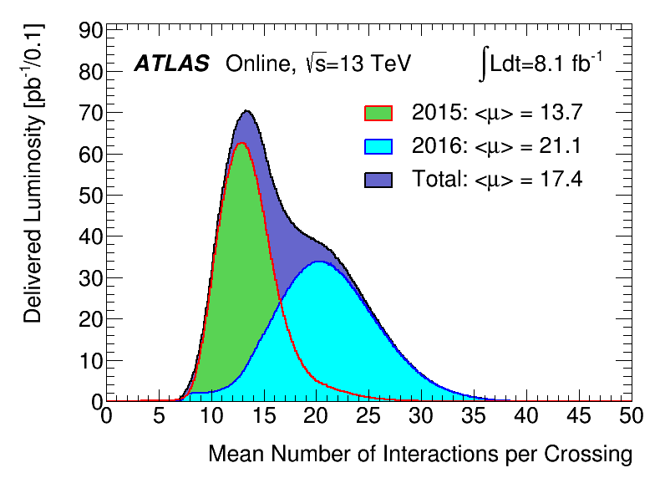
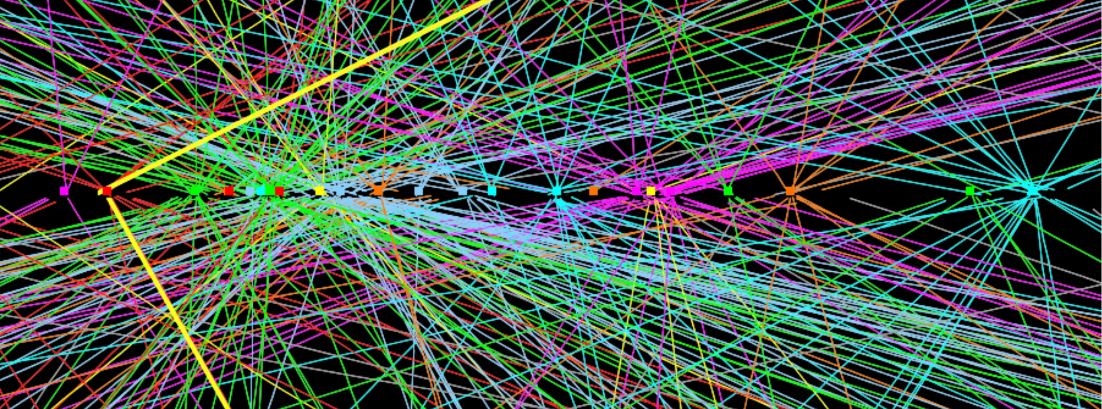
LHC and ATLAS Performance
Run 2 at 13 TeV (so far!…):
9.4x10³³cm⁻²s⁻¹ peak luminosity
Up to ≈40 pileup interactions
≈91% efficiency after physics-quality data requirements
5.96 fb⁻¹ recorded so far in 2016
3.2 fb⁻¹ physics data in 2015
Reached design instantaneous lumi L = 1x10³⁴cm⁻²s⁻¹
a few days ago!
Run 1:
7.7x10³³cm⁻²s⁻¹ peak luminosity
Up to ≈40 pileup interactions
≈95% efficiency after physics-quality data requirements
20.3 fb⁻¹ at 8 TeV
4.7-4.9 fb⁻¹ at 7 TeV

Slide 20
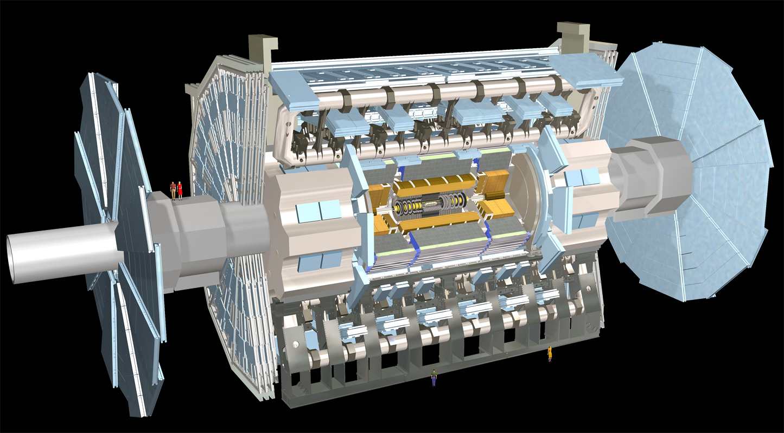
Muon Spectrometer: |η|<2.7
Air-core toroids and gas-based muon chambers
σ/p_{T} = 2% @ 50GeV to 10% @ 1TeV (ID+MS)
EM calorimeter: |η|<3.2
Pb-LAr Accordion
σ/E = 10%/√E ⊕ 0.7%
Hadronic calorimeter:
|η|<1.7 Fe/scintillator
1.3<|η|<4.9 Cu/W-Lar
σ/E_{jet}= 50%/√E ⊕ 3%
L = 44 m, ∅ ≈ 25 m
7000 tonnes
≈10⁸ electronic channels
3-level trigger reducing 40 MHz collision rate to 200 Hz of events to tape
Inner Tracker: |η|<2.5, B=2T
Si pixels/strips and Trans. Rad. Det.
σ/p_{T} = 0.05% p_{T} (GeV) ⊕ 1%

Slide 21
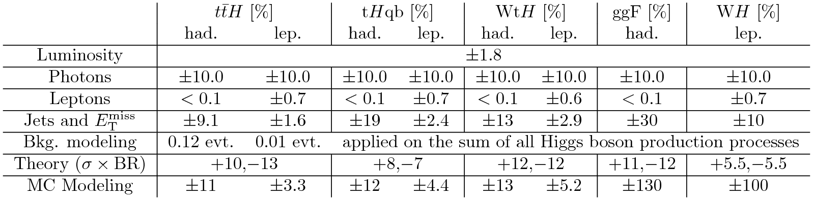
ttH, H→γγ Backup
Summary of systematic uncertainties on the final yield of events for 7 TeV data from tt̅H, tHqb and WtH production after applying the leptonic and hadronic selection requirements. The uncertainties for the dominant H → γγ processes without top quarks in the hadronic category, ggF, and in the leptonic category, WH, are also shown. For both tH production processes, the maximum uncertainty observed for all values of κ_{t} generated (+1, 0, -1) is reported. For branching fraction and cross section uncertainties which depend on mH, the numbers at mH = 125 GeV are quoted.

Slide 22


ttH, H→γγ backup
y_{top} = κ_{t} y_{top}SM
Analysis sensitive to ttH and tH:
  ttH cross section zero if κ_{t} = 0
  BR(H→γγ) zero if W and t contribution to H→γγ cancel
  tH cross section more complicated: only 1 of 3 diagrams at tree level
95% CL limits on (σ x BR x dependence on κ_{t}) give limits on κ_{t}

Slide 23



Multilepton backup

Slide 24
Multilepton event selection
Phys.Lett. B 749 (2015) 519-541
Cat. | Light leptons | Taus | jets | Other
2l0τ_{had} | 2 same-sign e/μ p_{T} > 25/20 GeV |η_{e}|<1.37 => charge rec. | none | ≥ 4 jets ≥ 1 b tag => suppress tt+jets and ttW | 6 subcategories of: N_{lepton} (e±e±, μ±μ±, e±μ±) x N_{jet} (==4, ≥5)
3l | 3 e± or μ± total charge ±1 p_{T} > 20 GeV same-sign e/μ pair => non-prompt BG | any | 3 jets + ≥ 2 b tags or ≥ 4 jets + 1 b => suppress tt+jets and ttV | |m_{ee/μμ} -m_{Z}| > 10 GeV => suppress ttZ
2l1τ_{had} | 2 same-sign e/μ p_{T} > 25/15 GeV | 1 τ_{had} p_{T} > 25GeV | ≥ 4 jets => suppress ttV and tt + jets ≥ 1 b tag => suppress V and VV prod | |m_{ee/μμ} -m_{Z}| > 10 GeV => suppress Z + jets
4l | 4 e± or μ± zero total charge p_{T} > 25/15 GeV for leading light leptons | any | ≥ 2 jets, ≥ 1 b tag => suppress tt+jets and ttW => suppress ttV and tt + jets | |m_{ee/μμ}-m_{Z}| > 10 GeV => suppress ttZ 100 < m_{4 lep}< 500 GeV => suppress Z → 4l, ttZ 2 categories: Z-enriched (ee/μμ pair) and Z-depleted
1l2τ_{had} | 1 e or μ p_{T} > 25 GeV | 2 τ_{had} opposite charge | ≥ 3 jets => suppress ttV and tt + jets ≥ 1 b tag => suppress V and VV production | 60 < m_{vis} (ττ) < 120 GeV => target H → ττ

Slide 25


H→bb: Background modeling
tt+jets modeling:
tt+bb MC reweighted from Sherpa OpenLoops prediction
  Fully ME+PS matched (MLM)
  NLO prediction
  Massive b quarks (4 Flavour Scheme)
  CT10 PDF set
tt+light jets and tt+cc reweighted
  As function of p_{T}(tt)
  As function of top quark p_{T}
  To correct Data/MC difference found in 7 TeV differential cross section
    Checked validity in simulation
After reweighting, Data/MC agreement clearly improved

Slide 26

Single-lepton H→bb – variable ranking

Slide 27

Dilepton H→bb – variable ranking

Slide 28

Dilepton + single-lepton H→bb Systematicsa
List of systematic uncertainties considered. An "N" means that the uncertainty is taken as normalisation-only for all processes and channels affected, whereas an "S" denotes systematic uncertainties that are considered shape-only in all processes and channels. An "SN" means that the uncertainty is taken on both shape and normalisation. Some of the systematic uncertainties are split into several components for a more accurate treatment. This is the number indicated in the column labelled as "Comp.”

Slide 29


Dilepton + single-lepton H→bb
The fitted values of the nuisance parameters with the largest impact on the measured signal strength. The points, which are drawn conforming to the scale of the bottom axis, show the deviation of each of the fitted nuisance parameters, hat{θ}, from θ₀, which is the nominal value of that nuisance parameter, in units of the pre-fit standard deviation Δθ. The error bars show the post-fit uncertainties, σ_{θ}, which are close to 1 if the data do not provide any further constraint on that uncertainty. Conversely, a value of σ_{θ} much smaller than 1 indicates a significant reduction with respect to the original uncertainty. The nuisance parameters are sorted according to the post-fit effect of each on μ (hashed blue area) conforming to the scale of the top axis, with those with the largest impact at the top.
Dilepton

Slide 30






Matrix Element Method
P_{i} = probability density of event with reco 4-momenta x coming from process i with parameters α
M_{i} = matrix element for process i with parton-level 4-momenta y – assume H→bb
W(y,x) = transfer functions mapping 4-momenta y to reconstruction level x – assume δ function
dΦ_{N} = phase space integration element
σ_{i}^{exp}(α) = cross section x acceptance x efficiency (to normalize P_{i})
Process likelihood: sum probabilities for each permutation of final state particles (assignment ambiguity)
Calculate likelihood ratio D1 of H→bb signal and tt+bb background (with α a norm. factor)
SSLL = log of summed signal likelihoods

Slide 31


Dilepton + single-lepton H→bb

Slide 32

All-hadronic ttH, H→bb

Slide 33
Event reconstruction
Electrons:
  From charged tracks and electromagnetic calorimeter energy clusters for p_{T} > 10 GeV
  Typically |η|<2.47; may also reject barrel-endcap transition 1.37<|η|<1.52
  Isolation cuts on additional E_{T} within ΔR = √(Δφ²+Δη²) = 0.2 of electron candidate must be < 0.05xE_{T}^{e} – measured in both calorimeter and tracks
  Check track longitudinal and transverse impact parameters wrt event primary vertex
Muons:
  From combining inner-detector charged tracks with muon-spectrometer tracks of segments for p_{T} > 10 GeV and |η|<2.50
  Isolation cuts of ΔR > 0.04+(10GeV)/p_{T}^{μ} from nearest jet
  Check track longitudinal and transverse impact parameters wrt event primary vertex
Hadronically-decaying taus (τ_{had}):
  Combine calorimeter clusters and 1 or 3 inner-detector charged tracks (total charge ±1) for p_{T} > 25 GeV and |η|<2.47
  Identification using two Boosted Decision Trees (BDT) to reject fake taus

Slide 34
Event reconstruction
Jets in multilepton analysis:
  Built within |η|<4.9 from calibrated calorimeter clusters with the anti-k_{T} algorithm with R parameter 0.4
  Calibrated with (simulation based) factors and in-situ corrections for data/simulation differences
  Typical cuts are p_{T} > 25 GeV; |η|<2.47 if requiring b-tagging
  Pileup-cleaning: jets with p_{T} < 50 GeV rejected if >50% of their track-based p_{T} not from primary vertex
B-tagging:
  Jets containg b-hadrons identified with multivariate discriminant combining track impact parameters with information from displaced decay vertices within jets
  Typical algorithm tunes give efficiencies of 70% with mis-tag rates of around 1% for light-quark jets and 20% for c-hadrons
  Other working points: b-tagging efficiency of 60%, 80% and 85%
  Algorithm efficiency and mis-tag rates calibrated based on data measurements

Slide 35
Event reconstruction
Missing E_{T}:
  Calculated from calorimeter clusters
  Corrections are applied to identified photons, electrons, muons, and jets
Photons in H→γγ analysis:
  From electromagnetic calorimeter energy clusters for p_{T} > 10 GeV
  May match one or two tracks
  Different energy calibration depends for clusters with tracks
  Typically |η|<2.37 rejecting barrel-endcap transition 1.37<|η|<1.52
  Isolation cut on track p_{T} within ΔR = √(Δφ²+Δη²) = 0.2 of photon candidate must be < 2.6GeV (2.2GeV) for 8TeV (7TeV) data
  Isolation cut on additional E_{T} within ΔR = √(Δφ²+Δη²) = 0.4 of photon candidate must be < 6GeV (5GeV) for 8TeV (7TeV) data
  Only 2-photon events retained
  Diphoton vertex reconstructed from longitudinal shower profile for un-converted photons, otherwise from conversion tracks, using Neural Net

Slide 36




CMS ttH results
7+8TeV combination: μ = 2.8 ± 1.0
https://twiki.cern.ch/twiki/bin/view/CMSPublic/PhysicsResultsHIG
13TeV multilepton
13TeV H->bb
13TeV combination

