Slide 1

Le boson de Higgs c’est quoi?
?
?
?
?
?
?
?
?
Ricardo Gonçalo
Royal Holloway, University of London
Collège Claparède, Genève
24 Janvier 2013

Slide 2
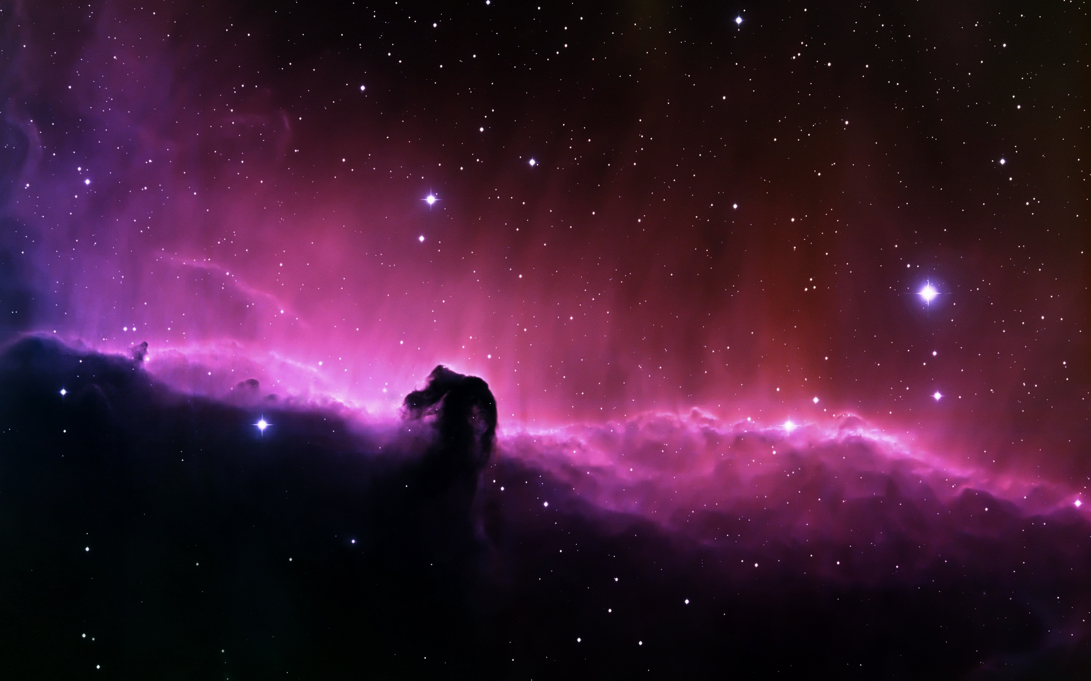

?

Slide 3
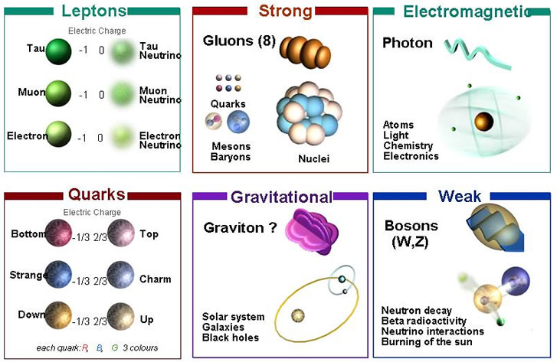
Le Modèle Standard

Slide 4
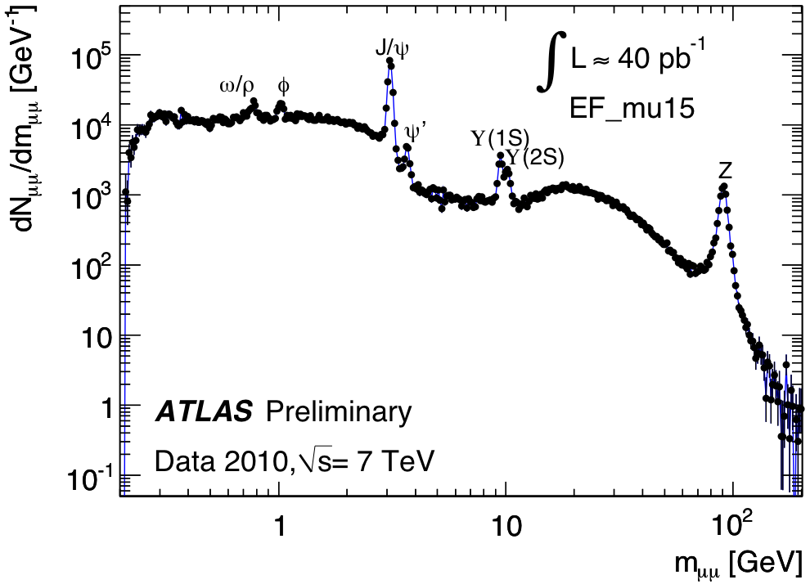

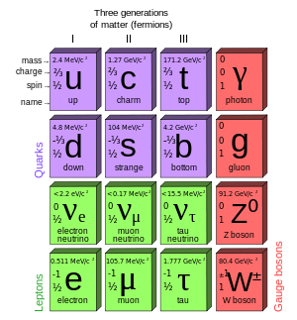

Slide 5
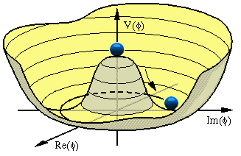
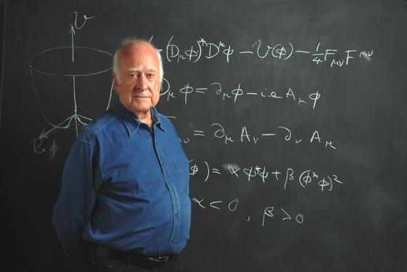
Pourquoi chercher le boson de Higgs?
Le Modèle Standard arrive à décrire l’Univers qu’on connaît (bon, la plupart… on y reviendra)
Mais il ne fonctionne pas avec des particules fondamentales qui ont de la masse
Entre le boson de Higgs!

Slide 6

La masse des particules fondamentales

Slide 7
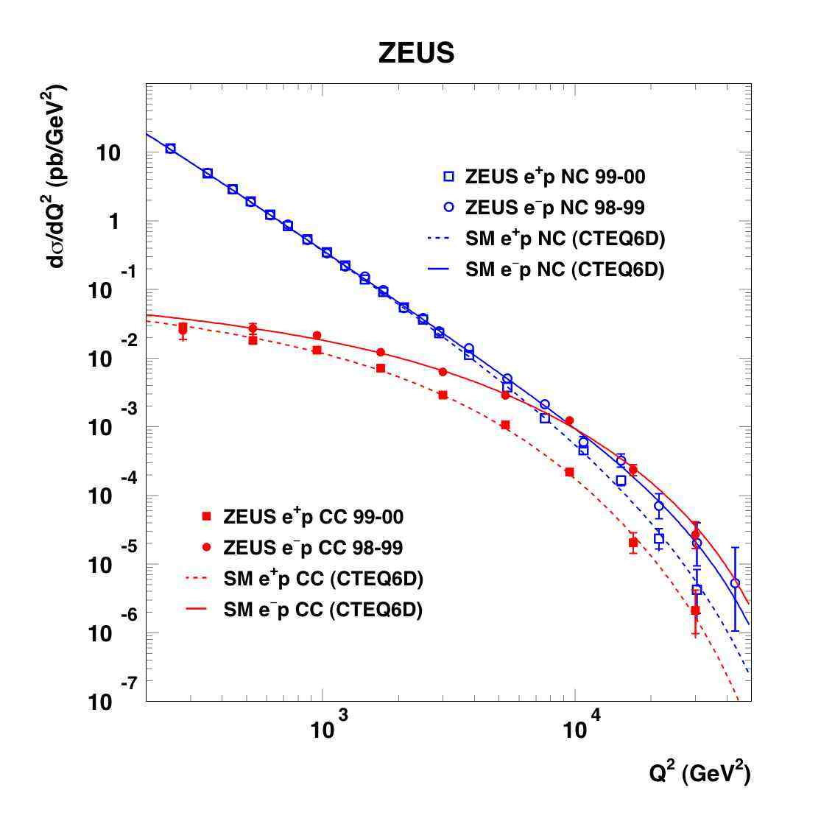
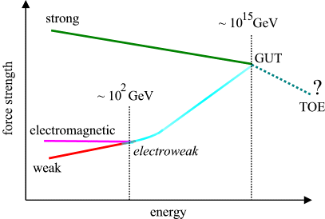
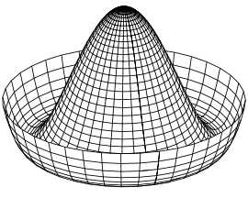

Unification des interactions
Z/γ
W±

Slide 8


Slide 9
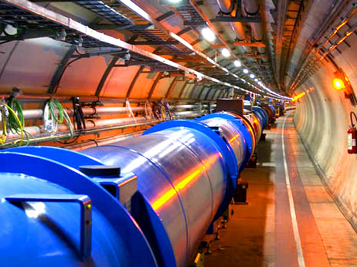

The Large Hadron Collider
26 659m circumference
9593 aimants: 1232 dipôles (champ maximum 8T)
Refroidit à 1.9K (plus froid que l’espace extérieur) avec 120 tonnes d’Helium liquide
Pression intérieure 10⁻¹³ atm (10x moins que la lune)
50ns entre collisions à 8TeV
Dans 2 ans: enérgie de collision √s = 14TeV, chaque 25ns (7m à v = c)
Light aircraft carrier (10,000 tonne) traveling at 30km/h

Slide 10
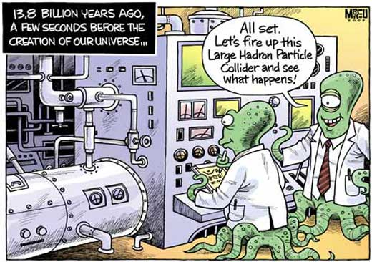

Slide 11
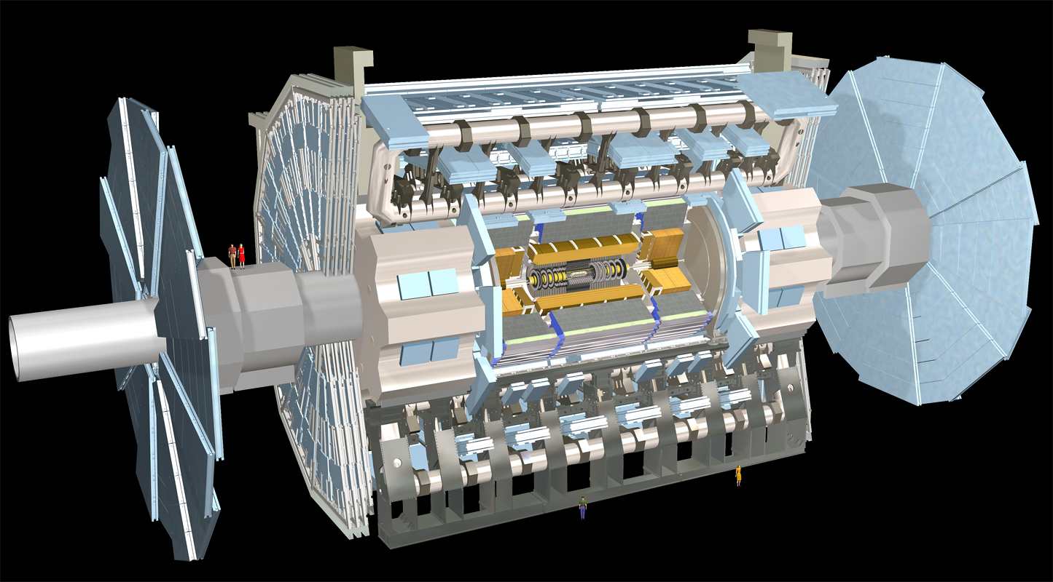
Muon Spectrometer: |η|<2.7
Air-core toroids and gas-based muon chambers
σ/p_{T} = 2% @ 50GeV to 10% @ 1TeV (ID+MS)
EM calorimeter: |η|<3.2
Pb-LAr Accordion
σ/E = 10%/√E ⊕ 0.7%
Hadronic calorimeter:
|η|<1.7 Fe/scintillator
1.3<|η|<4.9 Cu/W-Lar
σ/E_{jet}= 50%/√E ⊕ 3%
L = 44 m, ∅ ≈ 25 m
7000 tonnes
≈10⁸ electronic channels
3-level trigger reducing 40 MHz collision rate to 200 Hz of events to tape
Inner Tracker: |η|<2.5, B=2T
Si pixels/strips and Trans. Rad. Det.
σ/p_{T} = 0.05% p_{T} (GeV) ⊕ 1%

Slide 12
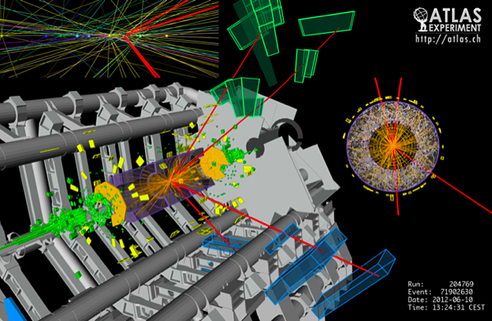
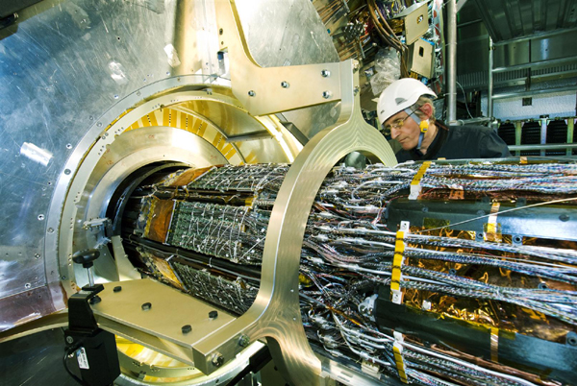
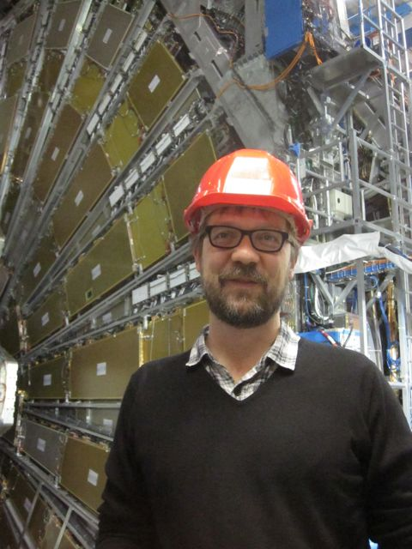
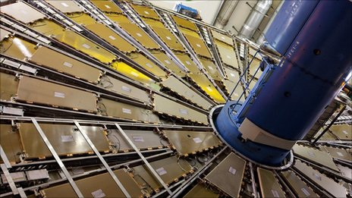
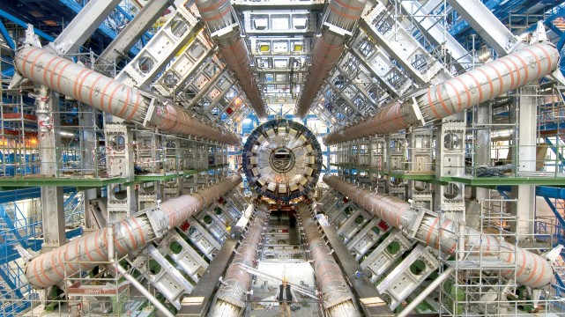

Slide 13
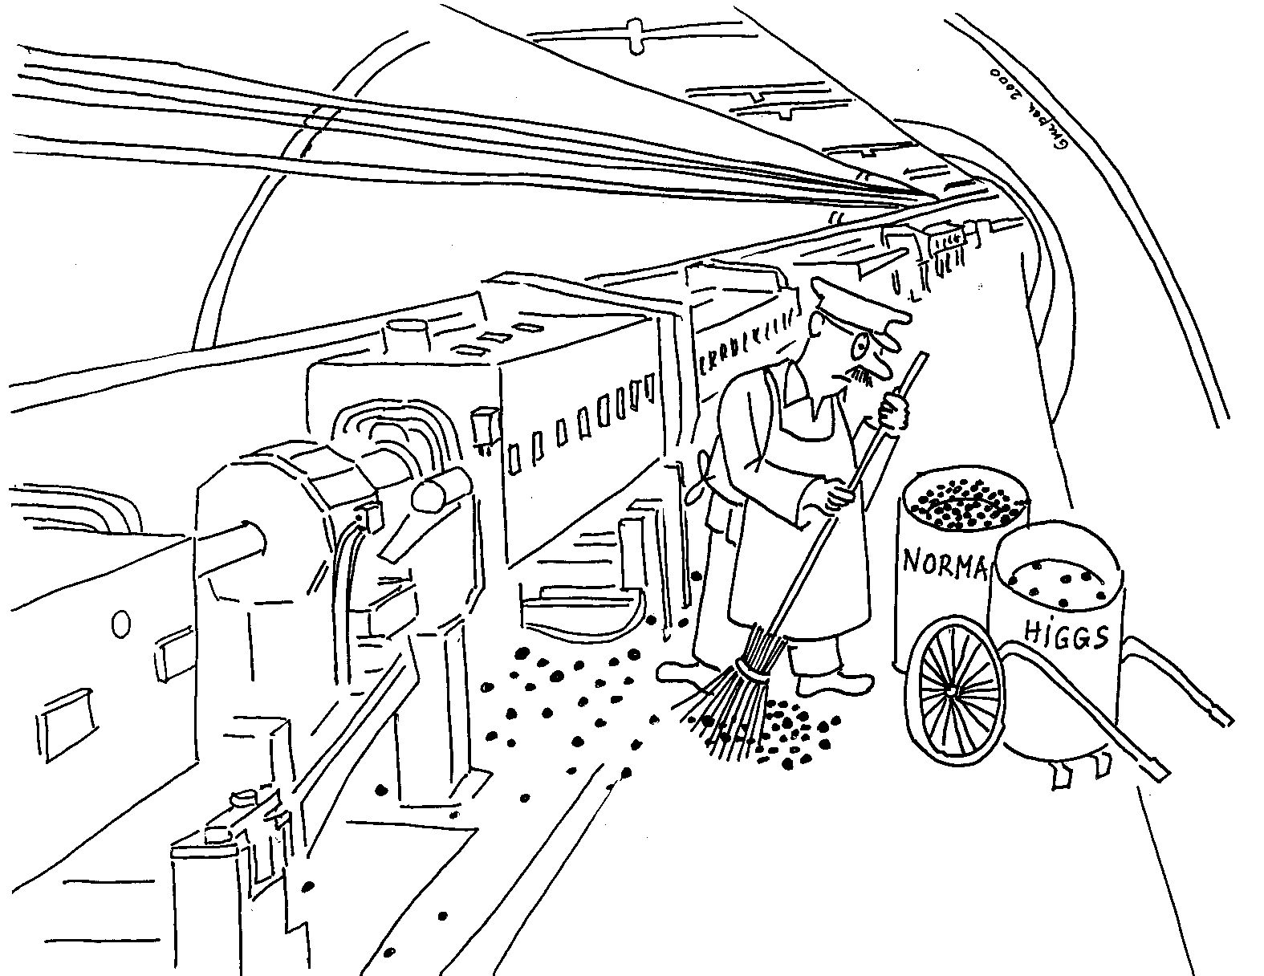
Le bruit de fond dans la recherche du Higgs

Slide 14
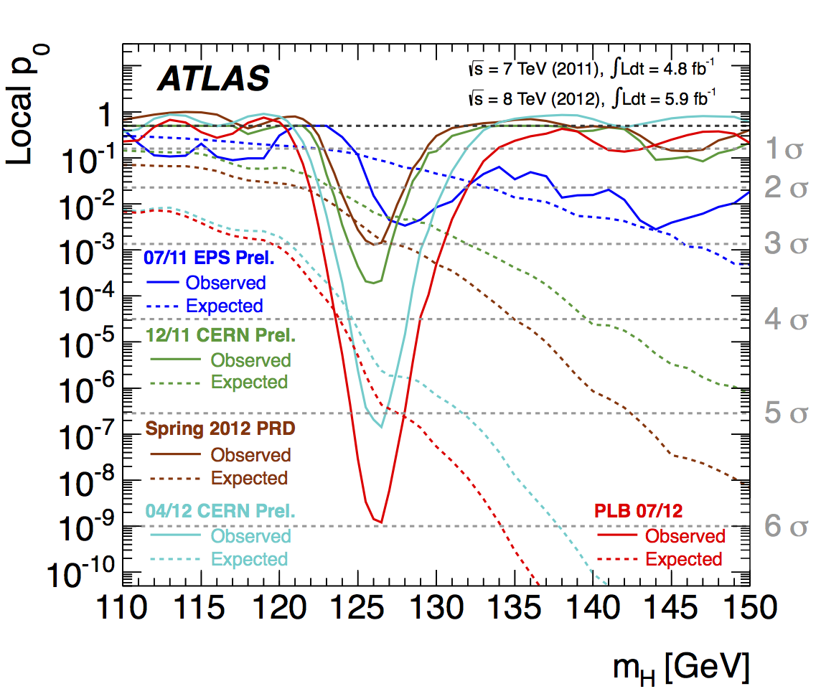
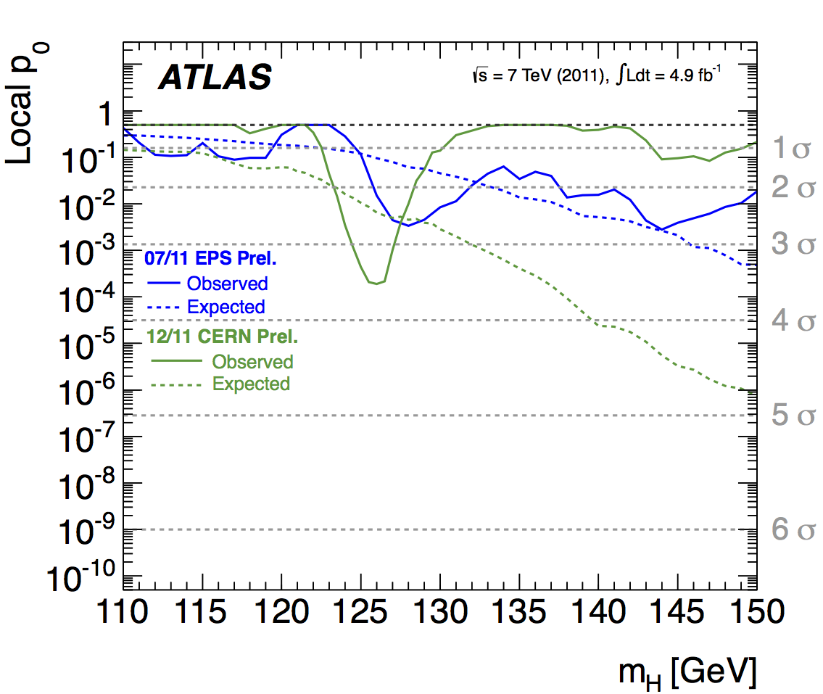
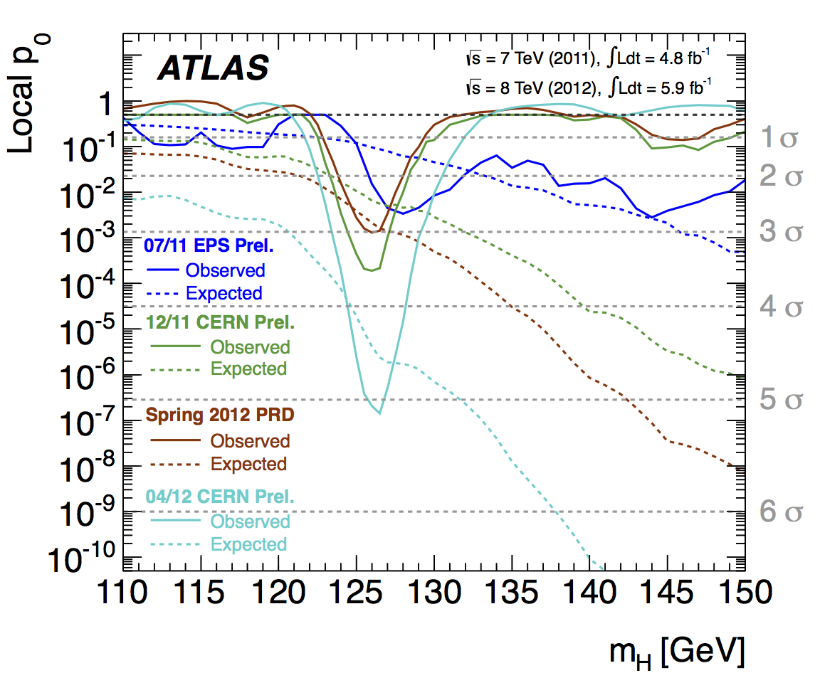
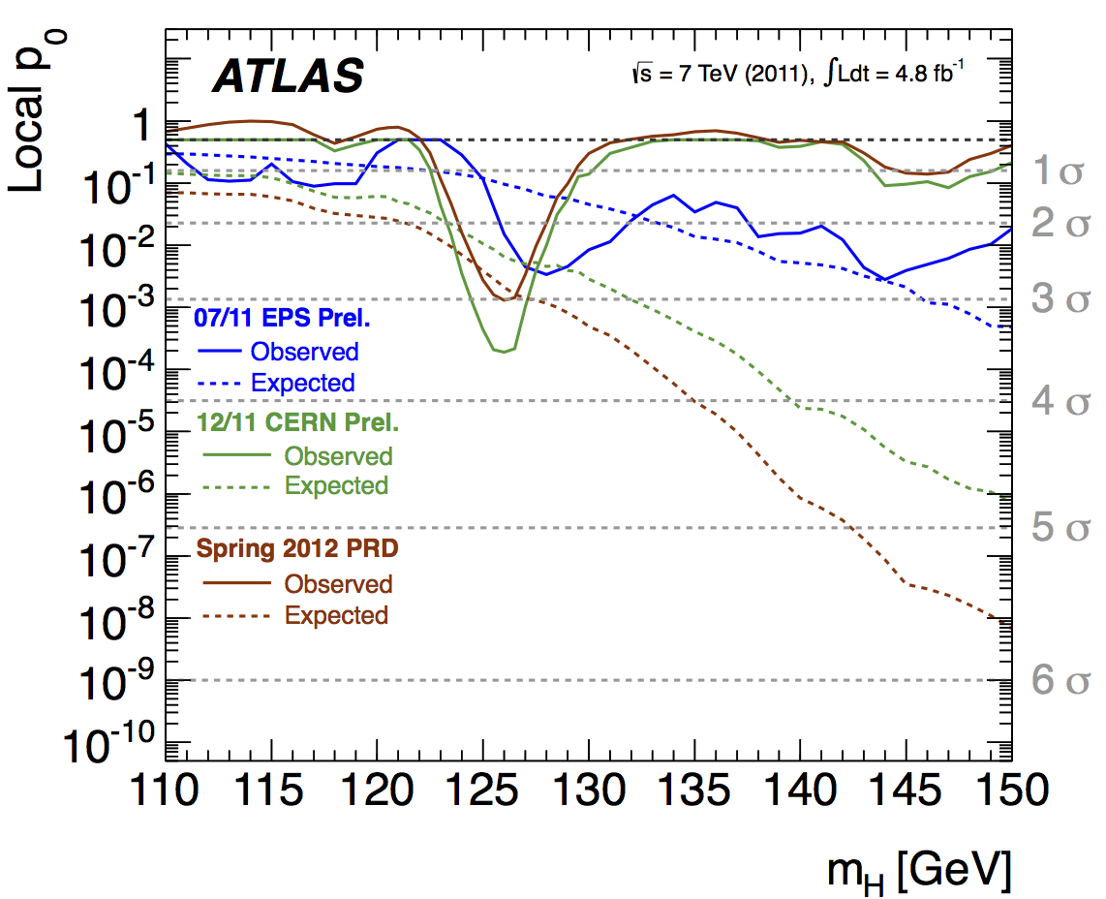
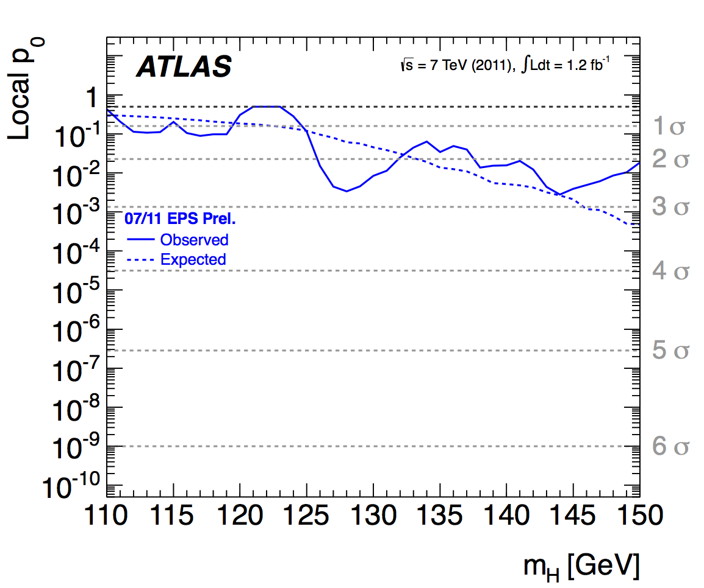
La découverte de la nouvelle particule au CERN

Slide 15


Slide 16

Est’ce le vrai boson de Higgs??

Slide 17
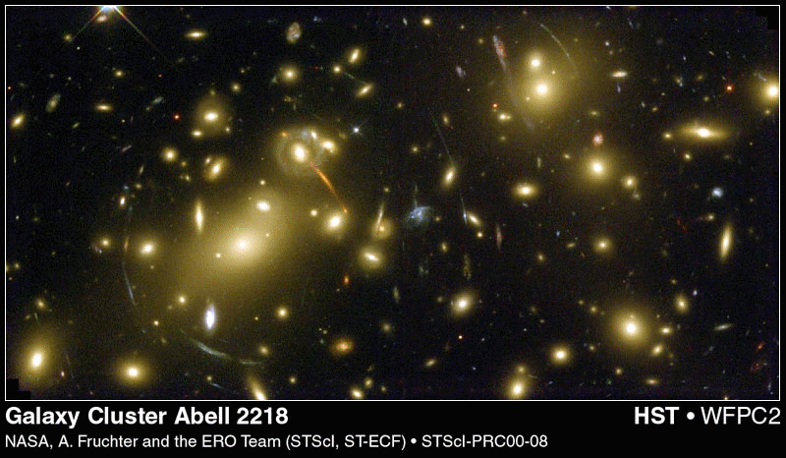
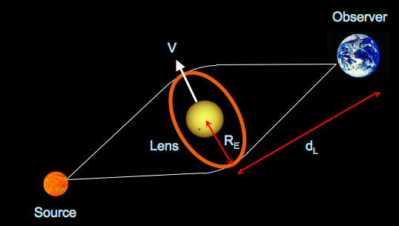
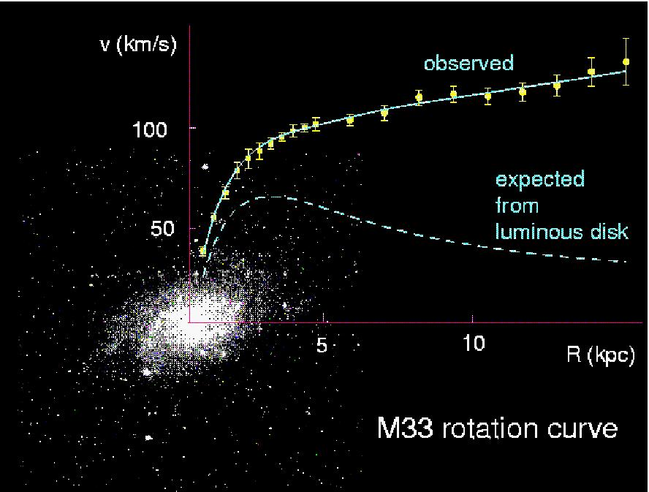
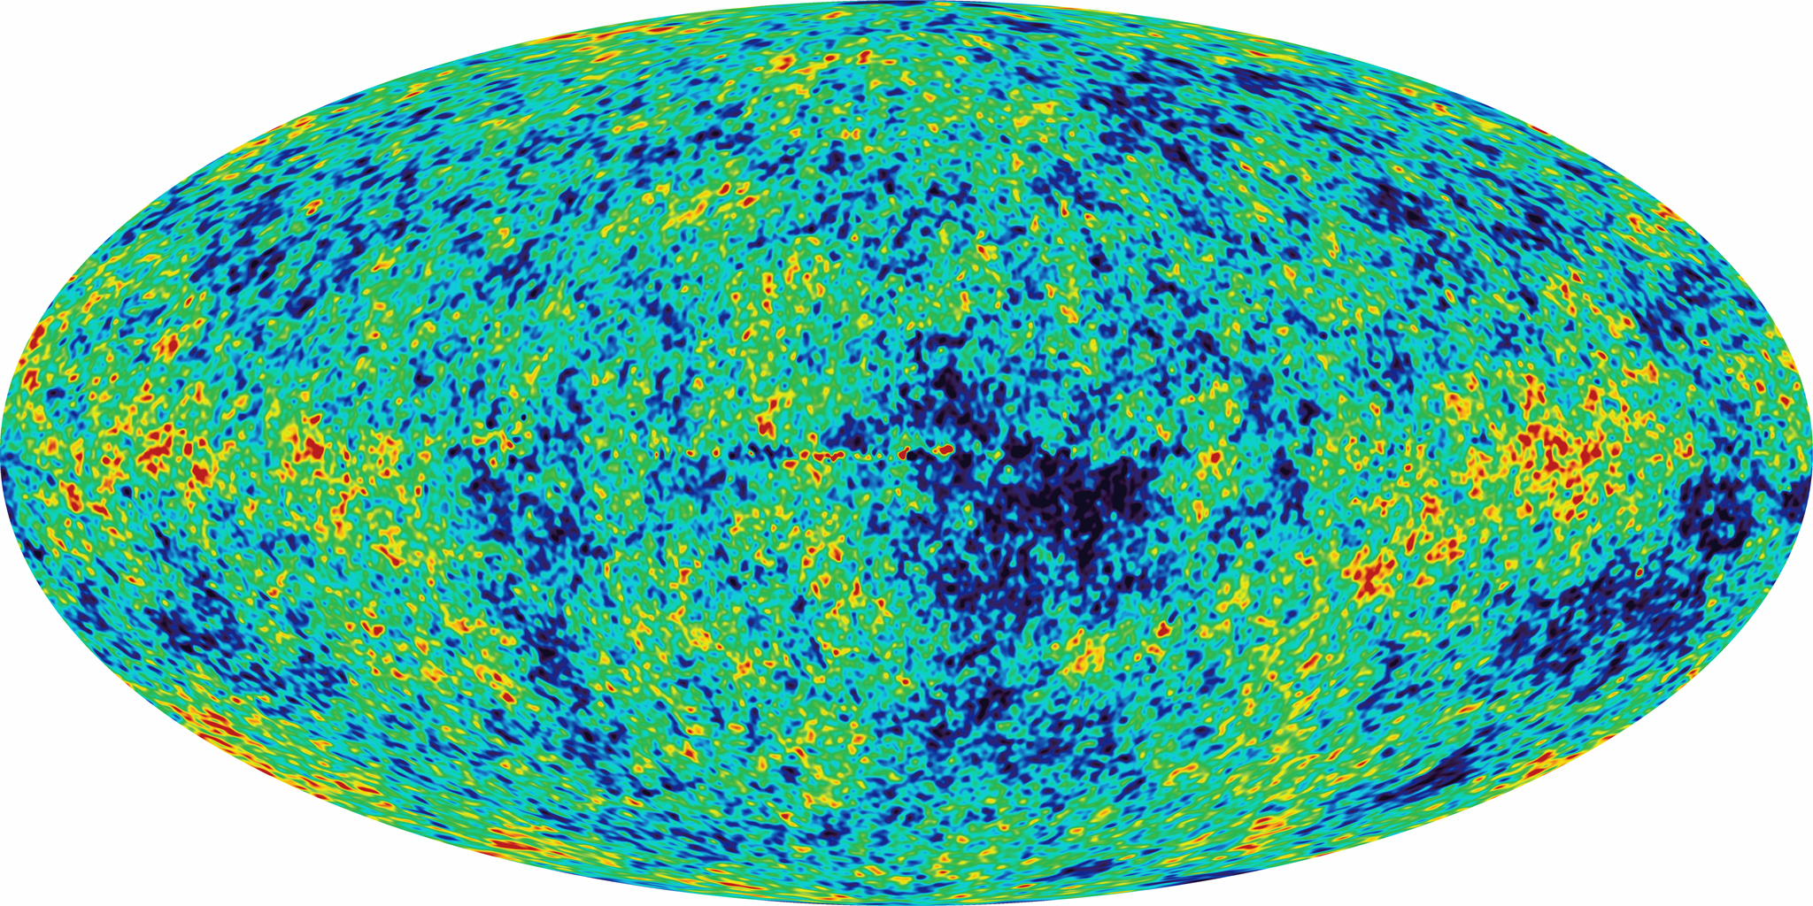
Juste le début!

Slide 19

Bonus slides

Slide 20
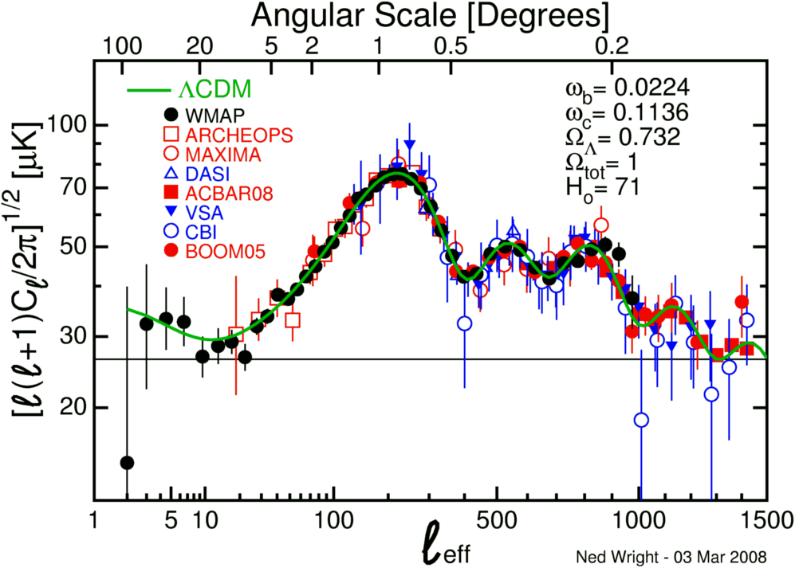

Slide 21
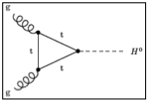
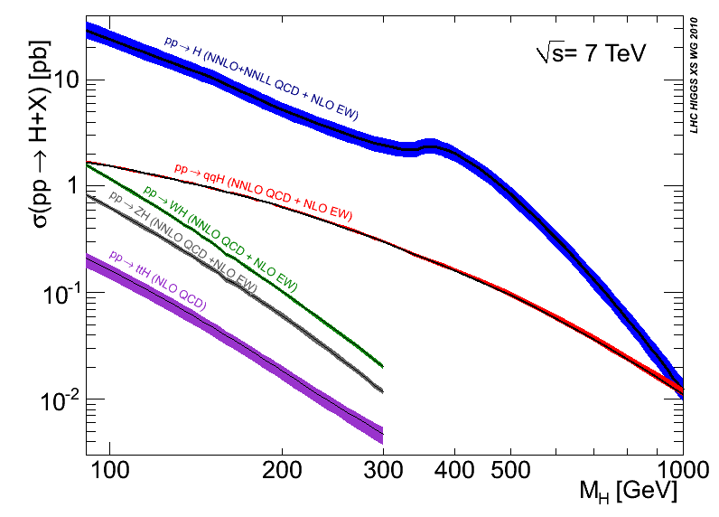
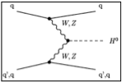
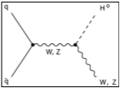
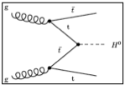
6 months ago: ICHEP 2012
1 ½ year ago: EPS 2011
CERN-2011-002; arXiv:1101.0593
Disfavoured by EW precision fits
Disfavoured by EW precision fits
Excluded by LHC
Excluded by LHC
Excluded by LEP
Excluded by Tevatron
Notes:
Main production channels: gluon fusion, Vector Boson Fusion, associated production with vector bosons, associated production with ttbar pair
Animation

Slide 22
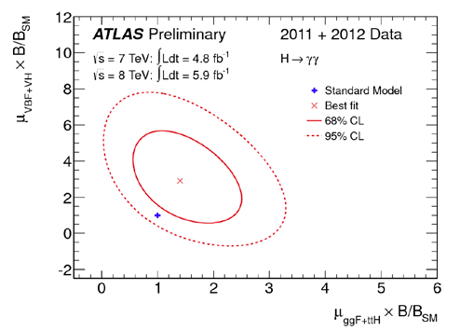
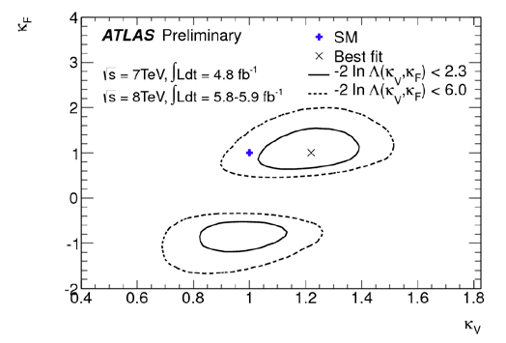
What do we know about the new particle?
  Mass ≈ 126 GeV
  Electric charge = 0 (neutral final state)
Unknown/incomplete knowledge:
  Spin (J) = 0, 1, 2, ... ? J=1 disfavored (Landau-Yang theorem and observation in H➞γγ)
  Charge-conjugation, parity (CP)
  Couplings?
September analysis used same data as July 2012 observation paper
  ATLAS-CONF-2012-127: https://cdsweb.cern.ch/record/1476765?ln=en
Fit data to estimate factors κ multiplying coupling in each SM production and decay mode
Signal strength for the γγ final state (gluon fusion vs VBF+VH)
  κ_{V} versus κ_{F} – assume a single κ_{F} factor for all fermions t, b, τ and a single factor κ_{V} for vector
  Sign comes from interference between t and W loops in H➞γγ

Slide 23
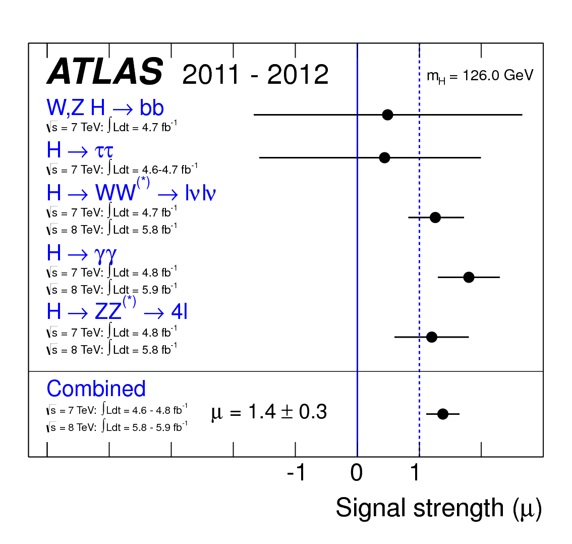
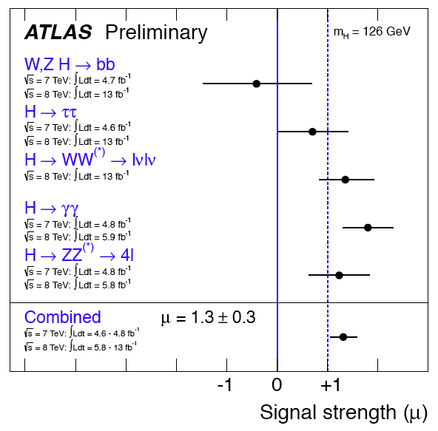
Updated signal strength
Previous combined signal strength result: μ = 1.4 ± 0.3
  2011 analyses of ττ and bb, July analyses for γγ, 4-lepton, and WW
New result using analysis shown today: μ = 1.3 ± 0.3
  Compatibility with SM μ=1 with observed measurement is 23%.
July 2012 results
New result including updates shown

Slide 24
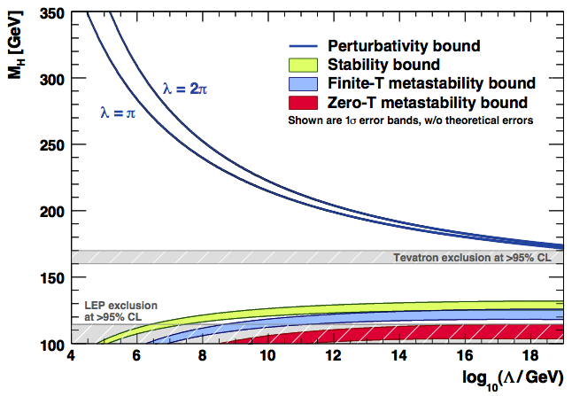
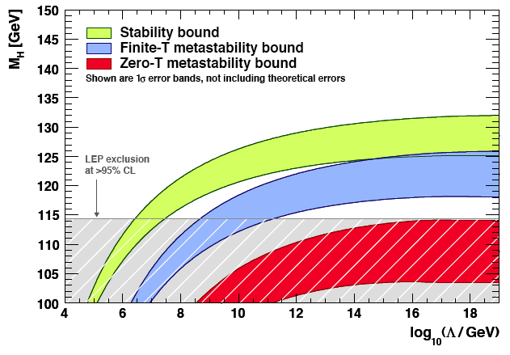
But there is more…
0906.0954v2 [hep-ph]
We know the SM is incomplete
For a low Higgs mass relative to the top quark mass, the quartic Higgs self-coupling runs at high energy towards lower values.
At some point it would turn negative indicating that the vacuum is unstable.
The universe could decay into a more stable lower energy vacuum state.
Unless new physics appears at some energy scale
The Higgs sector can give important clues to constrain new physics beyond the SM
It is a great way to search for new physics!

Slide 25



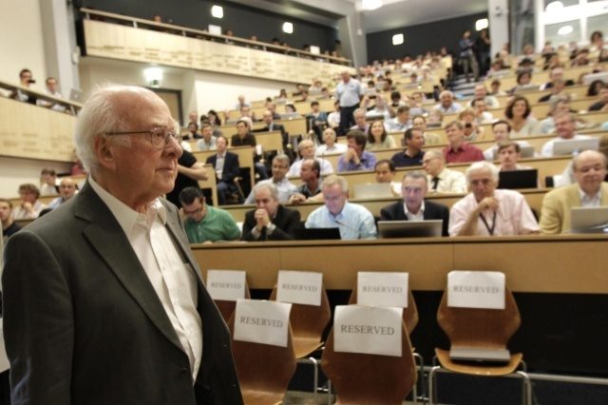

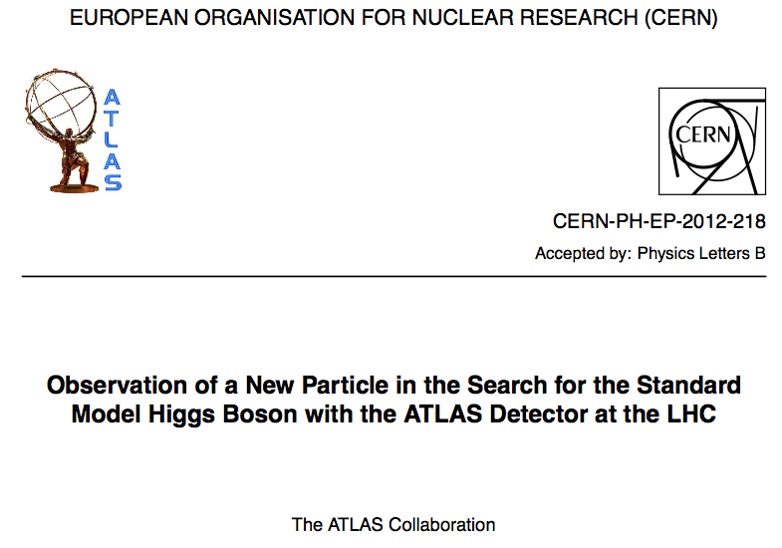
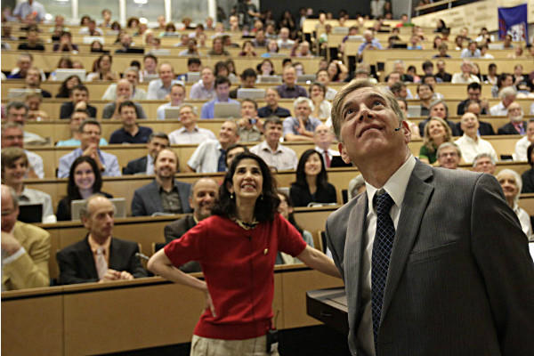
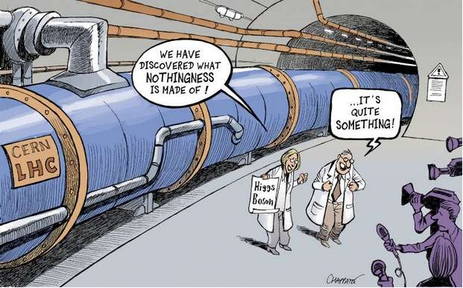
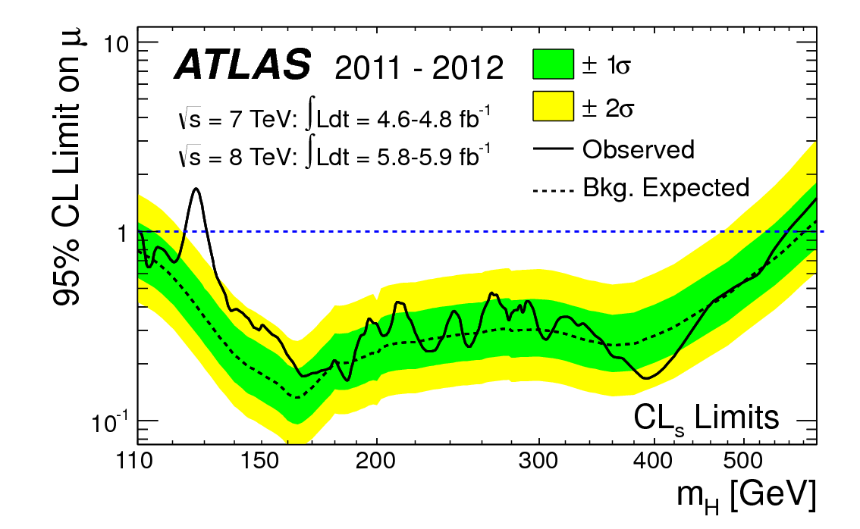


The story so far… we found a Higgs-like boson! ☺

Slide 26
