Slide 1
ttH Searches and Higgs couplings at the LHC
Ricardo Gonçalo, LIP

Slide 2
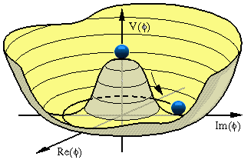
Outline
Discovery of the Higgs boson
What have we learned so far?
Exploring Higgs couplings
The road ahead (& my own favourite)

Slide 4
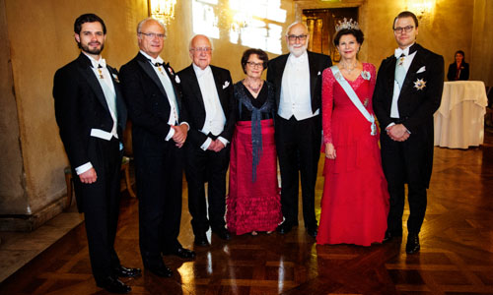
Truly global effort over many years led to this major discovery and a Nobel prize!
http://www.nobelprize.org/

Slide 5
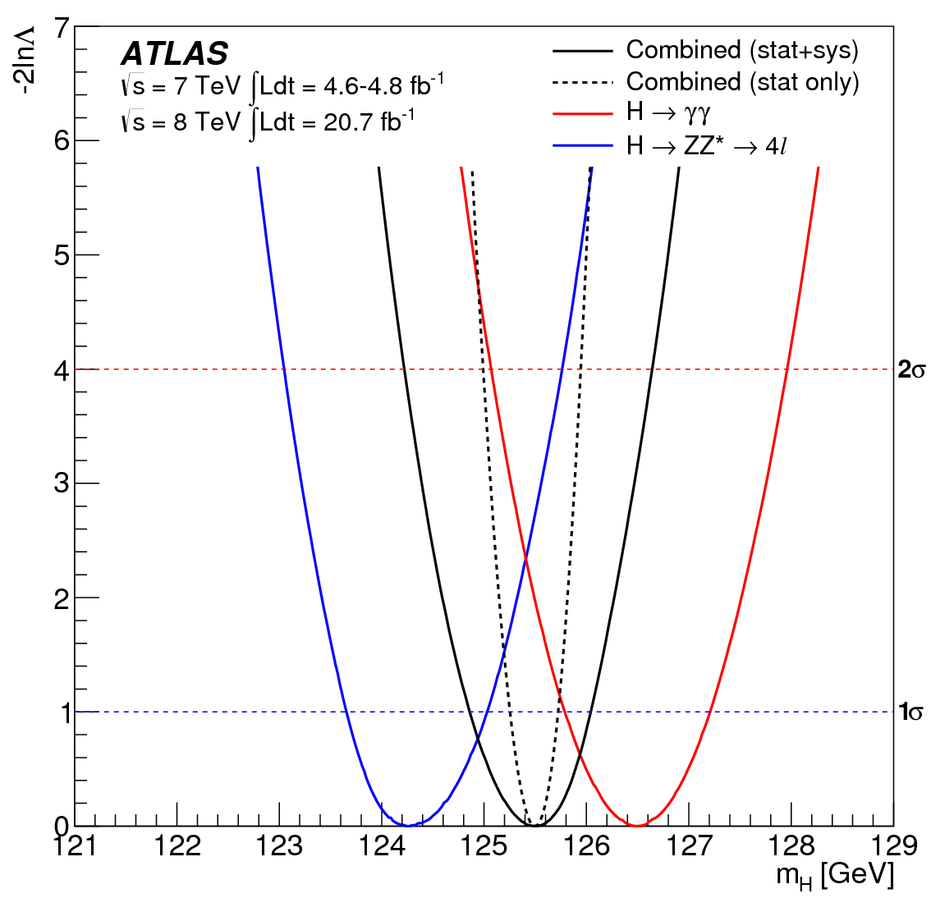
How much have we learned since then?
Mass: around 125GeV
Used to be the only unknown
SM-Higgs parameter, remember? ☺
ATLAS: arXiv:1307.1427
m_{H}^{H->4l} = 124.3 ±0.6(stat) ±0.5(sys)
m_{H}^{H->γγ} = 126.8 ±0.2(stat) ±0.7(sys)
Assuming single resonance:
m_{H} = 125.5 ±0.2(stat) ^{+0.5}_{-0.6}(sys)
Tension between channels!
Compatibility P=1.5% (2.4σ)
Rises to 8% with square syst.prior
CMS: arXiv:1312.5353
m_{H}^{H->4l} = 125.6 ±0.4(stat) ±0.6(sys)
Doesn’t look like two different resonances!...
ATLAS: arXiv:1307.1427
CMS (H->4l)

Slide 6
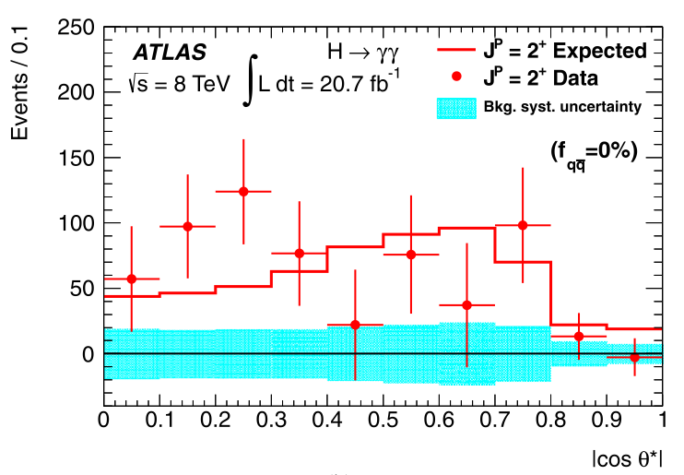
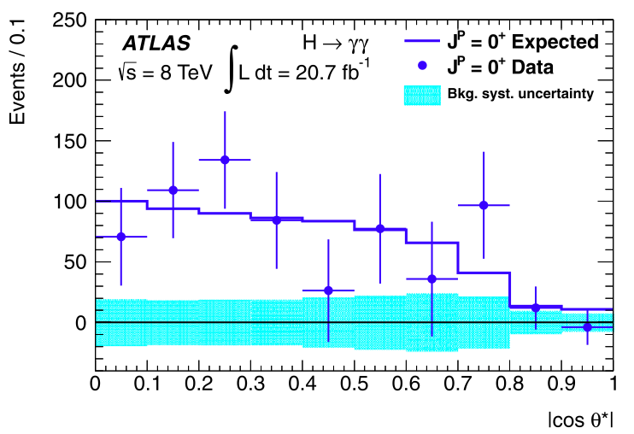
Spin and Parity
Pure J^{P} = 0⁻, 1⁺, 1⁻, and 2⁺ excluded with 97.8, 99.97, 99.7, and 99.9% Confidence Level (ATLAS arXiv 1307.1432)
But note: Higgs could have CP-violating component!
H->γγ – ATLAS arXiv 1307.1432

Slide 7
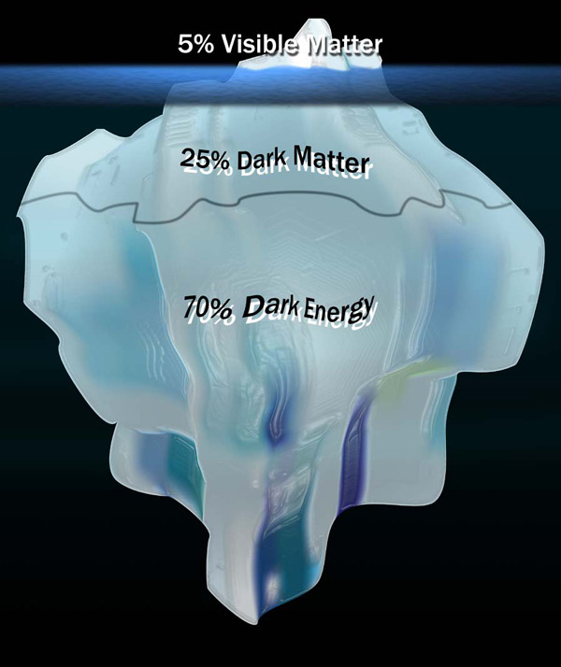
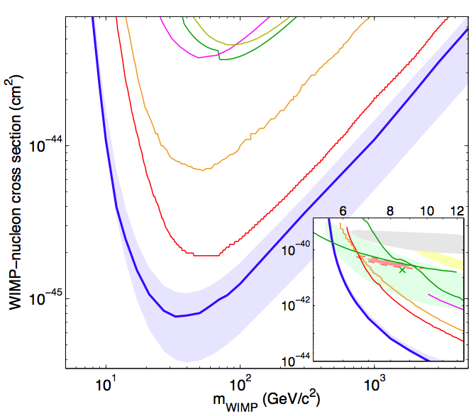
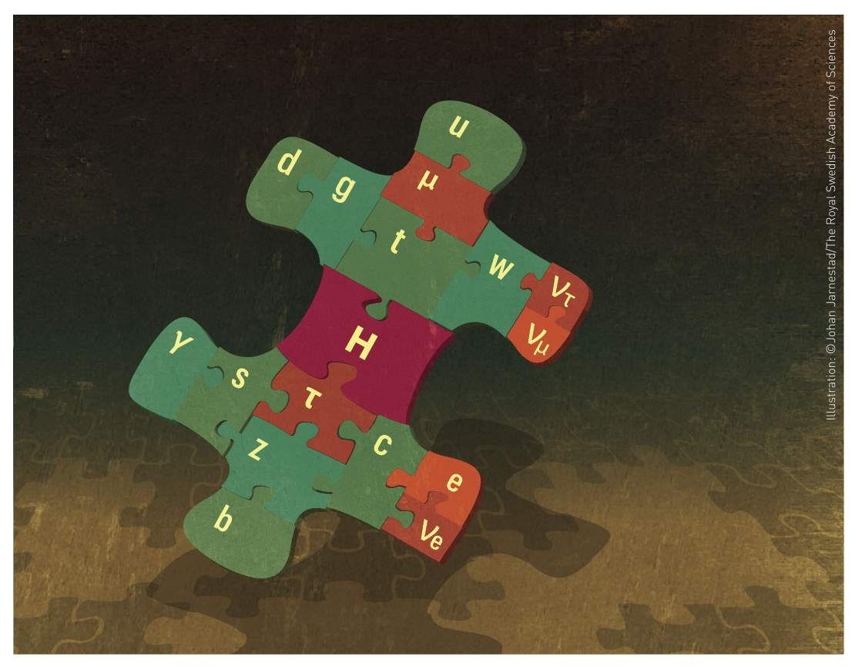
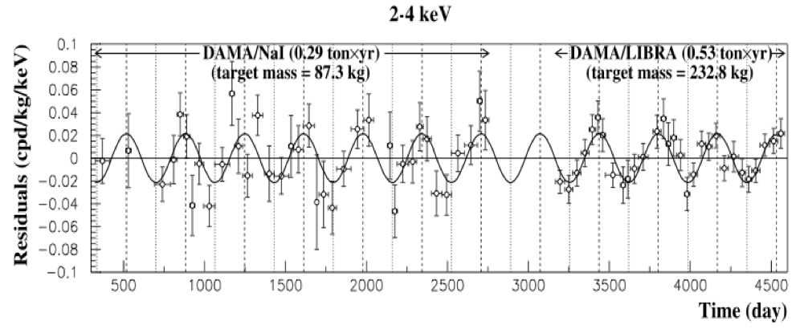
So, where do we stand?
LUX 1310.8214
We have found the missing piece of the Standard Model puzzle
The current data show us a SM-like Higgs boson
Each channel not so well measured
But combination fits well with expectations
Is this the end of the story?
DAMA 0804.2741
New Physics ➔ Modified Higgs sector(?)
Discovery ➔ Precision! (& a few more channels)

Slide 8
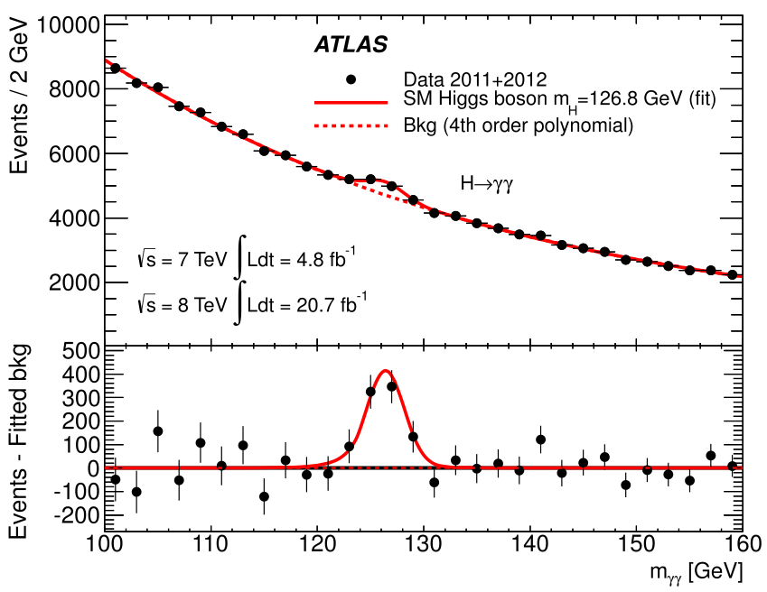
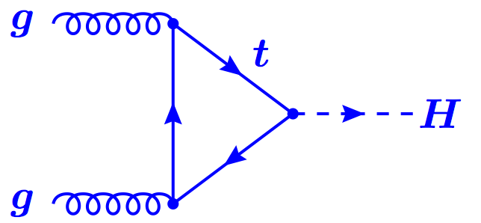
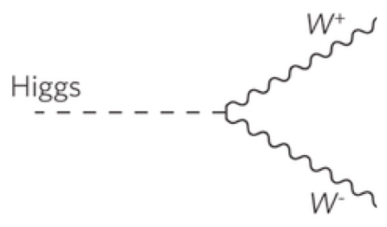
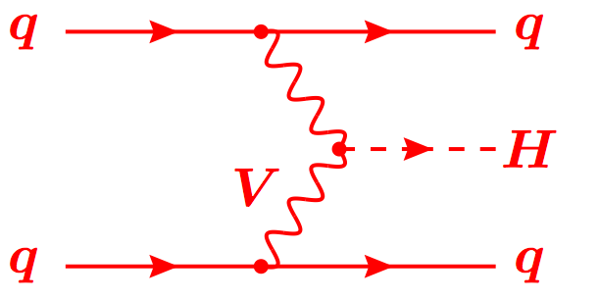
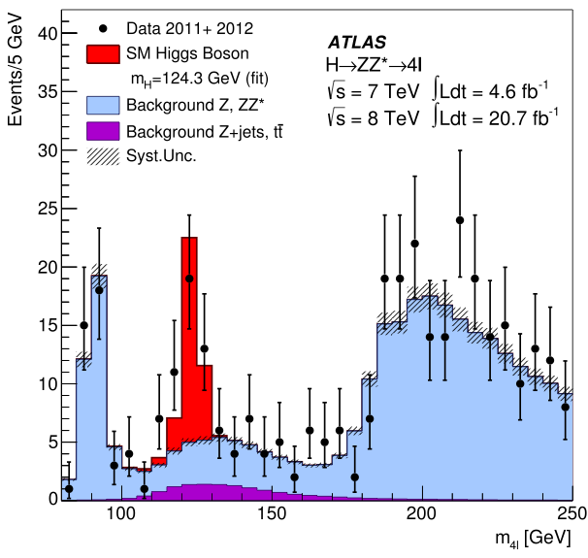
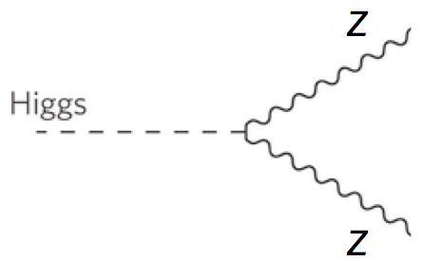
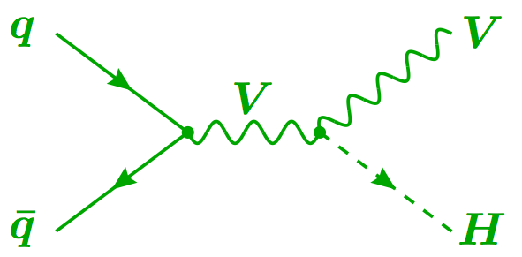
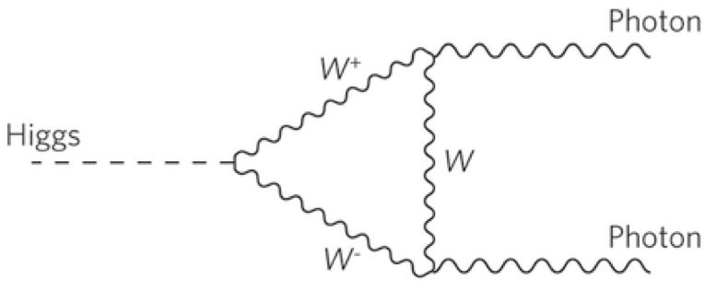
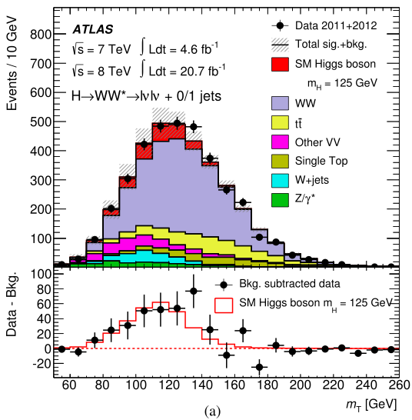
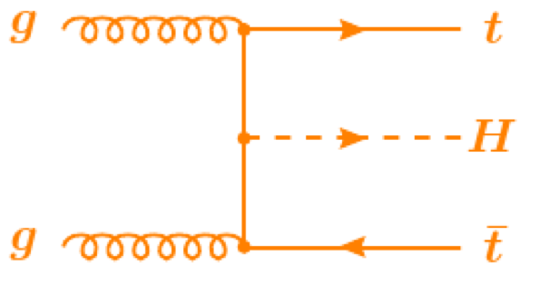
Combining Higgs Channels
Production
Decay
H->γγ
FIT
×
H->ZZ
H->WW
t
t
t
Backgrounds +

Slide 9
A bit more technically
Assumptions:
Single resonance (at m_{H} = 125.5GeV)
No modification of tensor structure of SM Lagrangian:
i.e. H has J^{P} = 0⁺
Narrow width approximation holds
i.e. rate for process i ➔ H ➔ f is:
Free parameters in framework:
Coupling scale factors: κ_{j}²
Total Higgs width: κ_{H}²
Or ratios of coupling scale factors: λ_{ij} = κ_{i} / κ_{j}
Tree-level motivated framework
Useful for studying deviations in data with respect to expectations
E.g. extract coupling scale factor to weak bosons κ_{V} by setting κ_{W} = κ_{Z} = κ_{V}
Not same thing as fitting a new model to the data

Slide 10
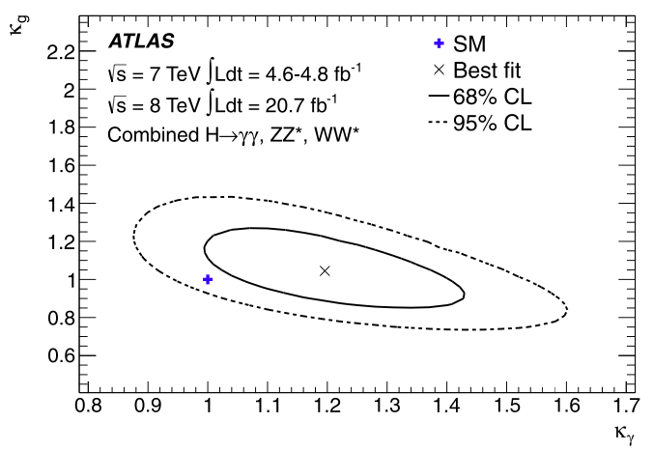
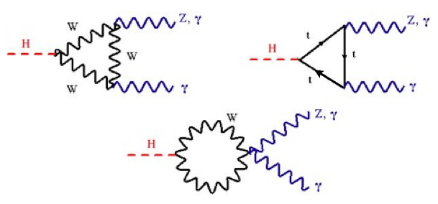
New Physics in the Loops?
W
New heavy particles may show up in loops
Dominant gluon-fusion through a (mostly) top loop production for H->ZZ, H->WW and H->γγ
H->γγ decay through top and W loops (and interference)
Assume no change in Higgs width and SM couplings to known particles
Introduce effective coupling scale factors:
κ_{g} and κ_{γ} for ggH and Hγγ loops
W
t
t
t
ATLAS 1307.1427
Best fit values: κ_{g} = 1.04 ± 0.14, κ_{γ} = 1.20 ± 0.15
Fit within 2σ of SM (compatibility P=14%)

Slide 11
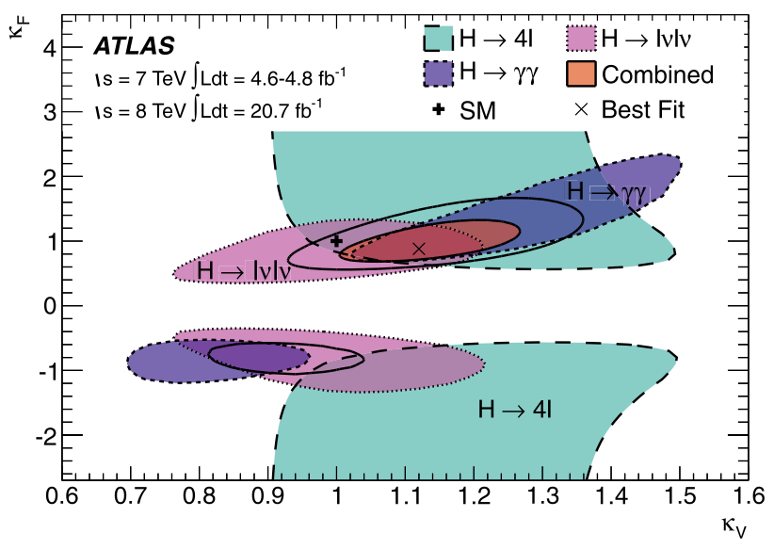
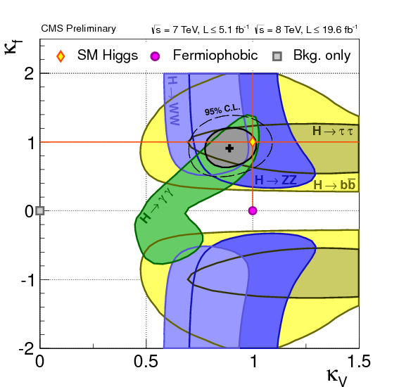
Fermion and Boson couplings from fit
Set one scale factor for all fermions (κ_{F} = κ_{t} = κ_{b}= κ_{τ} =…) and one for all vector bosons (κ_{V} = κ_{Z} = κ_{W})
Assume no new physics
Strongest constraint to κ_{F} comes form gg->H loop
ATLAS and CMS fits within 1-2σ of SM expectation (compatibility P=12%)
Note ATLAS and CMS κ_{V} different – see signal strength below
ATLAS 1307.1427
CMS public page

Slide 12
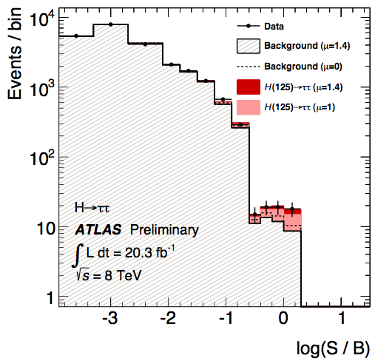
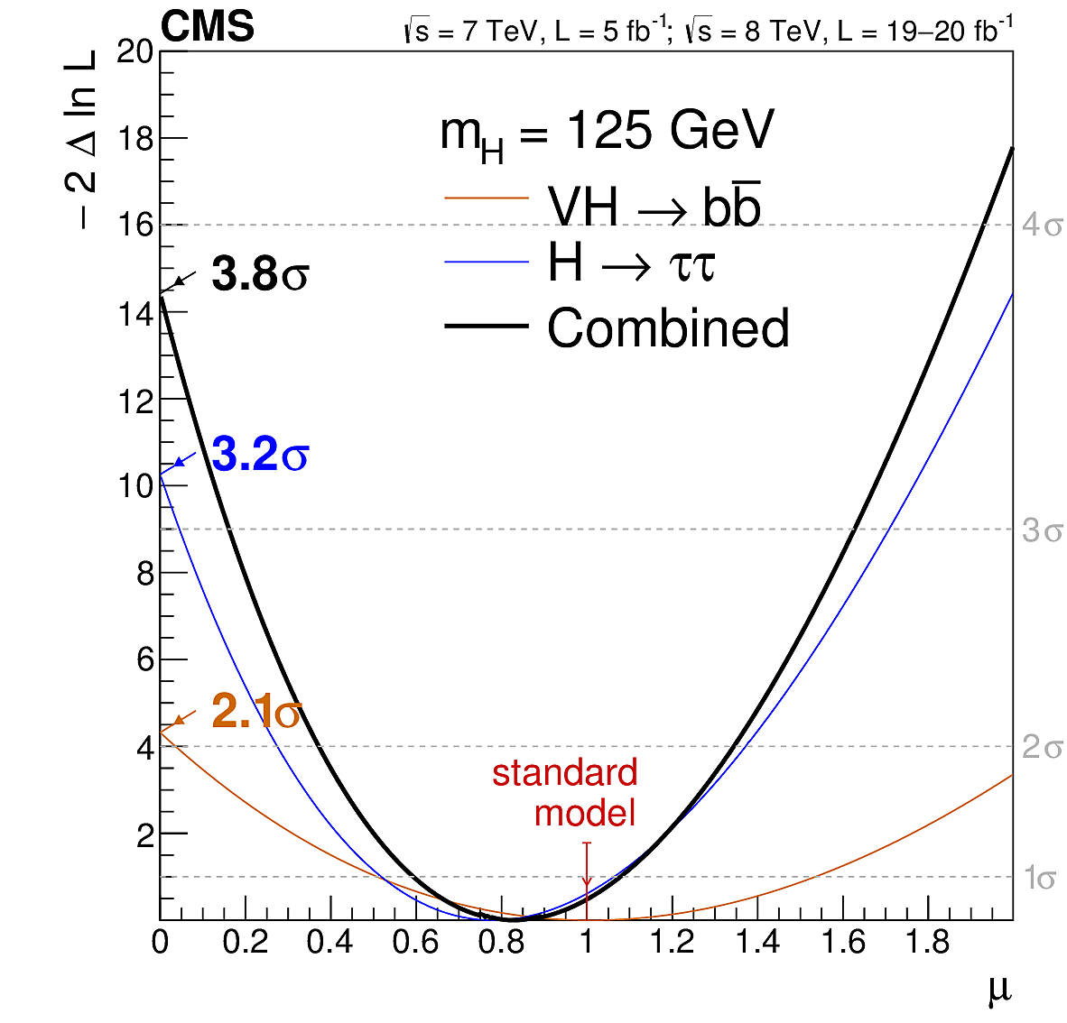
Direct Evidence of Fermion Couplings
Challenging channels at the LHC!
Huge backgrounds (H->bb,H->ττ)
Or low rate: H->μμ
New results!
ATLAS:
4.1σ evidence of H->ττ decay 3.2σ exp.
μ = σ_{obs.}/σ_{SM} = 1.4 ±0.3(stat) ±0.4(sys)
CMS: hot off the press!
Combination of H->bb and H->ττ:
3.8σ evidence (obs.) 4.4σ (expected)
μ = σ_{obs.}/σ_{SM} = 0.83 ±0.24
ATLAS-CONF-2013-108
CMS 1401.6527
CMS 1401.6527

Slide 13
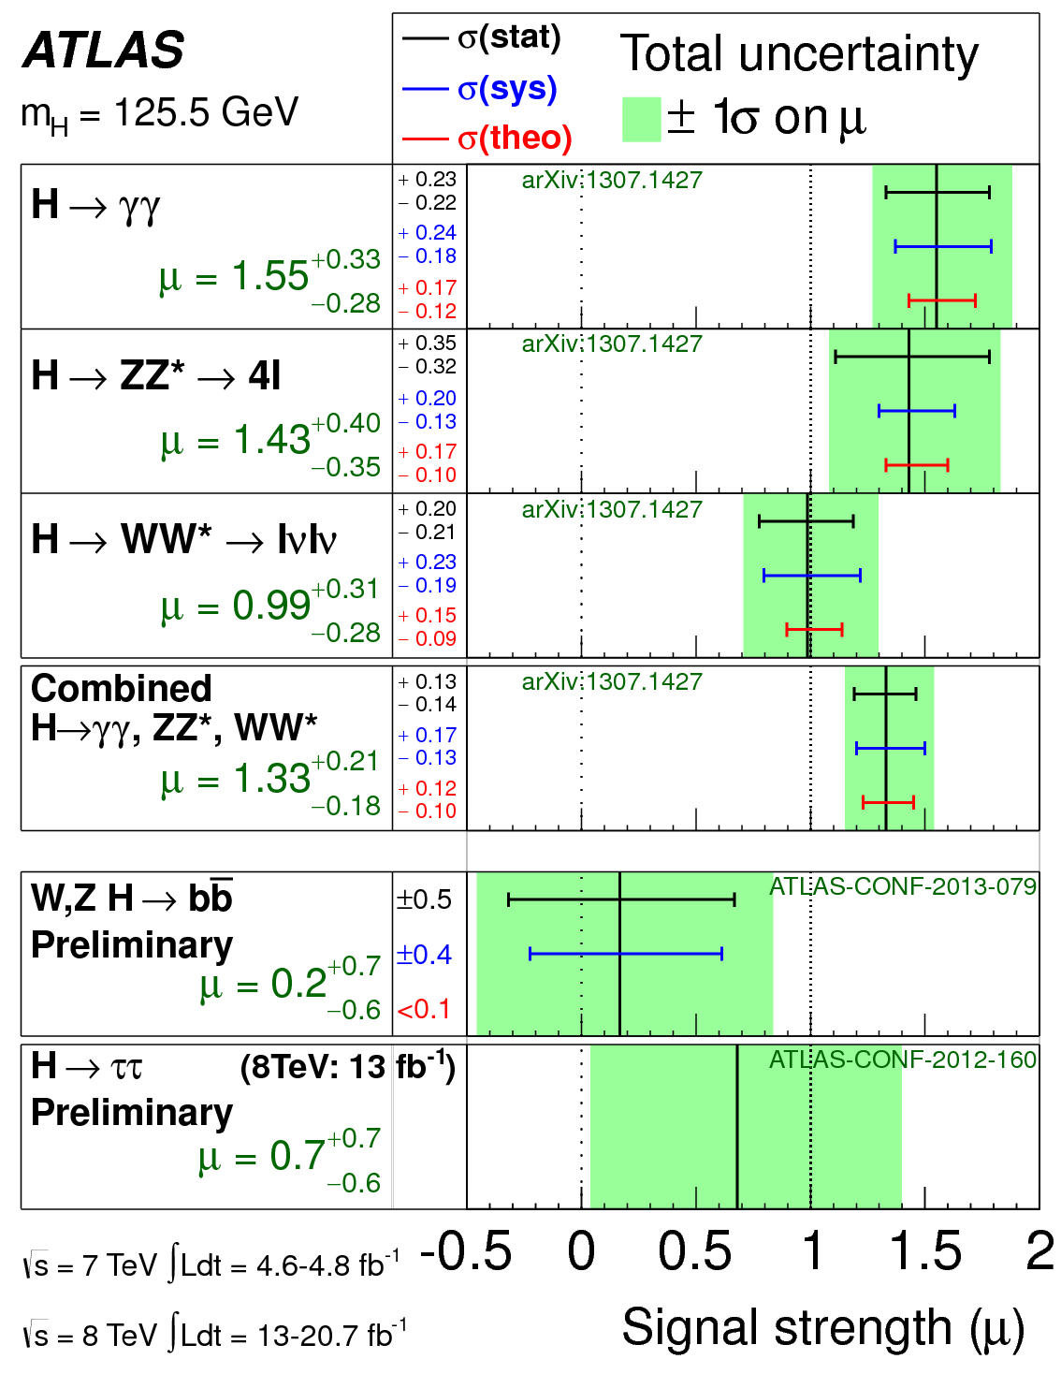
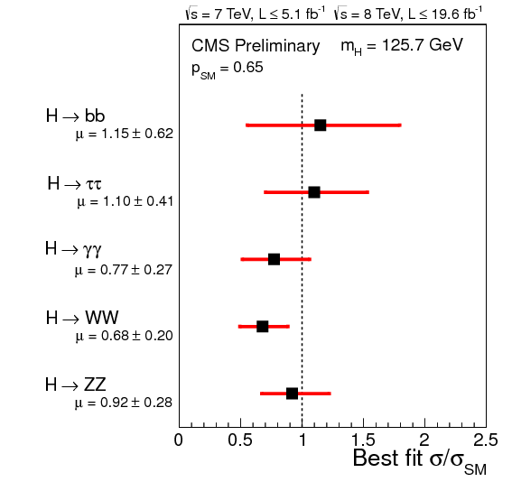
Signal Strength
Signal strength: μ = σ_{obs.}/σ_{SM}
ATLAS: global excess in H->γγ and H->ZZ
μ = 1.33 ±0.14(stat) ±0.15(sys)
Largest deviation in H->γγ (1.9σ)
When H->bb and (old) H->ττ added:
μ = 1.33 ±0.14(stat) ±0.15(sys)
CMS: under-fluctuation in H->WW/γγ
ATLAS-CONF-2013-079
CMS public page
Update: μ = 1.4 ^{+0.5}_{-0.4}
ATLAS-CONF-2013-108

Slide 14
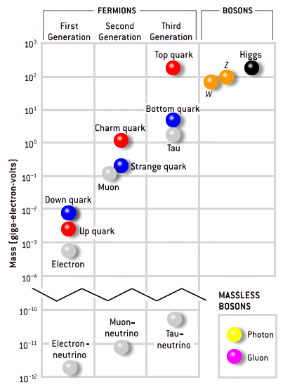
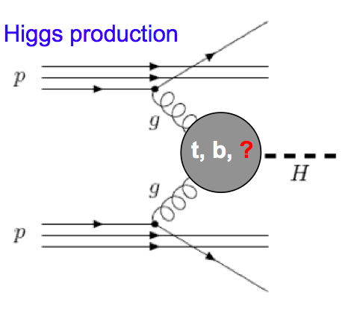
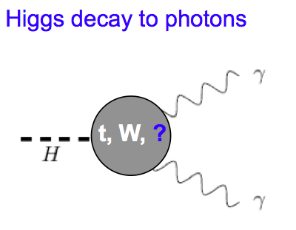
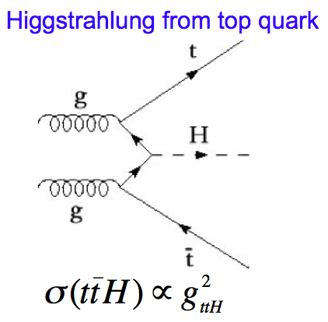
A favourite of mine: ttH
Indirect constraints on top-Higgs Yukawa coupling from loops in ggH and ttH vertices
Assumes no new particles contribute to loops
Top-Higgs Yukawa coupling can be measured directly
Allows probing for New Physics contributions in the ggH and γγH vertices
Top Yukawa coupling Y_{t} = √2M_{t}/vev = 0.996±0.005
Does this mean top plays a special role in EWSB?

Slide 15
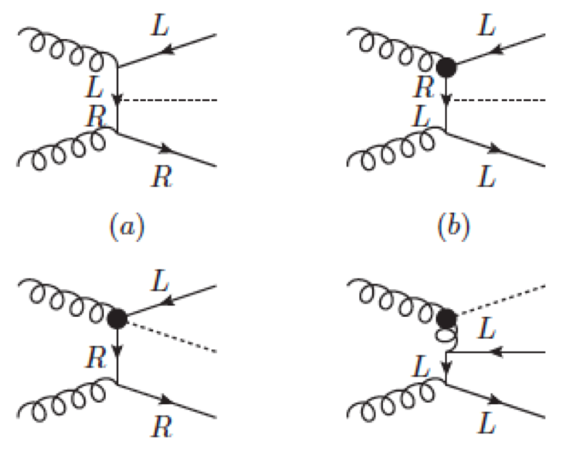
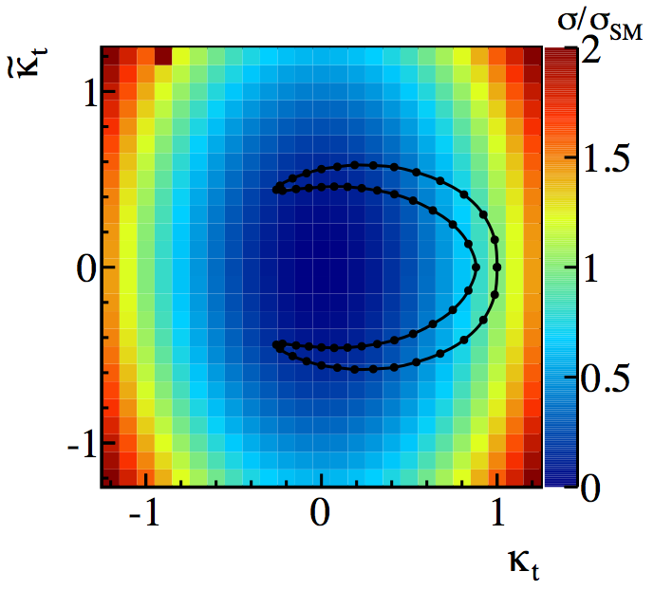
Sensitivity to New Physics
Degrande et al. arXiv:1205.1065
Effective top-Higgs Yukawa coupling may deviate from SM due to new higher-dimension operators
Change event kinematics – go differential!
ttH sensitive new physics: little Higgs, composite Higgs, Extra Dimensions,…
In the presence of CP violation, Higgs-top coupling have scalar (κ_{t})and pseudoscalar (˜κ_{t})components
Strong dependence on ttH cross section
Note: Indirect constraints from electron electric dipole moment not taken into account (give |˜κ_{t}| < 0.01)
Ellis et al. arXiv:1312.5736

Slide 16
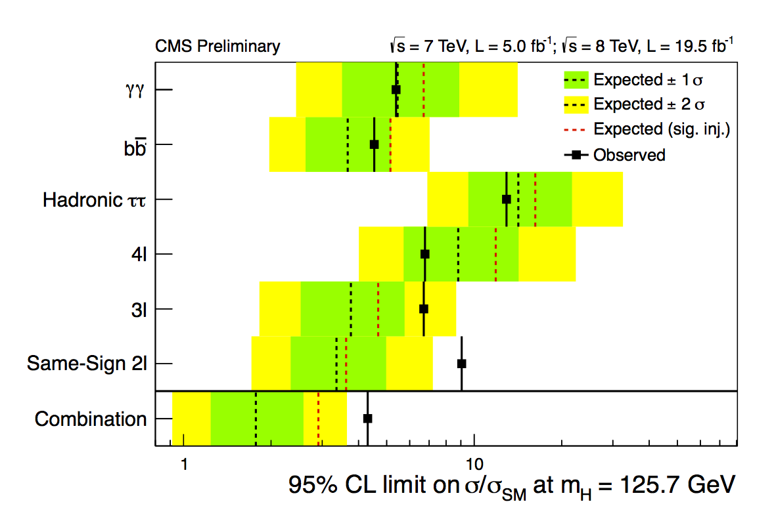
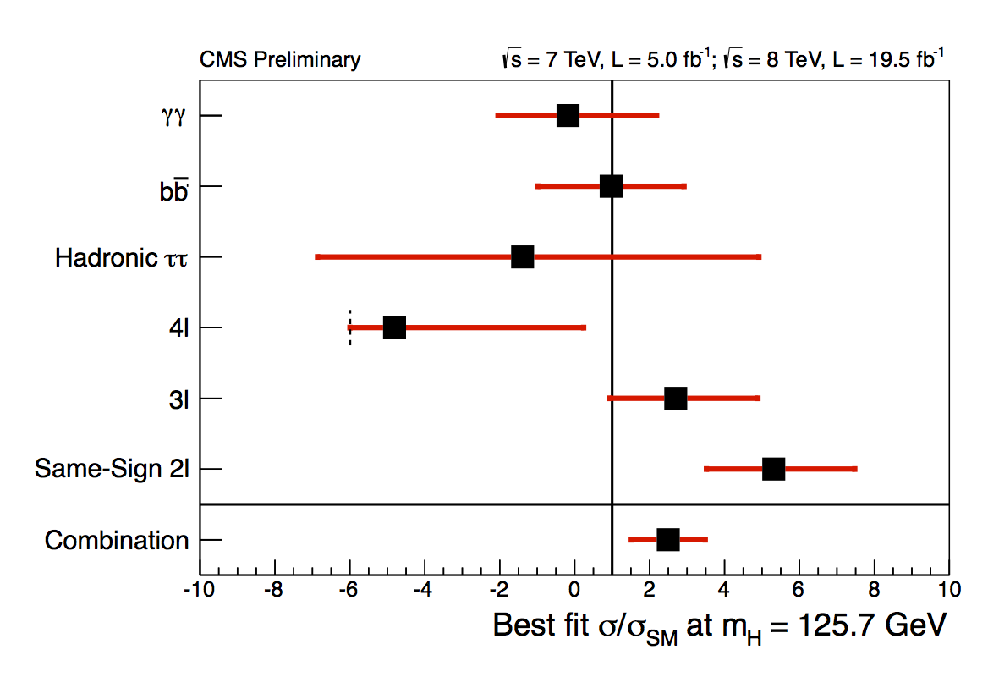
Status: latest ttH results from CMS
Combination of H -> bb, H -> ττ, H -> γγ and multilepton (H->WW/ZZ)
HIG-12-035, HIG-13-015, HIG-13-019, CMS public page
No statistically significant excess over background predictions
Need LHC run II data!

Slide 17
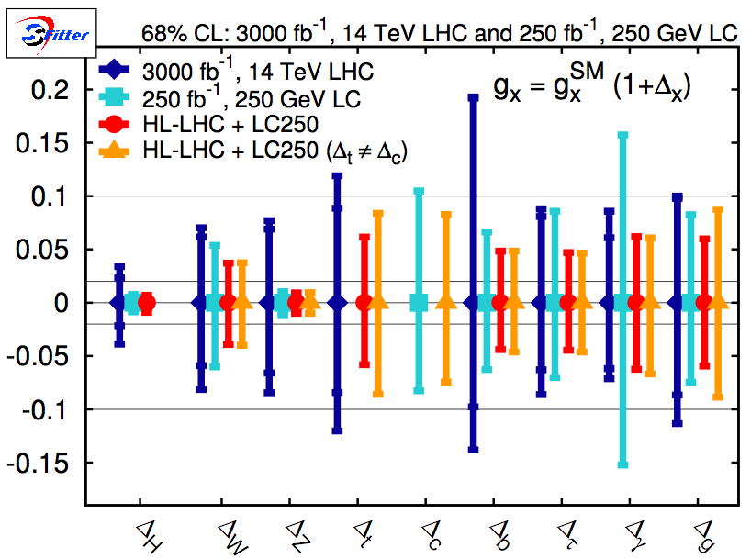
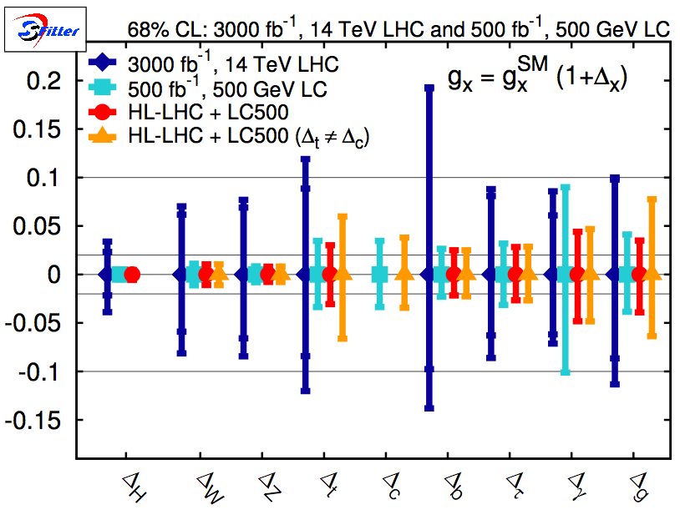
The Far Future
High-Luminosity LHC plus Linear Collider are “dream team” for Higgs properties!
LHC (√s=14TeV and L=3000fb⁻¹) systematics limited
Total width only at Linear Collider (√s=250GeV, L=250fb⁻¹: ≈10% accuracy)
2nd generation couplings (Δ_{c}, Δ_{μ}) challenging at LHC but possible at LC
Δ_{top} opens up for LC500 (√s=500GeV, L=500fb⁻¹): ≈3-7% from HL-LHC + LC500
Precision of HL-LHC + LC limited by LC statistical uncertainty, not systematics!
Klute et al, arXiv: 1301.1322

Slide 18
Conclusions & Outlook
Milestone discovery (finally!) opened field of Higgs properties
Measurement precision increasing but still limited
So far it looks like it says in the SM book… but we like surprises!
New results from challenging fermion channels
Will benefit enormously from future LHC data!
New Physics is out there!
Aim for precision analyses: can constrain a lot of model space
Look at more difficult SM channels: ttH, VH->Vbb, H->ττ, H->μμ
Keep looking for Beyond SM Higgs signals
Will benefit enormously from future LHC data! (did I mention this?)
Don’t forget longer term
HL-LHC + Linear Collider are our dream team

Slide 19
Bonus slides

Slide 20
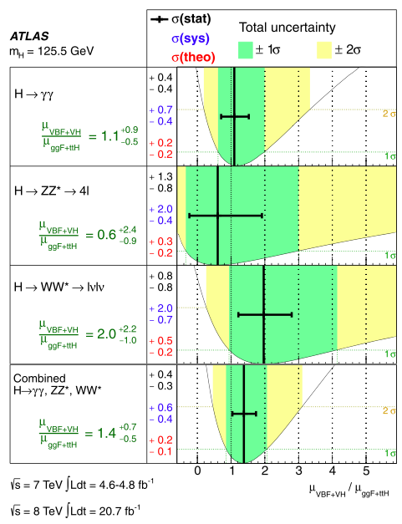
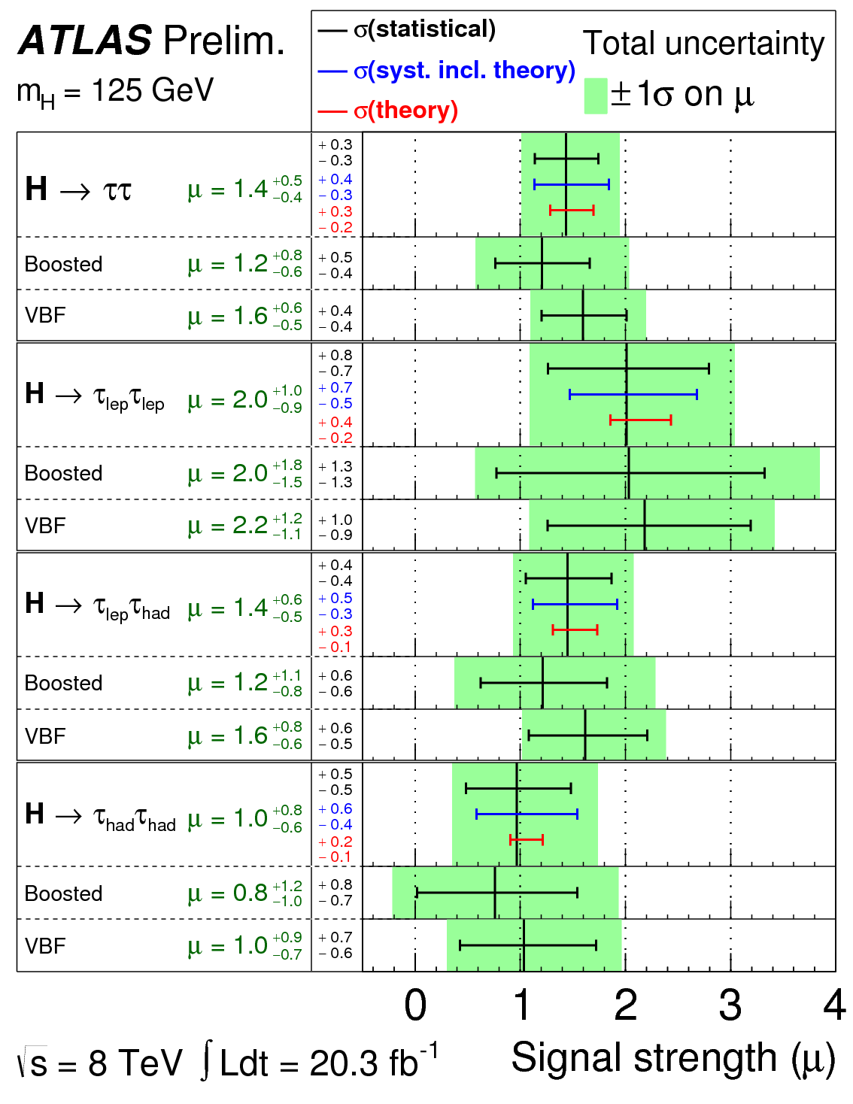
http://cds.cern.ch/record/1563235
ATLAS-CONF-2013-108

Slide 21
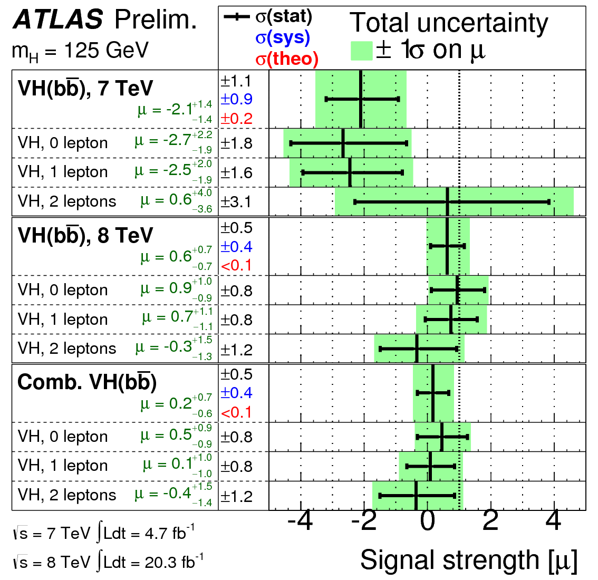
http://cds.cern.ch/record/1563235

Slide 22
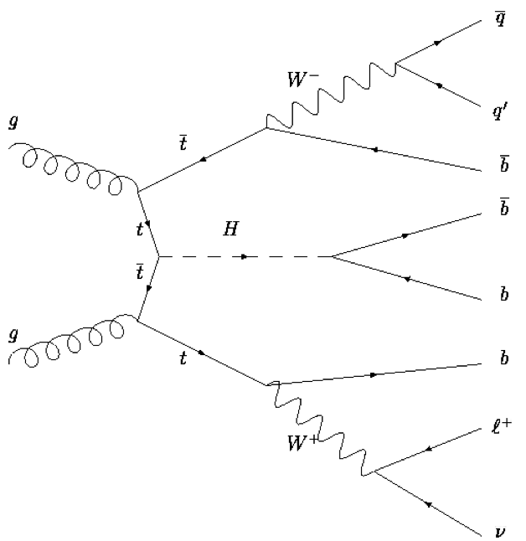
ATLAS Analysis – lepton+jets
Cut-based analysis
For ≥6 jets & ≥3 b-tags:
Use m_{bb}, as discriminating variable
Kinematic fit to reconstruct ttbar
Use leftover b-jets for H->bb
Elsewhere: use H_{T}^{had} (scalar sum of jet p_{T})
Fit Signal and Background regions to get limits
Get final background normalizations and systematic uncertainties (“nuisance parameters”) from fit to data – profiling
Use control regions to check fit is ok
2 light jets (mostly)
Up to 4 b-tags
e or μ, E_{T}^{miss} , M_{T}^{W}
 | 0 b-tags | 1 b-tag | 2 b-tags | 3 b-tags | ≥4 b-tags
4 jets | H_{T}^{had} | H_{T}^{had} | H_{T}^{had}
5 jets | H_{T}^{had} | H_{T}^{had} | H_{T}^{had} | H_{T}^{had} | H_{T}^{had}
≥6 jets | H_{T}^{had} | H_{T}^{had} | H_{T}^{had} | m_{bb} | m_{bb}
Signal
Background
Control regions

Slide 23
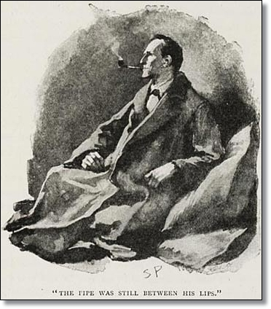
Direct BSM Higgs Searches (ATLAS)
FCNC in t→cH, H→γγ - upper limit on BR: Obs.(Exp.): 0.83%(0.53%) x SM for 125 GeV at 95% CL [ATLAS-CONF-2013-081]
H→ZZ→llνν: Excl. 320 - 560 GeV [ATLAS-CONF-2012-016]
H→ZZ→llqq: Excl. 300 - 310, 360 - 400 GeV. at 145 GeV 3.5 x SM [ATLAS-CONF-2012-017]
H→WW→lνjj: at 400 GeV Obs.(Exp.) 2.3(1.6) x SM [ATLAS-CONF-2012-018]
Higgs in SM with 4th fermion generation: model ruled out [ATLAS-CONF-2011-135]
Fermiophobic H to diphoton Model ruled out [ATLAS-CONF-2012-013]
MSSM neutral H [JHEP: JHEP02(2013)095]
NMSSM a1 to μμ [ATLAS-CONF-2011-020]
NMSSM H to a0a0 to 4γ [ATLAS-CONF-2012-079]
H±→ cs [EPJC73 (2013) 2465]
2HDM WW(lvlv) [ATLAS-CONF-2013-027]
'It is an old maxim of mine that when you have excluded the impossible, whatever remains, however improbable, must be the truth.'
Sherlock Holmes
-The Beryl Coronet

Slide 24
Lateral Thoughts

Slide 25
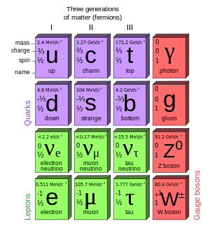
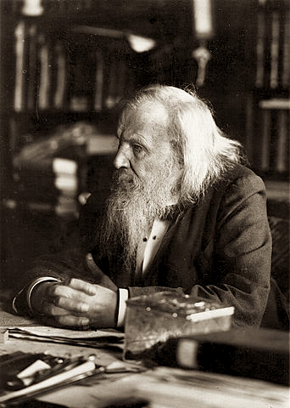
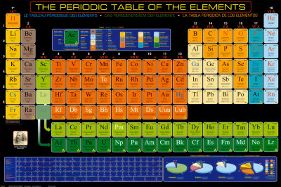
Many questions…
Higgs mechanism says how to give mass to fundamental particles
It doesn’t say why fermion masses and Yukawa couplings are so different: 10⁻¹⁰GeV (ν) – 10²GeV (t)
Top mass at the EW scale. Does it play a special role in breaking it?
(And by the way… why 3 families of leptons and quarks?)
What is the underlying theory?
Eh! Eh! Eh! Been there, done that!

