Slide 1



Higgs Boson Searches in the H➞bb channels in ATLAS
Ricardo Gonçalo
Royal Holloway, University of London
On behalf of the ATLAS Collaboration
New Worlds in Particle and Astroparticle Physics
Pavilhão do Conhecimento, Lisboa, December 2012

Slide 2


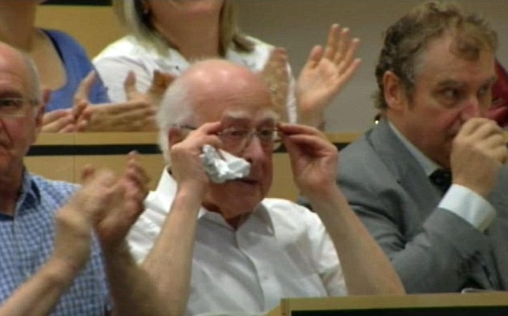


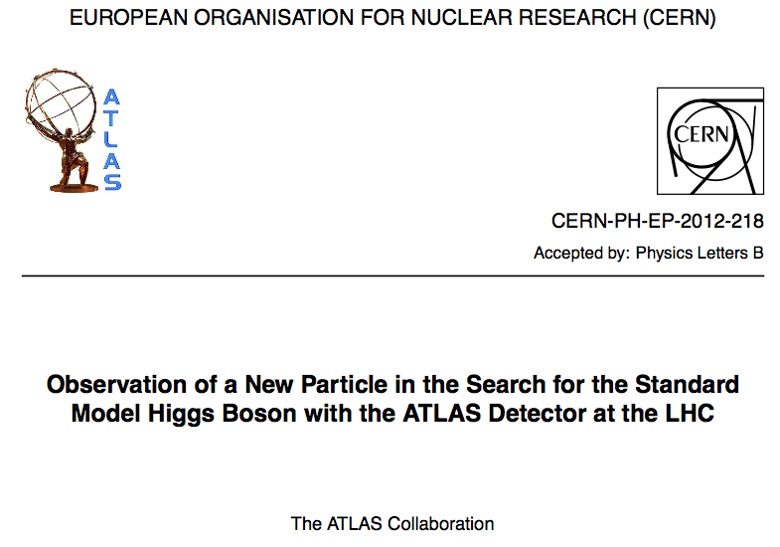

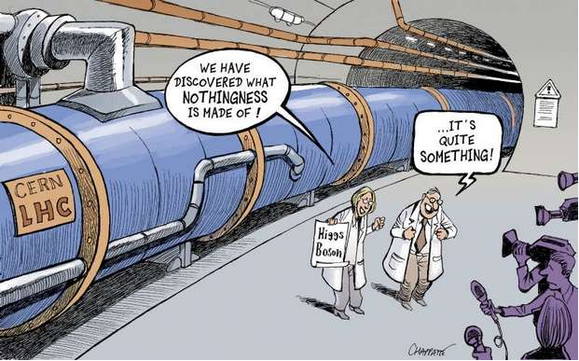
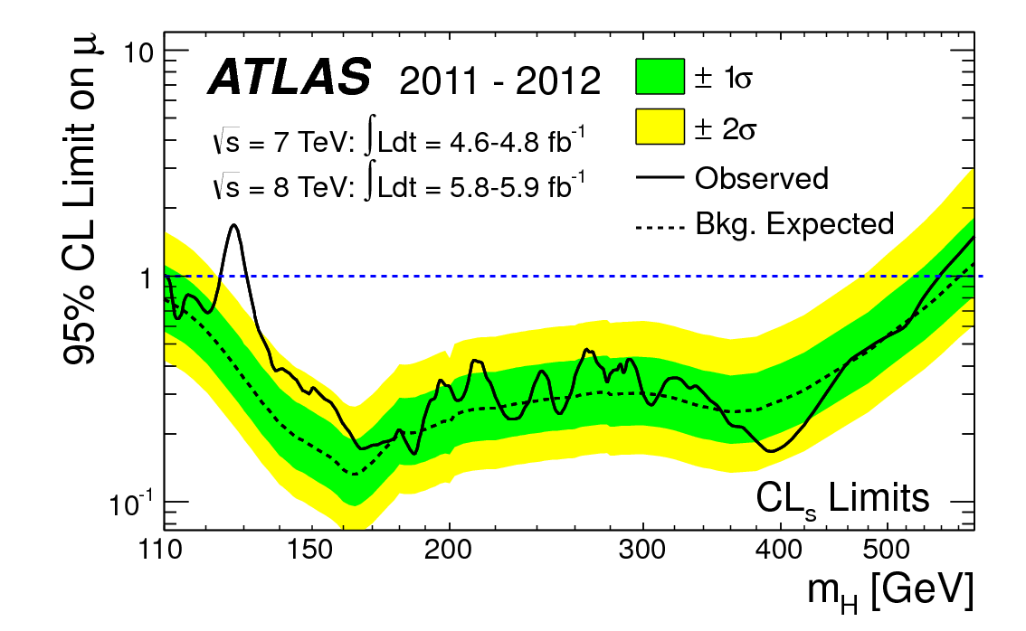

The story so far… we found a Higgs-like boson! ☺

Slide 3
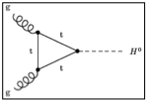
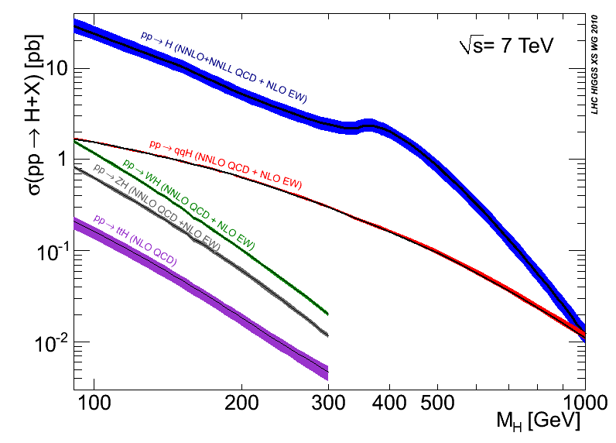
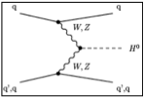
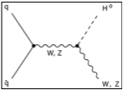
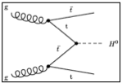
6 months ago: ICHEP 2012
1 ½ year ago: EPS 2011
CERN-2011-002; arXiv:1101.0593
Disfavoured by EW precision fits
Disfavoured by EW precision fits
Excluded by LHC
Excluded by LHC
Excluded by LEP
Excluded by Tevatron
Notes:
Main production channels: gluon fusion, Vector Boson Fusion, associated production with vector bosons, associated production with ttbar pair
Animation

Slide 4
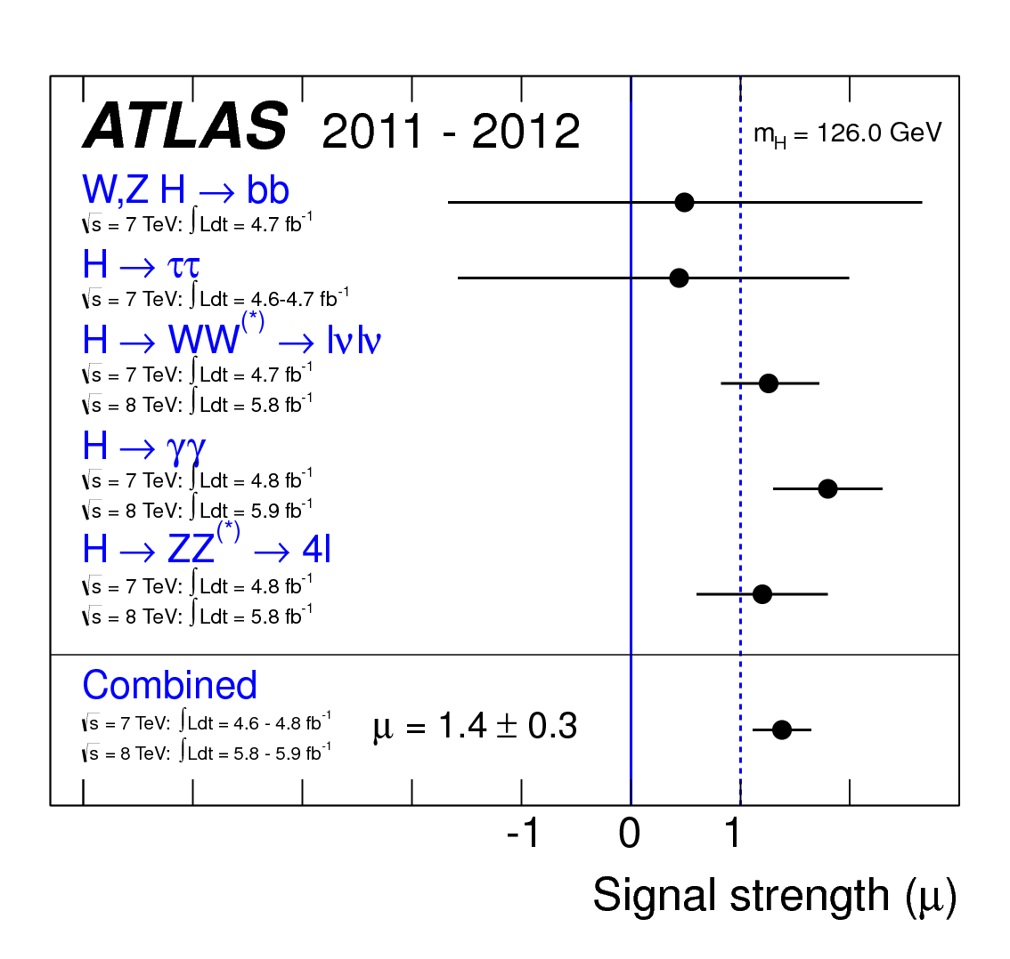
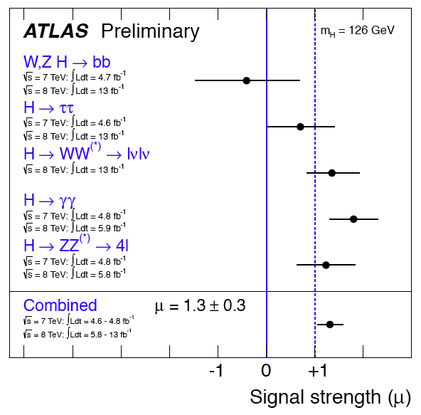
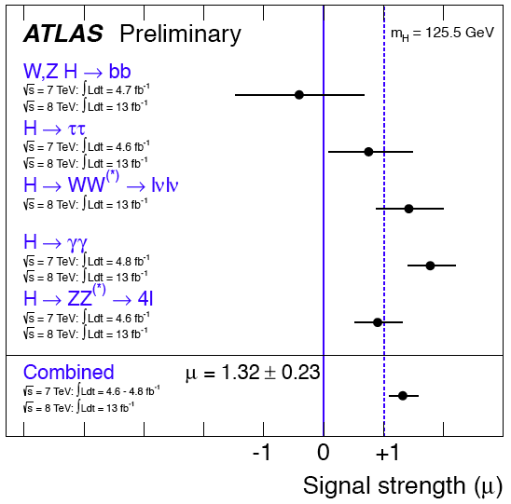
5σ – discovery! Announced on 4th of July independently by ATLAS and CMS!!
  Now up to ≈7σ … no doubts left!!
Clear excess only in bosonic decay channels: esp. H➞ZZ, H➞γγ, but also H➞WW
Hints of H➞ττ from LHC; 3σ evidence from Tevatron for H➞bb and hints from CMS
Data analysed:
  4.8 fb⁻¹ @7TeV & 13 fb⁻¹ @8TeV
  Another ≈10 fb⁻¹ waiting to be analysed! ☺
The 6 billion Swiss Franc question (Plus M&O…):
Is this THE Standard Model Higgs?...
Or something even more interesting?
SM Higgs search is a great way to search for new physics!
See e.g. talks by Andre David and Patricia Conde-Muiño yesterday

Slide 5

Why H➞bb ?
H ➞ bb is essential to answer this new big question!
  Direct sensitivity to Higgs couplings to fermions
  Largest SM Higgs BR (58% at ≈125GeV) – help constrain total width
  Measure top Yukawa coupling directly – largest in SM
  Challenging backgrounds: use associated production with W, Z, tt
This talk: VH results from 7 and 8 TeV and ttH for 7TeV

Slide 6
ttH analysis of
7 TeV data

Slide 7
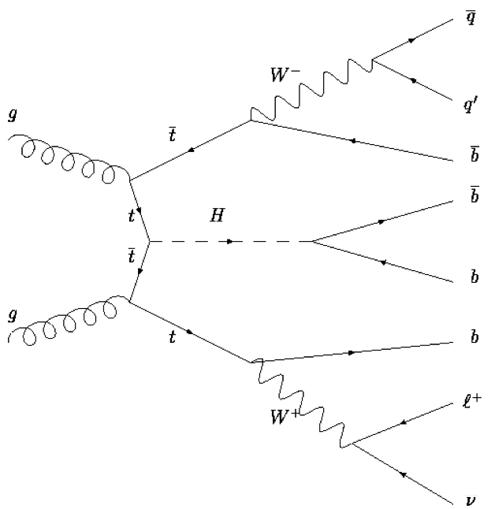
ttH, H➞bb Analysis
Challenging analysis!
  High combinatorial background
  Small signal cross section
  Data: 4.7fb⁻¹ at √s = 7 TeV (2011)
    ATLAS-CONF-2012-135: https://cdsweb.cern.ch/record/1478423
9 categories based on jet & b-tag multiplicity
  Signal enriched: (5 jets, ≥6 jets) x (3,≥4 b-tag)
  Other categories are background enriched to constrain those backgrounds
Final discriminants
  m_{bb} for ≥6 jets and (≥3 b-tag) categories
    Do kinematic fit to reconstruct tt+H➞bb
  H_{T}^{had} (∑p_{T,jet}) for other categories
Backgrounds constrained in limits fit by profiling nuisance parameters
To check fit control regions are used
2 light jets (mostly)
Up to 4 b-tags
e or μ, E_{T}^{miss} , M_{T}^{W}
 | 0 b-tags | 1 b-tag | 2 b-tags | 3 b-tags | ≥4 b-tags
4 jets | H_{T}^{had} | H_{T}^{had} | H_{T}^{had}
5 jets | H_{T}^{had} | H_{T}^{had} | H_{T}^{had} | H_{T}^{had} | H_{T}^{had}
≥6 jets | H_{T}^{had} | H_{T}^{had} | H_{T}^{had} | m_{bb} | m_{bb}
Signal
Background
Control regions

Slide 8
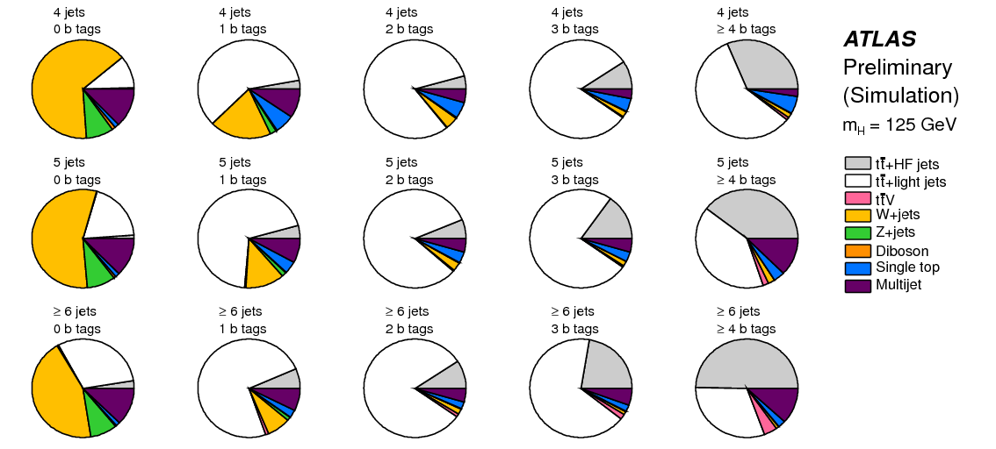
ttH, H➞bb Analysis

Slide 9
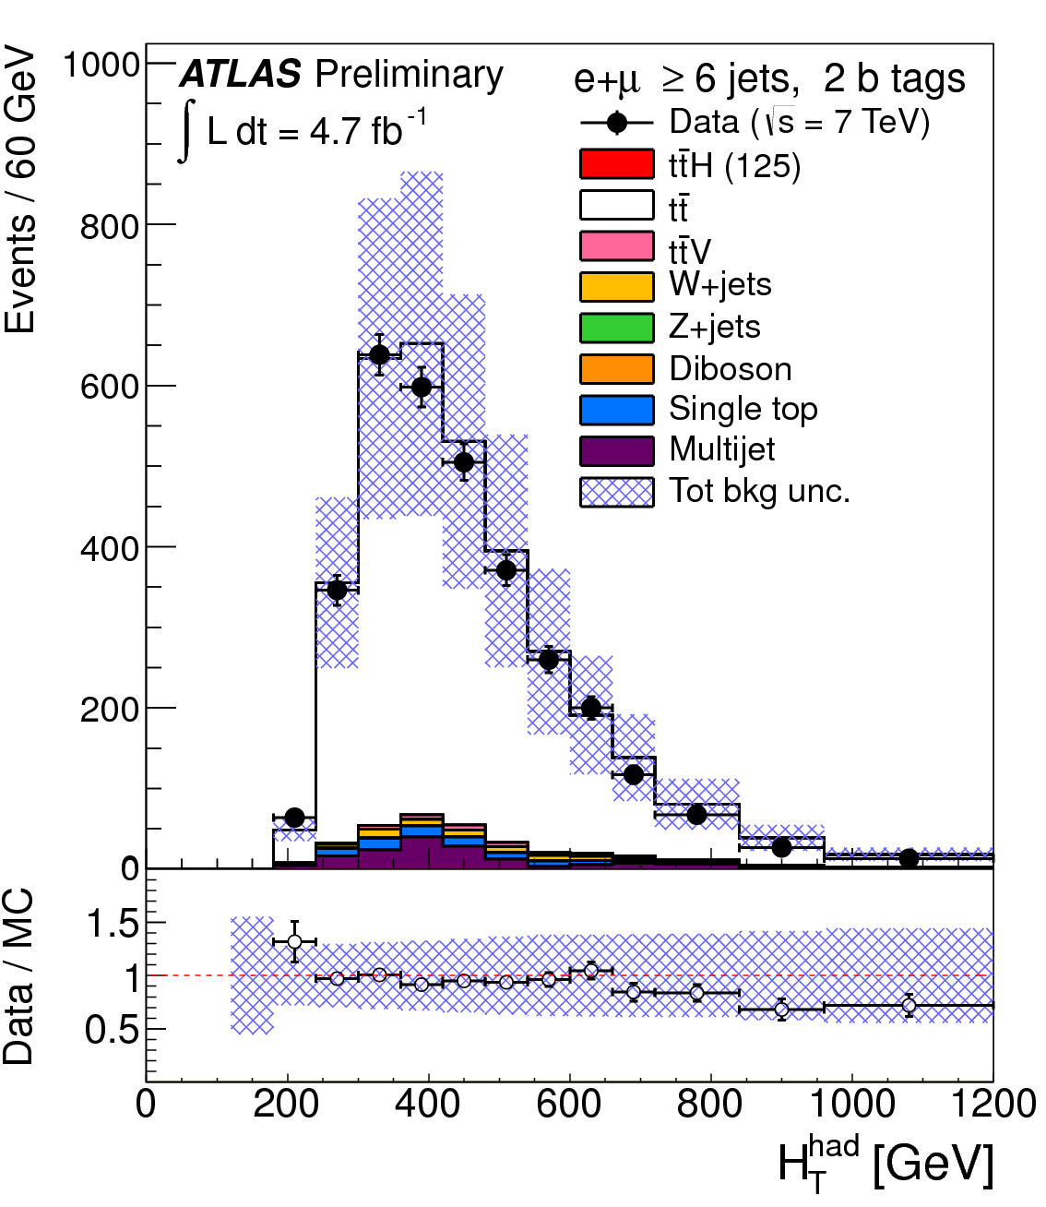
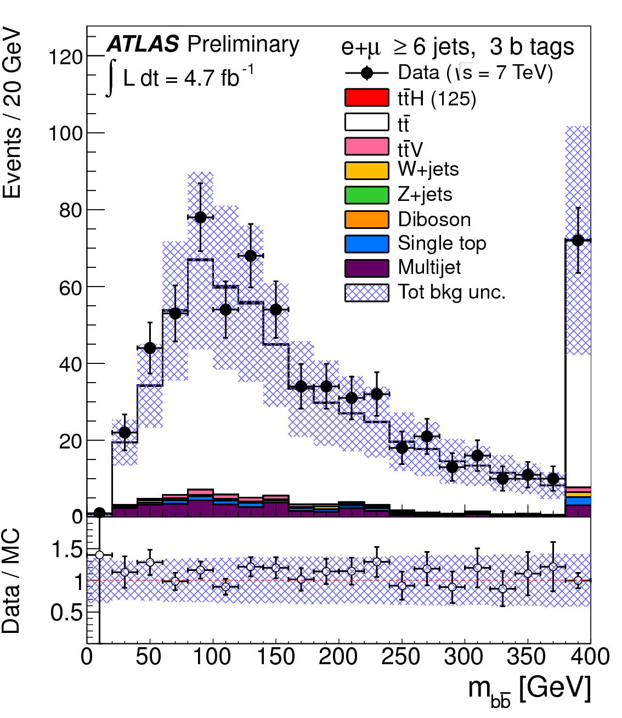
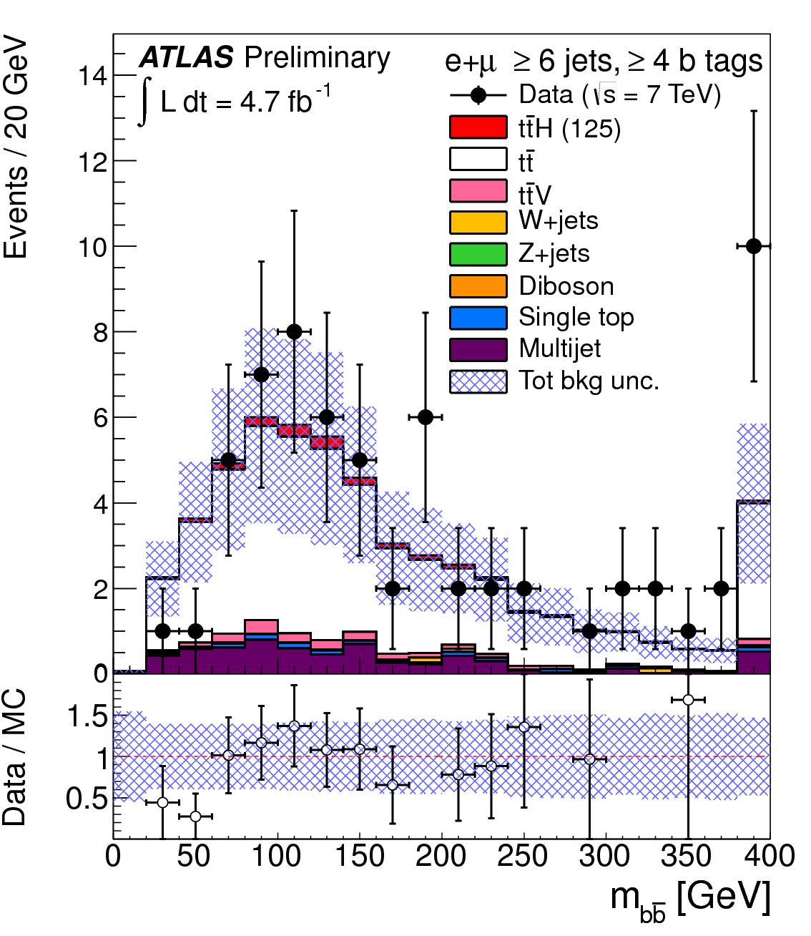
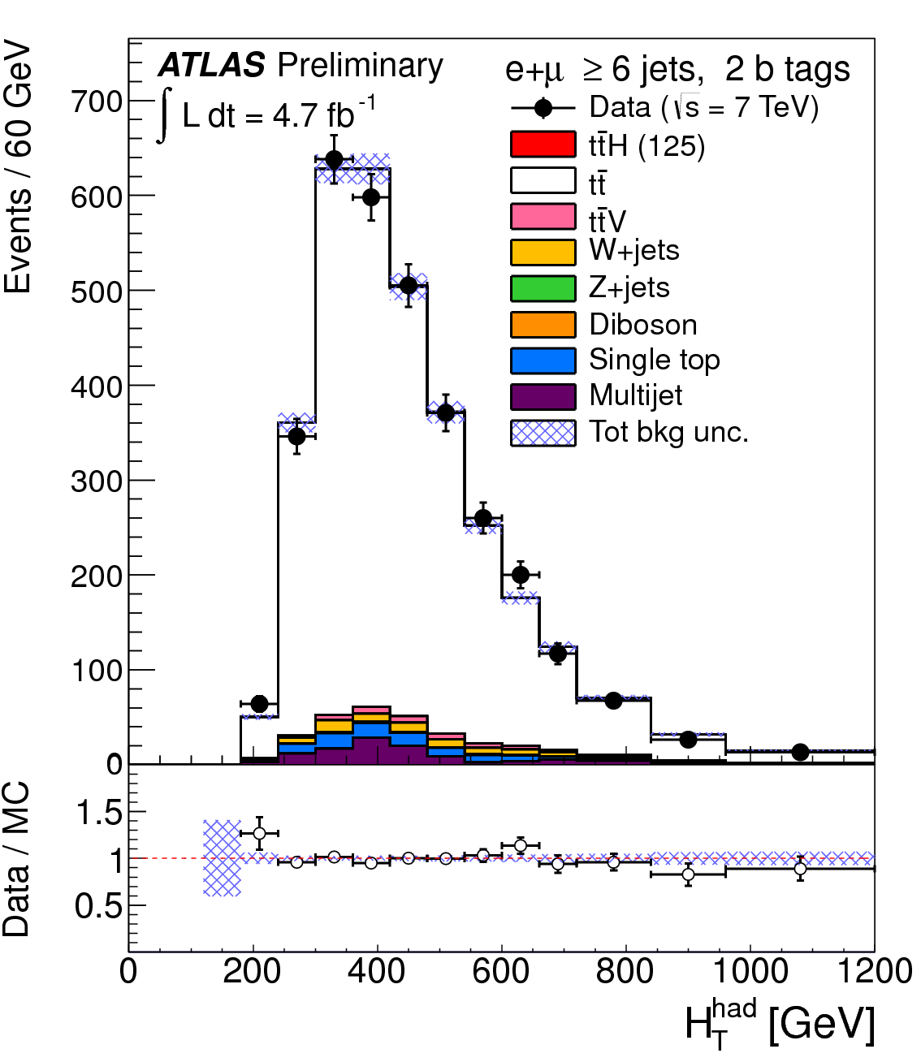
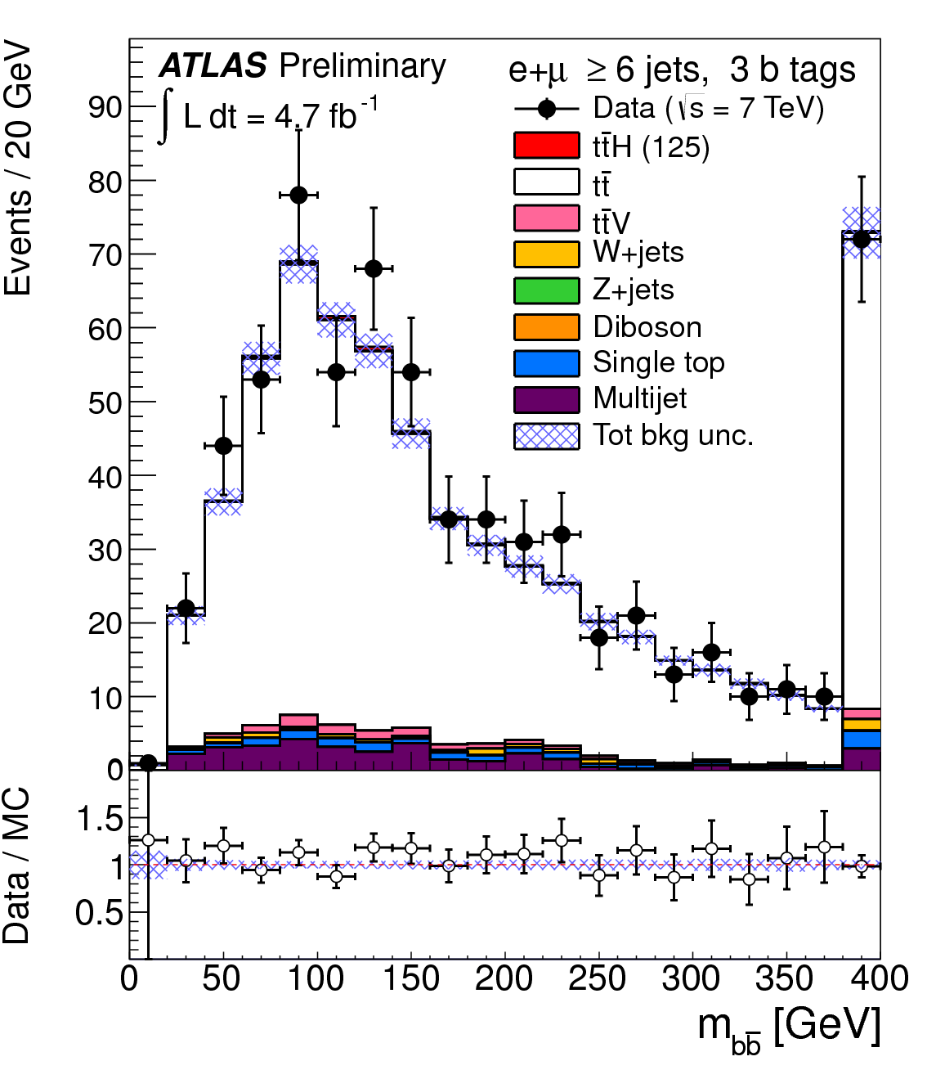
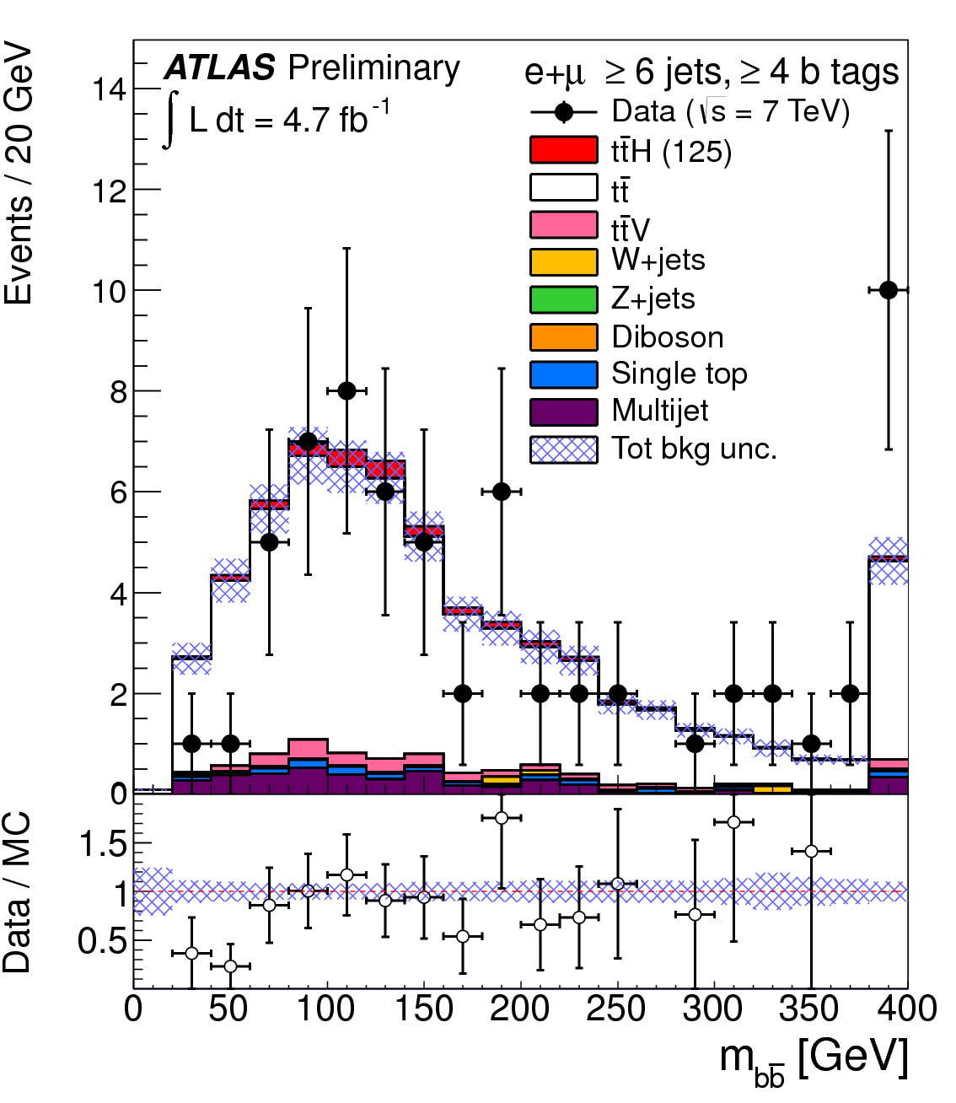
Pre-fit
Post-fit

Slide 10
ttH Systematic Uncertainties
tt+heavy-flavour fractions: vary by 50% - theory studies suggest cross section uncertainty is 50-75% ; should be weighted down by the fraction of this background. Fit puts it at 30%.
tt modeling (Alpgen):
  Qfac: (±2.3%) The factorization scale for the hard scatter is varied by a factor of two up and down relative to the original scale, Q² = Σ_{partons}m²+ p²_{T}
  kTfac: (±9.2%) The renormalisation scale associated with the evaluation of α_{s} at each local vertex in the matrix element calculation is varied by a factor of two up and down relative to the original scale, k_{T} , between two partons.
  Functional form of the factorization scale (iqopt2): (± 13%) Default choice (=1) for dynamic factorization scale, Q² = Σ_{partons}m²+ p²_{T}, changed to Q² = x₁x₂s. This has an order of magnitude larger effect than Qfac.

Slide 11
tt cross section: +9.9 -10.7% using NNLO Hathor.
Jet Energy scale: 16 eigenvectors recommended by the jet/ETmiss group are varied.
b, c and light tagging: 9 (btag),5(ctag) eigenvectors recommended by b-tagging group are varied for heavy flavours and the one value for light flavours.
QCD Multijets: Mostly in the electron channel. Correlated 50% uncertainty plus uncorrelated statistical estimate in each channel (66% in 6 jet 4 b-tag)
ttH parton shower modelling: 1-5% effect at mH = 120 GeV

Slide 12
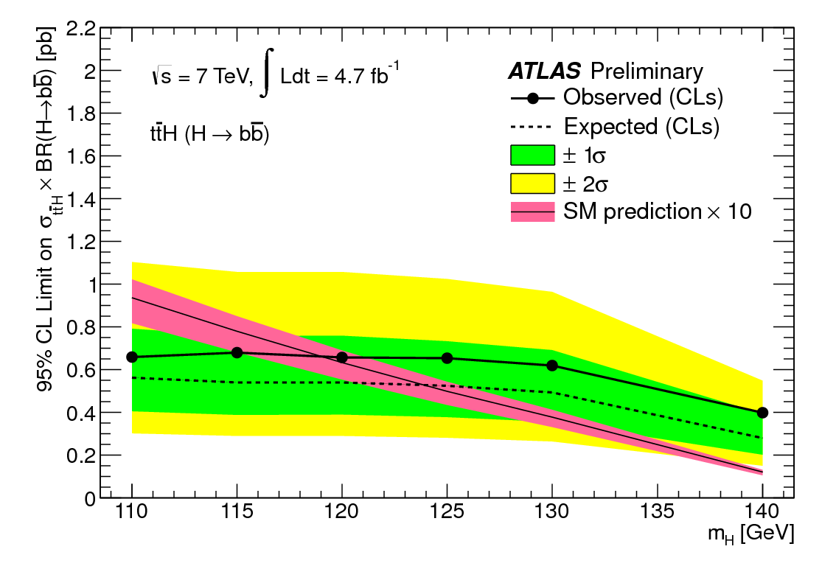
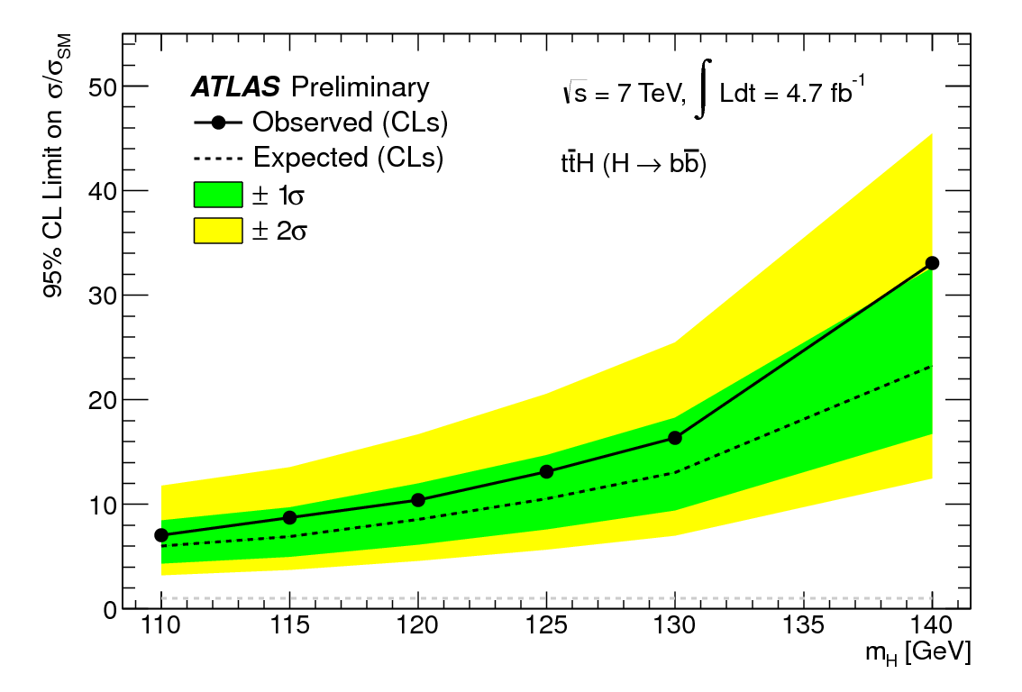
ttH, H->bb Analysis
Poor theory constraints on ttbb/ttjj ratio – ongoing interaction with theory community (important!)
Large impact of systematic uncertainties
…but we can do it! ☺
m_{H} (GeV) | Obs. limit | Exp. limit | Stat.-only
110 | 7.0 | 6.0 | 3.5
115 | 8.7 | 6.9 | 4.0
120 | 10.4 | 8.5 | 4.9
125 | 13.1 | 10.5 | 6.1
130 | 16.4 | 13.0 | 7.8
140 | 33.0 | 23.2 | 14.2

Slide 13
WH/ZH analysis of
7 and 8 TeV data

Slide 14
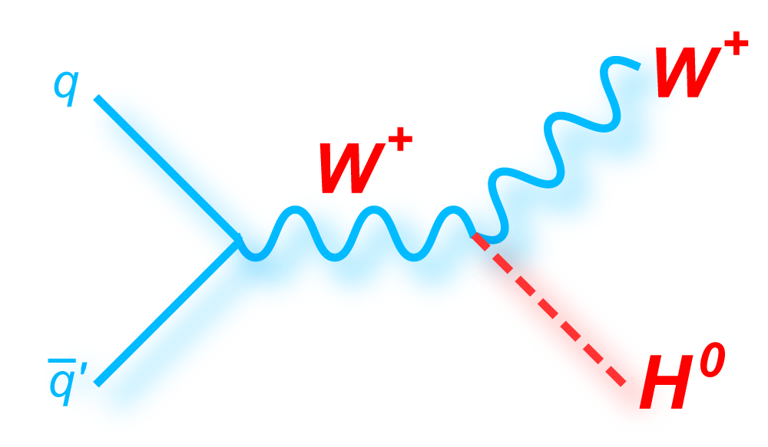
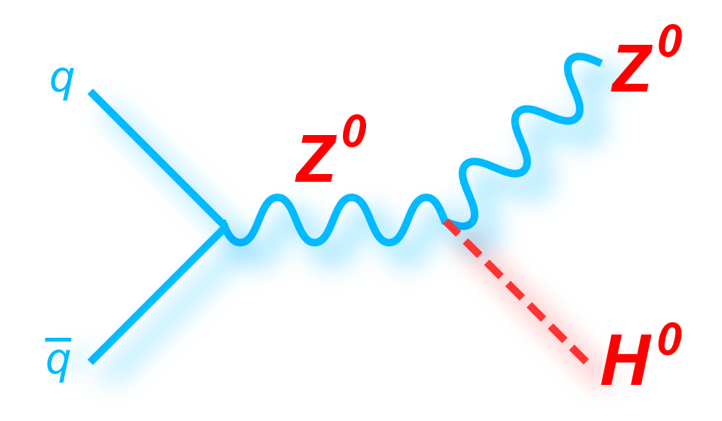
Search Strategy
Search for Higgs decaying to pair of b-quarks
  Associated production to reduce backgrounds
The analysis is divided into three channels
  Two (llbb), one (lνbb) or zero (ννbb) leptons, (l=e,μ)
Cuts common to all channels:
  Two or three jets: 1st jet p_{T} > 45 & other jets > 20 GeV
  Two b-tags: 70% efficiency per tag
    c-jet rejection factor ≈5
    Light-jet rejection factor ≈150
Two lepton
One lepton
Zero lepton
ZH ➞ llbb
No additional leptons
E_{T}^{miss} < 60 GeV
83 < m_{Z} < 99 GeV
Single & di-lepton trigger
WH ➞ lνbb
No additional leptons
E_{T}^{miss} > 25 GeV
40 < M_{T}^{W} < 120 GeV
Single lepton trigger
ZH ➞ ννbb
No leptons
E_{T}^{miss} > 120 GeV
E_{T}^{miss} trigger

Slide 15
Analysis Overview
  Previous publication: 4.7 fb⁻¹ √s=7 TeV http://arxiv.org/abs/1207.0210
This analysis: 4.7fb⁻¹ √s = 7 TeV & 13fb⁻¹ √s = 8 TeV
  S/B is not large, but increases as p_{T}^{bb} increases
  Therefore analysis broken into different p_{T} bins (use p_{T}^{V} of W or Z)
  Not yet enough ∫Ldt to use jet substructure techniques – future!
Various substantial improvements wrt previous analysis
  The analysis is divided into 16 categories using p_{T}^{V}
    0-lepton: E_{T}^{miss} [120-160] [160-200] [>200] GeV x (2 jets or 3 jets)
    1 & 2 lepton: p_{T}^{W/Z} [0-50],[50,100],[100-150],[150-200] [>200] GeV
  Cuts are optimised for each category (~30% increase in sensitivity)
  Muon energy (p_{T}>4 GeV) added for b-jets (~10% resolution improve/)
  Additional ttbar based b-tagging calibration (~50% reduction in b-tagging systematic uncertainty)
Signal
Backgr.
p_{T}^{H}

Slide 16
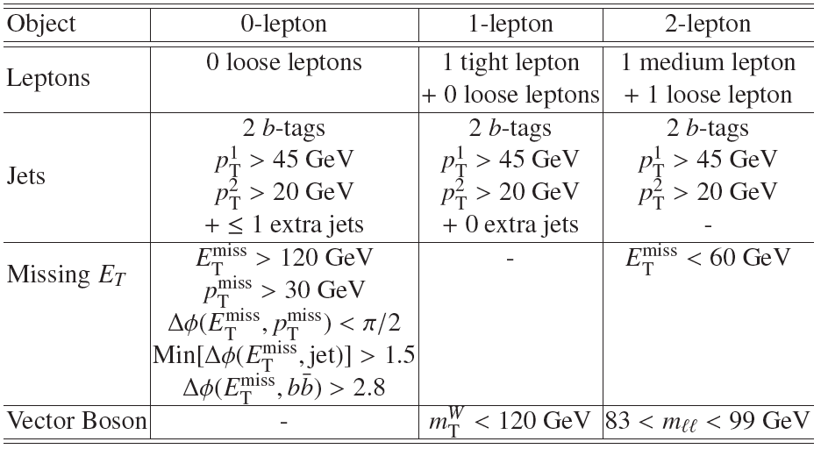
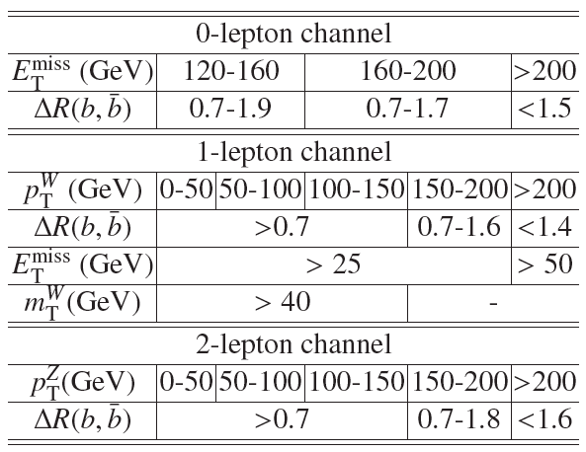
Details of event selection
Basic event selection:
Tuned kinematic cuts to optimise sensitivity in each category:

Slide 17
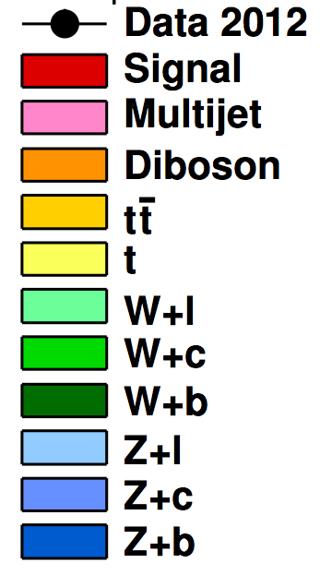
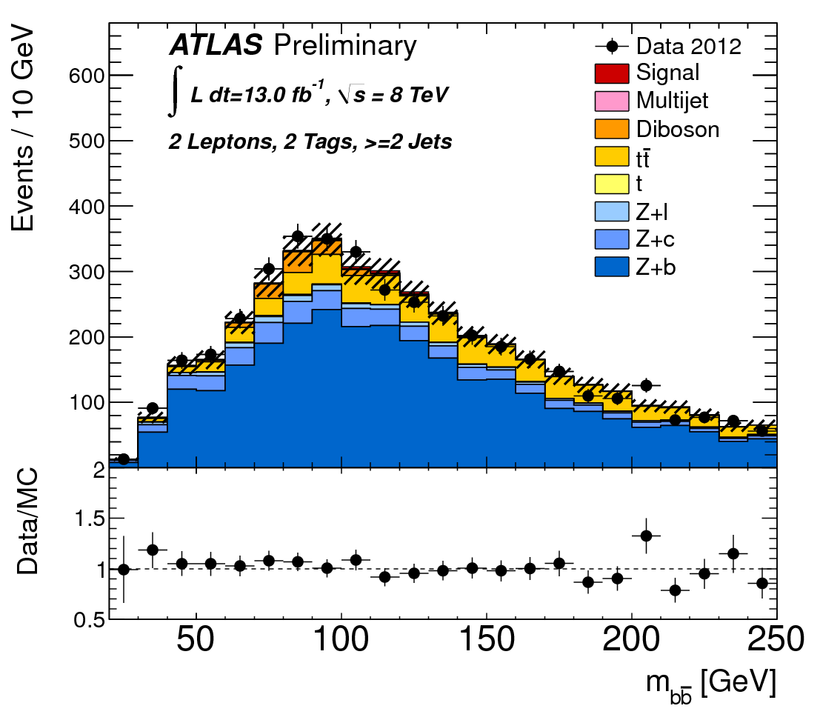
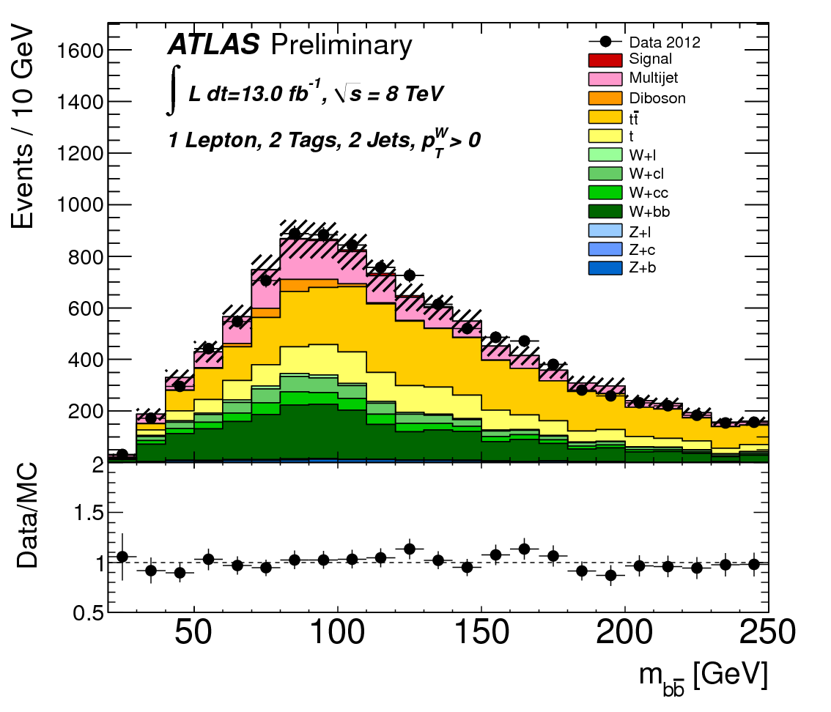
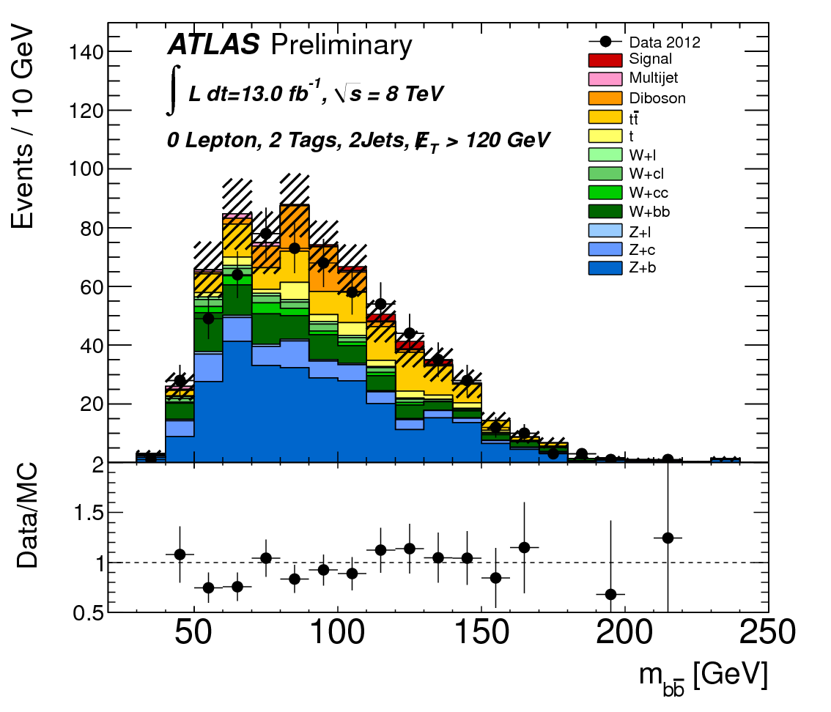
Backgrounds and MC
Signal: WH/ZH Pythia6/8
Diboson WW/WZ/ZZ Herwig
Multijet: Data driven
ttbar: MC@NLO
Single Top Acer/MC@NLO
W+b Powheg
W+c/light-jets Alpgen
Z+ b/c/light-jets Alpgen/Sherpa
Background shapes from simulation and normalised using flavour & data fit
Multi-jet bkg determined by data-driven techniques
WZ(Z➞bb) & ZZ(Z➞bb) resonant bkg normalisation and shape from simulation
2 lepton
1 lepton
0 lepton
Z+jets
Top/W+jets
Z+jets/W+jets/Top

Slide 18
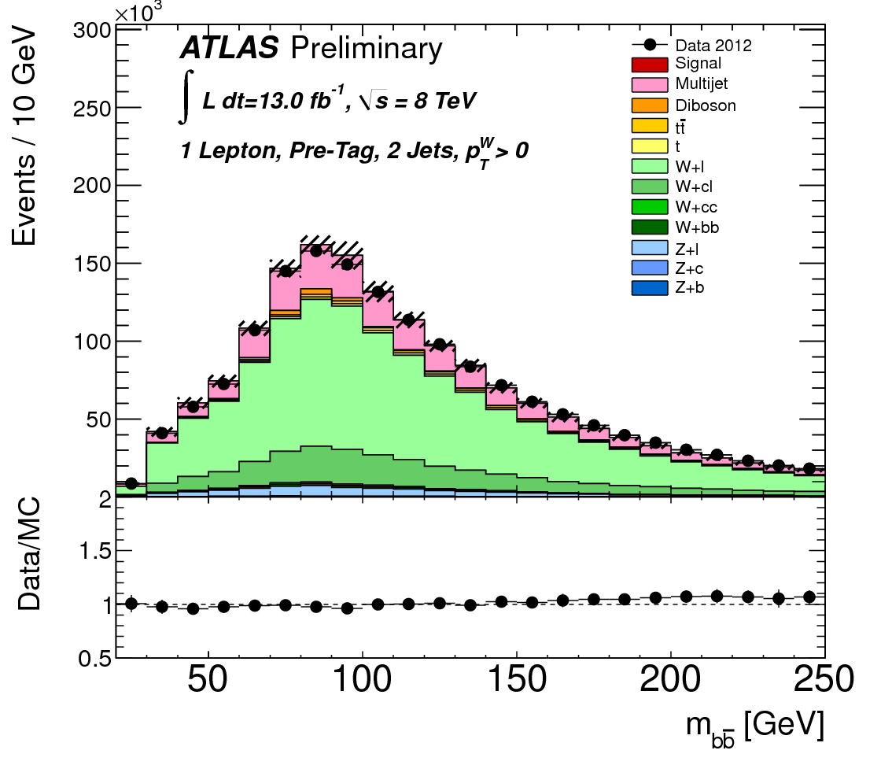

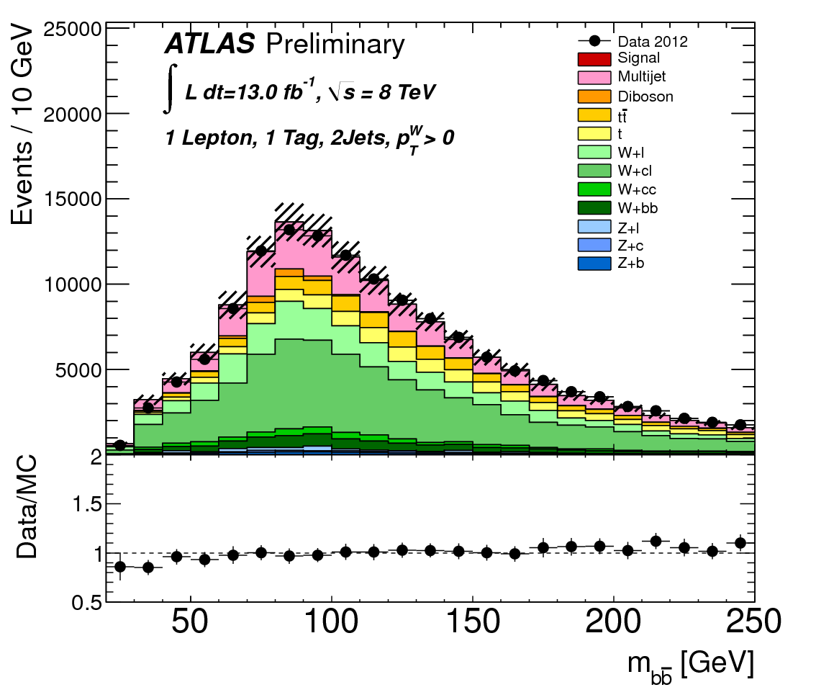
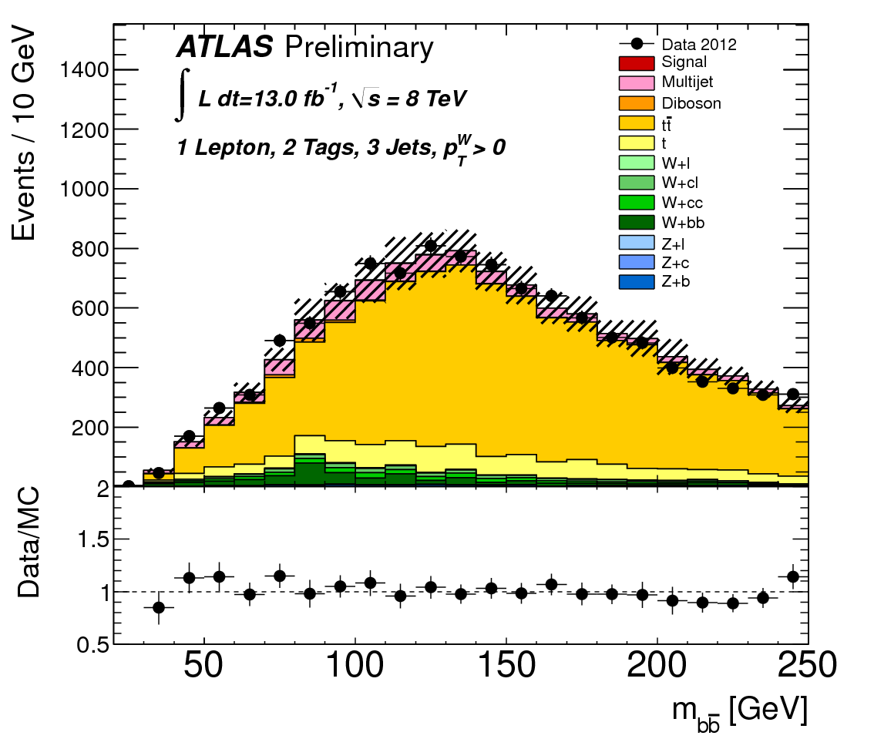


Control regions:
Pre b-tag: rich in V+light jets
1 b-tag: V+light, V+c, V+b etc
Top:
  1-lepton: ≥3-jet region;
  2-lepton: m(ll) sidebands of m_{Z}
Pre b-tag
enriched
1 b-tag
+ 1 jet
enriched
enriched

Slide 19
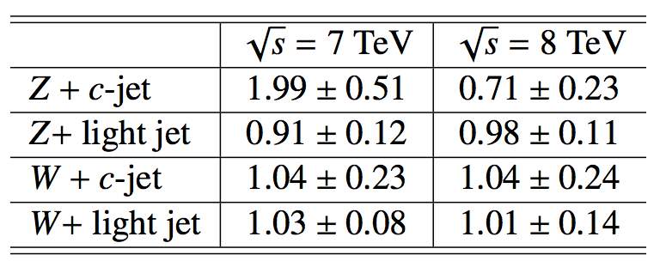
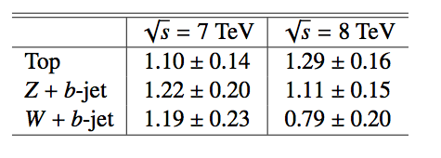
Maximum likelihood Fits
First perform the flavour ML fit
  Determined V+light and V+c scale factors
  Z+c factor changes due to MC treatment
  Improved understanding of bkg V pT
    Using the high statistics at 8 TeV we discovered that the V pT spectrum
    falls more rapidly in data than expected from MC ☺
  W + jets and Z + jets: 5-10 % correction required
  Top background: 15 % correction required
Using corrections & scale factors get good MC/data agreement
Binned profile likelihood fit to 16 signal regions & top control regions
  W+b, Z+b and top bkg are floated
  Rescaling factors from the fit ➠
L(μ,θ) fit to signal strength μ (= σ/σ_{SM})
  Nuisance parameters θ for systematics

Slide 20
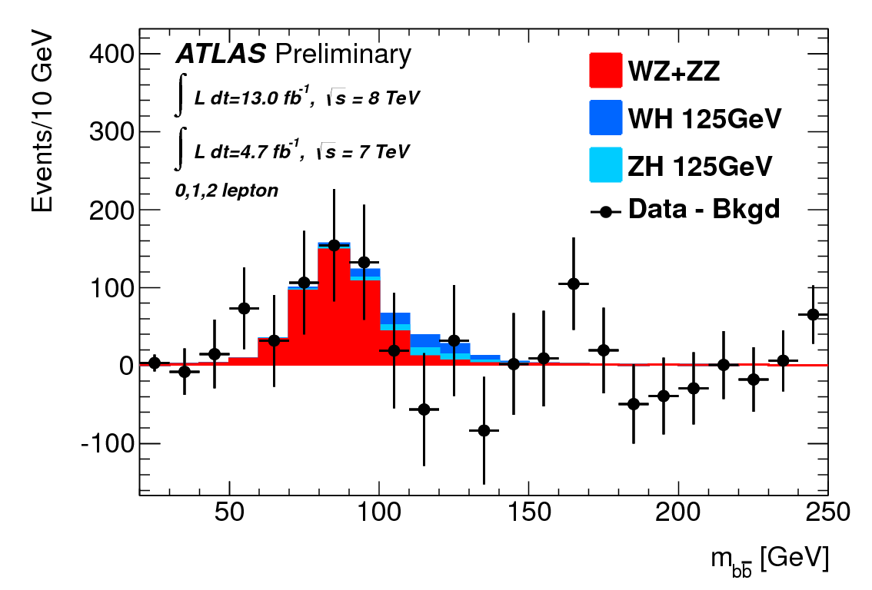
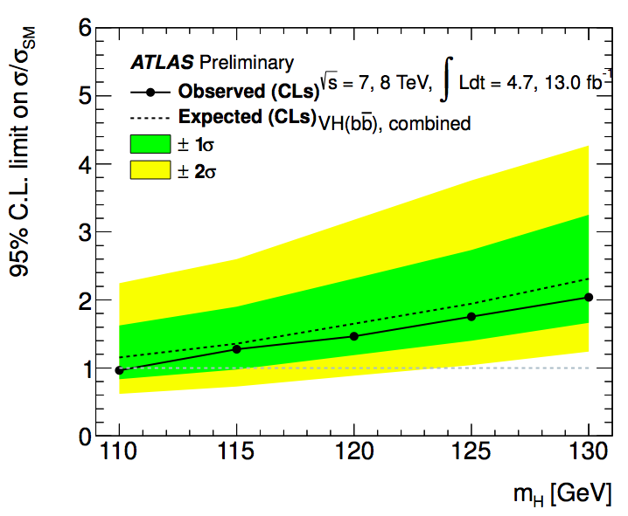
Analysis
Event selection:
0 lepton
1 lepton
2 lepton
Data-driven corrections:
Pre-tag
top CR (3/4j)
p_{T}^{V} correction of W+jets, Z+jets and top
MC
data
Flavour fit (V+c, V+light):
Use different b/c/light content to get correction to flavour fractions
Pre-tag
1 b-tag
2 b-tag
top CR (3/4j)
Fix Higgs to SM and fit to get diboson significance:
Fix diboson to SM and do fit to extract final background normalizations and limits:

Slide 21
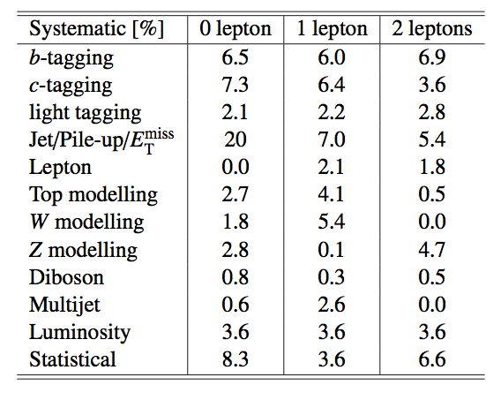
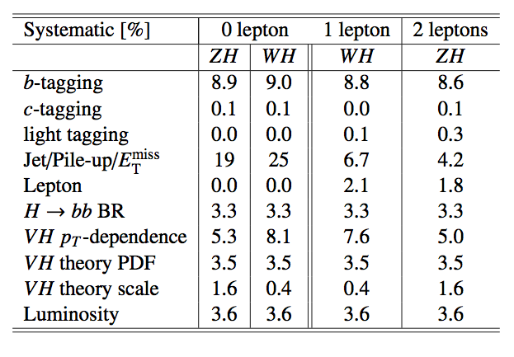
Systematic Uncertainties
Experimental uncertainties
  b-tagging and jet energy dominate
  Jets: components (7 JES, 1 p_{T}^{Reco}, resol.)
  E_{T}^{miss} – scale and resolution of soft components. Data/MC for E_{T}^{miss} trigger
  bTagging – light, c & 6 p_{T} bins for b-jet efficiency
  Lepton – energy, resolution, efficiency
  Multijet / diboson / Luminosity / MC stats
Theoretical uncertainties
  BR(H➞bb) @ mH=125 GeV (3.3%)
  W/Z+jet m_{bb} (20%) and V pT (5-10%)
  Single top/top normalisation (15%)
  W+c/W+jets (30%), Z+c/Z+jets (30%)
  Diboson (11%)
Background systematics
Uncertainties given are after full cuts (pre-fit)
Signal systematics

Slide 22
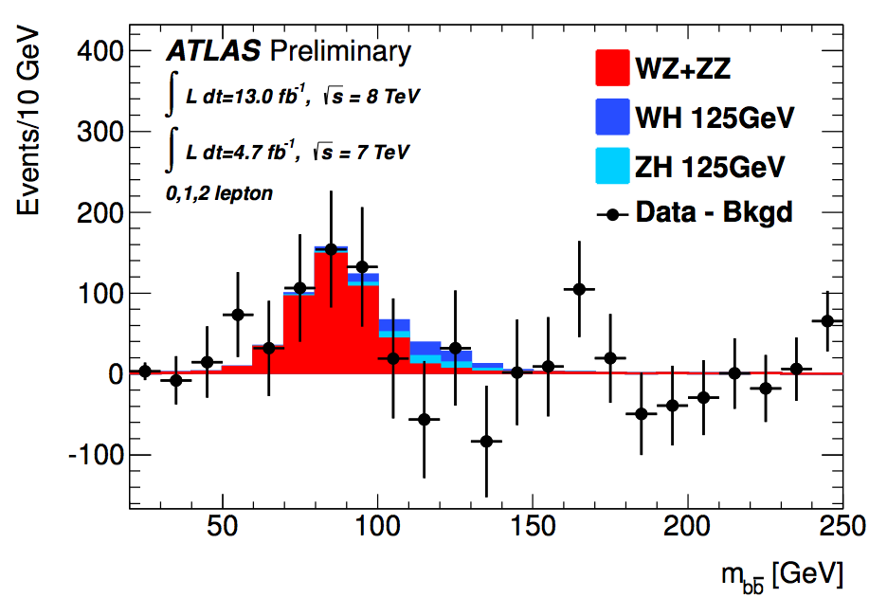
Diboson production
WZ & ZZ production with Z→bb
  Similar signature, but 5 times larger cross-section
Perform a separate fit for this to validate the analysis procedure
  Profile likelihood fit performed (with systematics)
  All bkgs (except diboson) subtracted
Clear excess is observed in data at the expected mass
0,1 and 2- lepton channels combined
2011 & 2012 data combined
Full systematics are applied
Results
  σ/σ_{SM} = μ_{D}= 1.05 ± 0.32
  Significance = 4.0 σ
In agreement with Standard Model
For the Higgs analysis the diboson contribution is fixed to its SM expectation in the likelihood profile, with an uncertainty of 11%

Slide 23
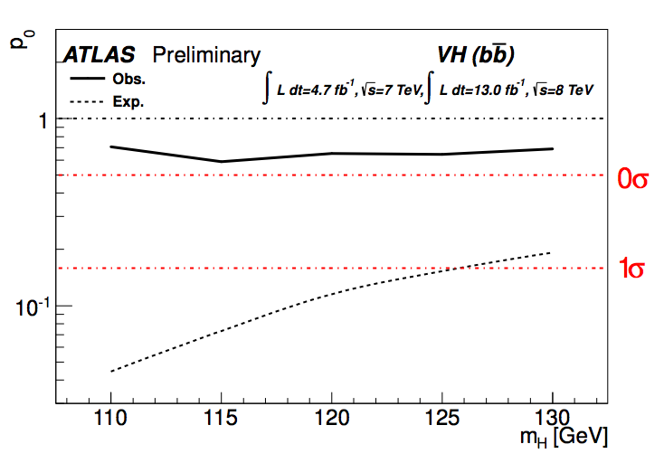
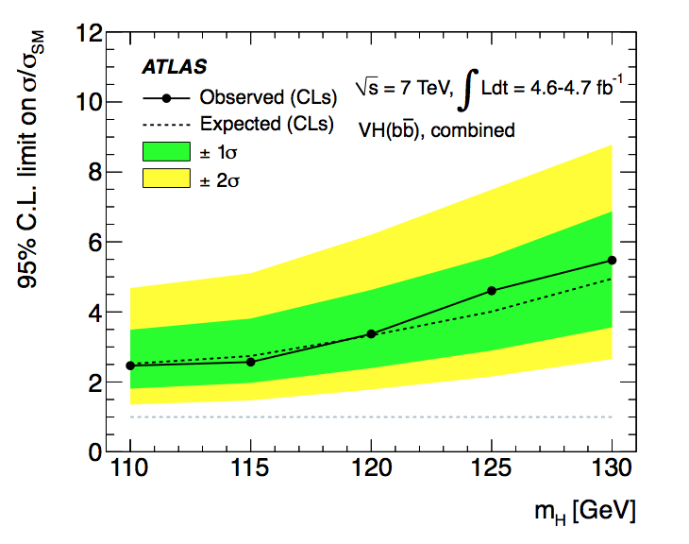
Combined (2011 & 2012) result
Previous publication
Observed (expected) limit at m_{H} =125 GeV
  1.8 (1.9) x SM prediction
Observed (expected) p₀ value 0.64 (0.15)
σ/σ_{SM} = μ = −0.4 ± 0.7(stat.) ± 0.8(syst.)
Exclusion at m_{H} ~ 110 GeV
More than doubled the analysis sensitivity ➠

Slide 24
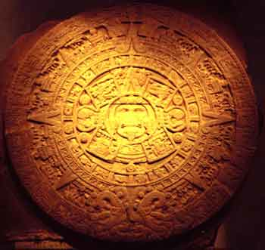
Conclusions
First combined 2011 & 2012 VH analysis in H->bb channel
  Using 4.7fb⁻¹ (2011) and 13fb⁻¹ (2012) data
  Significant improvements to all aspects of the analysis
  Observed (exp.) limits are 1.8 (1.9) x SM at m_{H} = 125
Clear di-boson signal measured
  μ_{Diboson} = 1.05 ± 0.32
  Significance = 3.9σ
ttH analysis of 7TeV data
  First iteration of a difficult analysis
  Severely affected by systematics
    But will benefit much from more stats
  Observed (exp.) limits are 13.1 (10.5) x SM at m_{H} = 125
No observation and no surprises… YET!
(But watch this space! Unless it’s the end of the world…)

Slide 25

Bonus slides

Slide 26


Slide 27
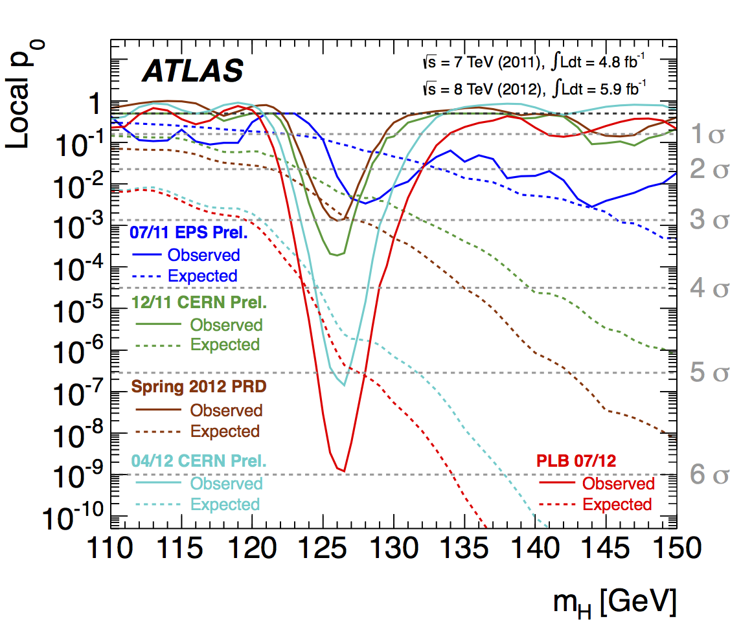
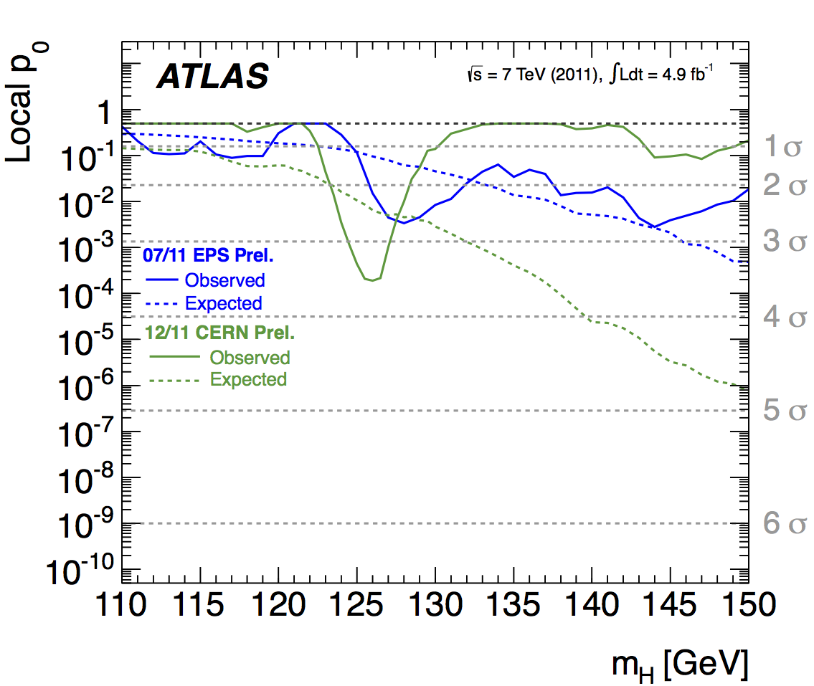
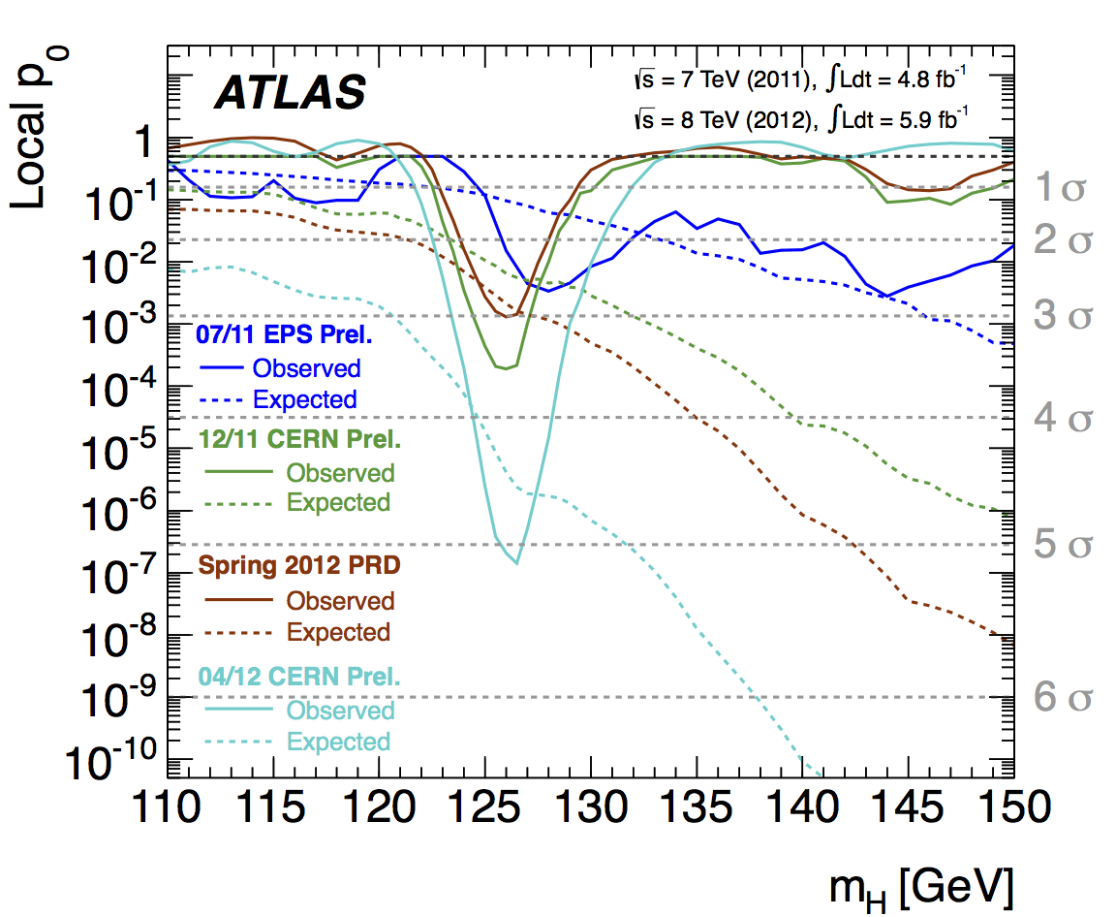
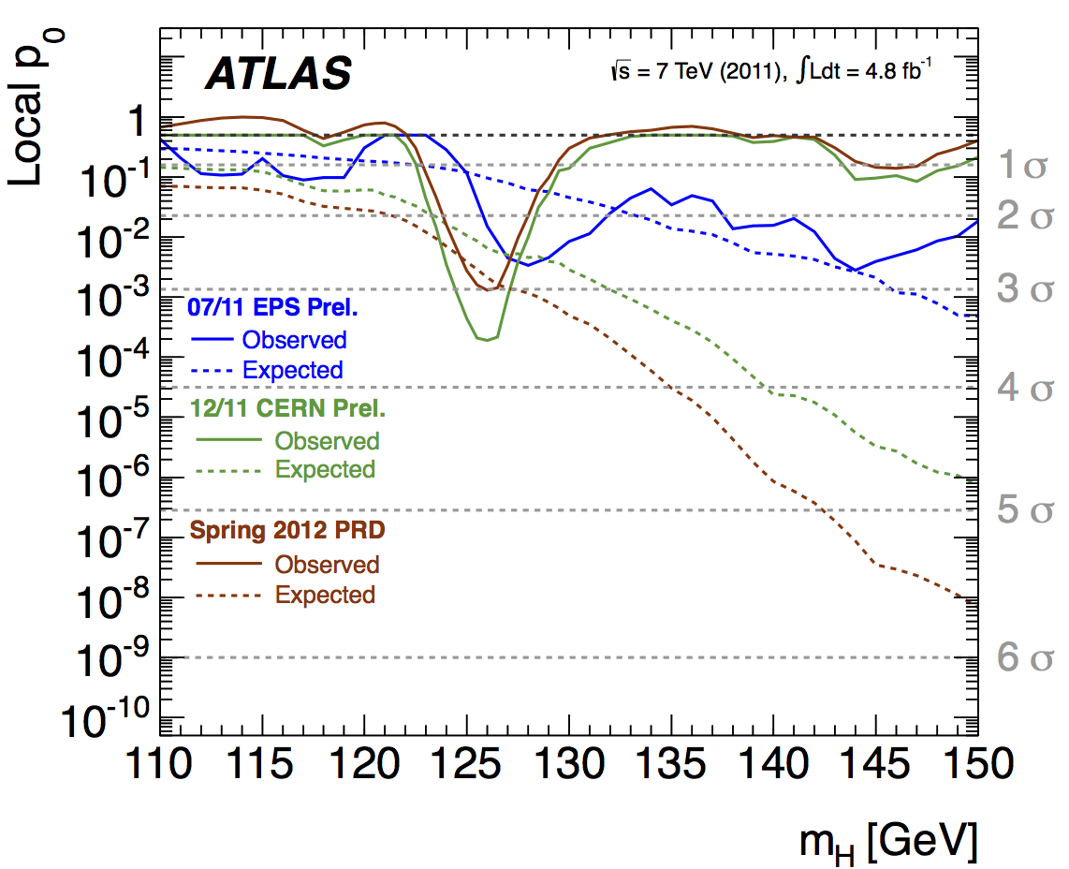
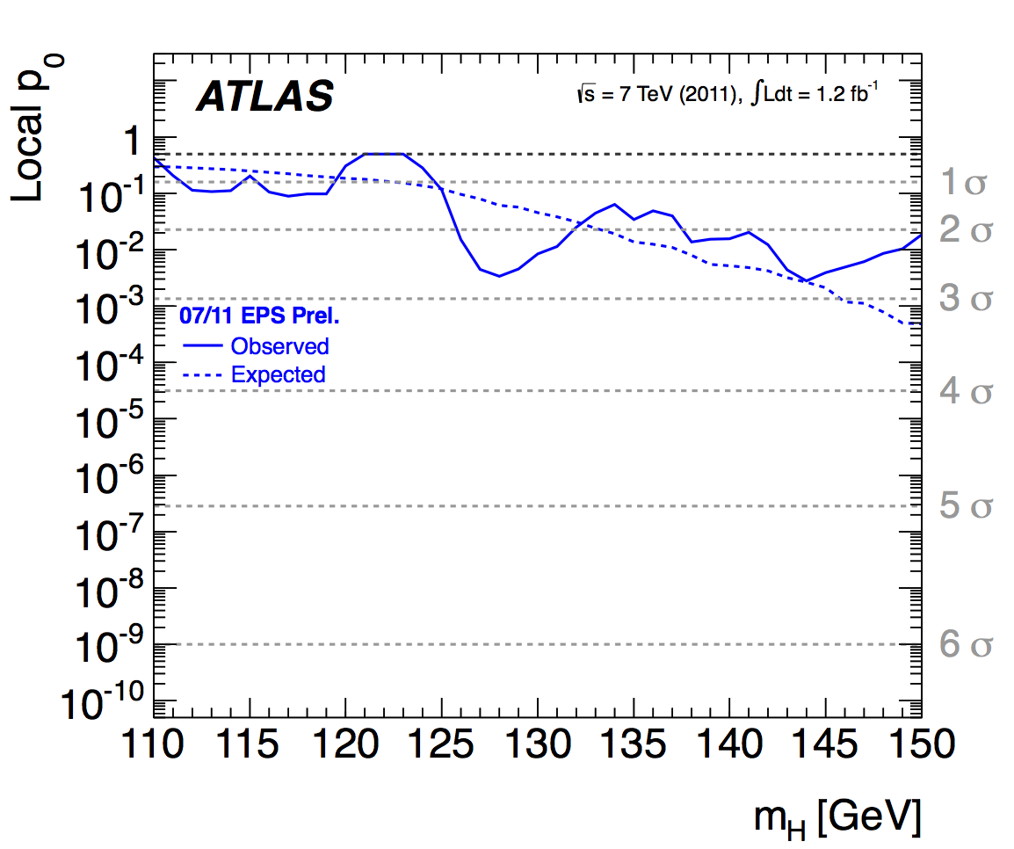
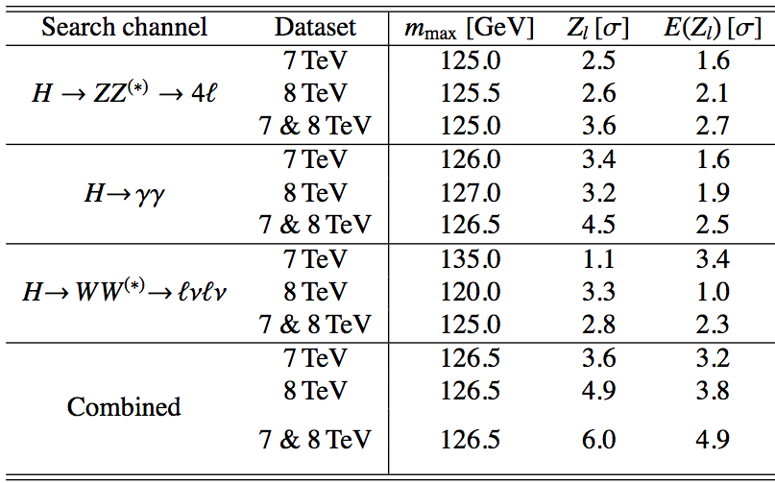
5σ announced on 4th of July independently by ATLAS and CMS!!
Data analysed:
  4.8 fb⁻¹ @7TeV & 5.6 fb⁻¹ @8TeV
Clear excess only in bosonic decay channels:
  H➞ZZ, H➞γγ, H➞WW
Hints of H➞ττ from LHC and evidence from Tevatron for H➞bb and hints from CMS
Need to keep looking!
  SM Higgs search is a great way to search new physics!
The 6 billion Swiss Franc question (+ M&O):
Is it THE Standard Model Higgs?...
Or something even more interesting?

Slide 28
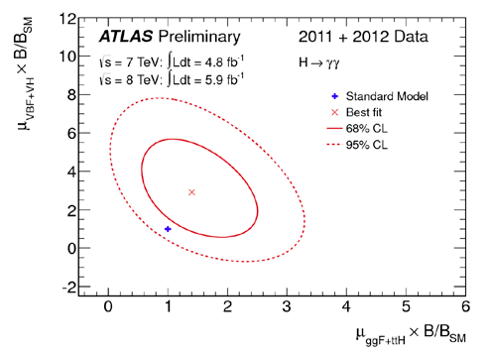

What do we know about the new particle?
  Mass ≈ 126 GeV
  Electric charge = 0 (neutral final state)
Unknown/incomplete knowledge:
  Spin (J) = 0, 1, 2, ... ? J=1 disfavored (Landau-Yang theorem and observation in H➞γγ)
  Charge-conjugation, parity (CP)
  Couplings?
September analysis used same data as July 2012 observation paper
  ATLAS-CONF-2012-127: https://cdsweb.cern.ch/record/1476765?ln=en
Fit data to estimate factors κ multiplying coupling in each SM production and decay mode
Signal strength for the γγ final state (gluon fusion vs VBF+VH)
  κ_{V} versus κ_{F} – assume a single κ_{F} factor for all fermions t, b, τ and a single factor κ_{V} for vector
  Sign comes from interference between t and W loops in H➞γγ

Slide 29






M_{bb} distribution (0-lepton, 8TeV)
2-jet categories
3-jet categories
120 < E_{T}^{miss} < 160 GeV
160 < E_{T}^{miss} < 200 GeV
160 < E_{T}^{miss} < 200 GeV

Slide 30





M_{bb} distribution (1-lepton, 8TeV)
p_{T}^{W} < 50 GeV
50 < p_{T}^{W} < 100 GeV
100 < p_{T}^{W} < 150 GeV
150 < p_{T}^{W} < 200 GeV
p_{T}^{W} > 200 GeV

Slide 31





M_{bb} distribution (2-lepton, 8TeV)
p_{T}^{Z} < 50 GeV
50 < p_{T}^{Z} < 100 GeV
100 < p_{T}^{Z} < 150 GeV
150 < p_{T}^{Z} < 200 GeV
p_{T}^{Z} > 200 GeV

Slide 32

Results: Exp. S+B & Obs. events
8TeV analysis:

Slide 33


QCD/multi-jet modelling
0 lepton
  Use ABCD method
  Regions defined by relative directions of MET/jets/pTmiss
  Found to be small (~1%)
1 lepton
  MET template by reverse isolation cuts
  Normalised by fitting each WpT bin
  Electroweak contamination removed from template
2 lepton
  Template: reverse isolation/quality selection
  Found to be small (<1%)
ABCD method
Use lack of correlation
Δϕ (Etmiss,pTmiss) vs
Δϕ (Etmiss,jets)
for multi-jet background estimation in signal region

Slide 34

B-tagging

Slide 35

Mbb distributions (0-lep, 7TeV)

Slide 36
V+light & V+c flavour fit
0 lepton
1 lepton
2 lepton
0 b-tag
0 b-tag
0 b-tag
1 b-tag
1 b-tag
1 b-tag

Slide 37


Flavour fit results (2-lepton)
0 b-tag
1 b-tag
top ctrl
2 b-tags

Slide 38

CL_{S} limit results
2011
2012
Observed & expected CL_{S} limit on normalised signal strength as function of Higgs Boson mass (0,1,2 lepton combined)
Observed (expected) values at m_{H} =125 GeV
  Limits 1.8 (3.3) & 3.4 (2.5) times the Standard Model
  p₀ values: 0.97 (0.26) & 0.17 (0.20)
  σ/σ_{SM}: μ = −2.7 ± 1.1(stat.) ± 1.1(syst.) & μ = 1.0 ± 0.9(stat.) ± 1.1(syst.)

Slide 39
Samples & Yields for ≥ 6 jets ≥ 4 b’s
Signal: 2.3 events
PYTHIA 6.425, m_{t} = 172.5 GeV. Charged lepton filter: p_{T} > 5, |η| < 5
Backgrounds:
Dominant are tt+jets (16.4 events) and ttbb (26.5 events):
  ALPGEN 2.13+HERWIG 6.520 HFOR overlap removal.
  tt+jets: Npartons = 0−5, σ=73.08pb, K=1.755;
  ttbb : σ = 0.856 pb, K=1.687 (biggest sys.)
Multijets (data-driven): 6.22 events (5.67 e channel; 0.55 μ channel)
ttV: 2.2 events
  Madgraph 4 + PYTHIA 6.425 σ_{ttW}= 0.12pb, σ_{ttZ} = 0.096pb
Single Top: 1.28 events
  s-channel (1.5 pb) and Wt (15.74 pb): MC@NLO 4.01 with HERWIG 6.520 and Jimmy 4.31.
  t-channel (20.92 pb, K=0.866): AcerMC 3.8 with PYTHIA 6.425
W+jets: 0.54 events
  ALPGEN 2.13+HERWIG 6.520: Wbb, Wcc, Wc, Z → ll, W → lν; HFOR overlap removal
  Uses data to normalize and change mix of heavy flavours
Minor backgrounds: 0.2 events
  Dibosons and Z + jets;
  Dibosons: HERWIG 6.520 and JIMMY 4.31; charged lepton filter p_{T} > 10GeV, |η| < 2.8.

Slide 40





CMS
Lepton+jets mode
ATLAS
Very big difference!...

Slide 41
ttH Systematic Uncertainties
tt+heavy-flavour fractions: vary by 50% - theory studies suggest cross section uncertainty is 50-75% ; should be weighted down by the fraction of this background. Fit puts it at 30%.
tt modeling (Alpgen):
  Qfac: (±2.3%) The factorization scale for the hard scatter is varied by a factor of two up and down relative to the original scale, Q² = Σ_{partons}m²+ p²_{T}
  kTfac: (±9.2%) The renormalisation scale associated with the evaluation of α_{s} at each local vertex in the matrix element calculation is varied by a factor of two up and down relative to the original scale, k_{T} , between two partons.
  Functional form of the factorization scale (iqopt2): (± 13%) Default choice (=1) for dynamic factorization scale, Q² = Σ_{partons}m²+ p²_{T}, changed to Q² = x₁x₂s. This has an order of magnitude larger effect than Qfac.

Slide 42
tt cross section: +9.9 -10.7% using NNLO Hathor.
Jet Energy scale: 16 eigenvectors recommended by the jet/ETmiss group are varied.
b, c and light tagging: 9 (btag),5(ctag) eigenvectors recommended by b-tagging group are varied for heavy flavours and the one value for light flavours.
QCD Multijets: Mostly in the electron channel. Correlated 50% uncertainty plus uncorrelated statistical estimate in each channel (66% in 6 jet 4 b-tag)
ttH parton shower modelling: 1-5% effect at mH = 120 GeV

Slide 43

ATLAS/CMS differences
Systematics:
No QCD systematics (no QCD background?!)
No ttH modeling
No W+jets/HF systematic
No JVF systematic (pileup suppression)
Different treatment of Jet Energy Scale (ATLAS 16 NP), b-tag sys. (ATLAS 9 NP) and c-tag sys (ATLAS 5 NP): CMS one Nuis. Par.
b and c tagging correlated
One tt systematic uncertainty (ATLAS 3 NP)
ttbar+HF 20% instead of 50% uncertainty
Cuts:
Electrons and muon:
  ATLAS p_{T}>20/25GeV
  CMS p_{T} > 30 GeV
Jets:
  ATLAS pT>25GeV
  CMS 3 leading jets pt > 40 GeV (otherwise 30 GeV)
More signal and higher cuts. Not clear what signal sources are used
Summary:
ATLAS using CMS systematics: 35% better
20% improvement from more signal
Remaining improvement from use of Multivariate analysis (22%)
In numbers:
σ/σ_{SM} = 10.5 -> 7.8 from systematics
Take 22% improvement from MVA: -> 6.1
Take 20% additional signal: σ/σ_{SM} -> 5.1 (expect)
CMS: 4.9 (expected)

Slide 44

The ATLAS detector

Slide 45

DIBOSON

Slide 46


