Slide 1
Hunting the Higgs Boson at the LHC
Ricardo Gonçalo
NExT PhD Workshop
University of Sussex – 21 August 2012

Slide 2
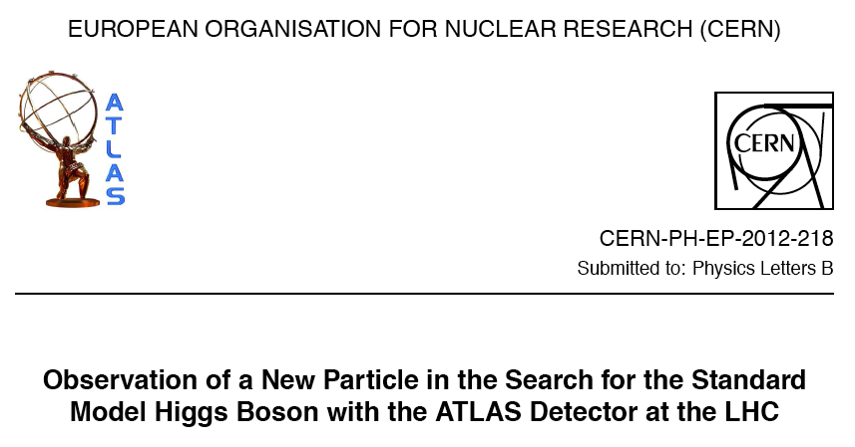
…and finding a New Particle with a mass of around 125 GeV/c² which could very well be… the Higgs boson!
Hunting the Higgs Boson at the LHC

Slide 3
Outline of the lecture
Part I: Introduction & old history
Part II: tools of the trade
  The LHC
  The ATLAS and CMS experiments
  Statistics survival guide
Part III: LHC Higgs searches
  The search channels
Part IV: what now?
  The big questions
  Roadmap for the LHC

Slide 4
Part I: Higgs Physics and (old) history

Slide 5
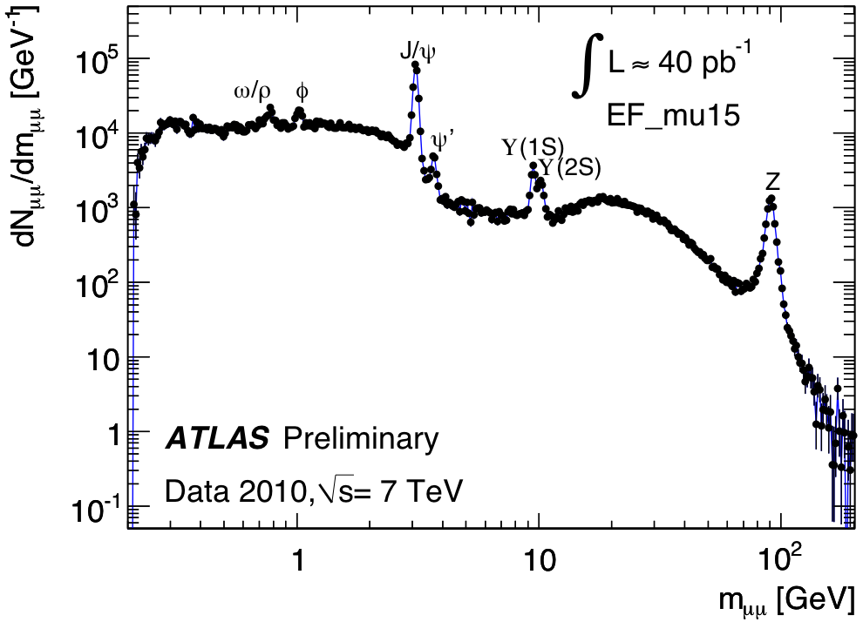
Why look for the Higgs boson?
Because the Standard Model works very well!
For everything, except…
Local gauge invariance of the Standard Model would be violated by particle mass terms
Theory would become non-renormalizable…

Slide 6
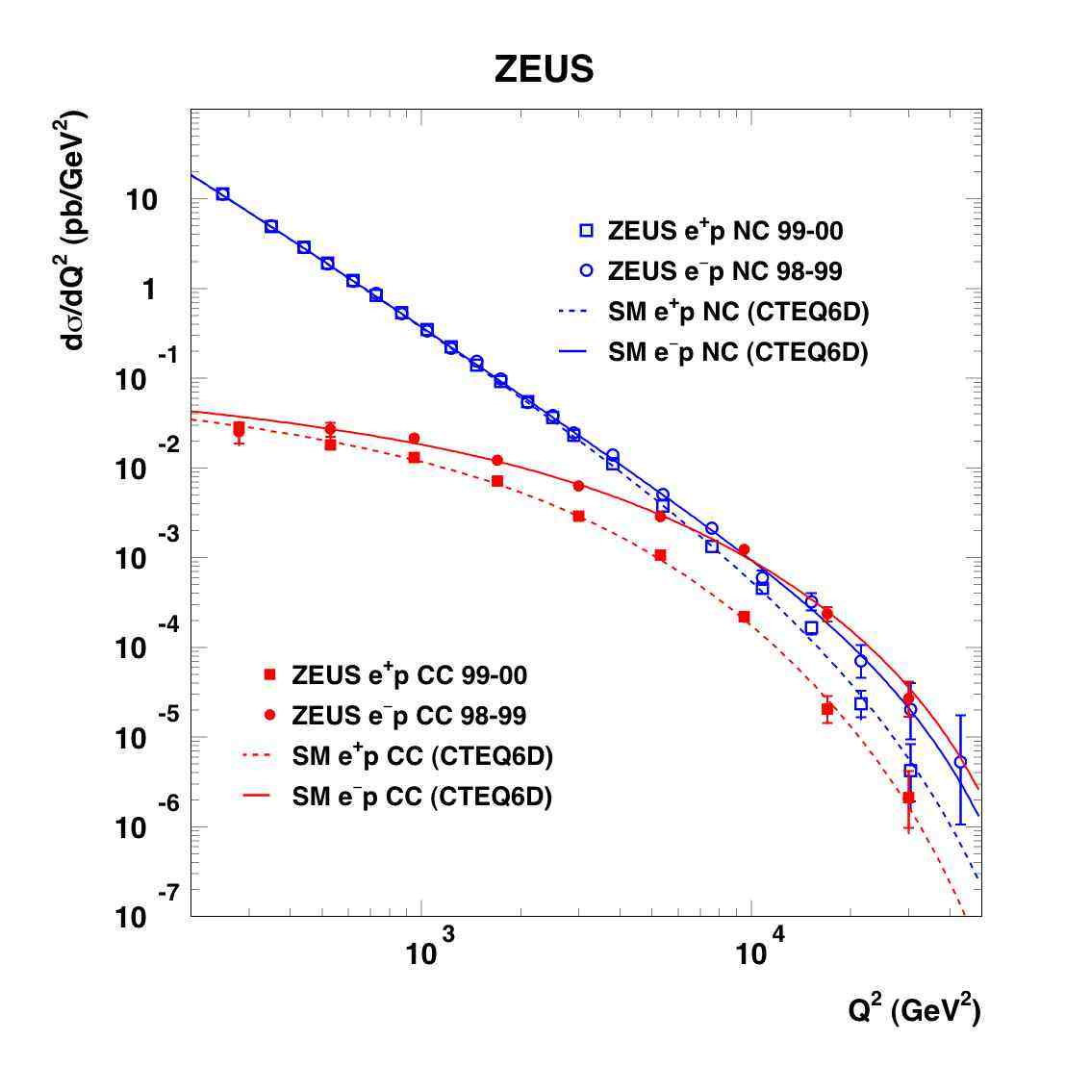
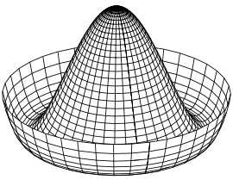

Why look for the Higgs boson?
Simplest solution:
  Introduces doublet of complex fields – 4 degrees of freedom
  Assume Mexican hat potential, to allow spontaneous symmetry breaking – potential follows symmetry but new vacuum doesn’t
  Three degrees of freedom turn into W± and Z longitudinal polarization (W± and Z now have mass!)
  Remaining degree of freedom becomes new scalar particle – the Higgs boson
  Fermions acquire mass through different mechanism – interaction with the Higgs field
  Higgs boson mass is the only unknown in the theory
In the process, explain electroweak symmetry breaking
Z/γ
W±
http://www-zeus.desy.de/physics/sfew/PUBLIC/sfew_results/preliminary/dis04/
We need the SM Higgs mechanism to make sense of the data!
(in the most economical way…)

Slide 7
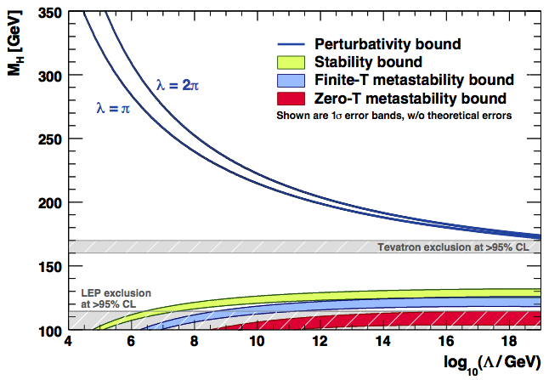
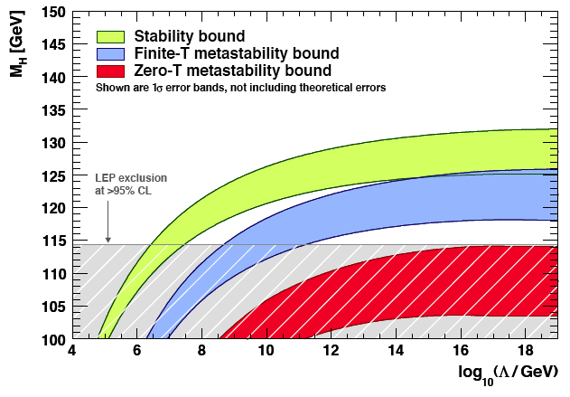
But there is more…
0906.0954v2 [hep-ph]
We know the SM is incomplete
For a low Higgs mass relative to the top quark mass, the quartic Higgs self-coupling runs at high energy towards lower values.
At some point it would turn negative indicating that the vacuum is unstable.
The universe could decay into a more stable lower energy vacuum state.
Unless new physics appears at some energy scale
The Higgs sector can give important clues to constrain new physics beyond the SM
It is a great way to search for new physics!

Slide 8
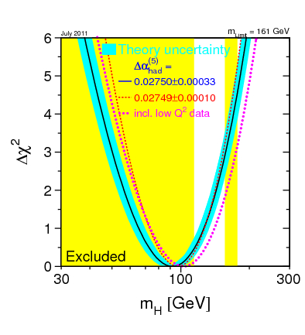
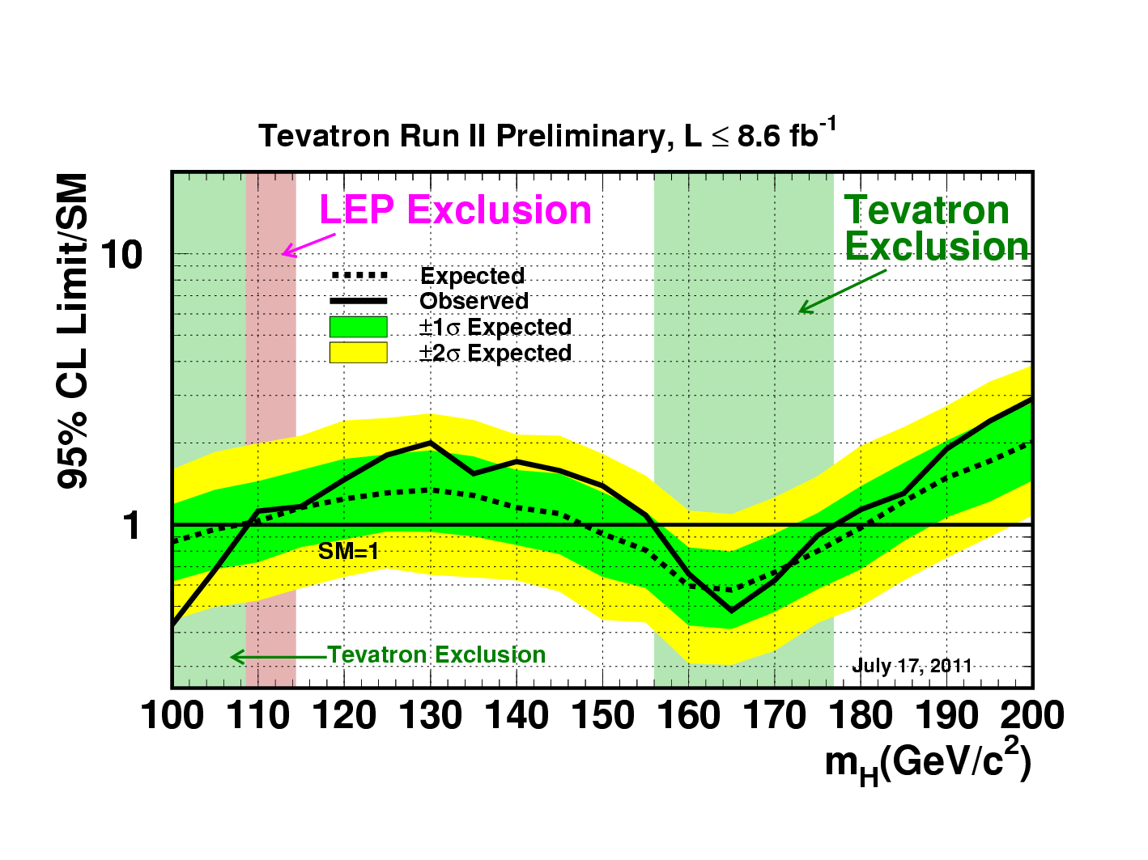
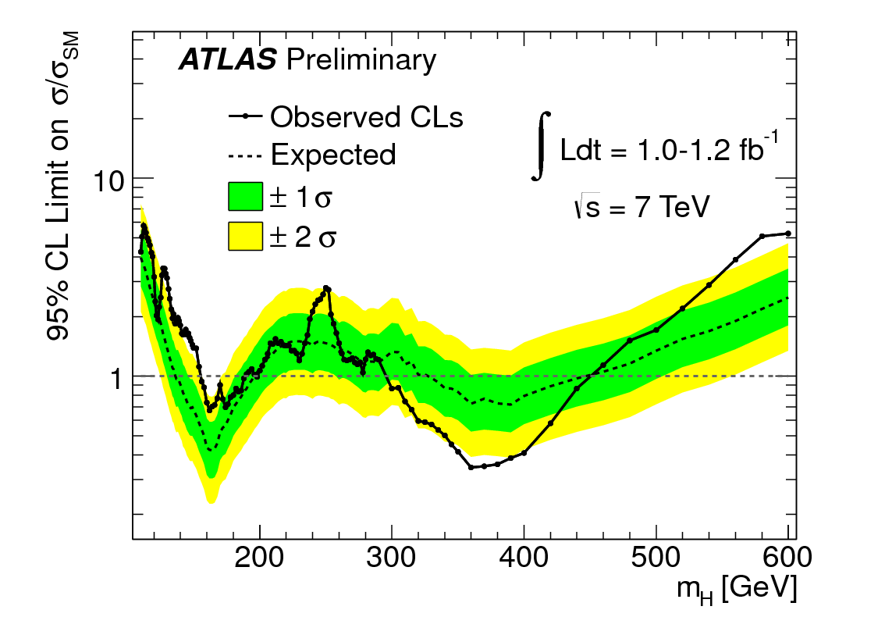
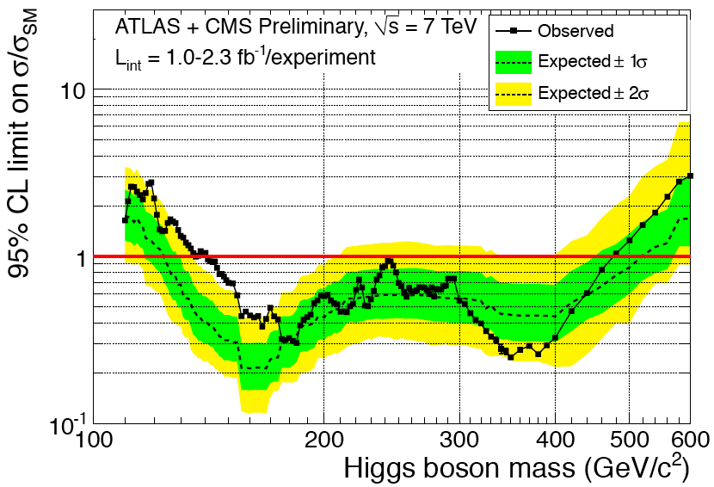
So how were we doing 1 year ago?
So how are we doing now?
2011 limits on Higgs boson mass (only unknown parameter):
  LEP excluded mass range below 114.4 GeV/c²
  EW fit: m_{H} = 92⁺³⁴₋₂₆ GeV/c² (July 2011)
  Including LEP: m_{H} < 185 GeV/c² (July 2011)
  Tevatron excluded ranges of 100 – 108 GeV/c² and 156 – 177 GeV/c²
http://lepewwg.web.cern.ch/LEPEWWG/
July 2011
July 2011
LHC?
The Brazil Plot
ATLAS+CMS Summer 2011
http://tevnphwg.fnal.gov/

Slide 9
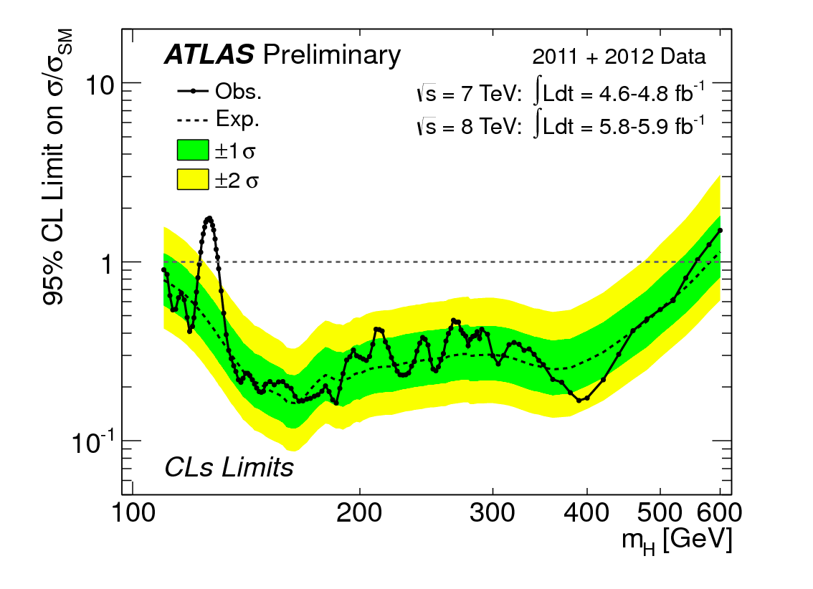
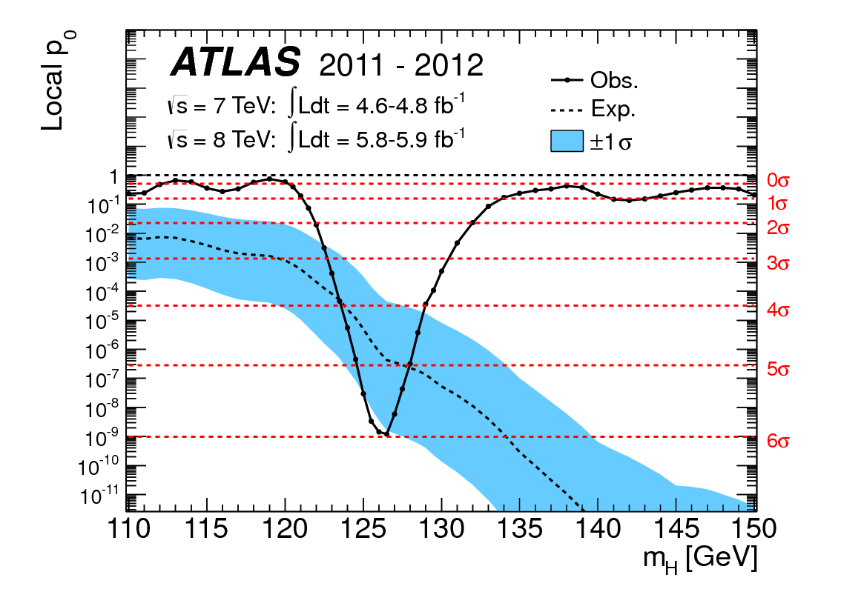
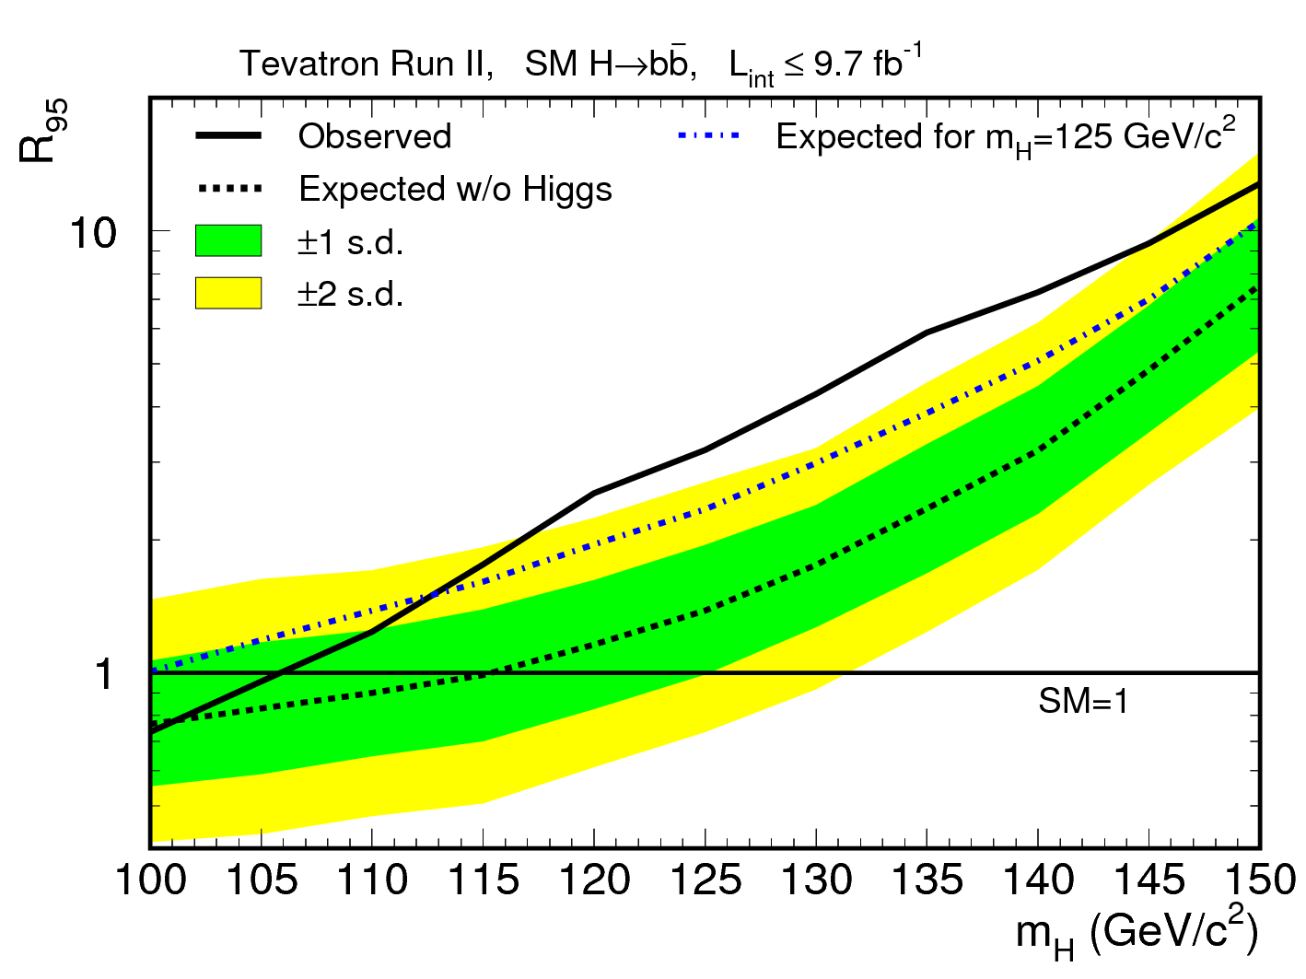
How were we doing 1 month ago?
So how are we doing now?
≈5σ including announced on 4th of July by ATLAS and CMS independently!!
ATLAS added H->WW later and published result with ≈6σ
Did we find the Higgs boson?!
ATLAS July 2012
The p0 Plot
D0+CDF July 2012

Slide 10


Slide 11
Part II: Tools of the Trade
The Hardware

Slide 12
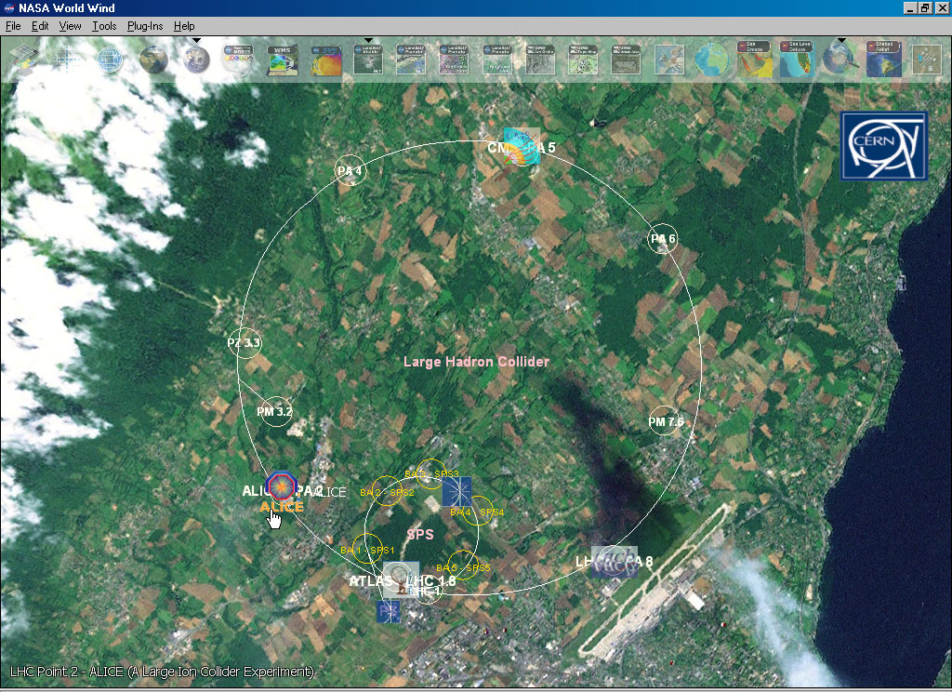

Slide 13
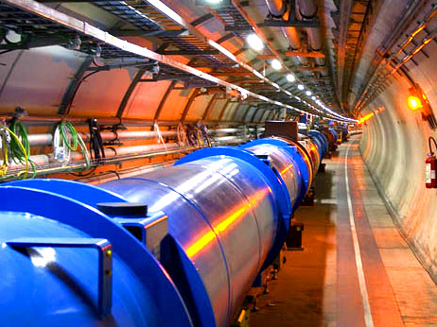

The Large Hadron Collider
26 659m circumference
9593 magnets: 1232 main dipoles (8T peak field)
Cooled to 1.9K (colder than outer space) by 120 tonnes of liquid Helium
Internal pressure 10-13 atm (10x less than on the Moon)
√s = 7TeV in 2010 and 2011
√s = 8TeV in 2012
50ns bunch crossing
Design √s = 14TeV and 25ns bunch crossing (7m at c)
Light aircraft carrier (10,000 tonne) traveling at 30km/h

Slide 14
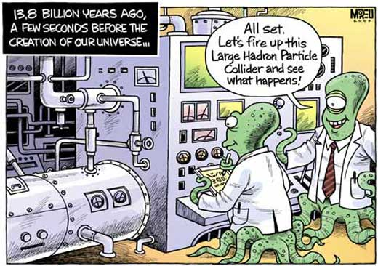

Slide 15
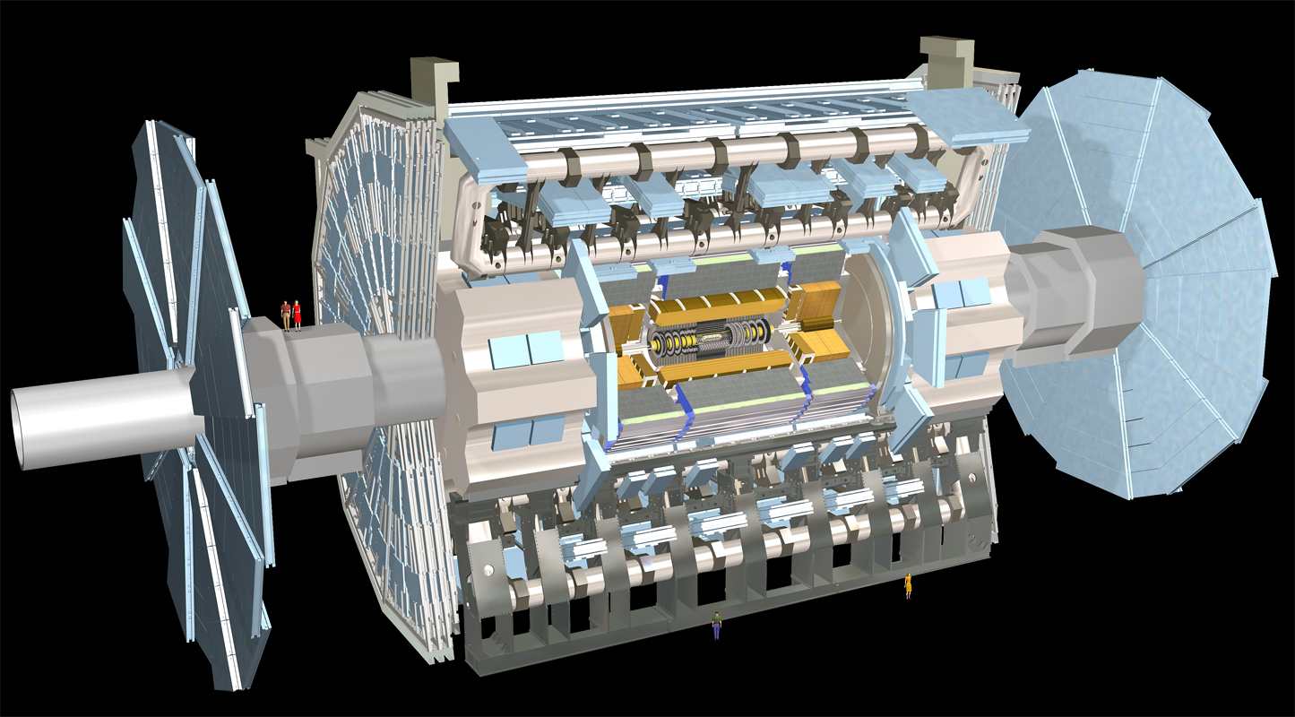
Muon Spectrometer: |η|<2.7
Air-core toroids and gas-based muon chambers
σ/p_{T} = 2% @ 50GeV to 10% @ 1TeV (ID+MS)
EM calorimeter: |η|<3.2
Pb-LAr Accordion
σ/E = 10%/√E ⊕ 0.7%
Hadronic calorimeter:
|η|<1.7 Fe/scintillator
1.3<|η|<4.9 Cu/W-Lar
σ/E_{jet}= 50%/√E ⊕ 3%
JINST (2008) 3 S08003
B field
L = 44 m, ∅ ≈ 25 m
7000 tonnes
≈10⁸ electronic channels
3-level trigger reducing 40 MHz collision rate to 200 Hz of events to tape
Inner Tracker: |η|<2.5, B=2T
Si pixels/strips and Trans. Rad. Det.
σ/p_{T} = 0.05% p_{T} (GeV) ⊕ 1%

Slide 16
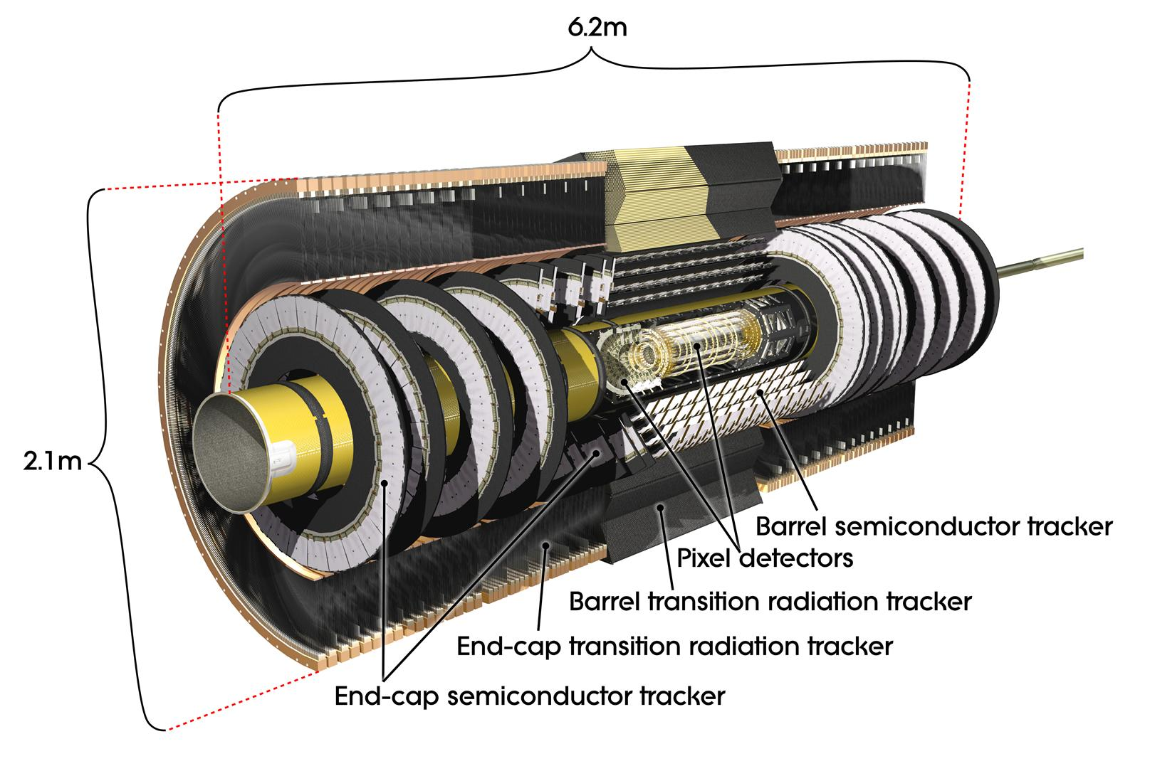
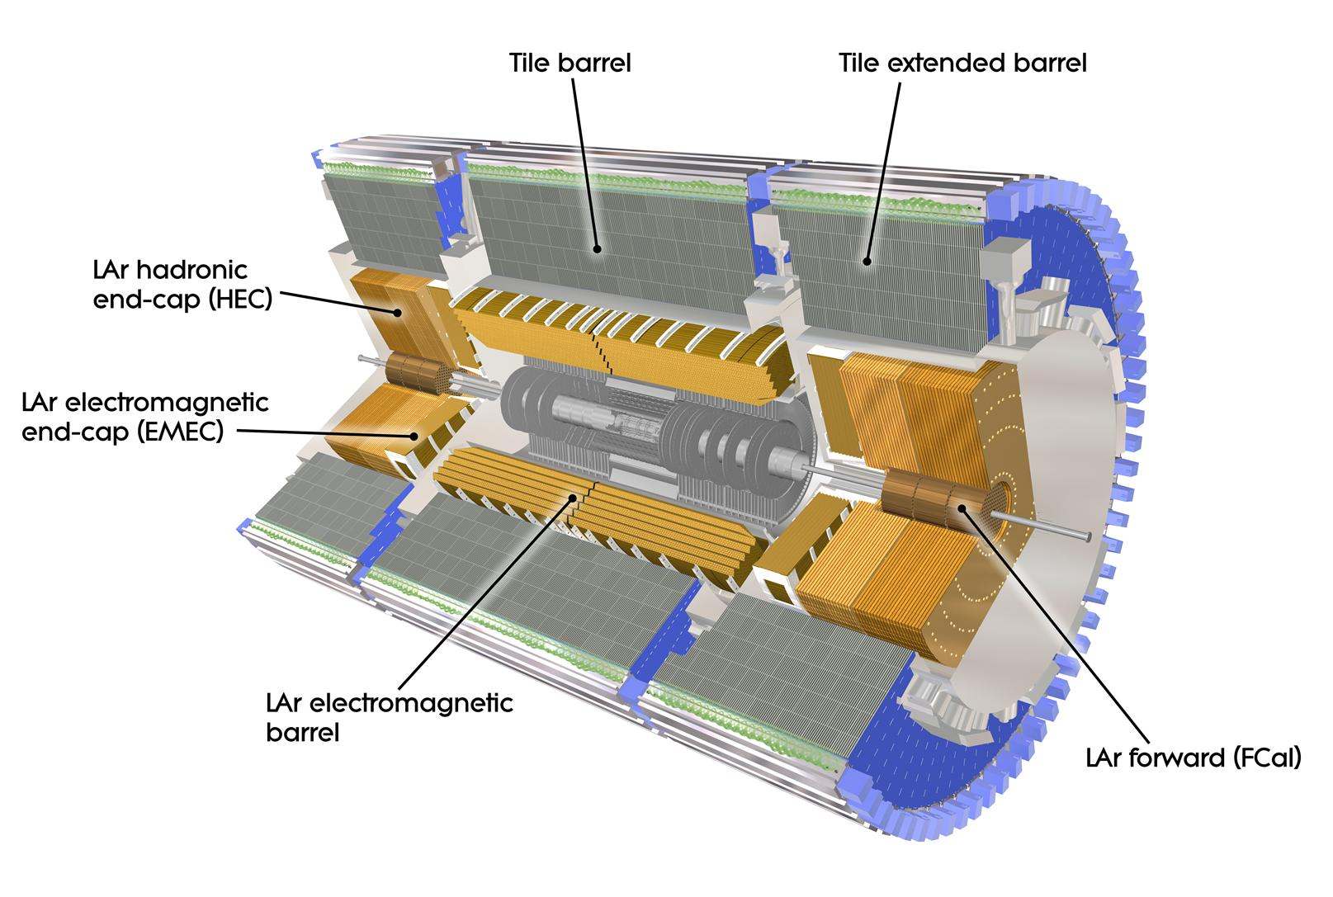
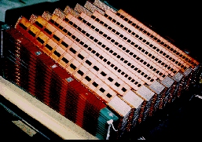
ATLAS
Large angular coverage (|η|<4.9; tracking coverage up to η~2.5)
Standalone muon spectrometer – separate fast muon chambers for trigger
Toroidal magnetic field in muon spectrometer (supercondutor air-core toroids)
Liquid Argon electromagnetic sampling calorimeter with accordion geometry
Pixel: 10x100μm; 80 M channels
Strips: 80μm; 6 M channels
160000 channels

Slide 18
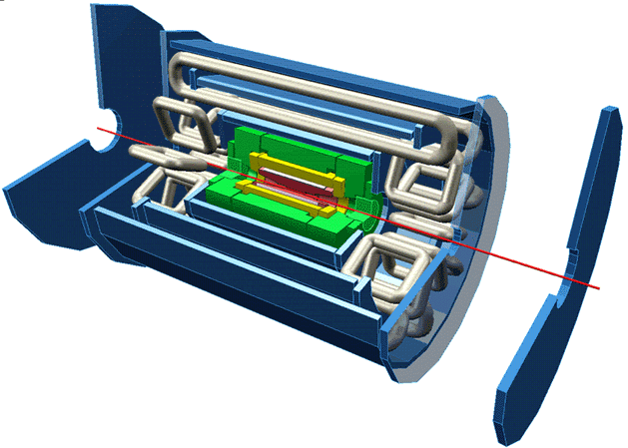
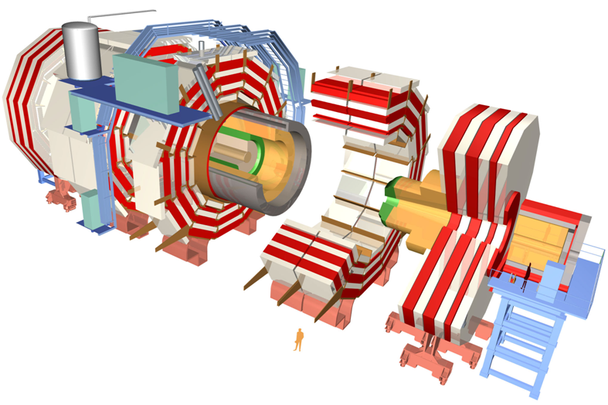
 | ATLAS | CMS
Magnetic field | 2 T solenoid + toroid (0.5 T barrel 1 T endcap) | 4 T solenoid + return yoke
Tracker | Si pixels, strips + TRT σ/p_{T} ≈ 5x10⁻⁴p_{T} + 0.01 | Si pixels, strips σ/p_{T} ≈ 1.5x10⁻⁴p_{T} + 0.005
EM calorimeter | Pb+LAr σ/E ≈ 10%/√E + 0.007 | PbWO4 crystals σ/E ≈ 2-5%/√E + 0.005
Hadronic calorimeter | Fe+scint. / Cu+LAr (10λ) σ/E ≈ 50%/√E + 0.03 GeV | Cu+scintillator (5.8λ + catcher) σ/E ≈ 100%/√E + 0.05 GeV
Muon | σ/p_{T} ≈ 2% @ 50GeV to 10% @ 1TeV (ID+MS) | σ/p_{T} ≈ 1% @ 50GeV to 5% @ 1TeV (ID+MS)
Trigger | L1 + RoI-based HLT (L2+EF) | L1+HLT (L2 + L3)

Slide 19
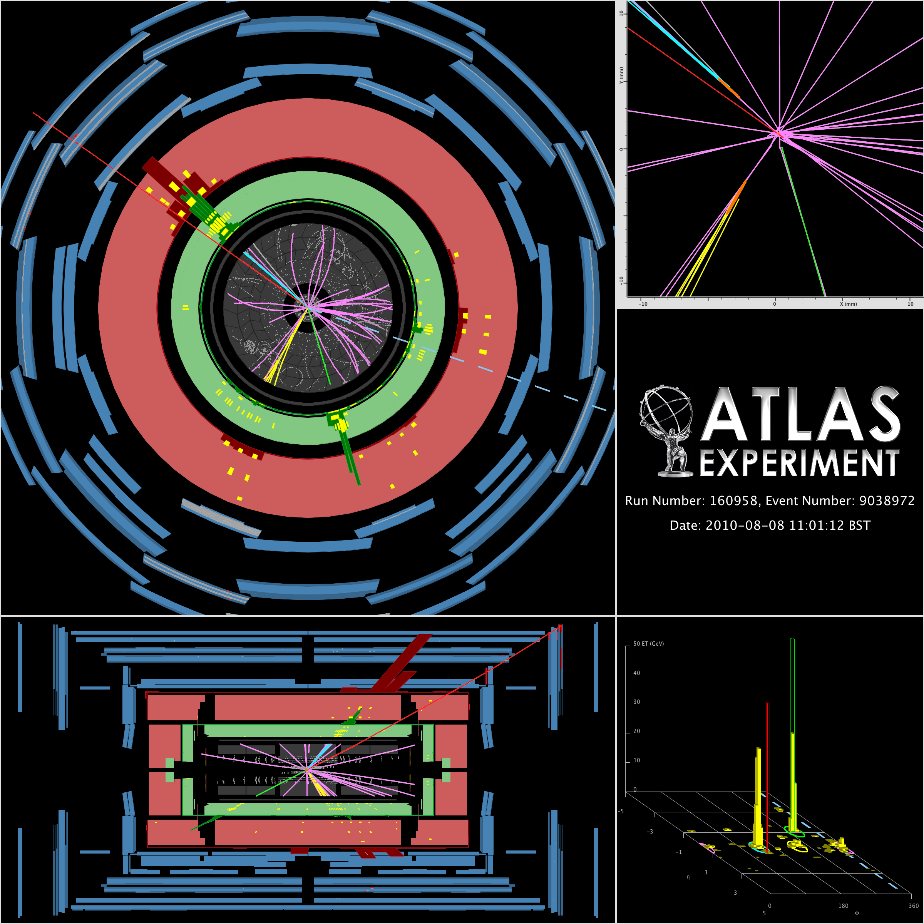
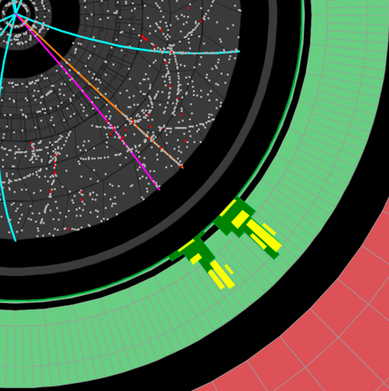
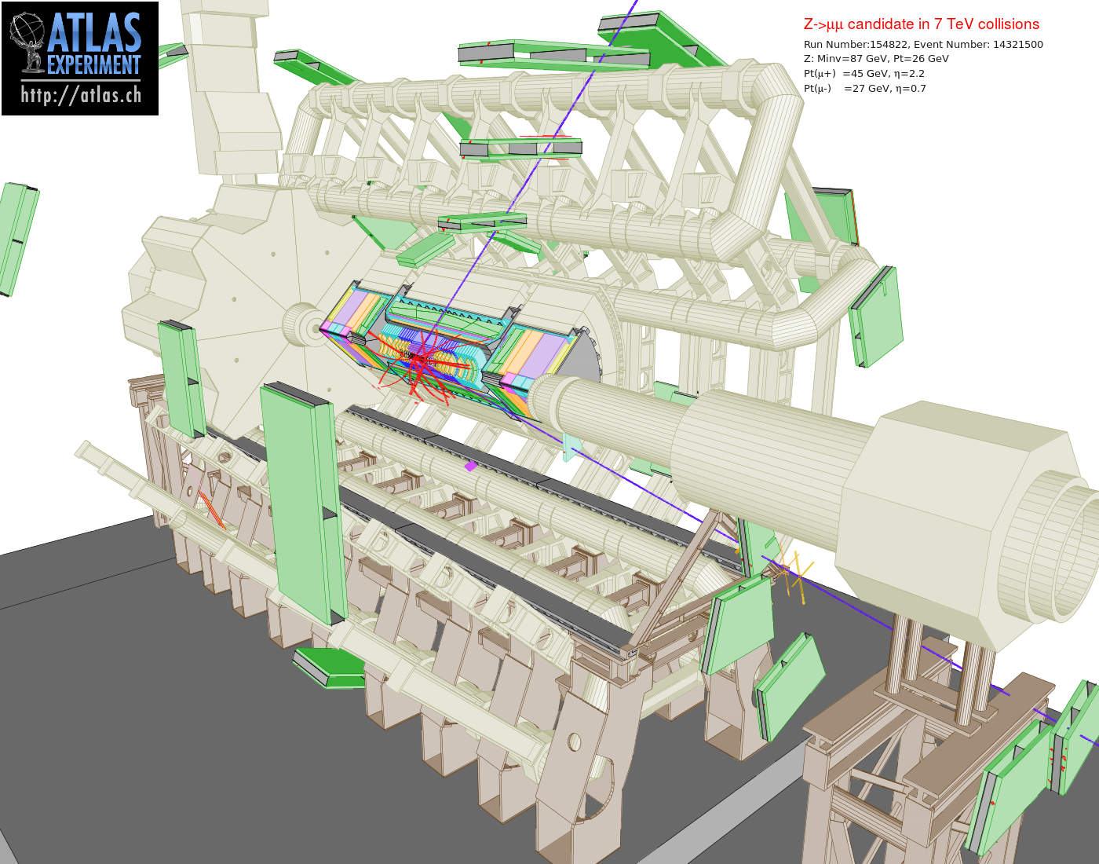
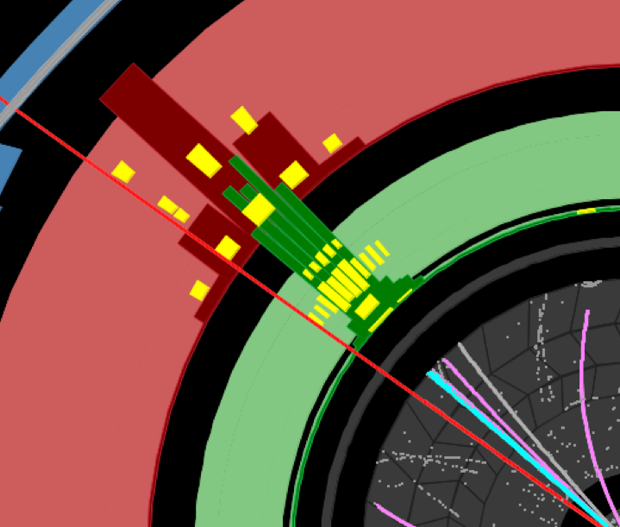
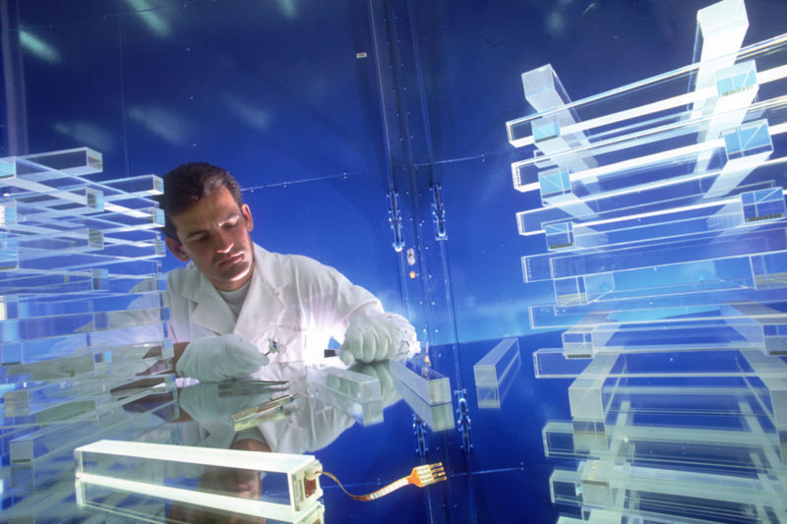
Event Reconstruction
Detector design is a balance between precision to reconstruct particles of interest, feasibility, cost, etc
  E.g. CMS electromagnetic calorimeter: excellent energy resolution for photons – designed with H->γγ in mind
Event reconstruction:
  Go from information in every sub-detector to reconstructed physical objects:
  Muons (inner detector + muon spectrometer)
  Electrons, tau leptons, hadronic jets, b-quark initiated jets (inner detector+ calorimeter)
  etc

Slide 20
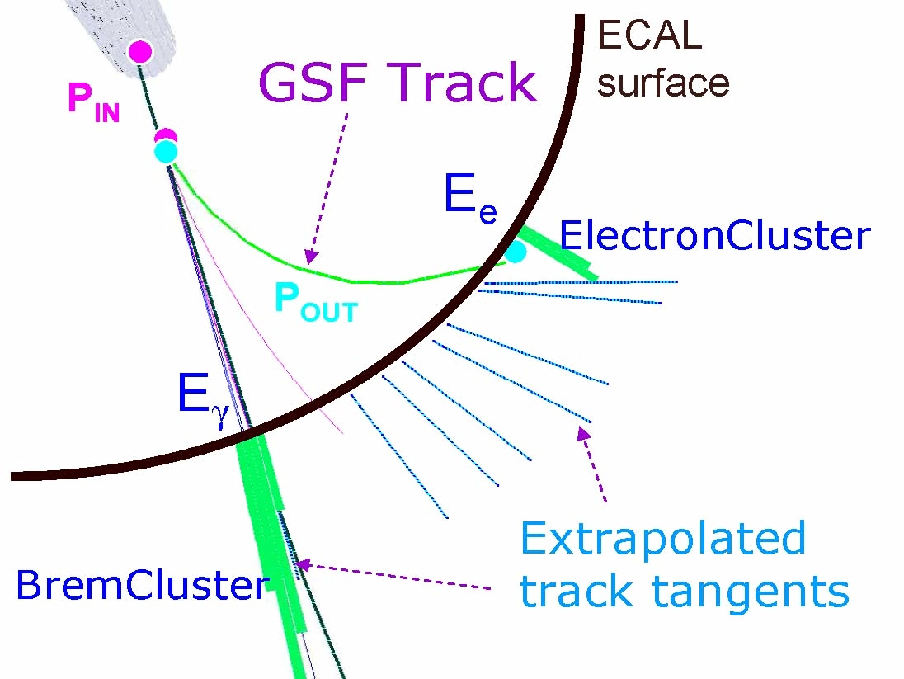
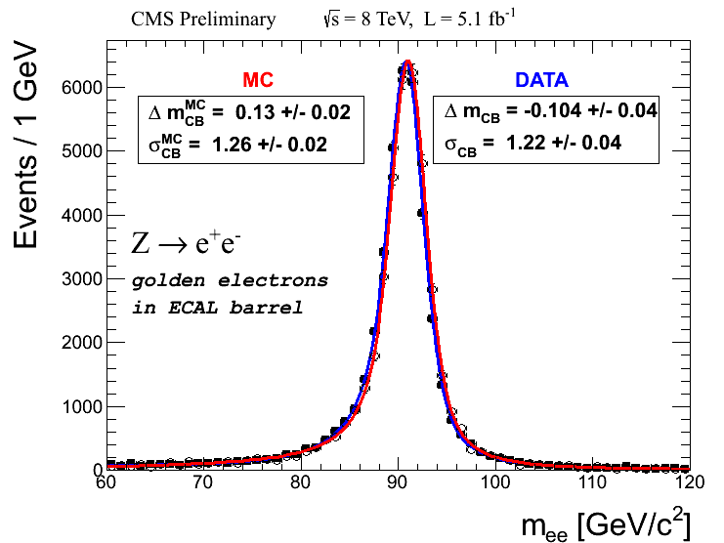
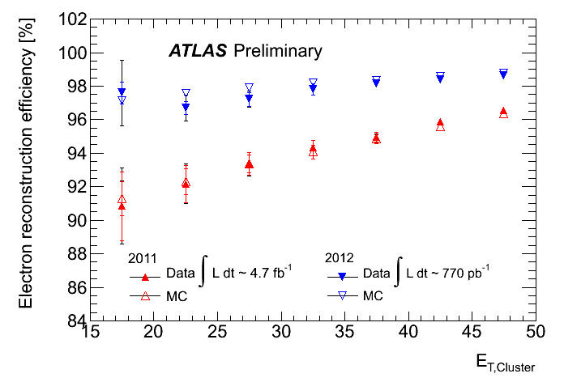
Electron & Photon Reconstruction
Electrons
ECAL Barrel

Slide 21
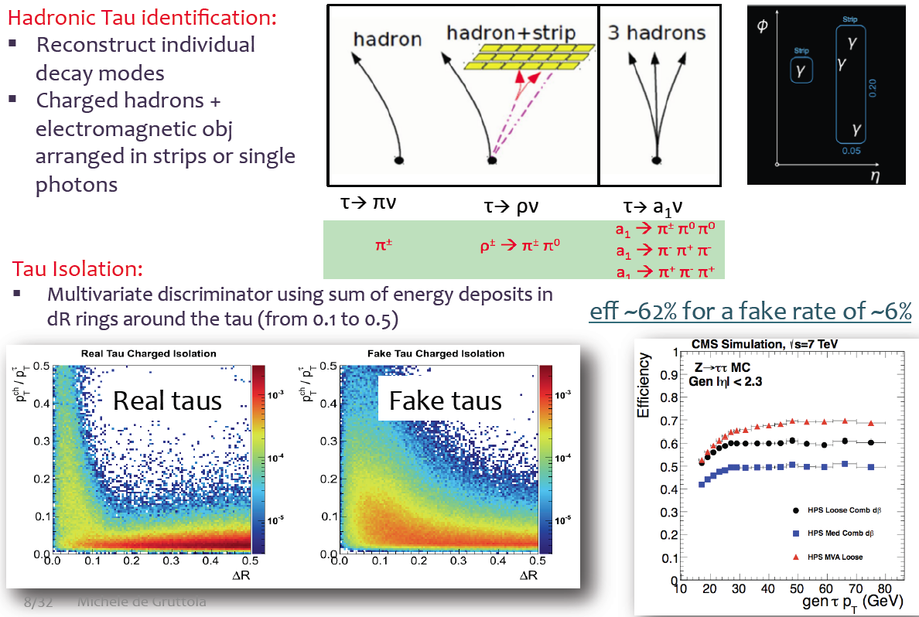
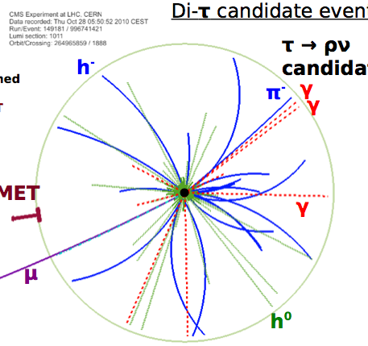
τ → hadron Reconstruction (CMS)

Slide 22
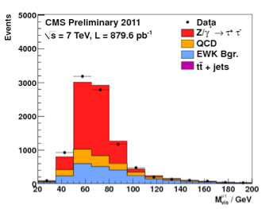
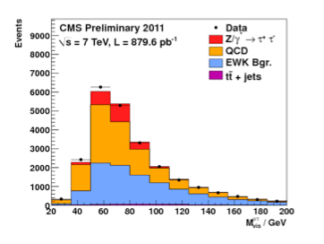
τ Identification and Energy Scale
Using Tag & Probe on Z→ττ→τμ
events in data for eff. with 6%
Misidentification rate measured in W+jets
& Multi-jet events
passed
Tau energy scale is within 3%
failed

Slide 23
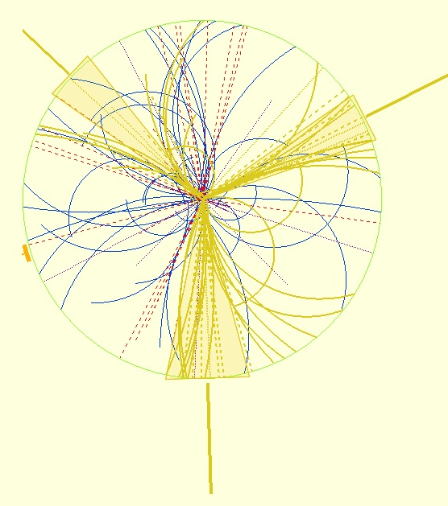
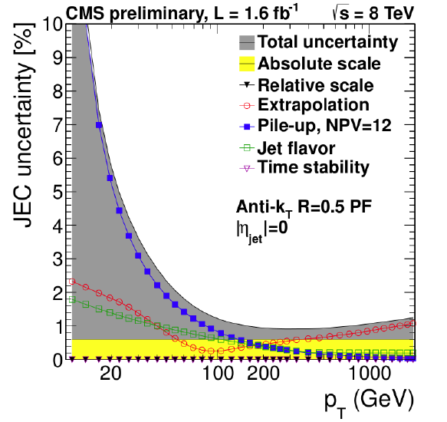
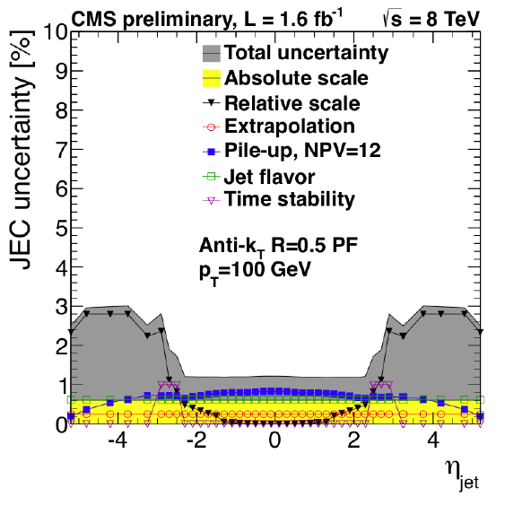
Jet Reconstruction
Jets reconstructed in a cone of ΔR≈0.4 (ATLAS) and ΔR≈0.5 (CMS)
Jet Energy Correction:
  Electronic noise
  Detector calibration & reconstruction efficiencies
  Energy deposits from pileup
  Dependence on η & P_{T}

Slide 24
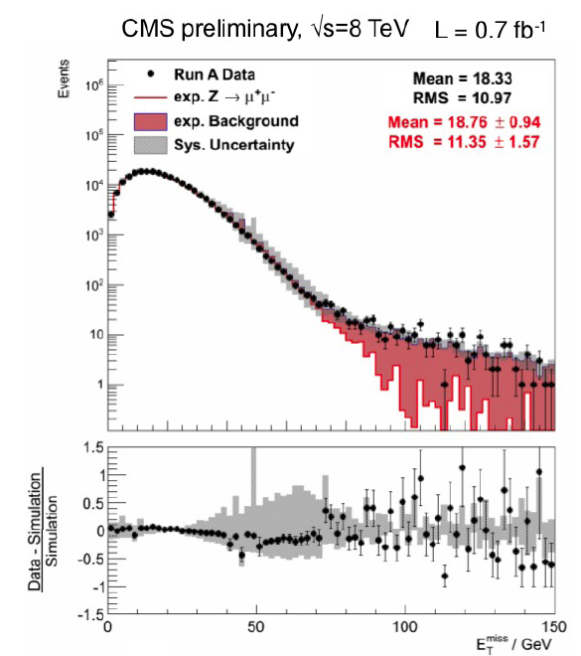
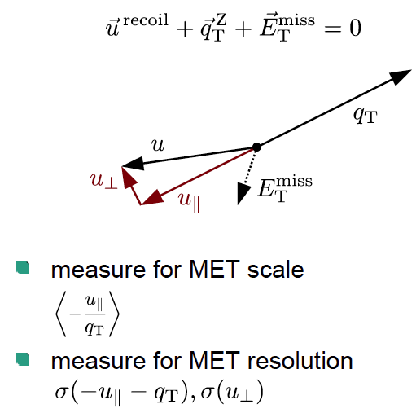
Transverse Missing Energy (M_{ET})
Energy conservation in direction transverse to colliding p-p beams
Need to account for
  Non-linear calorimeter response
  Instrumental noise, poorly instrumented area
  mis-measured objects
Use Z → μμ events with no intrinsic MET
to measure MET resolution
Z→μμ

Slide 25
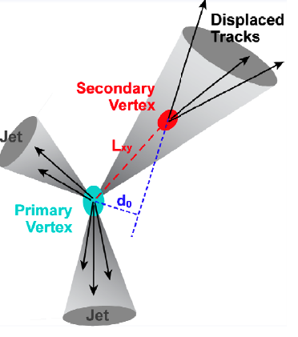
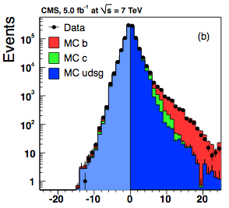
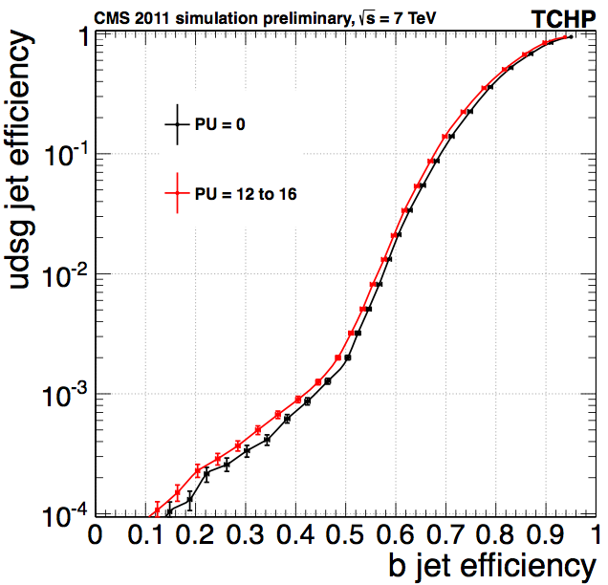
b-Jet Identification
B-lifetime ≈ 1.5ps, <βγcτ> ≈ 1800μ
Tracks from b-hadron decay have large P_{T}
Average multiplicity ≈ 6
B-taggers based on
  Large signed impact parameter significance
  Secondary vertex with large decay length
Mistag rate measured from “negative tags”
Signed decay length
of B vertex
Signed impact parameter of tracks in the jet
+
Operating
point

Slide 26
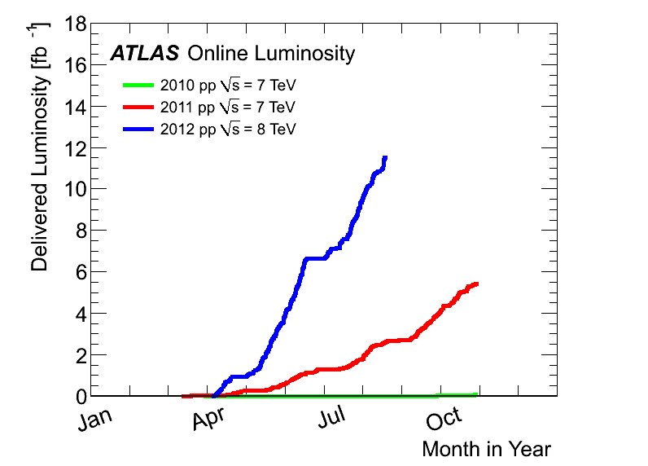
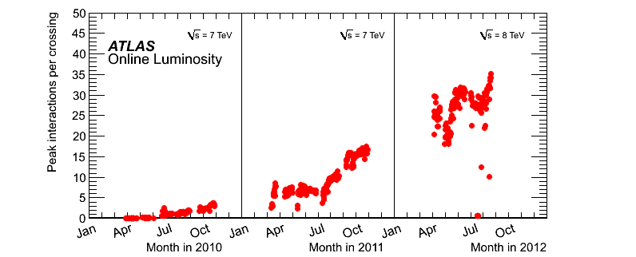
LHC Luminosity
2010 – ≈45 pb⁻¹ / experiment
  No chance of searching for Higgs boson
  But needed to understand our brand new detector!
2011 – ≈5 fb-1 per experiment
  Things start to be (very) interesting
  Tevatron breathing down the LHC’s metaphorical neck
2012 – ≈11 fb⁻¹ / experiment up to yesterday … and counting
  New Particle discovery announced!
And the rest is (will be) history

Slide 27
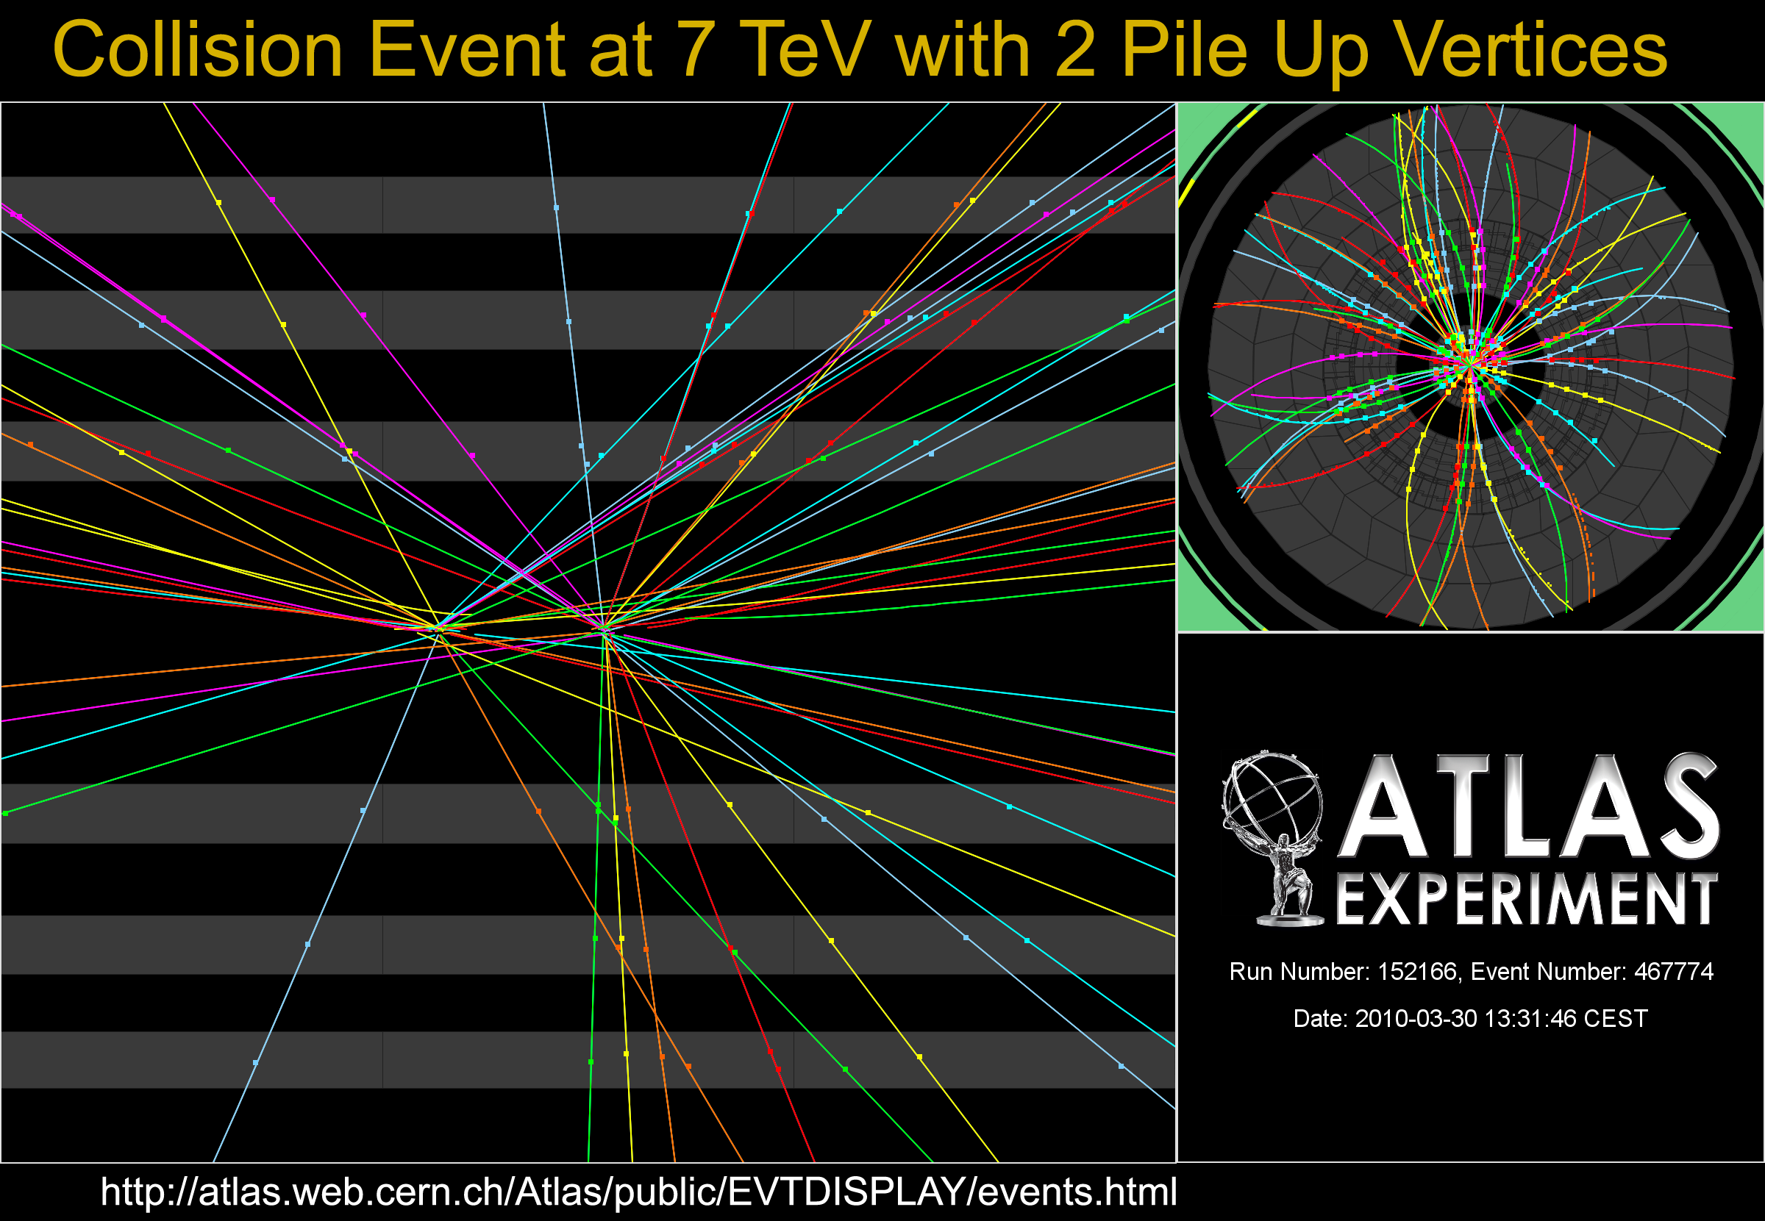
ATLAS: Pileup Evolution: 2010

Slide 28
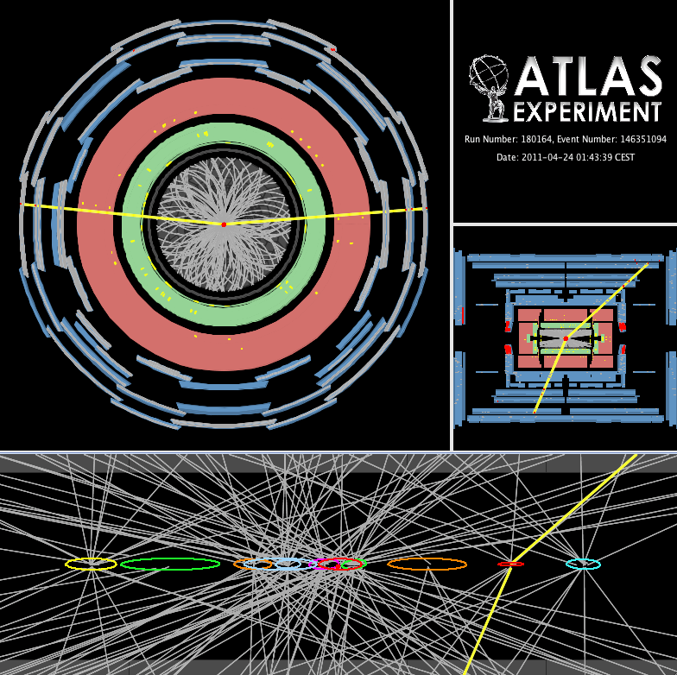
ATLAS: Pileup Evolution: 2011
11 vertices

Slide 29
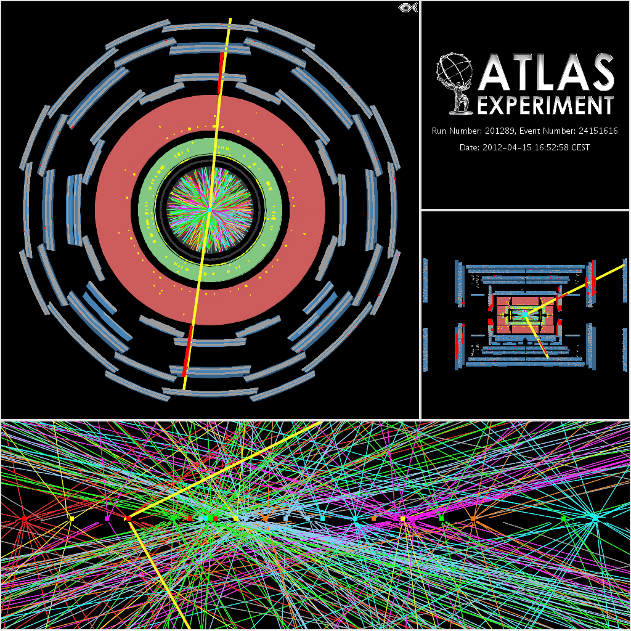
ATLAS: Pileup Evolution: 2012
25 vertices
<μ>≈35 is now common
Means ≈45 early in
the LHC fill

Slide 30
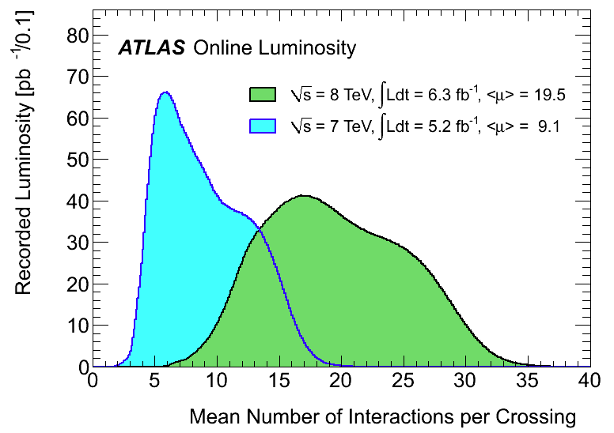
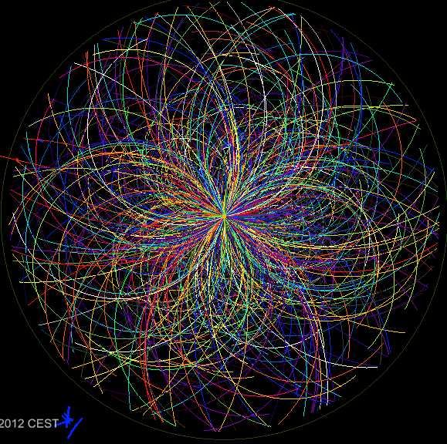
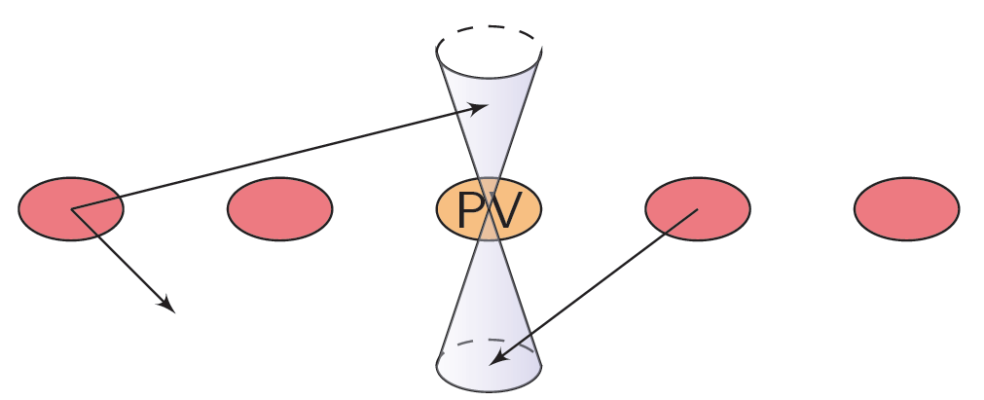

Pileup & Its Consequences
Many more particles to reconstruct
  ➔more CPU &
memory in event
reconstruction
Contaminated Jets
  (due to additional particles)
Worsening of MET resolution
  (more objects to sample)
Worsening of Isolation observables
Ambiguity in hard-scatter vertex identification, e.g. H → γγ
N_{PV}

Slide 31


Mitigating Pileup
Detector level mitigation: Readout over smaller time slice
  Significantly reduces OOT pileup
Remove from consideration charged hadrons that originate from pileup vertices
Amount of additional pileup energy is determined by the jet area (A) and the energy per unit area (ρ)
  and subtracted
Take advantage of the topological shape differences between jets from pileup and more collimated jets from hard-scatter of partons
Typical jet
Pileup jet

Slide 32

Hadron Collider Variables
p
p_{T}= psinθ
Z
θ
Pseudorapidity η = - ln(tanθ/2))
μ
Use relativistic cylindrical coordinates (r,η,ϕ)
  dN/dη is invariant for boosts along z for particles in a jet
For object definitions, identification criteria etc. use
cones with apex at interaction point and a radius ΔR:
  ΔR= √[(Φ-Φ₀)²+(η-η₀)²]
  where (Φ₀, η₀ ) gives the flight direction of object –e,μ,γ,τ.jets etc
ΔR

Slide 33
Trigger
First step in every physics analysis!
Much of LHC physics means cross sections x10⁶ times smaller than total cross section
ATLAS offline processing: ≈400 Hz
  ≈10 events per million crossings!
In one second at design luminosity:
  40 000 000 bunch crossings
  ≈2000 W events
  ≈500 Z events
  ≈10 top events
  400 events written out
Should take the right 400 events!...
Different designs in ATLAS and CMS
  ATLAS has 3 processing levels; Region-of-Interest driven reconstruction; event built after Level 2
  CMS has 3 levels but event built after Level 1
Also different strategies:
  ATLAS has most bandwidth assigned to exclusive triggers, e.g. muon trigger (+ anything)
  CMS relies more on exclusive triggers e.g. muon + 2 jets
7 TeV

Slide 34


Old History – Rediscovering The SM
Several Nobel prize winning
discoveries of 20th century
“rediscovered” within few months

Slide 35
Part II: Tools of the Trade
Statistics Survival Guide

Slide 36
The Brazil Plot
Expected:
Upper limit on σ(S+B)/σ(B) at 95% CL in Monte Carlo assuming B-only hypothesis
Observed:
Upper limit on σ(S+B)/σ(B) at 95% CL seen in data assuming B-only hypothesis

Slide 37

The p0 Discovery Plot
p0 is the probability that the background fluctuates to look like signal
Translated into the one-sided Gaussian probability

Slide 38

The Cyan Band Plot – signal strength
Best fit of μ=σ(S+B)/σ(B) to data
Error bands important…. As usual!

Slide 39
Part III: Higgs Hunting at the LHC

Slide 40





CERN-2011-002; arXiv:1101.0593
At √s = 8TeV cross sections 20-30% higher than at 7 TeV
Notes:
Main production channels: gluon fusion, Vector Boson Fusion, associated production with vector bosons, associated production with ttbar pair
Animation

Slide 41


Higgs Boson Decay Channels
Gluon-fusion has highest cross section
  BUT only useful in decay channels not overwhelmed by multi-jet background: H->γγ, H->ZZ, H->WW
VBF still not easy to distinguish from multi jets
H->ττ and H->bb very challenging due to very large backgrounds
Not only the production cross section matters
Decay branching ratio depends strongly on Higgs boson mass
5 decay modes studied:
  High mass: ZZ, WW
  Low mass: bb, ττ, γγ, WW, ZZ
Nature was kind! At m_{H}≈125GeV many channels can be used for measurements. Redundancy!

Slide 42
ICHEP results:
Higgs Decay | Final state | Mass range [GeV] | L [fb⁻¹]
H->γγ |  | 110 – 150 | 4.8+5.9
H->ZZ | lll’l’ | 110 – 600 | 4.8+5.8
 | llνν | 200 – 600 | 4.7
 | llqq | 200 – 600 | 4.7
H->WW | lνlν | 110 – 600 | 4.7+5.8
 | lνqq | 300 – 600 | 4.7
H->ττ | ll4ν | 110 – 150 | 4.7
 | lτ_{had}3ν | 110 – 150 | 4.7
 | τ_{had}τ_{had}2ν | 110 – 150 | 4.7
H->bb | llbb | 110 – 130 | 4.7
 | lνbb | 110 – 130 | 4.7
 | ννbb | 110 – 130 | 4.7

Slide 43

Blind Analysis
To avoid unintended experimenter’s bias in search for the Higgs boson
The analysis strategy, event selection & optimization criteria for each Higgs search channel were fixed by looking at data control samples before looking at the signal sensitive region
  Logistically quite painful
  But the right thing to do !

Slide 44

H->γγ
√s = 8 TeV
• ET1 = 62.2 GeV
• ET2 = 55.5 GeV
• E1 = 66.9 GeV
• E2 = 99.2 GeV
• Mγγ = 126.9 GeV

Slide 45



Diphoton mass reconstruction
m2γγ= 2 E1 E2 (1-cosα)
Present understanding of calorimeter E response (from Z, J/ψ -> ee, W -> eν data and MC):
  E-scale at m_{Z} known to ~ 0.3%
  Linearity better than 1% (few-100 GeV)
  “Uniformity” (constant term of resolution): ~ 1% (2.5% for 1.37<|η|<1.8)
High pile-up: many vertices distributed over
σZ (LHC beam spot) ~ 5-6 cm => difficult to know which one has produced the γγ pair
Primary vertex from:
  EM calorimeter longitudinal (and lateral) segmentation
  Tracks from converted photons
Calorimeter pointing alone reduces vertex uncertainty from beam spot spread of ~ 5-6 cm to ~ 1.5 cm and is robust against pile-up
  Good enough to make contribution to mass
Resolution from angular term negligible
Addition of track information (less pile-up robust) needed to reject fake jets from pile-up in 2j/VBF category
ϑ

Slide 46


Optimization wrt 2011 analysis
Neural-net based photon ID for 2011 data
Re-optimized cut-based photon ID for 2012, stable with high pileup
New ‘2-jets’ category to enhanced sensitivity to VBF
Events divided in 10 categories based on:
  γ rapidity,
  converted/unconverted γ;
  p_{Tt} (p_{T}^{γγ} perpendicular to γγ thrust axis);
  2jets (VBF-like)

Slide 47

Backgrounds
Main backgrounds:
  Continuum γγ production
  Followed by γ mis-identification
Smooth mγγ spectrum
  Use sidebands to fit sum of backgrounds
Confirm each background source by data-driven techniques
  E.g. reverse quality cuts on photon identification

Slide 48

Results
Combined m_{γγ} from all 10 categories and 7/8 TeV data

Slide 49

Exclusion at 95% C.L. :
Expected: 110 < mH < 139.5 GeV
Observed: 112 < mH < 122.5 GeV 132 < mH < 143 GeV

Slide 50


Results in more detail

Slide 51


Slide 52

H->ZZ(*)->4l
pT (muons)= 36.1, 47.5, 26.4, 71 .7 GeV m12= 86.3 GeV, m34= 31.6 GeV. 15 reconstructed vertices

Slide 53
The ”golden channel”:
  Small rates, but high S/B
  Can be fully reconstructed; mass resolution ~2% at 130 GeV
Cross section times branching ratio (at mH=125 GeV):
~ 4 fb at √s=7 TeV
~ 5 fb at √s=8 TeV
Backgrounds:
  Irreducible: pp->ZZ(*)->4l
  Reducible: Z+jets, Zbb, tt (sizeable at low Higgs masses)
Suppress backgrounds with isolation and impact parameters cut on two softest
Leptons
  Mass range under consideration: 110 GeV to 600 GeV
  Four final states: 4e, 4μ, 2e2μ, 2μ2e

Slide 54


Slide 55


Slide 56


H➝bb Searches in WH production

Slide 57


Slide 58


Slide 59


Slide 60


Slide 61
Where We Stand

Slide 62


Slide 63


Slide 64
References
J. Ellis, J.R. Espinosaa, G.F. Giudice, A. Hoecker and A. Riotto, The Probable Fate of the Standard Model, arXiv:0906.0954v2 [hep-ph], CERN-PH-TH/2009-058
Search for the Higgs boson in the H-­‐>WW-­‐>lnujj decay channel at sqrt(s) = 7 TeV with the ATLAS detector -­‐-­‐ CERN-­‐ PH-­‐EP-­‐2012-­‐162 -­‐-­‐ arXiv:1206.6074v1 [hep-­‐ex]
Search for a Standard Model Higgs boson in the mass range 200-­‐-­‐600 GeV in the H-­‐>ZZ-­‐>llqq decay channel with the ATLAS Detector -­‐-­‐ ATLAS-­‐CONF-­‐2012-­‐017 -­‐-­‐ arXiv:1206.2443
Search for a Standard Model Higgs boson in the mass range 200-­‐600 GeV in the H-­‐>ZZ-­‐>llqq decay channel -­‐-­‐ CERN-­‐PH-­‐EP-­‐2012-­‐125 -­‐-­‐ arXiv:1206.2443v1 [hep-­‐ex]
Search for the Standard Model Higgs boson in the diphoton decay channel with 4.9 T-­‐1 of ATLAS data at sqrt(s)=7 TeV -­‐-­‐ ATLAS-­‐CONF-­‐2011-­‐161 -­‐-­‐ arXiv:1202.1414
Search for the Standard Model Higgs boson in the decay channel H-­‐>ZZ(*)-­‐>4l with 4.8 T-­‐1 of pp collisions at sqrt(s) = 7 TeV with the ATLAS detector -­‐-­‐ Phys.Lev. B710 (2012) 383-­‐402 -­‐-­‐ arXiv:1202.1415
Search for the Standard Model Higgs boson in the H → WW(*) → lνlν decay mode with 4.7 T-­‐1 of ATLAS data at √s = 7 TeV -­‐-­‐ ATLAS-­‐CONF-­‐2012-­‐012, ATLAS-­‐CONF-­‐2012-­‐060 -­‐-­‐ arXiv:1206.0756
Search for the Standard Model Higgs boson in the H -­‐> tau tau decay mode in sqrt(s) = 7 Tev pp collisions with ATLAS -­‐-­‐ ATLAS-­‐CONF-­‐2012-­‐014 -­‐-­‐ arXiv:1206.5971
Search for the Standard Model Higgs boson produced in associaAon with a vector boson and decaying to a b-­‐quark pair with the ATLAS detector -­‐-­‐ CERN-­‐PH-­‐EP-­‐2012-­‐138 -­‐-­‐ arXiv:1207.0210v1 [hep-­‐ex
An update to the combined search for the Standard Model Higgs boson with the ATLAS detector at the LHC using up to 4.9 T−1 of pp collision data at √s = 7 TeV -­‐-­‐ ATLAS-­‐CONF-­‐2012-­‐019 -­‐-­‐ arXiv:1207.0319
Calculated cross sections:
LHC Higgs Cross Section Working Group, Handbook of LHC Higgs Cross Sections: 1. Inclusive Observables -­‐-­‐ arXiv:1101.0593, arXiv:1201.3084

Slide 65
Statistics
E. Gross, Statistical Issues for Higgs Physics, lecture at the SLAC Summer Institute, 2012
G. Cowan, K. Cramner, E. Gross and O. Vitells, Asymptotic formulae for likelihood-based tests of new physics, Eur. Phys. J. C71 (2011) 1554
A.L. Read, Presentation of search results: the CL(s) technique, J. Phys, G28 (2002) 2893
E. Gross and O. Vitells, Trial factors for the look elsewhere effect in high energy physics, Eur. Phys. J. C70 (2010) 525
L. Moneta et al., The RooStats project, arXiv:1009.1003
T. Junk, Confidence level computation for combining searches with small statistics, Nucl. Instr. Meth. A 434 (1999) 435

Slide 66
BACKUP SLIDES

Slide 67


Slide 68


Slide 69

Particle Detectors
Detectors and accelerators which push the boundaries of technology
But that would need a much longer talk…

Slide 70


Jets and Heavy Flavour Tagging

Slide 71


Slide 72

Trigger / DAQ architecture
CERN
computer
centre
4-code dual-socket nodes
6
~1600
~100
~ 500
Event rate
~ 200 Hz
Local
Storage
SubFarm
Outputs
(SFOs)
Event
Filter
(EF)
Event
Builder
SubFarm
Inputs
(SFIs)
LVL2
farm
Second-
level
trigger
Data
storage
DataFlow
Manager
Network
switches
pROS
stores
LVL2
output
Network switches
LVL2
Super-
visor
Gigabit Ethernet
Event data requests
Delete commands
Event data
pulled:
partial events
@ ≤ 100 kHz,
full events
@ ~ 3 kHz
Event size
~1.5MB
Requested event data
Regions Of Interest
Data of events accepted
by first-level trigger
~150
PCs
1600
Read-
Out
Links
VME
Dedicated links
Read-Out
Subsystems
(ROSs)
Read-
Out
Drivers
(RODs)
RoI
Builder
First-
level
trigger
Timing Trigger Control (TTC)
Event data pushed @ ≤ 100 kHz,
1600 fragments of ~ 1 kByte each

Slide 73
The ATLAS trigger
Three trigger levels:
Level 1:
  Hardware based (FPGA/ASIC)
  Coarse granularity detector data
  Calorimeter and muons only
  Latency 2.2 μs (on-detector buffer)
  Output rate ~75 kHz
Level 2:
  Software based
  Only detector sub-regions (Regions of Interest) processed; seeded by level 1
  Full detector granularity in RoIs
  Fast tracking and calorimetry
  Average execution time ~10 ms
  Output rate ~1 kHz
Event Filter (EF):
  Seeded by level 2
  Full detector granularity
  Potential full event access
  Offline algorithms
  Average execution time ~1 s
  Output rate ~200 Hz
High-Level Trigger

Slide 74

Selection method
Level1 Region of Interest is found and position in EM calorimeter is passed to Level 2
EMROI
L2 calorim.
Event rejection possible at each step
cluster?
Electromagnetic
clusters
Level 2 seeded by Level 1
Fast reconstruction algorithms
Reconstruction within RoI
L2 tracking
track?
match?
E.F.calorim.
E.F.tracking
Ev.Filter seeded by Level 2
Offline reconstruction algorithms
Refined alignment and calibration
track?
e/γ reconst.
e/γ OK?

Slide 75



Interlude: Vector Boson Fusion
Established by Zeppenfeld et al. for low-mass region
Earlier studies by Dokshitzer, Khoze, Sjöstrand, Troyan, Kleiss, Stirling
Important for low-mass region
  Improve significance
  Measure Higgs parameters
Two high-p_{T} tag jets with large rapidity gap in between
No color flow between tag jets – suppressed hadronic activity in central region
Studied in Higgs decays to WW, ττ
Pseudorapidity of leading jet in VBF H➔ττ and tt
Preliminary

Slide 76





  Leptons from the Higgs are likely to be close together
Main search channel for mass in range: 2m_{W} < m_{H} < 2m_{Z}
Highest branching ratio above ~140 GeV/c² : 95% @ m_{H} = 160 GeV/c²
Analyses:
  H + 0 jets -> lνlν (dominated by gluon fusion)
  H + 2 jets -> lνlν; H + 2 jets -> lνqq (dominated by VBF)
Main backgrounds: WW, Wt, tt
W⁺
H
W⁺
μ⁺
W⁻
ν_{μ}
W⁻
e⁻
ν_{e}
Preliminary
Two main discriminants:
  Angular correlation between leptons
  Veto on additional jets

