Slide 1









Update of the European Strategy for Particle Physics
The European Frontier of Particle Physics
Ricardo Gonçalo – Laboratório de Instrumentação e Física Experimental de Partículas

Slide 2
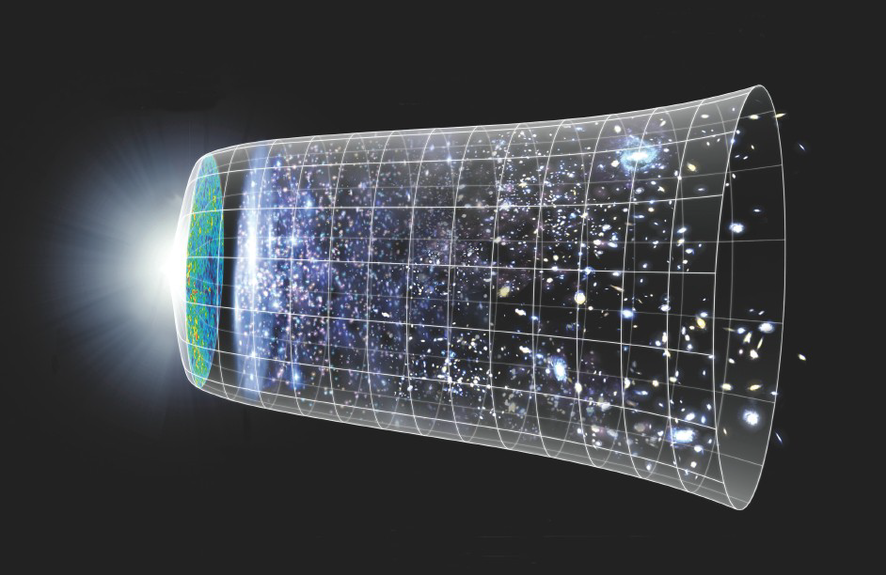

What is particle physics?
Particle physics
You are here
The Universe today
The Big Bang

Slide 3
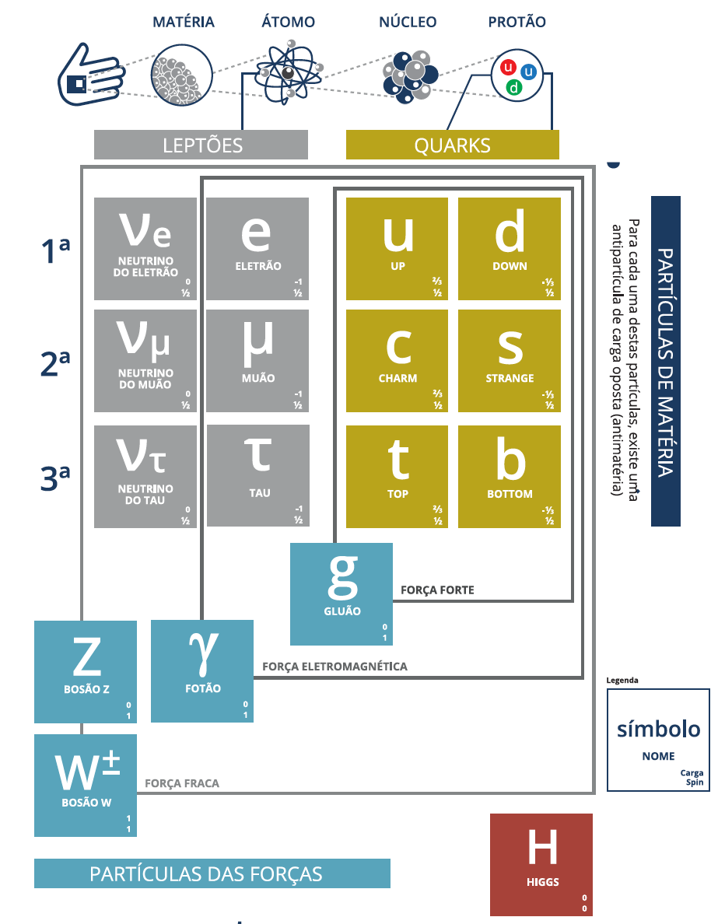
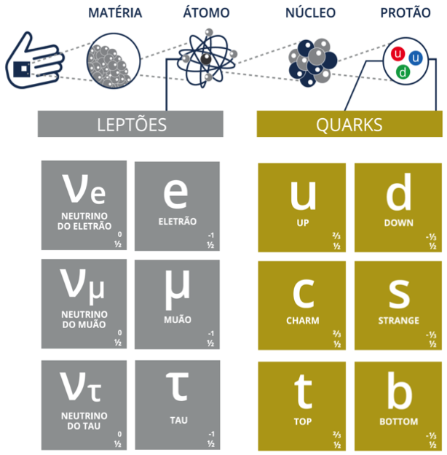
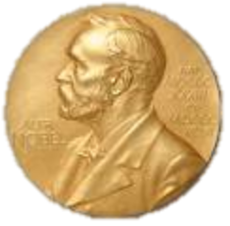
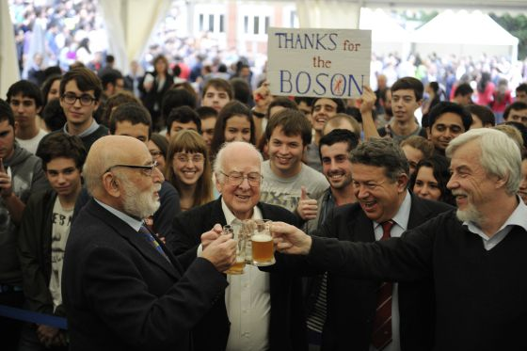
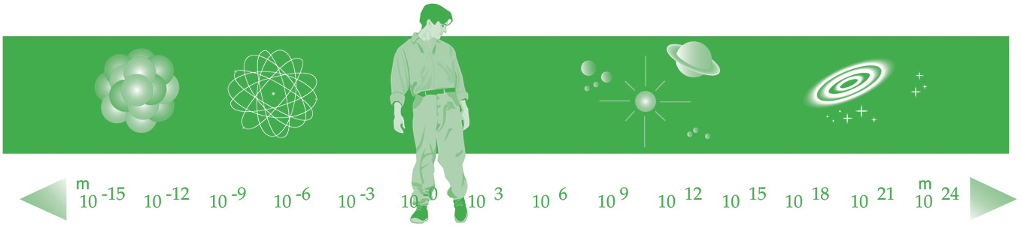
What do we know (so far)?
2015
This way to Particle Physics
2013
Notes:
The study of the elementary constituents of matter and their interactions.
What is the Universe made of? (…how did it develop and how will be its future?)
This means exploring smaller and smaller scales… The Big Bang The Universe today 2

Slide 4
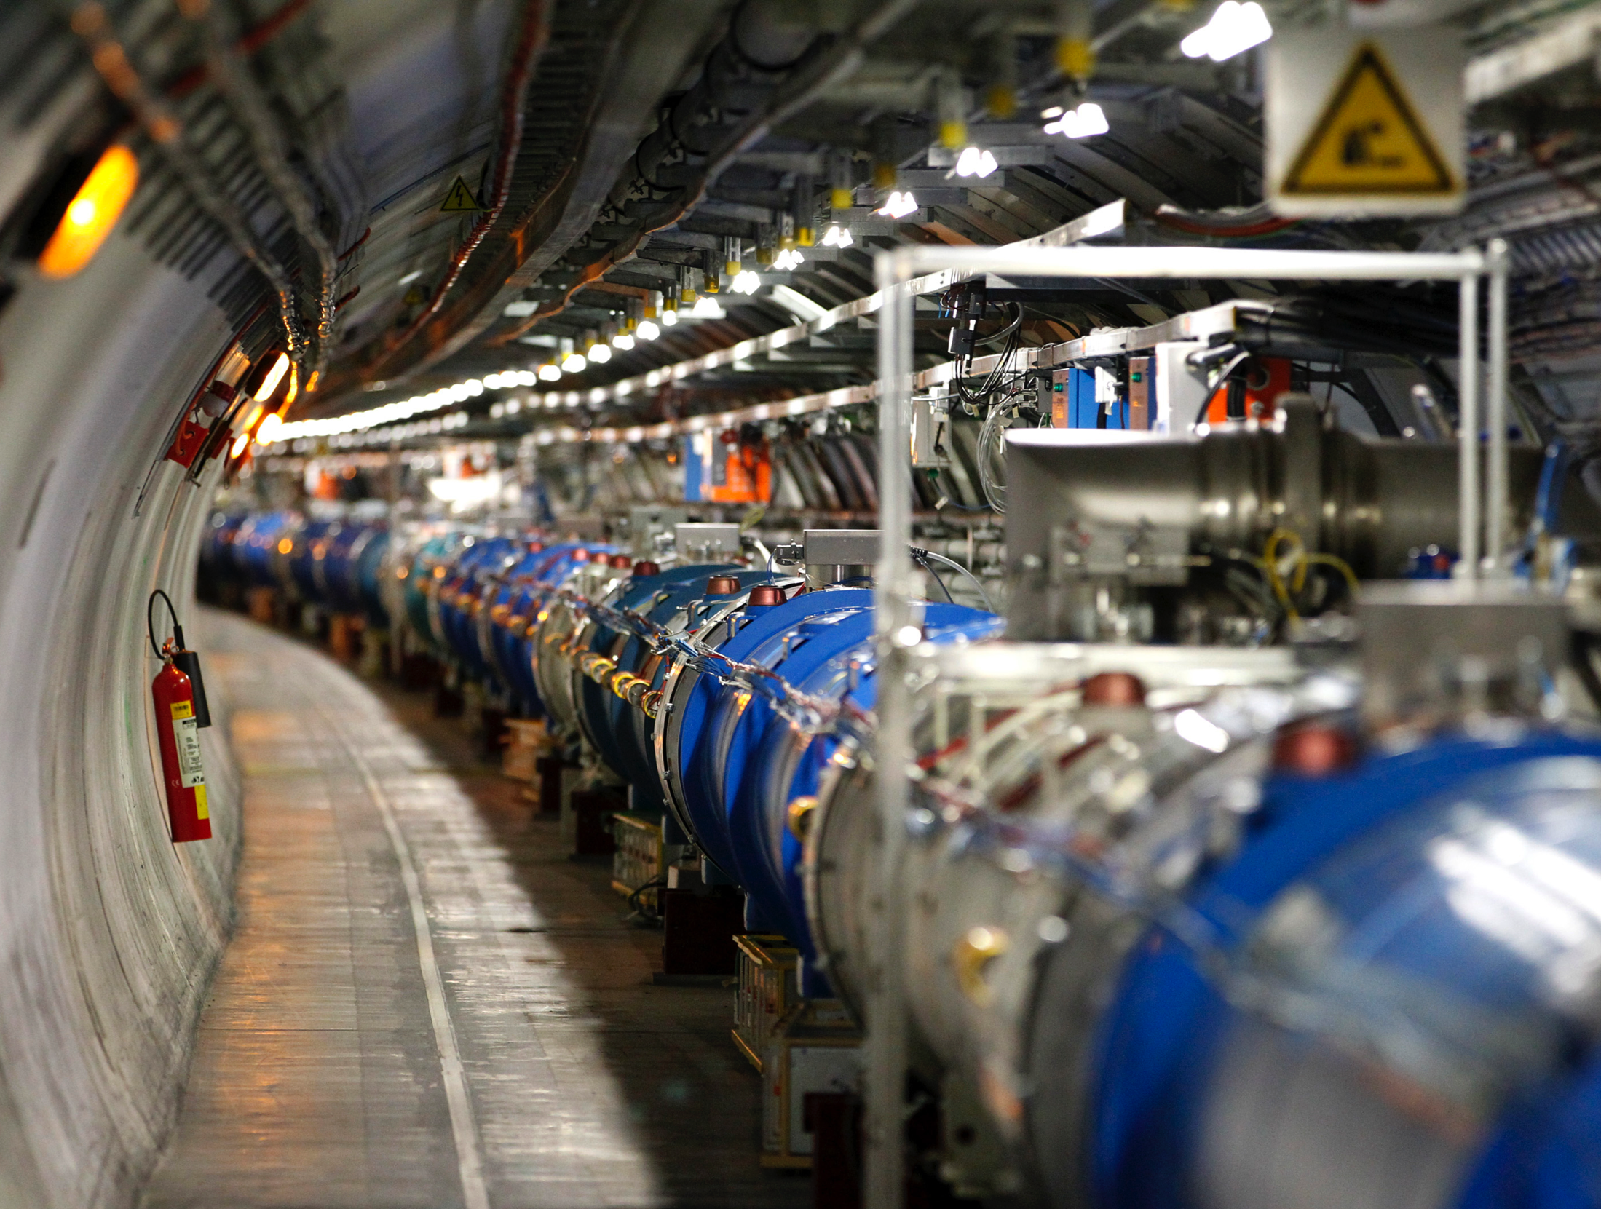
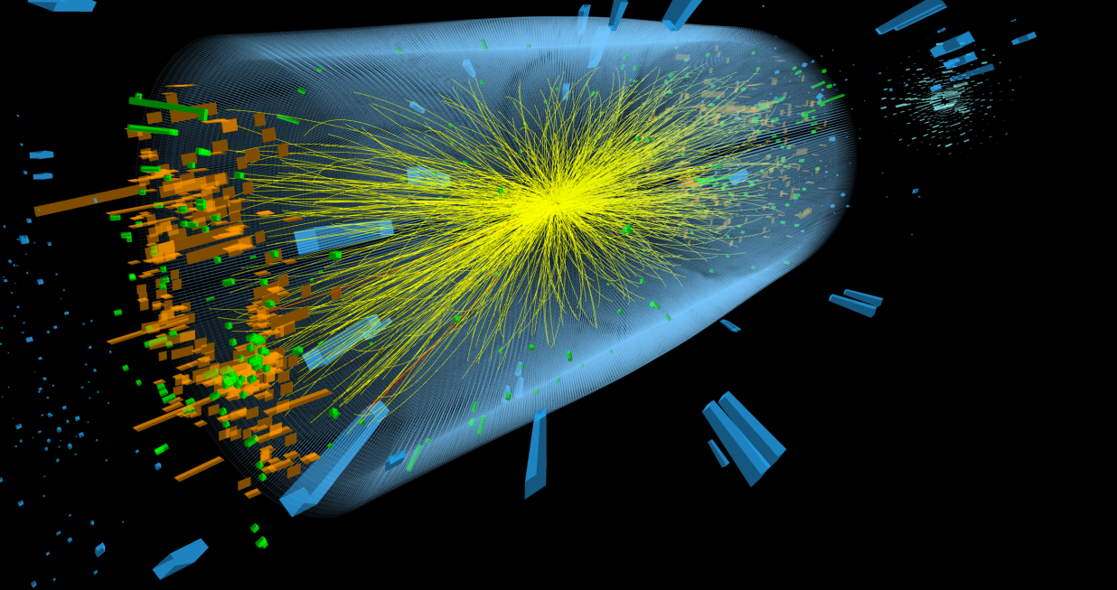
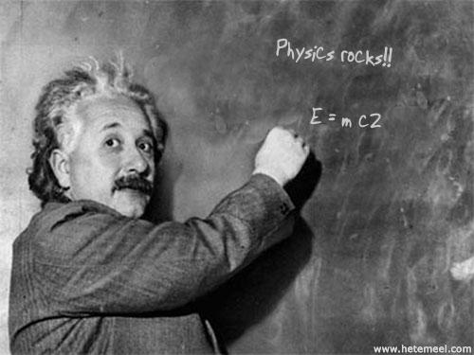
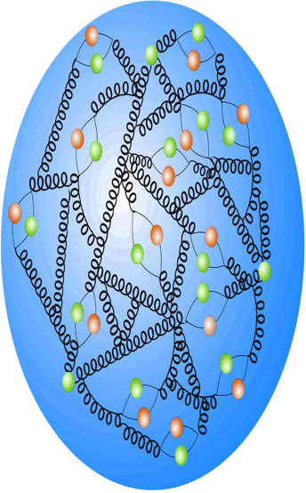
How do we know all this??
Notes:
Esta não é uma palestra sobre o vazio interestelar. É uma palestra sobre o vazio entre os átomos, dentro dos átomos, mesmo dentro do núcleo dos átomos.
Para explorar o infinitamente pequeno precisamos da física de partículas!

Slide 5
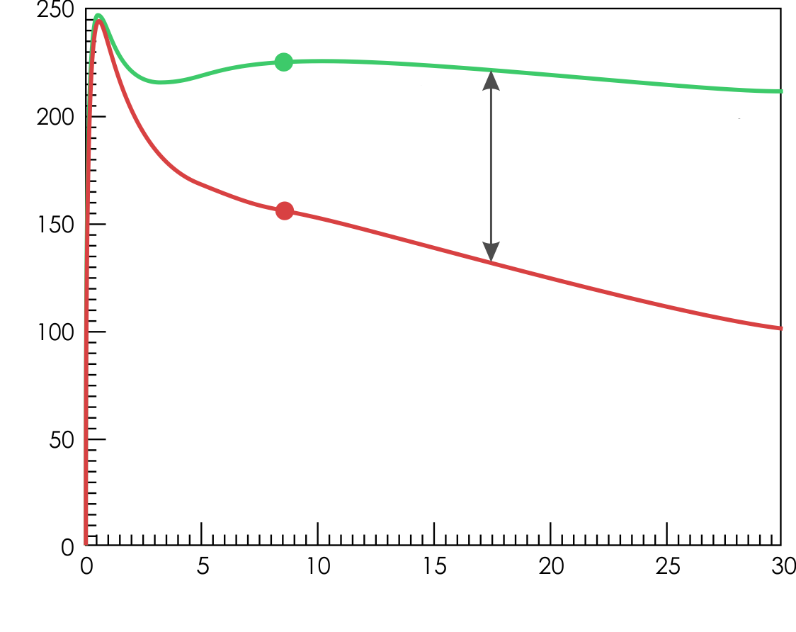
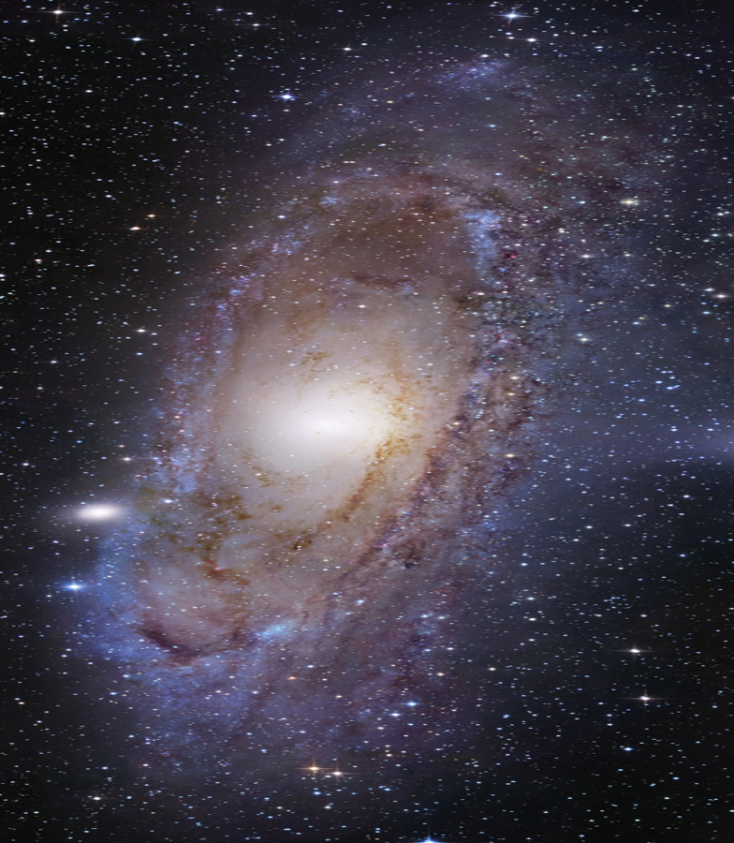
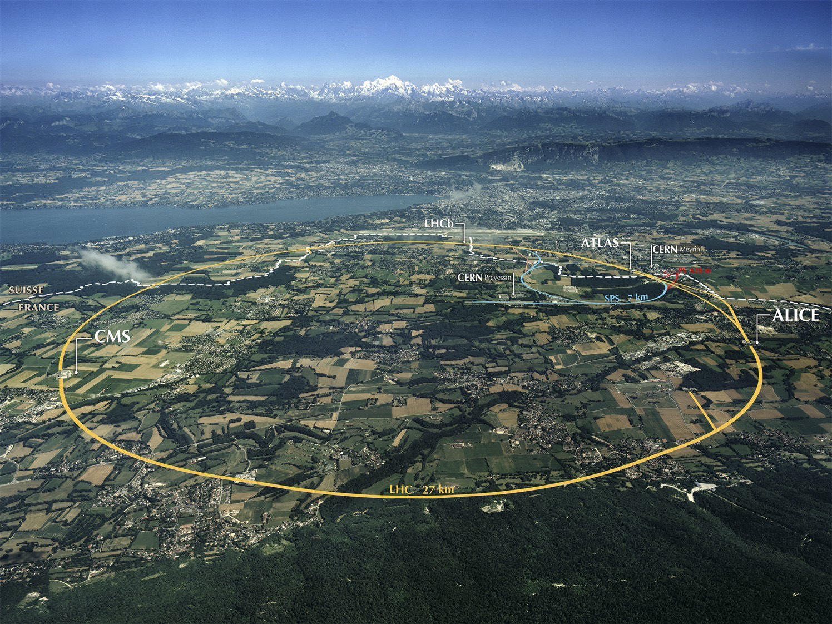
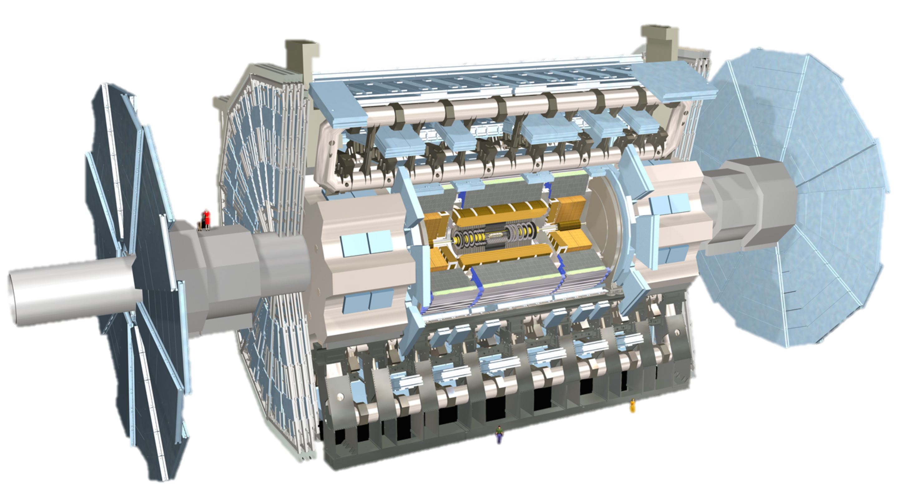
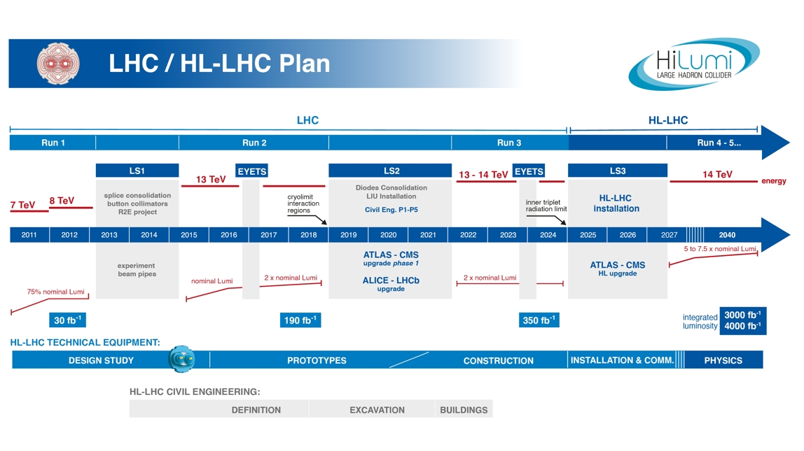
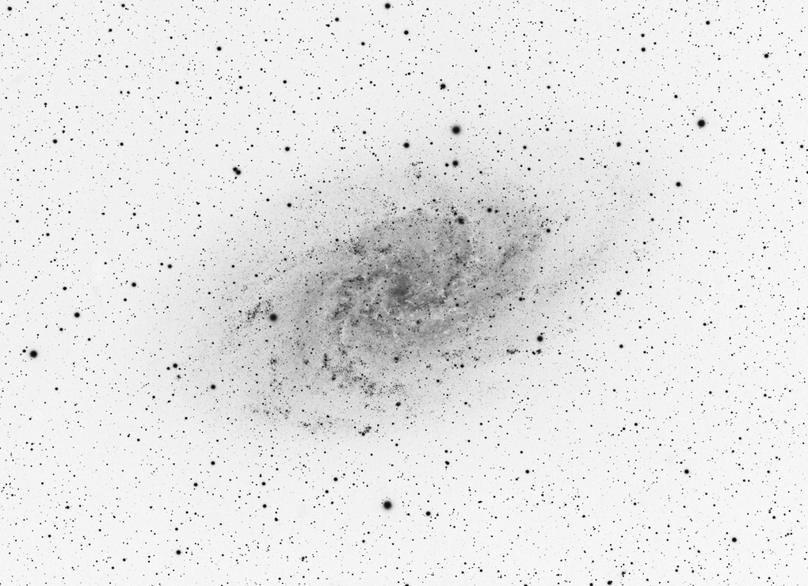
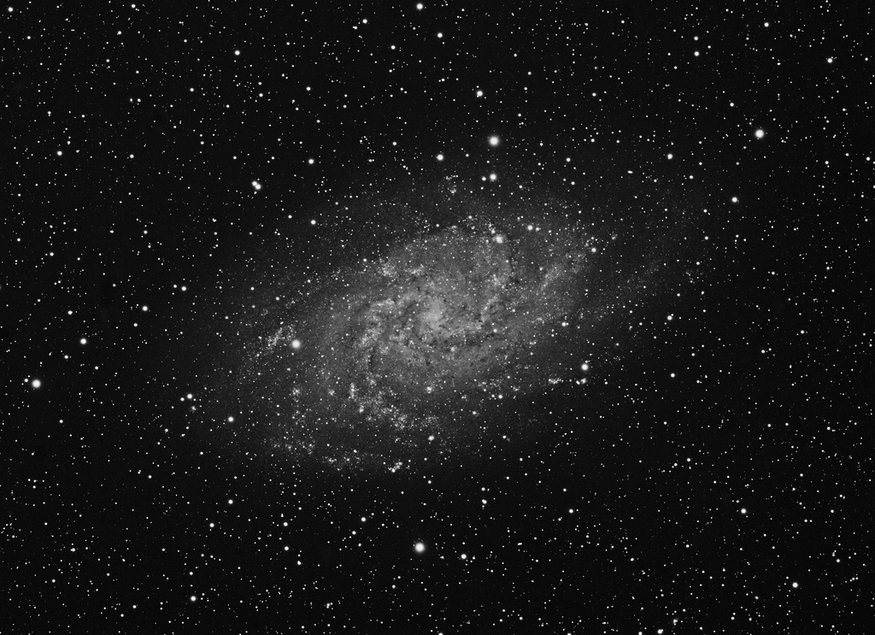
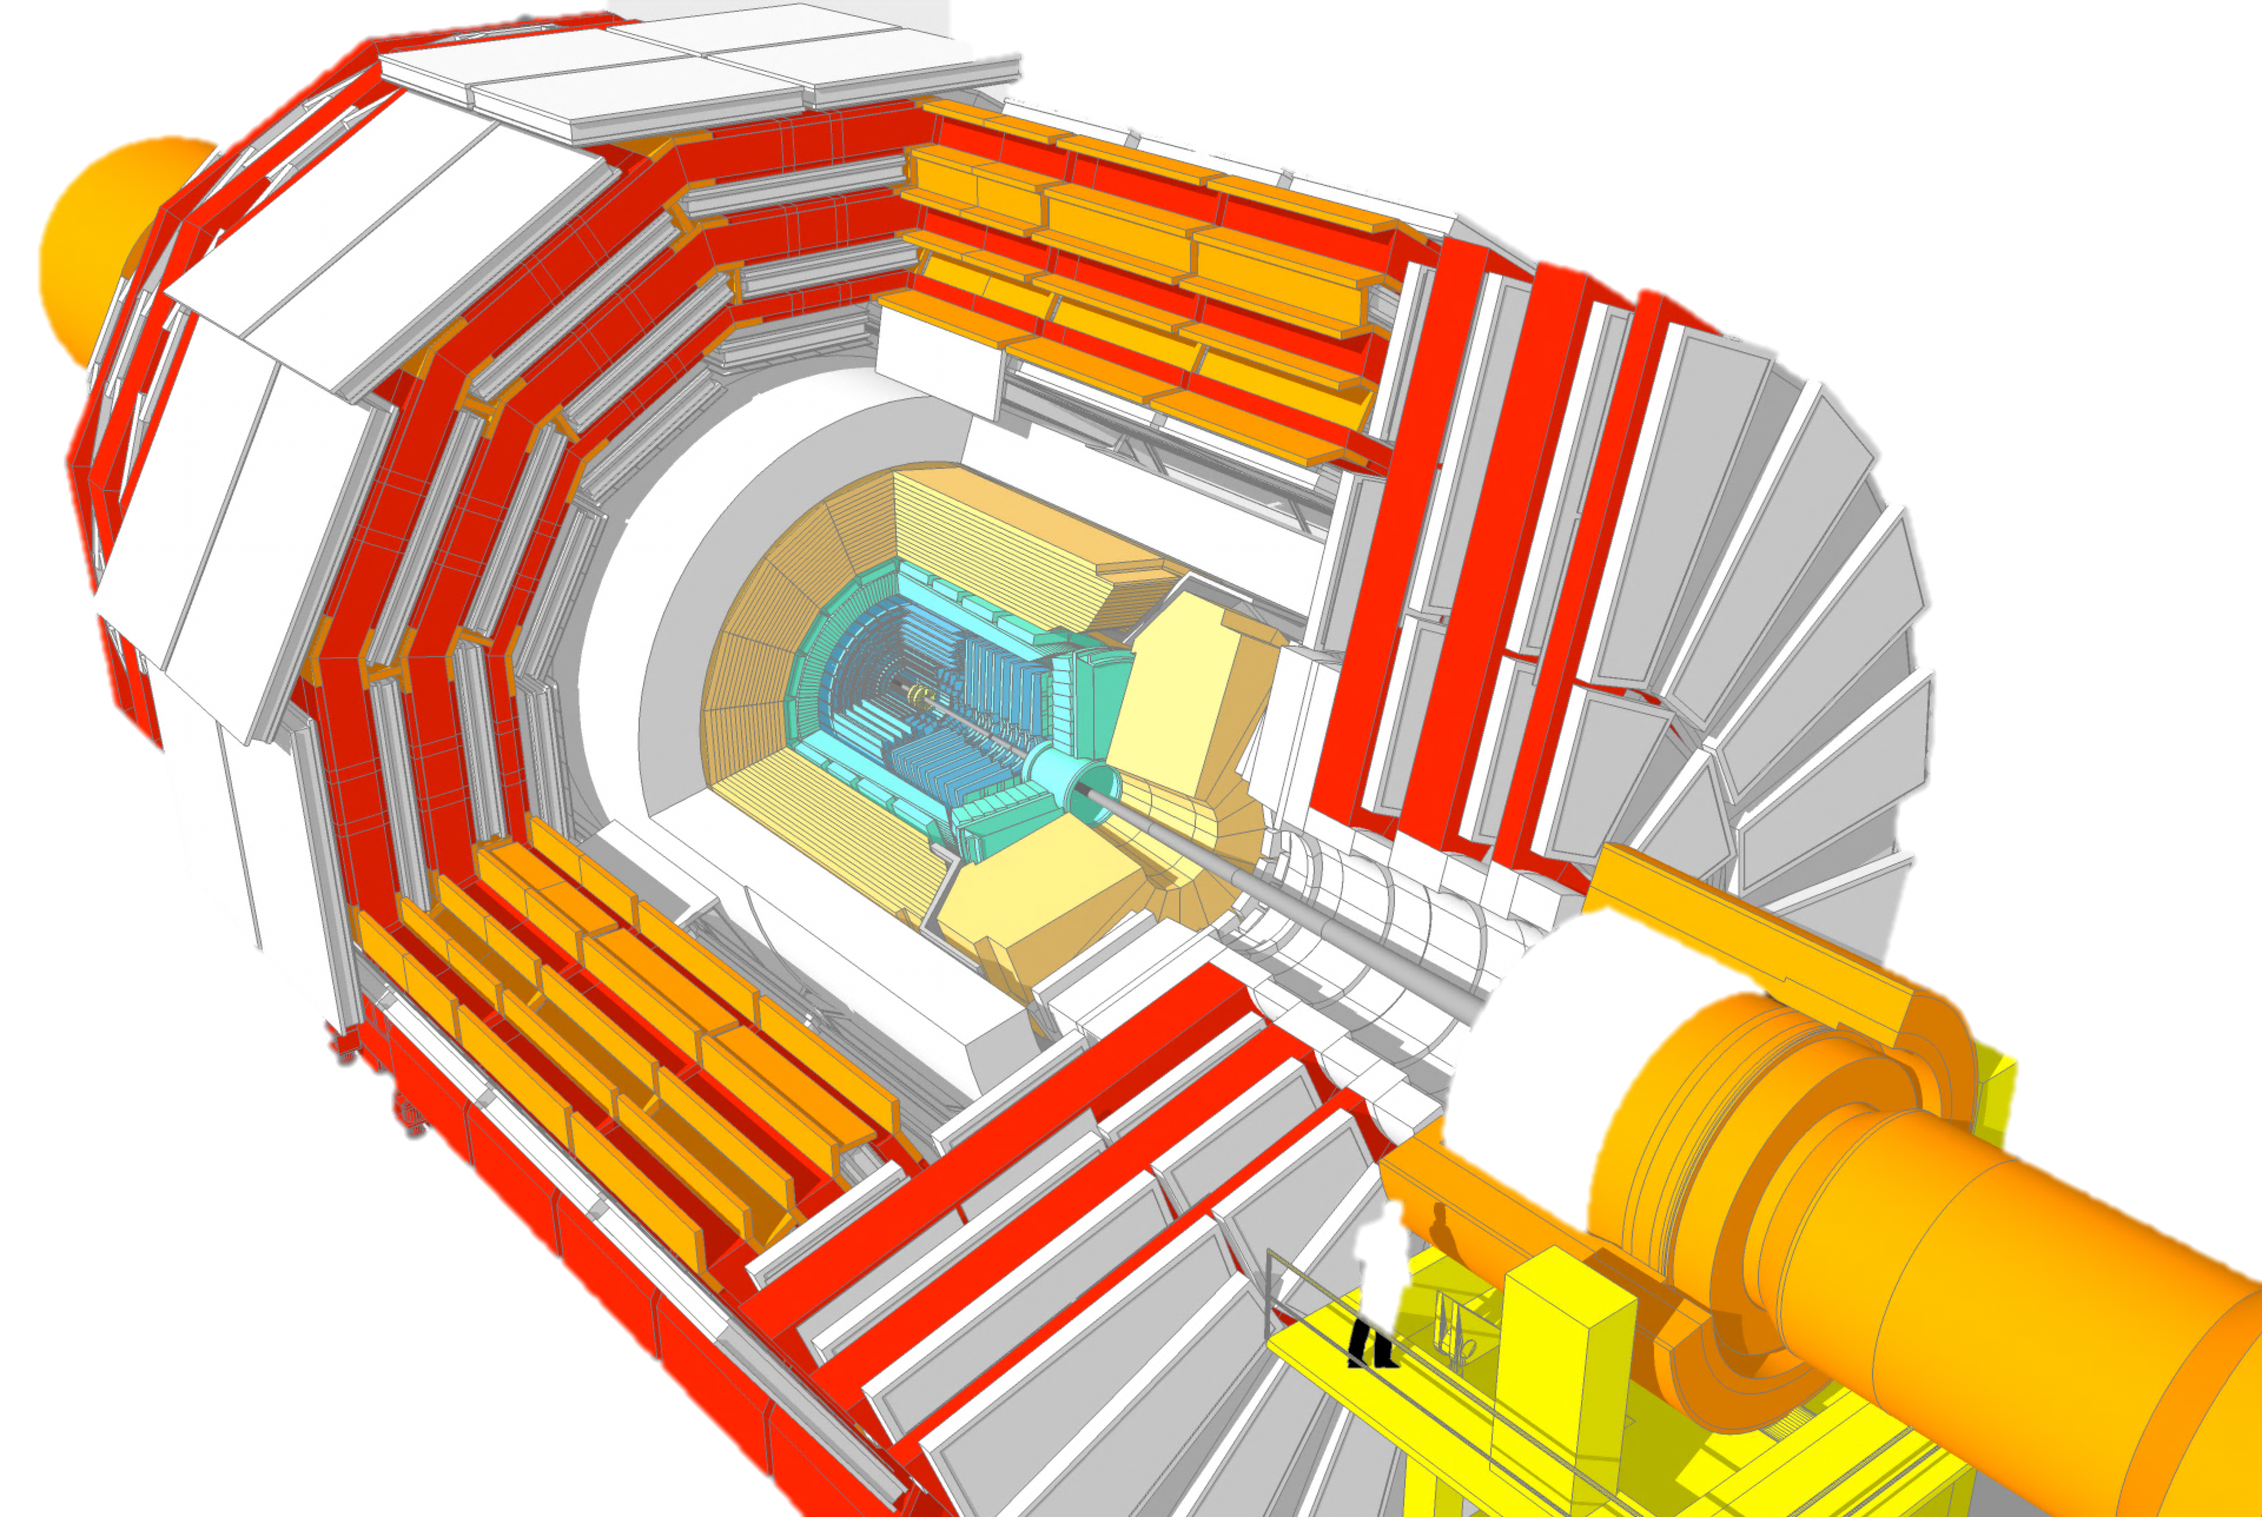
Where are we?
Notes:
Enormous progress made in last decade on many fronts:
LHC experiments incredibly successful science powerhouses
>1000 peer-reviewed papers from each of ATLAS and CMS experiments at the LHC
Higgs boson was major discovery and opened doors to deeper questions
Many great results from neutrino, cosmic-ray, and dark-matter experiments
And yet there is a lot more to discover!

Slide 6
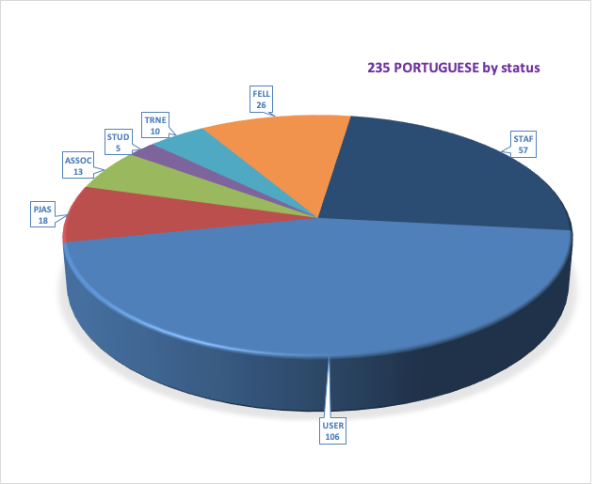
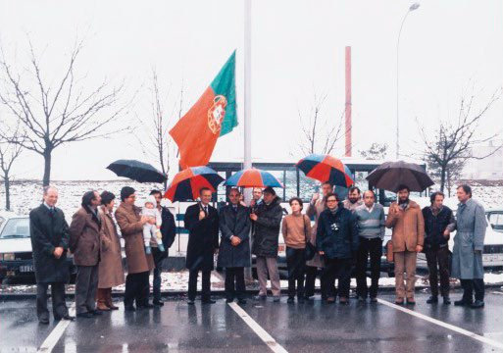
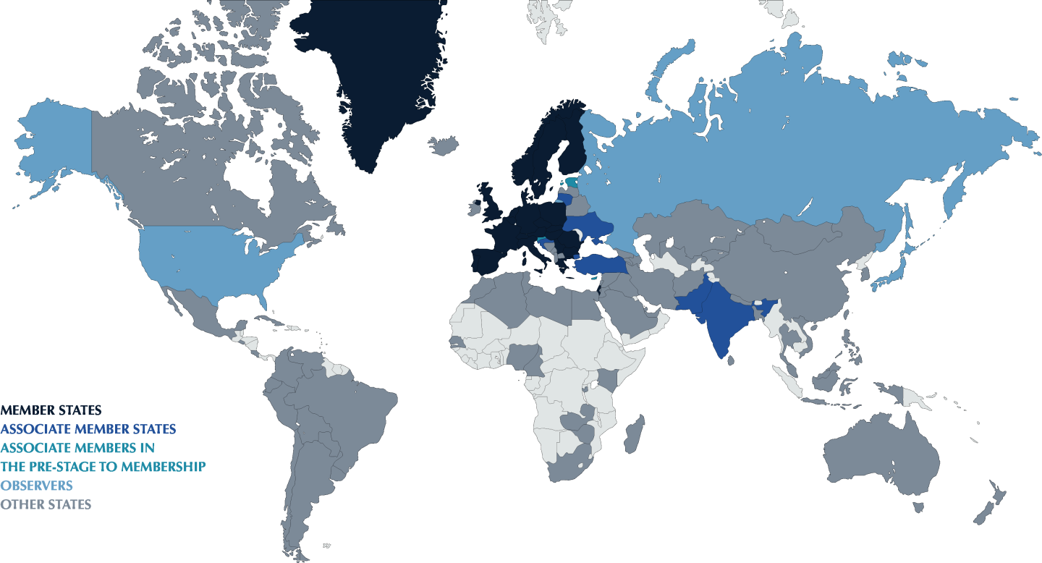
CERN and Portugal
Global laboratory
~2500 staff, 800 fellows
~12000 users of 110 nationalities
~1200 MCHF annual budget
  23 member states + 3 pre-membership
  3 observer states
  34 states have collaboration agreements
235 Portuguese at CERN
  57 members of CERN staff
  106 Users (academics, students etc)
  ~1/2 in LHC experiments; 1/3 in Isolde
  Programmes in education, engineer training, technology transfer, etc
Significant industrial return
  Total CERN spending ~500 MCHF/year
  >50 technology-based Portuguese companies work with CERN
1st hoisting of Portuguese flag at CERN, 1986

Slide 7
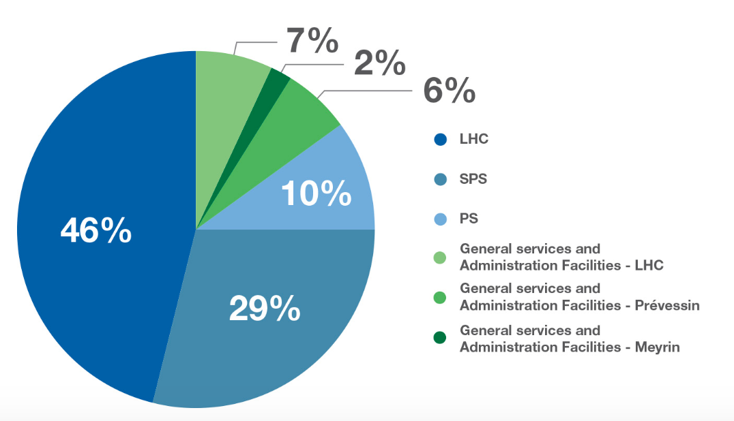
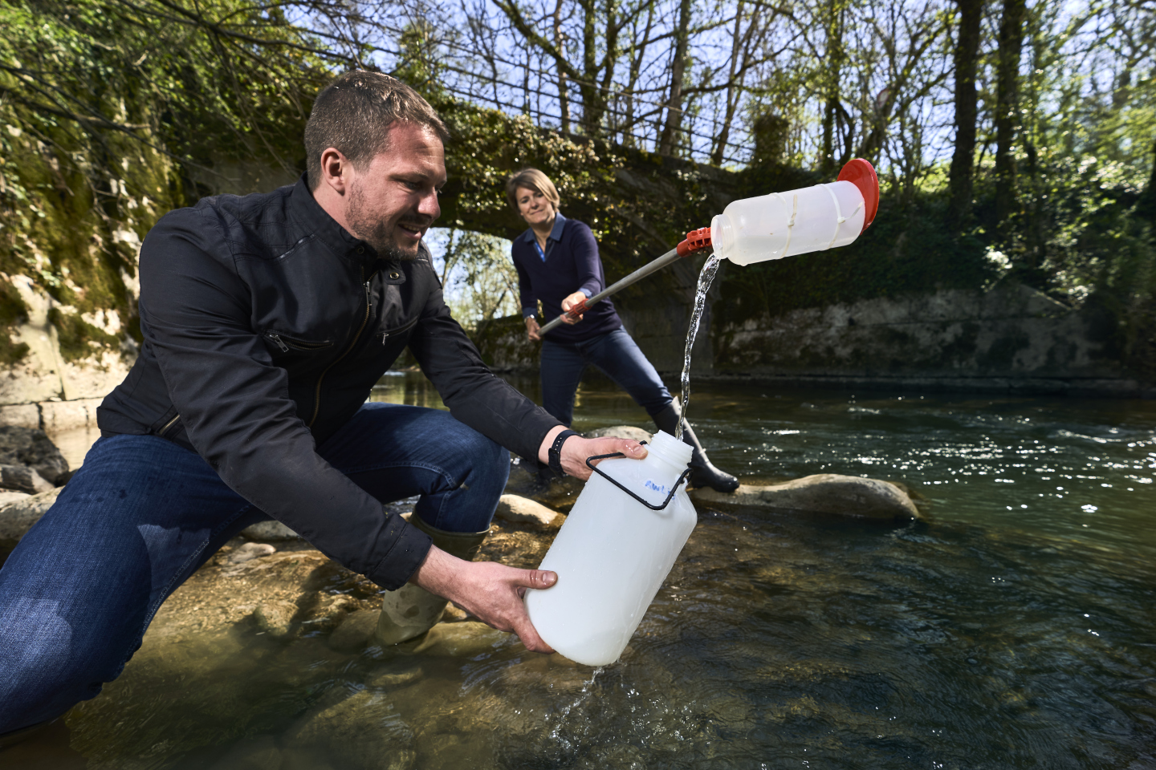
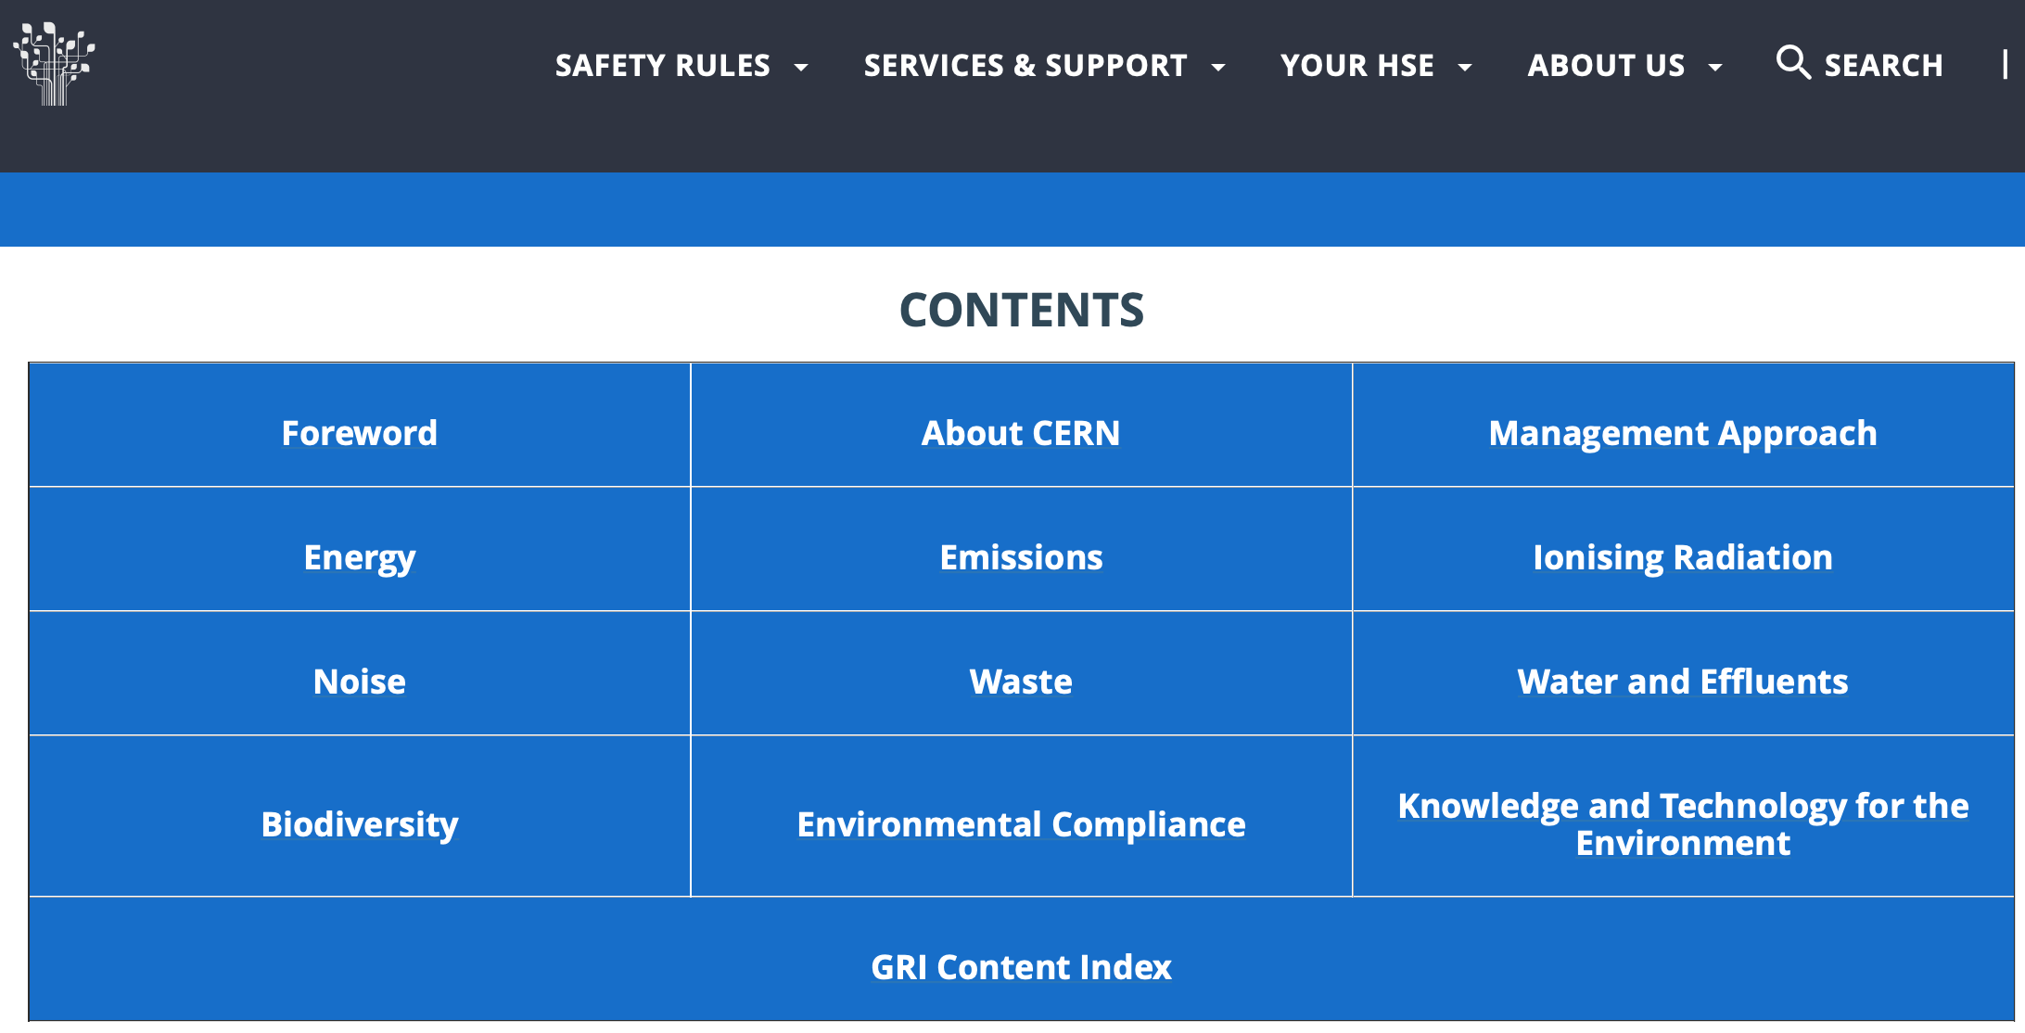
What about the environment?
CERN’s electrical consumption around 1.2 TWh / year
  Similar to domestic consumption of Geneva
  87.9% from carbon-free sources
A lot? Yes.
Other sources of impact? Yes.
Anything being done about it? Yes!
  First public Environment Report published in 2020
  CERN’s new strategy for reducing its ecological footprint
https://hse.cern/environment-report-2017-2018/waste

Slide 8
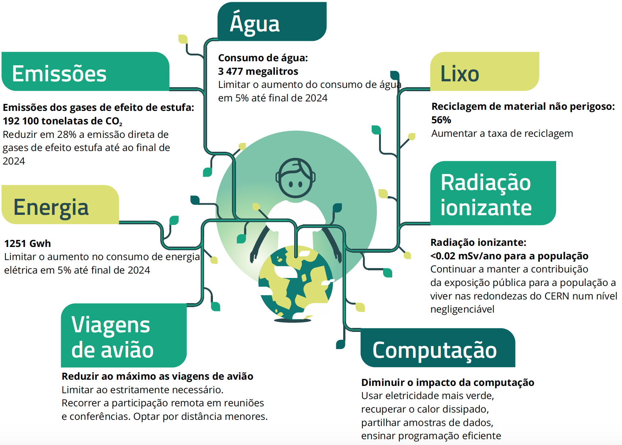

Slide 9
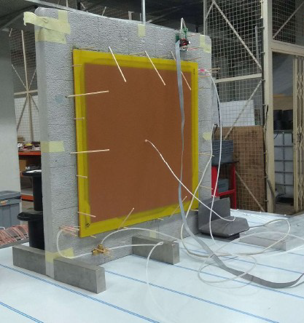

Can we do even better?
Sure we can!
Science is a precious resource for shaping the future of the planet
It must become more aware of its own impact on environment, and do the best to improve it
Example:
At LIP we are developing new particle detectors with no (zero!) greenhouse gas emmission

Slide 10

European Strategy for Particle Physics
Long development cycles and very large facilities
  LHC: construction started 1998 – physics run until 2040
European Strategy for Particle Physics
  Cornerstone of Europe’s decision-making process for the long-term future of the field
  Mandated by CERN Council
  Community-driven process: world-wide grass-roots consultation
  Close coordination with similar processes in US and Japan
First strategy document approved at a special Restricted Session of CERN Council in Lisbon, 14 July 2006
  Reviewed every ~7 years
  Updated in 2013 and recently in 2020

Slide 11
European Strategy for Particle Physics: 2020 update
Full physics exploitation of the LHC and HL-LHC
Next priority is a e⁺e⁻ “Higgs factory”
  Major contender: the FCC-ee (also CLIC or CEPC elsewhere)
Increased R&D on enabling accelerator technologies:
  High-field superconducting magnets, high-gradient accelerating structures, plasma wakefield, muon colliders, etc
  Support long-term goal of a 100 TeV hadron collider: FCC-hh
Support neutrino projects in US and Japan
Support high-impact scientific diversity programme complementary to high-energy colliders

Slide 12
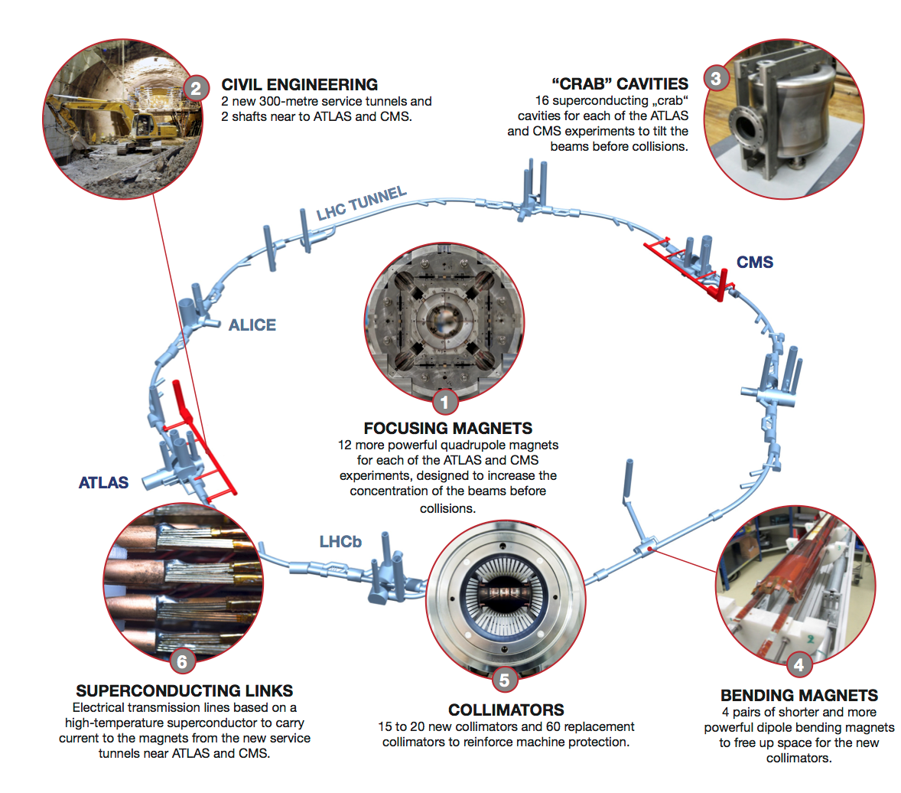
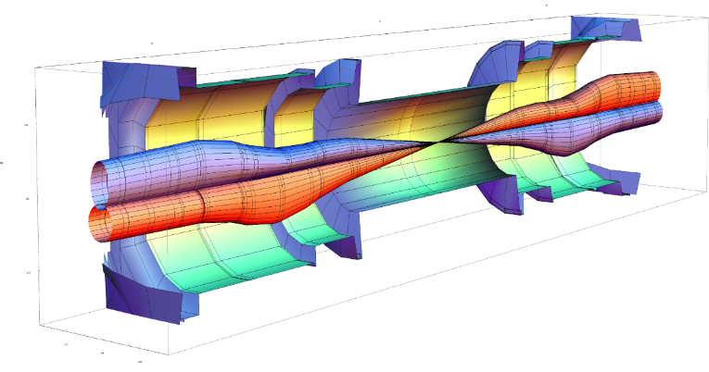
High-Luminosity LHC Upgrades
Development of a new generation of superconducting magnets (Nb₃Sn)
  Reach 13.5 T instead of 8 T (LHC, NbTi)
Novel accelerator features
  E.g. “crab cavities” to tilt beams and increase collision efficiency
Colimators, superconducting connectors, civil engineering, etc

Slide 13
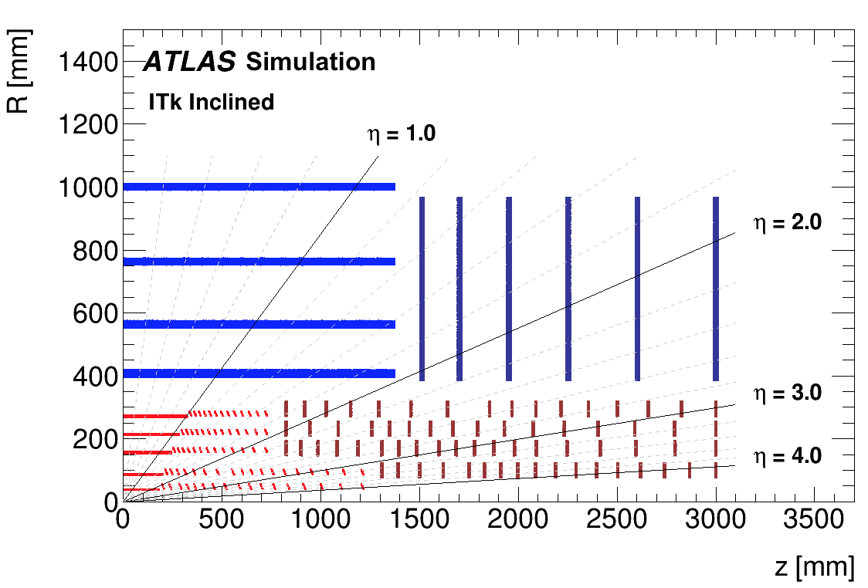
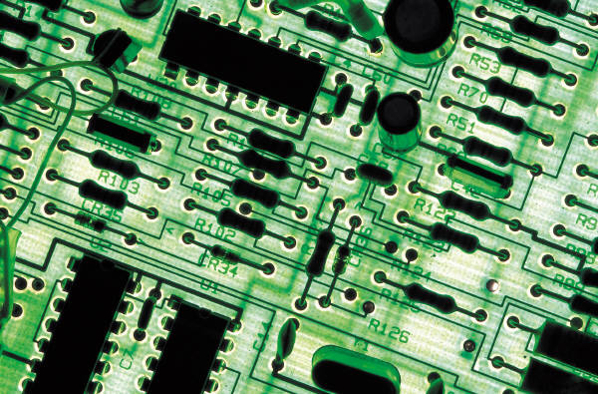
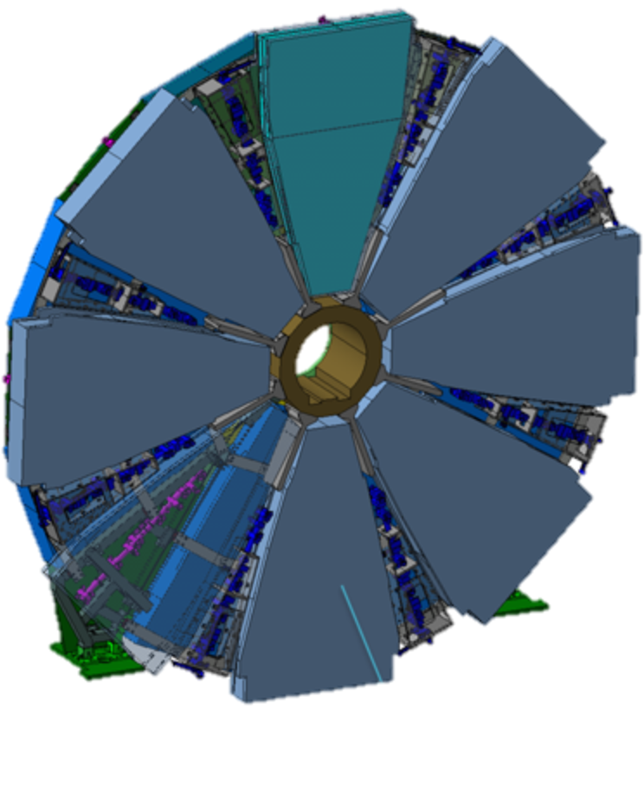
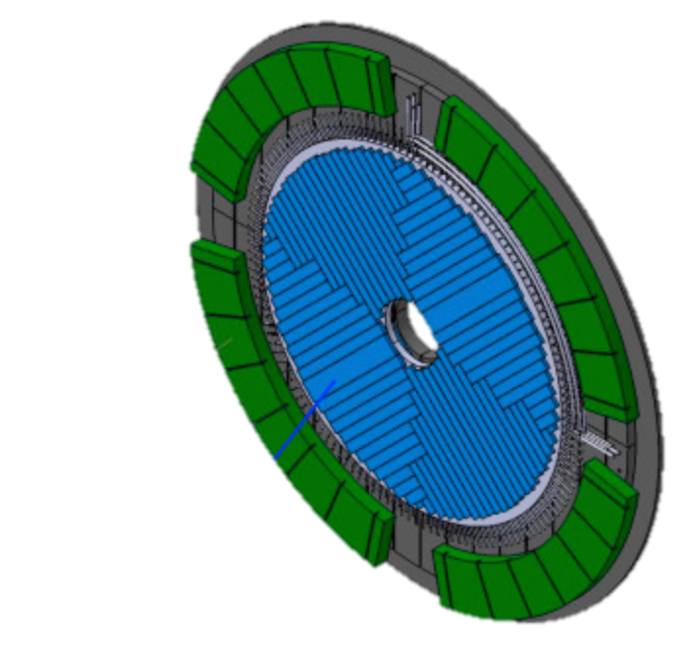
HL-LHC Upgrade
New, all-Silicon tracking detector
New electronics and High Voltage power supplies and distribution
New muon detector “Small Wheel”
Hardware to reconstruct charged tracks
High Granularity Timing Detector
(30ps/track)
Notes:
Add spacial granularity to separate close tracks and add tracking solid angle (b-tagging, vertex ident. Etc)
Add timing information to reject pileup: need O(mm) resolution => ~O(10ps) ; 30ps = 9mm
Replace damaged detectors with more rad.hard technologies
HGTD radius 120 – 640 mm ; • Completely replace Inner Detector with all-silicon

Slide 14
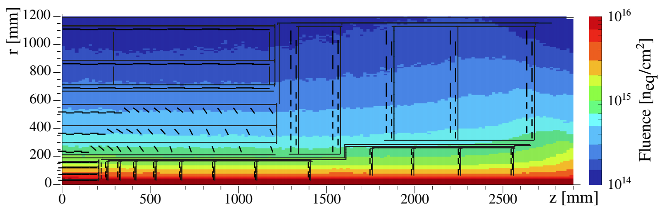
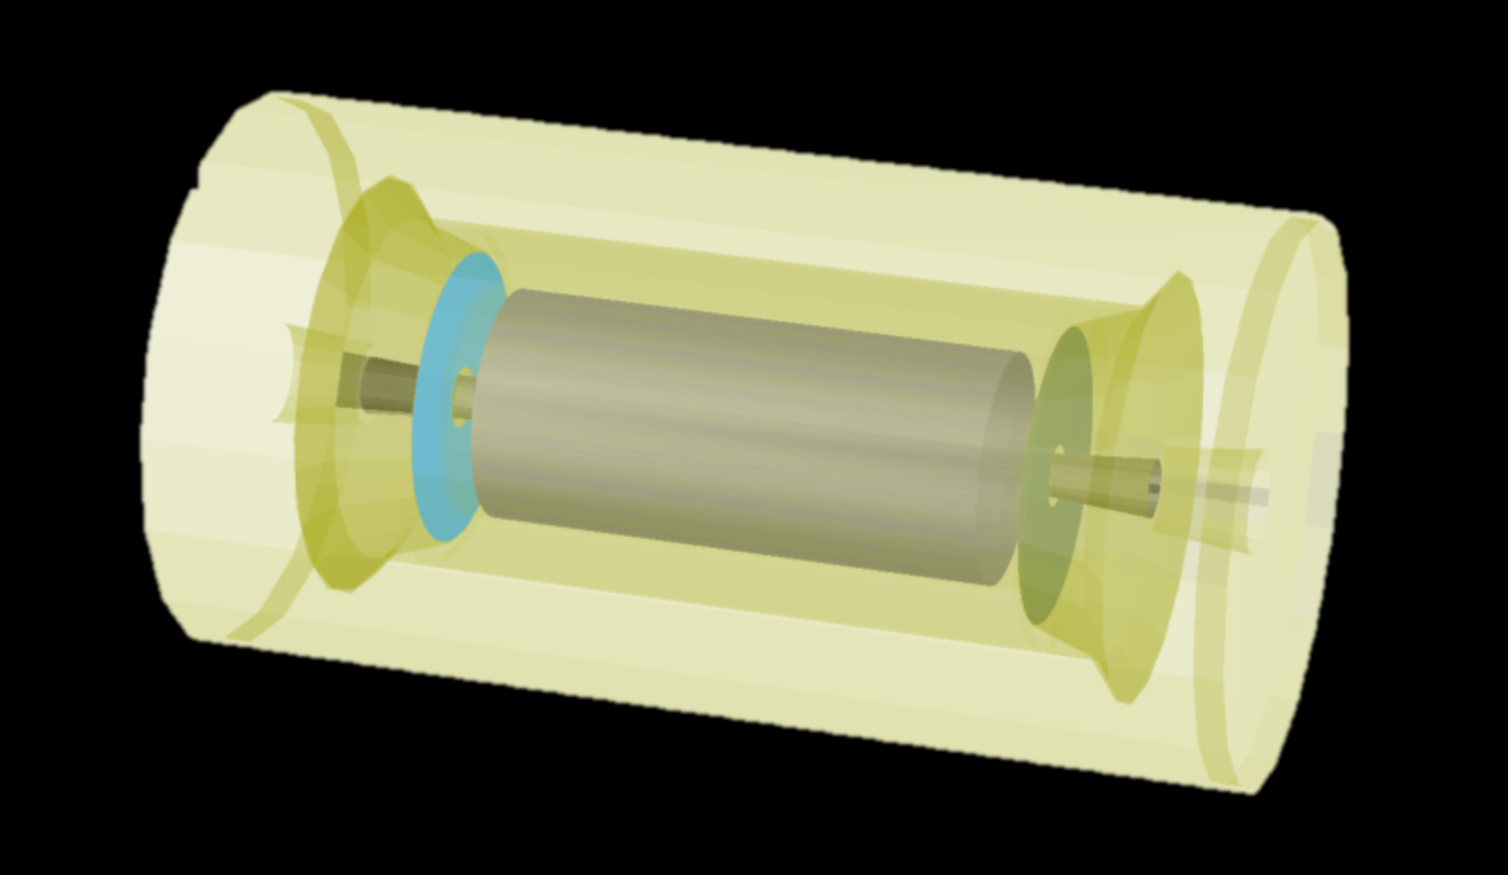
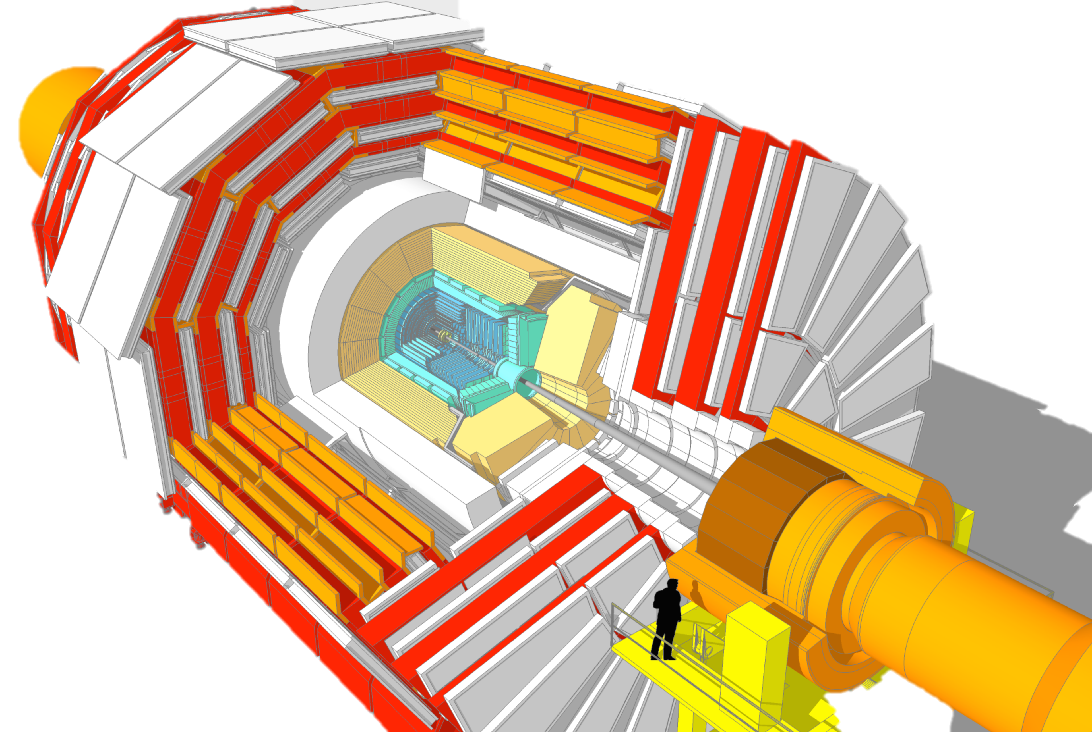
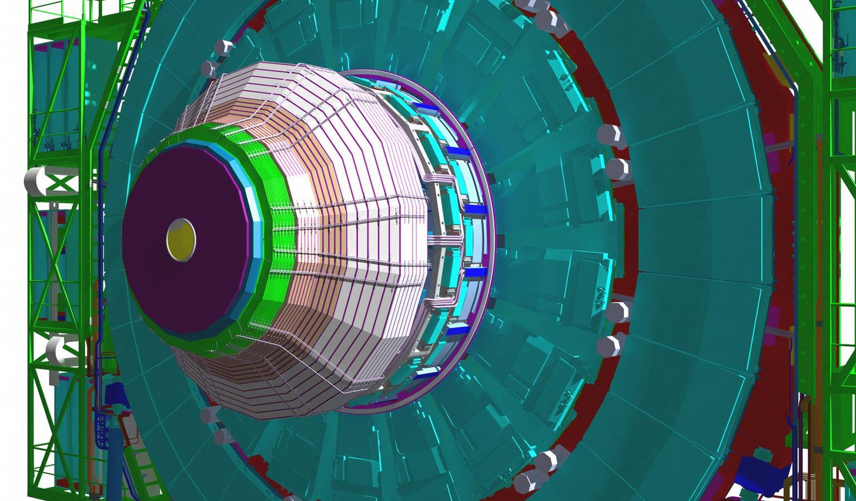
New MIP Timing Detector (Barrel & Endcap)
Replacement of tracking detector
New electronics for muon chamber operation
Hardware to reconstruct charged tracks (trigger)
New electronics for calorimeter readout
New High Granularity Calorimeter
Notes:
Add timing information to reject pileup: need O(mm) resolution => ~10ps
Add spacial granularity to separate close tracks
Rad.hard technology
Add tracking solid angle (b-tagging, vertex ident. Etc)

Slide 15
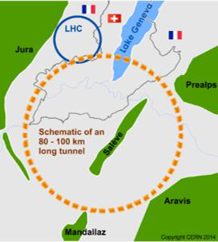
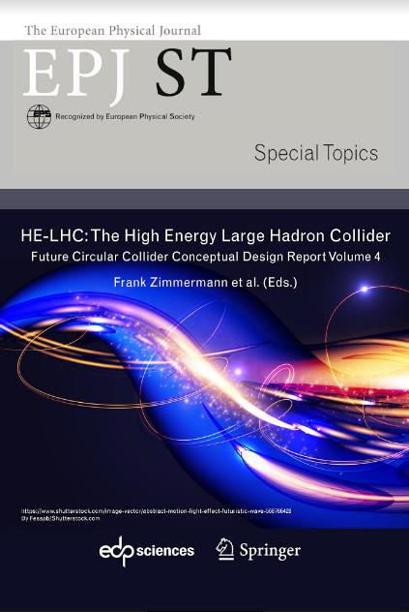
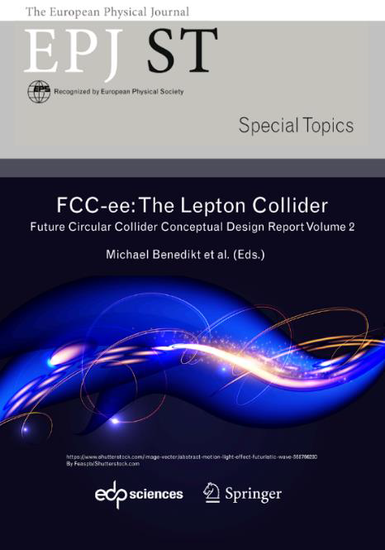
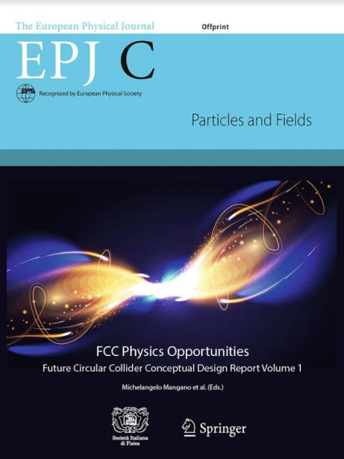
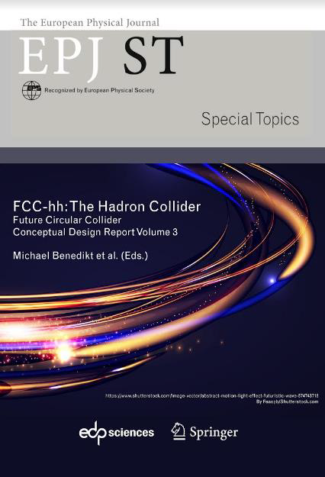
The Future Circular Collider Feasibility Study
http://fcc-cdr.web.cern.ch/
International study for FCC “Conceptual Design” as part of European Strategy discussion
  Very comprehensive study of physics potential and detector technologies
  1350 contributors from 370 institutes, including LIP
Two main scenarios - using the same tunnel:
  FCC-ee: 90 to 350 GeV e+e- collider
  FCC-hh: 100 TeV p-p and ion collider
  100 km perimeter tunnel!
Evolved to “FCC Feasibility Study” after European Strategy approval

Slide 16

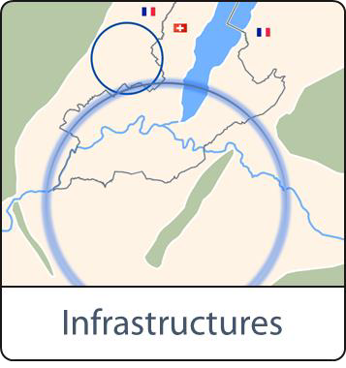
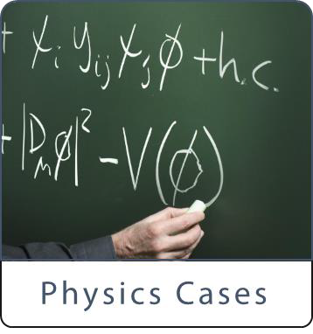
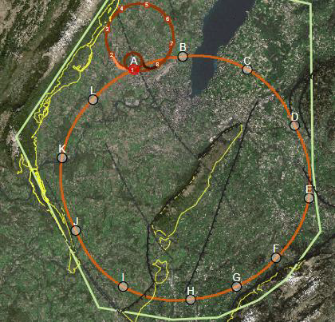
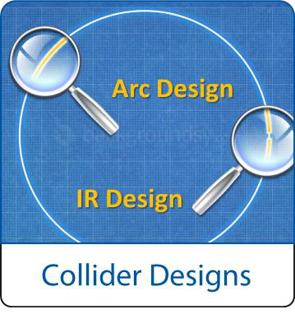
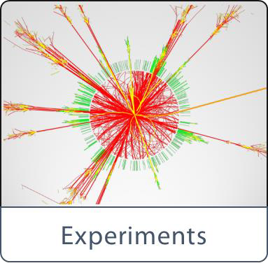
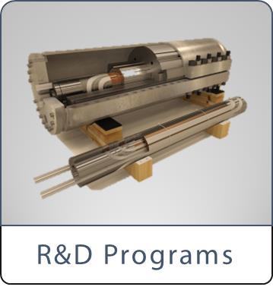

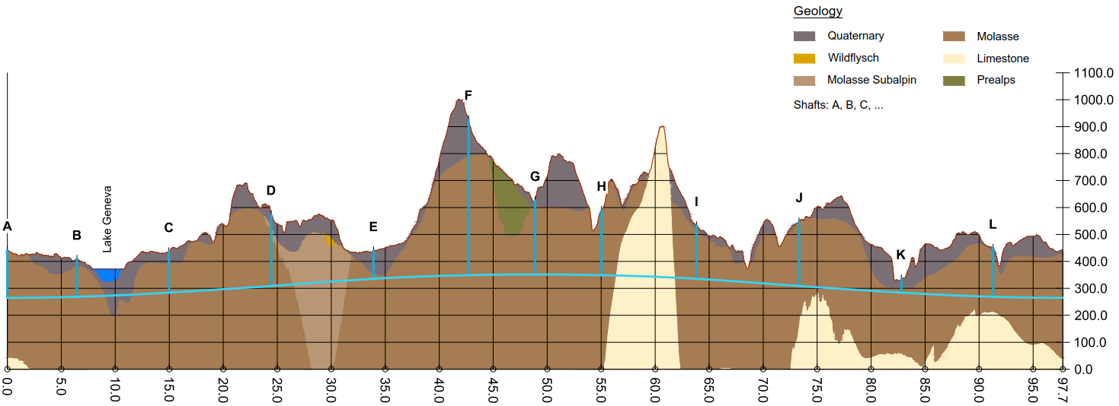
The Future Circular Collider Feasibility Study
Comprehensive long-term program, maximizing physics opportunities – timescale 2025:
  Stage 1: FCC-ee as Higgs factory, electroweak and top-quark factory
  Stage 2: FCC-hh to reach energy frontier - ion & e-h options
Complementary physics
Common civil engineering and technical infrastructures
Building on and reusing CERN’s existing infrastructure
FCC integrated project allows seamless continuation of Particle Physics programme after HL-LHC

Slide 17
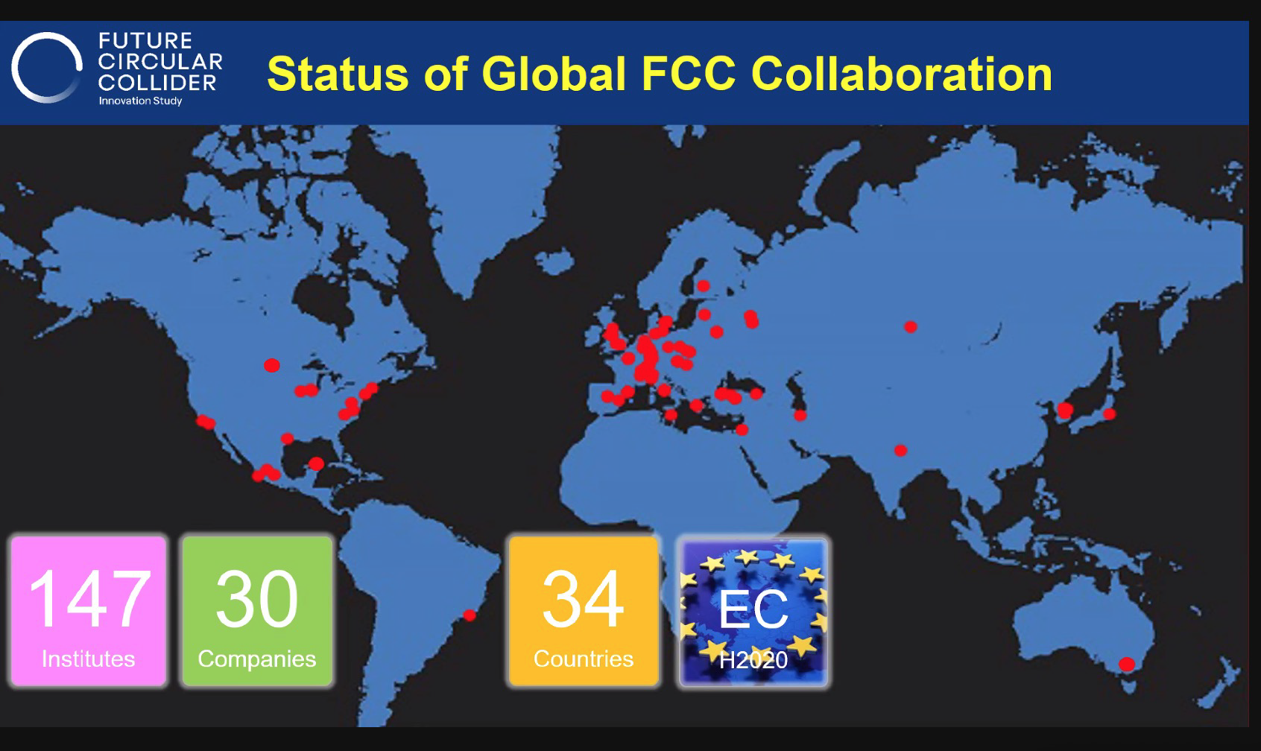
Portugal will be joining soon!

Slide 18
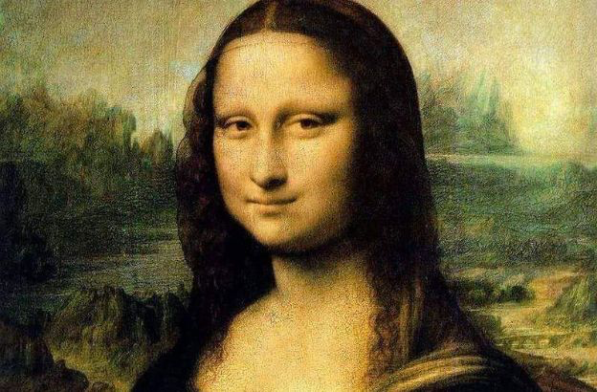

Conclusions
“The next accelerator and the next focus for particle physics must be in Europe. That is the only way to ensure that the best people will continue to come to Europe.”
José Mariano Gago, Special Restricted Session of the CERN Council, 1st European Strategy for Particle Physics, Lisbon, 14 July 2006
Particle physics is a vibrant field with huge scientific activity and potential for discovery
  Exploration at the deepest level: the elementary particles and fundamental forces in the Universe
Science (and big science) is an amazing achievement of mankind
  The capacity to explore, together in peaceful collaboration, the secrets of Nature is priceless
But we must be aware of our own impact on nature – ignorance is no longer an option!

Slide 19

Thank you!
LET’S INSPIRE PEOPLE
Notes:
https://docs.google.com/forms/d/1mYM3yW3vMMPyp9cSqKTQqStZdBoxiNMYR1FkCO48zpI/edit

Slide 20


Notes:
<mu>~40 in 2018 (up to 70-80)
Showing this particular collision for a reason...

Slide 21

4th July 2012
Discovery of the Higgs Boson

Slide 22


The Higgs mechanism

Slide 23

Doing business with CERN
2017 survey of 669 suppliers in 37 countries

Slide 24


Slide 25


Slide 26


Slide 27


