Slide 1
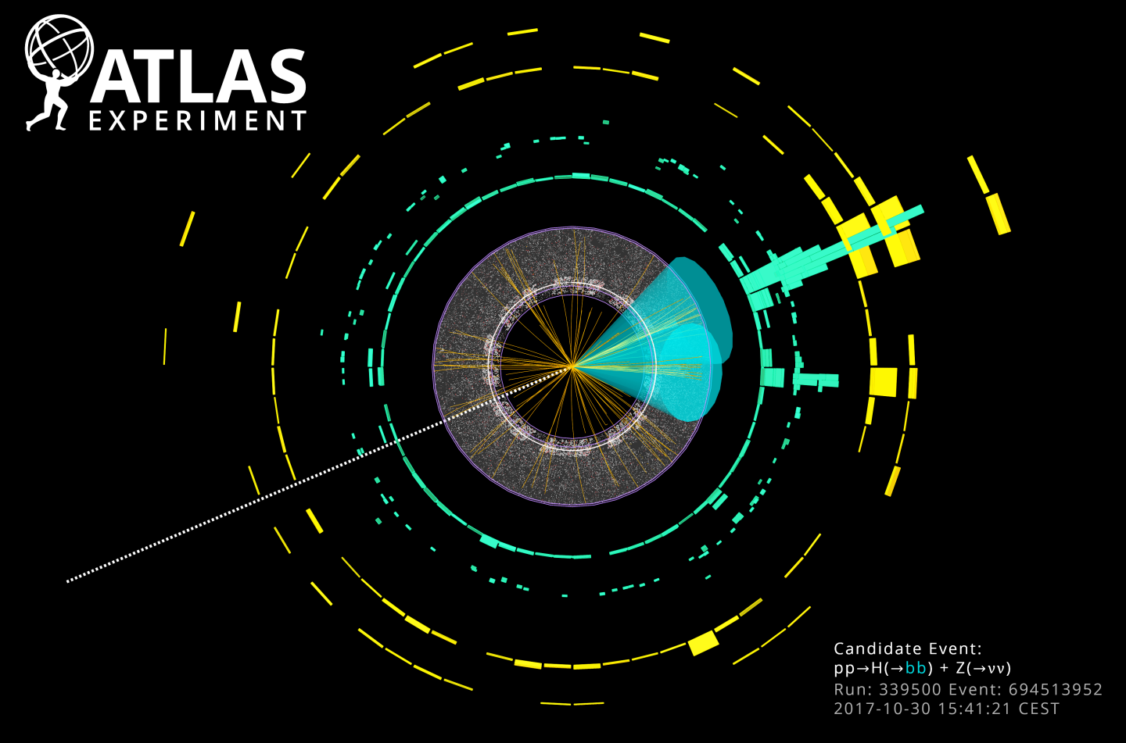






Latest Higgs results from ATLAS
Ricardo Gonçalo
LIP - Laboratório de Instrumentação e Física Experimental de Partículas
Workshop on Multi-Higgs Models 2018
IST, Lisboa, Portugal

Slide 2
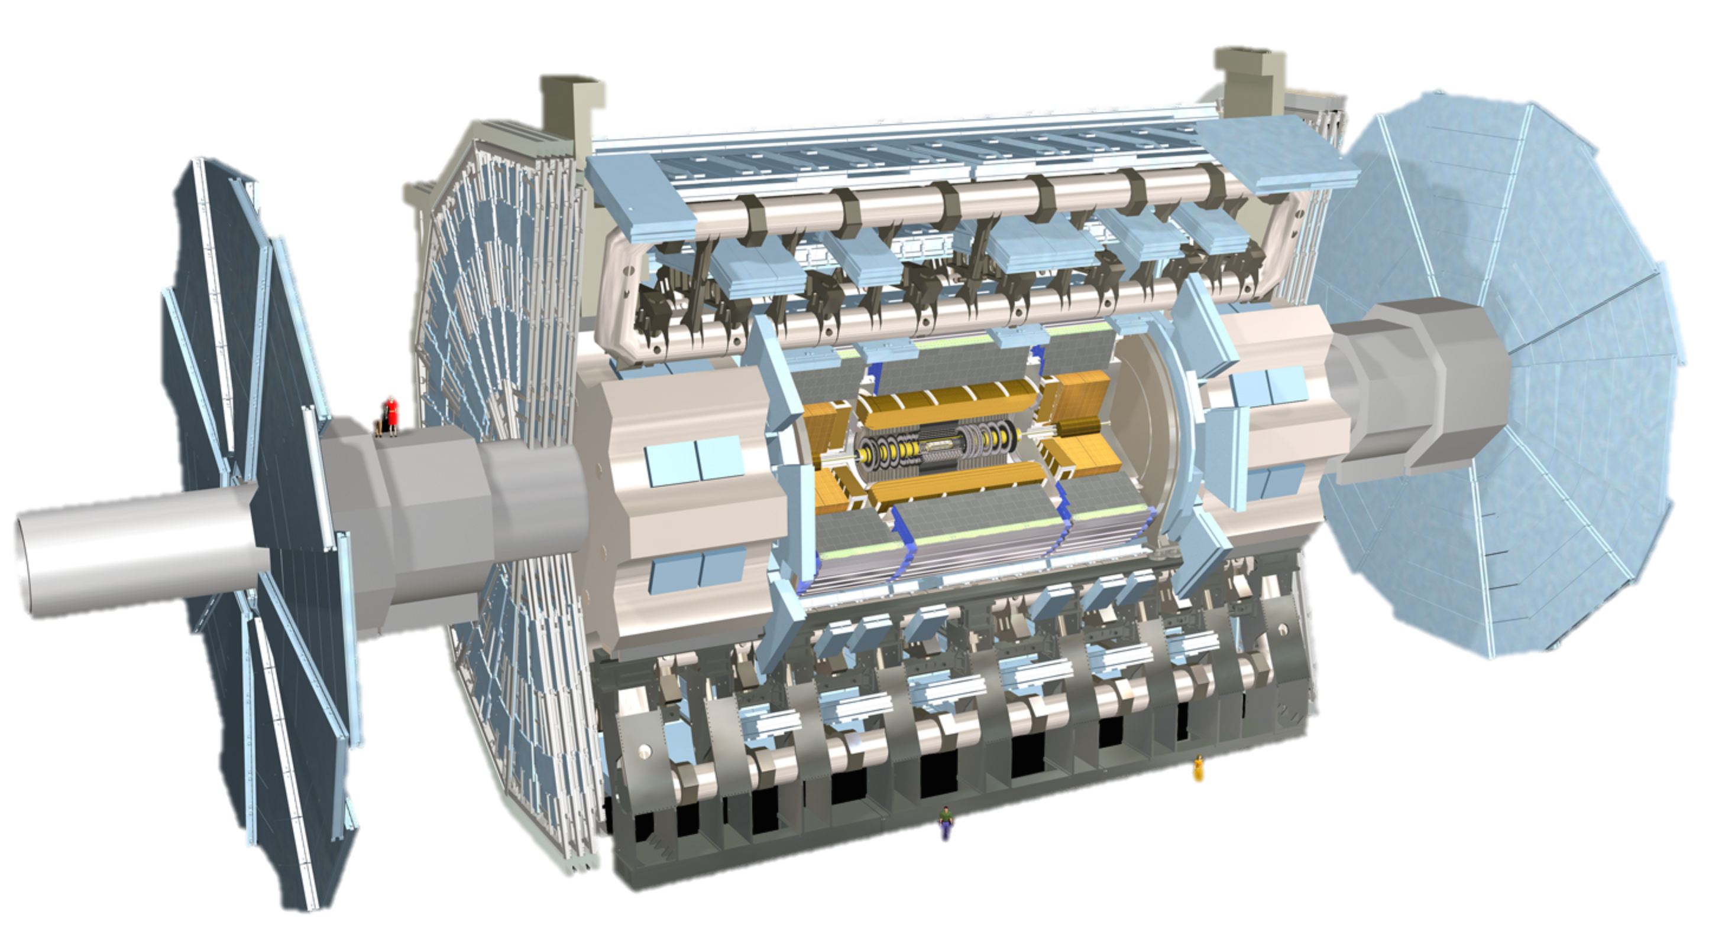
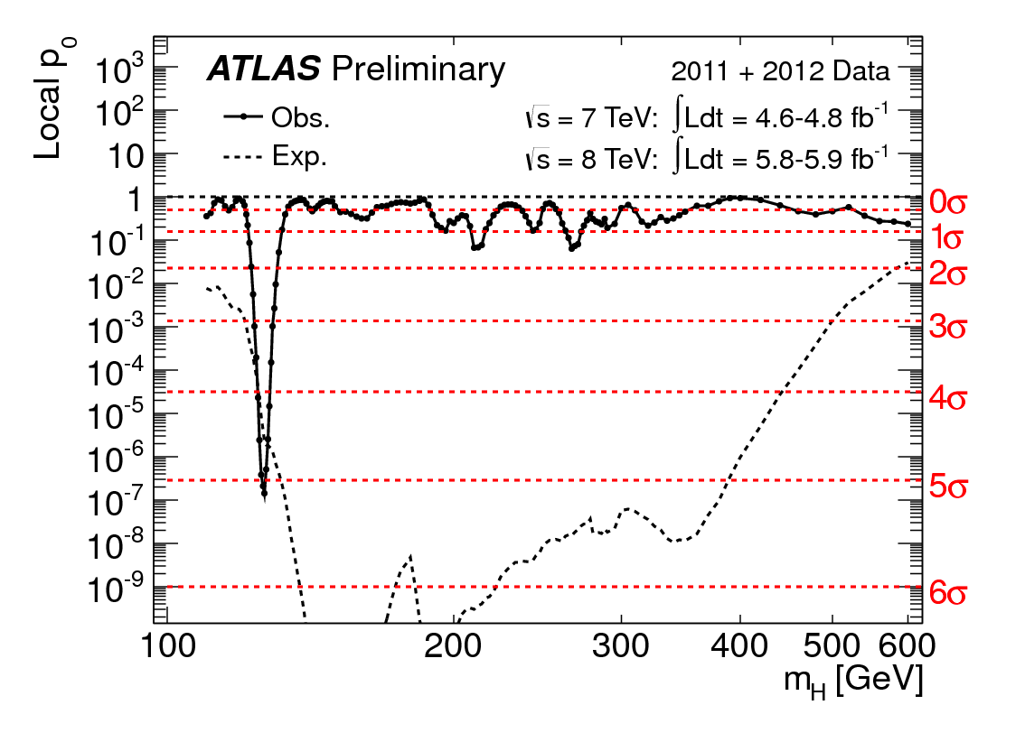

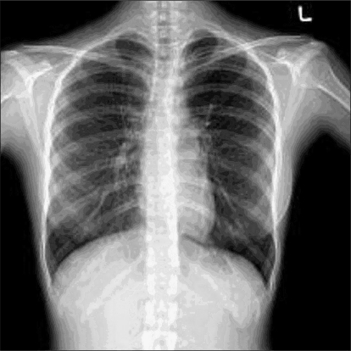


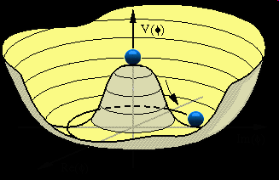
Outlook
ATLAS and the LHC
The Run 1 legacy
Probing the 125 GeV Higgs
Probing the Yukawa sector
Searching wider
The long run: di-Higgs

Slide 3
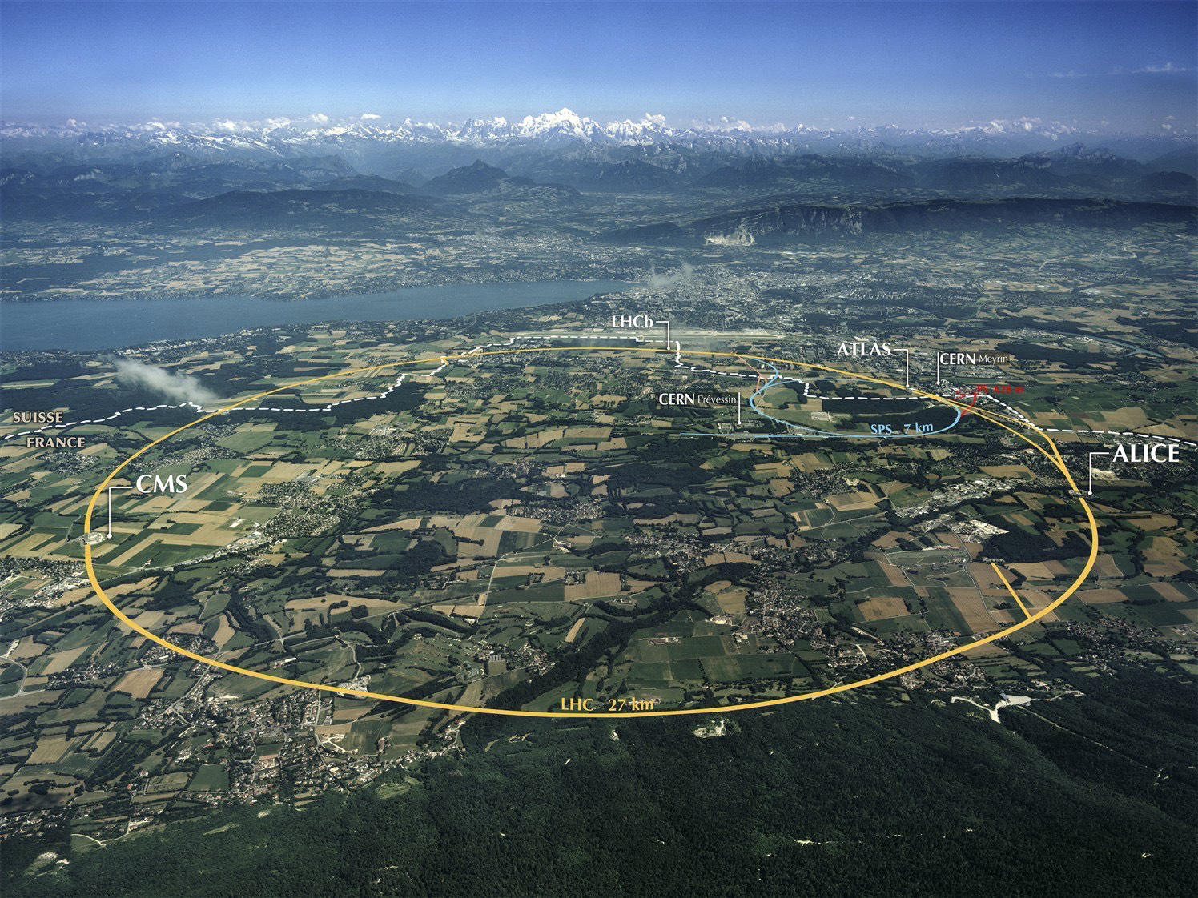
Design (p-p run):
√s = 14 TeV (design)
N_{p} = 1.2 x 10¹¹ p/bunch
2780 bunches
Peak L = 1 x 10³⁴ cm⁻²s⁻¹ (design)
β* = 55 cm
Run 1: 2009 – 2013 √s = 7/8 TeV
Run 2: 2015 – 2018 √s = 13 TeV
Mont Blanc
ATLAS
CMS
Notes:
LHC Running at 2x design luminosity
Expect 150/pb by end of this year

Slide 4
Muon Spectrometer: |η| < 2.7
Air-core toroid + gas-based muon chambers
σ/p_{T} = 2% @ 50GeV to 10% @ 1TeV (ID+MS)
EM calorimeter: |η| < 2.5 (3.2)
Pb-LAr accordion sampling
σ/E = 10%/√E ⊕ 0.7%
L = 44 m, ∅ ≈ 25 m
7000 tonnes
≈10⁸ electronic channels
2-level trigger reducing 40 MHz collision rate to 1 kHz of events to tape
Hadronic calorimeter:
Fe/scintillator / Cu/W-LAr
σ/E_{jet}= 50%/√E ⊕ 3%
Solenoid: B = 2 T
Inner Tracker: |η| < 2.5
Si pixels/strips and Trans. Rad. Det.
σ/p_{T} = 0.05% p_{T} (GeV) ⊕ 1%

Slide 5
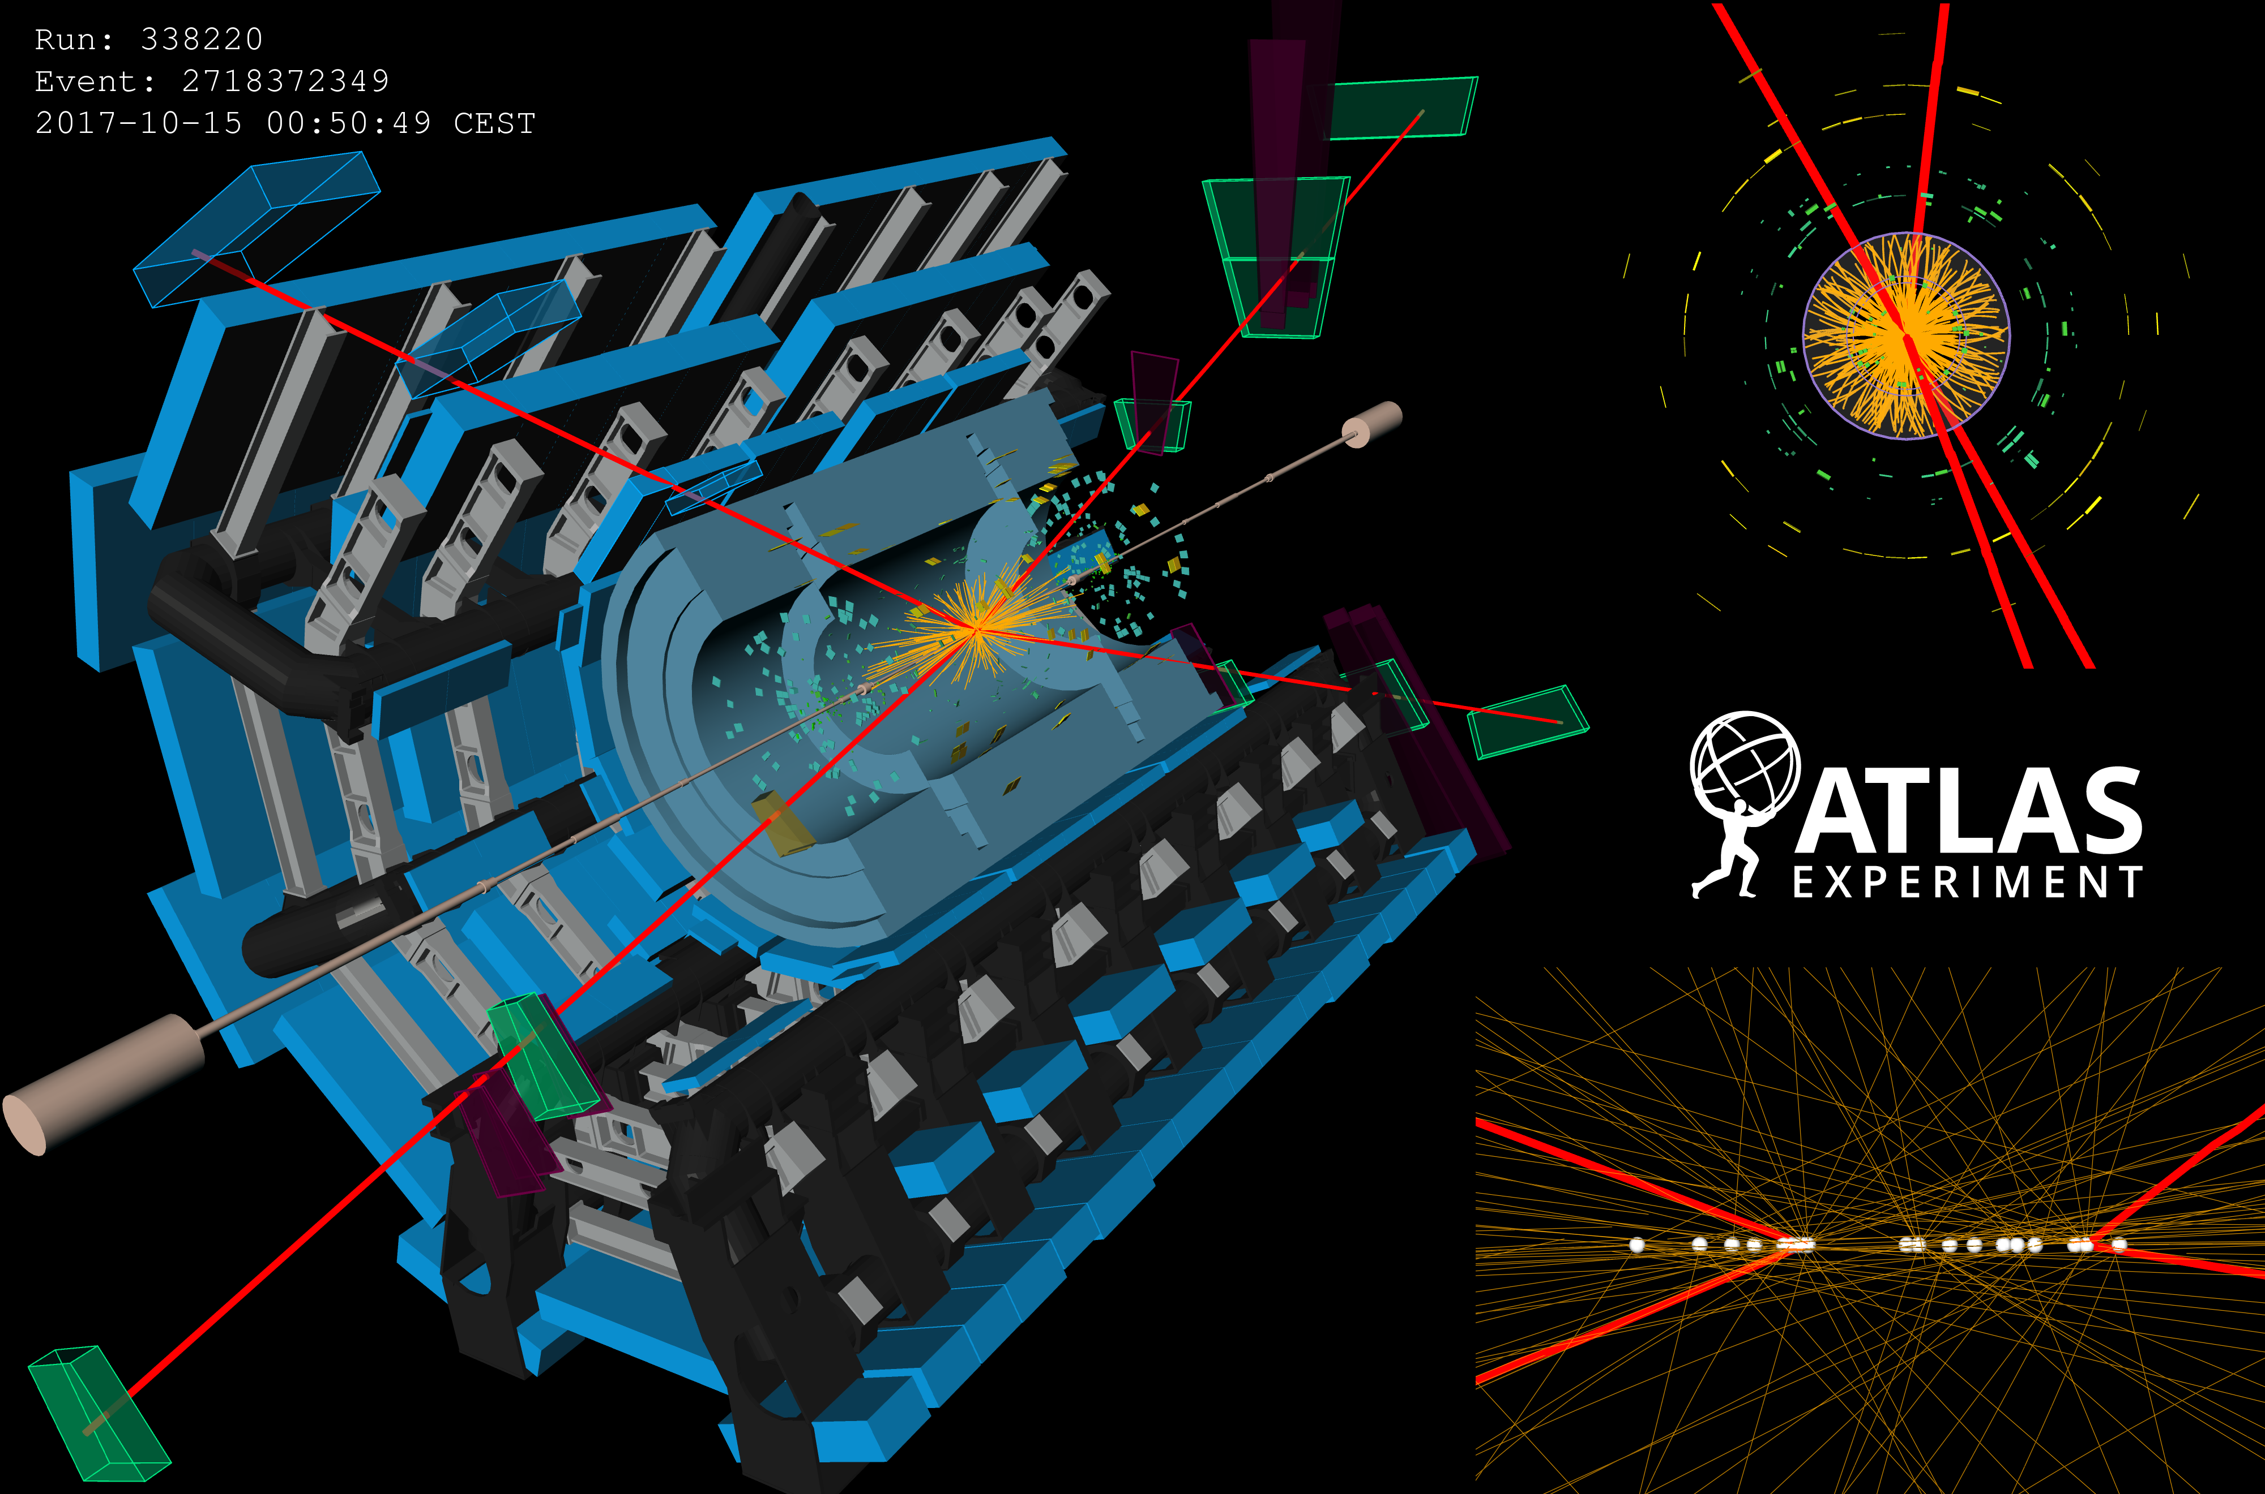
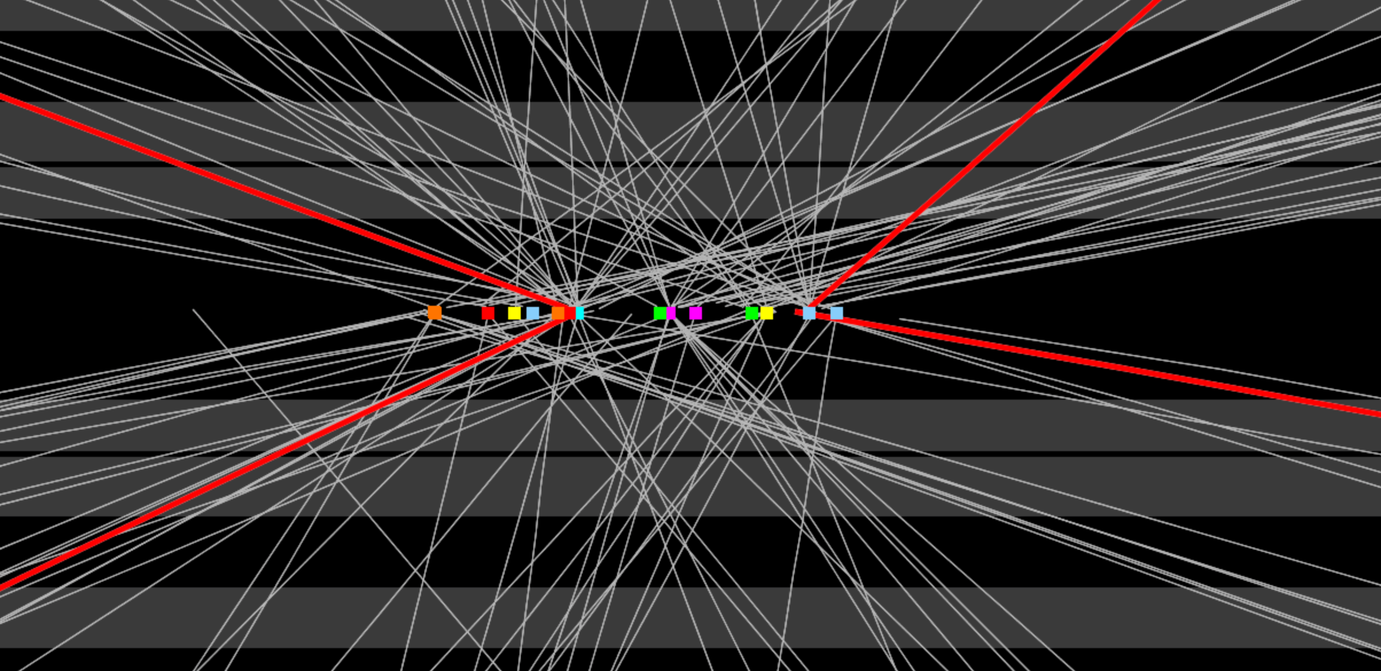

Slide 6
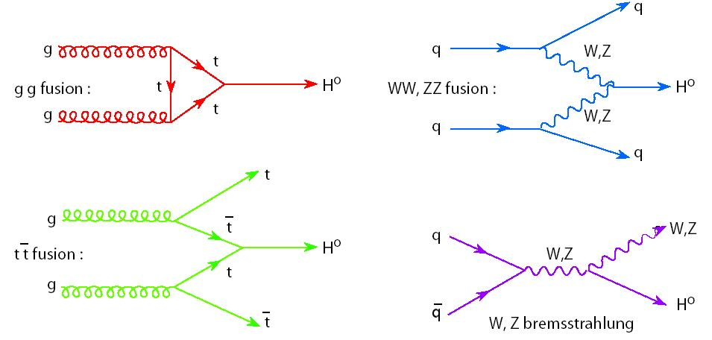
Higgs @ the LHC
Many different production and decay mechanisms
  Span 3 orders of magnitude in cross section and branching ratio
  Some very clean decays with low BR (γγ, 4l)
  Other very difficult with higher rates (bb, WW, ττ,...)
Access Higgs properties through combination of different channels
Enormous amount of progress since discovery 6 years ago!
Notes:
https://twiki.cern.ch/twiki/bin/view/LHCPhysics/LHCHXSWG#Latest_plots

Slide 7
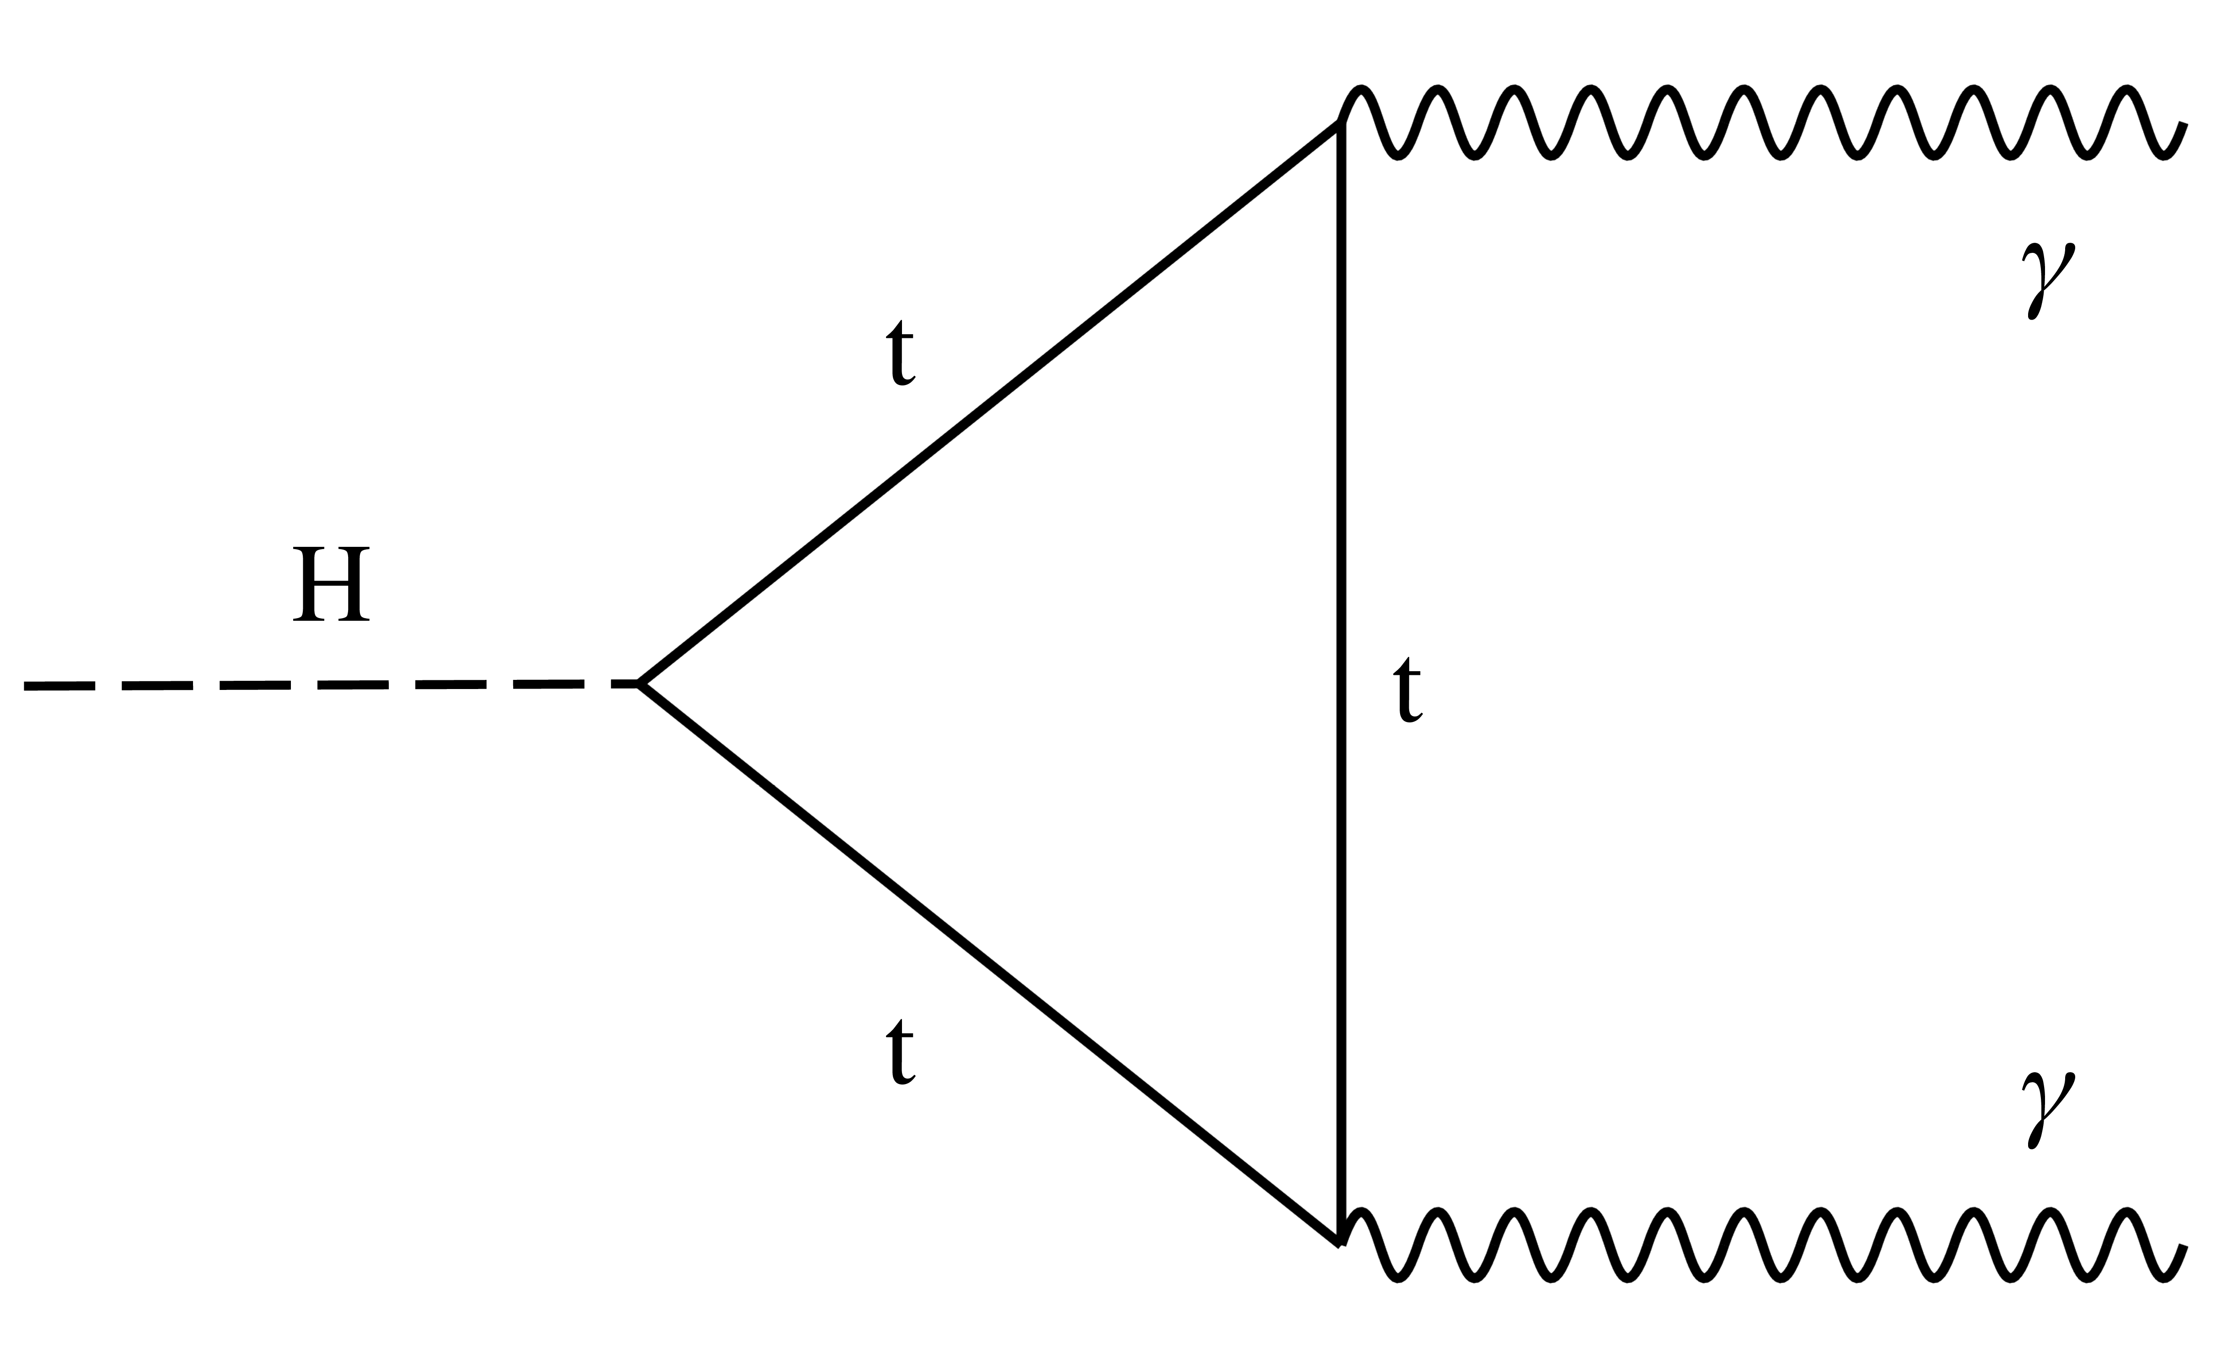
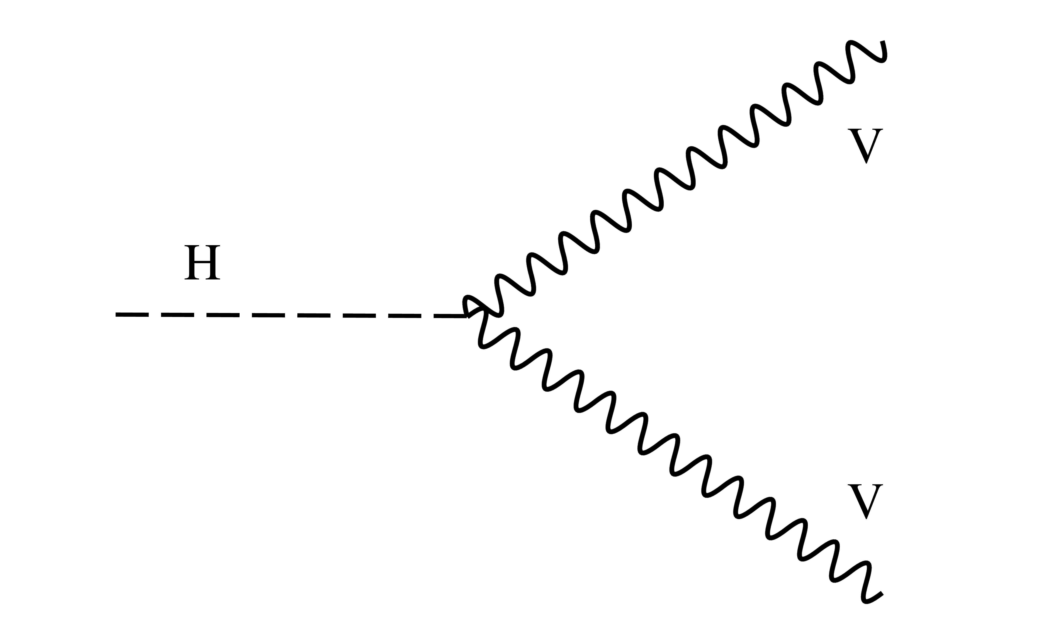
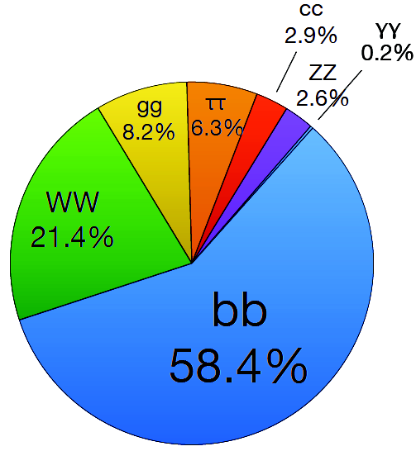
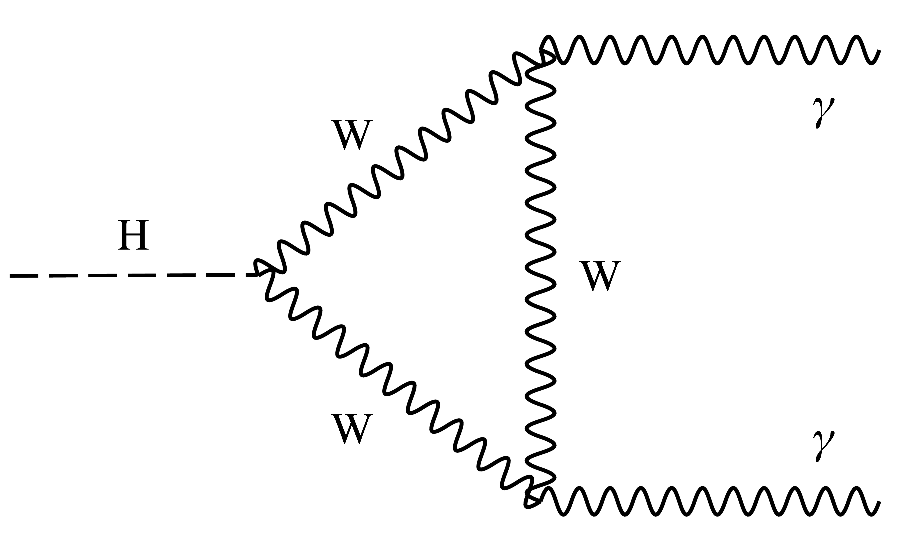
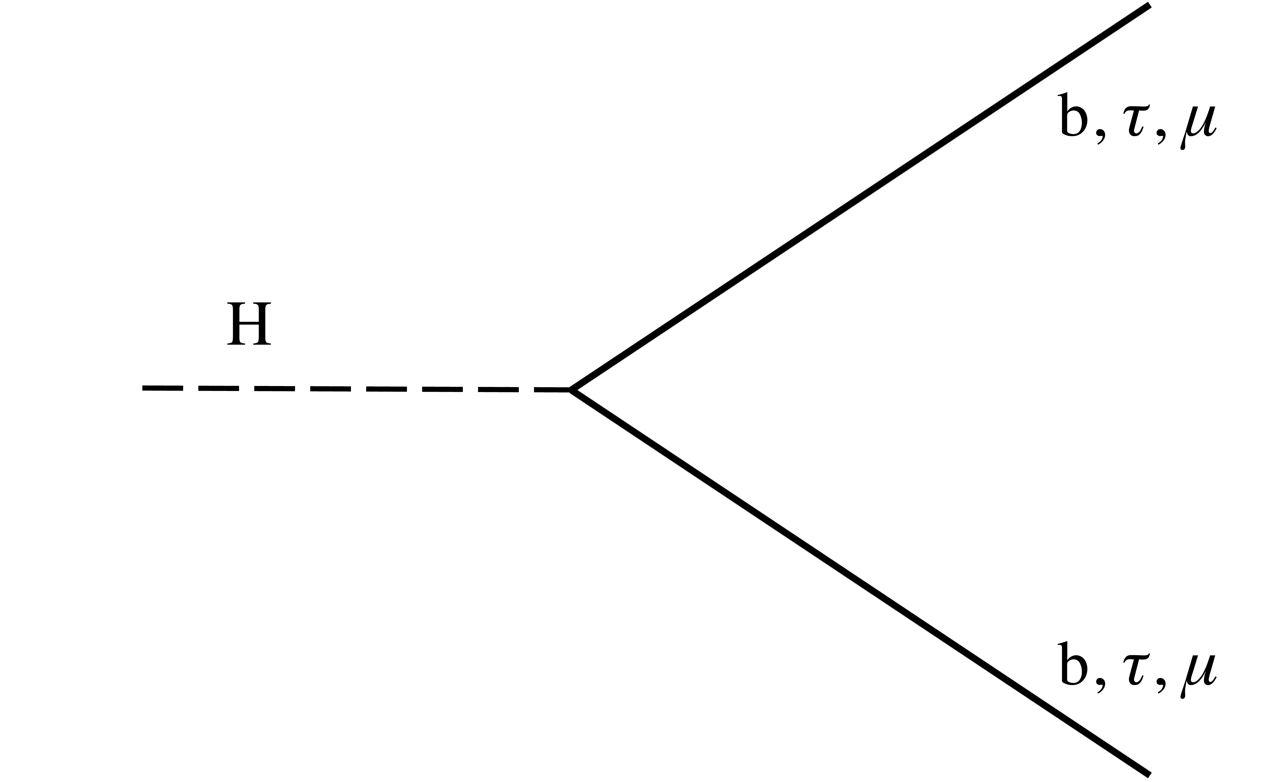
Higgs @ the LHC
Many different production and decay mechanisms
  Span 3 orders of magnitude in cross section and branching ratio
  Some very clean decays with low BR (γγ, 4l)
  Other very difficult with higher rates (bb, WW, ττ,...)
Access Higgs properties through combination of different channels
Enormous amount of progress since discovery 6 years ago!
Notes:
https://twiki.cern.ch/twiki/bin/view/LHCPhysics/LHCHXSWG#Latest_plots

Slide 8
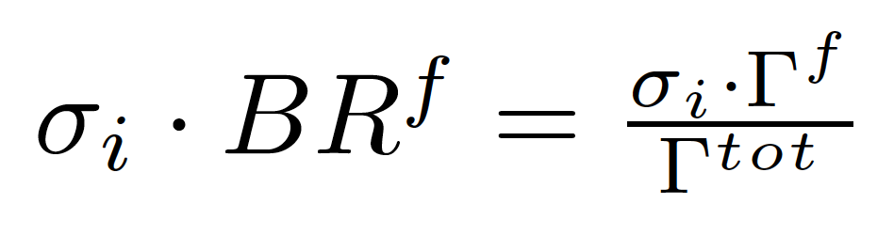
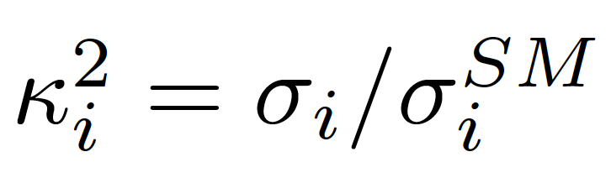
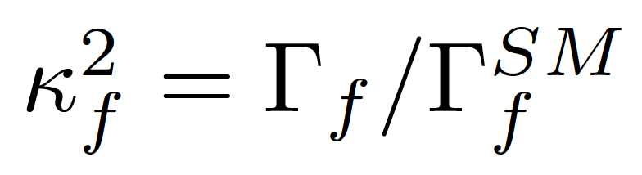
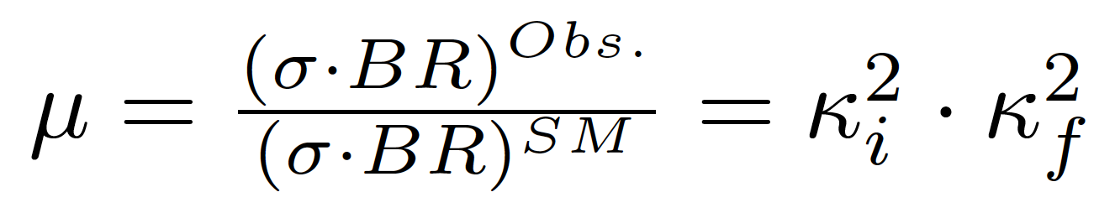
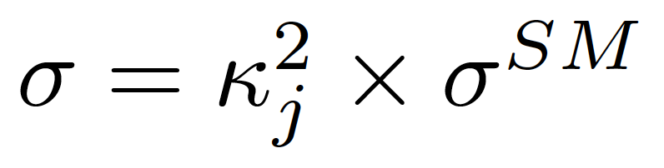
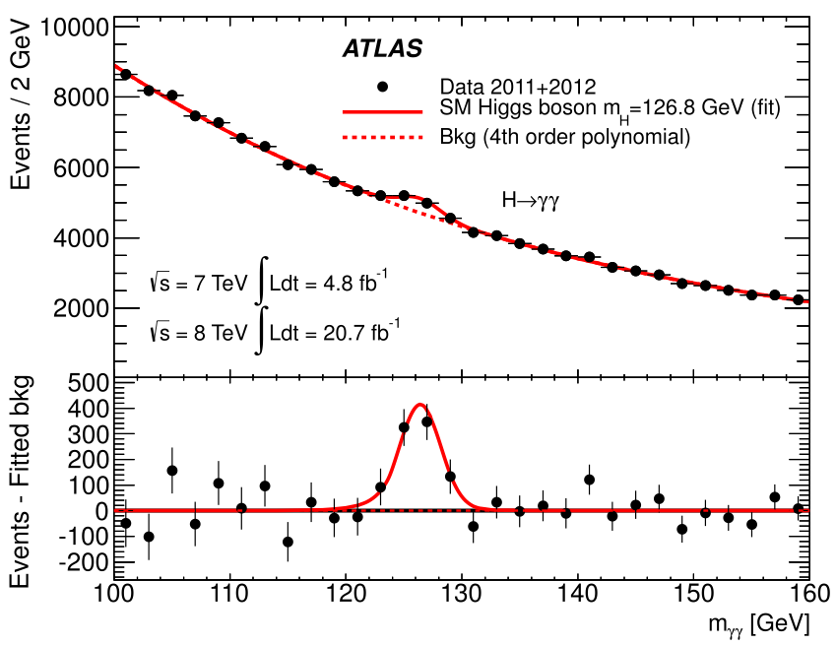
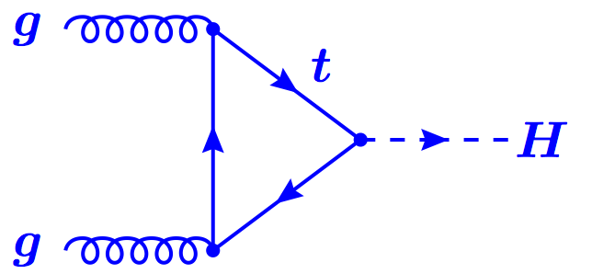
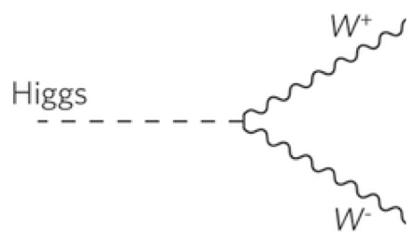
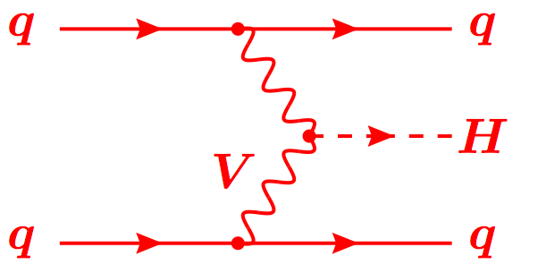
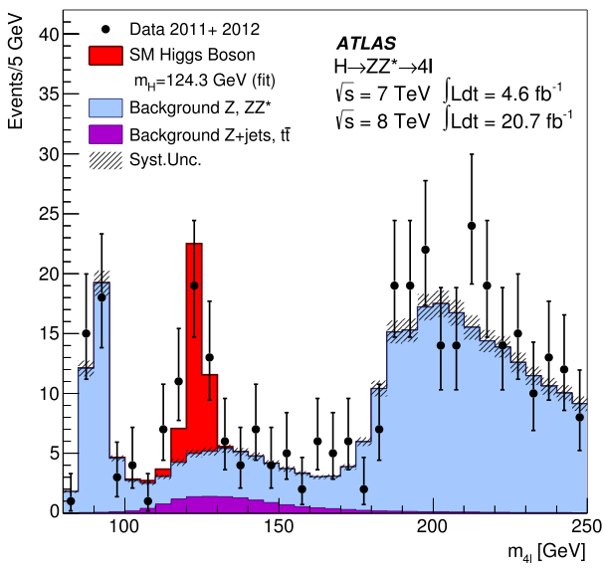

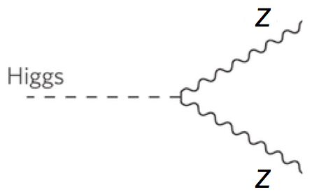
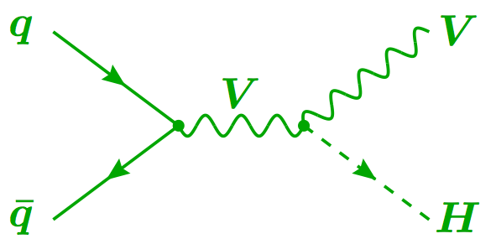

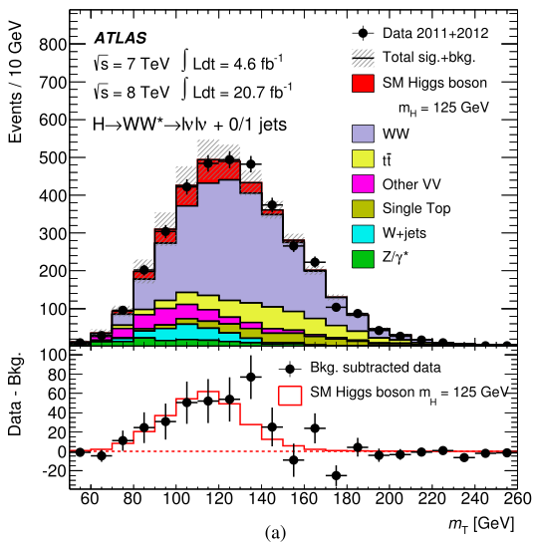
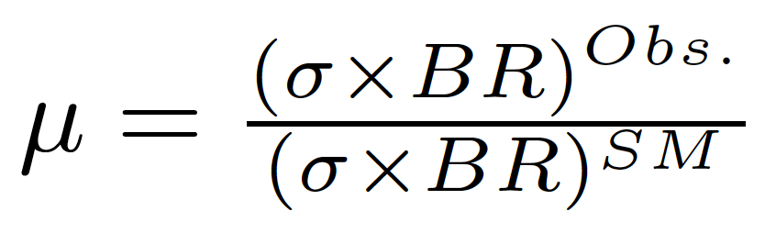
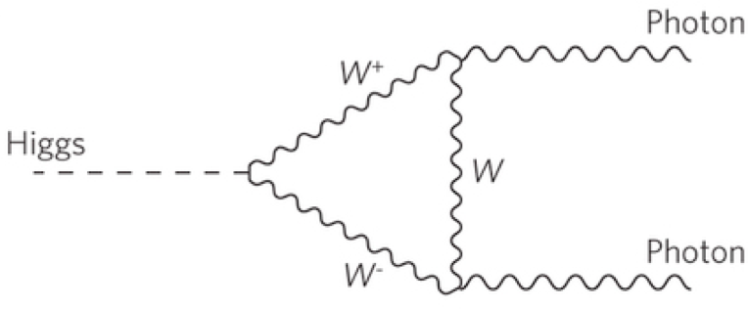
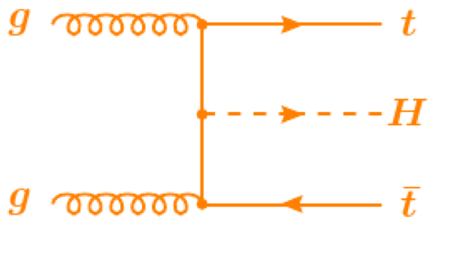
Production
Decay
FIT
H->γγ
×
H->ZZ
t
H->WW
t
Backgrounds +
t

Slide 9
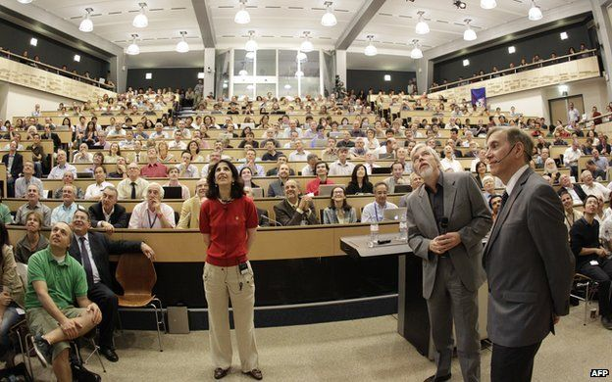
The Run 1 legacy

Slide 10
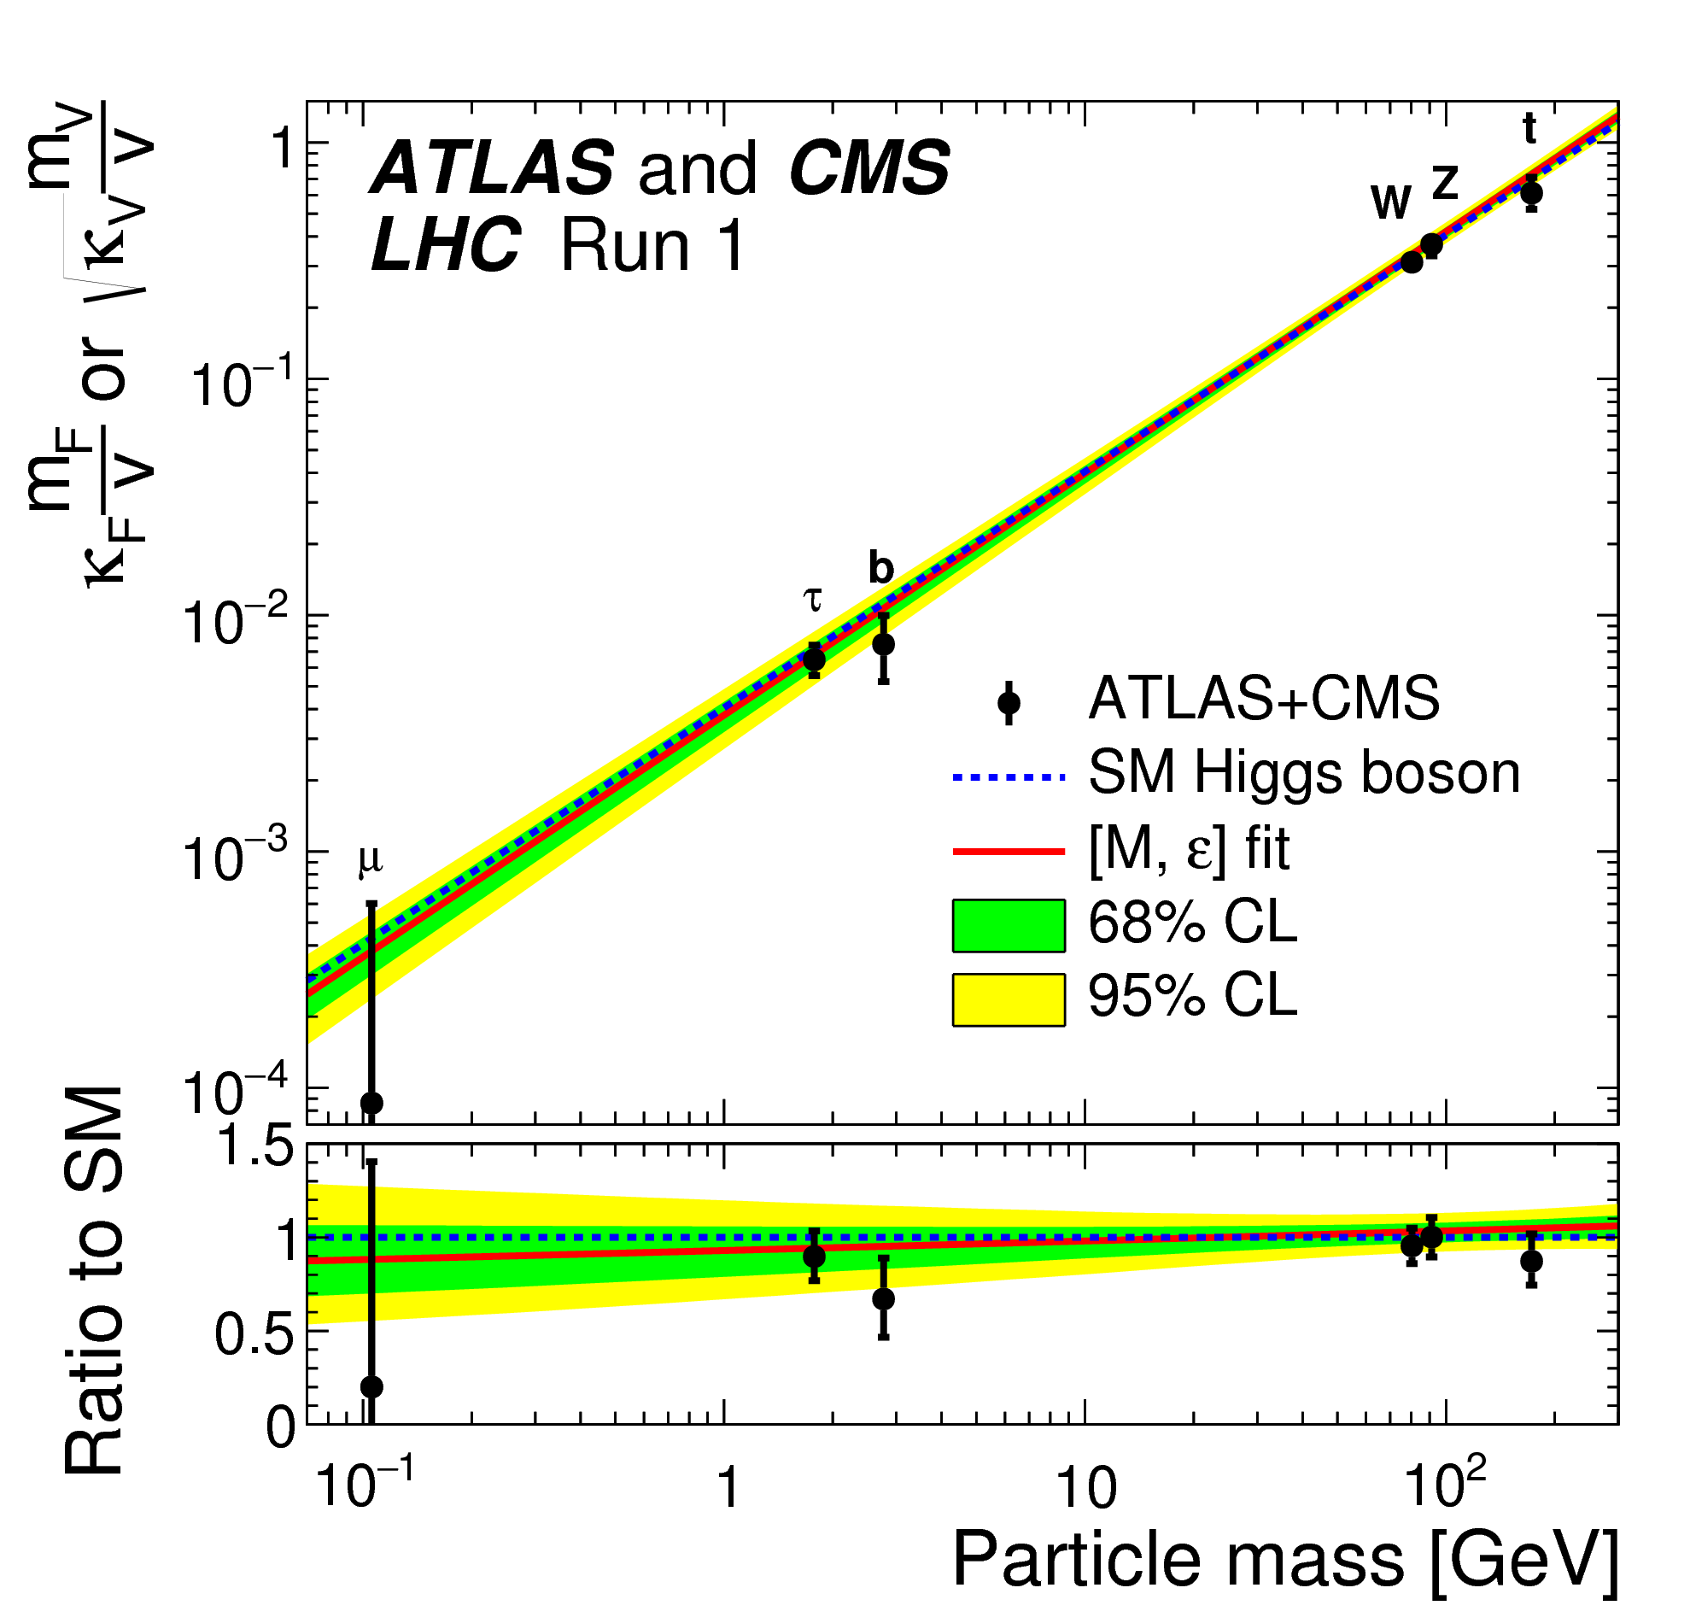
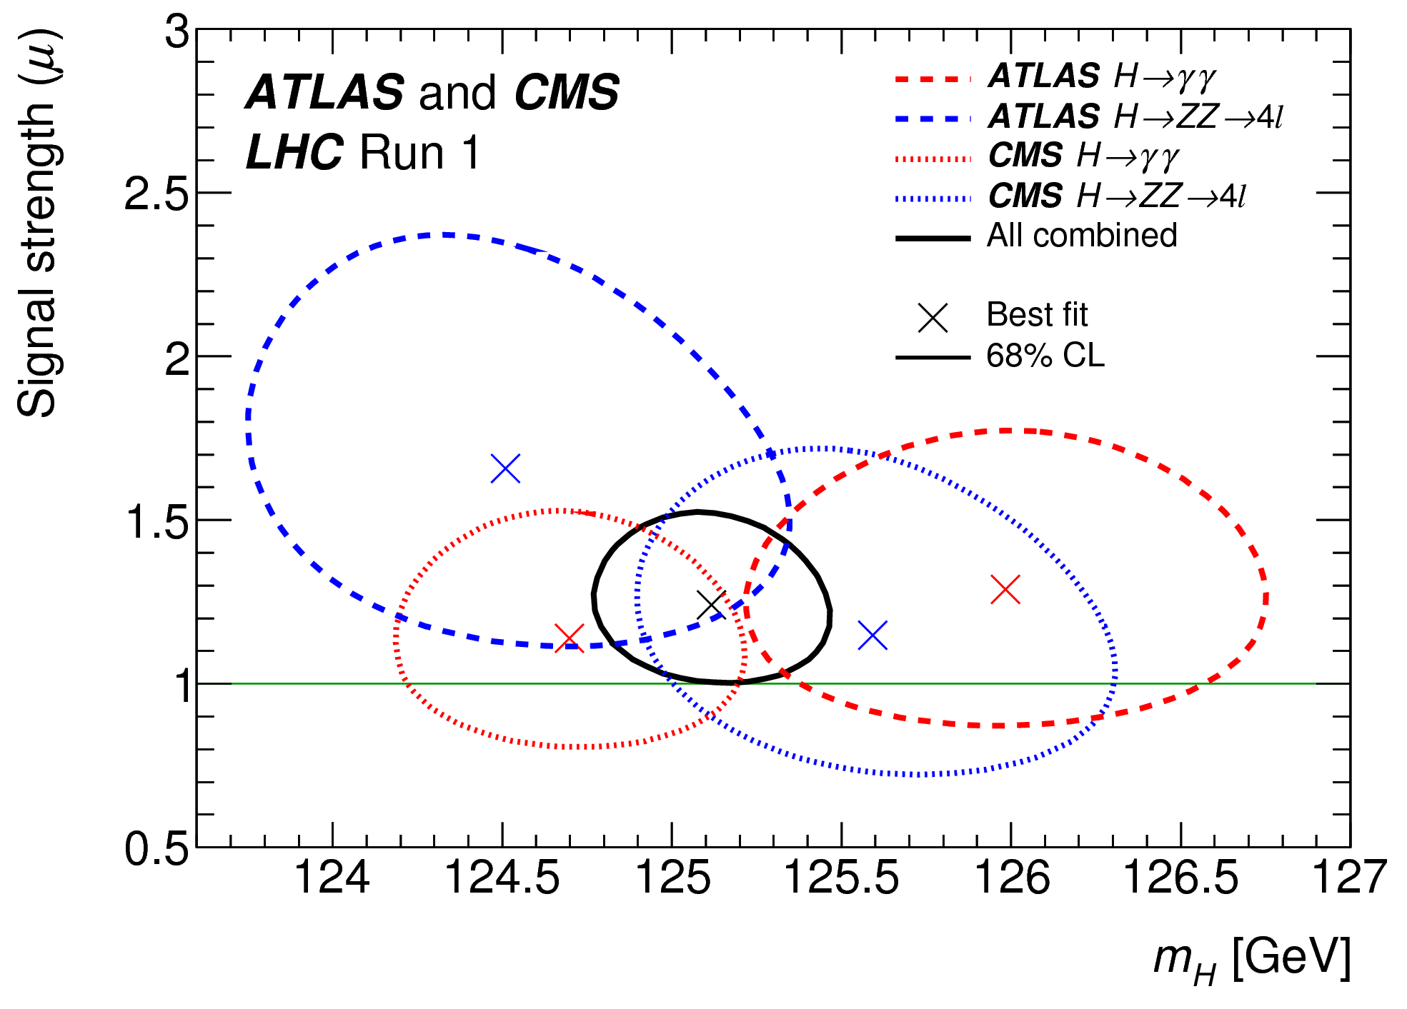
The Run 1 legacy
Phys. Rev. Lett. 114 (2015) 191803
JHEP 08 (2016) 045
Mass – Higgs mass measured with 0.2% accuracy:
  m_{H} = 125.09 ± 0.21 (stat.) ± 0.11 (scale) ± 0.02 (other) ± 0.01 (theory) GeV
Couplings:
  ggF with H → ZZ,,WW observed by individual experiments
  VBF and H →  observed with >5σ significance by ATLAS+CMS combination
  ttH, VH production and H → bb not observed during Run1
Couplings compatible with SM:
  Signal strength: μ_{VBF+VH}/μ_{ggF+ttH} = 1.06 ^{+0.35} _{-0.27}
  Coupling modifiers broadly consistent with SM but large uncertainty
μ = (σ ×BR)_{Obs}/ (σ×BR)_{SM}
Significance (σ)
Prod. | Obs. | Expect.
VBF | 5.4 | 4.7
VH | 3.5 | 4.2
ttH | 4.4 | 2.0
Decay | Obs. | Expect.
H→ττ | 5.5 | 5.0
H→bb | 2.6 | 3.7
Notes:
https://atlas.web.cern.ch/Atlas/GROUPS/PHYSICS/PAPERS/HIGG-2015-07/
https://atlas.web.cern.ch/Atlas/GROUPS/PHYSICS/PAPERS/HIGG-2014-14/

Slide 11
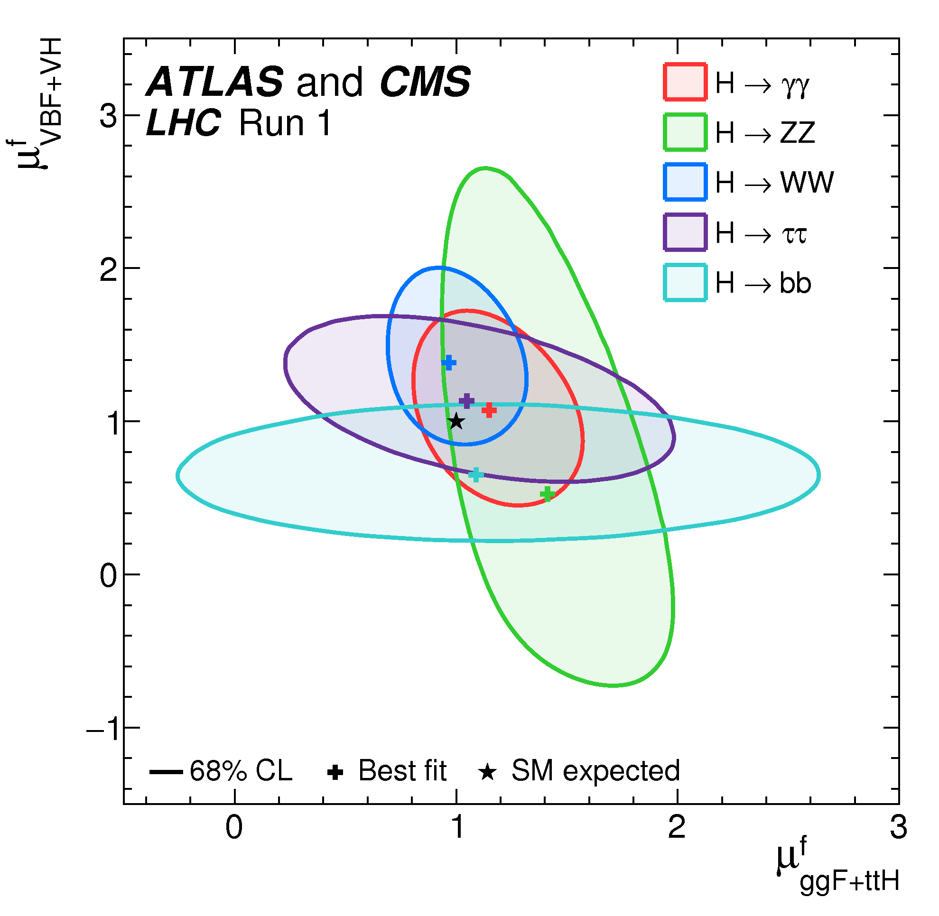
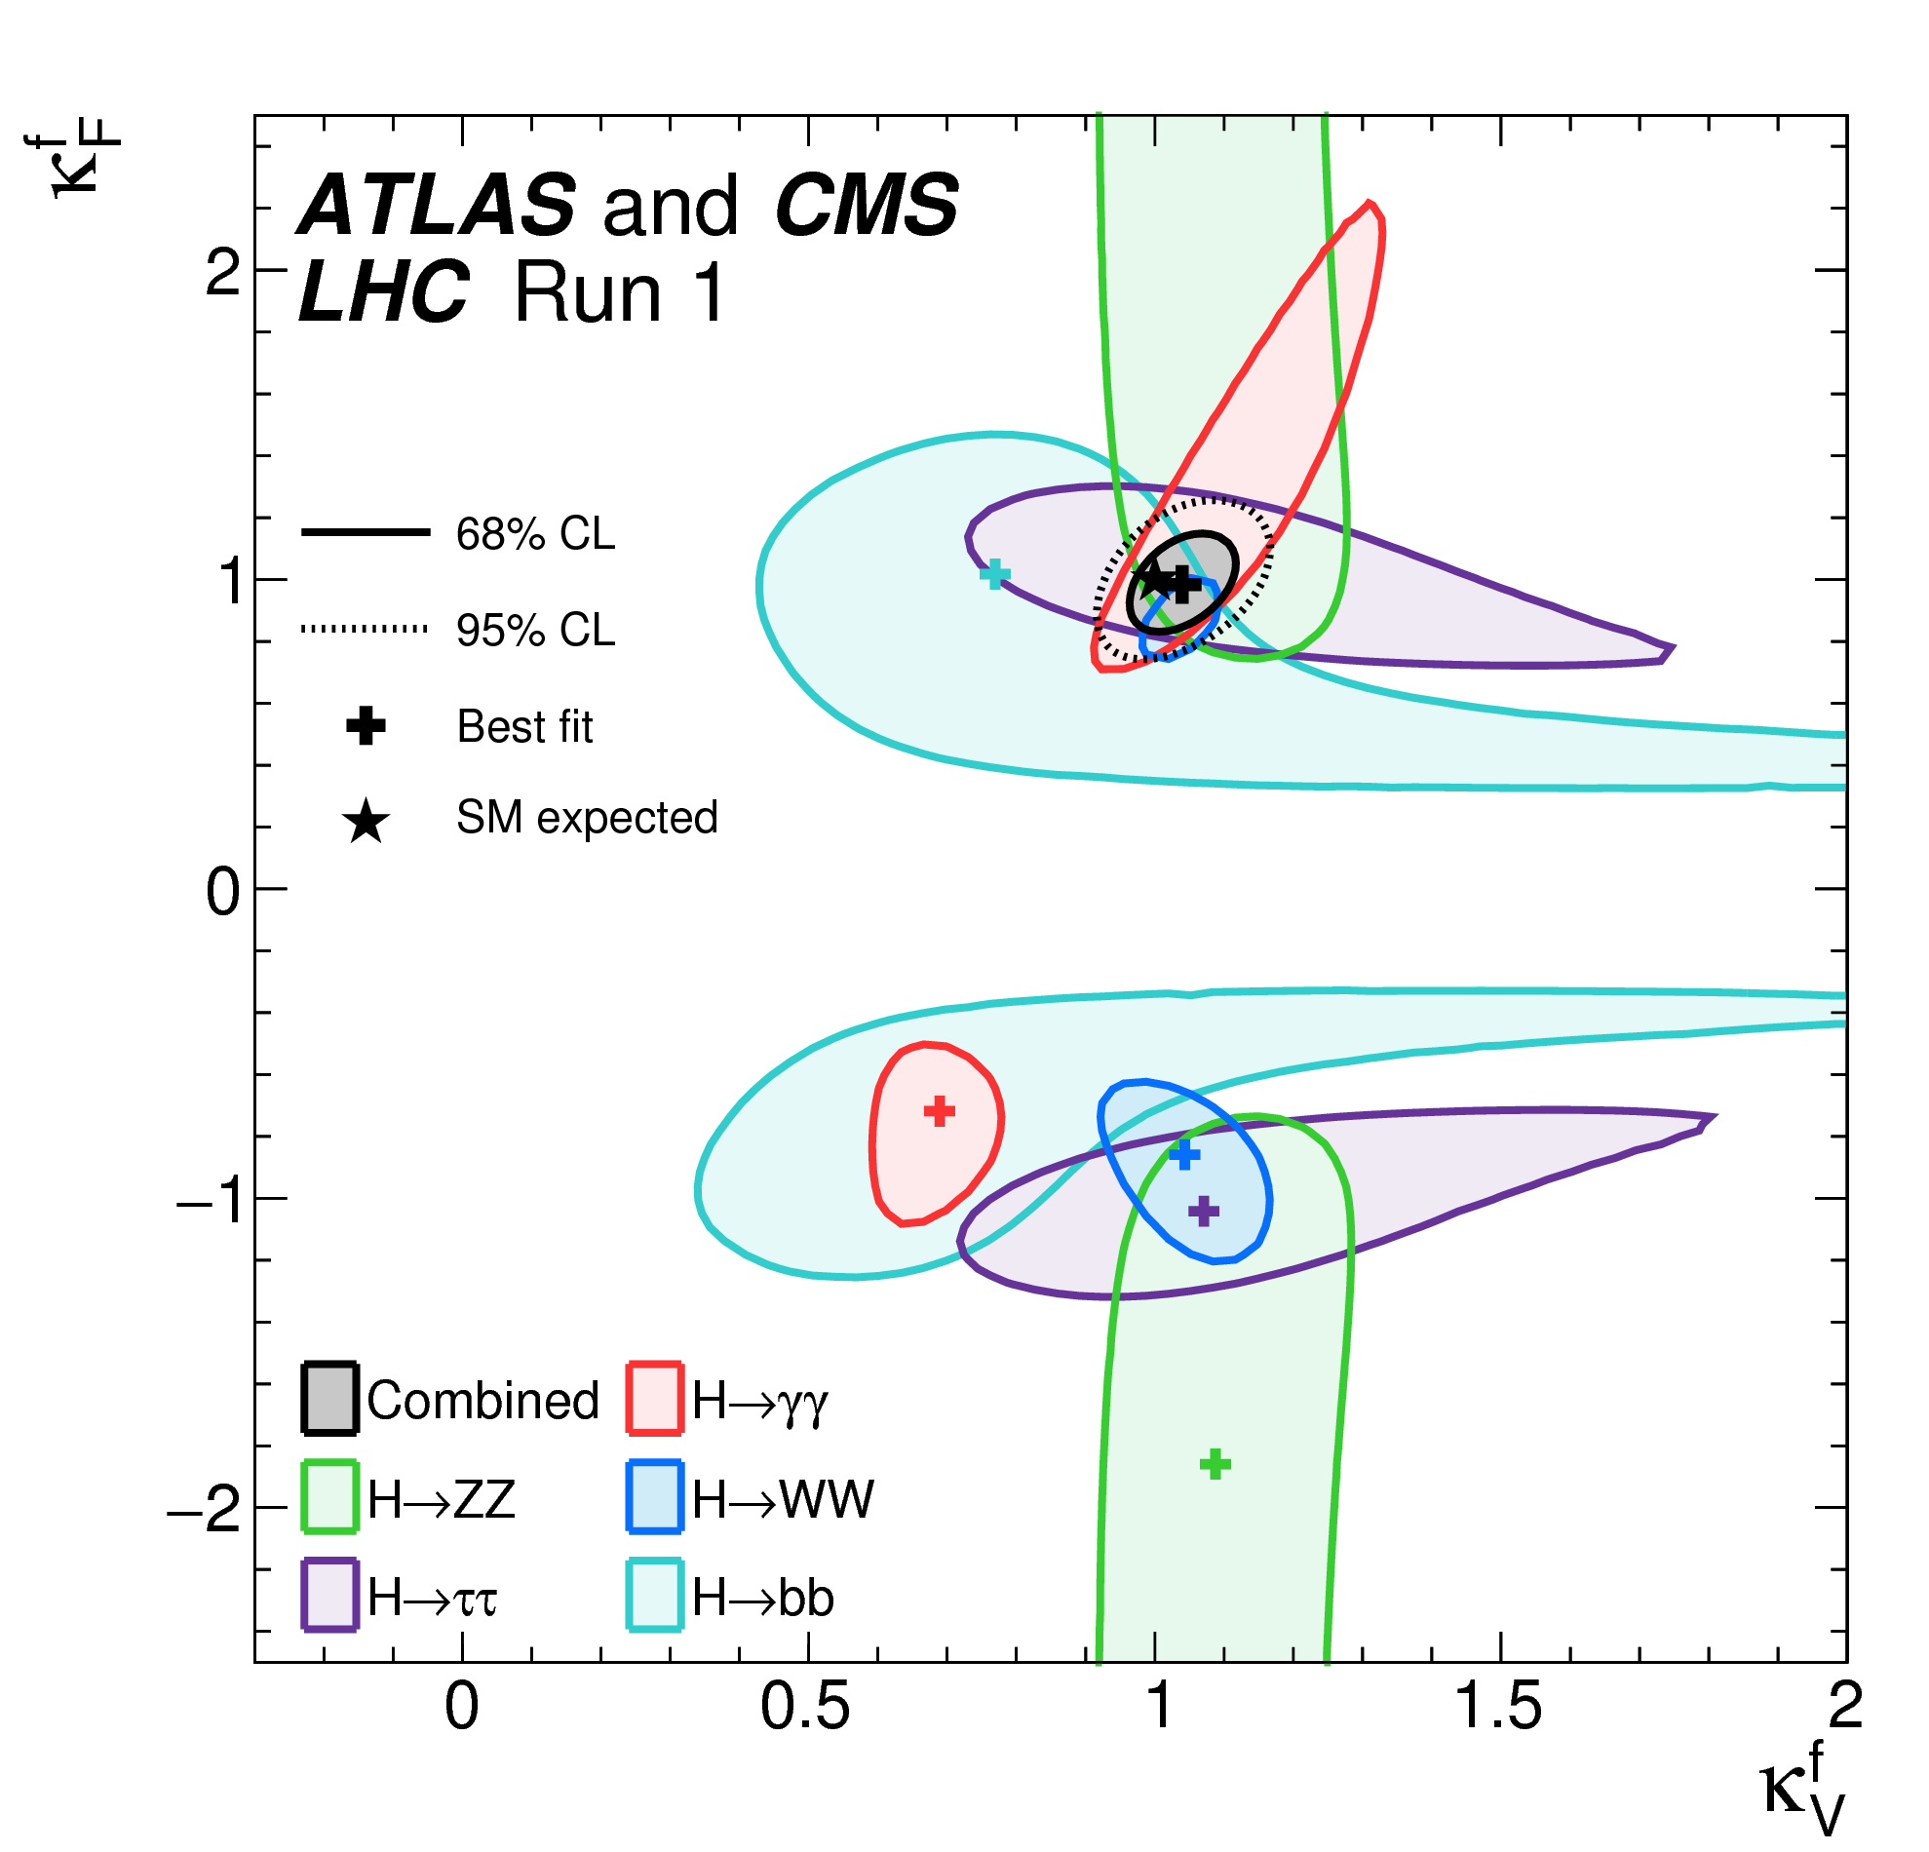
The Run 1 legacy
Phys. Rev. Lett. 114 (2015) 191803
JHEP 08 (2016) 045
Mass – Higgs mass measured with 0.2% accuracy:
  m_{H} = 125.09 ± 0.21 (stat.) ± 0.11 (scale) ± 0.02 (other) ± 0.01 (theory) GeV
Couplings:
  ggF with H → ZZ,,WW observed by individual experiments
  VBF and H →  observed with >5σ significance by ATLAS+CMS combination
  ttH, VH production and H → bb not observed during Run1
Couplings compatible with SM:
  Signal strength: μ_{VBF+VH}/μ_{ggF+ttH} = 1.06 ^{+0.35} _{-0.27}
  Coupling modifiers broadly consistent with SM but still large uncertainty
μ = (σ ×BR)_{Obs}/ (σ×BR)_{SM}
Significance (σ)
Prod. | Obs. | Expect.
VBF | 5.4 | 4.7
VH | 3.5 | 4.2
ttH | 4.4 | 2.0
Decay | Obs. | Expect.
H→ττ | 5.5 | 5.0
H→bb | 2.6 | 3.7
Notes:
https://atlas.web.cern.ch/Atlas/GROUPS/PHYSICS/PAPERS/HIGG-2015-07/
https://atlas.web.cern.ch/Atlas/GROUPS/PHYSICS/PAPERS/HIGG-2014-14/

Slide 12

Probing the 125 GeV Higgs
2HDM
Triple coupling λ₃
Clavicle
Aorta
Ribs
Yukawa
couplings
BSM

Slide 13
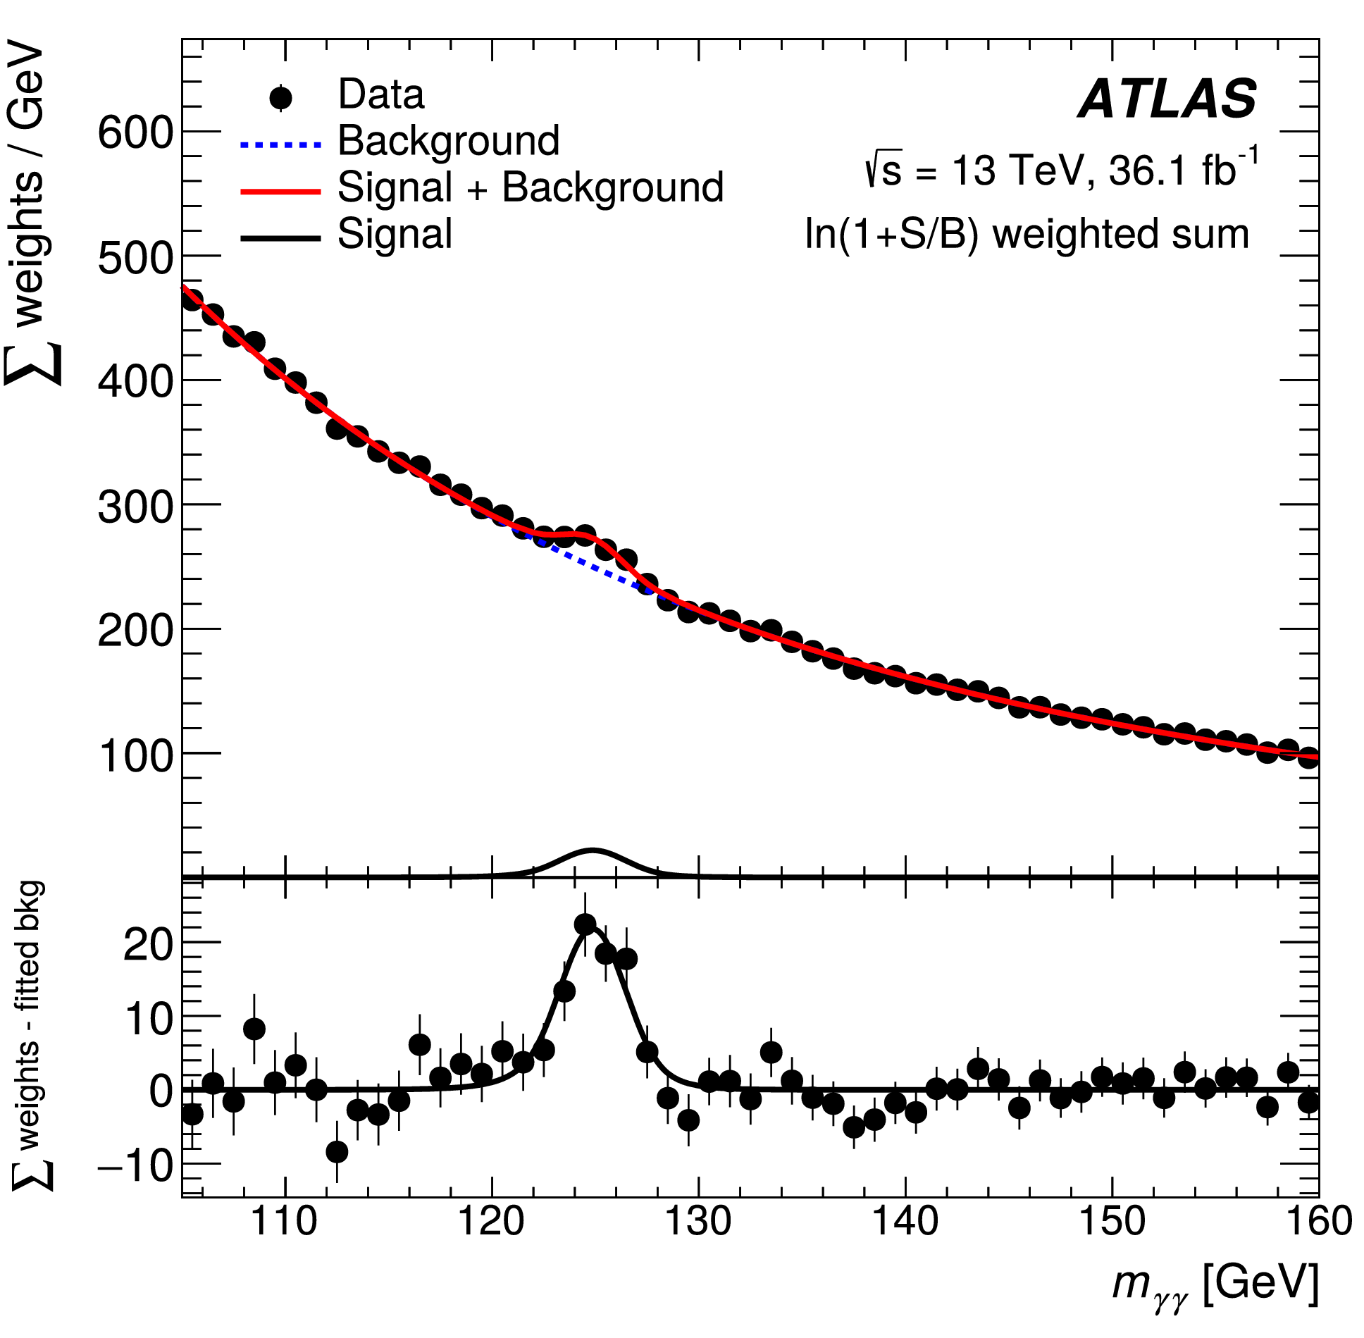

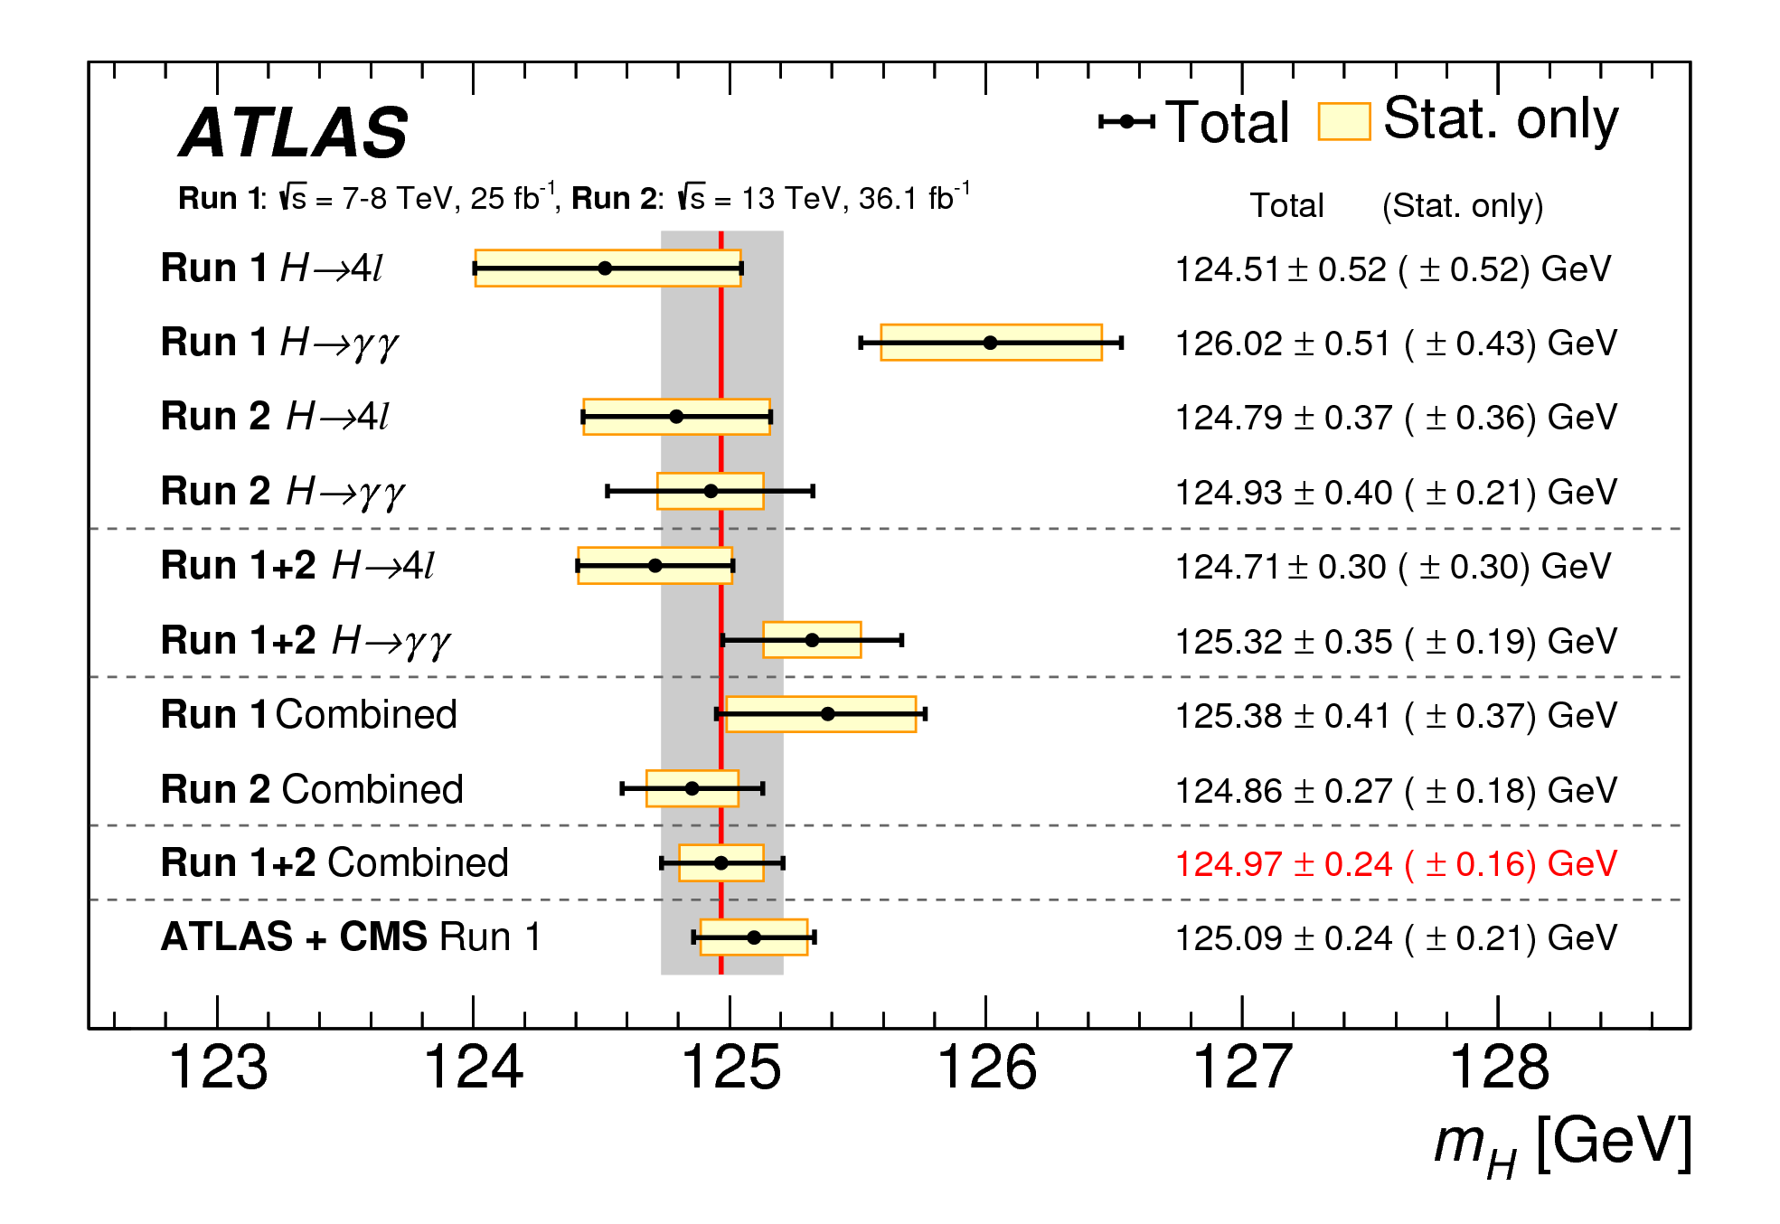
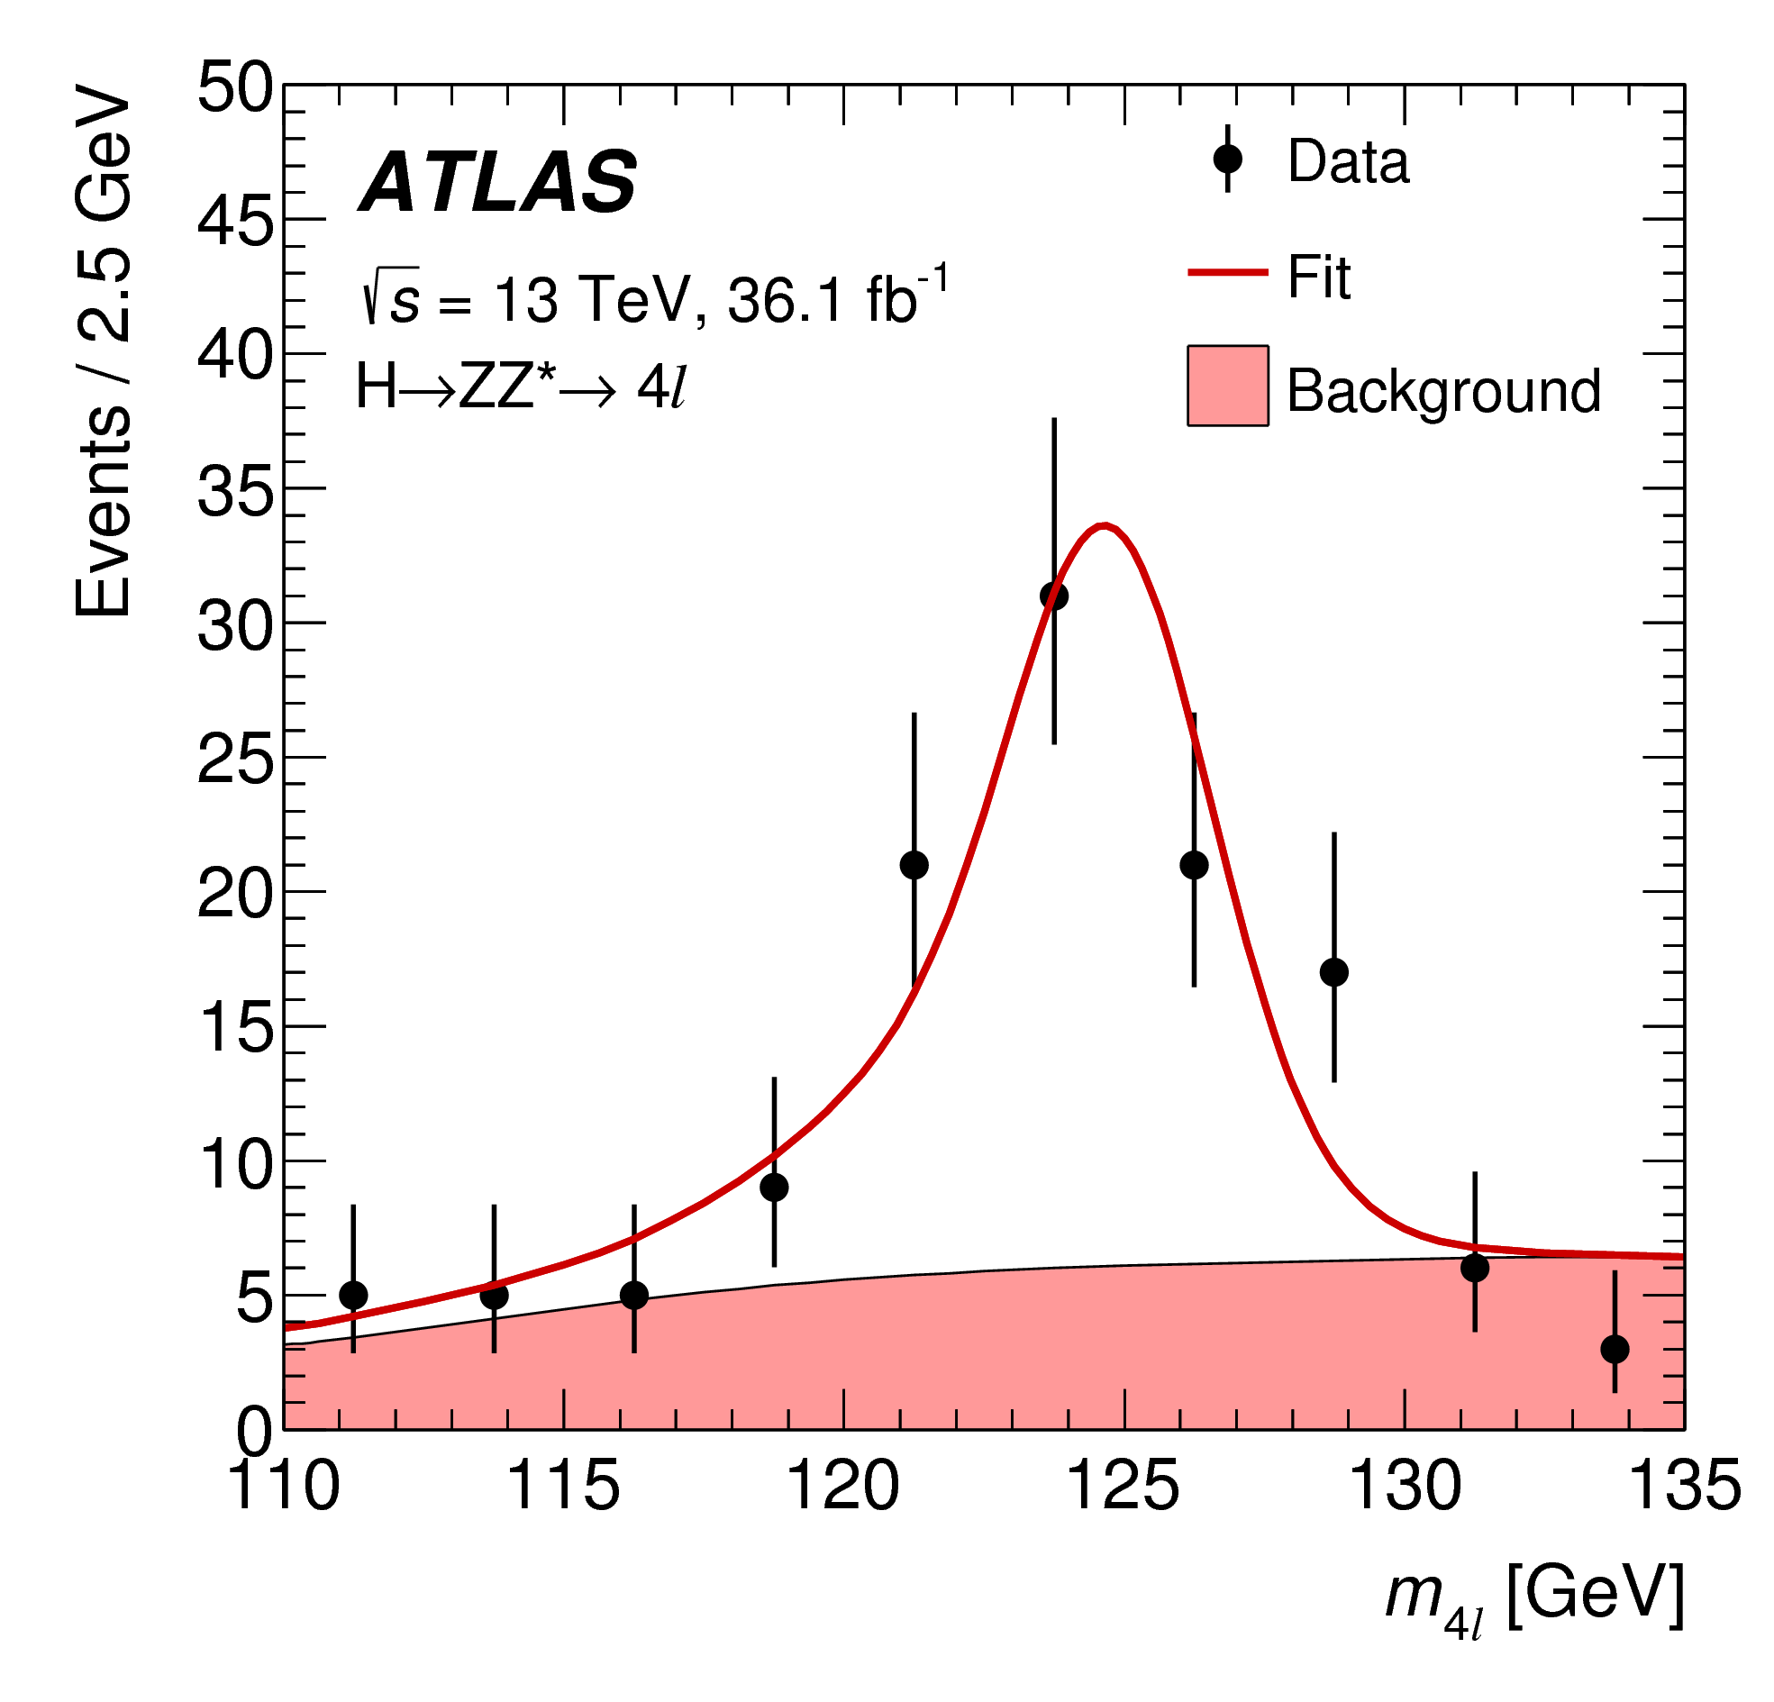
Higgs boson mass
arXiv:1806.00242 [hep-ex]/Phys.Lett. B 784 (2018) 345–366
Mass measurement from CMS H→ZZ*→4l:
m_{H}^{ZZ*}= 125.26 ± 0.20 (stat) ± 0.08 (syst) GeV
New Measurements from ATLAS
  H→ γγ: m_{H}^{γγ} = 124.93 ± 0.40 GeV
  H→ZZ*→4l: m_{H}^{ZZ∗} = 124.79 ± 0.37 GeV
Run 1+2 combination from ATLAS:
  m_{H} = 124.97 ± 0.19 (stat) ± 0.13 (syst.) GeV
1 June 2018
Notes:
https://atlas.web.cern.ch/Atlas/GROUPS/PHYSICS/PAPERS/HIGG-2016-33/ → 1 June 2018
Both use 36.1 fb⁻¹ from 2015+2016

Slide 14
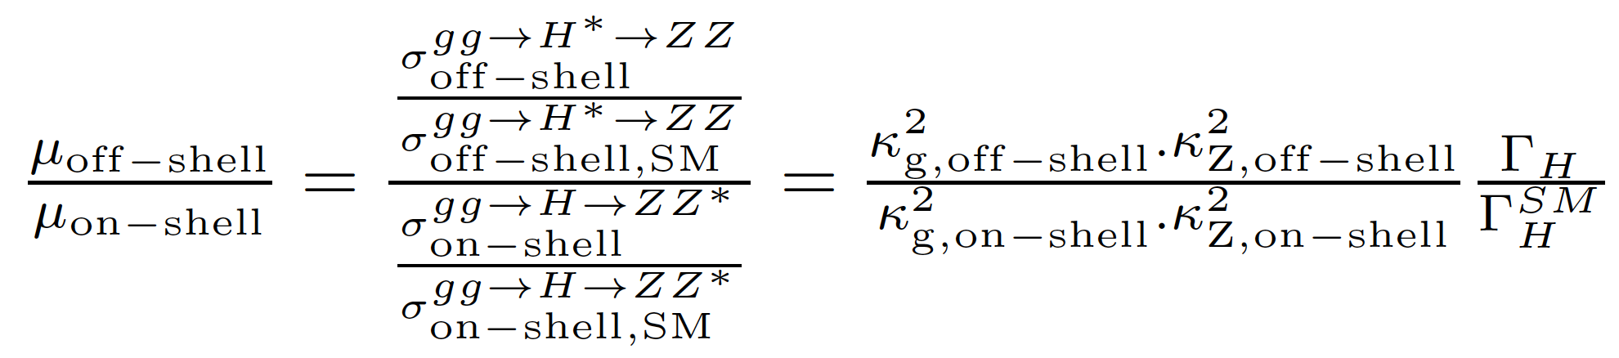
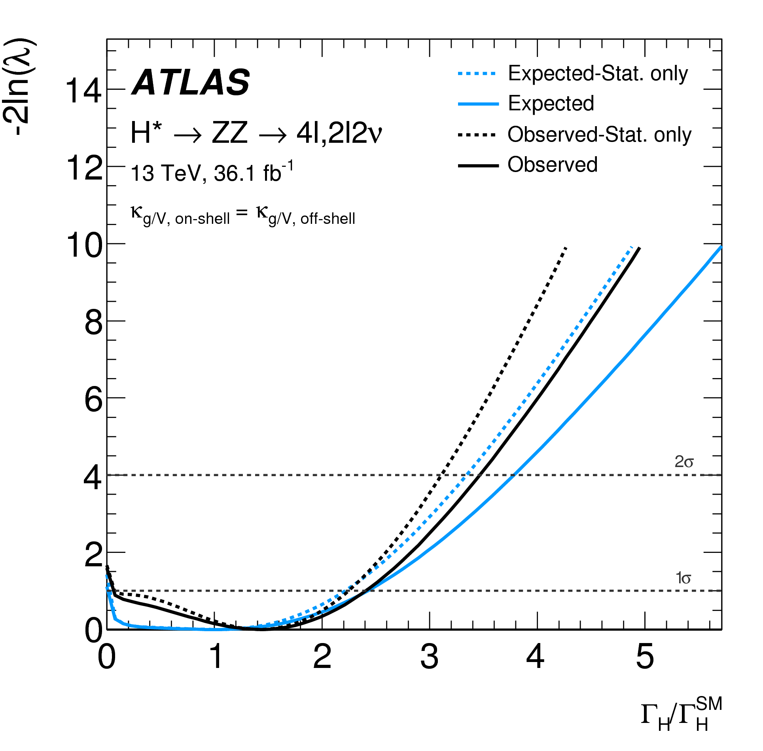
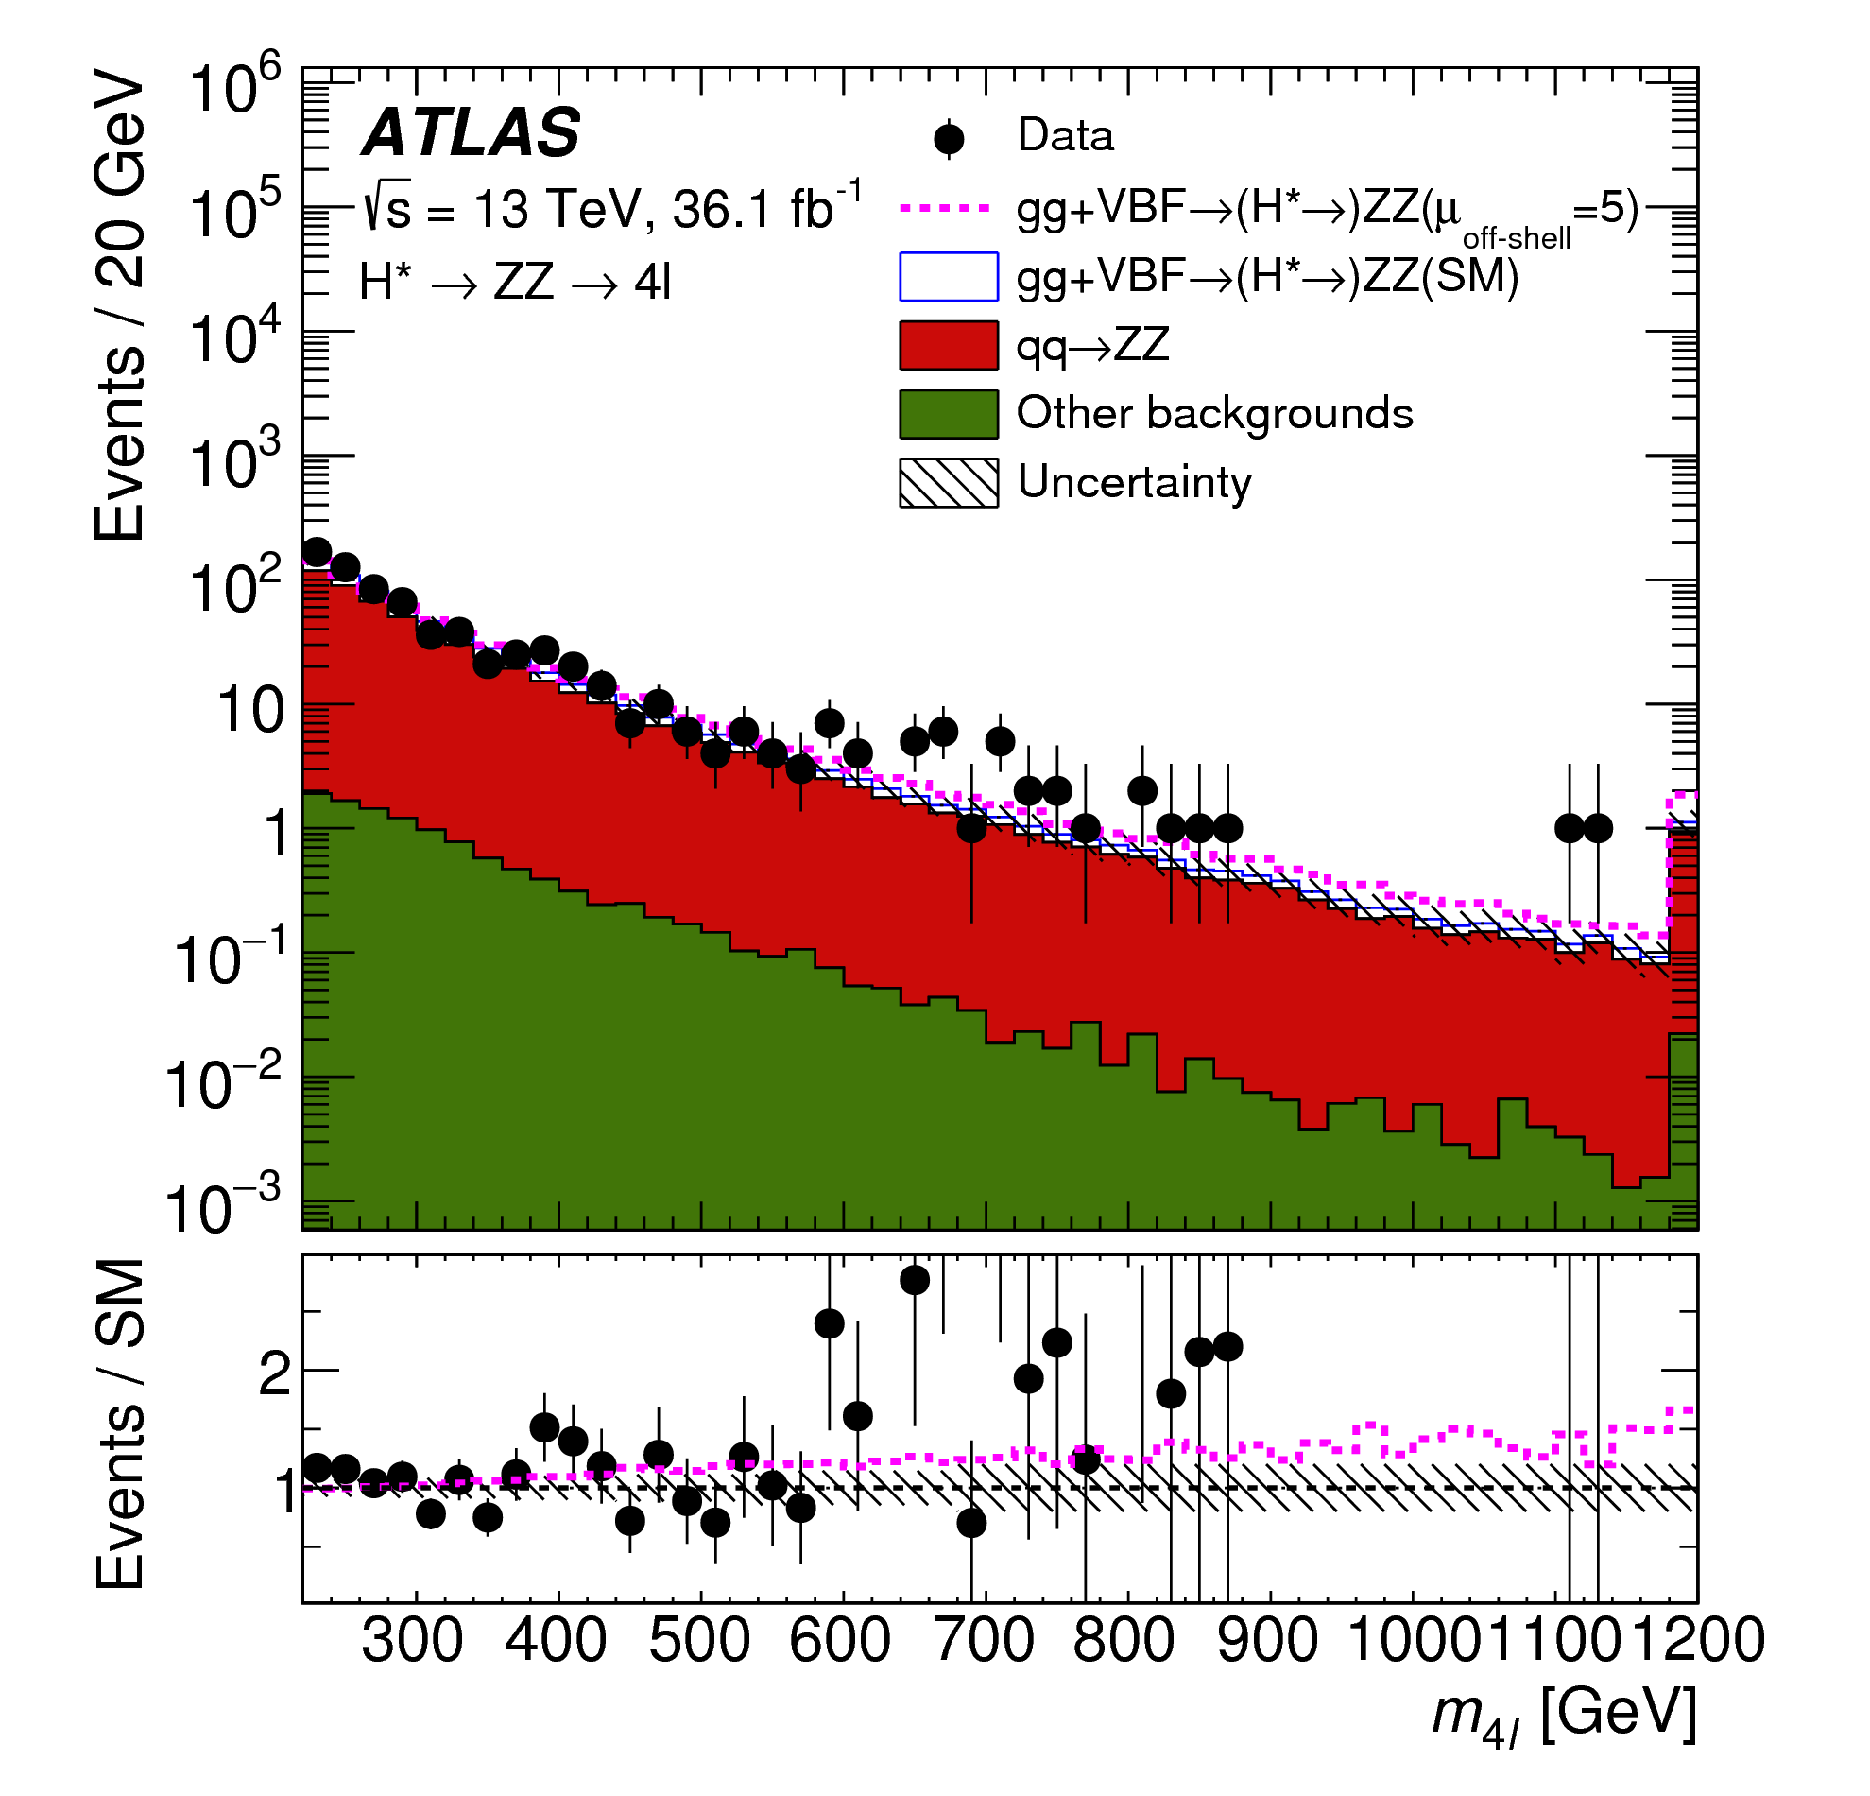
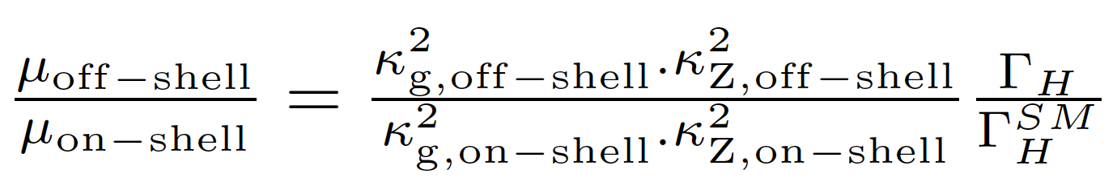
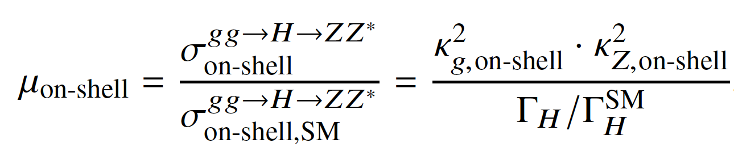

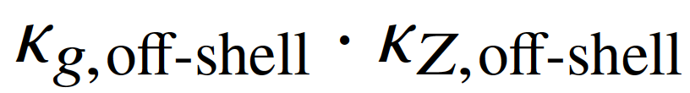
Higgs boson width
arXiv:1808.01191 [hep-ex]/HIGG-2017-06
2 Aug 2018
SM Higgs width Γ_{H}~4.1 MeV
  Too small to be measured directly
  Best direct limit from CMS:
    Γ_{H} < 1.1GeV @ 95% CL
Off-shell Higgs production sensitive(*) to Γ_{H}
ATLAS measurement:
  pp→H→ZZ→4l and ZZ→2l2ν
  m(H) > 2 m(Z)
  36.1 fb⁻¹ of 13 TeV data
  Observed (expected) limit:
    Γ_{H} < 14.4 (15.2) MeV
(*) Assume interference term with proportional to
Notes:
https://atlas.web.cern.ch/Atlas/GROUPS/PHYSICS/PAPERS/HIGG-2017-06/ → 2 Aug.2018
above 125 GeV off-shell production of the Higgs boson has a substantial cross section at the LHC [13–16], due to the increased phase space as the vector bosons (V = W; Z) and
top quark decay products become on-shell with the increasing energy scale

Slide 15
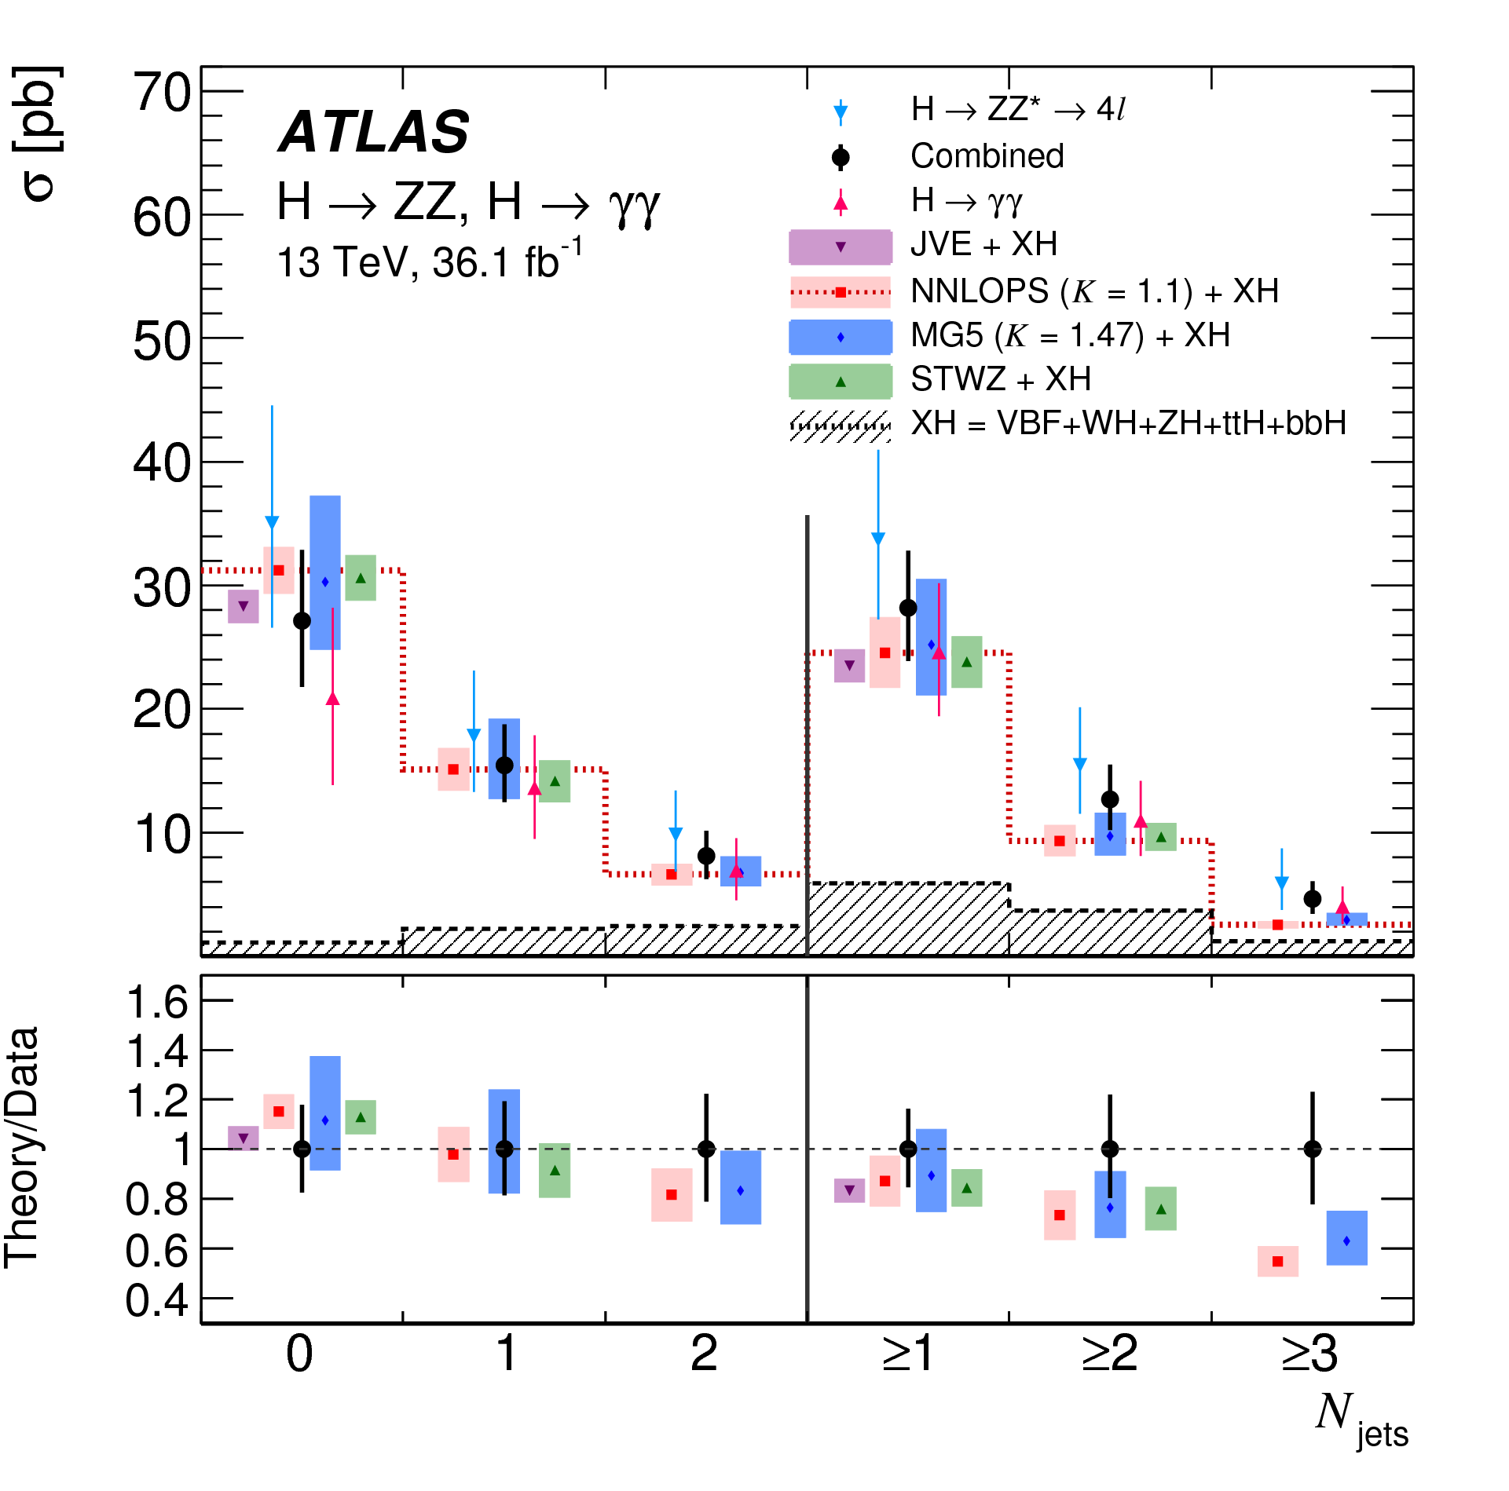
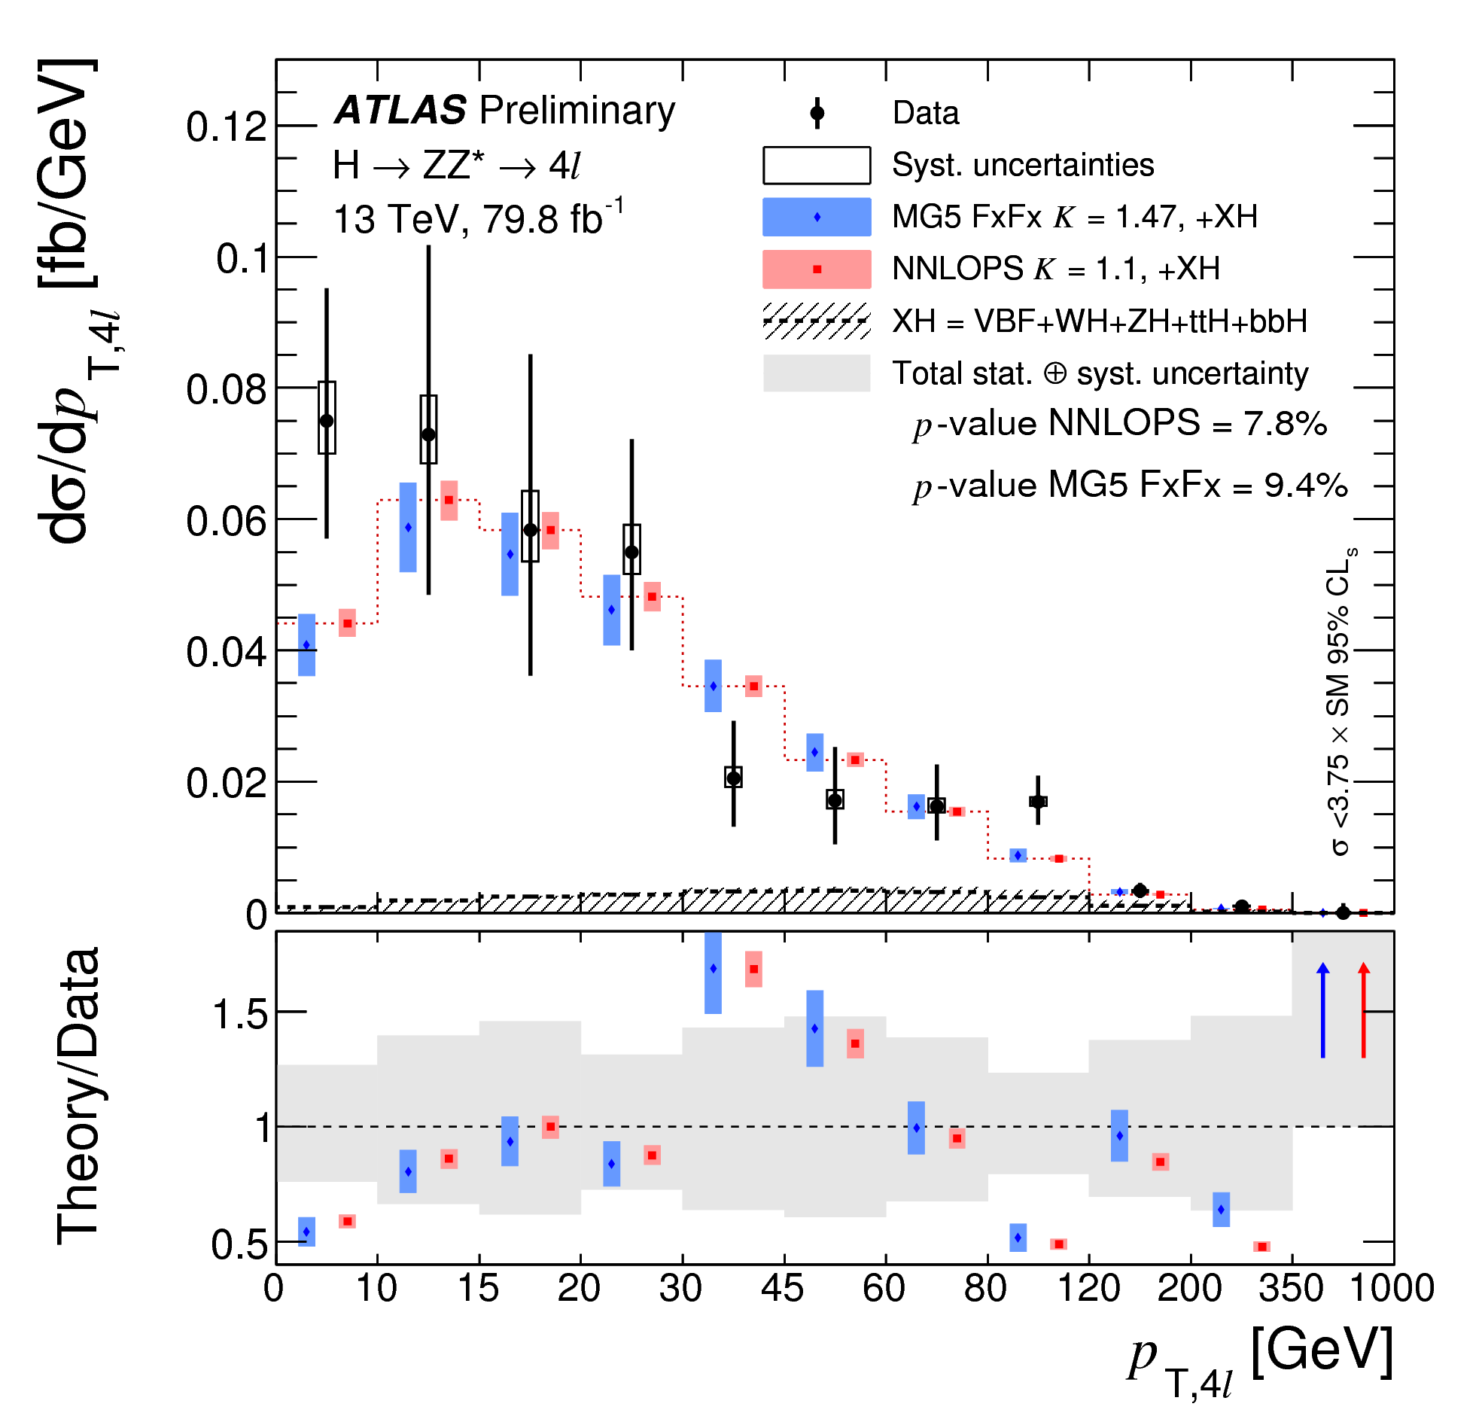
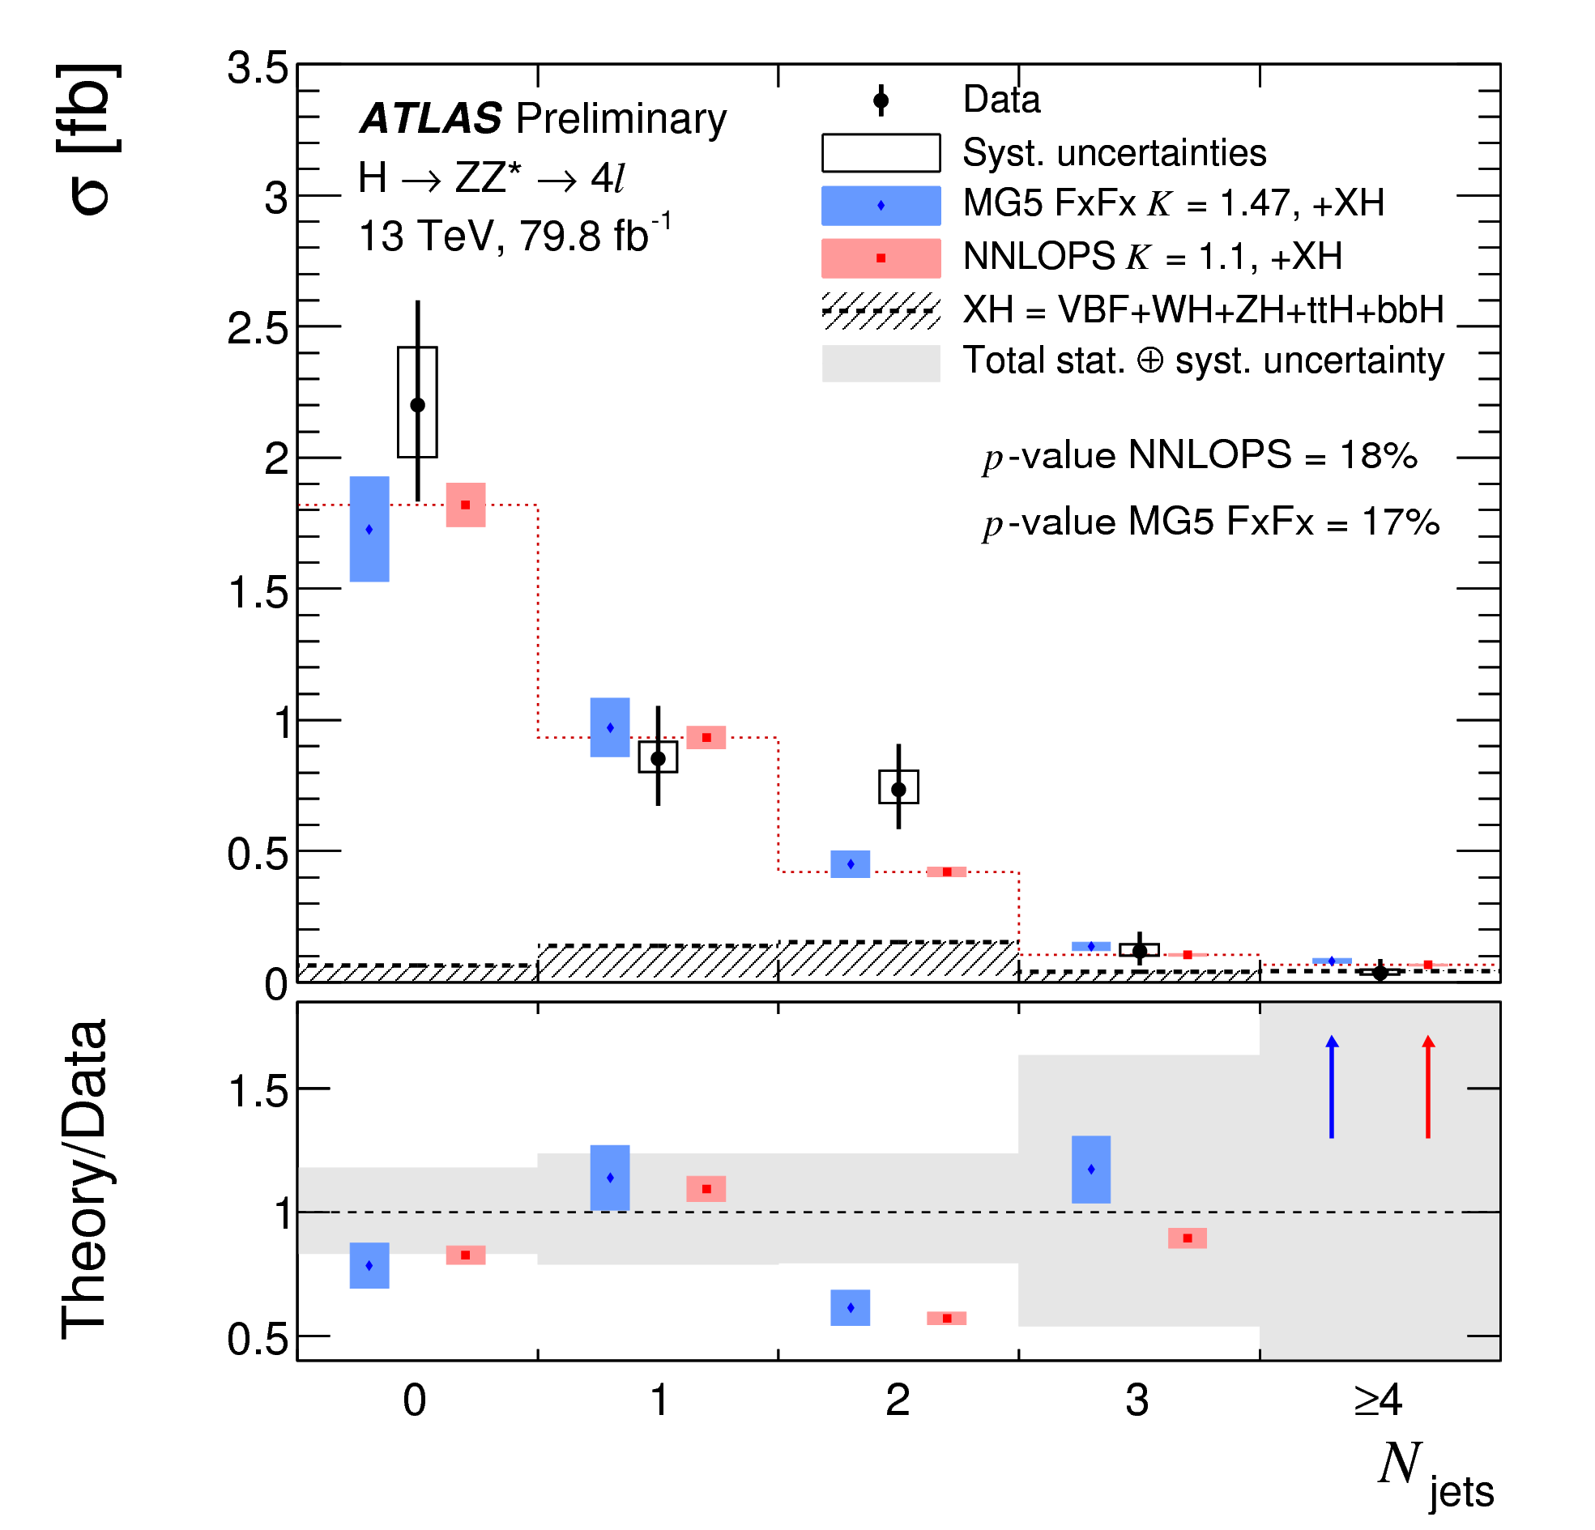
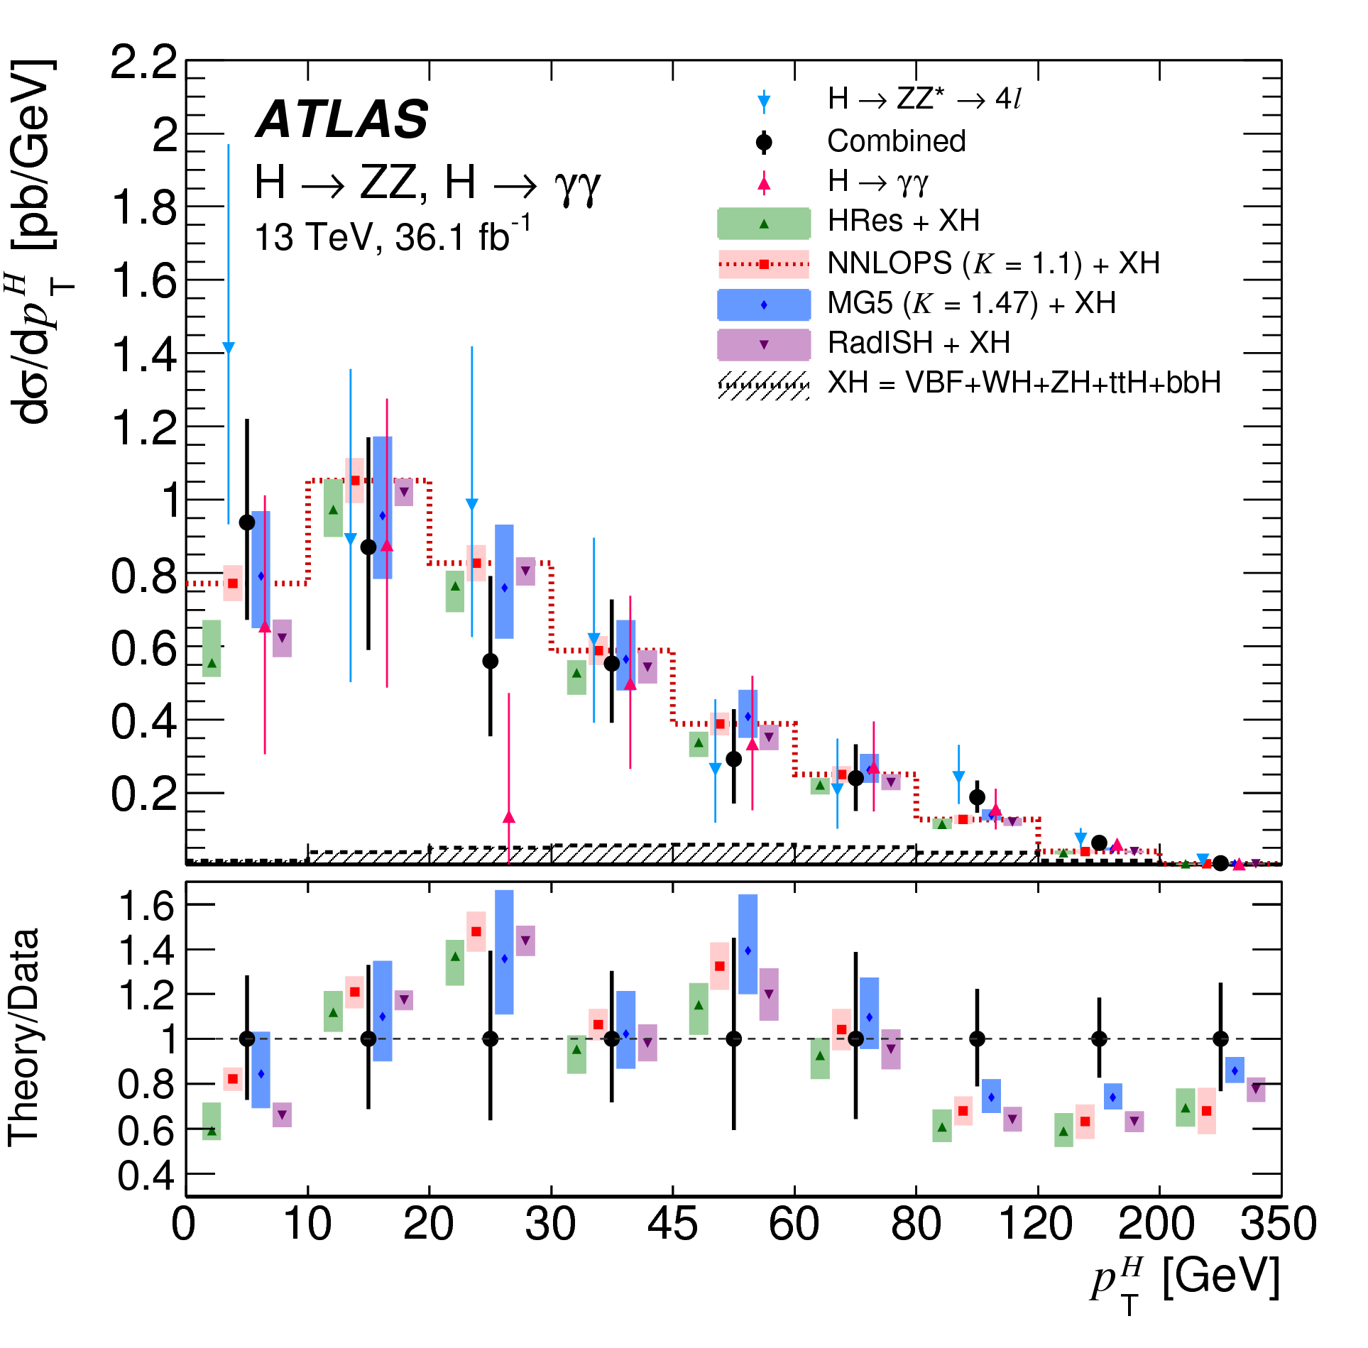
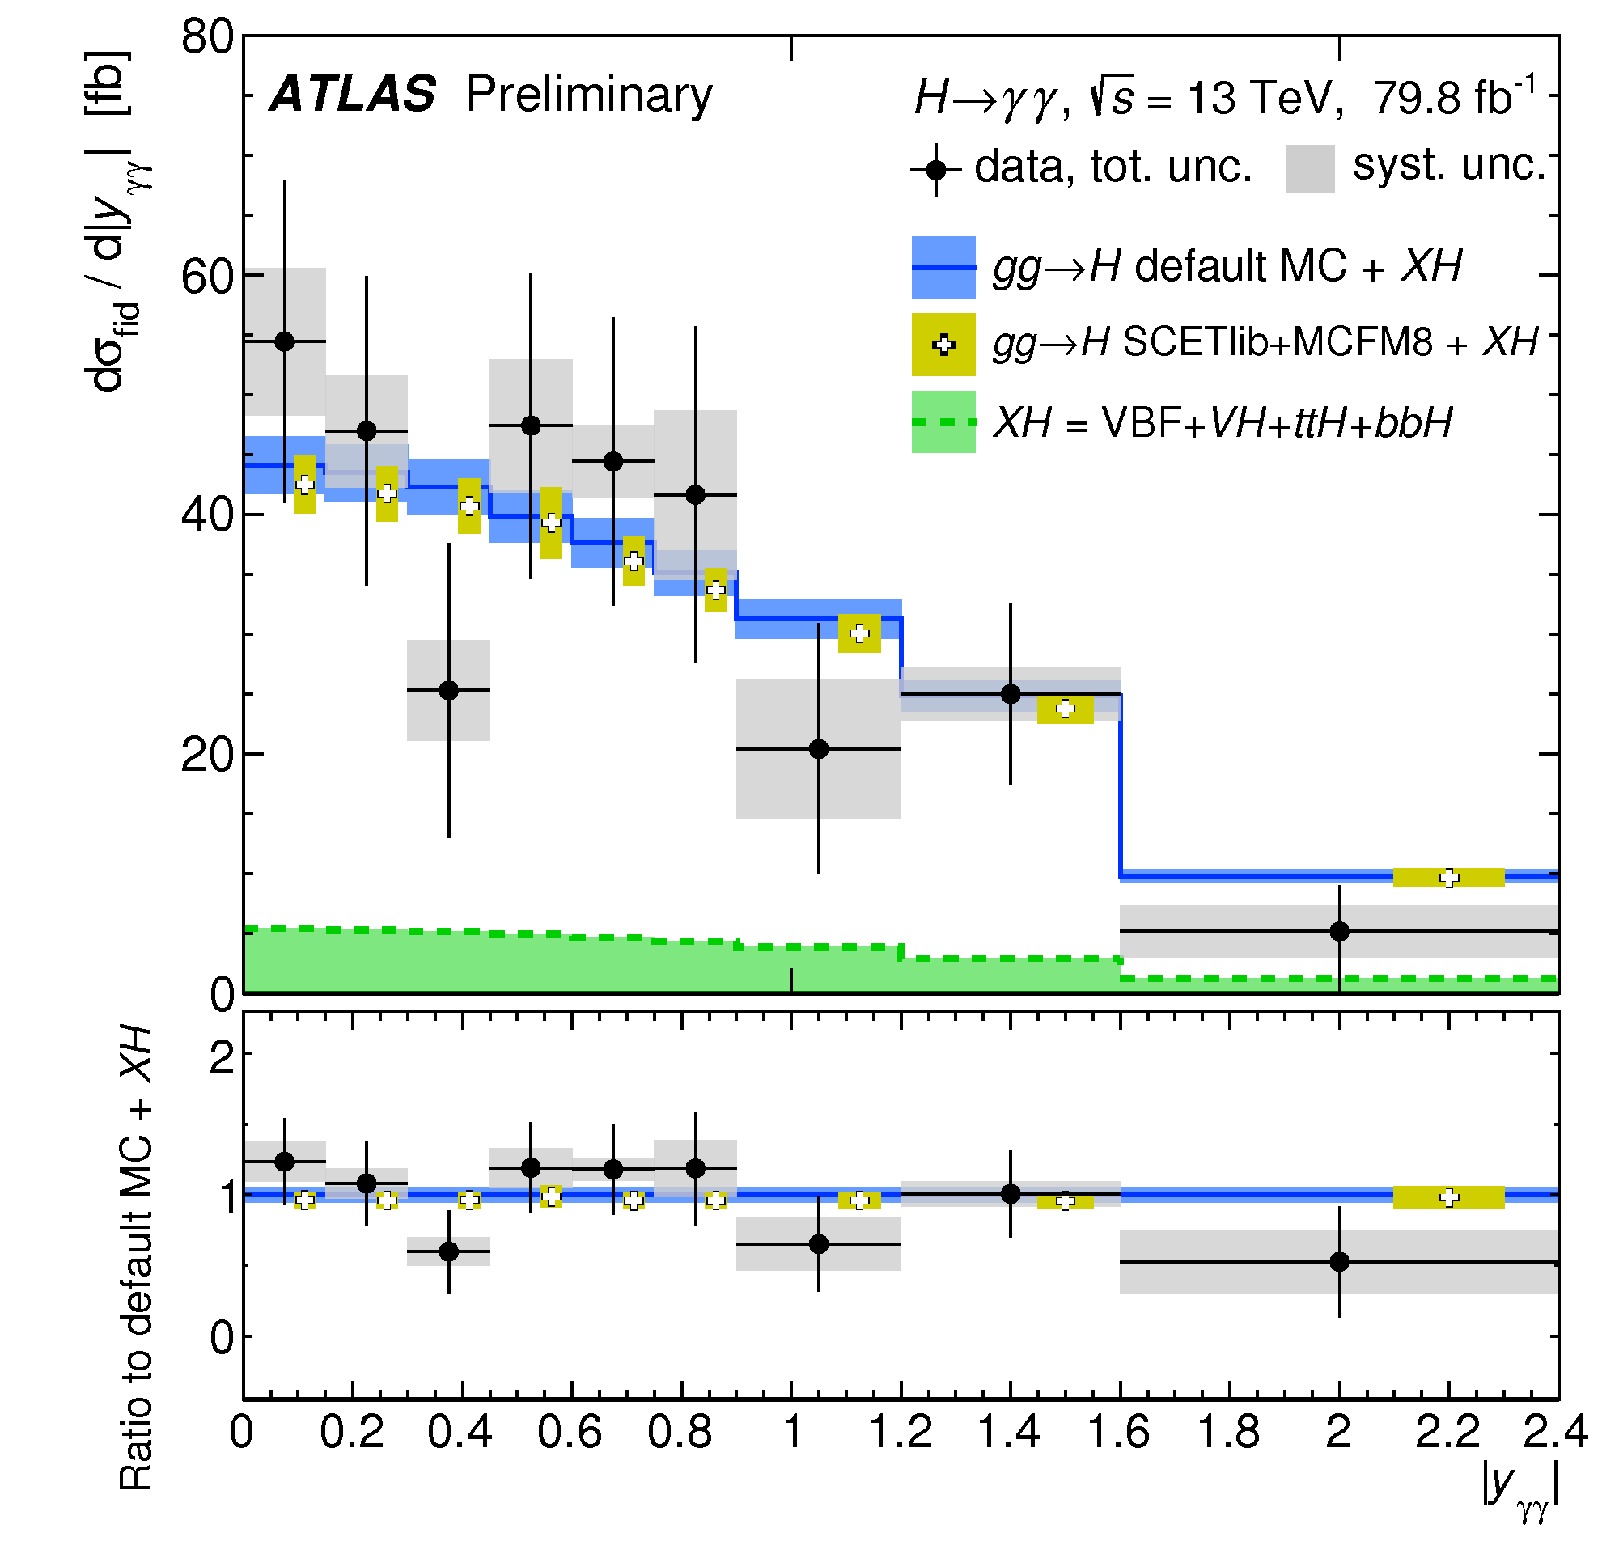
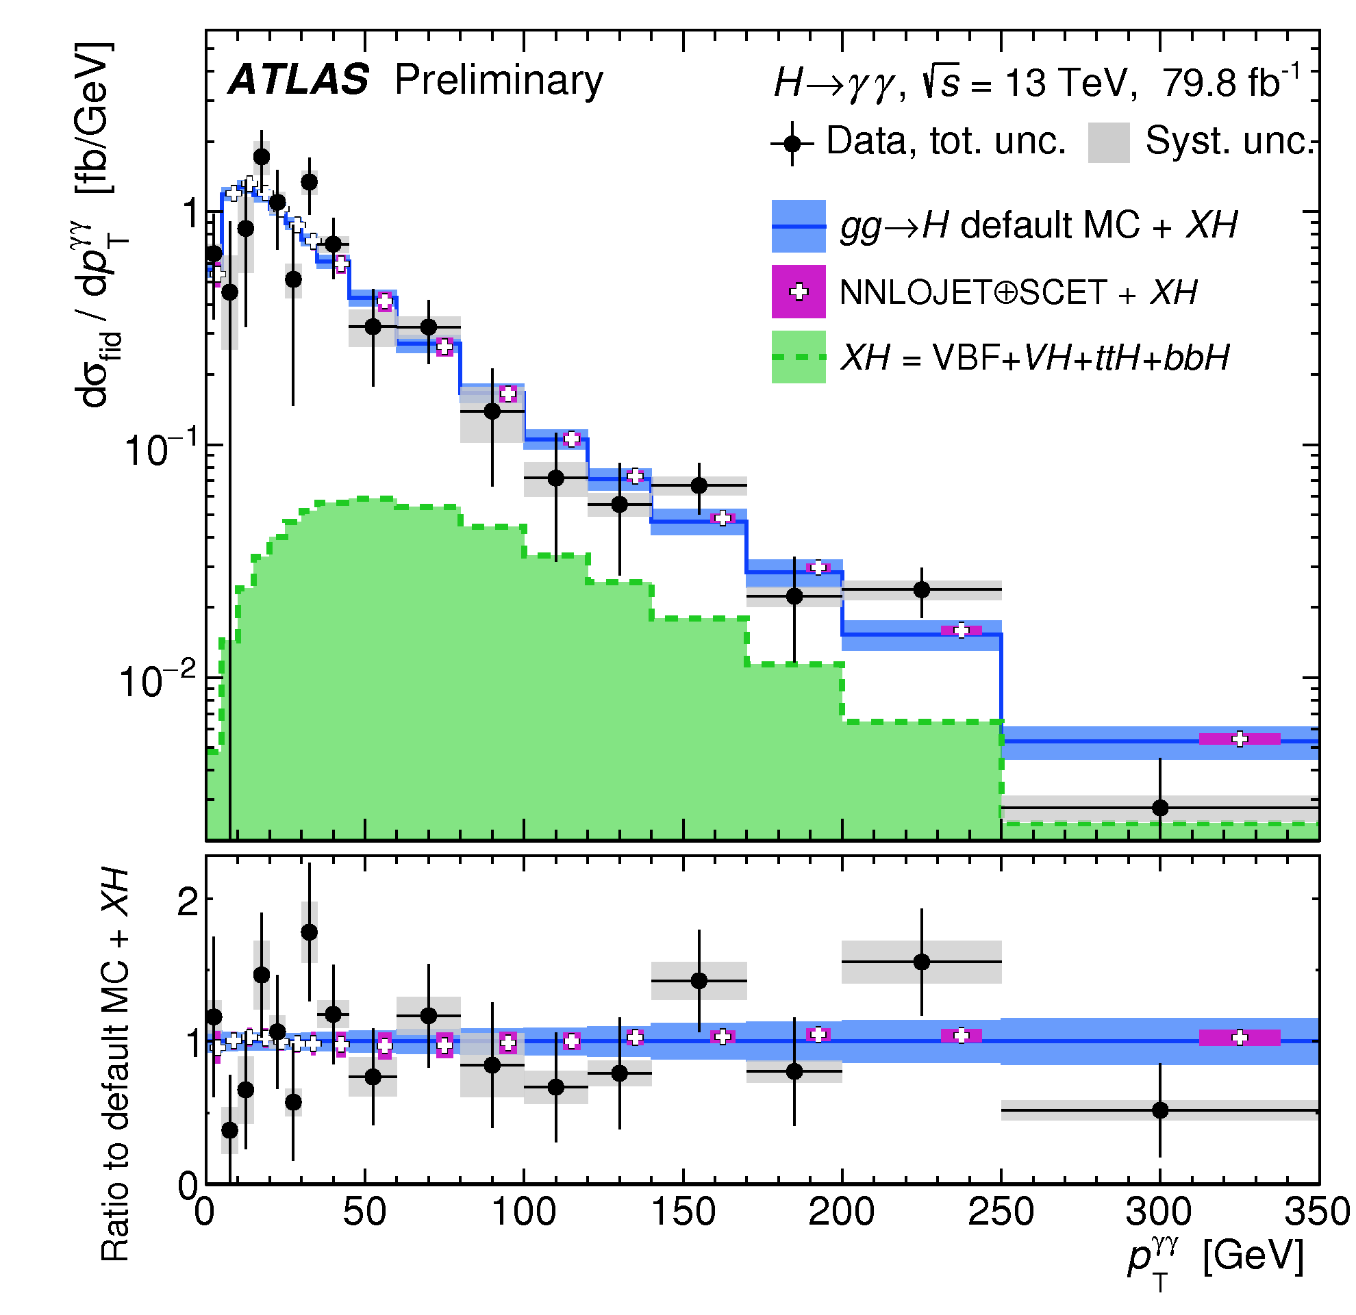
Higgs boson cross sections
ATLAS-CONF-2018-018; ATLAS-CONF-2018-028
4 June 2018
Reached a new phase in the exploration of the Higgs sector!
Differential cross sections:
  Higgs p_{T} sensitive to new physics in gluon-fusion loop
  Number of jets sensitive to modeling of radiation and different production modes
5 July 2018
Notes:
https://atlas.web.cern.ch/Atlas/GROUPS/PHYSICS/PAPERS/HIGG-2017-11/ → 24 May 2018
https://atlas.web.cern.ch/Atlas/GROUPS/PHYSICS/CONFNOTES/ATLAS-CONF-2018-018/ → 04 Jun 2018
https://atlas.web.cern.ch/Atlas/GROUPS/PHYSICS/CONFNOTES/ATLAS-CONF-2018-028/ → 5 July 2018

Slide 16




ATLAS-CONF-2017-047; ATLAS-CONF-2018-028
5 July 2018
Simplified template cross sections (STXS):
  Independent, simple fiducial region definitions for each Higgs production mode
  Common for ATLAS, CMS and theory
  Good balance between experimental precision and theory uncertainty
Notes:
http://atlas.web.cern.ch/Atlas/GROUPS/PHYSICS/PAPERS/HIGG-2016-21/ → 13 February 2018
https://atlas.web.cern.ch/Atlas/GROUPS/PHYSICS/CONFNOTES/ATLAS-CONF-2017-047/ → combination 5 July 2017
ATLAS: H→γγ and H→ZZ→4l cross section in 31 fiducial regions 36.1 fb⁻¹, 13 TeV used to measure
https://atlas.web.cern.ch/Atlas/GROUPS/PHYSICS/CONFNOTES/ATLAS-CONF-2018-028/ → 5 July 2018

Slide 17


Exploring the Yukawa sector

Slide 18



Observation of H→ττ
ATLAS-CONF-2018-021
Combine all final: 𝝉_{had}𝝉_{had}, 𝝉_{lep}𝝉_{had}, 𝝉_{lep}𝝉_{lep}
Categories targeting boosted Higgs (mostly ggF) and VBF (additional jets)
Dominant backgrounds from Z→𝝉𝝉 and jets faking taus
Cut-based analysis using fit to m𝜏𝜏 distribution in 13 signal regions
Largest uncertainties: data and MC statistics, signal modelling and jets
Cross section measurement (13 TeV):
𝝈^{ggF} = 3.0 ± 1.0 (stat.) ^{+1.6}_{-1.2} (syst.) pb; 𝝈^{VBF} = 0.28 ± 0.09 (stat.) ± 0.10 (syst.) pb
Significance:
  36 fb⁻¹ of 13 TeV data: 4.4 𝝈 observed; 4.1 𝝈 expected
  Combining with 7 and 8 TeV data: 6.4 𝝈 observed; 5.4 𝝈 expected
3 June 2018
Notes:
https://atlas.web.cern.ch/Atlas/GROUPS/PHYSICS/CONFNOTES/ATLAS-CONF-2018-021/ → 3 June 2018

Slide 19







Observation of ttH production
arXiv:1806.00425 [hep-ex];
Direct access to top Yukawa coupling
Experimental tour-de-force!
  Complex final states
  Large irreducible backgrounds
  Small cross sections: O(0.5)pb @ 13 TeV
Use all available final states:
  H→bb: high stats but low purity BR≈58%, S/B≈1-6%
  Multileptons: H→𝜏𝜏, H→WW*, H→ZZ* BR = 30%, S/B=4-34%
  H→𝛾𝛾: clean but low stats BR = 0.23%, S/B=5-200%
  H→ZZ*→4lep: clean but very low stats BR = 0.01%, S/B=50-500%
1 June 2018
Notes:
https://atlas.web.cern.ch/Atlas/GROUPS/PHYSICS/PAPERS/HIGG-2018-13/ → 1 June 2018
24/12/2017 – Evidence from ATLAS: 36.1 fb-1 in ttH(ττ, γγ, bb, VV): 4.2 σ observed, 3.8 σ expected
08/04/2018 – Observation in CMS: 5.1 (7 TeV), 19.7 (8TeV), and 35.9 (13 TeV) fb-1: 5.2 σ observed, 4.2 σ expected
01/06/2018 – Observation in ATLAS: 79.8 fb⁻¹ for ttH(γγ, ZZ→4l) and with 36.1 fb-1 in ttH(bb) (13 TeV): 5.2 σ observed, 4.9 σ expected
Adding 4.5 fb-1 (7 TeV) and 20.3 fb-1 (8 TeV): 6.3 σ observed, 5.1 σ expected

Slide 20








ttH observation: bb and Multileptons
ttH(ML) Phys. Rev. D 97 (2018) 072003; ttH(bb) Phys. Rev. D 97 (2018) 072016
ttH(H→leptons)
Sensitive to: H→𝜏𝜏, H→WW* and H→ZZ*
Backgrounds: ttW/ttZ, non-prompt leptons and jets faking taus
Main uncertainties: signal modelling, jet energy scale and non-prompt lepton estimate
4.1𝝈 observed; 2.8𝝈 expected
ttH(H→bb):
Profit from large H→bb branching ratio (58.4%)
But challenging final state: large ttbb irreducible background, theory uncertainties, combinatorics...
Main uncertainties: tt+heavy flavours, b tagging, jet calibration
ATLAS: 1.2𝝈 observed; 1.6𝝈 expected
For both channels:
Intensive use of dedicated machine learning (NN, BDT) and matrix element methods: suppress fake leptons, reconstruct events, flavour tagging, and enhance S/B
Notes:
ttH(ML) →https://atlas.web.cern.ch/Atlas/GROUPS/PHYSICS/PAPERS/HIGG-2017-02/ → 24 December 2017
ttH(bb) → http://atlas.web.cern.ch/Atlas/GROUPS/PHYSICS/PAPERS/HIGG-2017-03/ → 24 December 2017
http://cms-results.web.cern.ch/cms-results/public-results/publications/HIG-17-006/index.htm → 14 August 2017

Slide 21





ttH(H→γγ) and Combination
arXiv:1806.00425 [hep-ex]; arXiv:1804.02610 [hep-ex]
ttH(H→𝛾𝛾):
  New signal categories from BDT discriminant
  Sensitivity increased by 50%
ttH combination: ttH(H→leptons + H→bb + H→γγ)
Run 2 data from 2015+2016+2017 (𝛾𝛾/ZZ): 79.8 fb⁻¹
  5.2 σ observed, 4.9 σ expected
Adding Run 1: 6.3 σ observed, 5.1 σ expected
Measured production cross section at 13 TeV:
  670 ± 90 (stat.) +110−100 (syst.) fb
Notes:
http://cms-results.web.cern.ch/cms-results/public-results/publications/HIG-17-035/index.html → 8 Abril 2018
http://atlas.web.cern.ch/Atlas/GROUPS/PHYSICS/PAPERS/HIGG-2018-13/ → 1 Jun 2018

Slide 22

Notes:
http://atlas.web.cern.ch/Atlas/GROUPS/PHYSICS/PAPERS/HIGG-2018-13/
data event from the tt̄H(γγ) Had BDT bin with the largest signal over background ratio. The event contains two photon candidates, with a diphoton mass of 125.4 GeV. In addition, six jets are reconstructed using the anti-k_{t} algorithm and R=0.4, including one jet that is b-tagged using a 77% efficiency working point. The photons correspond to the green towers in the electromagnetic calorimeter, while the jets (b-jets) are shown as yellow (blue) cones.

Slide 23






Observation of H→bb
arXiv:1808.08238
See CERN seminar last week! (https://indico.cern.ch/event/750541/)
Largest branching fraction (58.4%) but huge background from heavy flavour production
Must use associated production: WH/ZH
  Require 2 b jets + 0 (Z→𝜈𝜈), 1 (W→ℓ𝜈) or 2 (Z→ℓℓ) leptons
Largest backgrounds:
  Z+heavy flavour (0- and 2-lepton) and tt (1-lepton)
  Irreducible background from VZ with Z→bb
9 July 2018
Notes:
http://cms-results.web.cern.ch/cms-results/public-results/publications/HIG-16-044/index.html → 21 September 2017
https://atlas.web.cern.ch/Atlas/GROUPS/PHYSICS/PAPERS/HIGG-2016-29/ → 10 August 2017
https://atlas.web.cern.ch/Atlas/GROUPS/PHYSICS/CONFNOTES/ATLAS-CONF-2018-036/ → 9 July 2018

Slide 24





Observation of H→bb
arXiv:1808.08238
Harder p_{T} spectrum for signal than backgrounds
  Go to high p_{T} to improve S/B
Use for event categories:
  75 < p_{T}^{V} < 150 GeV (2ℓ only)
  150 < p_{T}^{V} < 200 GeV
  p_{T}^{V} > 200 GeV
Main discriminant variables m_{bb}, p_{T}^{V} and ΔR_{bb}
  m_{bb} resolution extremely important!
Notes:
Evidence: https://atlas.web.cern.ch/Atlas/GROUPS/PHYSICS/PAPERS/HIGG-2016-29/fig_01.png→ 10 August 2017
Observation: https://atlas.web.cern.ch/Atlas/GROUPS/PHYSICS/PAPERS/HIGG-2018-04/fig_03.png→ 9 July 2018

Slide 25








Observation of H→bb
arXiv:1808.08238
Run 2:
  Observed (expected) of 4.9𝝈 (4.3𝝈)
Adding Run 1:
  Observed (expected) of 4.9𝝈 (5.1𝝈)
Adding ttH and VBF:
  Observed (expected) of 5.4𝝈 (5.5𝝈)
  Observation of H→bb decays
Adding H→ZZ and H→γγ:
  Observed (expected) of 5.3𝝈 (4.8𝝈)
  Observation of VH production
Notes:
Evidence: https://atlas.web.cern.ch/Atlas/GROUPS/PHYSICS/PAPERS/HIGG-2016-29/fig_01.png→ 10 August 2017
Observation: https://atlas.web.cern.ch/Atlas/GROUPS/PHYSICS/PAPERS/HIGG-2018-04/fig_03.png→ 9 July 2018

Slide 26


Slide 27


2nd generation Yukawa: H→μμ
ATLAS-CONF-2018-026
2 July 2018
Easy to trigger on, but very rare
Used 80 fb⁻¹ of 13 TeV data
Event categories based on muon η, p_{T}^{μμ}, and VBF (BDT)
Search peak in m_{μμ}
Background from sidebands à la H→γγ analysis
95% CL limits:
  2.1 (obs), 2.0 (exp)
Getting close to SM sensitivity!
Notes:
https://atlas.web.cern.ch/Atlas/GROUPS/PHYSICS/CONFNOTES/ATLAS-CONF-2018-026/ → 2 Jul 2018

Slide 28



Combination
ATLAS-CONF-2018-031
Combined γγ, ZZ, WW,ττ, μμ and bb (incl. ttH+tH modes)
  Up to 79.8 fb⁻¹ of √s = 13 TeV data
Combination yields VBF significance 6.5σ (5.3σ expected) from ATLAS alone
Main production modes (ggF, VBF, VH, ttH) have all been observed!!
Good agreement with SM predictions
  Overall signal strength:
  μ = 1.13 ^{+0.09} _{-0.08}
Quantified space for undetectable decays or modified BR (e.g. BSM H→cc)
  B_{BSM} < 0.13 at 95% CL.(*)
7 July 2018
(*) In determination of κ_{g} and κ_{γ} - assumption dependent
Notes:
https://atlas.web.cern.ch/Atlas/GROUPS/PHYSICS/CONFNOTES/ATLAS-CONF-2018-031/fig_05.png→ 7 July 2018

Slide 29




Implications for 2HDM
ATLAS-CONF-2018-031
H(125) assumed to be light CP-even neutral scalar h in 2HDM
h production and decay same as for SM Higgs boson
Notes:
https://atlas.web.cern.ch/Atlas/GROUPS/PHYSICS/CONFNOTES/ATLAS-CONF-2018-031/ → 7 July 2018
• Type I: one Higgs doublet couples to vector bosons, while the other one couples to fermions. The first doublet is ‘fermiophobic’ in the limit where the two Higgs doublets do not mix.
• Type II: one Higgs doublet couples to up-type quarks and the other one to down-type quarks and charged leptons.
• Lepton-specific: the Higgs bosons have the same couplings to quarks as in the Type I model and to charged leptons as in Type II.
• Flipped: the Higgs bosons have the same couplings to quarks as in the Type II model and to charged leptons as in Type I.

Slide 30
Casting a wider net

Slide 31




Higgs + Dark Matter
ATLAS-CONF-2018-039
25 July 2018
Used 79.8 fb⁻¹ of 13 TeV data
  High E_{T}^{miss} (>150GeV) and b-tagging to suppress backgrounds
  Reconstruct b-jets as 2 small jets or merged variable-radius (VR) track jets
Signal benchmark: Type-II 2HDM + U(1)_{Z’} symmetry (Z’-2HDM)
Main backgrounds: tt, W/Z+jets
Excluded region in m_{A} – m_{Z’} plane
Notes:
https://atlas.web.cern.ch/Atlas/GROUPS/PHYSICS/CONFNOTES/ATLAS-CONF-2018-039/ → 25 July 2018
VR jets: track jets reconstructed with an algorithm in which the radius parameter decreases with increasing jet transverse momentum (pT)
large missing transverse momentum and either two b-tagged small radius jets or a single large radius jet containing two b-tagged subjets

Slide 32



Charged Higgs: H⁺→tb
arXiv:1808.03599
10 Aug 2018
Explored single-lepton and dilepton tt final states
  In range m_{H+}: 200 – 2000 GeV
36.1 fb⁻¹ of 13 TeV data
Events categories: N_{jets} and N_{b-tags}
  Allow to constrain backgrounds in simultaneous fit
BDTs trained in signal regions
  Separate signal and background for 18 mass points
  Matrix method used in single-lepton channel
Extracted limits on σ x BR and on m_{H+} - tan β plane for two MSSM scenarios
Notes:
https://atlas.web.cern.ch/Atlas/GROUPS/PHYSICS/PAPERS/HIGG-2017-04/ → 10 August 2018

Slide 33








Triple Higgs coupling
arXiv:1808.00336 [hep-ex]; ATLAS-CONF-2018-043
7 July 2018
4 Sep 2018
The triple Higgs coupling λ_{HHH} can be probed through di-Higgs production
Very suppressed in SM!
  Negative interference between LO diagrams
  Cross section 1500x less than ggF
Wide range of decay BR and channel purity
bbττ analysis:
  Used 36 fb⁻¹ of 13 TeV data
  Final state BR(bbττ)=7%
  Non-Resonant 95% CL limit:
    μ < 12.7 observed (14.8 expexcted)
Combination: at ≈10 x SM sensitivity – with 3% of the HL-LHC luminosity analyzed
Di-Higgs combination plot here
Notes:
https://atlas.web.cern.ch/Atlas/GROUPS/PHYSICS/CONFNOTES/ATLAS-CONF-2018-026/ → 2 Jul 2018
https://atlas.web.cern.ch/Atlas/GROUPS/PHYSICS/CombinedSummaryPlots/HIGGS/ATLAS_HIGGS6100_HH_Summary/ATLAS_HIGGS6100_HH_Summary.png
https://atlas.web.cern.ch/Atlas/GROUPS/PHYSICS/CONFNOTES/ATLAS-CONF-2018-043/

Slide 34


Summary
Another milestone was crossed last week by ATLAS and CMS with the H→bb observation
Main production modes (ggF, VBF, VH, ttH) have all been observed!!
The Higgs sector continues to look SM-like
But!
We know there is new physics out there!
We have only collected ≈130 fb⁻¹ of 3000 fb⁻¹ of 13 TeV data expected at the HL-LHC
We have a strong programme of precision measurements and searches for new Higgs states and decays
Overall highlight from the past year (very personal bias!):
“The >5σ observations of ttH and H → ττ, independently by ATLAS and CMS, firmly establish the existence of a new kind of fundamental interaction, Yukawa interactions.”
Gavin Salam (LHCP’18)
Notes:
Gavin Salam (LHCP’18) “The >5σ observations of ttH and H → ττ, independently by ATLAS and CMS, firmly establish the existence of a new kind of fundamental interaction,
Yukawa interactions.”
(Hbb, Htt, etc.): not a gauge interaction, and unlike anything we’ve probed before

Slide 35




In conclusion
See here for more: ATLAS Public results page

Slide 36

Bonus slides
a

Slide 37


More on Combination
ATLAS-CONF-2018-031
Notes:
https://atlas.web.cern.ch/Atlas/GROUPS/PHYSICS/CONFNOTES/ATLAS-CONF-2018-031/fig_05.png→ 7 July 2018

Slide 38


Slide 39


ATLAS, CMS and the LHC
Run 1: 2009 – 2013; ≈ 5 fb⁻¹ at √s = 7 and ≈ 20 fb⁻¹ at 8 TeV per experiment
Run 2: 2013 – 2018; expect > 150 fb⁻¹ at √s = 13 TeV by the end of run
Instantaneous luminosity of 2 x 10³⁴ cm⁻²s⁻¹ in 2017 (2x design!)
  Downside is pileup => experimental challenge!
  Multiple vertices, large occupancy, degraded reconstruction resolution, etc
  LHC breaking new ground to go around this: leveling!
R. Steerenberg (CERN), LHCC 30 May 2018

Slide 40


Leveling by beam offset
Anti-leveling: crossing angle
Anti-leveling: β* reduction
Eckhard Elsen, LHCP’18
β* reduction
crossing angle reduction steps

Slide 41

Exploring the electroweak scale
Precision measurements of m_{W}, m_{t}, m_{H} are stringent tests of the SM at the EW scale
  E.g. excluding measured m_{H}, global EW fit gives m_{H} = 90 ± 21 GeV (1.7 σ tension) driven in part by m_{top}
arXiv:1803.01853

Slide 42

LHC and HL-LHC timeline

Slide 43



LHC Upgrades
Development of a new generation of superconducting magnets with higher critical field (Nb₃Sn):
  13.5 T instead of 8 T (LHC, NbTi)
Desenvolvimento de “crab cavities”
Aumentam eficiência das colisões
Colimadores, conectores, eng. civil, etc
R. Gonçalo - LIP
Ciência 2018
43
Notes:
High-Luminosity LHC (HL-LHC) (and challenges: 5x10^34 cm-2s-1 levelled; i.e. factor 5 over design
3 ab-1 by ~2035; requires focussing β*=15 cm; crab crossing
COST: 1300 MCHF; 100 MCHF/year operation
(NbTi) used in the LHC magnets can only bear magnetic fields of up to 9-10 Tesla

Slide 44




New tracking detector
Calorimeter: new DAQ electronics, HV sources and gap scintillators
New muon detector “Small Wheel”
New dedicated hardware tracking processor for trigger
High Granualrity Timing Detector
(30ps/track)
R. Gonçalo - LIP
Ciência 2018
44
Notes:
Add spacial granularity to separate close tracks and add tracking solid angle (b-tagging, vertex ident. Etc)
Add timing information to reject pileup: need O(mm) resolution => ~O(10ps) ; 30ps = 9mm
Replace damaged detectors with more rad.hard technologies
HGTD radius 120 – 640 mm ; • Completely replace Inner Detector with all-silicon

