Slide 1







Higgs Physics at ATLAS
Ricardo Gonçalo, Laboratório de Instrumentação e Física Experimental de Partículas (LIP)
Workshop on Multi-Higgs Models - 2014
Lisbon, 5 September 2014

Slide 2
Outline
The ATLAS detector and run-I performance
  ATLAS vs CMS – strengths and weaknesses
Higgs Boson Mass and Couplings
  Recent ATLAS mass measurement
  New coupling results – what changed?
Higgs boson width
Run 2 outlook

Slide 3
The ATLAS Detector

Slide 4
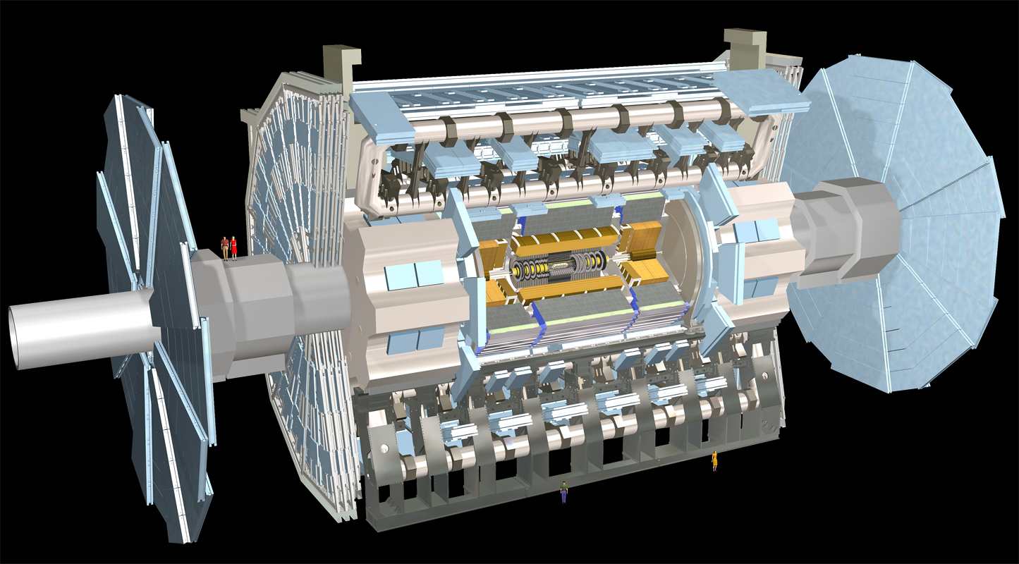
Muon Spectrometer: |η|<2.7
Air-core toroids and gas-based muon chambers
σ/p_{T} = 2% @ 50GeV to 10% @ 1TeV (ID+MS)
EM calorimeter: |η|<3.2
Pb-LAr Accordion
σ/E = 10%/√E ⊕ 0.7%
Hadronic calorimeter:
|η|<1.7 Fe/scintillator
1.3<|η|<4.9 Cu/W-Lar
σ/E_{jet}= 50%/√E ⊕ 3%
L = 44 m, ∅ ≈ 25 m
7000 tonnes
≈10⁸ electronic channels
3-level trigger reducing 40 MHz collision rate to 200 Hz of events to tape
Inner Tracker: |η|<2.5, B=2T
Si pixels/strips and Trans. Rad. Det.
σ/p_{T} = 0.05% p_{T} (GeV) ⊕ 1%

Slide 5
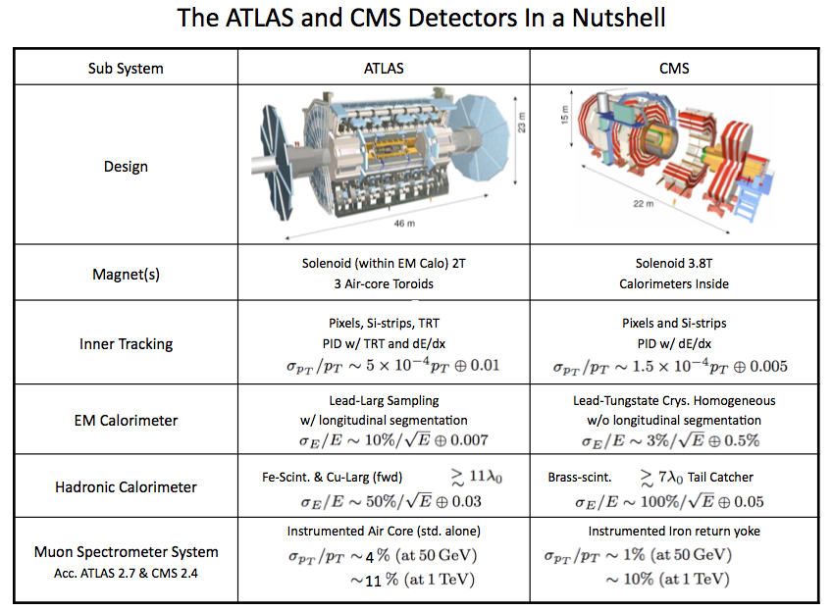

Slide 6
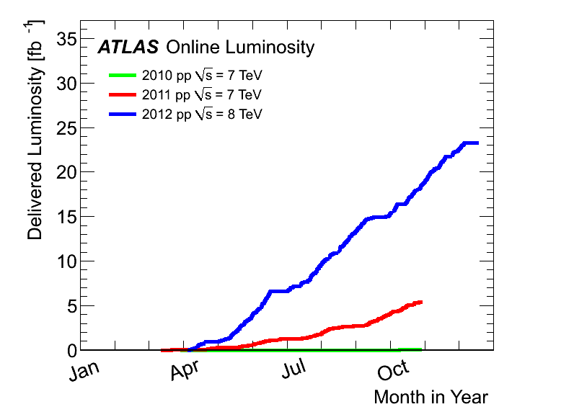
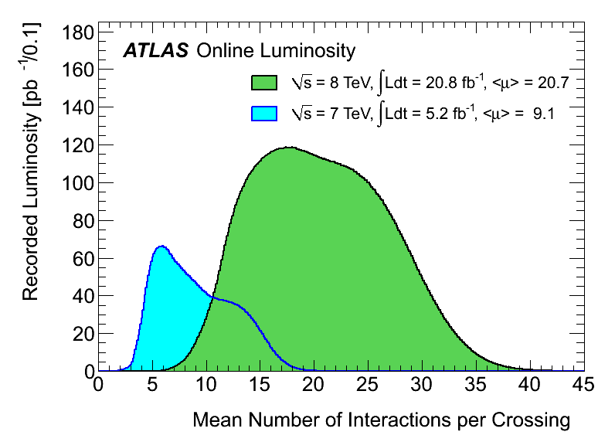
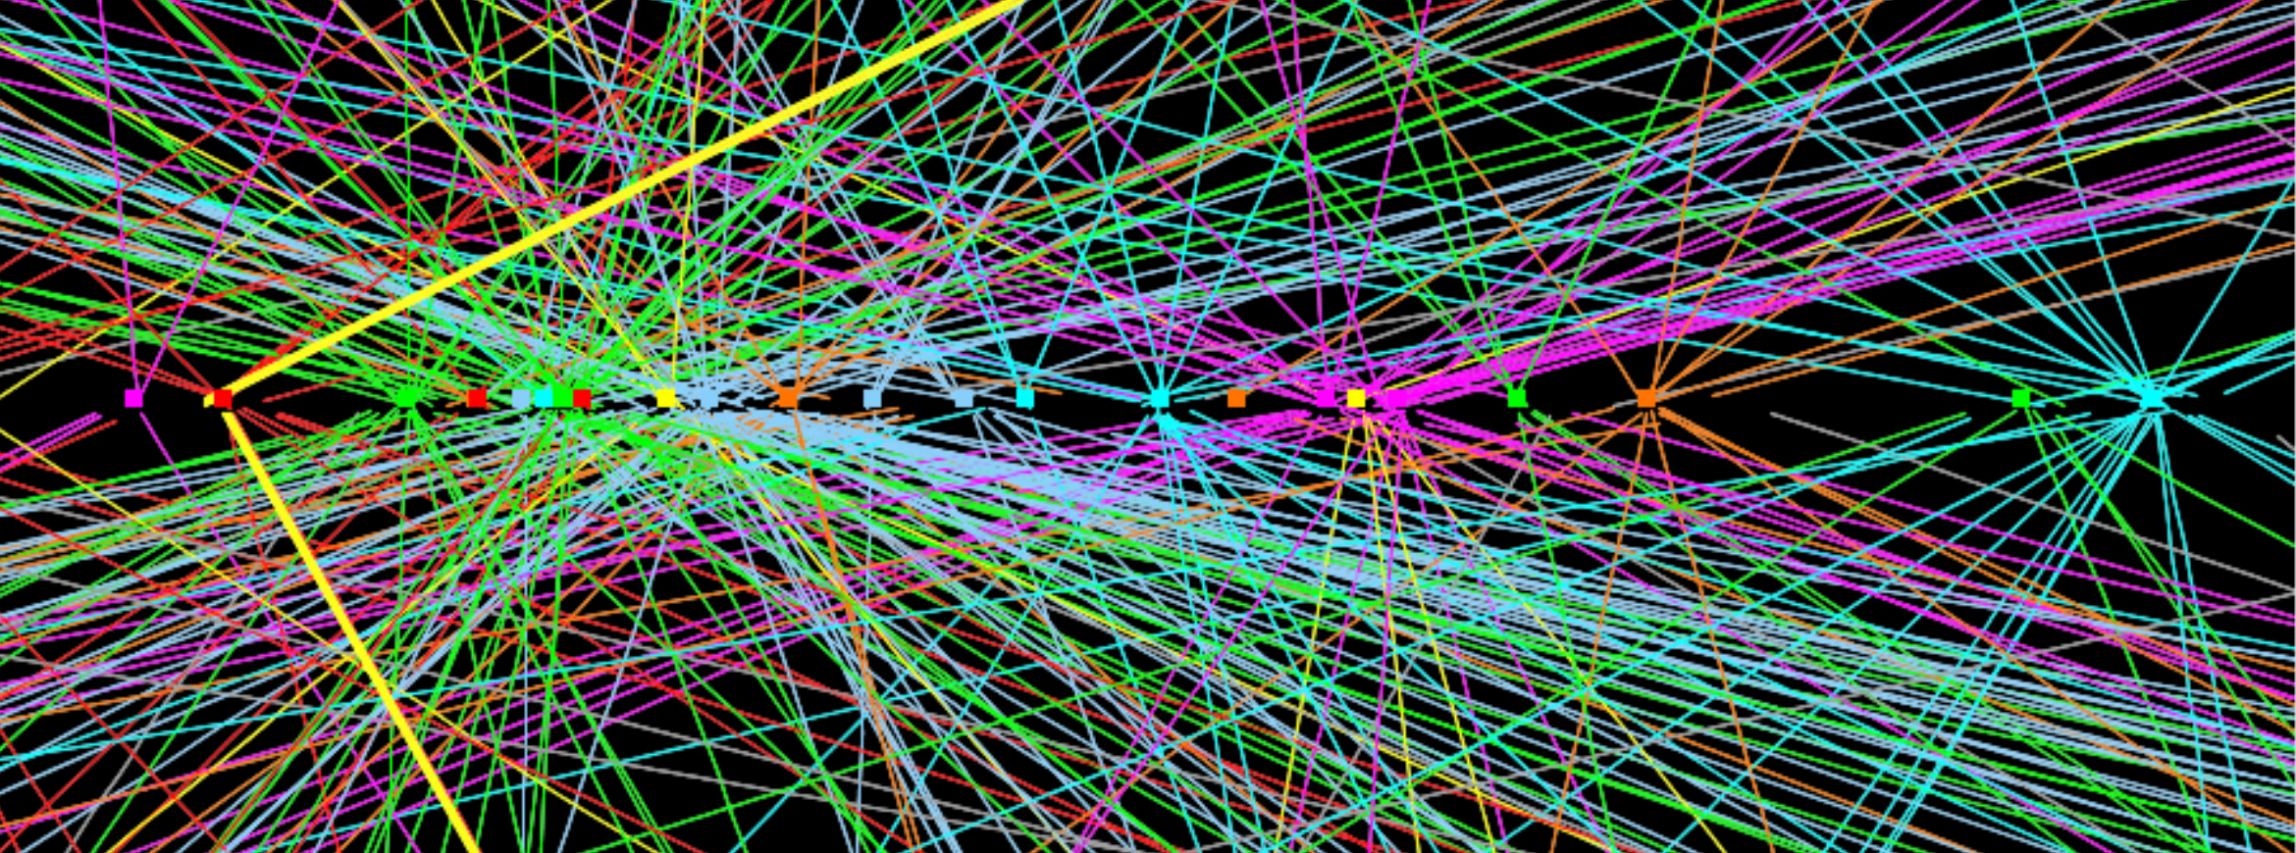
LHC and ATLAS Performance
Outstanding performance of LHC and ATLAS detector!
7.7x10³³cm⁻²s⁻¹ peak luminosity
Up to ≈40 pileup interactions
95% efficiency after physics-quality data requirements
20.3 fb⁻¹ at 8 TeV
4.7-4.9 fb⁻¹ at 7 TeV

Slide 7
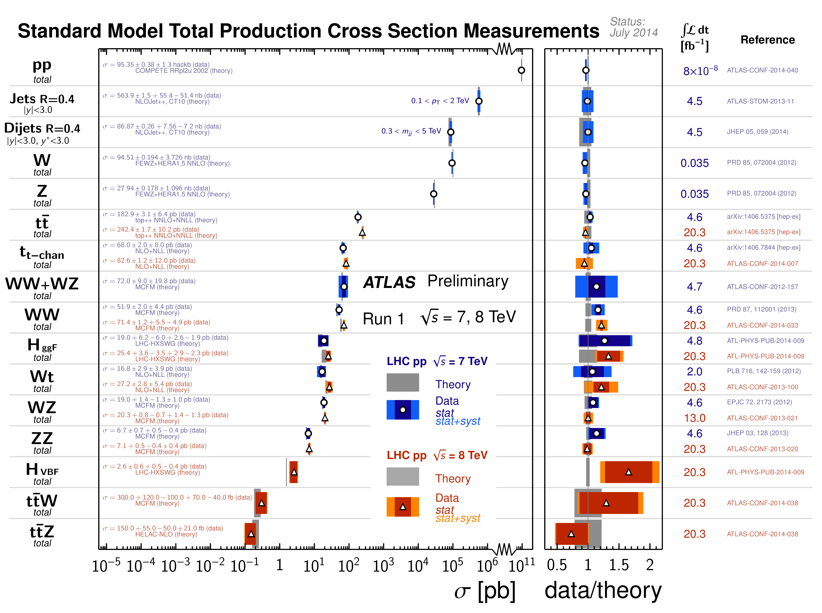

Slide 8
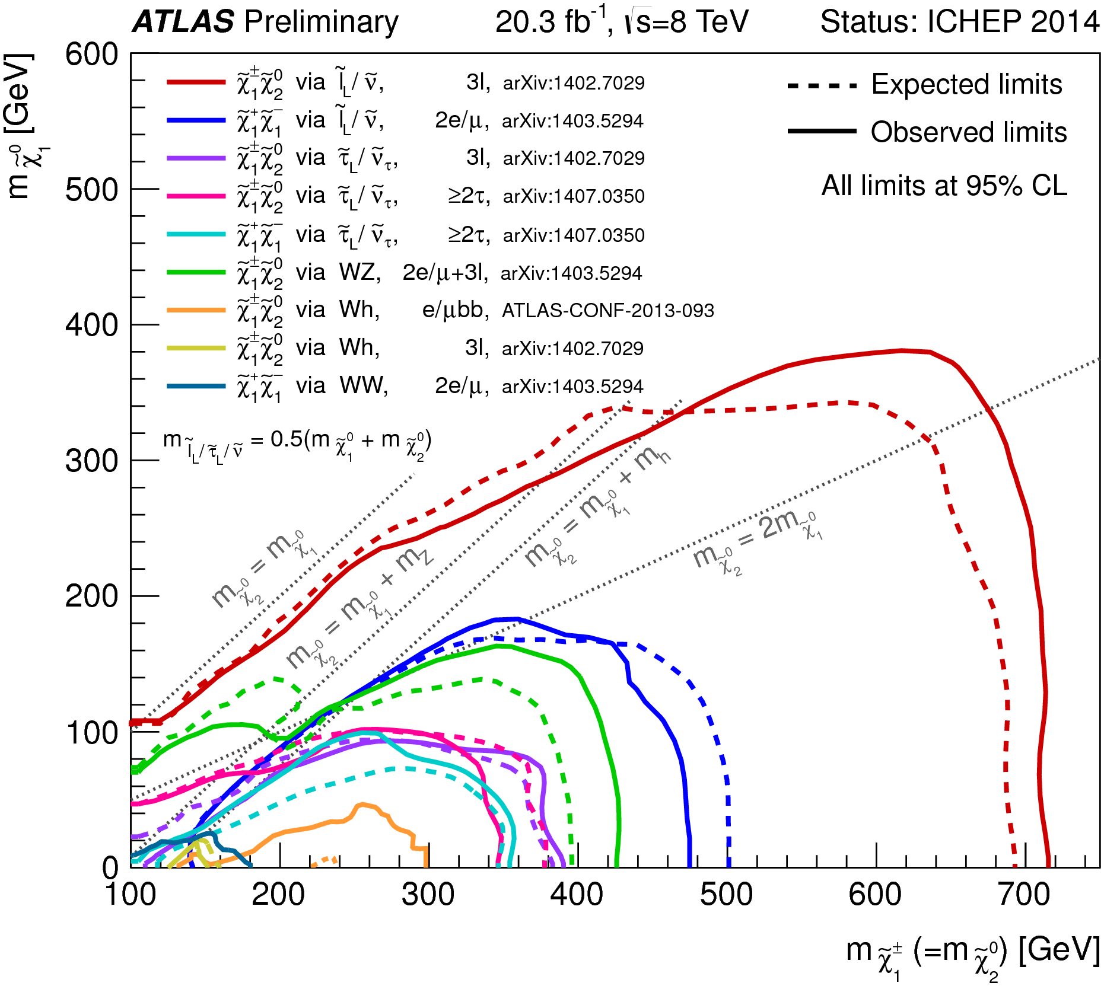
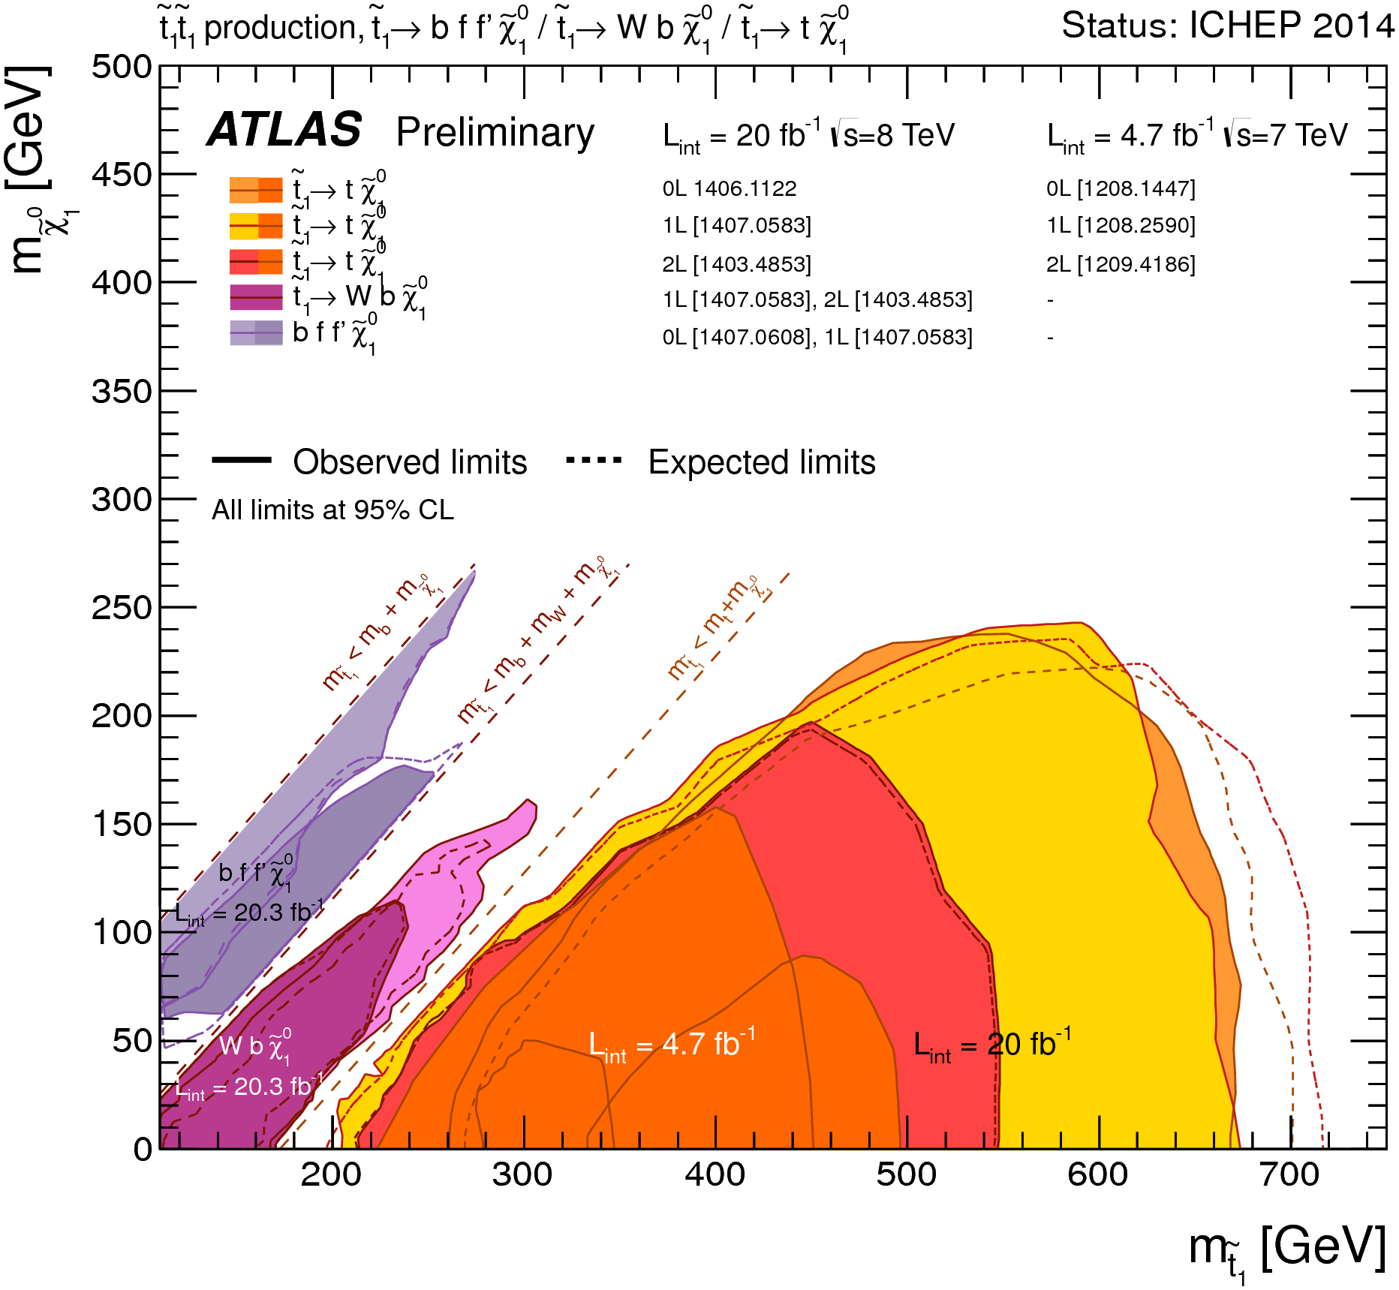
Many BSM direct searches
SUSY spectrum explored to ≈TeV scale
Many other scenarios explored up to ≈1 – ≈10 TeV: extra dimensions, new gauge bosons, Dark matter candidates, leptoquarks, fermion substructure, new heavy quarks, contact interactions, etc
Nothing new… so far!

Slide 9
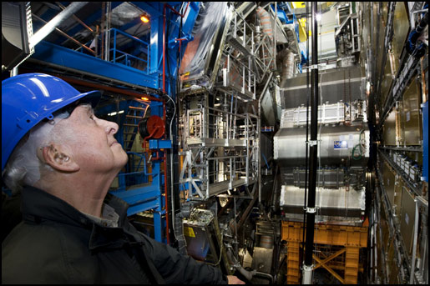
Higgs in ATLAS

Slide 10
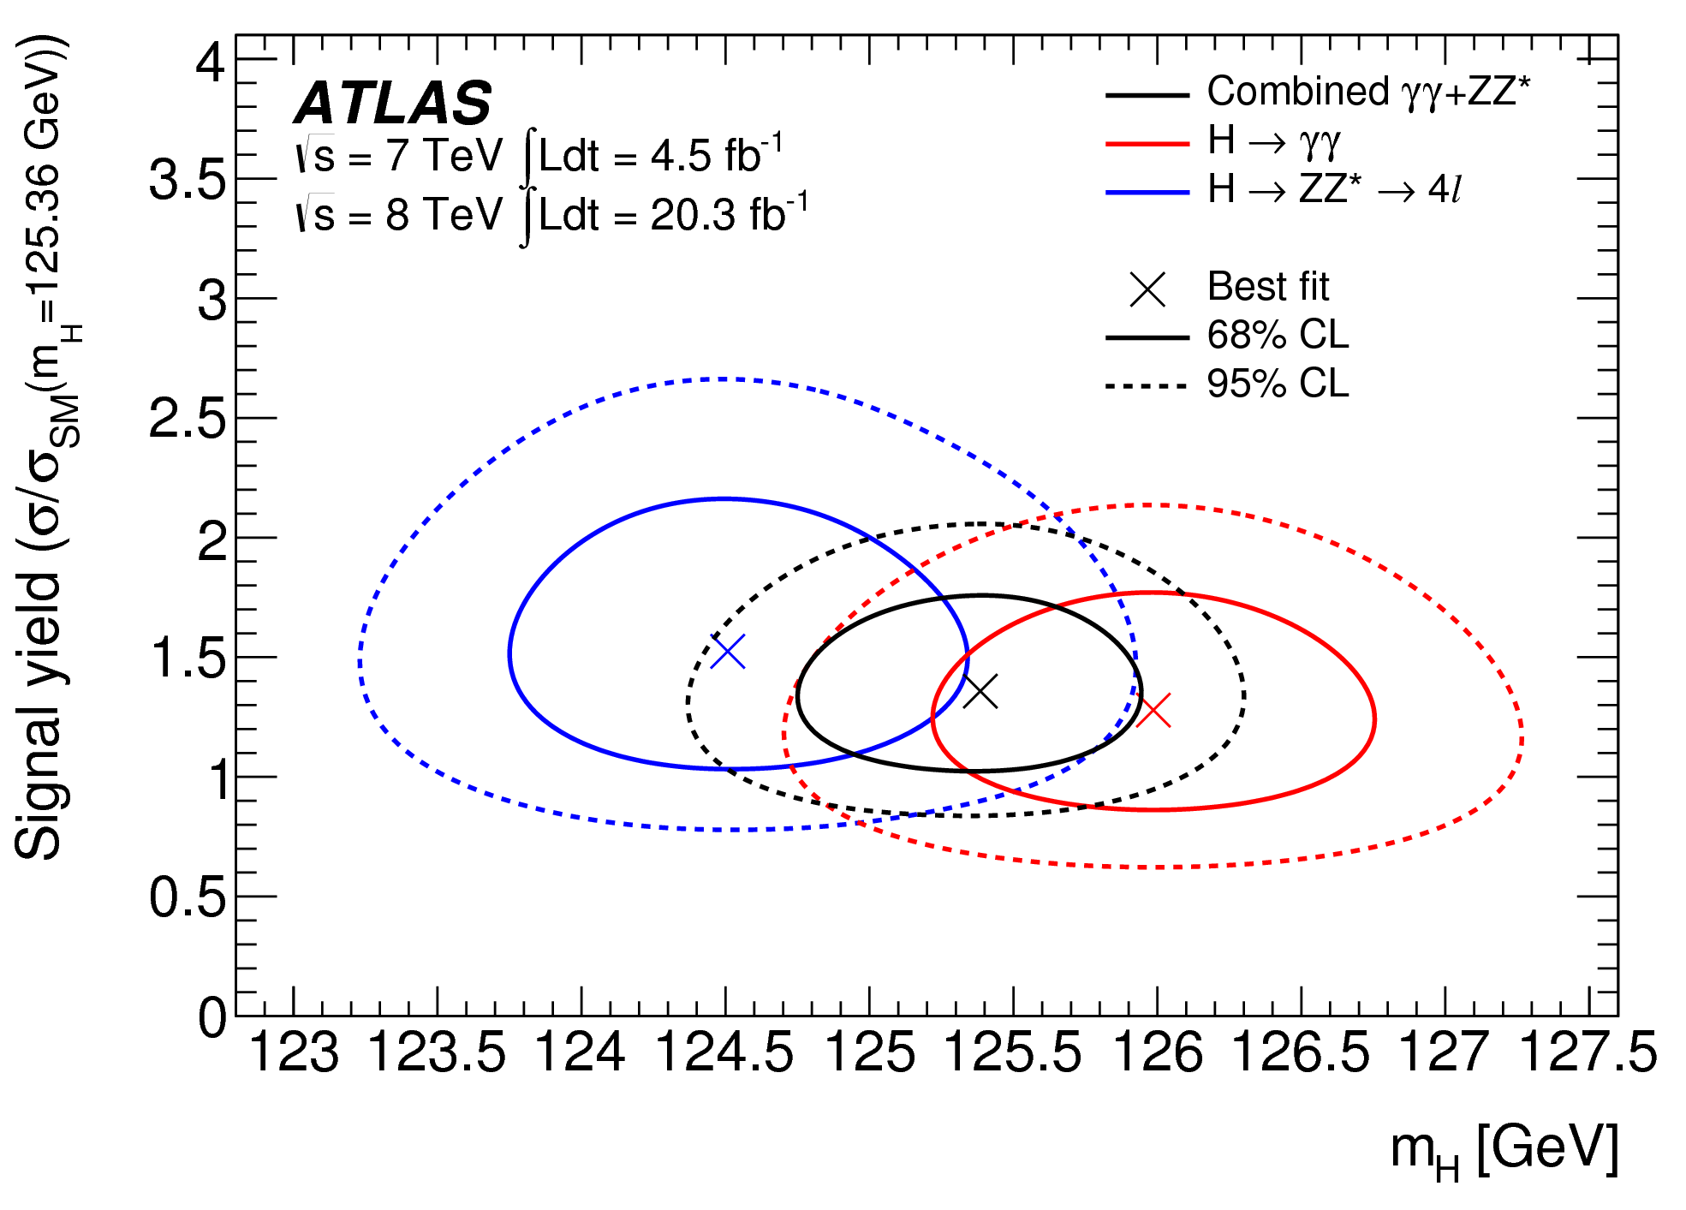
Higgs Boson Mass
arXiv:1406.3827, submitted to Phys.Rev.D
CMS-PAS-HIG-14-009
New combined: m_{H}= 125.36 ± 0.37 (stat.) ± 0.18 (syst.) GeV
m_{γγ}=125.98 ± 0.42 (stat.) ± 0.28 (syst.) GeV
m_{ZZ}=124.51 ± 0.52(stat.) ± 0.06(syst.) GeV
CMS: m_{H}=125.03 ^{+0.26}_{−0.27} (stat.) ^{+0.13}_{−0.15} (syst.) GeV

Slide 11
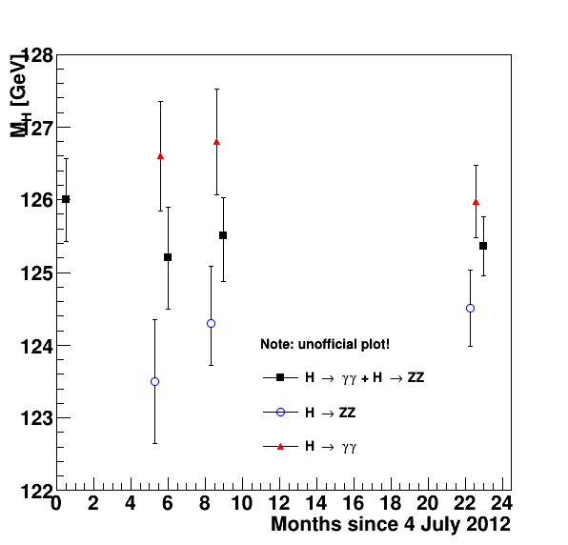
Higgs Boson Mass
arXiv:1406.3827, submitted to Phys.Rev.D
New combined: m_{H}= 125.36 ± 0.37 (stat.) ± 0.18 (syst.) GeV
m_{γγ} = 125.98 ± 0.42 (stat.) ± 0.28 (syst.) GeV
m_{ZZ} = 124.51 ± 0.52(stat.) ± 0.06(syst.) GeV
Old combination (PLB 726(2013)88): m_{H}= 125.5 ±0.2 (stat) ±0.6 (syst) GeV
m_{γγ} = 126.8 ± 0.2 (stat.) ± 0.7 (syst.) GeV
m_{ZZ} = 124.3 ± ^{+0.6}_{-0.5} (stat.) ± ^{+0.5}_{-0.3} (syst.) GeV

Slide 12
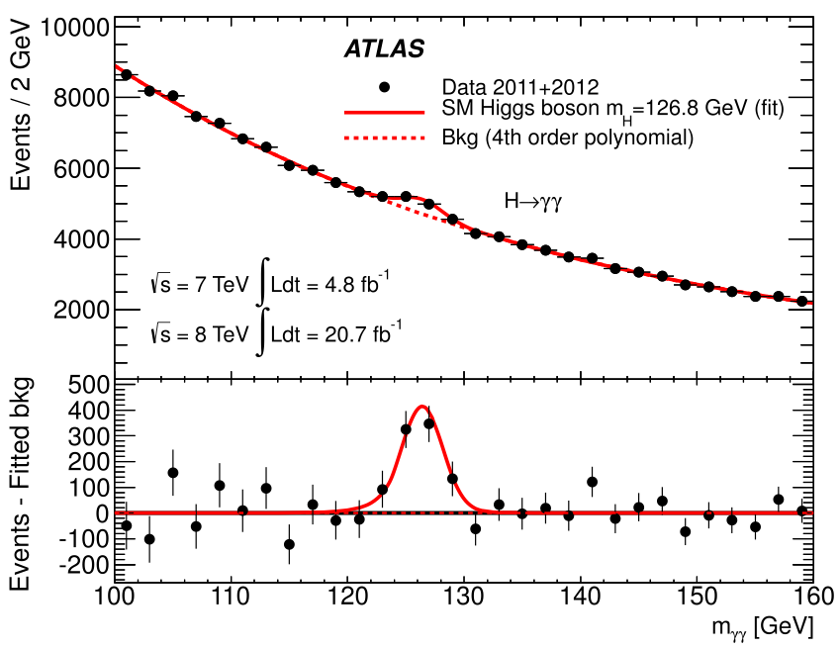
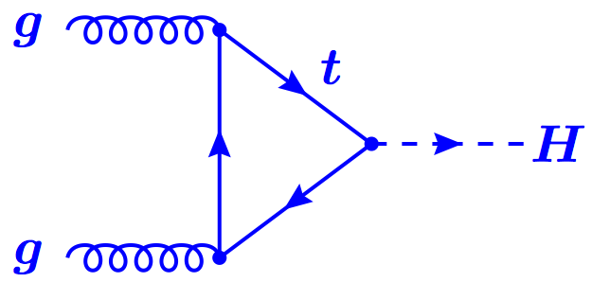
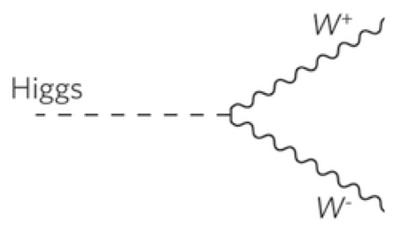
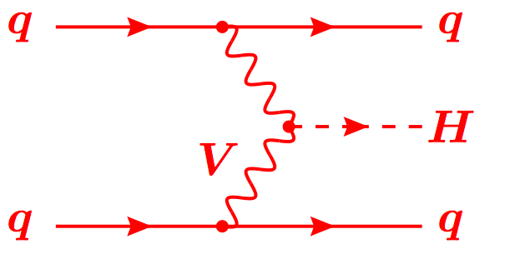
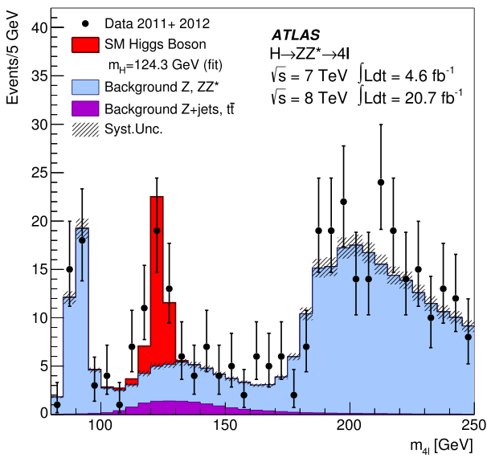
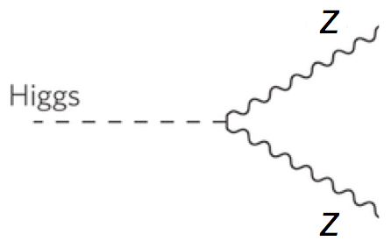
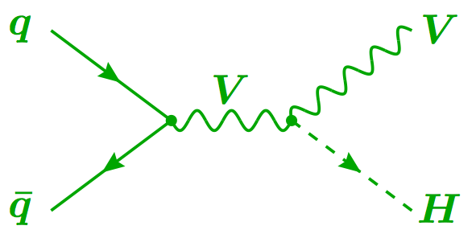
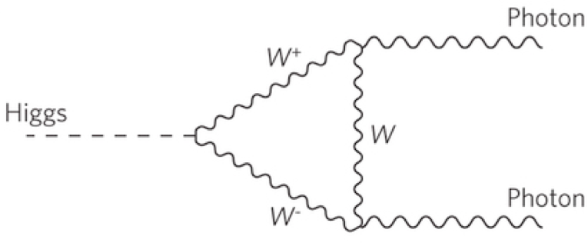
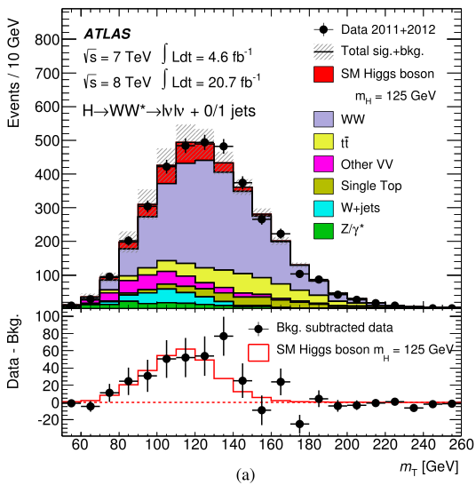
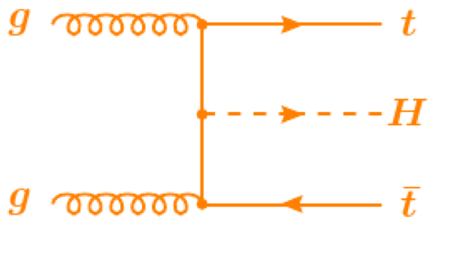
Combining Higgs Channels
Production
Decay
H->γγ
FIT
×
H->ZZ
H->WW
t
t
t
Backgrounds +

Slide 13
A bit more technically
Assumptions:
  Single resonance (at m_{H} = 125.5GeV)
  No modification of tensor structure of SM Lagrangian:
    i.e. H has J^{P} = 0⁺
  Narrow width approximation holds
    i.e. rate for process i ➔ H ➔ f is:
Free parameters in framework:
  Coupling scale factors: κ_{j}²
  Total Higgs width: κ_{H}²
  Or ratios of coupling scale factors: λ_{ij} = κ_{i} / κ_{j}
Tree-level motivated framework
  Useful for studying deviations in data with respect to expectations
    E.g. extract coupling scale factor to weak bosons κ_{V} by setting κ_{W} = κ_{Z} = κ_{V}
  Not same thing as fitting a new model to the data

Slide 14
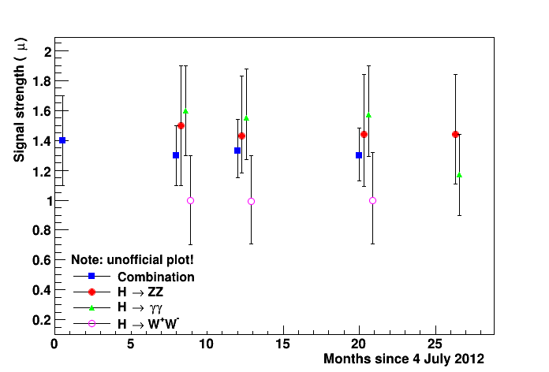
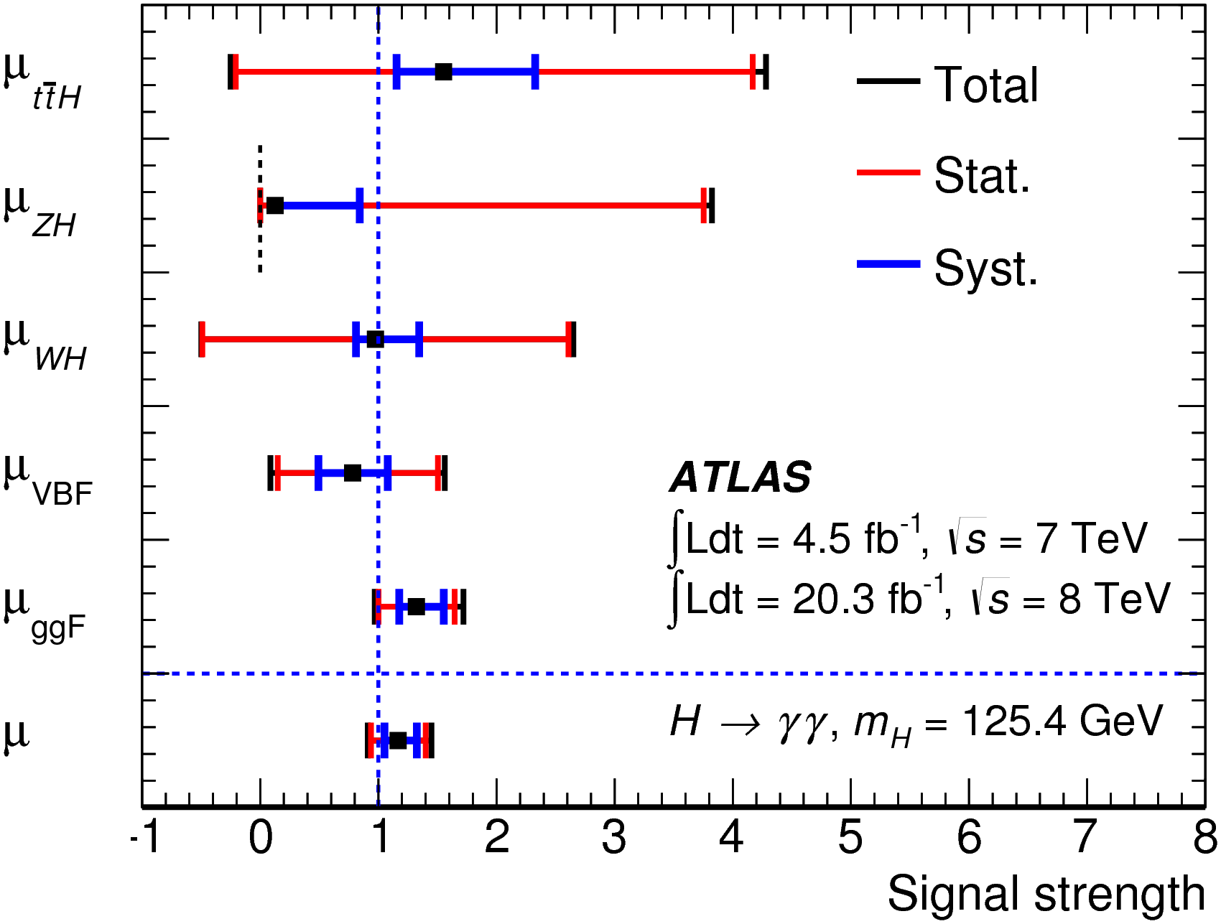
Higgs couplings: H➞γγ and H➞ZZ
H➞γγ (arXiv: 1408.7084) : μ_{γγ} = σ/σ_{SM} = 1.17 ± 0.27
H➞ZZ (arXiv: 1408.5191) : μ_{ZZ} = σ/σ_{SM} = 1.44 ^{+0.40}_{-0.33}
Old combination (PLB 726 (2013) 88):
μ_{γγ} = σ/σ_{SM} = 1.55 ^{+0.33}_{-0.28}
μ_{ZZ} = σ/σ_{SM} = 1.43 ^{+0.40}_{-0.35}
Large change in H➞γγ !!
μ_{γγ} now SM compatible
μ_{γγ} uncertainty increased !?
H➞ZZ unchanged

Slide 15
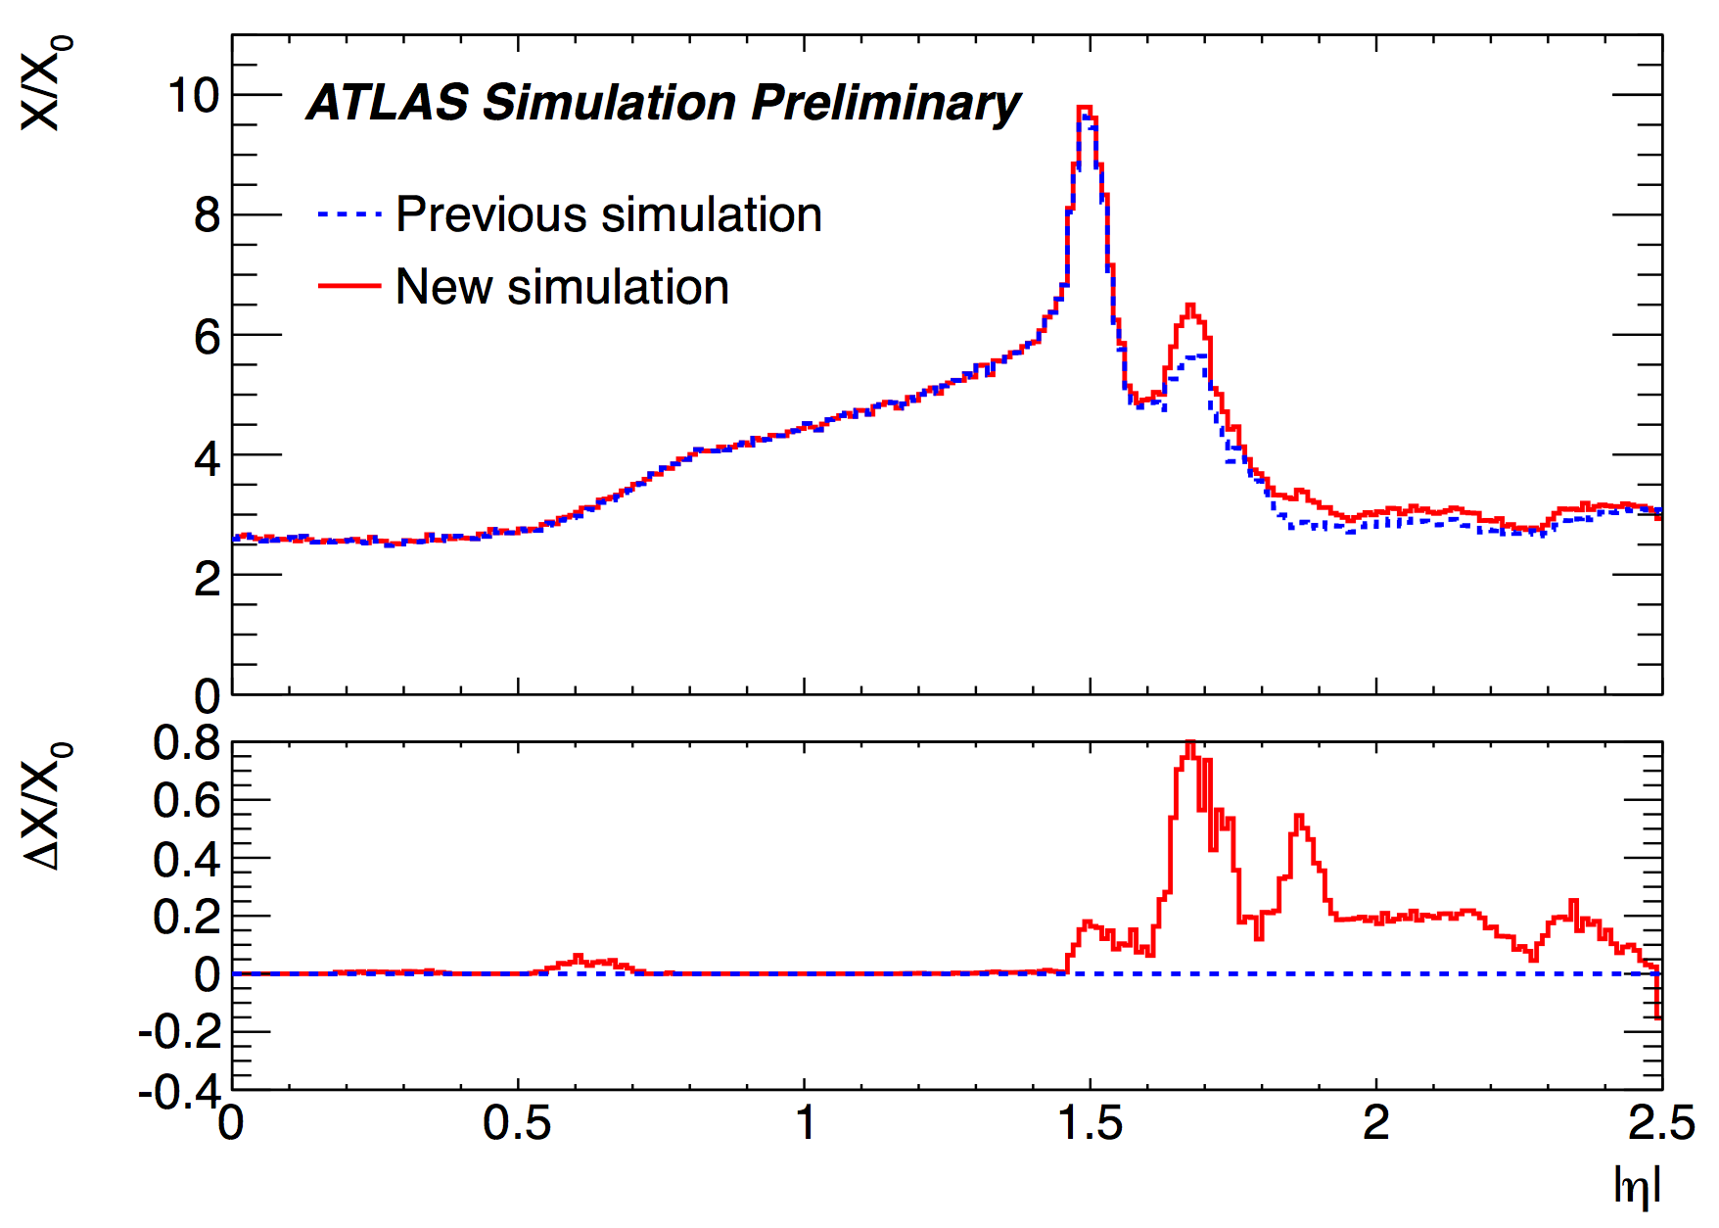
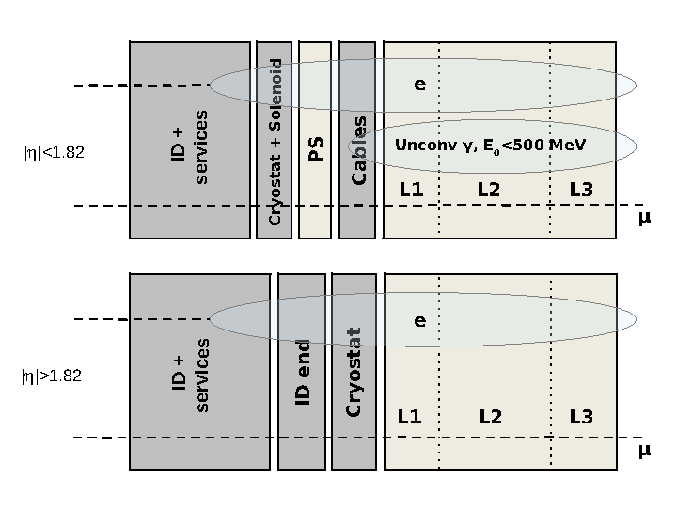
What happened?
New electron and photon energy calibrations
  Intercalibration of calorimeter layers
  New map of material in front of calorimeter
Multivariate regression to calibrate e and γ
  Inputs: cluster position, calorimeter related quantities (deposit per layer etc), tracks
Improved muon momentum scale and resolution systematics
Used large calibration samples accumulated during the run:
  Z➞ee (6.6M), Z➞μμ (9M), J/ψ➞μμ (6M) to determine calibration corrections
  J/ψ➞ee (0.3M), Z➞eeγ (6.6M), ϒ➞μμ (5M) to verify calibrations
Bottom line: improved systematics from ultimate Run-I detector calibration
  10% improvement on m_{γγ} resolution!
  ≈x2 improvement on γ resolution systematic uncertainty
  ≈10% improvement on μ(H➞γγ) uncertainty

Slide 16
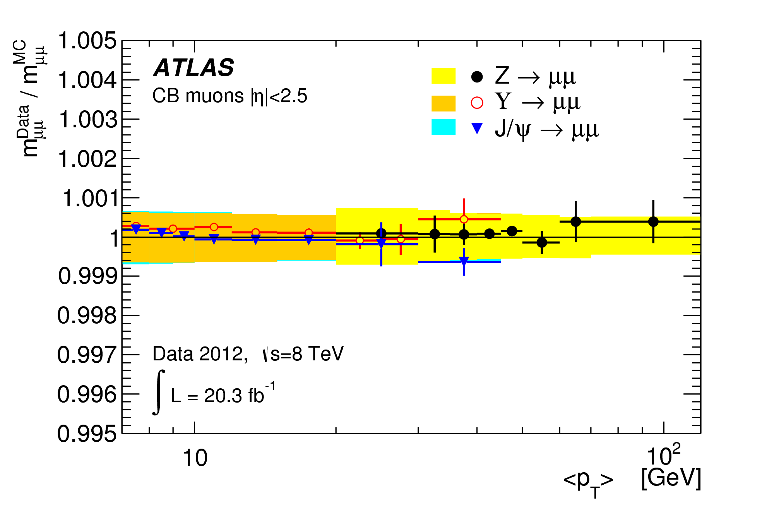
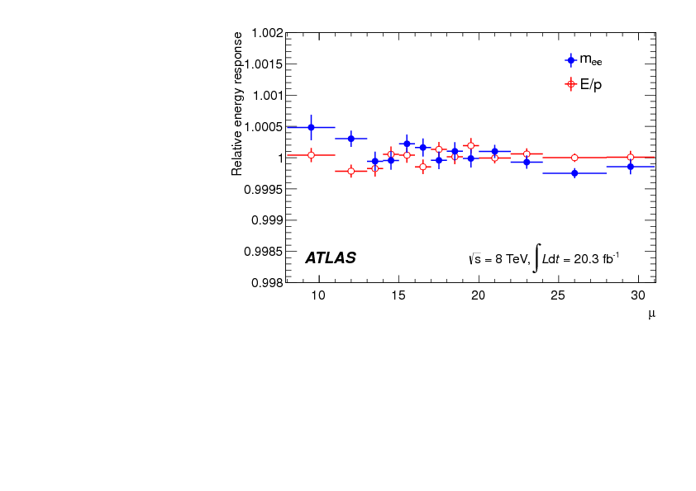
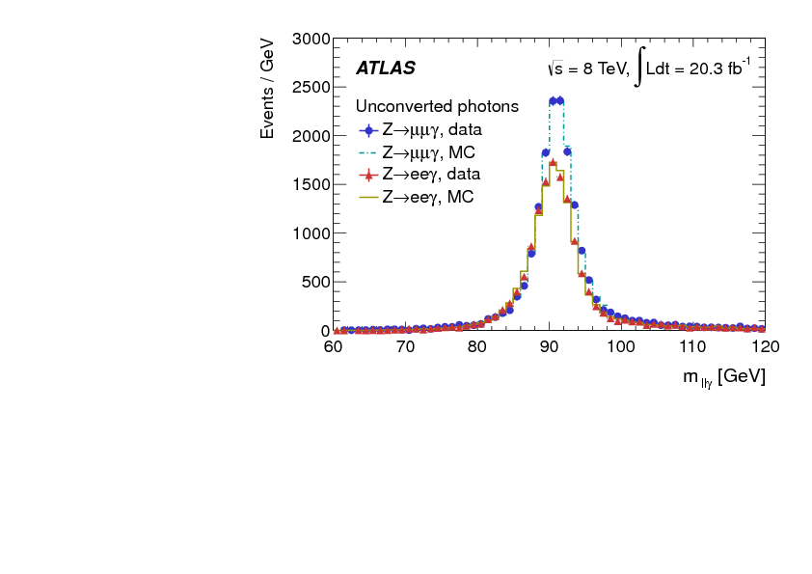
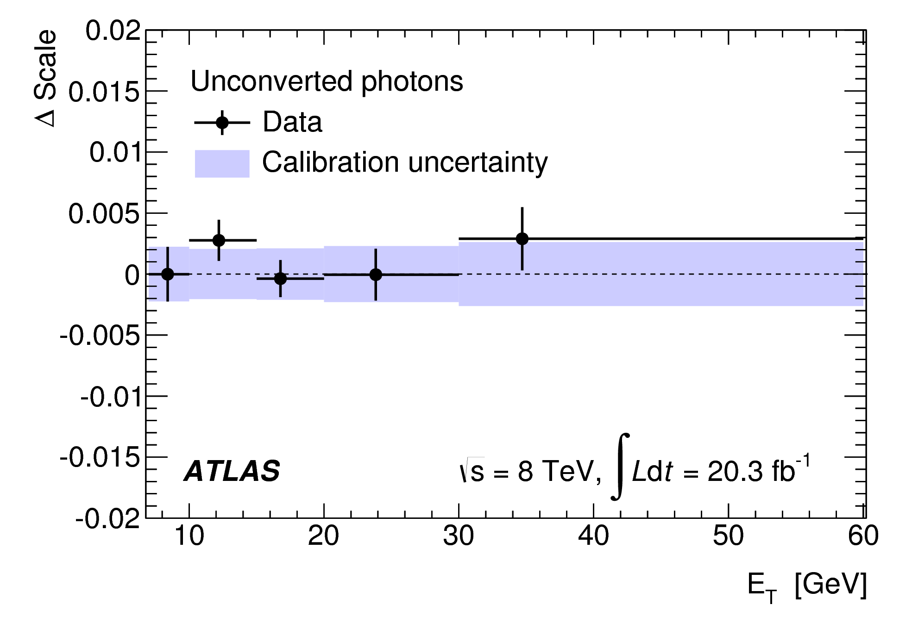
arXiv:1406.3827, CERN-PH-EP-2014-153
Muons
Electrons vs pileup
= Photons from Z➞eeγ
Radiative
Z decays test sample
Photons

Slide 17
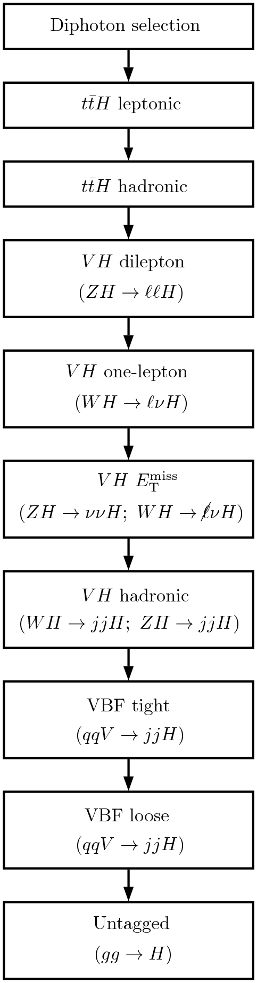
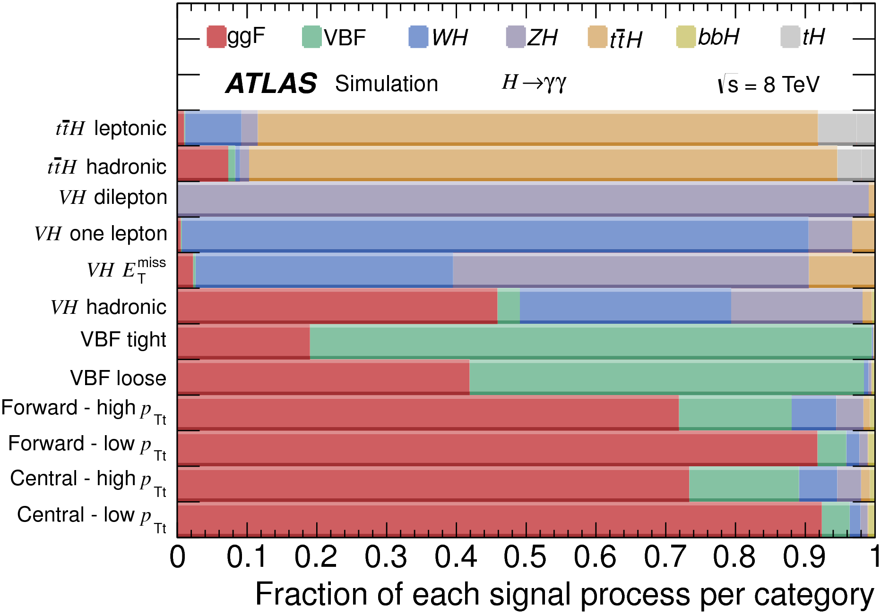
H➞γγ Analysis
γγ, 105<m_{γγ}<160GeV
1 e/μ and b-jets
No e/μ,
5-6 jets incl. b-jets
2 e/μ, m_{ee/μμ} ≈ m_{Z}
1 e/μ, E_{t}^{miss}
High E_{t}^{miss}
2 jets, m_{jj} ≈ m_{Z/W}
|Δη(lead jets)|>2, BDT tight
|Δη(lead jets)|>2, BDT loose
Untagged: 4 categories
Dominated by ggF
Analysis categories optimized for measuring signal strength
m_{H} set to 125.4 GeV, as determined in arXiv:1406.3827
20% reduction in total uncertainty with respect to an inclusive analysis

Slide 18
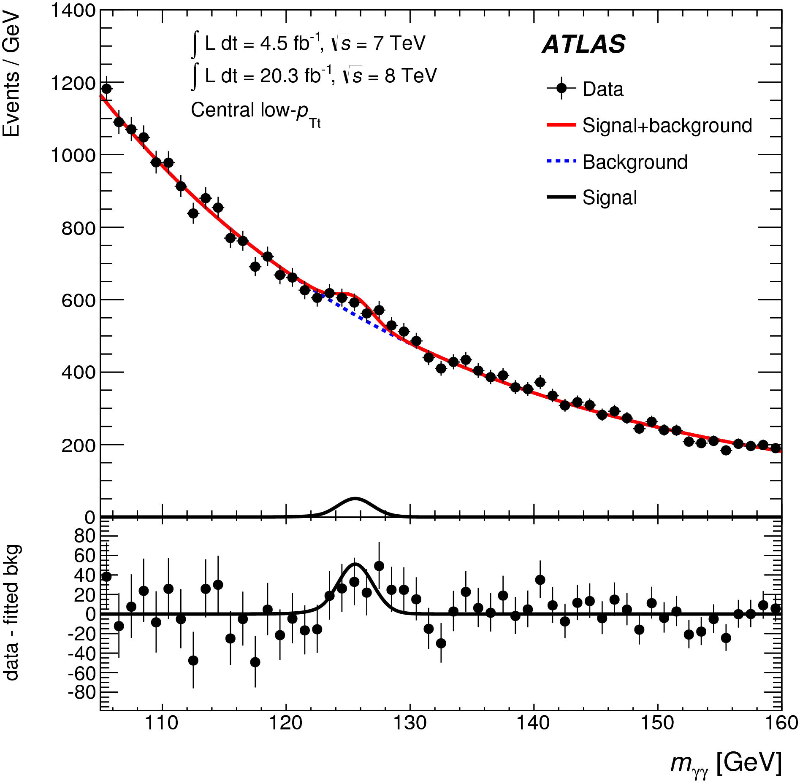
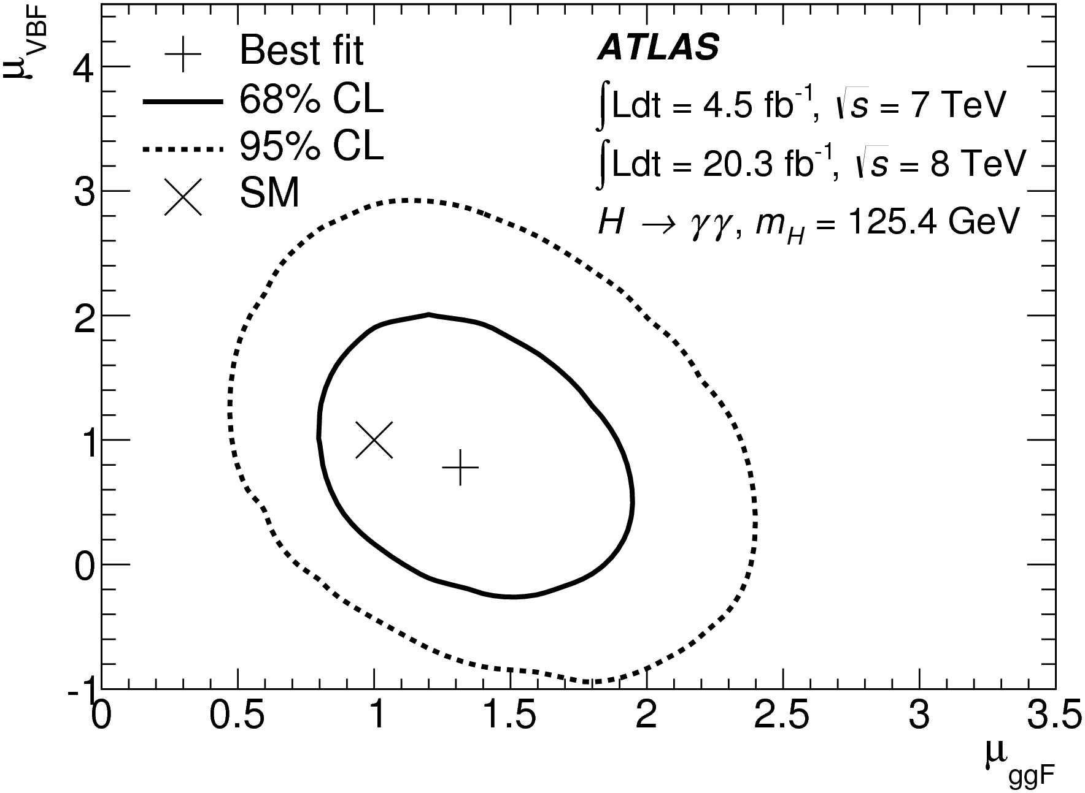
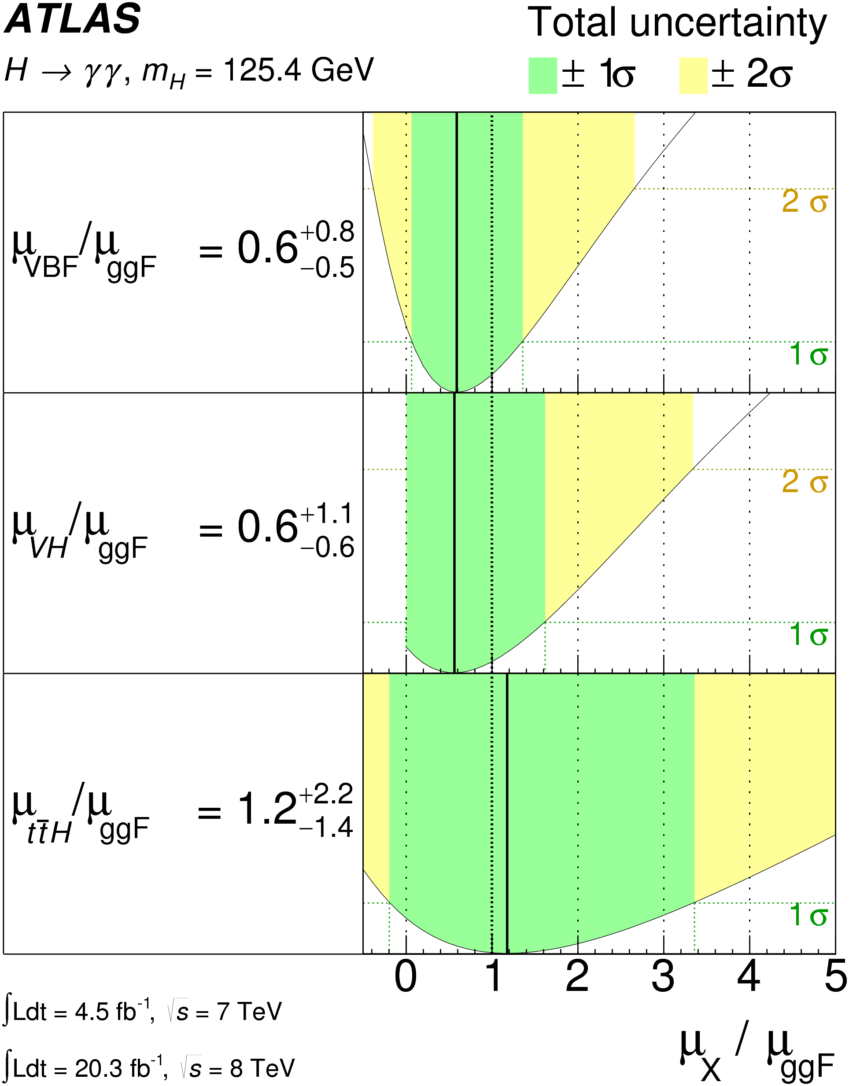
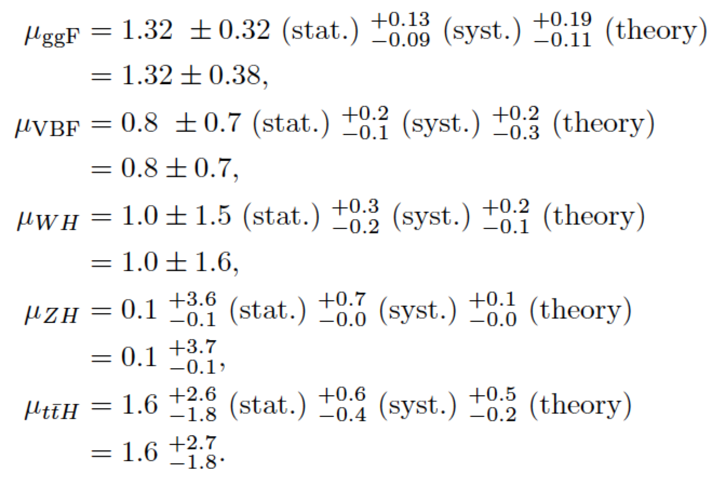
H➞γγ Analysis (cont.)
m_{H} fixed at 125.4 GeV
μ_{γγ} = σ/σ_{SM} = 1.17 ± 0.27 =
1.17 ± 0.23 (stat) ^{+0.10}_{-0.08} (syst) ^{+0.12}_{-0.08} (theory)
Increased statistical uncertainty due to:
  Lower signal rate
  Fluctuation – expected uncertainty 0.35 GeV

Slide 19
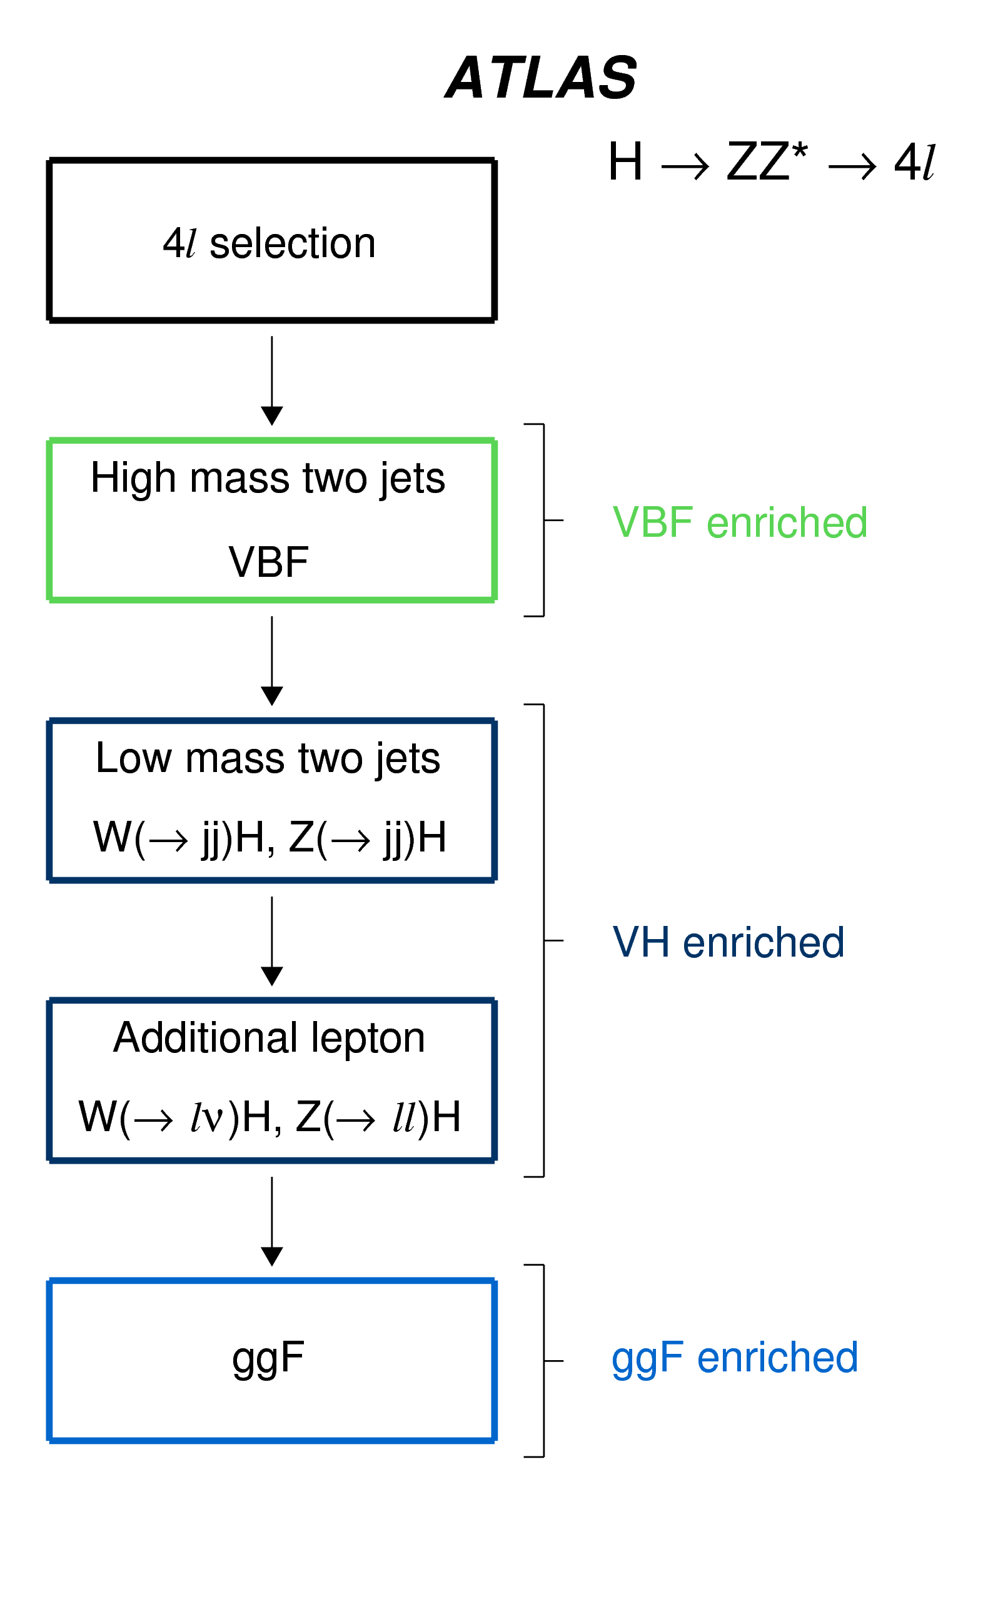
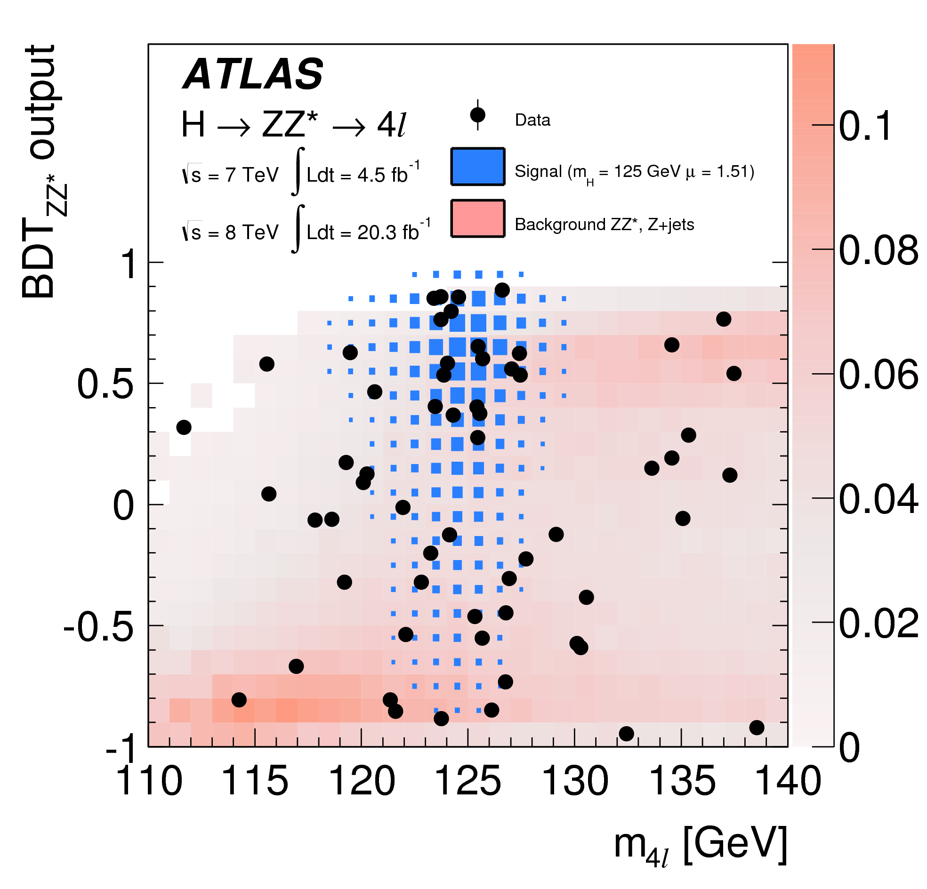
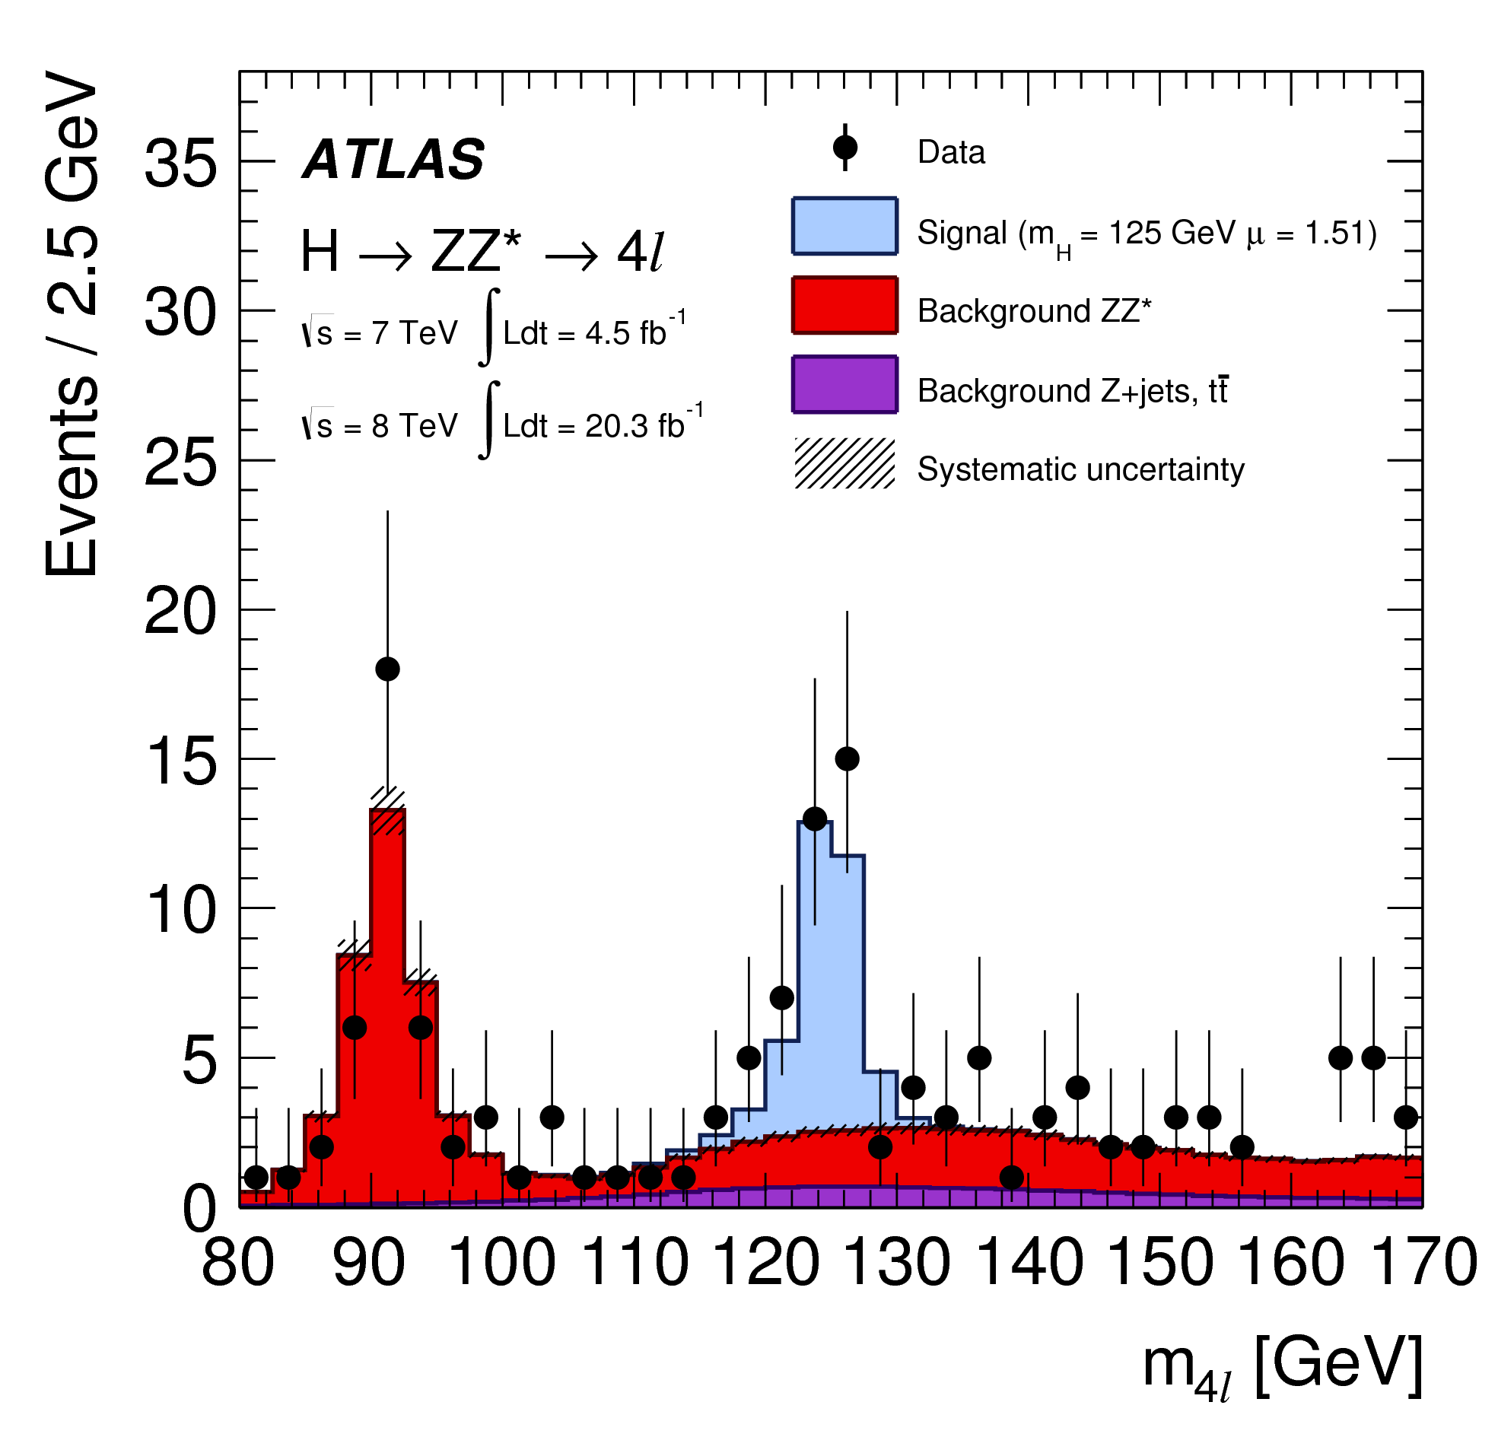
H➞ZZ Analysis
Also benefits from improved:
  Electron identification and energy measurement
  Muon momentum scale
Plus:
  New VH category
  Multivariate method to discriminate ZZ* (BDT_{ZZ*})
  Improved treatment of FSR photons
  2D fit to m(4l) and BDT_{ZZ*}
Signal strength: μ = σ/σ_{SM}
Inclusive:
  μ_{ZZ} = 1.44 ^{+0.34}_{-0.21} (stat) ^{+0.21}_{-0.11} (syst)
ggF and VBF categories:
  μ_{ggF} = 1.66 ^{+0.45}_{-0.41} (stat) ^{+0.26}_{-0.16} (syst)
  μ_{VBF} = 0.26 ^{+1.60}_{-0.91} (stat) ^{+0.38}_{-0.23} (syst)

Slide 20
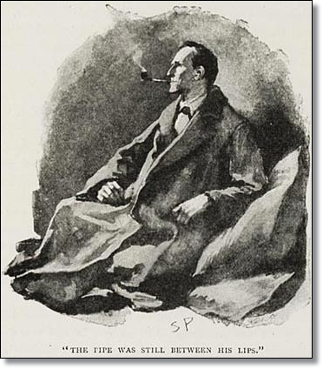
We’ve been keeping busy…
SM Higgs and its properties
Mass and couplings (ZZ+WW+γγ):
  Phys. Lett. B 726 (2013), pp. 88-119
  (Updated Mass): arXiv:1406.3827
  (Updated Coupling γγ): arXiv:1408.3827
  (Updated Coupling ZZ): arXiv:1408.5191
Spin and parity (ZZ+WW+γγ):
H → γγ: ATLAS-CONF-2013-012
H → WW: ATLAS-CONF-2013-030
H → Zγ: ATLAS-CONF-2013-009
H → bb: ATLAS-CONF-2013-079
H → ττ: ATLAS-CONF-2013-108
H → μμ: ATLAS-HIGG-2013-07
H → invisible:
Phys. Rev. Lett. 112, 201802 (2014)
ttH(γγ): ATLAS-CONF-2014-043
VH(WW): ATLAS-CONF-2013-075
Phys. Lett. B 726 (2013), pp. 120-14
H → ZZ (on-shell cross-section and pT): ATLAS-CONF-2014-044 (off-shell cross-section) ATLAS-CONF-2014-042
Additional Higgs Boson searches
H/h/A→ττ:
ATLAS-CONF-2014-049 ATLAS-CONF-2014-005
X→hh→4b:
H+ → τ ν: ATLAS-CONF-2013-090, JHEP03(2013)076
H+ → c ss̅ :
Eur. Phys. J. C, 73 6 (2013) 2465
H → WW (2HDM): ATLAS-CONF-2013-027
X→hh→γγbb: ATLAS-HIGG-2013-29
Multi-higgs cascade:
Phys. Rev. D 89, 032002 (2014)
SM Higgs Couplings and New Phenomena:
ATLAS-CONF-2014-010
'It is an old maxim of mine that when you have excluded the impossible, whatever remains, however improbable, must be the truth.'
Sherlock Holmes
-The Beryl Coronet

Slide 21
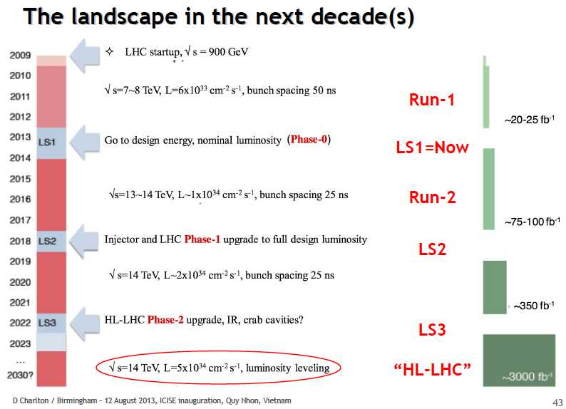

Slide 22
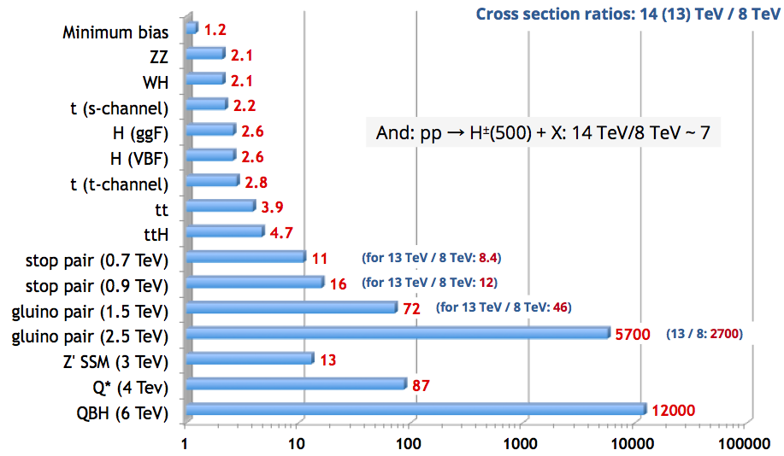
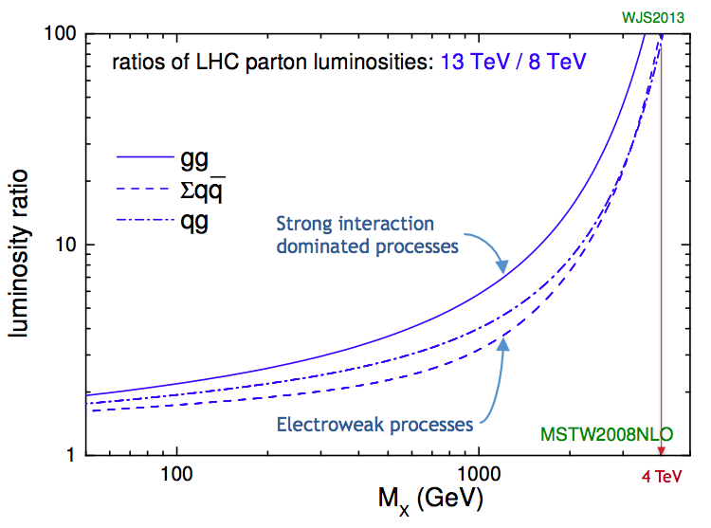
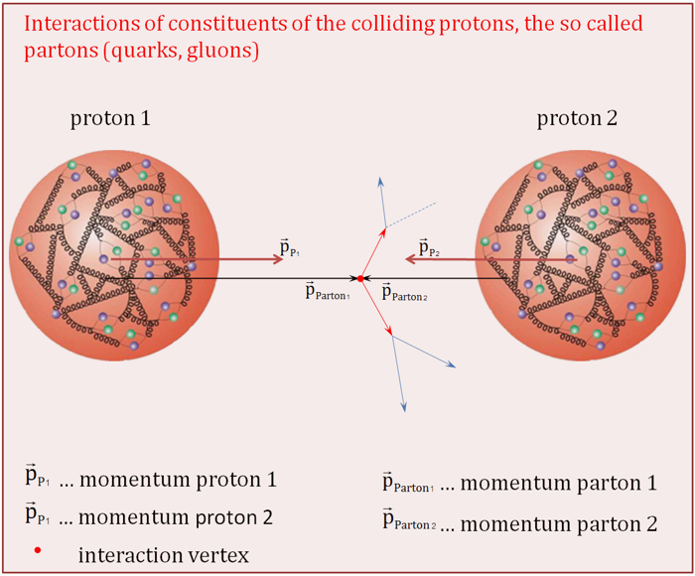
Run II – Not only more luminosity
Higher centre of mass energy gives access to higher masses
Hugely improves potential for discovery of heavy particles
Increases cross sections limited by phase space
  E.g. ttH increases faster than background (factor 4)
But may make life harder for light states
  E.g. only factor 2 increase for WH/ZH, H➞bb and more pileup
  Could be compensated by use of boosted jet techniques (jet substructure)
http://www.hep.ph.ic.ac.uk/~wstirlin/plots/plots.html

Slide 23
Conclusions
Only a very short review of the latest diboson mass and coupling results (apologies)
Looking forward to Run II
  Improve further on the precision measurements that I mentioned (and all the ones I didn’t)
  But not all channels will become easier

Slide 24

Any Questions?
?
?
?
?

Slide 25
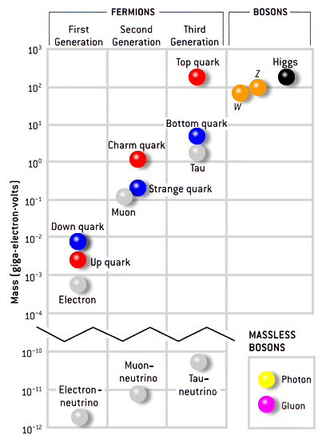
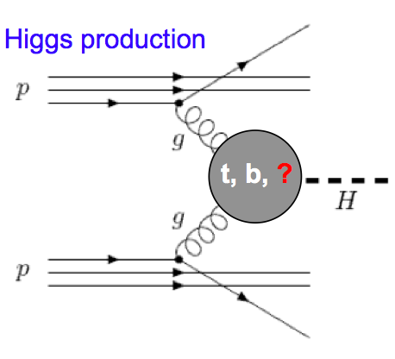
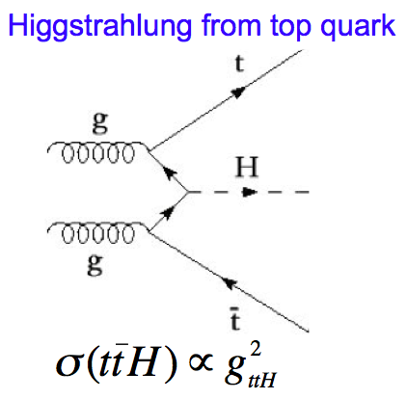
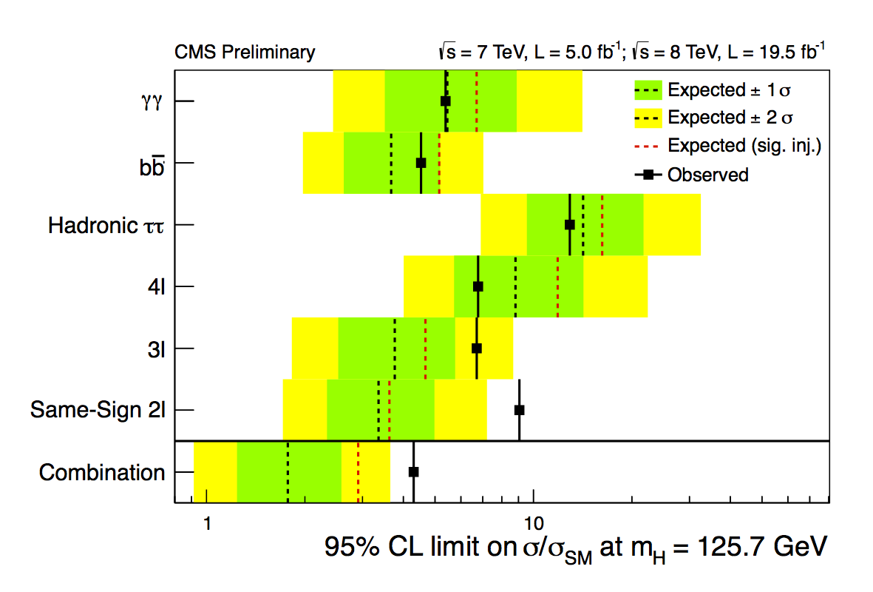
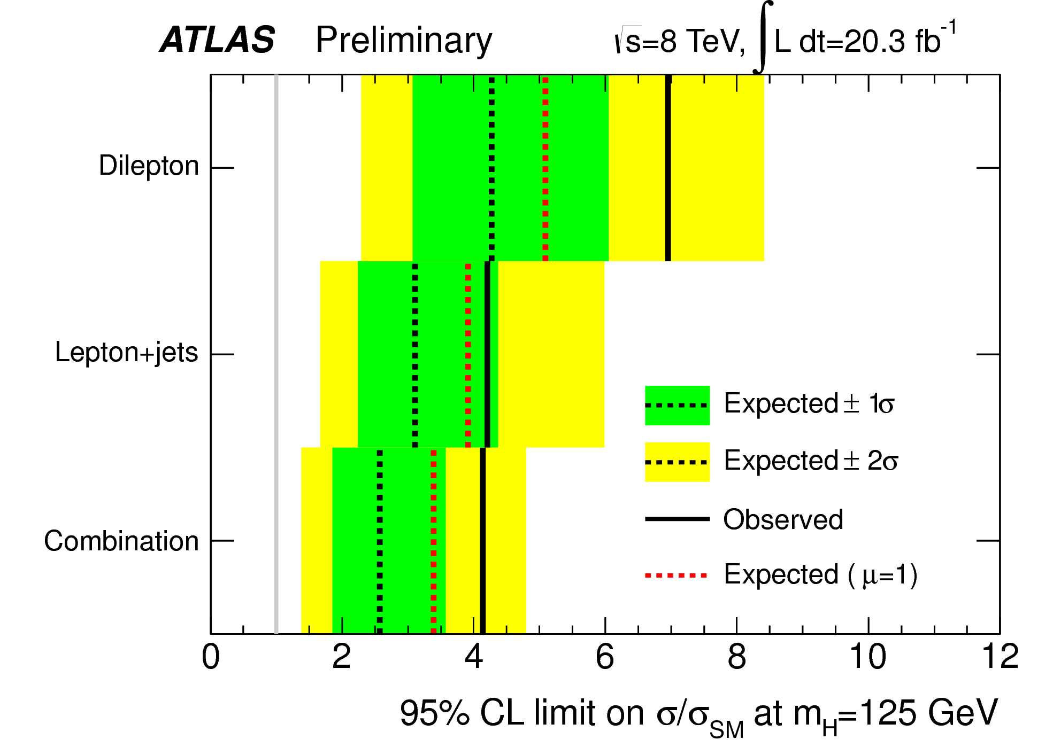
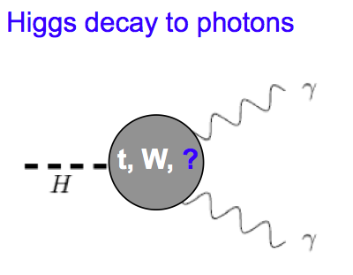
An example: ttH
Indirect constraints on top-Higgs Yukawa coupling from loops in ggH and ttH vertices
  Assumes no new particles contribute to loops
Top-Higgs Yukawa coupling can be measured directly
  Allows probing for New Physics contributions in the ggH and γγH vertices
Top Yukawa coupling Y_{t} = √2M_{t}/vev = 0.996±0.005
  Does this mean top plays a special role in EWSB?

Slide 26
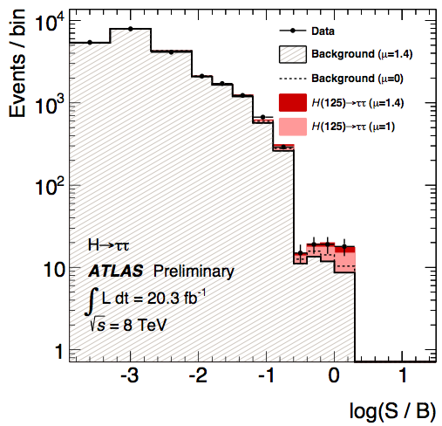


Direct Evidence of Fermion Couplings
Challenging channels at the LHC!
  Huge backgrounds (H->bb,H->ττ)
  Or low rate: H->μμ
ATLAS:
  4.1σ evidence of H->ττ decay 3.2σ exp.
  μ = σ_{obs.}/σ_{SM} = 1.4 ±0.3(stat) ±0.4(sys)
CMS:
  Combination of H->bb and H->ττ:
  3.8σ evidence (obs.) 4.4σ (expected)
  μ = σ_{obs.}/σ_{SM} = 0.83 ±0.24
ATLAS-CONF-2013-108
CMS 1401.6527
CMS 1401.6527

Slide 27

Direct Measure of Higgs Boson Width
Going back to latest ATLAS mass measurement
  Combination of H➞γγ and H➞ZZ
  arXiv:1406.3827
Direct measurement assuming no interference between signal and
backgrounds
Mass peak is a convolution of natural Higgs width and detector resolution
  SM: Γ = 4 MeV << resolution
H➞ZZ➞4l :
  Γ < 2.5 GeV @ 95% C.L.
  Expect 6.2 for μ = 1
H➞γγ:
  Γ < 2.5 GeV @ 95% C.L.
  Expect 6.2 for μ = 1

Slide 28




Indirect Measurement
ATLAS-CONF-2014-042
High-mass region in H➞ZZ ( m_{ZZ} > 2 m_{Z} ) provides access to total width
  Kauer and Passarino, JHEP 1208 (2012) 116
  Caola and Melnikov, PRD 88 (2013) 054024
  Campbell, Ellis, and Williams, PRD 89 (2014) 053011
Off-shell signal strength is independent of total width (depends only on couplings) – unlike on-shell
  Assumes background is immune to any new physics affecting off-shell couplings (and so κ factors)
  Assumes κi,off-shell = κi,on-shell
Backgr
Signal
Sig+Bak

Slide 29
Indirect Measurement
ATLAS-CONF-2014-042
Combination of ZZ➞4l and ZZ➞2l2ν to fit μ_{off-shell}
ZZ➞4l
Off-shell region m4l=[220,1000] GeV
Matrix element (ME) kinematic discriminant to separate gg➞H➞ZZ from gg➞ZZ and qq➞ZZ
ZZ➞2l2ν
- E_{t}^{miss} > 150 GeV, 76 < ml_{l} < 106 GeV
- Main backgrounds: qq➞ZZ + diboson
Off –shell signal region: mTZZ > 350 GeV
limit on μoff-shell
Small dependence on the ratio between gg➞ZZ and gg➞H➞ZZ k-factors
RHB is ~ 1 in the soÄ collinear approxima4on Include low-mass region (4l) to fit μon-shell
Ratio of μon-shell/μoff-shell gives ΓH
Off-shell signal strength is independent of total width (depends only on couplings) – unlike on-shell
  Assumes background is immune to any new physics affecting off-shell couplings (and so κ factors)
  Assumes κi,off-shell = κi,on-shell

Slide 30


Higgs in ATLAS

Slide 31


Slide 32

Trigger: sistema de seleção em tempo real
25 ns entre pacotes
  (i.e. ≈7.5m à velocidade de c)
  40 milhões de cruzamentos de feixes por segundo
  Cada colisão daria ≈1.5Mb
  => 60Tb por segundo
Impossível guardar todos os dados
  E desnecessário!
  A maioria das colisões é sem interesse
O sistema de trigger guarda apenas ≈10-15 colisões por cada milhão
Mas tem que decidir em 2,5μs!!

Slide 33


SDX1
dual-CPU nodes
Trigger / DAQ architecture
CERN
computer
centre
6
~1600
~100
~ 500
Event rate
~ 200 Hz
Local
Storage
SubFarm
Outputs
(SFOs)
Event
Filter
(EF)
Event
Builder
SubFarm
Inputs
(SFIs)
LVL2
farm
Second-
level
trigger
Data
storage
pROS
SDX1
DataFlow
Manager
Network
switches
stores
LVL2
output
Network switches
LVL2
Super-
visor
Gigabit Ethernet
Event data requests
Delete commands
Event data
pulled:
partial events
@ ≤ 100 kHz,
full events
@ ~ 3 kHz
Requested event data
USA15
Regions Of Interest
USA15
Data of events accepted
by first-level trigger
~150
PCs
1600
Read-
Out
Links
UX15
VME
Dedicated links
Read-Out
Subsystems
(ROSs)
Read-
Out
Drivers
(RODs)
RoI
Builder
First-
level
trigger
Timing Trigger Control (TTC)
Event data pushed @ ≤ 100 kHz,
1600 fragments of ~ 1 kByte each

Slide 34





Slide 35

A Colaboração ATLAS
3000 cientistas
(1000 estudantes)
33 países
177 universidades e laboratórios

Slide 36
Outline
The ATLAS detector and run-I performance
  ATLAS vs CMS – strengths and weaknesses
Standard Model Higgs
  Bosonic decay channels – γγ (incl., ttH), WW, ZZ, Zγ
    Differential analyses – γγ, ZZ
    ttH(H➞γγ)
    Couplings and Properties from Bosonic Channels – incl mass (ATLAS-CONF-2014-043)
  Fermionic decay channels – ττ, bb (VH, ttH), μμ
    H➞ττ, VH(H➞bb), ttH(H➞bb)
    Hcc access through H->J/Psi? http://arxiv.org/abs/1306.5770
  Di-Higgs production – γγbb
Beyond the Standard Model
  Constraints from current measurements
  Direct BSM Searches
    Additional γγ resonances
    Cascade decays
    Invisible Higgs in ZH production
    FCNC t➞Hq
    MSSM H➞ττ (in circulation)
    High Mass H➞γγ
    PROCURAR em exotics (e.g. H++) e SUSY

