Slide 1
Informations for the Week
Ricardo Gonçalo
(for a large team of enthusiastic researchers and lectureres!)

Slide 2
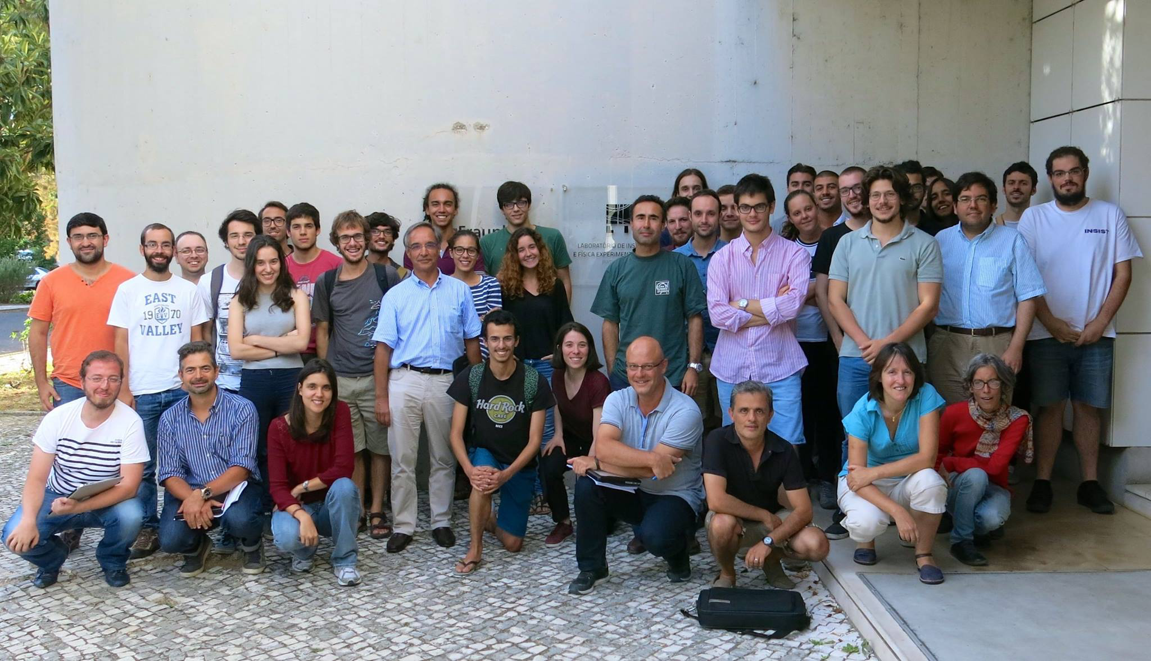
LIP Summer Internship 2017

Slide 3
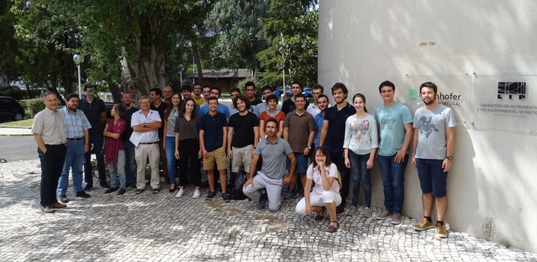
LIP Summer Internship 2018

Slide 4
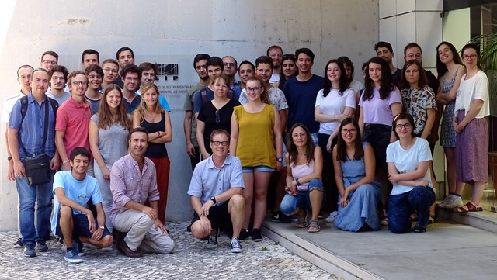
LIP Summer Internship 2019

Slide 5
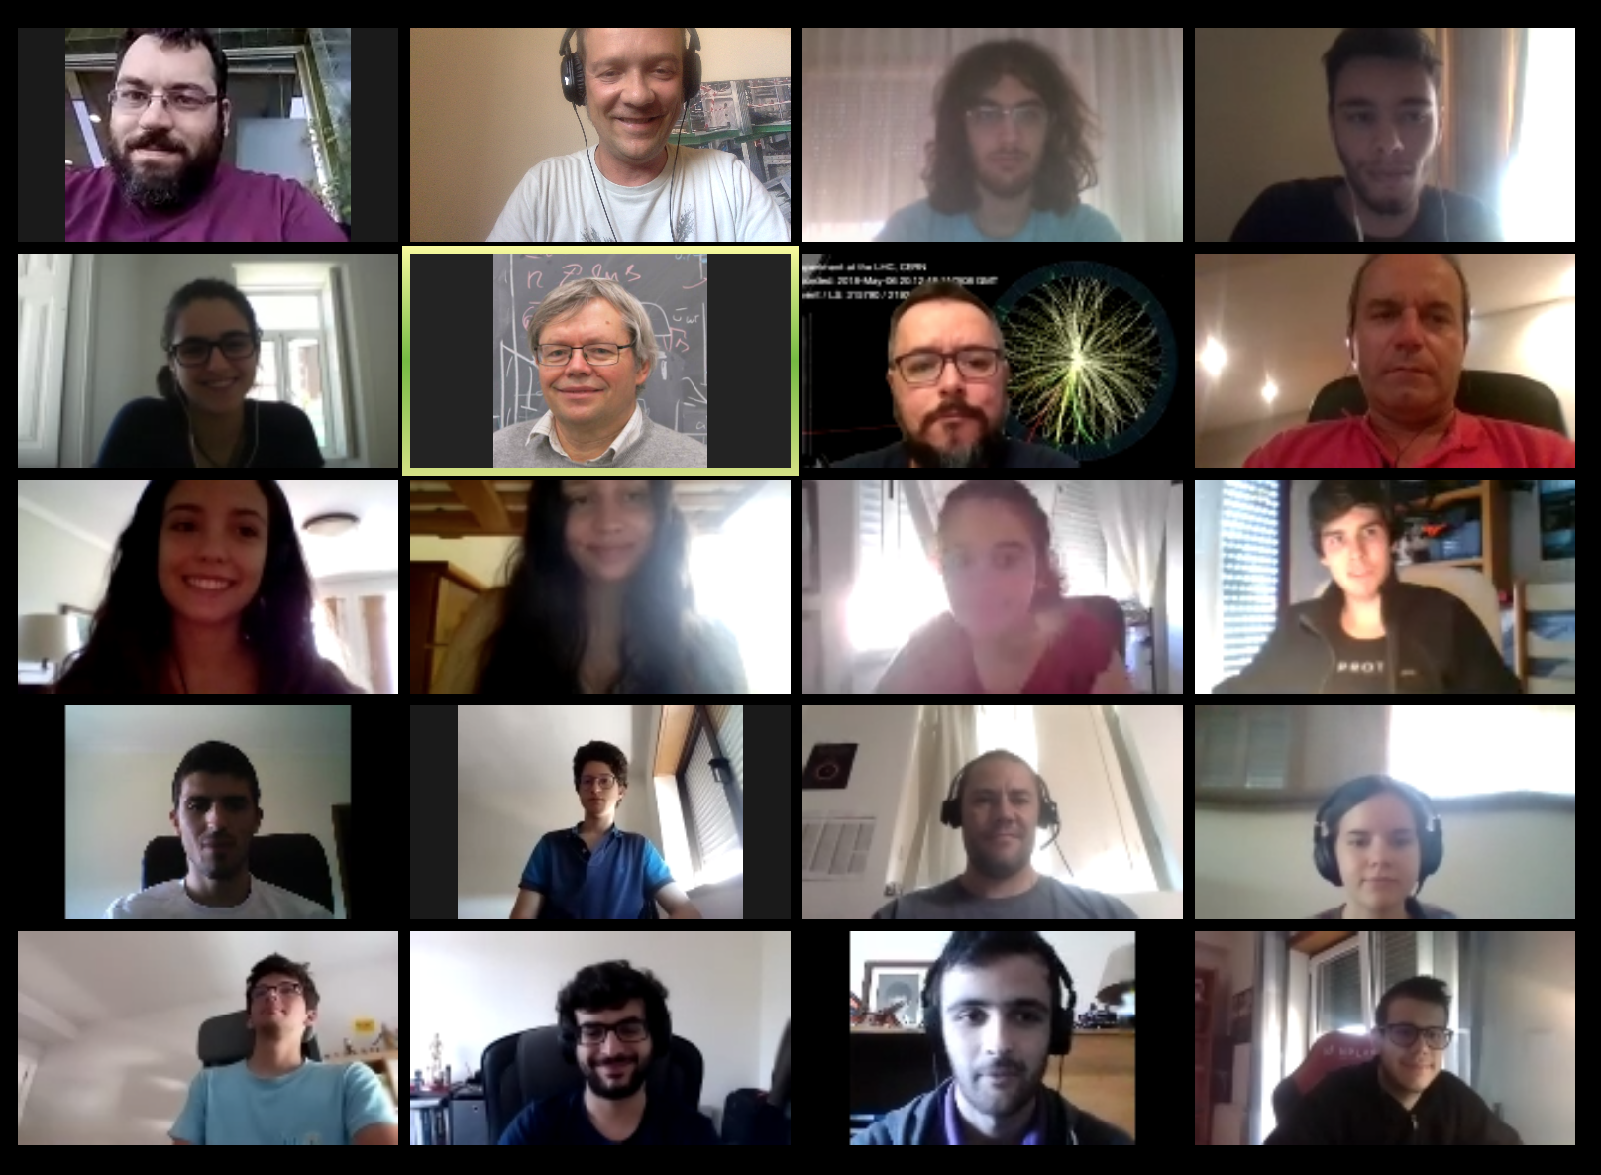
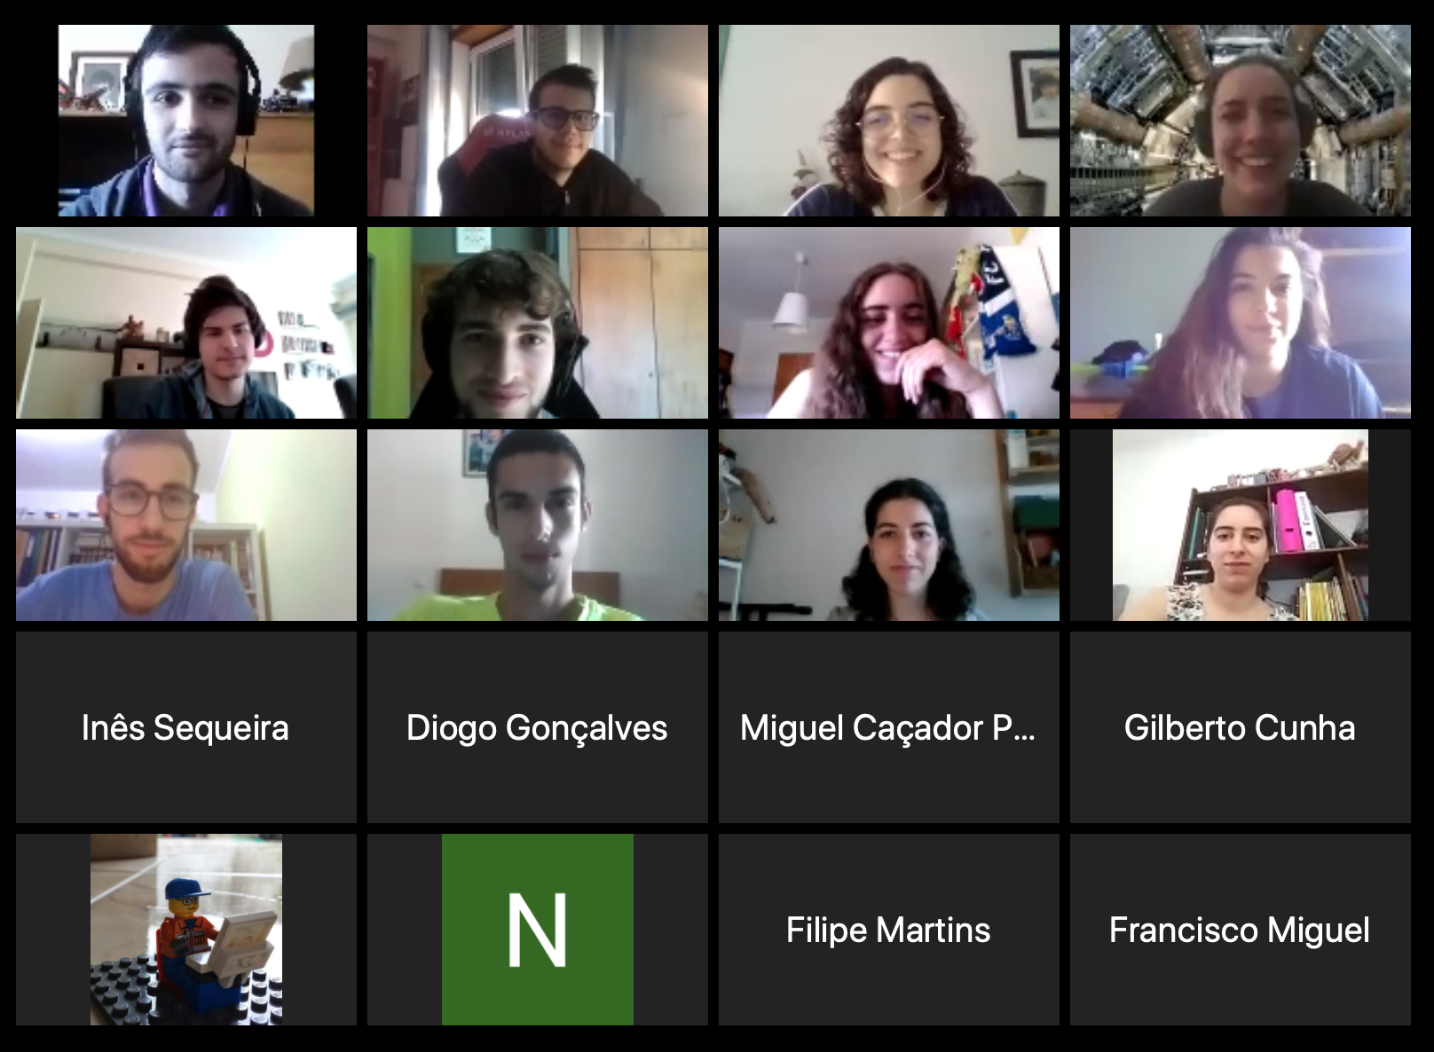
LIP Summer Internship 2020

Slide 6
LIP Summer Internship 2020

Slide 7
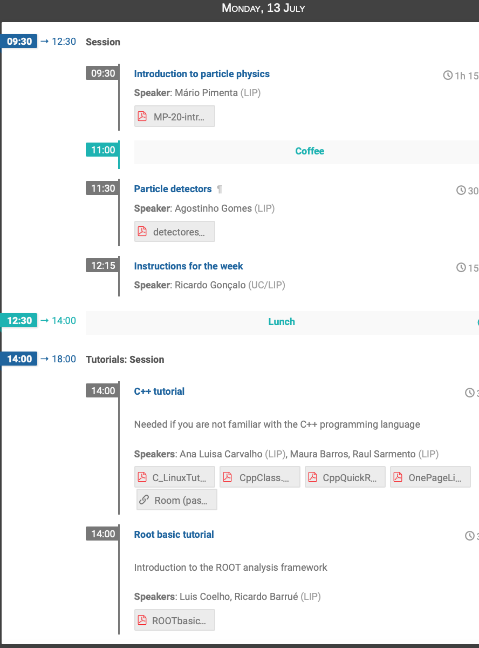
The Agenda
Mornings:
Two lectures themes covered in any of your projects
Followed by tutorial chats: your chance to ask everything you always wanted to know about particle physics but were afraid to ask! ☺
Afternoons:
Tutorials to give you the tools you need for your projects

Slide 8
Instructions for the afternoon tutorials
In order to follow the tutorials it is very important that you have access to the LIP machines so please:
Create an ssh key – instructions here:https://wiki.incd.pt/books/how-to-access/page/create-an-ssh-key
and send the public one (id_rsa.pub) to helpdesk@lip.pt
A dedicated slack workspace has been set up. Join here: https://join.slack.com/t/lip-internshipprogram/shared_invite/zt-fbacw5c7-Pi87gN4ipRycGp6i6oV23w
There is a specific channel "lip-machines" for questions about accessing the LIP machines, use it if necessary, we are happy to help with any questions!
Some tutorials will happen simultaneously so you have to choose which one you want participate in:
Links to the Zoom meeting rooms will be posted in the agenda, as well as the passwords
Use slack to let us know if you have problems connecting

Slide 9
The Great Particle Challenge!
Use this link:
https://docs.google.com/document/d/1CEEW_IPMR6xhZO4RlVtXo8G1N5ILQFaMZPWObmIDA6Y/edit
Send your replies to jgoncalo@lip.pt on Friday with subject “The Great Particle Challenge!”

Slide 10
Finally: HAVE FUN!... and...
https://www.lip.pt

