Slide 1
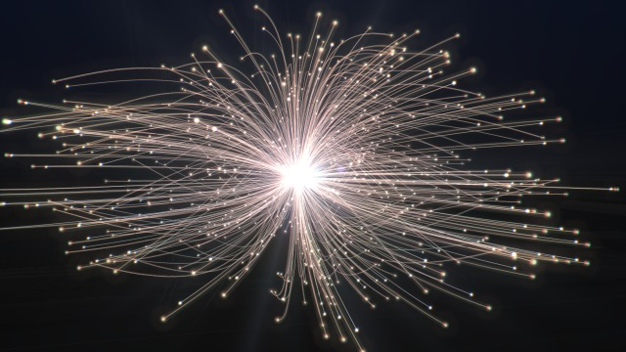
LIP Advisory Board Meeting 27 April 2023
FCC Group – Future Circular Collider
Ricardo Gonçalo – UC / LIP

Slide 2
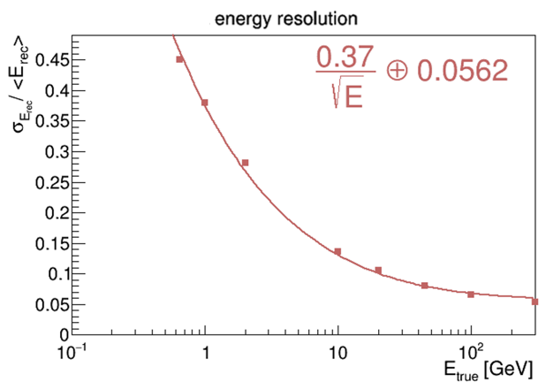
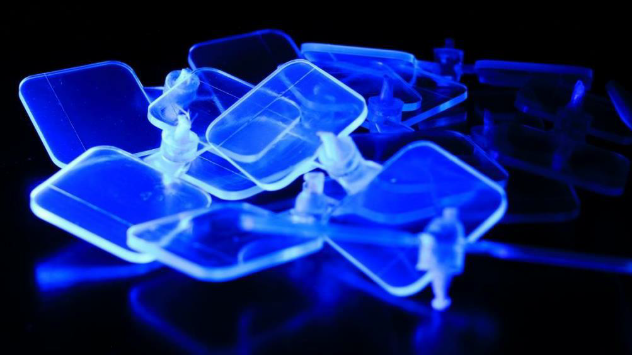
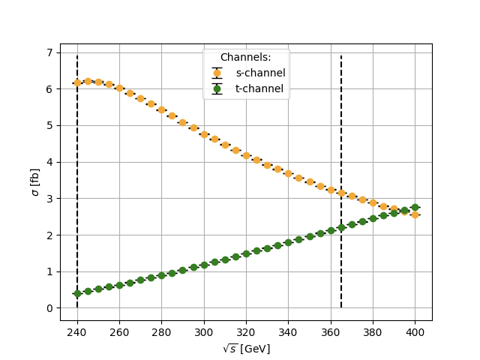
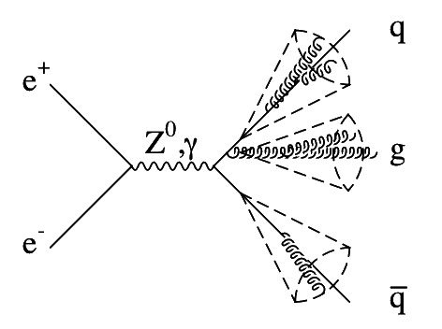
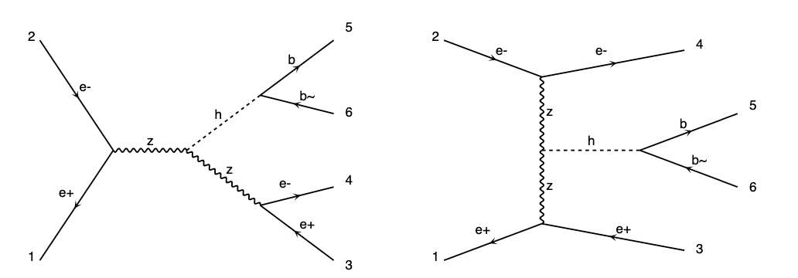
FCC Group
Group dedicated to future collider studies – main focus on FCC-ee
Increasing cross-talk with ECFA Detector R&D roadmap activities – DRD collabs.
Activity:
Rad-hard scintillator development
PET/PEN samples under testing
Calorimeter simulation for FCC-ee
Joined proposed scintillator+Fe/Pb HCAL option
Optimizing geometry, material, granularity,
depth, compensation etc, including M.Learning
Higgs at FCC-ee
Pheno. study of Higgs production channels
3-jet cross section and event shapes
Preparing for ultra-precise measurement
of 𝞪_{s} at FCC-ee Z-pole run

Slide 3
Strengths, Weaknesses, Opportunities and Threats
Strengths:
Experienced team from different LIP sites and universities – access to students
Weaknesses:
Little researcher time devoted to FCC – not the main interest of researchers in the group
Opportunities:
Contributing to feasibility study – long-term, unique facility in particle physics
Good opportunity for student training
Technological studies have wide applicability
Threats:
Shortness of dedicated research time
Limited specific funding
Team: Grigorios Chachamis, Guilherme Milhano, Inês Ochoa, João Nuno Pires, Michele Gallinaro, Patricia Conde, Rute Pedro, Beatriz Pinheiro Pereira (PhD), Francisco Casalinho (MSc), Joana Reis (MSc)

Slide 4
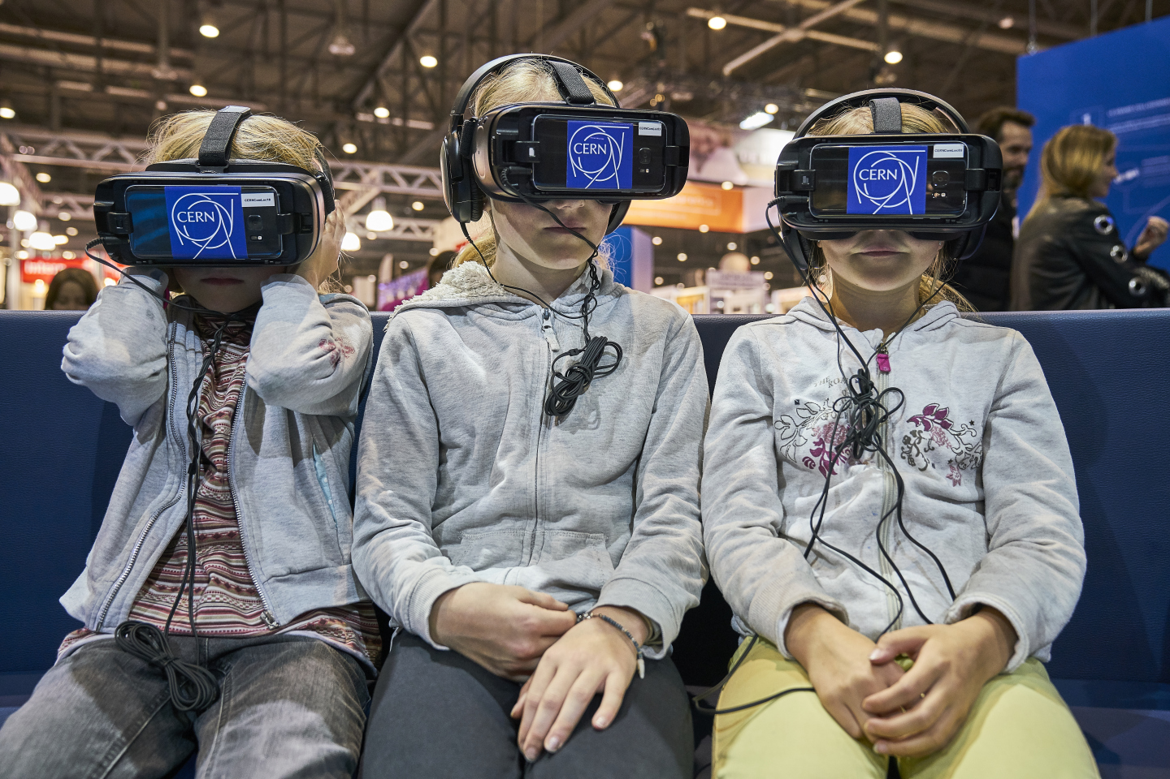
Bonus slides
LET’S INSPIRE PEOPLE
Notes:
https://docs.google.com/forms/d/1mYM3yW3vMMPyp9cSqKTQqStZdBoxiNMYR1FkCO48zpI/edit

Slide 6
FCC-ee:

Slide 7
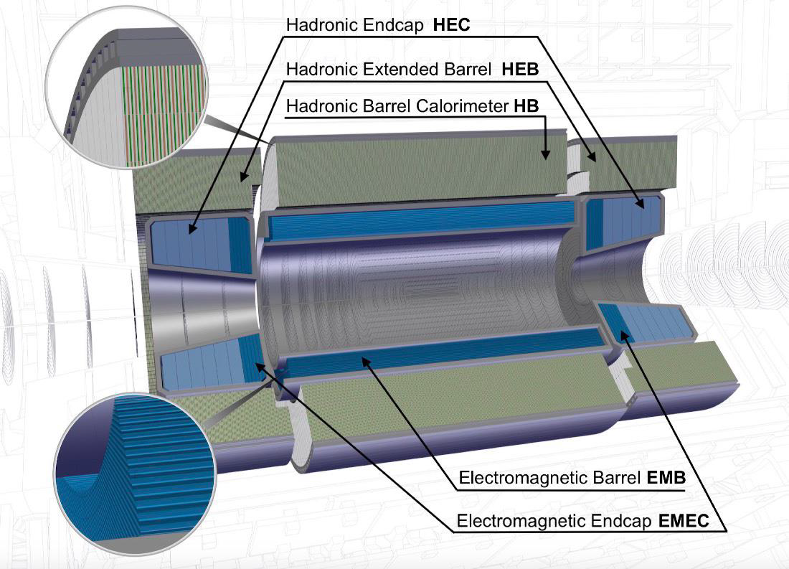
Hadronic calorimetry at FCC-hh
For FCC-hh a barrel hadron calorimeter Tilecal like in the central region is straight forward
Better granularity and new photosensors are key to get better performance keeping a low cost
Radiation hardness of the scintillators and WLS fibers are potential issues, improvement needed tocope with ~10 kGy

Slide 8
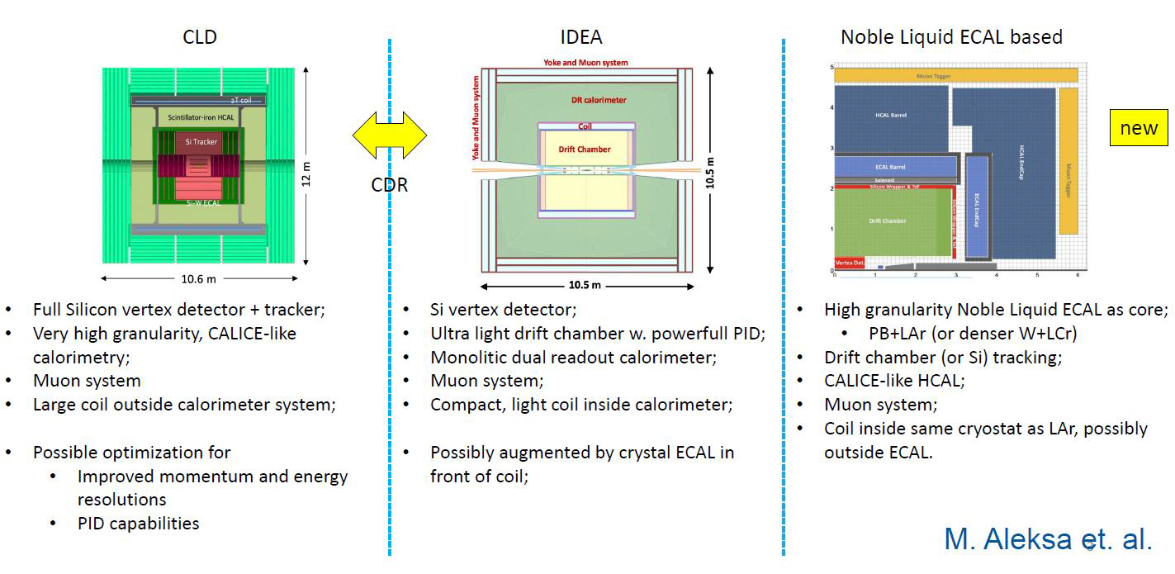
Design for FCC-ee central calorimeter system
A new proposal for a HCAL alternative: scintillating tile barrel calorimeter with Fe/Pb

Slide 16
Portugal and the FCC
Several contributions to the FCC Conceptual Design Report
Physics: Top, Higgs, Heavy Ion, etc – both theoretical explorations and feasibility studies
Detector design and studies
Most contributors from
LHC experimental groups
LHC-related theory interests
These are the core of people here today

Slide 17
Portugal and the European Strategy for Particle Physics
Contributed to the 2020 ESPP with local consultation
View that next major collider should be based at CERN
Aligned with priorities set out by ESPP:
Full physics exploitation of the LHC and HL-LHC
Next priority is a e⁺e⁻ “Higgs factory”
Increased R&D on enabling accelerator technologies:
Support neutrino projects in US and Japan
Support high-impact scientific diversity programme complementary to high-energy colliders
First strategy document approved at a special Restricted Session of CERN Council in Lisbon, 14 July 2006

