Slide 1
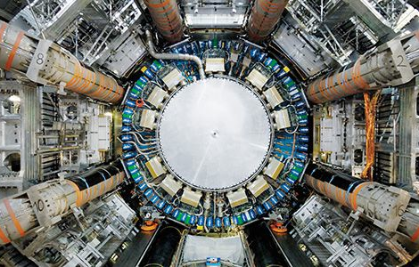



Investigação na Experiência ATLAS

Slide 2
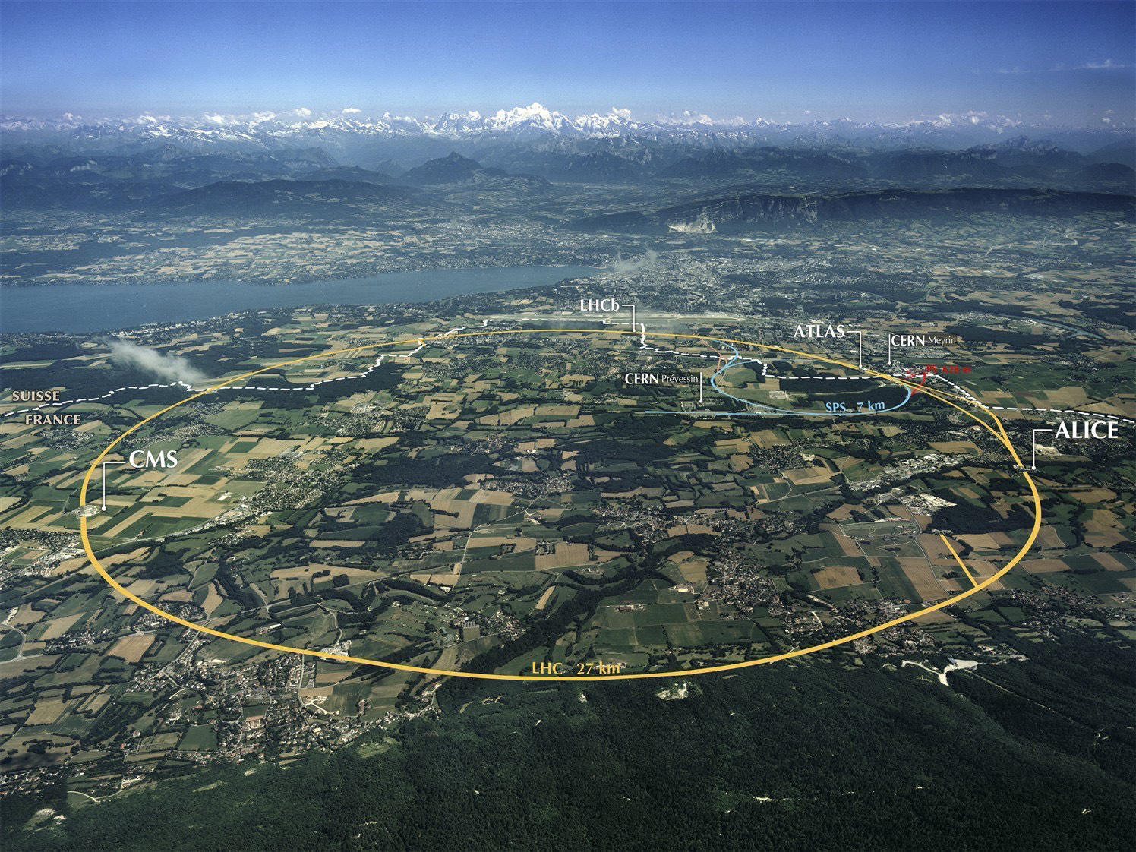
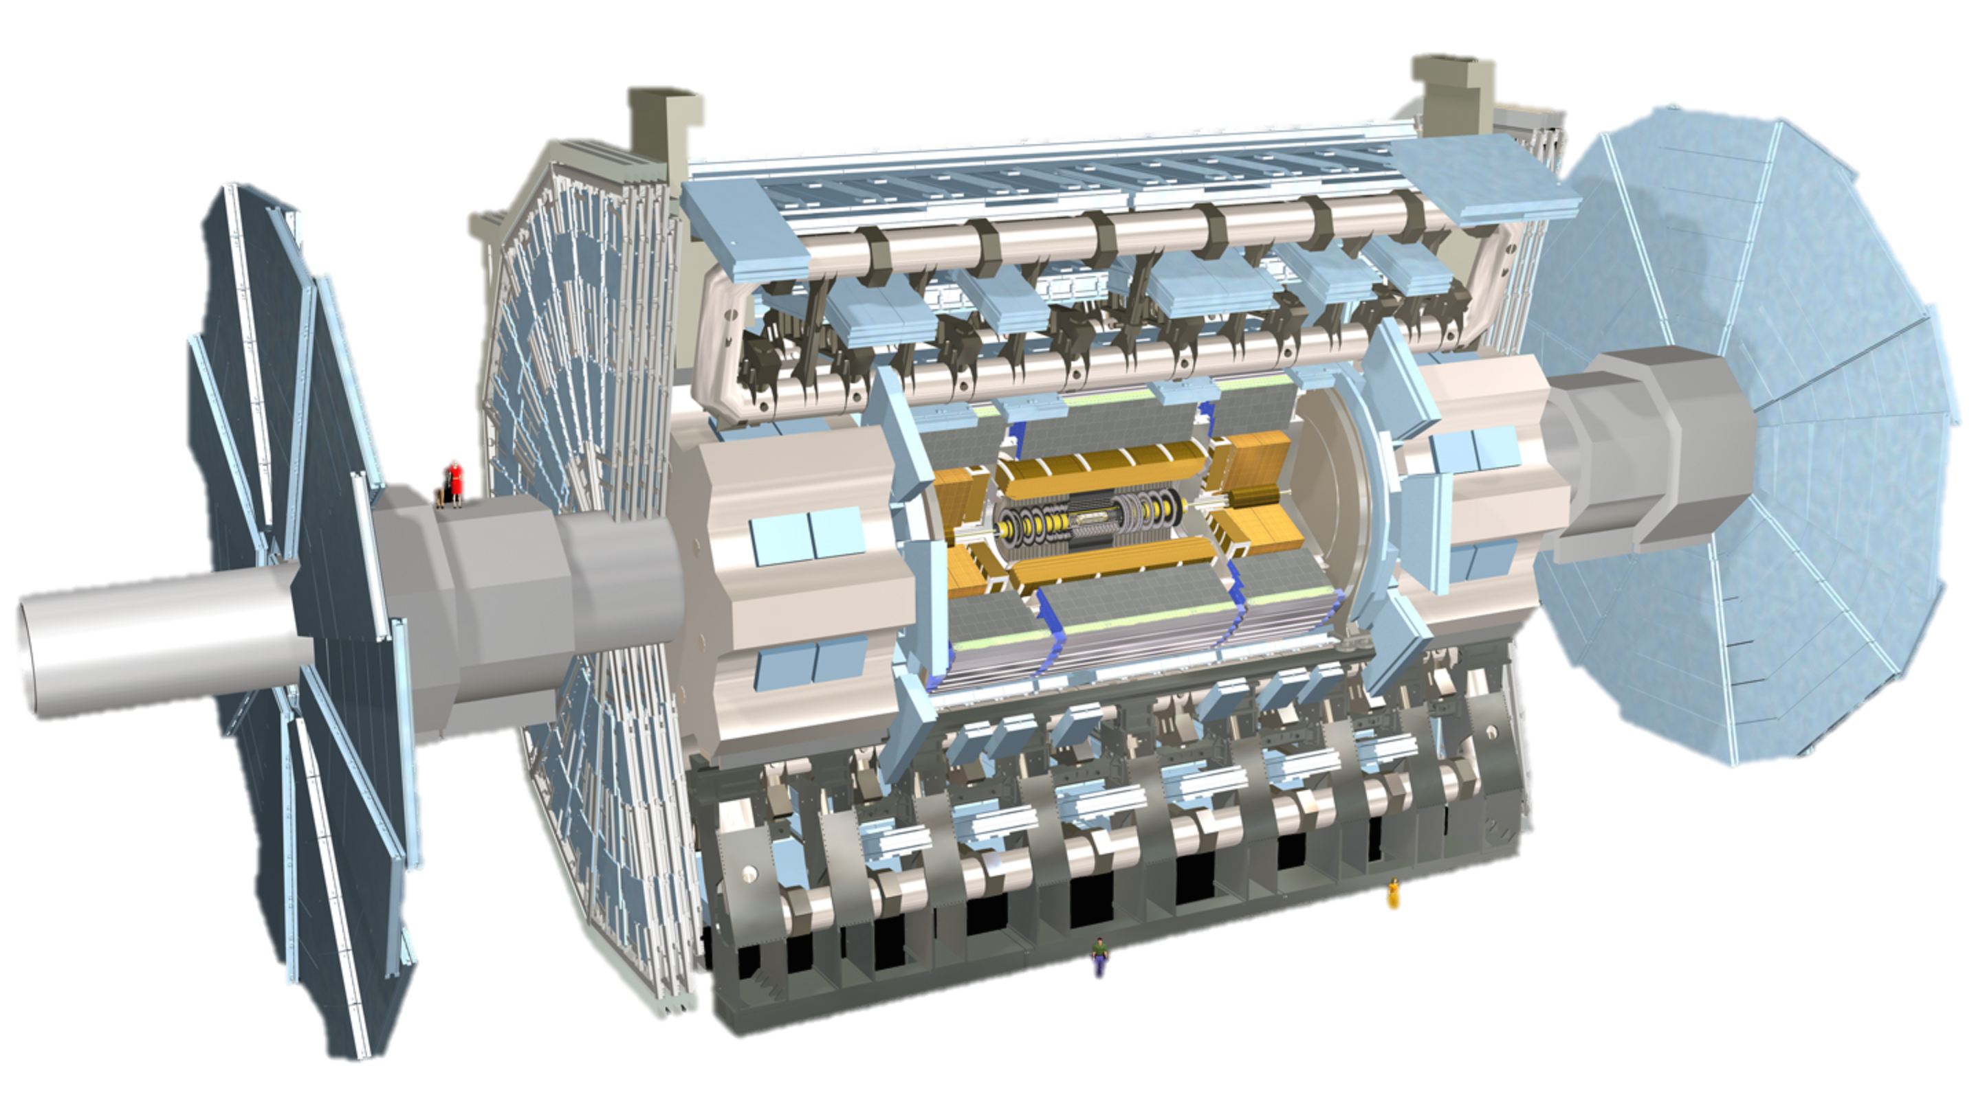
Mont Blanc
ATLAS
Notes:
LHC Running at 2x design luminosity
Expect 150/pb by end of this year

Slide 3
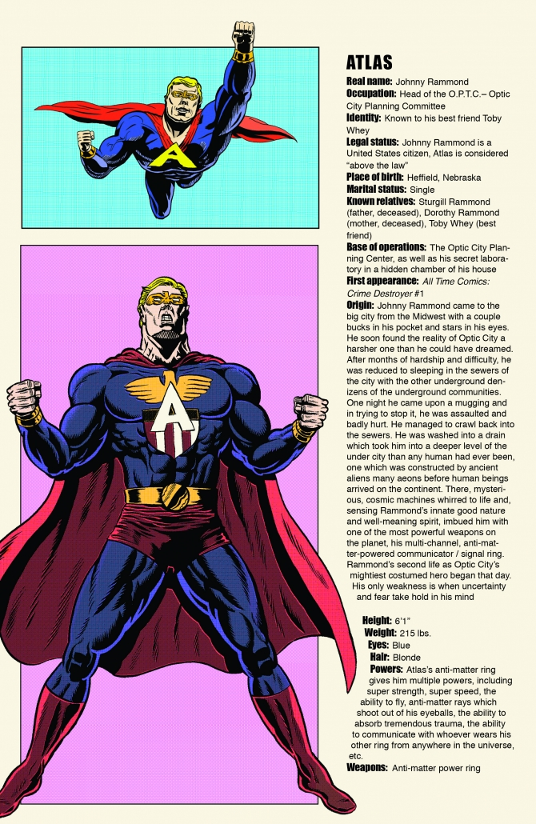
Notes:
Th only experiment I know with its own super-hero!

Slide 4

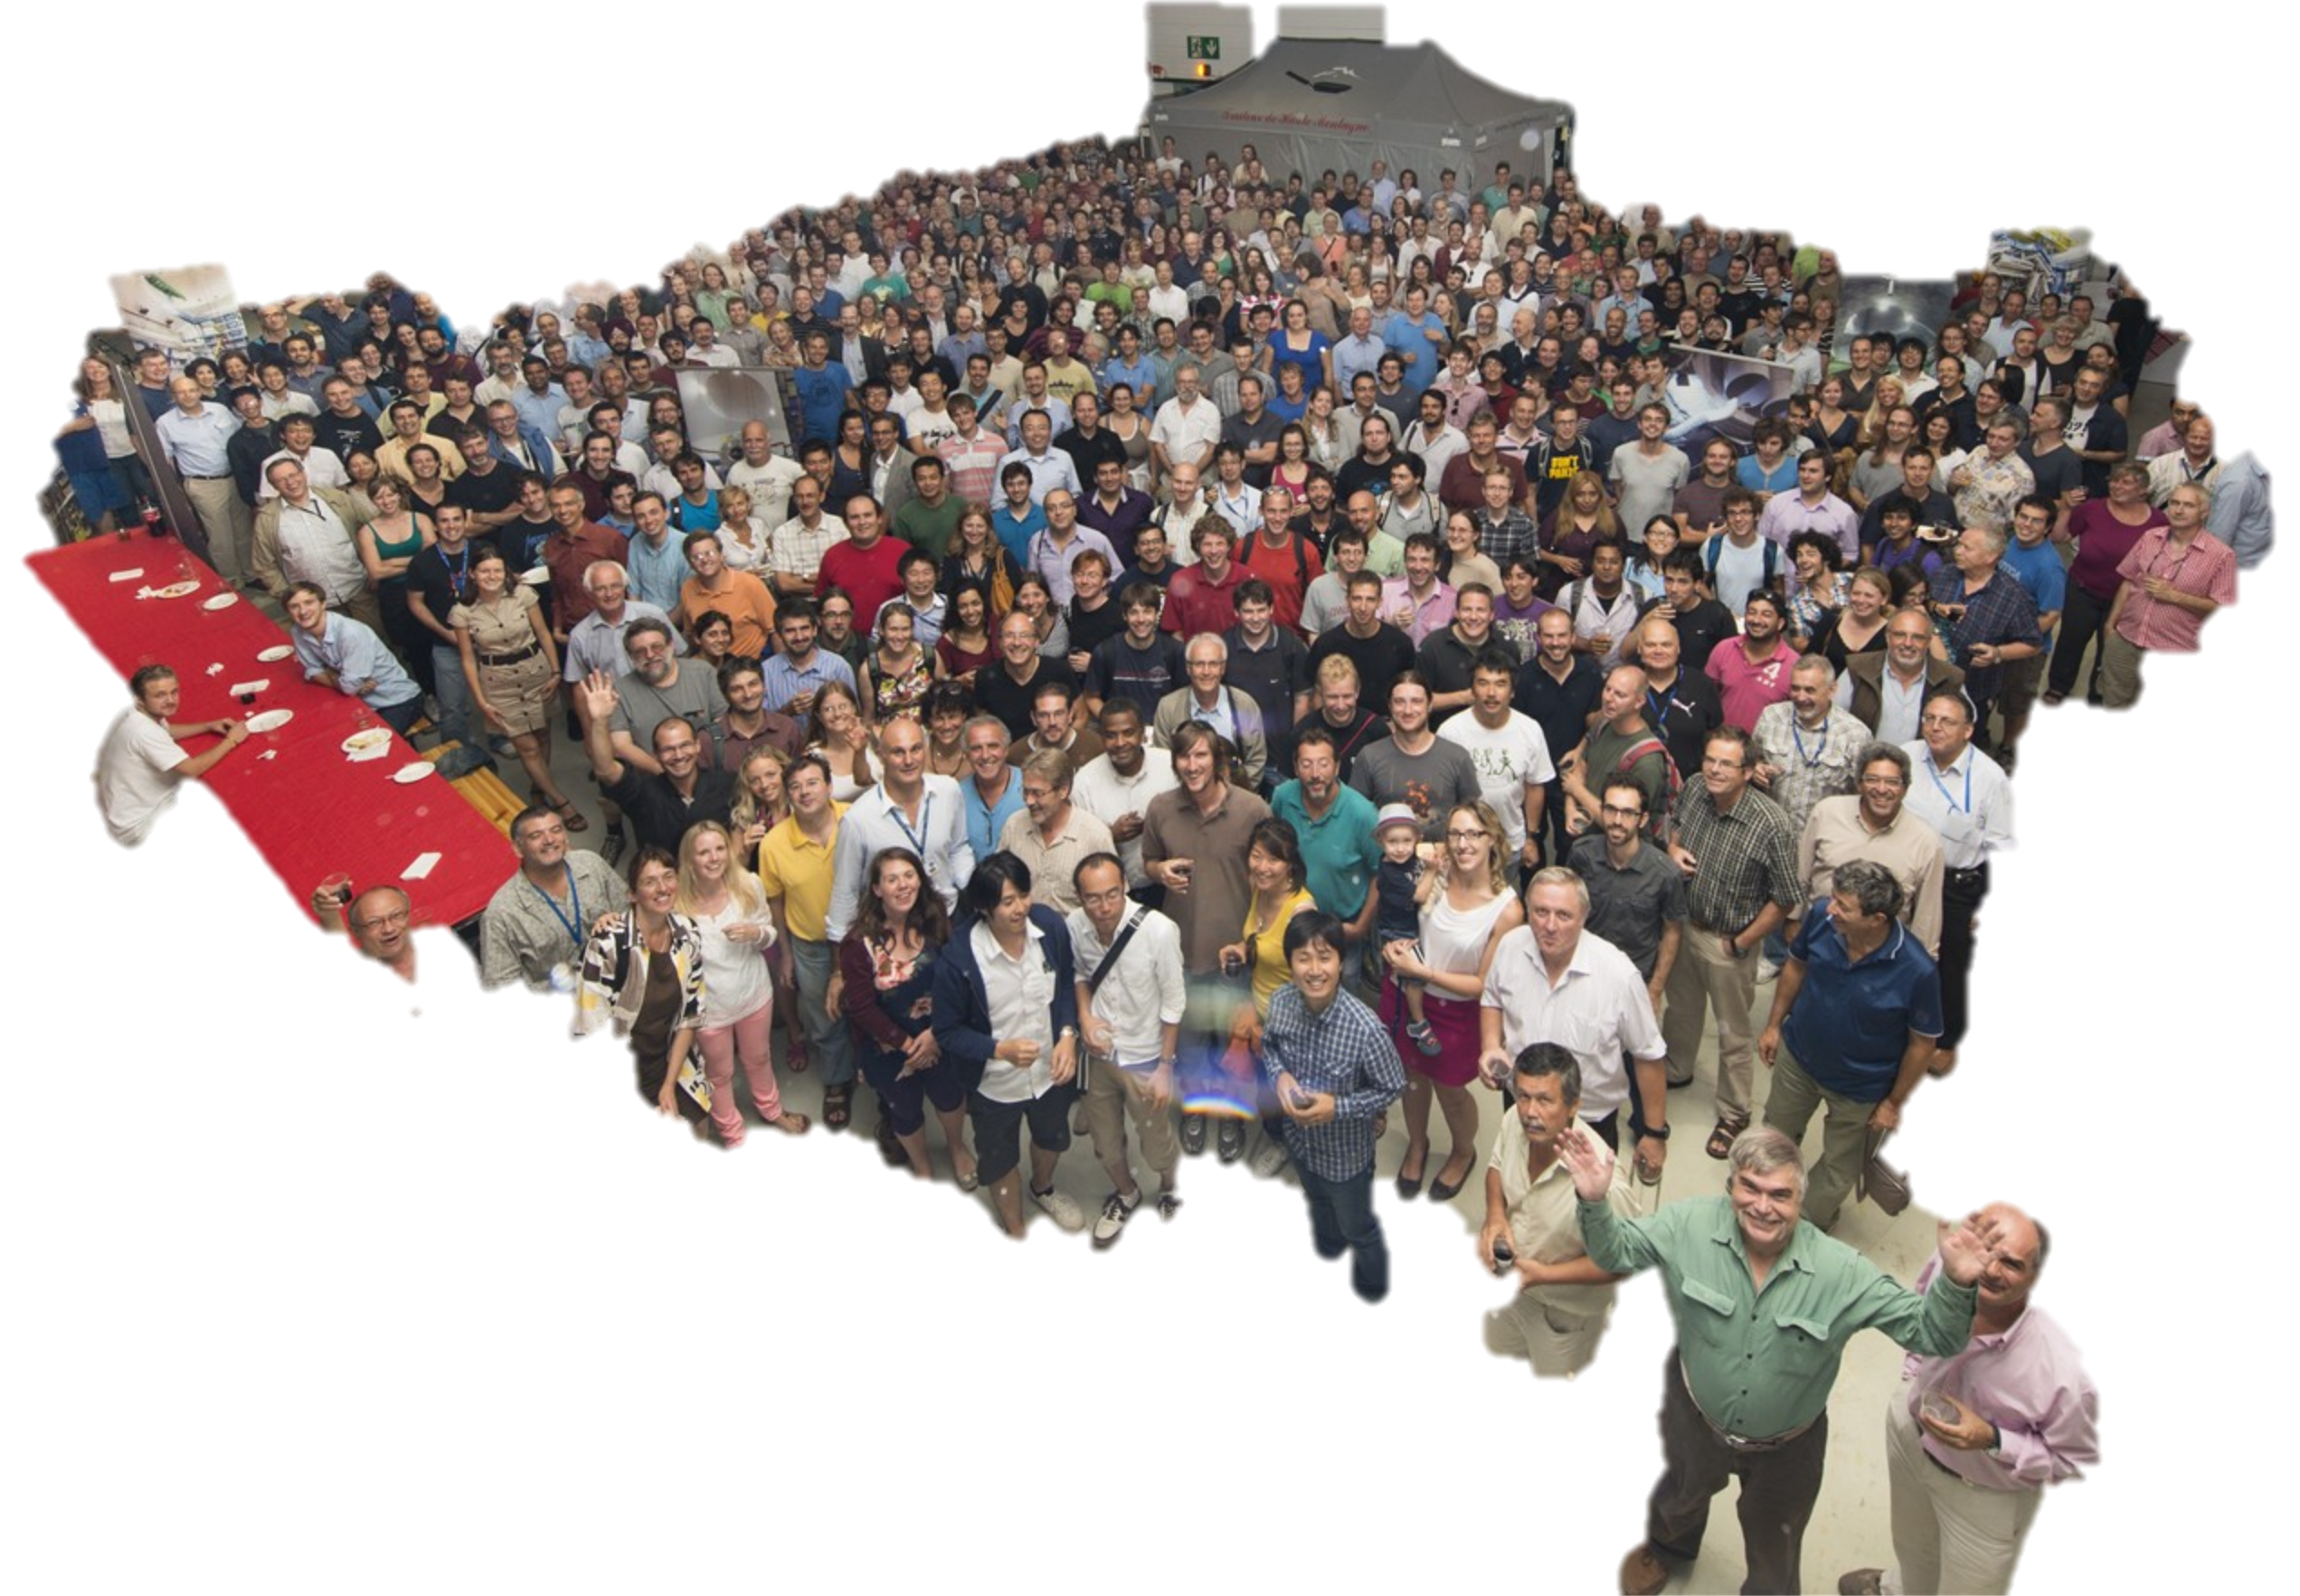
Notes:
3000 physicists and engineers including 1000 postgraduate students

Slide 5
Muon Spectrometer: |η| < 2.7
Air-core toroid + gas-based muon chambers
σ/p_{T} = 2% @ 50GeV to 10% @ 1TeV (ID+MS)
EM calorimeter: |η| < 2.5 (3.2)
Pb-LAr accordion sampling
σ/E = 10%/√E ⊕ 0.7%
L = 44 m, ∅ ≈ 25 m
7000 tonnes
≈10⁸ electronic channels
2-level trigger reducing 40 MHz collision rate to 1 kHz of events to tape
Hadronic calorimeter:
Fe/scintillator / Cu/W-LAr
σ/E_{jet}= 50%/√E ⊕ 3%
Solenoid: B = 2 T
Inner Tracker: |η| < 2.5
Si pixels/strips and Trans. Rad. Det.
σ/p_{T} = 0.05% p_{T} (GeV) ⊕ 1%
Notes:
Parts of the experiment → LIP contributed to the TileCal

Slide 6
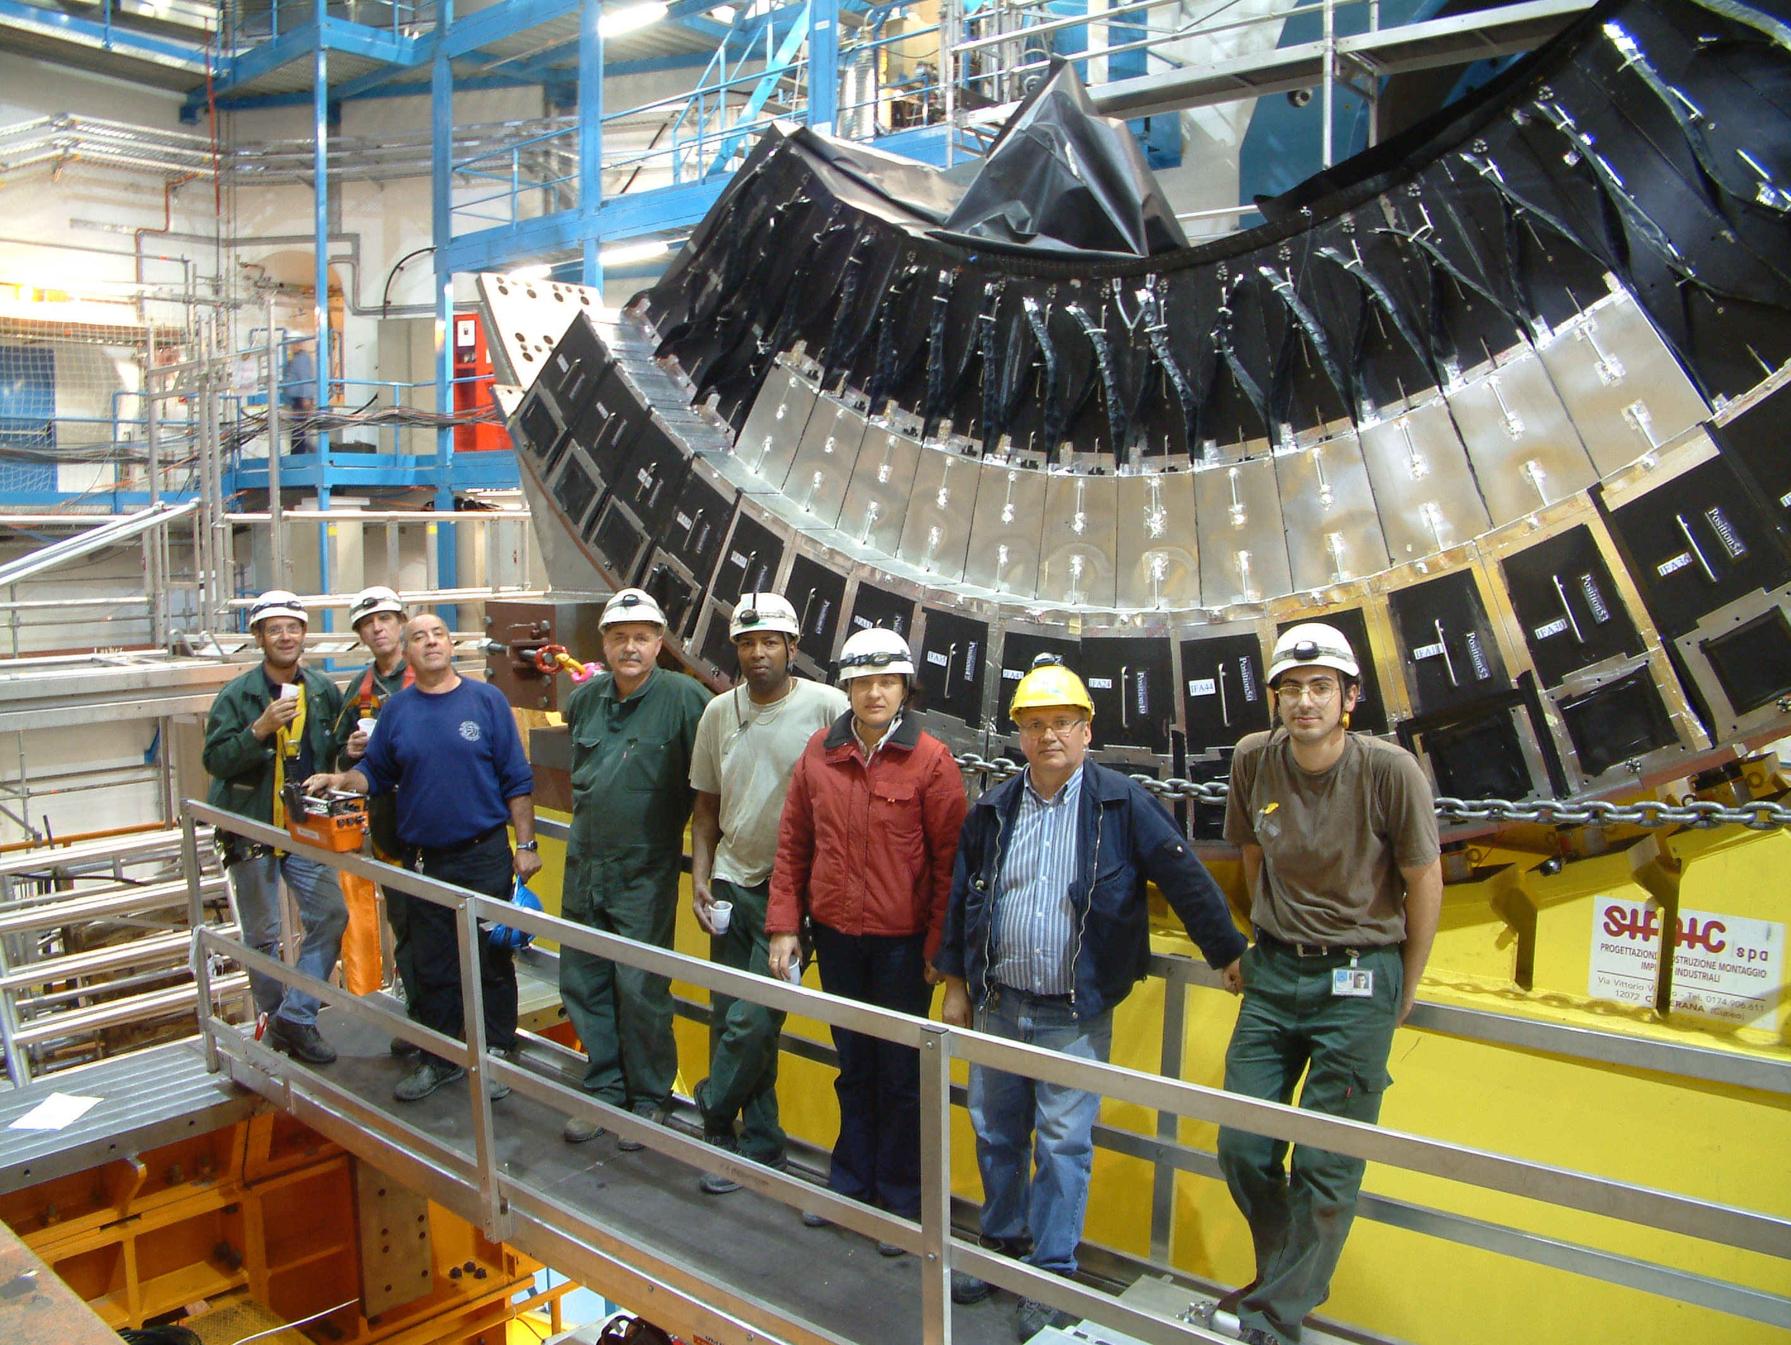
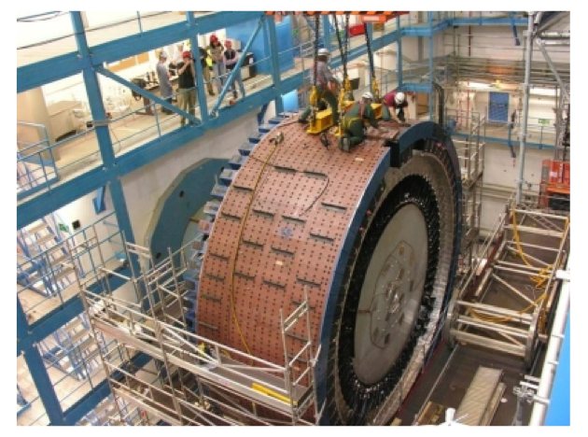
Notes:
LIP made an important contribution to the TileCal

Slide 7
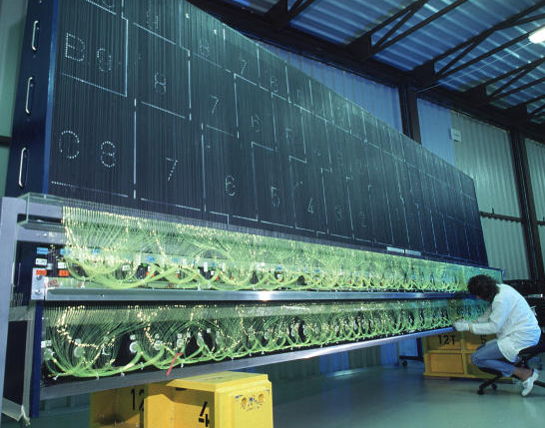
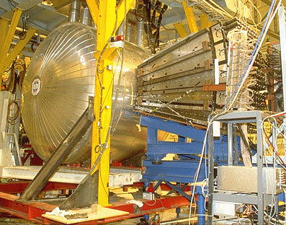
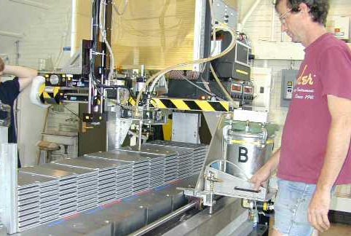
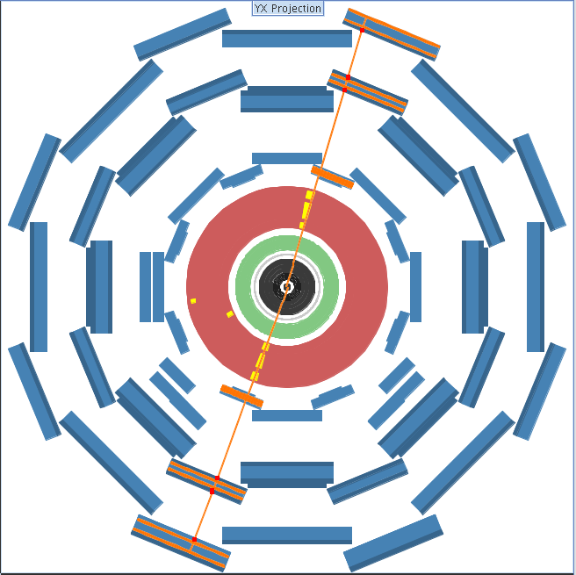
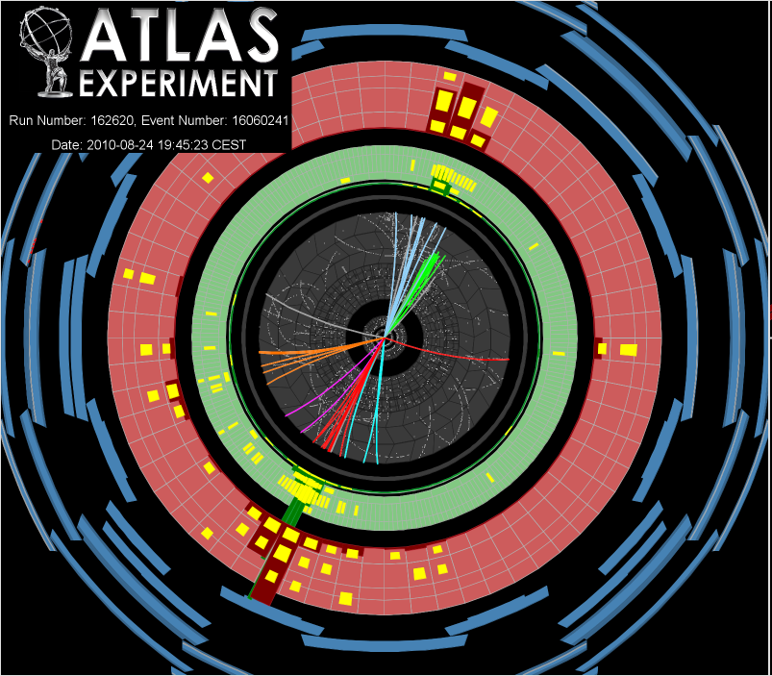
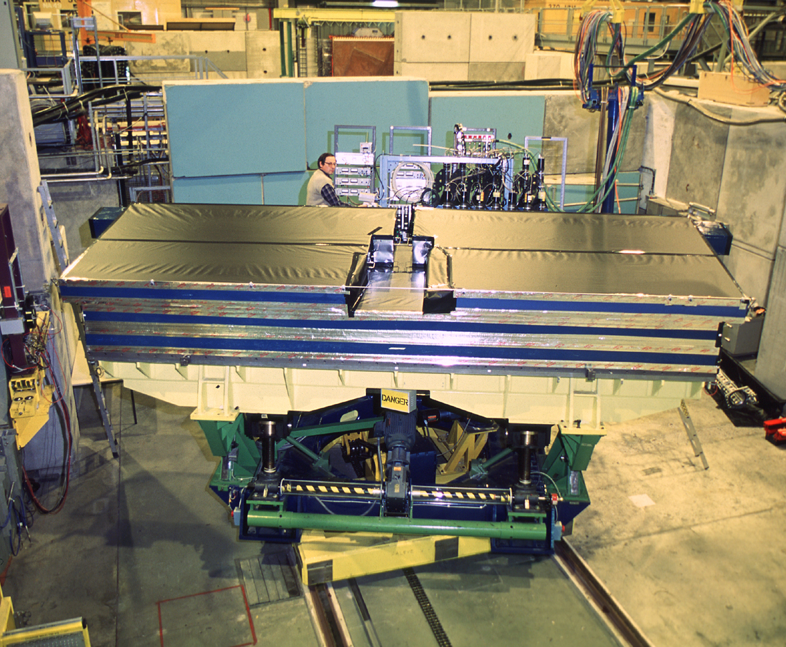
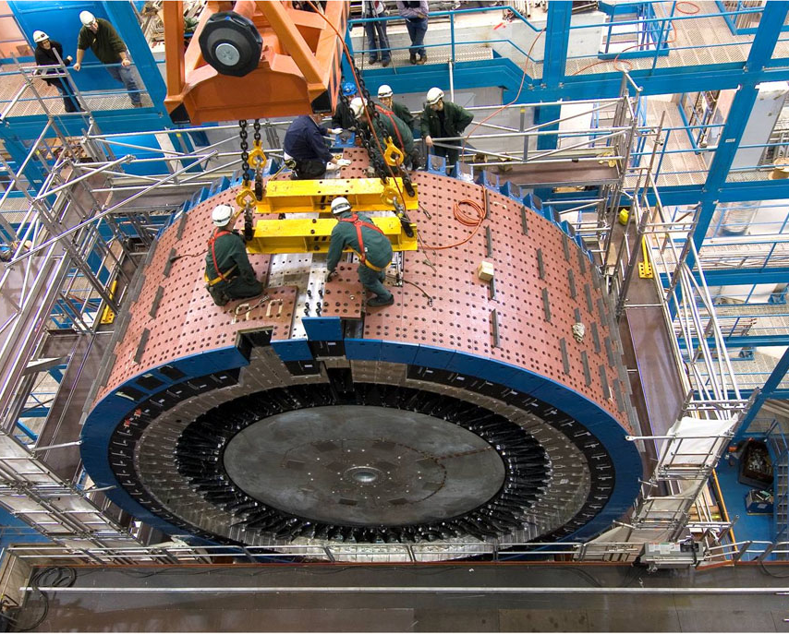
Etapas do projecto Tilecal (1993-2009)
1993-1995 R&D-protótipos
1996-2002:construção
1999-2002 Instrumentação
1999-2004: Electrónica
2002-2004: calibrações
2004-2006 Instalação
2007-2009 certificação
(raios cósmicos)
2009--→: aquisição/análise dados LHC
Notes:
Phases of the project

Slide 8
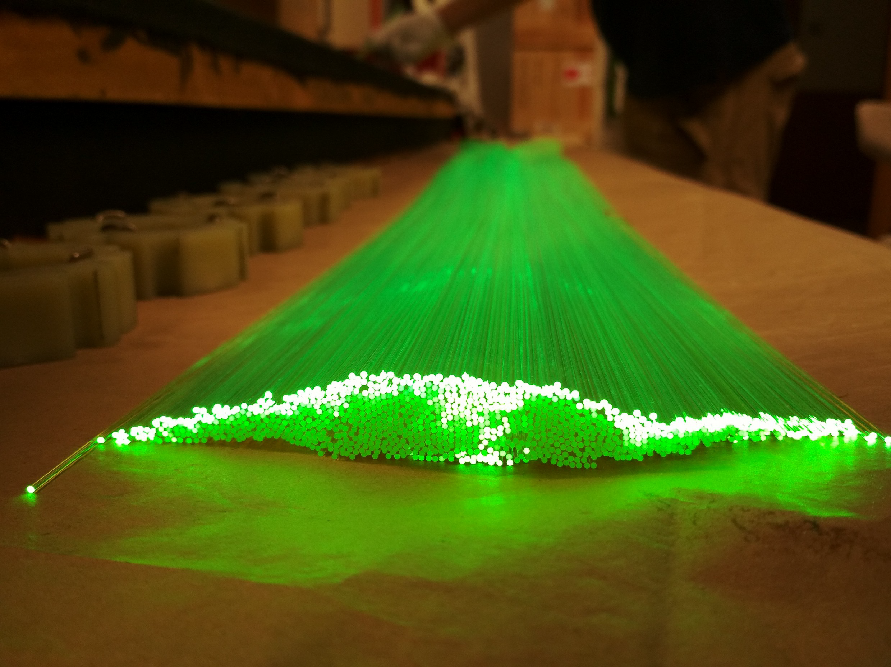
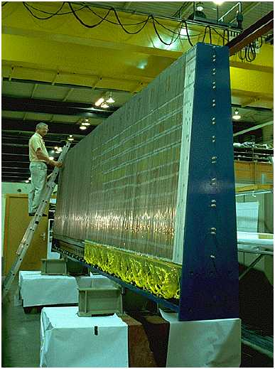
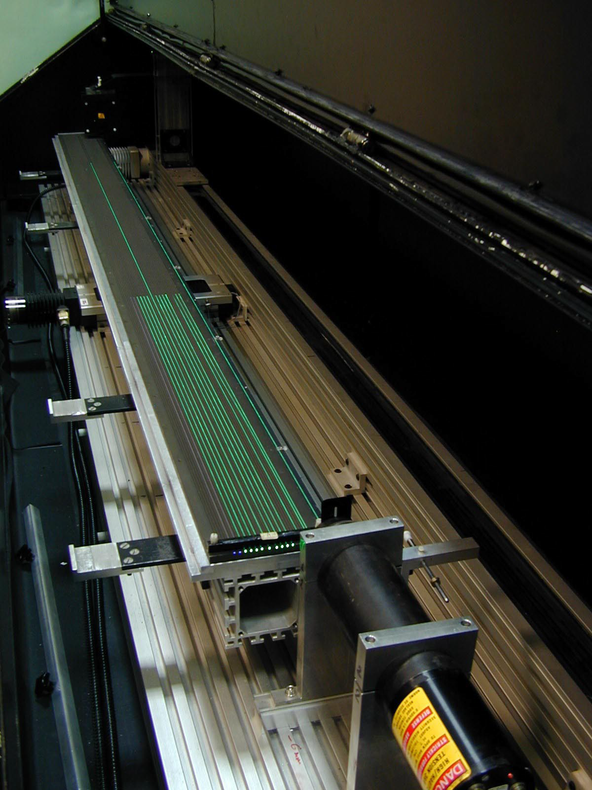
Notes:
Wavelength fibres which take light from scintillators to PMTs and adapt wavelength → made at LIP
Quality control instrument: fibres tested at LIP
One Tile module

Slide 9
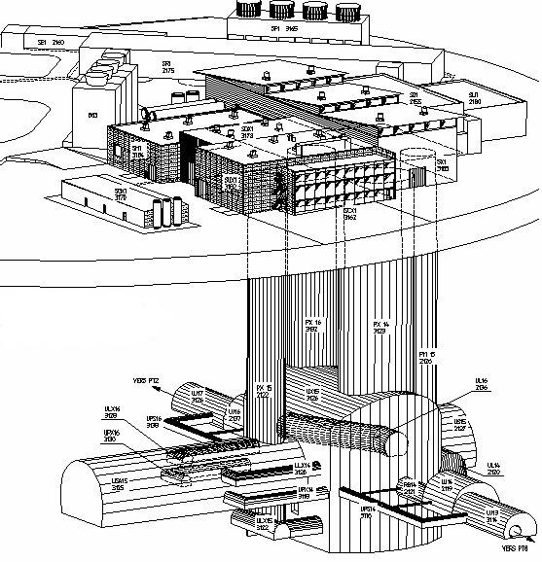

SDX1
dual-CPU nodes
Trigger / DAQ architecture
CERN
computer
centre
6
~1600
~100
~ 500
Event rate
~ 200 Hz
Local
Storage
SubFarm
Outputs
(SFOs)
Event
Filter
(EF)
Event
Builder
SubFarm
Inputs
(SFIs)
LVL2
farm
Second-
level
trigger
Data
storage
pROS
SDX1
DataFlow
Manager
Network
switches
stores
LVL2
output
Network switches
LVL2
Super-
visor
Gigabit Ethernet
Event data requests
Delete commands
Event data
pulled:
partial events
@ ≤ 100 kHz,
full events
@ ~ 3 kHz
Requested event data
USA15
Regions Of Interest
USA15
Data of events accepted
by first-level trigger
~150
PCs
1600
Read-
Out
Links
UX15
VME
Dedicated links
Read-Out
Subsystems
(ROSs)
Read-
Out
Drivers
(RODs)
RoI
Builder
First-
level
trigger
Timing Trigger Control (TTC)
Event data pushed @ ≤ 100 kHz,
1600 fragments of ~ 1 kByte each
Notes:
Other important contribution over last 10 years: trigger

Slide 10
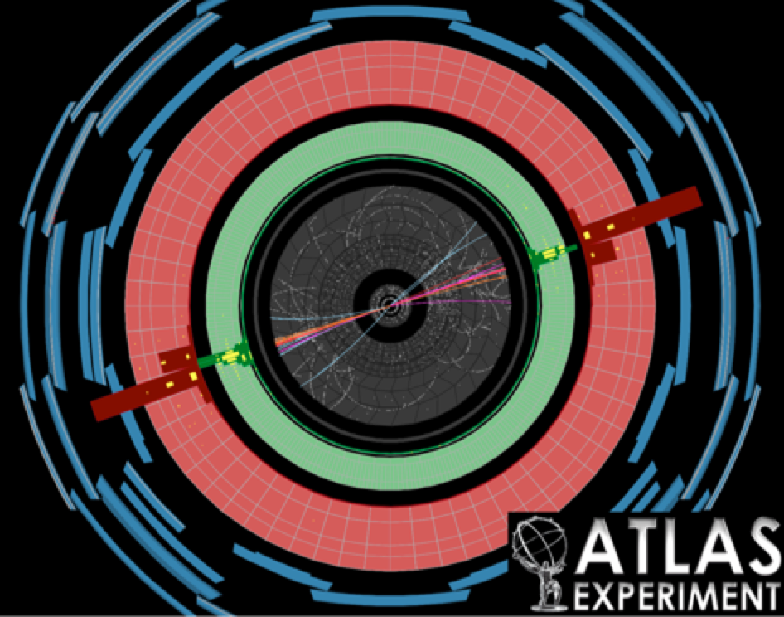
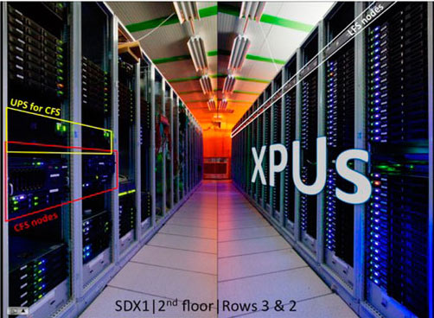
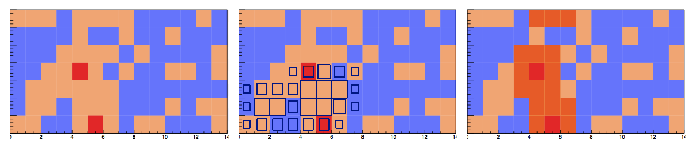
Notes:
Main area: jet trigger
GPU-based clustering for the upgrade

Slide 11
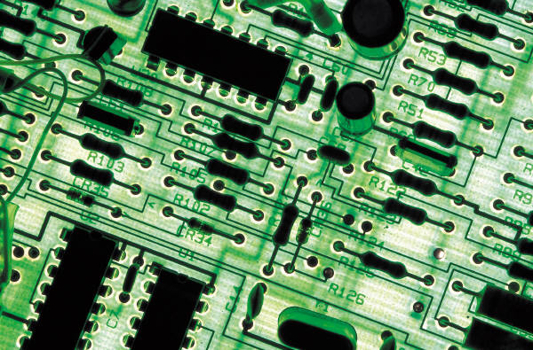
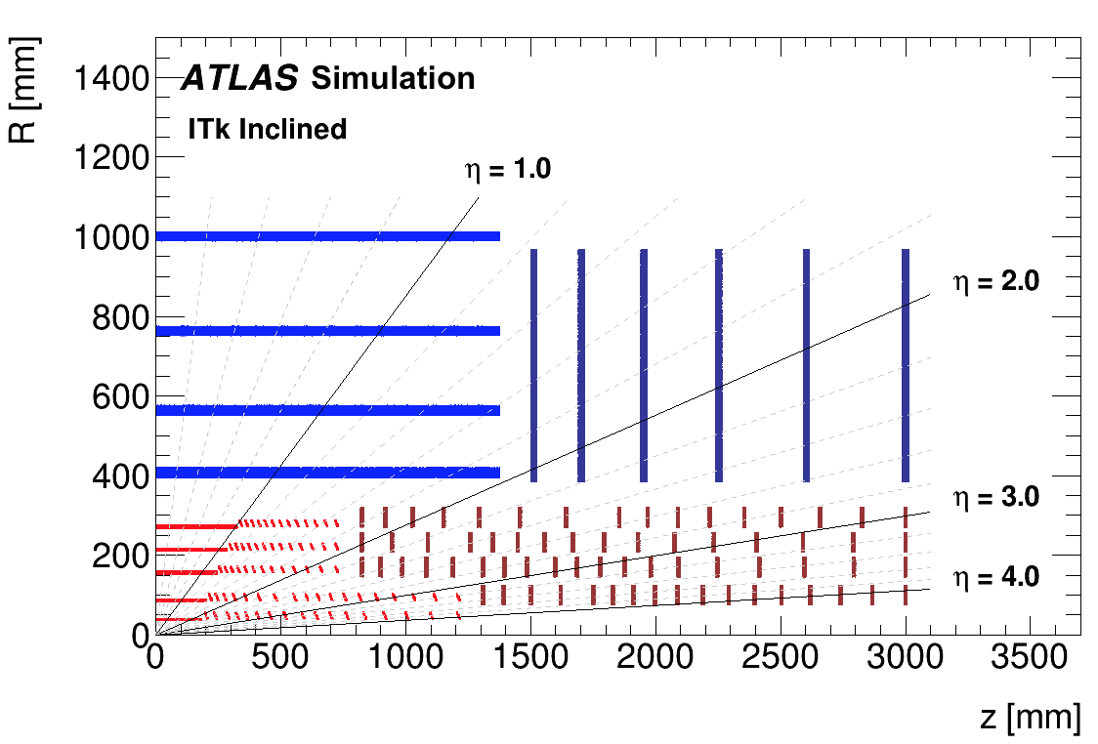
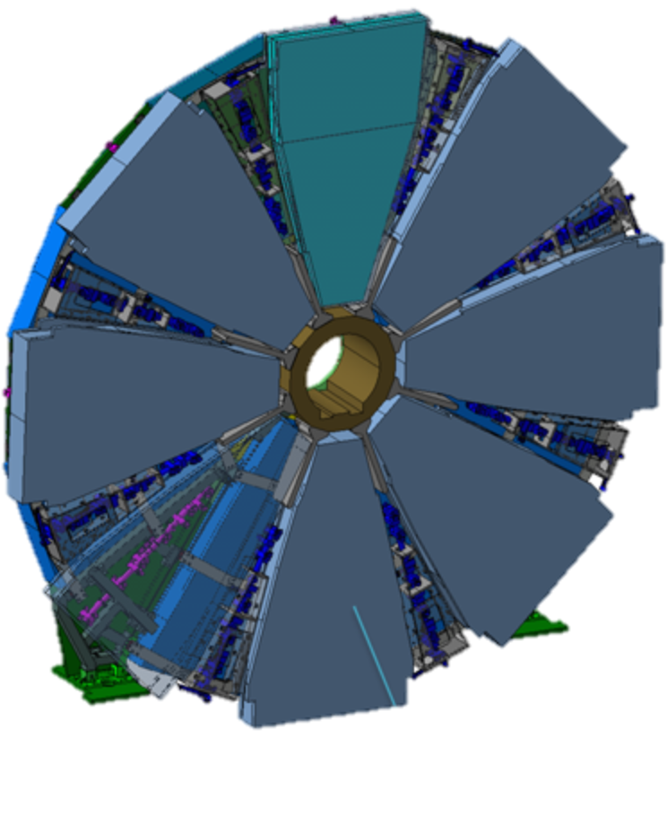
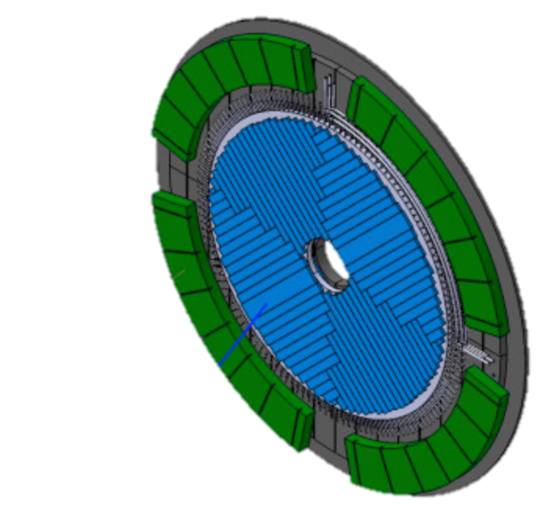
New tracking detector
Calorimeter: new DAQ electronics, HV sources and gap scintillators
New muon detector “Small Wheel”
New dedicated hardware tracking co-processor for trigger
High Granualrity Timing Detector
(30ps/track)
R. Gonçalo - LIP
Ciência 2018
11
Notes:
UPGRADE: (LIP areas in red)
Add spacial granularity to separate close tracks and add tracking solid angle (b-tagging, vertex ident. Etc)
Add timing information to reject pileup: need O(mm) resolution => ~O(10ps) ; 30ps = 9mm
Replace damaged detectors with more rad.hard technologies
HGTD radius 120 – 640 mm ; • Completely replace Inner Detector with all-silicon

Slide 12
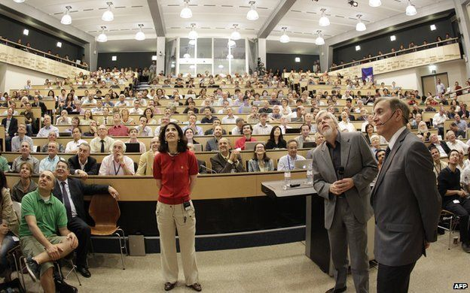
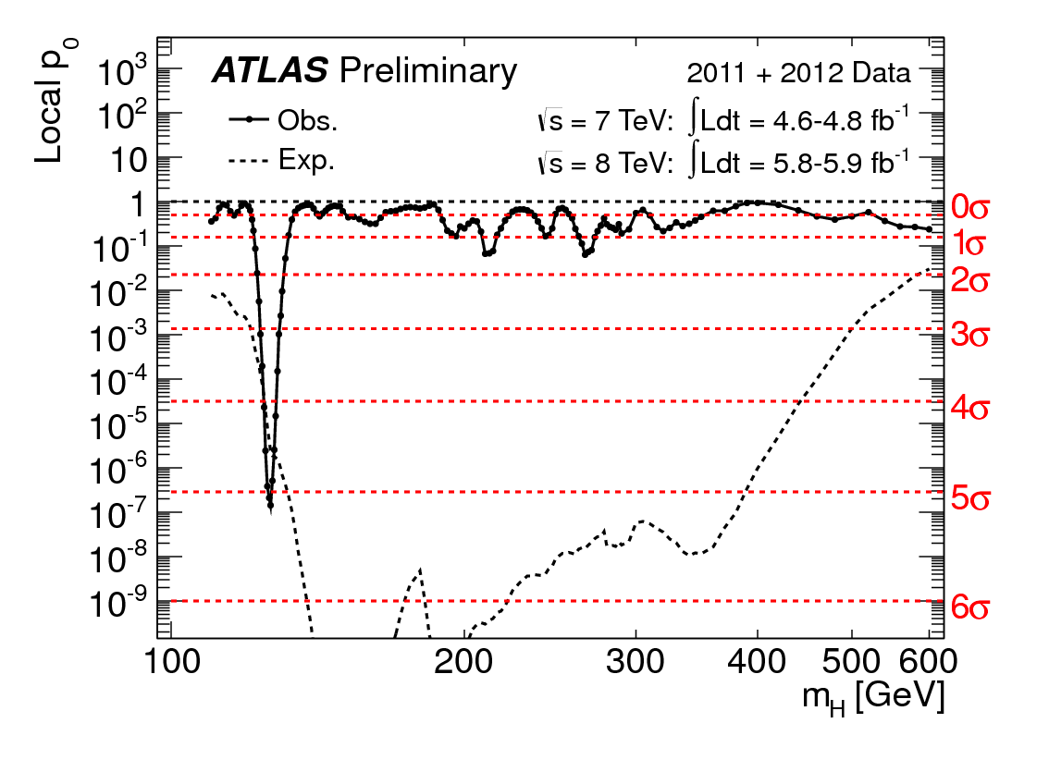
The Run 1 legacy
Notes:
Now Higgs physics: the discovery announced to the world
Helena will talk about Heavy Ions next

Slide 13
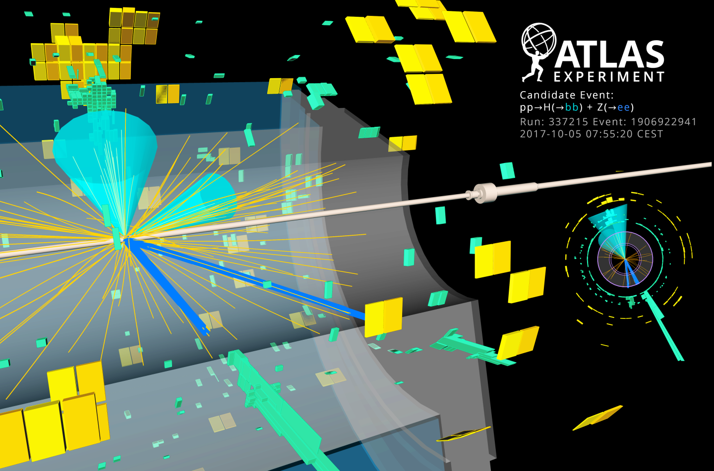

Higgs decay to b-quarks
9 July 2018
Notes:
VH channel with H→ bb observed last year after many years searching → one of LIP’s involvements

Slide 14
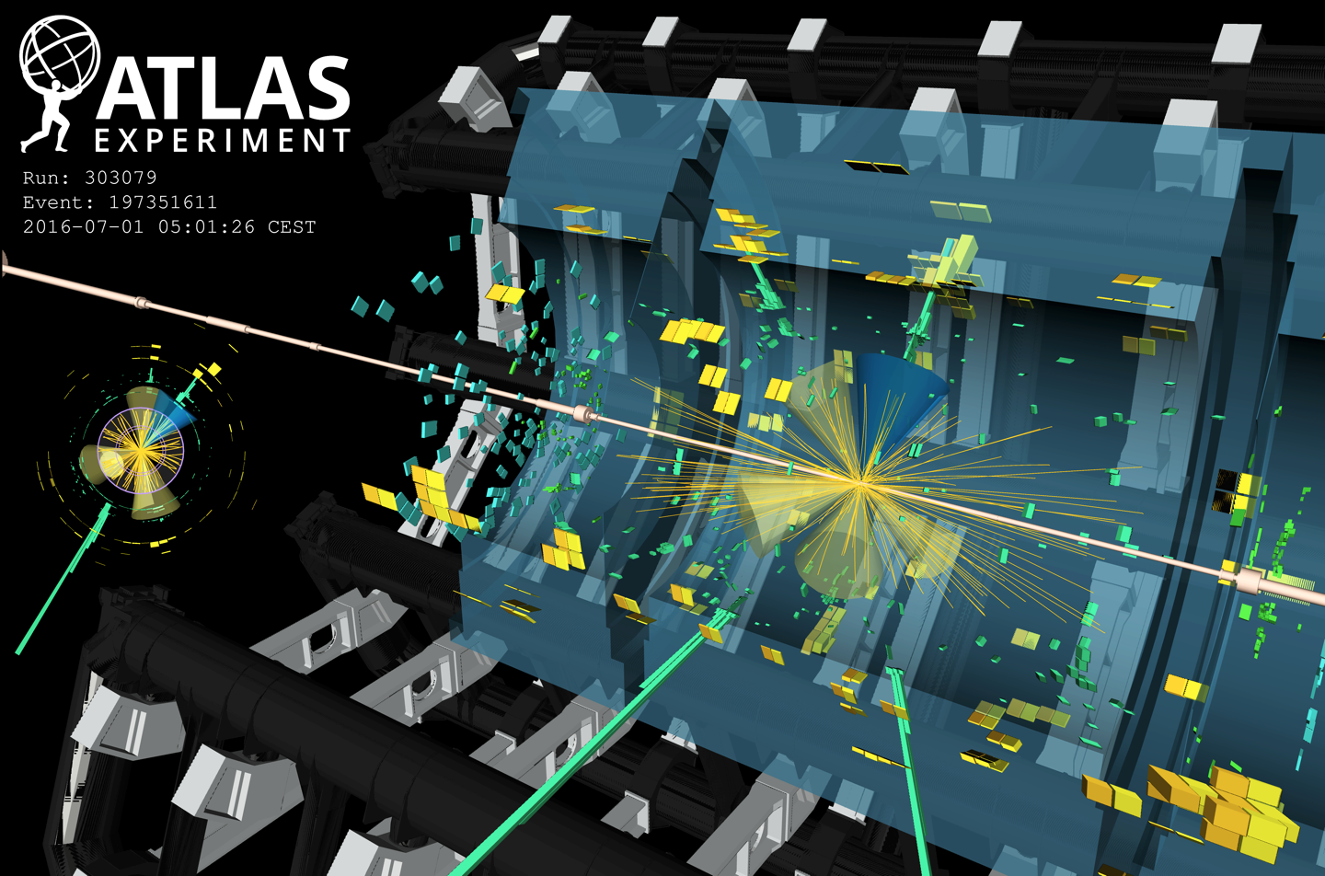
Higgs production with top quarks
Notes:
The other Higgs area at LIP: ttH observed last year
http://atlas.web.cern.ch/Atlas/GROUPS/PHYSICS/PAPERS/HIGG-2018-13/
data event from the tt̄H(γγ) Had BDT bin with the largest signal over background ratio. The event contains two photon candidates, with a diphoton mass of 125.4 GeV. In addition, six jets are reconstructed using the anti-k_{t} algorithm and R=0.4, including one jet that is b-tagged using a 77% efficiency working point. The photons correspond to the green towers in the electromagnetic calorimeter, while the jets (b-jets) are shown as yellow (blue) cones.

Slide 15

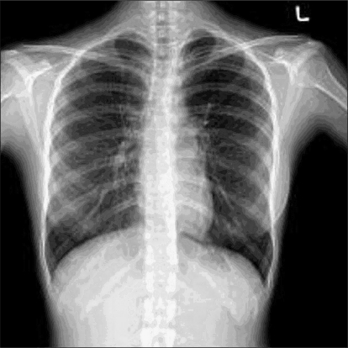

Probing the 125 GeV Higgs
2HDM
Triple coupling λ₃
Clavicle
Aorta
Ribs
Yukawa
couplings
BSM
Notes:
Now they can be used as tools to probe the Higgs

Slide 16
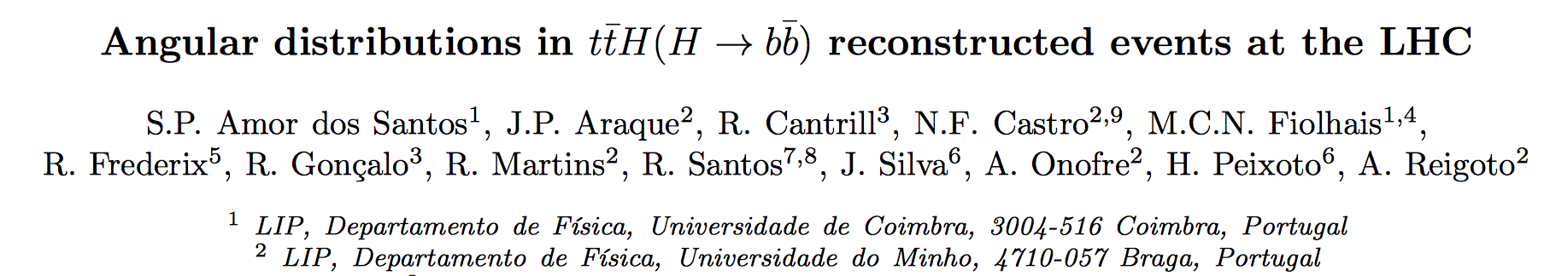
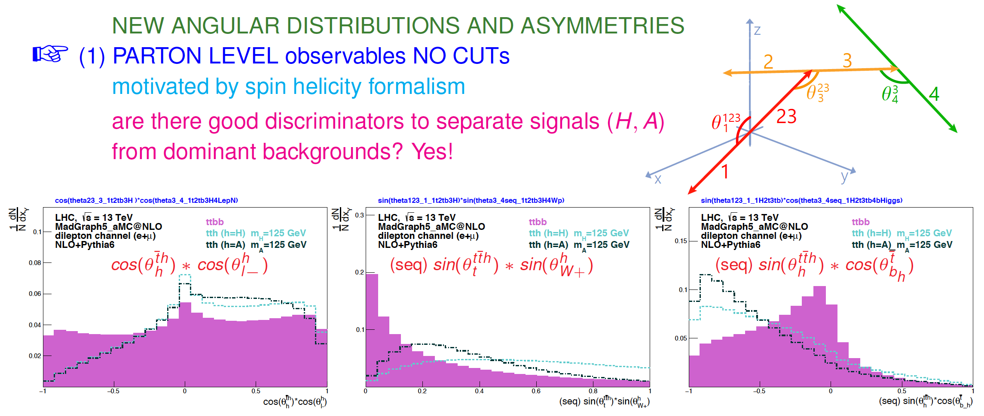
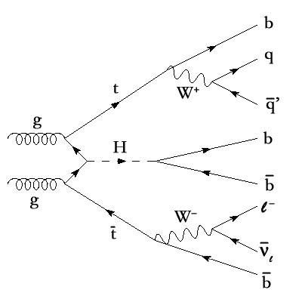
Phys. Rev. D 96, 013004 (2017)
Notes:
Example for the near future: find if CP quantum numbers hold surprise → using a method proposed by us

Slide 17
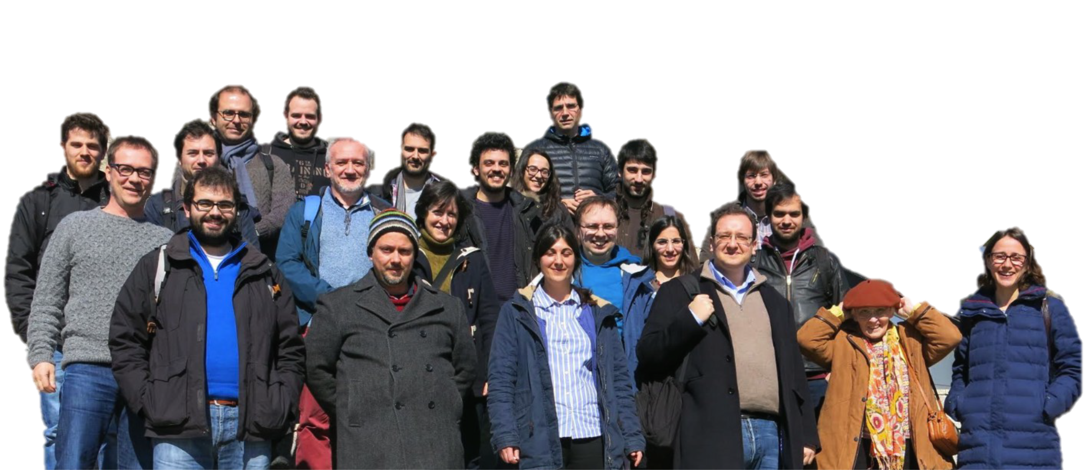
https://www.lip.pt/atlas/ atlasinfo@lip.pt
Notes:
More info at...

Slide 18
