Slide 1
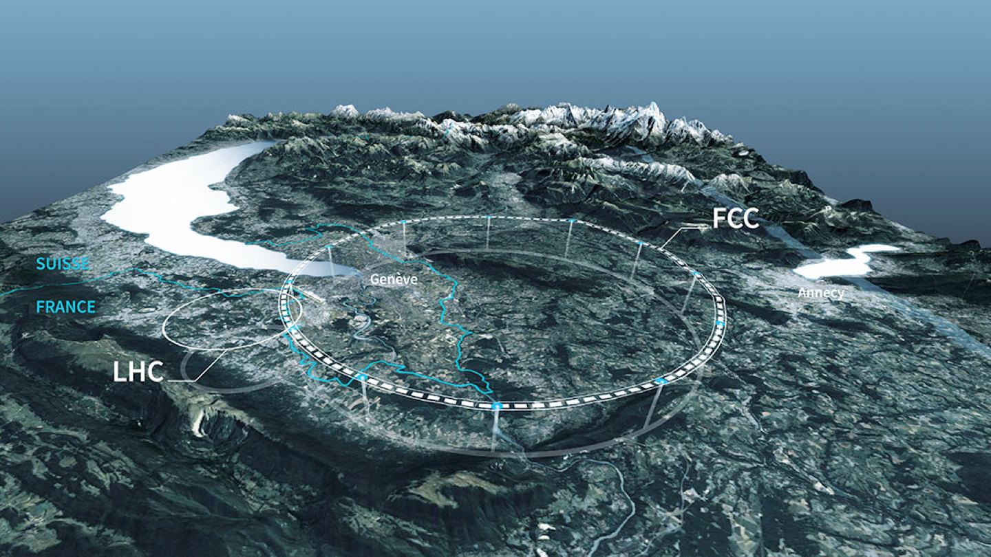




FCC @ LIP
R

Slide 2
The FCC Feasibility Study
International study for FCC “Conceptual Design” as part of European Strategy discussion
  Comprehensive study of physics case and enabling technologies
  1350 contributors from 370 institutes, including LIP
Mainly two accelerators using the same tunnel:
  FCC-ee: 90, 240 to 350 GeV e+e- collider
  FCC-hh: 100 TeV p-p and ion collider
  80 - 100 km perimeter tunnel!
Evolved to “FCC Feasibility Study” approved by CERN Council to conclude in 2025

Slide 3
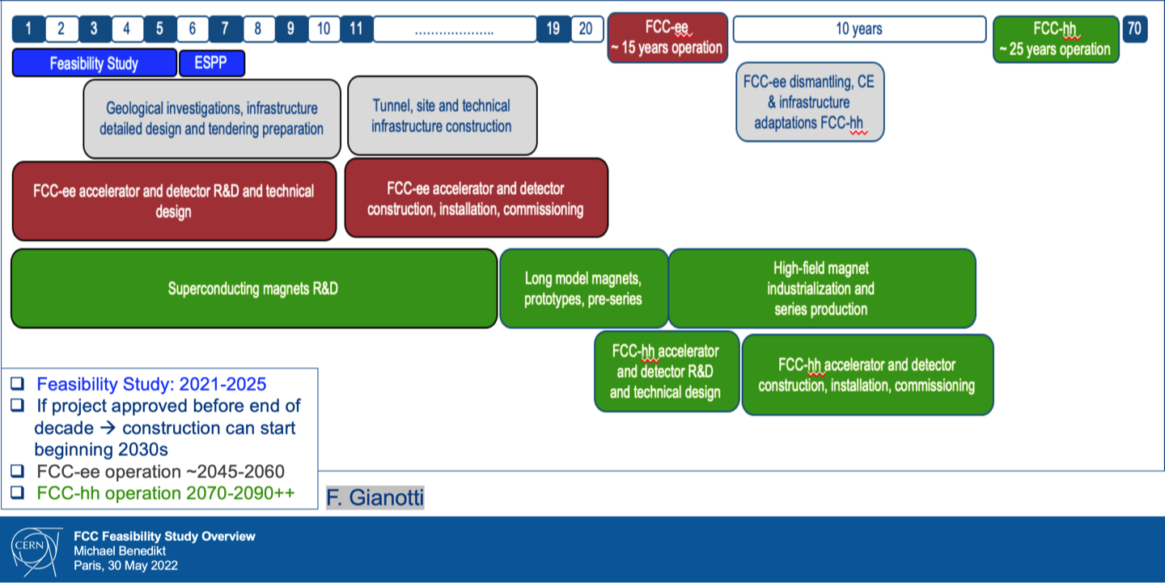
Future Circular Collider
a

Slide 4
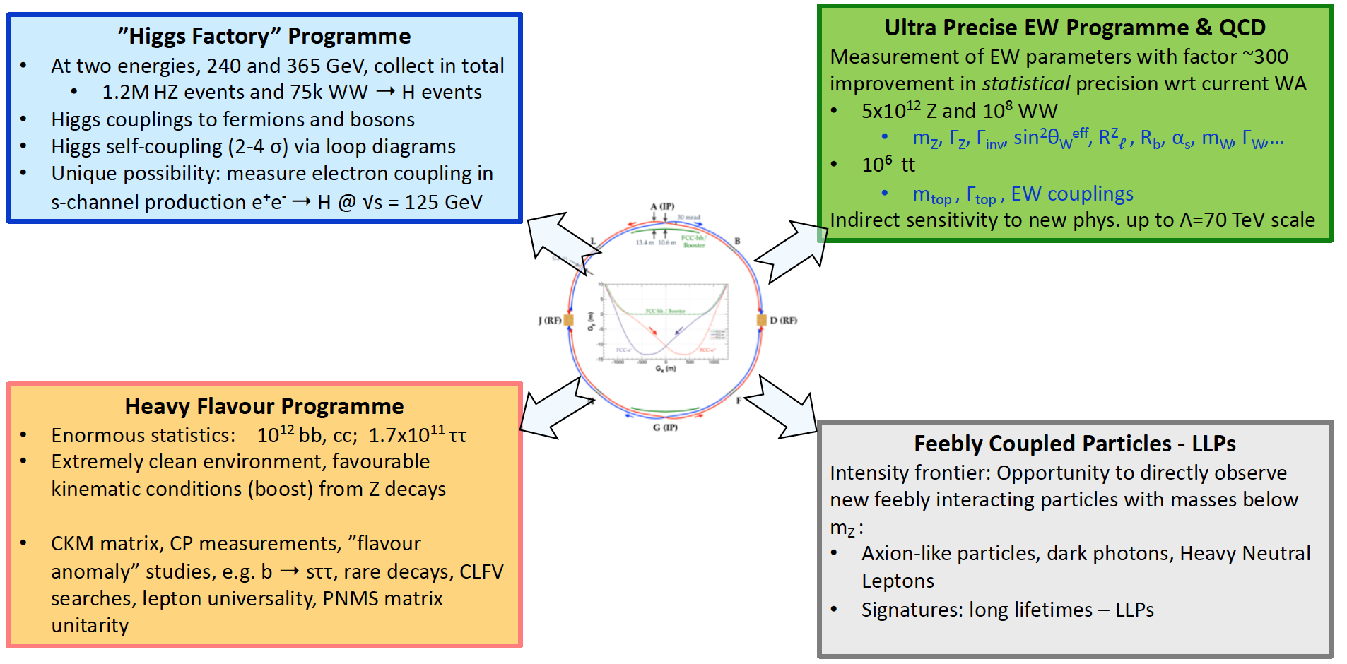
FCC-ee Physics Landscape
Mogens Dam, CERN EP&RD Days, Jun 2022

Slide 5
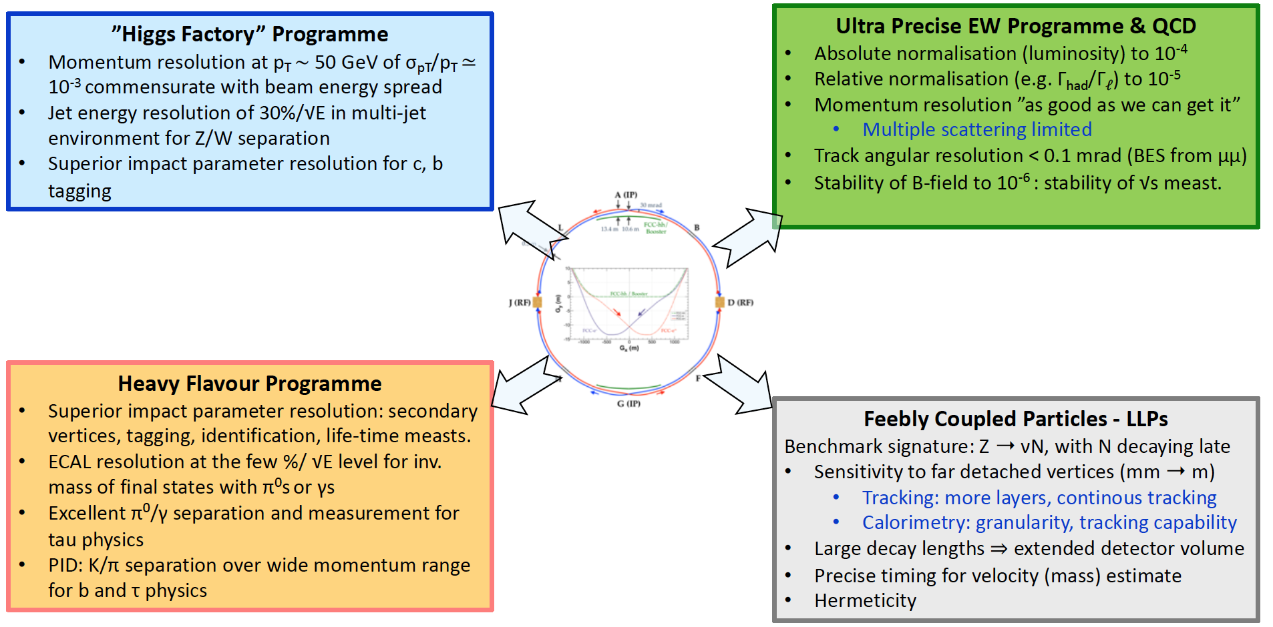
Detector Requirements
Mogens Dam, CERN EP&RD Days, Jun 2022

Slide 6
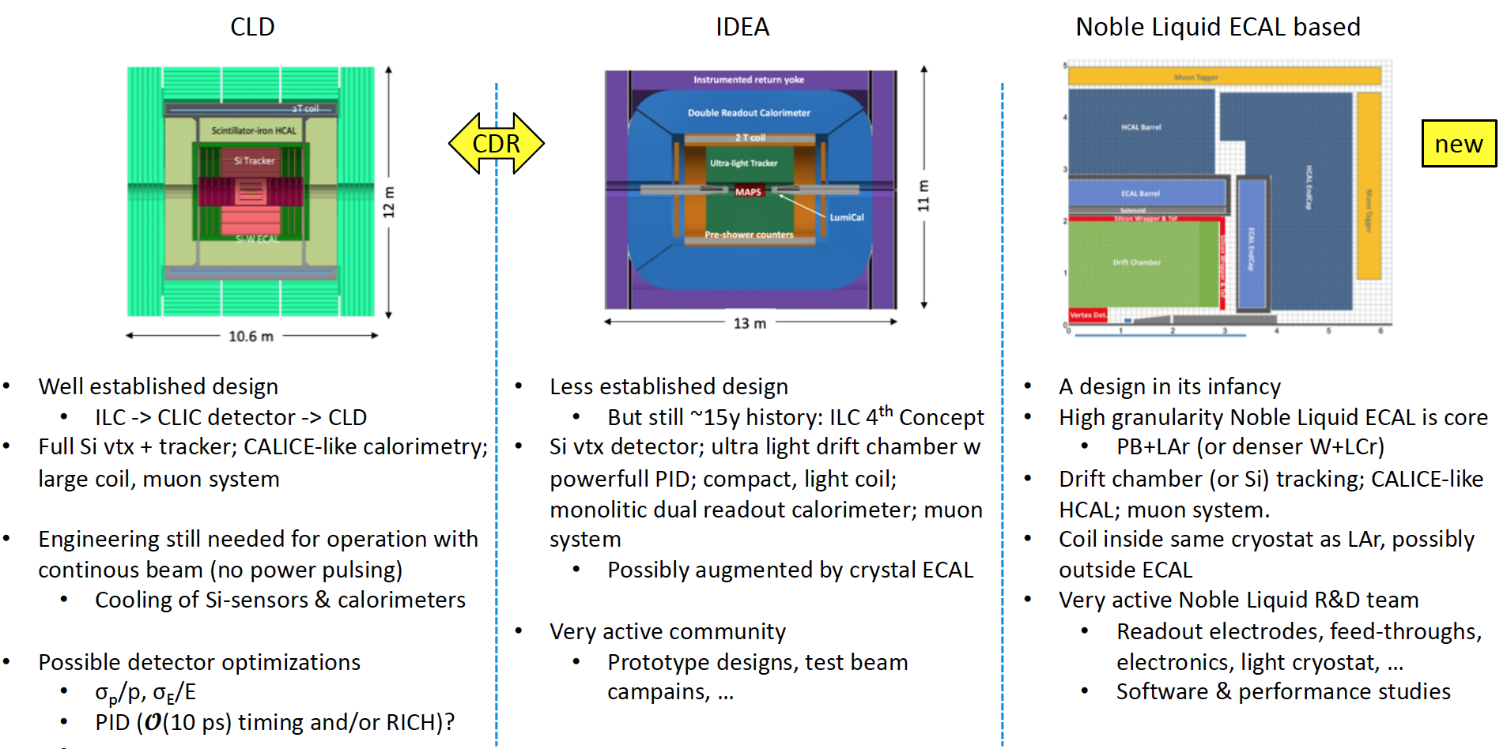
Detector Concepts
Mogens Dam, CERN EP&RD Days, Jun 2022

Slide 7
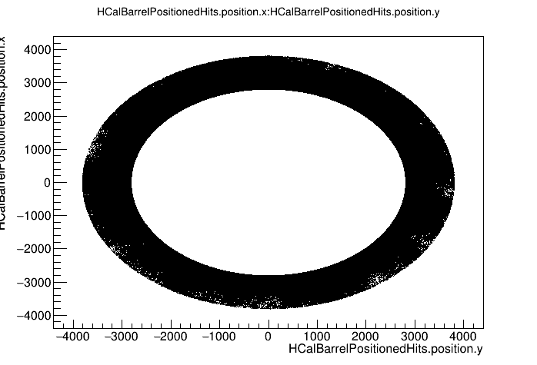
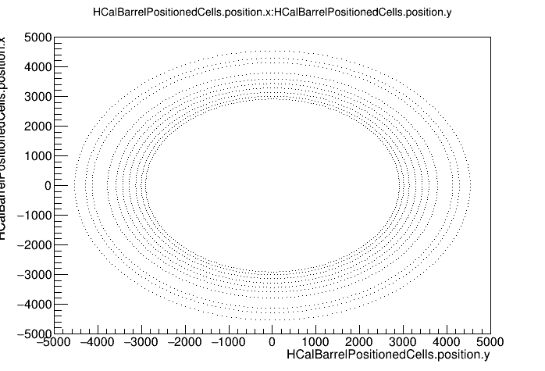
@LIP: Performance Studies for FCC-ee HCal
Requirements for the precision goals
  High granularity
  Good energy resolution
The HCal is composed of
  10 readout layers in R
  Steel, lead and scintillator plates
We have started simulation of a scintillator tile sampling calorimeter with a particle gun of
  20 GeV charged pions (Figures)
  20 GeV Muons
  45 GeV electrons

Slide 8
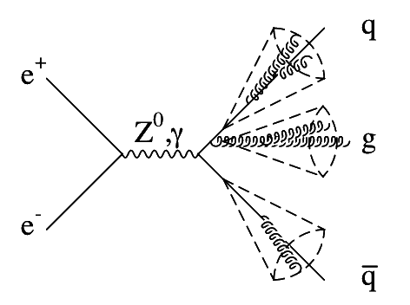
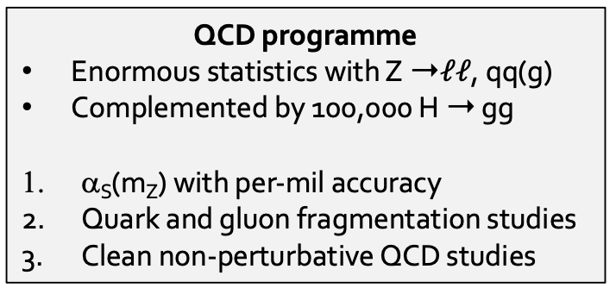


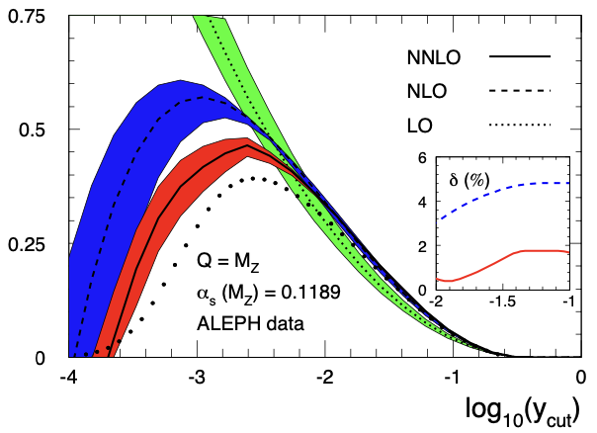
@LIP: QCD Precision Programme at FCC-ee
Clean environment! No parton distributions functions, hadron remnant, or underlying event!
Theory challenges:
  Extend NNLOJET program to describe e+e- collisions with higher-order perturbative QCD effects
  Calculate e⁺e⁻ → 3 j at N3LO and include massive b-quark effects
  Search for observables with smaller hadronization corrections (e.g., groomed event shapes)
➞
3-jet rate measurement at LEP and ⍺s extraction
Aim one order of magnitude improvement in the precision of ⍺s with FCC-ee

Slide 9
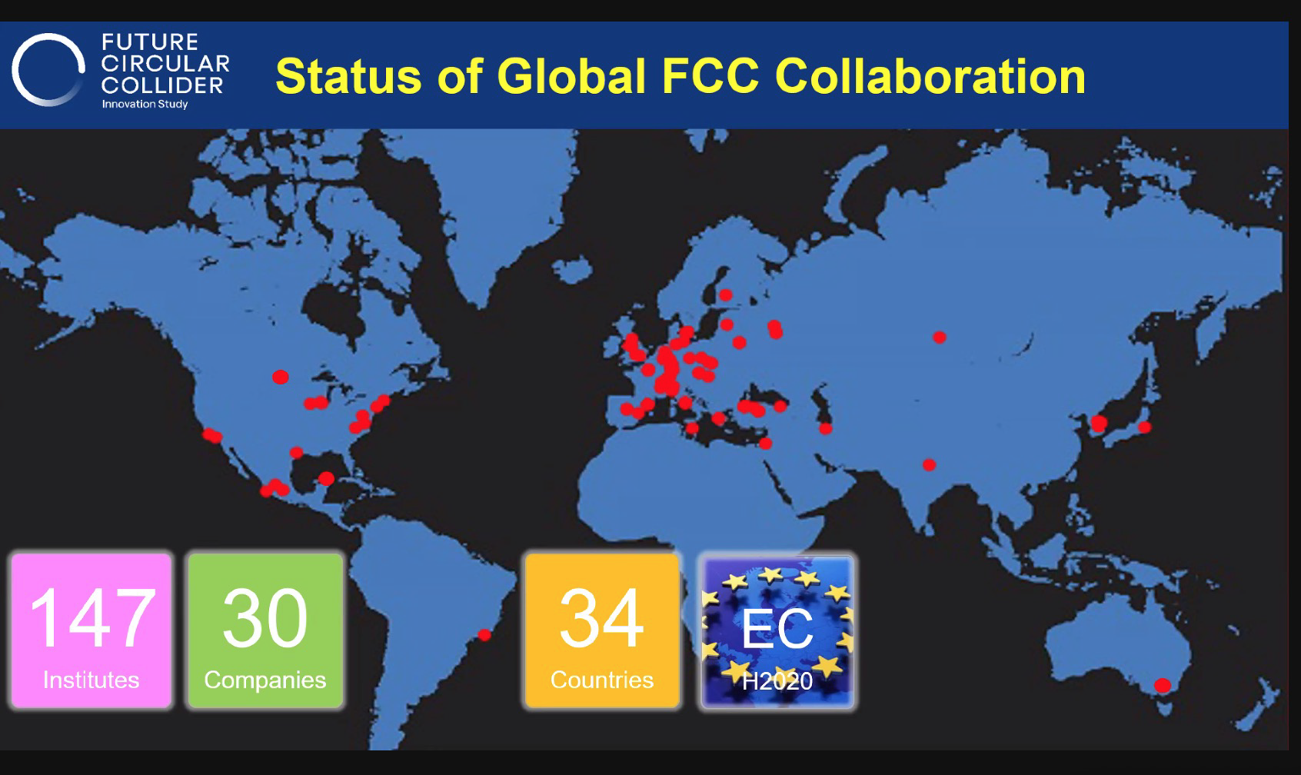
We are now part of the FCC!

Slide 10
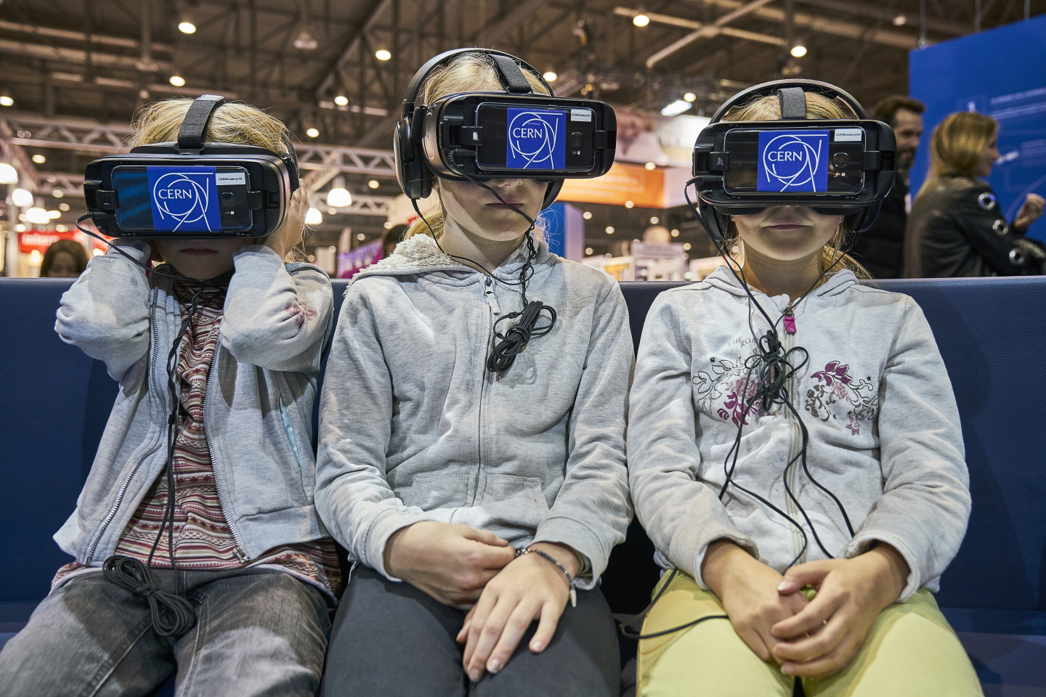


Thank you!
LET’S INSPIRE PEOPLE
Notes:
https://docs.google.com/forms/d/1mYM3yW3vMMPyp9cSqKTQqStZdBoxiNMYR1FkCO48zpI/edit

Slide 11
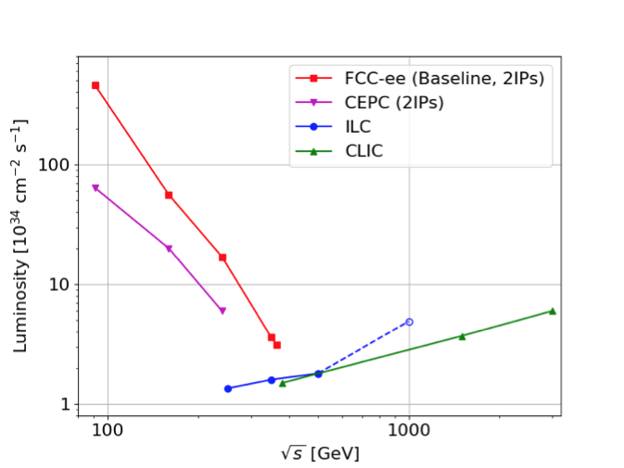

Slide 12
