Slide 1
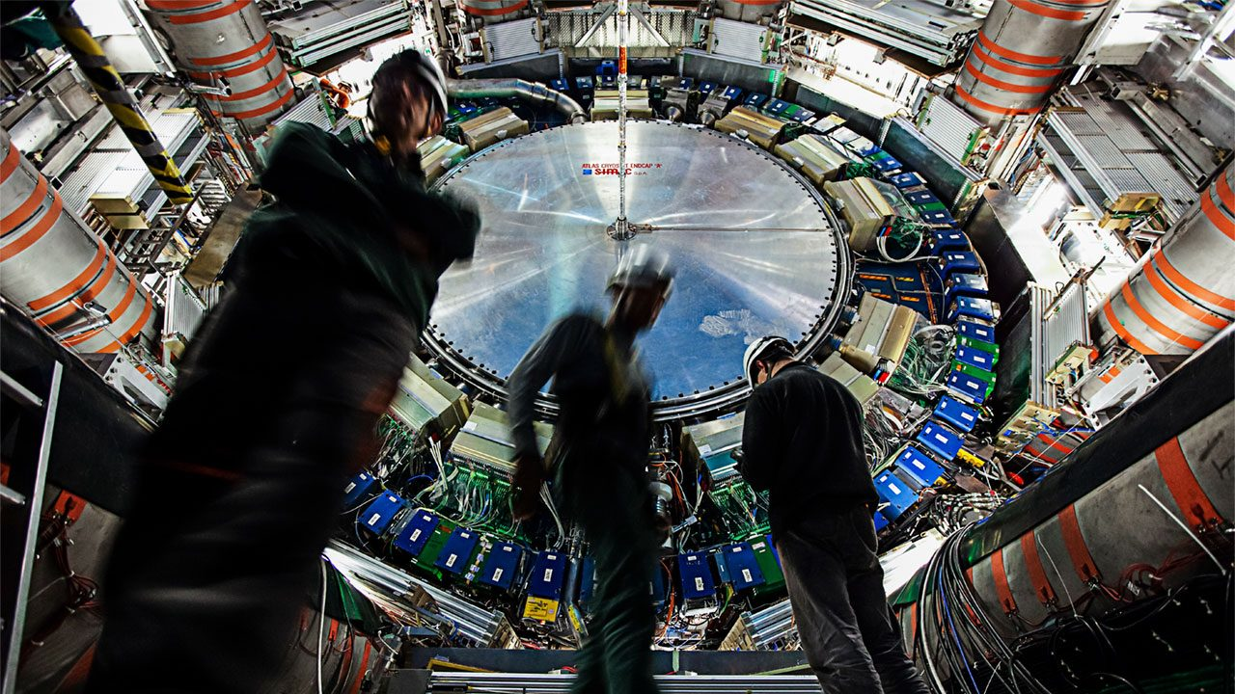





ATLAS Upgrade
Jornadas do LIP
Universidade de Coimbra – 8 July 2022
Ricardo Gonçalo
Universidade de Coimbra / LIP
Notes:
Agradecer o interesse!
E aos alunos por tirarem uma hora para me ouvir falar sobre coisas de que gosto

Slide 2
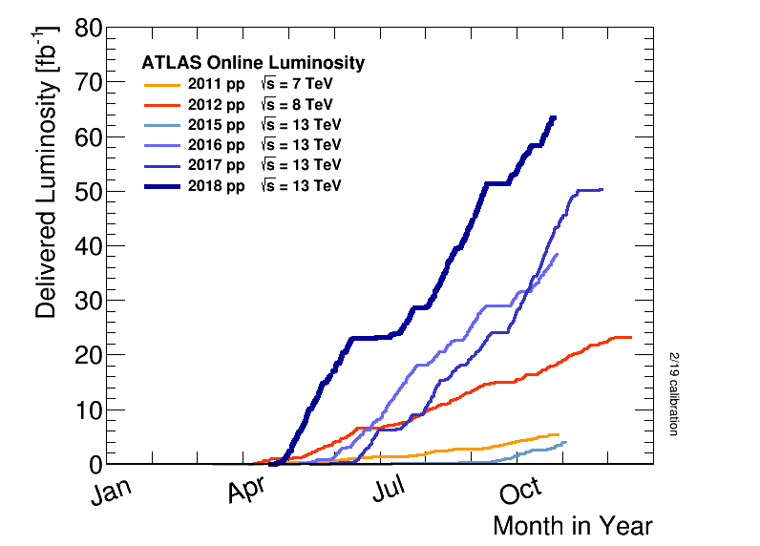
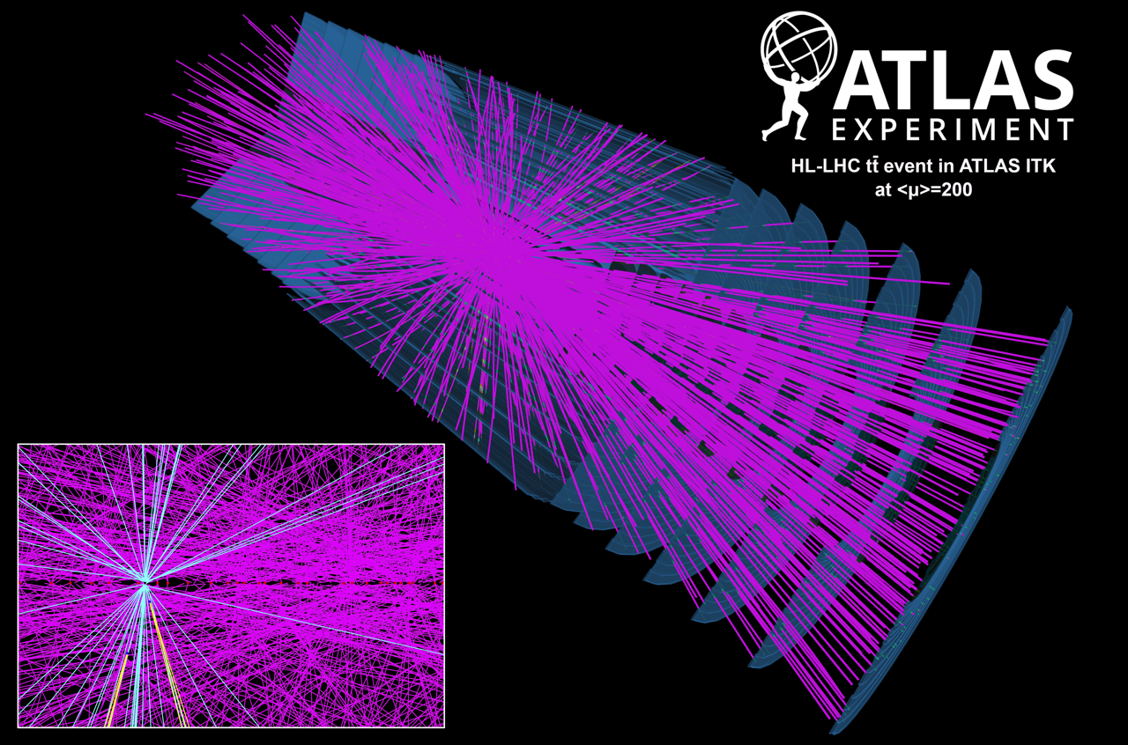
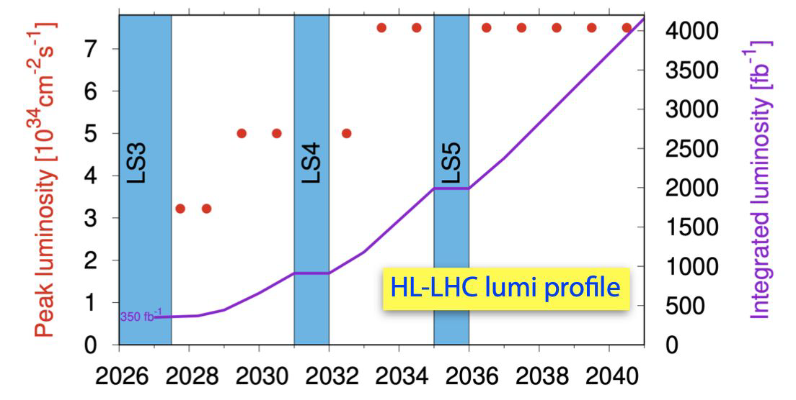
ATLAS Upgrade: Motivation for HL-LHC
High-Luminosity!
  Statistical uncertainty depends on √L
So far collected ≈150 fb⁻¹ of data at √s=7, 8 and 13 TeV
  Less than 5% of final
  Resulted in 1039 published papers
  Goal is to collect up to 4000 fb⁻¹ until end of LHC
=> Increase instantaneous luminosity!
Downside: PILEUP
  Affects experiment performance
  Average ≈30 so far
  Expect up to 200 in HL-LHC
Notes:
Statistical precision depends on sqrt(L)

Slide 3
ATLAS Upgrade: pileup = 200

Slide 4
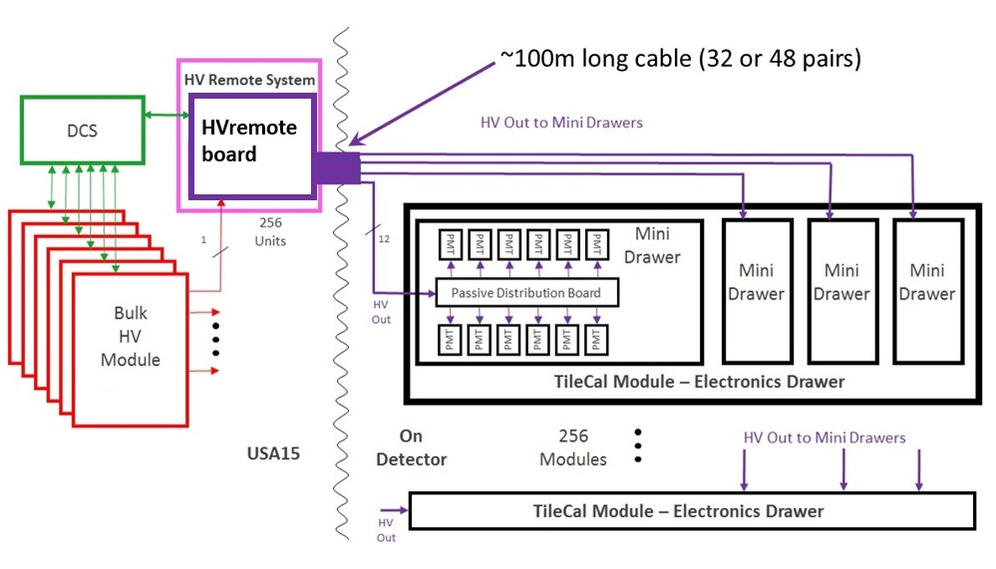

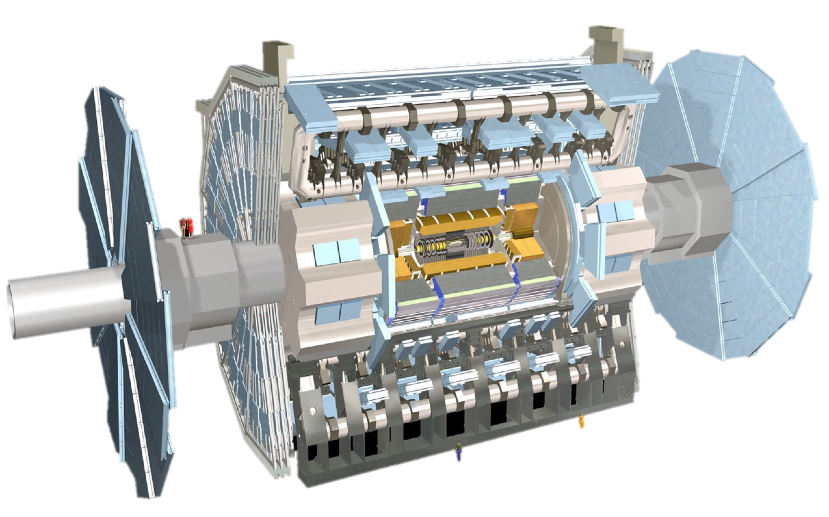
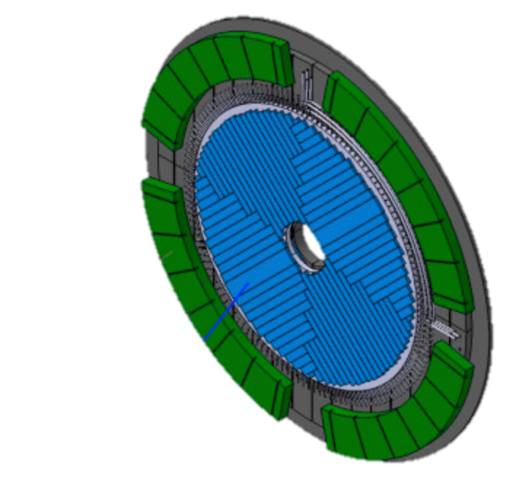
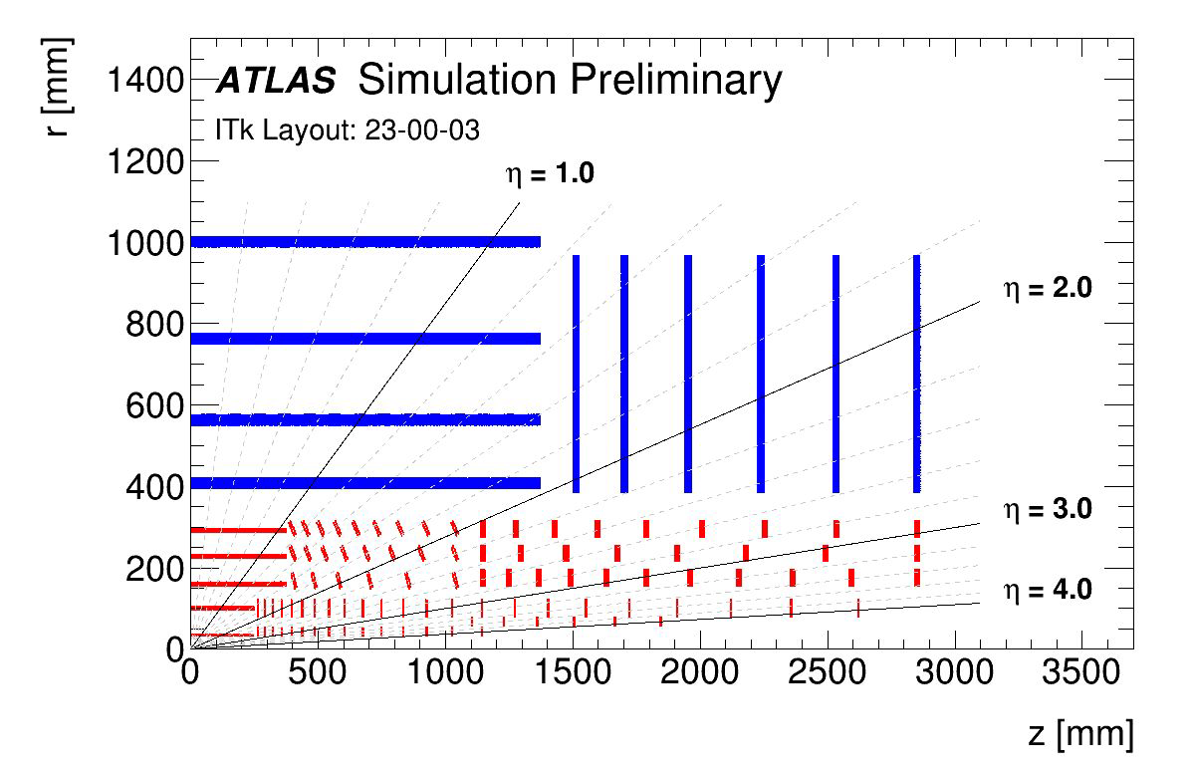
ATLAS Upgrade @ LIP
New Tile Calorimeter High-Voltage system
R&D on hardware acceleration for trigger
High Granularity Timing Detector
(30ps/track)
Track reconstruction for New Inner Tracker (ITk)

Slide 5
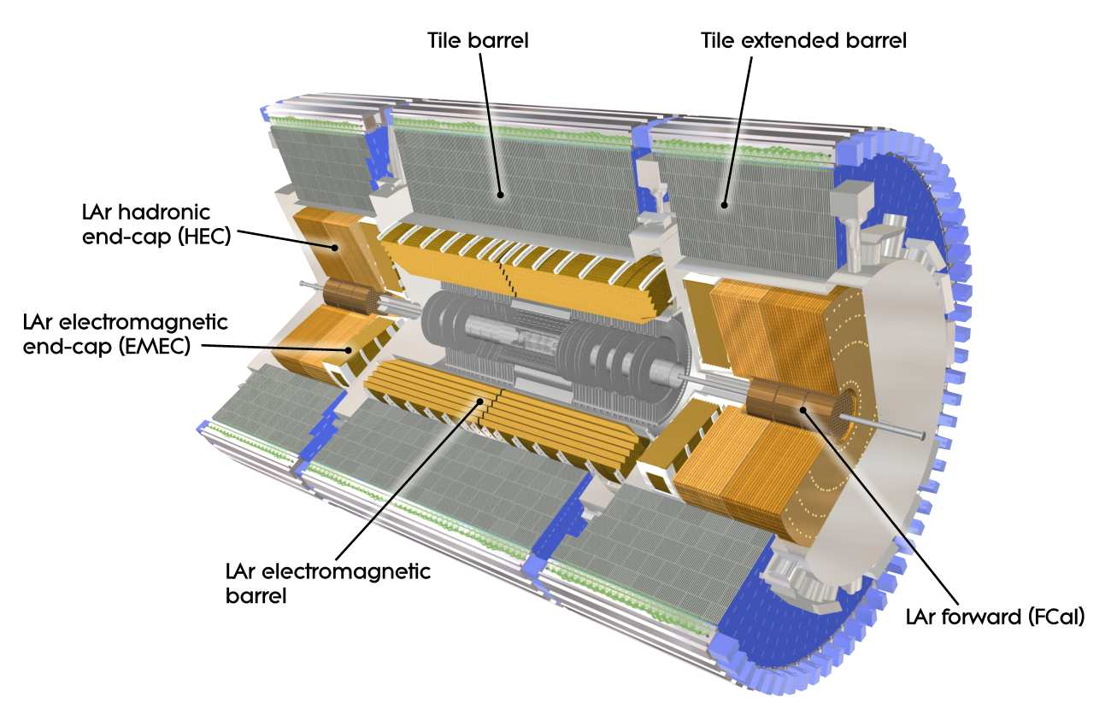
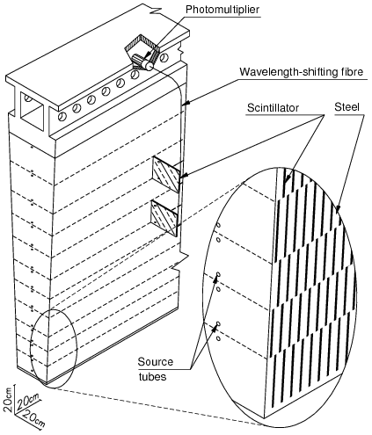
ATLAS TileCal Upgrade
HV System: Agostinho Gomes, Guiomar Evans, Luís Gurriana, Filipe Martins, José Augusto, Rui Fernandez, Pedro Assis, Miguel Ferreira, José Carlos Nogueira (collaboration with eCRLab)
Optics Robustness: Rute Pedro, Beatriz Pereira

Slide 6
TileCal High-Voltage System
DCS system: SoC board for High Voltage monitoring & control
HVRemote boards - Regulation and control system off detector at USA15 (256 boards)
HVSupplies provide primary High Voltage
(256 boards)
>100m long cables
from service cavern
16 crates in service cavern
System parameters:
10000 PMTs
High Voltage < 950 V – so far used ≈750 V
Individual currents < 400 μA
High Voltage stability < 0.5 V rms
HVBus – passive distribution board distributes HV to PMTs (1024 boards)

Slide 7
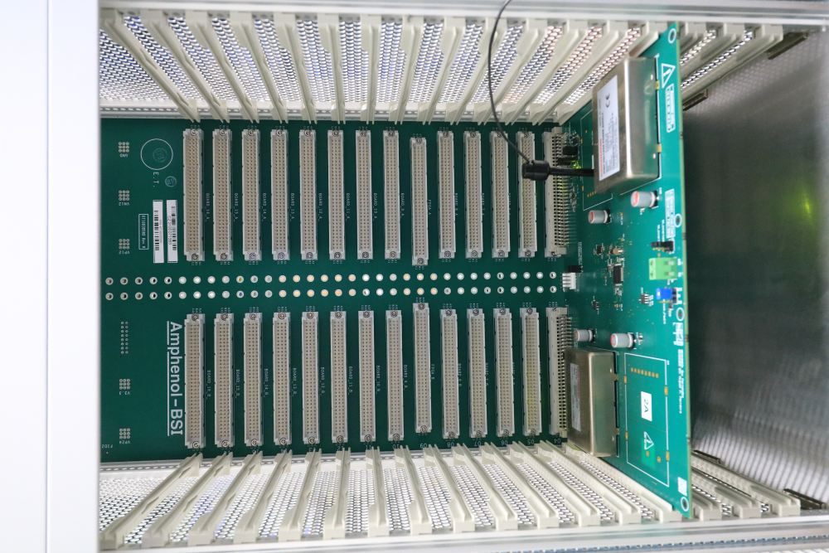
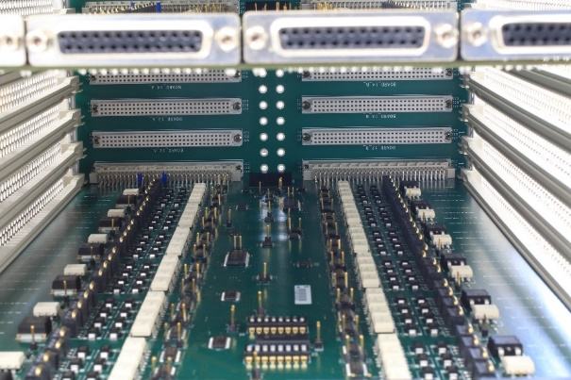
High Voltage System Components
Front of crate: HVSupplies board
Back of crate: HVRemote boards
Middle plane

Slide 8
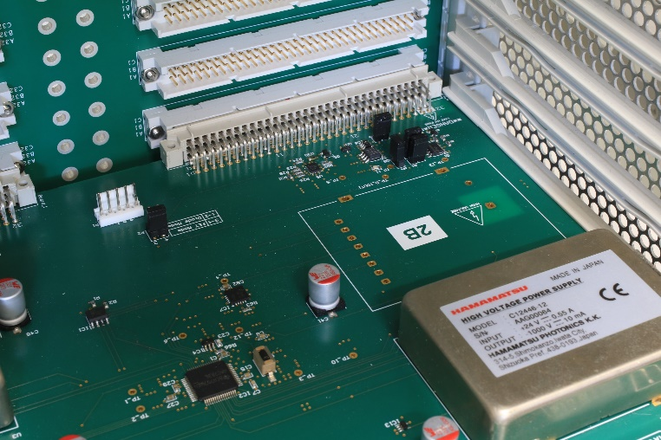
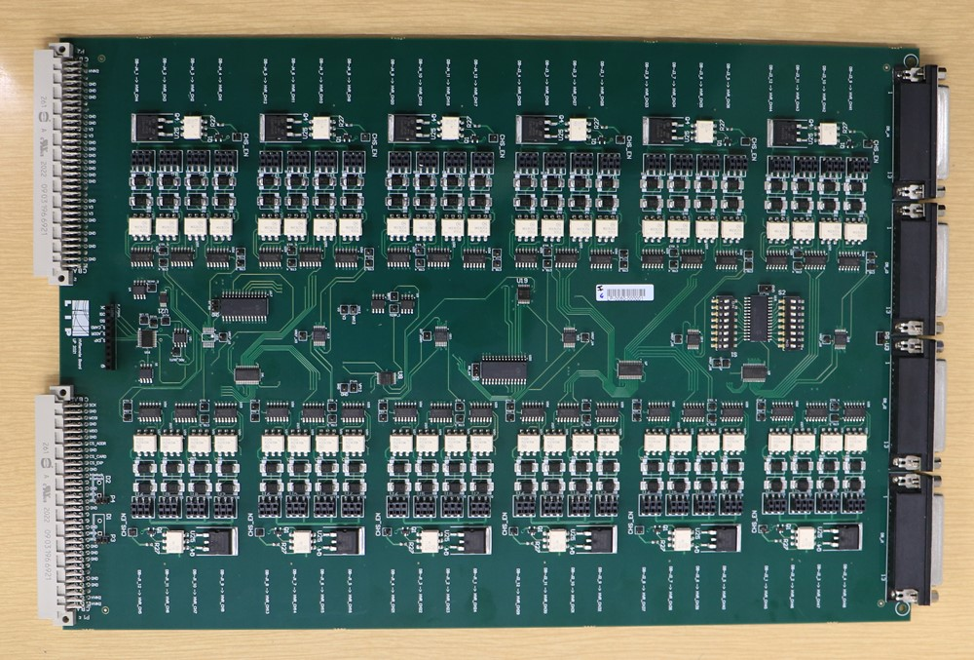
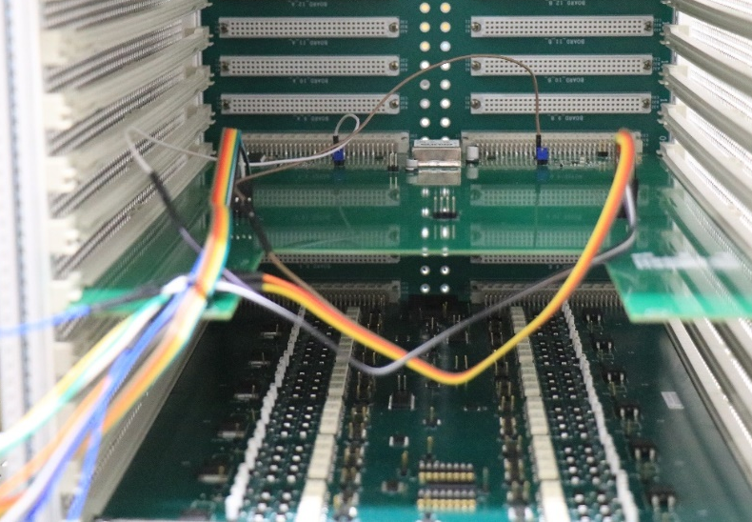
High Voltage System Components
HVSupplies:
DC-DC converters to produce primary HV
Connects with the ATLAS Detector Safety System Designed by eCRLab
First prototypes successfully tested and a new design finished for production
HVRemote:
Receives 2 primary HV inputs from HVSupplies
Sends 48 individually regulated HV outputs to HVBus
  DACs to set the individual voltages
  Regulation loops based on optocouplers
  On/Off available for sets of 4 channels
HV Control Board:
One Zybo Z7 Zynq System-on-Chip (SoC) interface board per crate
Two SPI buses (one to the HVRemote and other to the power supply boards);
Tests showed a few bugs, some corrections required

Slide 9
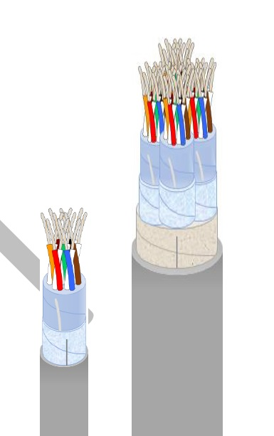
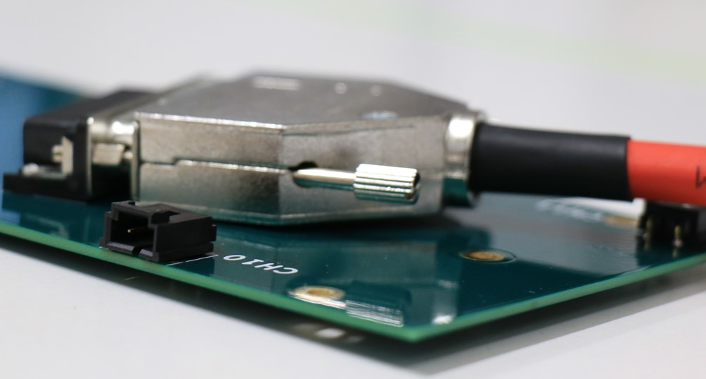
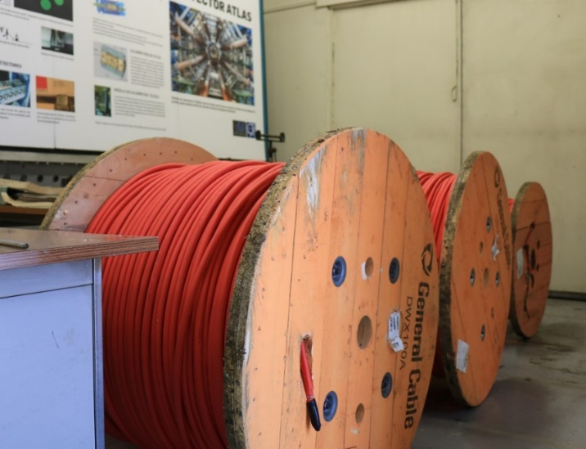
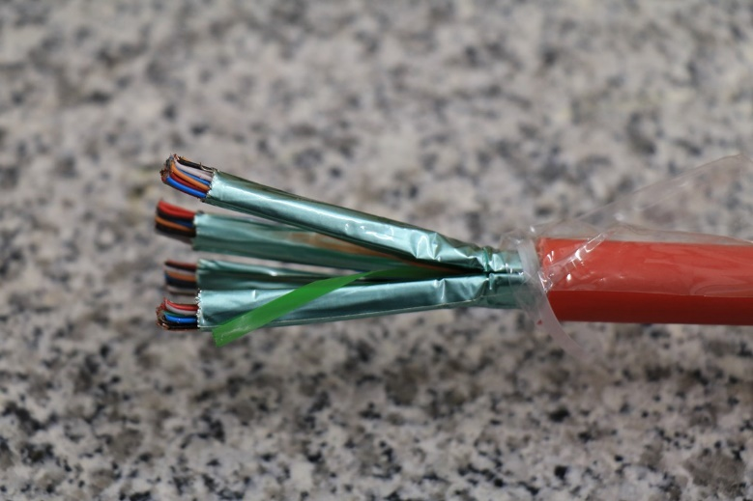
High Voltage Distribution
Cables:
New 48 wire pairs cable developed in Portugal with General Cable
  10000 PMTs => 20000 wires 100 m long
  > 41 km for final system
  Wire diameter: 0.4 mm
  Aluminium/PETP tape screen and drain wire ensures electromagnetic shielding
  Prototypes produced
HVBus:
HV bus and short cables for HV distribution produced and being tested

Slide 10
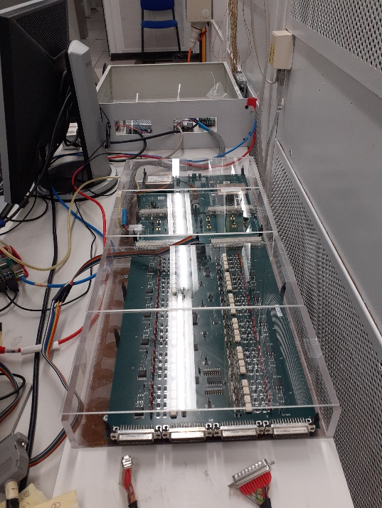
Testing Programme
Testbeam:
  Tested HVSupplies + adapter board + HVRemote + Hvbus in 2021 and June 2022
  Will test Crate + SoC interface + final boards in November 2022
Stability tests:
  > 5h long tests
  rms ≈ 0.21 – 0.23 V

Slide 11
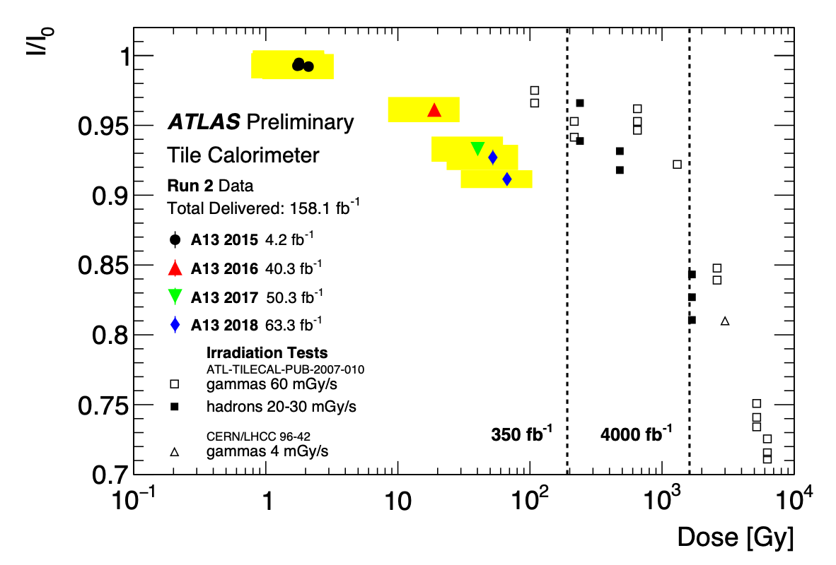
TileCal Optics Robustness for HL-LHC
The HL-LHC will bring additional radiation exposure and damage to the TileCal scintillators and fibres
Measured Run 2 light yield from Laser and Cs data
Modeling the light response as a function of ionising dose
Cs calibration data at sub-cell level helps to reduce uncertainties due to dose spread within the cell volume (ongoing work)

Slide 12
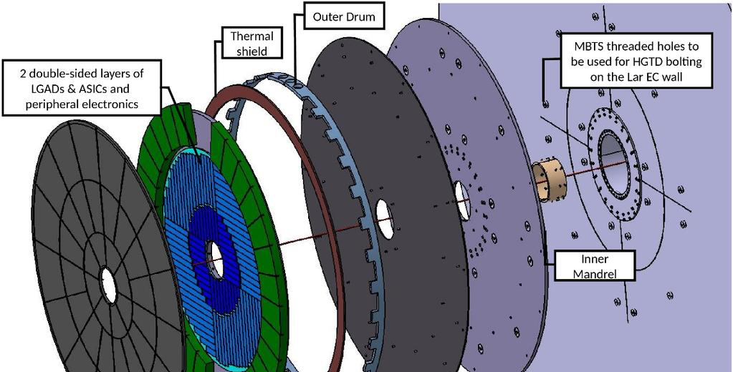
High Granularity Timing Detector
HV System: Luis Lopes, Orlando Cunha, Ricardo Gonçalo – collaboration with Detector Lab
ASIC tests: Rui Fernandez, Pedro Assis, Miguel Ferreira – collaboration with eCRLab
DCS and Interlocks: Filipe Martins, Rui Fernandez, Helena Santos, Guiomar Evans

Slide 13
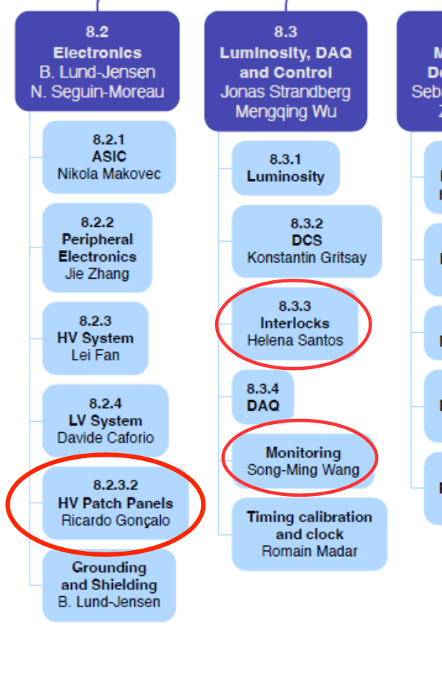
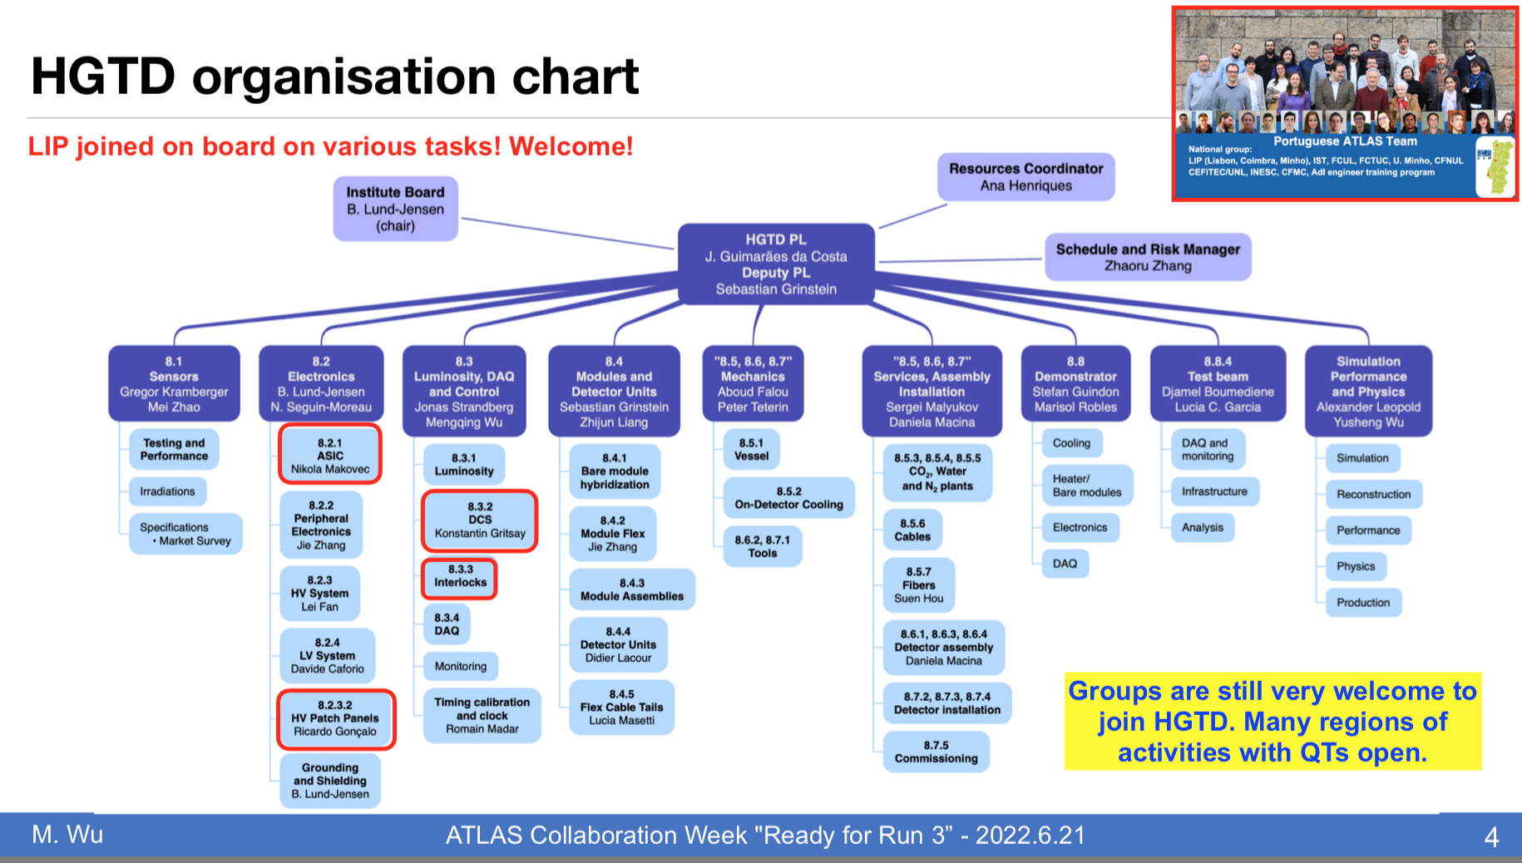
HGTD @ LIP
Recent involvement since last year, but significant impact
Contributing to several areas:
  Electronics: readout ASIC tests, High Voltage filtering
  Detector control and safety Interlocks
  Monitoring
Other possibilities being followed:
  Cable production in Portuguese industry
  Mechanical design and production at LIP

Slide 14
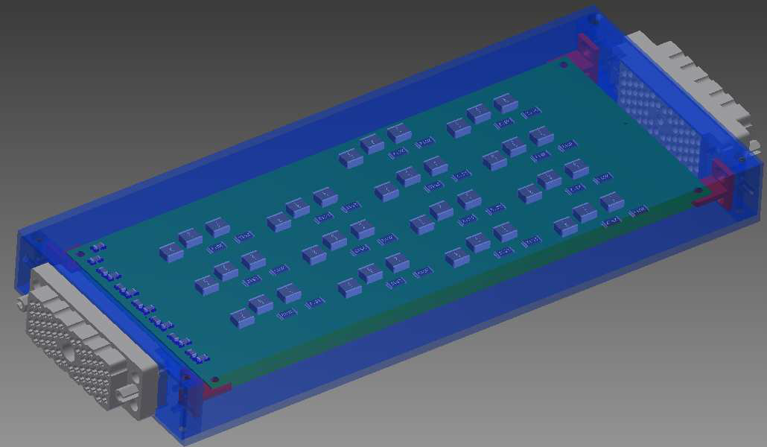
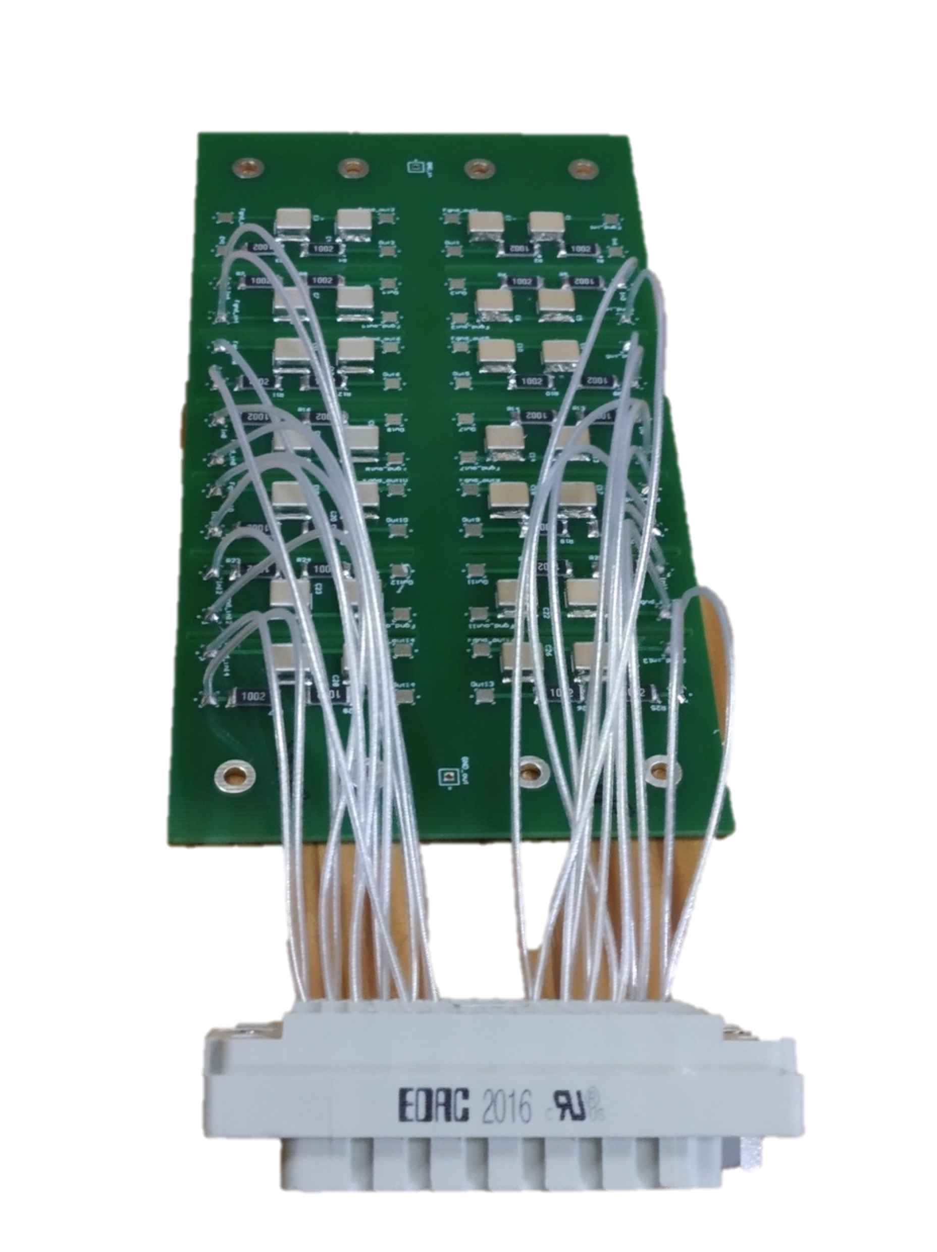
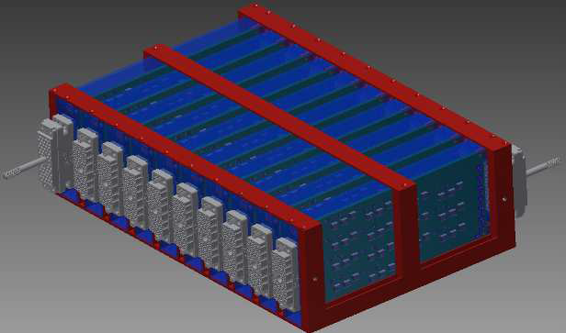
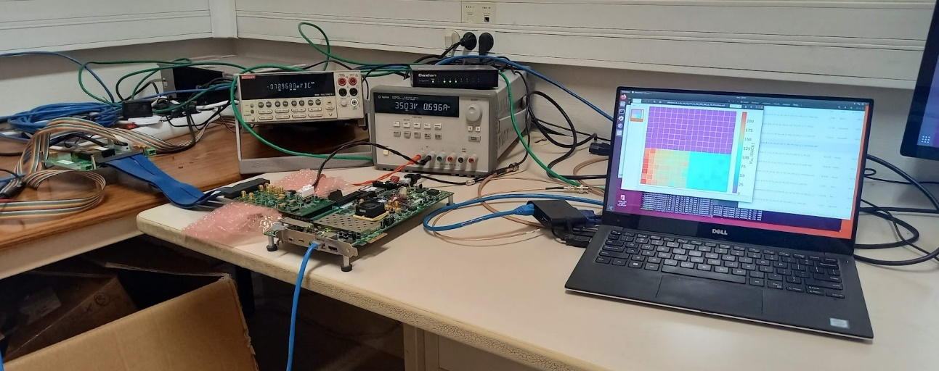
Electronics and High-Voltage
HV patch panels:
Responsible for producing HV patch panels
Routing and filtering High Voltage to HGTD detector
Preliminary layout done and prototype tested
Design being updated after review
Cables:
May also produce HV cables (under negotiation)
ALTIROC:
ASIC under development for LGAD readout
Plan to take part in ASIC development tests
Contact established with developers (OMEGA) and testing infrastructure almost in place

Slide 15
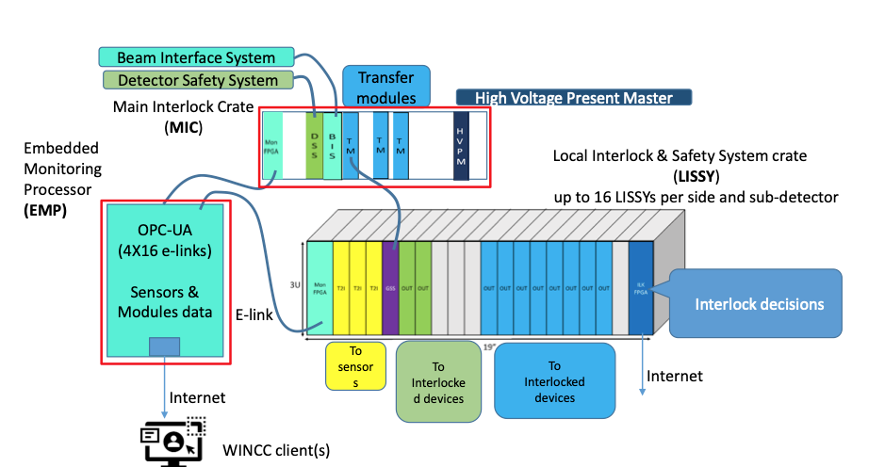
DCS and Interlocks
Detector Control System (DCS):
  Contributing to DCS architecture definition
  Readout of DCS environment data through ELMB2 communication board
Interlocks (started recetly):
  Taking responsability for HGTD Interlocks – mostly will re-use ITk design
    Likely to produce an interlock module ourselves (HV-Present)

Slide 16
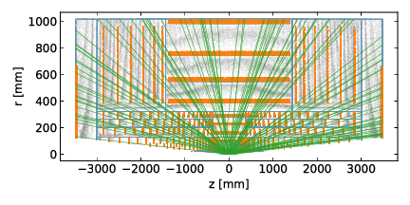
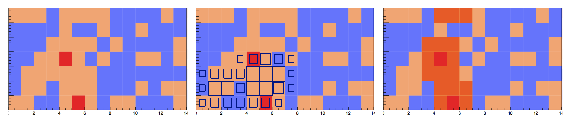
Reconstruction Algorithms for Phase 2
GPUs: Nuno Fernandes, Patricia Conde
Muon trigger: João Gentil
ACTS: Luis Coelho, Noemi Calace, R.goncalo

Slide 17
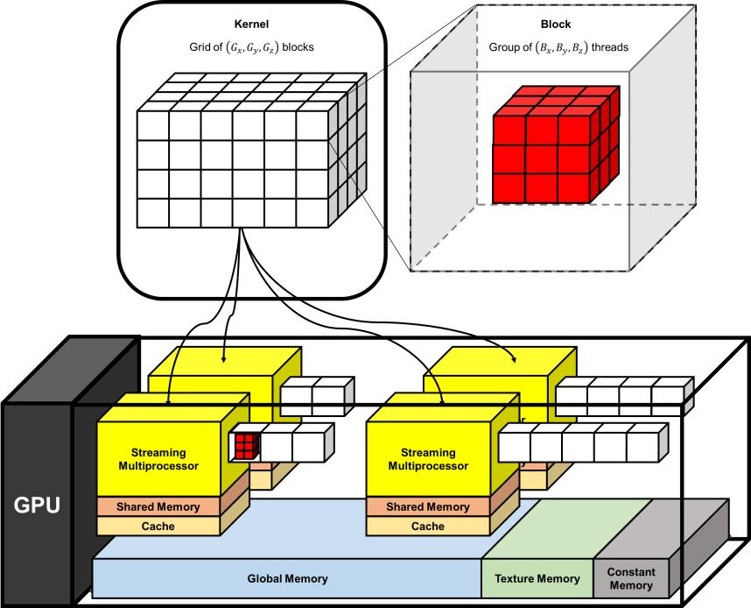
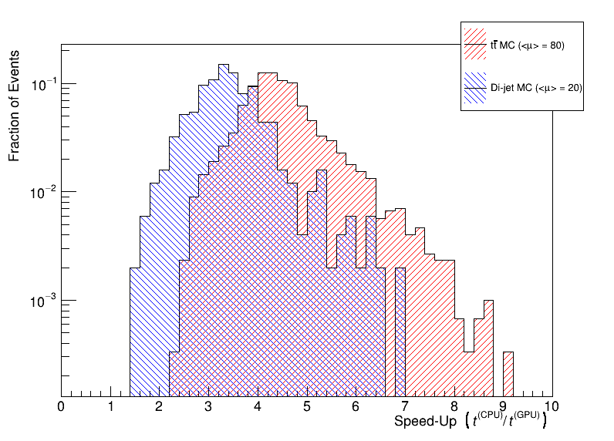
ATLAS Trigger Upgrades
GPU acceleration to deal with increased event rates
  GPU-based Topo-Automaton Clustering (TAC) cellular automaton algorithm
    Group cells by signal-to-noise ratio
    Important overhead from data structure convertion to and from GPU format
Speed-up:
  3.5 (di-jets) to 4.5 (top pairs)
  < 40% of time: algorithm
  50 - 55% of time conversion overhead
  10 - 15% of time CPU↔GPU data transfer (TeslaT4andaAMDEPYC7552)
Also new Muon trigger:
  Using minimum-bias scintillators for fake jet rejection (J.Gentil)

Slide 18
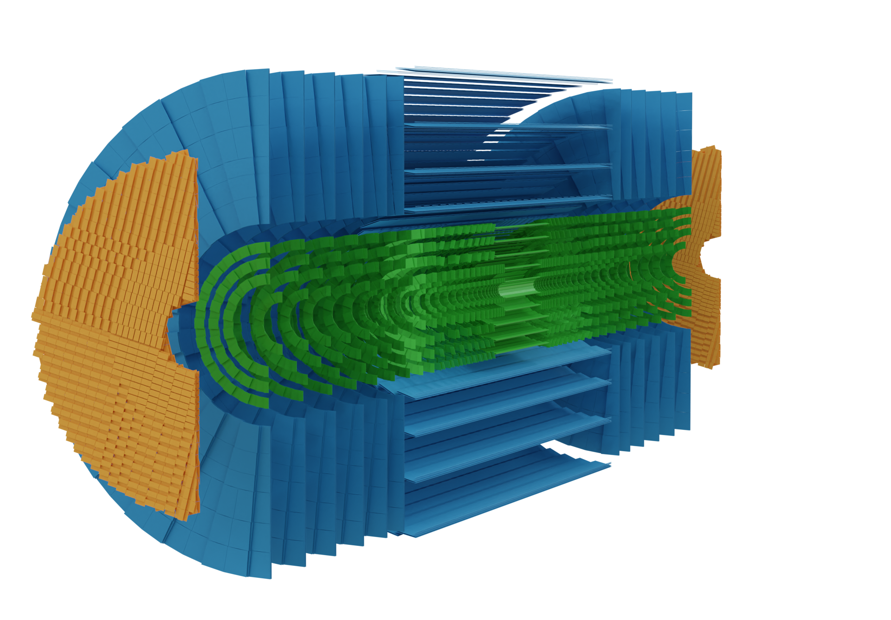
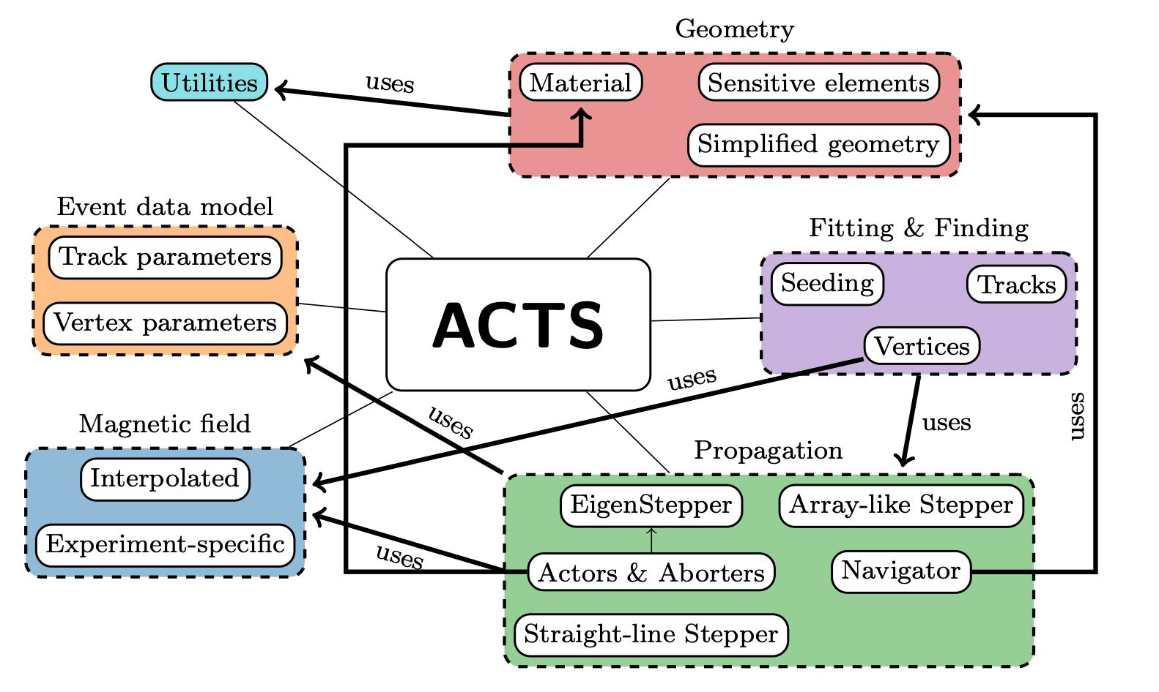
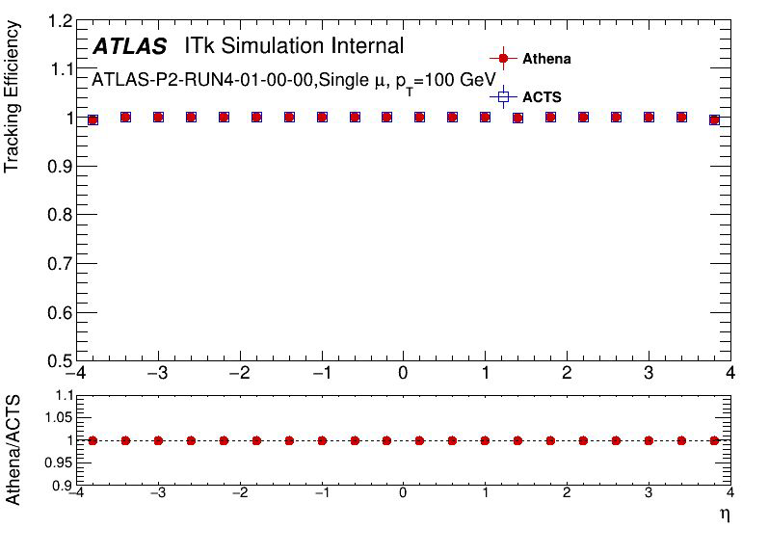
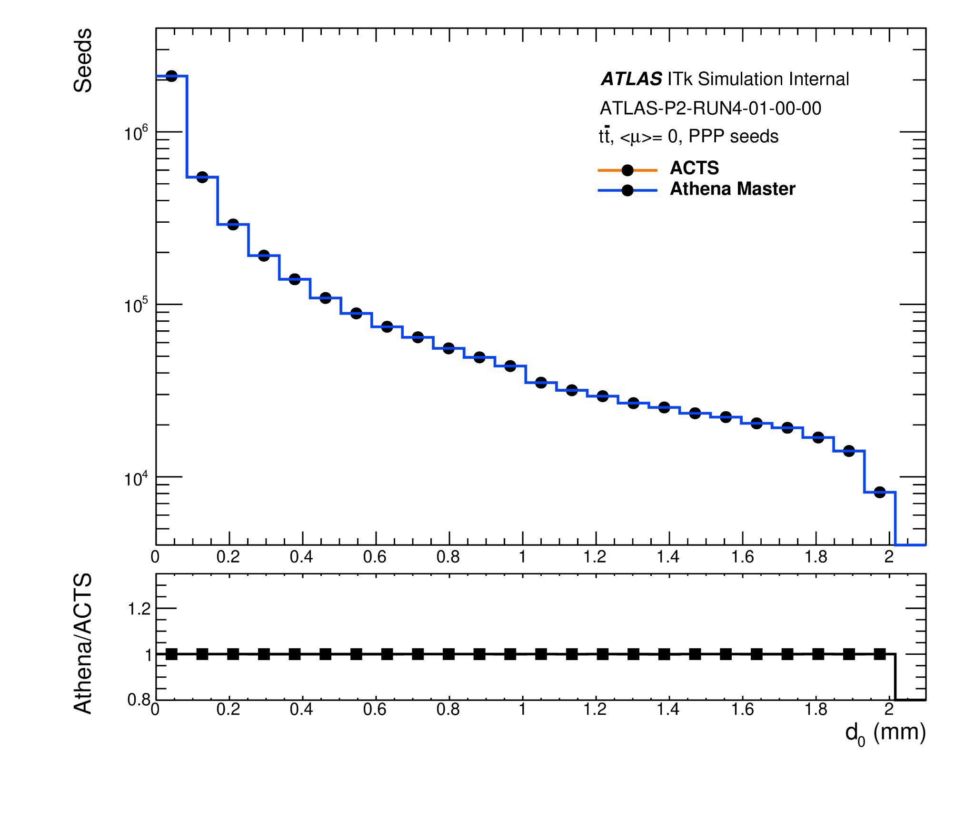
A Common Tracking Software (ACTS)
Tracking of charged particles is one of the the most complex and CPU consuming phases of event reconstruction
Will become even greater computational challenge during HL-LHC
ACTS:
Experiment-independent toolkit for particle track reconstruction
Designed for modern computing architectures and multi-threaded event processing
Goal:
Implement ITk seeding algorithm in ACTS and integrate into standard ATLAS code and validate its performance
The Seeding Algorithm
Forms track seeds consisting of triplets of space-points (SP) based on geometrical assumptions relative to the interaction point

Slide 19

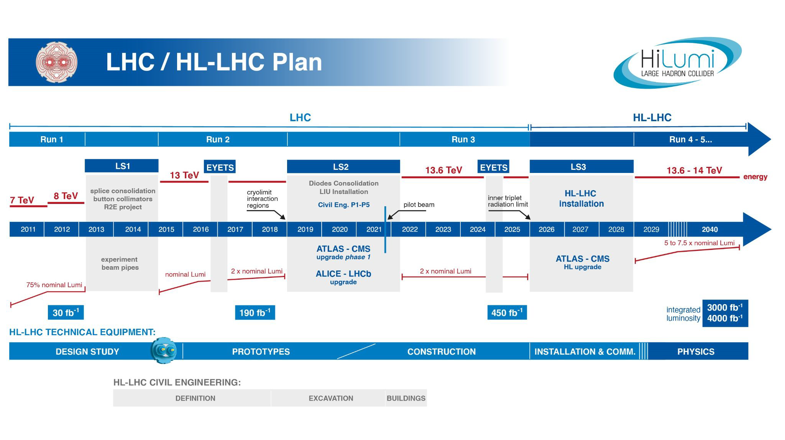
Summary and Outlook
A lot of activity was started on upgrades for HL-LHC since the last LIP Jornadas
Interesting times!
  First HL-LHC run will be on 2029 – 7 years to develop, build, install,and commission – Lots of fun ahead!

Slide 20
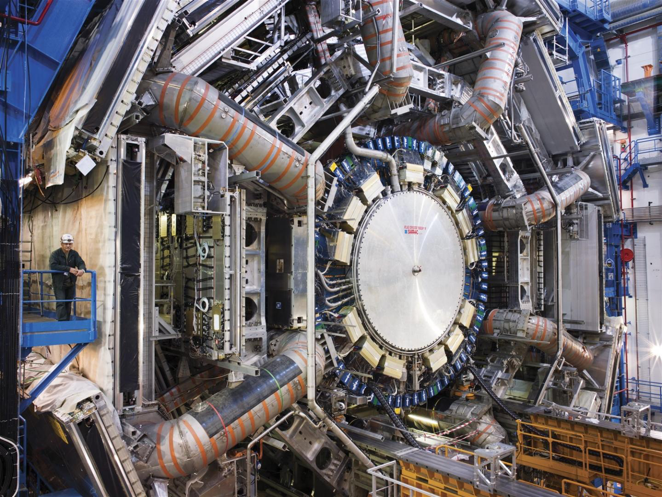
Backup Slides
E-mail: Ricardo Gonçalo (jgoncalo@lip.pp

Slide 21
