Slide 1
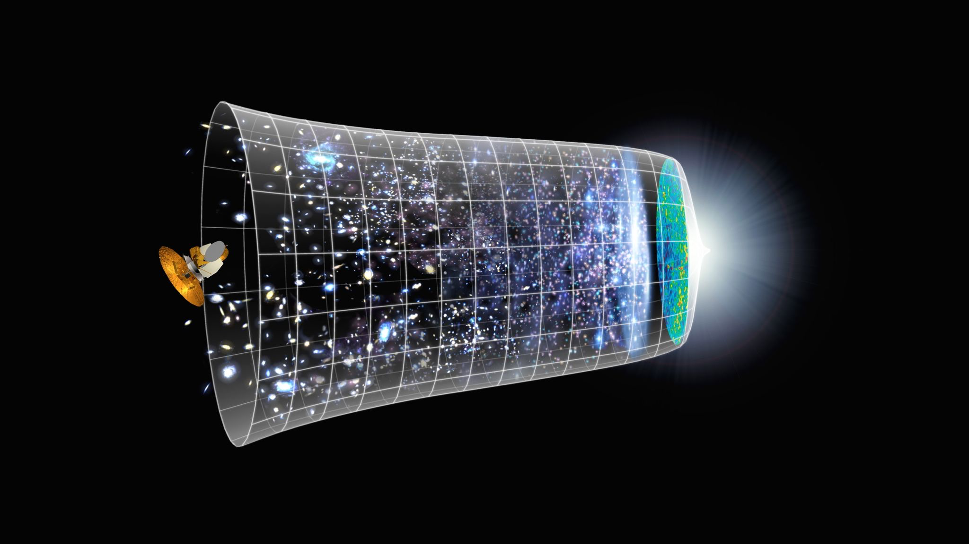
10th IDPASC Summer School
Closing Remarks
6 – 17 September 2021 – Nazaré, Portugal/Online

Slide 2
A great edition!
A very wide range of topical subjects from particle physics, astrophysics and cosmology
25 hours of lectures
About 16 hours of tutorials

Slide 3
A great edition!
A very wide range of topical subjects from particle physics, astrophysics and cosmology
25 hours of lectures
About 16 hours of tutorials
People involved:
15 lecturers
>10 people in organisation and support
THANK YOU!!

Slide 4
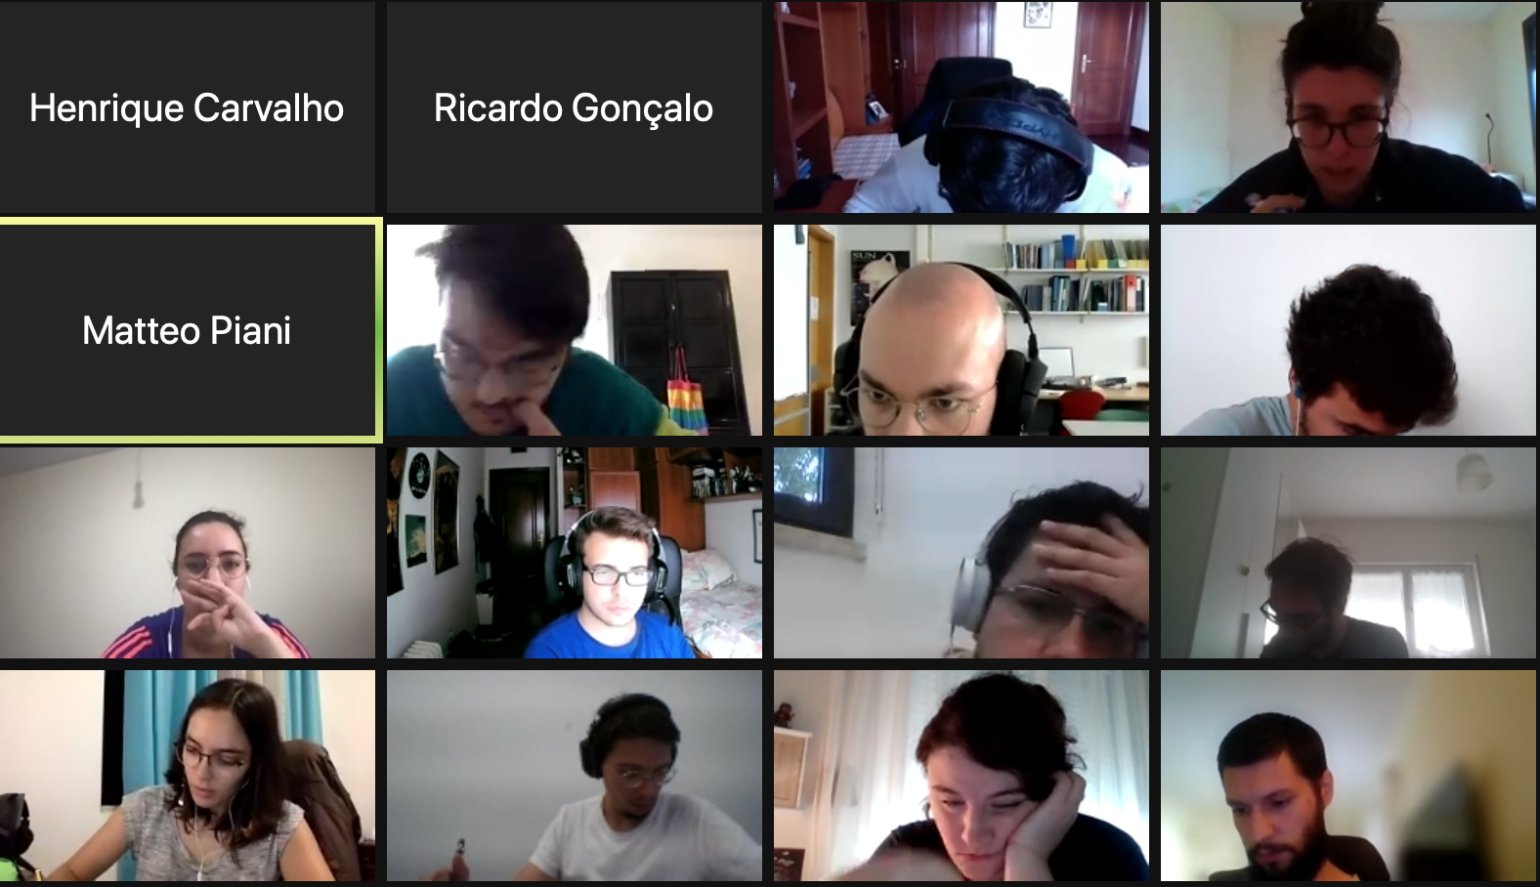
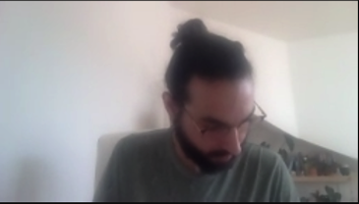
And the motive of the school: you!
20 students
25 lectures
15 lecturers and some 10 other people involved
About 16 hours of tutorials
A very wide range of topical subjects from particle physics, astrophysics and cosmology
Hope you enjoyed it. See you around!!

