Slide 1







Higgs Physics – Lecture 1
Higgs Physics at the LHC – Introduction
Ricardo Gonçalo – UC/LIP
IDPASC Course on Physics at the LHC – LIP, 7 April 2020

Slide 2

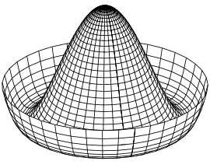
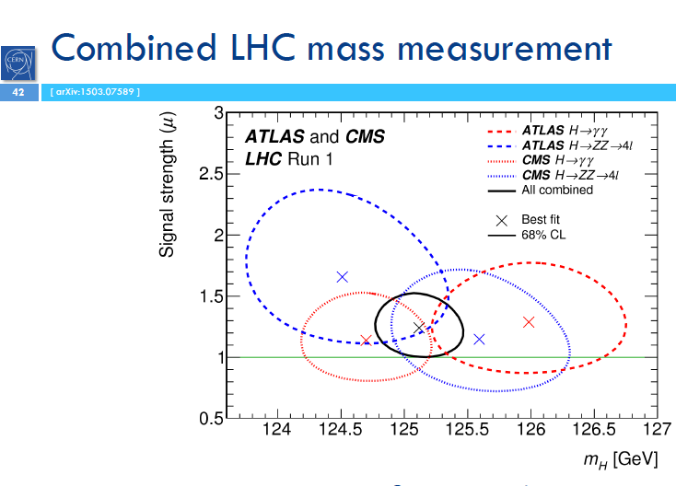
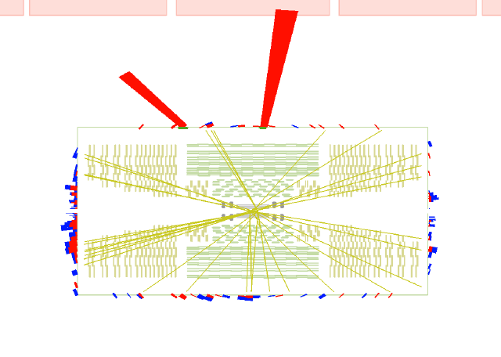
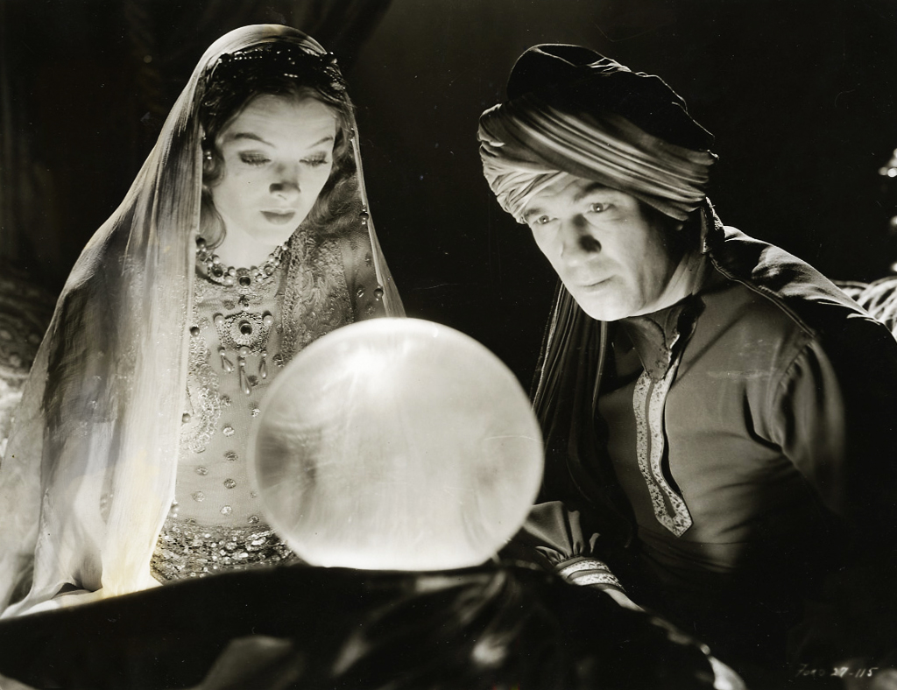
Higgs Lectures

Slide 3

Outlook
Introduction
Some theory
Problems with the Standard Model
The Higgs mechanism
The long way to discovery
  LEP experiments
  Tevatron experiments
  Search and Discovery at the LHC
Higgs boson properties
Open questions
Notes:
What we thought we knew – teoria e pre-LHC data
How we know what we know – experimental aspects
What we know – we found a Higgs boson
All we have found out in the meantime – mass, spin, parity, cross sections
What we know we don’t know...
What we think we know – teoria e o BSM Higgs

Slide 4
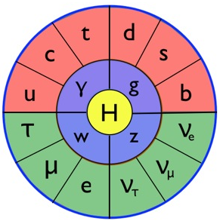
Introduction
The Standard Model particles and interactions, and some theory to set the scene…

Slide 5
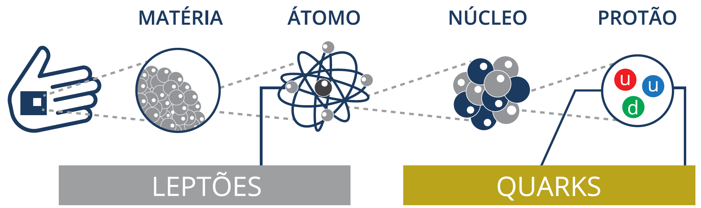
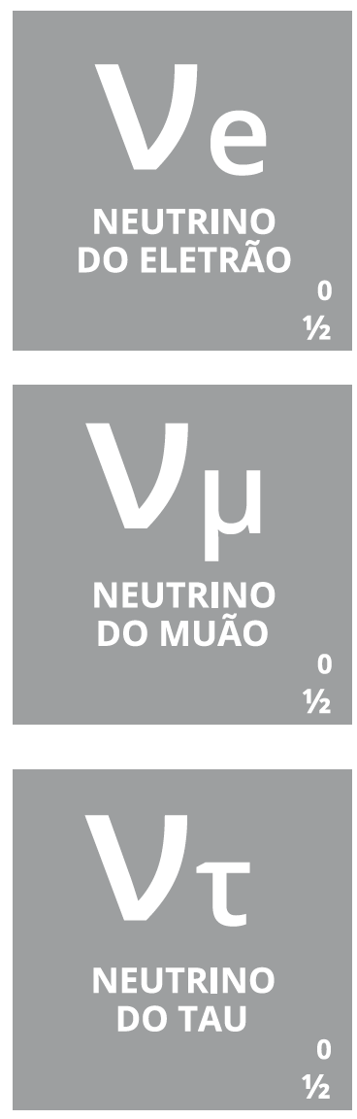

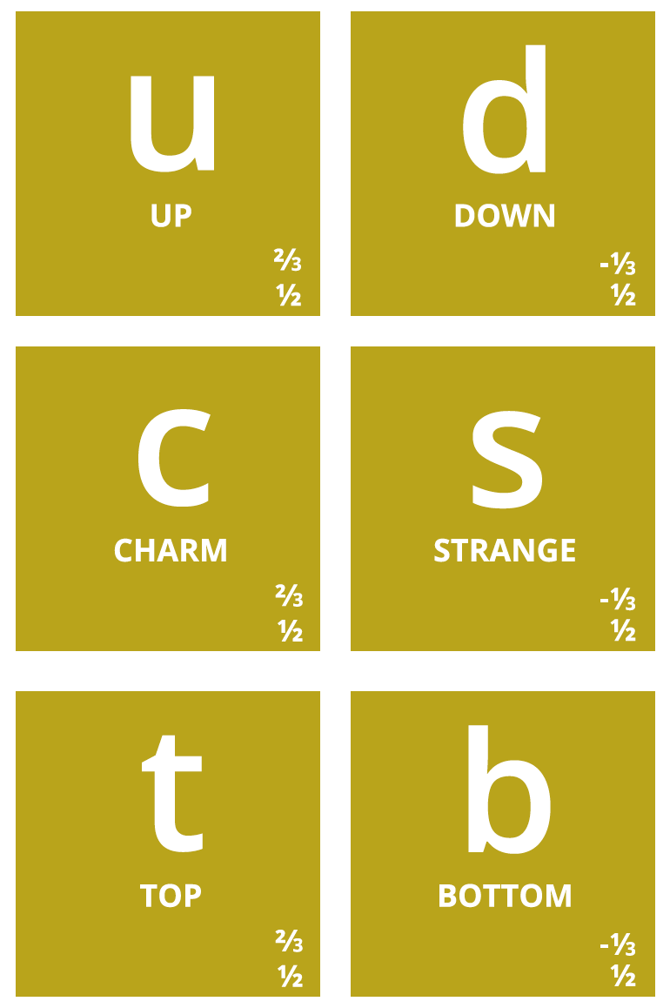
Notes:
Então, quais são afinal as partículas elementares? Temos os quarks, que dão as diferentes propriedades da nova tabela periódica
Também temos o electrão (já conhecíamos), e os seus primos mais pesados: muão e tau. Para cada um destes temos os neutrinos (não são feitos de quarks), que são produzidos em reações no Sol, por exemplo.
Por alguma razão (que desconhecemos) há 3 gerações de partículas elementares, cada uma mais pesada que a anterior → mistério!

Slide 6

E as forças fundamentais?

Slide 7
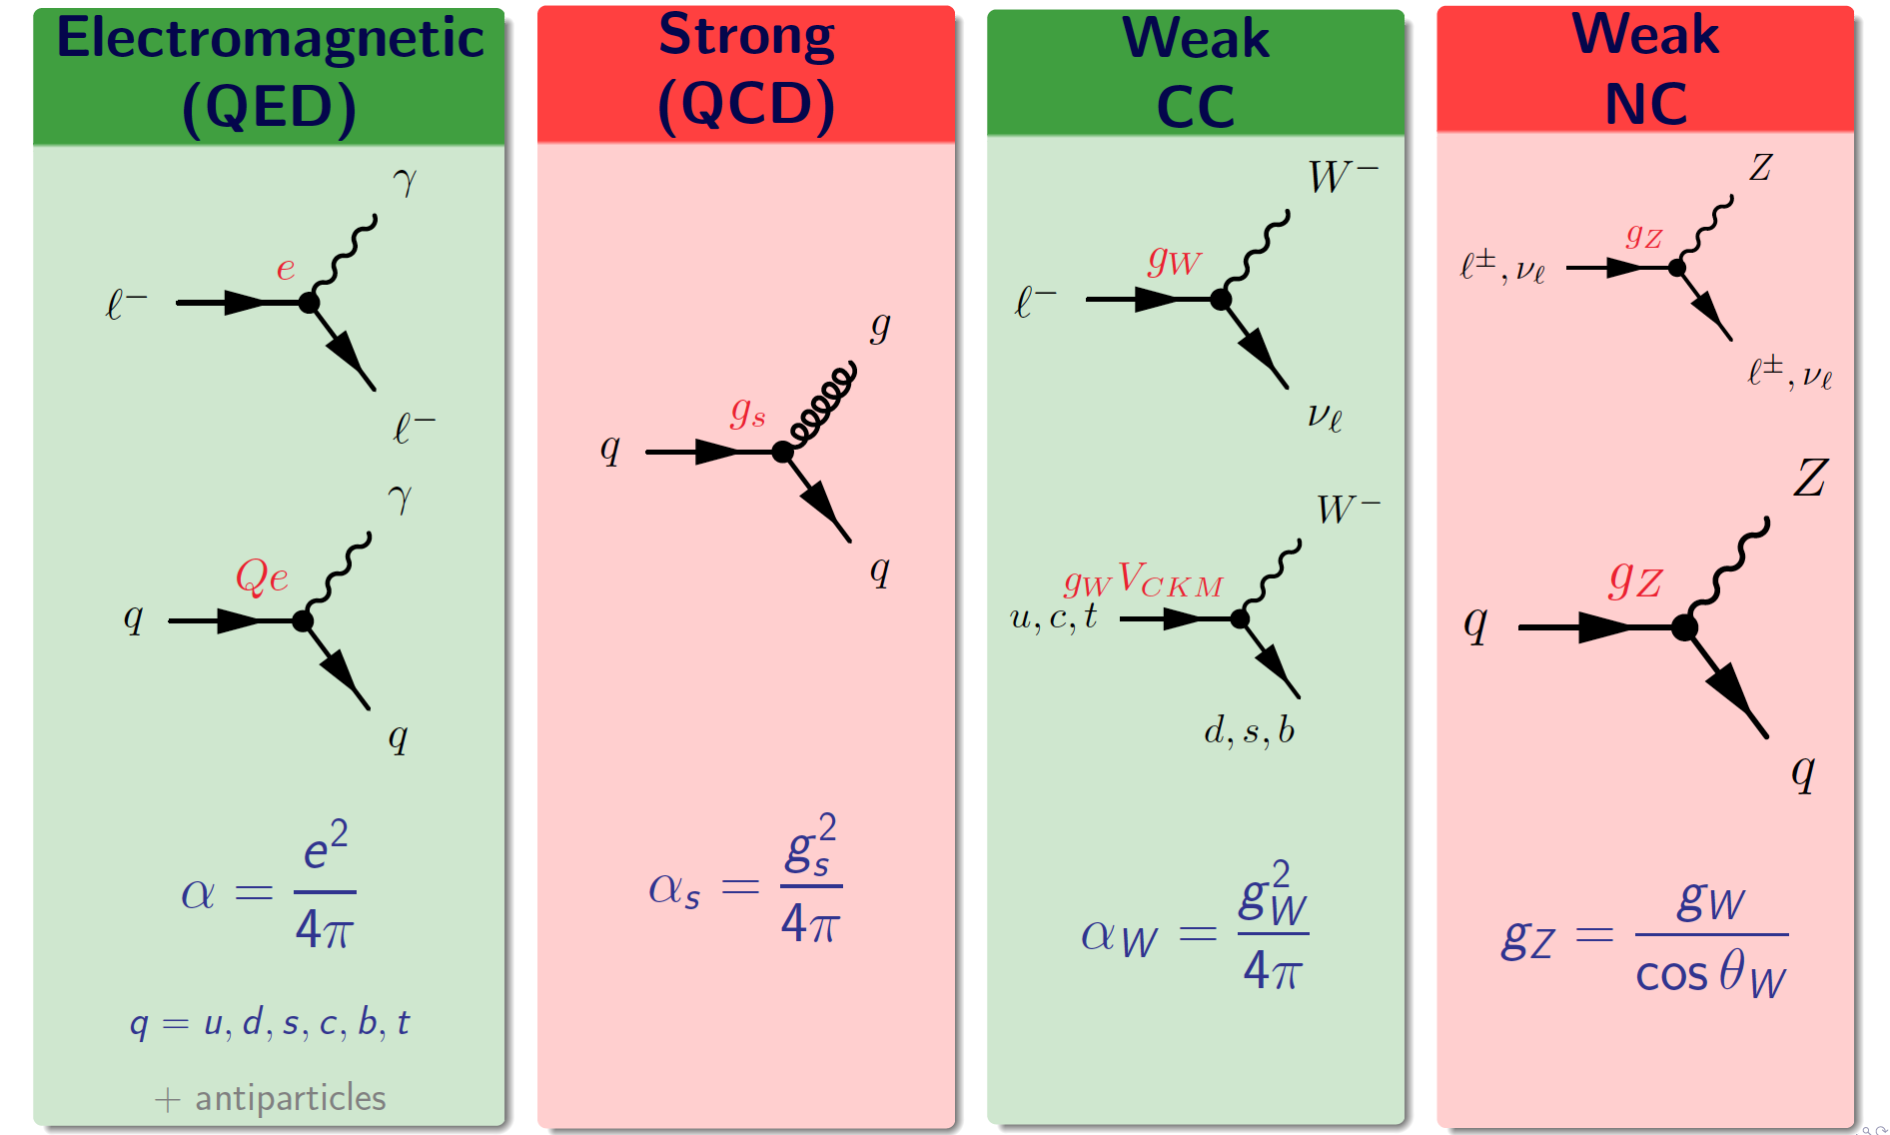
Summary of Standard Model matter vertices

Slide 8
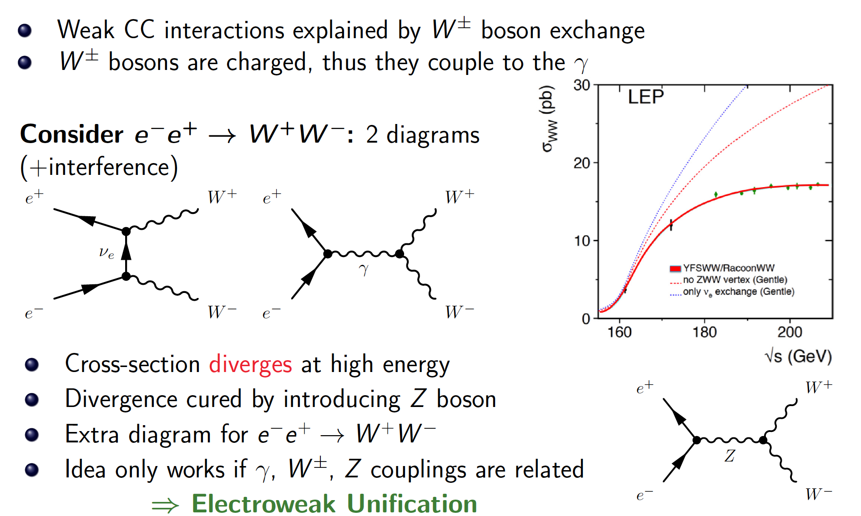
Electroweak Unification

Slide 9
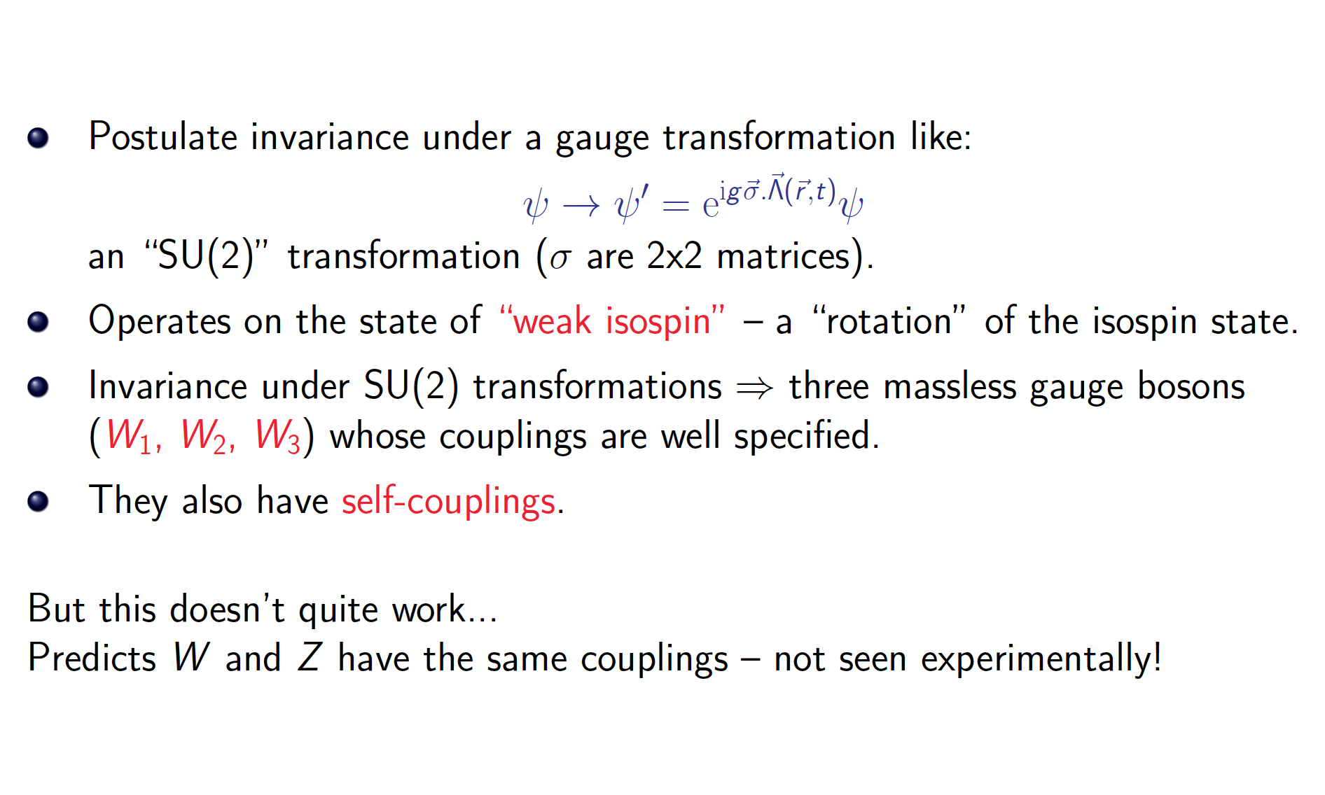
Electroweak Gauge Theory

Slide 10
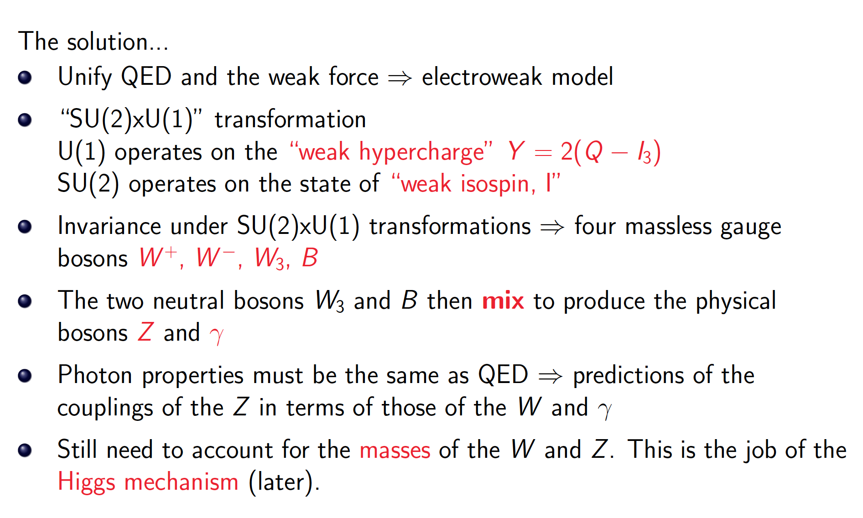
Electroweak Gauge Theory

Slide 11
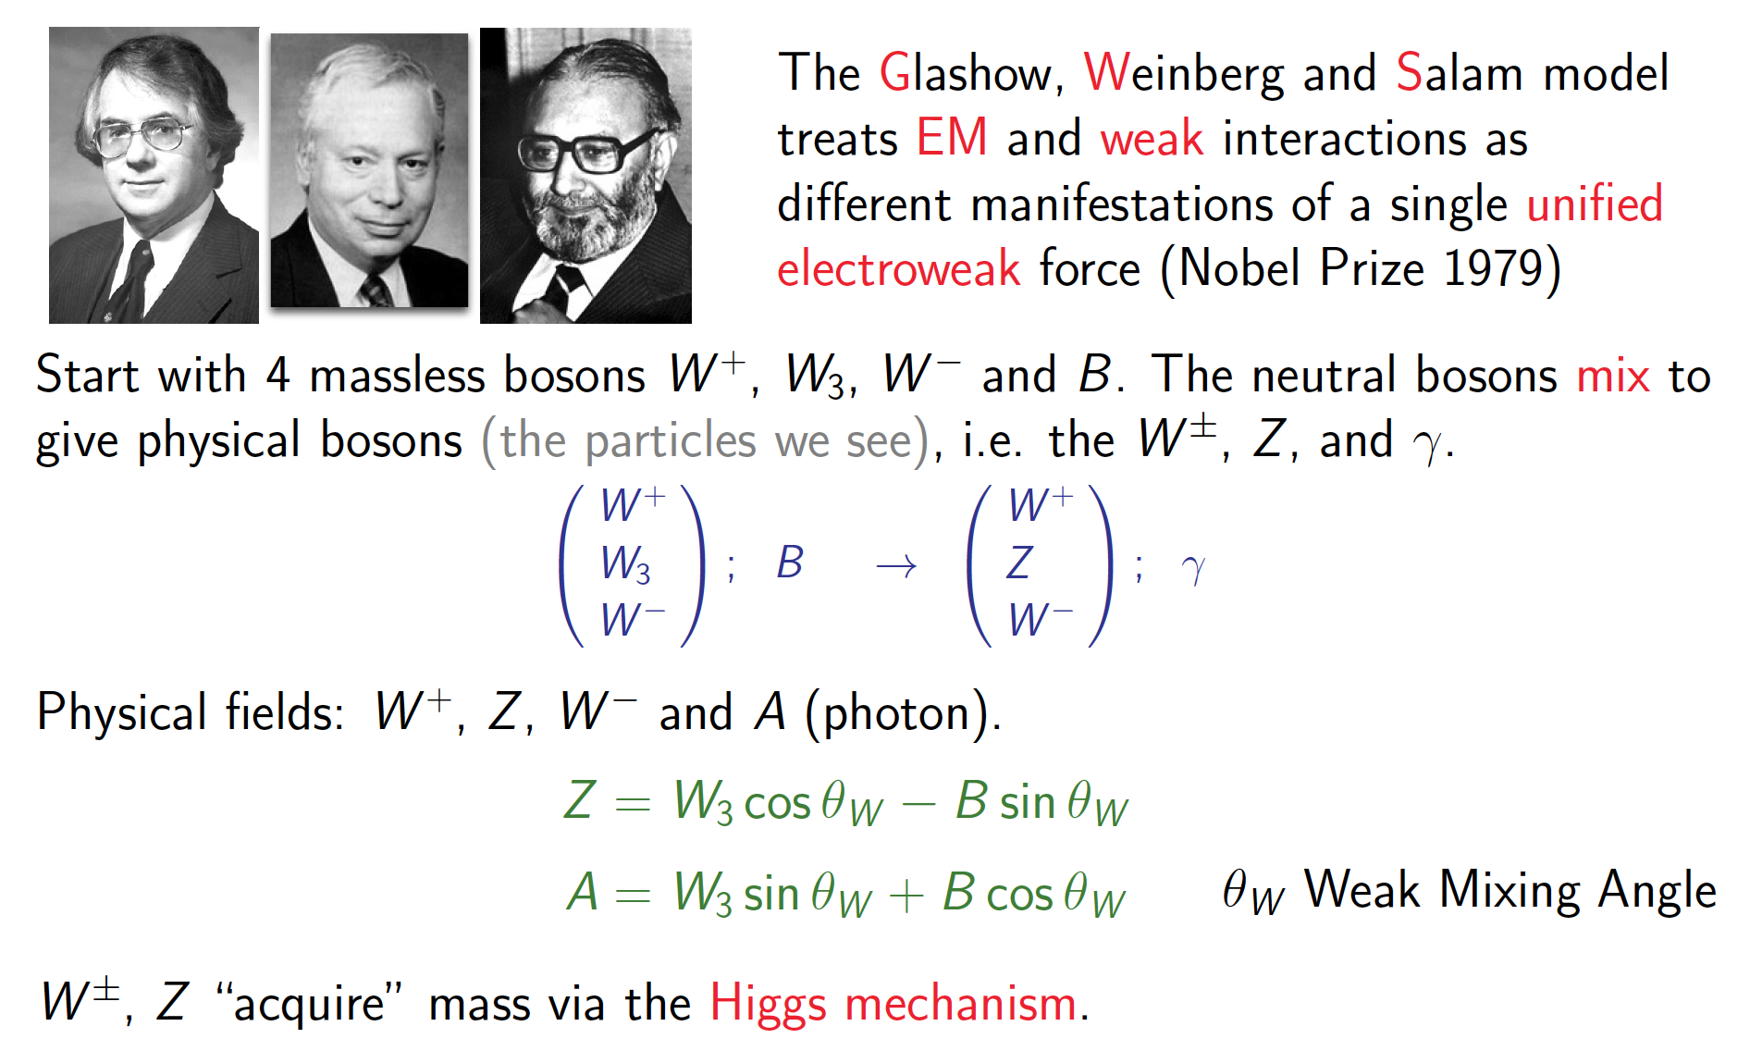
The GWS Model

Slide 12
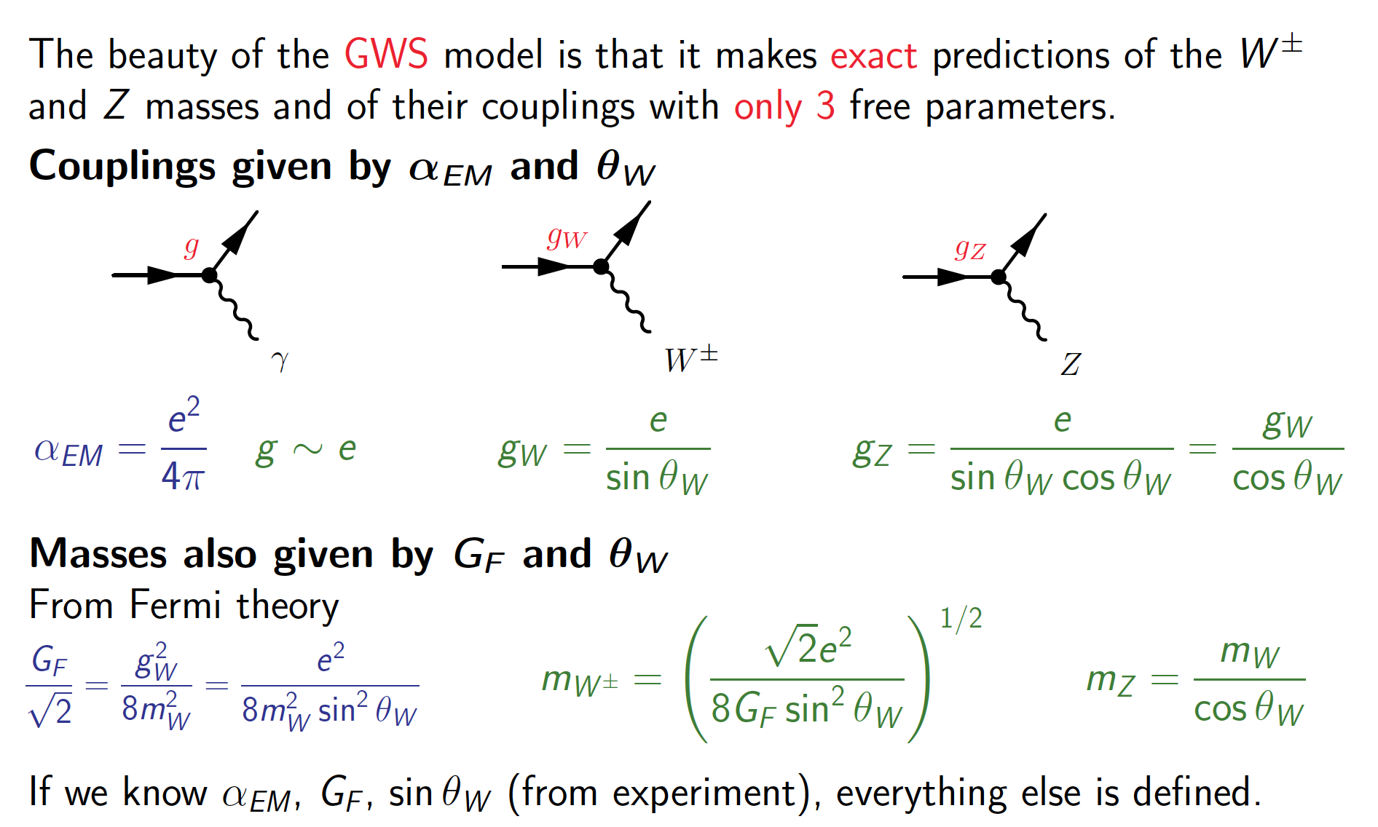
The GWS Model

Slide 13
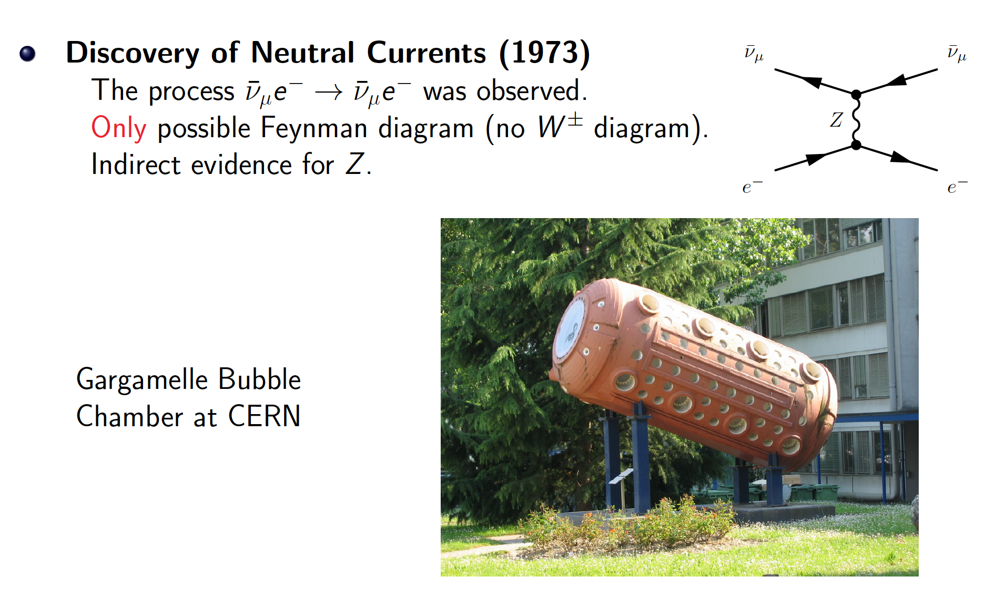
Evidence for the GWS model

Slide 14
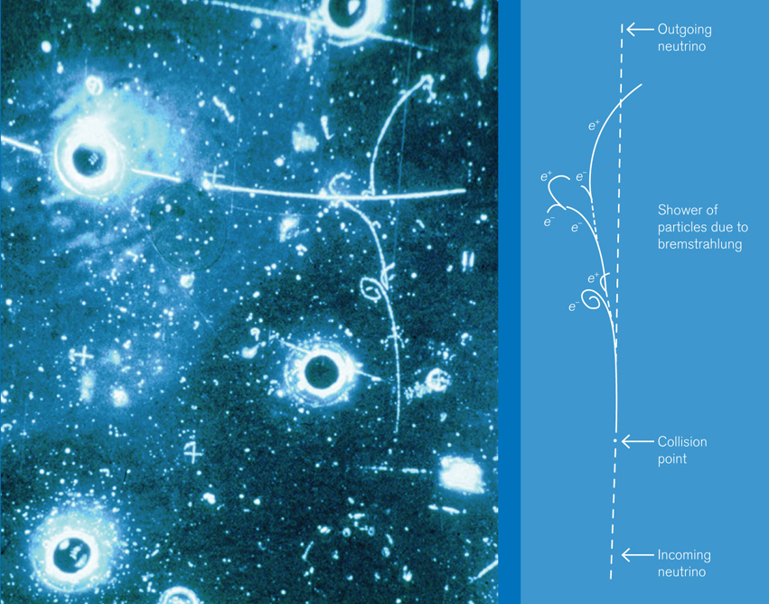
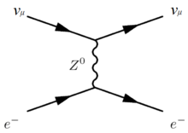

Slide 15
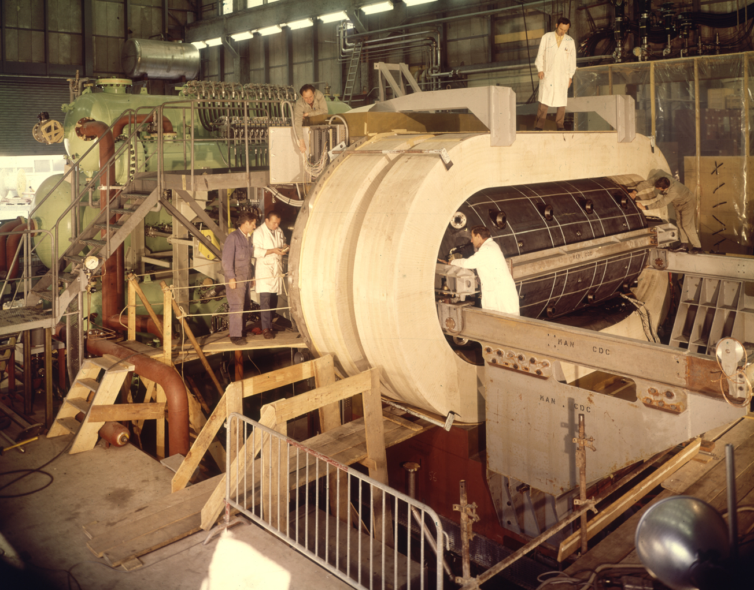

Slide 16
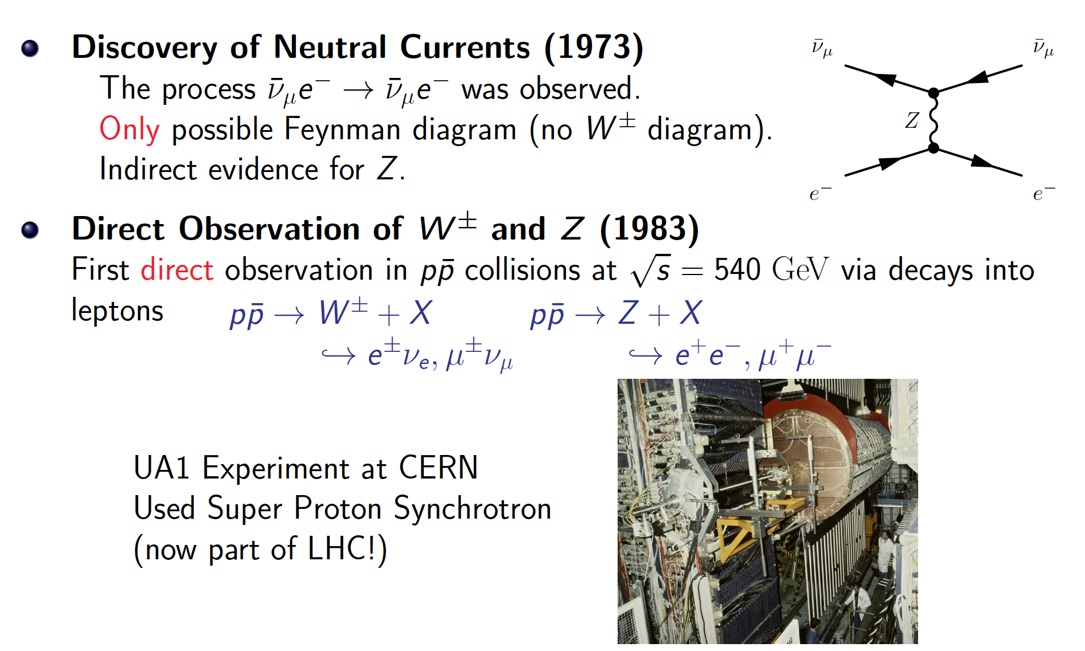
Evidence for the GWS model

Slide 17
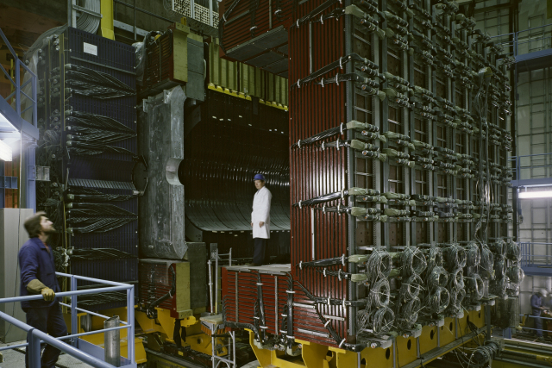

Slide 18
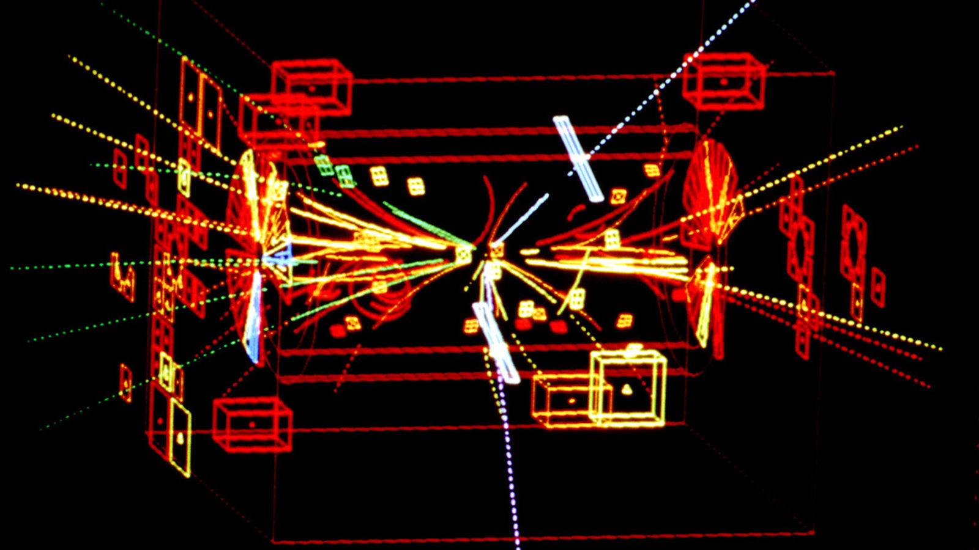

Slide 19
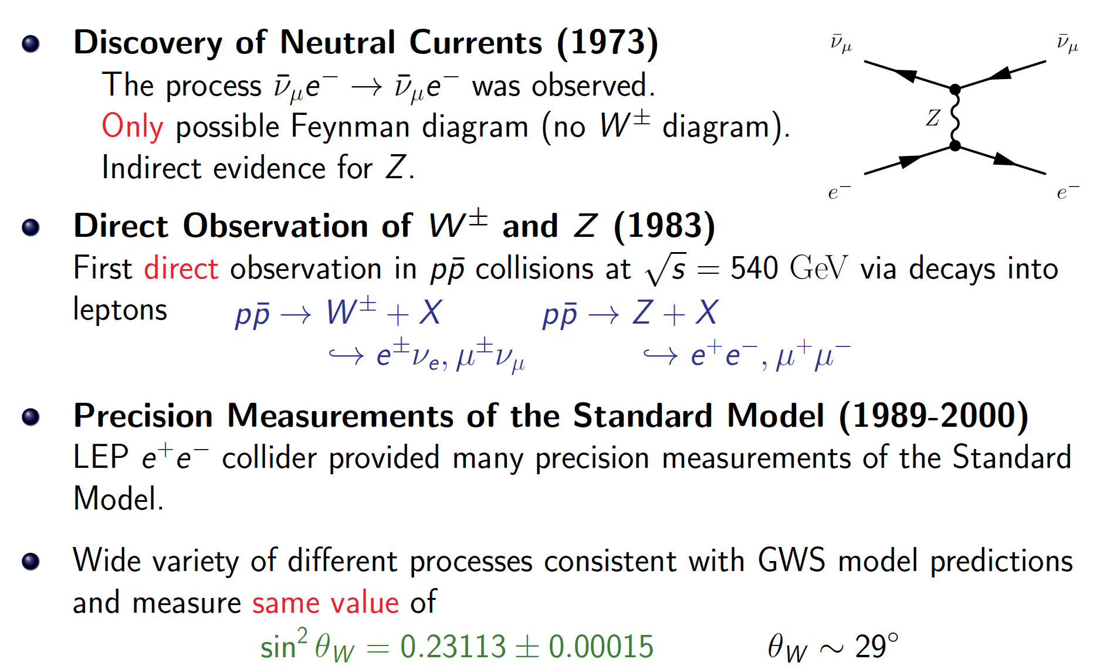
Evidence for the GWS model

Slide 20
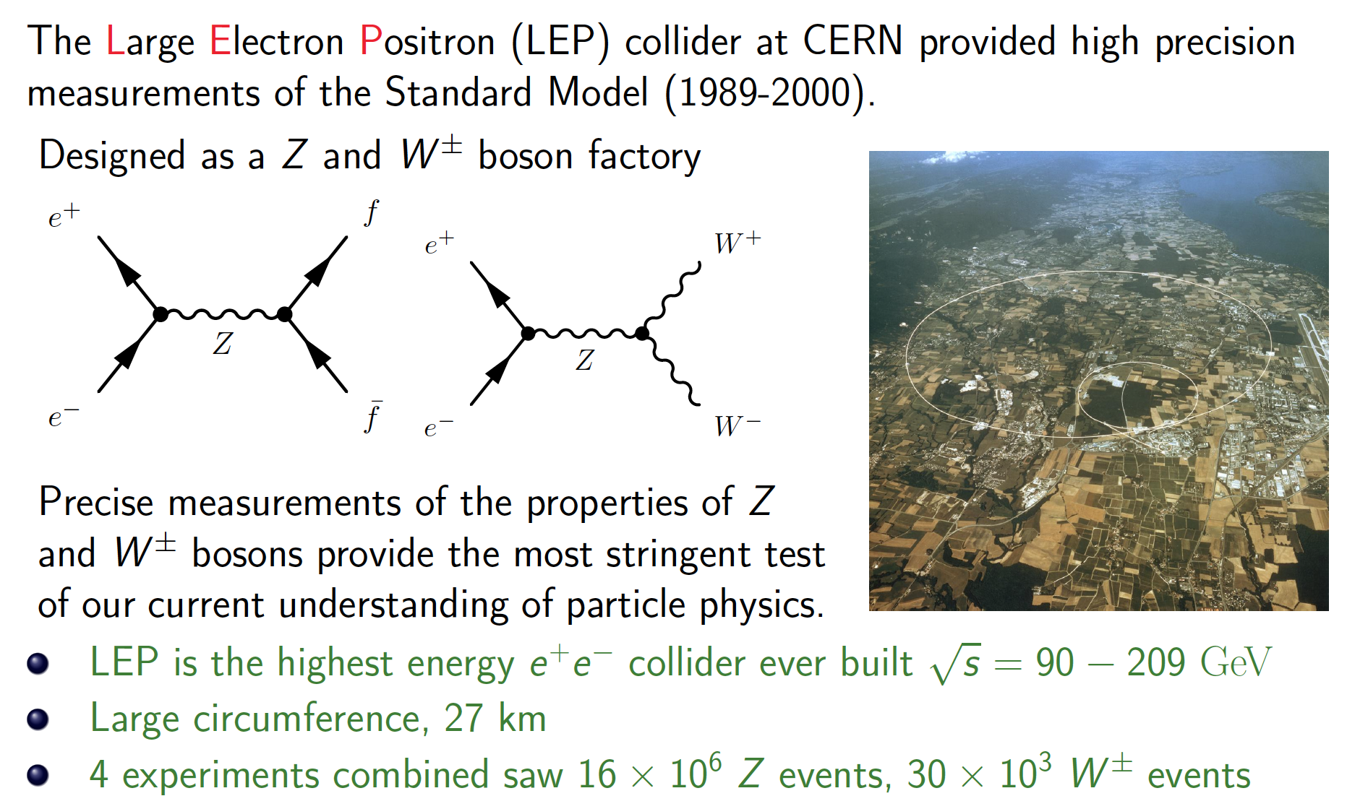
Experimental tests of the Electroweak model at LEP

Slide 21
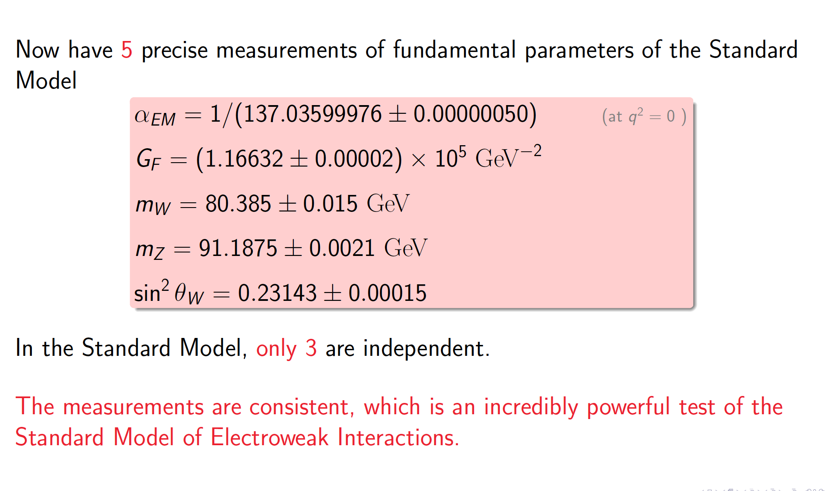
Summary of Electroweak tests

Slide 22
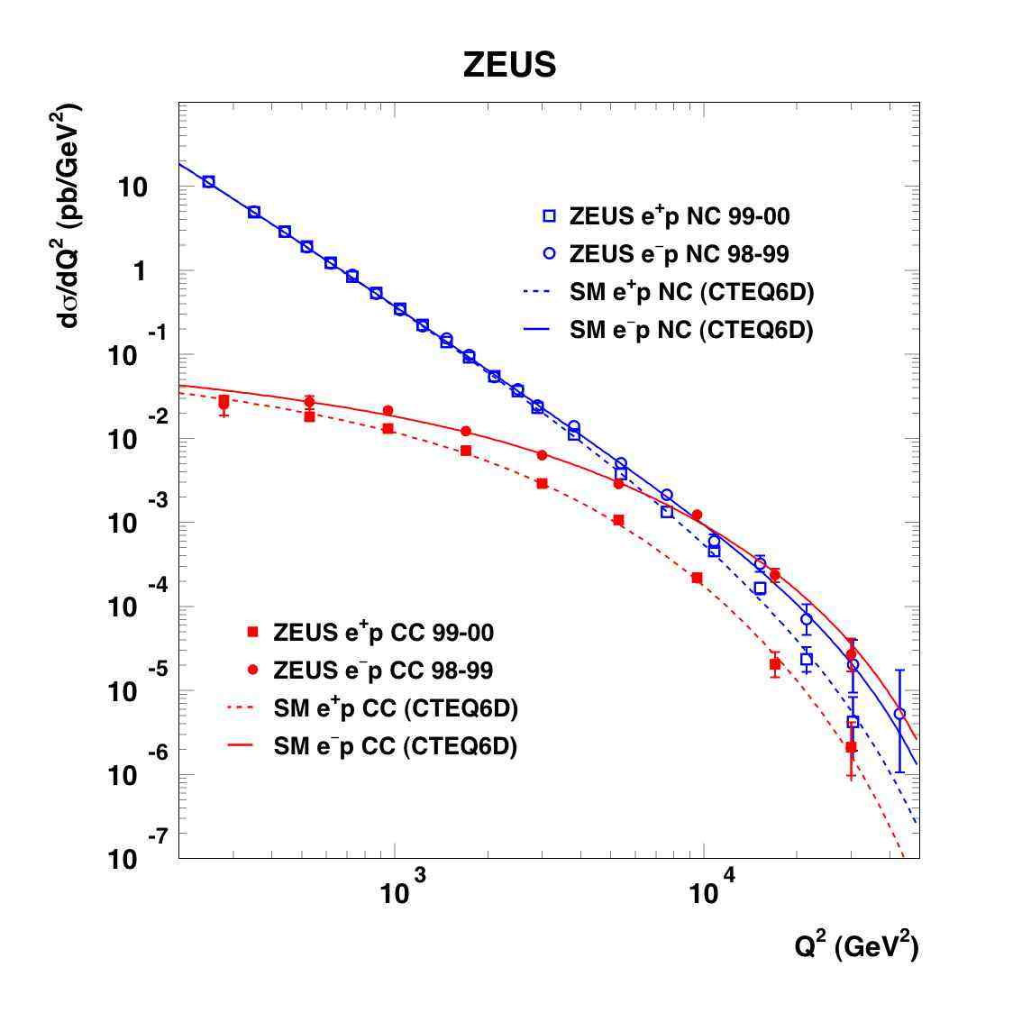
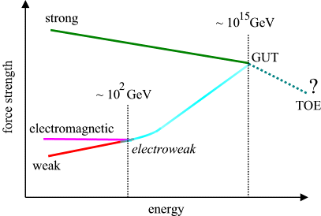
Electromagnetic interaction
γ
W±
Weak Nuclear Interaction
Notes:
Como é que sabíamos disto? Ou só estávamos só a adivinhar?
Vemos isto em medidas experimentais!! Neste gráfico vemos a probabilidade de um certo tipo de reação entre partículas.
Há duas possibilidades: uma reação governada pela força fraca e outra reação pela força eletromagnética.
A altas energias, vemos que as duas forças se tornam numa só força: a força electrofraca.
É a quebra de simetria ao contrário, como se andássemos para trás no tempo, em direção ao Big Bang

Slide 23
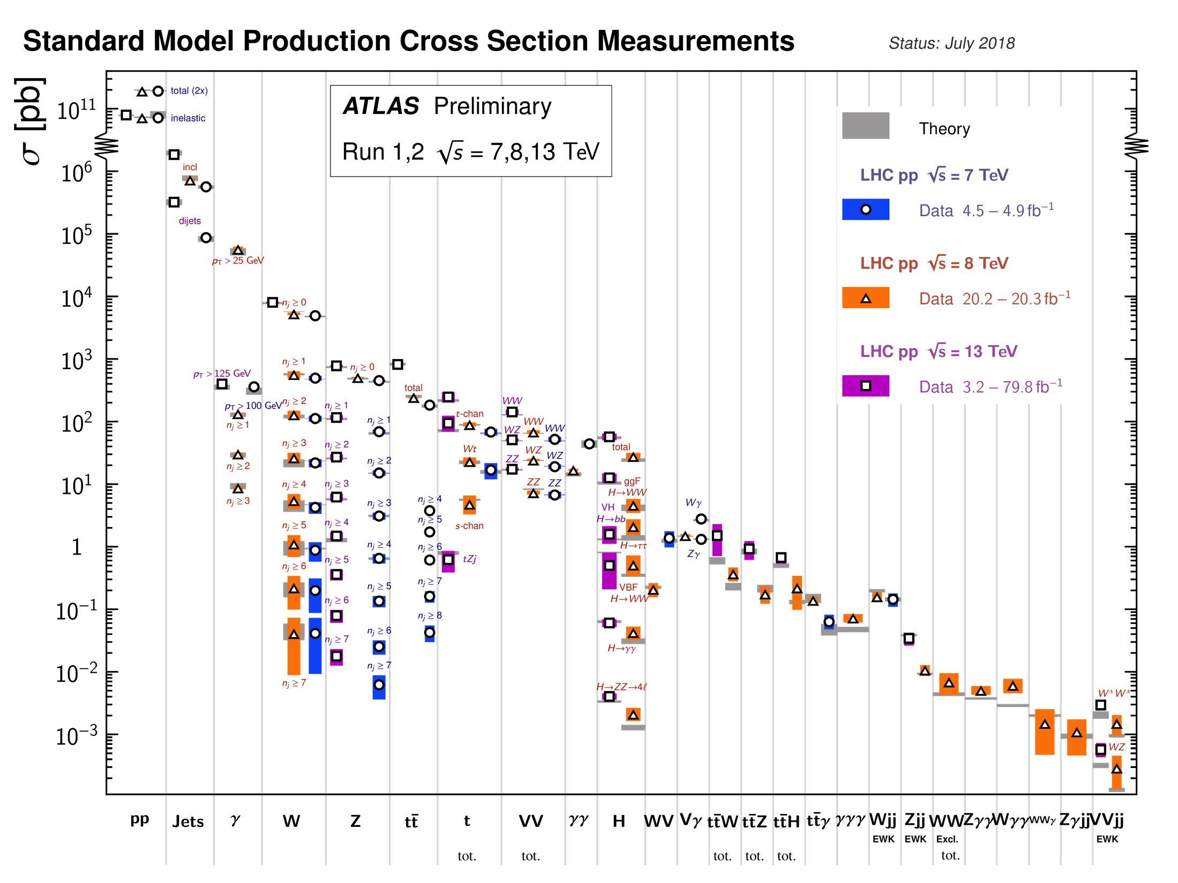
Notes:
SM expectations match measurements at the LHC over a huge range (12 orders of magnitude)! Clearly we do know something....

Slide 24
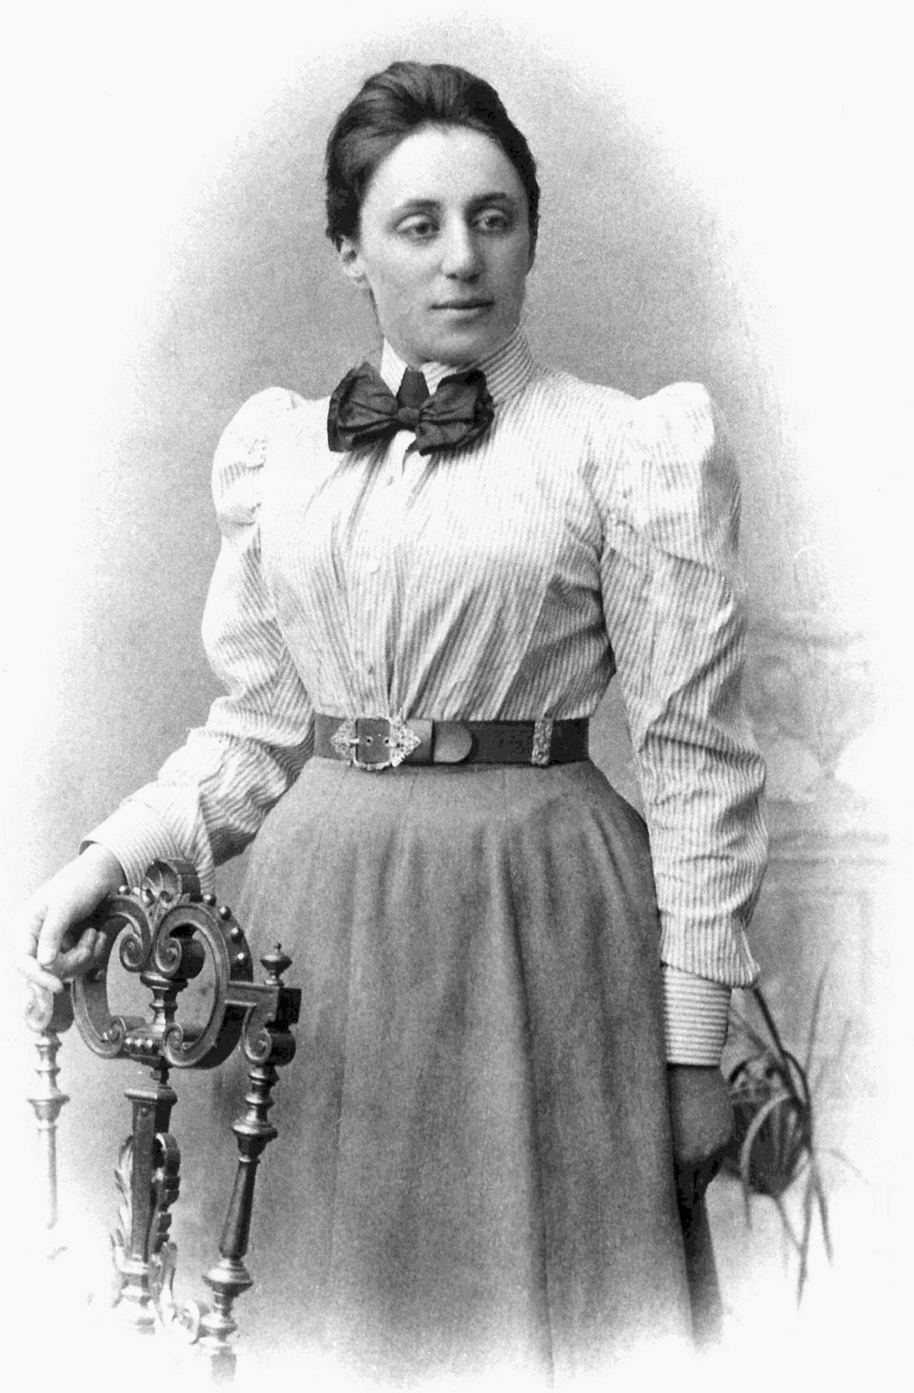
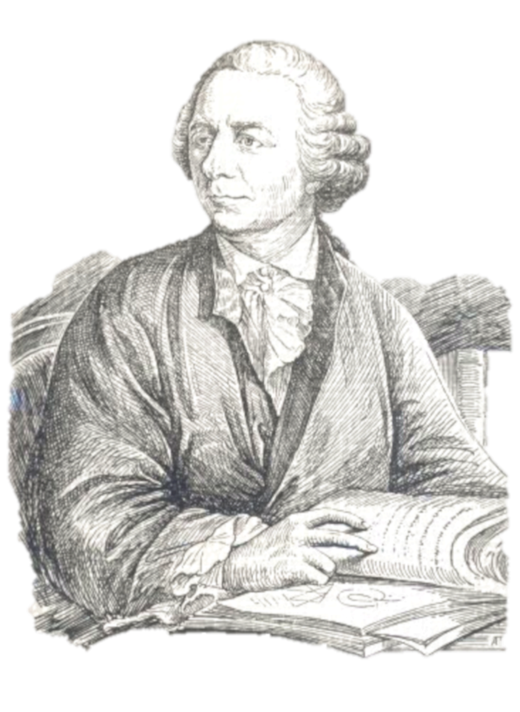
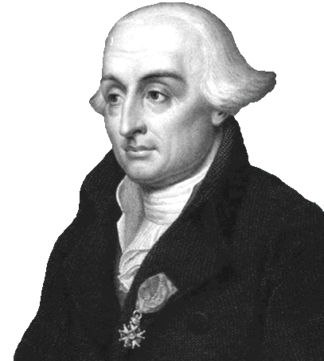
Lagrangians, symmetries and all that
Leonhard Euler(1707–1783)
Emmy Noether (1882 – 1935)
Joseph-Louis Lagrange (1736–1813)
Notes:
Italian-French mathematician and astronomer Joseph-Louis Lagrange in 1788 (born Giuseppe Lodovico Lagrangia to a french father and italian mother) lived in Turin, Berlin and Paris, and was one of the most a renowned mathematicians of his age, teaching . He was president of the commission which defined the metre and kilogram as units. Fourier, who attended his lectures in 1795, wrote: “his voice is very feeble, at least in that he does not become heated; he has a very marked Italian accent and pronounces the s like z [...] The students, of whom the majority are incapable of appreciating him, give him little welcome, but the professeurs make amends for it.” https://en.wikipedia.org/wiki/Joseph-Louis_Lagrange
Amalie Emmy Noether was a German mathematician known for her landmark contributions to abstract algebra and theoretical physics. In physics, Noether's theorem explains the connection between symmetry and conservation laws. Noether was born to a Jewish family in Germany; her father was a mathematician, Max Noether. She studied mathematics at the University of Erlangen. She was invited by David Hilbert and Felix Klein to join the mathematics department at the University of Göttingen, a world-renowned center of mathematical research. But the philologists and historians among the philosophical faculty blocked her: women, they insisted, should not become privatdozent. One faculty member protested: "What will our soldiers think when they return to the university and find that they are required to learn at the feet of a woman? She spent four years lecturing under Hilbert's name. Her habilitation was approved in 1919. Noether remained a leading member of the Göttingen mathematics department until 1933, when Germany's Nazi government dismissed Jews from university positions, and Noether moved to the United States to take up a position at Bryn Mawr College in Pennsylvania. In 1935 she underwent surgery for an ovarian cyst and, despite signs of a recovery, died four days later at the age of 53.
Leonhard Euler (1707 - 1783) was a Swiss mathematician, physicist, astronomer, logician and engineer who made important and influential discoveries in many branches of mathematics like infinitesimal calculus and graph theory while also making pioneering contributions to several branches such as topology and analytic number theory. He also introduced much of the modern mathematical terminology and notation, particularly for mathematical analysis, such as the notion of a mathematical function. He is also known for his work in mechanics, fluid dynamics, optics, astronomy, and music theory. Euler was one of the most eminent mathematicians of the 18th century, and is held to be one of the greatest in history. He is also widely considered to be the most prolific mathematician of all time. He spent most of his adult life in St. Petersburg, Russia, and in Berlin, then the capital of Prussia.

Slide 25
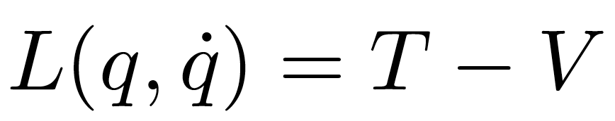
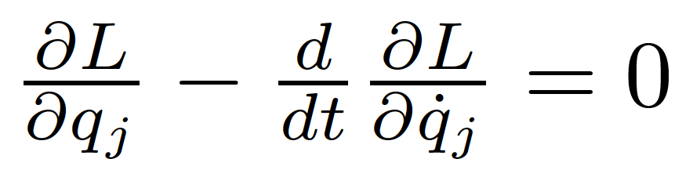
Reminder: Lagrangians in classical mechanics
The equations of motion of a system are derived from a scalar Lagrangian function of generalized coordinates and velocities (time derivatives of the coordinates)
and from the Euler-Lagrange equations:

Slide 26
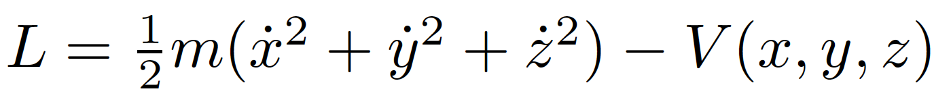
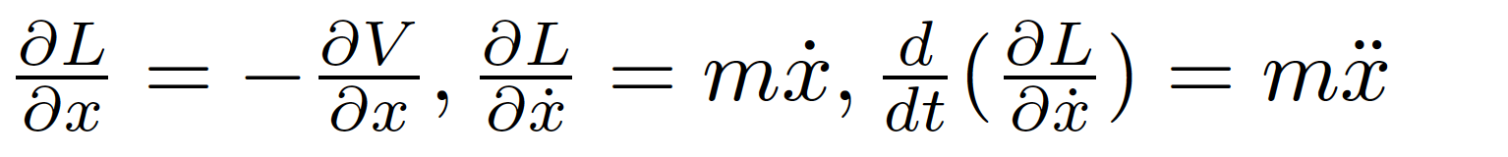
Example
Particle in a conservative potential V. The Lagrangian
has derivatives (e.g. for x)
and Euler-Lagrange’s equations
finally give us Newton’s familiar 2nd law!

Slide 27
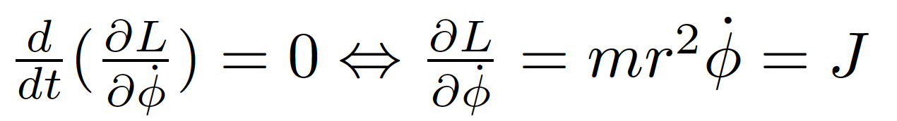
Symmetries and conservation laws
Noether’s theorem:
  If a system has a continuous symmetry property, then there are corresponding quantities whose values are conserved in time.
Simplest case: Coordinates not explicitly appearing in the Lagrangian
Lagrangian invariant over a continuous transformation of the coordinates
Example: mass m orbiting in the field of a fixed mass M
Since the lagrangian doesn’t depend explicitly on φ (symmetry with respect to rotations in space), the Euler-Lagrange equation gives
Where the angular momentum J is a constant of motion!

Slide 28
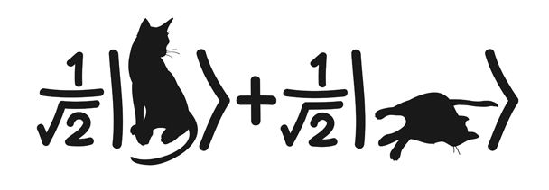
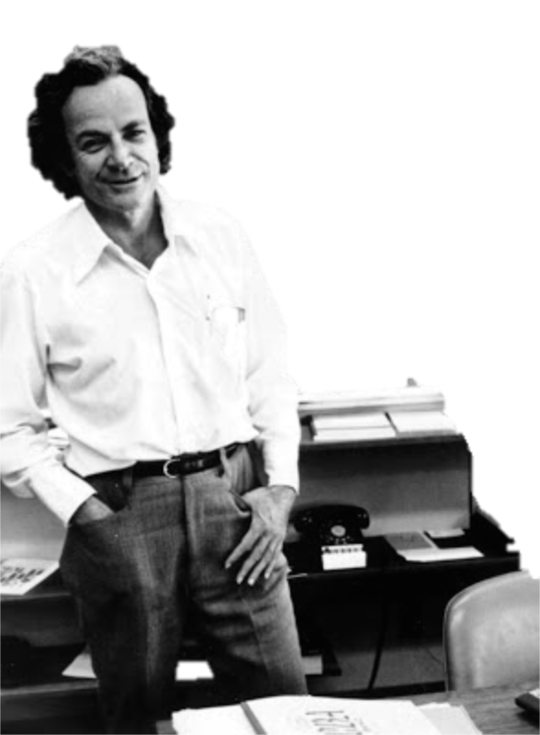
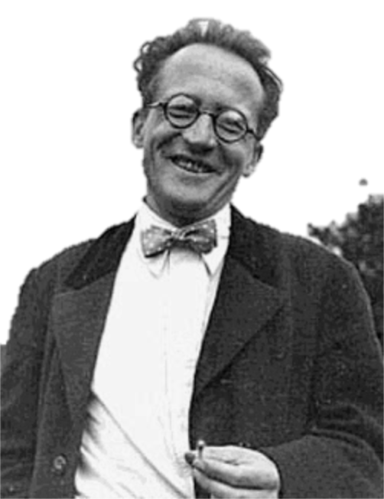

Let’s go to quantum fields...
Erwin Schrödinger (1887 - 1961)
Richard Feynman (1918 - 1988)
Schrödinger’s cat (?-?)
Notes:
Erwin Rudolf Josef Alexander Schrödinger (1887 –1961), sometimes written as Erwin Schrodinger or Erwin Schroedinger, was a Nobel Prize-winning Austrian physicist who developed a number of fundamental results in the field of quantum theory, which formed the basis of wave mechanics: he formulated the wave equation (stationary and time-dependent Schrödinger equation) and revealed the identity of his development of the formalism and matrix mechanics. Schrödinger proposed an original interpretation of the physical meaning of the wave function.
Richard Phillips Feynman (1918 – 1988) was an American theoretical physicist known for his work in the path integral formulation of quantum mechanics, the theory of quantum electrodynamics, and the physics of the superfluidity of supercooled liquid helium, as well as in particle physics for which he proposed the parton model. For his contributions to the development of quantum electrodynamics, Feynman, jointly with Julian Schwinger and Sin-Itiro Tomonaga, received the Nobel Prize in Physics in 1965.

Slide 29
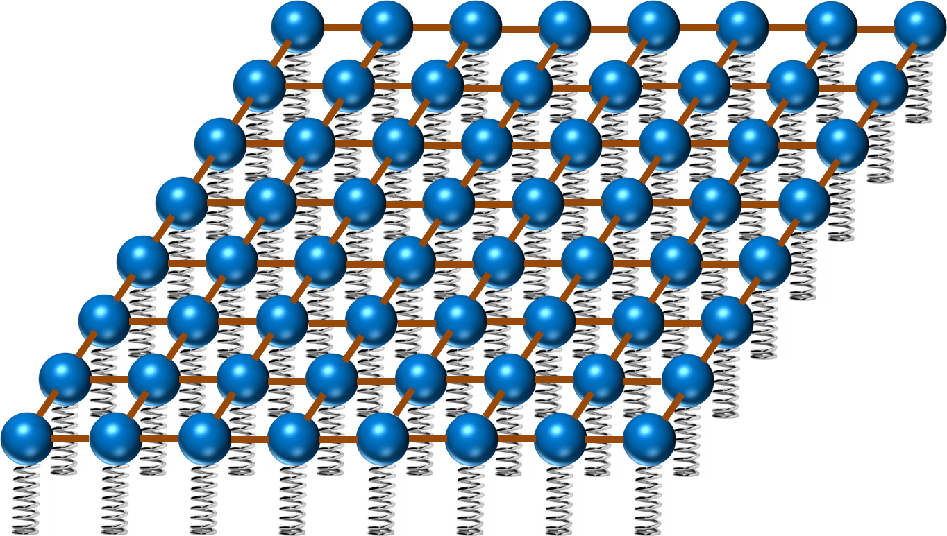
Now in quantum field theory…
Imagine space as an infinite continuum of balls and springs, where each ball is connected to its neighbours by elastic bands. Particles are perturbations of this field
y
ϕ(x,y)
x

Slide 30
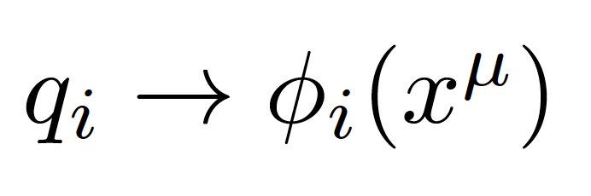
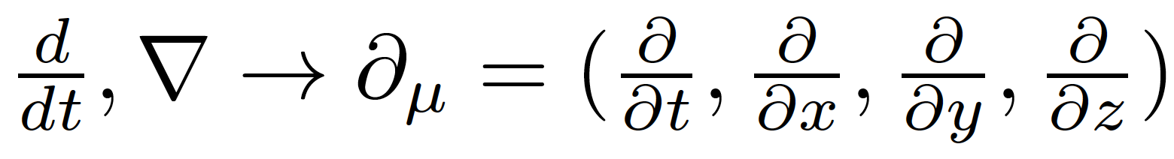
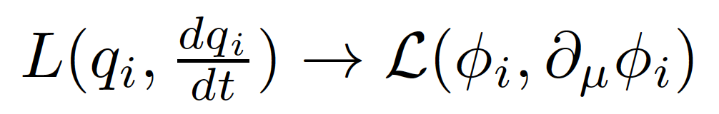
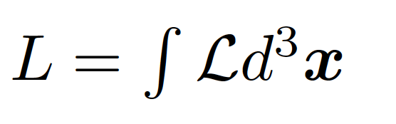
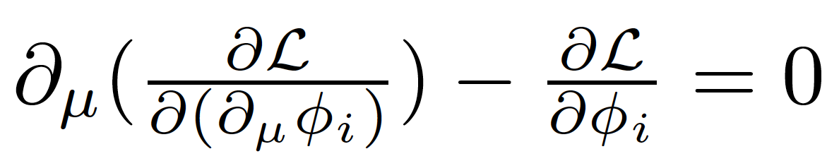
Generalized coordinates are now fields (dislocation of each spring)
In a relativistic theory we must treat space and time coordinates on an equal footing, so the derivatives in the classical equations are now
In place of a Lagrangian we have a Lagrangian density (we call it Lagrangian anyway, just to be confusing)
with:
The new Euler-Lagrange equation now becomes

Slide 31
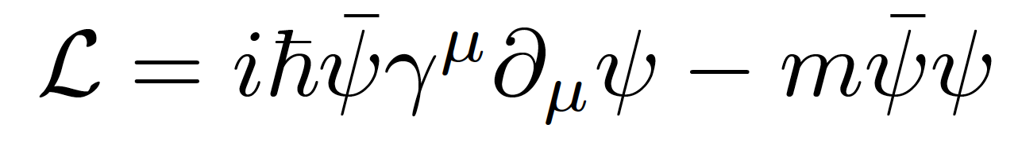
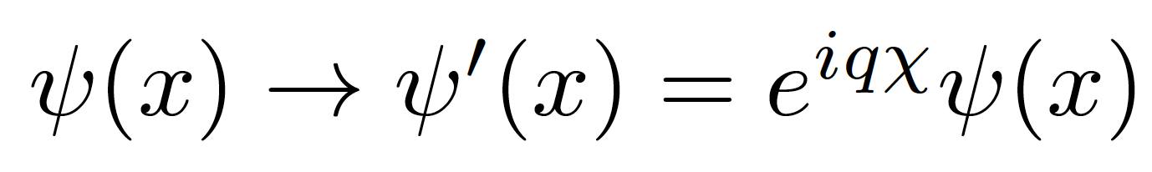
Gauge invariance
Take the Dirac Lagrangian for a spinor field ψ representing a spin-½ particle, for example an electron:
It is invariant under a global U(1) phase transformation like:
Where χ is a constant
Notes:
By the way: this is related to the conservation of electric charge!

Slide 32
Gauge invariance
Take the Dirac Lagrangian for a spinor field ψ representing a spin-½ particle, for example an electron:
It is invariant under a global U(1) phase transformation like:
Where χ is a constant
Notes:
By the way: this is related to the conservation of electric charge!

Slide 33
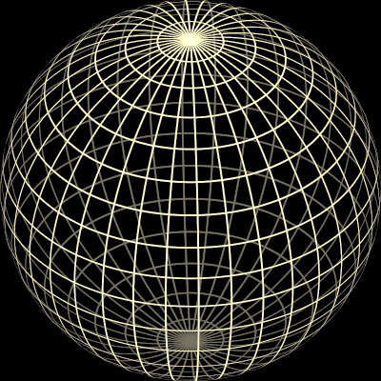
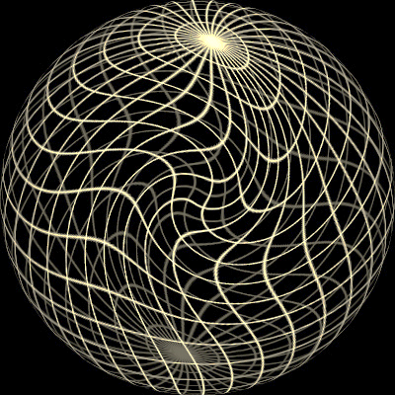
Original sphere
Global transformation
Local transformação
χ = constant
χ = χ (x)

Slide 34

Now for the problems...

Slide 35
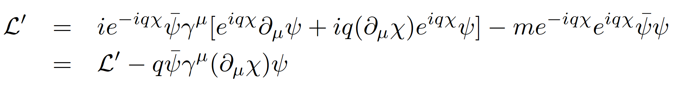
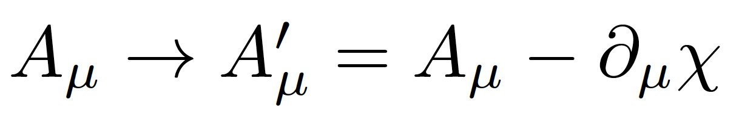

Local gauge invariance and interactions
If χ = χ (x) then we get extra terms in the Lagrangian:
But we can now make the Lagrangian invariant by adding an interaction term with a new gauge field A_{μ} which transforms as:
We get:
A few things to note:
Gauge theories are renormalizable, i.e. calculable without infinities popping up everywhere (Nobel prize of t’Hooft and Veltman)
The new gauge field A_{μ} is the photon in QED
The mass of the fermion is the coefficient of the term on ψψ
There is no term in A_{μ}A^{μ} (the photon has zero mass) → this is the beginning of the Higgs story…
Notes:
Demanding local gauge conservation resulted in obtaining a new field (the photon) and its interactions with the fermion fields. This is the blueprint of all Standard Model theories (called “Gauge theories”).
Gauge theories are automatically renormalizable (‘t Hooft & Veltman’s Nobel prize) i.e. don’t produce nonsense.

Slide 36
Problem 1: Mass of elementary particles and gauge bosons
To keep the Lagrangian gauge invariant (against a U(1) local phase transformation) the photon field transforms as:
But the A^{μ} mass term breaks the invariance of the Lagrangian:
For the SU(2)_{L} gauge symmetry transformations of the weak interaction the fermion mass term m_{e}ψψ also breaks invariance!

Slide 37

It should not work…
MASS
p
n
e
μ
γ
W±
Z
u
d
t
Notes:
1: mass of elementary bosons and fermions

Slide 38


Problem 2:
Longitudinal gauge-boson scattering
In the absence of the Higgs, some processes have cross sections that grow with the centre of mass energy of the collision… i.e. breaks unitarity!
The Higgs regulates the cross section through negative interference
J.C.Romão [5]
Bottom line: the SM (without the Higgs mechanism) results in wrong calculations and breaks down for massive particles
Feynman diagrams contributing to longitudinal WW scattering

Slide 39



The Higgs Mechanism
Robert Brout (1928 – 2011)
François Englert (b. 1932)
Peter Higgs (b. 1929)
Notes:
Peter Ware Higgs (born 29 May 1929) is a British theoretical physicist, emeritus professor at the University of Edinburgh. In the 1960s, he proposed that broken symmetry in electroweak theory could explain the origin of mass of elementary particles in general and of the W and Z bosons in particular. This so-called Higgs mechanism, which was proposed by several physicists besides Higgs at about the same time, predicts the existence of a new particle, the Higgs boson, the detection of which became one of the great goals of physics.
Robert Brout (1928 –2011) was a Belgian theoretical physicist who made significant contributions in elementary particle physics. He was a Professor of Physics at Université Libre de Bruxelles where he had created, together with François Englert, the Service de Physique Théorique.
François Baron Englert (born 1932) is a Belgian theoretical physicist and 2013 Nobel prize laureate (shared with Peter Higgs). He is Professor emeritus at the Université libre de Bruxelles (ULB) where he is member of the Service de Physique Théorique. He is also a Sackler Professor by Special Appointment in the School of Physics and Astronomy at Tel Aviv University and a member of the Institute for Quantum Studies at Chapman University in California.

Slide 40


Slide 41





Introduce a SU(2) doublet of spin-0 complex fields
The Lagrangian is
With a potential
For λ>0, μ²<0 the potential has a
minimum at the origin
For λ>0, μ²<0 the potential has an
infinite number of minima at:
The choice of vacuum (lowest
energy state of the field) breaks the symmetry of the Lagrangian

Slide 42



Notes:
Quebra da simetria electrofraca após o Big Bang: quando a densidade de energia baixou, as próprias forças fundamentais mudaram
No fim ficamos com W e Z com massa, fotão na mesma sem massa, e resta-nos um bosão de Higgs; mas as proprias forças mudam!
In the Standard Model with no Higgs mechanism, interactions are symmetric and particles do not have mass
Electroweak symmetry is broken: Photon does not have mass W, Z have a large mass
Higgs mechanism: mass of W and Z results from the Higgs mechanism; Masses of fermions come from a direct interaction with the Higgs field

Slide 43
Magnetic material at high temperatures
Symmetric in direction

Slide 44
Magnetic material at low temperature
Symmetry broken – special direction

Slide 45

EWK Symmetry Breaking in Pictures

Slide 46

The Story So Far...
Notes:
Como é que sabíamos disto? Ou só estávamos só a adivinhar?
Vemos isto em medidas experimentais!! Neste gráfico vemos a probabilidade de um certo tipo de reação entre partículas.
Há duas possibilidades: uma reação governada pela força fraca e outra reação pela força eletromagnética.
A altas energias, vemos que as duas forças se tornam numa só força: a força electrofraca.
É a quebra de simetria ao contrário, como se andássemos para trás no tempo, em direção ao Big Bang

Slide 47




The Standard Model of particle physics
2013
Notes:
Particulas fundamentais conhecidas; forças a que elas reagem; Z tem massa alta ao contrario de gamma e gluoes; Higgs pedra basilar do edificio; dá massa mas só pequena fração nos hadroes;

Slide 48


The Long Way to Discovery

Slide 49






Slide 50

Searches at LEP

Slide 51

Low-mass searches at LEP

Slide 52

Higher-mass Higgs production at LEP

Slide 53


Slide 54

LEP’s Final Legacy: the Blue Band Plot
Decades of searches in many experiments...
By July 2010:
  LEP+Tevatron+SLD limits
  Higgs excluded m_{h}<114.4 GeV at 95% CL
  Plus between 158 and 175 GeV
CERN-PH-EP-2010-05

Slide 55

Searches at the Tevatron

Slide 56

Higgs production at the Tevatron

Slide 57


The final stand of the Tevatron
By the end of its lifetime, the Tevatron had very sophisticated analyses of a huge number of channels
By that time the LHC was collecting data and analysing it very fast
The CDF and D0 experiments obtained a significant excess of around 3 standard deviations in the mass range 115<M_{H}<140 GeV
Not enough to claim discovery, but consistent with the LHC results

Slide 58



Discovery at the LHC
Proton-proton (and Heavy Ion) collider
s^{1/2} = 7, 8, 13 TeV so far
Operation started 2008
Physics data from 2010
Expected closure 2035
Luminosity so far: about 150 fb⁻¹ per experiment for ATLAS and CMS

Slide 59





At the LHC
https://twiki.cern.ch/twiki/bin/view/LHCPhysics/LHCHXSWG
gluon-fusion
VBF
WH
ZH
ttH
Notes:
Main production channels: gluon fusion, Vector Boson Fusion, associated production with vector bosons, associated production with ttbar pair
Animation

Slide 60





Slide 61

2012: Descoberta do bosão de Higgs: H->γγ
Notes:
The weighting of events is similar to what is used in the final significance extraction

Slide 62



Discovery channels
Discovery was made in ATLAS and CMS with about 5 fb⁻¹ of 7 TeV data and 20 fb⁻¹ of 8 TeV data per experiment; several channels combined
This means about 400 000 Higgs bosons produced in about 8 000 000 000 000 000 (8x10¹⁵) proton collisions
  Only about 4000 events with Higgs bosons contributed to the discovery

Slide 63


2013 Physics Nobel Prize Higgs for the Higgs Boson Discovery
François Englert,
Belga,
born 1932,
U. Libre
de Bruxelles
Peter Higgs,
English,
born
1929,
Univ. of
Edimburgh
"for the theoretical discovery of a mechanism that contributes to our understanding of the origin of mass of subatomic particles, and which recently was confirmed through the discovery of the predicted fundamental particle, by the ATLAS and CMS experiments at CERN's Large Hadron Collider"
Notes:
A Descoberta do bosão de Higgs premiada com o Prémio Nobel 2013
E mostrou finalmente que os termos com phi na caneca existem

Slide 64



Slide 65



It takes time to get it right
EPS-HEP 2011 conference [6]

Slide 66



Probing the 125 GeV Higgs - Examples
2HDM
Triple coupling λ₃
Clavicle
Aorta
Ribs
Yukawa
couplings
BSM

Slide 67



Higgs boson mass
Mass: around 125GeV
  Was the only unknown
  SM parameter ☺
For a while, different mass values were being measured in ATLAS and CMS, and in different channels
Numbers evolved with accumulated statistics
Current most precise value from ATLAS+CMS has 0.2% precision!
  ATLAS: arXiv:1307.1427
Phys. Rev. Lett. 114, 191803
m_{H}=125.09±0.21 (stat)±0.11 (syst) GeV

Slide 68


Exploring the electroweak scale
Precision measurements of m_{W}, m_{t}, m_{H} are stringent tests of the SM at the EW scale
  E.g. excluding measured m_{H}, global EW fit gives m_{H} = 90 ± 21 GeV (1.7 σ tension) driven in part by m_{top}
arXiv:1803.01853

Slide 69






Run 2: Higgs boson mass
arXiv:1804.02716 [hep-ex]; arXiv:1706.09936 [hep-ex]; arXiv:1806.00242 [hep-ex]
Mass measurement from CMS H→ZZ*→4l:
m_{H}^{ZZ*}= 125.26 ± 0.20 (stat) ± 0.08 (syst) GeV
New Measurements from ATLAS
  H→ γγ: m_{H}^{γγ} = 124.93 ± 0.40 GeV
  H→ZZ*→4l: m_{H}^{ZZ∗} = 124.79 ± 0.37 GeV
Run 1+2 combination from ATLAS:
  m_{H} = 124.97 ± 0.19 (stat) ± 0.13 (syst.) GeV
Notes:
https://atlas.web.cern.ch/Atlas/GROUPS/PHYSICS/PAPERS/HIGG-2016-33/ → 1 June 2018
http://cms-results.web.cern.ch/cms-results/public-results/publications/HIG-16-040/index.html → 8 April 2018
Both use 36.1 fb⁻¹ from 2015+2016

Slide 70

Casting a wider net

Slide 71







Additional Higgs bosons?

Slide 72




Higgs + Dark Matter
ATLAS-CONF-2018-039
Used 79.8 fb⁻¹ of 13 TeV data
  High E_{T}^{miss} (>150GeV) and b-tagging to suppress backgrounds
  Reconstruct b-jets as 2 small jets or merged variable-radius (VR) track jets
Signal benchmark: Type-II 2HDM + U(1)_{Z’} symmetry (Z’-2HDM)
Main backgrounds: tt, W/Z+jets
Excluded region in m_{A} – m_{Z’} plane
Notes:
https://atlas.web.cern.ch/Atlas/GROUPS/PHYSICS/CONFNOTES/ATLAS-CONF-2018-039/ → 25 July 2018
VR jets: track jets reconstructed with an algorithm in which the radius parameter decreases with increasing jet transverse momentum (pT)
large missing transverse momentum and either two b-tagged small radius jets or a single large radius jet containing two b-tagged subjets

Slide 73








Triple Higgs coupling
arXiv:1808.00336 [hep-ex]; ATLAS-CONF-2018-043
The triple Higgs coupling λ_{HHH} can be probed through di-Higgs production
Very suppressed in SM!
  Negative interference between LO diagrams
  Cross section 1500x less than ggF
Wide range of decay BR and channel purity
bbττ analysis:
  Used 36 fb⁻¹ of 13 TeV data
  Final state BR(bbττ)=7%
  Non-Resonant 95% CL limit:
    μ < 12.7 observed (14.8 expexcted)
Combination: at ≈10 x SM sensitivity – with 3% of the HL-LHC luminosity analyzed
Di-Higgs combination plot here
Notes:
https://atlas.web.cern.ch/Atlas/GROUPS/PHYSICS/CONFNOTES/ATLAS-CONF-2018-026/ → 2 Jul 2018
https://atlas.web.cern.ch/Atlas/GROUPS/PHYSICS/CombinedSummaryPlots/HIGGS/ATLAS_HIGGS6100_HH_Summary/ATLAS_HIGGS6100_HH_Summary.png
https://atlas.web.cern.ch/Atlas/GROUPS/PHYSICS/CONFNOTES/ATLAS-CONF-2018-043/

Slide 74




A bit of fun…
1-loop effective potential
RG-improved potential
What if…
  At higher orders, Higgs potential doesn’t have to be stable
  Depending on m_{t} and m_{H} second minimum can be lower than EW minimum ⇒ tunneling between EW vacuum and true vacuum?!
“For a narrow band of values of the top quark and Higgs boson masses, the Standard Model Higgs potential develops a shallow local minimum at energies of about 10¹⁶ GeV, where primordial inflation could have started in a cold metastable state”, I. Masina, arXiv:1403.5244 [astro-ph.CO]
  See also: V. Brachina, Moriond 2014 (Phys.Rev.Lett.111, 241801 (2013)), G. Degrassi et al, arXiv:1205.6497v2; R.Contino, Workshop sulla fisica p-p a LHC, 2013

Slide 75



The universe seems to live near a critical condition
JHEP 1208 (2012) 098
Why?!
Explained by underlying theory?
Anthropic principle?

Slide 76

Questions?
Thank you for your interest!
jgoncalo@lip.pt

