Slide 1







Higgs Physics – Lecture 1
Higgs Physics at the LHC – Introduction
Ricardo Gonçalo – LIP
IDPASC Course on Physics at the LHC – LIP, 1 April 2020

Slide 2

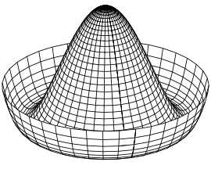
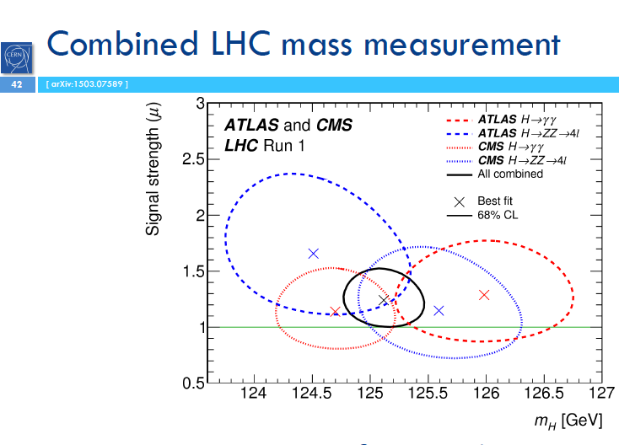
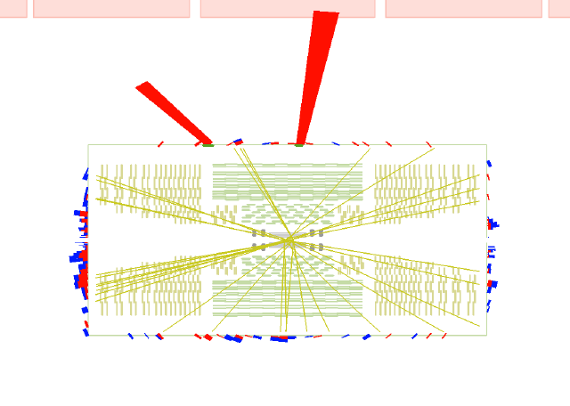
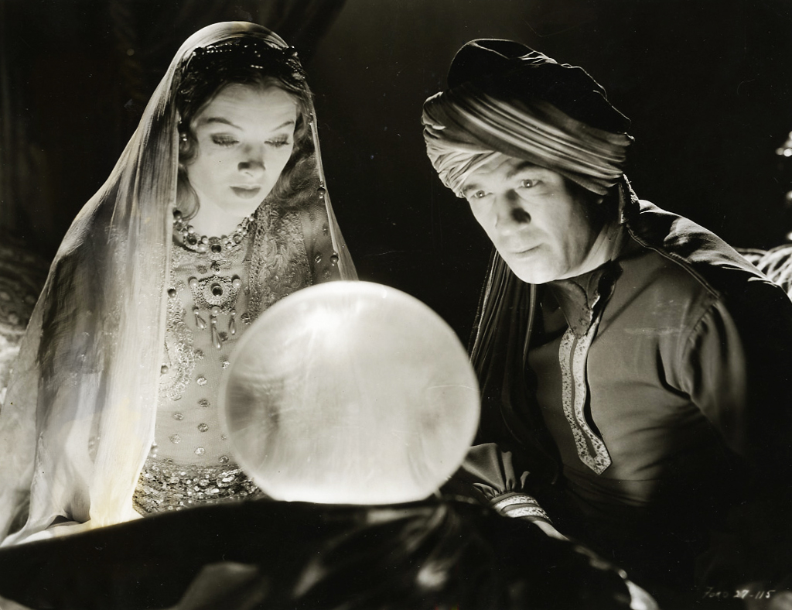
Higgs Lectures

Slide 3

Outlook
Introduction
Some theory
  Problems with the Standard Model
The Higgs mechanism
The long way to discovery
  LEP experiments
  Tevatron experiments
  Search and Discovery at the LHC
Higgs boson properties
Open questions
Notes:
What we thought we knew – teoria e pre-LHC data
How we know what we know – experimental aspects
What we know – we found a Higgs boson
All we have found out in the meantime – mass, spin, parity, cross sections
What we know we don’t know...
What we think we know – teoria e o BSM Higgs

Slide 4
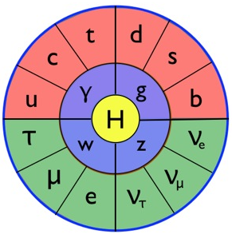
Introduction
The Standard Model particles and interactions, and some theory to set the scene…

Slide 5
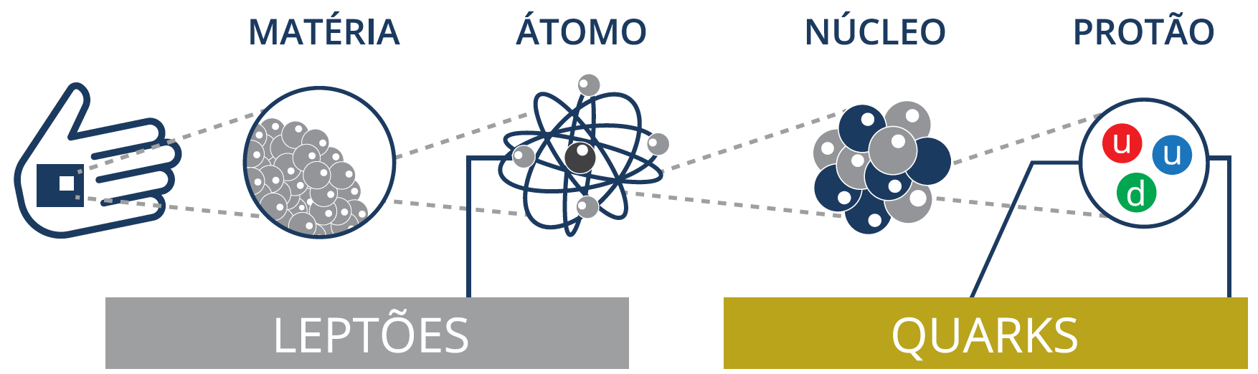
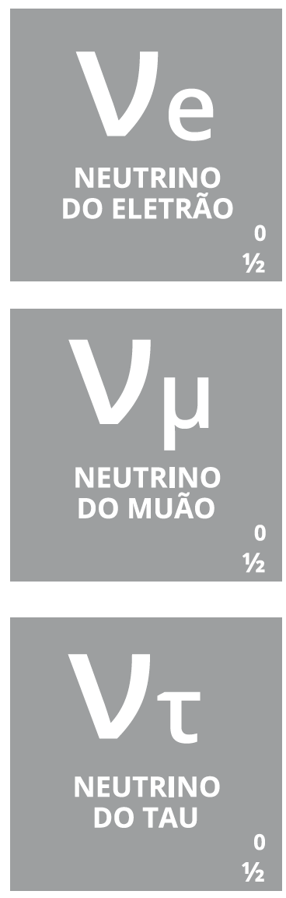

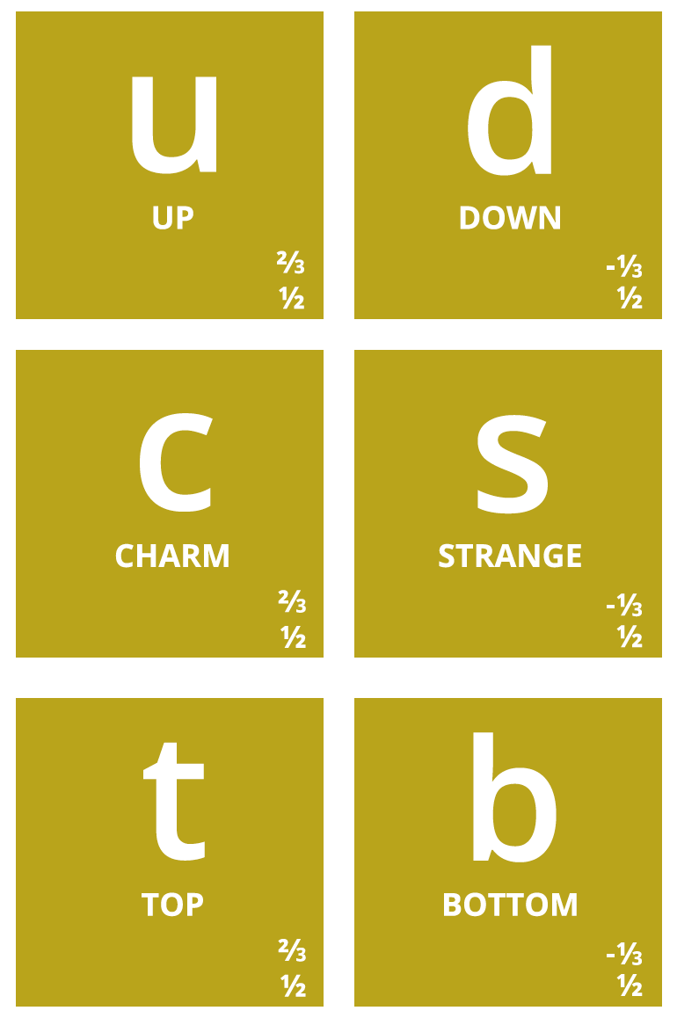
Notes:
Então, quais são afinal as partículas elementares? Temos os quarks, que dão as diferentes propriedades da nova tabela periódica
Também temos o electrão (já conhecíamos), e os seus primos mais pesados: muão e tau. Para cada um destes temos os neutrinos (não são feitos de quarks), que são produzidos em reações no Sol, por exemplo.
Por alguma razão (que desconhecemos) há 3 gerações de partículas elementares, cada uma mais pesada que a anterior → mistério!

Slide 6

E as forças fundamentais?

Slide 7
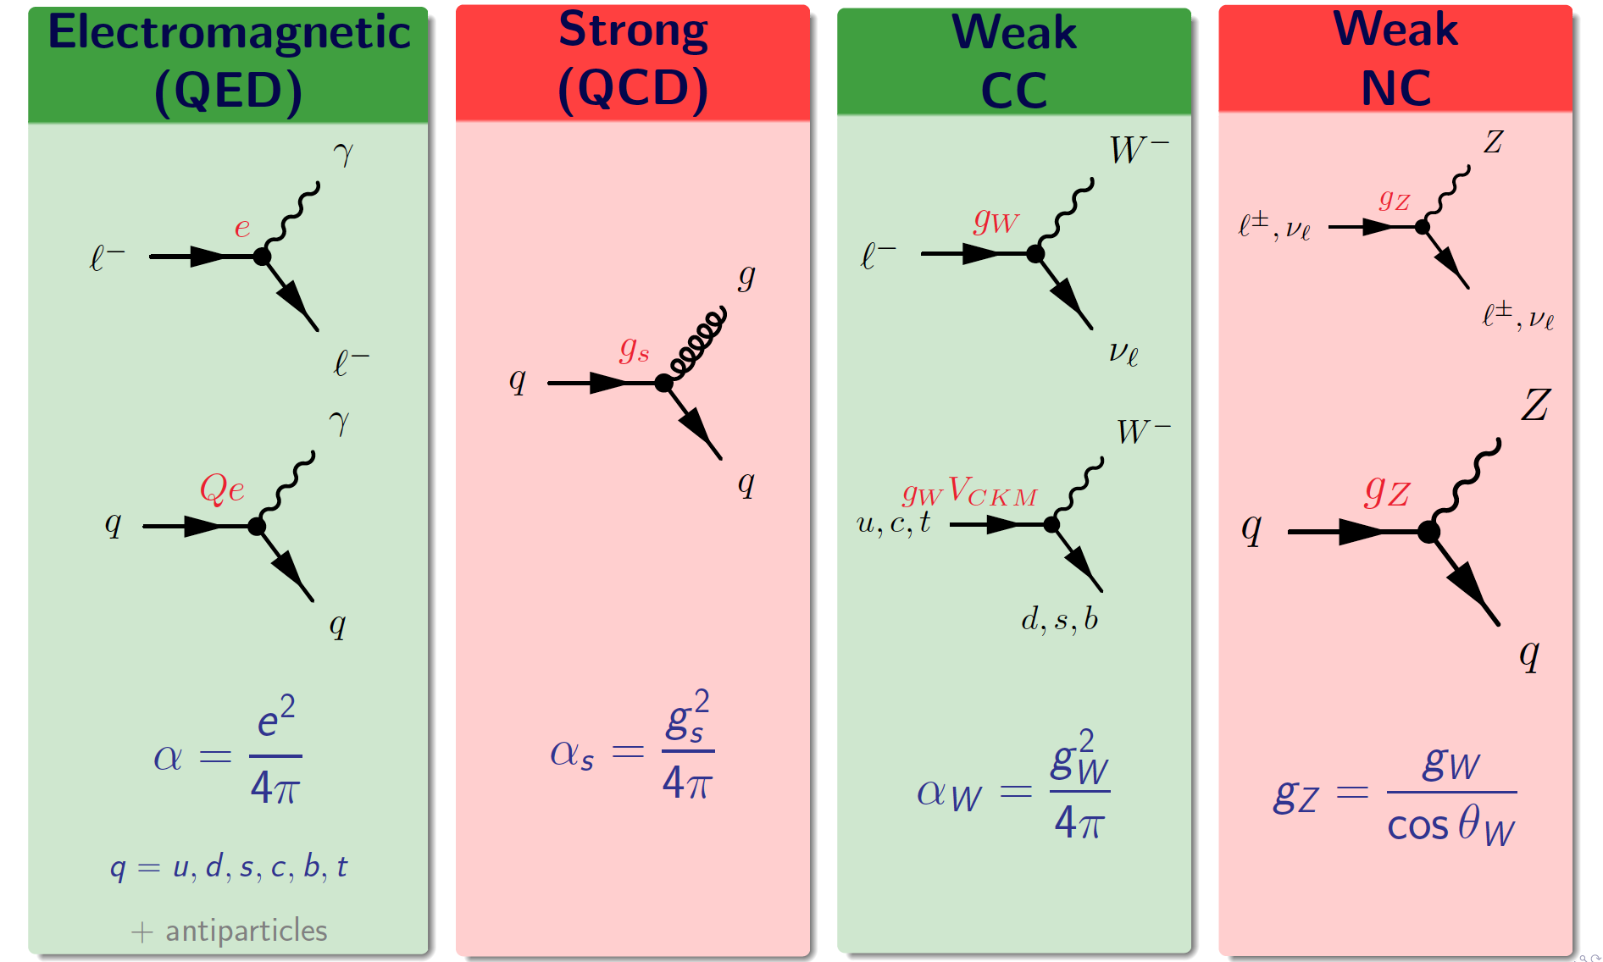
Summary of Standard Model matter vertices

Slide 8
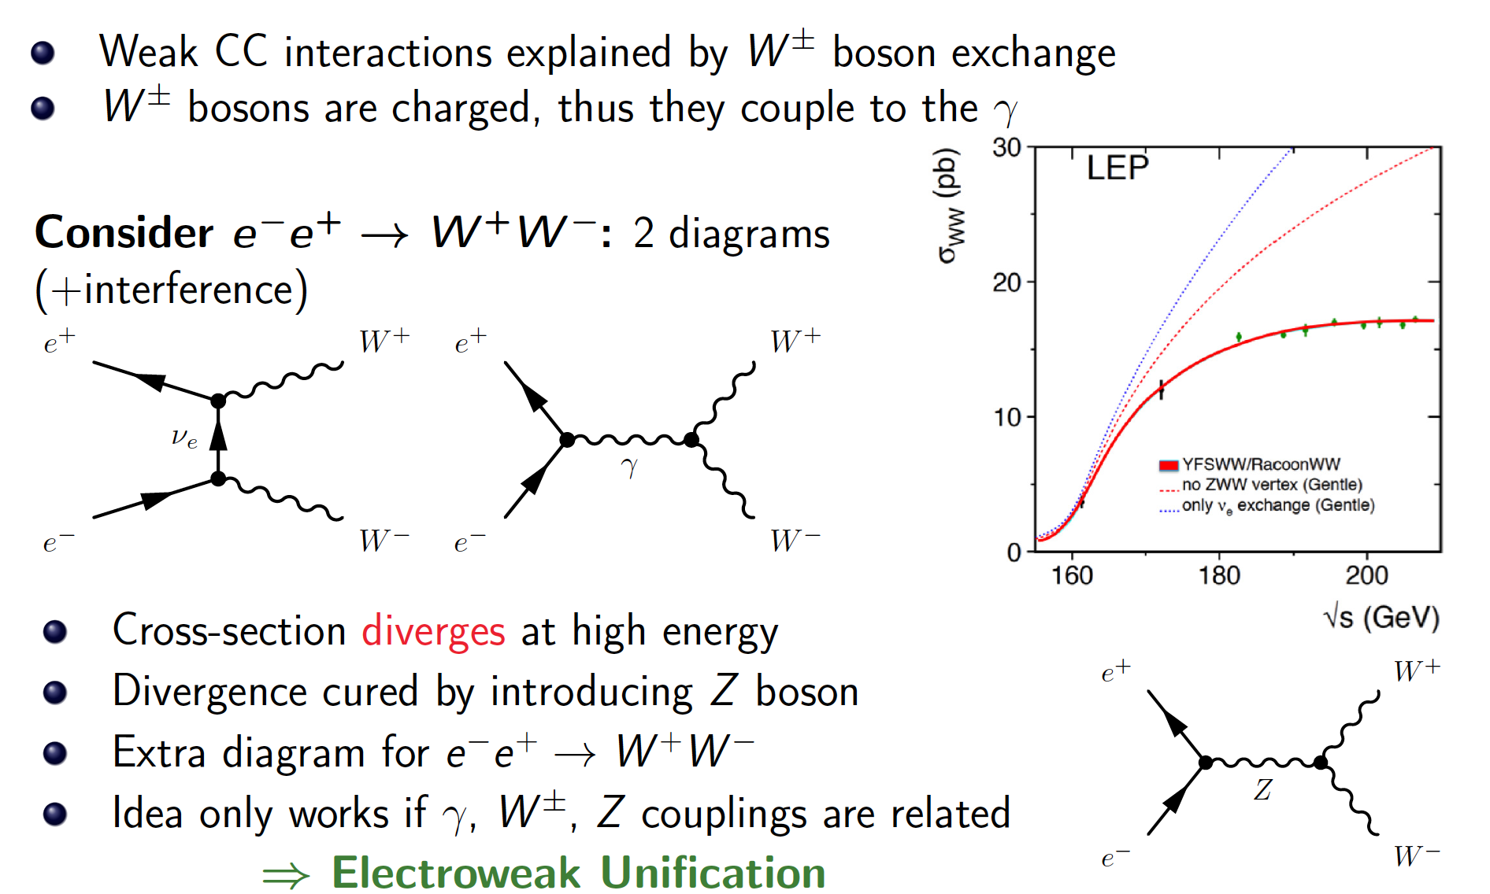
Electroweak Unification

Slide 9
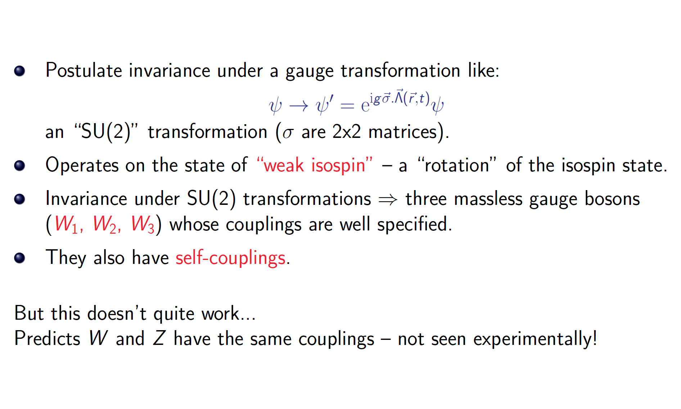
Electroweak Gauge Theory

Slide 10
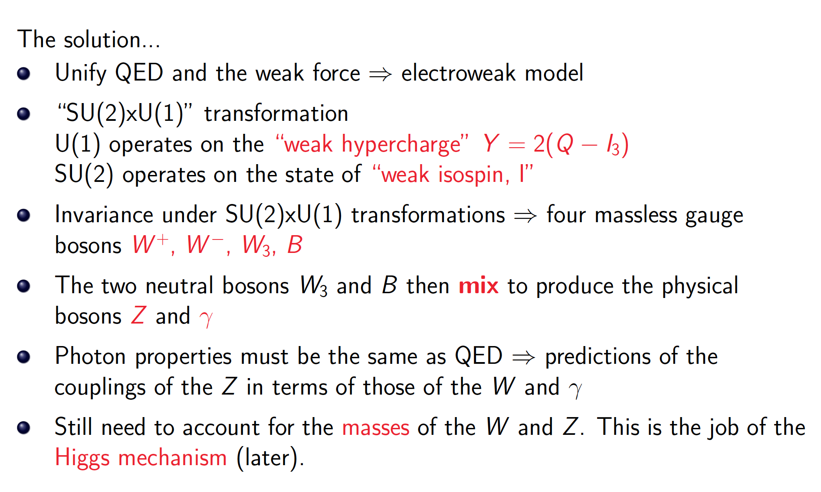
Electroweak Gauge Theory

Slide 11
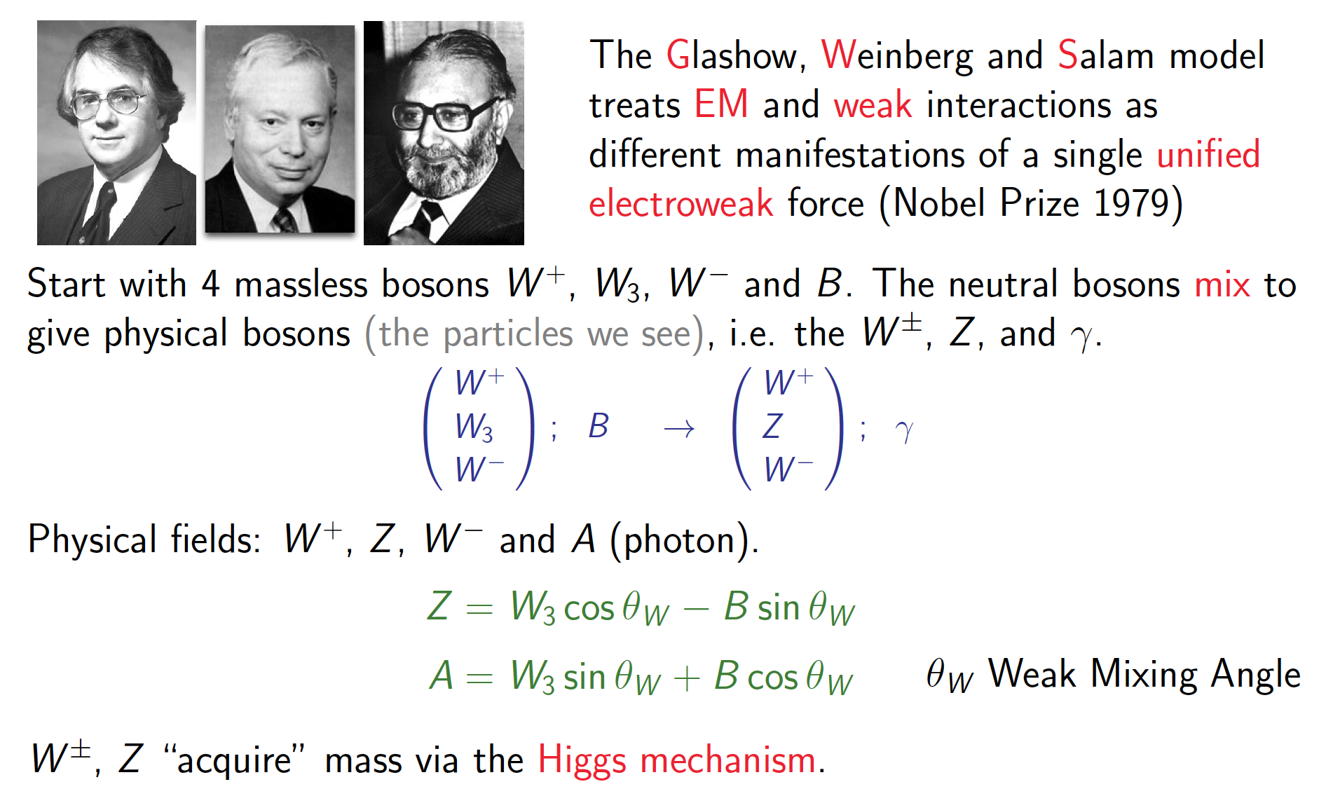
The GWS Model

Slide 12
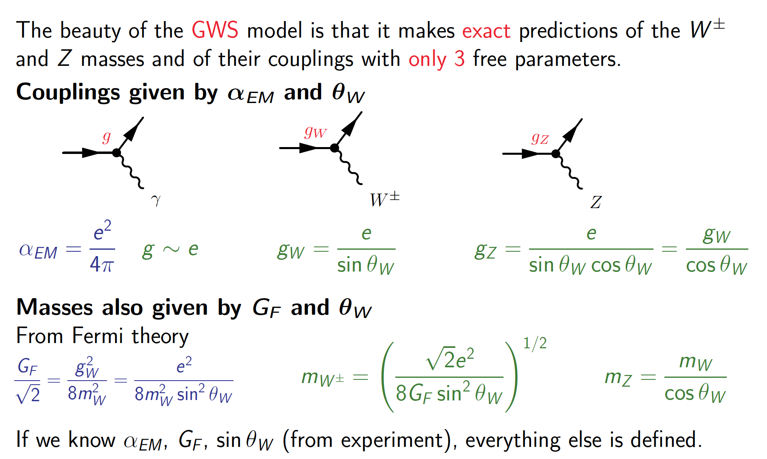
The GWS Model

Slide 13
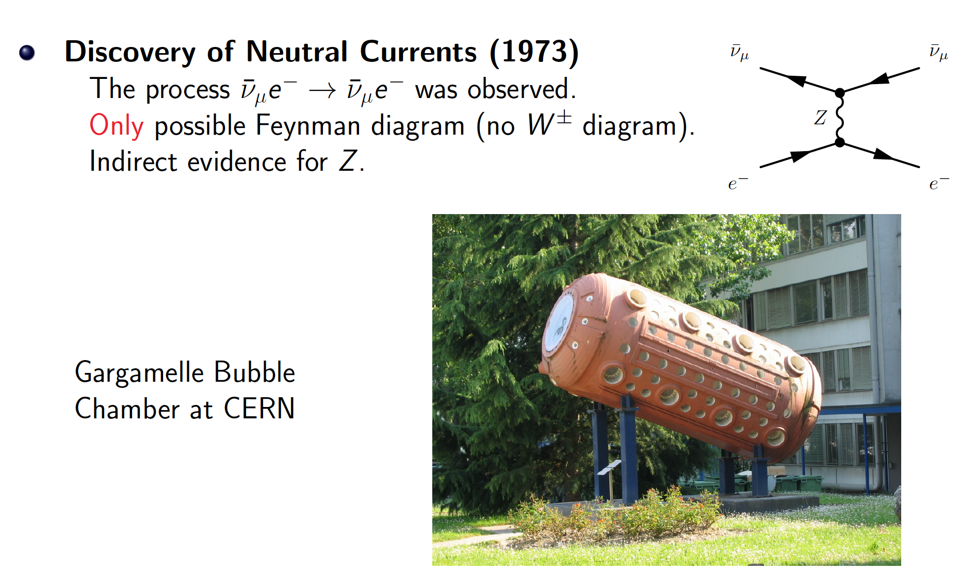
Evidence for the GWS model

Slide 14

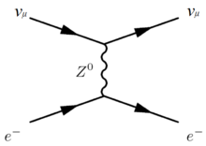

Slide 15
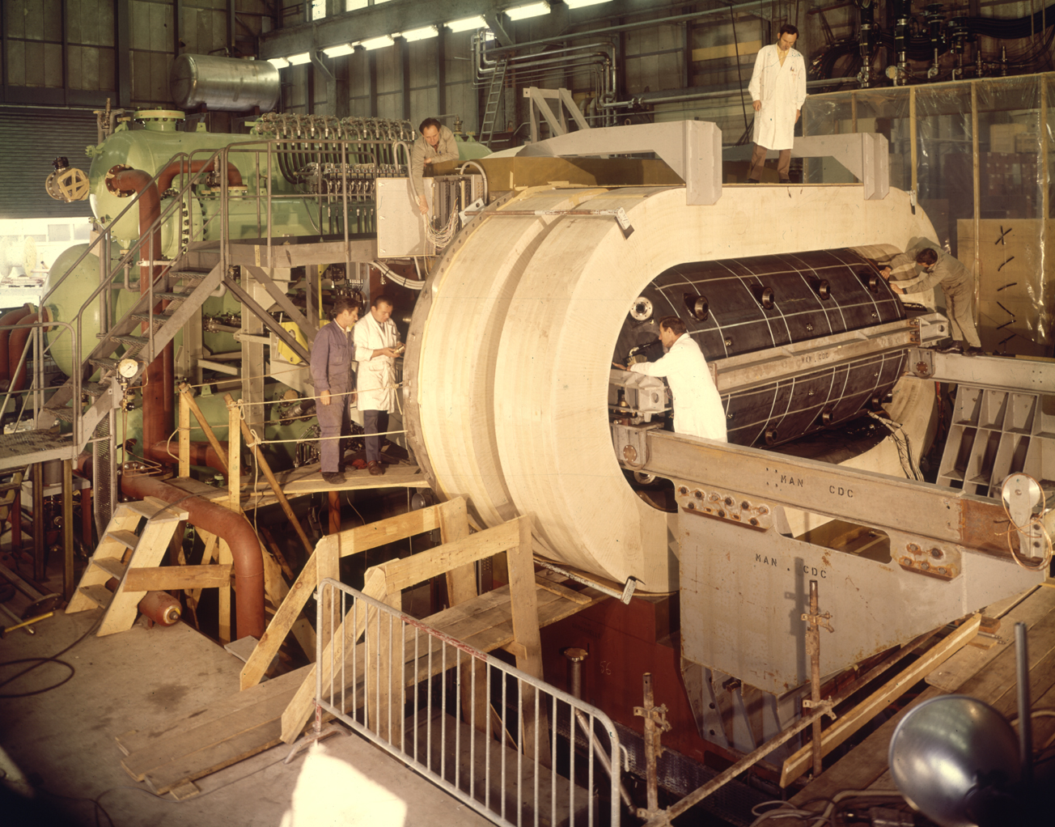

Slide 16
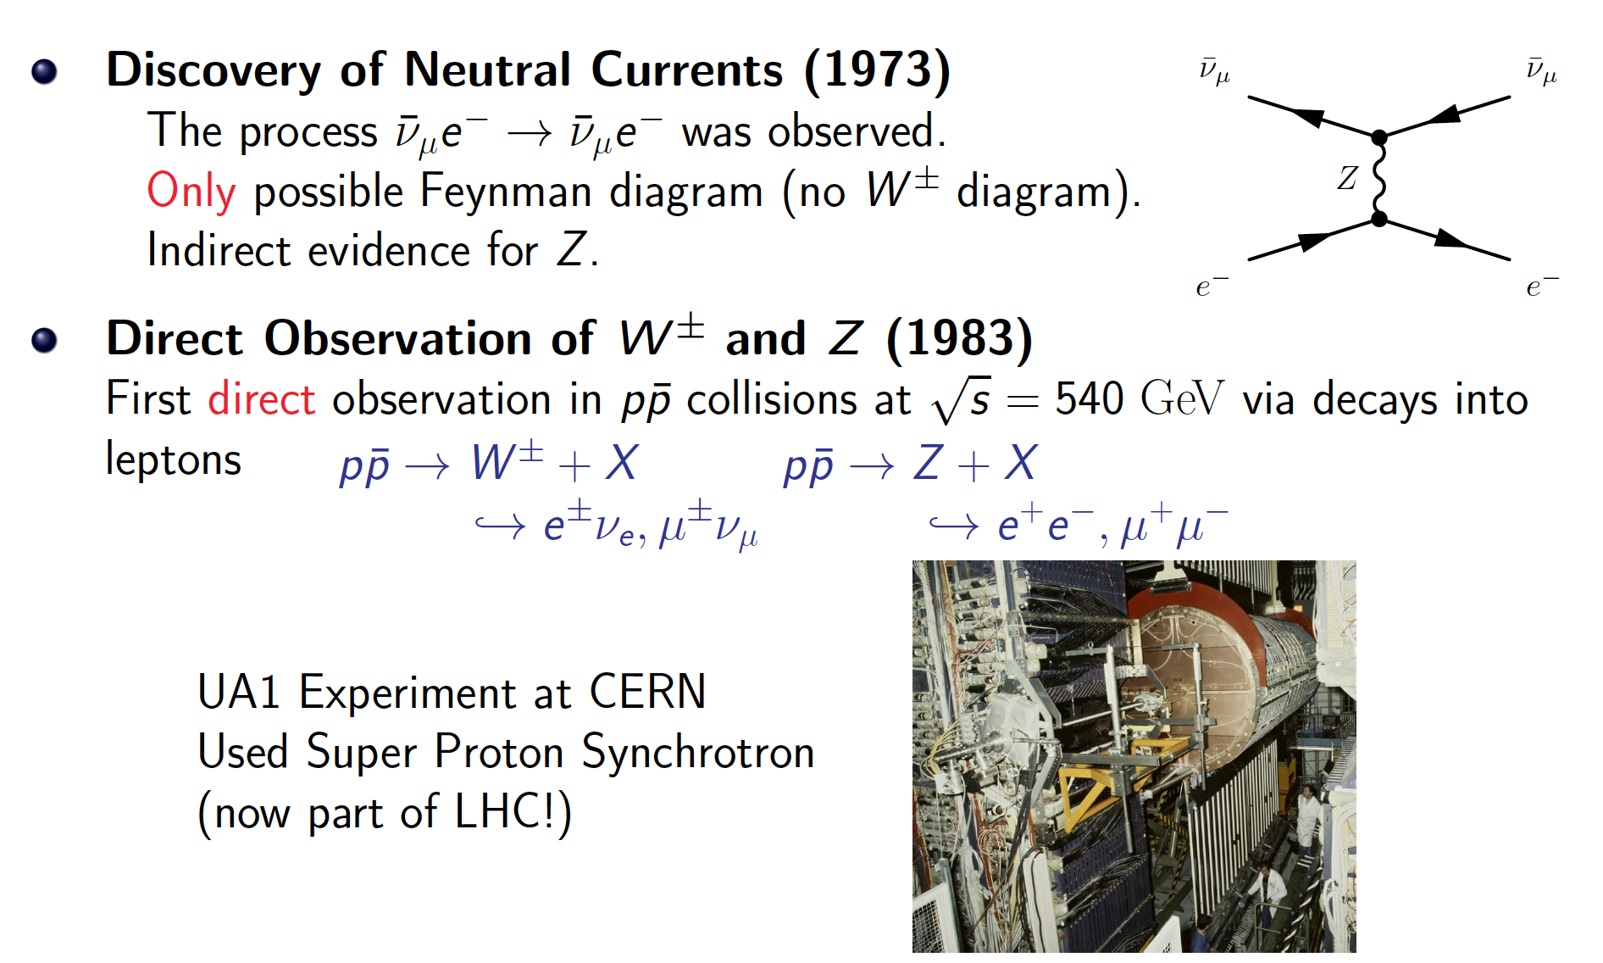
Evidence for the GWS model

Slide 17
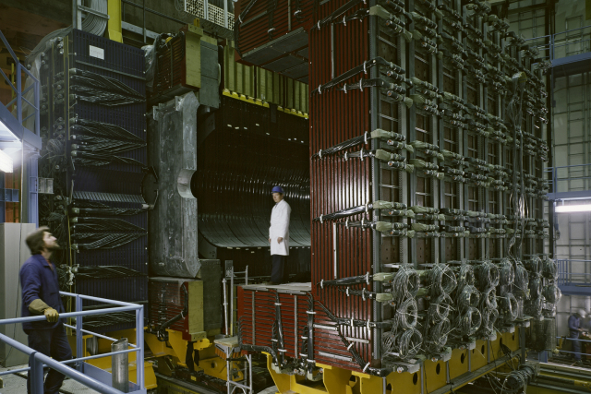

Slide 18
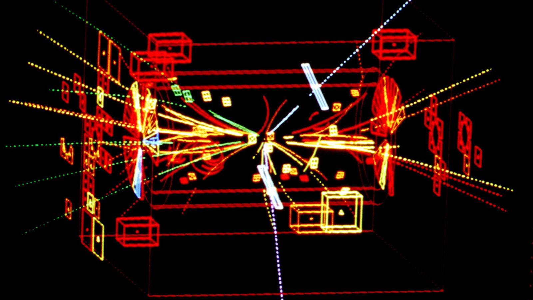

Slide 19
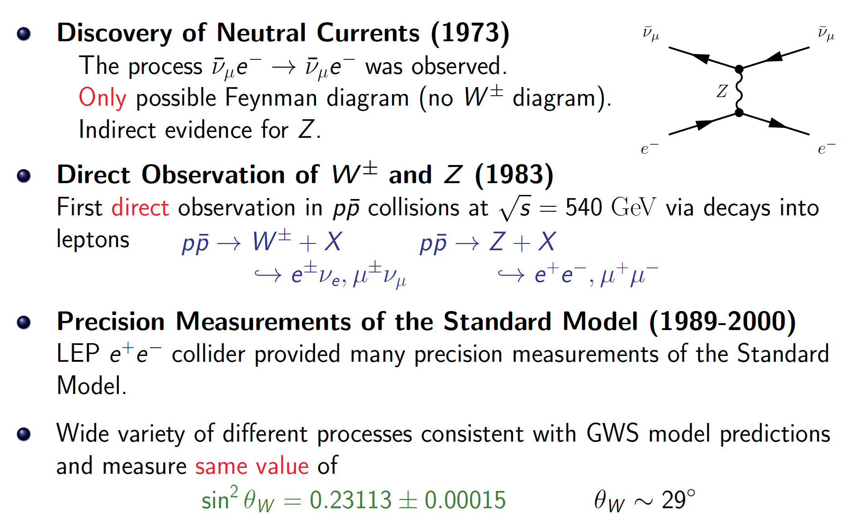
Evidence for the GWS model

Slide 20
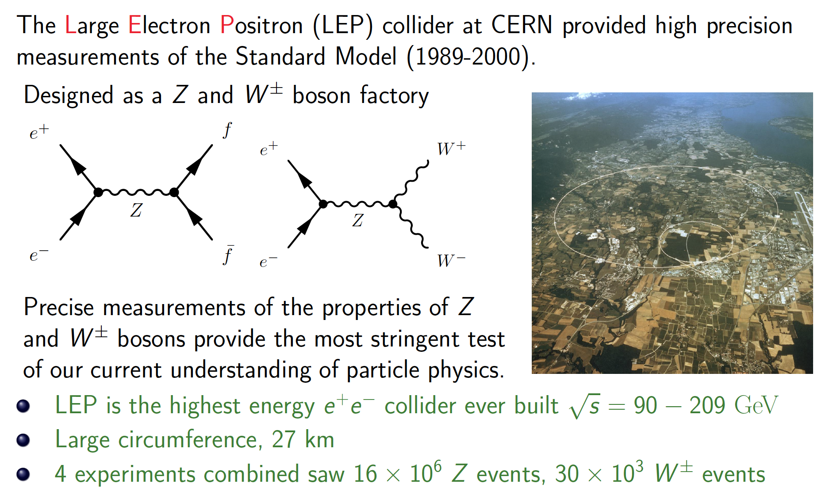
Experimental tests of the Electroweak model at LEP

Slide 21
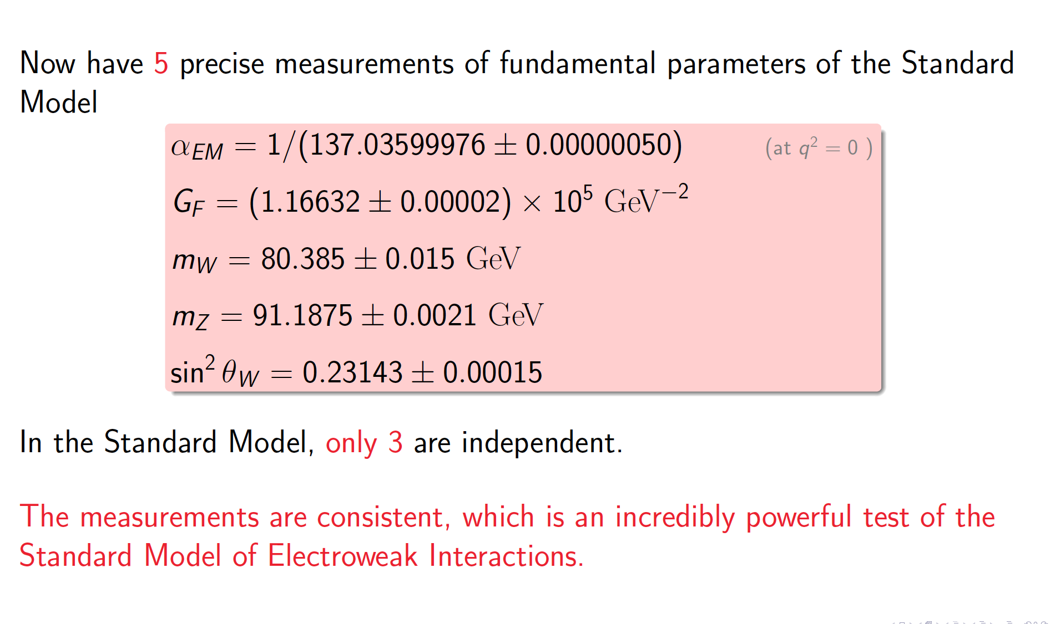
Summary of Electroweak tests

Slide 22
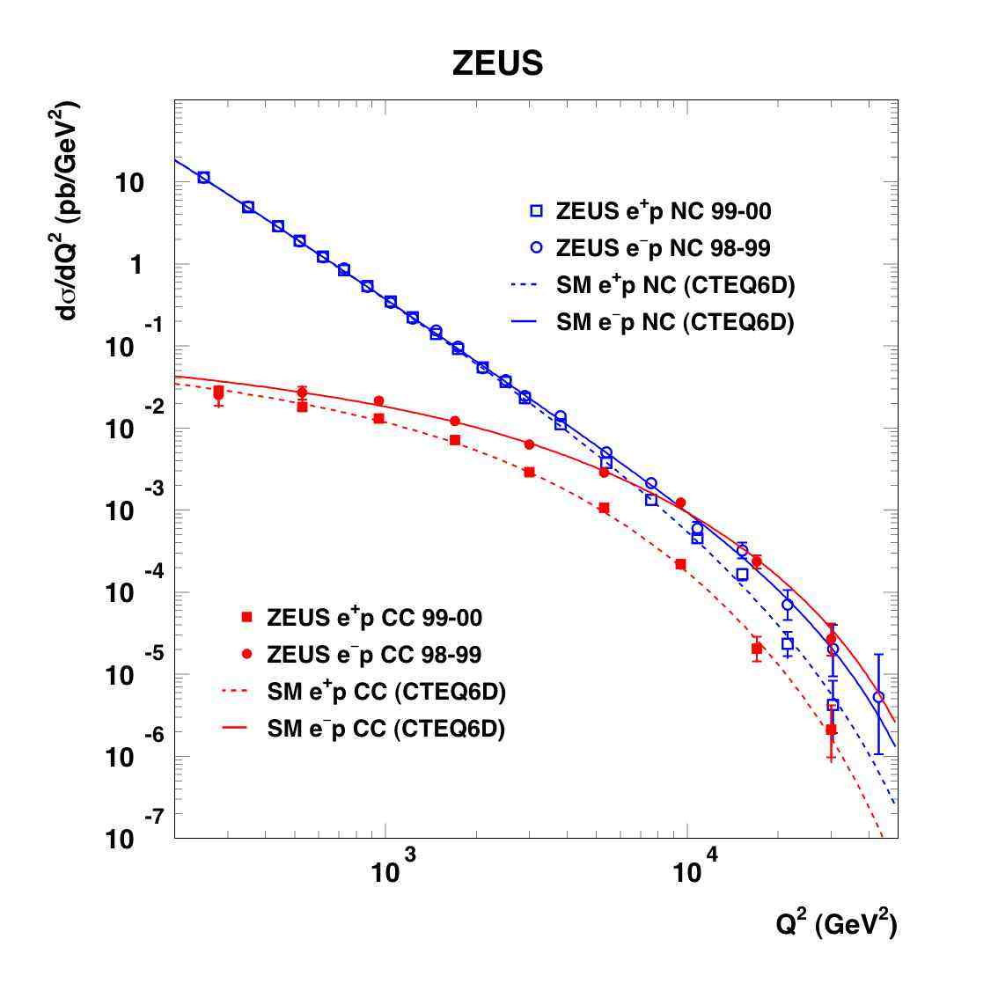
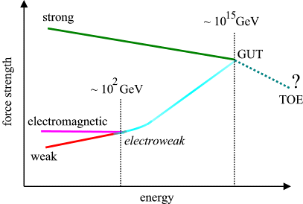
Electromagnetic interaction
γ
W±
Weak Nuclear Interaction
Notes:
Como é que sabíamos disto? Ou só estávamos só a adivinhar?
Vemos isto em medidas experimentais!! Neste gráfico vemos a probabilidade de um certo tipo de reação entre partículas.
Há duas possibilidades: uma reação governada pela força fraca e outra reação pela força eletromagnética.
A altas energias, vemos que as duas forças se tornam numa só força: a força electrofraca.
É a quebra de simetria ao contrário, como se andássemos para trás no tempo, em direção ao Big Bang

Slide 23
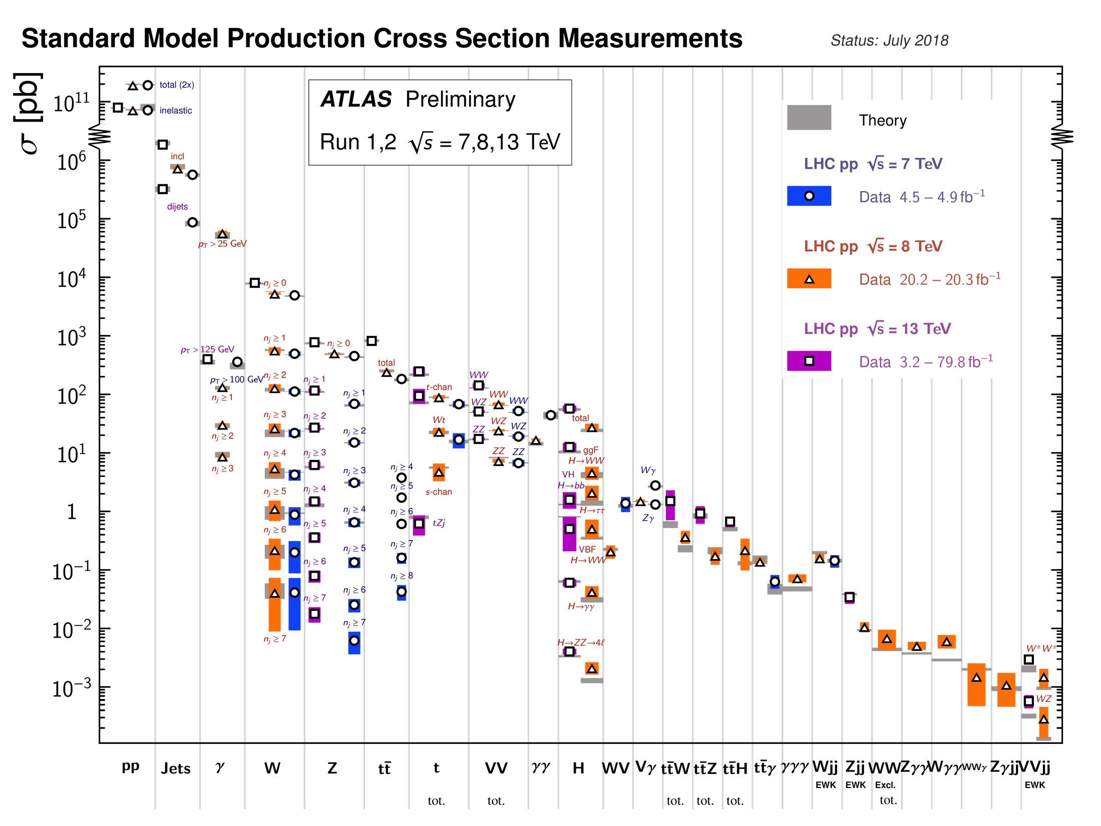
Notes:
SM expectations match measurements at the LHC over a huge range (12 orders of magnitude)! Clearly we do know something....

Slide 24

Now for the problems...

Slide 25
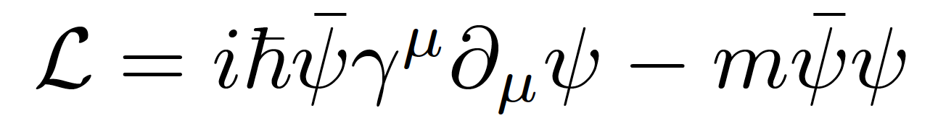
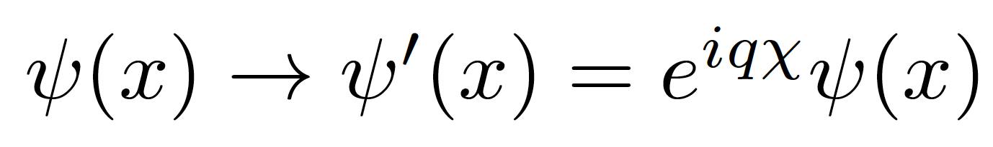
Gauge invariance
Take the Dirac Lagrangian for a spinor field ψ representing a spin-½ particle, for example an electron:
It is invariant under a global U(1) phase transformation like:
Where χ is a constant
Notes:
By the way: this is related to the conservation of electric charge!

Slide 26


Original sphere
Global transformation
Local transformação
χ = constant
χ = χ (x)

Slide 27
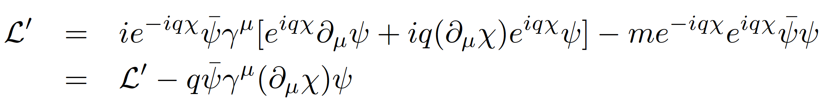
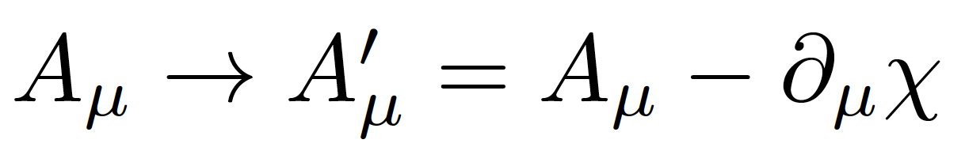
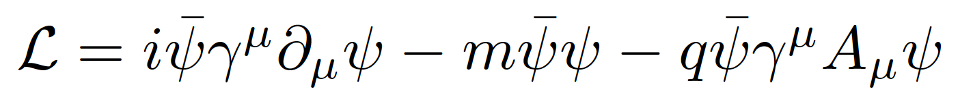
Local gauge invariance and interactions
If χ = χ (x) then we get extra terms in the Lagrangian:
But we can now make the Lagrangian invariant by adding an interaction term with a new gauge field A_{μ} which transforms as:
We get:
A few things to note:
Gauge theories are renormalizable, i.e. calculable without infinities popping up everywhere (Nobel prize of t’Hooft and Veltman)
The new gauge field A_{μ} is the photon in QED
The mass of the fermion is the coefficient of the term on ψψ
There is no term in A_{μ}A^{μ} (the photon has zero mass) → this is the beginning of the Higgs story…
Notes:
Demanding local gauge conservation resulted in obtaining a new field (the photon) and its interactions with the fermion fields. This is the blueprint of all Standard Model theories (called “Gauge theories”).
Gauge theories are automatically renormalizable (‘t Hooft & Veltman’s Nobel prize) i.e. don’t produce nonsense.

Slide 28
Problem 1: Mass of elementary particles and gauge bosons
To keep the Lagrangian gauge invariant (against a U(1) local phase transformation) the photon field transforms as:
But the A^{μ} mass term breaks the invariance of the Lagrangian:
For the SU(2)_{L} gauge symmetry transformations of the weak interaction the fermion mass term m_{e}ψψ also breaks invariance!

Slide 29
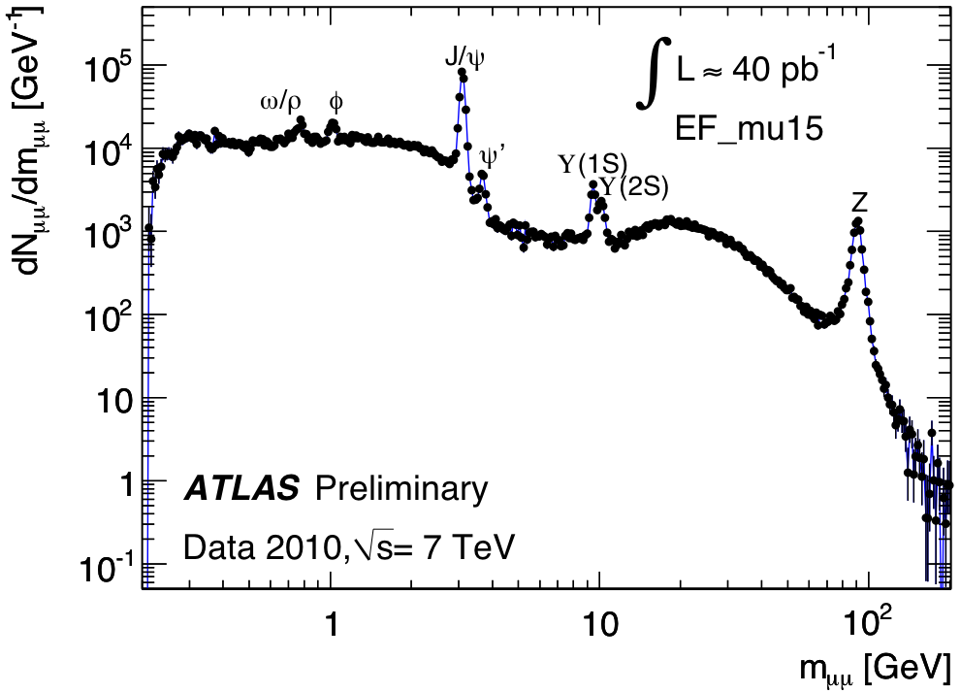
It should not work…
MASS
p
n
e
μ
γ
W±
Z
u
d
t
Notes:
1: mass of elementary bosons and fermions

Slide 30
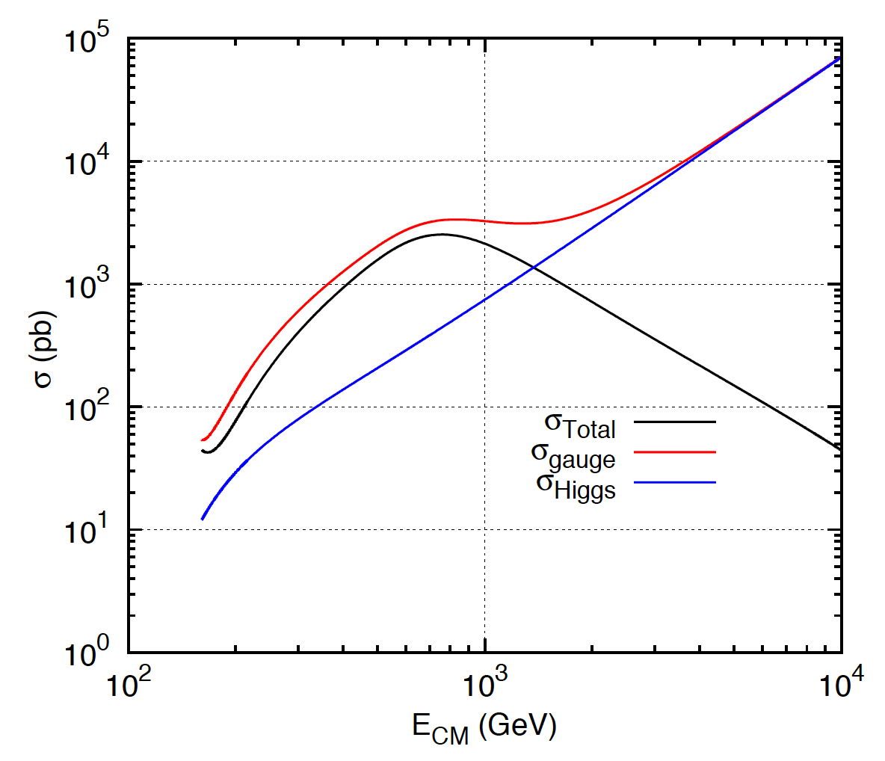
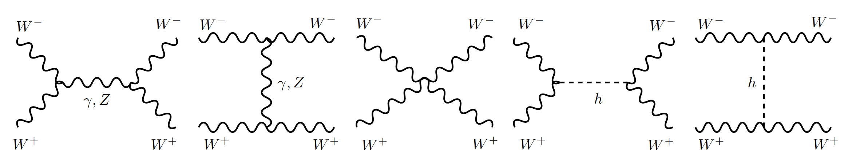
Problem 2:
Longitudinal gauge-boson scattering
In the absence of the Higgs, some processes have cross sections that grow with the centre of mass energy of the collision… i.e. breaks unitarity!
The Higgs regulates the cross section through negative interference
J.C.Romão [5]
Bottom line: the SM (without the Higgs mechanism) results in wrong calculations and breaks down for massive particles
Feynman diagrams contributing to longitudinal WW scattering

Slide 31

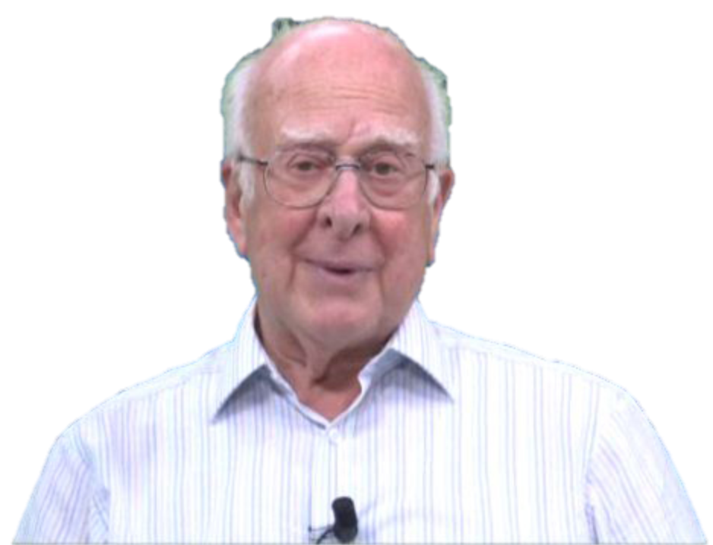

The Higgs Mechanism
Robert Brout (1928 – 2011)
François Englert (b. 1932)
Peter Higgs (b. 1929)
Notes:
Peter Ware Higgs (born 29 May 1929) is a British theoretical physicist, emeritus professor at the University of Edinburgh. In the 1960s, he proposed that broken symmetry in electroweak theory could explain the origin of mass of elementary particles in general and of the W and Z bosons in particular. This so-called Higgs mechanism, which was proposed by several physicists besides Higgs at about the same time, predicts the existence of a new particle, the Higgs boson, the detection of which became one of the great goals of physics.
Robert Brout (1928 –2011) was a Belgian theoretical physicist who made significant contributions in elementary particle physics. He was a Professor of Physics at Université Libre de Bruxelles where he had created, together with François Englert, the Service de Physique Théorique.
François Baron Englert (born 1932) is a Belgian theoretical physicist and 2013 Nobel prize laureate (shared with Peter Higgs). He is Professor emeritus at the Université libre de Bruxelles (ULB) where he is member of the Service de Physique Théorique. He is also a Sackler Professor by Special Appointment in the School of Physics and Astronomy at Tel Aviv University and a member of the Institute for Quantum Studies at Chapman University in California.

Slide 32


Slide 33
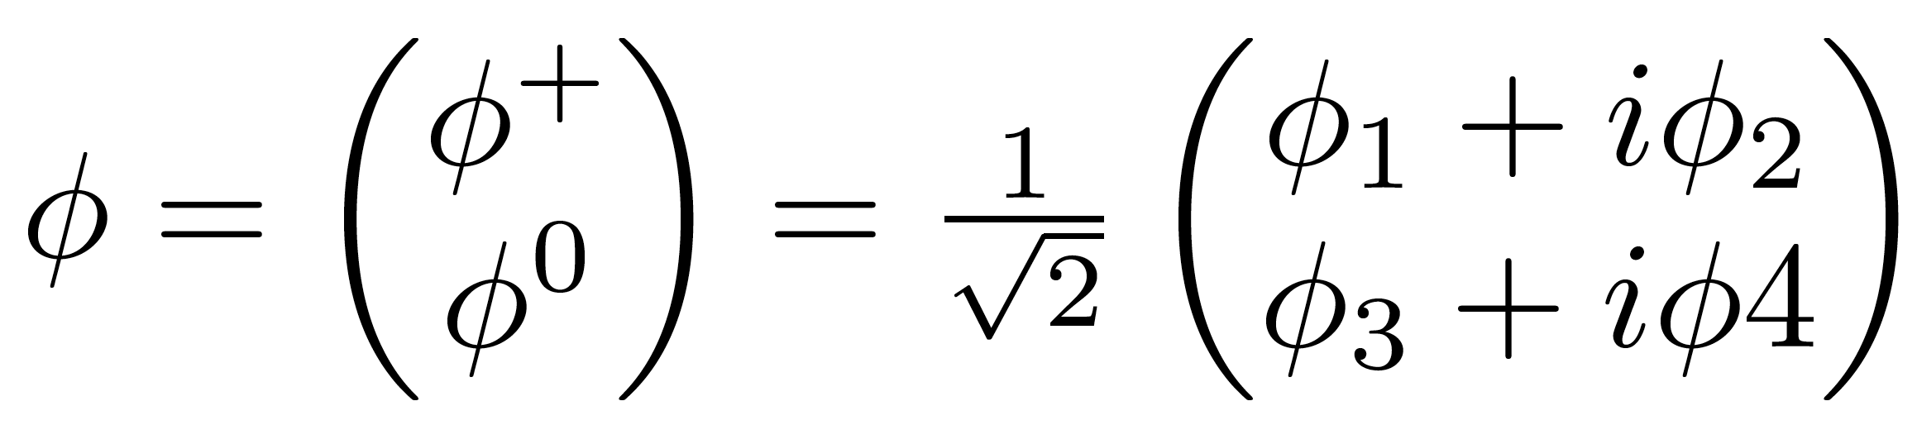
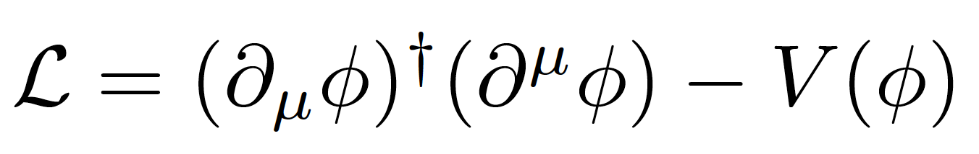
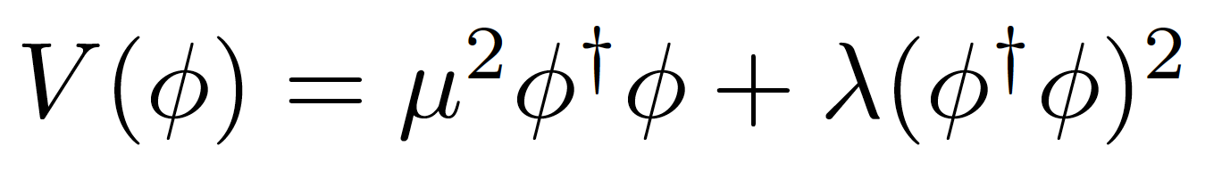
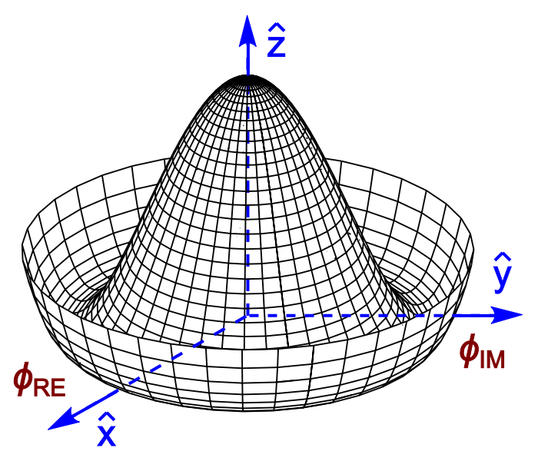
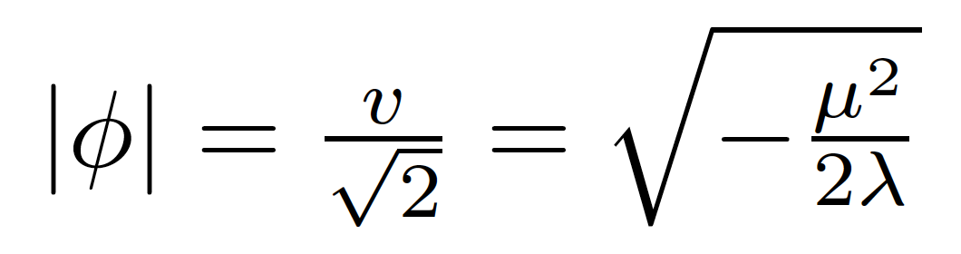
Introduce a SU(2) doublet of spin-0 complex fields
The Lagrangian is
With a potential
For λ>0, μ²<0 the potential has a
minimum at the origin
For λ>0, μ²<0 the potential has an
infinite number of minima at:
The choice of vacuum (lowest
energy state of the field) breaks the symmetry of the Lagrangian

Slide 34



Notes:
Quebra da simetria electrofraca após o Big Bang: quando a densidade de energia baixou, as próprias forças fundamentais mudaram
No fim ficamos com W e Z com massa, fotão na mesma sem massa, e resta-nos um bosão de Higgs; mas as proprias forças mudam!
In the Standard Model with no Higgs mechanism, interactions are symmetric and particles do not have mass
Electroweak symmetry is broken: Photon does not have mass W, Z have a large mass
Higgs mechanism: mass of W and Z results from the Higgs mechanism; Masses of fermions come from a direct interaction with the Higgs field

Slide 35
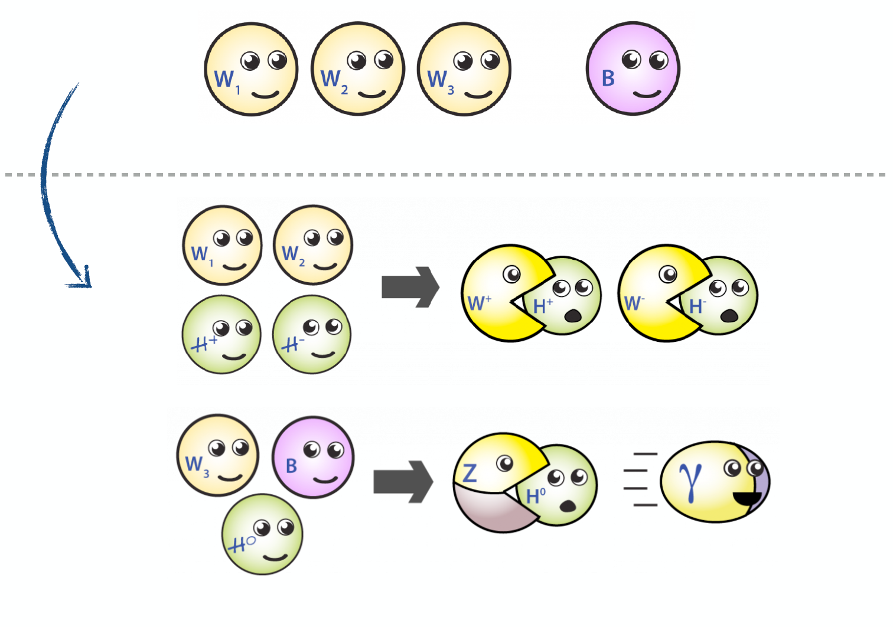
EWK Symmetry Breaking in Pictures

Slide 36

The Story So Far...
Notes:
Como é que sabíamos disto? Ou só estávamos só a adivinhar?
Vemos isto em medidas experimentais!! Neste gráfico vemos a probabilidade de um certo tipo de reação entre partículas.
Há duas possibilidades: uma reação governada pela força fraca e outra reação pela força eletromagnética.
A altas energias, vemos que as duas forças se tornam numa só força: a força electrofraca.
É a quebra de simetria ao contrário, como se andássemos para trás no tempo, em direção ao Big Bang

Slide 37
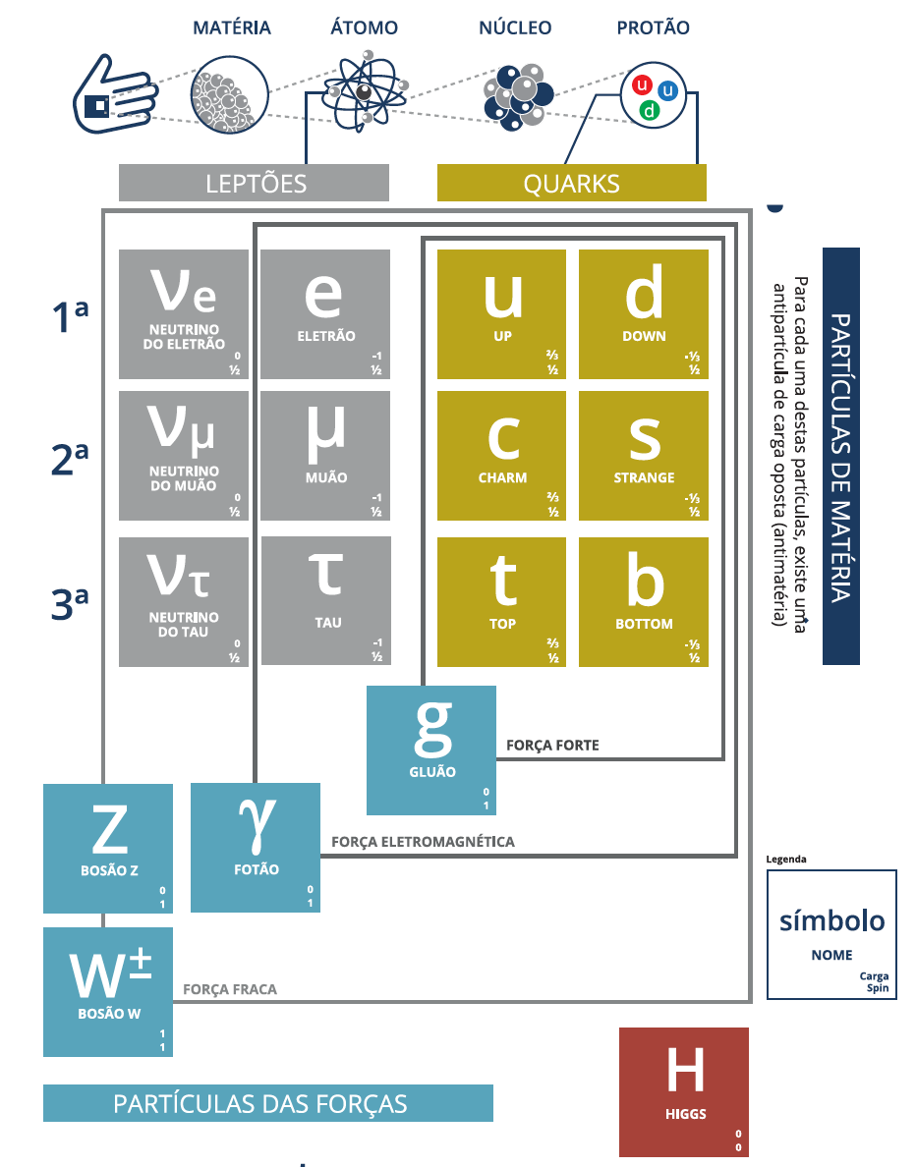
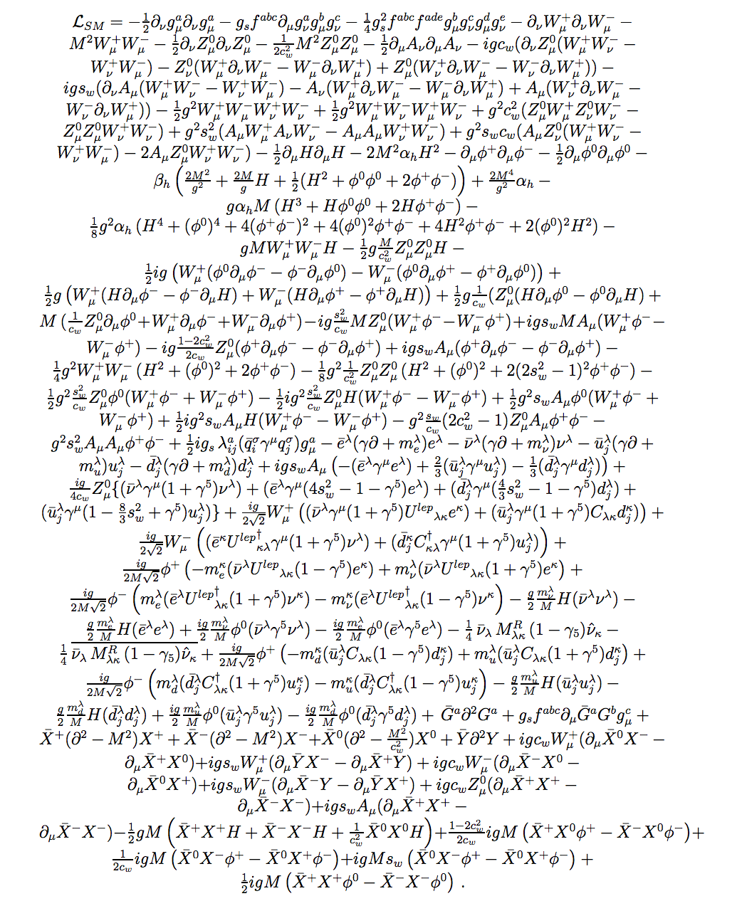
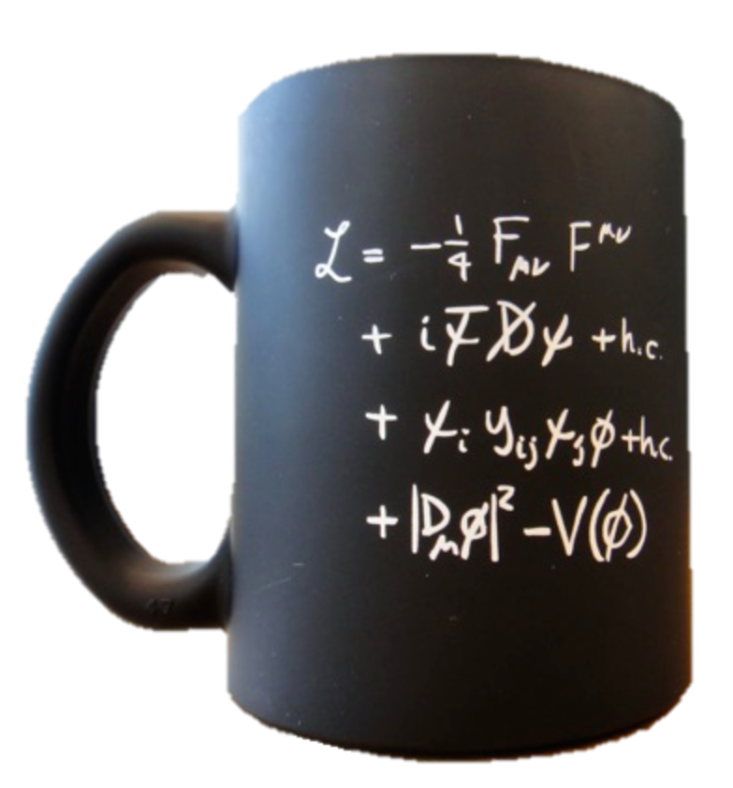

The Standard Model of particle physics
2013
Notes:
Particulas fundamentais conhecidas; forças a que elas reagem; Z tem massa alta ao contrario de gamma e gluoes; Higgs pedra basilar do edificio; dá massa mas só pequena fração nos hadroes;

Slide 38
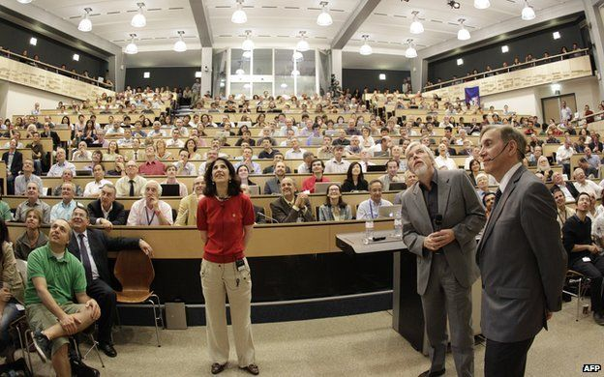
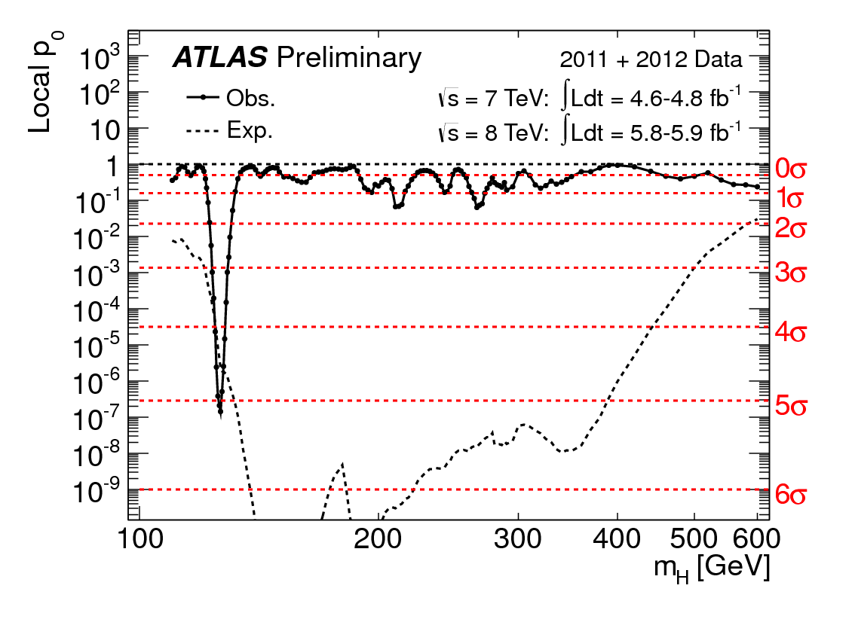
The Long Way to Discovery

Slide 39




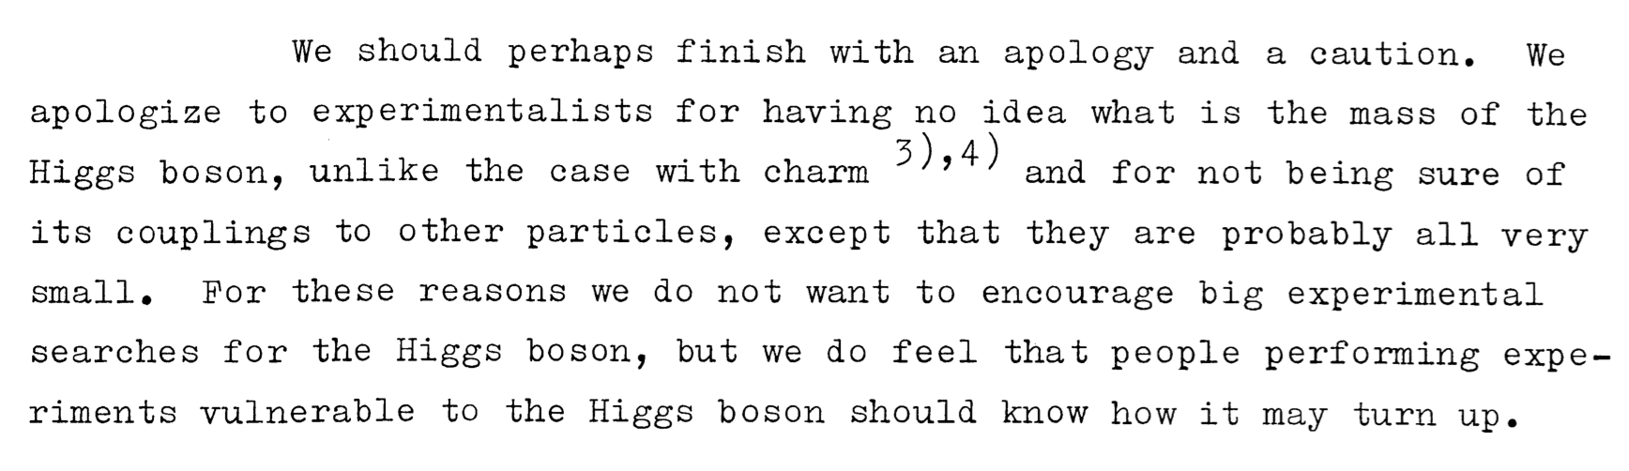

Slide 40
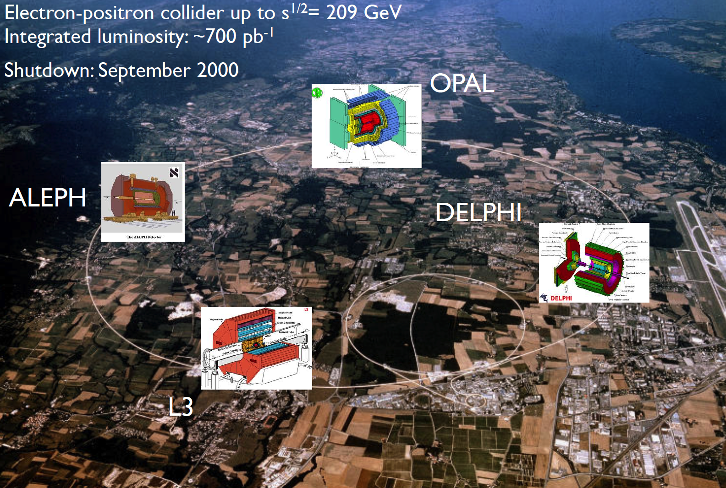
Searches at LEP

Slide 41
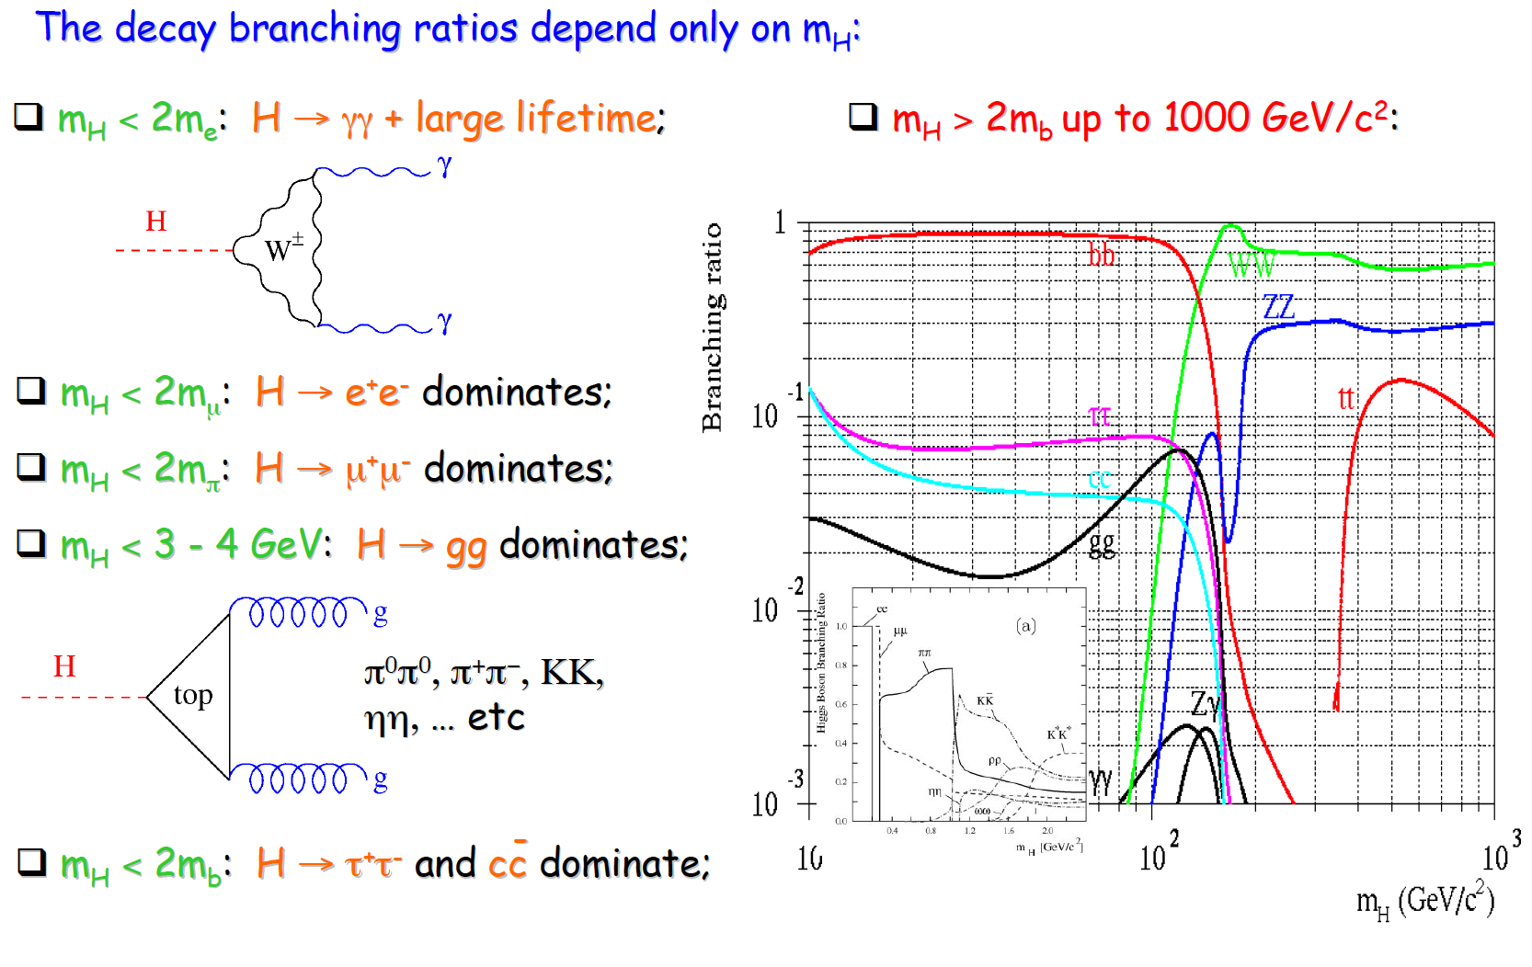
Low-mass searches at LEP

Slide 42
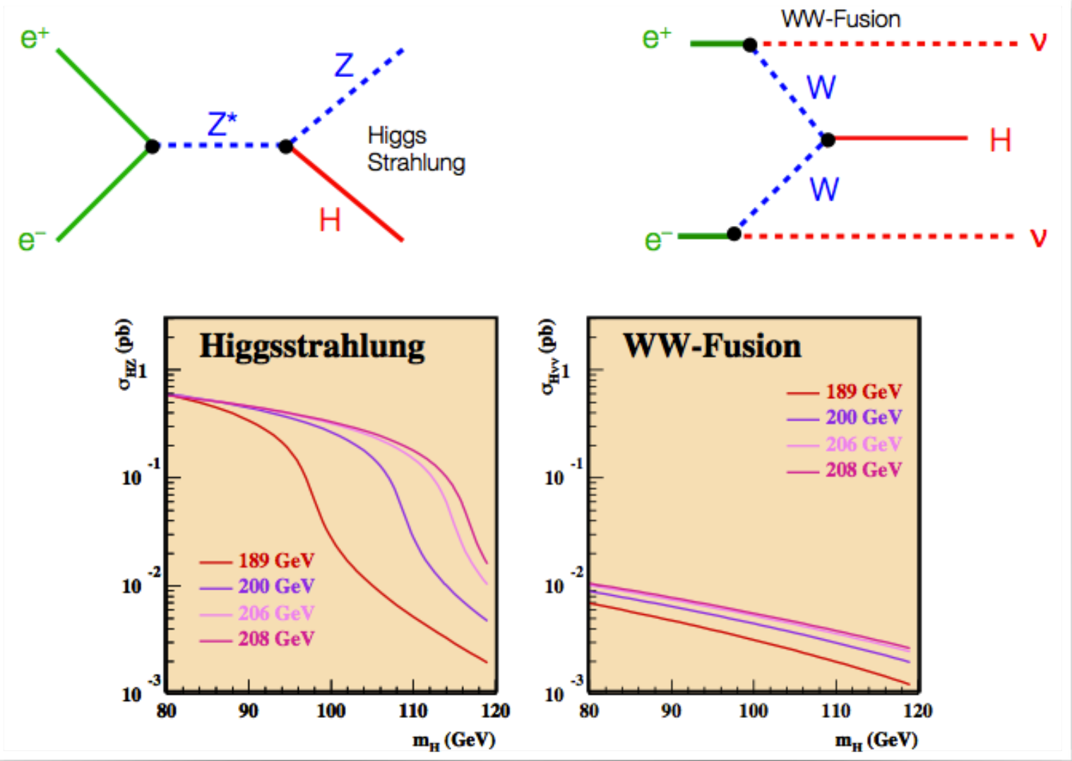
Higher-mass Higgs production at LEP

Slide 43

Higgs decays: focus on 3rd generation

Slide 44


Slide 45

LEP’s Final Legacy: the Blue Band Plot
Decades of searches in many experiments...
By July 2010:
  LEP+Tevatron+SLD limits
  Higgs excluded m_{h}<114.4 GeV at 95% CL
  Plus between 158 and 175 GeV
CERN-PH-EP-2010-05

Slide 46

Searches at the Tevatron

Slide 47

Higgs production at the Tevatron

Slide 48

Most sensitive searches

Slide 49


The final stand of the Tevatron
By the end of its lifetime, the Tevatron had very sophisticated analyses of a huge number of channels
By that time the LHC was collecting data and analysing it very fast
The CDF and D0 experiments obtained a significant excess of around 3 standard deviations in the mass range 115<M_{H}<140 GeV
Not enough to claim discovery, but consistent with the LHC results

Slide 50



Discovery at the LHC
Proton-proton (and Heavy Ion) collider
s^{1/2} = 7, 8, 13 TeV so far
Operation started 2008
Physics data from 2010
Expected closure 2035
Luminosity so far: about 150 fb⁻¹ per experiment for ATLAS and CMS

Slide 51





At the LHC
https://twiki.cern.ch/twiki/bin/view/LHCPhysics/LHCHXSWG
gluon-fusion
VBF
WH
ZH
ttH
Notes:
Main production channels: gluon fusion, Vector Boson Fusion, associated production with vector bosons, associated production with ttbar pair
Animation

Slide 52





Slide 53

2012: Descoberta do bosão de Higgs: H->γγ
Notes:
The weighting of events is similar to what is used in the final significance extraction

Slide 54



Discovery channels
Discovery was made in ATLAS and CMS with about 5 fb⁻¹ of 7 TeV data and 20 fb⁻¹ of 8 TeV data per experiment; several channels combined
This means about 400 000 Higgs bosons produced in about 8 000 000 000 000 000 (8x10¹⁵) proton collisions
  Only about 4000 events with Higgs bosons contributed to the discovery

Slide 55










Combining Higgs Channels
Production
Decay
H->γγ
FIT
×
H->ZZ
H->WW
t
t
t
Backgrounds +

Slide 56
The p₀ Discovery Plot
p₀ is the combined probability that the background fluctuates to look like signal
Translated into the one-sided Gaussian probability
This corresponds to a probability of 1 in 3.5 million that this was a false positive from fluctuating backgrounds

Slide 57


2013 Physics Nobel Prize Higgs for the Higgs Boson Discovery
François Englert,
Belga,
born 1932,
U. Libre
de Bruxelles
Peter Higgs,
English,
born
1929,
Univ. of
Edimburgh
"for the theoretical discovery of a mechanism that contributes to our understanding of the origin of mass of subatomic particles, and which recently was confirmed through the discovery of the predicted fundamental particle, by the ATLAS and CMS experiments at CERN's Large Hadron Collider"
Notes:
A Descoberta do bosão de Higgs premiada com o Prémio Nobel 2013
E mostrou finalmente que os termos com phi na caneca existem

Slide 58



Slide 59



It takes time to get it right
EPS-HEP 2011 conference [6]

Slide 60



Probing the 125 GeV Higgs
2HDM
Triple coupling λ₃
Clavicle
Aorta
Ribs
Yukawa
couplings
BSM

Slide 61



Spin and Parity
First concern after observation!
Some observable quantities sensitive to J^{P}: for example angle between leptons from W decay in H->WW
Pure J^{P} = 0⁻, 1⁺, 1⁻, and 2⁺ excluded with 97.8, 99.97, 99.7, and 99.9% Confidence Level (ATLAS arXiv 1307.1432; CMS Phys. Rev. D 92, 012004)
H->γγ – ATLAS arXiv 1307.1432
H
W⁺
W⁺
μ⁺
W⁻
ν_{μ}
W⁻
e⁻
ν_{e}

Slide 62



Higgs boson mass
Mass: around 125GeV
  Was the only unknown
  SM parameter ☺
For a while, different mass values were being measured in ATLAS and CMS, and in different channels
Numbers evolved with accumulated statistics
Current most precise value from ATLAS+CMS has 0.2% precision!
  ATLAS: arXiv:1307.1427
Phys. Rev. Lett. 114, 191803
m_{H}=125.09±0.21 (stat)±0.11 (syst) GeV

Slide 63

Cross section compared to SM expectation

Slide 64


Exploring the electroweak scale
Precision measurements of m_{W}, m_{t}, m_{H} are stringent tests of the SM at the EW scale
  E.g. excluding measured m_{H}, global EW fit gives m_{H} = 90 ± 21 GeV (1.7 σ tension) driven in part by m_{top}
arXiv:1803.01853

Slide 65


The Run 1 legacy
Phys. Rev. Lett. 114 (2015) 191803
JHEP 08 (2016) 045
Mass – Higgs mass measured with 0.4% accuracy:
  m_{H} = 125.09 ± 0.21 (stat.) ± 0.11 (scale) ± 0.02 (other) ± 0.01 (theory) GeV
Couplings:
  ggF with H → ZZ,,WW observed by individual experiments
  VBF and H →  observed with >5σ significance by ATLAS+CMS combination
  ttH, VH production and H → bb not observed during Run1
Couplings compatible with SM:
  Signal strength: μ_{VBF+VH}/μ_{ggF+ttH} = 1.06 ^{+0.35} _{-0.27}
  Coupling modifiers broadly consistent with SM but still large uncertainty
μ = (σ ×BR)_{Obs}/ (σ×BR)_{SM}
Significance (σ)
Prod. | Obs. | Expect.
VBF | 5.4 | 4.7
VH | 3.5 | 4.2
ttH | 4.4 | 2.0
Decay | Obs. | Expect.
H→ττ | 5.5 | 5.0
H→bb | 2.6 | 3.7
Notes:
https://atlas.web.cern.ch/Atlas/GROUPS/PHYSICS/PAPERS/HIGG-2015-07/
https://atlas.web.cern.ch/Atlas/GROUPS/PHYSICS/PAPERS/HIGG-2014-14/

Slide 66






Run 2: Higgs boson mass
arXiv:1804.02716 [hep-ex]; arXiv:1706.09936 [hep-ex]; arXiv:1806.00242 [hep-ex]
Mass measurement from CMS H→ZZ*→4l:
m_{H}^{ZZ*}= 125.26 ± 0.20 (stat) ± 0.08 (syst) GeV
New Measurements from ATLAS
  H→ γγ: m_{H}^{γγ} = 124.93 ± 0.40 GeV
  H→ZZ*→4l: m_{H}^{ZZ∗} = 124.79 ± 0.37 GeV
Run 1+2 combination from ATLAS:
  m_{H} = 124.97 ± 0.19 (stat) ± 0.13 (syst.) GeV
Notes:
https://atlas.web.cern.ch/Atlas/GROUPS/PHYSICS/PAPERS/HIGG-2016-33/ → 1 June 2018
http://cms-results.web.cern.ch/cms-results/public-results/publications/HIG-16-040/index.html → 8 April 2018
Both use 36.1 fb⁻¹ from 2015+2016

Slide 67




Differential Higgs boson cross sections
JHEP 11 (2017) 047; CMS-HIG-17-015; ATLAS-CONF-2018-002; ATLAS-CONF-2018-018
Reached a new phase in the exploration of the Higgs sector!
Differential cross sections:
  Higgs p_{T} sensitive to new physics in gluon-fusion loop
  Number of jets sensitive to modeling of radiation and different production modes
Notes:
https://atlas.web.cern.ch/Atlas/GROUPS/PHYSICS/PAPERS/HIGG-2017-11/ → 24 May 2018
https://atlas.web.cern.ch/Atlas/GROUPS/PHYSICS/CONFNOTES/ATLAS-CONF-2018-018/ → 04 Jun 2018
http://cms-results.web.cern.ch/cms-results/public-results/publications/HIG-16-041/ → 30 June 2017
http://cms-results.web.cern.ch/cms-results/public-results/preliminary-results/HIG-17-015/index.html → March 2017
http://cms-results.web.cern.ch/cms-results/public-results/publications/HIG-17-025/ → 11 July 2018(after the conference)

Slide 68

Casting a wider net

Slide 69







Additional Higgs bosons?

Slide 70




Higgs + Dark Matter
ATLAS-CONF-2018-039
Used 79.8 fb⁻¹ of 13 TeV data
  High E_{T}^{miss} (>150GeV) and b-tagging to suppress backgrounds
  Reconstruct b-jets as 2 small jets or merged variable-radius (VR) track jets
Signal benchmark: Type-II 2HDM + U(1)_{Z’} symmetry (Z’-2HDM)
Main backgrounds: tt, W/Z+jets
Excluded region in m_{A} – m_{Z’} plane
Notes:
https://atlas.web.cern.ch/Atlas/GROUPS/PHYSICS/CONFNOTES/ATLAS-CONF-2018-039/ → 25 July 2018
VR jets: track jets reconstructed with an algorithm in which the radius parameter decreases with increasing jet transverse momentum (pT)
large missing transverse momentum and either two b-tagged small radius jets or a single large radius jet containing two b-tagged subjets

Slide 71



Charged Higgs: H⁺→tb
arXiv:1808.03599
Explored single-lepton and dilepton tt final states
  In range m_{H+}: 200 – 2000 GeV
36.1 fb⁻¹ of 13 TeV data
Events categories: N_{jets} and N_{b-tags}
  Allow to constrain backgrounds in simultaneous fit
BDTs trained in signal regions
  Separate signal and background for 18 mass points
  Matrix method used in single-lepton channel
Extracted limits on σ x BR and on m_{H+} - tan β plane for two MSSM scenarios
Notes:
https://atlas.web.cern.ch/Atlas/GROUPS/PHYSICS/PAPERS/HIGG-2017-04/ → 10 August 2018

Slide 72








Triple Higgs coupling
arXiv:1808.00336 [hep-ex]; ATLAS-CONF-2018-043
The triple Higgs coupling λ_{HHH} can be probed through di-Higgs production
Very suppressed in SM!
  Negative interference between LO diagrams
  Cross section 1500x less than ggF
Wide range of decay BR and channel purity
bbττ analysis:
  Used 36 fb⁻¹ of 13 TeV data
  Final state BR(bbττ)=7%
  Non-Resonant 95% CL limit:
    μ < 12.7 observed (14.8 expexcted)
Combination: at ≈10 x SM sensitivity – with 3% of the HL-LHC luminosity analyzed
Di-Higgs combination plot here
Notes:
https://atlas.web.cern.ch/Atlas/GROUPS/PHYSICS/CONFNOTES/ATLAS-CONF-2018-026/ → 2 Jul 2018
https://atlas.web.cern.ch/Atlas/GROUPS/PHYSICS/CombinedSummaryPlots/HIGGS/ATLAS_HIGGS6100_HH_Summary/ATLAS_HIGGS6100_HH_Summary.png
https://atlas.web.cern.ch/Atlas/GROUPS/PHYSICS/CONFNOTES/ATLAS-CONF-2018-043/

Slide 73




Implications for 2HDM
ATLAS-CONF-2018-031
H(125) assumed to be light CP-even neutral scalar h in 2HDM
h production and decay same as for SM Higgs boson
Notes:
https://atlas.web.cern.ch/Atlas/GROUPS/PHYSICS/CONFNOTES/ATLAS-CONF-2018-031/ → 7 July 2018
• Type I: one Higgs doublet couples to vector bosons, while the other one couples to fermions. The first doublet is ‘fermiophobic’ in the limit where the two Higgs doublets do not mix.
• Type II: one Higgs doublet couples to up-type quarks and the other one to down-type quarks and charged leptons.
• Lepton-specific: the Higgs bosons have the same couplings to quarks as in the Type I model and to charged leptons as in Type II.
• Flipped: the Higgs bosons have the same couplings to quarks as in the Type II model and to charged leptons as in Type I.

Slide 74




A bit of fun…
1-loop effective potential
RG-improved potential
What if…
  At higher orders, Higgs potential doesn’t have to be stable
  Depending on m_{t} and m_{H} second minimum can be lower than EW minimum ⇒ tunneling between EW vacuum and true vacuum?!
“For a narrow band of values of the top quark and Higgs boson masses, the Standard Model Higgs potential develops a shallow local minimum at energies of about 10¹⁶ GeV, where primordial inflation could have started in a cold metastable state”, I. Masina, arXiv:1403.5244 [astro-ph.CO]
  See also: V. Brachina, Moriond 2014 (Phys.Rev.Lett.111, 241801 (2013)), G. Degrassi et al, arXiv:1205.6497v2; R.Contino, Workshop sulla fisica p-p a LHC, 2013

Slide 75



The universe seems to live near a critical condition
JHEP 1208 (2012) 098
Why?!
Explained by underlying theory?
Anthropic principle?

Slide 76



Local News
Notes:
Porque é que interessa?
O Higgs desintegra-se sobretudo em quarks bottom. Se vemos isto há menos espaço para nova física!

Slide 77






Observation of H→bb
arXiv:1808.08238
See CERN seminar last week! (https://indico.cern.ch/event/750541/)
Largest branching fraction (58.4%) but huge background from heavy flavour production
Must use associated production: WH/ZH
  Require 2 b jets + 0 (Z→𝜈𝜈), 1 (W→ℓ𝜈) or 2 (Z→ℓℓ) leptons
Largest backgrounds:
  Z+heavy flavour (0- and 2-lepton) and tt (1-lepton)
  Irreducible background from VZ with Z→bb
Notes:
http://cms-results.web.cern.ch/cms-results/public-results/publications/HIG-16-044/index.html → 21 September 2017
https://atlas.web.cern.ch/Atlas/GROUPS/PHYSICS/PAPERS/HIGG-2016-29/ → 10 August 2017
https://atlas.web.cern.ch/Atlas/GROUPS/PHYSICS/CONFNOTES/ATLAS-CONF-2018-036/ → 9 July 2018

Slide 78





Observation of H→bb
arXiv:1808.08238
Harder p_{T} spectrum for signal than backgrounds
  Go to high p_{T} to improve S/B
Use for event categories:
  75 < p_{T}^{V} < 150 GeV (2ℓ only)
  150 < p_{T}^{V} < 200 GeV
  p_{T}^{V} > 200 GeV
Main discriminant variables m_{bb}, p_{T}^{V} and ΔR_{bb}
  m_{bb} resolution extremely important!
Notes:
Evidence: https://atlas.web.cern.ch/Atlas/GROUPS/PHYSICS/PAPERS/HIGG-2016-29/fig_01.png→ 10 August 2017
Observation: https://atlas.web.cern.ch/Atlas/GROUPS/PHYSICS/PAPERS/HIGG-2018-04/fig_03.png→ 9 July 2018

Slide 79








Observation of H→bb
arXiv:1808.08238
Run 2:
  Observed (expected) of 4.9𝝈 (4.3𝝈)
Adding Run 1:
  Observed (expected) of 4.9𝝈 (5.1𝝈)
Adding ttH and VBF:
  Observed (expected) of 5.4𝝈 (5.5𝝈)
  Observation of H→bb decays
Adding H→ZZ and H→γγ:
  Observed (expected) of 5.3𝝈 (4.8𝝈)
  Observation of VH production
Notes:
Evidence: https://atlas.web.cern.ch/Atlas/GROUPS/PHYSICS/PAPERS/HIGG-2016-29/fig_01.png→ 10 August 2017
Observation: https://atlas.web.cern.ch/Atlas/GROUPS/PHYSICS/PAPERS/HIGG-2018-04/fig_03.png→ 9 July 2018

Slide 80



Combination
ATLAS-CONF-2018-031
Combined γγ, ZZ, WW,ττ, μμ and bb (incl. ttH+tH modes)
  Up to 79.8 fb⁻¹ of √s = 13 TeV data
Combination yields VBF significance 6.5σ (5.3σ expected) from ATLAS alone
Main production modes (ggF, VBF, VH, ttH) have all been observed!!
Good agreement with SM predictions
  Overall signal strength:
  μ = 1.13 ^{+0.09} _{-0.08}
Quantified space for undetectable decays or modified BR (e.g. BSM H→cc)
  B_{BSM} < 0.13 at 95% CL.(*)
(*) In determination of κ_{g} and κ_{γ} - assumption dependent
Notes:
https://atlas.web.cern.ch/Atlas/GROUPS/PHYSICS/CONFNOTES/ATLAS-CONF-2018-031/fig_05.png→ 7 July 2018

Slide 81







Observation of ttH production
arXiv:1806.00425 [hep-ex];
Direct access to top Yukawa coupling
Experimental tour-de-force!
  Complex final states
  Large irreducible backgrounds
  Small cross sections: O(0.5)pb @ 13 TeV
Use all available final states:
  H→bb: high stats but low purity BR≈58%, S/B≈1-6%
  Multileptons: H→𝜏𝜏, H→WW*, H→ZZ* BR = 30%, S/B=4-34%
  H→𝛾𝛾: clean but low stats BR = 0.23%, S/B=5-200%
  H→ZZ*→4lep: clean but very low stats BR = 0.01%, S/B=50-500%
Notes:
https://atlas.web.cern.ch/Atlas/GROUPS/PHYSICS/PAPERS/HIGG-2018-13/ → 1 June 2018
24/12/2017 – Evidence from ATLAS: 36.1 fb-1 in ttH(ττ, γγ, bb, VV): 4.2 σ observed, 3.8 σ expected
08/04/2018 – Observation in CMS: 5.1 (7 TeV), 19.7 (8TeV), and 35.9 (13 TeV) fb-1: 5.2 σ observed, 4.2 σ expected
01/06/2018 – Observation in ATLAS: 79.8 fb⁻¹ for ttH(γγ, ZZ→4l) and with 36.1 fb-1 in ttH(bb) (13 TeV): 5.2 σ observed, 4.9 σ expected
Adding 4.5 fb-1 (7 TeV) and 20.3 fb-1 (8 TeV): 6.3 σ observed, 5.1 σ expected

Slide 82








ttH observation: bb and Multileptons
ttH(ML) Phys. Rev. D 97 (2018) 072003; ttH(bb) Phys. Rev. D 97 (2018) 072016
ttH(H→leptons)
Sensitive to: H→𝜏𝜏, H→WW* and H→ZZ*
Backgrounds: ttW/ttZ, non-prompt leptons and jets faking taus
Main uncertainties: signal modelling, jet energy scale and non-prompt lepton estimate
4.1𝝈 observed; 2.8𝝈 expected
ttH(H→bb):
Profit from large H→bb branching ratio (58.4%)
But challenging final state: large ttbb irreducible background, theory uncertainties, combinatorics...
Main uncertainties: tt+heavy flavours, b tagging, jet calibration
ATLAS: 1.2𝝈 observed; 1.6𝝈 expected
For both channels:
Intensive use of dedicated machine learning (NN, BDT) and matrix element methods: suppress fake leptons, reconstruct events, flavour tagging, and enhance S/B
Notes:
ttH(ML) →https://atlas.web.cern.ch/Atlas/GROUPS/PHYSICS/PAPERS/HIGG-2017-02/ → 24 December 2017
ttH(bb) → http://atlas.web.cern.ch/Atlas/GROUPS/PHYSICS/PAPERS/HIGG-2017-03/ → 24 December 2017
http://cms-results.web.cern.ch/cms-results/public-results/publications/HIG-17-006/index.htm → 14 August 2017

Slide 83





ttH(H→γγ) and Combination
arXiv:1806.00425 [hep-ex]; arXiv:1804.02610 [hep-ex]
ttH(H→𝛾𝛾):
  New signal categories from BDT discriminant
  Sensitivity increased by 50%
ttH combination: ttH(H→leptons + H→bb + H→γγ)
Run 2 data from 2015+2016+2017 (𝛾𝛾/ZZ): 79.8 fb⁻¹
  5.2 σ observed, 4.9 σ expected
Adding Run 1: 6.3 σ observed, 5.1 σ expected
Measured production cross section at 13 TeV:
  670 ± 90 (stat.) +110−100 (syst.) fb
Notes:
http://cms-results.web.cern.ch/cms-results/public-results/publications/HIG-17-035/index.html → 8 Abril 2018
http://atlas.web.cern.ch/Atlas/GROUPS/PHYSICS/PAPERS/HIGG-2018-13/ → 1 Jun 2018

Slide 84




Latest News!!
arXiv:2003.10866 [hep-ex] - last week!

Slide 85

Questions?
Thank you for your interest!
jgoncalo@lip.pt

