Slide 1







Higgs Physics – Lecture 1
Higgs Physics at the LHC – Introduction
Ricardo Gonçalo – LIP
IDPASC Course on Physics at the LHC – LIP, 2 April 2018

Slide 2

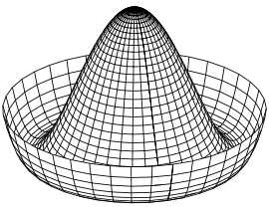
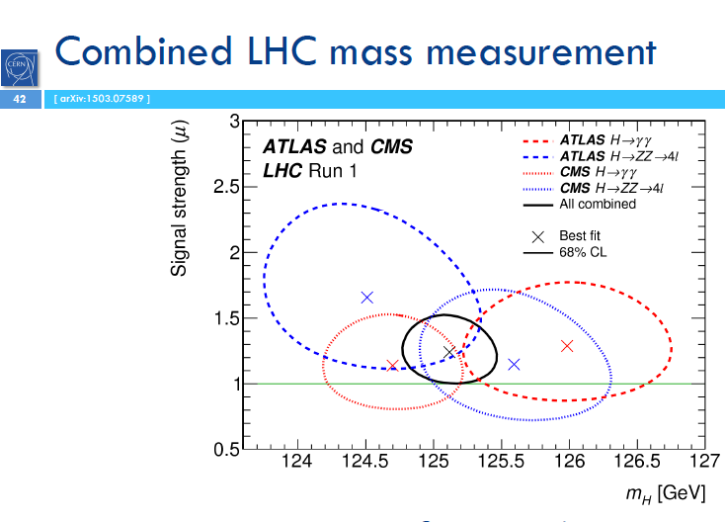
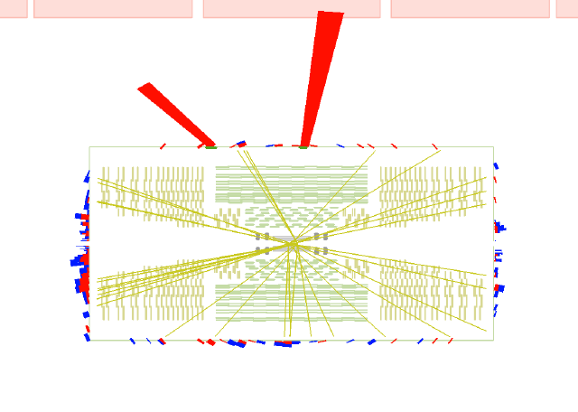
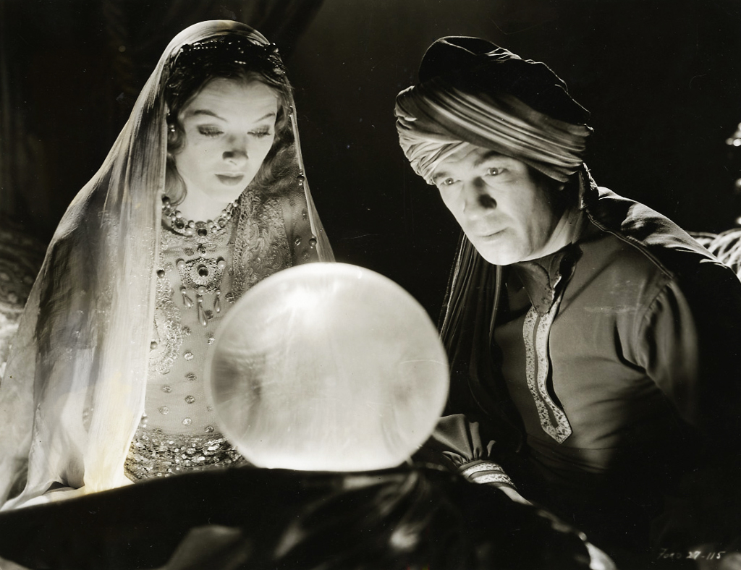
Higgs Lectures

Slide 3

Outlook
Introduction
Hard-core theory
  Lagrangians and symmetries
  Quantum fields
  Problems with the Standard Model
The Higgs mechanism
The long way to discovery
  LEP experiments
  Tevatron experiments
  Search and Discovery at the LHC
Higgs boson properties
Open questions
Notes:
What we thought we knew – teoria e pre-LHC data
How we know what we know – experimental aspects
What we know – we found a Higgs boson
All we have found out in the meantime – mass, spin, parity, cross sections
What we know we don’t know...
What we think we know – teoria e o BSM Higgs

Slide 4
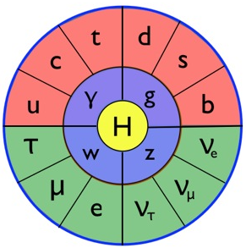
Introduction
Standard Model particles, interactions, and hard-core theory to set the scene…

Slide 5
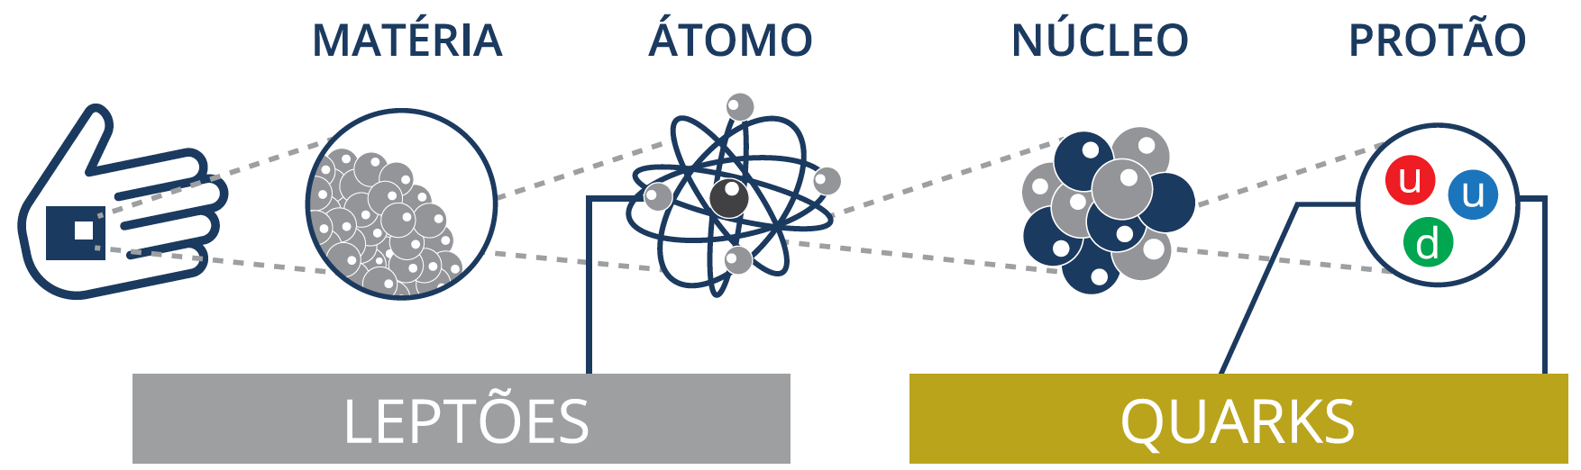
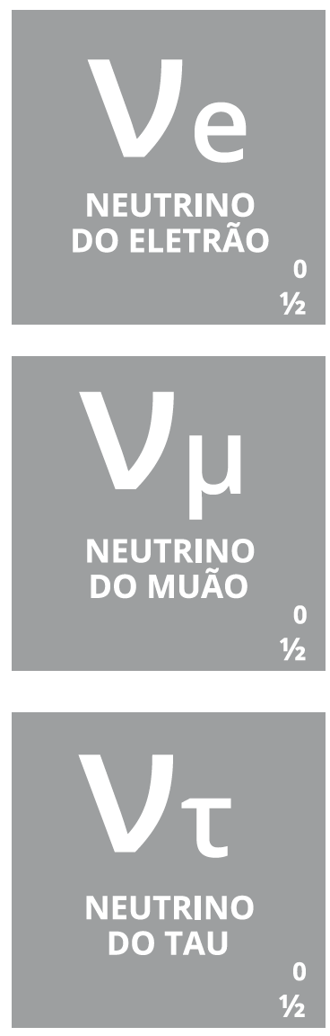
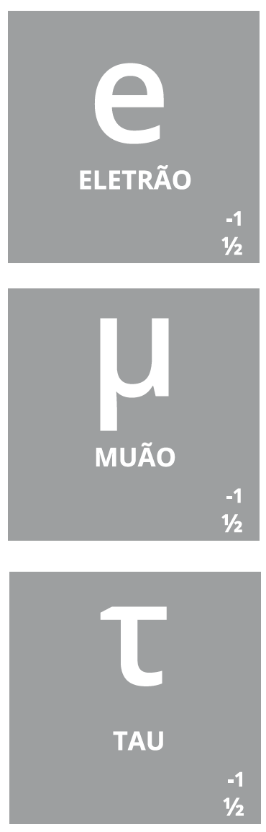
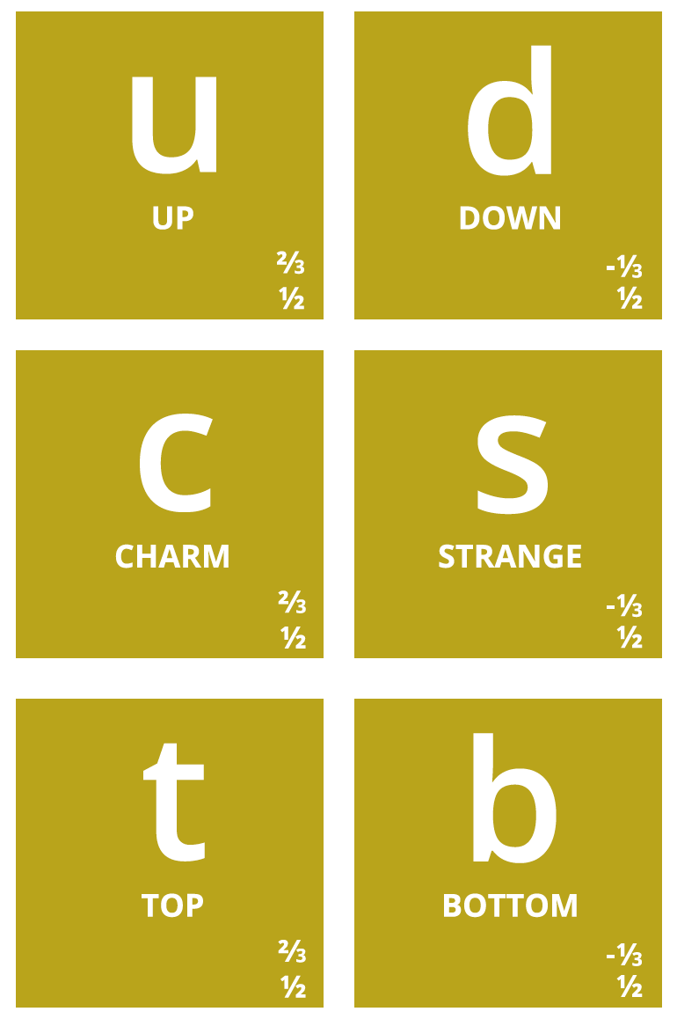
Notes:
Então, quais são afinal as partículas elementares? Temos os quarks, que dão as diferentes propriedades da nova tabela periódica
Também temos o electrão (já conhecíamos), e os seus primos mais pesados: muão e tau. Para cada um destes temos os neutrinos (não são feitos de quarks), que são produzidos em reações no Sol, por exemplo.
Por alguma razão (que desconhecemos) há 3 gerações de partículas elementares, cada uma mais pesada que a anterior → mistério!

Slide 6
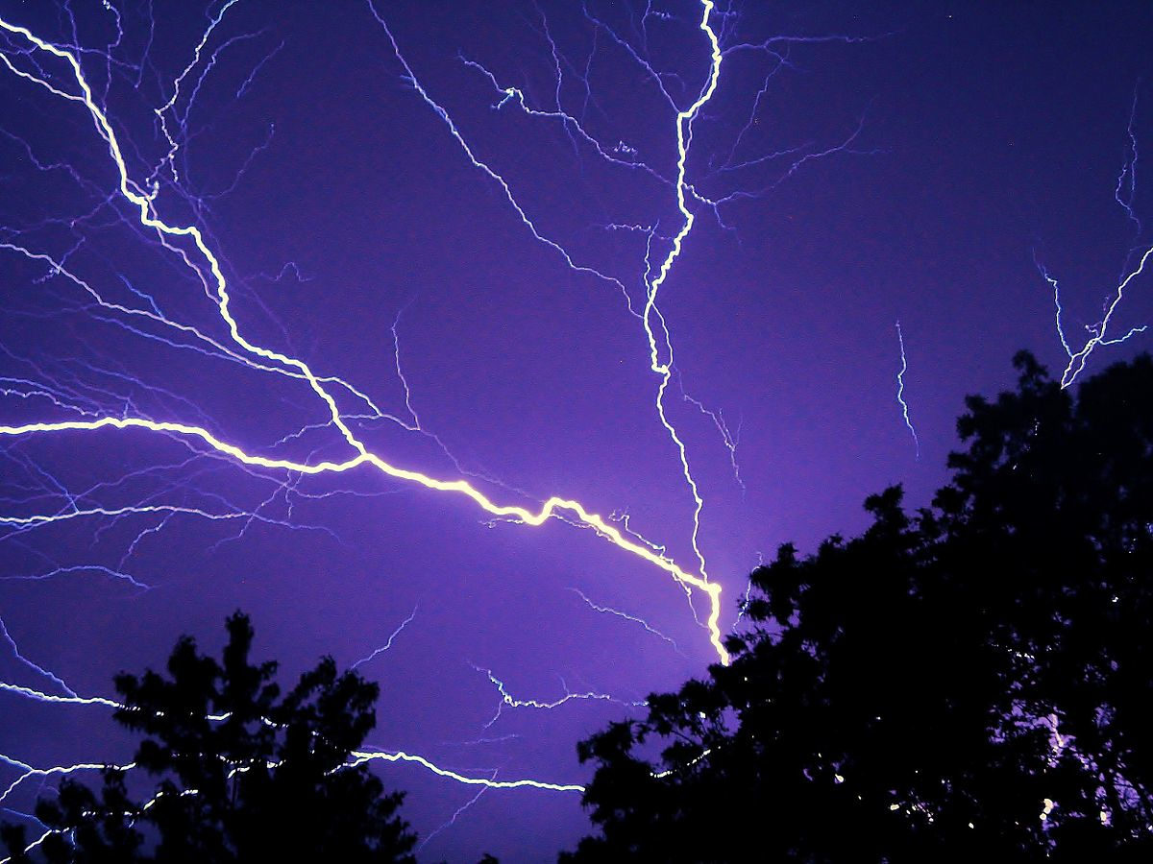
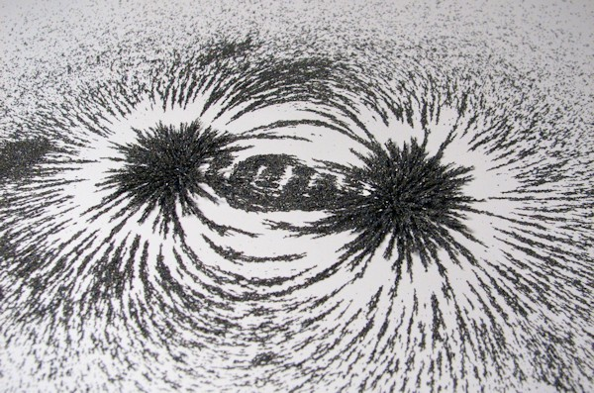
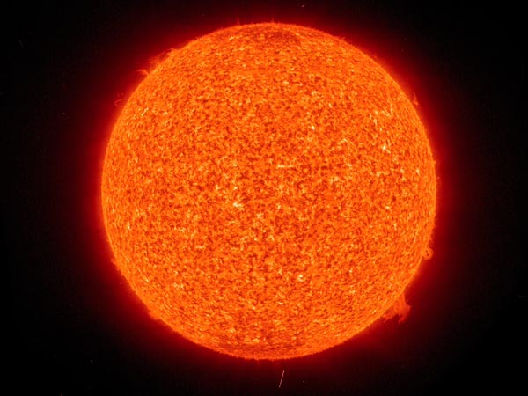
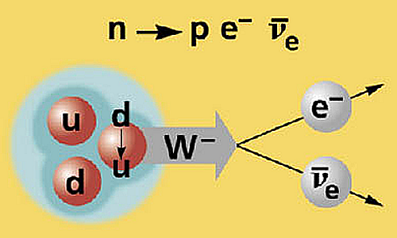

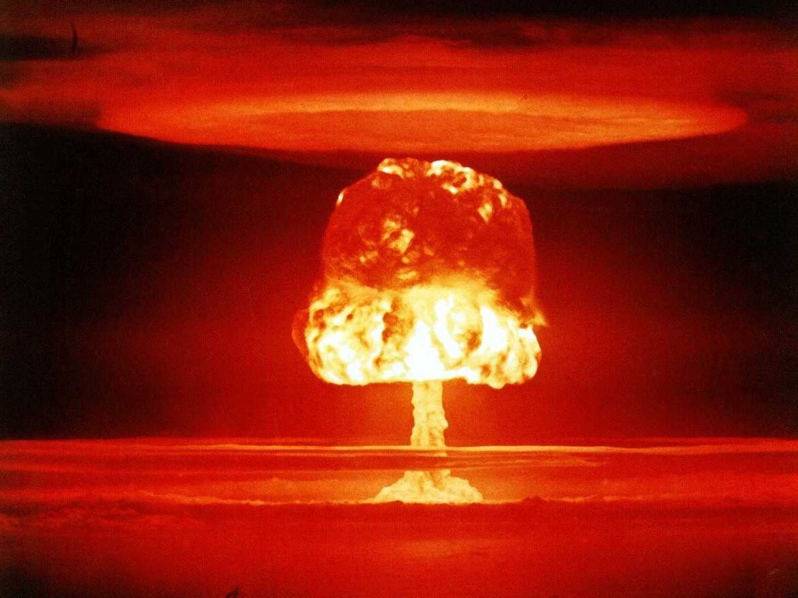
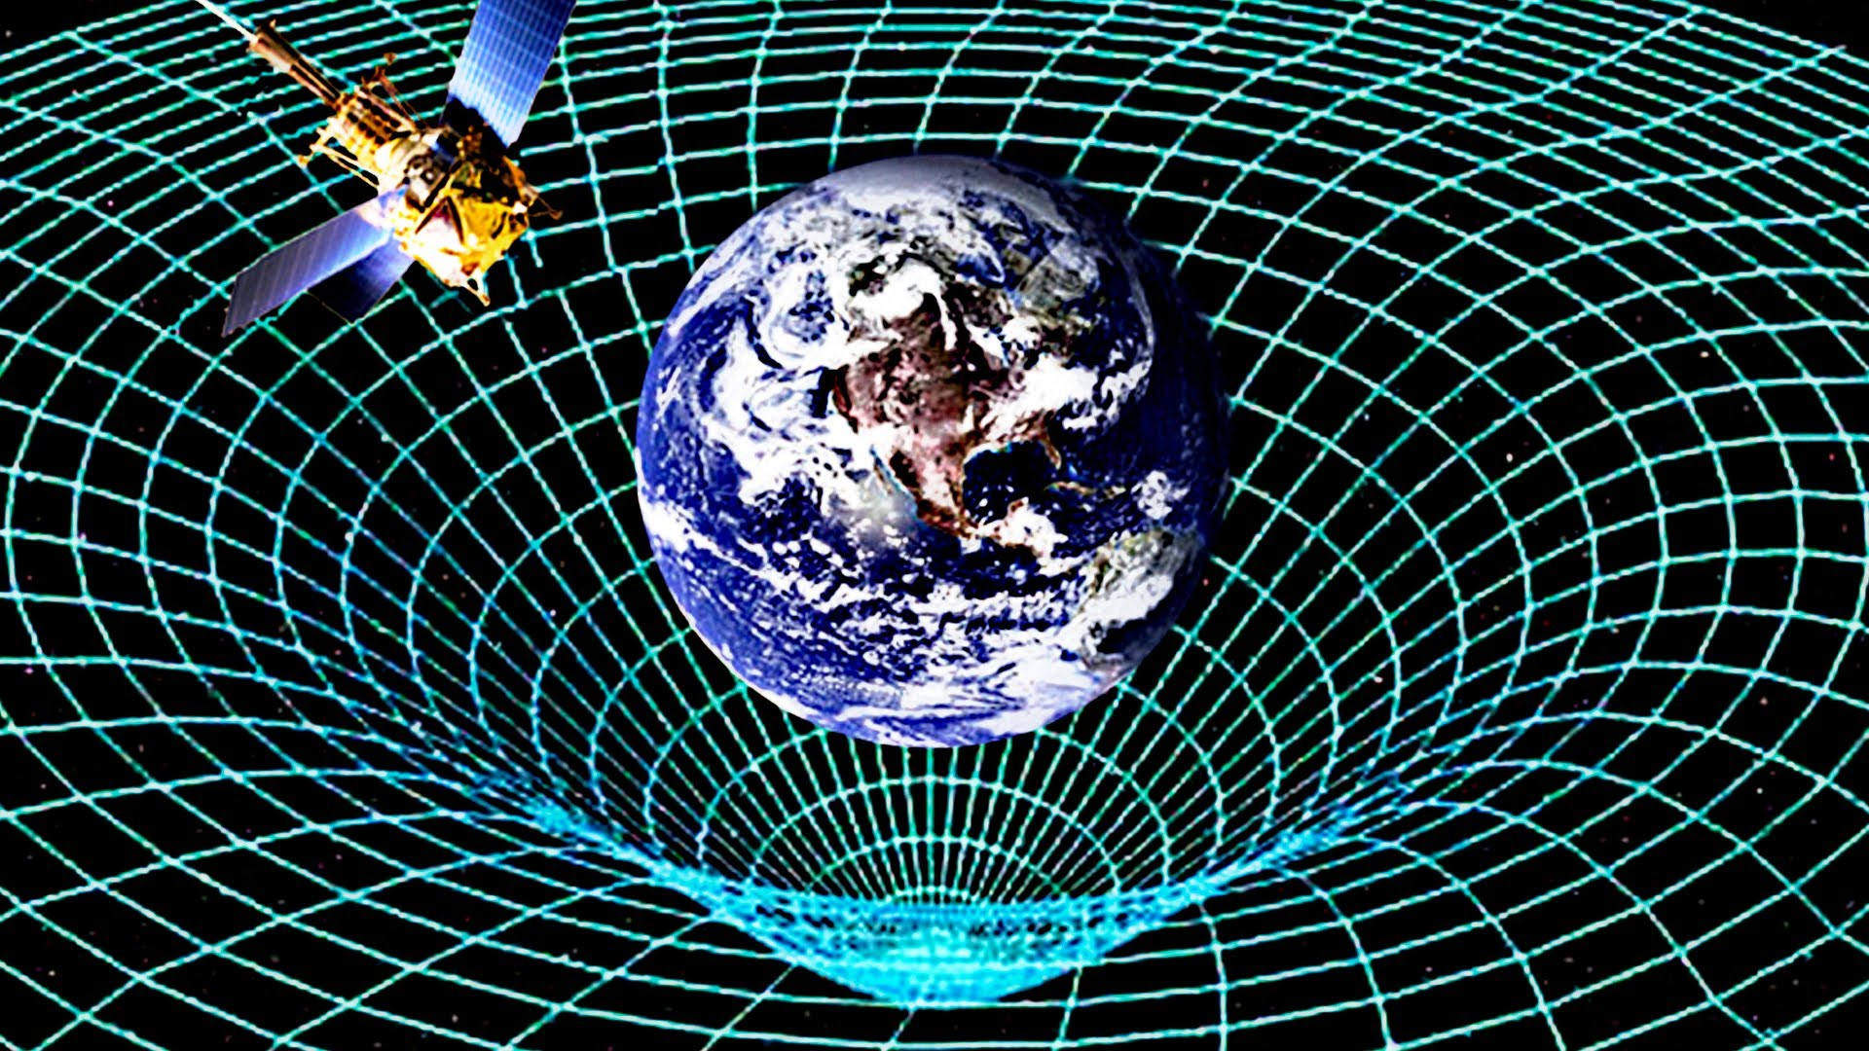
Photon
W±, Z⁰
8 gluons
Graviton??

Slide 7
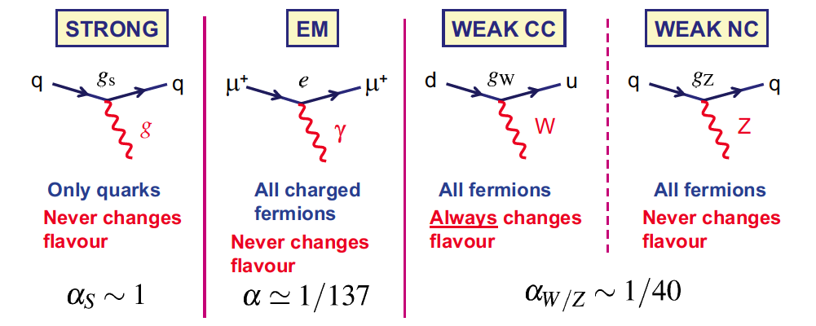
Standard model interactions
The interaction of gauge bosons with fermions is (very) well described by the Standard Model
Gluons
massless
Photon
massless
W+, W-
very massive
Z⁰
very massive
Notes:
Acoplamento (e intensidade do acoplamento) para cada força

Slide 8
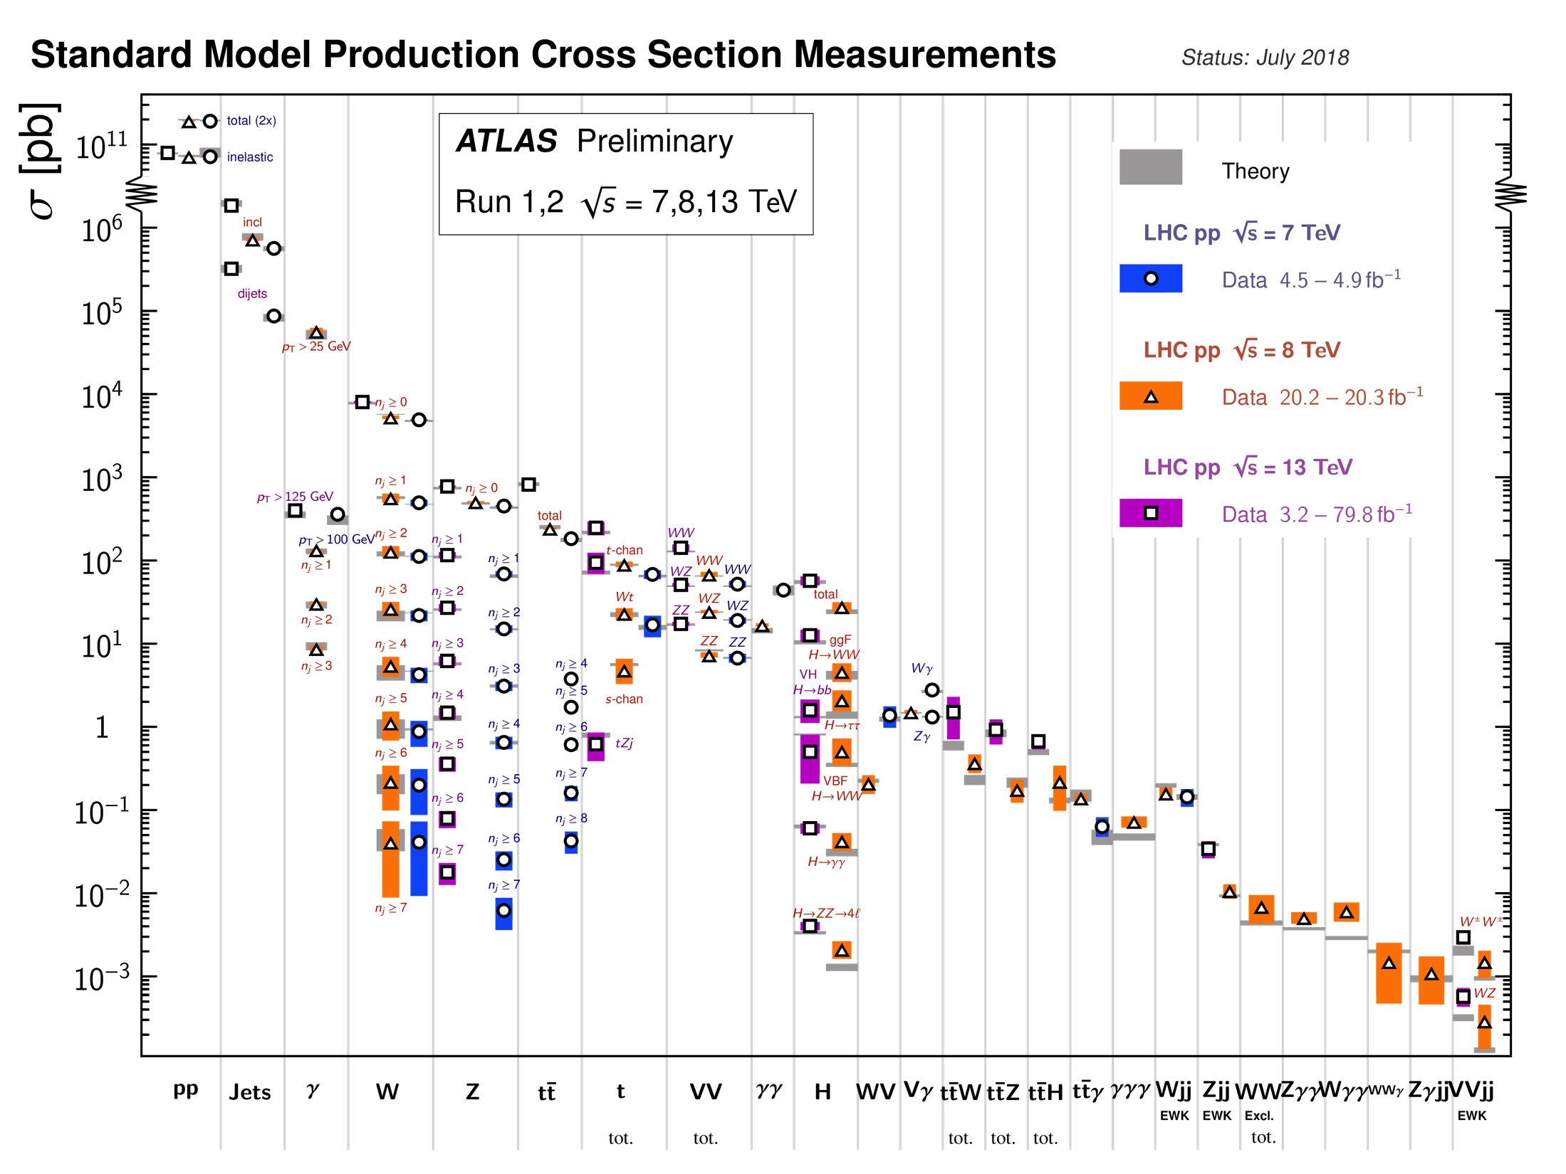
Notes:
SM expectations match measurements at the LHC over a huge range (12 orders of magnitude)! Clearly we do know something....

Slide 9
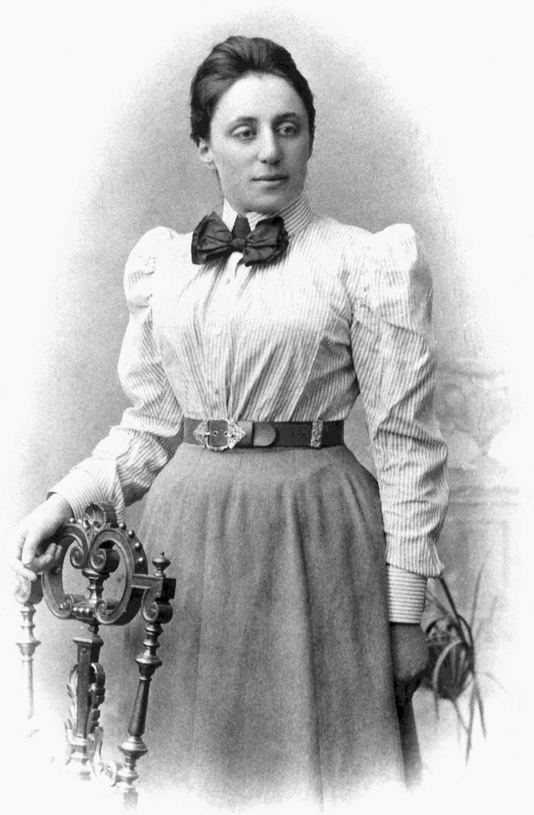
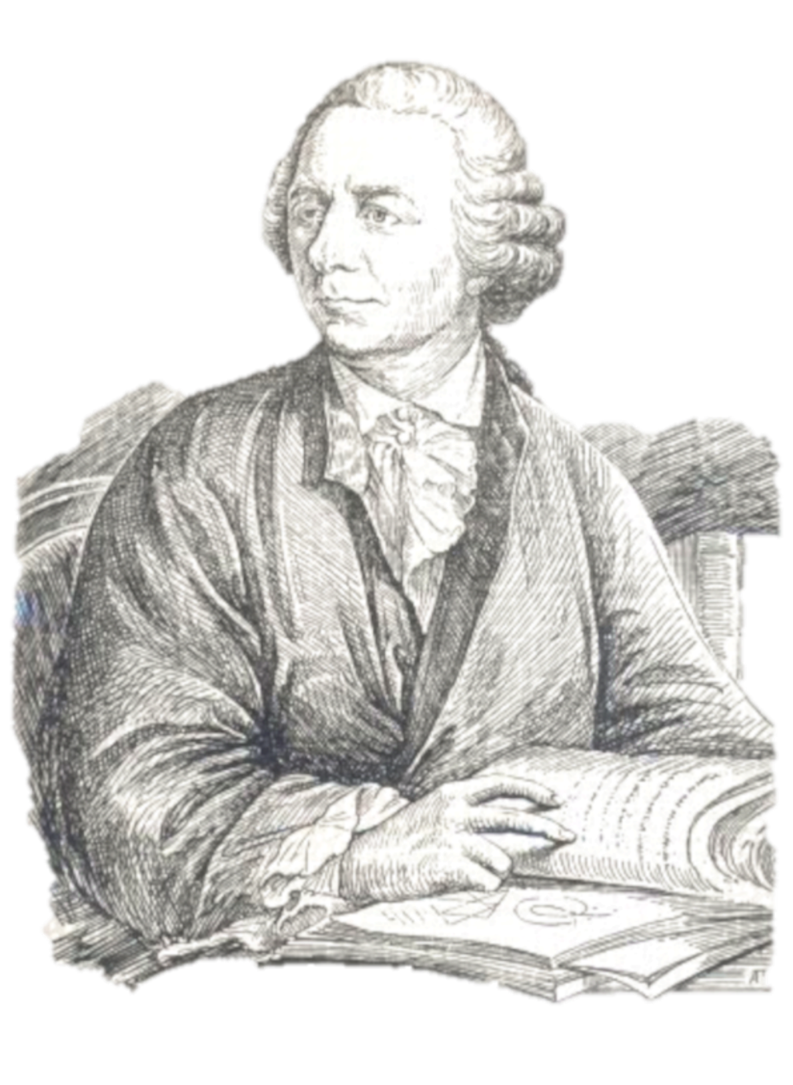
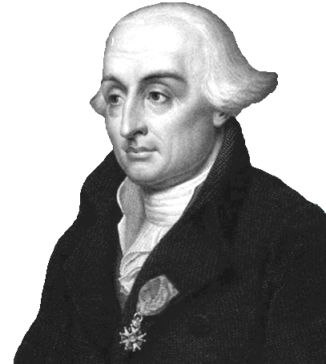
Lagrangians, symmetries and all that
Leonhard Euler(1707–1783)
Emmy Noether (1882 – 1935)
Joseph-Louis Lagrange (1736–1813)
Notes:
Italian-French mathematician and astronomer Joseph-Louis Lagrange in 1788 (born Giuseppe Lodovico Lagrangia to a french father and italian mother) lived in Turin, Berlin and Paris, and was one of the most a renowned mathematicians of his age, teaching . He was president of the commission which defined the metre and kilogram as units. Fourier, who attended his lectures in 1795, wrote: “his voice is very feeble, at least in that he does not become heated; he has a very marked Italian accent and pronounces the s like z [...] The students, of whom the majority are incapable of appreciating him, give him little welcome, but the professeurs make amends for it.” https://en.wikipedia.org/wiki/Joseph-Louis_Lagrange
Amalie Emmy Noether was a German mathematician known for her landmark contributions to abstract algebra and theoretical physics. In physics, Noether's theorem explains the connection between symmetry and conservation laws. Noether was born to a Jewish family in Germany; her father was a mathematician, Max Noether. She studied mathematics at the University of Erlangen. She was invited by David Hilbert and Felix Klein to join the mathematics department at the University of Göttingen, a world-renowned center of mathematical research. But the philologists and historians among the philosophical faculty blocked her: women, they insisted, should not become privatdozent. One faculty member protested: "What will our soldiers think when they return to the university and find that they are required to learn at the feet of a woman? She spent four years lecturing under Hilbert's name. Her habilitation was approved in 1919. Noether remained a leading member of the Göttingen mathematics department until 1933, when Germany's Nazi government dismissed Jews from university positions, and Noether moved to the United States to take up a position at Bryn Mawr College in Pennsylvania. In 1935 she underwent surgery for an ovarian cyst and, despite signs of a recovery, died four days later at the age of 53.
Leonhard Euler (1707 - 1783) was a Swiss mathematician, physicist, astronomer, logician and engineer who made important and influential discoveries in many branches of mathematics like infinitesimal calculus and graph theory while also making pioneering contributions to several branches such as topology and analytic number theory. He also introduced much of the modern mathematical terminology and notation, particularly for mathematical analysis, such as the notion of a mathematical function. He is also known for his work in mechanics, fluid dynamics, optics, astronomy, and music theory. Euler was one of the most eminent mathematicians of the 18th century, and is held to be one of the greatest in history. He is also widely considered to be the most prolific mathematician of all time. He spent most of his adult life in St. Petersburg, Russia, and in Berlin, then the capital of Prussia.

Slide 10
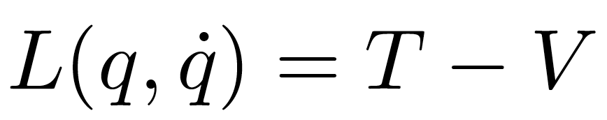
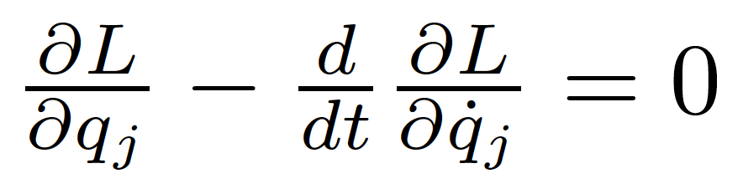
Reminder: Lagrangians in classical mechanics
The equations of motion of a system are derived from a scalar Lagrangian function of generalized coordinates and velocities (time derivatives of the coordinates)
and from the Euler-Lagrange equations:

Slide 11
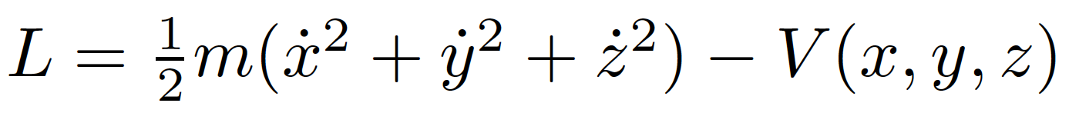
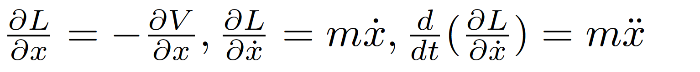
Example
Particle in a conservative potential V. The Lagrangian
has derivatives (e.g. for x)
and Euler-Lagrange’s equations
finally give us Newton’s familiar 2nd law!

Slide 12
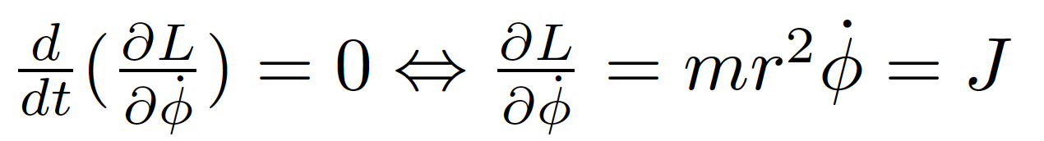
Symmetries and conservation laws
Noether’s theorem:
  If a system has a continuous symmetry property, then there are corresponding quantities whose values are conserved in time.
Simplest case: Coordinates not explicitly appearing in the Lagrangian
Lagrangian invariant over a continuous transformation of the coordinates
Example: mass m orbiting in the field of a fixed mass M
Since the lagrangian doesn’t depend explicitly on φ (symmetry with respect to rotations in space), the Euler-Lagrange equation gives
Where the angular momentum J is a constant of motion!

Slide 13
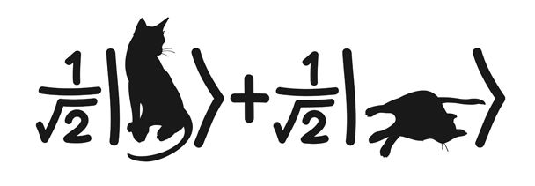
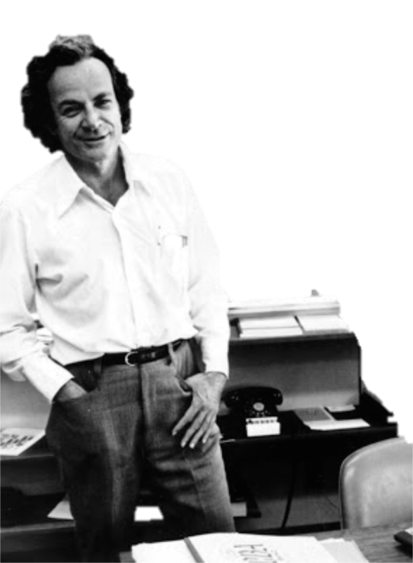
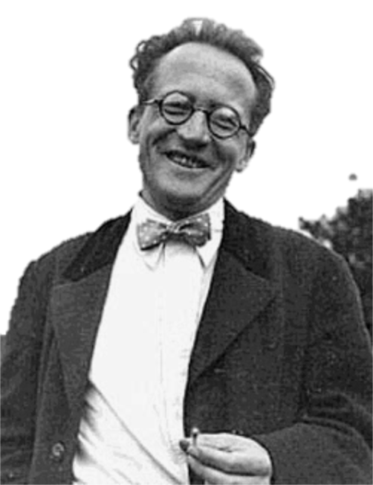

Let’s go to quantum fields...
Erwin Schrödinger (1887 - 1961)
Richard Feynman (1918 - 1988)
Schrödinger’s cat (?-?)
Notes:
Erwin Rudolf Josef Alexander Schrödinger (1887 –1961), sometimes written as Erwin Schrodinger or Erwin Schroedinger, was a Nobel Prize-winning Austrian physicist who developed a number of fundamental results in the field of quantum theory, which formed the basis of wave mechanics: he formulated the wave equation (stationary and time-dependent Schrödinger equation) and revealed the identity of his development of the formalism and matrix mechanics. Schrödinger proposed an original interpretation of the physical meaning of the wave function.
Richard Phillips Feynman (1918 – 1988) was an American theoretical physicist known for his work in the path integral formulation of quantum mechanics, the theory of quantum electrodynamics, and the physics of the superfluidity of supercooled liquid helium, as well as in particle physics for which he proposed the parton model. For his contributions to the development of quantum electrodynamics, Feynman, jointly with Julian Schwinger and Sin-Itiro Tomonaga, received the Nobel Prize in Physics in 1965.

Slide 14
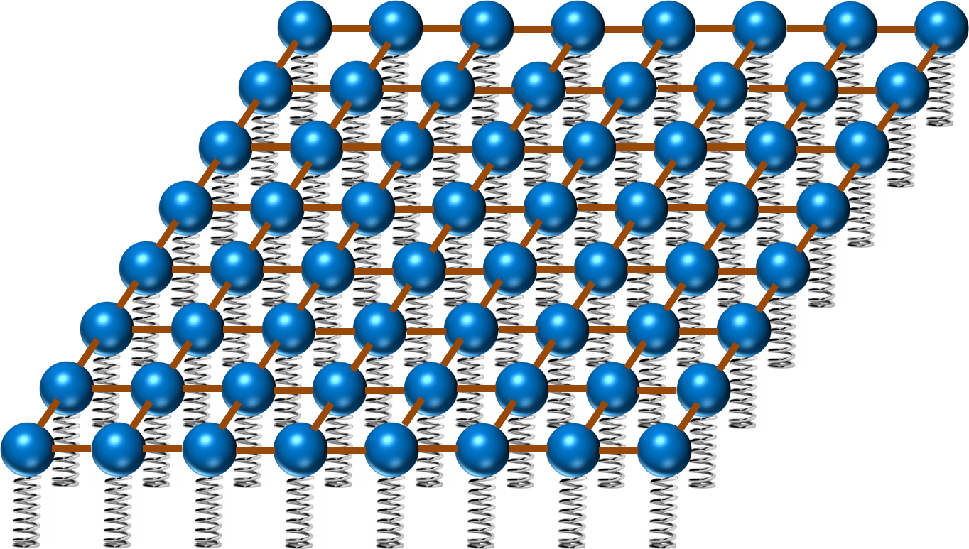
Now in quantum field theory…
Imagine space as an infinite continuum of balls and springs, where each ball is connected to its neighbours by elastic bands. Particles are perturbations of this field
y
ϕ(x,y)
x

Slide 15
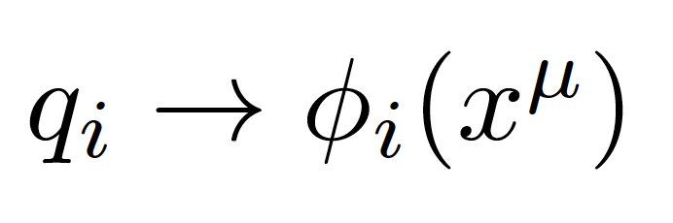
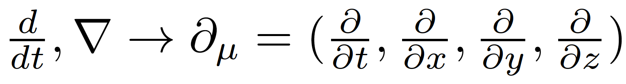
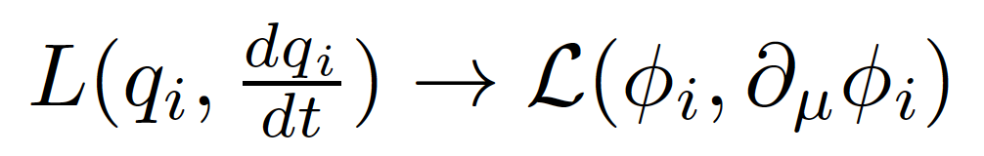
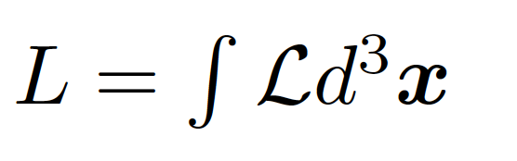
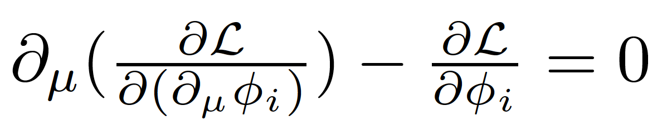
Generalized coordinates are now fields (dislocation of each spring)
In a relativistic theory we must treat space and time coordinates on an equal footing, so the derivatives in the classical equations are now
In place of a Lagrangian we have a Lagrangian density (we call it Lagrangian anyway, just to be confusing)
with:
The new Euler-Lagrange equation now becomes

Slide 16
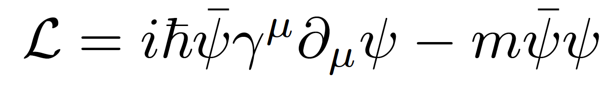
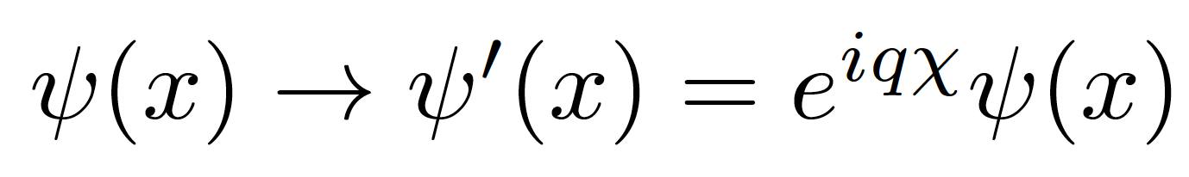
Gauge invariance
Take the Dirac Lagrangian for a spinor field ψ representing a spin-½ particle, for example an electron:
It is invariant under a global U(1) phase transformation like:
Where χ is a constant
Notes:
By the way: this is related to the conservation of electric charge!

Slide 17
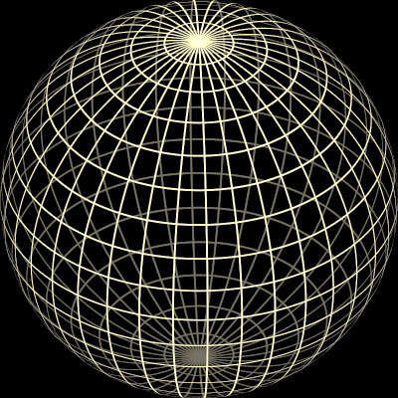
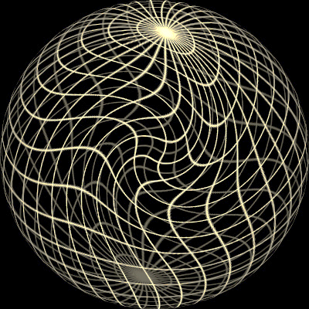
Original sphere
Global transformation
Local transformação
χ = constant
χ = χ (x)

Slide 18
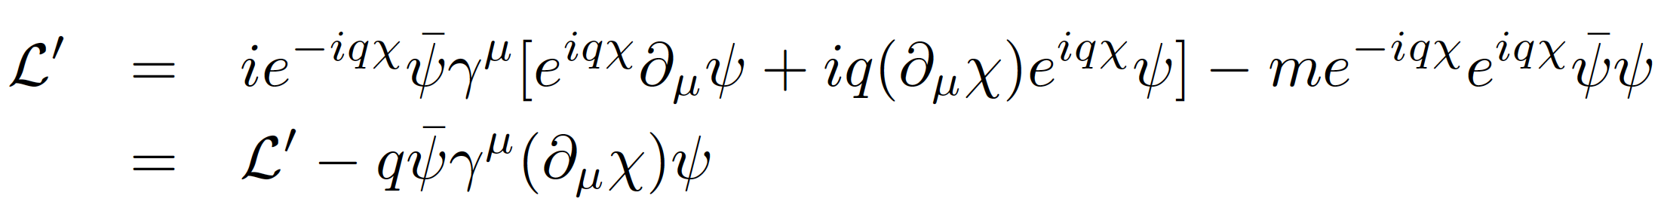
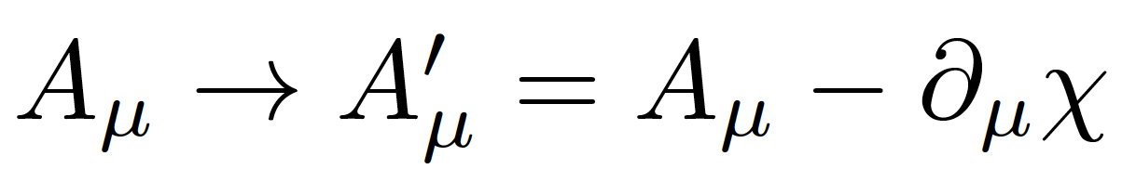
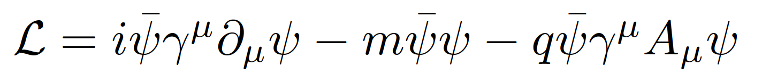
Local gauge invariance and interactions
If χ = χ (x) then we get extra terms in the Lagrangian:
But we can now make the Lagrangian invariant by adding an interaction term with a new gauge field A_{μ} which transforms as:
We get:
A few things to note:
Gauge theories are renormalizable, i.e. calculable without infinities popping up everywhere (Nobel prize of t’Hooft and Veltman)
The new gauge field A_{μ} is the photon in QED
The mass of the fermion is the coefficient of the term on ψψ
There is no term in A_{μ}A^{μ} (the photon has zero mass) → this is the beginning of the Higgs story…
Notes:
Demanding local gauge conservation resulted in obtaining a new field (the photon) and its interactions with the fermion fields. This is the blueprint of all Standard Model theories (called “Gauge theories”).
Gauge theories are automatically renormalizable (‘t Hooft & Veltman’s Nobel prize) i.e. don’t produce nonsense.

Slide 19

Now for the problems...

Slide 20
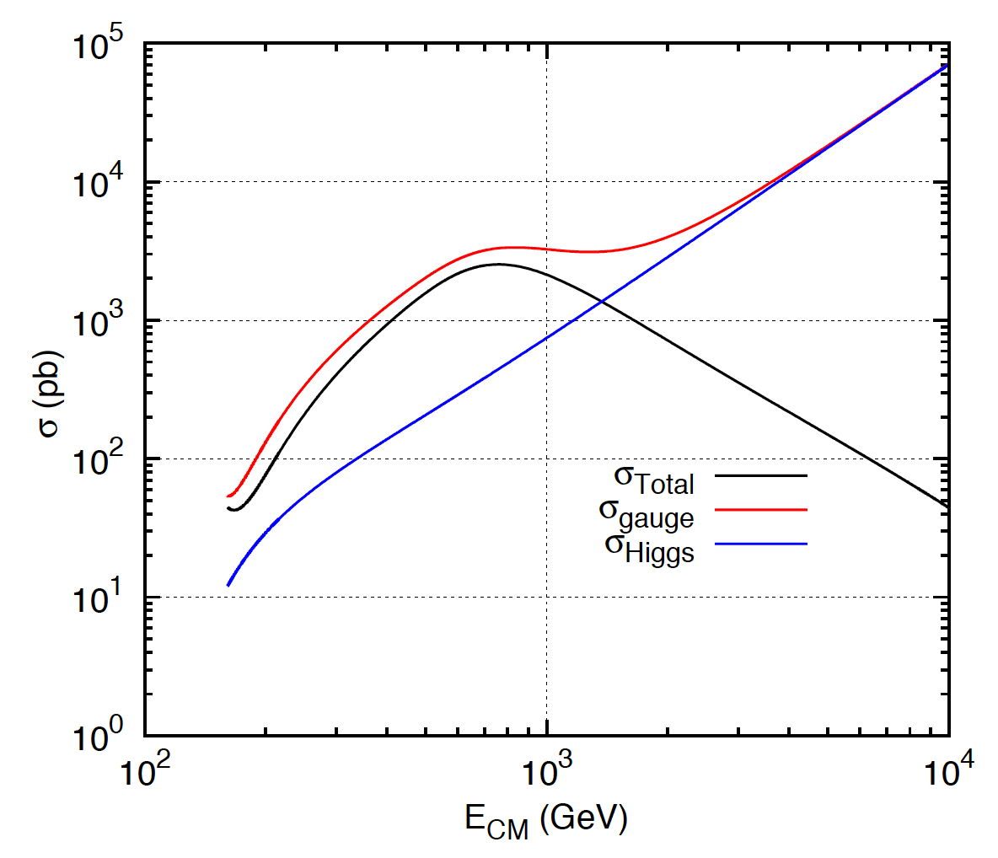
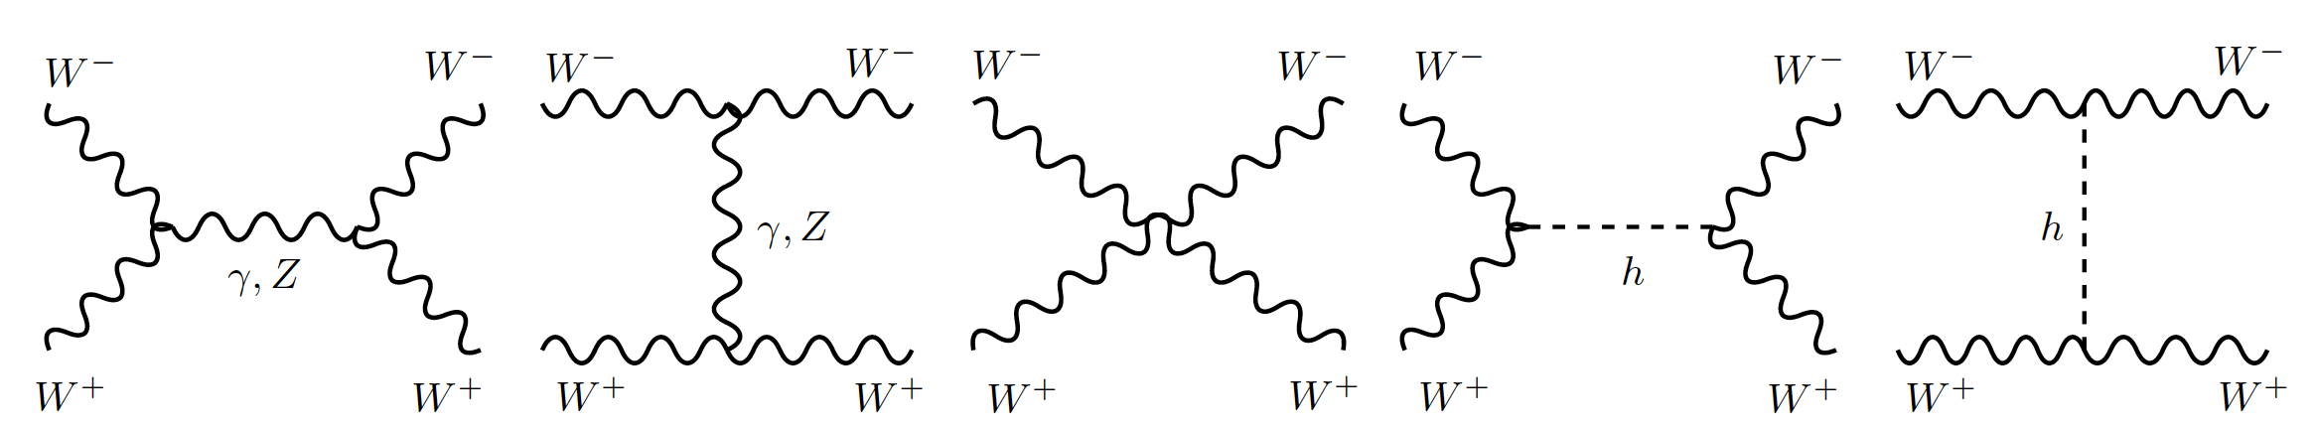
1: Longitudinal gauge-boson scattering
In the absence of the Higgs, some processes have cross sections that grow with the centre of mass energy of the collision… i.e. breaks unitarity!
The Higgs regulates the cross section through negative interference
J.C.Romão [5]
Feynman diagrams contributing to longitudinal WW scattering

Slide 21
2: Mass of elementary particles and gauge bosons
To keep the Lagrangian gauge invariant (against a U(1) local phase transformation) the photon field transforms as:
But the A^{μ} mass term breaks the invariance of the Lagrangian:
For the SU(2)_{L} gauge symmetry transformations of the weak interaction the fermion mass term m_{e}ψψ also breaks invariance!
Bottom line: the SM (without the Higgs mechanism) results in wrong calculations and breaks down for massive particles

Slide 22
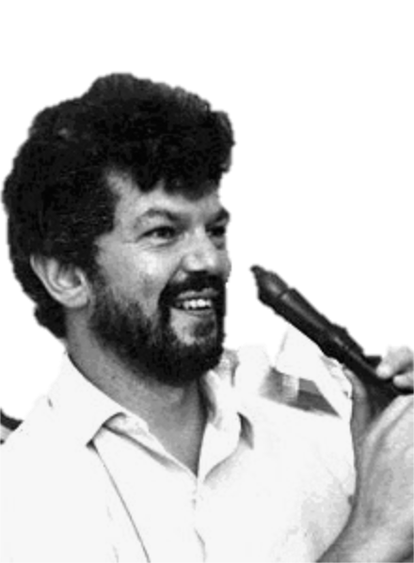
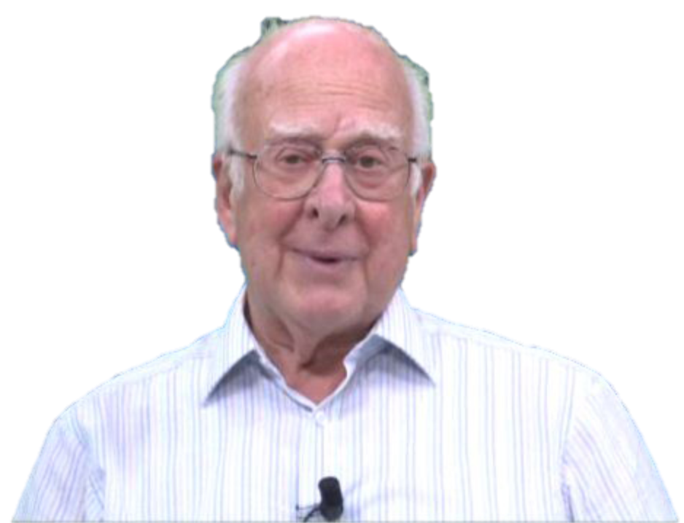
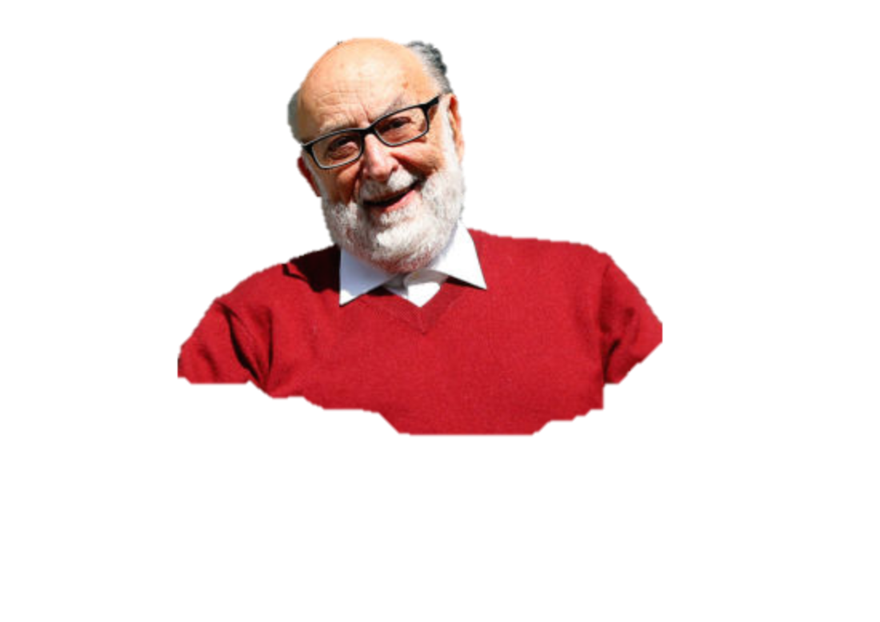
The Higgs Mechanism
Robert Brout (1928 – 2011)
François Englert (b. 1932)
Peter Higgs (b. 1929)
Notes:
Peter Ware Higgs (born 29 May 1929) is a British theoretical physicist, emeritus professor at the University of Edinburgh. In the 1960s, he proposed that broken symmetry in electroweak theory could explain the origin of mass of elementary particles in general and of the W and Z bosons in particular. This so-called Higgs mechanism, which was proposed by several physicists besides Higgs at about the same time, predicts the existence of a new particle, the Higgs boson, the detection of which became one of the great goals of physics.
Robert Brout (1928 –2011) was a Belgian theoretical physicist who made significant contributions in elementary particle physics. He was a Professor of Physics at Université Libre de Bruxelles where he had created, together with François Englert, the Service de Physique Théorique.
François Baron Englert (born 1932) is a Belgian theoretical physicist and 2013 Nobel prize laureate (shared with Peter Higgs). He is Professor emeritus at the Université libre de Bruxelles (ULB) where he is member of the Service de Physique Théorique. He is also a Sackler Professor by Special Appointment in the School of Physics and Astronomy at Tel Aviv University and a member of the Institute for Quantum Studies at Chapman University in California.

Slide 23
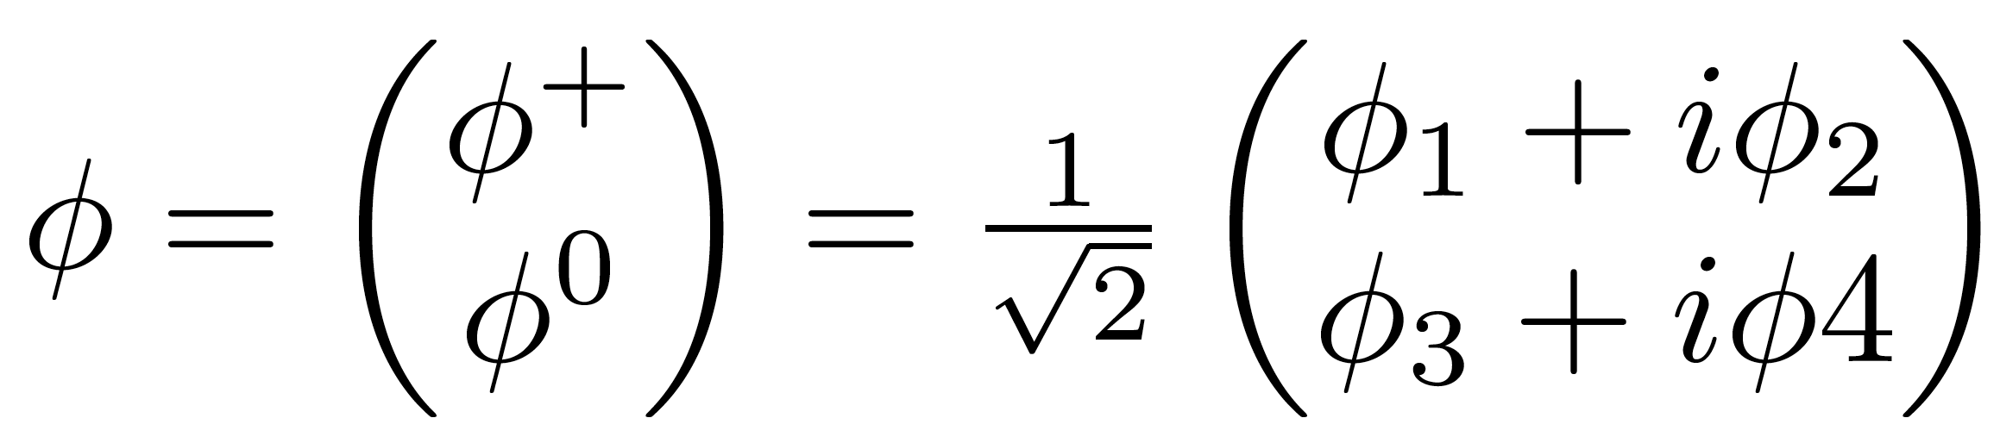
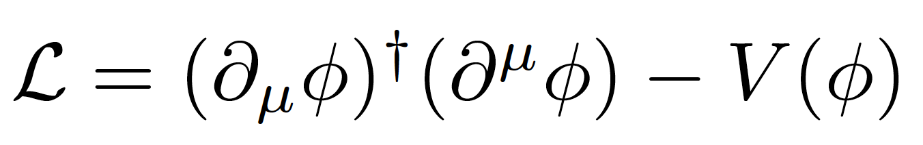
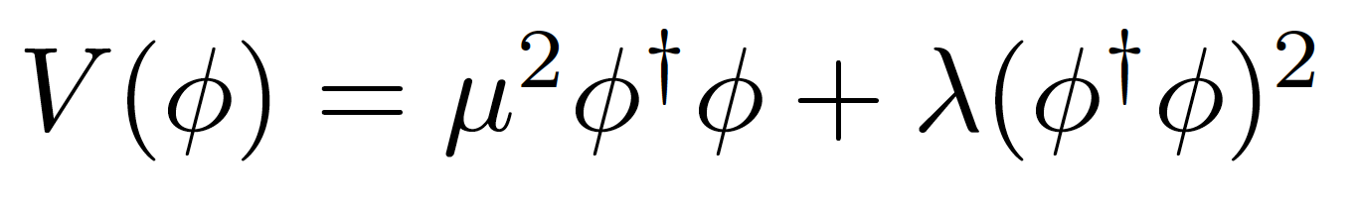
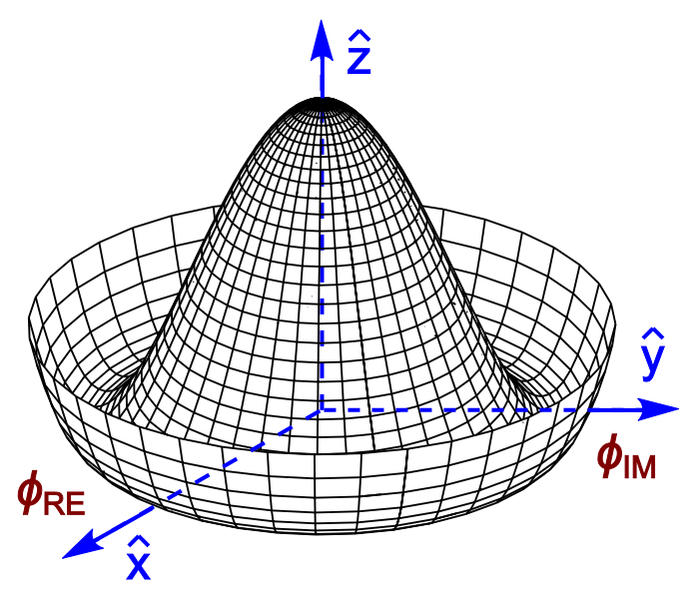

Introduce a SU(2) doublet of spin-0 complex fields
The Lagrangian is
With a potential
For λ>0, μ²<0 the potential has a
minimum at the origin
For λ>0, μ²<0 the potential has an
infinite number of minima at:
The choice of vacuum (lowest
energy state of the field) breaks the symmetry of the Lagrangian

Slide 24



Notes:
Quebra da simetria electrofraca após o Big Bang: quando a densidade de energia baixou, as próprias forças fundamentais mudaram
No fim ficamos com W e Z com massa, fotão na mesma sem massa, e resta-nos um bosão de Higgs; mas as proprias forças mudam!
In the Standard Model with no Higgs mechanism, interactions are symmetric and particles do not have mass
Electroweak symmetry is broken: Photon does not have mass W, Z have a large mass
Higgs mechanism: mass of W and Z results from the Higgs mechanism; Masses of fermions come from a direct interaction with the Higgs field

Slide 25

Electroweak symmetry breaking
In the Standard Model with no Higgs mechanism, interactions are symmetric and particles do not have mass
Electroweak gauge symmetry is broken:
  Photon does not have mass
  W, Z have a large mass
Higgs mechanism: mass of W and Z results from the Higgs mechanism
Masses of fermions come from a direct interaction with the Higgs field
see J.Varela’s lecture

Slide 26


Slide 27

EWK Symmetry Breaking in Pictures

Slide 28







We have at this point a massive scalar field with vacuum expectation value v and mass
4 gauge fields: W⁽¹⁾, W⁽²⁾, W⁽³⁾, and B⁽¹⁾ which transform to give the massive W⁺, W⁻ and Z, and massless A (the photon)
with g, g_{W} the couplings of electromagnetic and weak forces
Defining the Weinberg angle as
we also get the relation between
the masses of W and Z
Fermions get their masses from interaction terms with the Higgs field (Yukawa coupling)

Slide 29


Electromagnetic interaction
γ
W±
Weak Nuclear Interaction
Notes:
Como é que sabíamos disto? Ou só estávamos só a adivinhar?
Vemos isto em medidas experimentais!! Neste gráfico vemos a probabilidade de um certo tipo de reação entre partículas.
Há duas possibilidades: uma reação governada pela força fraca e outra reação pela força eletromagnética.
A altas energias, vemos que as duas forças se tornam numa só força: a força electrofraca.
É a quebra de simetria ao contrário, como se andássemos para trás no tempo, em direção ao Big Bang

Slide 30

Notes:
Isto equivale a uma transição de fase no universo primitivo em que umas forças se transformaram noutras
NOTA: talvez um dia seja possível observar as ondas gravitacionais produzidas por bolhas de nucleação desta transição de fase

Slide 31

The Story So Far...
Notes:
Como é que sabíamos disto? Ou só estávamos só a adivinhar?
Vemos isto em medidas experimentais!! Neste gráfico vemos a probabilidade de um certo tipo de reação entre partículas.
Há duas possibilidades: uma reação governada pela força fraca e outra reação pela força eletromagnética.
A altas energias, vemos que as duas forças se tornam numa só força: a força electrofraca.
É a quebra de simetria ao contrário, como se andássemos para trás no tempo, em direção ao Big Bang

Slide 32





The Standard Model of particle physics
2013
Notes:
Particulas fundamentais conhecidas; forças a que elas reagem; Z tem massa alta ao contrario de gamma e gluoes; Higgs pedra basilar do edificio; dá massa mas só pequena fração nos hadroes;

Slide 33



Slide 34


What we think we know:
Higgs mass (was) the only unknown parameter
We can give mass to W± and Z while keeping the photon massless
Relation between masses of W and Z
Higgs couples to W and Z with strengths proportional to their masses
Higgs couples to all fermions with a strength proportional to their mass

Slide 35


Exploring the electroweak scale
Precision measurements of m_{W}, m_{t}, m_{H} are stringent tests of the SM at the EW scale
  E.g. excluding measured m_{H}, global EW fit gives m_{H} = 90 ± 21 GeV (1.7 σ tension) driven in part by m_{top}
arXiv:1803.01853

Slide 36


The Long Way to Discovery

Slide 37






Slide 38

Searches at LEP

Slide 39

Low-mass searches at LEP

Slide 40

Higher-mass Higgs production at LEP

Slide 41

Higgs decays: focus on 3rd generation

Slide 42


Slide 43

LEP’s Final Legacy: the Blue Band Plot
Decades of searches in many experiments...
By July 2010:
  LEP+Tevatron+SLD limits
  Higgs excluded m_{h}<114.4 GeV at 95% CL
  Plus between 158 and 175 GeV
CERN-PH-EP-2010-05

Slide 44

Searches at the Tevatron

Slide 45

Higgs production at the Tevatron

Slide 46

Most sensitive searches

Slide 47


The final stand of the Tevatron
By the end of its lifetime, the Tevatron had very sophisticated analyses of a huge number of channels
By that time the LHC was collecting data and analysing it very fast
The CDF and D0 experiments obtained a significant excess of around 3 standard deviations in the mass range 115<M_{H}<140 GeV
Not enough to claim discovery, but consistent with the LHC results

Slide 48



Discovery at the LHC
Proton-proton (and Heavy Ion) collider
s^{1/2} = 7, 8, 13 TeV so far
Operation started 2008
Physics data from 2010
Expected closure 2035
Luminosity so far: about 150 fb⁻¹ per experiment for ATLAS and CMS

Slide 49





At the LHC
https://twiki.cern.ch/twiki/bin/view/LHCPhysics/LHCHXSWG
gluon-fusion
VBF
WH
ZH
ttH
Notes:
Main production channels: gluon fusion, Vector Boson Fusion, associated production with vector bosons, associated production with ttbar pair
Animation

Slide 50





Slide 51



It takes time to get it right
EPS-HEP 2011 conference [6]

Slide 52



Discovery channels
Discovery was made in ATLAS and CMS with about 5 fb⁻¹ of 7 TeV data and 20 fb⁻¹ of 8 TeV data per experiment; several channels combined
This means about 400 000 Higgs bosons produced in about 8 000 000 000 000 000 (8x10¹⁵) proton collisions
  Only about 4000 events with Higgs bosons contributed to the discovery

Slide 53










Combining Higgs Channels
Production
Decay
H->γγ
FIT
×
H->ZZ
H->WW
t
t
t
Backgrounds +

Slide 54
The p₀ Discovery Plot
p₀ is the combined probability that the background fluctuates to look like signal
Translated into the one-sided Gaussian probability
This corresponds to a probability of 1 in 3.5 million that this was a false positive from fluctuating backgrounds

Slide 55


2013 Physics Nobel Prize Higgs for the Higgs Boson Discovery
François Englert,
Belga,
born 1932,
U. Libre
de Bruxelles
Peter Higgs,
English,
born
1929,
Univ. of
Edimburgh
"for the theoretical discovery of a mechanism that contributes to our understanding of the origin of mass of subatomic particles, and which recently was confirmed through the discovery of the predicted fundamental particle, by the ATLAS and CMS experiments at CERN's Large Hadron Collider"
Notes:
A Descoberta do bosão de Higgs premiada com o Prémio Nobel 2013
E mostrou finalmente que os termos com phi na caneca existem

Slide 56



Slide 57

What we have found out since
A (quick) foretaste of the next few lectures

Slide 58



Spin and Parity
First concern after observation!
Some observable quantities sensitive to J^{P}: for example angle between leptons from W decay in H->WW
Pure J^{P} = 0⁻, 1⁺, 1⁻, and 2⁺ excluded with 97.8, 99.97, 99.7, and 99.9% Confidence Level (ATLAS arXiv 1307.1432; CMS Phys. Rev. D 92, 012004)
H->γγ – ATLAS arXiv 1307.1432
H
W⁺
W⁺
μ⁺
W⁻
ν_{μ}
W⁻
e⁻
ν_{e}

Slide 59



Higgs boson mass
Mass: around 125GeV
  Was the only unknown
  SM parameter ☺
For a while, different mass values were being measured in ATLAS and CMS, and in different channels
Numbers evolved with accumulated statistics
Current most precise value from ATLAS+CMS has 0.2% precision!
  ATLAS: arXiv:1307.1427
Phys. Rev. Lett. 114, 191803
m_{H}=125.09±0.21 (stat)±0.11 (syst) GeV

Slide 60

Cross section compared to SM expectation

Slide 61



Probing the 125 GeV Higgs
2HDM
Triple coupling λ₃
Clavicle
Aorta
Ribs
Yukawa
couplings
BSM

Slide 62


The Run 1 legacy
Phys. Rev. Lett. 114 (2015) 191803
JHEP 08 (2016) 045
Mass – Higgs mass measured with 0.4% accuracy:
  m_{H} = 125.09 ± 0.21 (stat.) ± 0.11 (scale) ± 0.02 (other) ± 0.01 (theory) GeV
Couplings:
  ggF with H → ZZ,,WW observed by individual experiments
  VBF and H →  observed with >5σ significance by ATLAS+CMS combination
  ttH, VH production and H → bb not observed during Run1
Couplings compatible with SM:
  Signal strength: μ_{VBF+VH}/μ_{ggF+ttH} = 1.06 ^{+0.35} _{-0.27}
  Coupling modifiers broadly consistent with SM but still large uncertainty
μ = (σ ×BR)_{Obs}/ (σ×BR)_{SM}
Significance (σ)
Prod. | Obs. | Expect.
VBF | 5.4 | 4.7
VH | 3.5 | 4.2
ttH | 4.4 | 2.0
Decay | Obs. | Expect.
H→ττ | 5.5 | 5.0
H→bb | 2.6 | 3.7
Notes:
https://atlas.web.cern.ch/Atlas/GROUPS/PHYSICS/PAPERS/HIGG-2015-07/
https://atlas.web.cern.ch/Atlas/GROUPS/PHYSICS/PAPERS/HIGG-2014-14/

Slide 63







Run 2: Higgs boson mass
arXiv:1804.02716 [hep-ex]; arXiv:1706.09936 [hep-ex]; arXiv:1806.00242 [hep-ex]
Mass measurement from CMS H→ZZ*→4l:
m_{H}^{ZZ*}= 125.26 ± 0.20 (stat) ± 0.08 (syst) GeV
New Measurements from ATLAS
  H→ γγ: m_{H}^{γγ} = 124.93 ± 0.40 GeV
  H→ZZ*→4l: m_{H}^{ZZ∗} = 124.79 ± 0.37 GeV
Run 1+2 combination from ATLAS:
  m_{H} = 124.97 ± 0.19 (stat) ± 0.13 (syst.) GeV
Notes:
https://atlas.web.cern.ch/Atlas/GROUPS/PHYSICS/PAPERS/HIGG-2016-33/ → 1 June 2018
http://cms-results.web.cern.ch/cms-results/public-results/publications/HIG-16-040/index.html → 8 April 2018
Both use 36.1 fb⁻¹ from 2015+2016

Slide 64




Differential Higgs boson cross sections
JHEP 11 (2017) 047; CMS-HIG-17-015; ATLAS-CONF-2018-002; ATLAS-CONF-2018-018
Reached a new phase in the exploration of the Higgs sector!
Differential cross sections:
  Higgs p_{T} sensitive to new physics in gluon-fusion loop
  Number of jets sensitive to modeling of radiation and different production modes
Notes:
https://atlas.web.cern.ch/Atlas/GROUPS/PHYSICS/PAPERS/HIGG-2017-11/ → 24 May 2018
https://atlas.web.cern.ch/Atlas/GROUPS/PHYSICS/CONFNOTES/ATLAS-CONF-2018-018/ → 04 Jun 2018
http://cms-results.web.cern.ch/cms-results/public-results/publications/HIG-16-041/ → 30 June 2017
http://cms-results.web.cern.ch/cms-results/public-results/preliminary-results/HIG-17-015/index.html → March 2017
http://cms-results.web.cern.ch/cms-results/public-results/publications/HIG-17-025/ → 11 July 2018(after the conference)

Slide 65



Últimas novidades!!
Notes:
Porque é que interessa?
O Higgs desintegra-se sobretudo em quarks bottom. Se vemos isto há menos espaço para nova física!

Slide 66

Casting a wider net

Slide 67
Going beyond the standard model
But the Standard Model is not complete; there are still many unanswered questions.
Why do we observe matter and almost no antimatter if we believe there is a symmetry between the two in the universe?
What is this "dark matter" that we can't see but has visible gravitational effects in the cosmos?
Are quarks and leptons actually fundamental, or made up of even more fundamental particles?
Why are there exactly three generations of quarks and leptons? What is the explanation for the observed pattern for particle masses?
How does gravity fit into all of this?

Slide 68
Many possible theories
There are a large number of models which predict new physics at the TeV scale accessible at the LHC:
Supersymmetry (SUSY)
Extra dimensions
Extended Higgs Sector e.g. in SUSY Models
Grand Unified Theories (SU(5), O(10), E6, …)
Leptoquarks
New Heavy Gauge Bosons
Technicolour
Compositeness
Any of this could still be found at the LHC and most have a connection to the Higgs boson

Slide 69







Additional Higgs bosons?

Slide 70




Higgs + Dark Matter
ATLAS-CONF-2018-039
25 July 2018
Used 79.8 fb⁻¹ of 13 TeV data
  High E_{T}^{miss} (>150GeV) and b-tagging to suppress backgrounds
  Reconstruct b-jets as 2 small jets or merged variable-radius (VR) track jets
Signal benchmark: Type-II 2HDM + U(1)_{Z’} symmetry (Z’-2HDM)
Main backgrounds: tt, W/Z+jets
Excluded region in m_{A} – m_{Z’} plane
Notes:
https://atlas.web.cern.ch/Atlas/GROUPS/PHYSICS/CONFNOTES/ATLAS-CONF-2018-039/ → 25 July 2018
VR jets: track jets reconstructed with an algorithm in which the radius parameter decreases with increasing jet transverse momentum (pT)
large missing transverse momentum and either two b-tagged small radius jets or a single large radius jet containing two b-tagged subjets

Slide 71



Charged Higgs: H⁺→tb
arXiv:1808.03599
10 Aug 2018
Explored single-lepton and dilepton tt final states
  In range m_{H+}: 200 – 2000 GeV
36.1 fb⁻¹ of 13 TeV data
Events categories: N_{jets} and N_{b-tags}
  Allow to constrain backgrounds in simultaneous fit
BDTs trained in signal regions
  Separate signal and background for 18 mass points
  Matrix method used in single-lepton channel
Extracted limits on σ x BR and on m_{H+} - tan β plane for two MSSM scenarios
Notes:
https://atlas.web.cern.ch/Atlas/GROUPS/PHYSICS/PAPERS/HIGG-2017-04/ → 10 August 2018

Slide 72








Triple Higgs coupling
arXiv:1808.00336 [hep-ex]; ATLAS-CONF-2018-043
7 July 2018
4 Sep 2018
The triple Higgs coupling λ_{HHH} can be probed through di-Higgs production
Very suppressed in SM!
  Negative interference between LO diagrams
  Cross section 1500x less than ggF
Wide range of decay BR and channel purity
bbττ analysis:
  Used 36 fb⁻¹ of 13 TeV data
  Final state BR(bbττ)=7%
  Non-Resonant 95% CL limit:
    μ < 12.7 observed (14.8 expexcted)
Combination: at ≈10 x SM sensitivity – with 3% of the HL-LHC luminosity analyzed
Di-Higgs combination plot here
Notes:
https://atlas.web.cern.ch/Atlas/GROUPS/PHYSICS/CONFNOTES/ATLAS-CONF-2018-026/ → 2 Jul 2018
https://atlas.web.cern.ch/Atlas/GROUPS/PHYSICS/CombinedSummaryPlots/HIGGS/ATLAS_HIGGS6100_HH_Summary/ATLAS_HIGGS6100_HH_Summary.png
https://atlas.web.cern.ch/Atlas/GROUPS/PHYSICS/CONFNOTES/ATLAS-CONF-2018-043/

Slide 73




Implications for 2HDM
ATLAS-CONF-2018-031
H(125) assumed to be light CP-even neutral scalar h in 2HDM
h production and decay same as for SM Higgs boson
Notes:
https://atlas.web.cern.ch/Atlas/GROUPS/PHYSICS/CONFNOTES/ATLAS-CONF-2018-031/ → 7 July 2018
• Type I: one Higgs doublet couples to vector bosons, while the other one couples to fermions. The first doublet is ‘fermiophobic’ in the limit where the two Higgs doublets do not mix.
• Type II: one Higgs doublet couples to up-type quarks and the other one to down-type quarks and charged leptons.
• Lepton-specific: the Higgs bosons have the same couplings to quarks as in the Type I model and to charged leptons as in Type II.
• Flipped: the Higgs bosons have the same couplings to quarks as in the Type II model and to charged leptons as in Type I.

Slide 74




A bit of fun…
1-loop effective potential
RG-improved potential
What if…
  At higher orders, Higgs potential doesn’t have to be stable
  Depending on m_{t} and m_{H} second minimum can be lower than EW minimum ⇒ tunneling between EW vacuum and true vacuum?!
“For a narrow band of values of the top quark and Higgs boson masses, the Standard Model Higgs potential develops a shallow local minimum at energies of about 10¹⁶ GeV, where primordial inflation could have started in a cold metastable state”, I. Masina, arXiv:1403.5244 [astro-ph.CO]
  See also: V. Brachina, Moriond 2014 (Phys.Rev.Lett.111, 241801 (2013)), G. Degrassi et al, arXiv:1205.6497v2; R.Contino, Workshop sulla fisica p-p a LHC, 2013

Slide 75



The universe seems to live near a critical condition
JHEP 1208 (2012) 098
Why?!
Explained by underlying theory?
Anthropic principle?

Slide 76

Questions?
Thank you for your interest!
jgoncalo@lip.pt

Slide 77







Observation of ttH production
arXiv:1806.00425 [hep-ex];
Direct access to top Yukawa coupling
Experimental tour-de-force!
  Complex final states
  Large irreducible backgrounds
  Small cross sections: O(0.5)pb @ 13 TeV
Use all available final states:
  H→bb: high stats but low purity BR≈58%, S/B≈1-6%
  Multileptons: H→𝜏𝜏, H→WW*, H→ZZ* BR = 30%, S/B=4-34%
  H→𝛾𝛾: clean but low stats BR = 0.23%, S/B=5-200%
  H→ZZ*→4lep: clean but very low stats BR = 0.01%, S/B=50-500%
1 June 2018
Notes:
https://atlas.web.cern.ch/Atlas/GROUPS/PHYSICS/PAPERS/HIGG-2018-13/ → 1 June 2018
24/12/2017 – Evidence from ATLAS: 36.1 fb-1 in ttH(ττ, γγ, bb, VV): 4.2 σ observed, 3.8 σ expected
08/04/2018 – Observation in CMS: 5.1 (7 TeV), 19.7 (8TeV), and 35.9 (13 TeV) fb-1: 5.2 σ observed, 4.2 σ expected
01/06/2018 – Observation in ATLAS: 79.8 fb⁻¹ for ttH(γγ, ZZ→4l) and with 36.1 fb-1 in ttH(bb) (13 TeV): 5.2 σ observed, 4.9 σ expected
Adding 4.5 fb-1 (7 TeV) and 20.3 fb-1 (8 TeV): 6.3 σ observed, 5.1 σ expected

Slide 78








ttH observation: bb and Multileptons
ttH(ML) Phys. Rev. D 97 (2018) 072003; ttH(bb) Phys. Rev. D 97 (2018) 072016
ttH(H→leptons)
Sensitive to: H→𝜏𝜏, H→WW* and H→ZZ*
Backgrounds: ttW/ttZ, non-prompt leptons and jets faking taus
Main uncertainties: signal modelling, jet energy scale and non-prompt lepton estimate
4.1𝝈 observed; 2.8𝝈 expected
ttH(H→bb):
Profit from large H→bb branching ratio (58.4%)
But challenging final state: large ttbb irreducible background, theory uncertainties, combinatorics...
Main uncertainties: tt+heavy flavours, b tagging, jet calibration
ATLAS: 1.2𝝈 observed; 1.6𝝈 expected
For both channels:
Intensive use of dedicated machine learning (NN, BDT) and matrix element methods: suppress fake leptons, reconstruct events, flavour tagging, and enhance S/B
Notes:
ttH(ML) →https://atlas.web.cern.ch/Atlas/GROUPS/PHYSICS/PAPERS/HIGG-2017-02/ → 24 December 2017
ttH(bb) → http://atlas.web.cern.ch/Atlas/GROUPS/PHYSICS/PAPERS/HIGG-2017-03/ → 24 December 2017
http://cms-results.web.cern.ch/cms-results/public-results/publications/HIG-17-006/index.htm → 14 August 2017

Slide 79





ttH(H→γγ) and Combination
arXiv:1806.00425 [hep-ex]; arXiv:1804.02610 [hep-ex]
ttH(H→𝛾𝛾):
  New signal categories from BDT discriminant
  Sensitivity increased by 50%
ttH combination: ttH(H→leptons + H→bb + H→γγ)
Run 2 data from 2015+2016+2017 (𝛾𝛾/ZZ): 79.8 fb⁻¹
  5.2 σ observed, 4.9 σ expected
Adding Run 1: 6.3 σ observed, 5.1 σ expected
Measured production cross section at 13 TeV:
  670 ± 90 (stat.) +110−100 (syst.) fb
Notes:
http://cms-results.web.cern.ch/cms-results/public-results/publications/HIG-17-035/index.html → 8 Abril 2018
http://atlas.web.cern.ch/Atlas/GROUPS/PHYSICS/PAPERS/HIGG-2018-13/ → 1 Jun 2018

Slide 80






Observation of H→bb
arXiv:1808.08238
See CERN seminar last week! (https://indico.cern.ch/event/750541/)
Largest branching fraction (58.4%) but huge background from heavy flavour production
Must use associated production: WH/ZH
  Require 2 b jets + 0 (Z→𝜈𝜈), 1 (W→ℓ𝜈) or 2 (Z→ℓℓ) leptons
Largest backgrounds:
  Z+heavy flavour (0- and 2-lepton) and tt (1-lepton)
  Irreducible background from VZ with Z→bb
9 July 2018
Notes:
http://cms-results.web.cern.ch/cms-results/public-results/publications/HIG-16-044/index.html → 21 September 2017
https://atlas.web.cern.ch/Atlas/GROUPS/PHYSICS/PAPERS/HIGG-2016-29/ → 10 August 2017
https://atlas.web.cern.ch/Atlas/GROUPS/PHYSICS/CONFNOTES/ATLAS-CONF-2018-036/ → 9 July 2018

Slide 81





Observation of H→bb
arXiv:1808.08238
Harder p_{T} spectrum for signal than backgrounds
  Go to high p_{T} to improve S/B
Use for event categories:
  75 < p_{T}^{V} < 150 GeV (2ℓ only)
  150 < p_{T}^{V} < 200 GeV
  p_{T}^{V} > 200 GeV
Main discriminant variables m_{bb}, p_{T}^{V} and ΔR_{bb}
  m_{bb} resolution extremely important!
Notes:
Evidence: https://atlas.web.cern.ch/Atlas/GROUPS/PHYSICS/PAPERS/HIGG-2016-29/fig_01.png→ 10 August 2017
Observation: https://atlas.web.cern.ch/Atlas/GROUPS/PHYSICS/PAPERS/HIGG-2018-04/fig_03.png→ 9 July 2018

Slide 82








Observation of H→bb
arXiv:1808.08238
Run 2:
  Observed (expected) of 4.9𝝈 (4.3𝝈)
Adding Run 1:
  Observed (expected) of 4.9𝝈 (5.1𝝈)
Adding ttH and VBF:
  Observed (expected) of 5.4𝝈 (5.5𝝈)
  Observation of H→bb decays
Adding H→ZZ and H→γγ:
  Observed (expected) of 5.3𝝈 (4.8𝝈)
  Observation of VH production
Notes:
Evidence: https://atlas.web.cern.ch/Atlas/GROUPS/PHYSICS/PAPERS/HIGG-2016-29/fig_01.png→ 10 August 2017
Observation: https://atlas.web.cern.ch/Atlas/GROUPS/PHYSICS/PAPERS/HIGG-2018-04/fig_03.png→ 9 July 2018

Slide 83



Combination
ATLAS-CONF-2018-031
Combined γγ, ZZ, WW,ττ, μμ and bb (incl. ttH+tH modes)
  Up to 79.8 fb⁻¹ of √s = 13 TeV data
Combination yields VBF significance 6.5σ (5.3σ expected) from ATLAS alone
Main production modes (ggF, VBF, VH, ttH) have all been observed!!
Good agreement with SM predictions
  Overall signal strength:
  μ = 1.13 ^{+0.09} _{-0.08}
Quantified space for undetectable decays or modified BR (e.g. BSM H→cc)
  B_{BSM} < 0.13 at 95% CL.(*)
7 July 2018
(*) In determination of κ_{g} and κ_{γ} - assumption dependent
Notes:
https://atlas.web.cern.ch/Atlas/GROUPS/PHYSICS/CONFNOTES/ATLAS-CONF-2018-031/fig_05.png→ 7 July 2018

Slide 84


Slide 85



Feixes de protões

