Slide 1







Higgs Physics – Lecture 1
Higgs Physics at the LHC – Introduction
Ricardo Gonçalo – LIP
IDPASC Course on Physics at the LHC – LIP, 2 April 2018

Slide 2

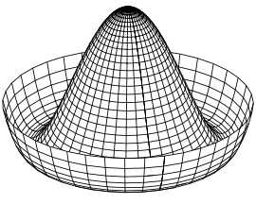
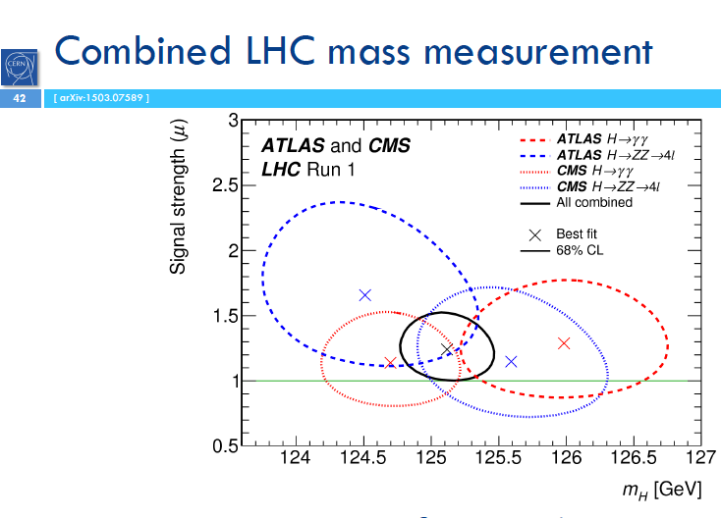
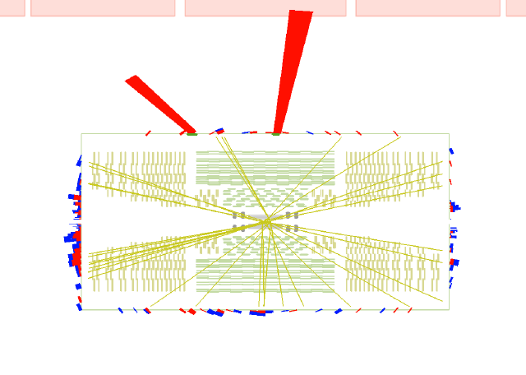
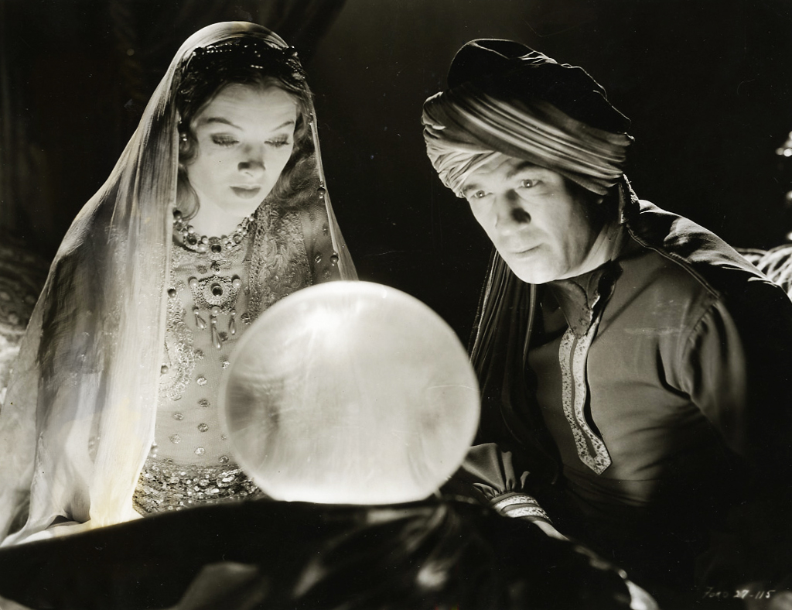
Higgs Lectures

Slide 3
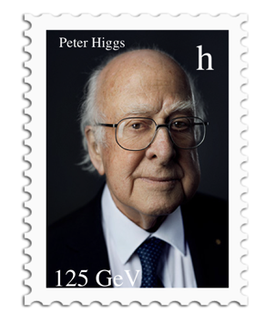
Outlook
Introduction
Hard-core theory
  Lagrangians and symmetries
  Quantum fields
  Problems with the Standard Model
The Higgs mechanism
The long way to discovery
  LEP experiments
  Tevatron experiments
  Search and Discovery at the LHC
Higgs boson properties
Open questions
Notes:
What we thought we knew – teoria e pre-LHC data
How we know what we know – experimental aspects
What we know – we found a Higgs boson
All we have found out in the meantime – mass, spin, parity, cross sections
What we know we don’t know...
What we think we know – teoria e o BSM Higgs

Slide 4
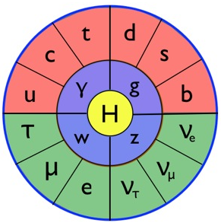
Introduction
Standard Model particles, interactions, and hard-core theory to set the scene…

Slide 5
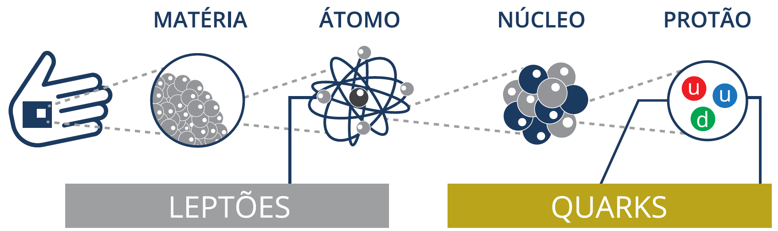
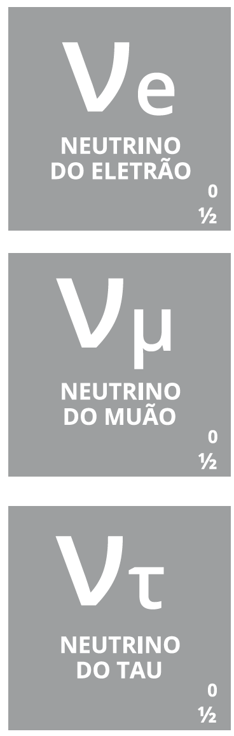
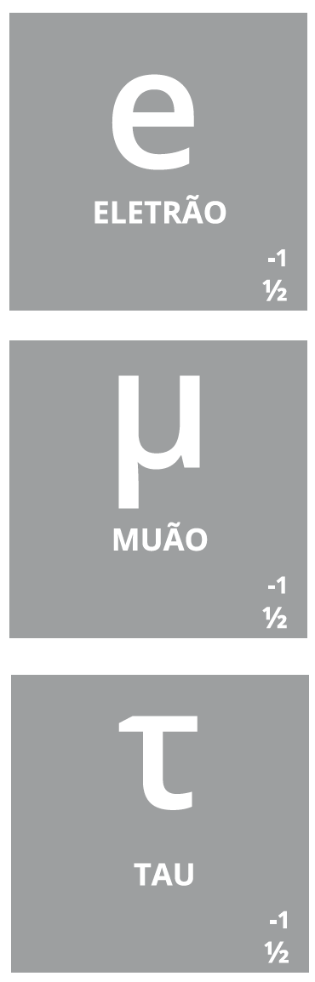
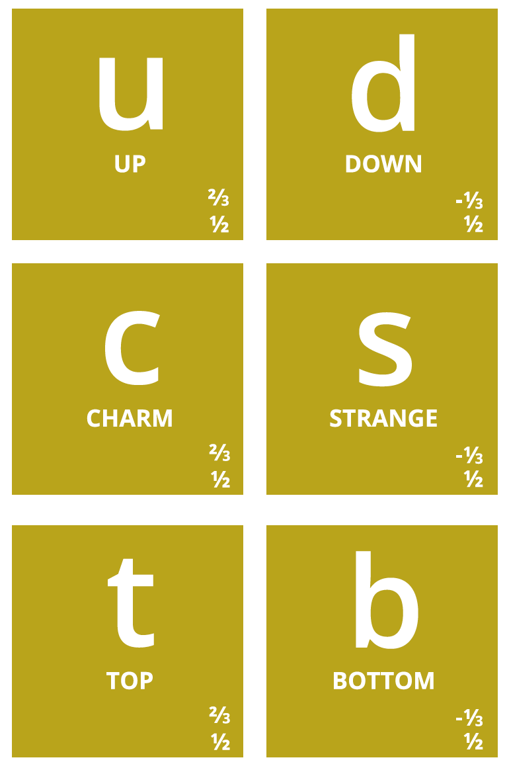
Notes:
Então, quais são afinal as partículas elementares? Temos os quarks, que dão as diferentes propriedades da nova tabela periódica
Também temos o electrão (já conhecíamos), e os seus primos mais pesados: muão e tau. Para cada um destes temos os neutrinos (não são feitos de quarks), que são produzidos em reações no Sol, por exemplo.
Por alguma razão (que desconhecemos) há 3 gerações de partículas elementares, cada uma mais pesada que a anterior → mistério!

Slide 6
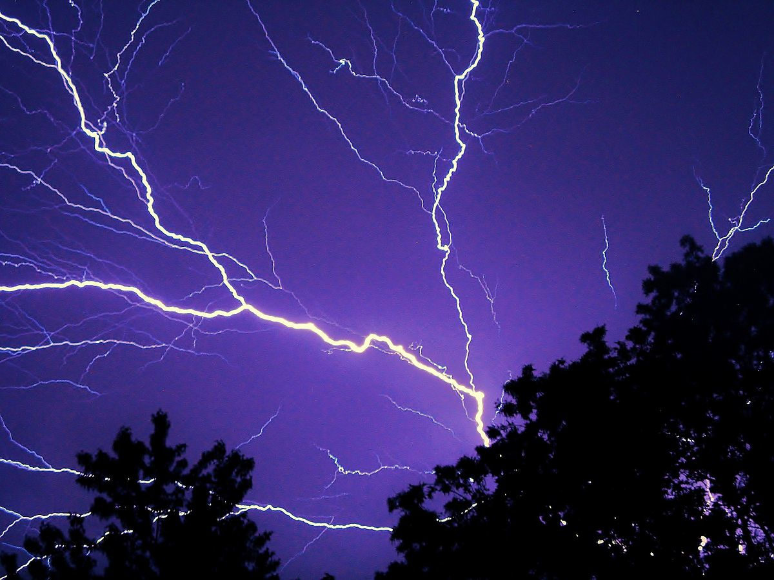
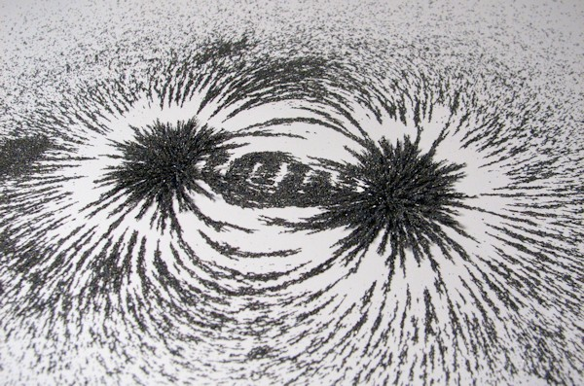
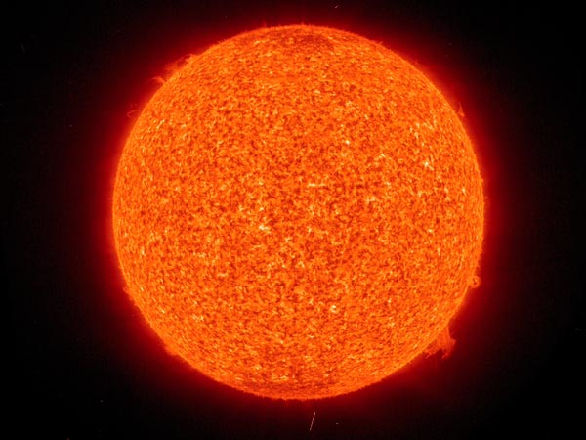
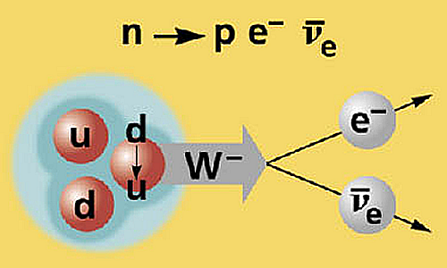

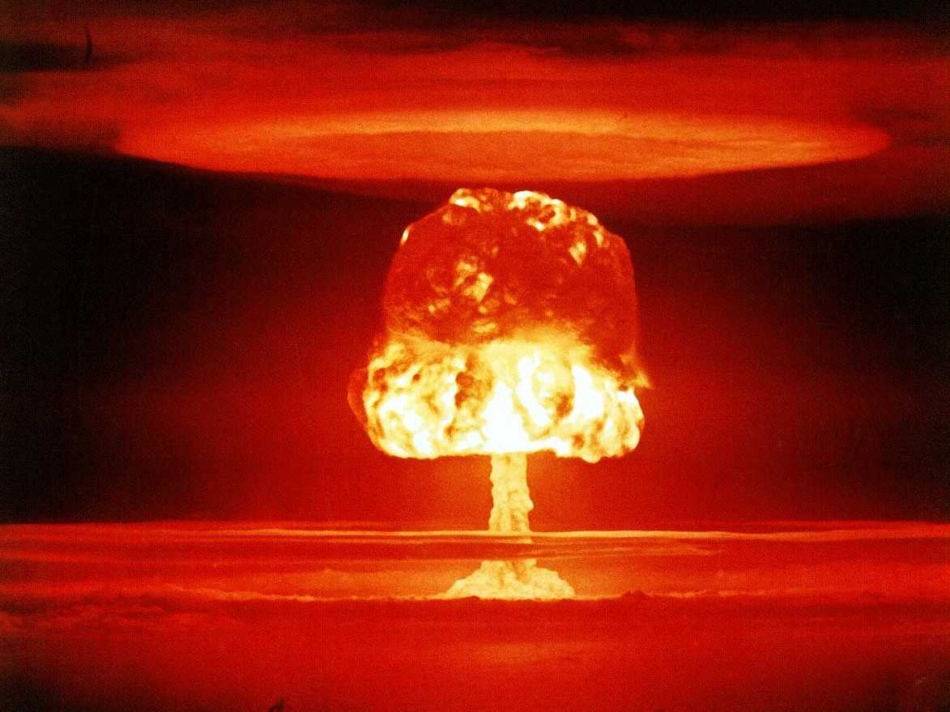
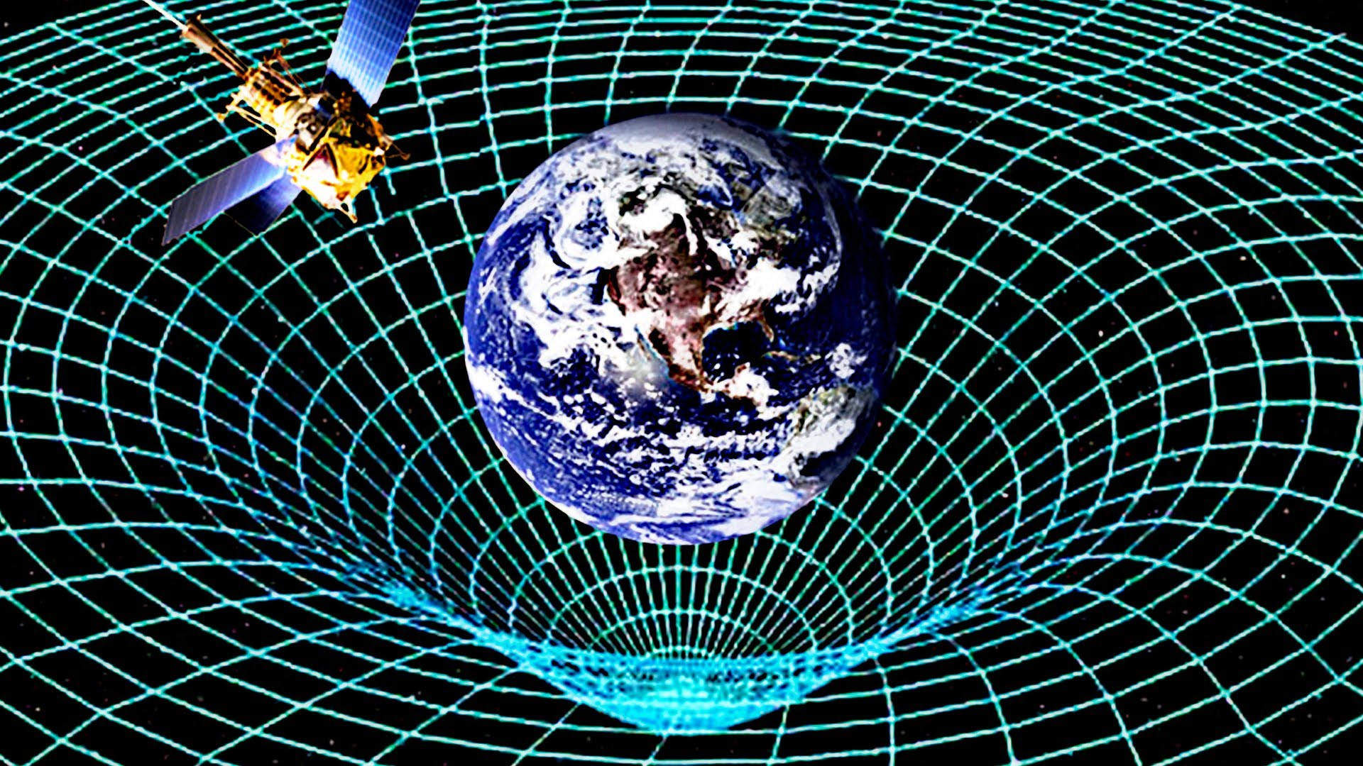
Photon
W±, Z⁰
8 gluons
Graviton??

Slide 7
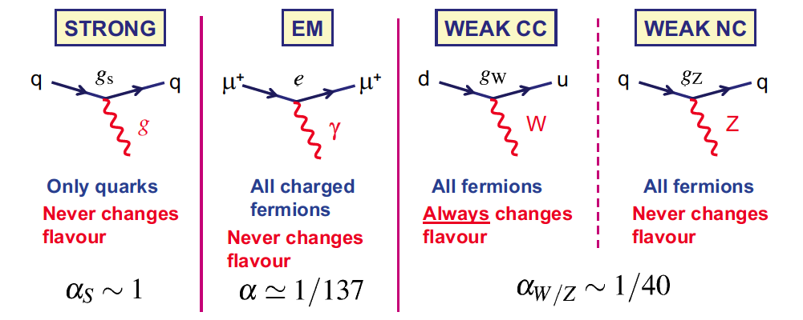
Standard model interactions
The interaction of gauge bosons with fermions is (very) well described by the Standard Model
Gluons
massless
Photon
massless
W+, W-
very massive
Z⁰
very massive
Notes:
Acoplamento (e intensidade do acoplamento) para cada força

Slide 8
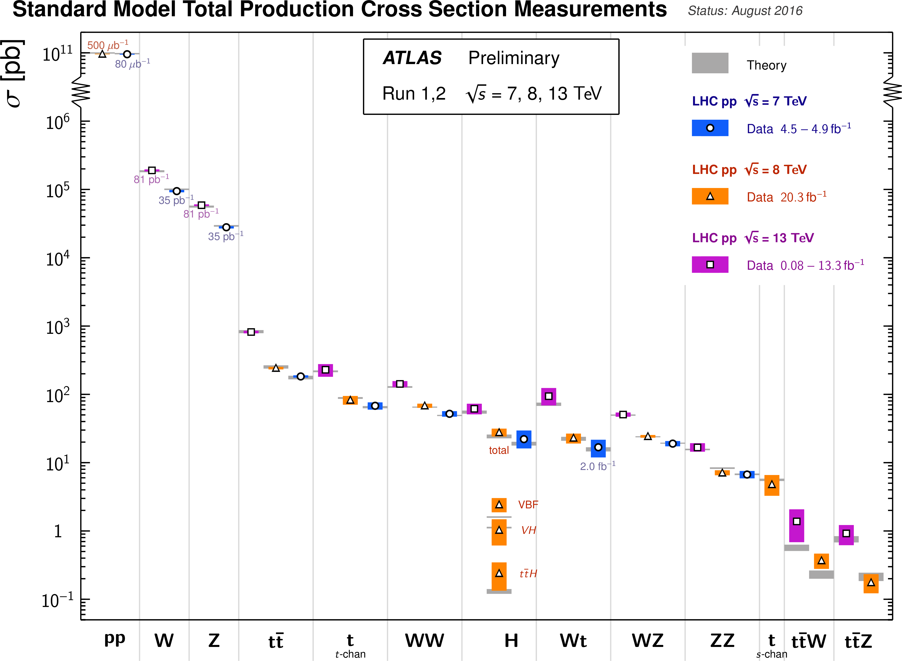
Notes:
SM expectations match measurements at the LHC over a huge range (12 orders of magnitude)! Clearly we do know something....

Slide 9
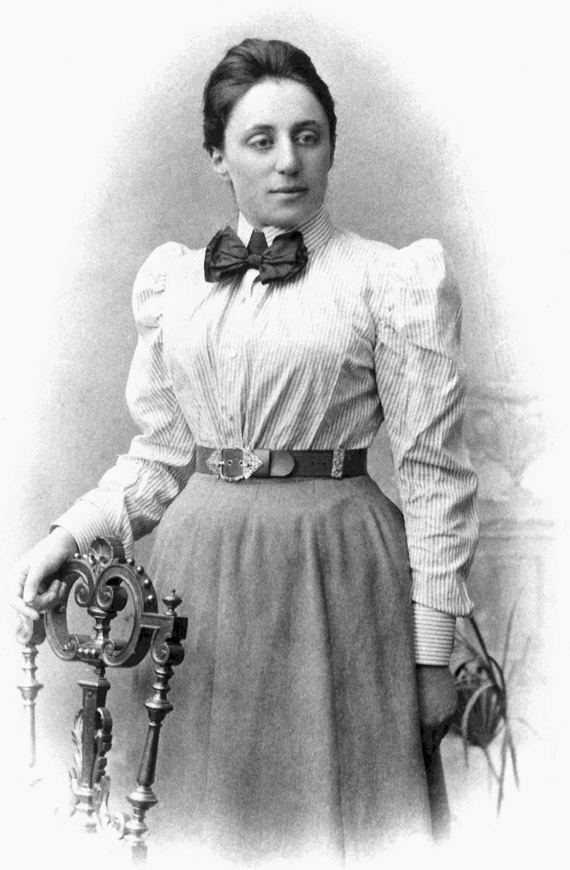
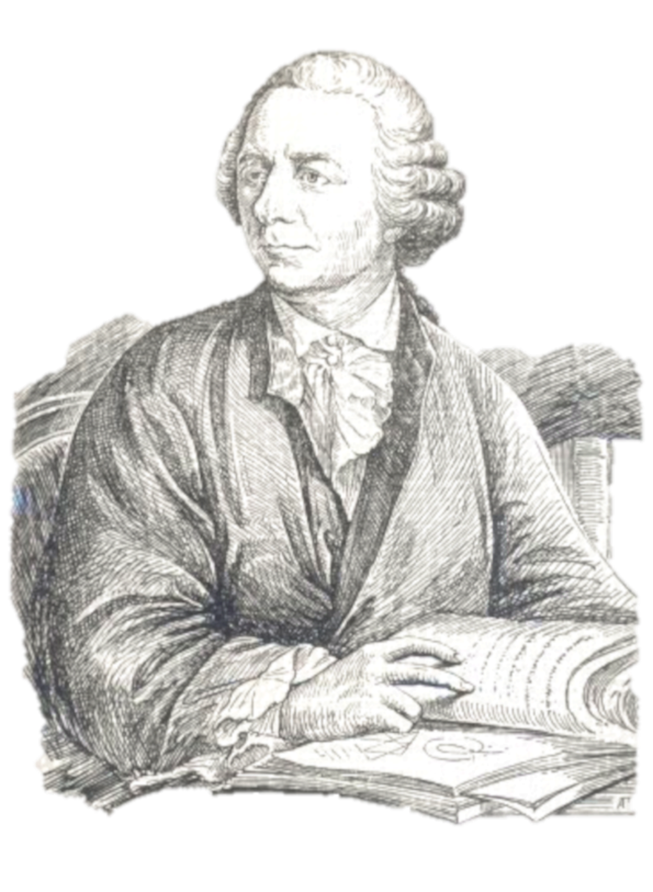
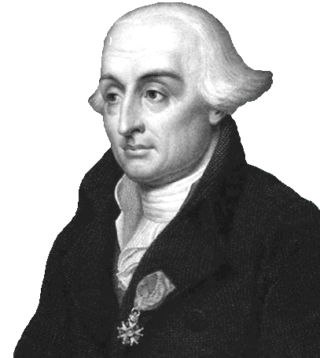
Lagrangians, symmetries and all that
Leonhard Euler(1707–1783)
Emmy Noether (1882 – 1935)
Joseph-Louis Lagrange (1736–1813)
Notes:
Italian-French mathematician and astronomer Joseph-Louis Lagrange in 1788 (born Giuseppe Lodovico Lagrangia to a french father and italian mother) lived in Turin, Berlin and Paris, and was one of the most a renowned mathematicians of his age, teaching . He was president of the commission which defined the metre and kilogram as units. Fourier, who attended his lectures in 1795, wrote: “his voice is very feeble, at least in that he does not become heated; he has a very marked Italian accent and pronounces the s like z [...] The students, of whom the majority are incapable of appreciating him, give him little welcome, but the professeurs make amends for it.” https://en.wikipedia.org/wiki/Joseph-Louis_Lagrange
Amalie Emmy Noether was a German mathematician known for her landmark contributions to abstract algebra and theoretical physics. In physics, Noether's theorem explains the connection between symmetry and conservation laws. Noether was born to a Jewish family in Germany; her father was a mathematician, Max Noether. She studied mathematics at the University of Erlangen. She was invited by David Hilbert and Felix Klein to join the mathematics department at the University of Göttingen, a world-renowned center of mathematical research. But the philologists and historians among the philosophical faculty blocked her: women, they insisted, should not become privatdozent. One faculty member protested: "What will our soldiers think when they return to the university and find that they are required to learn at the feet of a woman? She spent four years lecturing under Hilbert's name. Her habilitation was approved in 1919. Noether remained a leading member of the Göttingen mathematics department until 1933, when Germany's Nazi government dismissed Jews from university positions, and Noether moved to the United States to take up a position at Bryn Mawr College in Pennsylvania. In 1935 she underwent surgery for an ovarian cyst and, despite signs of a recovery, died four days later at the age of 53.
Leonhard Euler (1707 - 1783) was a Swiss mathematician, physicist, astronomer, logician and engineer who made important and influential discoveries in many branches of mathematics like infinitesimal calculus and graph theory while also making pioneering contributions to several branches such as topology and analytic number theory. He also introduced much of the modern mathematical terminology and notation, particularly for mathematical analysis, such as the notion of a mathematical function. He is also known for his work in mechanics, fluid dynamics, optics, astronomy, and music theory. Euler was one of the most eminent mathematicians of the 18th century, and is held to be one of the greatest in history. He is also widely considered to be the most prolific mathematician of all time. He spent most of his adult life in St. Petersburg, Russia, and in Berlin, then the capital of Prussia.

Slide 10
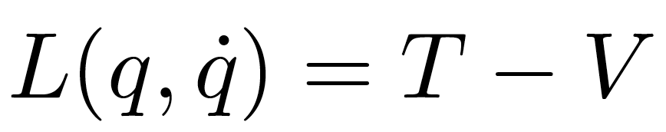
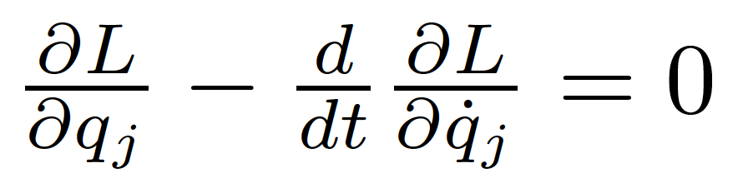
Reminder: Lagrangians in classical mechanics
The equations of motion of a system are derived from a scalar Lagrangian function of generalized coordinates and velocities (time derivatives of the coordinates)
and from the Euler-Lagrange equations:

Slide 11
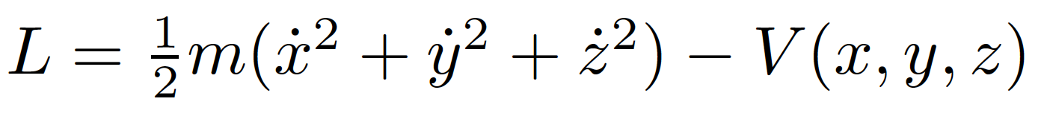
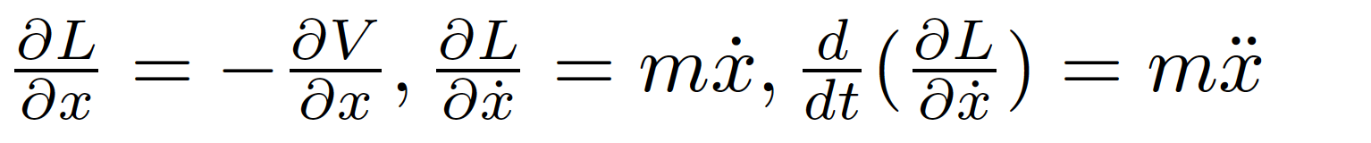
Example
Particle in a conservative potential V. The Lagrangian
has derivatives (e.g. for x)
and Euler-Lagrange’s equations
finally give us Newton’s familiar 2nd law!

Slide 12
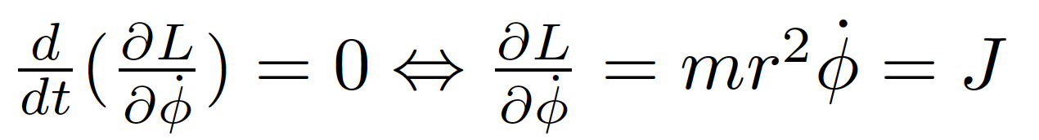
Symmetries and conservation laws
Noether’s theorem:
  If a system has a continuous symmetry property, then there are corresponding quantities whose values are conserved in time.
Simplest case: Coordinates not explicitly appearing in the Lagrangian
Lagrangian invariant over a continuous transformation of the coordinates
Example: mass m orbiting in the field of a fixed mass M
Since the lagrangian doesn’t depend explicitly on φ (symmetry with respect to rotations in space), the Euler-Lagrange equation gives
Where the angular momentum J is a constant of motion!

Slide 13
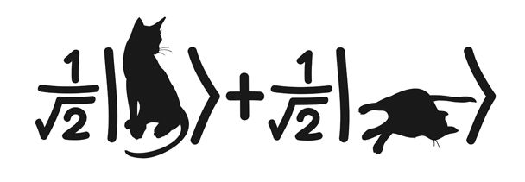
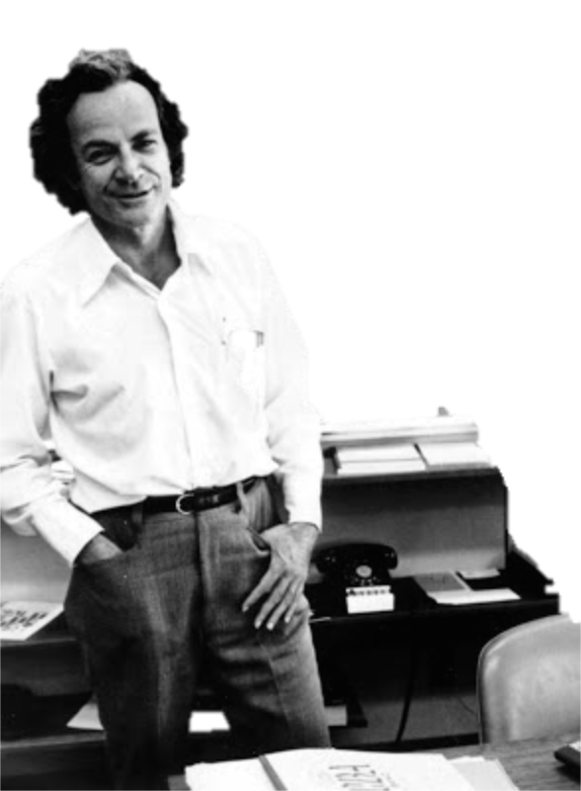
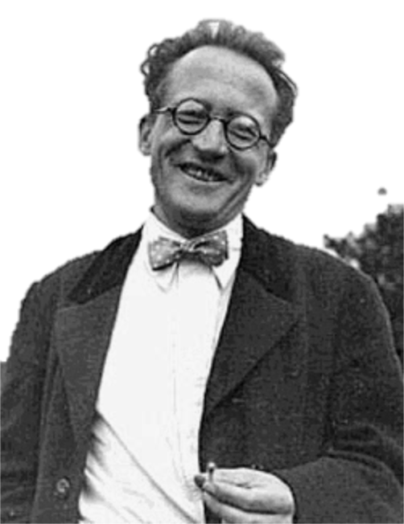

Let’s go to quantum fields...
Erwin Schrödinger (1887 - 1961)
Richard Feynman (1918 - 1988)
Schrödinger’s cat (?-?)
Notes:
Erwin Rudolf Josef Alexander Schrödinger (1887 –1961), sometimes written as Erwin Schrodinger or Erwin Schroedinger, was a Nobel Prize-winning Austrian physicist who developed a number of fundamental results in the field of quantum theory, which formed the basis of wave mechanics: he formulated the wave equation (stationary and time-dependent Schrödinger equation) and revealed the identity of his development of the formalism and matrix mechanics. Schrödinger proposed an original interpretation of the physical meaning of the wave function.
Richard Phillips Feynman (1918 – 1988) was an American theoretical physicist known for his work in the path integral formulation of quantum mechanics, the theory of quantum electrodynamics, and the physics of the superfluidity of supercooled liquid helium, as well as in particle physics for which he proposed the parton model. For his contributions to the development of quantum electrodynamics, Feynman, jointly with Julian Schwinger and Sin-Itiro Tomonaga, received the Nobel Prize in Physics in 1965.

Slide 14
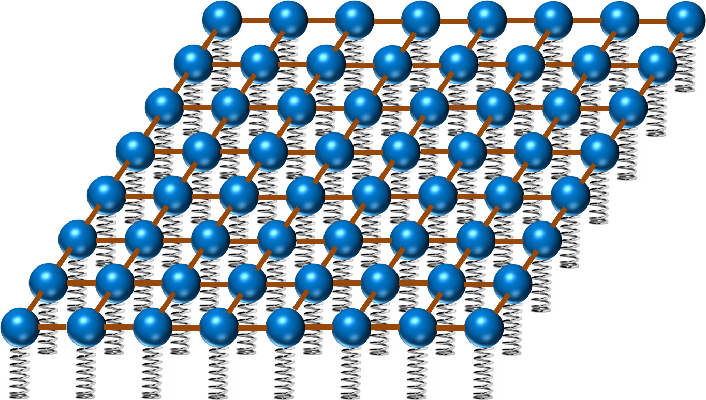
Now in quantum field theory…
Imagine space as an infinite continuum of balls and springs, where each ball is connected to its neighbours by elastic bands. Particles are perturbations of this field
y
ϕ(x,y)
x

Slide 15
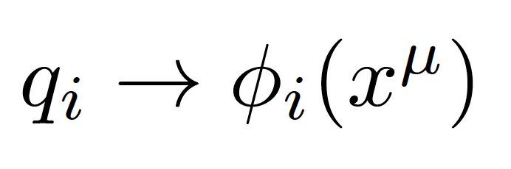
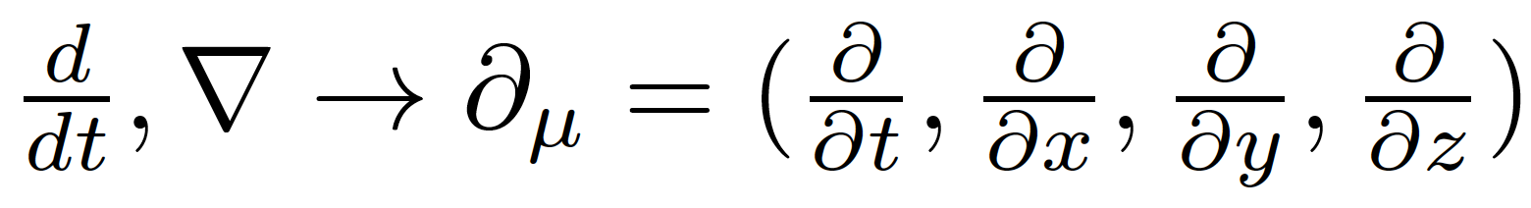
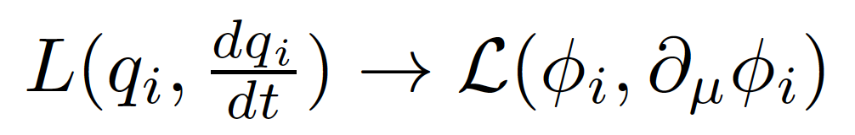
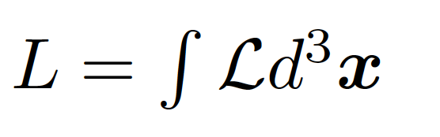
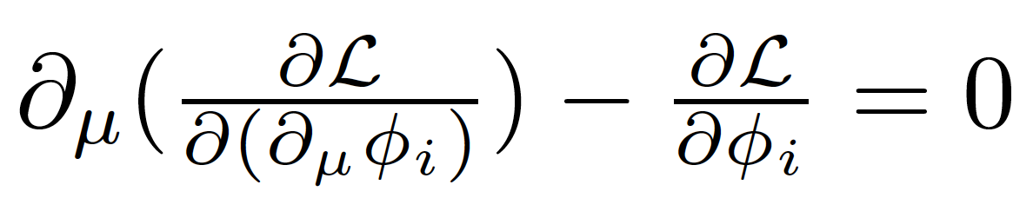
Generalized coordinates are now fields (dislocation of each spring)
In a relativistic theory we must treat space and time coordinates on an equal footing, so the derivatives in the classical equations are now
In place of a Lagrangian we have a Lagrangian density (we call it Lagrangian anyway, just to be confusing)
with:
The new Euler-Lagrange equation now becomes

Slide 16
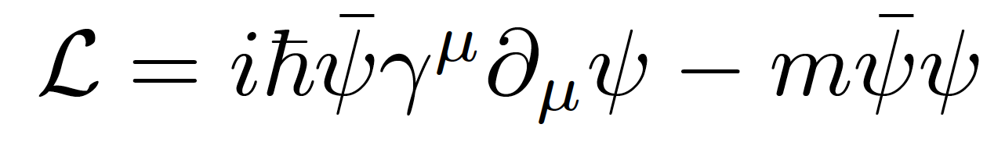
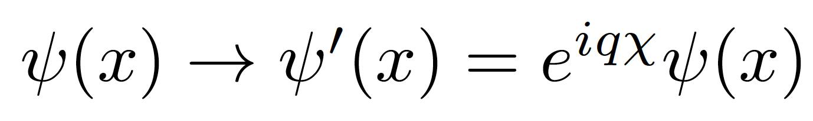
Gauge invariance
Take the Dirac Lagrangian for a spinor field ψ representing a spin-½ particle, for example an electron:
It is invariant under a global U(1) phase transformation like:
Where χ is a constant
Notes:
By the way: this is related to the conservation of electric charge!

Slide 17
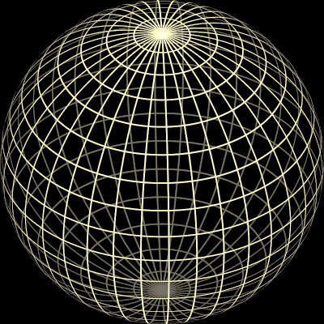
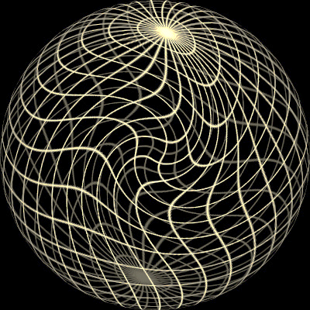
Original sphere
Global transformation
Local transformação
χ = constant
χ = χ (x)

Slide 18
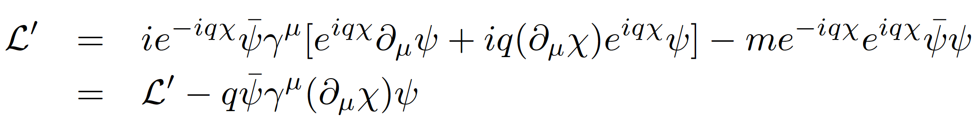
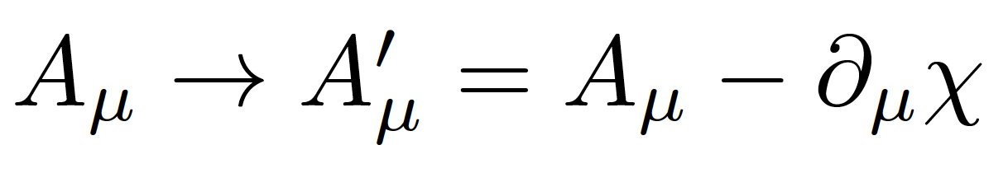
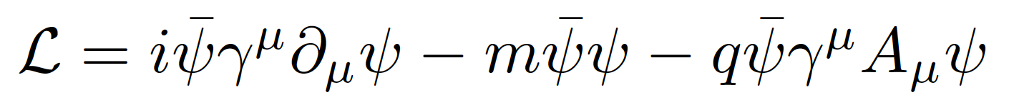
Local gauge invariance and interactions
If χ = χ (x) then we get extra terms in the Lagrangian:
But we can now make the Lagrangian invariant by adding an interaction term with a new gauge field A_{μ} which transforms as:
We get:
A few things to note:
Gauge theories are renormalizable, i.e. calculable without infinities popping up everywhere (Nobel prize of t’Hooft and Veltman)
The new gauge field A_{μ} is the photon in QED
The mass of the fermion is the coefficient of the term on ψψ
There is no term in A_{μ}A^{μ} (the photon has zero mass) → this is the beginning of the Higgs story…
Notes:
Demanding local gauge conservation resulted in obtaining a new field (the photon) and its interactions with the fermion fields. This is the blueprint of all Standard Model theories (called “Gauge theories”).
Gauge theories are automatically renormalizable (‘t Hooft & Veltman’s Nobel prize) i.e. don’t produce nonsense.

Slide 19

Now for the problems...

Slide 20
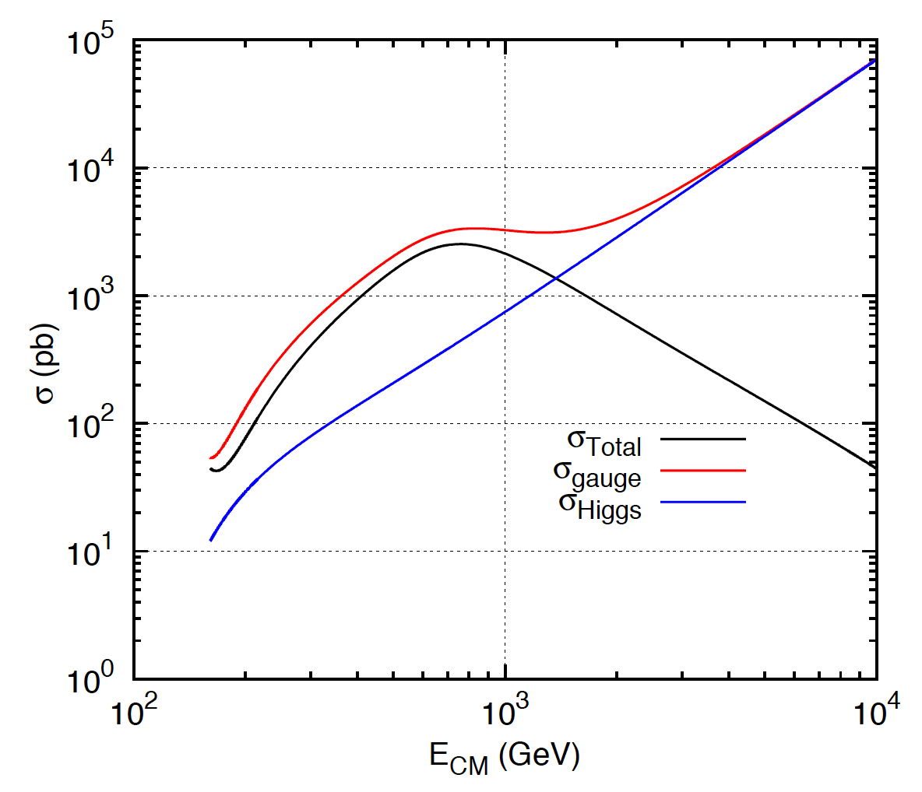
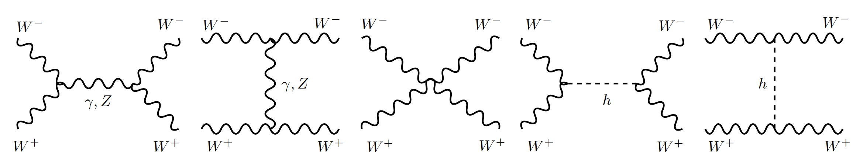
1: Longitudinal gauge-boson scattering
In the absence of the Higgs, some processes have cross sections that grow with the centre of mass energy of the collision… i.e. breaks unitarity!
The Higgs regulates the cross section through negative interference
J.C.Romão [5]
Feynman diagrams contributing to longitudinal WW scattering

Slide 21
2: Mass of elementary particles and gauge bosons
To keep the Lagrangian gauge invariant (against a U(1) local phase transformation) the photon field transforms as:
But the A^{μ} mass term breaks the invariance of the Lagrangian:
For the SU(2)_{L} gauge symmetry transformations of the weak interaction the fermion mass term m_{e}ψψ also breaks invariance!
Bottom line: the SM (without the Higgs mechanism) results in wrong calculations and breaks down for massive particles

Slide 22
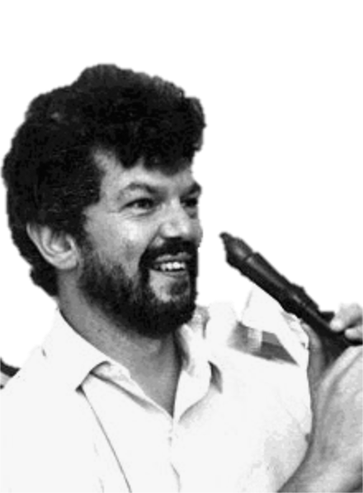
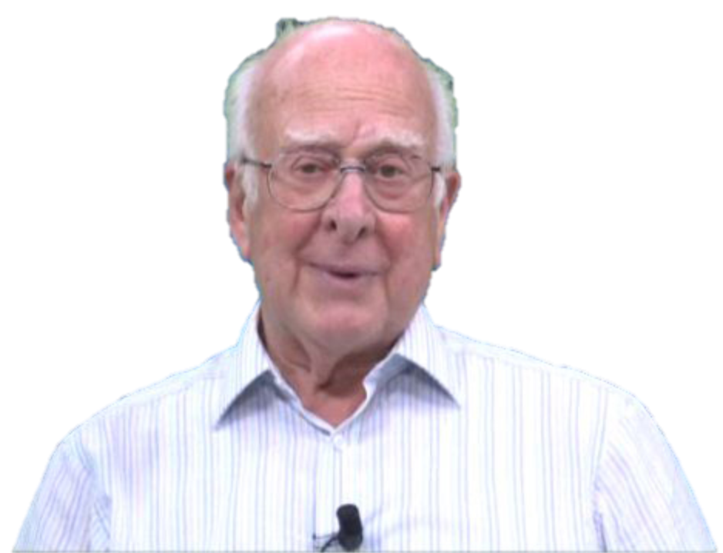
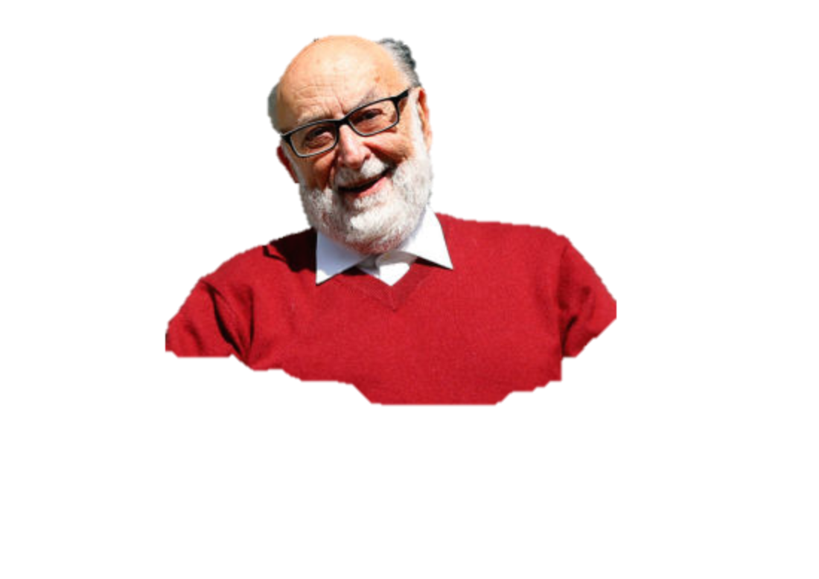
The Higgs Mechanism
Robert Brout (1928 – 2011)
François Englert (b. 1932)
Peter Higgs (b. 1929)
Notes:
Peter Ware Higgs (born 29 May 1929) is a British theoretical physicist, emeritus professor at the University of Edinburgh. In the 1960s, he proposed that broken symmetry in electroweak theory could explain the origin of mass of elementary particles in general and of the W and Z bosons in particular. This so-called Higgs mechanism, which was proposed by several physicists besides Higgs at about the same time, predicts the existence of a new particle, the Higgs boson, the detection of which became one of the great goals of physics.
Robert Brout (1928 –2011) was a Belgian theoretical physicist who made significant contributions in elementary particle physics. He was a Professor of Physics at Université Libre de Bruxelles where he had created, together with François Englert, the Service de Physique Théorique.
François Baron Englert (born 1932) is a Belgian theoretical physicist and 2013 Nobel prize laureate (shared with Peter Higgs). He is Professor emeritus at the Université libre de Bruxelles (ULB) where he is member of the Service de Physique Théorique. He is also a Sackler Professor by Special Appointment in the School of Physics and Astronomy at Tel Aviv University and a member of the Institute for Quantum Studies at Chapman University in California.

Slide 23
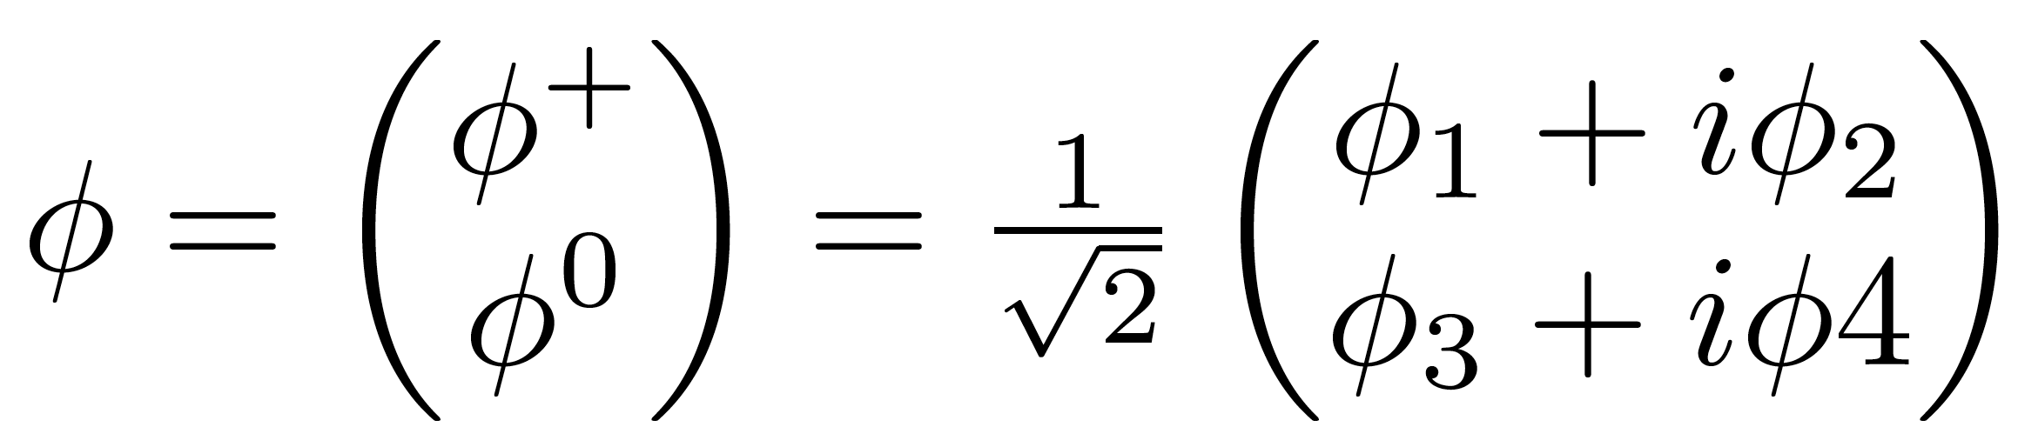
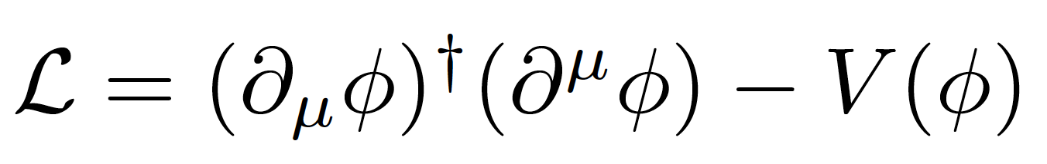
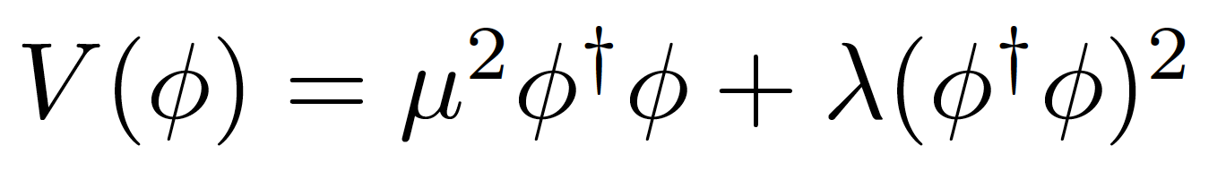


Introduce a SU(2) doublet of spin-0 complex fields
The Lagrangian is
With a potential
For λ>0, μ²<0 the potential has a
minimum at the origin
For λ>0, μ²<0 the potential has an
infinite number of minima at:
The choice of vacuum (lowest
energy state of the field) breaks the symmetry of the Lagrangian

Slide 24



Notes:
Quebra da simetria electrofraca após o Big Bang: quando a densidade de energia baixou, as próprias forças fundamentais mudaram
No fim ficamos com W e Z com massa, fotão na mesma sem massa, e resta-nos um bosão de Higgs; mas as proprias forças mudam!
In the Standard Model with no Higgs mechanism, interactions are symmetric and particles do not have mass
Electroweak symmetry is broken: Photon does not have mass W, Z have a large mass
Higgs mechanism: mass of W and Z results from the Higgs mechanism; Masses of fermions come from a direct interaction with the Higgs field

Slide 25

Electroweak symmetry breaking
In the Standard Model with no Higgs mechanism, interactions are symmetric and particles do not have mass
Electroweak symmetry is broken:
  Photon does not have mass
  W, Z have a large mass
Higgs mechanism: mass of W and Z results from the Higgs mechanism
Masses of fermions come from a direct interaction with the Higgs field
see J.Varela’s lecture

Slide 26

EWK Symmetry Breaking in Pictures

Slide 27







We have at this point a massive scalar field with vacuum expectation value v and mass
4 gauge fields: W⁽¹⁾, W⁽²⁾, W⁽³⁾, and B⁽¹⁾ which transform to give the massive W⁺, W⁻ and Z, and massless A (the photon)
with g, g_{W} the couplings of electromagnetic and weak forces
Defining the Weinberg angle as
we also get the relation between
the masses of W and Z
Fermions get their masses from interaction terms with the Higgs field (Yukawa coupling)

Slide 28


Electromagnetic interaction
γ
W±
Weak Nuclear Interaction
Notes:
Como é que sabíamos disto? Ou só estávamos só a adivinhar?
Vemos isto em medidas experimentais!! Neste gráfico vemos a probabilidade de um certo tipo de reação entre partículas.
Há duas possibilidades: uma reação governada pela força fraca e outra reação pela força eletromagnética.
A altas energias, vemos que as duas forças se tornam numa só força: a força electrofraca.
É a quebra de simetria ao contrário, como se andássemos para trás no tempo, em direção ao Big Bang

Slide 29

Notes:
Isto equivale a uma transição de fase no universo primitivo em que umas forças se transformaram noutras
NOTA: talvez um dia seja possível observar as ondas gravitacionais produzidas por bolhas de nucleação desta transição de fase

Slide 30

The Story So Far...
Notes:
Como é que sabíamos disto? Ou só estávamos só a adivinhar?
Vemos isto em medidas experimentais!! Neste gráfico vemos a probabilidade de um certo tipo de reação entre partículas.
Há duas possibilidades: uma reação governada pela força fraca e outra reação pela força eletromagnética.
A altas energias, vemos que as duas forças se tornam numa só força: a força electrofraca.
É a quebra de simetria ao contrário, como se andássemos para trás no tempo, em direção ao Big Bang

Slide 31


The Standard Model of particle physics
Notes:
Particulas fundamentais conhecidas; forças a que elas reagem; Z tem massa alta ao contrario de gamma e gluoes; Higgs pedra basilar do edificio; dá massa mas só pequena fração nos hadroes;

Slide 32



Slide 33


What we think we know:
Higgs mass (was) the only unknown parameter
We can give mass to W± and Z while keeping the photon massless
Relation between masses of W and Z
Higgs couples to W and Z with strengths proportional to their masses
Higgs couples to all fermions with a strength proportional to their mass

Slide 34


The Long Way to Discovery

Slide 35






Slide 36

Searches at LEP

Slide 37

Low-mass searches at LEP

Slide 38

Higher-mass Higgs production at LEP

Slide 39

Higgs decays: focus on 3rd generation

Slide 40


Slide 41

LEP’s Final Legacy: the Blue Band Plot
Decades of searches in many experiments...
By July 2010:
  LEP+Tevatron+SLD limits
  Higgs excluded m_{h}<114.4 GeV at 95% CL
  Plus between 158 and 175 GeV
CERN-PH-EP-2010-05

Slide 42

Searches at the Tevatron

Slide 43

Higgs production at the Tevatron

Slide 44

Most sensitive searches

Slide 45


The final stand of the Tevatron
By the end of its lifetime, the Tevatron had very sophisticated analyses of a huge number of channels
By that time the LHC was collecting data and analysing it very fast
The CDF and D0 experiments obtained a significant excess of around 3 standard deviations in the mass range 115<M_{H}<140 GeV
Not enough to claim discovery, but consistent with the LHC results

Slide 46



Discovery at the LHC
Proton-proton (and Heavy Ion) collider
s^{1/2} = 7, 8, 13 TeV so far
Operation started 2008
Physics data from 2010
Expected closure 2035
Luminosity so far: about 95 fb⁻¹ per experiment for ATLAS and CMS

Slide 47





At the LHC
https://twiki.cern.ch/twiki/bin/view/LHCPhysics/LHCHXSWG
gluon-fusion
VBF
WH
ZH
ttH
Notes:
Main production channels: gluon fusion, Vector Boson Fusion, associated production with vector bosons, associated production with ttbar pair
Animation

Slide 48





Slide 49



It takes time to get it right
EPS-HEP 2011 conference [6]

Slide 50



Discovery channels
Discovery was made in ATLAS and CMS with about 5 fb⁻¹ of 7 TeV data and 20 fb⁻¹ of 8 TeV data per experiment; several channels combined
This means about 400 000 Higgs bosons produced in about 8 000 000 000 000 000 (8x10¹⁵) proton collisions
  Only about 4000 events with Higgs bosons contributed to the discovery

Slide 51










Combining Higgs Channels
Production
Decay
H->γγ
FIT
×
H->ZZ
H->WW
t
t
t
Backgrounds +

Slide 52
The p₀ Discovery Plot
p₀ is the combined probability that the background fluctuates to look like signal
Translated into the one-sided Gaussian probability
This corresponds to a probability of 1 in 3.5 million that this was a false positive from fluctuating backgrounds

Slide 53

What we have found out since
A (quick) foretaste of the next few lectures

Slide 54



Spin and Parity
First concern after observation!
Some observable quantities sensitive to J^{P}: for example angle between leptons from W decay in H->WW
Pure J^{P} = 0⁻, 1⁺, 1⁻, and 2⁺ excluded with 97.8, 99.97, 99.7, and 99.9% Confidence Level (ATLAS arXiv 1307.1432; CMS Phys. Rev. D 92, 012004)
H->γγ – ATLAS arXiv 1307.1432
H
W⁺
W⁺
μ⁺
W⁻
ν_{μ}
W⁻
e⁻
ν_{e}

Slide 55



Higgs boson mass
Mass: around 125GeV
  Used to be the only unknown
  SM-Higgs parameter, remember? ☺
For a while, different mass values were being measured in ATLAS and CMS, and in different channels
Numbers evolved with accumulated statistics
Current most precise value from ATLAS+CMS has 0.2% precision!
  ATLAS: arXiv:1307.1427
Phys. Rev. Lett. 114, 191803
m_{H}=125.09±0.21 (stat)±0.11 (syst) GeV

Slide 56

Cross section compared to SM expectation

Slide 57
Going beyond the standard model
But the Standard Model is not complete; there are still many unanswered questions.
Why do we observe matter and almost no antimatter if we believe there is a symmetry between the two in the universe?
What is this "dark matter" that we can't see but has visible gravitational effects in the cosmos?
Are quarks and leptons actually fundamental, or made up of even more fundamental particles?
Why are there exactly three generations of quarks and leptons? What is the explanation for the observed pattern for particle masses?
How does gravity fit into all of this?

Slide 58
Many possible theories
There are a large number of models which predict new physics at the TeV scale accessible at the LHC:
Supersymmetry (SUSY)
Extra dimensions
Extended Higgs Sector e.g. in SUSY Models
Grand Unified Theories (SU(5), O(10), E6, …)
Leptoquarks
New Heavy Gauge Bosons
Technicolour
Compositeness
Any of this could still be found at the LHC and most have a connection to the Higgs boson

Slide 59




A bit of fun…
1-loop effective potential
RG-improved potential
What if…
  At higher orders, Higgs potential doesn’t have to be stable
  Depending on m_{t} and m_{H} second minimum can be lower than EW minimum ⇒ tunneling between EW vacuum and true vacuum?!
“For a narrow band of values of the top quark and Higgs boson masses, the Standard Model Higgs potential develops a shallow local minimum at energies of about 10¹⁶ GeV, where primordial inflation could have started in a cold metastable state”, I. Masina, arXiv:1403.5244 [astro-ph.CO]
  See also: V. Brachina, Moriond 2014 (Phys.Rev.Lett.111, 241801 (2013)), G. Degrassi et al, arXiv:1205.6497v2; R.Contino, Workshop sulla fisica p-p a LHC, 2013

Slide 60



The universe seems to live near a critical condition
JHEP 1208 (2012) 098
Why?!
Explained by underlying theory?
Anthropic principle?

Slide 61

Where we stand now?
The Higgs may very well be a window into the new physics which we know must exist
We now have very precise results from the Higgs sector
And no surprises (yet?)
But the truth is out there! Must keep looking!

Slide 62

The End
Goldstein, ‘Classical Mechanics’, ‪Addison-Wesley Publishing Company (1980‬)
D. Griffiths, ‘Introduction to Elementary Particles ', John Wiley and Sons (1987)
Exposição “Partículas – do Bosão de Higgs à Matéria Escura”: http://www.lip.pt/particulas/
Wikipedia: https://en.wikipedia.org/
M. Thompson, Modern Particle Physics, Cambridge University Press, 2013
J. Butterworth, Smashing Physics – inside the world’s biggest experiment, Headline Publishing Group, 2014
J.C. Romão, The need for the Higgs boson in the Standard Model, private note, http://porthos.ist.utl.pt/CTQFT/
W.Murray on behalf of the ATLAS and CMS Collaborations, proceedings of the 2011 Europhysics Conference on High Energy Physics, EPS-HEP 2011, July 21-27, 2011 Grenoble, Rhône-Alpes, France, PoS (EPS-HEP2011) 031
LEP Electroweak Working Group, Precision Electroweak Measurements and Constraints on the Standard Model, CERN-PH-EP-2010-095, July 2010
LHC Higgs Cross Section Working Group: https://twiki.cern.ch/twiki/bin/view/LHCPhysics/LHCHXSWG
CMS Collaboration, Constraints on the spin-parity and anomalous HVV couplings of the Higgs boson in proton collisions at 7 and 8 TeV, Phys. Rev. D 92, 012004, 2015
ATLAS and CMS Collaborations, Combined Measurement of the Higgs Boson Mass in pp Collisions at s√=7 and 8 TeV with the ATLAS and CMS Experiments, Phys. Rev. Lett. 114, 191803
I. Masina, arXiv:1403.5244 [astro-ph.CO], V. Brachina, Moriond 2014 (Phys.Rev.Lett.111, 241801 (2013)), G. Degrassi et al, arXiv:1205.6497v2; R.Contino, Workshop sulla fisica p-p a LHC, 2013

