Slide 1
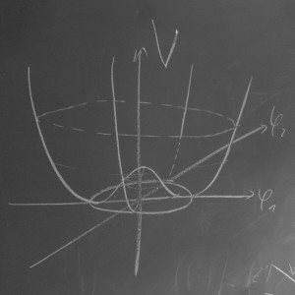



Higgs Physics – Lecture 1
Higgs Physics at the LHC – Introduction
Ricardo Gonçalo – LIP
IDPASC Course on Physics at the LHC – LIP, 18 April 2016

Slide 2

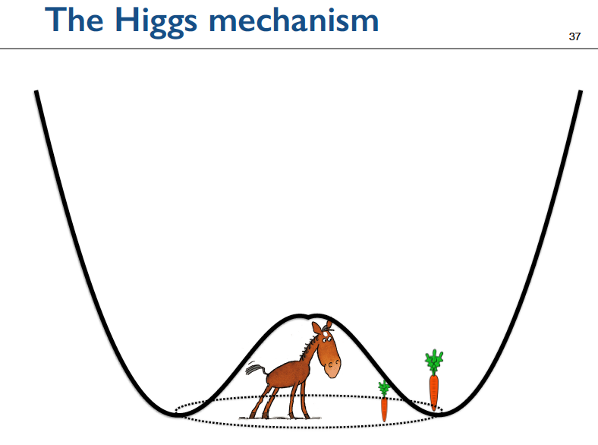
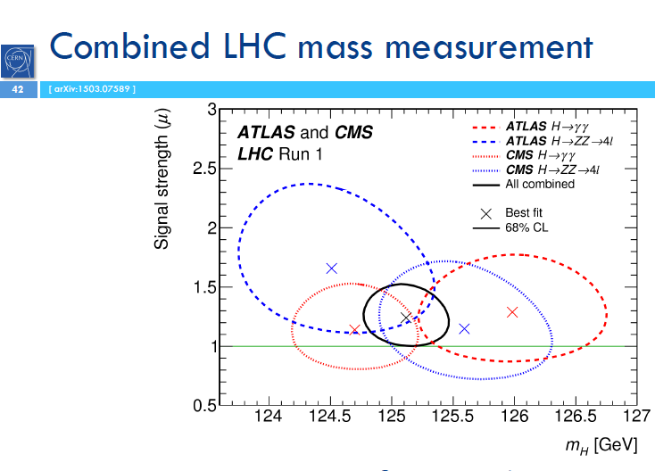
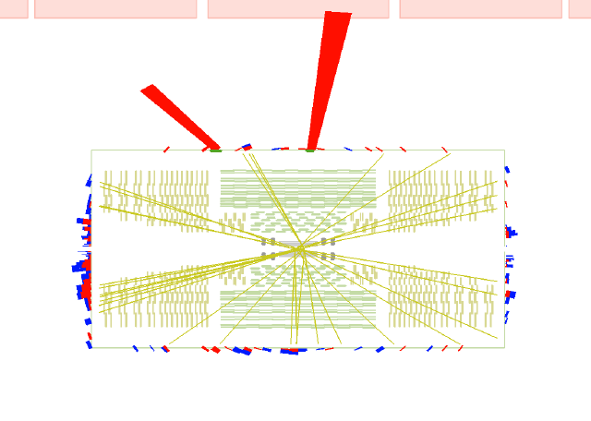
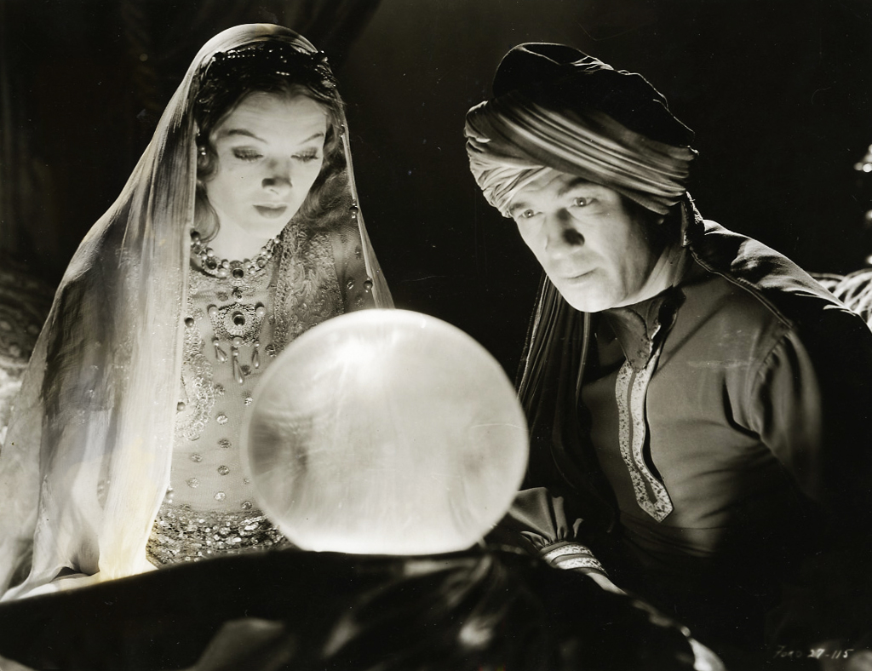
Outlook

Slide 3
This lecture:
Introduction:
  Focus lecture on Standard Model (SM) and experimental searches for SM Higgs
Reminder of some shortcomings of the SM:
  Masses, WW scattering
The Higgs mechanism
Production and decay of the Higgs boson:
  Early searches, searches at LEP, Tevatron and LHC
Discovery at the LHC!

Slide 4
Introduction
or “Hard-core theory to set the scene”

Slide 5
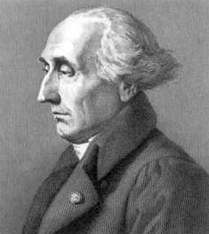

Lagrangians in classical mechanics
Equations of motion are derived from a scalar Lagrangian function of generalized coordinates and velocities (time derivatives):
and from Euler-Lagrange’s equations:
Joseph-Louis Lagrange (1736–1813)

Slide 6


Lagrangians in classical mechanics
Equations of motion are derived from a scalar Lagrangian function of generalized coordinates and velocities (time derivatives):
and from Euler-Lagrange’s equations:
Joseph-Louis Lagrange (1736–1813)
Example:
A particle in a conservative potential V is subjected to force:
It’s Lagrangian is:
This gives the following terms in the Euler-Lagrange equations:
And we end up with the familiar equations of motion given by Newton’s second law:

Slide 7



Lagrangians in classical mechanics
Equations of motion are derived from a scalar Lagrangian function of generalized coordinates and velocities (time derivatives):
and from Euler-Lagrange’s equation:
Joseph-Louis Lagrange (1736–1813)
Why is this formulation useful? Example:
Coordinates not explicitly appearing in the Lagrangian indicate that the corresponding momentum is conserved:
The generalized momentum associated to coordinate q is:
e.g. for
It’s obvious that
So, if the Lagrangian doesn’t depend on some coordinate q_{i},
Euler-Lagrange’s equation tells us that the corresponding
momentum p_{i} is conserved:

Slide 8








Parenthesis: quantum cooking
Non-relativistic quantum mechanics for a free particle:
From the usual energy-momentum relation:
Using the usual prescription:
Gives Schrödinger’s equation:
In relativistic notation the same recipe is written:
The relativistic energy-momentum relation is now
So in relativistic quantum mechanics we
end up with Klein-Gordon’s equation:
(for spin-zero, free particles)

Slide 9
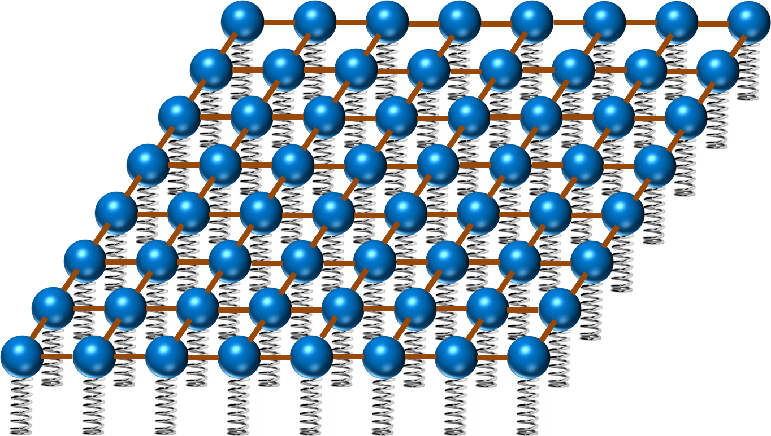


Now in quantum field theory…
We now have fields instead of the classical point-like particles
Imagine space as an infinite continuum of balls
and springs, where each ball is connected to its
neighbours by elastic bands. Particles are
perturbations of this field!
The Lagrangian is now the integral of a Lagrangian density, function of each field and its space and time derivatives
Lagrangian density: Lagrangian:
The Euler-Lagrange equation is now:
Note that in a relativistic theory we must treat space and time coordinates in an equal footing, so the time derivative in the classical equation is now _{μ}

Slide 10





Example:
If we have a scalar field φ and a Lagrangian:
The terms in the Euler-Lagrange equation are:
and and so:
And we end up with Klein-Gordon’s equation
(with no need for cooking recipes)
Let’s go back to the Klein-Gordon Lagrangian density for a second:
Notice that the mass term is the one which is second order in the field. This is a general feature that we will exploit later

Slide 11





Gauge invariance
Take the Dirac Lagrangian (for spinor fields ϕ representing fermions)
It is invariant under global gauge transformations like:
Where θ is a constant. Now, what about local gauge transformations? If θ=θ(x) then the field derivative gives us extra terms:
or
(with and q the charge of the particle)
But we can now make the Lagrangian local-gauge invariant by adding an interaction term with a new gauge field A_{μ}:

Slide 12

For this to work, the new field needs to transform like
So that the last term cancels the change in the ϕ terms due to gauge transformations. But what has just happened? We have added a new field, and so a new particle to the Lagrangian. For this to make sense we also need a new free term for this field. We end up with:
Where
Now, the last 2 terms in the new Lagrangian correspond to Maxwell’s Lagrangian and give all of electrodynamics!!
Demanding local gauge conservation resulted in obtaining a new field (the photon) and its interactions with the fermion fields. This is the blueprint of all Standard Model theories (called “Gauge theories”).
Gauge theories are automatically renormalizable (‘t Hooft & Veltman’s Nobel prize) i.e. don’t produce nonsense. BUT: notice there is no term depending on the square of the A_{μ} field:
➔ There is no mass term for the photon – this is the beginning of the Higgs story!

Slide 13
Shortcomings of the Standard Model
Elementary particle masses
WW scattering.

Slide 14
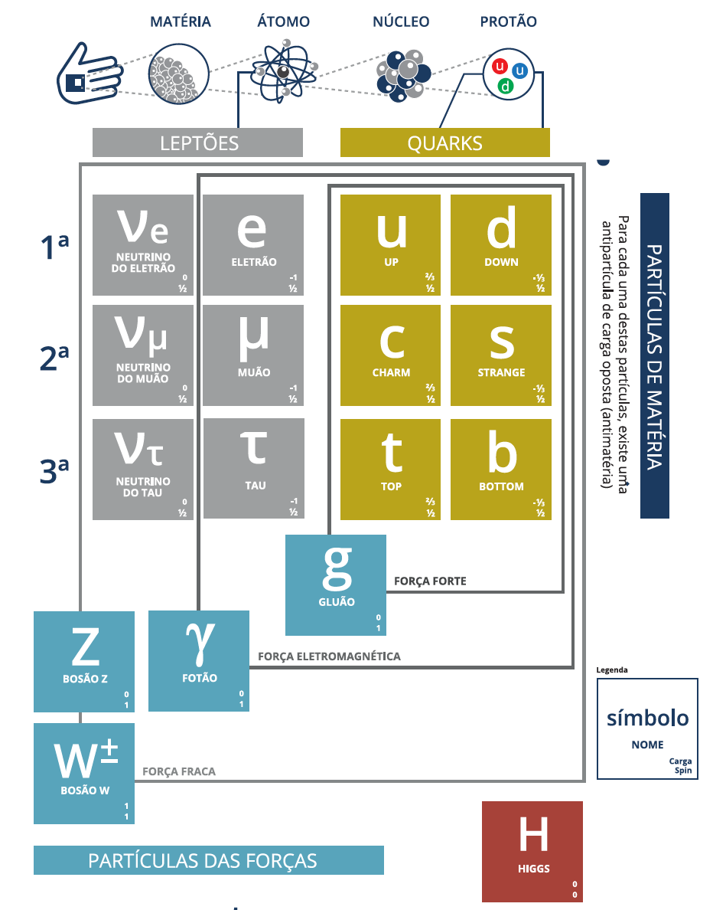
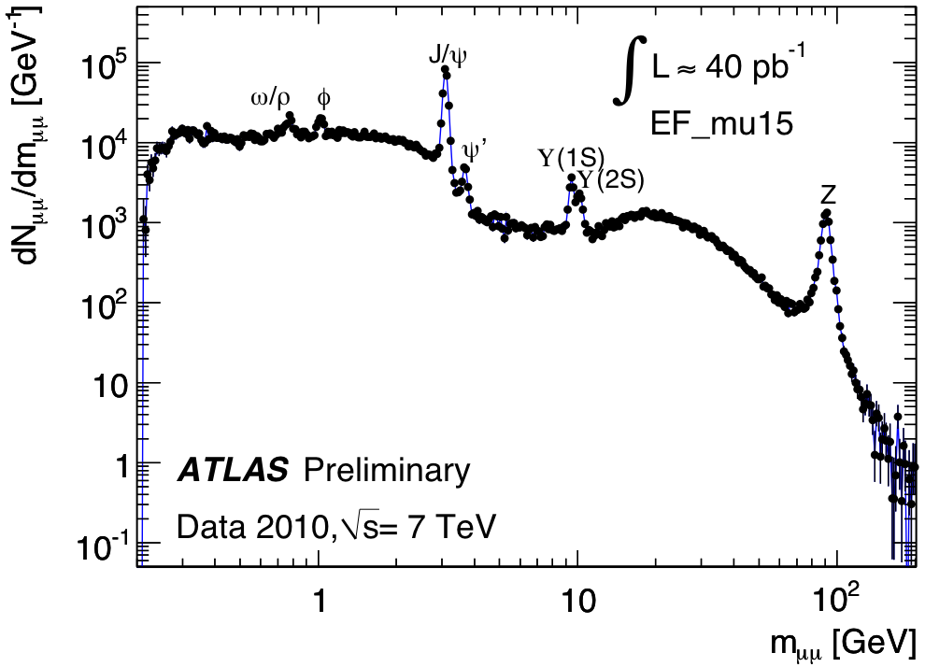
The Standard Model in 1 slide

Slide 15
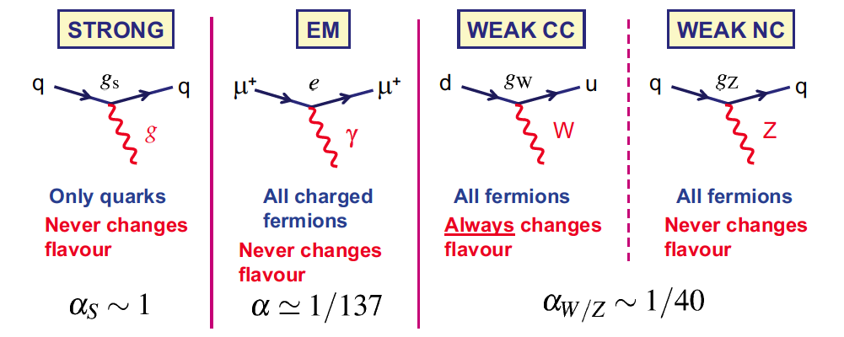
Standard model interactions
The interaction of gauge bosons with fermions is (very) well described by the Standard Model
Gluons
massless
Photon
massless
W+, W-
very massive
Z⁰
very massive

Slide 16
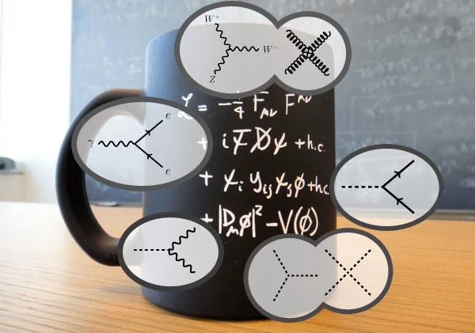
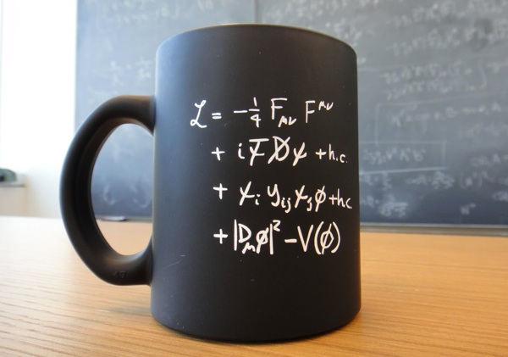
Back to Lagrangians… and coffee mugs
Throughout history, we have been looking mostly at the second line
Interactions between fermion matter particles transmitted by force carriers
I.e. all of chemistry and most of physics
Disclamer: gravity not on the mug

Slide 17
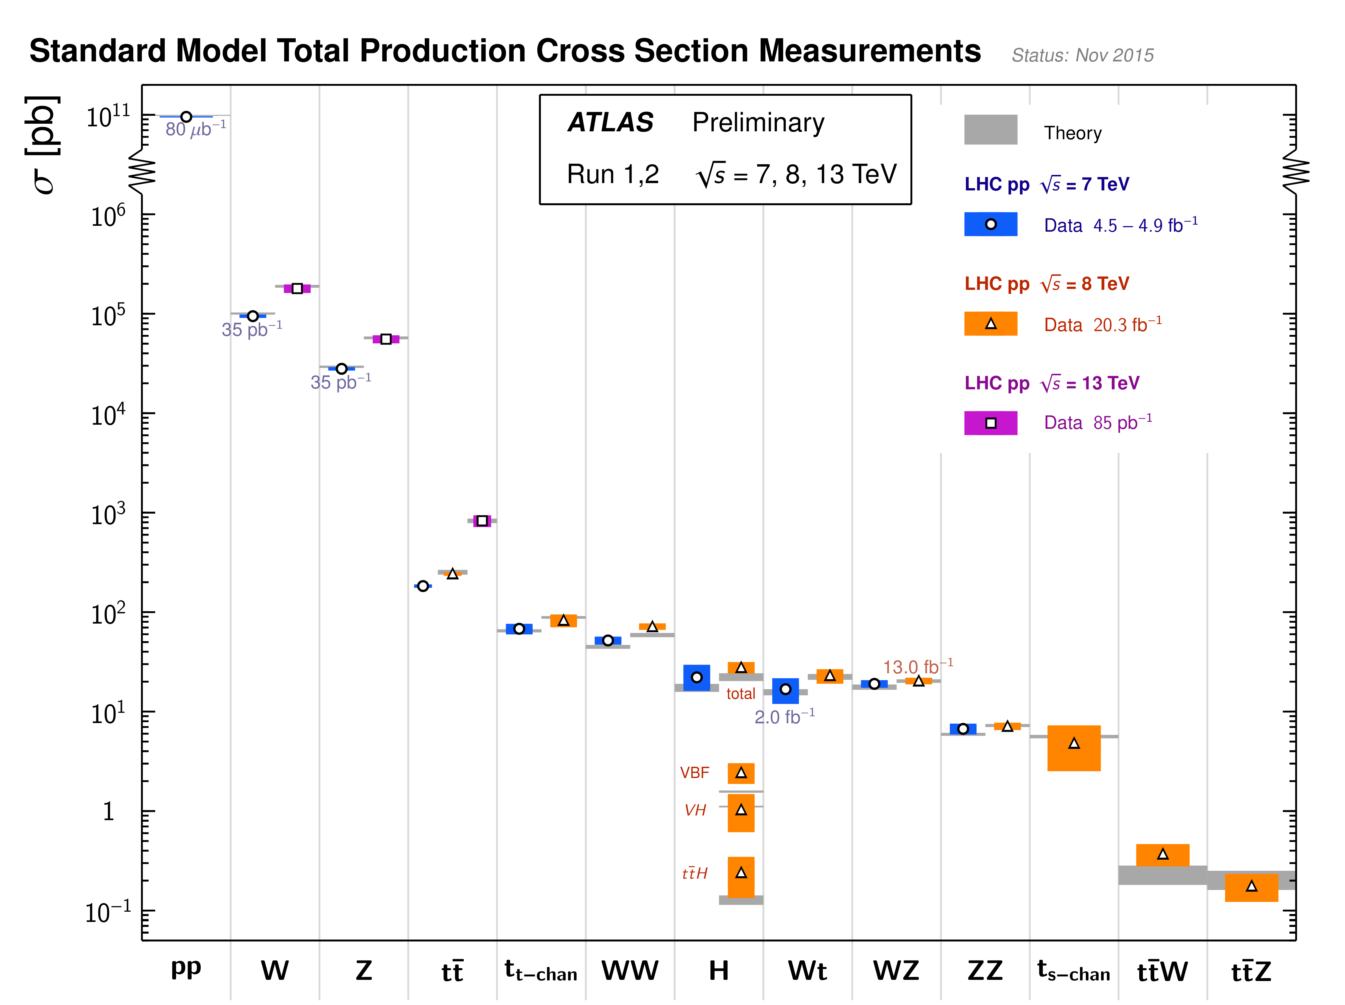
What shortcomings?

Slide 18
Now the problems…
Mass of elementary particles and gauge bosons
Longitudinal gauge-boson scattering (see below)

Slide 19
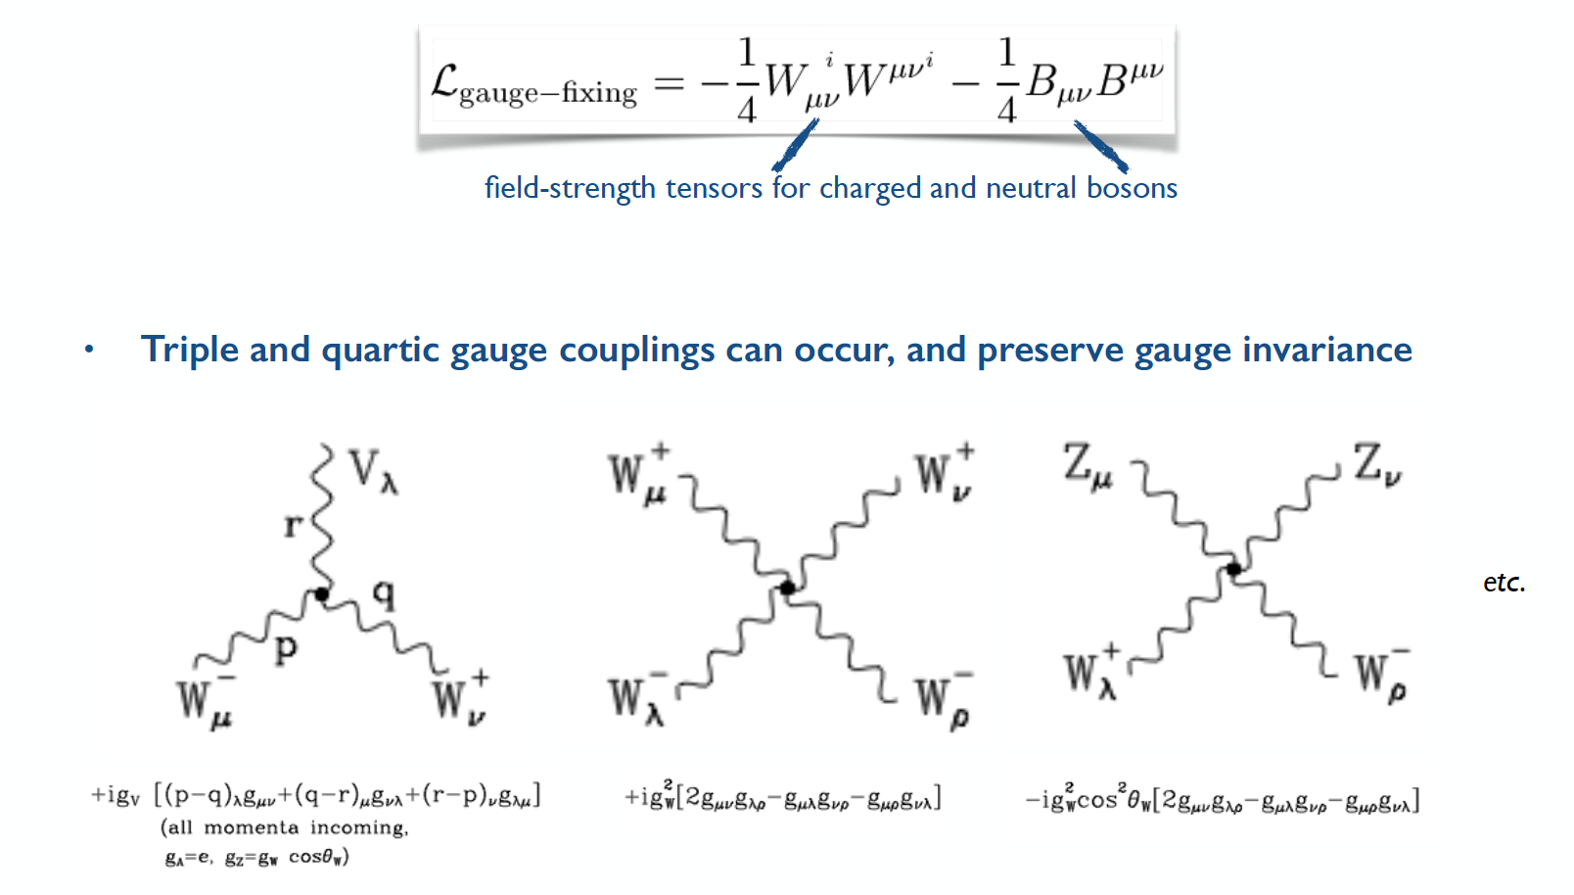
Pure gauge-boson interactions exist in SM

Slide 20
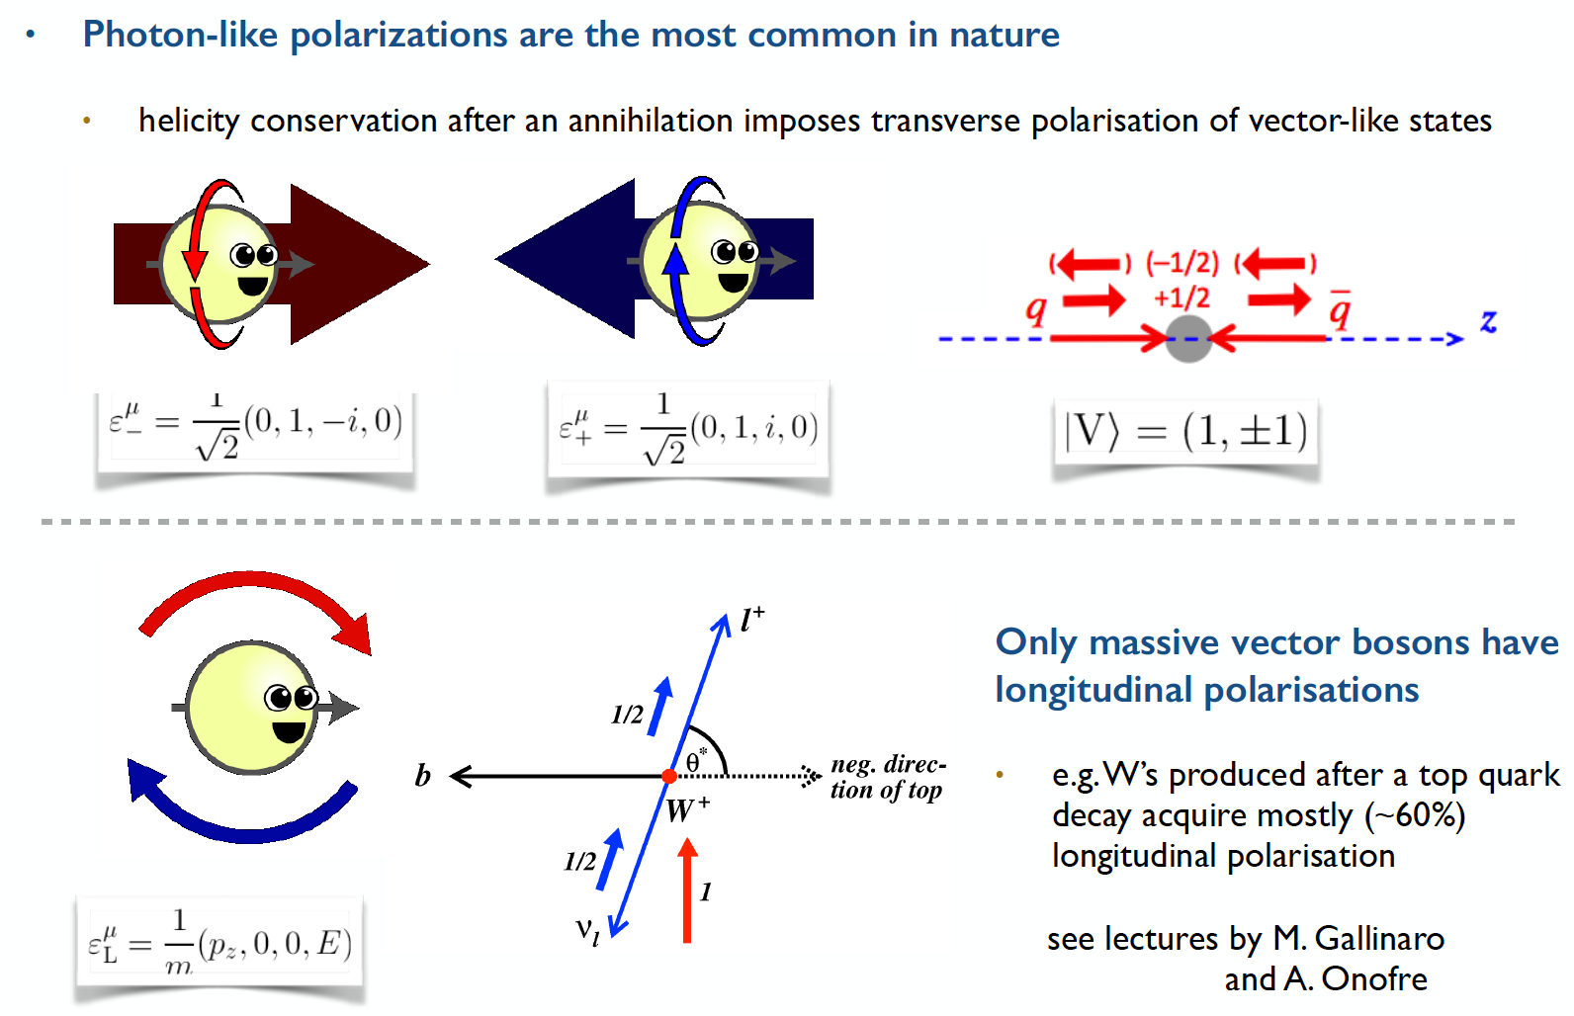
… and depending on polarization…

Slide 21
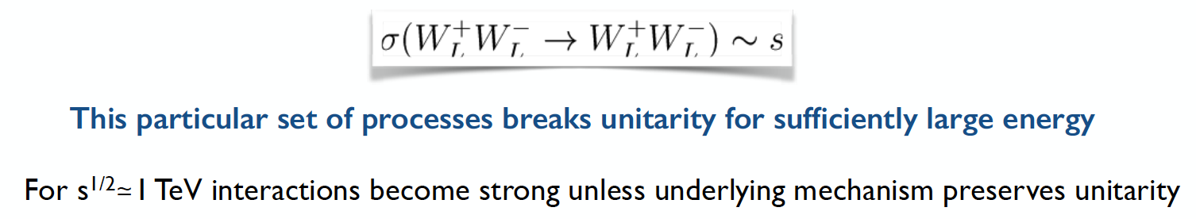
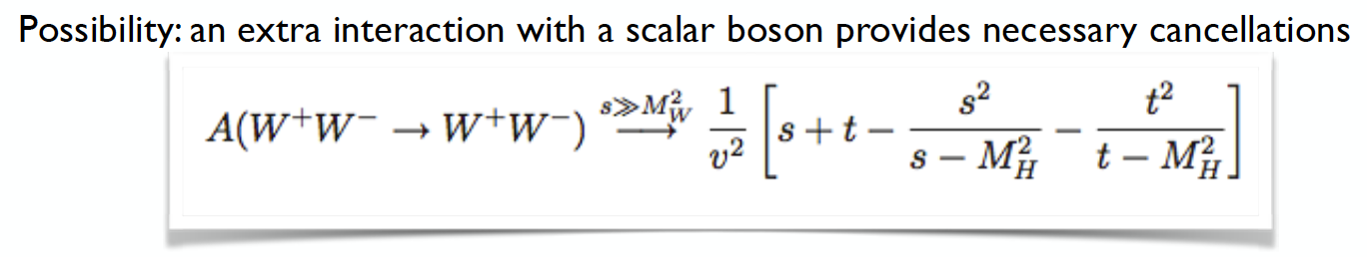
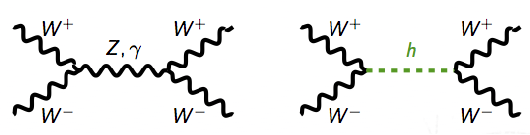
May have strange results!
The cross section for the scattering of longitudinally polarized W bosons grows with energy until it becomes unphysical

Slide 22
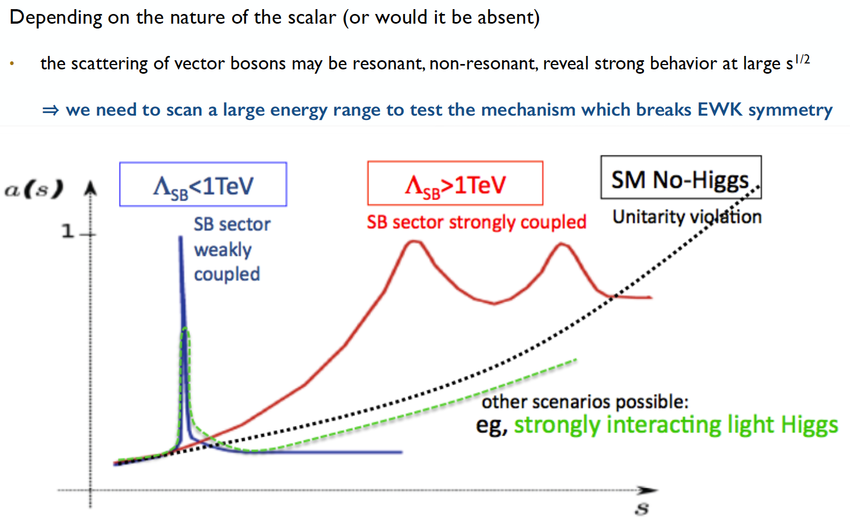
Possibilities (before Higgs discovery)

Slide 23
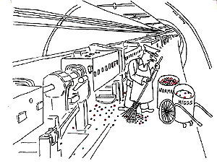
The Higgs Mechanism

Slide 24
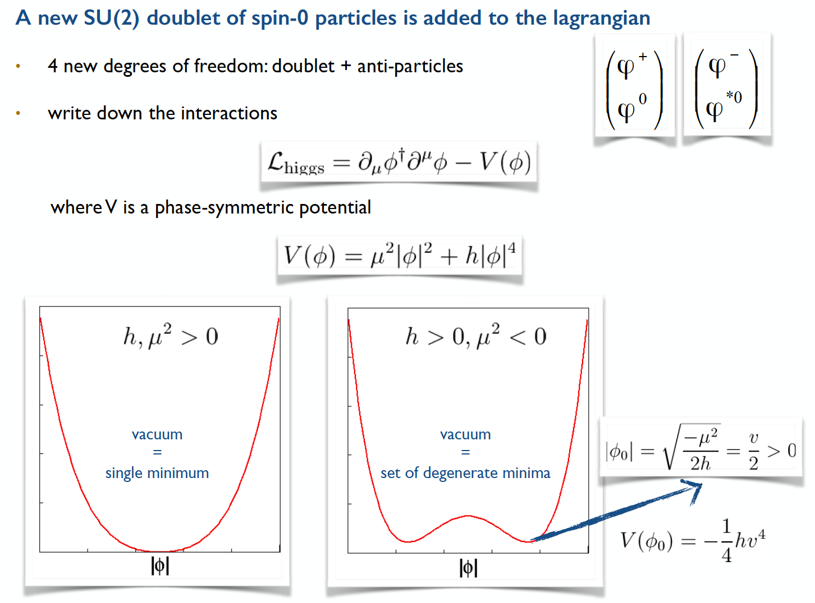

Slide 25
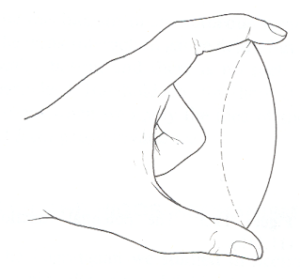
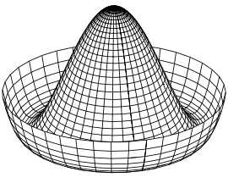
Electroweak symmetry breaking
In the Standard Model with no Higgs mechanism, interactions are symmetric and particles do not have mass
Electroweak symmetry is broken:
  Photon does not have mass
  W, Z have a large mass
Higgs mechanism:
  mass of W and Z results from the Higgs mechanism
see J.Varela’s lecture

Slide 26



Electroweak regime
Electroweak Lagrangian before spontaneous symmetry breaking
Electroweak gauge bosons: B⁰ W⁰ W±
Fermion kinetic terms
Higgs term (note: vacuum expectation value zero before symmetry breaking)
Yukawa interaction term between Higgs field and fermions

Slide 27

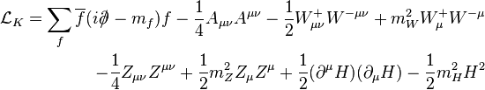
After the phase transition
After electroweak symmetry breaking
Spontaneous symmetry breaking:
New bosons γ and Z⁰ from W⁰ and B⁰
Kinetic terms: notice boson masses for Z⁰,W±, H

Slide 28
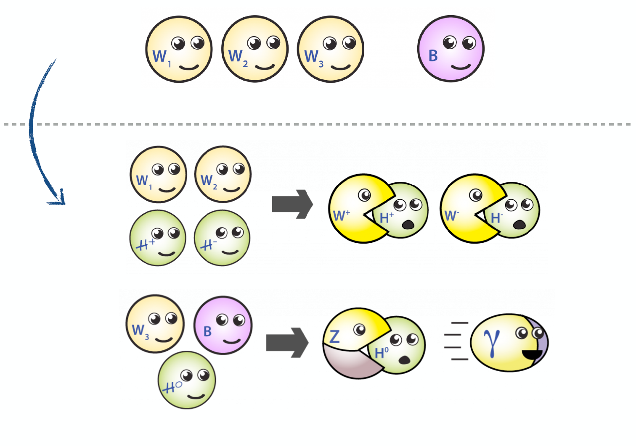
EWK Symmetry Breaking in Pictures

Slide 29
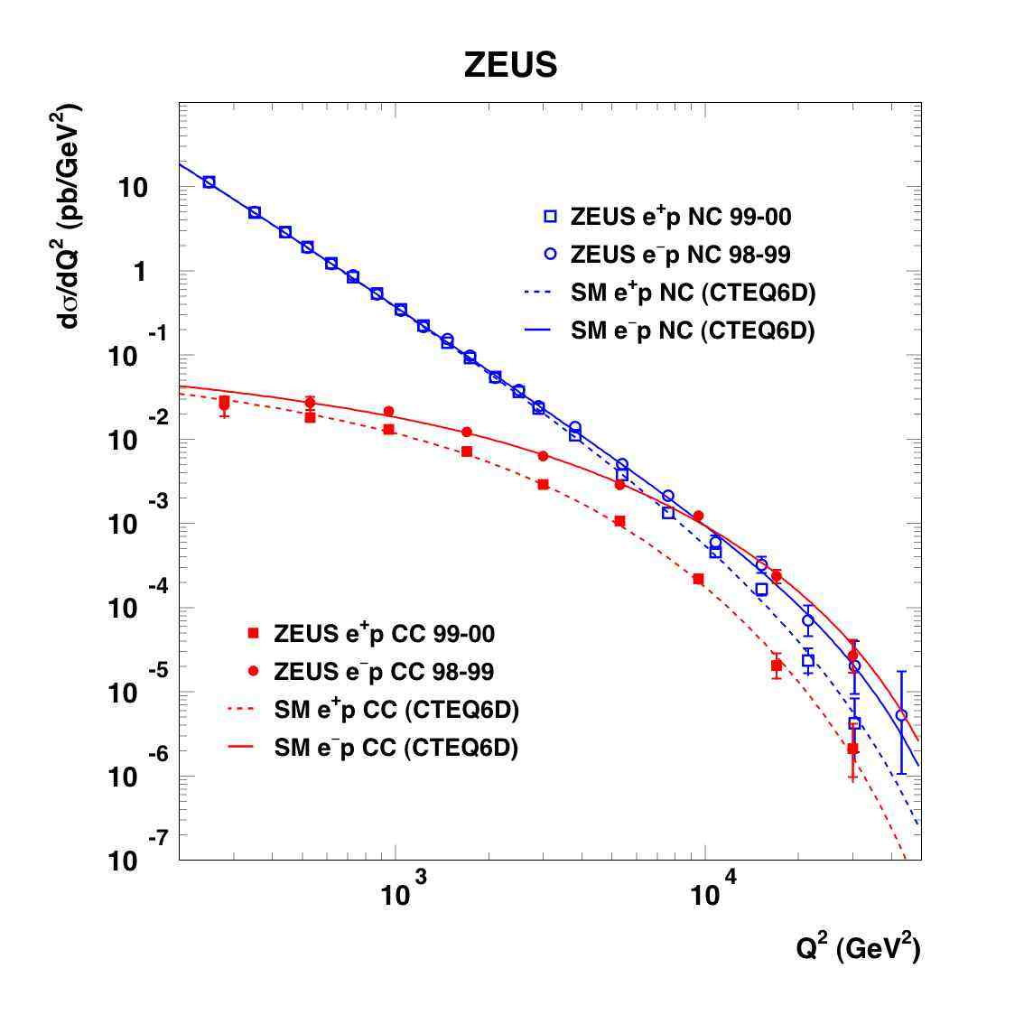
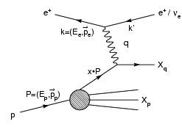
Why does it matter?
Because it’s real!
  Data shows Higgs mechanism (or something like it) needed in the theory
Because it may lead us to new discoveries and a new understanding of Nature!
  “There is nothing so practical as a good theory” (Kurt Lewin)
Z/γ
W±
http://www-zeus.desy.de/physics/sfew/PUBLIC/sfew_results/preliminary/dis04/

Slide 30
Searches at: LEP, Tevatron and LHC
…or why did it take 50 years?

Slide 31

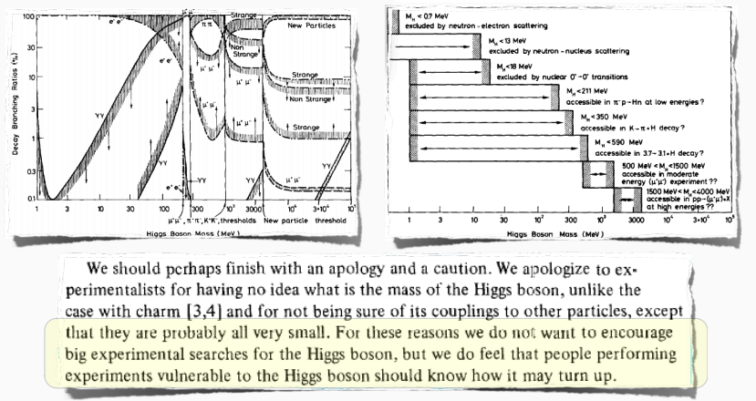
Before LEP

Slide 32
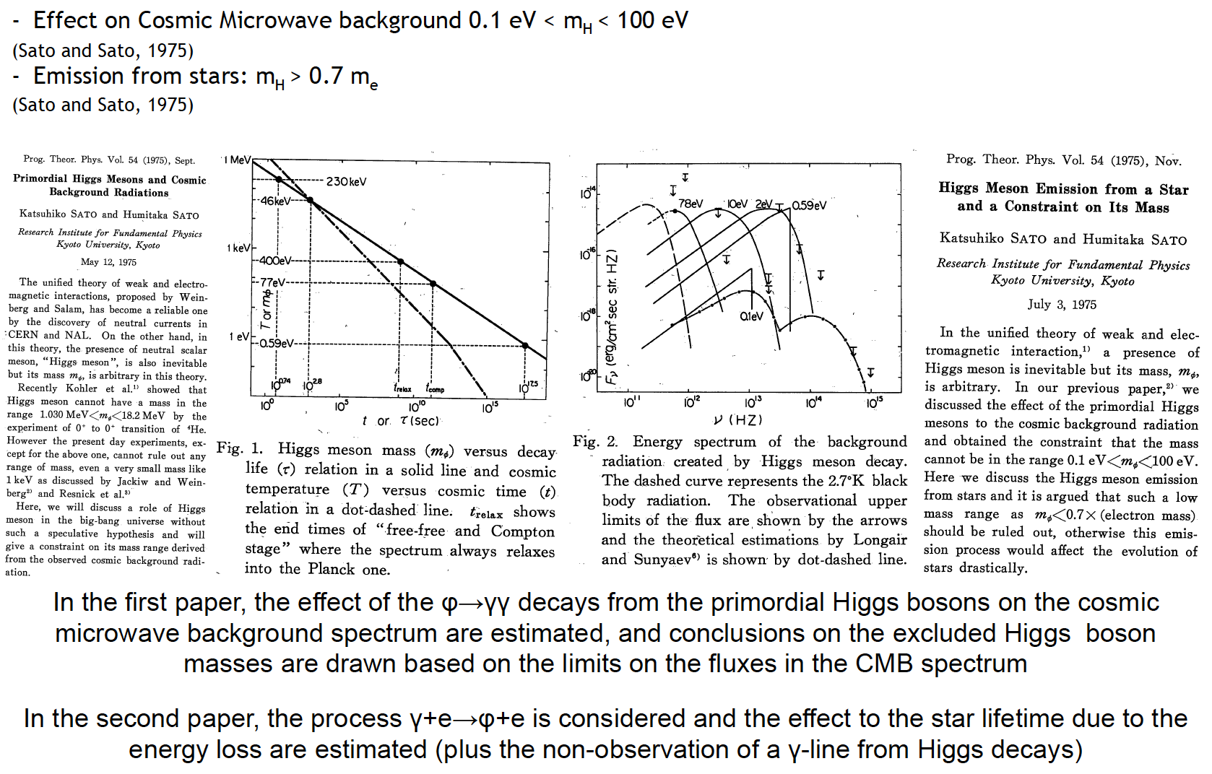
Astrophysical constraints

Slide 33
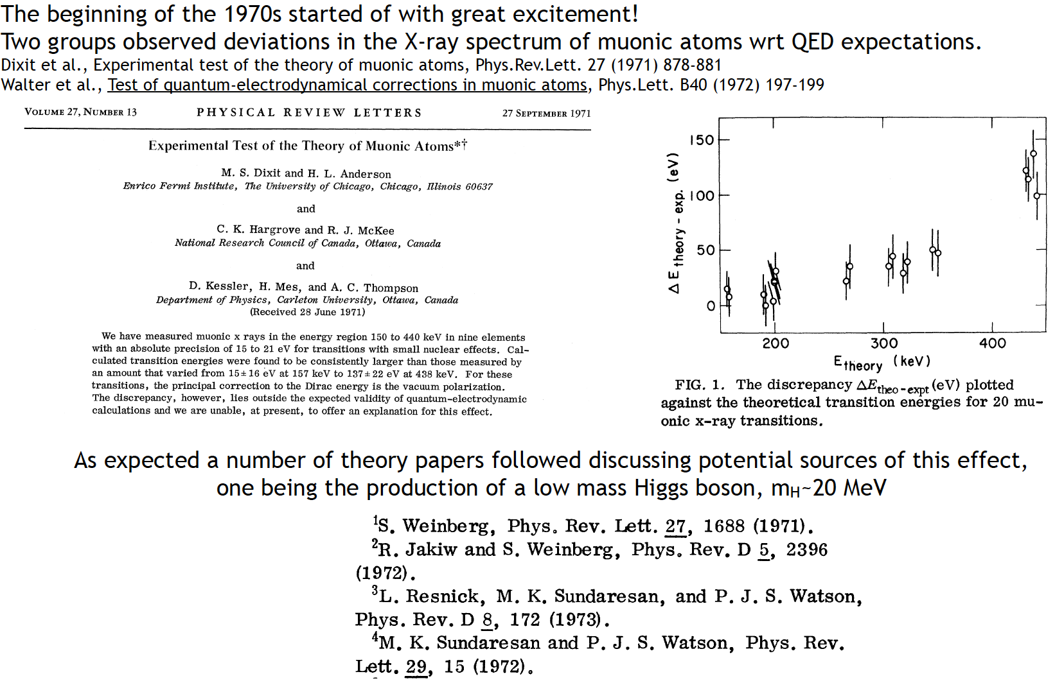
Searches in nuclear physics

Slide 34
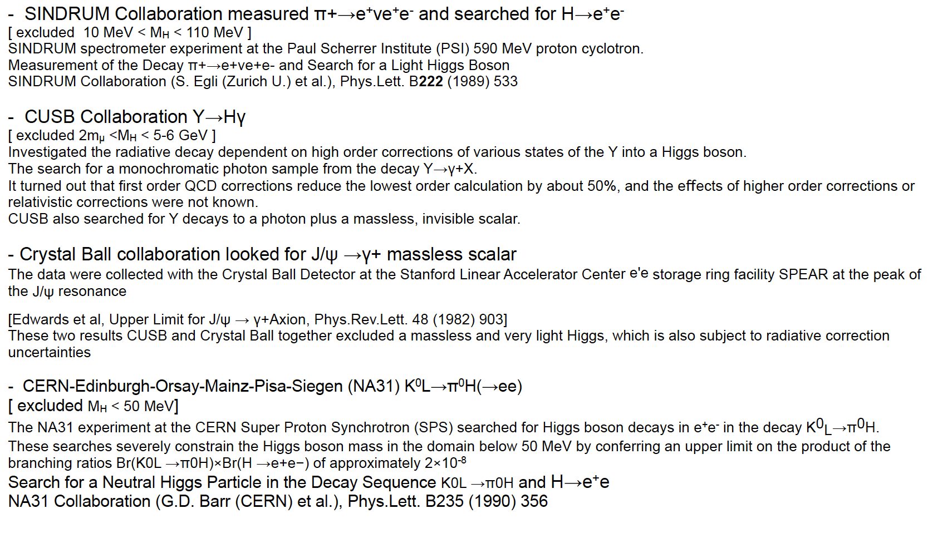
Searches in particle decays

Slide 35
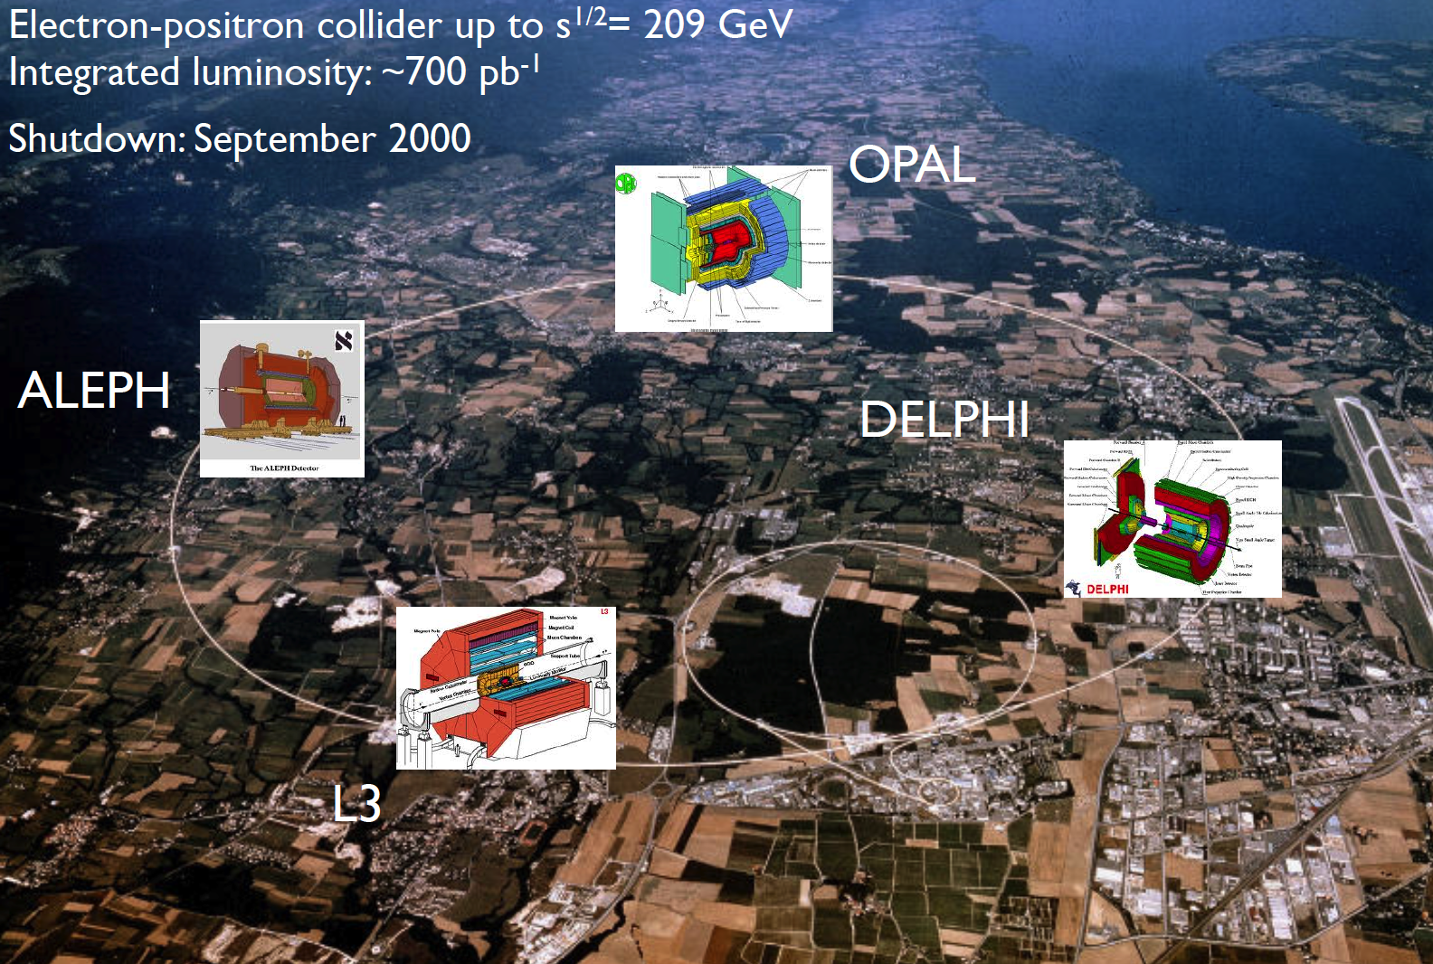
Searches at LEP

Slide 36
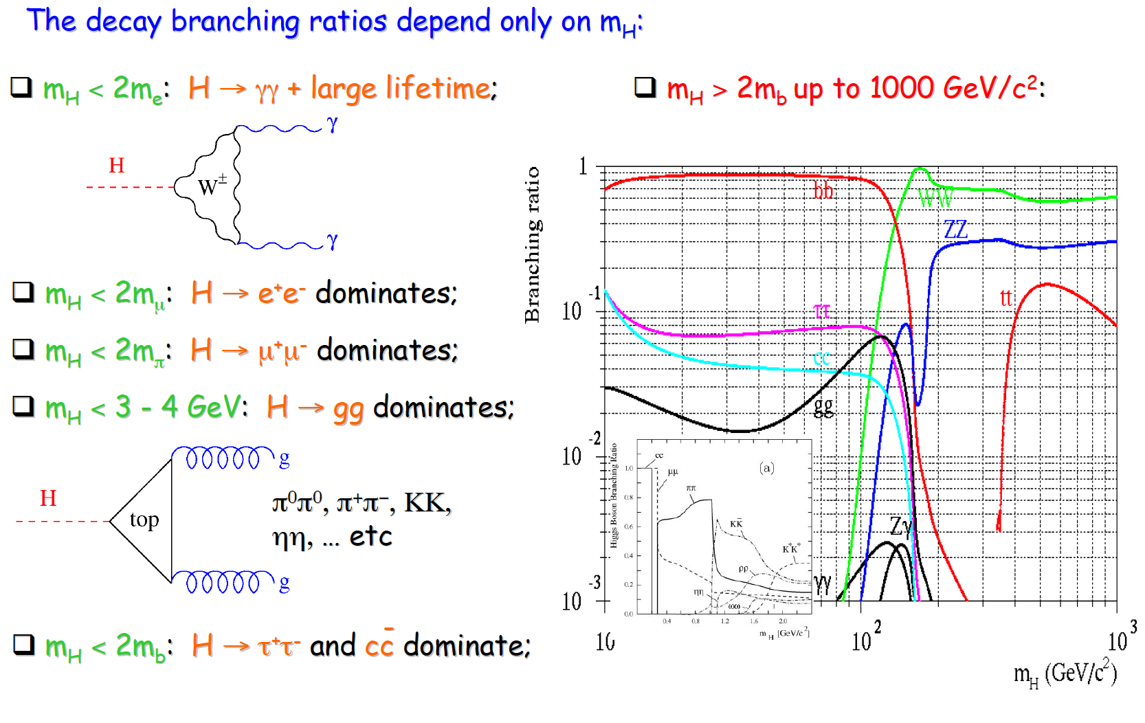
Low-mass searches at LEP

Slide 37
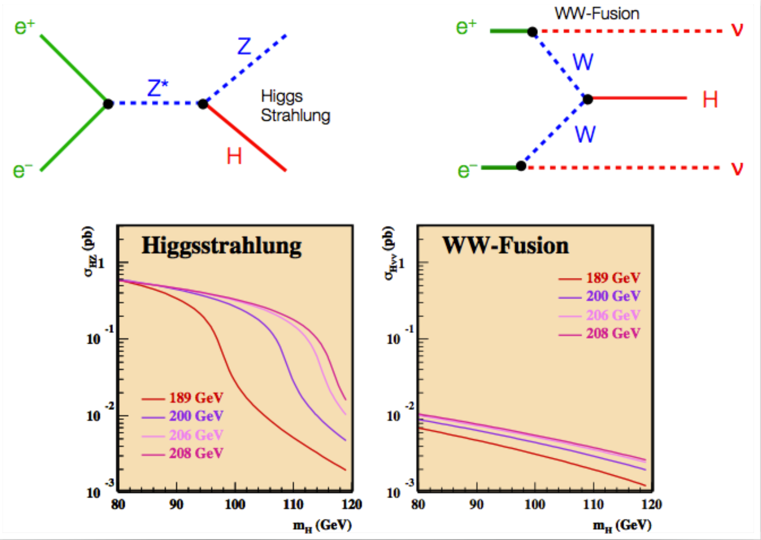
Higher-mass Higgs production at LEP

Slide 38
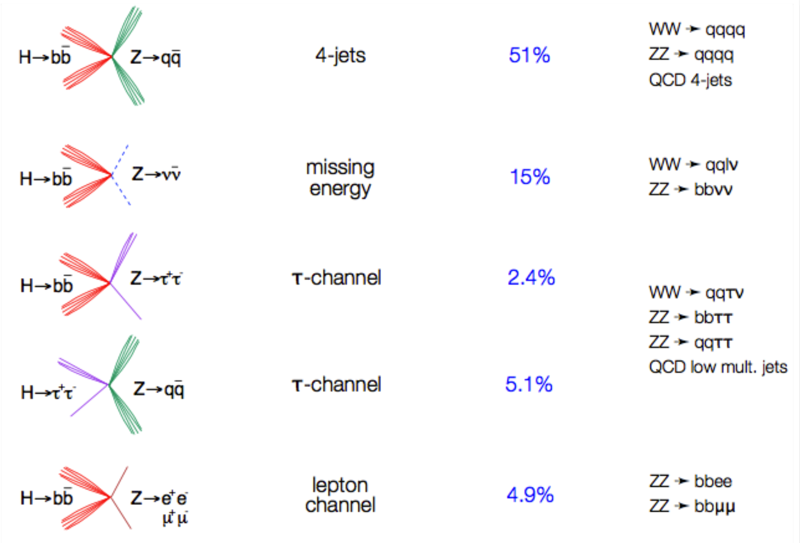
Higgs decays: focus on 3rd generation

Slide 39
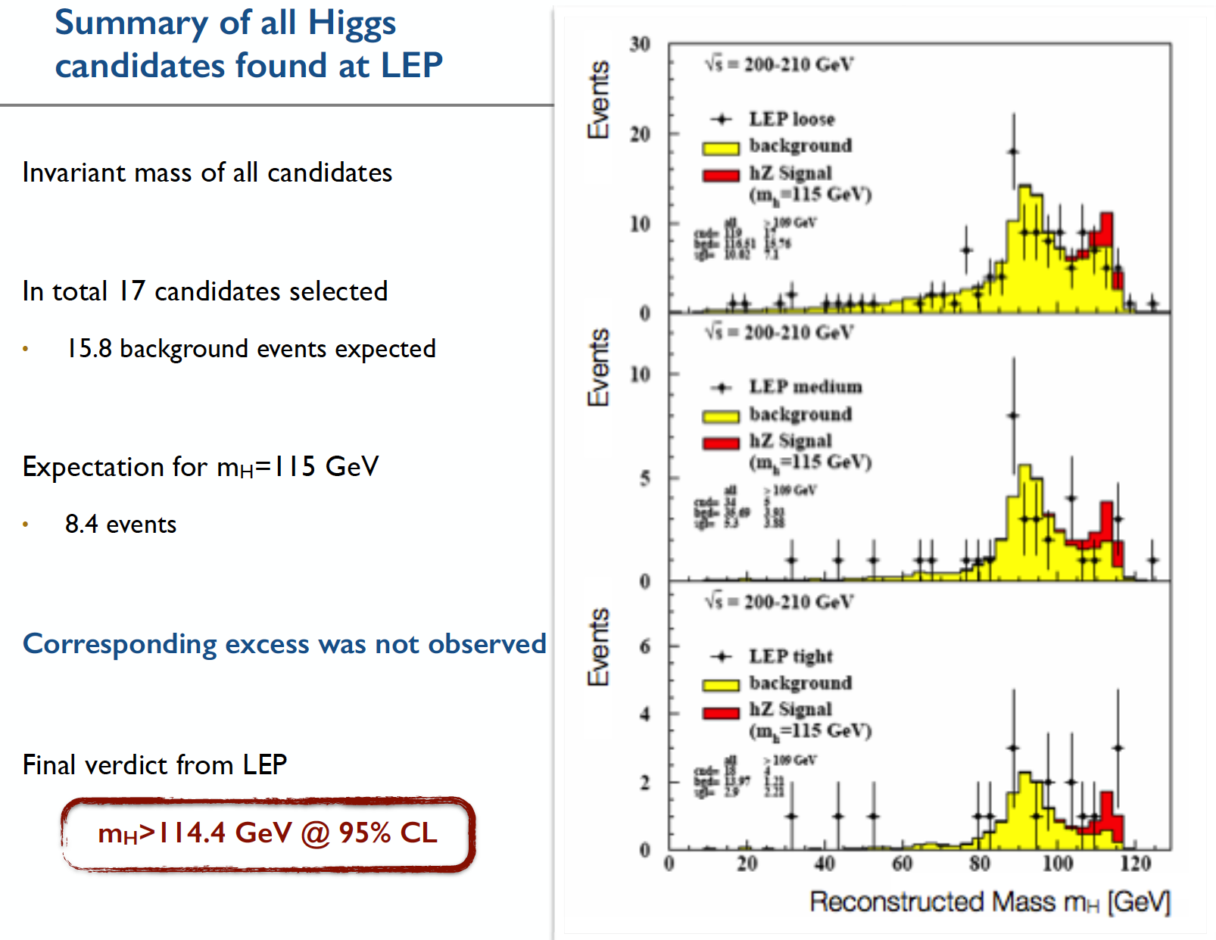

Slide 40
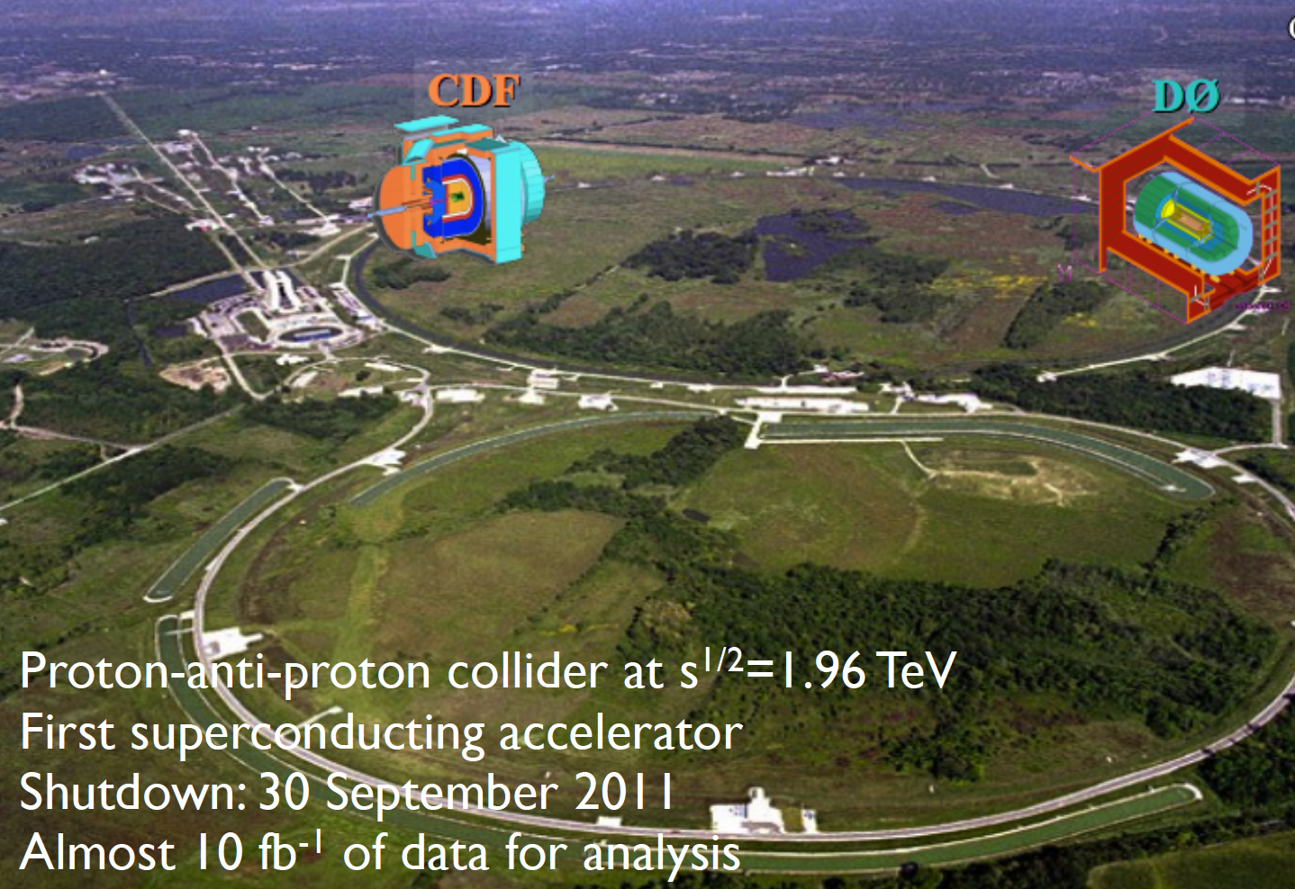
Searches at the Tevatron

Slide 41
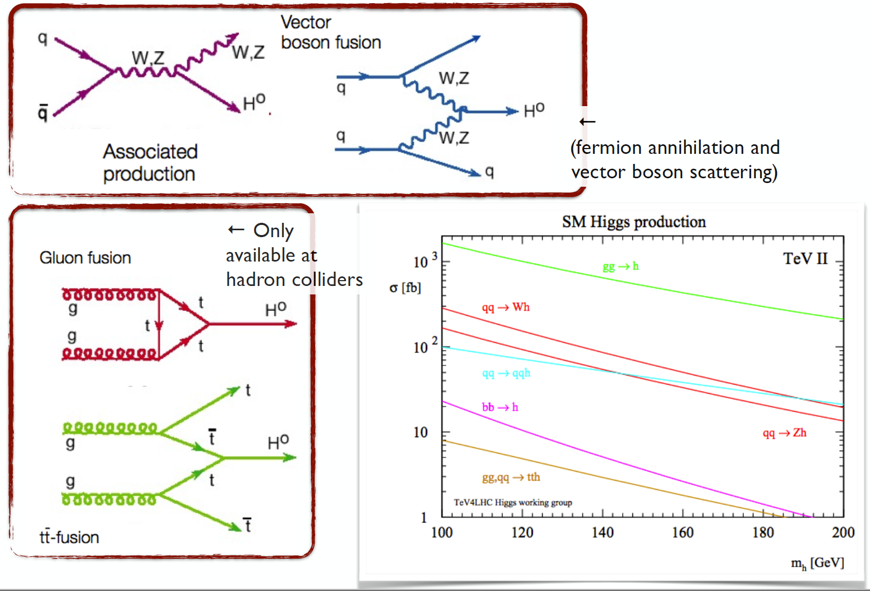
Higgs production at the Tevatron

Slide 42
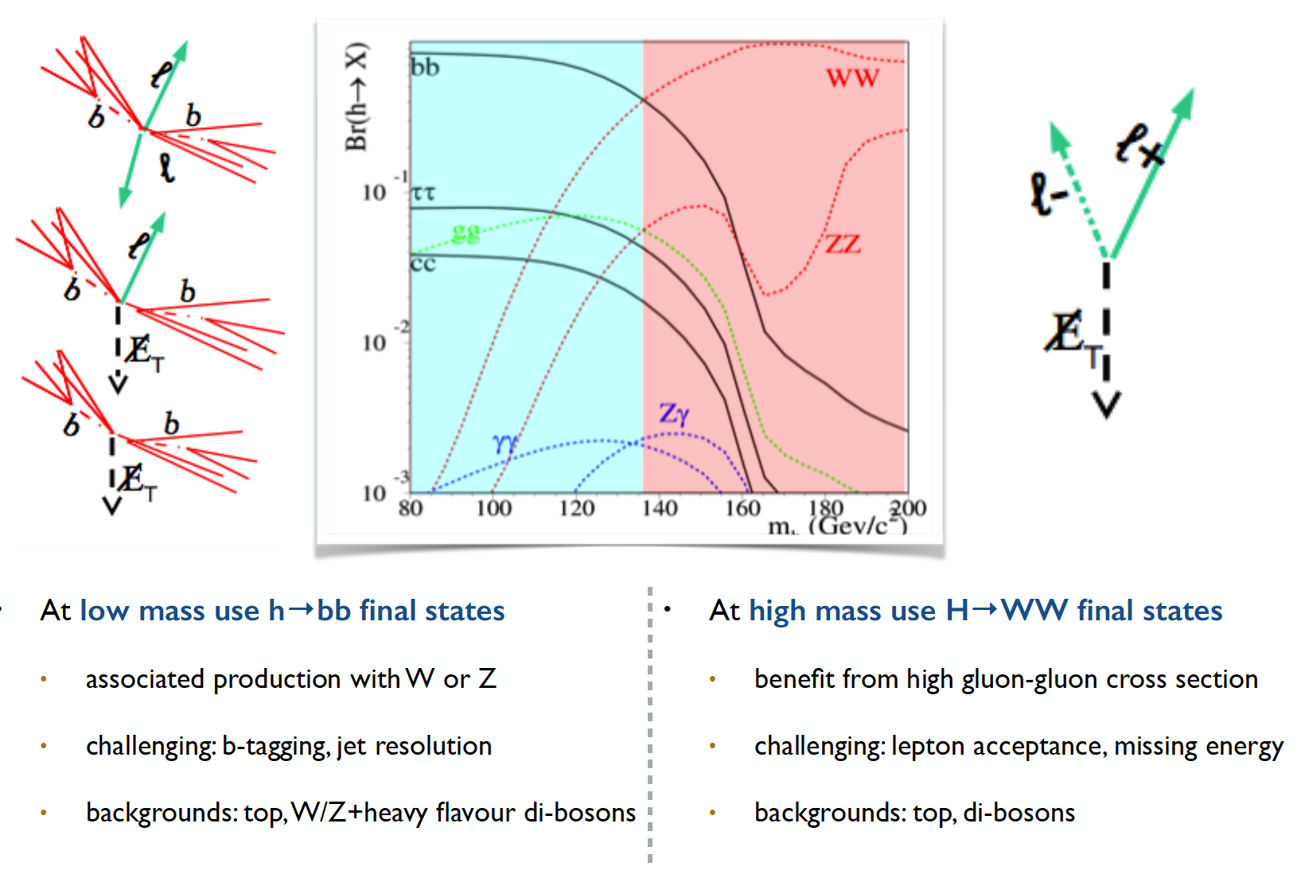
Most sensitive searches

Slide 43
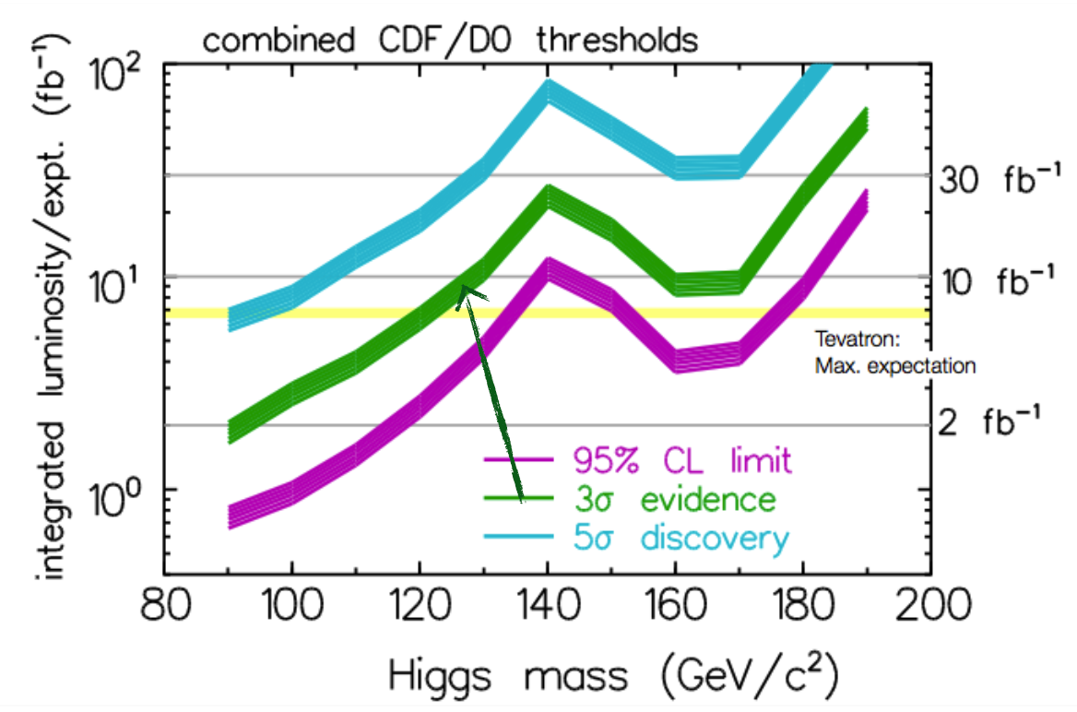
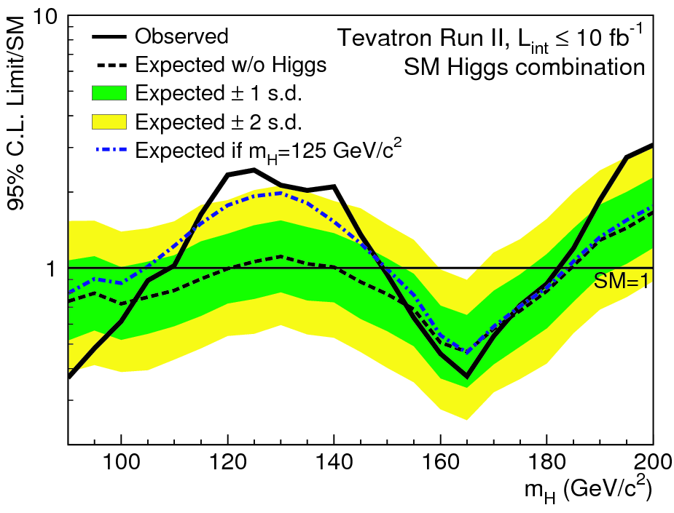
The final stand of the Tevatron
By the end of its lifetime, the Tevatron had very sophisticated analyses of a huge number of channels
By that time the LHC was collecting data and analysing it very fast
The CDF and D0 experiments obtained a significant excess of around 3 standard deviations in the mass range 115<M_{H}<140 GeV
Not enough to claim discovery, but consistent with the LHC results

Slide 44

Discovery at the LHC

Slide 45
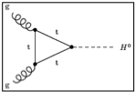
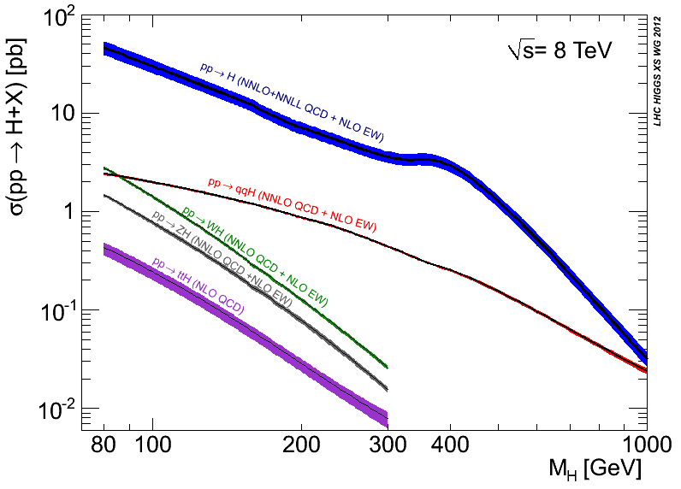
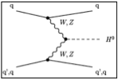
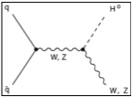
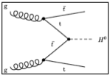
https://twiki.cern.ch/twiki/bin/view/LHCPhysics/CrossSections
gluon-fusion
VBF
WH
ZH
ttH
See previous lectures
Notes:
Main production channels: gluon fusion, Vector Boson Fusion, associated production with vector bosons, associated production with ttbar pair
Animation

Slide 46
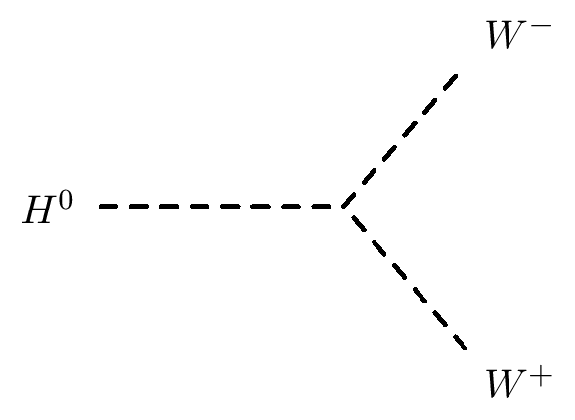
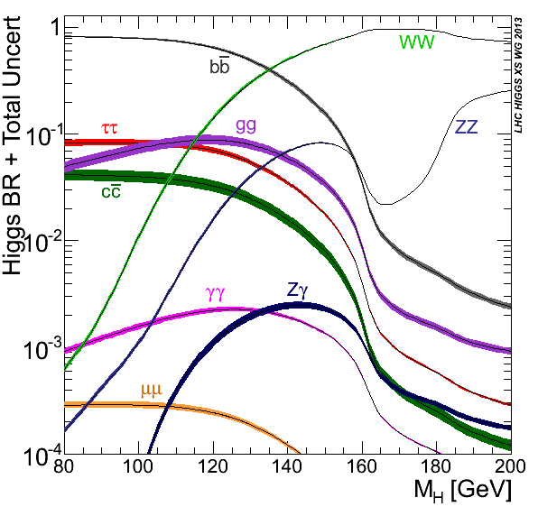
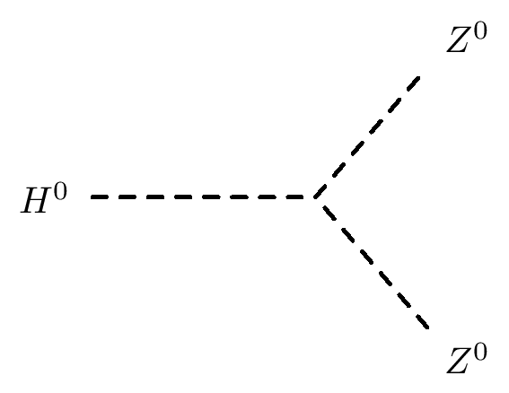
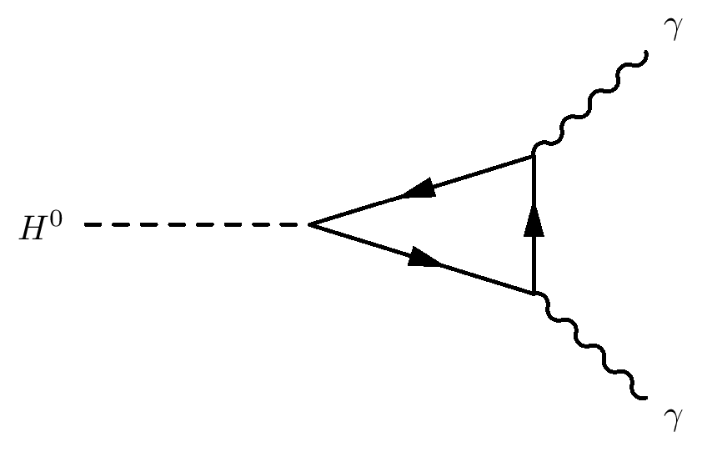

Slide 47

Discovery time!

Slide 48

The Brazil Plot
Expected:
Upper limit on σ(S+B)/σ(B) at 95% CL in Monte Carlo assuming B-only hypothesis
Observed:
Upper limit on σ(S+B)/σ(B) at 95% CL seen in data assuming B-only hypothesis

Slide 49

The p0 Discovery Plot
p0 is the probability that the background fluctuates to look like signal
Translated into the one-sided Gaussian probability

Slide 50

The Cyan Band Plot – signal strength
Best fit of μ=σ(S+B)/σ(B) to data
Error bands important…. As usual!

Slide 51

Blind Analysis
To avoid unintended experimenter’s bias in search for the Higgs boson
The analysis strategy, event selection & optimization criteria for each Higgs search channel were fixed by looking at data control samples before looking at the signal sensitive region
  Logistically quite painful
  But the right thing to do !

Slide 52

H->γγ
√s = 8 TeV
• ET1 = 62.2 GeV
• ET2 = 55.5 GeV
• E1 = 66.9 GeV
• E2 = 99.2 GeV
• Mγγ = 126.9 GeV

Slide 53



Diphoton mass reconstruction
m2γγ= 2 E1 E2 (1-cosα)
Understanding of calorimeter E response (from Z, J/ψ -> ee, W -> eν data and MC):
  E-scale at m_{Z} known to ~ 0.3%
  Linearity better than 1% (few-100 GeV)
  “Uniformity” (constant term of resolution): ~ 1% (2.5% for 1.37<|η|<1.8)
High pile-up: many vertices distributed over
σZ (LHC beam spot) ~ 5-6 cm => difficult to know which one has produced the γγ pair
Primary vertex from:
  EM calorimeter longitudinal (and lateral) segmentation
  Tracks from converted photons
Calorimeter pointing alone reduces vertex uncertainty from beam spot spread of ~ 5-6 cm to ~ 1.5 cm and is robust against pile-up
  Good enough to make contribution to mass
Resolution from angular term negligible
Addition of track information (less pile-up robust) needed to reject fake jets from pile-up in 2j/VBF category
ϑ

Slide 54

Backgrounds
Main backgrounds:
  Continuum γγ production
  Followed by γ mis-identification
Smooth mγγ spectrum
  Use sidebands to fit sum of backgrounds
Confirm each background source by data-driven techniques
  E.g. reverse quality cuts on photon identification

Slide 55

Results
Combined m_{γγ} from all 10 categories and 7/8 TeV data

Slide 56

Exclusion at 95% C.L. :
Expected: 110 < mH < 139.5 GeV
Observed: 112 < mH < 122.5 GeV 132 < mH < 143 GeV

Slide 57


Results in more detail

Slide 58


Slide 59

H->ZZ(*)->4l
pT (muons)= 36.1, 47.5, 26.4, 71 .7 GeV m12= 86.3 GeV, m34= 31.6 GeV. 15 reconstructed vertices

Slide 60
The ”golden channel”:
  Small rates, but high S/B
  Can be fully reconstructed; mass resolution ~2% at 130 GeV
Cross section times branching ratio (at mH=125 GeV):
~ 4 fb at √s=7 TeV
~ 5 fb at √s=8 TeV
Backgrounds:
  Irreducible: pp->ZZ(*)->4l
  Reducible: Z+jets, Zbb, tt (sizeable at low Higgs masses)
Suppress backgrounds with isolation and impact parameters cut on two softest
Leptons
  Mass range under consideration: 110 GeV to 600 GeV
  Four final states: 4e, 4μ, 2e2μ, 2μ2e

Slide 61


Slide 62


Slide 63




http://www.nobelprize.org/

Slide 64
Where we stand now?
Combination of ATLAS and CMS results in September 2015:
  ATLAS-CONF-2015-044 / CMS-PAS-HIG-15-002, https://cds.cern.ch/record/2052552
Used data recorded by the ATLAS and CMS detectors in 2011 and 2012, corresponding to integrated luminosities per experiment of 5 fb⁻¹ at √s=7 TeV and 20 fb⁻¹ at √s = 8 TeV
Results:
  Combined signal strength: μ = 1.09 ± 0.11
  m_{H} = 125.09 ± 0.21(stat) ± 0.11(syst) GeV
  Latest modes observed:
  VBF observed at 5.4σ
  H -> ττ decay observed at 5.5σ
Bottom line is that this looks much like the SM Higgs boson (see next few slides)
  But the truth is out there! Keep looking!

Slide 65

Higgs boson couplings
Best-fit values of ratios of Higgs boson coupling modifiers
The error bars indicate the 1σ (thick lines) and 2σ (thin lines) intervals
Hatched areas indicate the parameters which are assumed to be positive without loss of generality.

Slide 66

Signal strength
Best-fit results for the production signal strengths
Error bars indicate the 1σ (thick lines) and 2σ (thin lines) intervals.
The measurements of the global signal strength μ are also shown.

Slide 67

Couplings versus mass
Reduced coupling modifiers as a function of the particle mass:
For weak vector bosons:
y_{V,i} = √ κ_{V,i} g_{V/i}/2v = √κ_{V,i}m_{V/i}/v
For fermions:
y_{F,i} = κ_{F,i}g_{F/i}/ √2 = κ_{F,i}m_{F/i}/v
Dashed line indicates the predicted dependence on the particle mass for the SM Higgs boson

Slide 68

Is this the end?

Slide 69




A bit of fun…
1-loop effective potential
RG-improved potential
What if…
  At higher orders, Higgs potential doesn’t have to be stable
  Depending on m_{t} and m_{H} second minimum can be lower than EW minimum ⇒ tunneling between EW vacuum and true vacuum?!
“For a narrow band of values of the top quark and Higgs boson masses, the Standard Model Higgs potential develops a shallow local minimum at energies of about 10¹⁶ GeV, where primordial inflation could have started in a cold metastable state”, I. Masina, arXiv:1403.5244 [astro-ph.CO]
  See also: V. Brachina, Moriond 2014 (Phys.Rev.Lett.111, 241801 (2013)), G. Degrassi et al, arXiv:1205.6497v2; R.Contino, Workshop sulla fisica p-p a LHC, 2013

Slide 70



The universe seems to live near a critical condition
JHEP 1208 (2012) 098
Why?!
Explained by underlying theory?
Anthropic principle?

Slide 71

The End
Goldstein, ‘Classical Mechanics’, ‪Addison-Wesley Publishing Company (1980‬)
D. Griffiths, ‘Introduction to Elementary Particles ', John Wiley and Sons (1987)

Slide 72



?
?
?
?
?
?
Back to the big questions!!

Slide 73
Going beyond the standard model
But the Standard Model is not complete; there are still many unanswered questions.
Why do we observe matter and almost no antimatter if we believe there is a symmetry between the two in the universe?
What is this "dark matter" that we can't see that has visible gravitational effects in the cosmos?
Are quarks and leptons actually fundamental, or made up of even more fundamental particles?
Why are there exactly three generations of quarks and leptons? What is the explanation for the observed pattern for particle masses?
How does gravity fit into all of this?

Slide 74
Many possible theories
There are a large number of models which predict new physics at the TeV scale accessible at the LHC:
Supersymmetry (SUSY)
Extra dimensions
Extended Higgs Sector e.g. in SUSY Models
Grand Unified Theories (SU(5), O(10), E6, …)
Leptoquarks
New Heavy Gauge Bosons
Technicolour
Compositeness
Any of this could still be found at the LHC

Slide 75

Forces and expansion of the Universe
E=k. T
k=8.62 10⁻⁵ eV K⁻¹
LHC

Slide 76

The dark side of the Universe
Long standing problem:
  We know that ordinary matter is only ~4% of the matter-energy in the Universe.
  What is the remaining 96%?
The LHC may help to solve this problem, discovering dark matter

Slide 77

Most modes available with current lumi explored
Precision: obvious signal in bosonic decays
  Mass around 125GeV
  Signal strength consistent with SM – some questions
  Main alternatives to J^{P} = 0⁺ discarded – questions remain
Fermion couplings seen in H➞ττ (4σ)
Evidence for VBF production (3σ)
Mainly indirect sensitivity to ttH coupling through loops
Many direct searches for other Higgses turned out nothing (yet)
 | H➞γγ | H➞WW | H➞ZZ | H➞bb | H➞ττ | H➞Zγ | H➞μμ | H➞cc | H➞HH | H➞inv
ggF | ✔ | ✔ | ✔ |  | ✔ | ✔ | ✔
VBF | ✔ | ✔ | ✔ |  | ✔ | ✔ | ✔ |  |  | ✔
VH | ✔ | ✔ | ✔ | ✔ | ✔ |  |  |  |  | ✔
ttH | ✔ | ✔ | ✔ | ✔ | ✔
See A.David and P.Conde’s lectures

Slide 78










Combining Higgs Channels
Production
Decay
H->γγ
FIT
×
H->ZZ
H->WW
t
t
t
Backgrounds +
See A.David’s lecture

Slide 79
A bit more technically
Assumptions:
  Single resonance (at m_{H} = 125.5GeV)
  No modification of tensor structure of SM Lagrangian:
    i.e. H has J^{P} = 0⁺
  Narrow width approximation holds
    i.e. rate for process i ➔ H ➔ f is:
Free parameters in framework:
  Coupling scale factors: κ_{j}²
  Total Higgs width: κ_{H}²
  Or ratios of coupling scale factors: λ_{ij} = κ_{i} / κ_{j}
Tree-level motivated framework
  Useful for studying deviations in data with respect to expectations
    E.g. extract coupling scale factor to weak bosons κ_{V} by setting κ_{W} = κ_{Z} = κ_{V}
  Not same thing as fitting a new model to the data

Slide 80

Higgs boson mass
Mass: around 125GeV
  Used to be the only unknown
  SM-Higgs parameter, remember? ☺
ATLAS: arXiv:1307.1427
  m_{H}^{H->4l} = 124.3 ±0.6(stat) ±0.5(sys)
  m_{H}^{H->γγ} = 126.8 ±0.2(stat) ±0.7(sys)
  Assuming single resonance:
  m_{H} = 125.5 ±0.2(stat) ^{+0.5}_{-0.6}(sys)
Tension between channels!
  Compatibility P=1.5% (2.4σ)
  Rises to 8% with square syst.prior
BUT:
CMS: arXiv:1312.5353
  m_{H}^{H->4l} = 125.6 ±0.4(stat) ±0.6(sys)
CMS: CMS-PAS-HIG-13-005
  m_{H}^{H->γγ} = 125.4 ±0.5(stat) ±0.6(sys)
Doesn’t look like two different resonances!...
  ATLAS: arXiv:1307.1427
CMS

Slide 81



Spin and Parity
Pure J^{P} = 0⁻, 1⁺, 1⁻, and 2⁺ excluded with 97.8, 99.97, 99.7, and 99.9% Confidence Level (ATLAS arXiv 1307.1432)
But note: Higgs could have CP-violating component!
H->γγ – ATLAS arXiv 1307.1432

Slide 82



Direct Evidence of Fermion Couplings
Challenging channels at the LHC!
  Huge backgrounds (H->bb,H->ττ)
  Or low rate: H->μμ
ATLAS:
  4.1σ evidence of H->ττ decay 3.2σ exp.
  μ = σ_{obs.}/σ_{SM} = 1.4 ±0.3(stat) ±0.4(sys)
CMS:
  Combination of H->bb and H->ττ:
  3.8σ evidence (obs.) 4.4σ (expected)
  μ = σ_{obs.}/σ_{SM} = 0.83 ±0.24
ATLAS-CONF-2013-108
CMS 1401.6527
CMS 1401.6527

Slide 83




Higgs Width
Total width not measurable at the LHC
  Hadronic decays invisible in huge jet background
Sensitivity can be achieved through “interferometric” measurement
  Use gg➞H➞ZZ with H on- or off-shell
Proof of principle done, although still very far from theoretically expected value (4MeV)
  Γ_{H} < 22 MeV at 95% CL
http://arxiv.org/pdf/1405.3455.pdf

Slide 84


Signal strength
Take-home messages:
Need more data!
Always run two experiments!

Slide 85


Fermion and Boson couplings from fit
Set one scale factor for all fermions (κ_{F} = κ_{t} = κ_{b}= κ_{τ} =…) and one for all vector bosons (κ_{V} = κ_{Z} = κ_{W})
Assume no new physics
Strongest constraint to κ_{F} comes form gg->H loop
ATLAS and CMS fits within 1-2σ of SM expectation (compatibility P=12%)
Note ATLAS and CMS κ_{V} different – see signal strength below
ATLAS 1307.1427
CMS public page

Slide 86

Production Modes
Combination of channels allows consistency checks
Evidence for VBF production (3σ)
Sensitivity to top Yukawa coupling only through loops so far

Slide 87


New Physics in the Loops?
W
New heavy particles may show up in loops
  Dominant gluon-fusion through a (mostly) top loop production for H->ZZ, H->WW and H->γγ
  H->γγ decay through top and W loops (and interference)
Assume no change in Higgs width and SM couplings to known particles
Introduce effective coupling scale factors:
  κ_{g} and κ_{γ} for ggH and Hγγ loops
W
t
t
t
ATLAS 1307.1427
Best fit values: κ_{g} = 1.04 ± 0.14, κ_{γ} = 1.20 ± 0.15
Fit within 2σ of SM (compatibility P=14%)

Slide 88
Going beyond the Standard Model

Slide 89

Two Higgs Doublet Model (2HDM)
No reason for simplest Higgs sector scenario to be true!
One of the simplest alternatives: 2 Higgs doublets
Leads to 5 different Higgs bosons:
  CP even (scalar): h, H
  CP odd (pseudoscalar): A
  charged: H⁺, H⁻
  Two doublets => two vacuum expectation values (mean field strength in the vacuum) – v₁ and v₂

Slide 90

Two Higgs Doublet Model (2HDM)
Free parameters:
  4 masses (Do we know one? Assume it’s m_{h})
  tan β = v₁/v₂ ratio of v.e.v.’s
  Mixing angle of h and H: α
4 possible Yukawa coupling arrangements (“types”)
Most common SUSY benchmark (MSSM) is based on Type II
If cos(β-α) = 0, h = Standard Model H⁰

Slide 91

Constraints from SM channels
What can our data already say about the 2HDM?
  If it exists in Nature, then some of the measured rates (signal strength) are modified
  Existing measurements can already rule out many possibilities
  Used final states γγ, ZZ, WW, bb, ττ
ATLAS-CONF-2014-010

Slide 92



Invisible Higgs
Direct searches for Dark Matter usually hidden in deep caverns for low noise. But there is another way…
  Dark matter has mass! Should couple to the Higgs. Do we see it?
  Weakly interacting particles would leave no trace in detector – “Invisible” Higgs decays
  Could be e.g. neutralinos in SUSY scenario
  Would contribute to total Higgs width

Slide 93


Invisible Higgs
Require dileptons from Z
Back to back with Missing E_{T} and p_{T}(ll)
No jets
Main backgrounds ZZ, WZ
Claire Shepherd-Themistocleous - 26th Rencontres de Blois 2014

Slide 94

Z(H -> Invisible): Analysis Strategy
R.Vanguri, Lake Louise Winter Institute 2015

Slide 95


Invisible Higgs
90% CL limits
Upper limit Br to inv. 75%
Upper limit interpreted as limit on DM-nucleon scattering cross section
Fox et al. Phys. Rev. D 85 050611
DM scenarios scalar, vector or Majorana fermion
Higgs-nucleon coupling 0.33 ^{+0.30}_{-0.07} Djouadi et al. Phys. Lett. B 709 65 (2012)

Slide 96




Invisible Higgs
Other search channels:
Search in VBF and ZH , Z → ll and bb
VBF mode requires 2 jets in forward region
( Δη_{jj} > 4.2 ) , E_{t}^{miss} > 130 GeV
Central jet veto on any jet p_{T} > 30 GeV.
Dominant beckgrounds
Z(νν) + jets, W(lν) + jets

Slide 97


Invisible Higgs
7 TeV 4.9 fb⁻¹ 8 TeV ~ 19 fb⁻¹
Upper limit on Br to invisible
0.58 for Higgs mass 125 GeV
m_{H}/2
Higgs nucleon coupling 0.33 (range 0.26 - 0.63)
DM scenarios scalar, vector or Majorana fermion

Slide 98

Rare decays
Only way to probe Higgs decays to charm – charm Yukawa coupling – at LHC
Deviations in coupling from SM value can lead to increase in branching fraction
Analysis also probes Z decays to J/Ψ or ϒ(nS) plus γ – improved LEP limits by 2

Slide 99

Backgrounds

Slide 100

Results
Upper limit set on branching fraction of H decay to J/Ψ plus γ at 95% confidence:
Br (J/Ψ γ ) < 1.5 x 10⁻³ (expected 1.2^{+0.6}_{−0.3} x 10⁻³ )
540 ≈ SM Expectation

Slide 101
Looking into the future

Slide 102

Future LHC Running

Slide 103



Not only more luminosity
Higher centre of mass energy gives access to higher masses
Hugely improves potential for discovery of heavy particles
Increases cross sections limited by phase space
  E.g. ttH increases faster than background (factor 4)
But may make life harder for light states
  E.g. only factor 2 increase for WH/ZH, H➞bb and more pileup
  Could be compensated by use of boosted jet techniques (jet substructure)
http://www.hep.ph.ic.ac.uk/~wstirlin/plots/plots.html

Slide 104

Run II/High-Lumi LHC Programme
Precision AND searches!
Precision:
  Continue to look for deviations wrt Standard Model
Differential cross sections:
  New physics in loops could modify event kinematics
Complete measurement of properties:
  E.g. CP quantum numbers:
  Sensitivity in H➞ZZ and VBF
  Search for CP violation in Higgs sector
Search for rare decay modes:
  H➞HH to access self coupling (long term!)
Search for additional Higgs bosons:
  E.g. 2-Higgs Doublet Model is a natural extension and predicted in SUSY

Slide 105



Higgs differential cross sections
Get access to the loop structure where there may be new physics
ATLAS H→γγ and ZZ so far – more to come in run 2
W
W
W

Slide 106






Another example: ttH
Indirect constraints on top-Higgs Yukawa coupling from loops in ggH and ttH vertices
  Assumes no new particles contribute to loops
Top-Higgs Yukawa coupling can be measured directly
  Allows probing for New Physics contributions in the ggH and γγH vertices
Top Yukawa coupling Y_{t} = √2M_{t}/vev = 0.996±0.005
  Does this mean top plays a special role in EWSB?

Slide 107


Sensitivity to New Physics
Degrande et al. arXiv:1205.1065
Effective top-Higgs Yukawa coupling may deviate from SM due to new higher-dimension operators
  Change event kinematics – go differential!
ttH sensitive new physics: little Higgs, composite Higgs, Extra Dimensions,…
In the presence of CP violation, Higgs-top coupling have scalar (κ_{t})and pseudoscalar (˜κ_{t})components
  Strong dependence on ttH cross section
  Note: Indirect constraints from electron electric dipole moment not taken into account (give |˜κ_{t}| < 0.01)
Ellis et al. arXiv:1312.5736

Slide 108
Summary
Recapitulation:
  Electroweak symmetry breaking
  Higgs boson in Electroweak Lagrangian
  Higgs boson production and decay at the LHC
  The landscape at the end of LHC run I
The Higgs sector beyond the Standard Model
  Constraints from current data
  Examples of rare and exotic channels
Future Higgs measurements at LHC and beyond
  Fundamental questions at the end of run I
  Future LHC running – luminosity, energy, and physics reach
  Higgs physics in future LHC analyses – Precision and Searches
  An example: associated production with top-quark pair – SM and BSM

