Slide 1
Higgs Physics – Lecture 4
Future Directions in Higgs Physics at the LHC
Ricardo Gonçalo – LIP
Course on Physics at the LHC – LIP, 26 May 2014

Slide 2
Outlook
Introduction
Where do we stand
Answers and questions at the end of run-I
Future LHC Higgs Physics:
LHC Machine scenarios
Precision Higgs Measurements
Higgs sector Searches
Higgs physics at future accellerators

Slide 3
Introduction

Slide 4
Higgs lectures so far…
Lecture 1 – overview of theory and history
Lecture 2 – some search channels in detail
Lecture 3 – channel combination and properties of observed Higgs
This lecture – try to get overview and look ahead

Slide 5
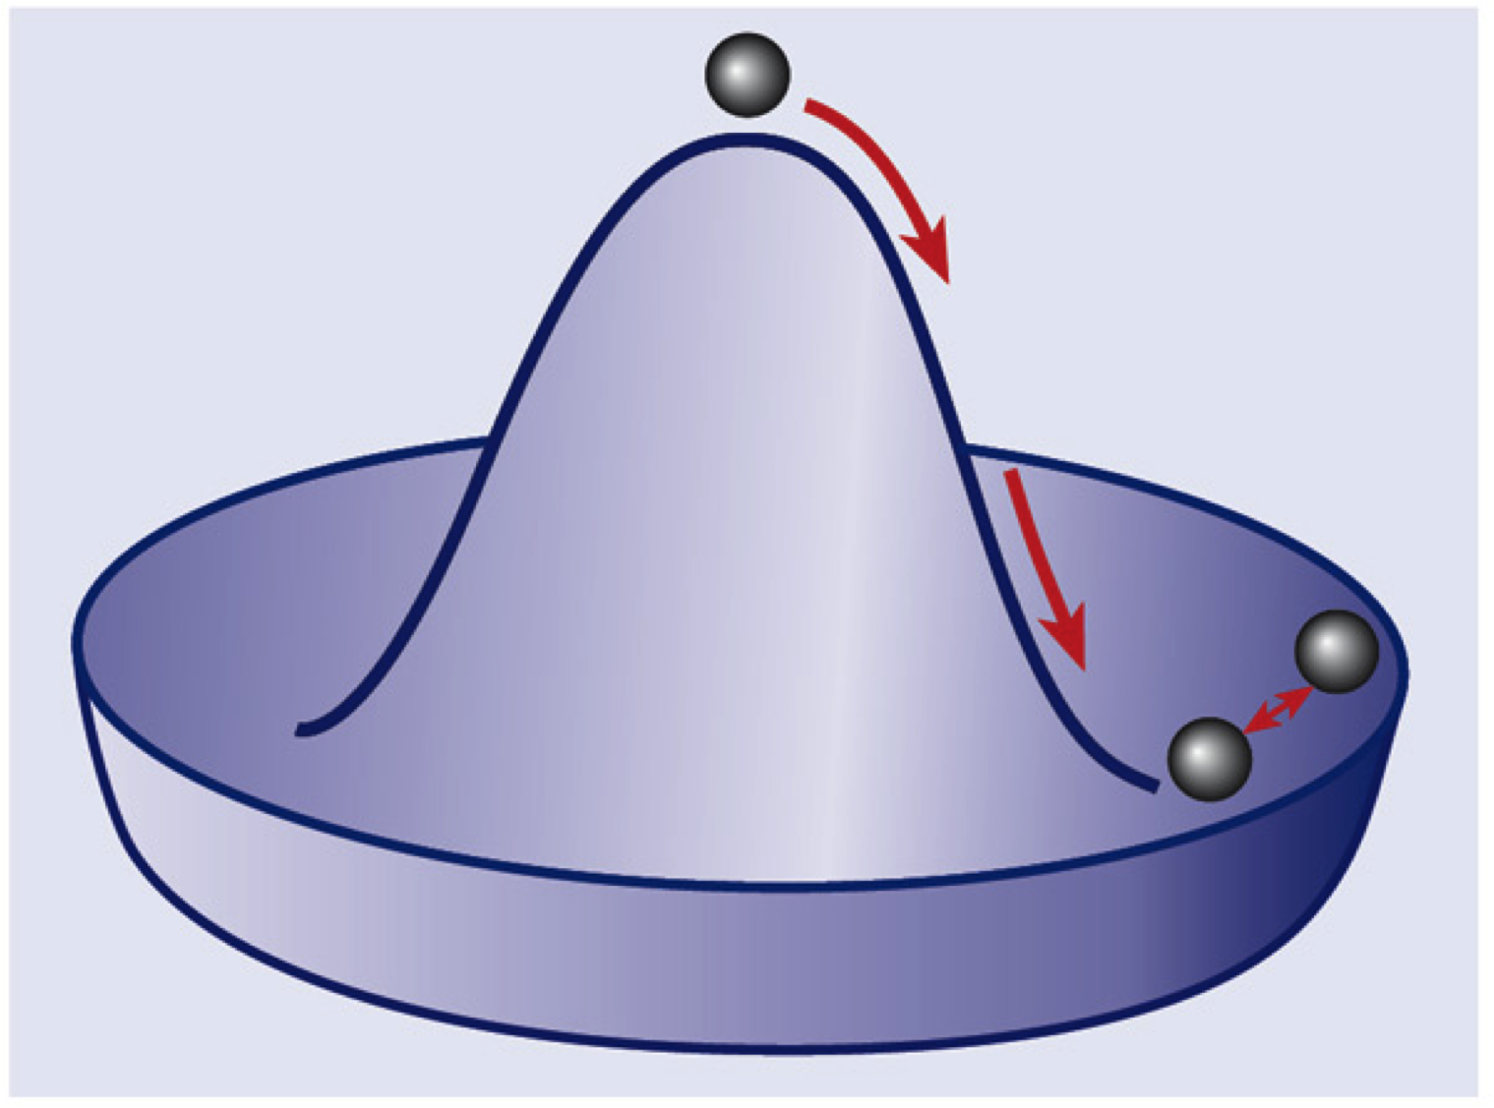
Electroweak Lagrangian before spontaneous symmetry breaking
Electroweak gauge bosons: B⁰ W⁰ W±
Fermion kinetic terms
Higgs term (note: vacuum expectation value zero before symmetry breaking)
Yukawa interaction term between Higgs field and fermions
Massive Higgs boson: transverse oscillation mode
Spontaneous symmetry breaking:
New bosons γ and Z⁰ from W⁰ and B⁰

Slide 6
After sym. breaking
Kinetic terms: notice boson masses (Z,W,H)!
Neutral and charged current terms: fermions and gauge boson interactions
Higgs boson 3- and 4-point self-interaction
Higgs boson interaction with gauge bosons
Gauge boson self interaction:
Yukawa interactions between Higgs and fermions: note fermion masses!

Slide 7
http://www.nobelprize.org/

Slide 8
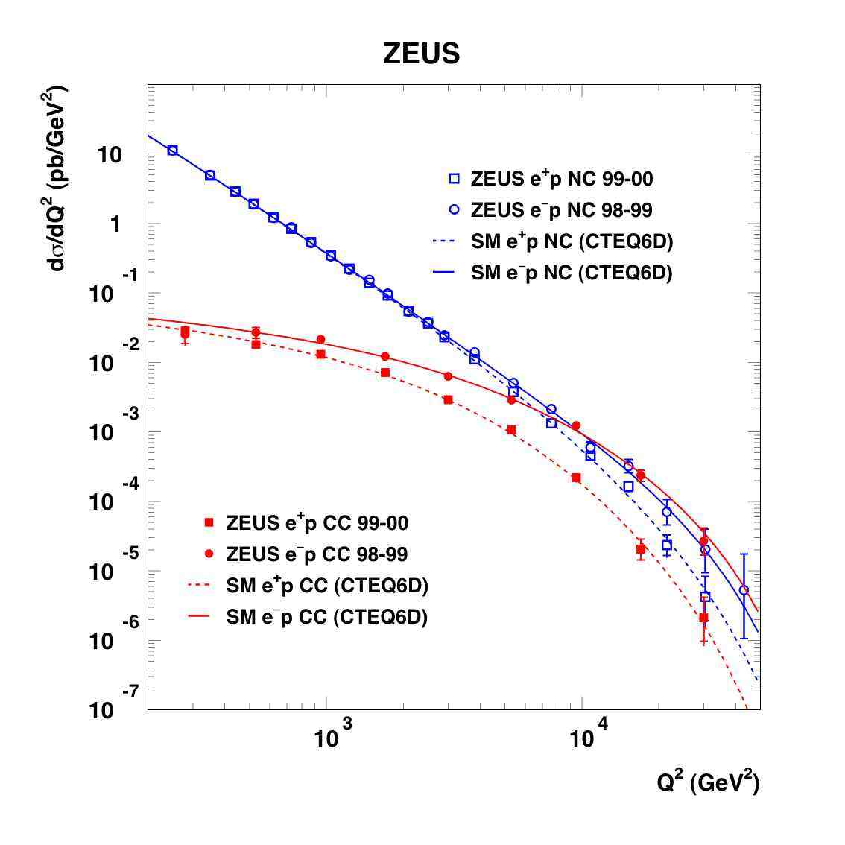
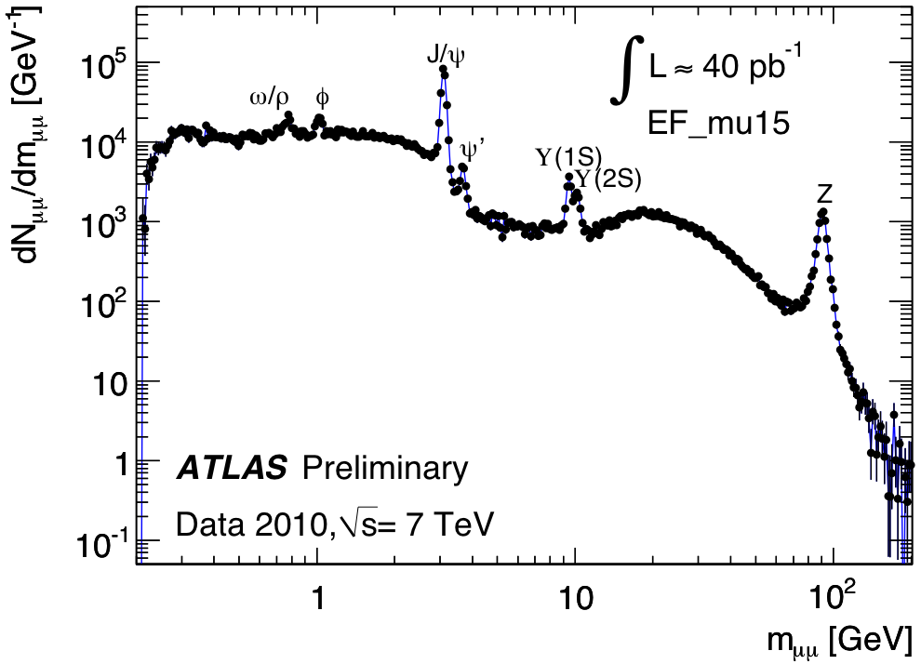
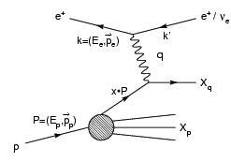
Why does it matter?
Because it’s real!
Data shows Higgs mechanism (or something like it) needed in the theory
Because it may lead us to new discoveries and a new understanding of Nature!
“There is nothing so practical as a good theory” (Kurt Lewin)
Z/γ
W±
http://www-zeus.desy.de/physics/sfew/PUBLIC/sfew_results/preliminary/dis04/

Slide 9
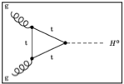
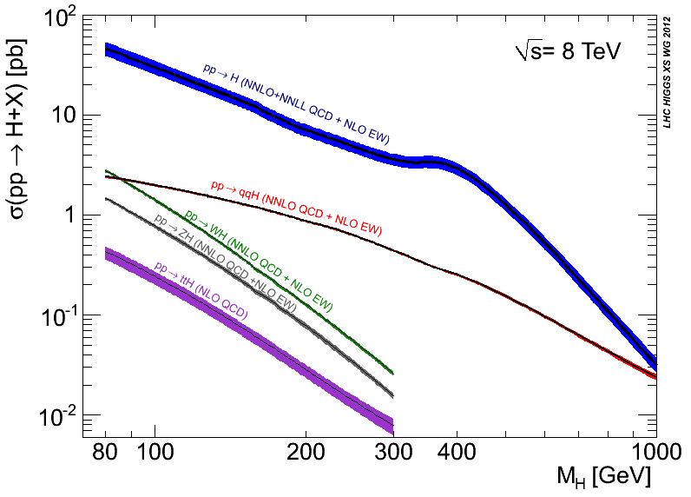
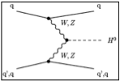
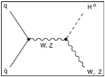
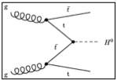
https://twiki.cern.ch/twiki/bin/view/LHCPhysics/CrossSections
gluon-fusion
VBF
WH
ZH
ttH
Notes:
Main production channels: gluon fusion, Vector Boson Fusion, associated production with vector bosons, associated production with ttbar pair
Animation

Slide 10
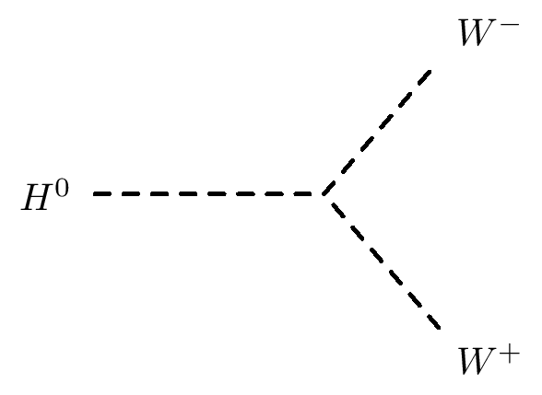
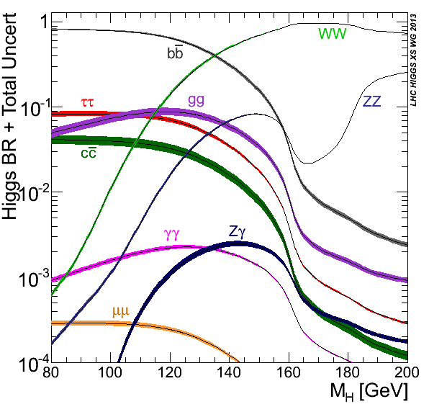
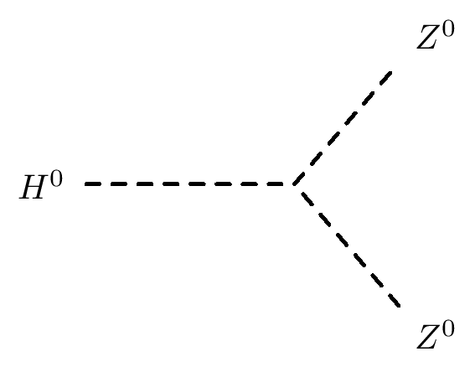
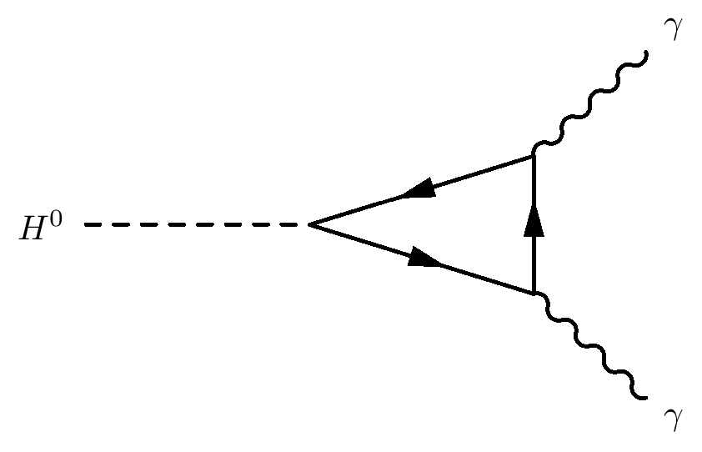

Slide 11
Where do we stand?

Slide 12
Questions and answers at the end of Run I
Most modes available with current lumi explored
Precision: obvious signal in bosonic decays
Mass around 125GeV – some questions
Signal strength consistent with SM – some questions
Main alternatives to J^{P} = 0⁺ discarded – questions remain
Fermion couplings probably seen in H➞ττ (4σ)
Evidence for VBF production (3σ)
Mainly indirect sensitivity to ttH coupling through loops
Many direct searches for other Higgses turned out nothing (yet)
 | H➞γγ | H➞WW | H➞ZZ | H➞bb | H➞ττ | H➞Zγ | H➞μμ | H➞cc | H➞HH | H➞inv
ggF | ✔ | ✔ | ✔ |  | ✔ | ✔ | ✔
VBF | ✔ | ✔ | ✔ |  | ✔ | ✔ | ✔ |  |  | ✔
VH | ✔ | ✔ | ✔ | ✔ | ✔ |  |  |  |  | ✔
ttH | ✔ | ✔ | ✔ | ✔ | ✔

Slide 13
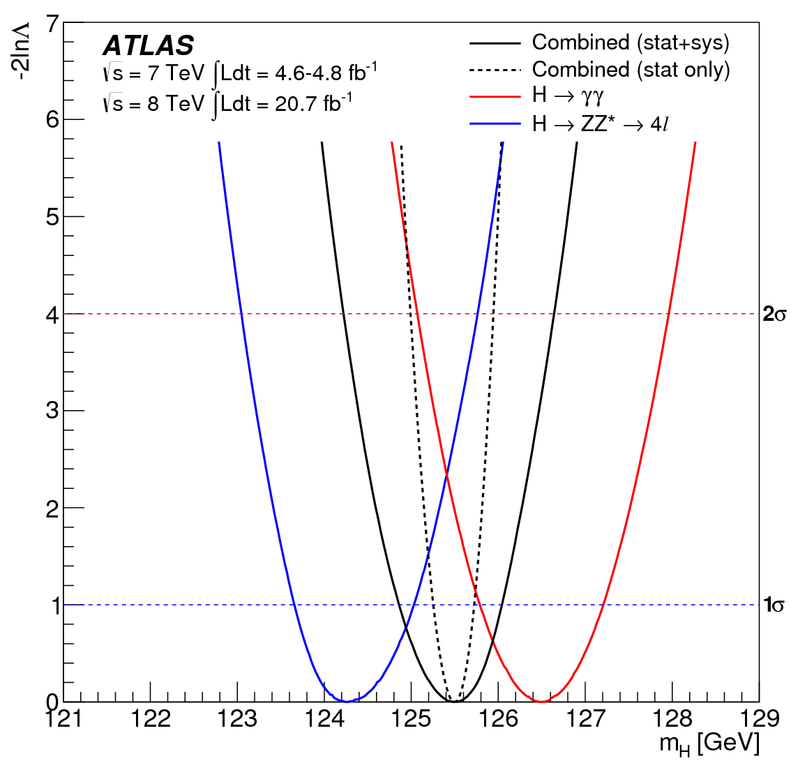
Higgs boson mass
Mass: around 125GeV
Used to be the only unknown
SM-Higgs parameter, remember? ☺
ATLAS: arXiv:1307.1427
m_{H}^{H->4l} = 124.3 ±0.6(stat) ±0.5(sys)
m_{H}^{H->γγ} = 126.8 ±0.2(stat) ±0.7(sys)
Assuming single resonance:
m_{H} = 125.5 ±0.2(stat) ^{+0.5}_{-0.6}(sys)
Tension between channels!
Compatibility P=1.5% (2.4σ)
Rises to 8% with square syst.prior
BUT:
CMS: arXiv:1312.5353
m_{H}^{H->4l} = 125.6 ±0.4(stat) ±0.6(sys)
CMS: CMS-PAS-HIG-13-005
m_{H}^{H->γγ} = 125.4 ±0.5(stat) ±0.6(sys)
Doesn’t look like two different resonances!...
ATLAS: arXiv:1307.1427
CMS

Slide 14
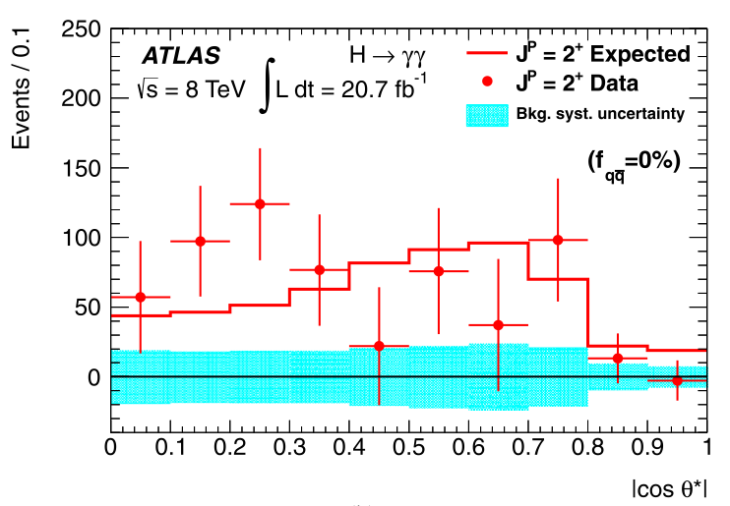
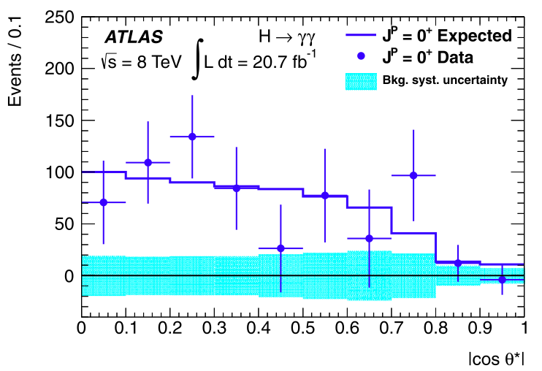
Spin and Parity
Pure J^{P} = 0⁻, 1⁺, 1⁻, and 2⁺ excluded with 97.8, 99.97, 99.7, and 99.9% Confidence Level (ATLAS arXiv 1307.1432)
But note: Higgs could have CP-violating component!
H->γγ – ATLAS arXiv 1307.1432

Slide 15
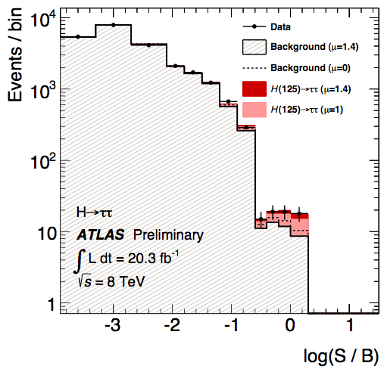
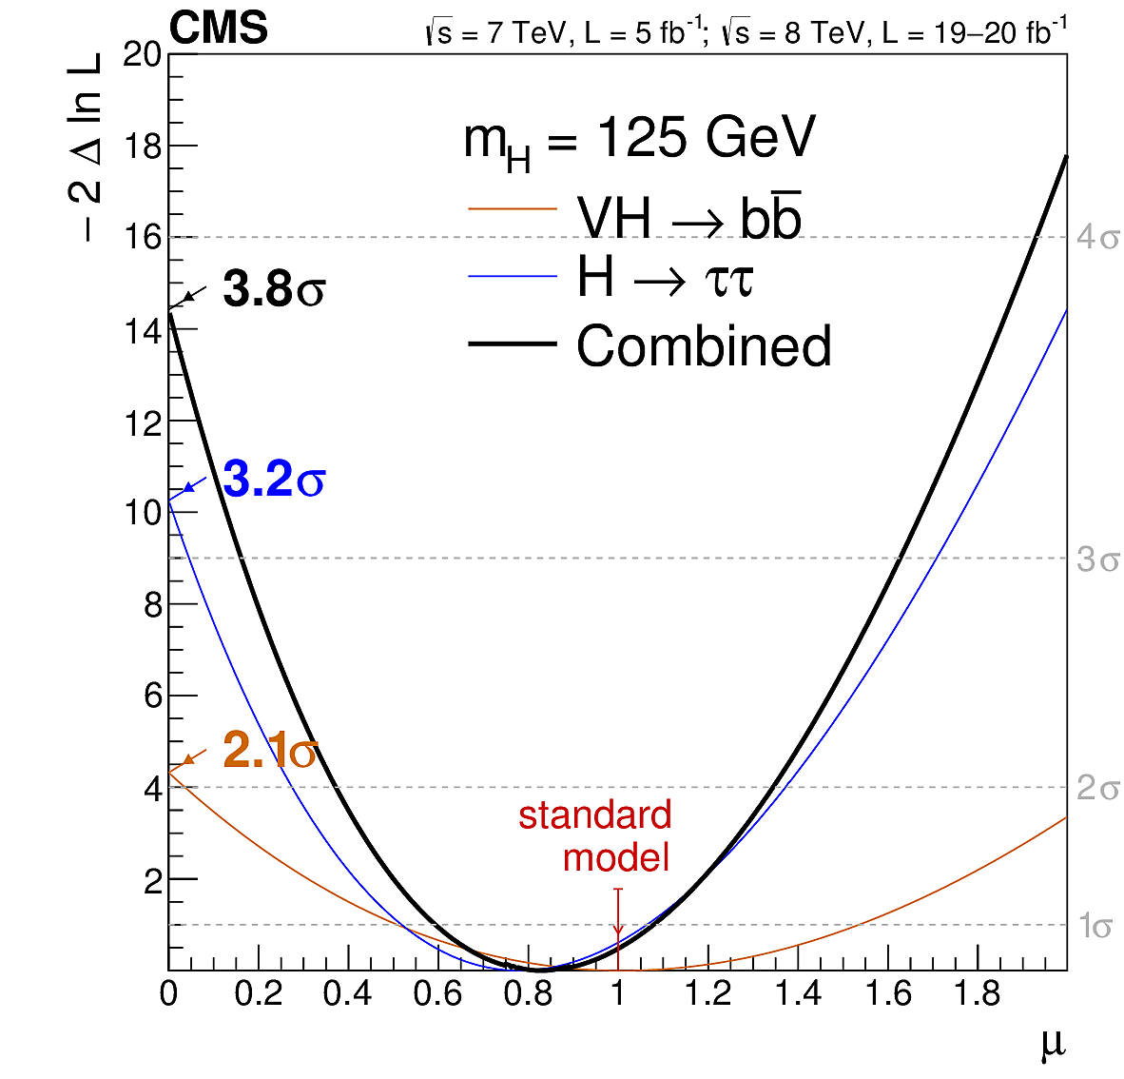
Direct Evidence of Fermion Couplings
Challenging channels at the LHC!
Huge backgrounds (H->bb,H->ττ)
Or low rate: H->μμ
ATLAS:
4.1σ evidence of H->ττ decay 3.2σ exp.
μ = σ_{obs.}/σ_{SM} = 1.4 ±0.3(stat) ±0.4(sys)
CMS:
Combination of H->bb and H->ττ:
3.8σ evidence (obs.) 4.4σ (expected)
μ = σ_{obs.}/σ_{SM} = 0.83 ±0.24
ATLAS-CONF-2013-108
CMS 1401.6527
CMS 1401.6527

Slide 16
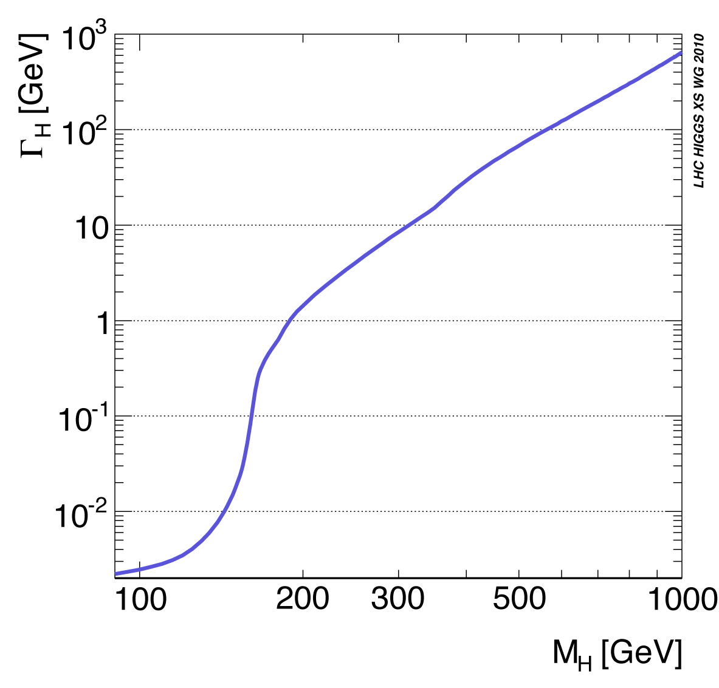
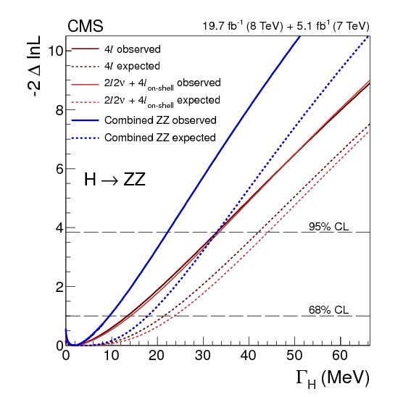
Higgs Width
Total width not measurable at the LHC
Hadronic decays invisible in huge jet background
Sensitivity can be achieved through “interferometric” measurement
Use gg➞H➞ZZ with Z on- or off-shell
Proof of principle done, although still very far from theoretically expected value (4MeV)
Γ_{H} < 22 MeV at 95% CL
http://arxiv.org/pdf/1405.3455.pdf

Slide 17
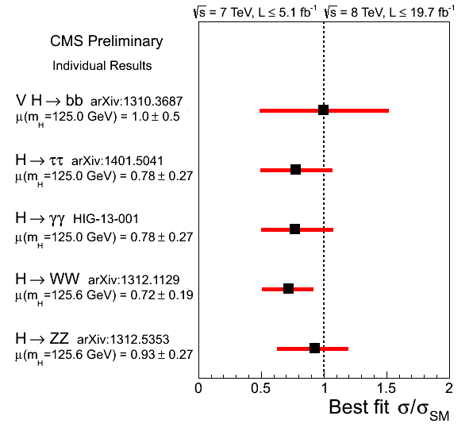
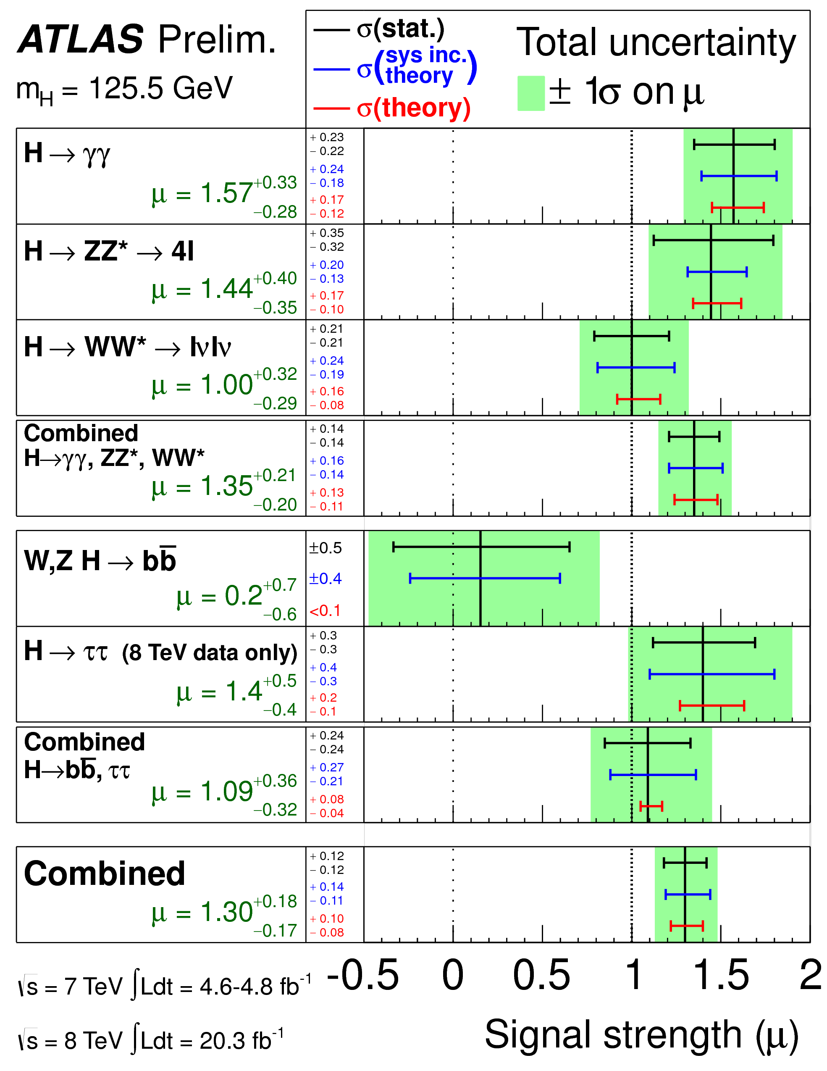
Signal strength
Take-home messages:
Need more data!
Always run two experiments!

Slide 18
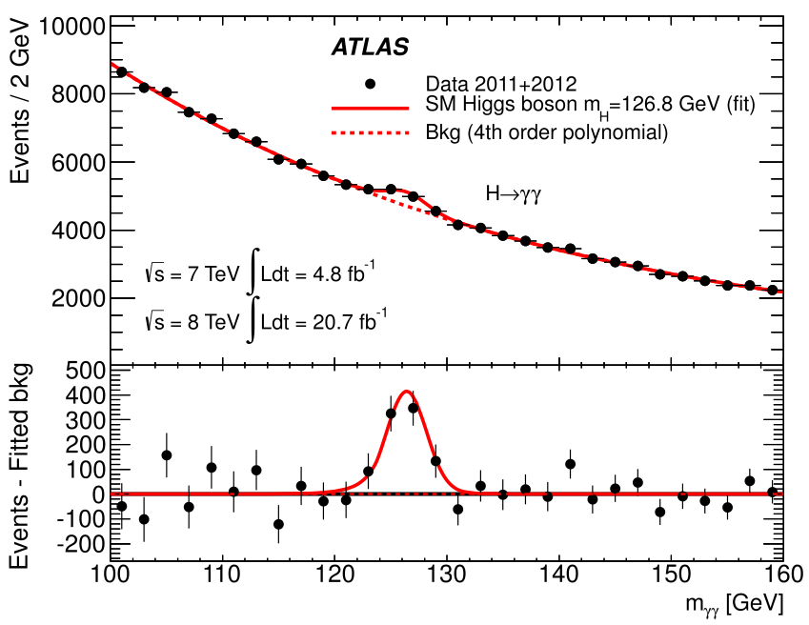
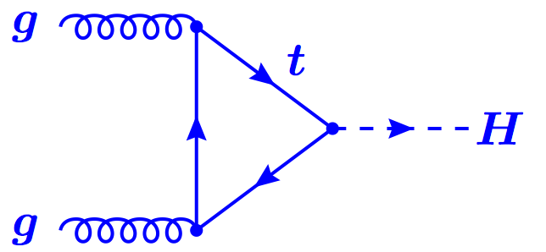
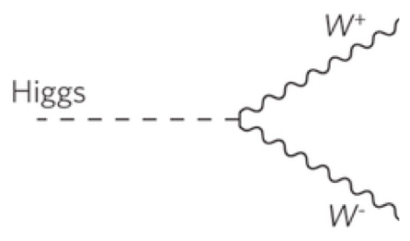
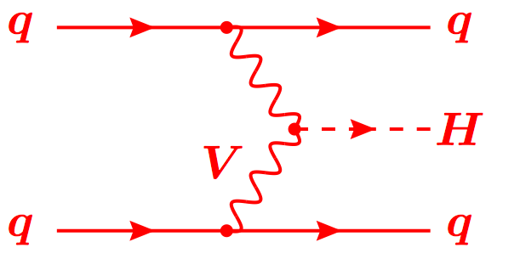
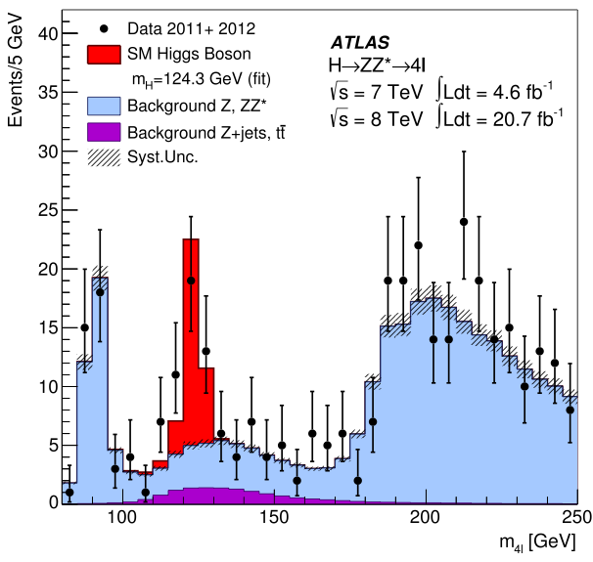
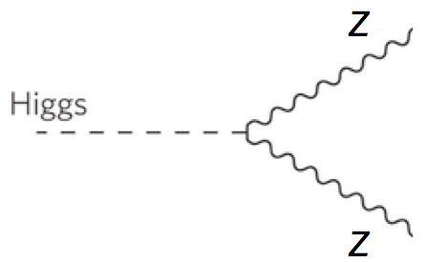
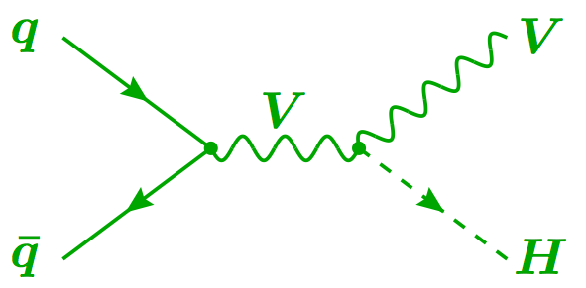
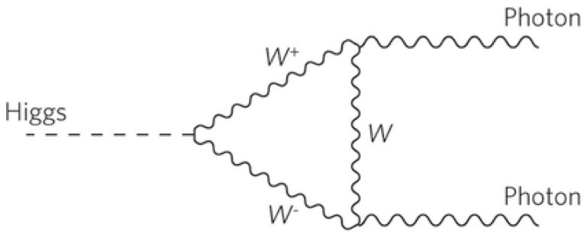
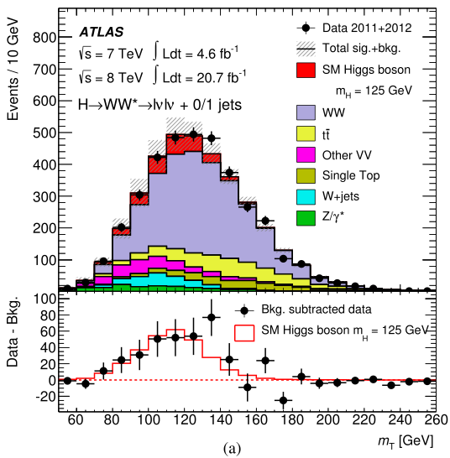
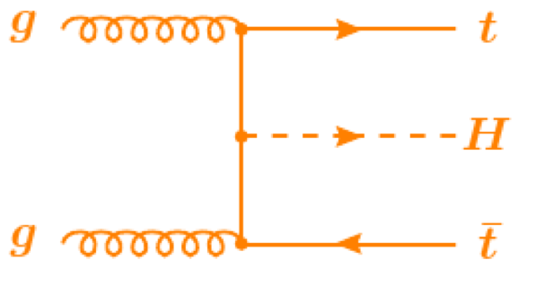
Combining Higgs Channels
Production
Decay
H->γγ
FIT
×
H->ZZ
H->WW
t
t
t
Backgrounds +

Slide 19
A bit more technically
Assumptions:
Single resonance (at m_{H} = 125.5GeV)
No modification of tensor structure of SM Lagrangian:
i.e. H has J^{P} = 0⁺
Narrow width approximation holds
i.e. rate for process i ➔ H ➔ f is:
Free parameters in framework:
Coupling scale factors: κ_{j}²
Total Higgs width: κ_{H}²
Or ratios of coupling scale factors: λ_{ij} = κ_{i} / κ_{j}
Tree-level motivated framework
Useful for studying deviations in data with respect to expectations
E.g. extract coupling scale factor to weak bosons κ_{V} by setting κ_{W} = κ_{Z} = κ_{V}
Not same thing as fitting a new model to the data

Slide 20
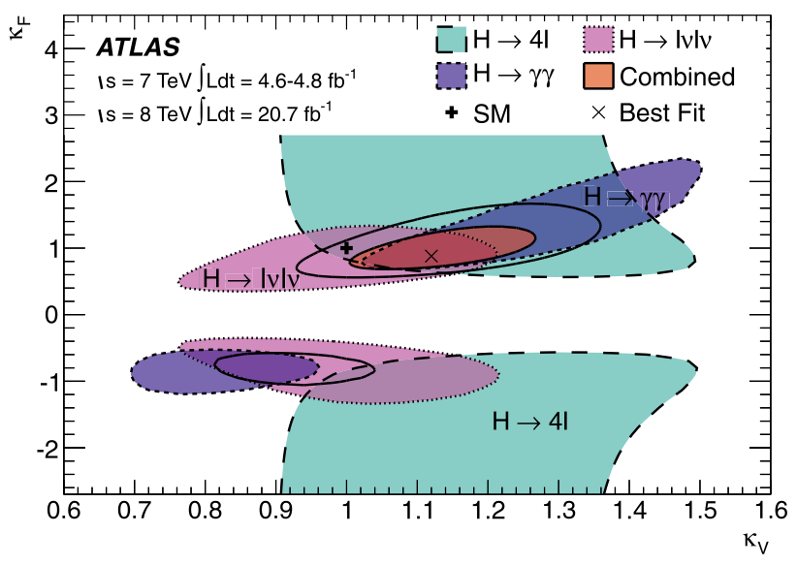
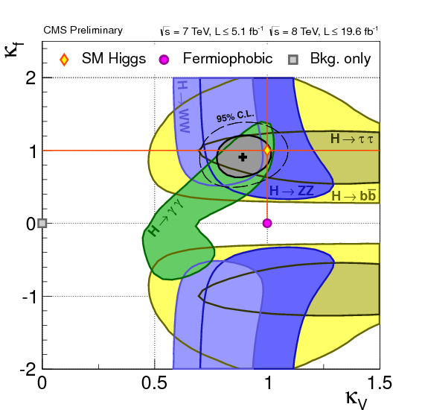
Fermion and Boson couplings from fit
Set one scale factor for all fermions (κ_{F} = κ_{t} = κ_{b}= κ_{τ} =…) and one for all vector bosons (κ_{V} = κ_{Z} = κ_{W})
Assume no new physics
Strongest constraint to κ_{F} comes form gg->H loop
ATLAS and CMS fits within 1-2σ of SM expectation (compatibility P=12%)
Note ATLAS and CMS κ_{V} different – see signal strength below
ATLAS 1307.1427
CMS public page

Slide 21
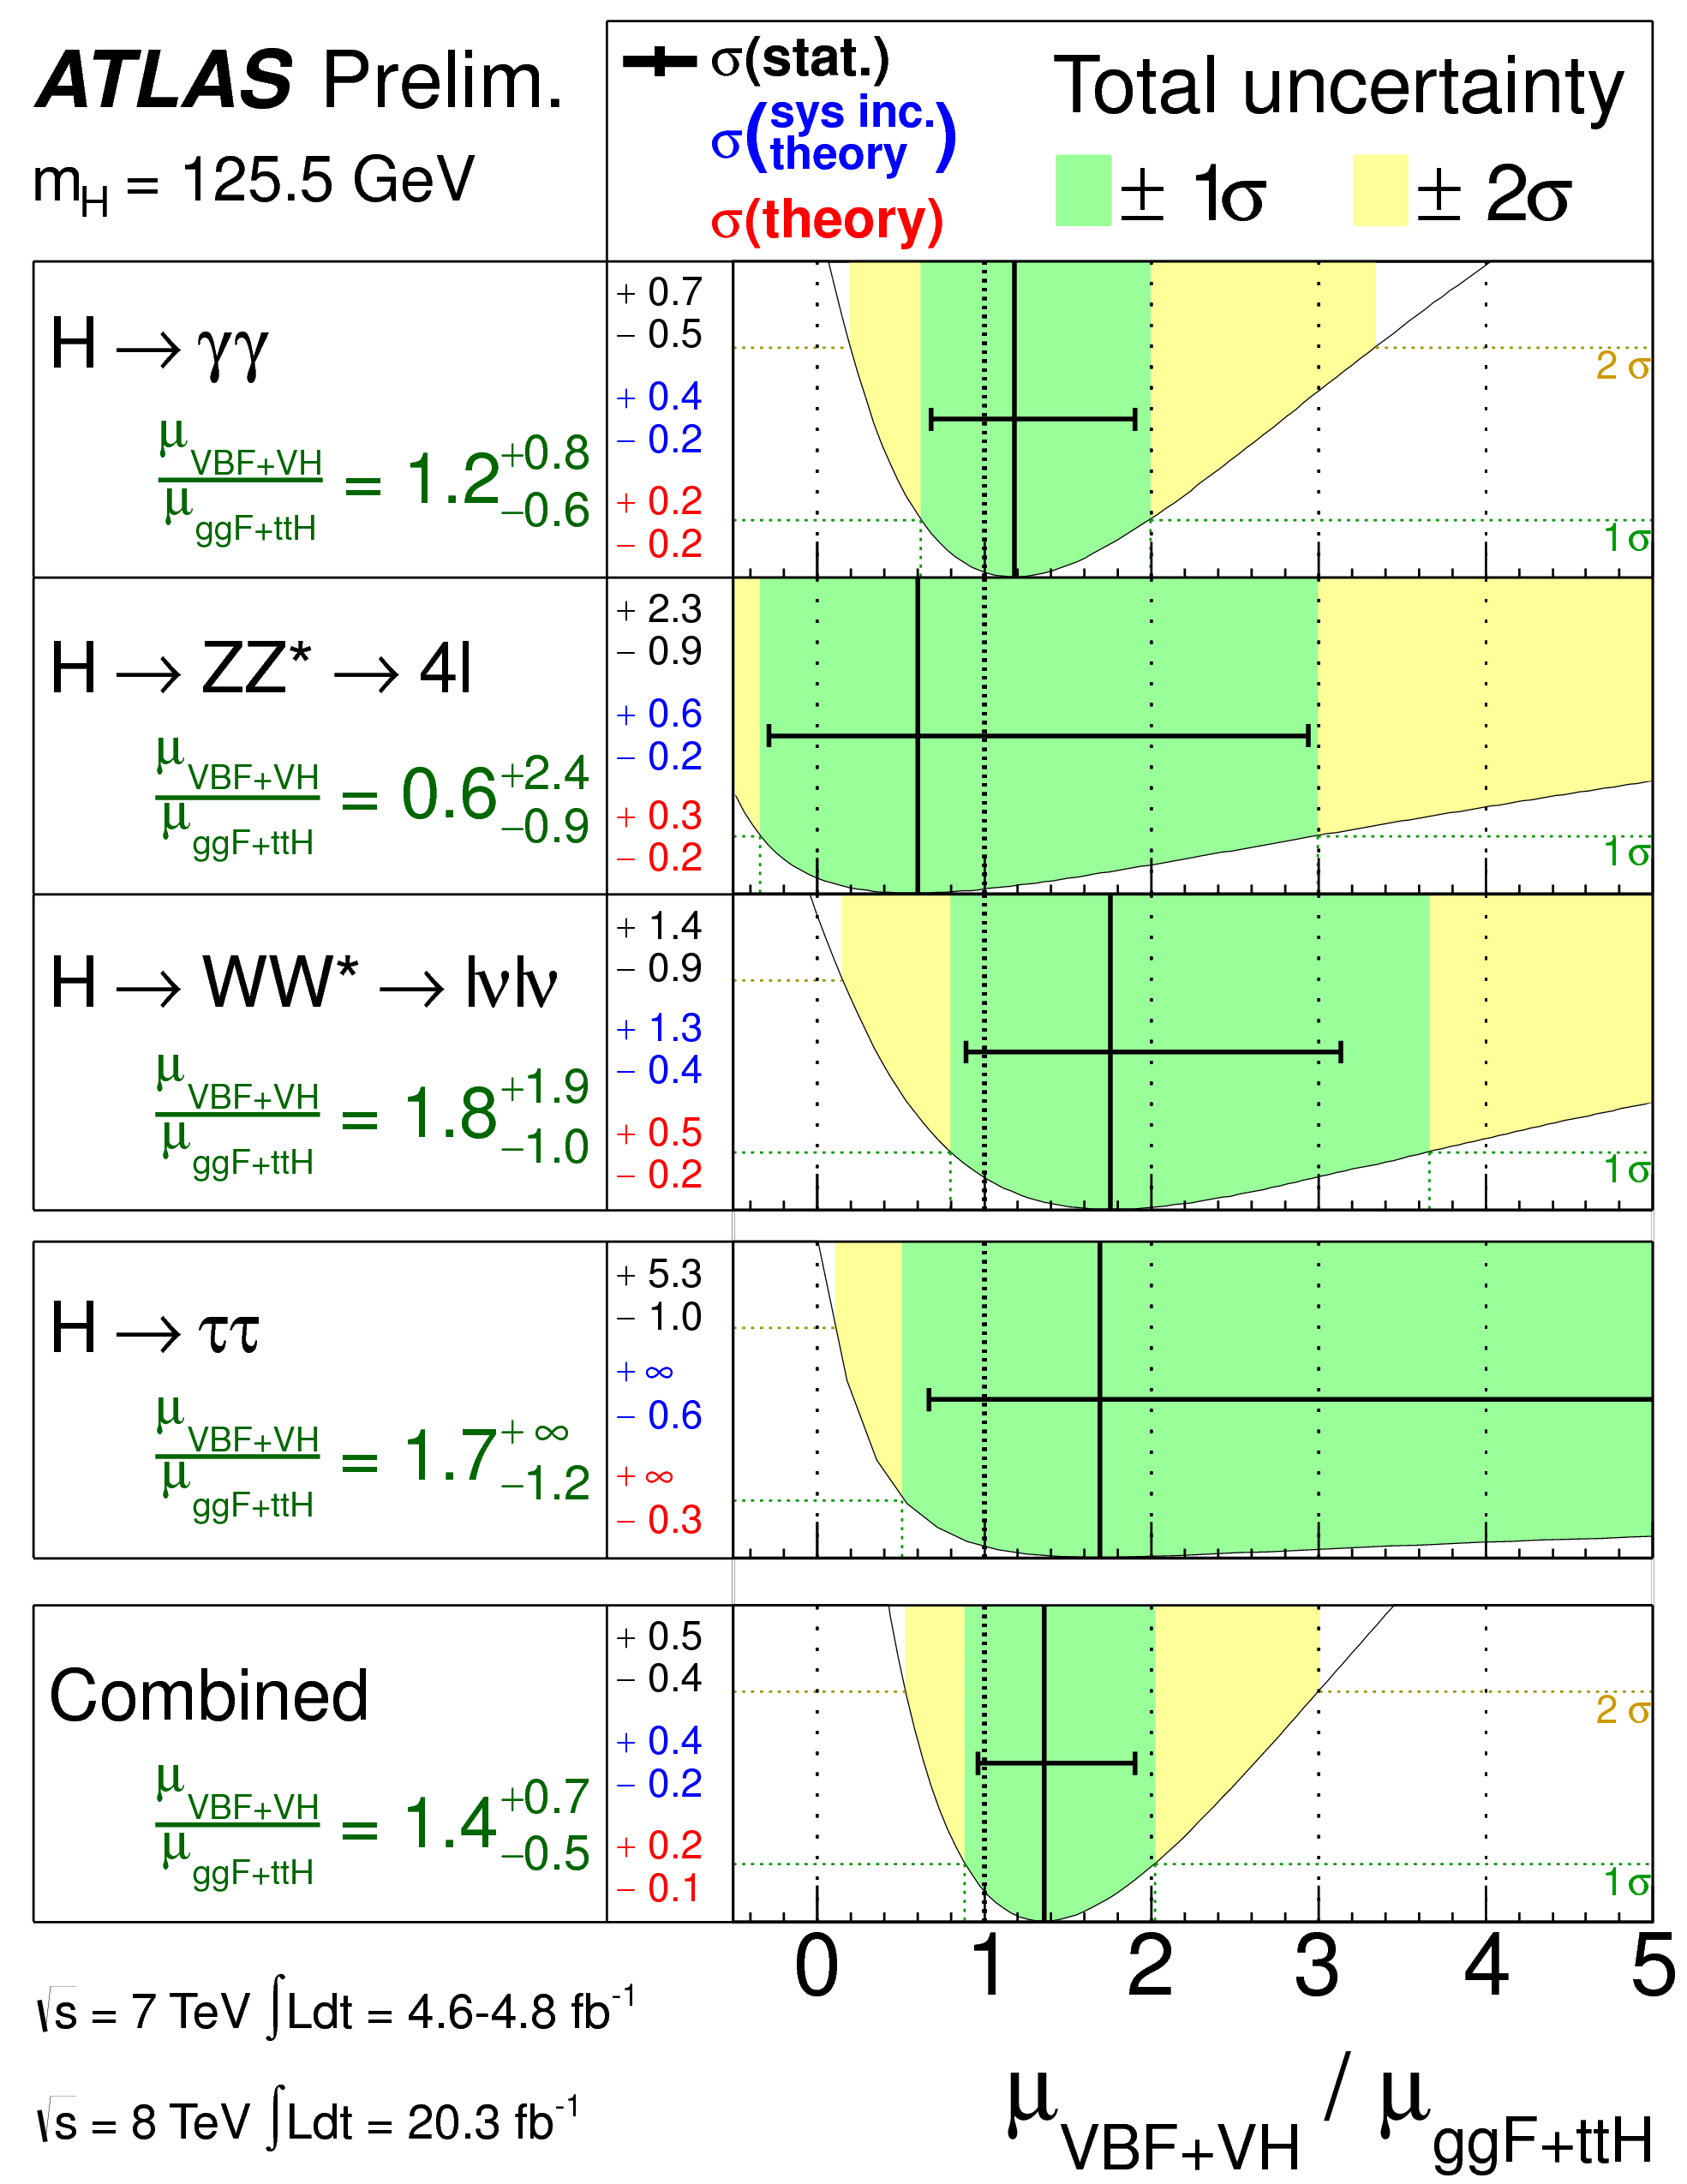
Production Modes
Combination of channels allows consistency checks
Evidence for VBF production (3σ)
Sensitivity to top Yukawa coupling only through loops so far

Slide 22
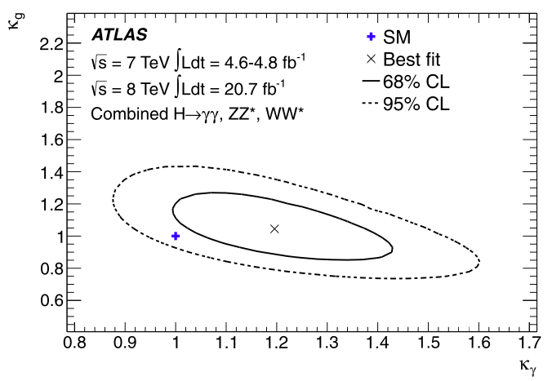
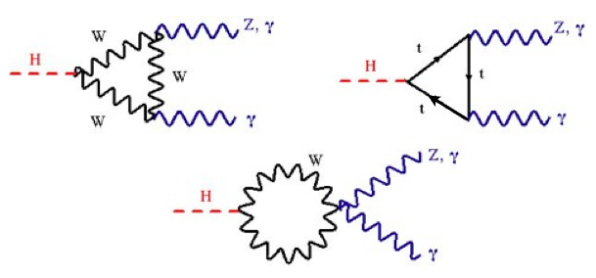
New Physics in the Loops?
W
New heavy particles may show up in loops
Dominant gluon-fusion through a (mostly) top loop production for H->ZZ, H->WW and H->γγ
H->γγ decay through top and W loops (and interference)
Assume no change in Higgs width and SM couplings to known particles
Introduce effective coupling scale factors:
κ_{g} and κ_{γ} for ggH and Hγγ loops
W
t
t
t
ATLAS 1307.1427
Best fit values: κ_{g} = 1.04 ± 0.14, κ_{γ} = 1.20 ± 0.15
Fit within 2σ of SM (compatibility P=14%)

Slide 23
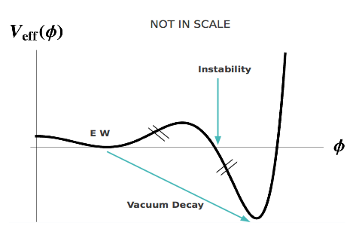
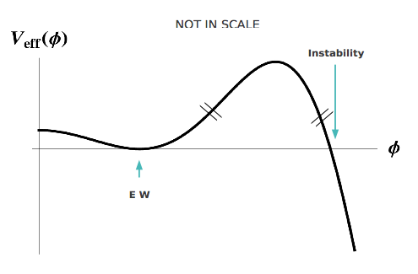
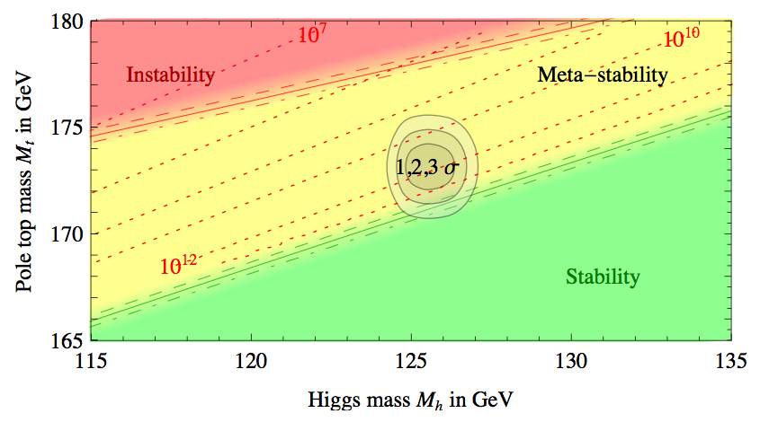
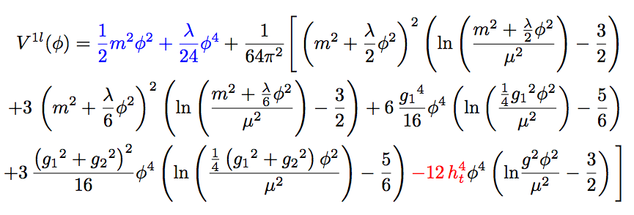
A bit of fun…
1-loop effective potential
RG-improved potential
What if…
At higher orders, Higgs potential doesn’t have to be stable
Depending on m_{t} and m_{H} second minimum can be lower than EW minimum ⇒ tunneling between EW vacuum and true vacuum?!
“For a narrow band of values of the top quark and Higgs boson masses, the Standard Model Higgs potential develops a shallow local minimum at energies of about 10¹⁶ GeV, where primordial inflation could have started in a cold metastable state”, I. Masina, arXiv:1403.5244 [astro-ph.CO]
See also: V. Brachina, Moriond 2014 (Phys.Rev.Lett.111, 241801 (2013)), G. Degrassi et al, arXiv:1205.6497v2

Slide 24
Peering through the crystal ball

Slide 25
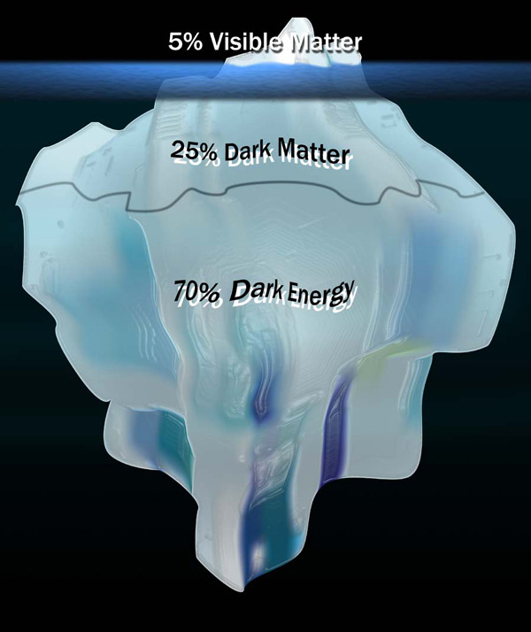
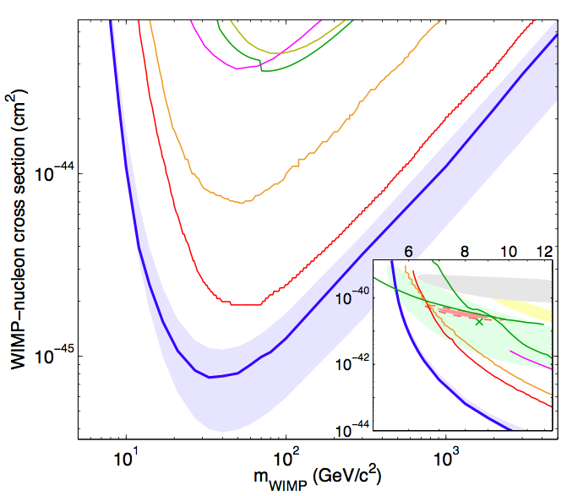
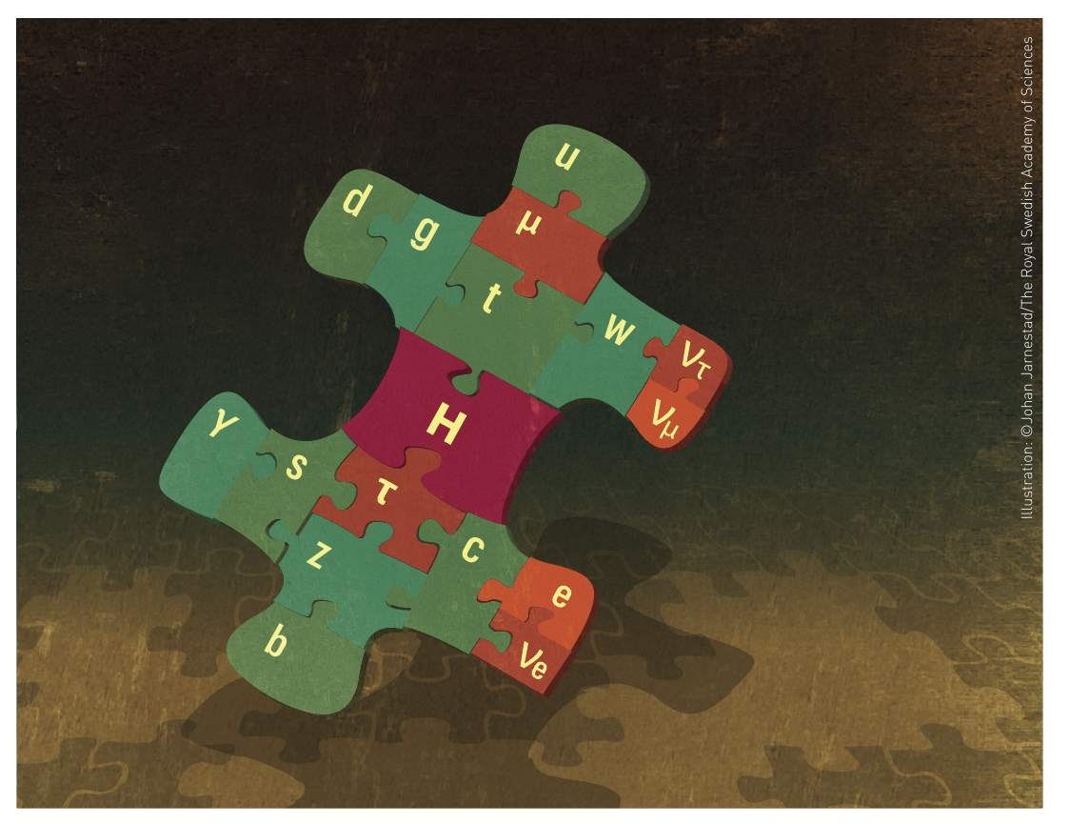
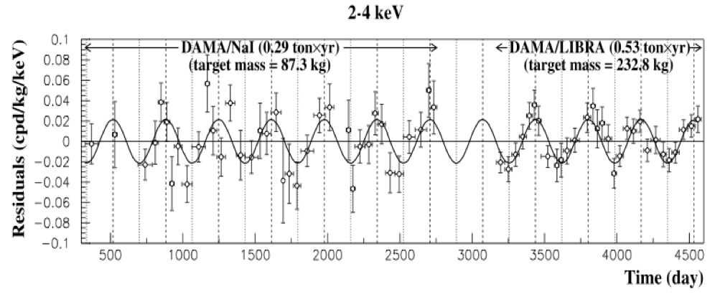
So, where do we stand?
LUX 1310.8214
We have found the missing piece of the Standard Model puzzle
The current data show us a SM-like Higgs boson
Each channel not so well measured
But combination fits well with expectations
Is this the end of the story?
DAMA 0804.2741
New Physics ➔ Modified Higgs sector(?)
Discovery ➔ Precision! (& a few more channels)

Slide 26
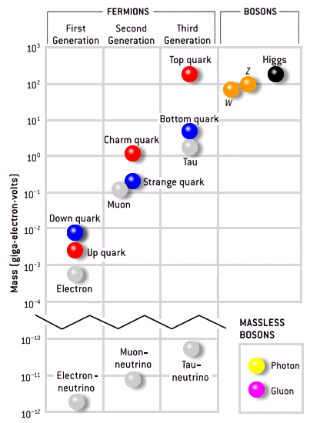
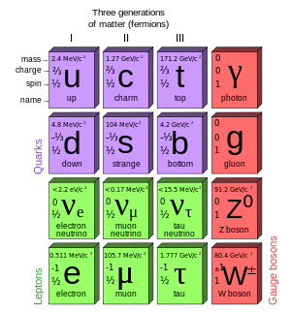
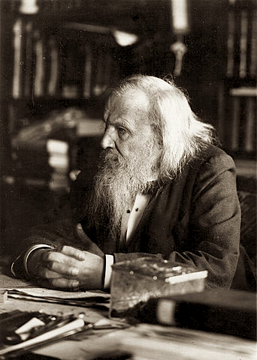
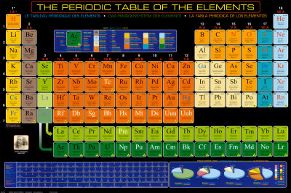
Many questions…
Higgs mechanism says how to give mass to fundamental particles
It doesn’t say why fermion masses and Yukawa couplings are so different:
10⁻¹⁰GeV (ν) – 10²GeV (t)
Top mass at the EW scale. Does it play a special role in breaking it?
(And by the way… why 3 families of leptons and quarks?)
What is the underlying theory?
Eh! Eh! Eh! Been there, done that!

Slide 27
Future LHC Running

Slide 28
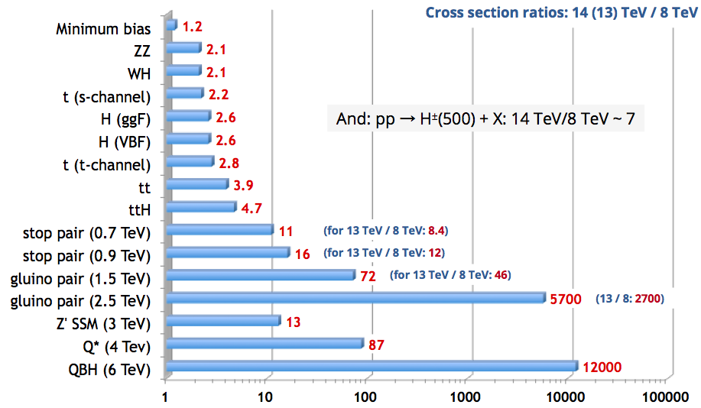
Not only more luminosity
Higher centre of mass energy gives access to higher masses
Hugely improves potential for discovery of heavy particles
Increases cross sections limited by phase space
E.g. ttH increases faster than background (factor 4)
But may make life harder for light states
E.g. only factor 2 increase for WH/ZH, H➞bb and more pileup
Could be compensated by use of boosted jet techniques (jet substructure)
http://www.hep.ph.ic.ac.uk/~wstirlin/plots/plots.html

Slide 29
Run II/High-Lumi LHC Programme
Precision AND searches!
Precision:
Continue to look for deviations wrt Standard Model
Differential cross sections:
New physics in loops could modify event kinematics
Complete measurement of properties:
E.g. CP quantum numbers:
Sensitivity in H➞ZZ and VBF
Search for CP violatin in Higgs sector
Search for rare decay modes:
H➞HH to access self coupling (long term!)
Search for additional Higgs bosons:
E.g. 2-Higgs Doublet Model is a natural extension and predicted in SUSY

Slide 30
Direct BSM Higgs Searches (ATLAS)
FCNC in t→cH, H→γγ - upper limit on BR: Obs.(Exp.): 0.83%(0.53%) x SM for 125 GeV at 95% CL [ATLAS-CONF-2013-081]
H→ZZ→llνν: Excl. 320 - 560 GeV [ATLAS-CONF-2012-016]
H→ZZ→llqq: Excl. 300 - 310, 360 - 400 GeV. at 145 GeV 3.5 x SM [ATLAS-CONF-2012-017]
H→WW→lνjj: at 400 GeV Obs.(Exp.) 2.3(1.6) x SM [ATLAS-CONF-2012-018]
Higgs in SM with 4th fermion generation: model ruled out [ATLAS-CONF-2011-135]
Fermiophobic H to diphoton Model ruled out [ATLAS-CONF-2012-013]
MSSM neutral H [JHEP: JHEP02(2013)095]
NMSSM a1 to μμ [ATLAS-CONF-2011-020]
NMSSM H to a0a0 to 4γ [ATLAS-CONF-2012-079]
H±→ cs [EPJC73 (2013) 2465]
2HDM WW(lvlv) [ATLAS-CONF-2013-027]
'It is an old maxim of mine that when you have excluded the impossible, whatever remains, however improbable, must be the truth.'
Sherlock Holmes
-The Beryl Coronet

Slide 31
An example: ttH
Indirect constraints on top-Higgs Yukawa coupling from loops in ggH and ttH vertices
Assumes no new particles contribute to loops
Top-Higgs Yukawa coupling can be measured directly
Allows probing for New Physics contributions in the ggH and γγH vertices
Top Yukawa coupling Y_{t} = √2M_{t}/vev = 0.996±0.005
Does this mean top plays a special role in EWSB?

Slide 32
Sensitivity to New Physics
Degrande et al. arXiv:1205.1065
Effective top-Higgs Yukawa coupling may deviate from SM due to new higher-dimension operators
Change event kinematics – go differential!
ttH sensitive new physics: little Higgs, composite Higgs, Extra Dimensions,…
In the presence of CP violation, Higgs-top coupling have scalar (κ_{t})and pseudoscalar (˜κ_{t})components
Strong dependence on ttH cross section
Note: Indirect constraints from electron electric dipole moment not taken into account (give |˜κ_{t}| < 0.01)
Ellis et al. arXiv:1312.5736

Slide 33
Future experimental programme
High-Luminosity LHC plus Linear Collider are “dream team” for Higgs properties!
LHC (√s=14TeV and L=3000fb⁻¹) systematics limited
Total width only at Linear Collider (√s=250GeV, L=250fb⁻¹: ≈10% accuracy)
2nd generation couplings (Δ_{c}, Δ_{μ}) challenging at LHC but possible at LC
Δ_{top} opens up for LC500 (√s=500GeV, L=500fb⁻¹): ≈3-7% from HL-LHC + LC500
Precision of HL-LHC + LC limited by LC statistical uncertainty, not systematics!
NOTE: Not yet clear what machine will follow the LHC… but Higgs physics is a big part of it’s physics motivation!
Klute et al, arXiv: 1301.1322

Slide 34
Summary
Recapitulation:
Electroweak symmetry breaking
Higgs boson in Electroweak Lagrangian
Practical implications
Higgs boson production and decay at the LHC
The landscape at the end of LHC run I
Higgs properties: mass, spin, couplings
Review of statistical combination of Higgs channels
The power of combining different channels – examples
Implications of Higgs measurements beyond Higgs sector
Future Higgs measurements at LHC and beyond
Fundamental questions at the end of run I
Future LHC running – luminosity, energy, and physics reach
Higgs physics in future LHC analyses – Precision and Searches
An example: associated production with top-quark pair – SM and BSM
Precision of Higgs properties at future colliders

