Slide 1
CP violation results in the ATLAS experiment
R. Gonçalo (U.Coimbra / LIP) on behalf of the ATLAS Collaboration
Higgs Hunting, Orsay-Paris, Sep.12-14 2022

Slide 2
CP Violation in the Higgs Sector?
Sakharov conditions for a matter-dominated universe require CP violation⁽¹⁾
Some CP-violating processes are well known and measured:
Described with complex phases in CKM-matrix - quark mixing
Maybe in PNMS-matrix as well - neutrino mixing
But insufficient, by orders of magnitude, to explain baryon asymmetry⁽¹⁾
CP violation in Higgs sector?
Possible in some models with extended Higgs sector (e.g. some 2HDMs)
Mixing of scalar (CP-even) and pseudo-scalar (CP-odd) Higgs states would make CP violation an enticing possibility
What do we know about Higgs CP properties?
In the SM, Higgs scalar is a CP eigenstate with J^{CP} = 0⁺⁺
Pure J^{P} = 0⁻ hypothesis for observed Higgs boson was ruled out in Run 1⁽²⁾
But hypothesis of a CP-odd admixture is far from being constrained experimentally!
⁽¹⁾ See e.g. Mod.Phys.Lett.A 9 (1994) 795-810
⁽²⁾ See e.g. Eur.Phys.J C75 (2015) 476

Slide 3
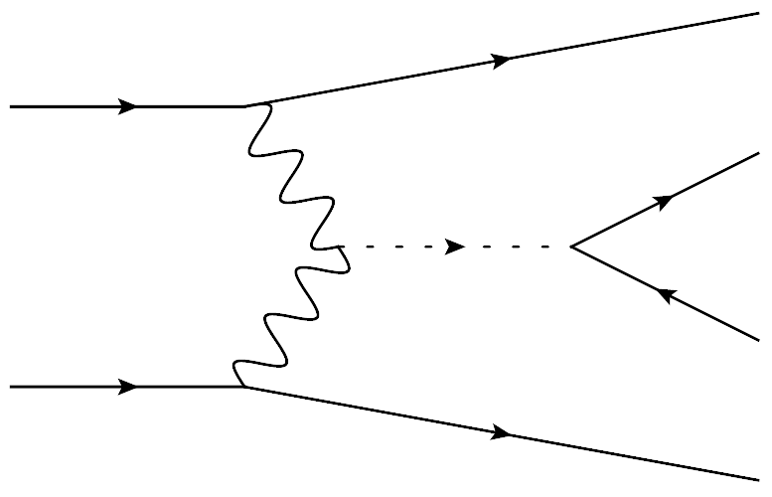
How to search for a CP-odd admixture?
Effect of CP-odd components on bosonic couplings parametrized as expansion with higher order terms suppressed by powers of scale of new physics Λ
Could explain why a CP-odd admixture has not been seen
Fermionic couplings are affected at tree level
Mixing angle α between CP-even and CP-odd coupling components
More notable for heavier fermions due to enhanced coupling
Notes:
2nd term is interference between CP-even and CP-odd – is zero for CP-even effective operators
3rd term is CP-even but affects rates – cannot be distinguished from other BSM rate enhancements
MadGraph: , arXiv:1405.0301 [hep-ph]

Slide 4
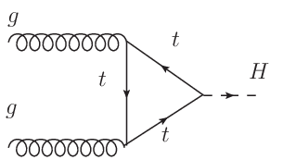
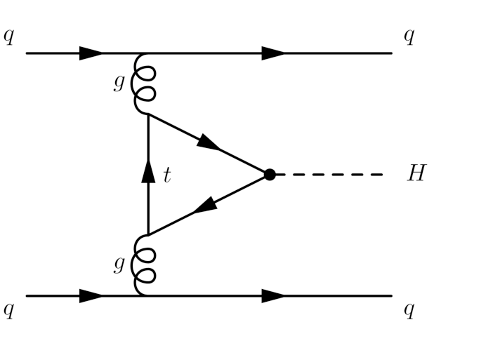
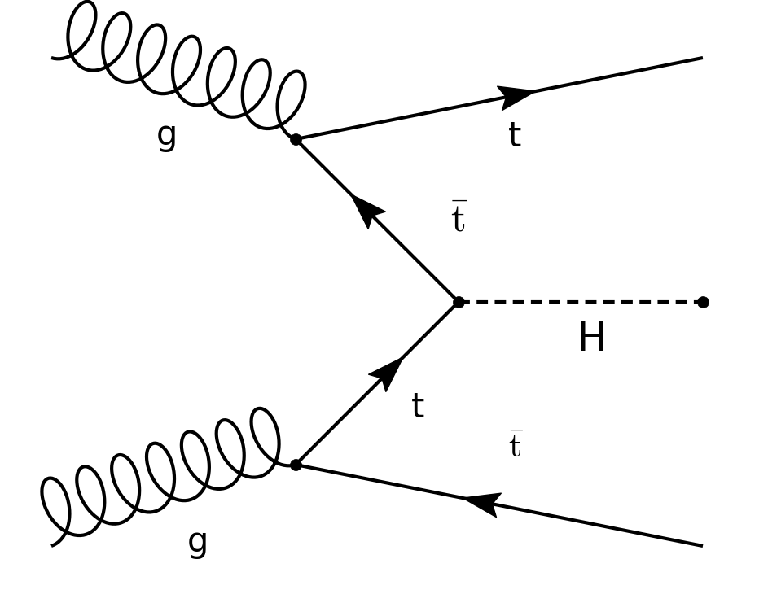
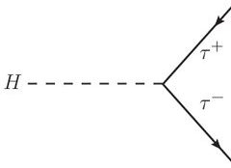
Fermionic Higgs Couplings

Slide 5
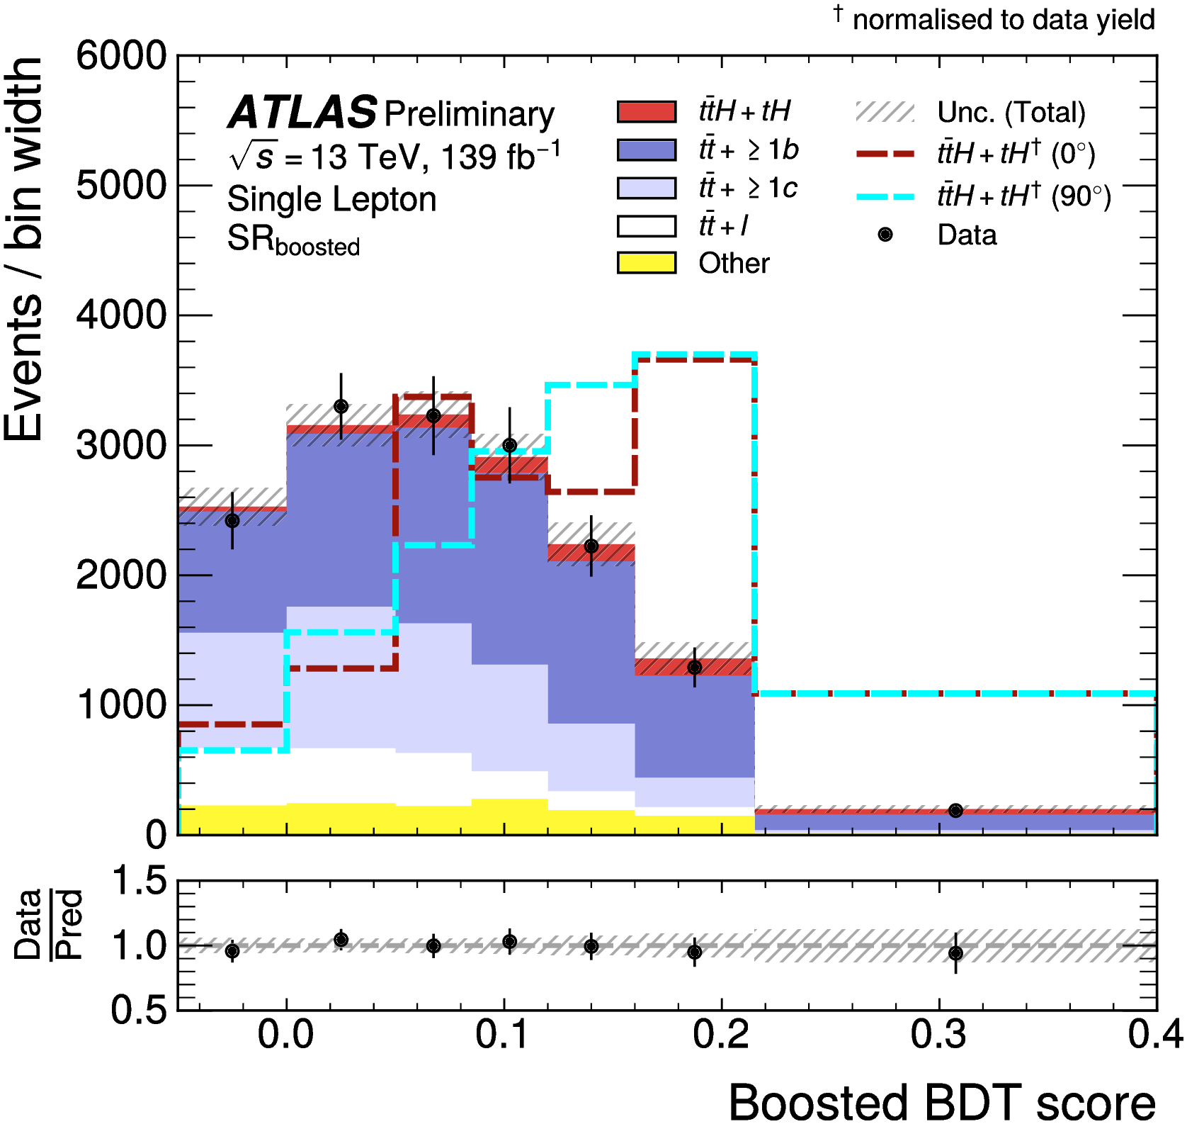
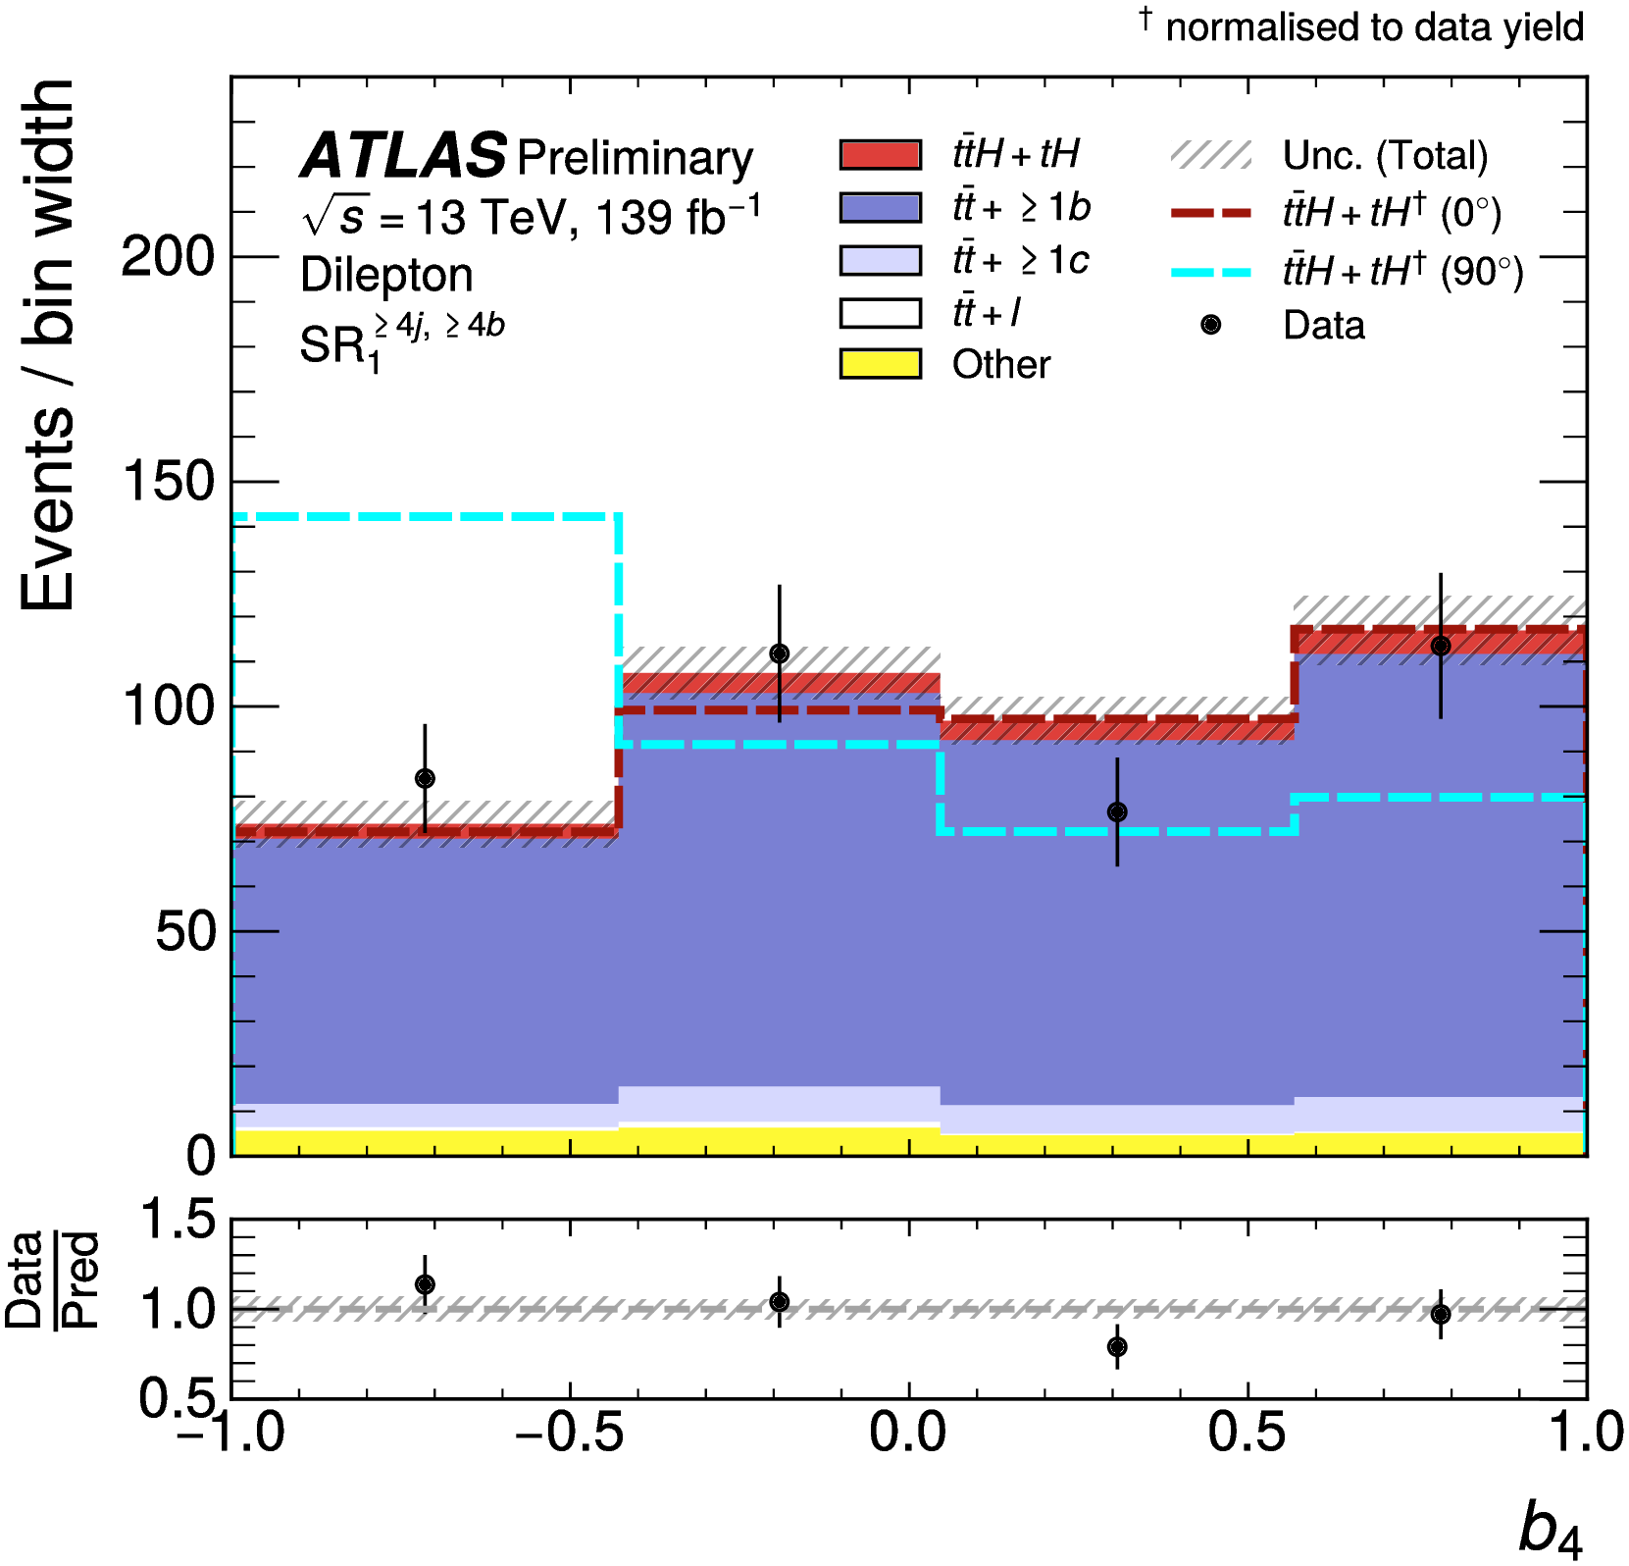
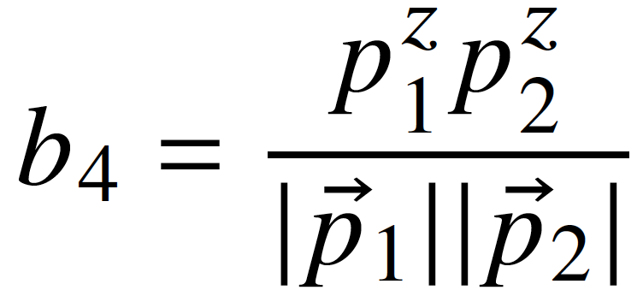
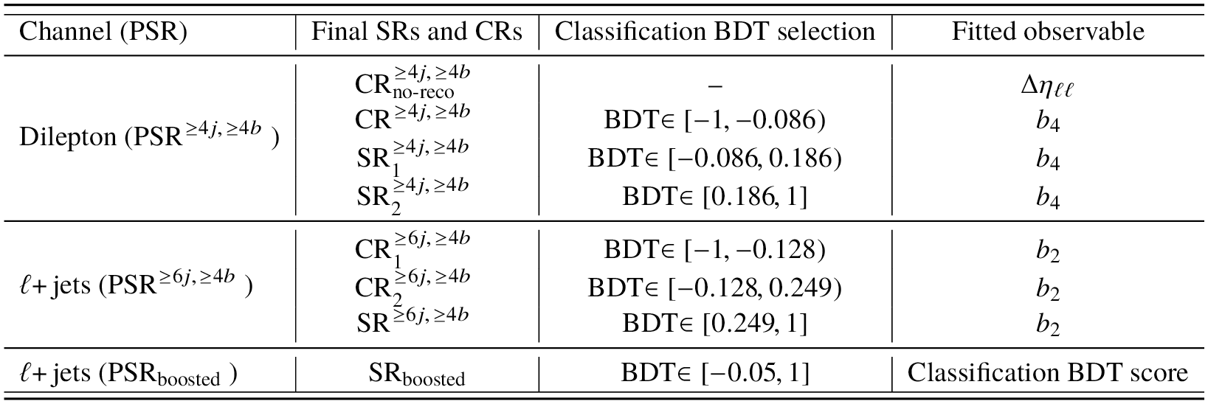
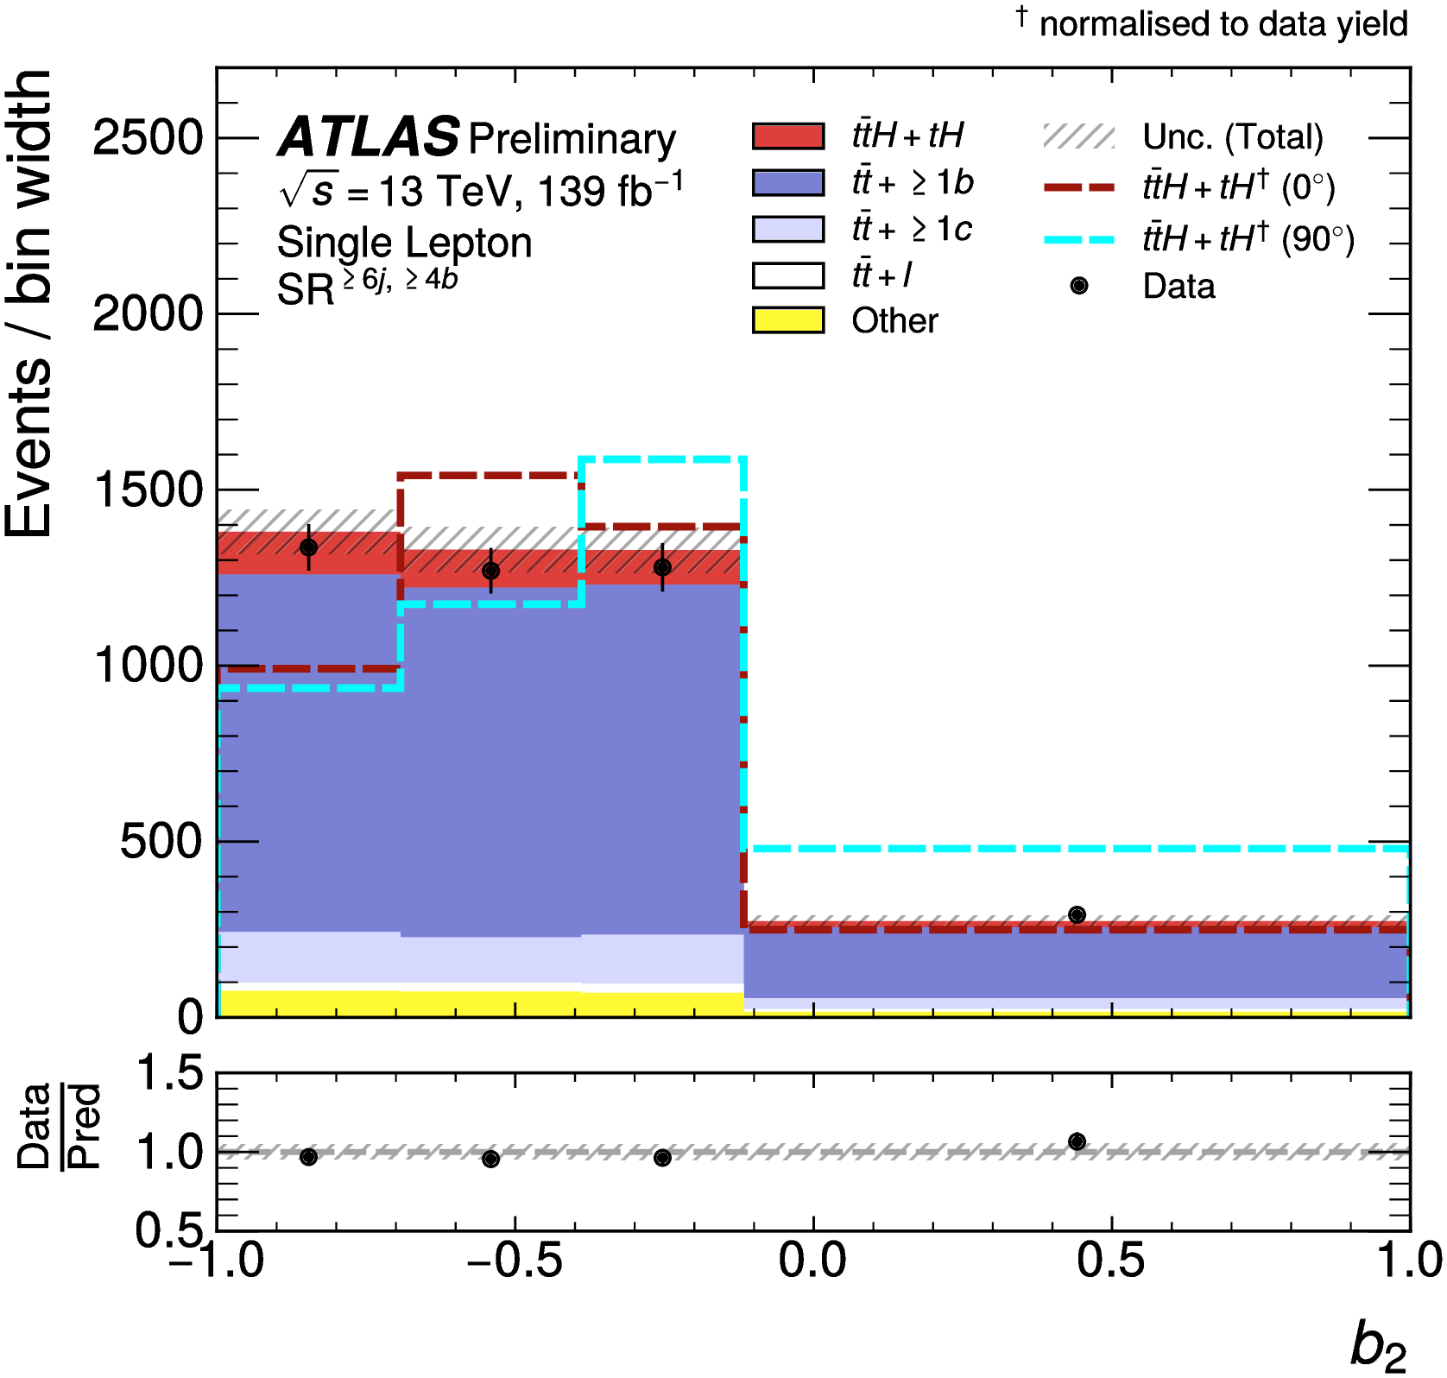
H-top Coupling in ttH/tH production
ATLAS-CONF-2022-016 (16 March 2022)
See talk by Neelam in YSF yesterday
Calculate CP-sensitive observables b₂ and b₄ from top-quark 3-momenta
Use different observables in combined fit depending on region
Notes:
Reco BDT trained with ttH signal
Lep: target 1 or 2 semi-leptonic top decays
2 leptons: no top reconstruction
1 lepton: build W candidate (lep+E_{T}^{miss})and then top candidate from W + BDT-favoured jet
Had: target hadronic top decays
reconstruct 1 or 2 tops from jets
CP BDT:

Slide 6
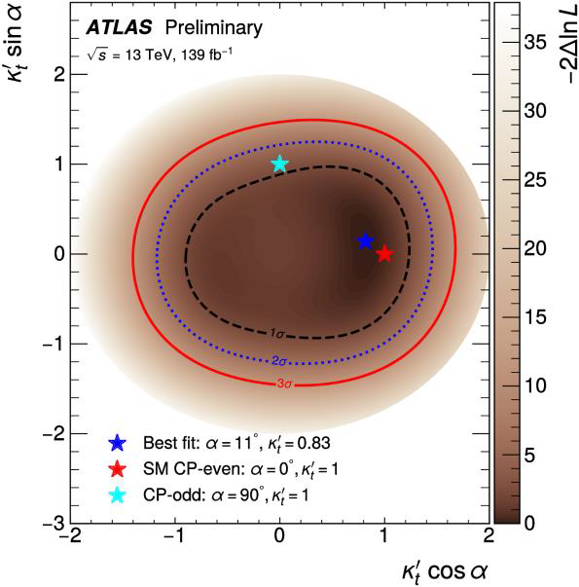
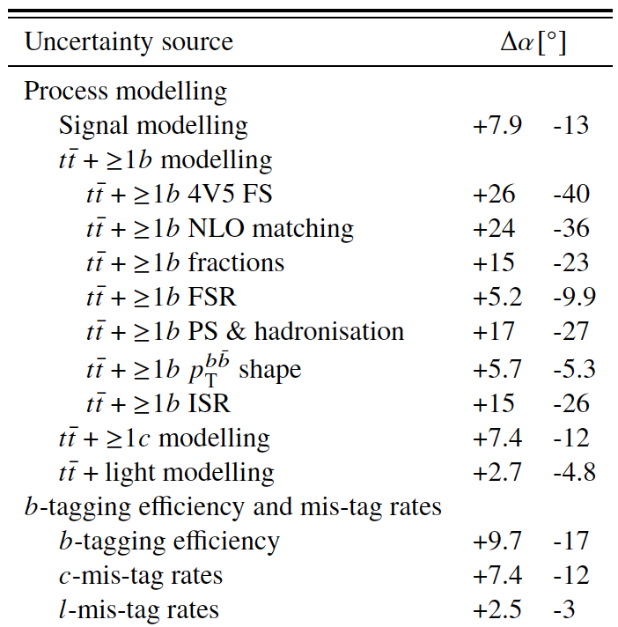
H-top Coupling in ttH/tH production
ATLAS-CONF-2022-016 (16 March 2022)
Simultaneous fit in all regions
μ = 0.83^{+0.30}_{-0.46}
α = 11° ⁺⁵⁵₋₇₇
Expected:
μ = 1.0^{+0.25}_{-0.27}
α = 0° ⁺⁴⁹₋₅₀
Pure CP-odd (α = 90°) disfavoured at 1.2 σ
Systematics-dominated analysis:
Dominant uncertainties from tt+≥1b modelling: NLO matching, PS and hadronisation, flavour scheme
α
Notes:
Reco BDT trained with ttH signal
Lep: target 1 or 2 semi-leptonic top decays
2 leptons: no top reconstruction
1 lepton: build W candidate (lep+E_{T}^{miss})and then top candidate from W + BDT-favoured jet
Had: target hadronic top decays
reconstruct 1 or 2 tops from jets
CP BDT:

Slide 7
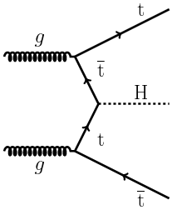
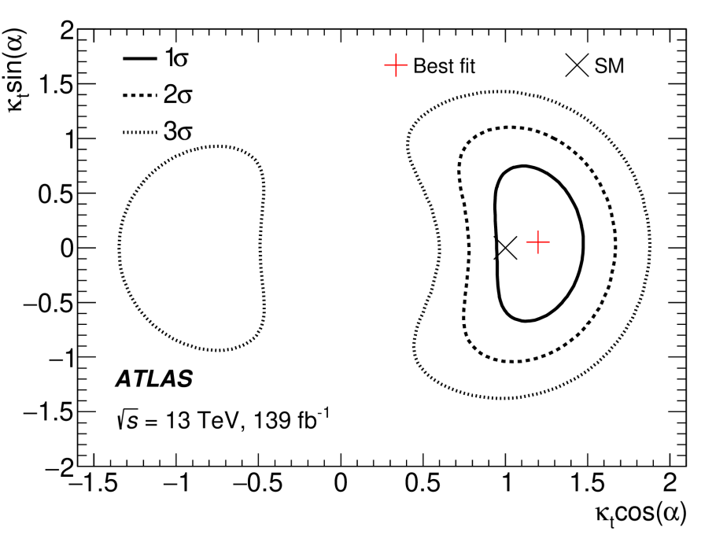
H-top Coupling in ttH/tH production
ATLAS-CONF-2022-016 vs Phys. Rev. Lett. 125 (2020) 061802
New analysis: ttH (H→bb):
μ = 0.83^{+0.30}_{-0.46} (exp. μ = 1.0^{+0.25}_{-0.27})
α = 11° ⁺⁵⁵₋₇₇ (exp. α = 0° ⁺⁴⁹₋₅₀)
Pure CP-odd (α = 90°) disfavoured at 1.2 σ
Complementary to previous ttH(H→γγ) analysis:
Phys. Rev. Lett. 125 (2020) 061802
Pure CP-odd (α = 90°) excluded at 3.9 σ
Limit on |α| < 43° at 95% C.L.
Notes:
Stats dominated
Reco BDT trained with ttH signal
Lep: target 1 or 2 semi-leptonic top decays
2 leptons: no top reconstruction
1 lepton: build W candidate (lep+E_{T}^{miss})and then top candidate from W + BDT-favoured jet
Had: target hadronic top decays
reconstruct 1 or 2 tops from jets
CP BDT:

Slide 8
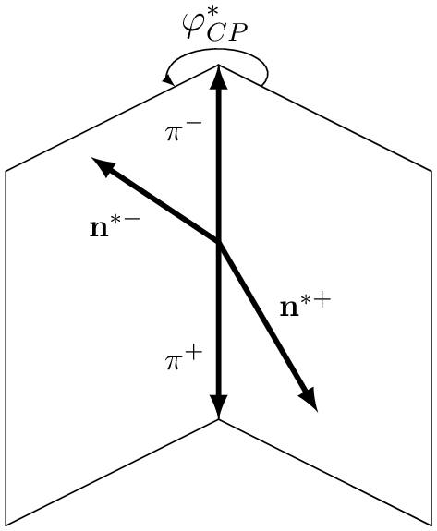
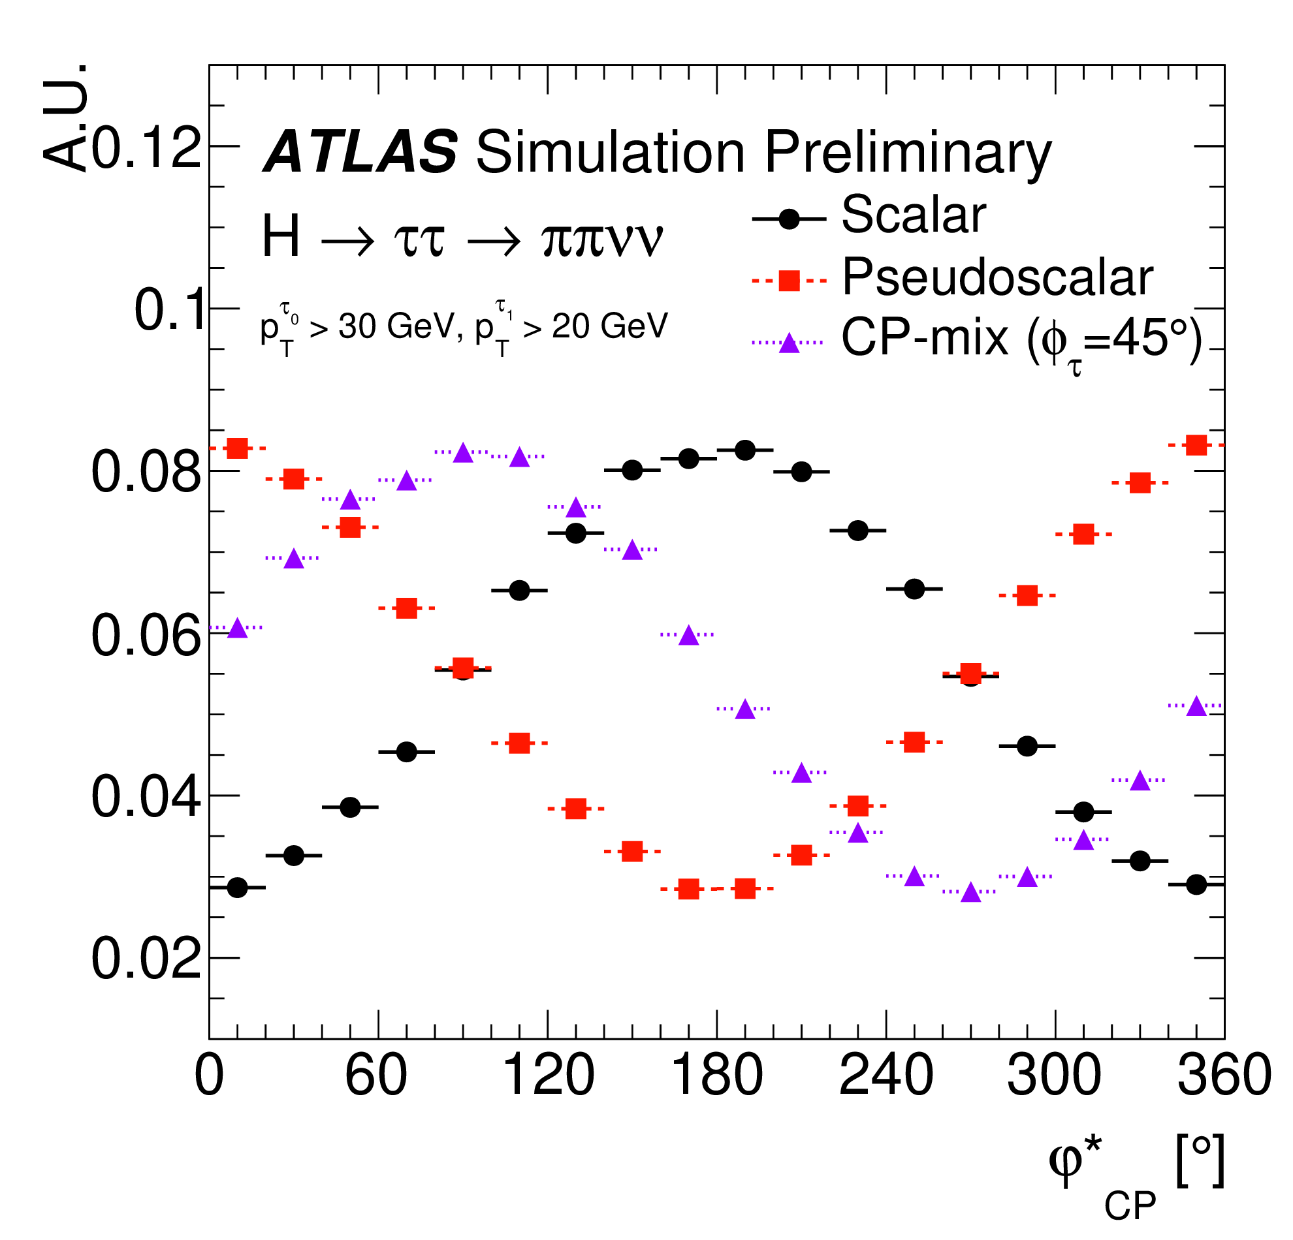
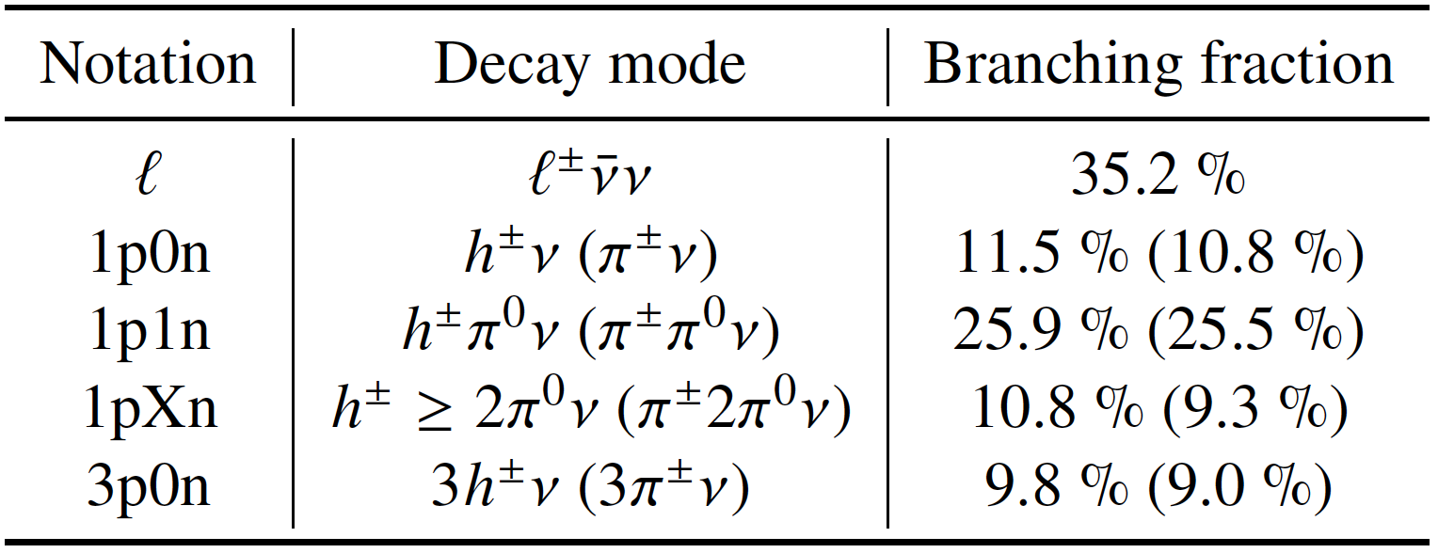
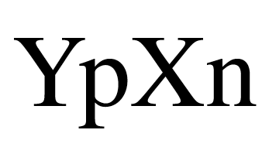
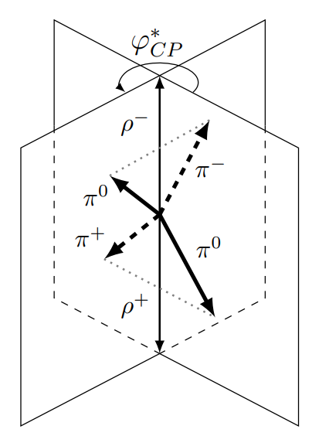
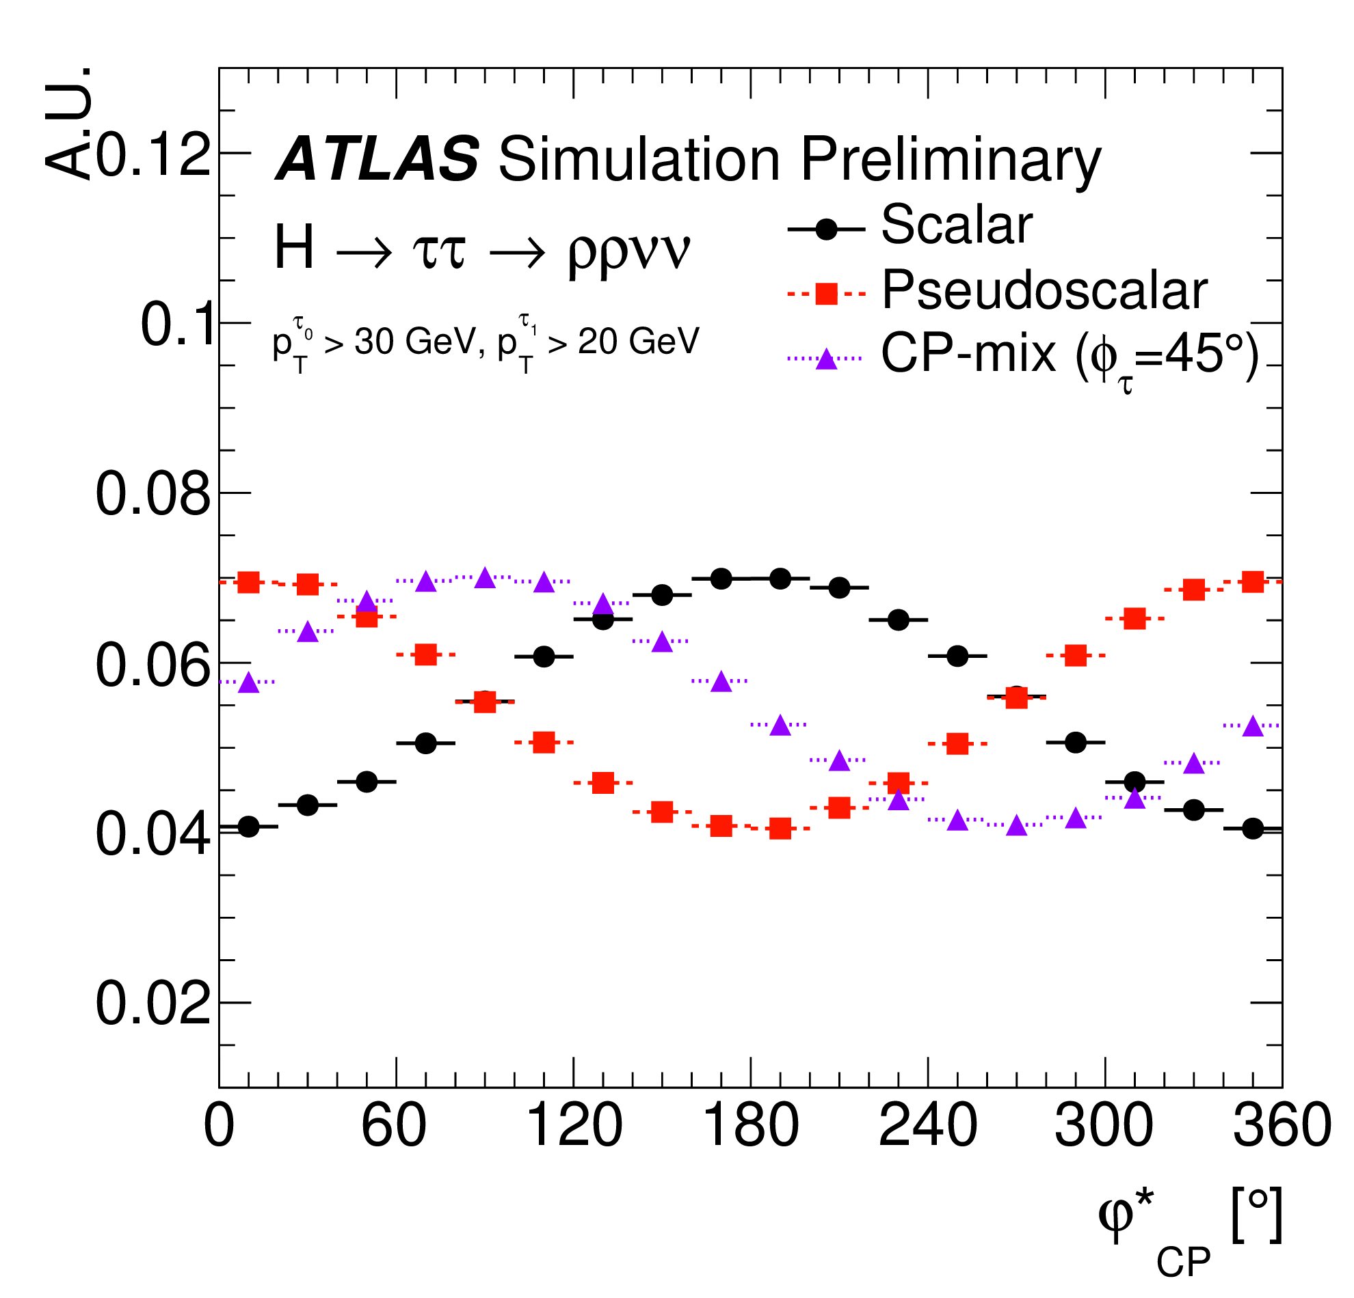
H-τ Coupling in inclusive production
ATLAS-CONF-2022-032 (18 May 2022)
Y charged pions; X neutral pions
Angle between τ decay planes in H rest frame sensitive to CP mixing angle φ_{τ}
Due to neutrinos, use ϕ^{*CP} angle as proxy:
Acoplanarity angle between τ decay planes in Zero Momentum Frame of visible decay products
ϕ^{*CP} reconstructed with dedicated methods for semi-exclusive decay modes
Total branching ratio in targeted decay modes: 68%
Notes:
Impact parameter: n

Slide 9
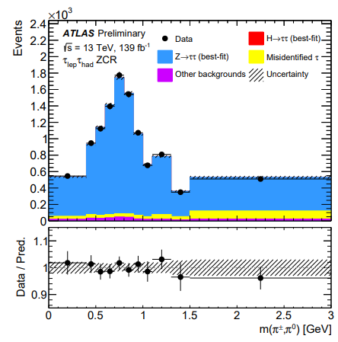
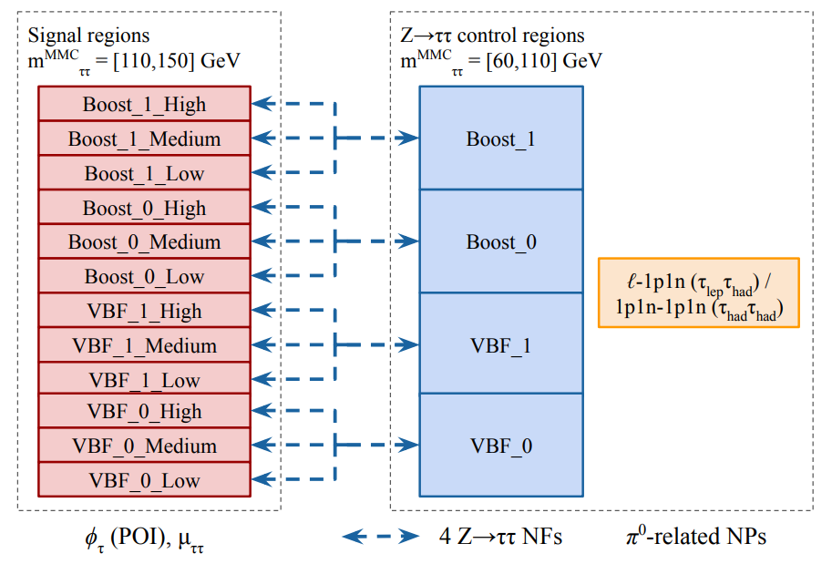
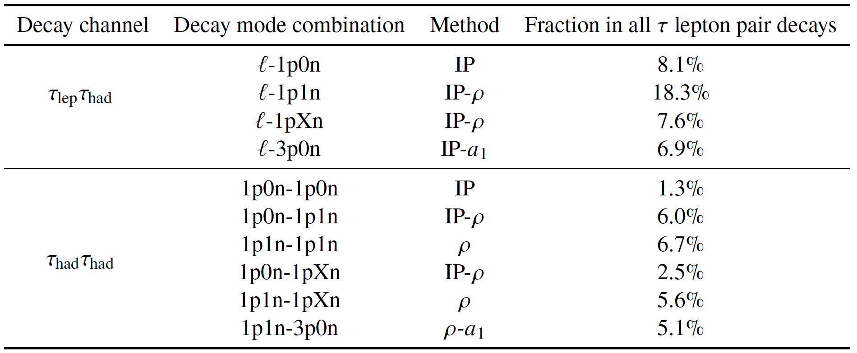
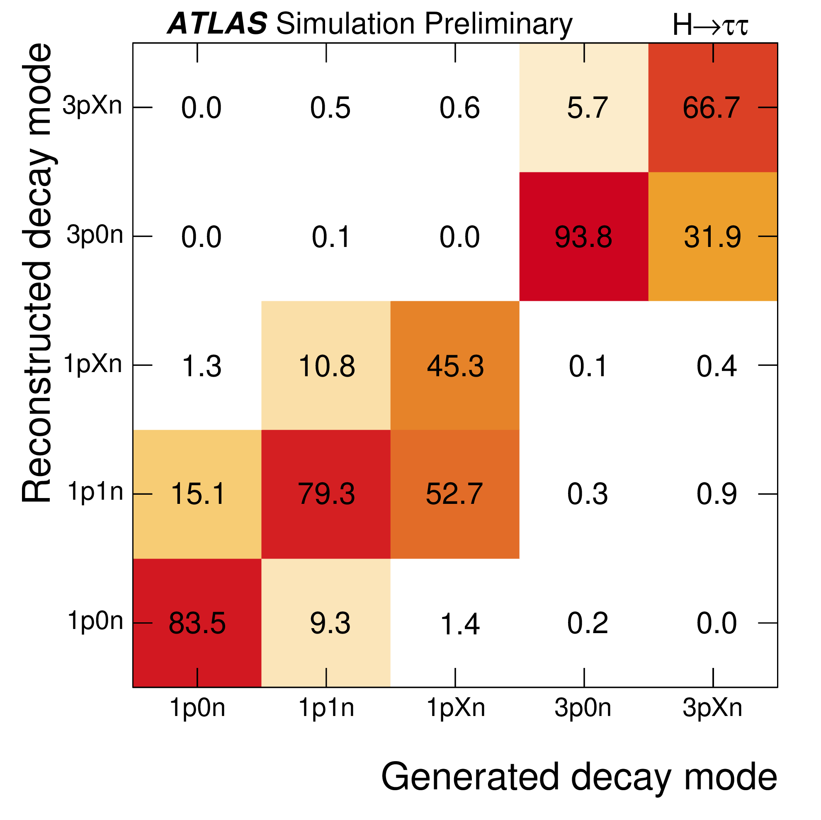
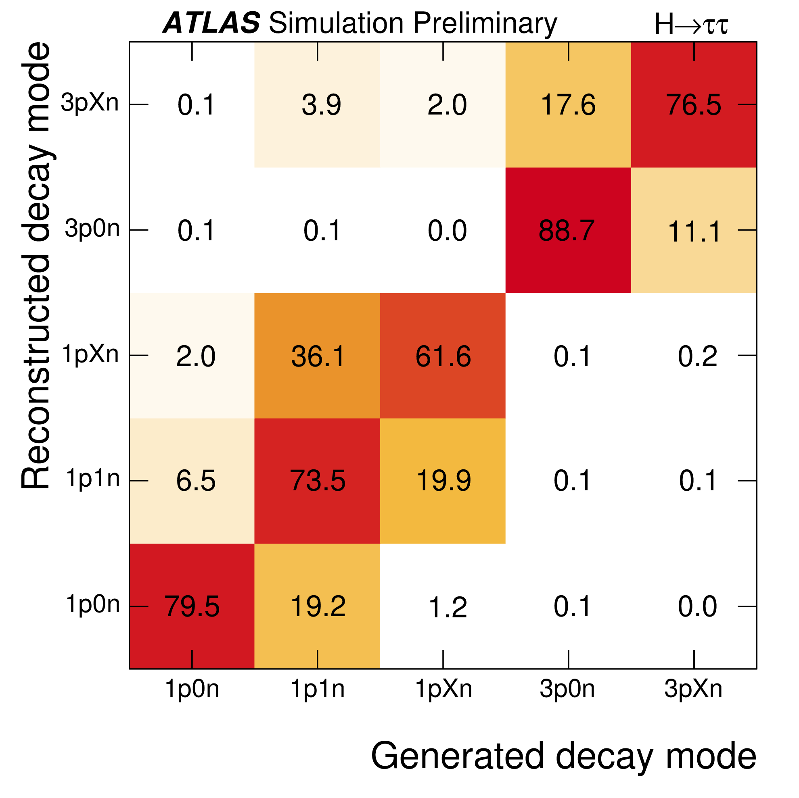
H-τ Coupling in inclusive production
ATLAS-CONF-2022-032 (18 May 2022)
_1: higher purity
_0: lower purity
ggF
VBF
Efficiency
Purity
Y charged pions; X neutral pions
24 Signal categories and 10 Control Regions
2 channels × VBF or Boost (ggF p_{T}^{H} > 100 GeV) × 2 purity regions × High/Medium/Low sensitivity
Angle reconstruction requires excellent performance:
Particle flow based τ_{had} reconstruction
π⁰→γγ and vertex / impact parameter reconstrucion
Both efficiency and purity around 80% for dominant decays
Notes:
Reco BDT trained with ttH signal
Lep: target 1 or 2 semi-leptonic top decays
2 leptons: no top reconstruction
1 lepton: build W candidate (lep+E_{T}^{miss})and then top candidate from W + BDT-favoured jet
Had: target hadronic top decays
reconstruct 1 or 2 tops from jets
CP BDT:

Slide 10
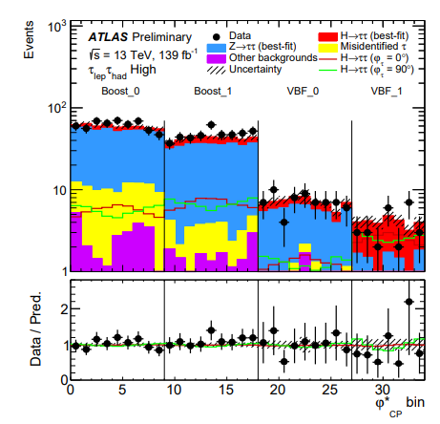
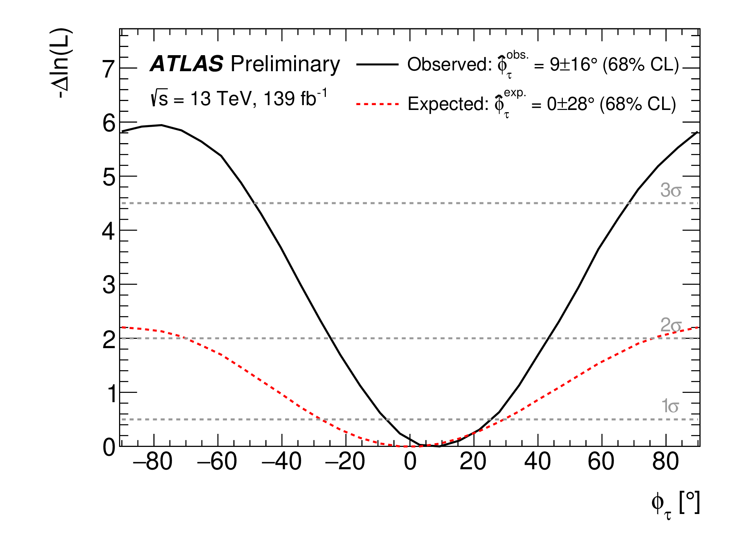
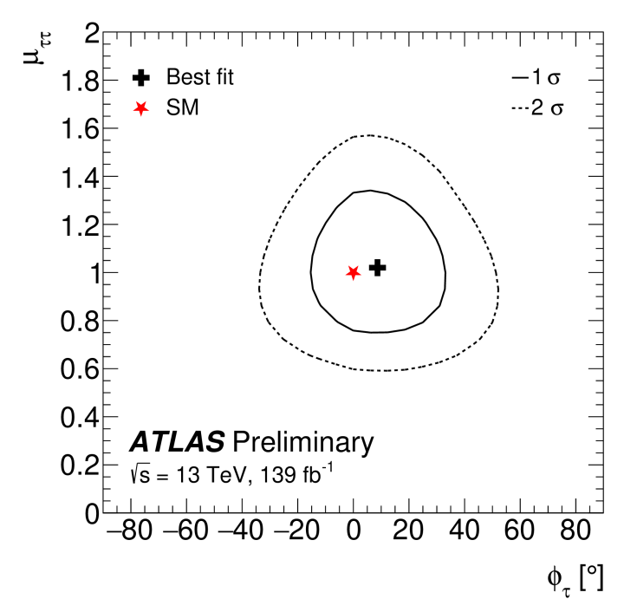
H-τ Coupling in inclusive production
ATLAS-CONF-2022-032 (18 May 2022)
Simultaneous fit in all regions
Analysis leaves μ free to float – agnostic with respect to rate effects
Best fit observed: φ_{τ} = 9° ± 16° (expected: φ_{τ} = 0° ± 28°)
Pure CP-odd (α = 90°) disfavoured at 3.4 σ
Dominant background is Z→ττ: constrained from Control Regions
Statistics-dominated analysis; dominant systematic uncertainty from jet calibration
CP-odd
CP-even
Notes:
Reco BDT trained with ttH signal
Lep: target 1 or 2 semi-leptonic top decays
2 leptons: no top reconstruction
1 lepton: build W candidate (lep+E_{T}^{miss})and then top candidate from W + BDT-favoured jet
Had: target hadronic top decays
reconstruct 1 or 2 tops from jets
CP BDT:

Slide 11
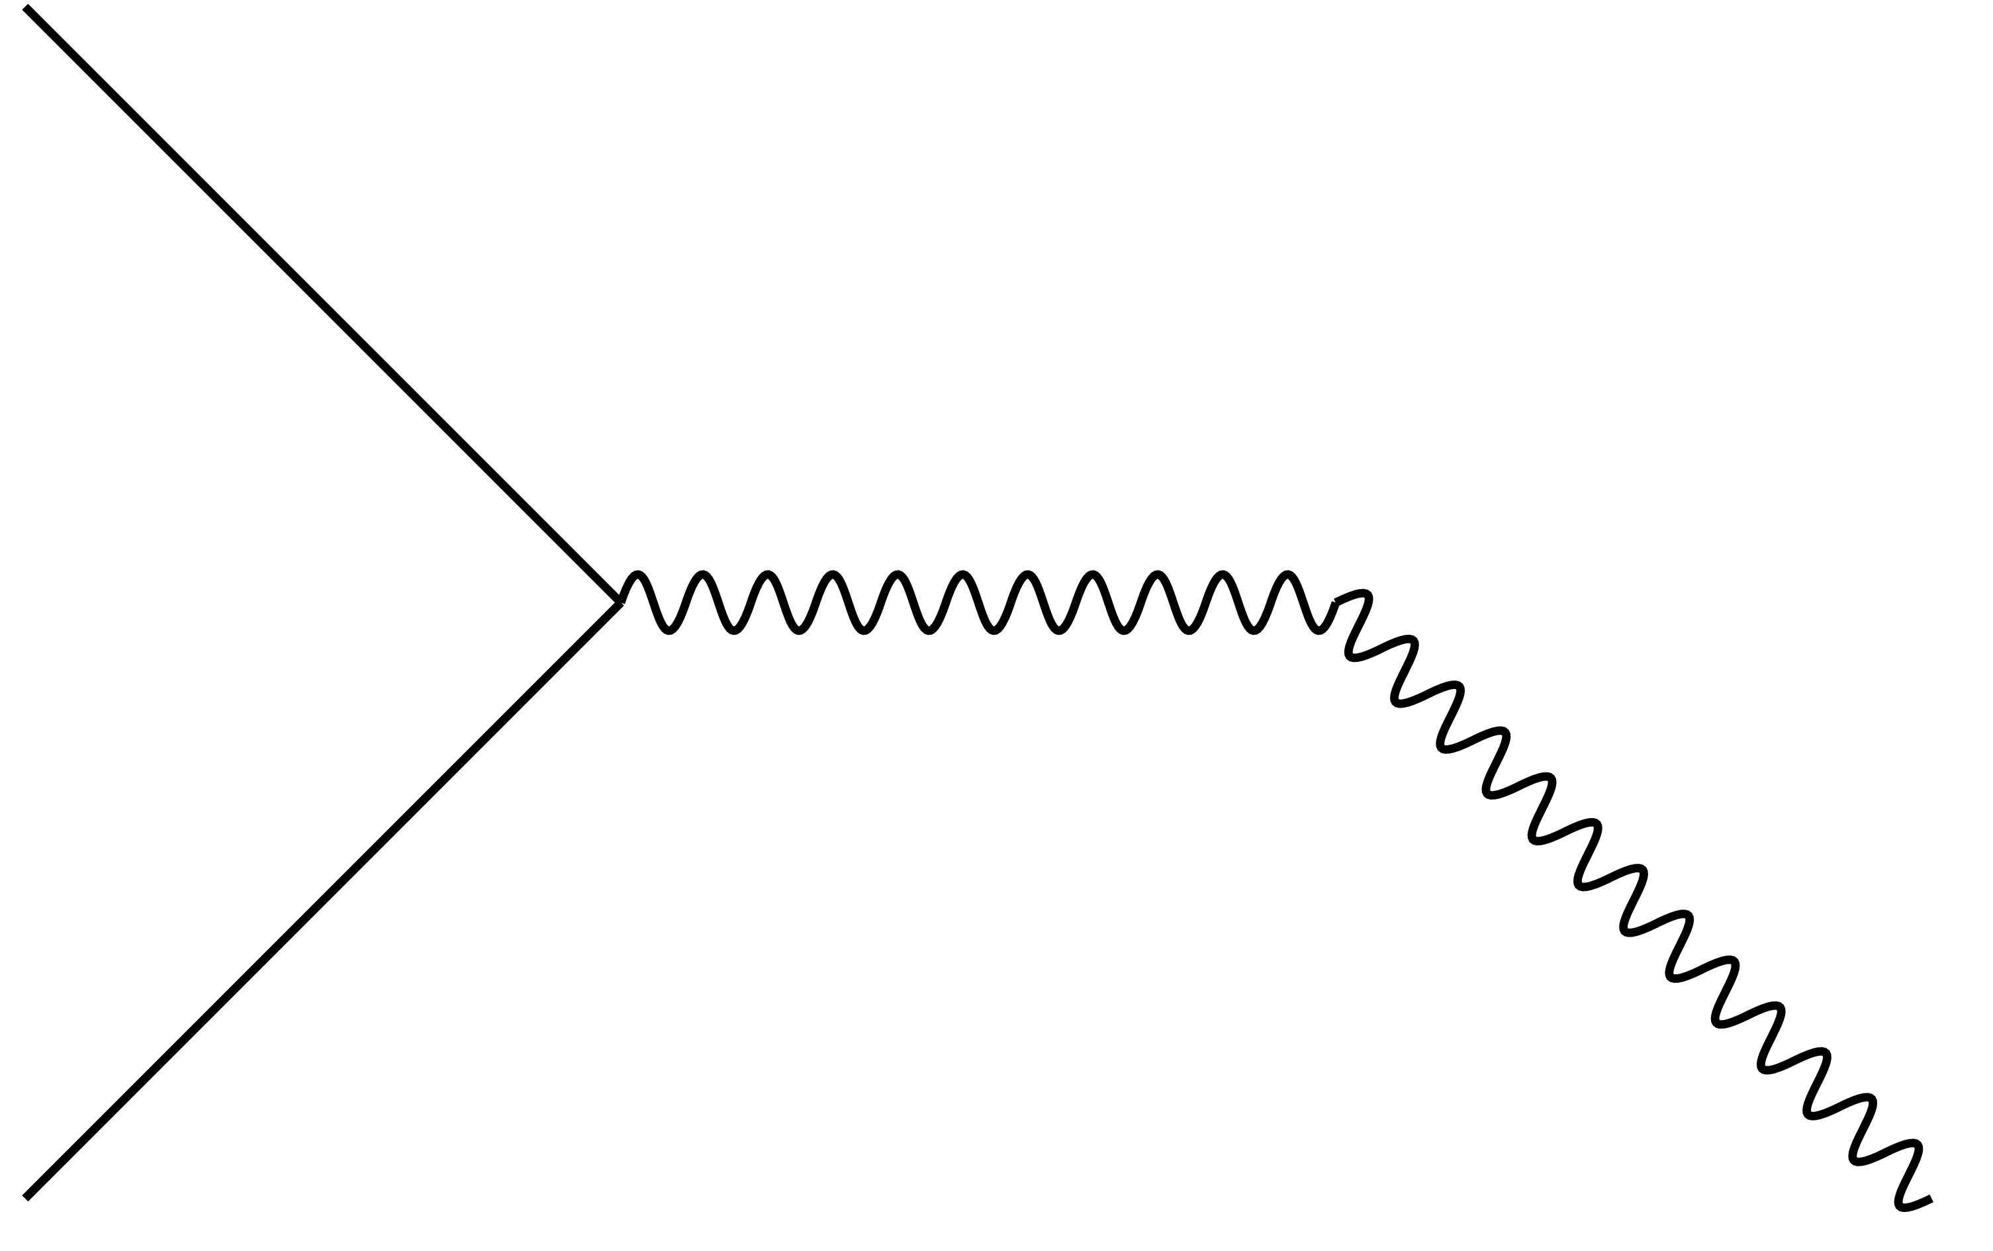
Bosonic Higgs Couplings

Slide 12
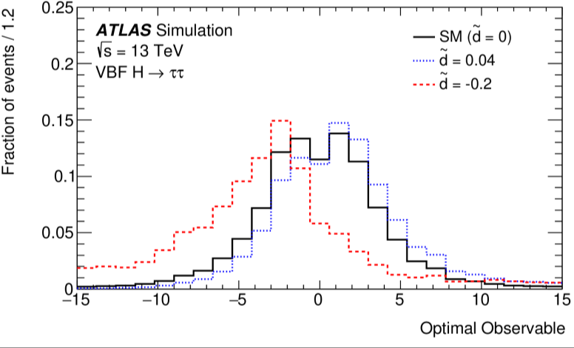
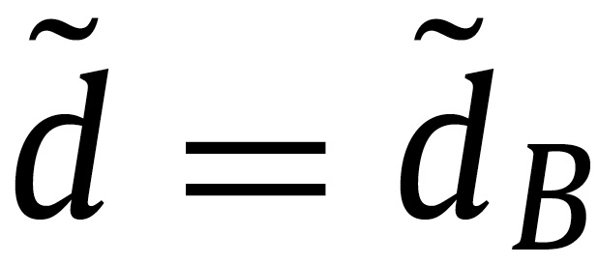
HVV Coupling in Vector Boson Fusion
CERN-EP-2022-134 (3 August 2022)
New analysis: VBF H→γγ
Consider effective HVV Lagrangian augmented with dimension six CP-odd operators
Strength of CP violation in VBF matrix element can be described by a single parameter^{(*)} giving:
Phys. Lett. B 805 (2020) 135426
Calculate LO matrix elements using 4-momenta of Higgs and VBF jets
Extract initial-state parton momentum fractions from jet momenta
Use to calculate Optimal Observable (OO):
Expected to be symmetric with mean value of zero if no CP-violation
^{(*)} Slightly simplified scenario: see Phys. Lett. B 805 (2020) 135426 , set:
Notes:
Reco BDT trained with ttH signal
Lep: target 1 or 2 semi-leptonic top decays
2 leptons: no top reconstruction
1 lepton: build W candidate (lep+E_{T}^{miss})and then top candidate from W + BDT-favoured jet
Had: target hadronic top decays
reconstruct 1 or 2 tops from jets
CP BDT:
Third term is even: affects only rate and is ignored in this analysis
Interference (CP-odd) term cannot change total cross section

Slide 13
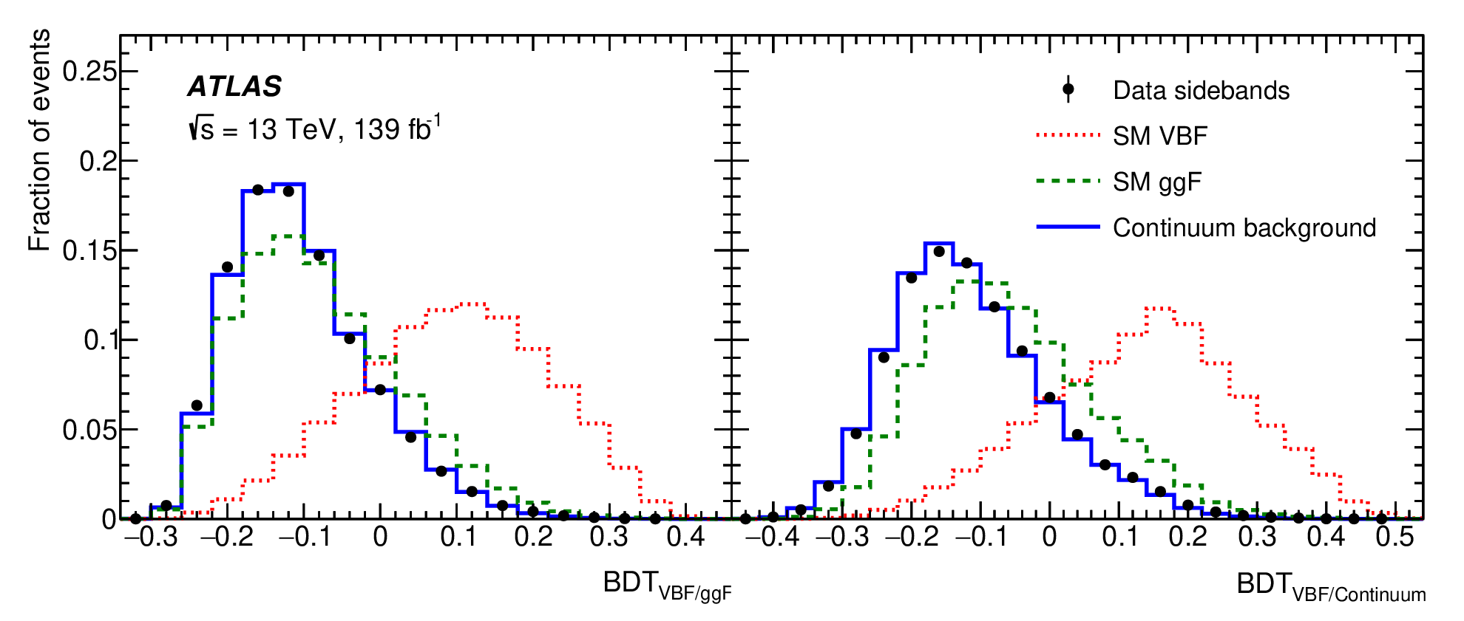
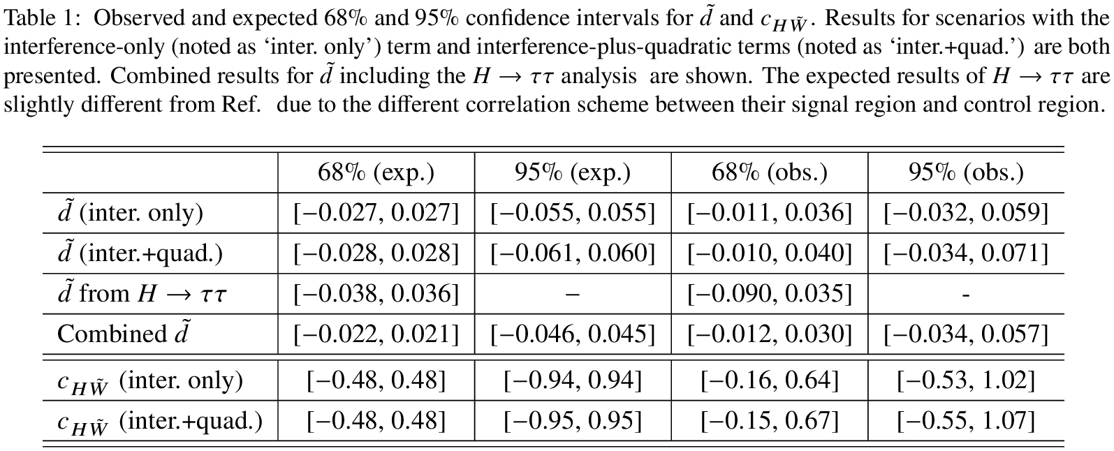
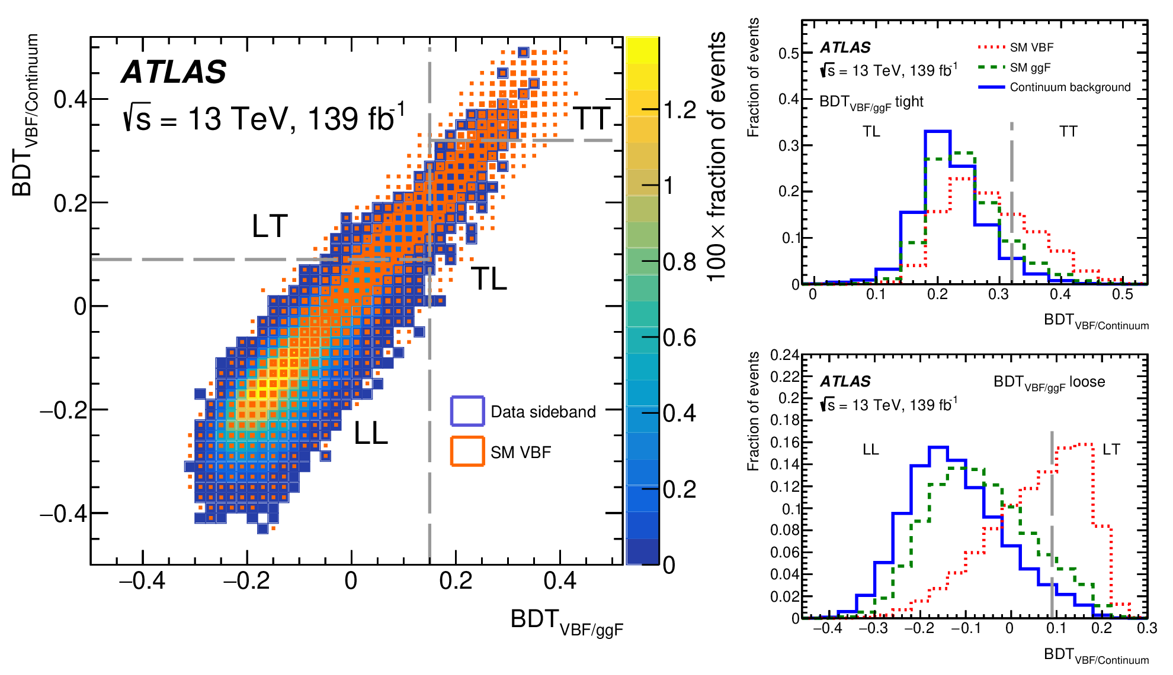
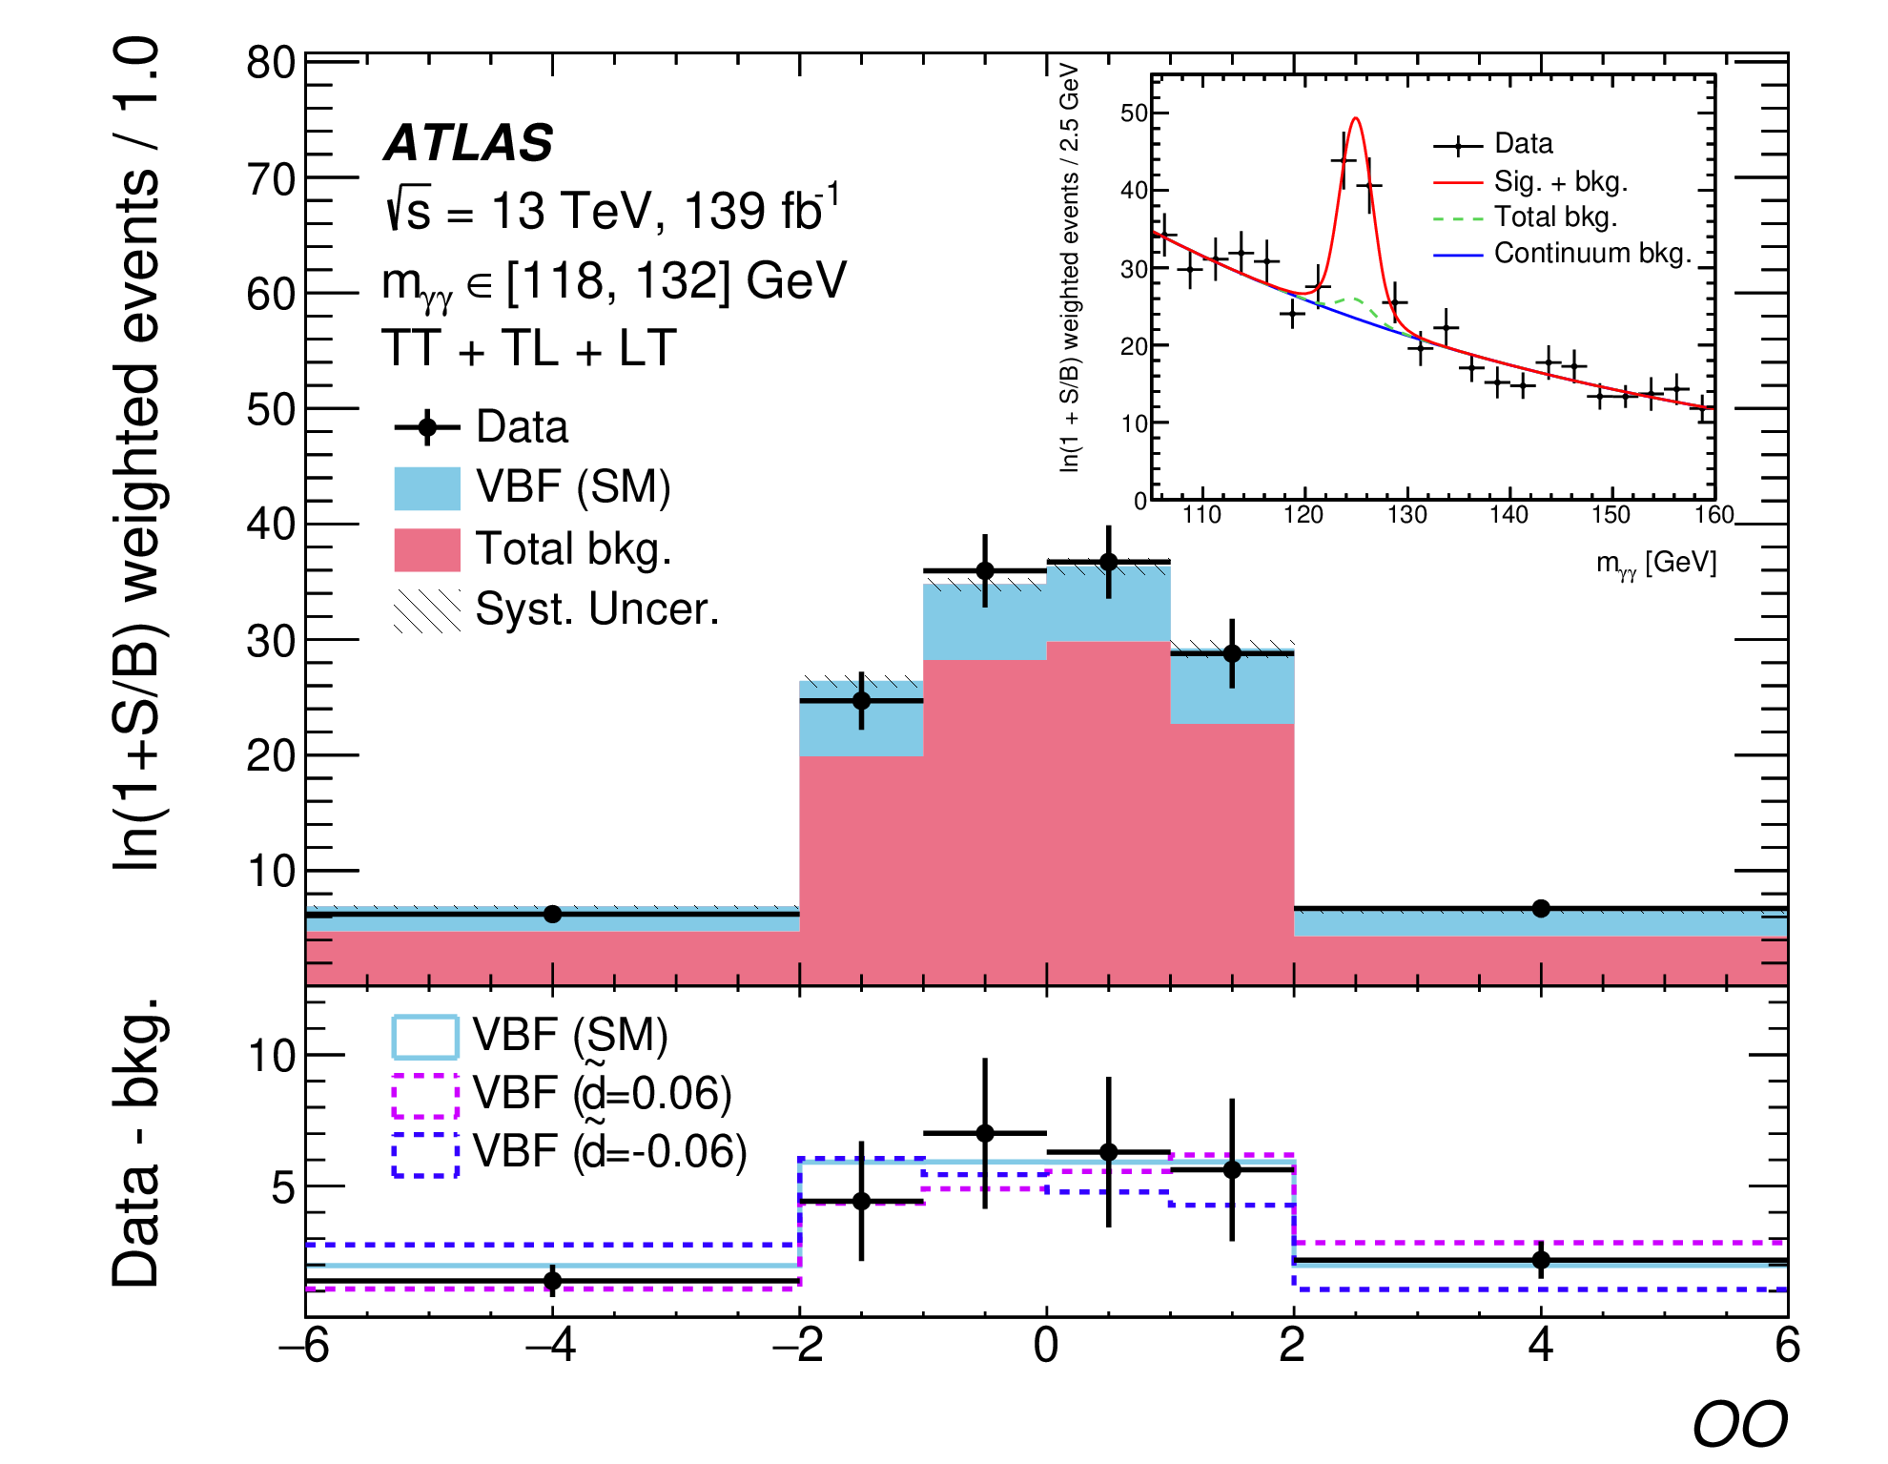
HVV Coupling in Vector Boson Fusion
CERN-EP-2022-134 (3 August 2022)
Select events with ≥2 photons and ≥2 tag jets (energy flow)
Increase signal purity with 2 BDTs:
BDT_{VBF/ggF}: separate VBF signal from gluon-fusion Higgs production
BDTVBF/Continuum: separate VBF signal from continuum diphoton background
Split into signal regions using BDT output: Tight-Tight (TT); Loose-Tight (LT); Tight-Loose (TL)
In each OO bin extract signal yield from a fit to the di-photon mass spectrum
Fit shape of Optimal Observable to extract the coefficient of the interference term
Pure shape analysis – signal normalisation is left floating in the fit to depend only on interference term
Notes:
Reco BDT trained with ttH signal
Lep: target 1 or 2 semi-leptonic top decays
2 leptons: no top reconstruction
1 lepton: build W candidate (lep+E_{T}^{miss})and then top candidate from W + BDT-favoured jet
Had: target hadronic top decays
reconstruct 1 or 2 tops from jets
CP BDT:

Slide 14
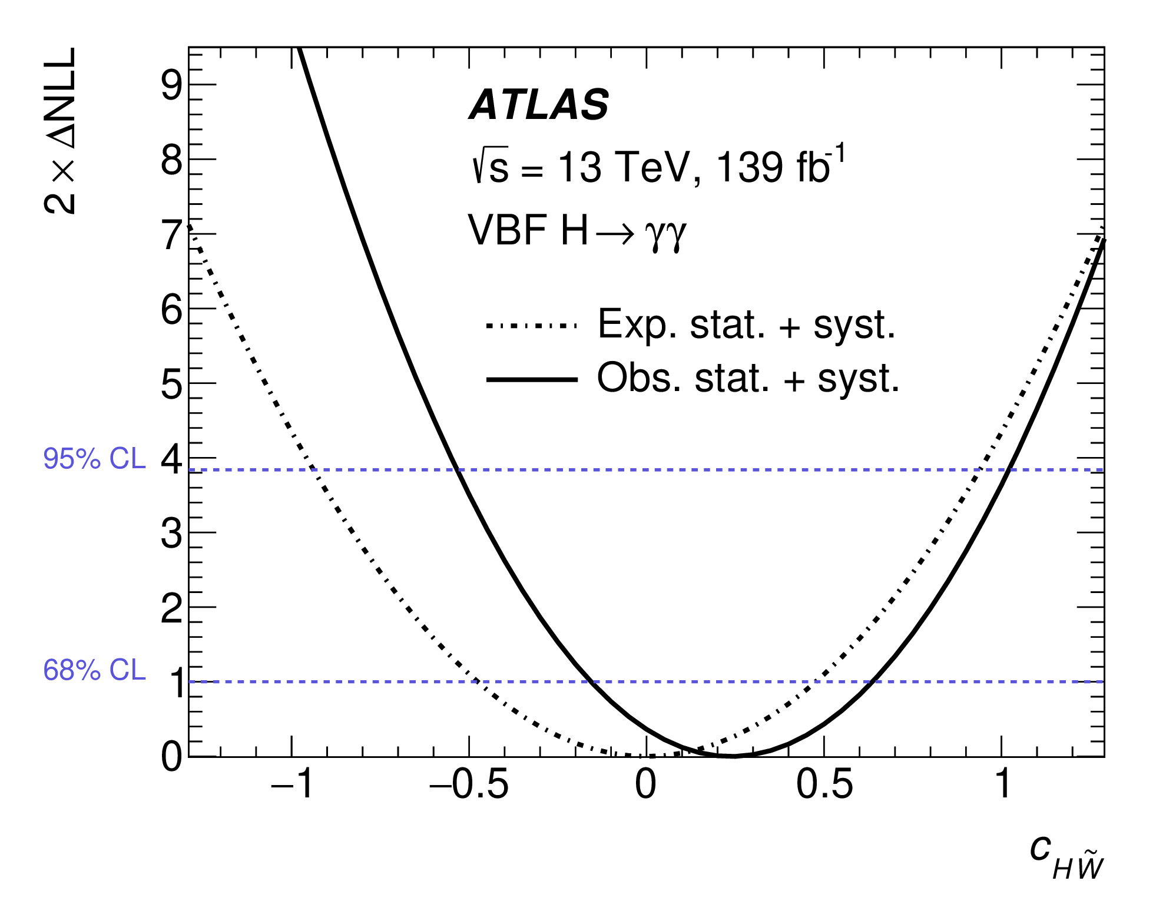
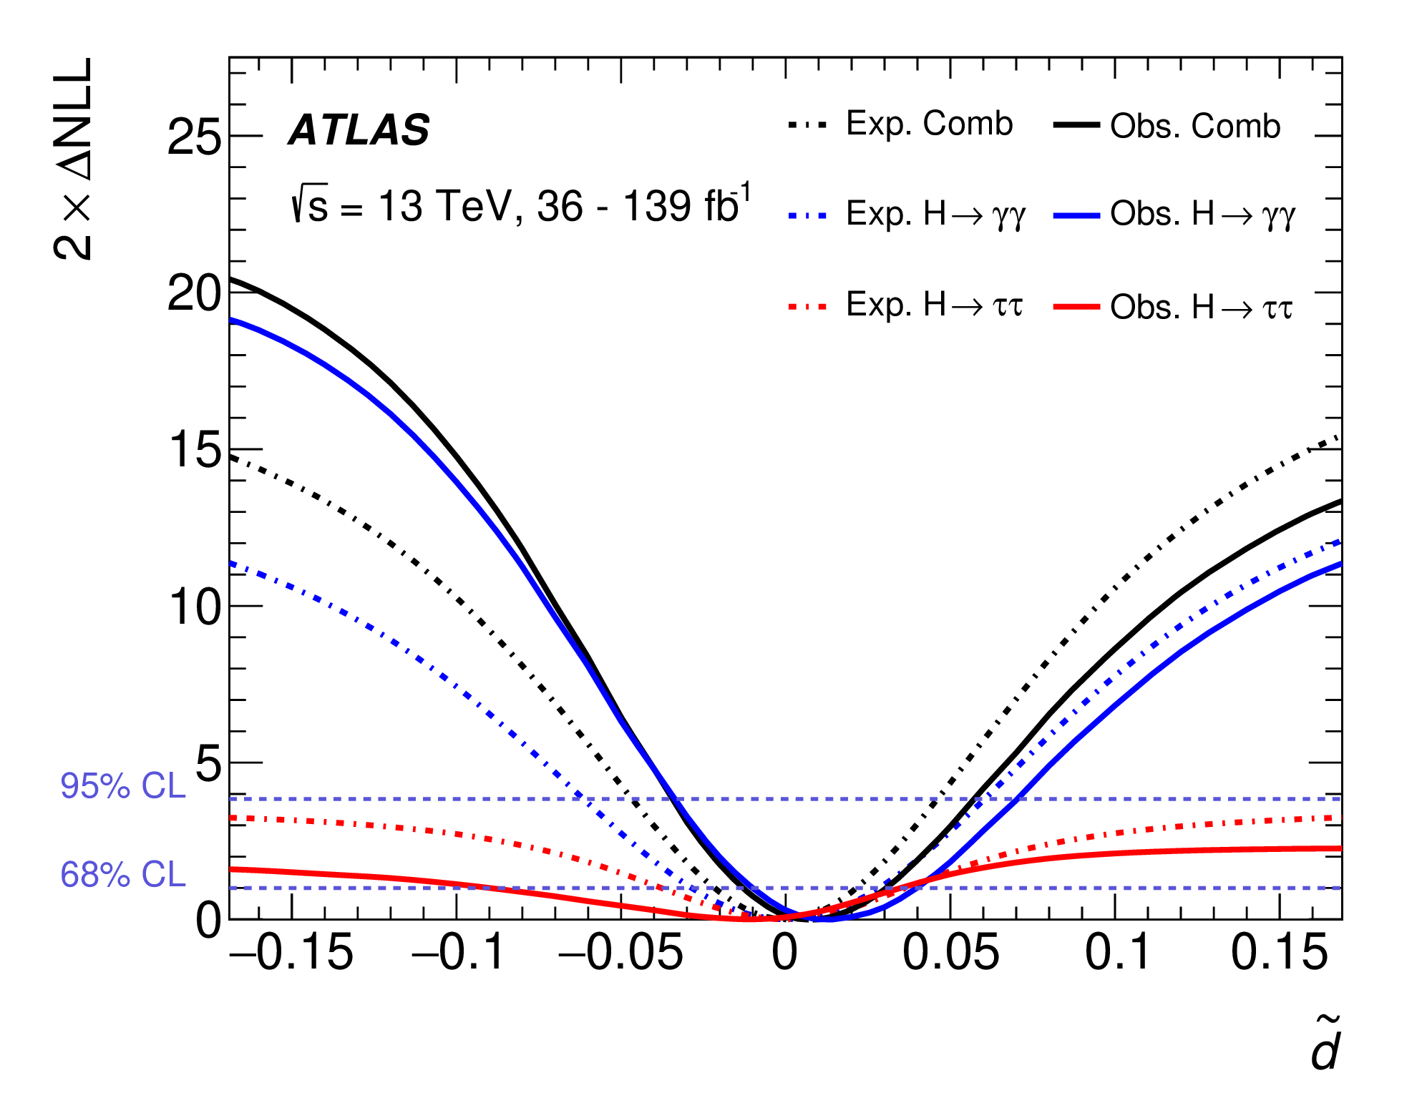
HVV Coupling in Vector Boson Fusion
CERN-EP-2022-134 (3 August 2022)
Result interpretation with (HISZ EFT operator basis) but also (Warsaw basis)
No improvement from using quadratic term – sensitivity driven by interference
Results are the strongest existing bounds on CP violation in HVV
Combination with previous analysis of VBF H→ττ (36 fb⁻¹)
Phys. Lett. B 805 (2020) 135426
Confidence intervals further improved
Notes:
Reco BDT trained with ttH signal
Lep: target 1 or 2 semi-leptonic top decays
2 leptons: no top reconstruction
1 lepton: build W candidate (lep+E_{T}^{miss})and then top candidate from W + BDT-favoured jet
Had: target hadronic top decays
reconstruct 1 or 2 tops from jets
CP BDT:

Slide 15
Summary & Outlook
The search for a CP structure of Higgs boson couplings is being very actively pursued in ATLAS
Still much space for CP odd admixture, potential source for CP violation
Would be clear evidence for deeper theory, beyond the SM and might address fundamental question of baryon asymmetry
Results generally in agreement with Standard Model CP-even hypothesis
Several Run 2 measurements using 139 fb⁻¹
Produced about 8 M Higgs bosons in Run 2!
A lot to expect from Run 3 and later!
Today: showed only latest results in this presentation:
H-top Coupling in ttH/tH production with H → γγ, H → bb
H-τ Coupling in VBF + hhF production
HVV Coupling in VBF , H → γγ
More Run 2 analyses reaching results soon
Pure CP-odd ttH coupling excluded at 3.9 σ
Pure CP-odd Hττ coupling excluded at 3.4 σ
Strongest existing bounds on and

Slide 16
Backup slides

Slide 17
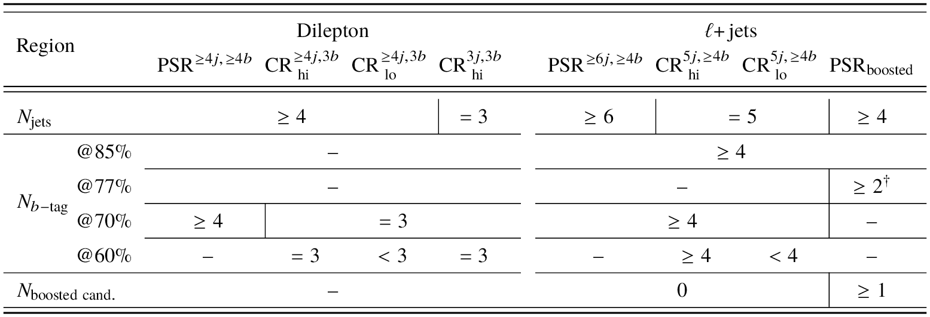
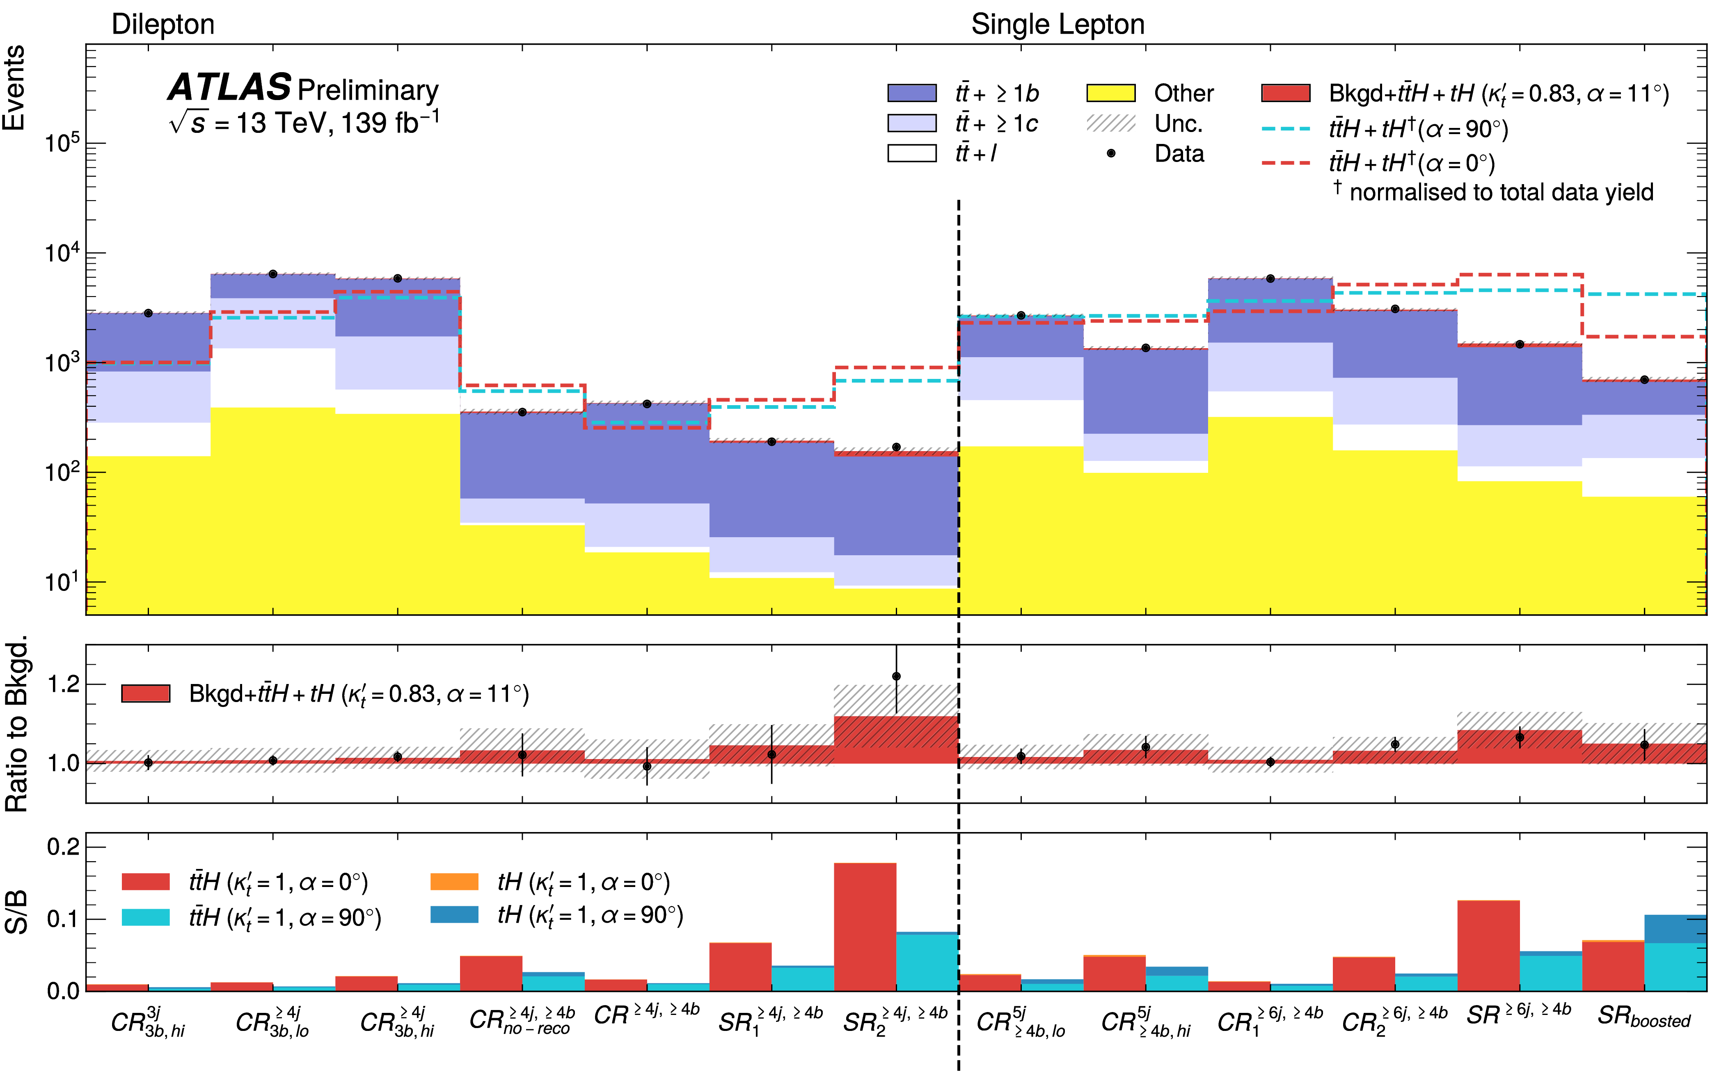
H-top Coupling in ttH/tH production
ATLAS-CONF-2022-016 (16 March 2022)
PSR: Preliminary Signal Region (before classification BDT)
Recent analysis with H→bb decay
High branching ratio, but challenging backgrounds
Complementary to previous ttH(H→γγ) analysis
Two channels:
Lepton+jets: target 1 semi-leptonic top decay – dedicated boosted region targets p_{T}^{H}>200 GeV using large-R jets (R=1, m_{j} > 50 GeV)
Dilepton: target 2 semi-leptonic top decays
Reconstruct top and Higgs candidates in regions
“Reconstruction” BDT selects jet combinations to build top and Higgs candidates
“Classification” BDT separates signal (trained on ttH) from background
See talk by Neelam in YSF yesterday
Notes:
Dedicated Neural Net to identify H→bb decays in boosted region
Separate “no-reco” region in dilepton channel if no top reconstruction is possible
Reco BDT trained with ttH signal
Lep: target 1 or 2 semi-leptonic top decays
2 leptons: no top reconstruction
1 lepton: build W candidate (lep+E_{T}^{miss})and then top candidate from W + BDT-favoured jet
Had: target hadronic top decays
reconstruct 1 or 2 tops from jets
CP BDT:

Slide 18
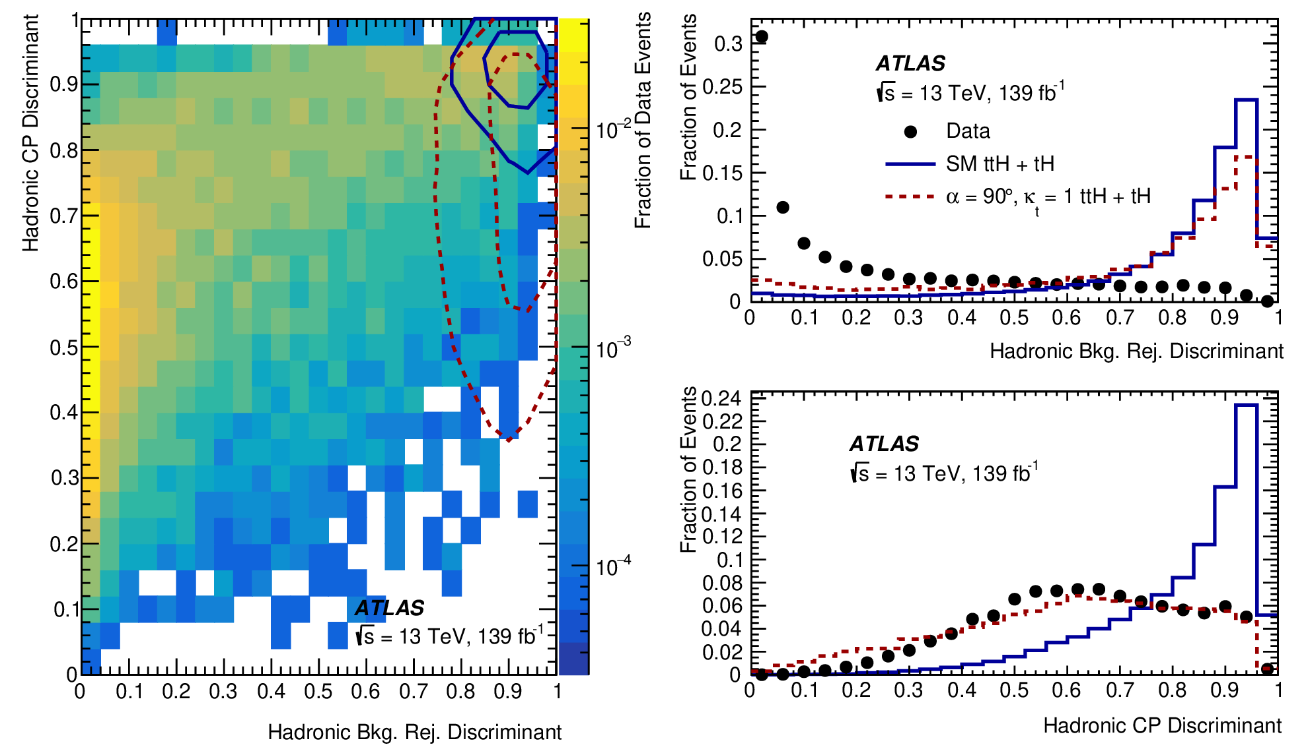
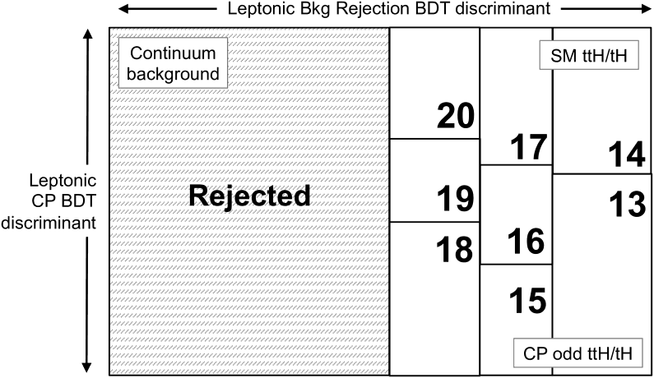
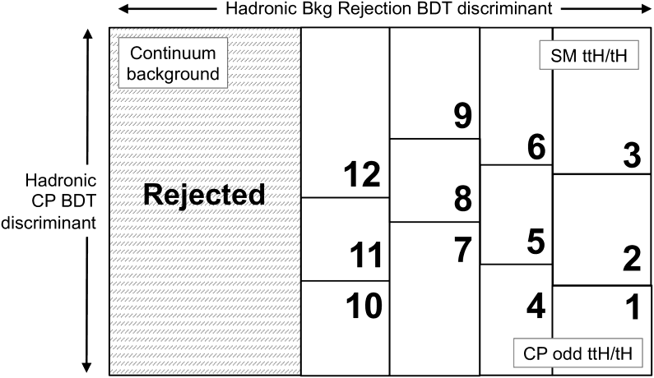
H-top Coupling in ttH/tH production
Phys. Rev. Lett. 125 (2020) 061802
Reconstruct Leptonic or Hadronic γγ + top events
Two BDTs to define 2D space:
Reject continuum background and
Enrich in CP-odd-like events (kinematic and angular variables)
Simultaneous fit to m_{γγ} in 2D regions defined by BDT outputs
Established 5σ observation of ttH(γγ)
Assuming SM decay get μ = 1.43^{+0.33}_{-0.31}(stat)^{+0.17}_{-0.14} (sys)
Set upper limit of 12×SM for tH production
Pure CP-odd (α = 90°) excluded at 3.9 σ and |α|>43° at 95% C.L.
Statistics-dominated analysis
θ
Notes:
Stats dominated
Reco BDT trained with ttH signal
Lep: target 1 or 2 semi-leptonic top decays
2 leptons: no top reconstruction
1 lepton: build W candidate (lep+E_{T}^{miss})and then top candidate from W + BDT-favoured jet
Had: target hadronic top decays
reconstruct 1 or 2 tops from jets
CP BDT:

Slide 19
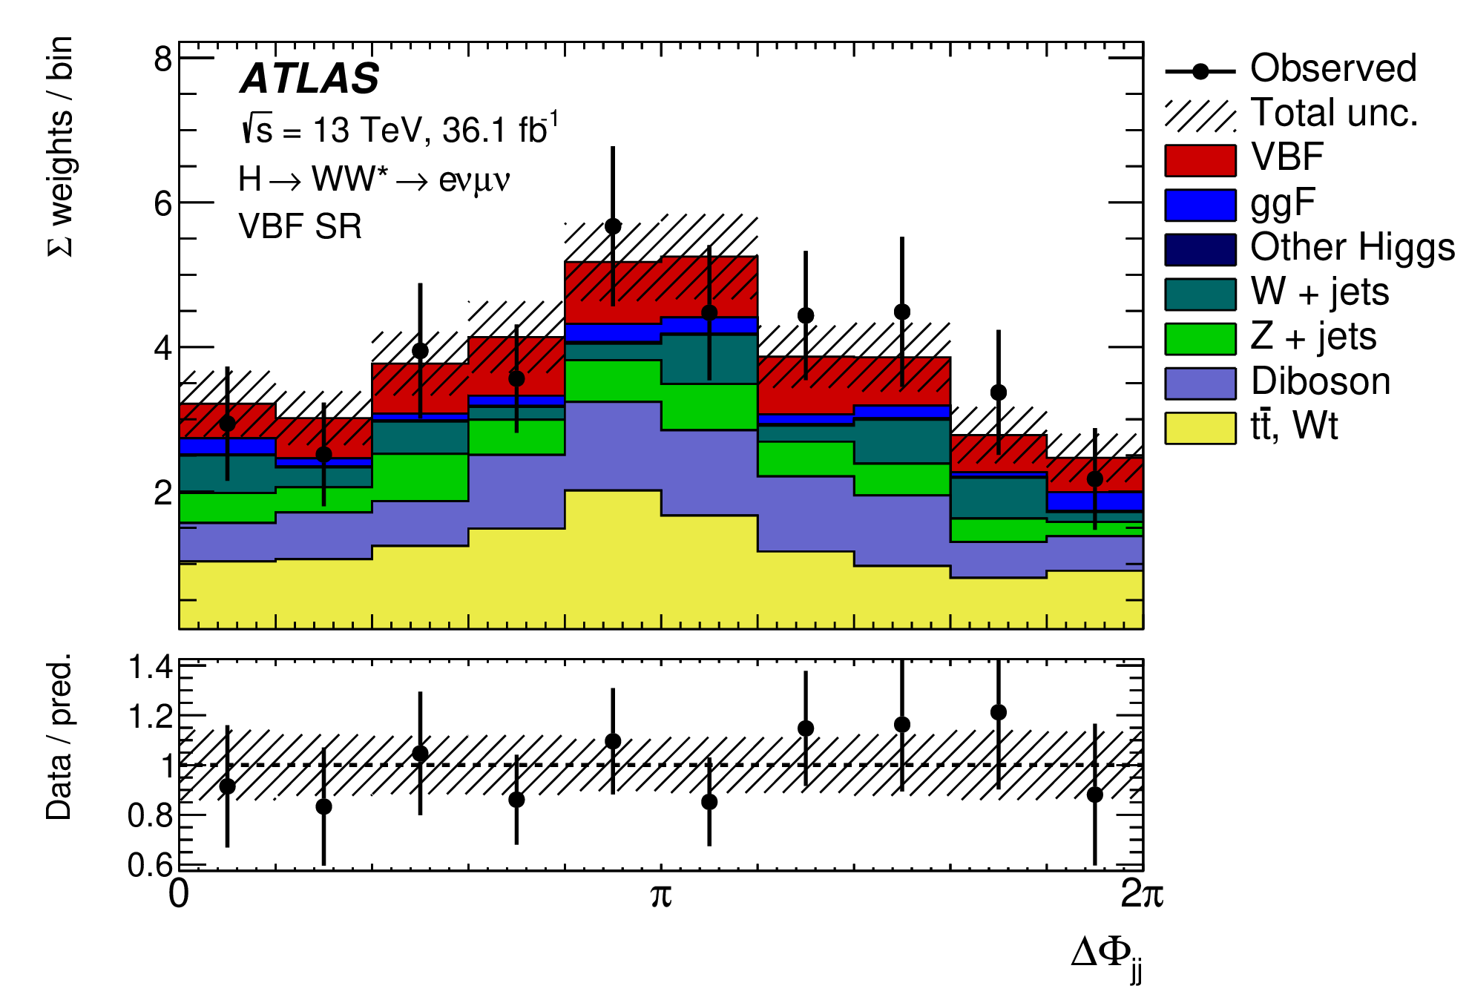
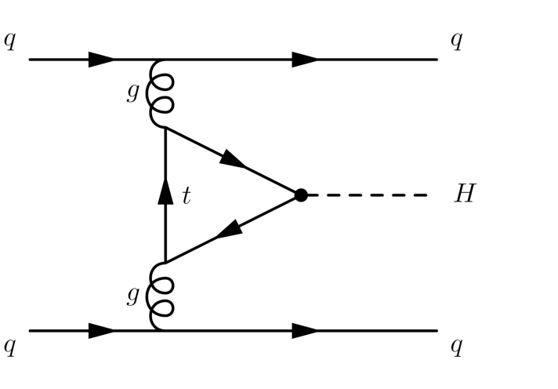
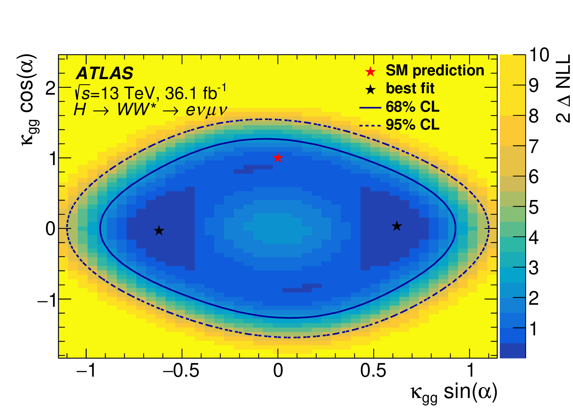
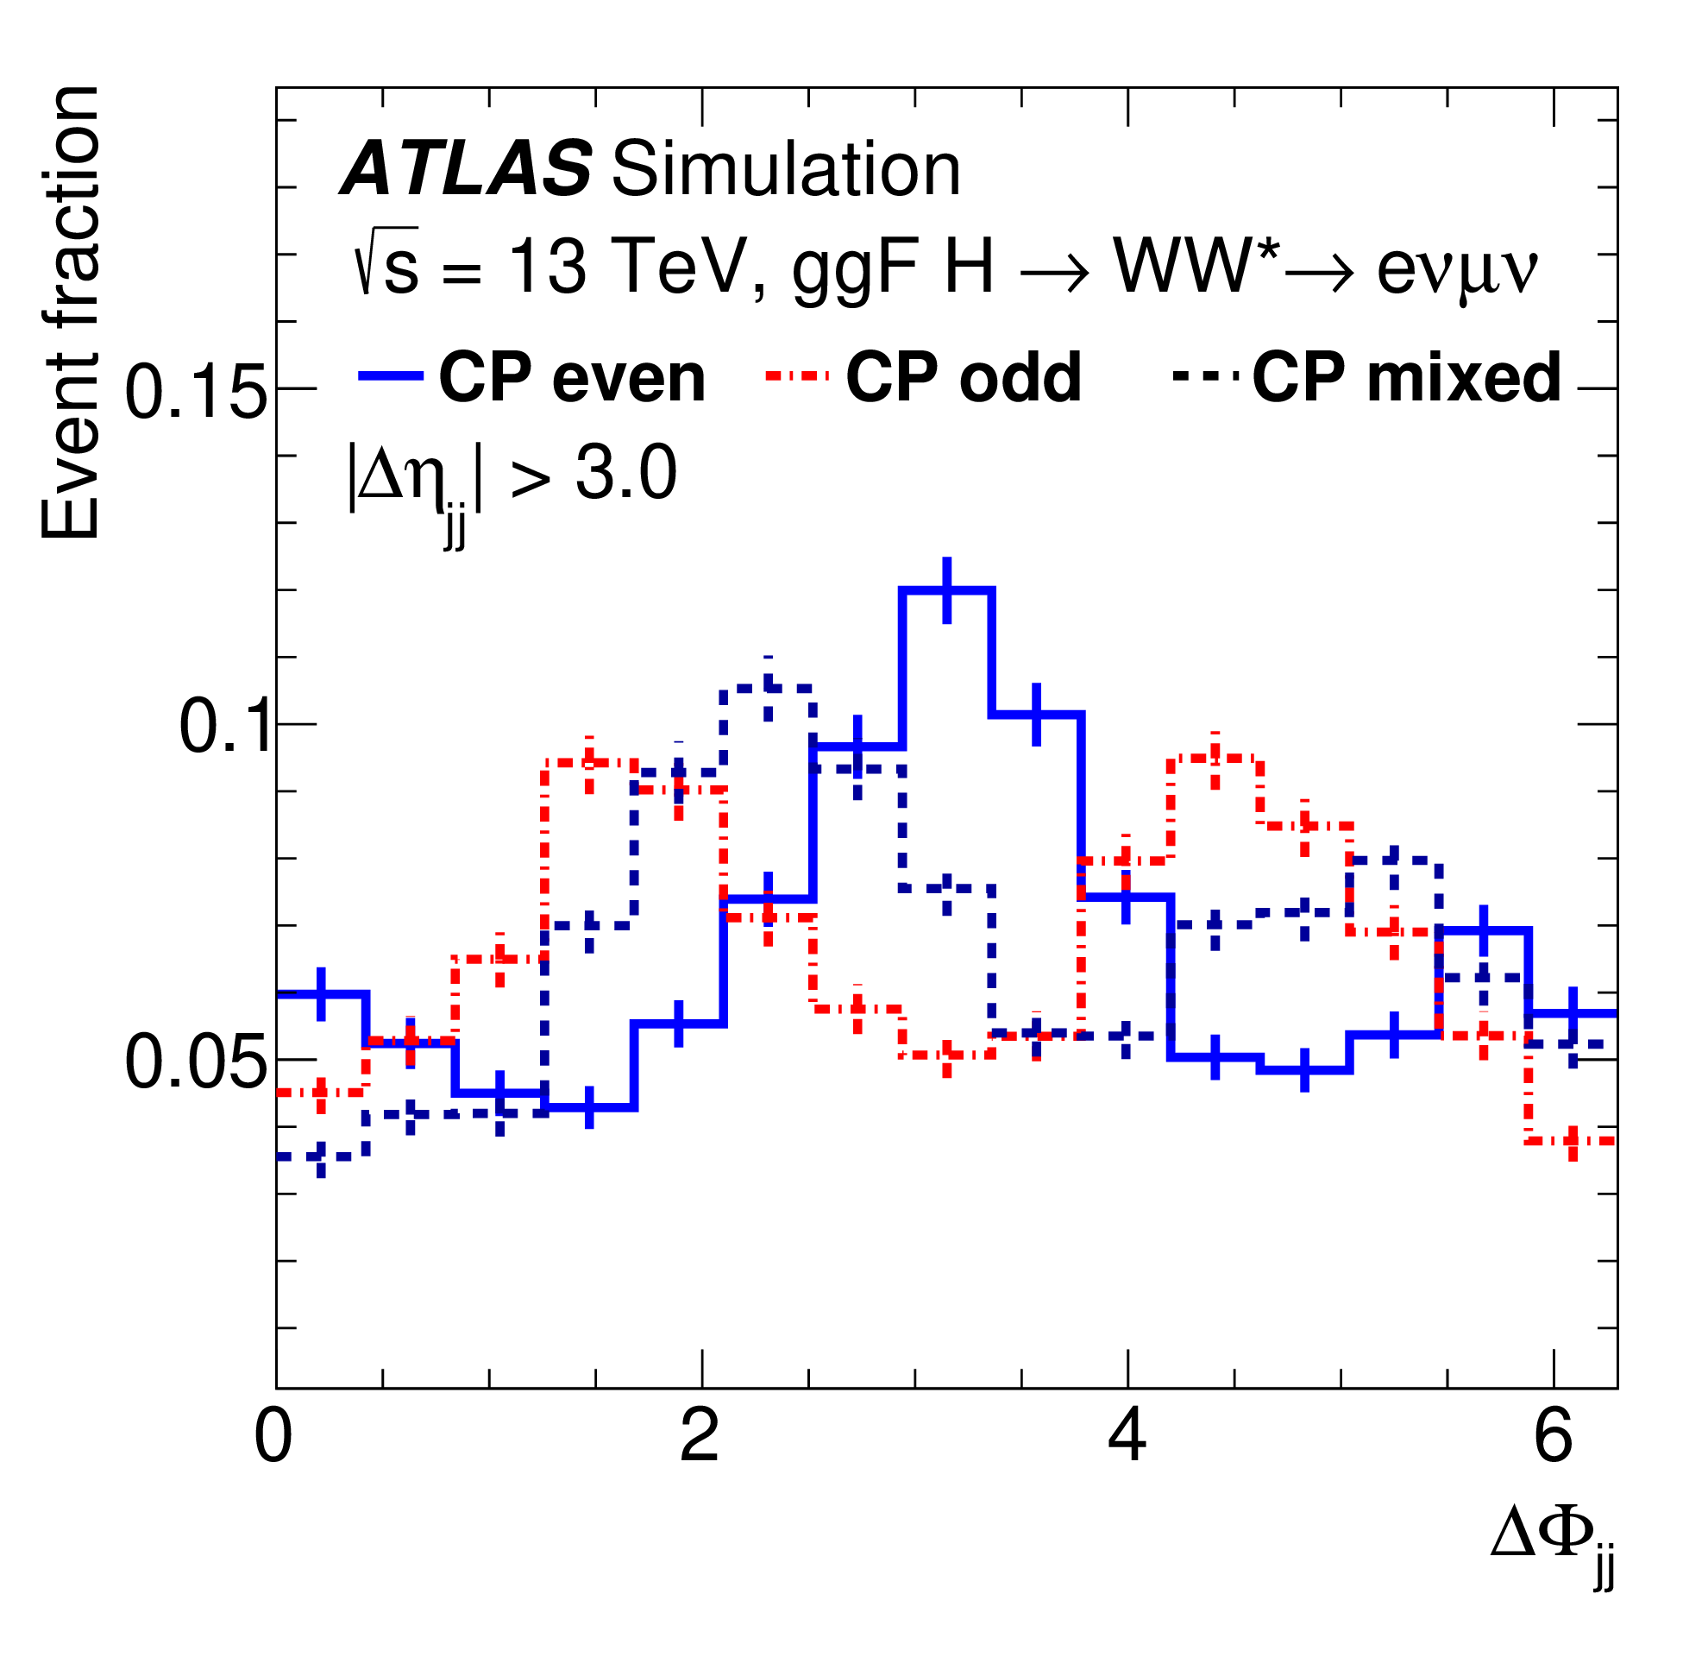
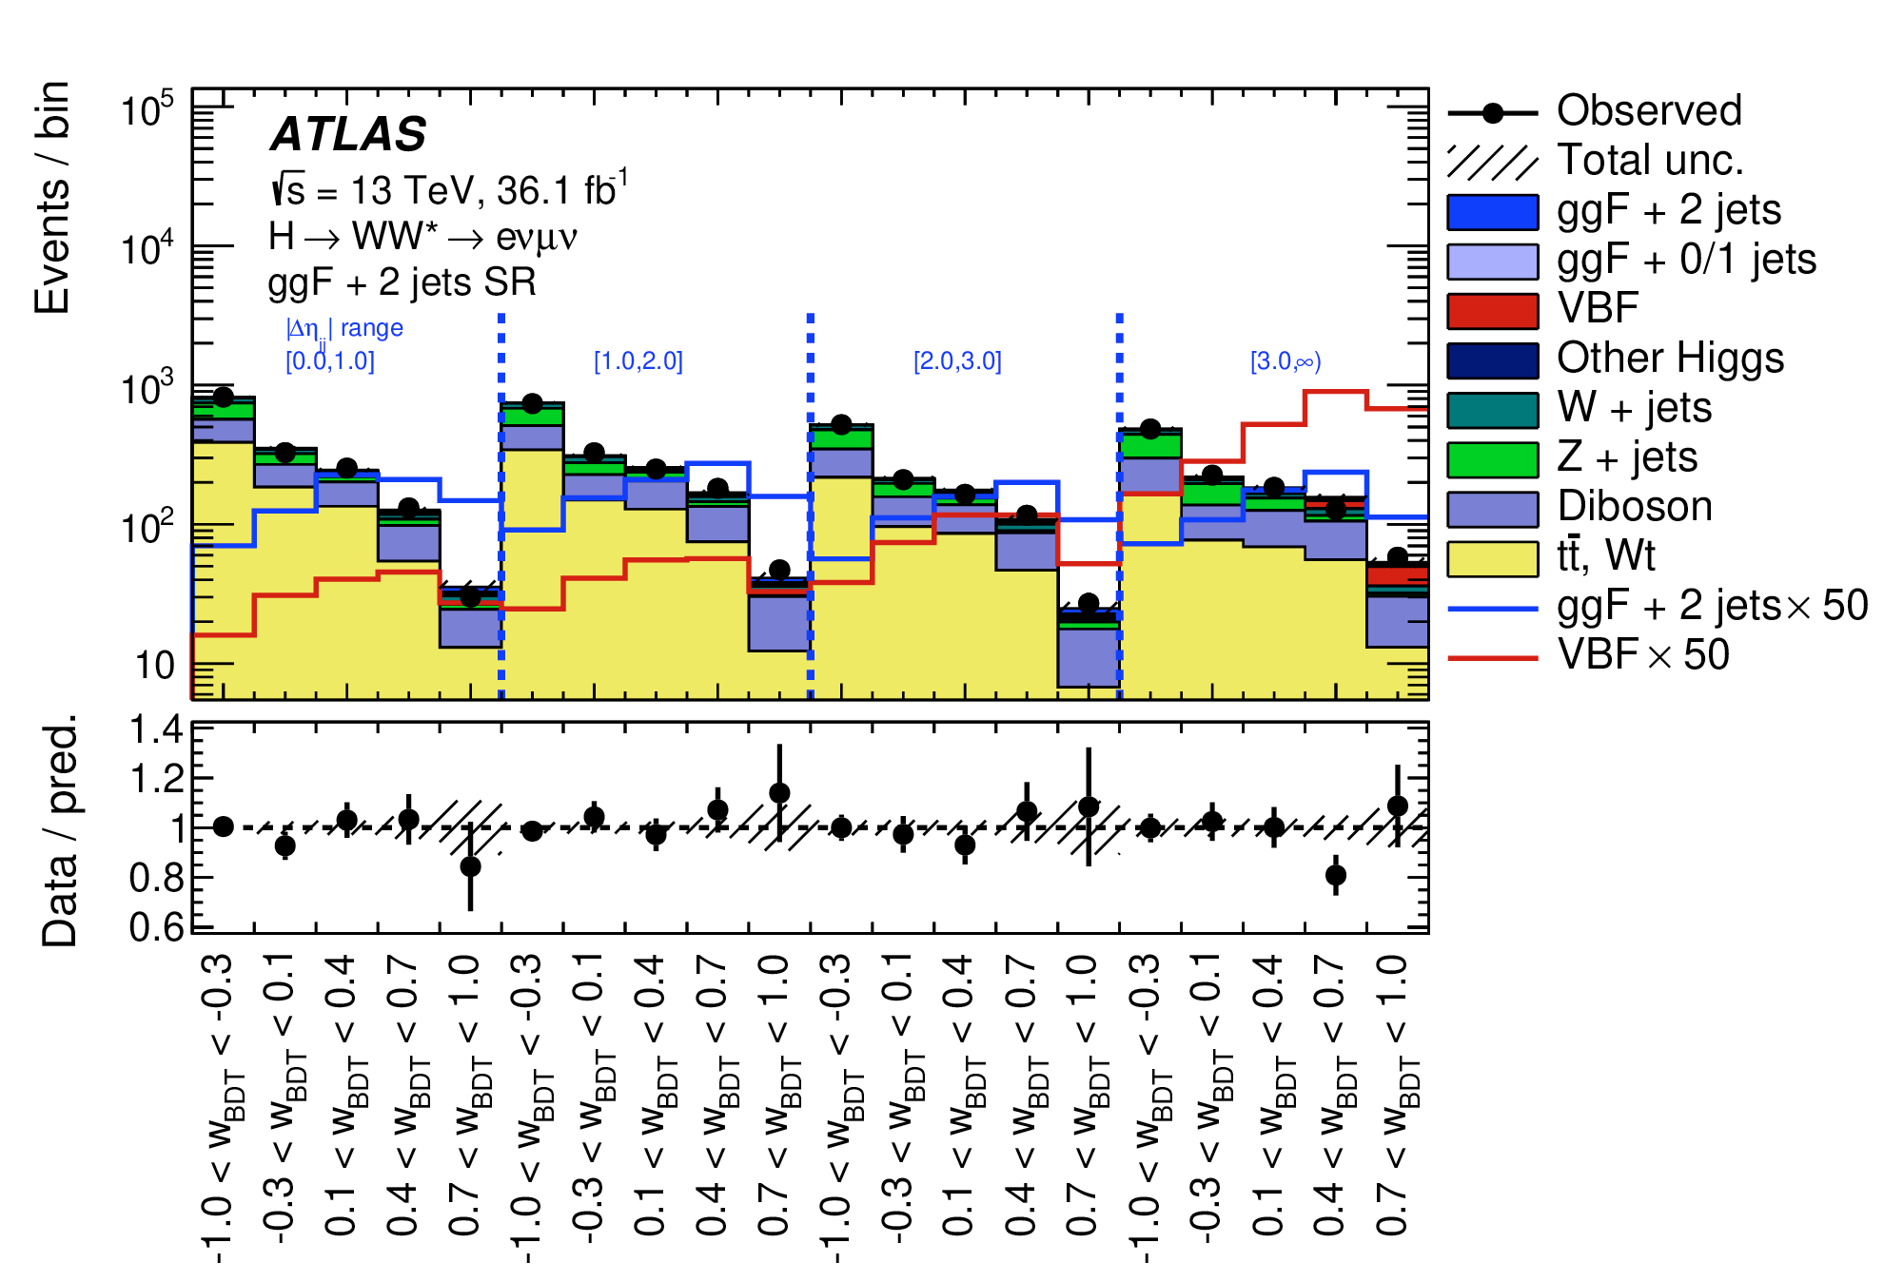
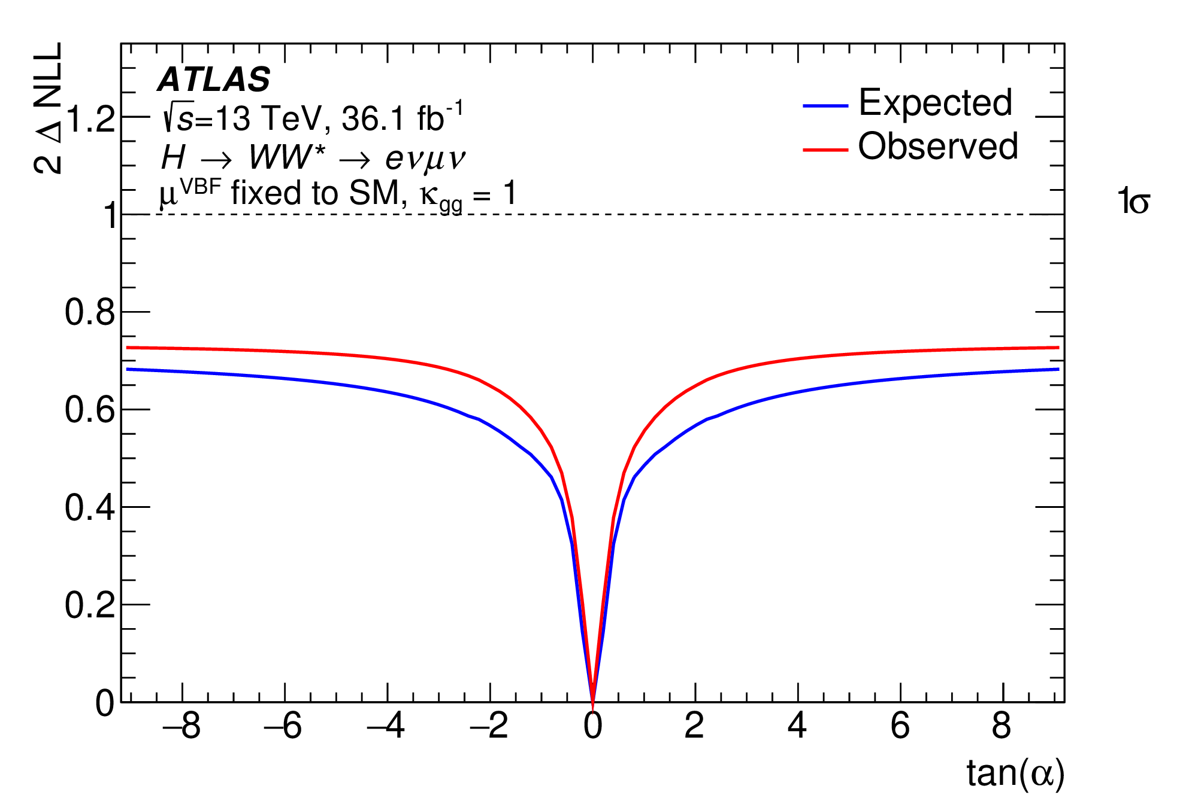
Hgg Effective Coupling
Eur. Phys. J. C 82 (2022) 622
Depending on the production mode, H+2 jets probse CP violation (for ggF) or W/Z polarization (for VBF)
In gluon fusion:
Effective vertex either or top Yukawa coupling or BSM particles in loop
Use BDT to separate signal and background (no CP sensitivity)
Classify H+2jets into 4x5 categories according to |Δη| and BDT score

Slide 20
Search for changed shapes of differential cross sections due to CP-odd observables (2nd term)
Or on process rates (cross sections) from 3rd term – but other BSM scenarios can change rates
See e.g. arXiv:2208.02338 [hep-ex], arXiv:1008.3869v3 [hep-ph], or C.Grefe, ICHEP’22

