Slide 1


H->bb at the LHC
BANG
Ricardo Gonçalo (RHUL)
HSG5 Meeting – 19 September 2012

Slide 2


WH/ZH Searches

Slide 3
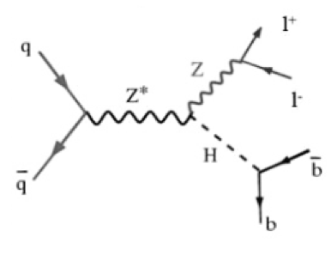
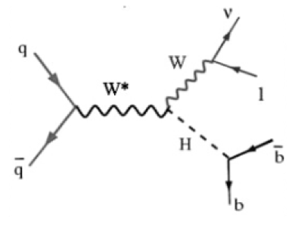
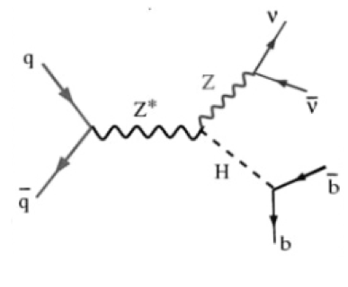
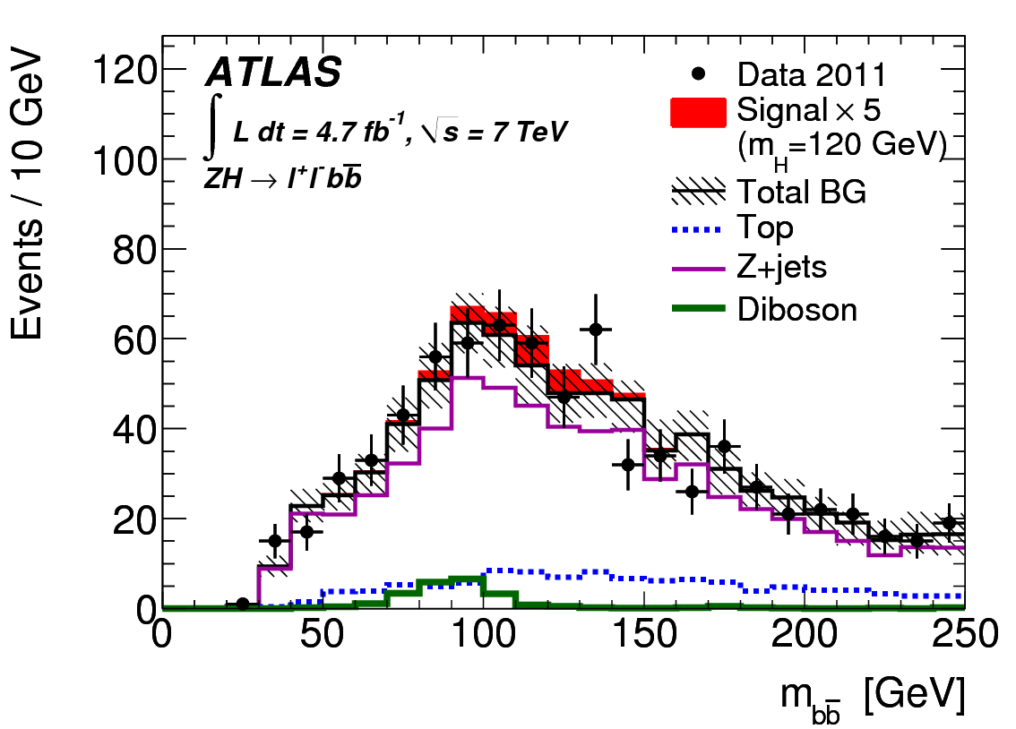
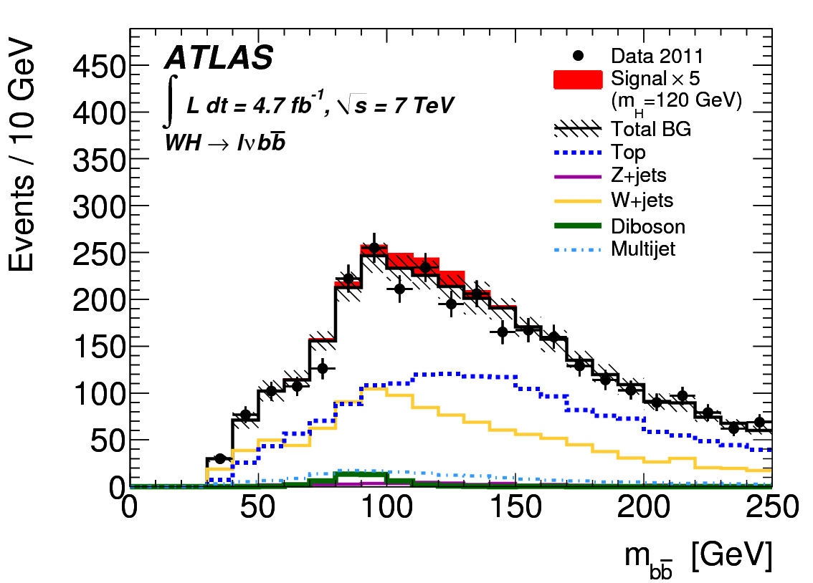
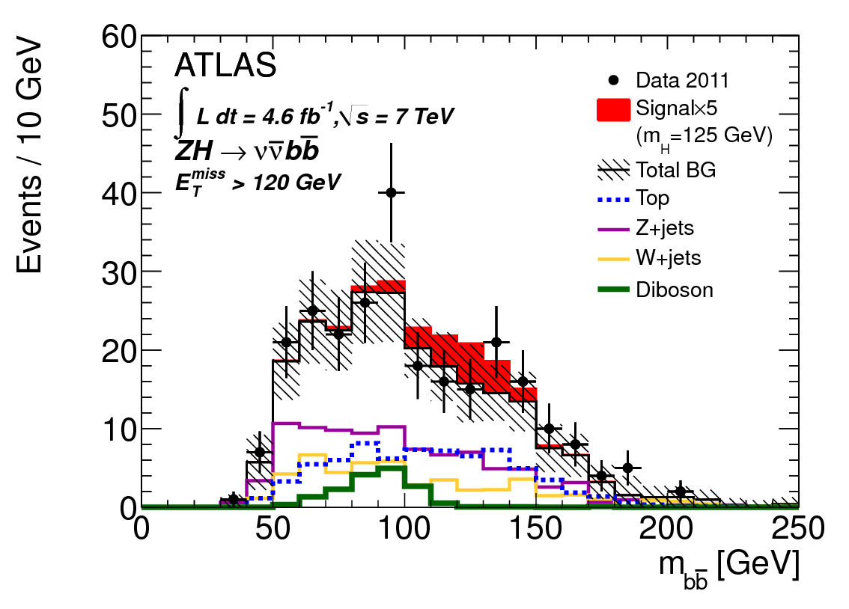
ATLAS VH, H->bb Analyses
Cut-based analyses of 2011 data (4.7 fb⁻¹): ZH->llbb, WH->lνbb, ZH->ννbb
Select events with 2, 1, 0 leptons and 2, 3 jets; cut on E_{T}^{miss} and m_{T}^{W}
Reconstruct m_{bb} to search for H->bb
Background shapes from MC (±systematics), normalized in control regions
  Control of background and associated systematics is the dominant factor in sensitivity
Divide in categories of p_{T} of vector boson recoiling against Higgs
  ZH->llbb, WH->lνbb: [0,50], [50,100], [100,200], [200, ∞]; ZH->ννbb: [120,160], [160,200] [200, ∞]
Sensitivity dominated by higher p_{T} bins
http://arxiv.org/pdf/1207.0210v1.pdf

Slide 4
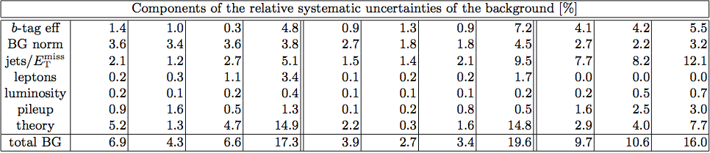
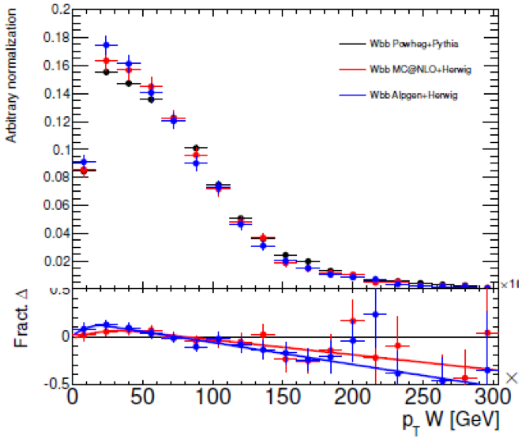
Background Systematic Uncertainty
Background normalization from control reg.
Systematic in modeling of m_{bb} and p_{T}^{W/Z} shape
Dominates theory uncertainty, especially p_{T}^{W/Z} shape – analysis categories in p_{T}^{W/Z}
Considered differences between models: Alpgen+Hwg, Powheg+Pythia or Herwig, aMC@NLO+Hwg
Dominant uncertainty in highest sensitivity categories!
Wbb Powheg+Pythia
Wbb MC@NLO+Herwig
Wbb Alpgen+Herwig
G.Piacquadio LHC Th.WG 23/5/12

Slide 5

ttH Search

Slide 6

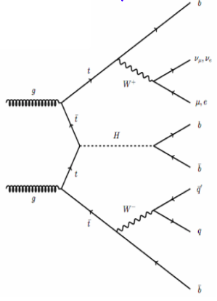

Early LHC ttH analyses:
Yes we can!
Very difficult analysis, plagued by combinatorial “background”, and ttbar+X actual background
First LHC results shown by CMS at ICHEP
  CMS-PAS-HIG-12-025: https://cdsweb.cern.ch/record/1460423/
  Single-lepton and di-lepton modes
  2011 data (5fb⁻¹)
ATLAS just released ttH analysis of 2011 data (4.7fb⁻¹)
  ATLAS-CONF-2012-135: https://cdsweb.cern.ch/record/1478423 Single-lepton mode

Slide 7
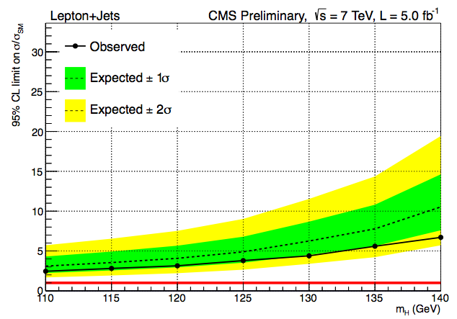
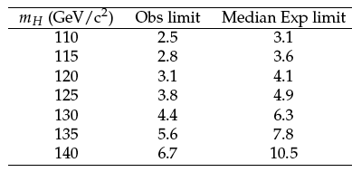
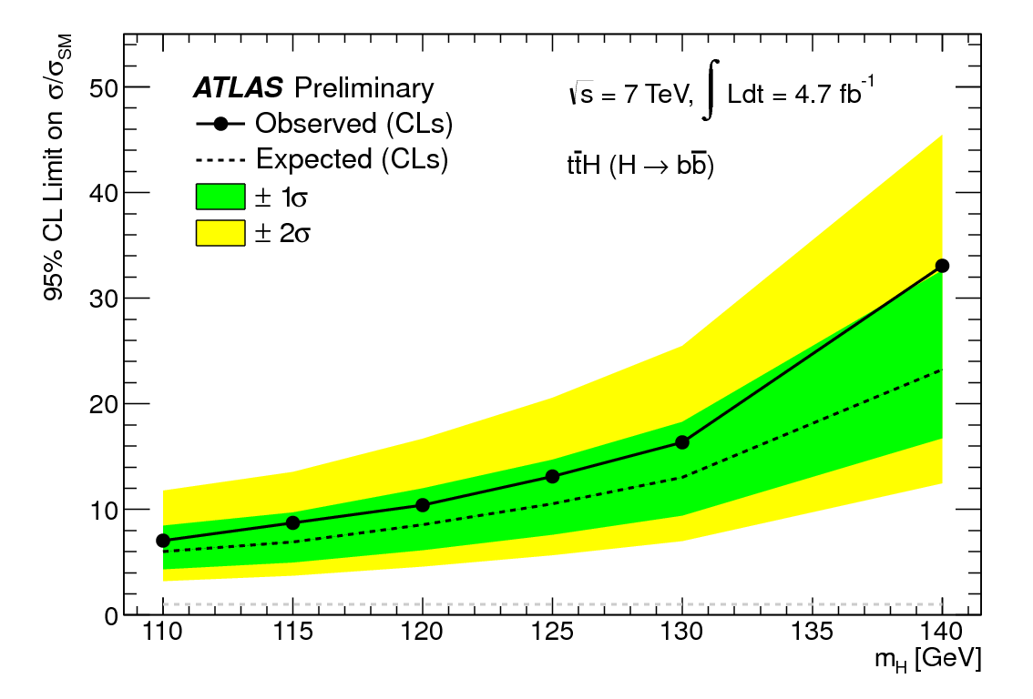
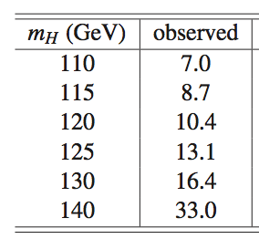
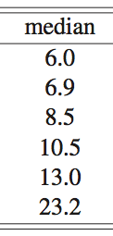
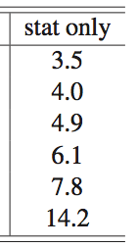
CMS
Lepton+jets mode
ATLAS
Very big difference!...

Slide 8
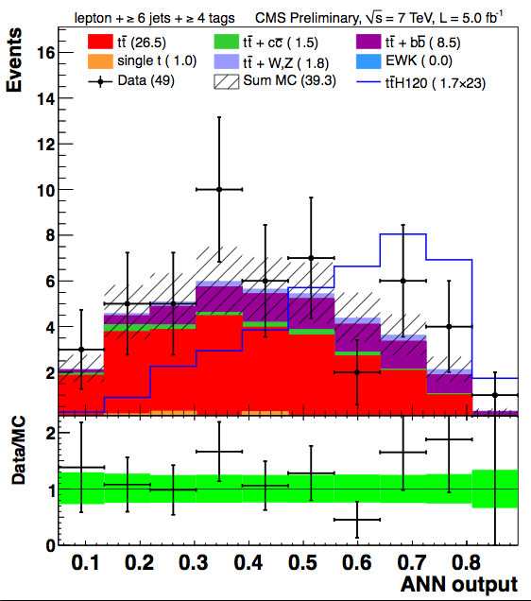
CMS Analysis
Neural Network analysis
Lepton+jets & di-lepton analyses
10 best kinematic/event shape/b-tagging variables chosen from “pool” of candidate variables
Optimized for each #jets/#b-tags category
Simultaneous fit for S and B on NN output distributions
CMS
e: p_{T}>30GeV |η|<2.5
μ: p_{T}>30GeV |η|<2.1
Jets (0.5): p_{T}>30/40GeV |η|<2.4
B-tag: 70% (b) 20% (c) 2% (lite)
✔ Used
✗ Not used
 | 0 b-tags | 1 b-tag | 2 b-tags | 3 b-tags | ≥4 b-tags
4 jets | ✗ | ✗ | ✗ | ✔ | ✔
5 jets | ✗ | ✗ | ✗ | ✔ | ✔
≥6 jets | ✗ | ✗ | ✔ | ✔ | ✔

Slide 9
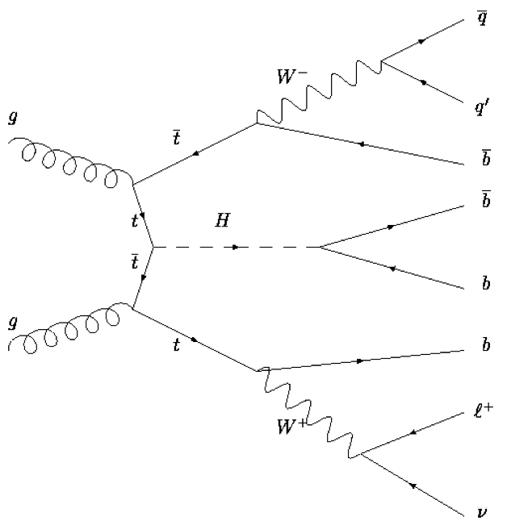
ATLAS Analysis – lepton+jets
Cut-based analysis
For ≥6 jets & ≥3 b-tags:
  Use m_{bb}, as discriminating variable
  Kinematic fit to reconstruct ttbar
  Use leftover b-jets for H->bb
Elsewhere: use H_{T}^{had} (scalar sum of jet p_{T})
Fit Signal and Background regions to get limits
Get final background normalizations and systematic uncertainties (“nuisance parameters”) from fit to data – profiling
Use control regions to check fit is ok
2 light jets (mostly)
Up to 4 b-tags
e or μ, E_{T}^{miss} , M_{T}^{W}
 | 0 b-tags | 1 b-tag | 2 b-tags | 3 b-tags | ≥4 b-tags
4 jets | H_{T}^{had} | H_{T}^{had} | H_{T}^{had}
5 jets | H_{T}^{had} | H_{T}^{had} | H_{T}^{had} | H_{T}^{had} | H_{T}^{had}
≥6 jets | H_{T}^{had} | H_{T}^{had} | H_{T}^{had} | m_{bb} | m_{bb}
Signal
Background
Control regions

Slide 10
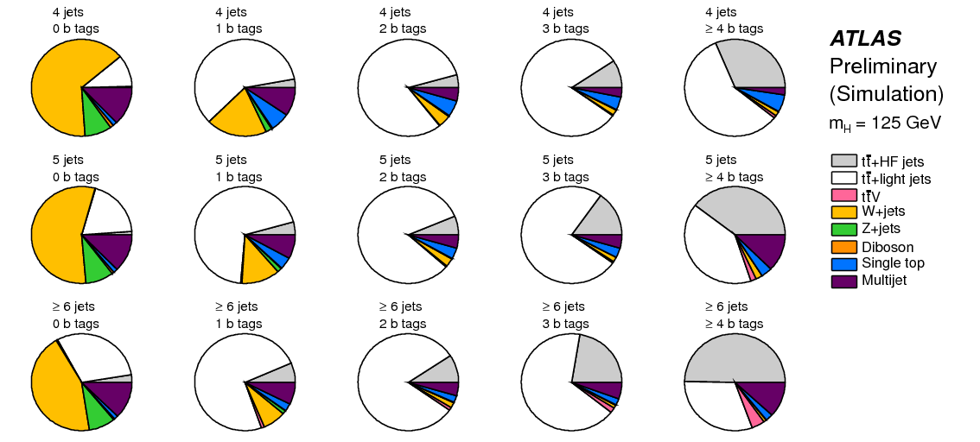
ATLAS Analysis

Slide 11
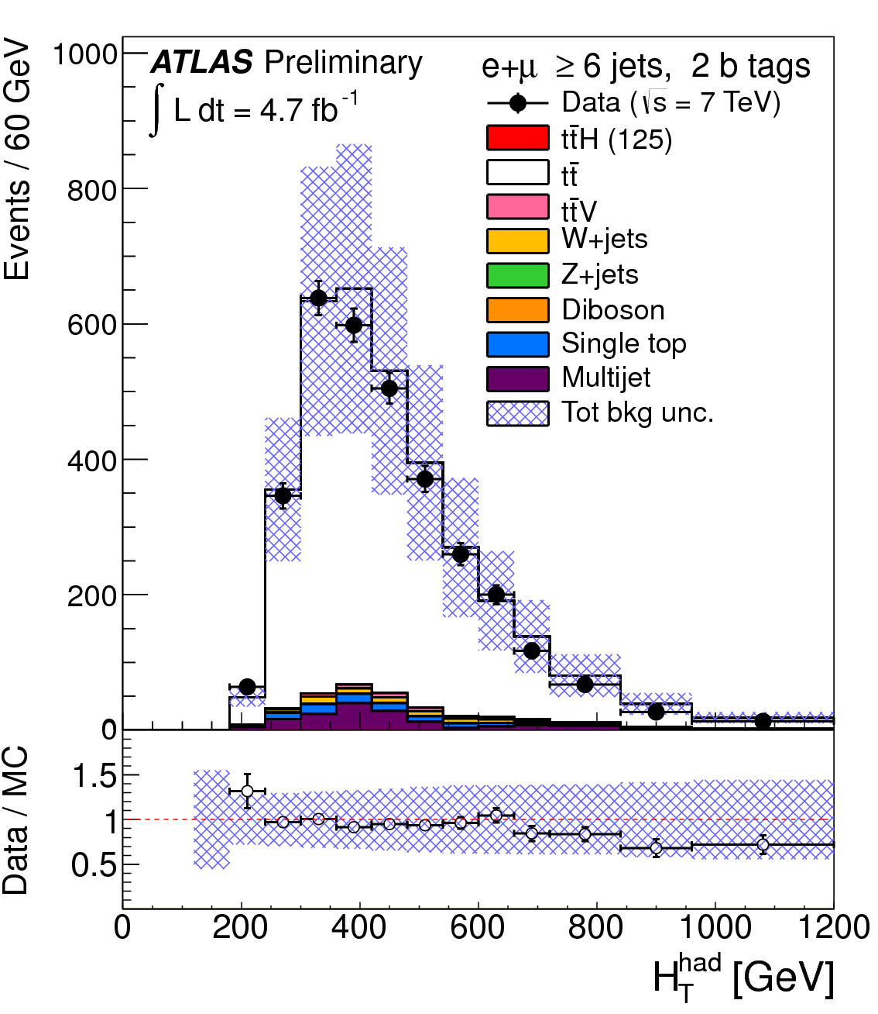
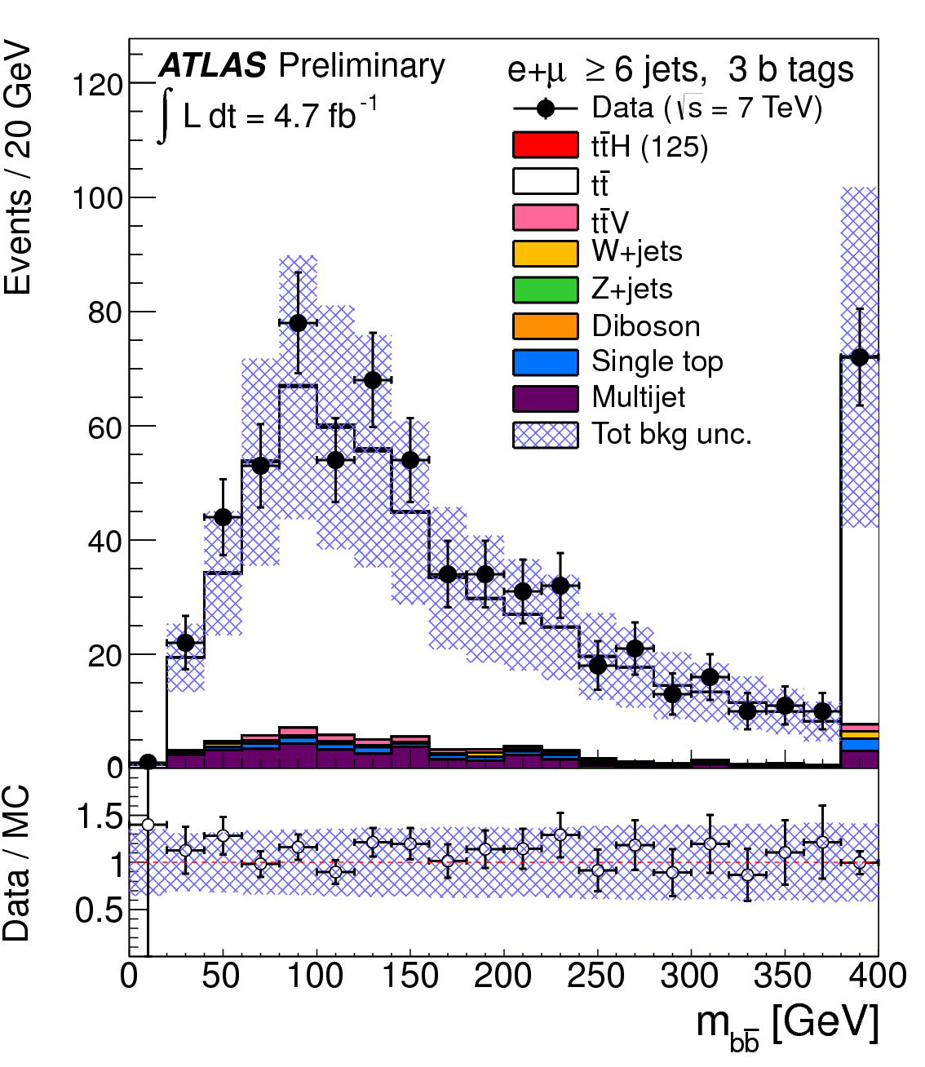
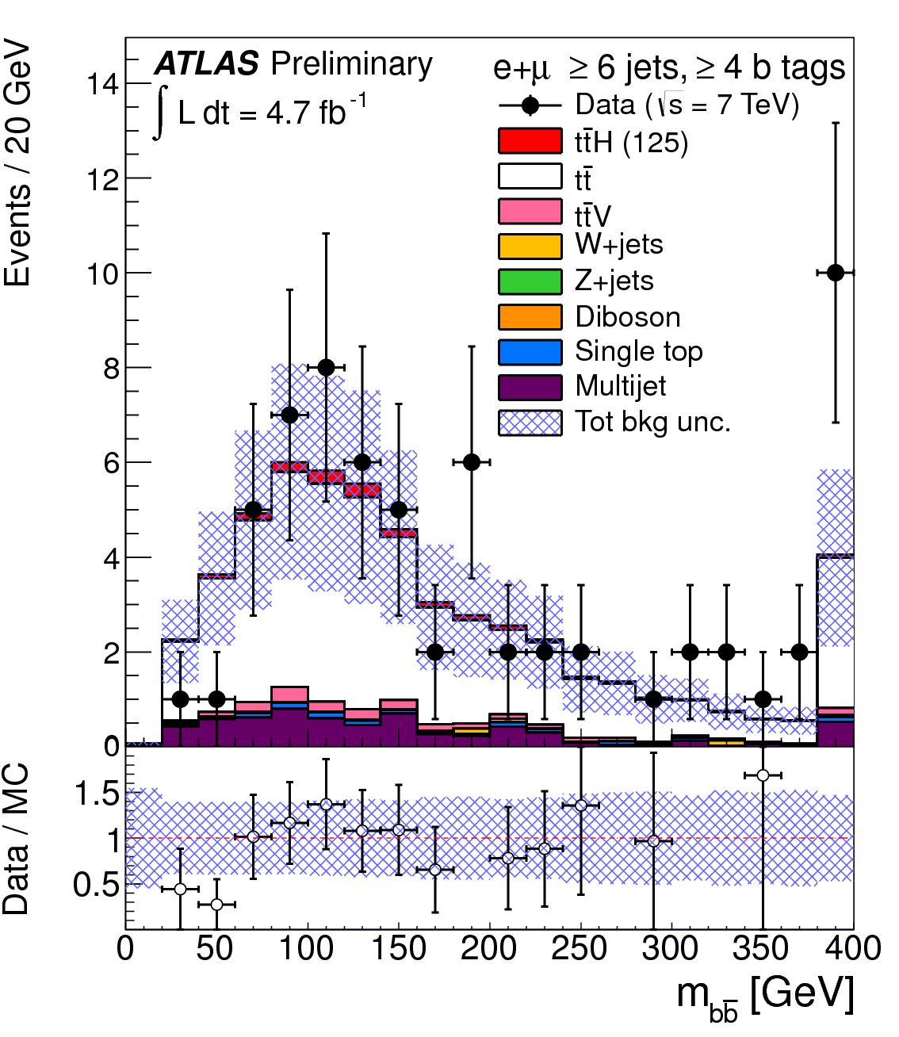
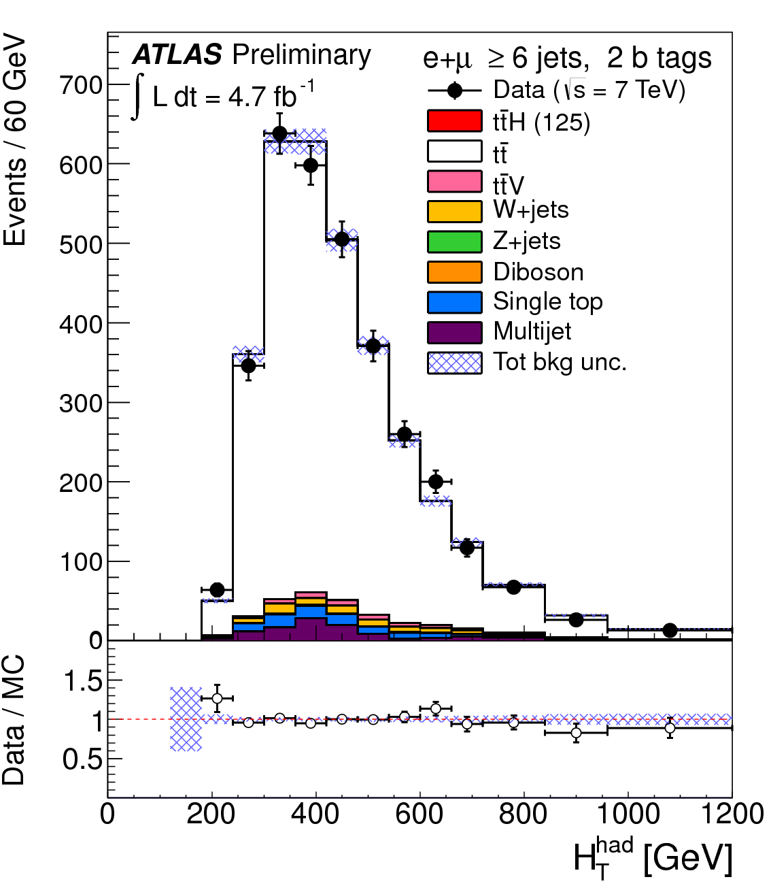
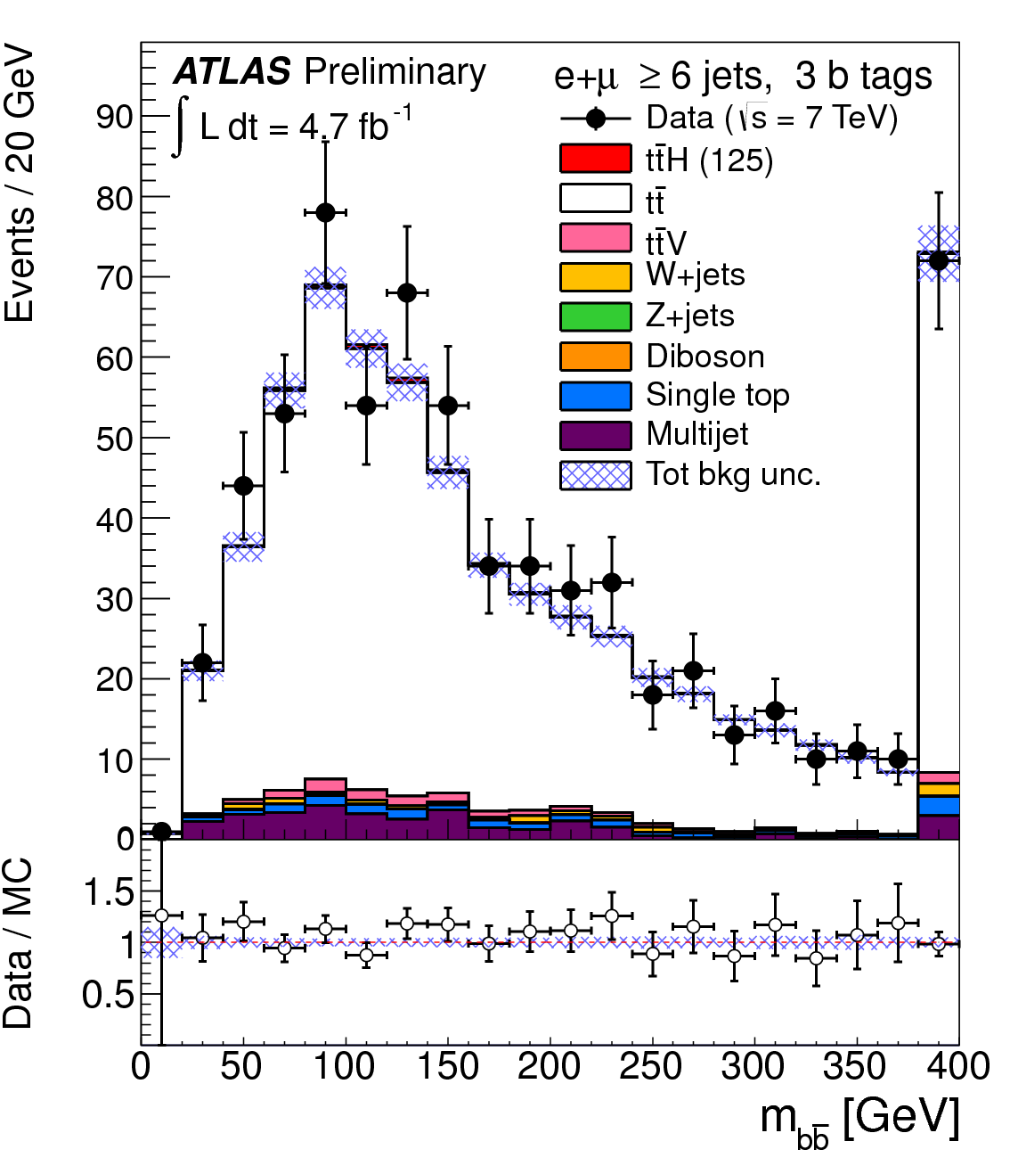
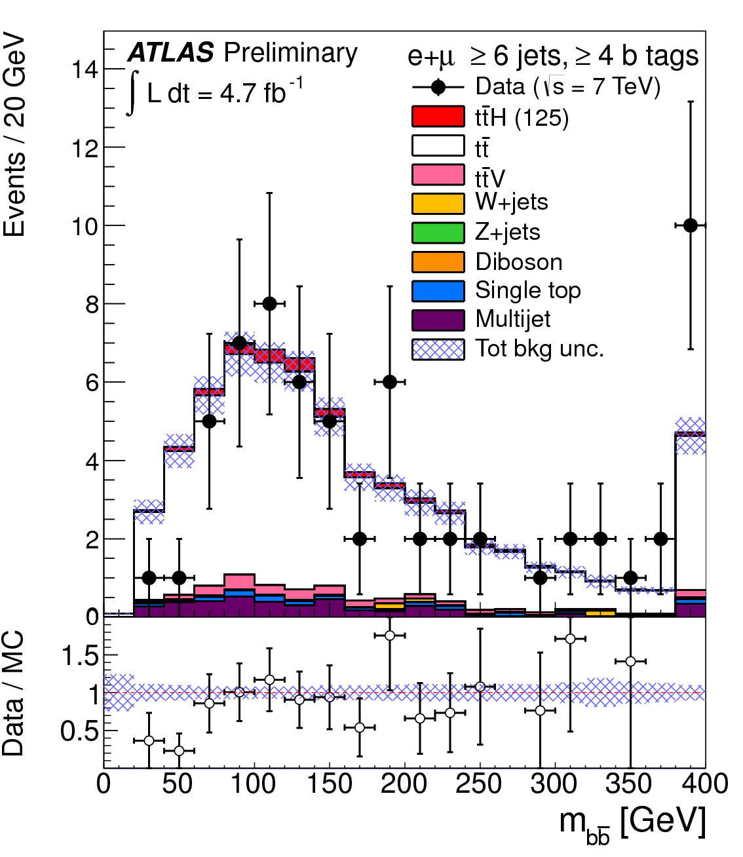
Pre-fit
Post-fit

Slide 12
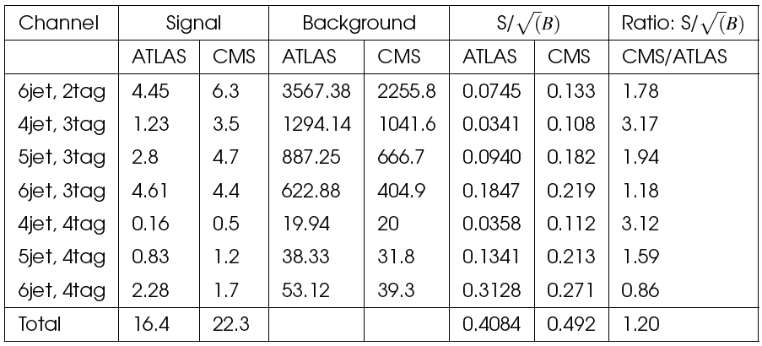
ATLAS/CMS differences
Systematics:
No QCD systematics (no QCD background?!)
No ttH modeling
No W+jets/HF systematic
No JVF systematic (pileup suppression)
Different treatment of Jet Energy Scale (ATLAS 16 NP), b-tag sys. (ATLAS 9 NP) and c-tag sys (ATLAS 5 NP): CMS one Nuis. Par.
b and c tagging correlated
One tt systematic uncertainty (ATLAS 3 NP)
ttbar+HF 20% instead of 50% uncertainty
Cuts:
Electrons and muon:
  ATLAS p_{T}>20/25GeV
  CMS p_{T} > 30 GeV
Jets:
  ATLAS pT>25GeV
  CMS 3 leading jets pt > 40 GeV (otherwise 30 GeV)
More signal and higher cuts. Not clear what signal sources are used
Summary:
ATLAS using CMS systematics: 35% better
20% improvement from more signal
Remaining improvement from use of Multivariate analysis (22%)
In numbers:
σ/σ_{SM} = 10.5 -> 7.8 from systematics
Take 22% improvement from MVA: -> 6.1
Take 20% additional signal: σ/σ_{SM} -> 5.1 (expect)
CMS: 4.9 (expected)

Slide 13

Conclusions
Should get to the bottom of ttH differences…
  BUT Nice problem to have!ttH can be done at LHC!!
Uncertainties:
  Background matters!
  Theory uncertainty matters!
  Background theory uncertainty matters!

Slide 14

Bonus slides

Slide 15
Details and Results:
WH/ZH Analyses

Slide 16
Simulation of signal and background
ATLAS:
W+b-jets – Powheg+Pythia
W+c-jets – Sherpa
W+light jets – Alpgen+Herwig
Z+b/c-jets - Sherpa
Z+light jets – Alpgen+Herwig
ttbar – MC@NLO
Single top – MC@NLO
Dibosons– Herwig
Signal – Pythia 6.4
  Normalized to NLO (EW) + NNLO (QCD)
  Tried Powheg but got wrong b-tagging efficiency (10%!)
CMS:
W+jets – Madgraph
Z+jets - Madgraph
ttbar - Madgraph
Single top – Powheg+Herwig
Dibosons – Pythia
Signal – Powheg+Herwig

Slide 17
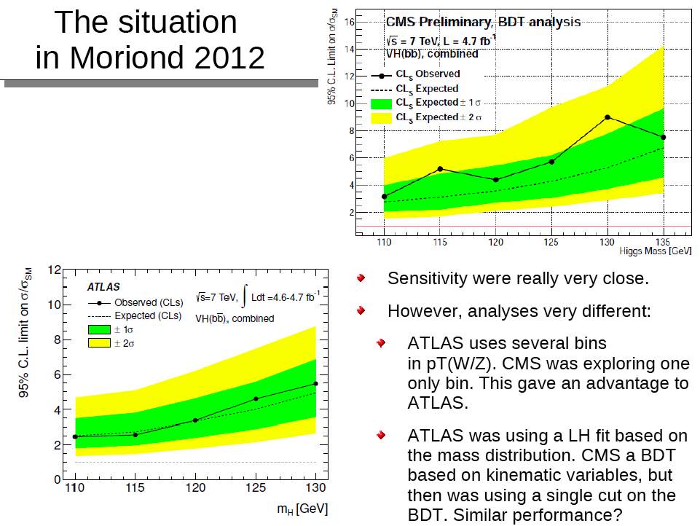

Slide 18
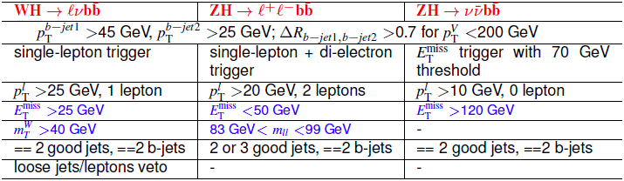
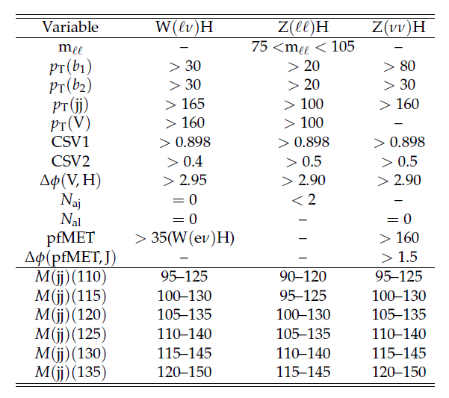
ATLAS/CMS Comparison
ATLAS
CMS
Most striking differences:
B-tagging:
  CMS always has one loose (~70% eff.), one tight (~50% eff.) tag
  ATLASuse two loose tags (too much c- contamination??)
QCD rejection:
  CMS uses no cut on m_{T}(W), and a cut on MET>35 GeV only for WH->eνbb channel
  ATLAS has not optimized this as a function of p_{T}^{W}
Z → vv:
  CMS uses also events with additional jets, whereas ATLAS requires 2 jets to avoid ttbar

Slide 19
ATLAS/CMS Comparison
ATLAS Expected exclusions:
  llbb 6-12 (9 @ 125)
  lvbb 4-9 (7.5 @ 125)
  vvbb 4-7.5 (6.0 @ 125)
  Combination 2.5-6 (4.0 @ 125 GeV)
CMS Expected exclusions @ 125:
  Cut based S/√B
  lvbb ~0.50 → excl. ~4 w/o systematics
  llbb ~0.29 → excl. ~6.9 w/o systematics
  vvbb ~0.41 →excl. ~5 w/o systematics
  After BDT + full analysis + full systematics => CMS combined exclusion is ~4.27@ 125 GeV.

Slide 20
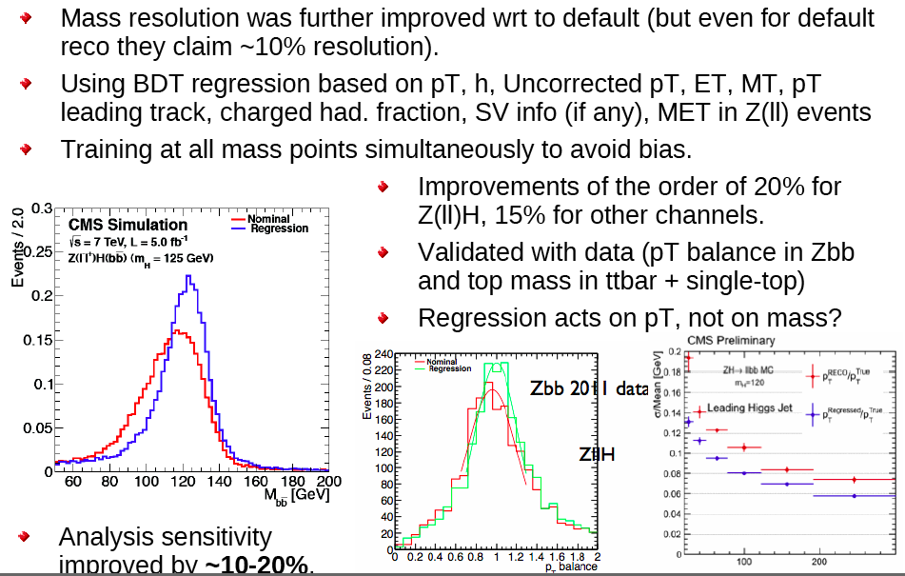
CMS VH analysis: changes for ICHEP

Slide 21
CMS VH analysis: changes for ICHEP
An additional lower pT(W/Z) bin was added to all three analysis a la ATLAS:
  lvbb: [120-170],[170-inf]
  vvbb: [120,160],[160-inf]
  llbb: [50,100],[100-inf]
but then in addition the same p_{T} info is used again in the analysis BDT.
Sensitivity improvement: ~10-15% depending on channel.

Slide 22
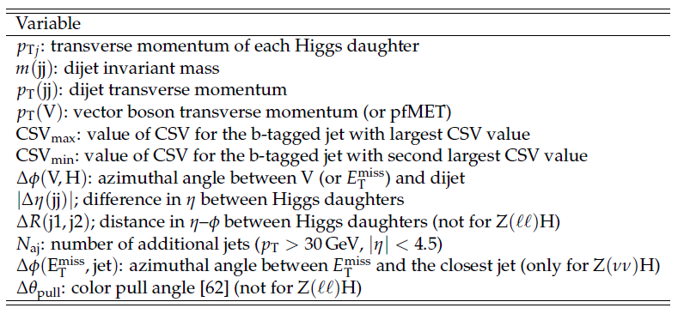
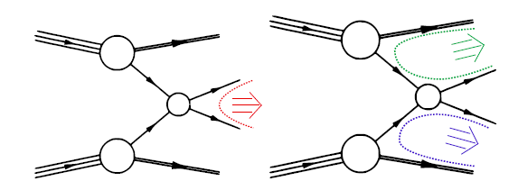
CMS VH analysis: changes for ICHEP
The full BDT shape was used. Sensitivity improved by ~20%.
Input variables:
These variables are all reasonable.
Notice that pT(add. jet) is not used.
Notice the interesting use of Dq(pull) of color connections
  Tried in ATLAS, but basically no sensitivity after rest of the analysis optimization

Slide 23
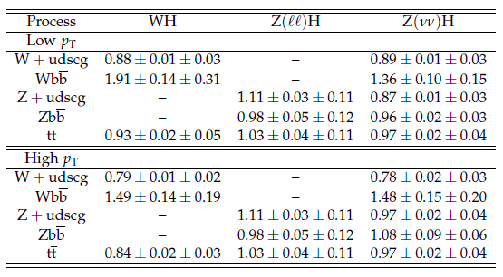
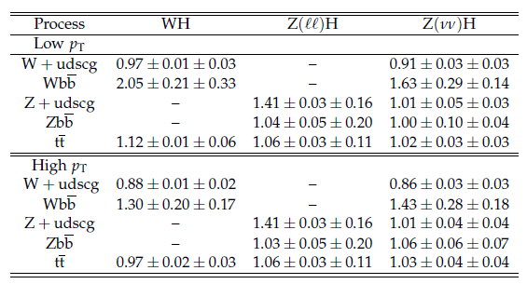
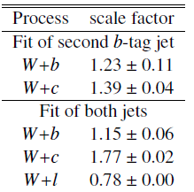

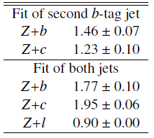
Data-driven background determination
CMS 2011
Control regions not clear in the CMS note
CMS fit background components using a single discriminant variable (dependent on analysis) defined in a control region.
Then apply the main BDT fit.
Scale factors quite different
from ours (but different MC).
No separation of W/Z+c...
CMS 2012
ATLAS WH->lvbb
ATLAS ZH->llbb

Slide 24
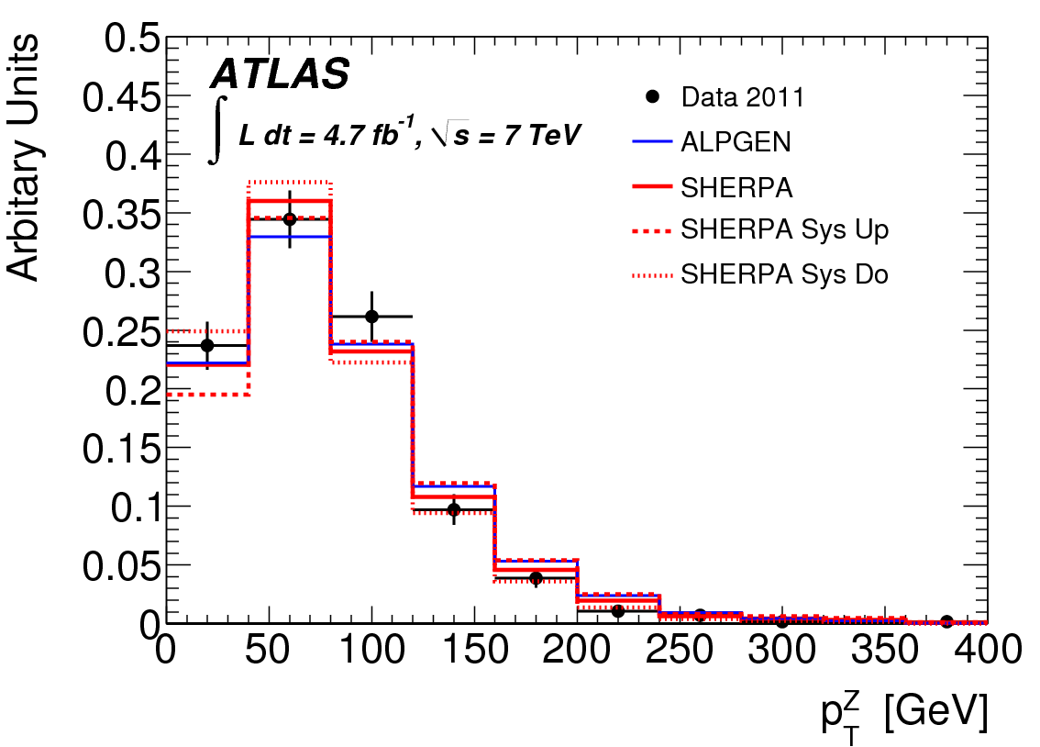
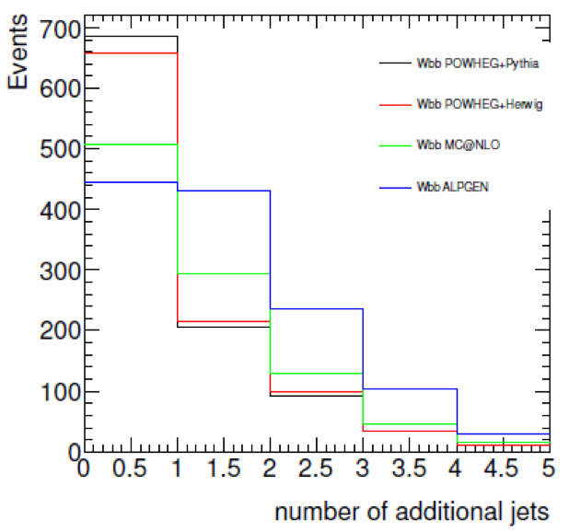
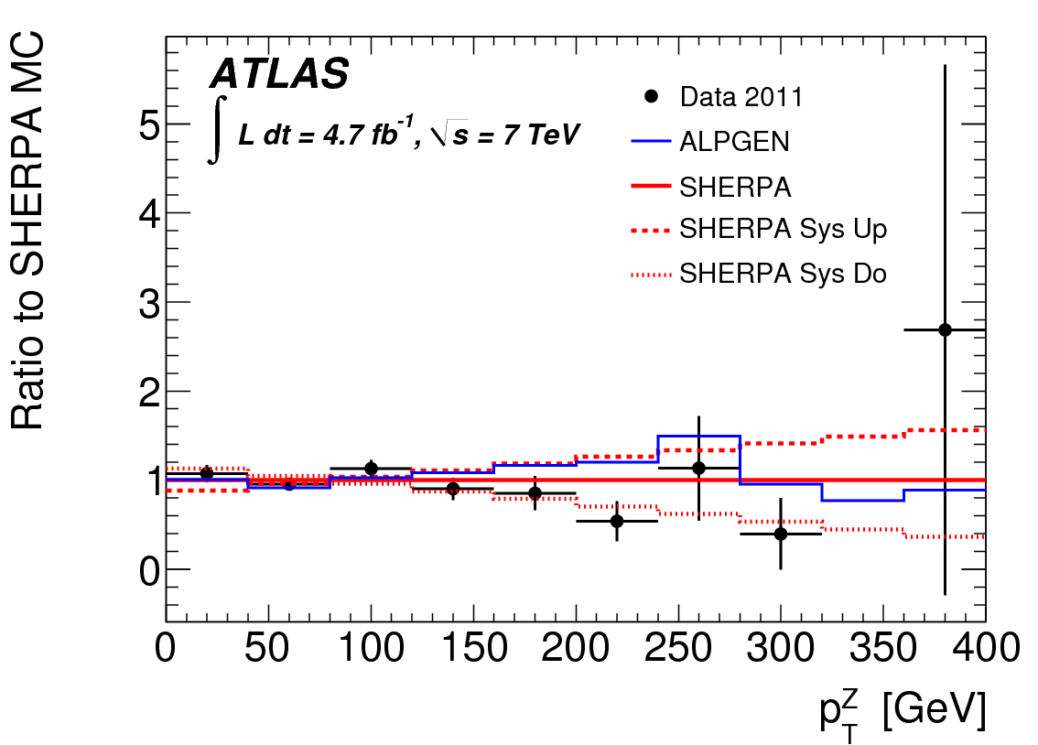
Theory uncertainty

Slide 25
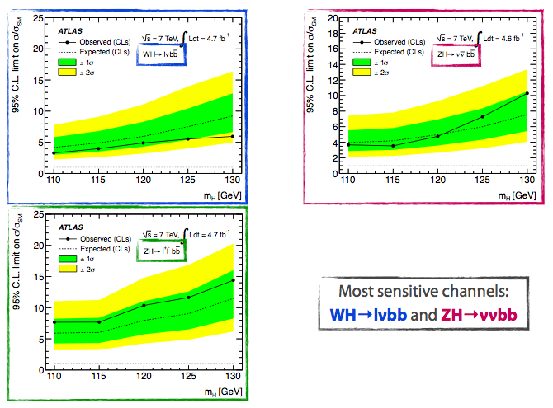
Individual channel limits

Slide 26
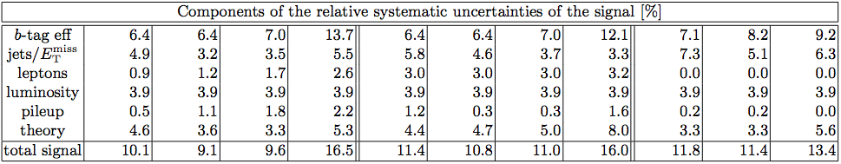
Signal Systematic Uncertainties

Slide 27
Details and Results: ttH Analyses

Slide 28
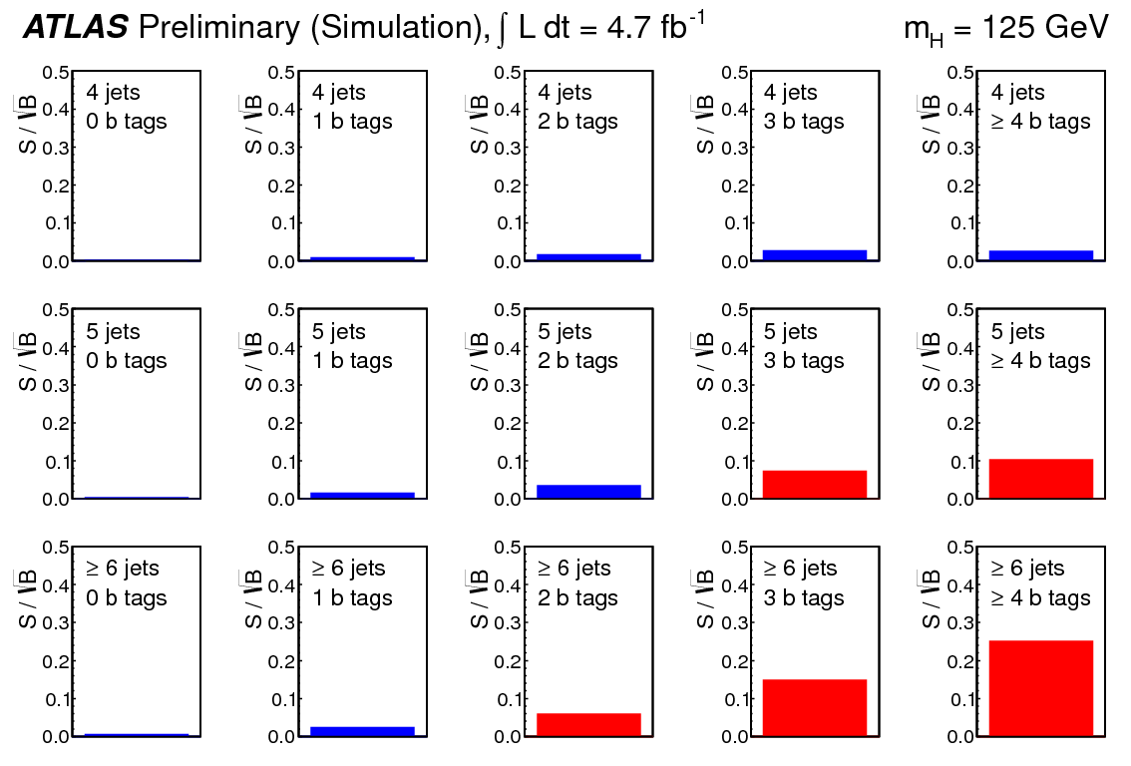

Slide 29
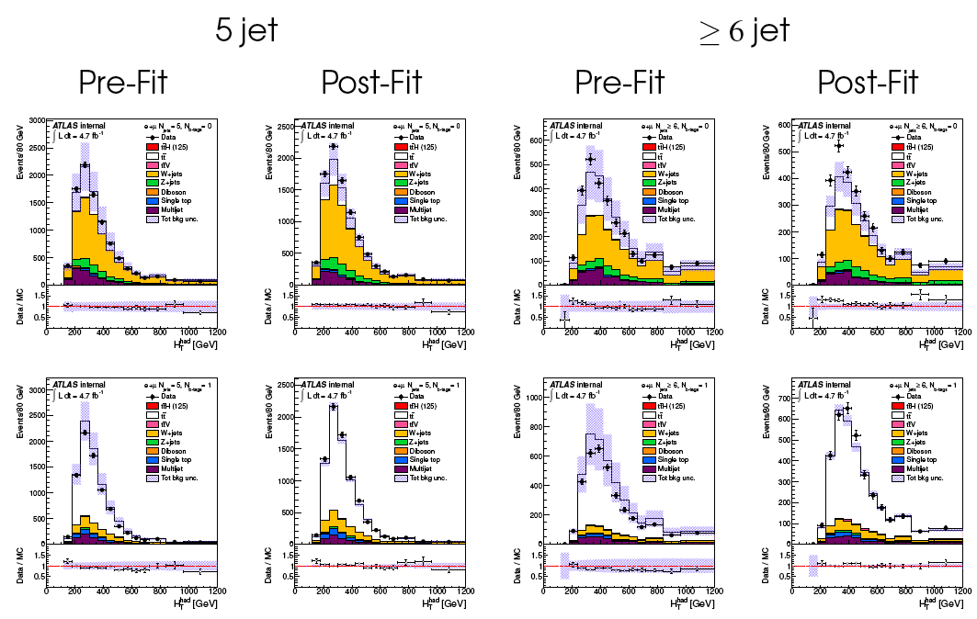
ATLAS Analysis – Control Regions

Slide 30
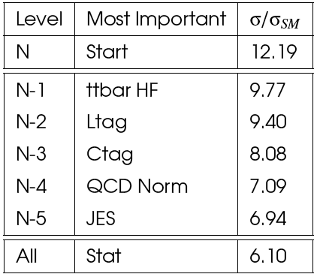
Profiling
Parameters strongly constrained
W+jets, QCD multijet overall normalization, tt , b-tag: 4 jet channels
W+jet and tt: 4 jet 0b has W+jet, 4 jet 1b and 2b
b tagging: four jet evolution across the number of tags
tt modelling and rate uncertainties: 4, 5 and 6 jets with 2 b-tags
tt+HF fraction: Five channels with 3 and 4 b-tags constrains
Importance of systematic uncertainties evaluated with “N-1” test:
  Remove one, put back, remove next…
  Largest impact: freeze (param set to the best fitted value) and repeat
Ordered nuisance parameters:

Slide 31
Systematics
tt+heavy-flavour fractions: Vary by 50% - theory studies suggest cross section uncertainty is 75% ; should be weighted down by the fraction. Fit puts it at 30%.
tt modeling (Alpgen):
  Qfac: (±2.3%) The factorization scale for the hard scatter is varied by a factor of two up and down relative to the original scale, Q² = Σ_{partons}m²+ p²_{T}
  kTfac: (±9.2%) The renormalisation scale associated with the evaluation of α_{s} at each local vertex in the matrix element calculation is varied by a factor of two up and down relative to the original scale, k_{T} , between two partons.
  Functional form of the factorization scale (iqopt2): (± 13%) Default choice (=1) for dynamic factorization scale, Q² = Σ_{partons}m²+ p²_{T}, changed to Q² = x₁x₂s. This has an order of magnitude larger effect than Qfac.

Slide 32
t¯t cross section +9.9 -10.7% using NNLO Hathor.
Jet Energy scale : 16 eigenvectors recommended by the jet/ETmiss group are varied.
b, c and light tagging : 9 (btag),5(ctag) eigenvectors recommended by b-tagging group are varied for heavy flavours and the one value for light flavours.
QCD Multijets Mostly in the electron channel. Correlated 50% uncertainty plus uncorrelated statistical estimate in each channel (66% in 6 jet 4 b-tag)
ttH parton shower modelling: 1-5% effect at mH = 120 GeV

Slide 33
ATLAS vs CMS Comparison
ATLAS | CMS
e: p_{T}>25GeV |η|<2.5 | e: p_{T}>30GeV |η|<2.5
μ: p_{T}>20GeV |η|<2.5 | μ: p_{T}>30GeV |η|<2.1
jets: (0.4): p_{T}>30GeV / 40GeV | Jets (0.5): p_{T}>30/40GeV |η|<2.4
B-tag: 70% (b) 20% (c) 0.8% (lite) | B-tag: 70% (b) 20% (c) 2% (lite)
e ch.: E_{T}^{miss} > 30 GeV M_{T}^{W} > 30GeV
μ ch.: E_{T}^{miss}> 20GeV E_{T}^{miss}+M_{T}^{W} > 60GeV

Slide 34
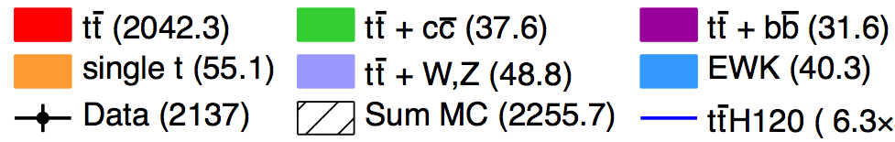
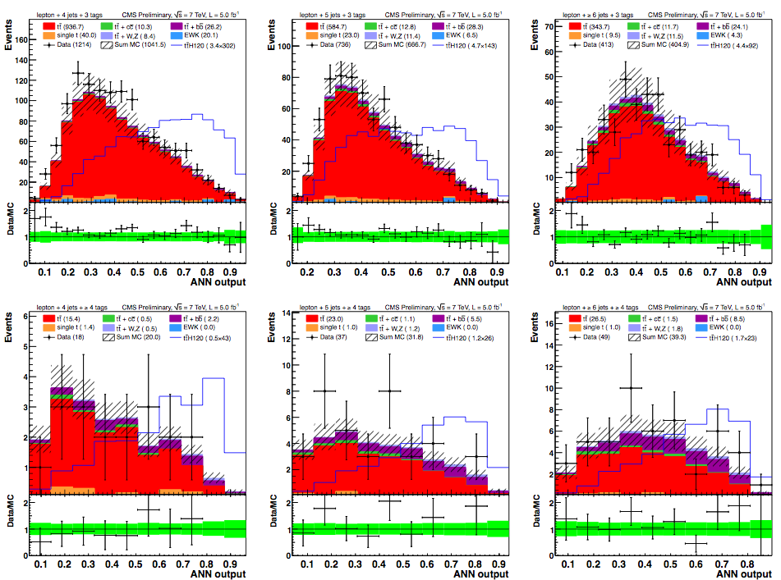
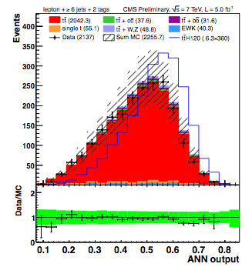
CMS Analysis
4j, 3b
5j, 3b
6j, 3b
6j, 2b
4j, 4b
5j, ≥4b
6j, ≥4b

Slide 35
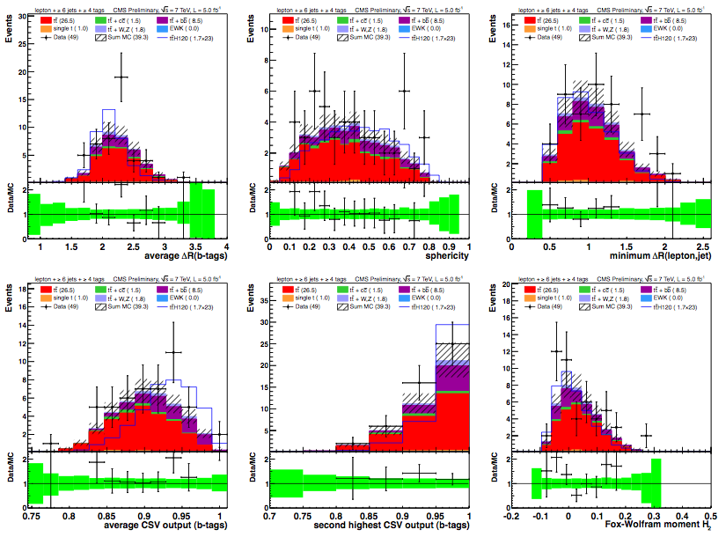
CMS Analysis
Neural-net based analysis of 2011 data
Separate events into categories of #jets and #b-tagged jets
10 best kinematic/event shape/b-tagging variables chosen from “pool of candidates”
Optimized for each #jets/#b-tags category
Simultaneous fit for S and B on NN output distributions
≥6 jets, ≥4 b-tags

Slide 36
CMS
Lepton+jets mode
ATLAS
Very big difference!...

Slide 37
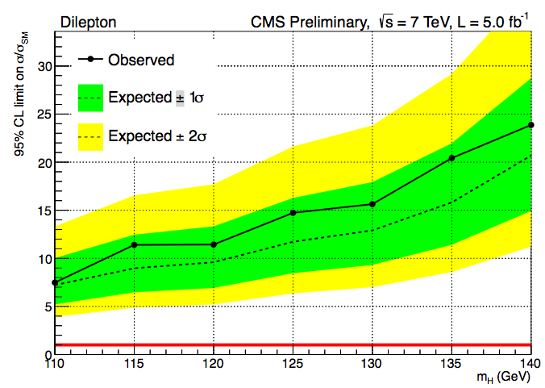
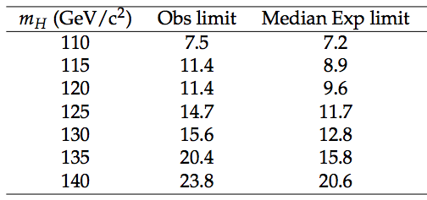
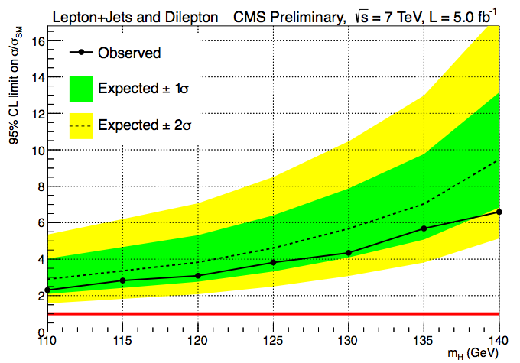

Di-lepton channel
Single-lepton + Di-lepton channels combined
(di-lepton improves expected limit by 6.5%)

Slide 38
Questions to CMS
1. While you state in the abstract that you set limits on sigma*BR(Higgs to bb) your yields tables indicate H -> anything. Is this a mistake and, if not, do you have the H !b¯b and H !WW yields available separately?
2. Your plots show systematics error bands. Are these the a-priori systematics or does it reflect the result of the fit? If it is a-priori, do you have plots with the reduced systematics after the fit? Is table 3 the a-priori systematics or post fit? Can you give us the details for the most senstive region, ge6j ge4b?
3. Have you got numbers on how the systematic uncertainties are constrained by your likelihood fit and if so can we see them?
4. You have not provided definitions of your variables. Can you give us precise definition of the discriminants? We can guess on many of them but it would be better to know what you really used.

Slide 39
5. You say that your largest systematic is ’b-tag heavy flavour scale factor’. Is this the b-tagging uncertainty or a theoretical uncertainty? This is presumablly b-Tag SF (b/c) in table 3, is it? Does b-Tag SF (b/c) mean that you take the uncertainties in b and c tagging as correlated?
6. What is your sensitivity in the semileptonic mode without systematics? (ie. stat only).
7. What is the impact of the shape uncertainties? ie. if you only have rate uncertainties, what is the sensitivity?
8. Can you please expand on your experimental uncertainties in tagging: ie. separate out the b and c tag uncertainties and describe it by the channel fit? Do you have tables available for all uncertainties in each channel, and in particular for ttbar background in the >=6j >=4b channel?

Slide 40
Tools of the Trade:
Statistics Survival Guide

Slide 41

The Brazil Plot
Expected:
Upper limit on σ(S+B)/σ(B) at 95% CL in Monte Carlo assuming B-only hypothesis
Observed:
Upper limit on σ(S+B)/σ(B) at 95% CL seen in data assuming B-only hypothesis

Slide 42

The p0 Discovery Plot
p0 is the probability that the background fluctuates to look like signal
Translated into the one-sided Gaussian probability

Slide 43

The Cyan Band Plot – signal strength
Best fit of μ=σ(S+B)/σ(B) to data
Error bands important…. As usual!

Slide 44
Tools of the Trade:
The Hardware

Slide 45


The Large Hadron Collider
26 659m circumference
9593 magnets: 1232 main dipoles (8T peak field)
Cooled to 1.9K (colder than outer space) by 120 tonnes of liquid Helium
Internal pressure 10-13 atm (10x less than on the Moon)
√s = 7TeV in 2010 and 2011
√s = 8TeV in 2012
50ns bunch crossing
Design √s = 14TeV and 25ns bunch crossing (7m at c)
Light aircraft carrier (10,000 tonne) traveling at 30km/h

Slide 46


Slide 47

Muon Spectrometer: |η|<2.7
Air-core toroids and gas-based muon chambers
σ/p_{T} = 2% @ 50GeV to 10% @ 1TeV (ID+MS)
EM calorimeter: |η|<3.2
Pb-LAr Accordion
σ/E = 10%/√E ⊕ 0.7%
Hadronic calorimeter:
|η|<1.7 Fe/scintillator
1.3<|η|<4.9 Cu/W-Lar
σ/E_{jet}= 50%/√E ⊕ 3%
JINST (2008) 3 S08003
B field
L = 44 m, ∅ ≈ 25 m
7000 tonnes
≈10⁸ electronic channels
3-level trigger reducing 40 MHz collision rate to 200 Hz of events to tape
Inner Tracker: |η|<2.5, B=2T
Si pixels/strips and Trans. Rad. Det.
σ/p_{T} = 0.05% p_{T} (GeV) ⊕ 1%

Slide 48



ATLAS
Large angular coverage (|η|<4.9; tracking coverage up to η~2.5)
Standalone muon spectrometer – separate fast muon chambers for trigger
Toroidal magnetic field in muon spectrometer (supercondutor air-core toroids)
Liquid Argon electromagnetic sampling calorimeter with accordion geometry
Pixel: 10x100μm; 80 M channels
Strips: 80μm; 6 M channels
160000 channels

Slide 50


 | ATLAS | CMS
Magnetic field | 2 T solenoid + toroid (0.5 T barrel 1 T endcap) | 4 T solenoid + return yoke
Tracker | Si pixels, strips + TRT σ/p_{T} ≈ 5x10⁻⁴p_{T} + 0.01 | Si pixels, strips σ/p_{T} ≈ 1.5x10⁻⁴p_{T} + 0.005
EM calorimeter | Pb+LAr σ/E ≈ 10%/√E + 0.007 | PbWO4 crystals σ/E ≈ 2-5%/√E + 0.005
Hadronic calorimeter | Fe+scint. / Cu+LAr (10λ) σ/E ≈ 50%/√E + 0.03 GeV | Cu+scintillator (5.8λ + catcher) σ/E ≈ 100%/√E + 0.05 GeV
Muon | σ/p_{T} ≈ 2% @ 50GeV to 10% @ 1TeV (ID+MS) | σ/p_{T} ≈ 1% @ 50GeV to 5% @ 1TeV (ID+MS)
Trigger | L1 + RoI-based HLT (L2+EF) | L1+HLT (L2 + L3)

Slide 51





Event Reconstruction
Detector design is a balance between precision to reconstruct particles of interest, feasibility, cost, etc
  E.g. CMS electromagnetic calorimeter: excellent energy resolution for photons – designed with H->γγ in mind
Event reconstruction:
  Go from information in every sub-detector to reconstructed physical objects:
  Muons (inner detector + muon spectrometer)
  Electrons, tau leptons, hadronic jets, b-quark initiated jets (inner detector+ calorimeter)
  etc

Slide 52



Electron & Photon Reconstruction
Electrons
ECAL Barrel

Slide 53



Jet Reconstruction
Jets reconstructed in a cone of ΔR≈0.4 (ATLAS) and ΔR≈0.5 (CMS)
Jet Energy Correction:
  Electronic noise
  Detector calibration & reconstruction efficiencies
  Energy deposits from pileup
  Dependence on η & P_{T}

Slide 54


Transverse Missing Energy (M_{ET})
Energy conservation in direction transverse to colliding p-p beams
Need to account for
  Non-linear calorimeter response
  Instrumental noise, poorly instrumented area
  mis-measured objects
Use Z → μμ events with no intrinsic MET
to measure MET resolution
Z→μμ

Slide 55



b-Jet Identification
B-lifetime ≈ 1.5ps, <βγcτ> ≈ 1800μ
Tracks from b-hadron decay have large P_{T}
Average multiplicity ≈ 6
B-taggers based on
  Large signed impact parameter significance
  Secondary vertex with large decay length
Mistag rate measured from “negative tags”
Signed decay length
of B vertex
Signed impact parameter of tracks in the jet
+
Operating
point

Slide 56


LHC Luminosity
2010 – ≈45 pb⁻¹ / experiment
  No chance of searching for Higgs boson
  But needed to understand our brand new detector!
2011 – ≈5 fb-1 per experiment
  Things start to be (very) interesting
  Tevatron breathing down the LHC’s metaphorical neck
2012 – ≈11 fb⁻¹ / experiment up to yesterday … and counting
  New Particle discovery announced!
And the rest is (will be) history

Slide 57

ATLAS: Pileup Evolution: 2010

Slide 58

ATLAS: Pileup Evolution: 2011
11 vertices

Slide 59

ATLAS: Pileup Evolution: 2012
25 vertices
<μ>≈35 is now common
Means ≈45 early in
the LHC fill

Slide 60




Pileup & Its Consequences
Many more particles to reconstruct
  ➔more CPU &
memory in event
reconstruction
Contaminated Jets
  (due to additional particles)
Worsening of MET resolution
  (more objects to sample)
Worsening of Isolation observables
Ambiguity in hard-scatter vertex identification, e.g. H → γγ
N_{PV}

Slide 61


Mitigating Pileup
Detector level mitigation: Readout over smaller time slice
  Significantly reduces OOT pileup
Remove from consideration charged hadrons that originate from pileup vertices
Amount of additional pileup energy is determined by the jet area (A) and the energy per unit area (ρ)
  and subtracted
Take advantage of the topological shape differences between jets from pileup and more collimated jets from hard-scatter of partons
Typical jet
Pileup jet

Slide 62
Trigger
First step in every physics analysis!
Much of LHC physics means cross sections x10⁶ times smaller than total cross section
ATLAS offline processing: ≈400 Hz
  ≈10 events per million crossings!
In one second at design luminosity:
  40 000 000 bunch crossings
  ≈2000 W events
  ≈500 Z events
  ≈10 top events
  400 events written out
Should take the right 400 events!...
Different designs in ATLAS and CMS
  ATLAS has 3 processing levels; Region-of-Interest driven reconstruction; event built after Level 2
  CMS has 3 levels but event built after Level 1
Also different strategies:
  ATLAS has most bandwidth assigned to exclusive triggers, e.g. muon trigger (+ anything)
  CMS relies more on exclusive triggers e.g. muon + 2 jets
7 TeV

Slide 63
Other:

Slide 64

Tevatron Higgs cross section

