Slide 1



[ Tile light yield and uniformity ]
Miguel Bernardo, João Gentil, Ricardo Gonçalo
FCC-hh Calo Meeting – 20 March 2018
Notes:
1

Slide 2
Summary
Our goal is to characterize real-sized plastic tiles as planned for the FCC HCAL
Measure of the light yield and uniformity
Use realistic readout:
      Wavelength shifting optical fibre of appropriate length
      Readout by PMT – no SiPM available at the moment
      Outline:
      Cutting tiles to realistic sizes
      Experimental setup
      Light yield measurements

Slide 3
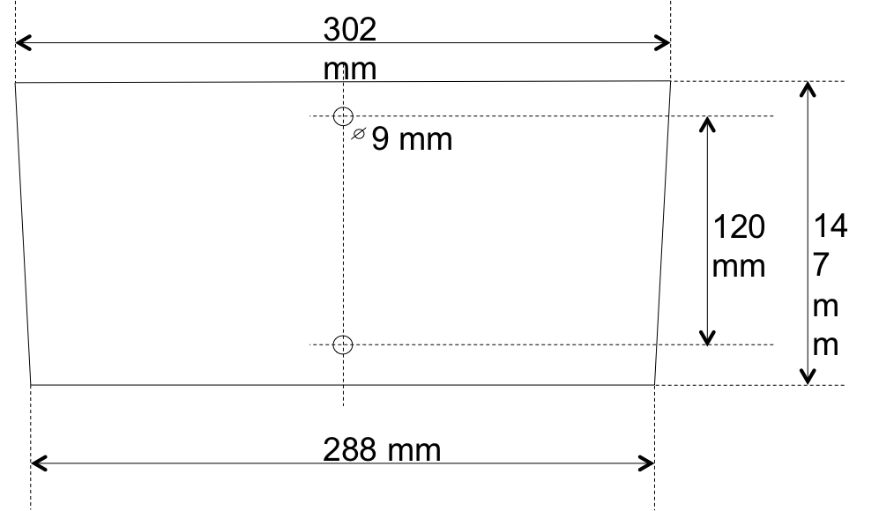
Scintillating Tiles
Used one #7 tile from ATLAS TileCal pre-production to obtain:
One half-tile from layer 1
One tile from layer 1
One half-tile from layer 10
ATLAS
Tile #7
WLS fibre

Slide 4
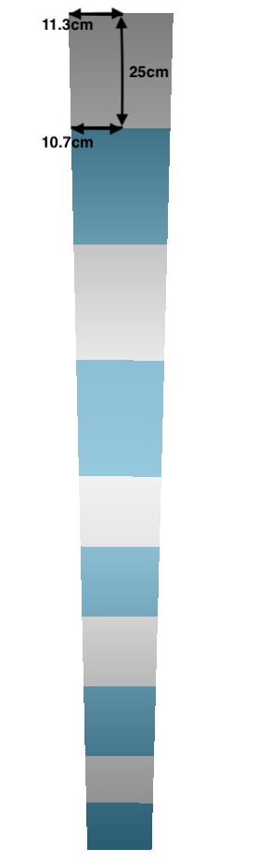
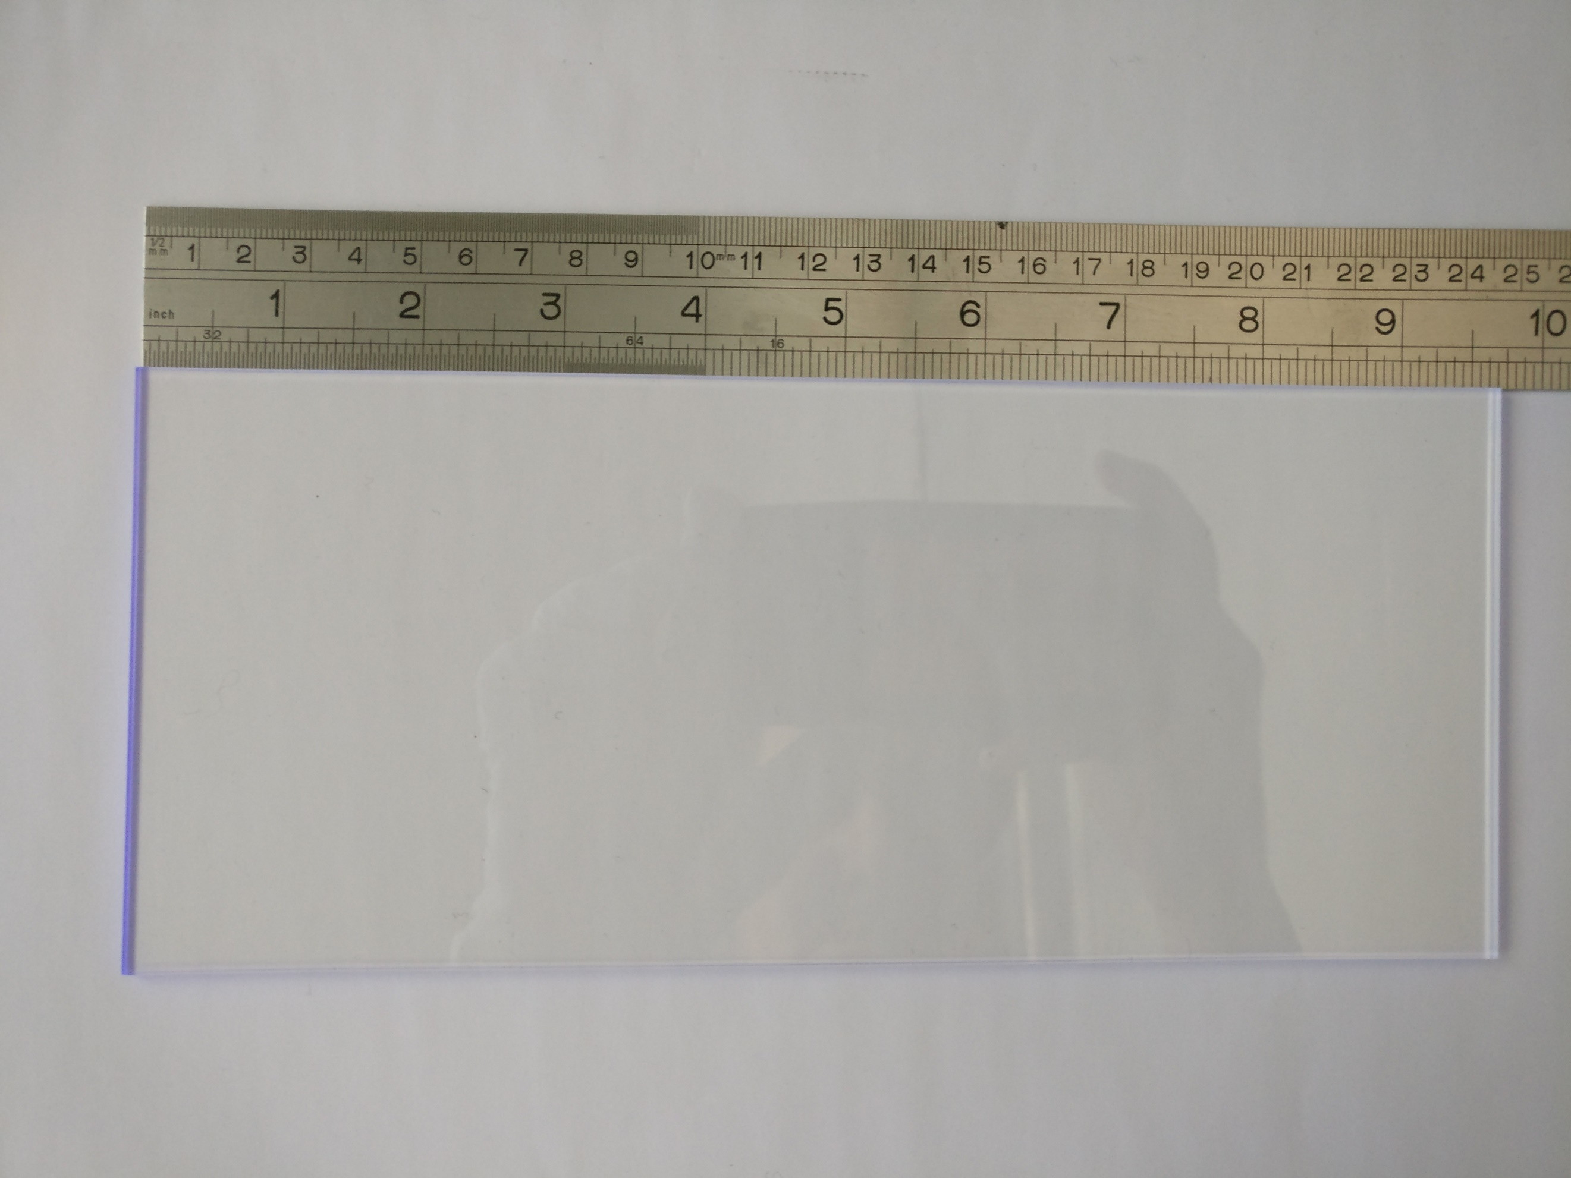
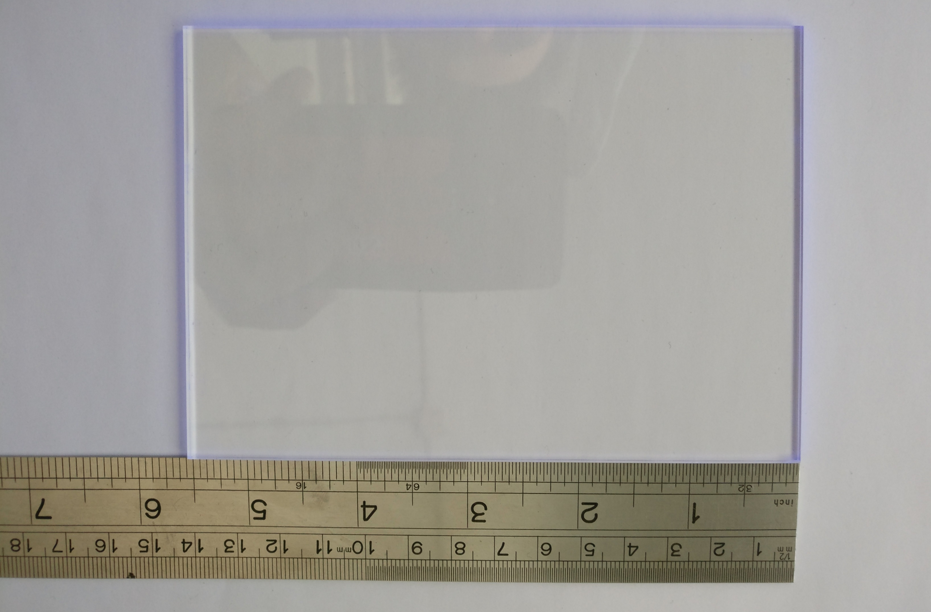
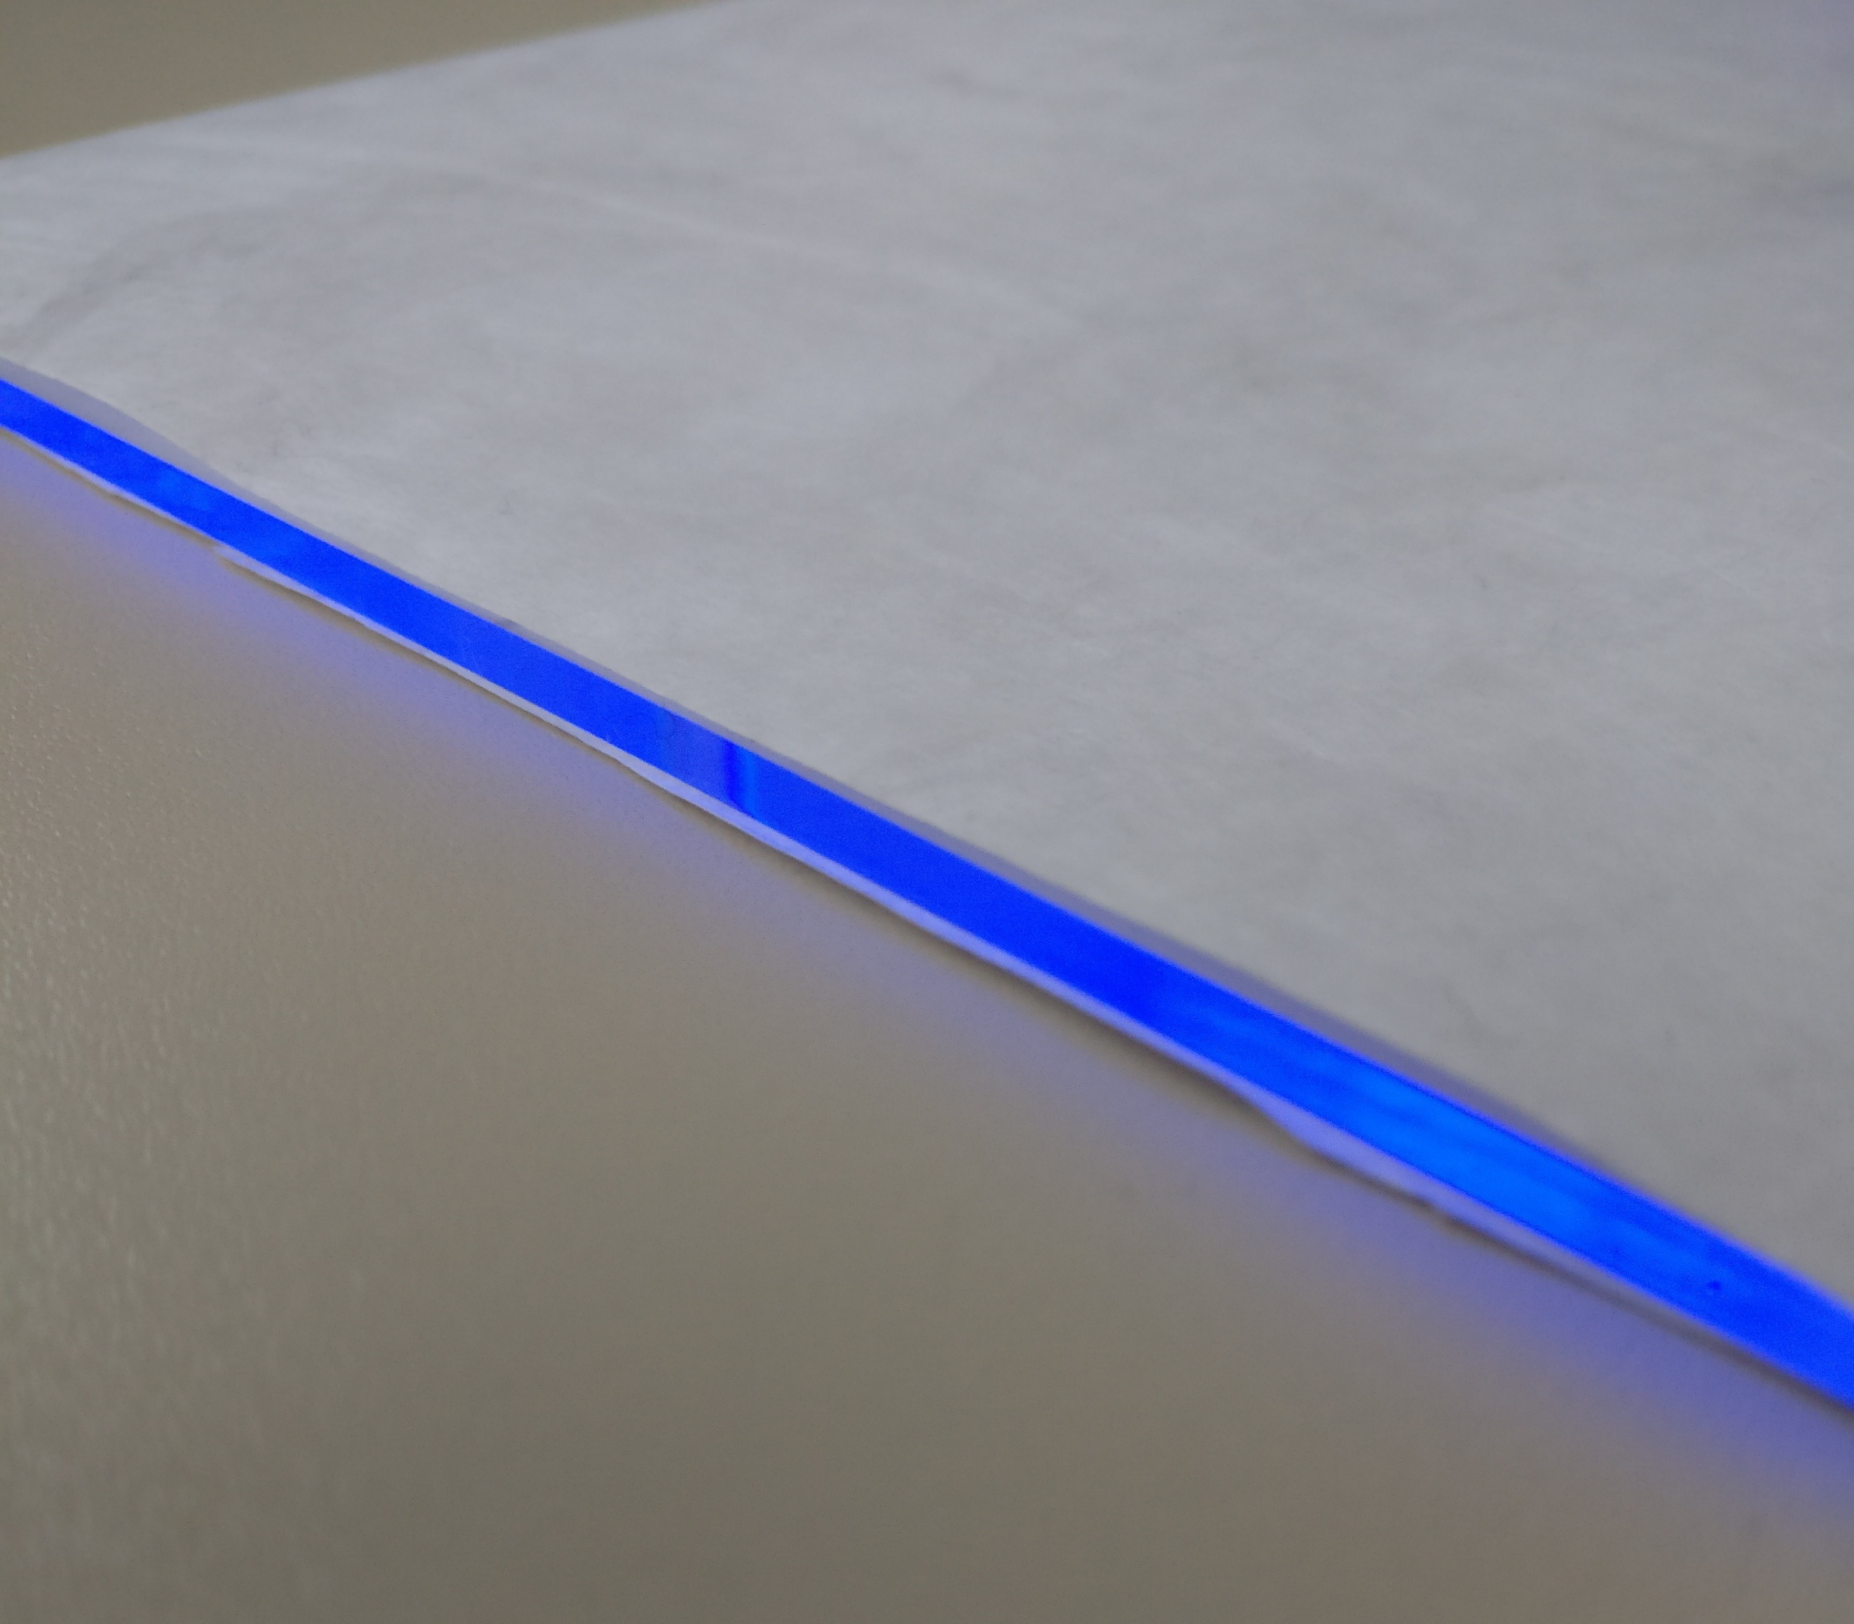
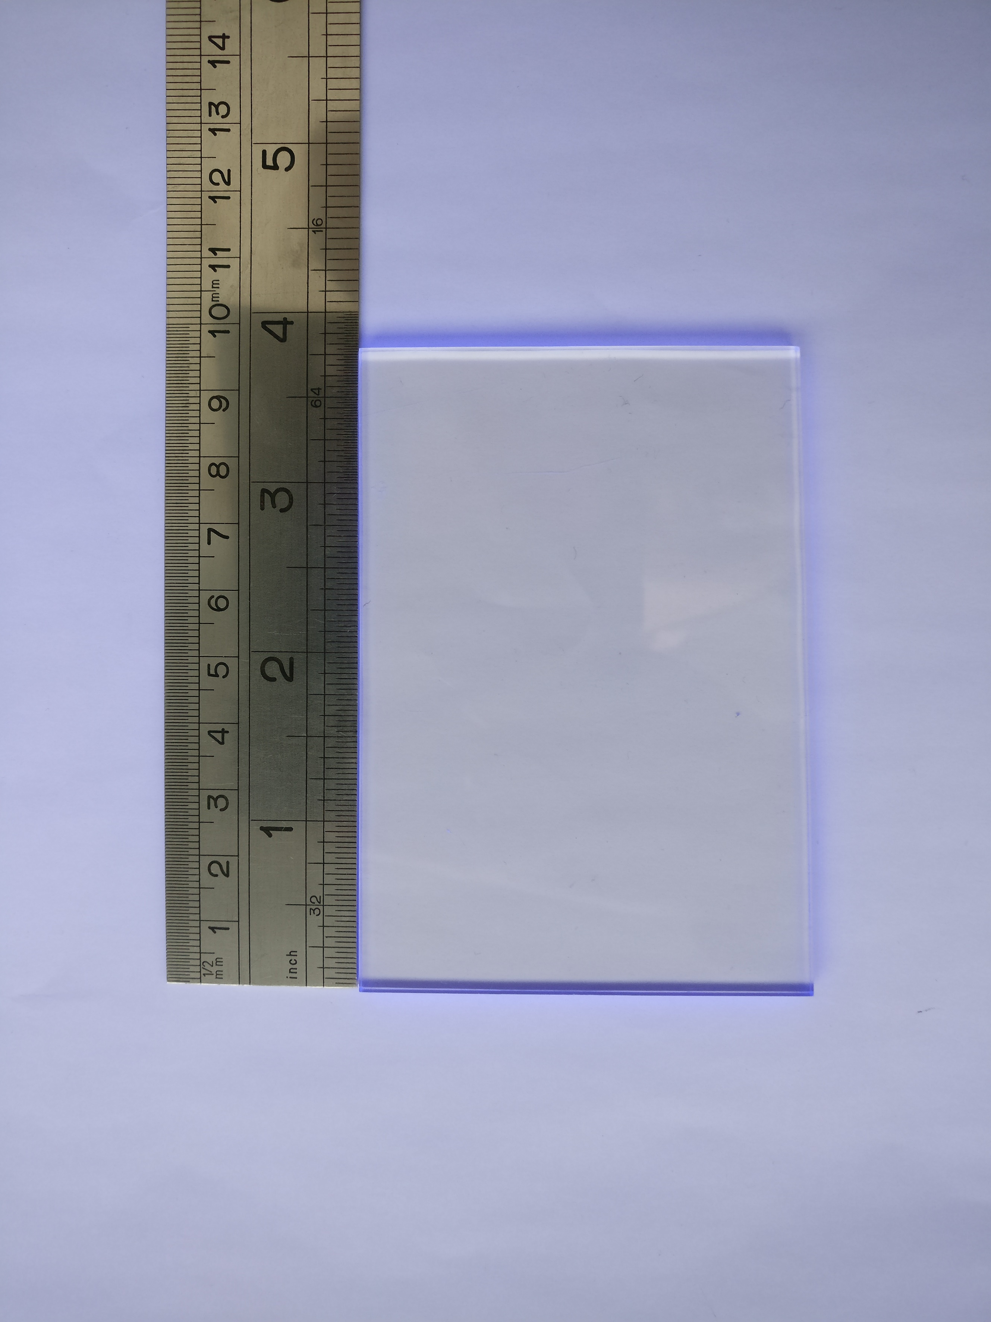
Scintillating Tiles
Used one #7 tile from ATLAS TileCal pre-production to obtain:
One half-tile from layer 1
One tile from layer 1
One half-tile from layer 10
Tiles wrapped in TYVEK to increase uniformity

Slide 5
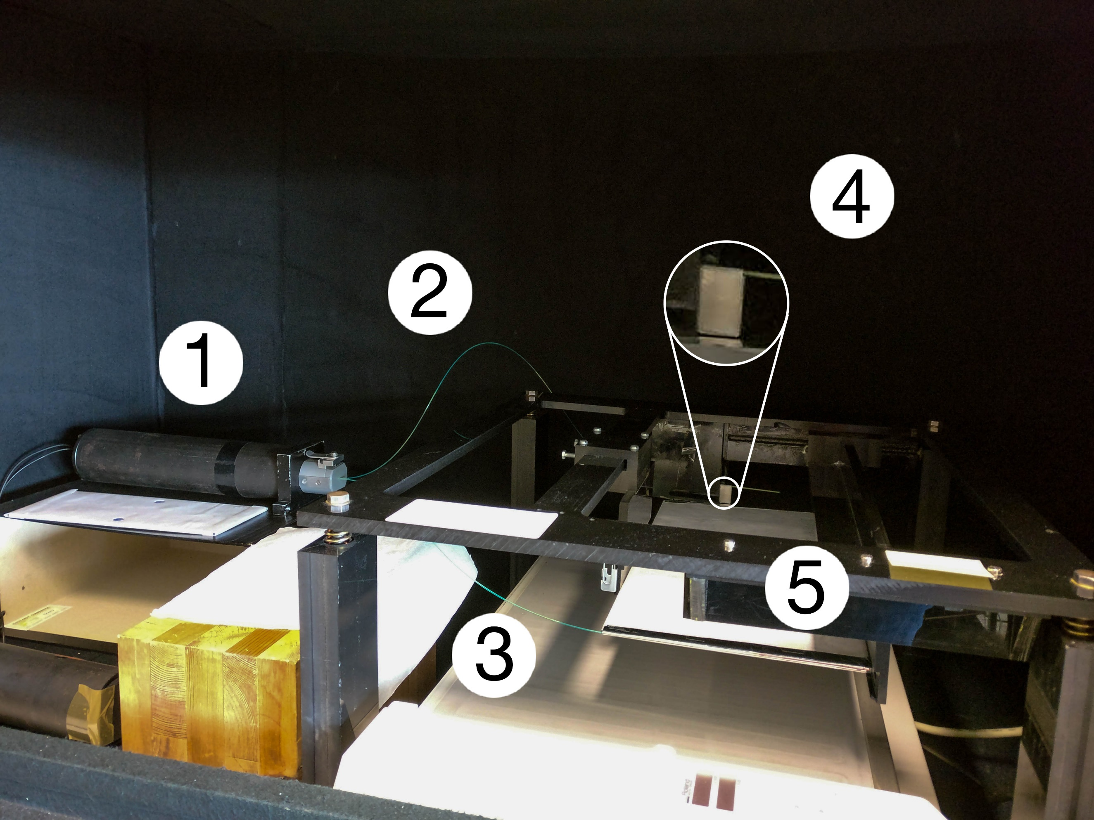
Experimental Setup
Source mounted on a X-Y arm
⁹⁰Sr/⁹⁰Y β⁻ source
E_{max} = 546 keV / 2.283 MeV, A ≈ 0.5 mCi
Optical readout: wavelength-shifting fibre
Readout: photomultiplier in current mode
Light yield is with respect to reference plastic scintillator tile
Photomultiplier tube
WLS fibre reading reference tile
WLS fibre reading test tile
Reference scintillating tile
Test scintillating tile

Slide 6
Results so far
Response uniformity of tile #10 (note relative yield)
X (400 steps / cm)
X (400 steps / cm)
WLS fibre

Slide 7
Results so far
Reproducibility of results tested with of tile #10
Around 2% except for changing/unstable conditions (around 5% for cold HV source)
X (400 steps / cm)
X (400 steps / cm)
WLS fibre

Slide 8
Results so far
Response uniformity of tile #10 (note relative yield)

Slide 9
Results so far
Response uniformity of tile #1 (note relative yield)
Response = 100 x (Signal – Noise) / Reference
Tiles read by 2.3 m WLS fibre
Tiles wrapped in TYVEK
WLS fibre contact-coupled to tile
Held in place by TYVEK envelope
Each point corresponds to 30 current measurements
Error bar is standard deviation
Curves in figure:
Nearer to PMT
Middle
Far end
X
X – 400 steps / cm
WLS fibre

Slide 10
Results so far
Response uniformity of tile #10 (note relative yield)
Response = 100 x (Signal – Noise) / Reference
Tiles read by 1 m WLS fibre
Tiles wrapped in TYVEK
WLS fibre contact-coupled to tile
Held in place by TYVEK envelope
Each point corresponds to 30 current measurements
Error bar is standard deviation
Y
Y
X
X
WLS fibre

Slide 11
Outlook
First measurements done but many still missing:
Measure tile #10 with shorter fibre
Comparing uniformity with/without TYVEK
Comparing with known TileCal tile – to normalize response
Ideally get hold of SiPM to repeat measurements
19
Notes:
11

Slide 12
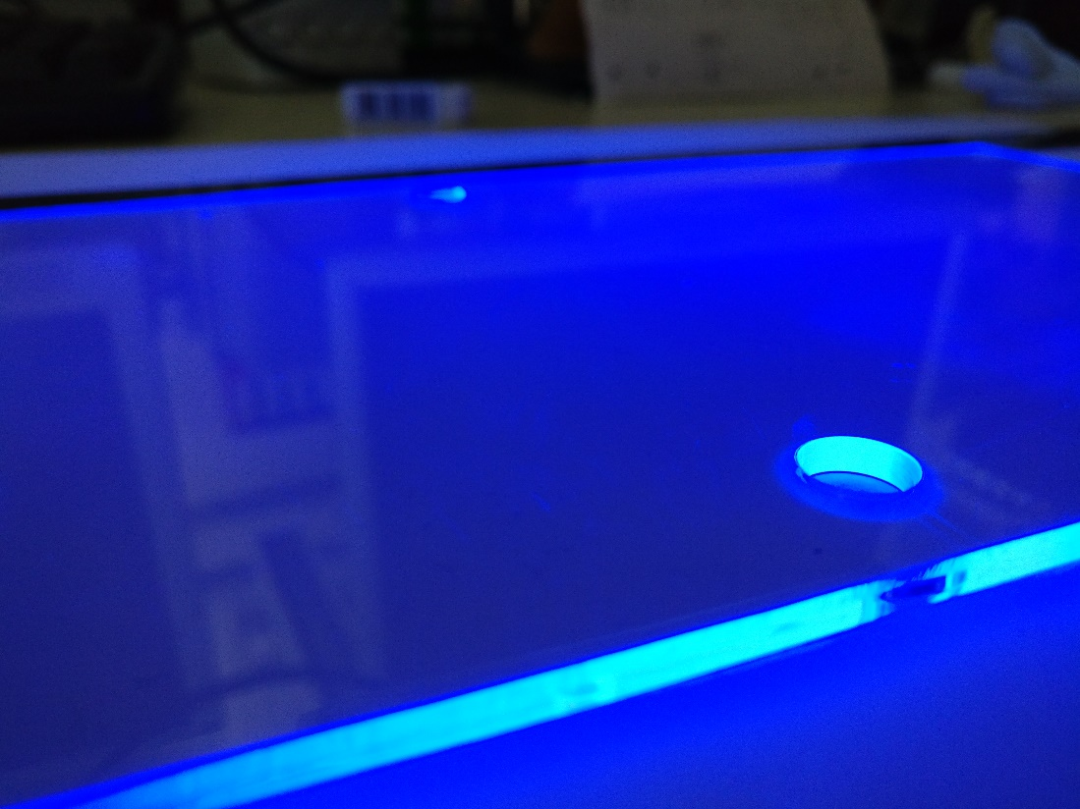






Bonus slides
Comments welcome!
Notes:
12

Slide 13
Corte e polimento
Telha tipo 7 de ATLAS TileCal
Hipótese B (Telha #2): obter um trapézio com altura de 100 mm de altura e bases de 144 e 138 mm, mais um meio trapézio cortado pelo eixo de simetria
302 mm
144 mm
72 mm
91.7°
100 mm
100 mm
91.7°
138 mm
9 mm
69 mm
288 mm

Slide 14
Corte e polimento
Telha tipo 7 de ATLAS TileCal
Hipótese B (Telha #3): obter meio trapézio com altura de 250 mm e bases de 226/2 = 113 mm e 214/2 = 107 mm, cortado pelo eixo de simetria
302 mm
6 mm
9 mm
107 mm
113 mm
250 mm
288 mm

Slide 15
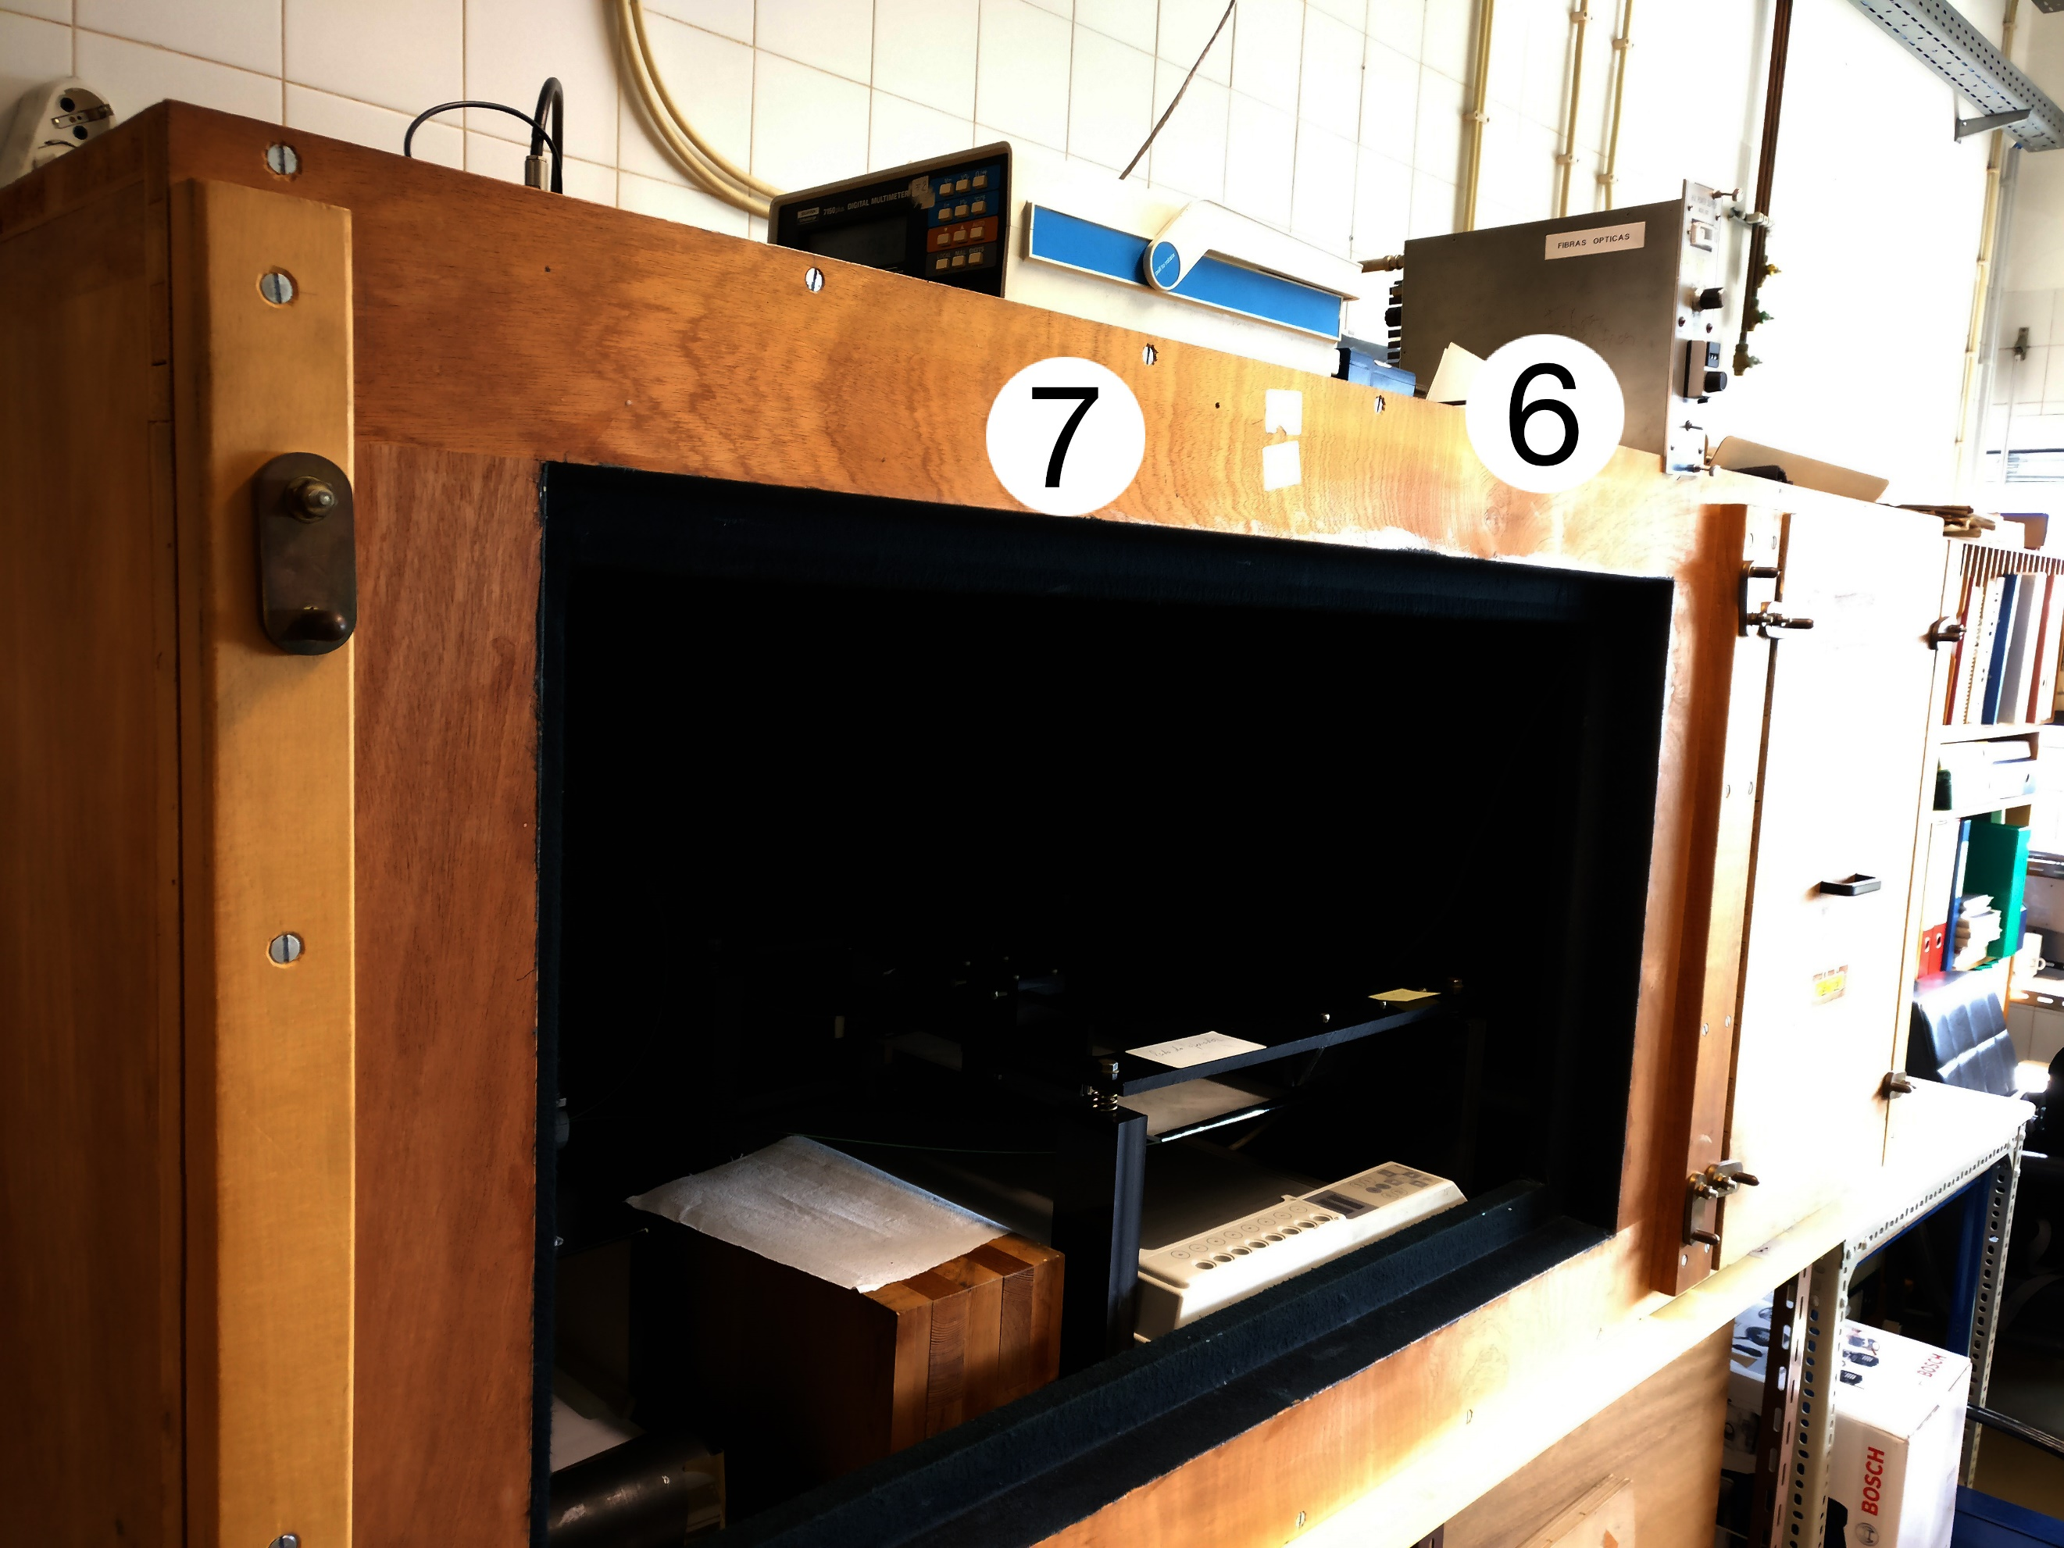
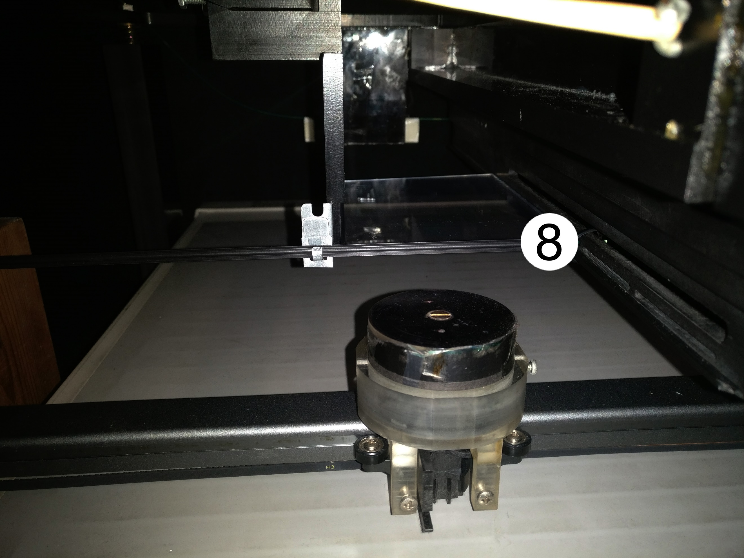
Experimental setup
6 – high-voltage source
7 – digital multimeter to read PMT current
8 radioactive source on X-Y arm

Slide 16
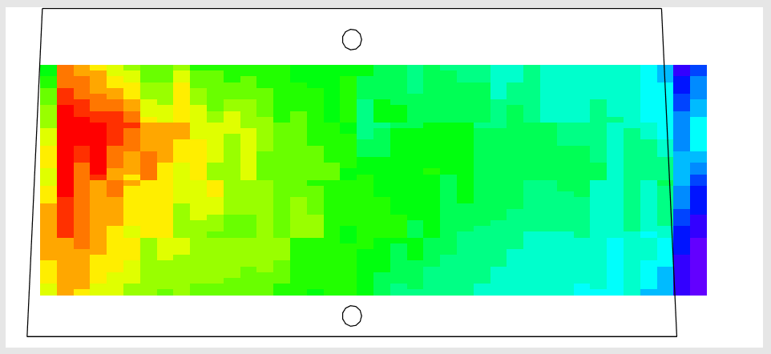
Test using ATLAS #7 tile

