Slide 1
FCC Portugal Engagement Meeting
Overview of HEP Activities in Portugal
Ricardo Gonçalo – UC / LIP

Slide 2
Outlook
Portuguese HEP community
Portugal and the FCC
Experiments
Detector R&D
Theory and phenomenology
A little about LIP
Priorities and conclusions

Slide 3
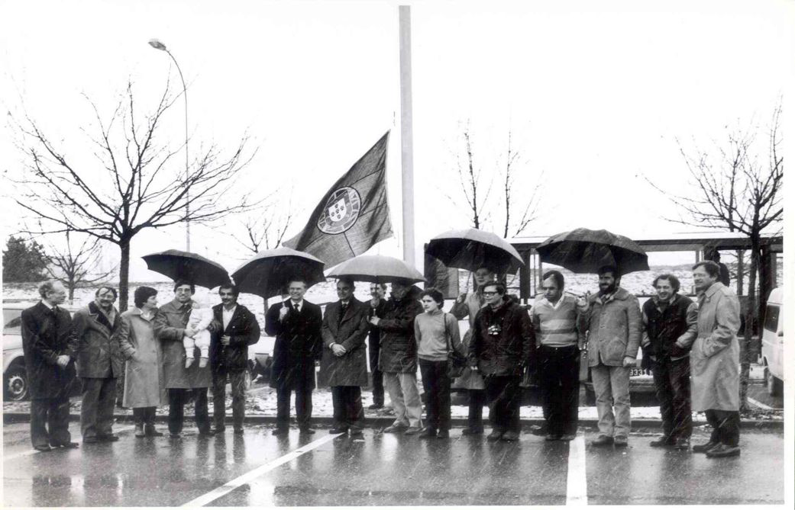
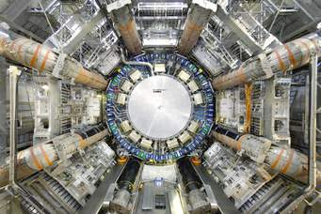
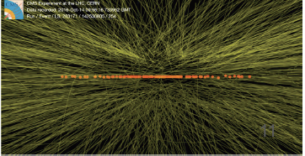
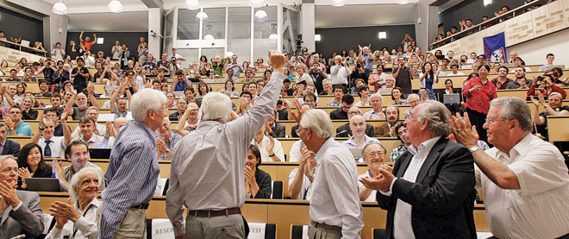
Portugal and CERN
Portugal joined CERN in 1986
Participated in the last 35 years of CERN’s life:
Fixed target, LEP, LHC, HL-LHC, R&D, Theory
But also Training programs, ECFA, EPPCN, etc
Want to participate in its future!

Slide 4
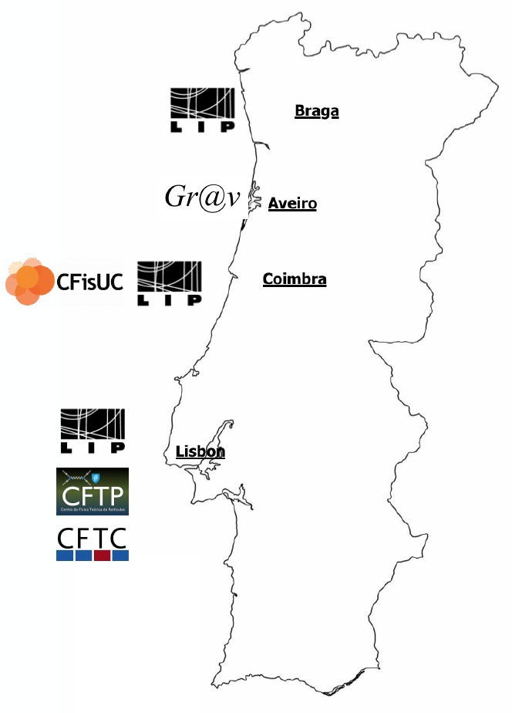
Portuguese HEP Community
Around 350 people in Portuguese institutions
~150 postgraduate students
>100 CERN users
~1/2 in LHC experiments
~1/3 in Isolde
Activity on:
Experimental particle physics (LIP)
Detector development for HEP and other (LIP, CFisUC)
Grid/HTC computing (LIP, FCCN)
Particle theory and phenomenology (LIP, CFTP, CFTC, CFisUC, Gr@v)
Plasma wakefield acceleration (IPFN)
Close connection to universities in Lisbon, Coimbra, Minho
Also connections to several technology-based Portuguese companies working with CERN

Slide 5
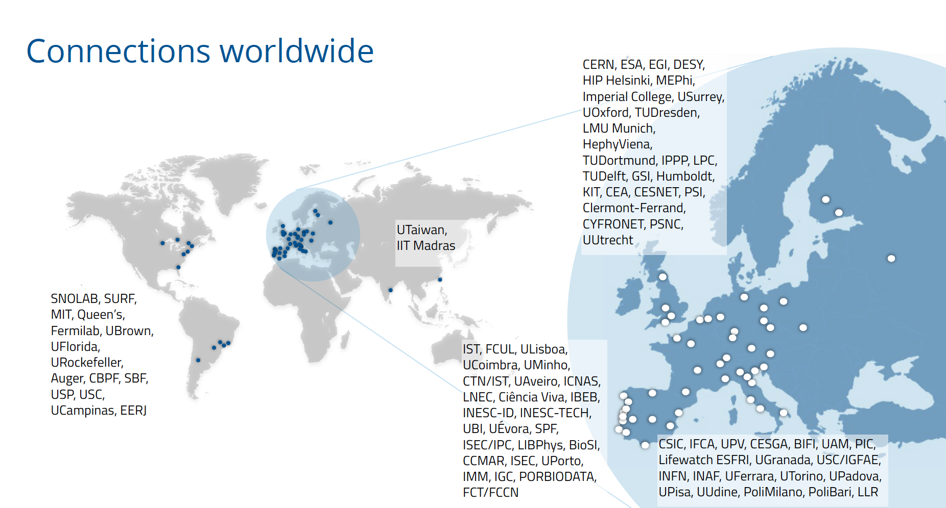

Slide 6
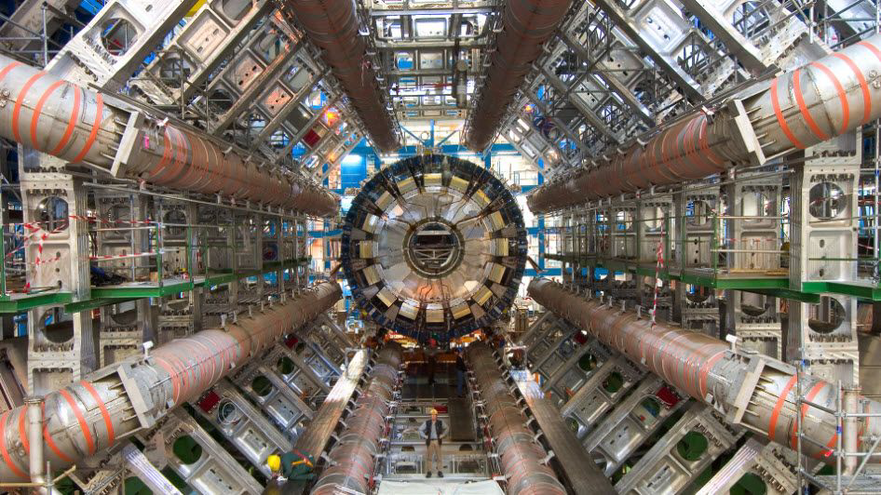
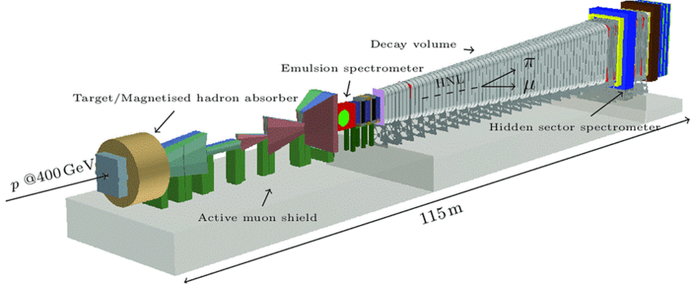
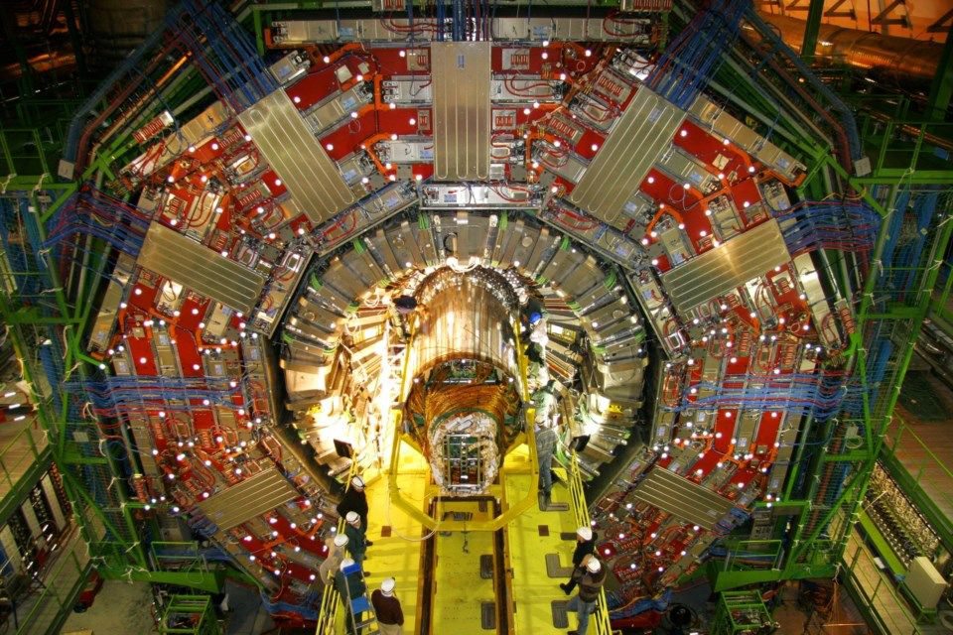
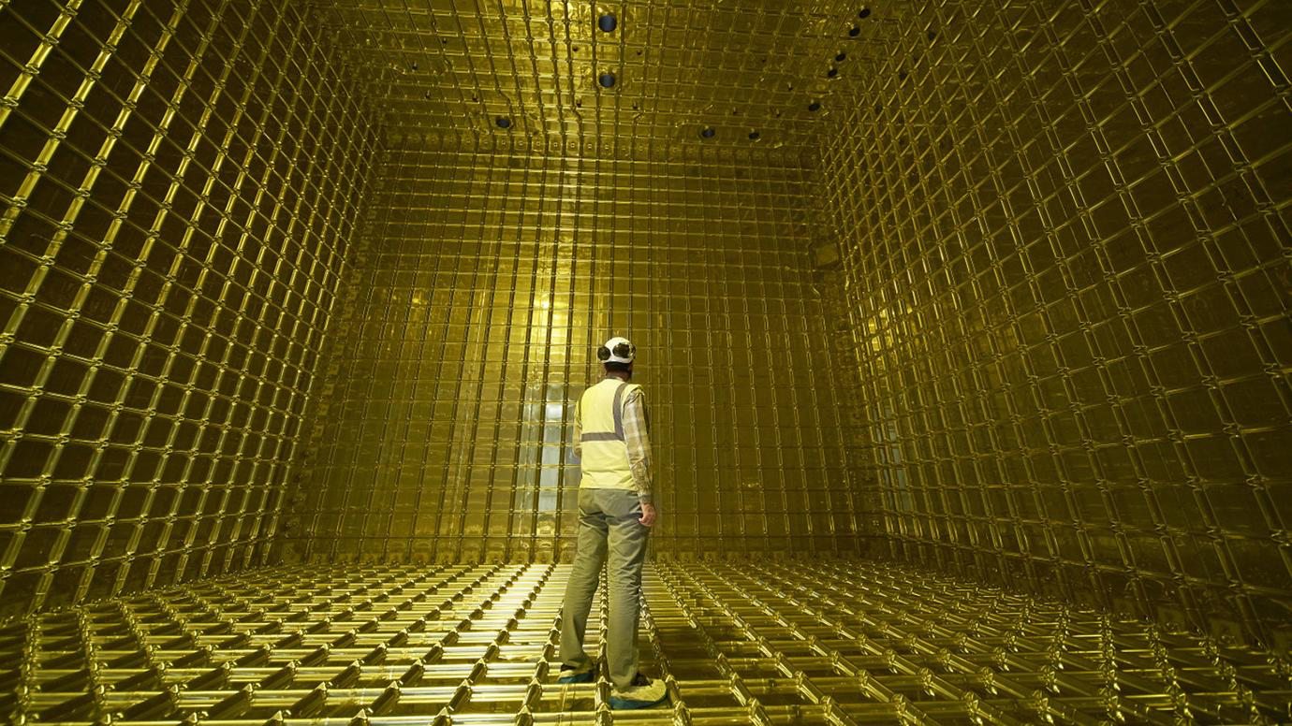
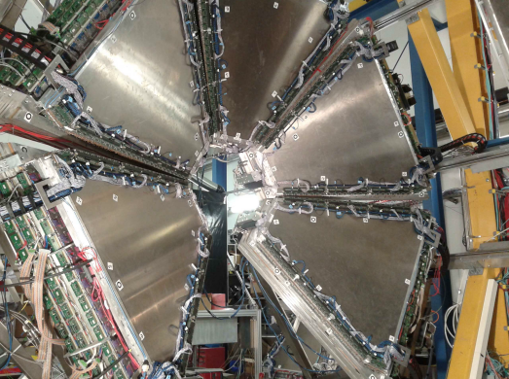
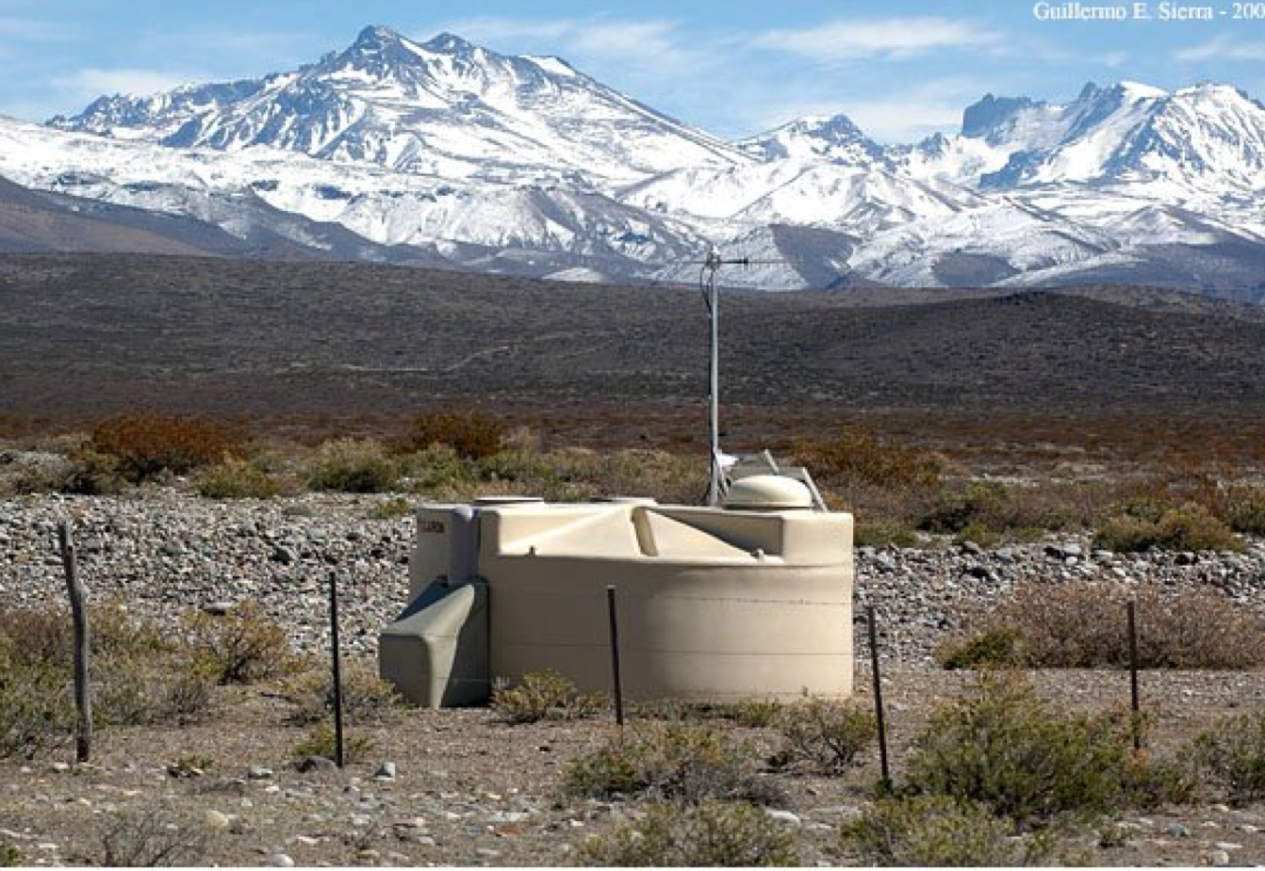
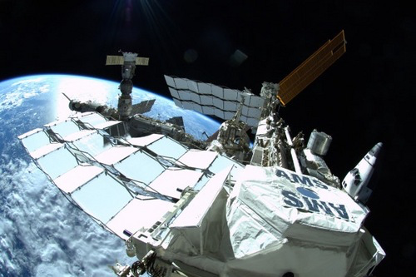
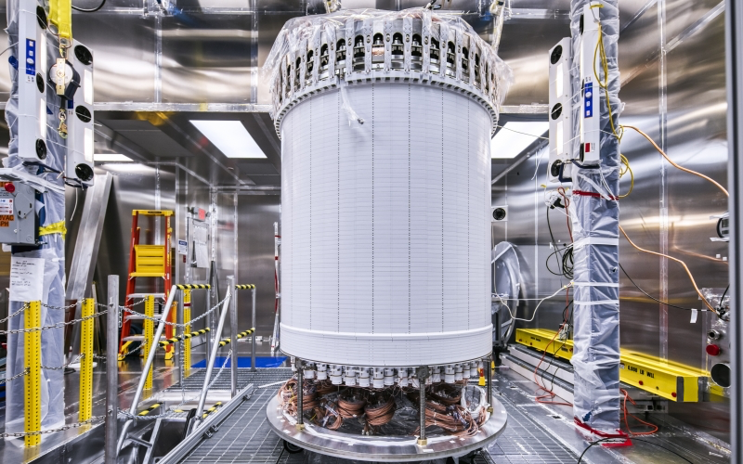
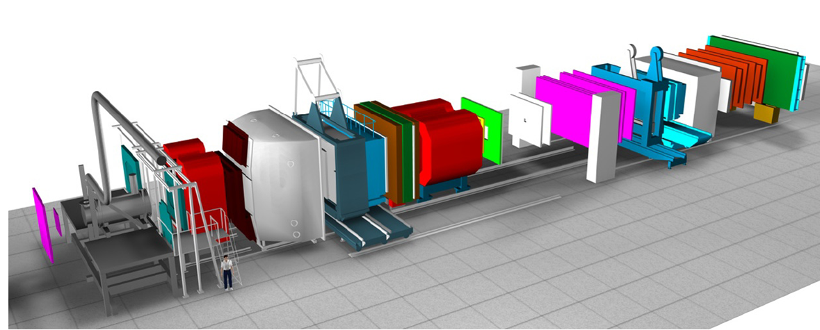
Experiments
At CERN:
LHC: ATLAS, CMS
Fixed target: COMPASS/AMBER, ISOLDE, SHiP/SND
At GSI-Darmstadt: HADES
Neutrino: SNO+, DUNE
Dark matter: LUX, LZ
Cosmic ray:
Pierre Auger Observatory
AMS

Slide 7
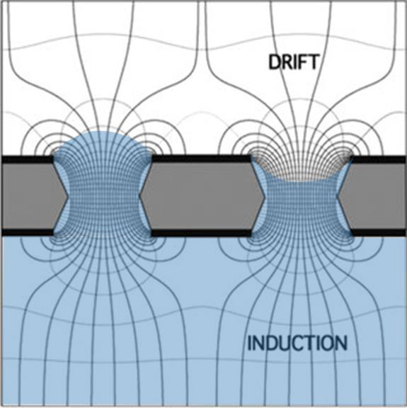
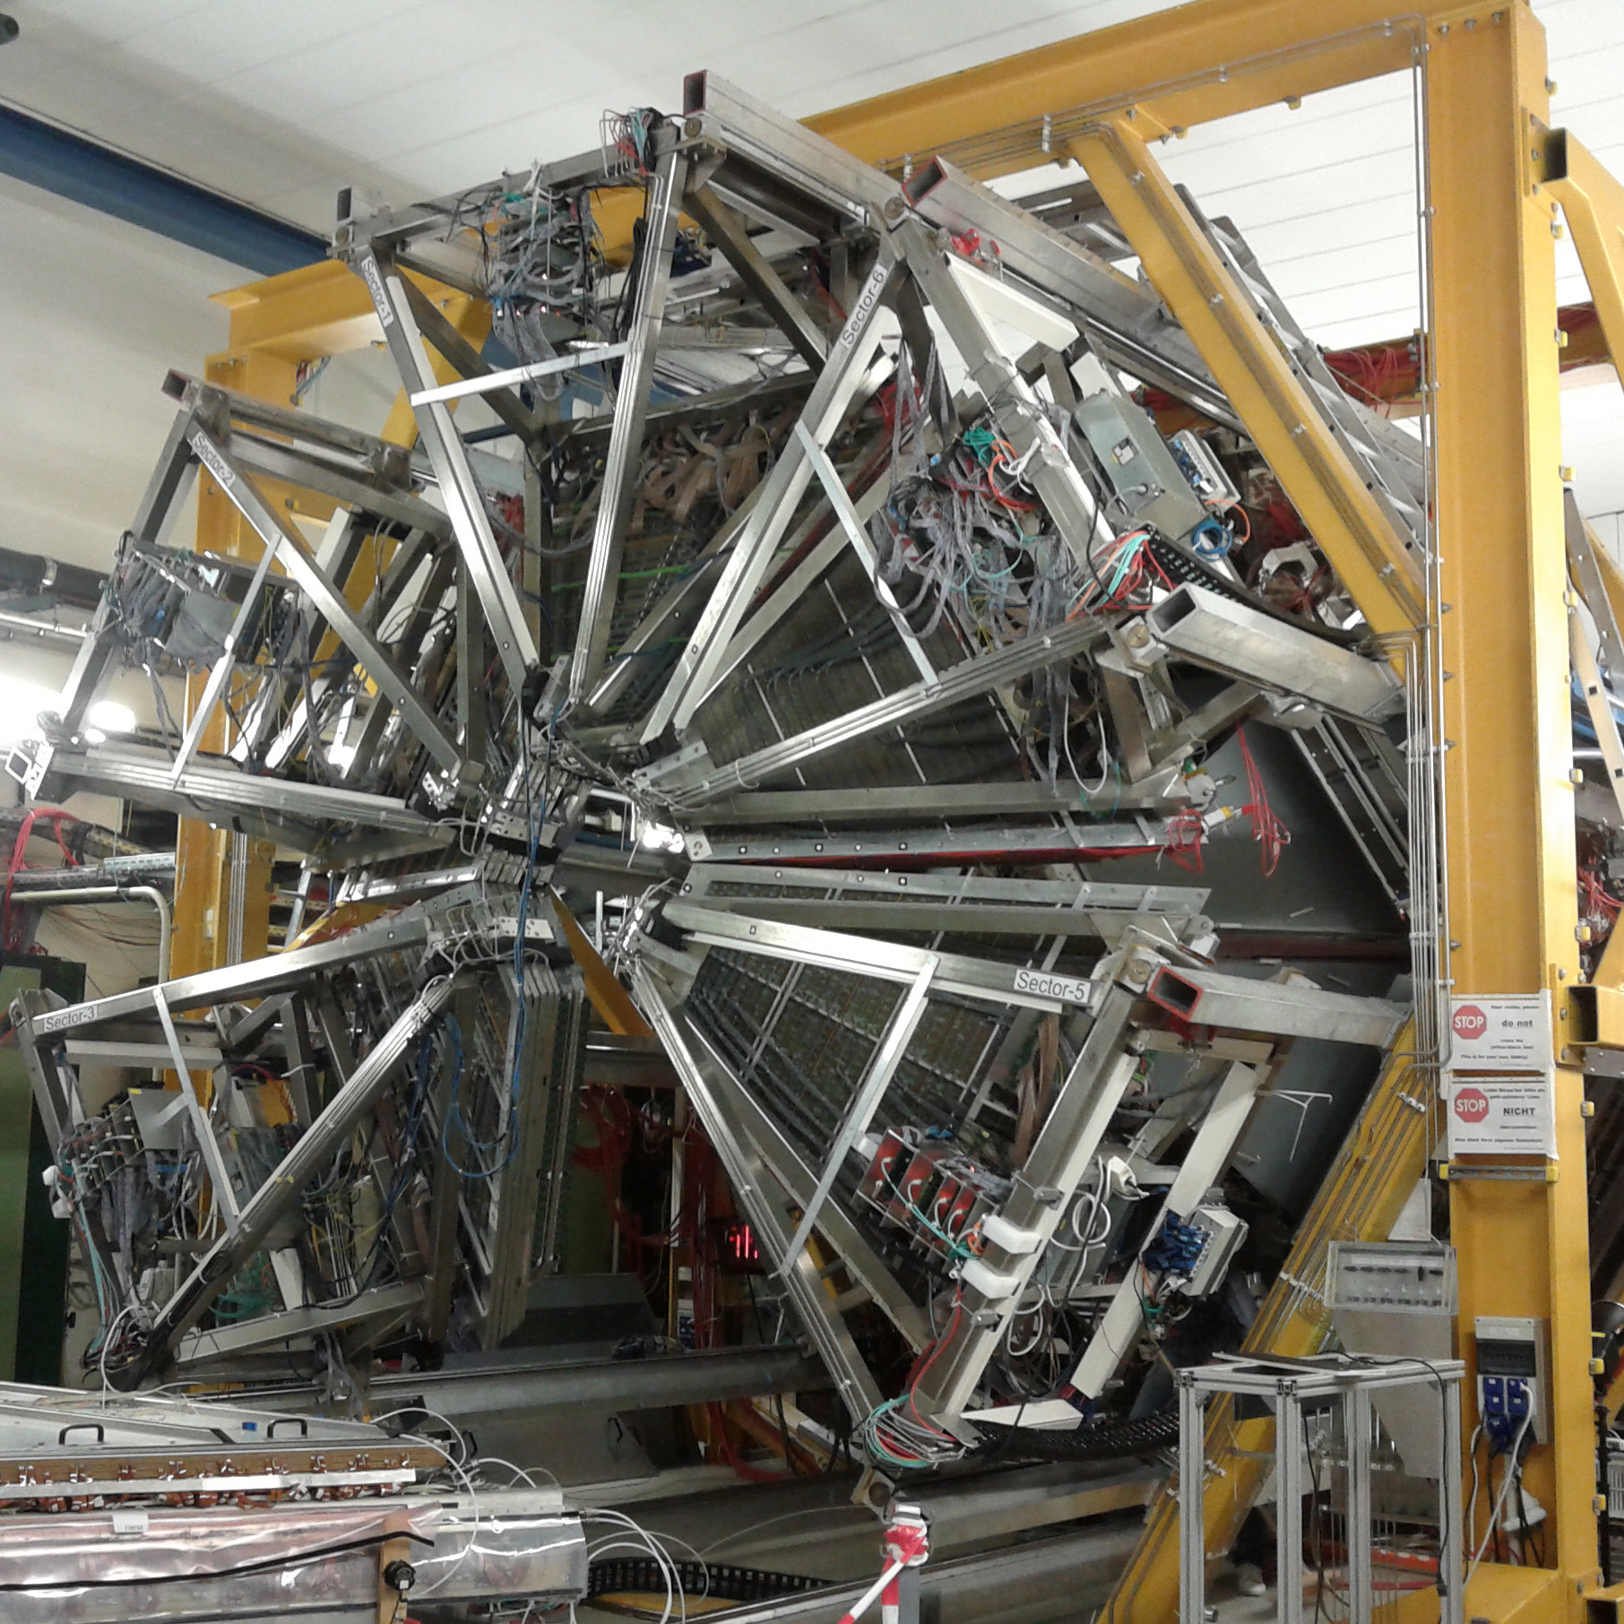
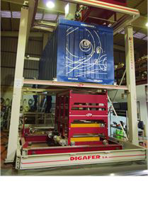
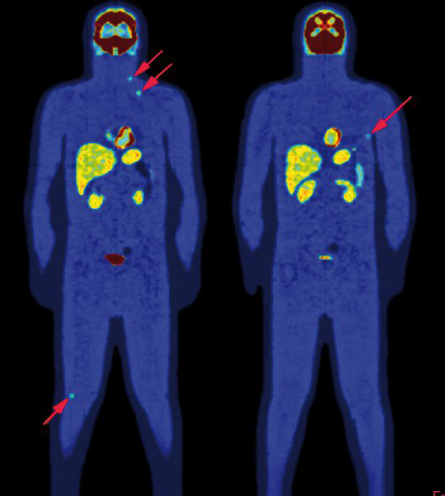
Detector development
History of gaseous, noble liquid and scintillating detetor development
Contributions include e.g. ATLAS hadronic calorimeter and HADES time of flight detector
Allowed to branch out into medical imaging instrumentation R&D, environmental monitoring, national security, and space applications

Slide 8
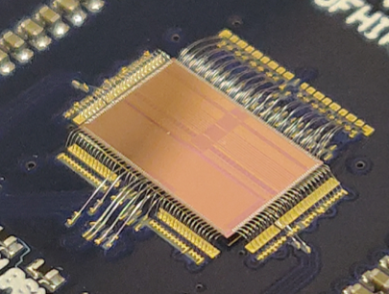
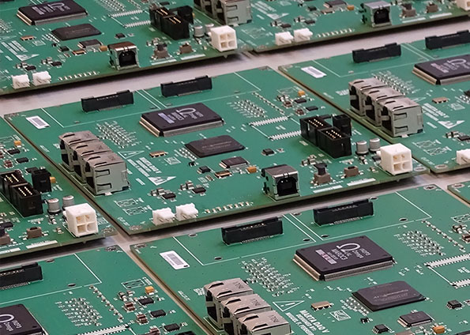
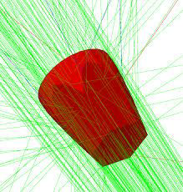
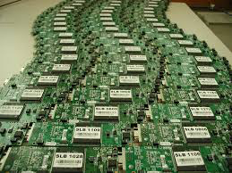
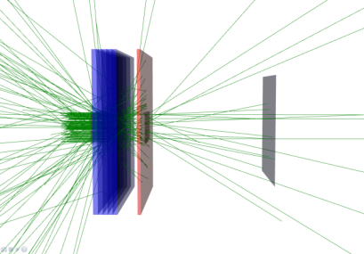
Electronics, simulation
Also history in readout electronics for HEP
Examples are synchronization board for CMS ECAL, fast front-end ASIC for CMS MTD, or low power consumption front-end cards for Auger detector stations
Competences in detector simulation with many applications from HEP to medical physics and space

Slide 9
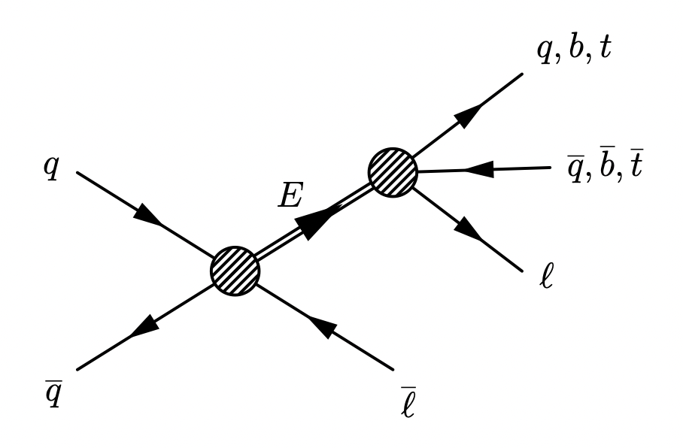
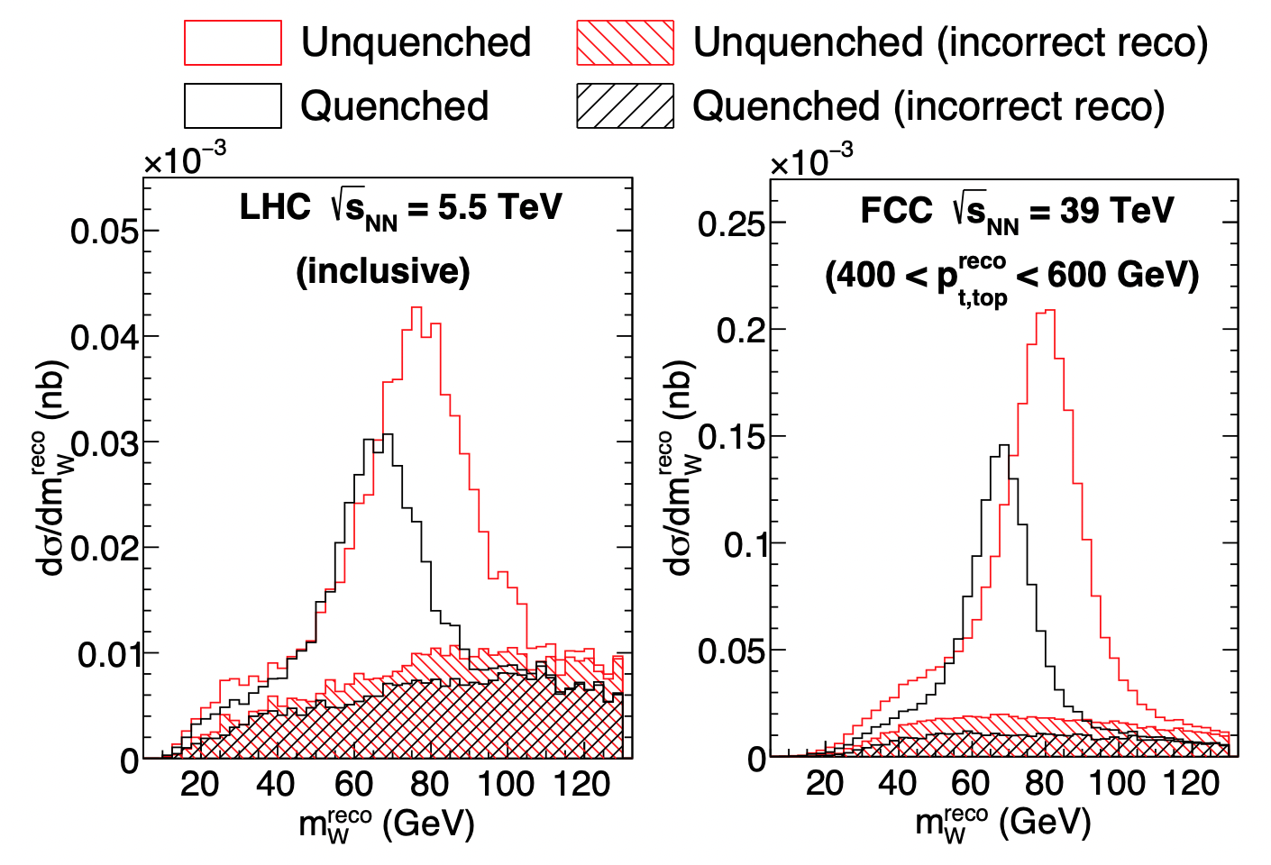
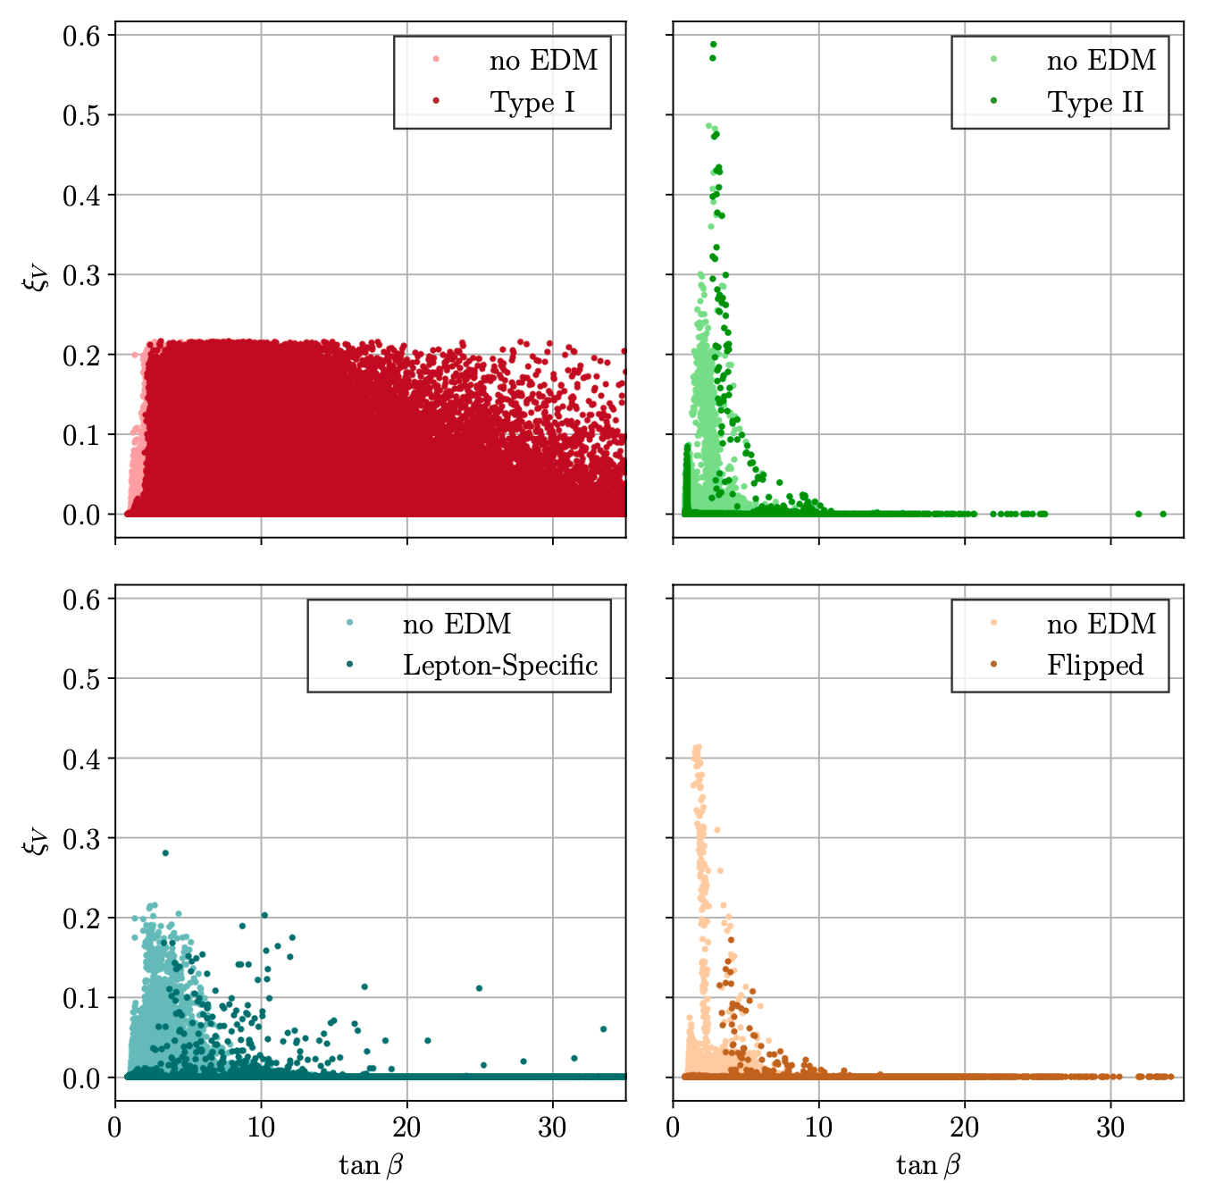
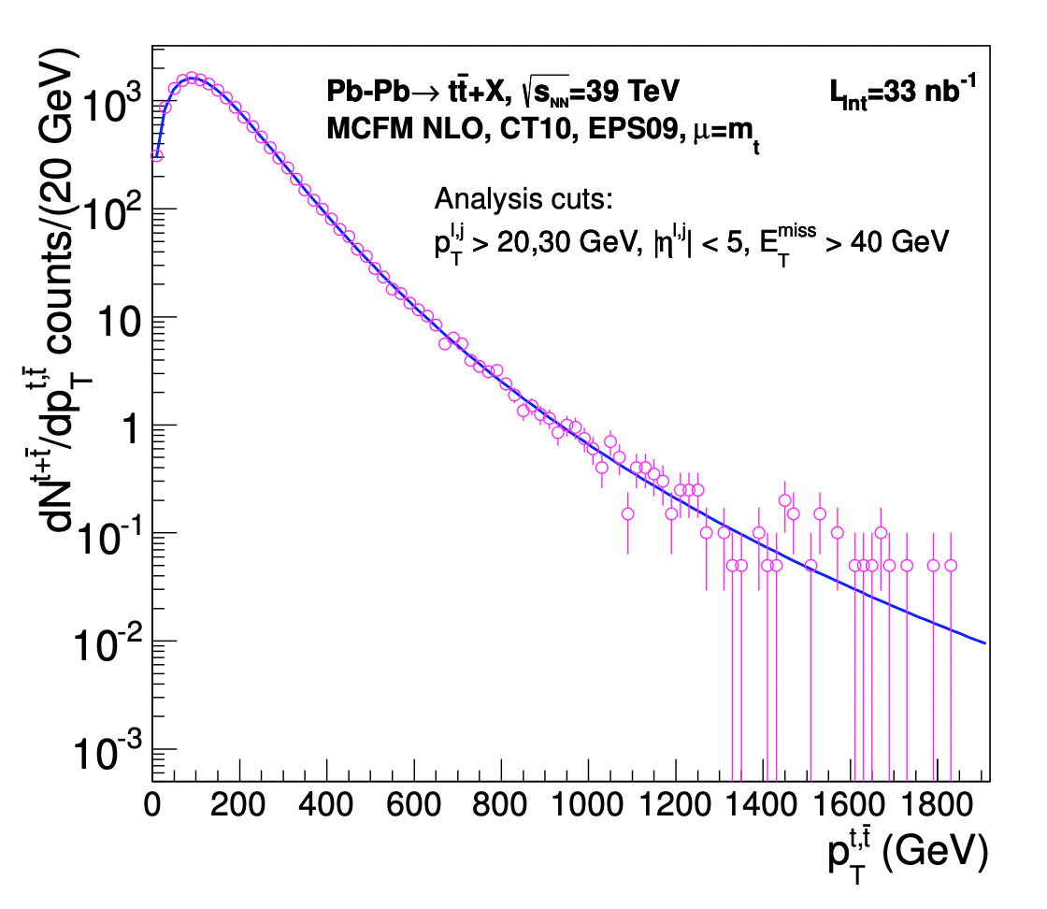
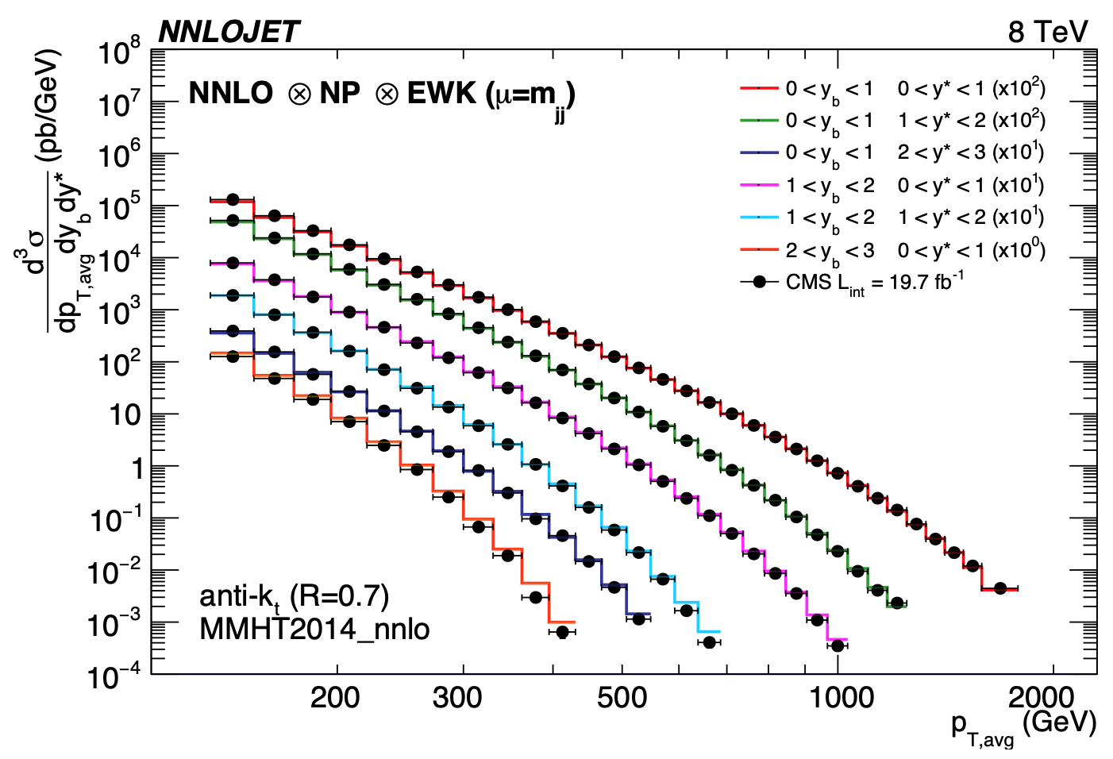
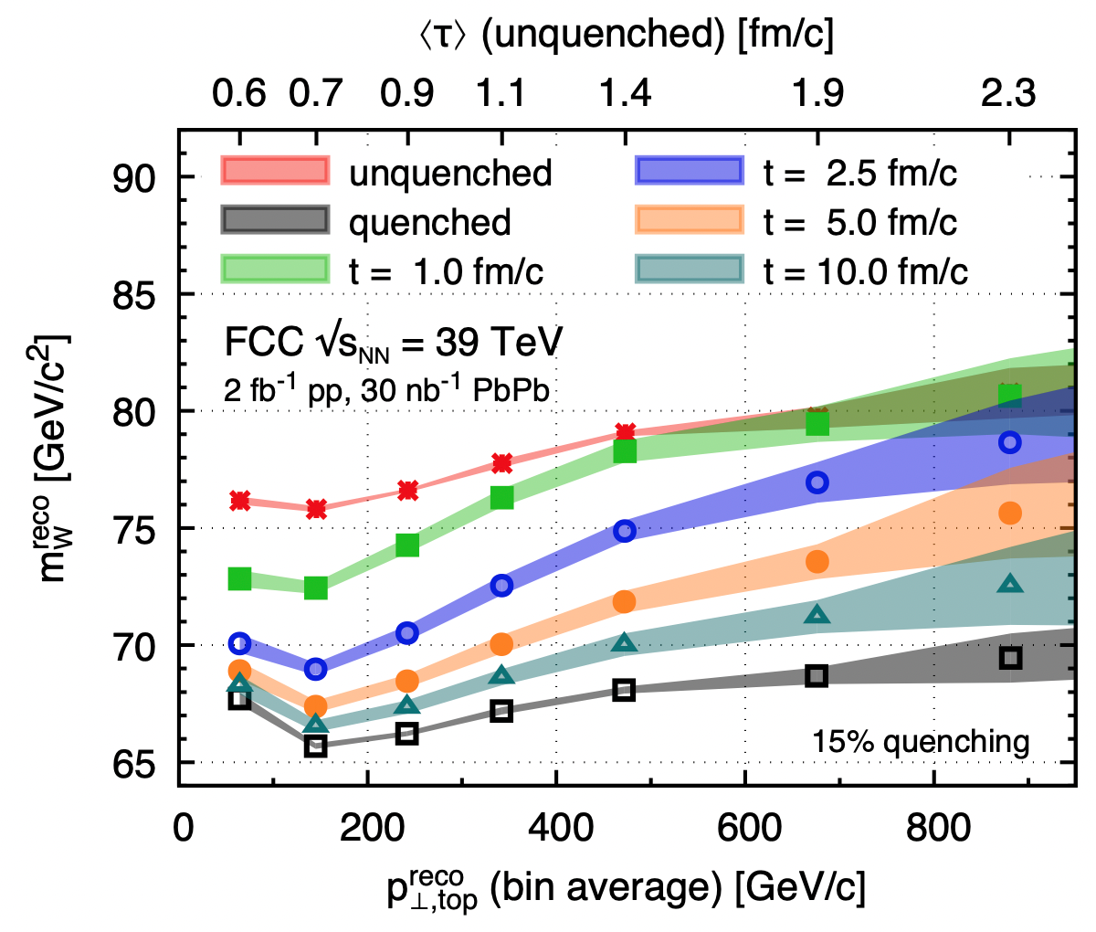
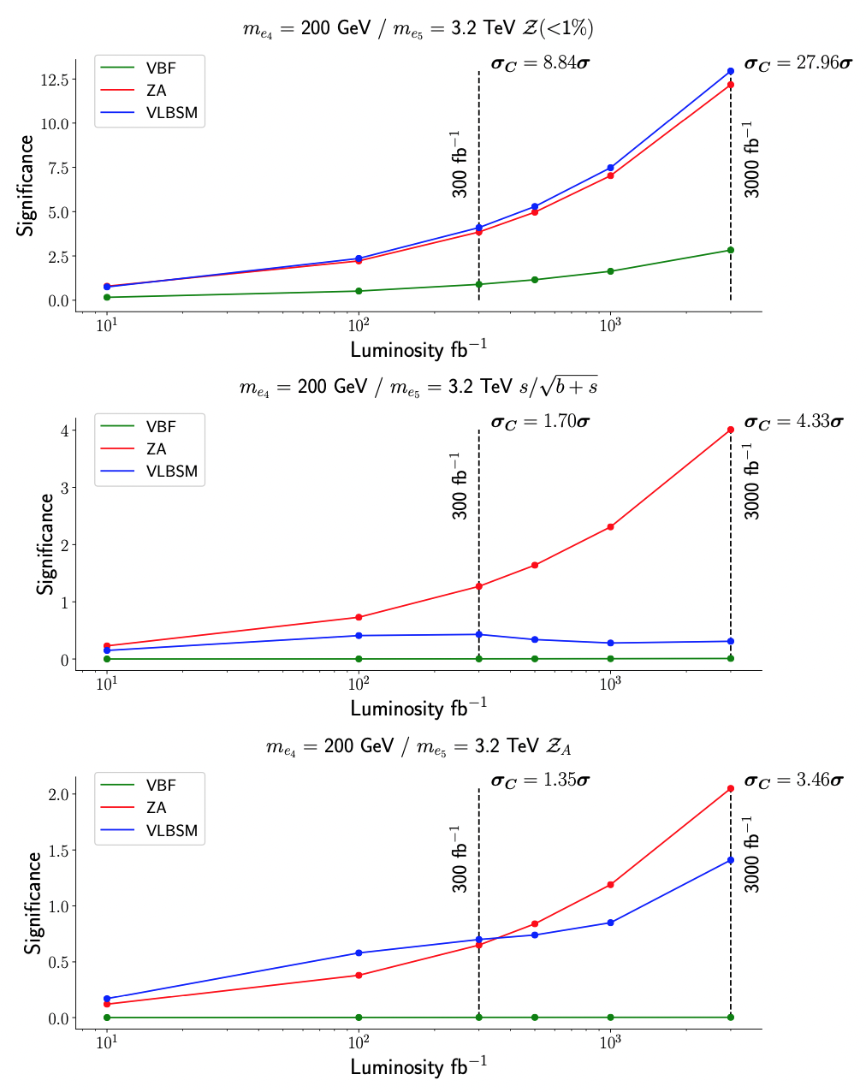
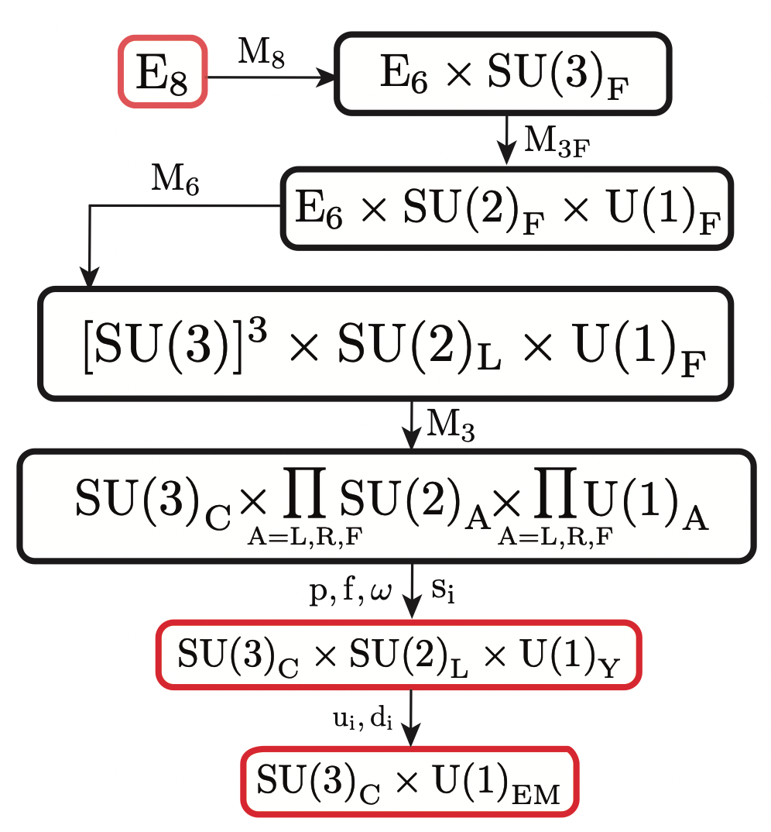
Theory and phenomenology
Multi-Higgs models
CP violation
Flavour and BSM
Effective field theory for searches
Quark-gluon plasma
Jets and QCD
Hadronic cascade modelling
Experimental observables for CP violation in Higgs sector
Etc...
Close links and fruitful exchange with experimental community

Slide 10
Portugal and the FCC
Several contributions to the FCC Conceptual Design Report
Physics: Top, Higgs, Heavy Ion, etc – both theoretical explorations and feasibility studies
Detector design and studies
Most contributors from
LHC experimental groups
LHC-related theory interests
These are the core of people here today

Slide 11
Portugal and the European Strategy for Particle Physics
Contributed to the 2020 ESPP with local consultation
View that next major collider should be based at CERN
Aligned with priorities set out by ESPP:
Full physics exploitation of the LHC and HL-LHC
Next priority is a e⁺e⁻ “Higgs factory”
Increased R&D on enabling accelerator technologies:
Support neutrino projects in US and Japan
Support high-impact scientific diversity programme complementary to high-energy colliders
First strategy document approved at a special Restricted Session of CERN Council in Lisbon, 14 July 2006

Slide 12
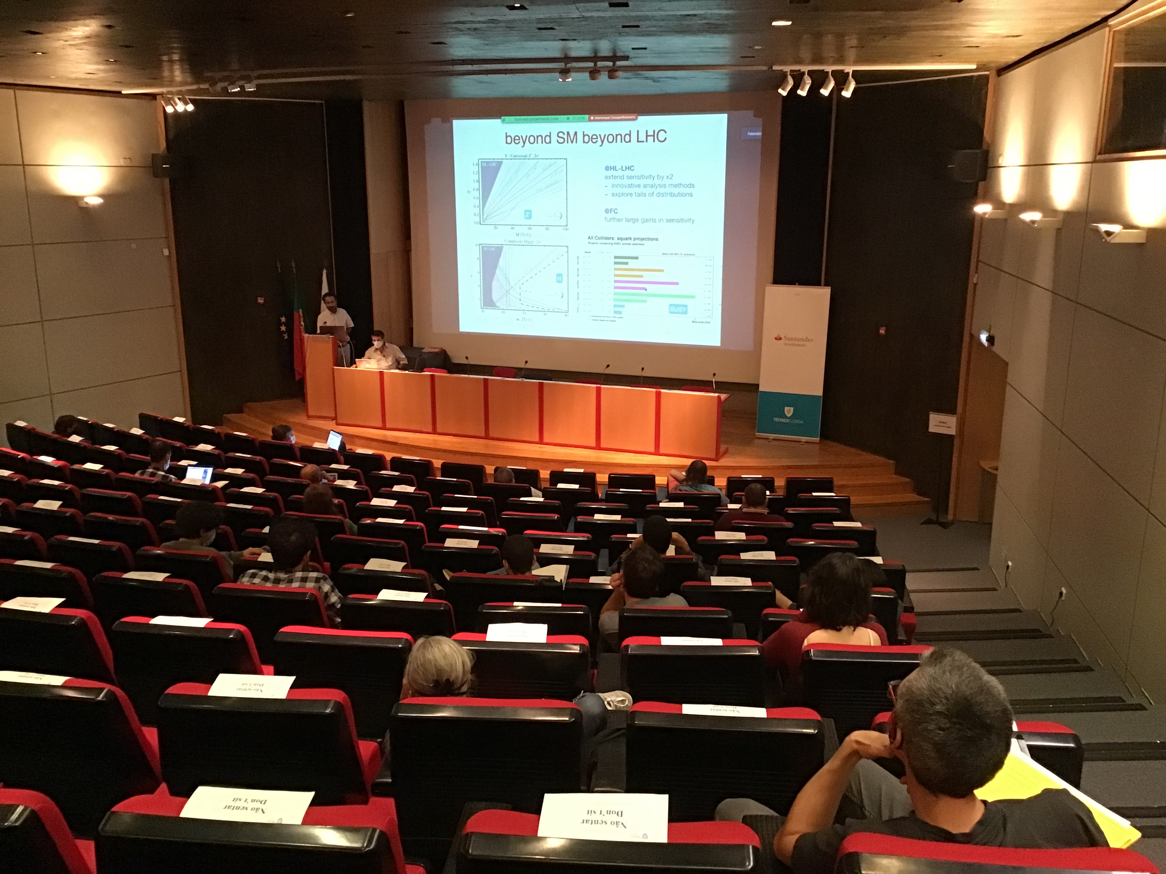
Portugal and the FCC
Public and scientific sessions organized following the 2020 update of the European Particle Physics Strategy
https://indico.lip.pt/event/738/
Organising Committee
Pedro Abreu (IST/LIP)
Gustavo Castelo-Branco (IST/CFTP)
Nuno Castro (UM/LIP)
Patricia Conde (IST/LIP)
João Correia (C2TN/DECN/IST)
Michele Gallinaro (LIP/IST)
Ricardo Gonçalo (UC/LIP)
Brigitte Hiller (UC/CFisUC)
José Maneira (LIP)
Orlando Oliveira (UC/CFisUC)
António Onofre (UM/LIP)
Guilherme Milhano (IST/LIP)
Mário Pimenta (IST/LIP)
Constança Providência (UC/CFisUC)
Margarida Rebelo (IST/CFTP)
Jorge Romão (IST/CFTP)
Rui Santos (ISEL/CFTC)
João P. Silva (IST/CFTP)
João Varela (IST/LIP)
Pedro Vaz (IST/C2TN)
https://indico.lip.pt/event/748/

Slide 13
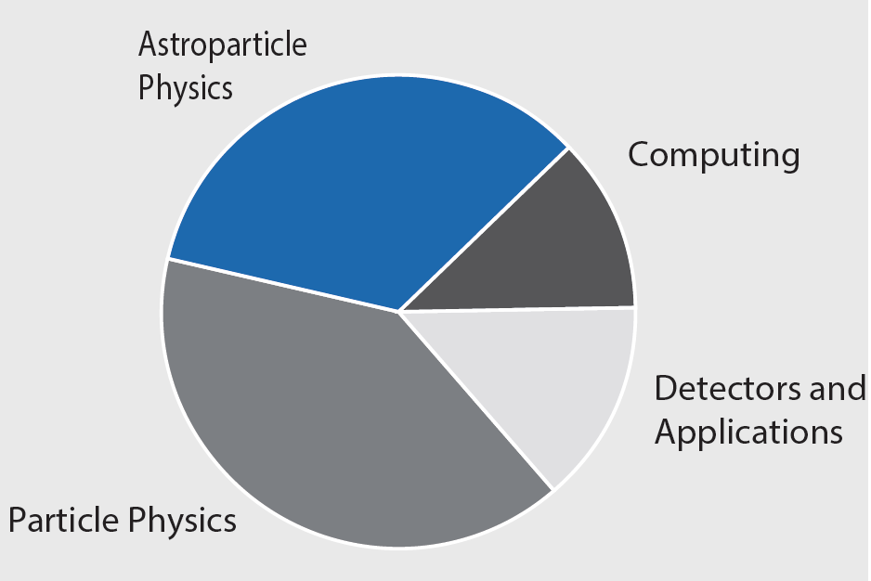
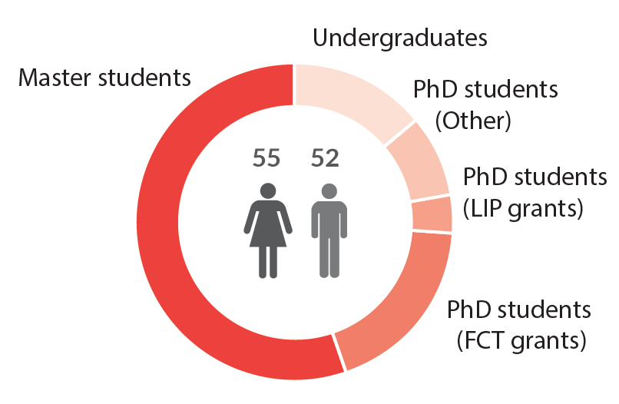
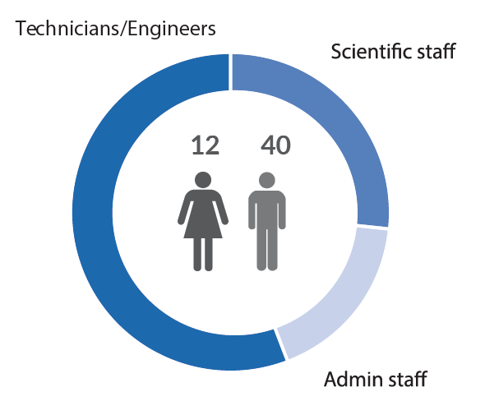
A bit about LIP
Concentrates experimental work in HEP in Portugal
243 members: 102 researchers, 107 students, 52 staff (~1/4 researchers)

Slide 14
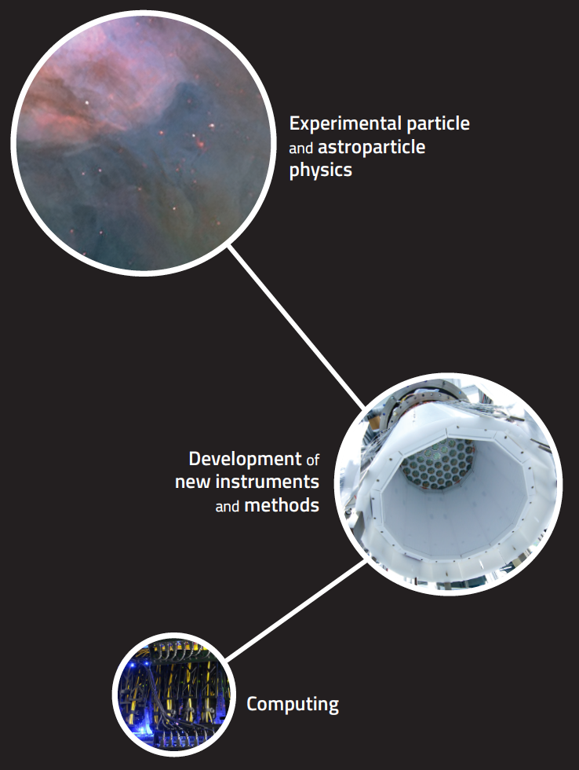
Activity at LIP
Phenomenology and
4 pillars:
Particle and astroparticle physics research
Development of new instruments and methods
Detectors for experiments, health care, space, national security
Computing
Supports scientific activity at LIP
Provides backbone of national scientific computing network with important impact across disciplines
Outreach, advanced training, knowledge transfer
Essential to boost efforts of other areas in answering societal challenges
Competence centers in
Monitoring and control
Simulation and machine learning

Slide 15
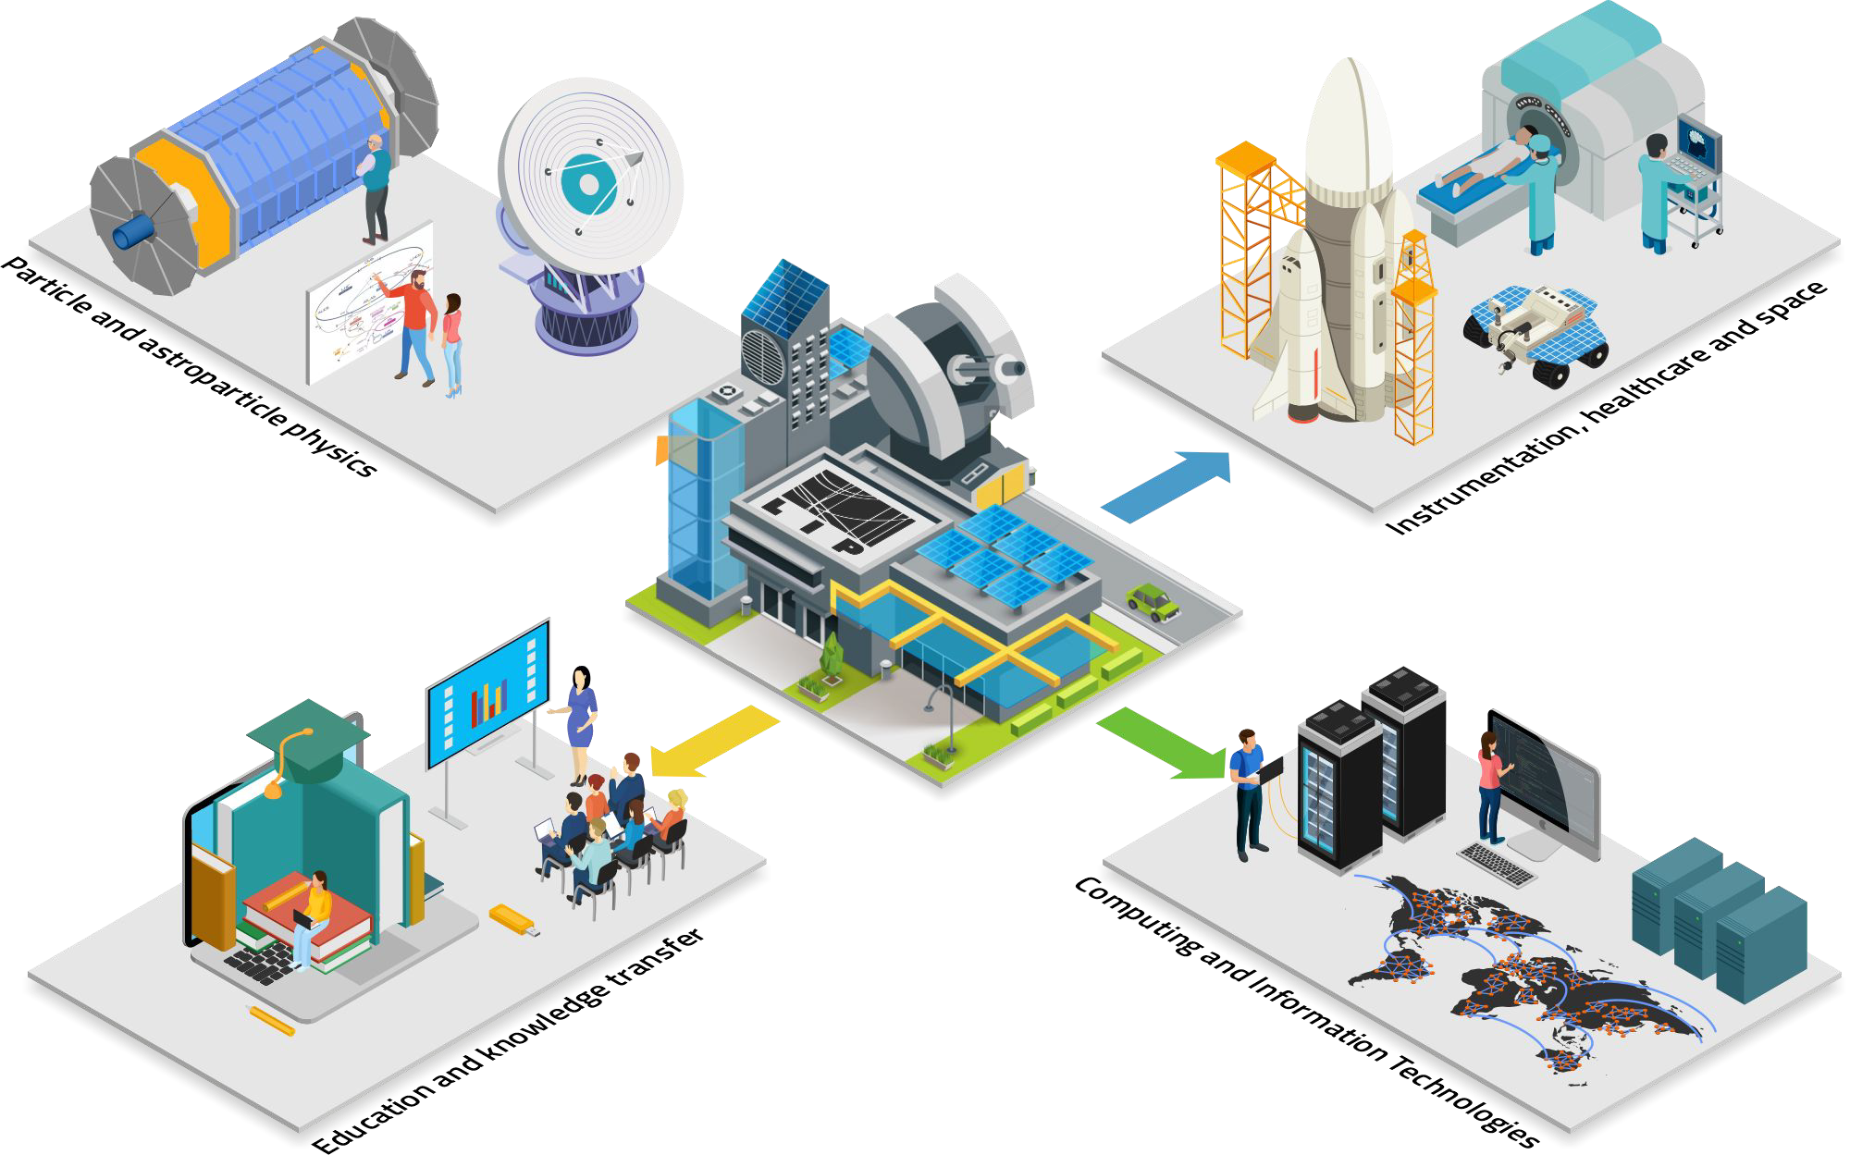

Slide 16
Computing
Both infrastructure management and R&D
Computing challenges posed by research in particle physics – huge requirements already from HL-LHC
Extension to other domains across the public and private sectors

Slide 17
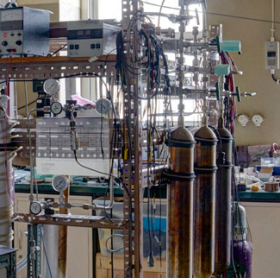
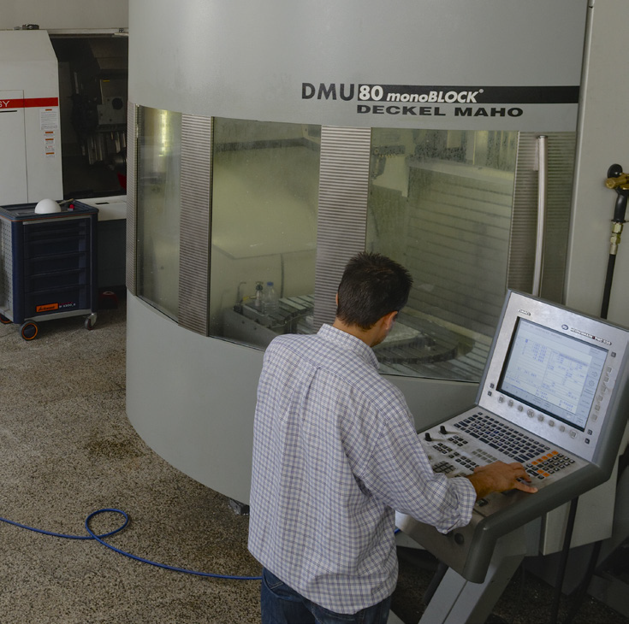
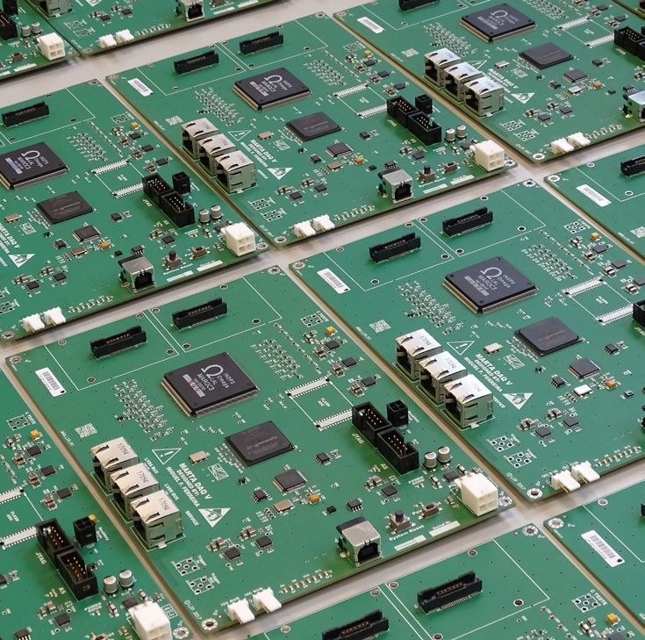
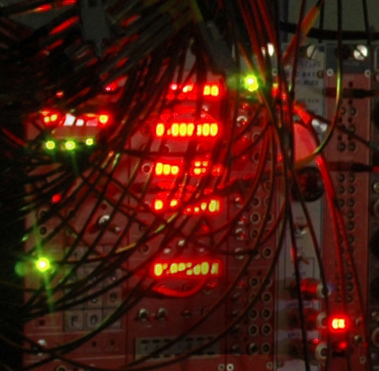
Infrastructures
Laboratory of Optics and Scintillating Materials – scintillating detectors
Detector Laboratory – mostly gaseous detector
Precision mechanical workshop
Cosmic-ray electronics Laboratory – mostly front-end readout electronics
TagusLIP Laboratory – electronics including front-end ASIC for HEP and PET

Slide 18
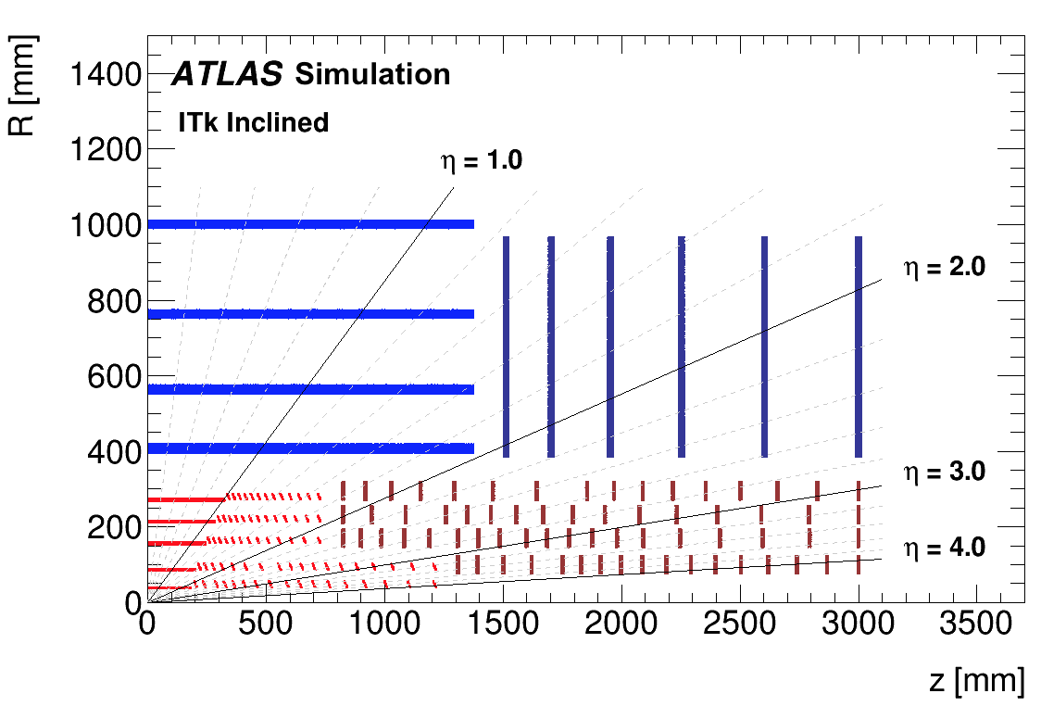
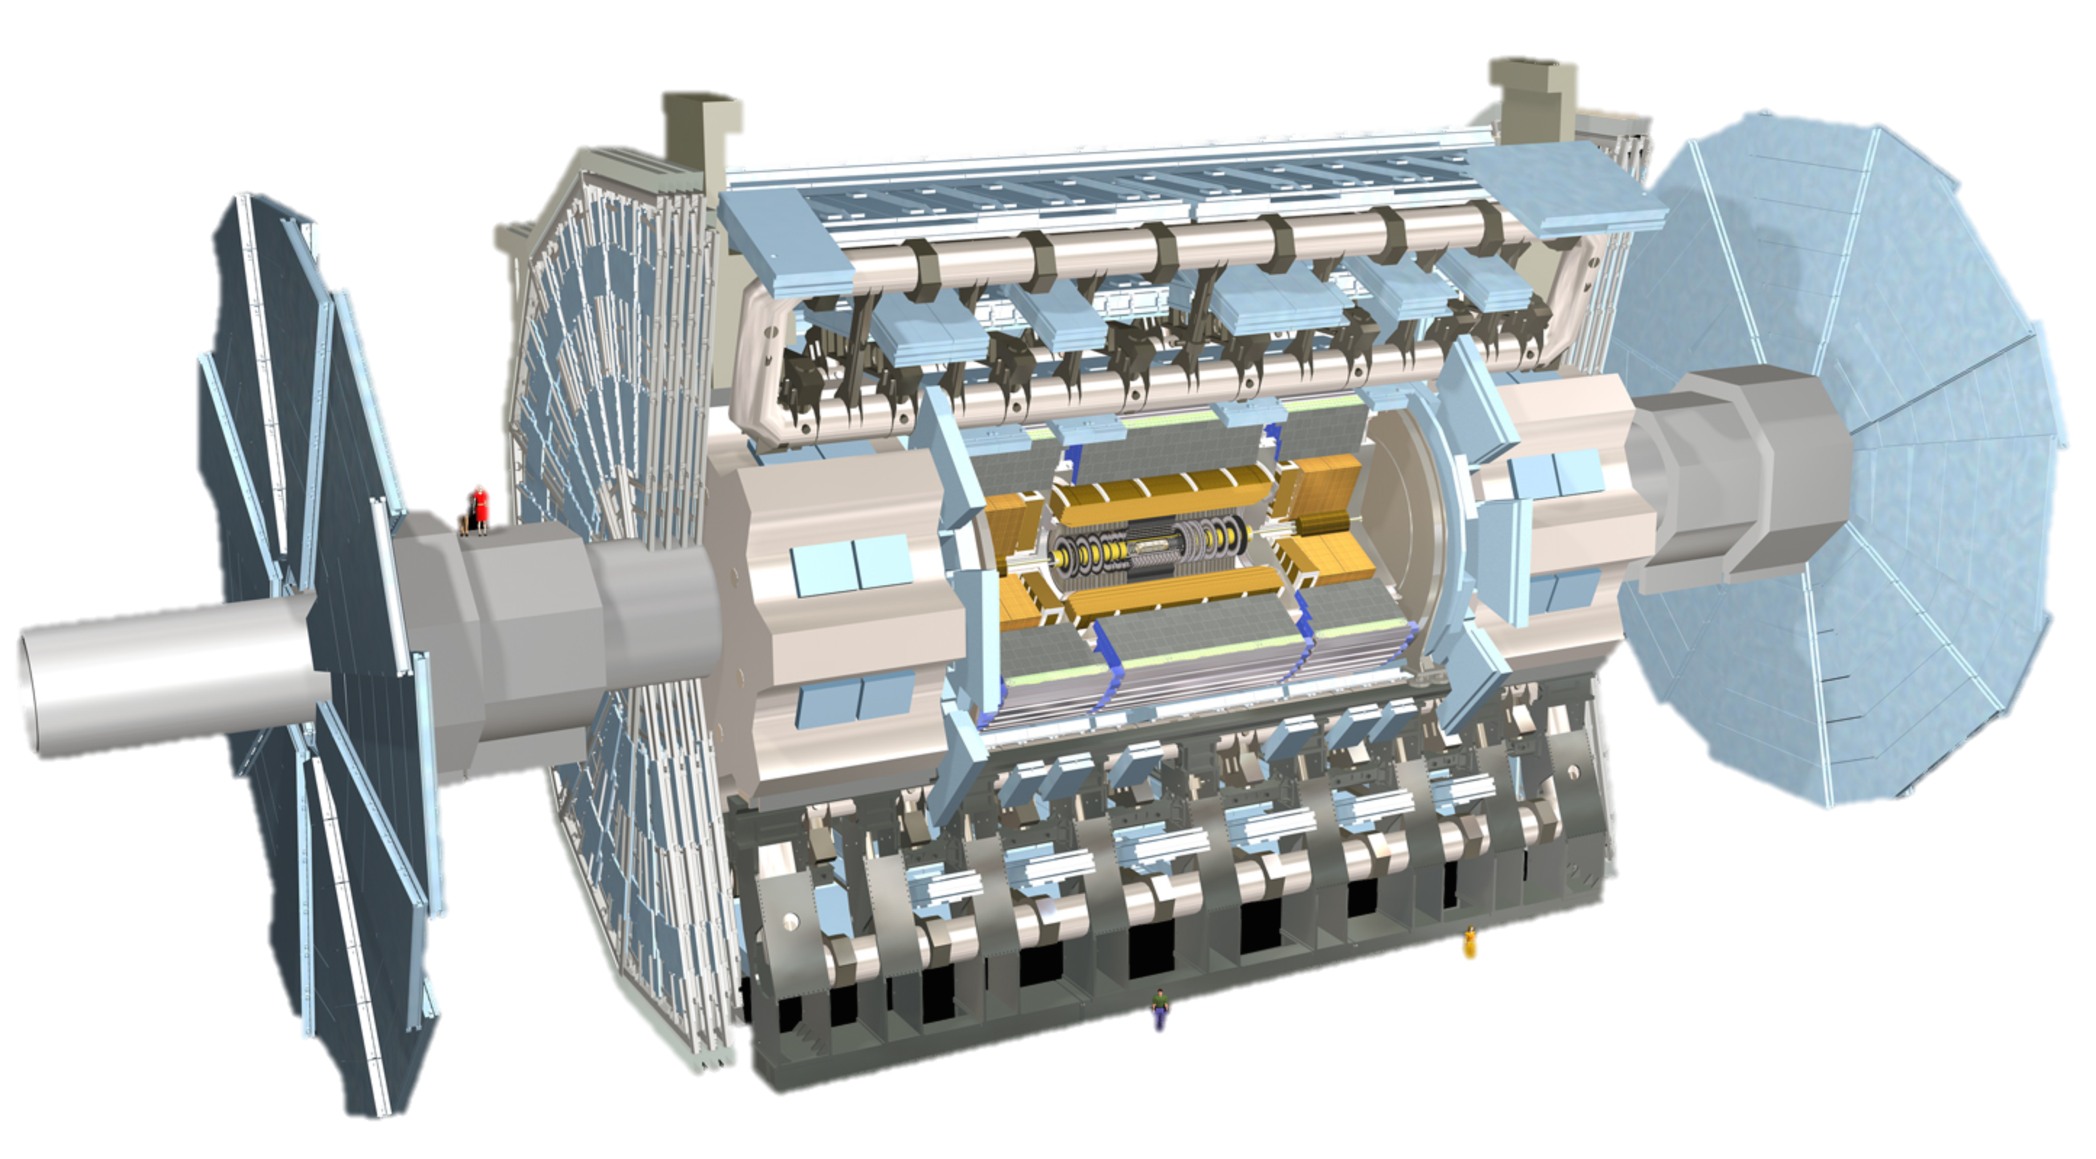
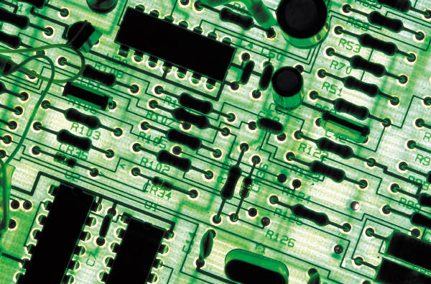
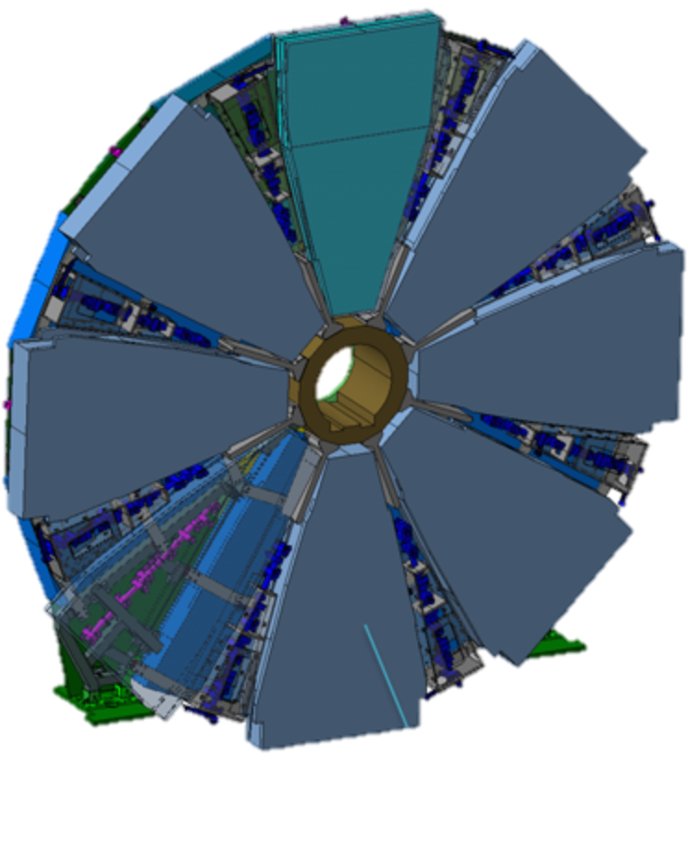
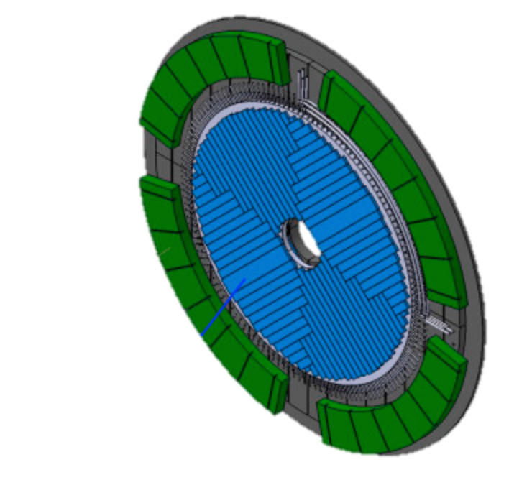
HL-LHC Upgrade
New, all-Silicon tracking detector
New electronics and High Voltage power supplies and distribution
New muon detector “Small Wheel”
High Granularity Timing Detector
(30ps/track)
Many changes to Trigger/DAQ
Notes:
Add spacial granularity to separate close tracks and add tracking solid angle (b-tagging, vertex ident. Etc)
Add timing information to reject pileup: need O(mm) resolution => ~O(10ps) ; 30ps = 9mm
Replace damaged detectors with more rad.hard technologies
HGTD radius 120 – 640 mm ; • Completely replace Inner Detector with all-silicon

Slide 19
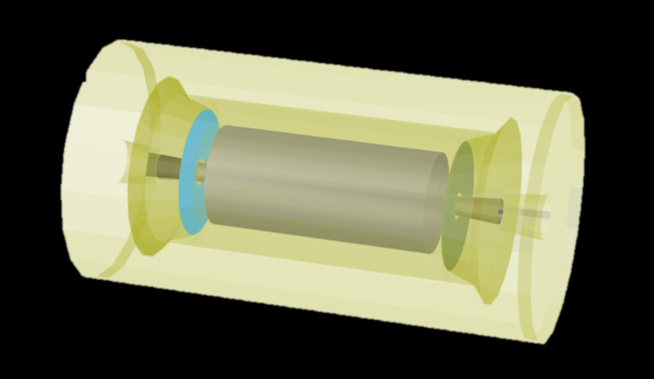
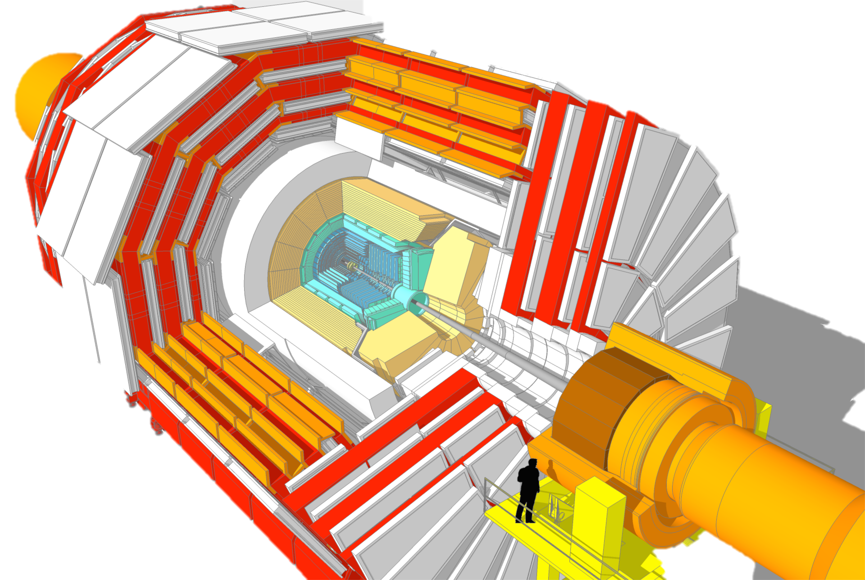
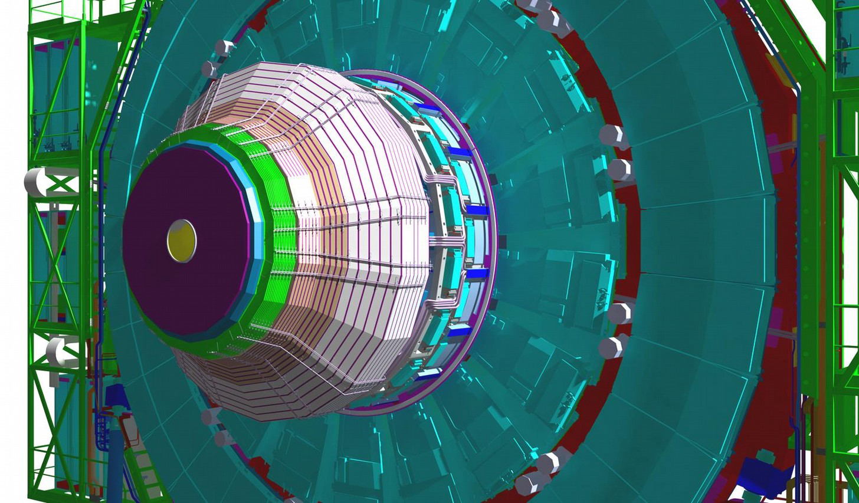
New MIP Timing Detector (Barrel & Endcap)
Replacement of tracking detector
New electronics for muon chamber operation
Hardware to reconstruct charged tracks (trigger)
New electronics for calorimeter readout
New High Granularity Calorimeter
Notes:
Add timing information to reject pileup: need O(mm) resolution => ~10ps
Add spacial granularity to separate close tracks
Rad.hard technology
Add tracking solid angle (b-tagging, vertex ident. Etc)

Slide 20
Conclusions
“The next accelerator and the next focus for particle physics must be in Europe. That is the only way to ensure that the best people will continue to come to Europe.”
José Mariano Gago, Special Restricted Session of the CERN Council, 1st European Strategy for Particle Physics, Lisbon, 14 July 2006
We are a lively HEP community with a diverse set of activities and interests
Also R&D on plasma wakefield acceleration
Most people interested in FCC come from LHC experiments and related theory
LHC and HL-LHC are main priorities, but interest in FCC is growing
Relevant funded R&D project will start soon – on rad-hard plastic scintillator development
See following talks by:
Michele Gallinaro on current LHC activities
João Pires with overview of theory work
Rute Pedro on perspective detector developments

Slide 22
Thank you!
LET’S INSPIRE PEOPLE
Notes:
https://docs.google.com/forms/d/1mYM3yW3vMMPyp9cSqKTQqStZdBoxiNMYR1FkCO48zpI/edit

Slide 23
Outreach&Training
Masterclasses, public events, visits to schools, CERN Portuguese language teachers school, engineers training programme, summer internships, etc

