Slide 1
Higgs search in the H➝bb channel in ATLAS
Ricardo Gonçalo
Royal Holloway University of London
on behalf of the ATLAS Collaboration
International Europhysics Conference on High Energy Physics, Grenoble, July 21-27 2011

Slide 2
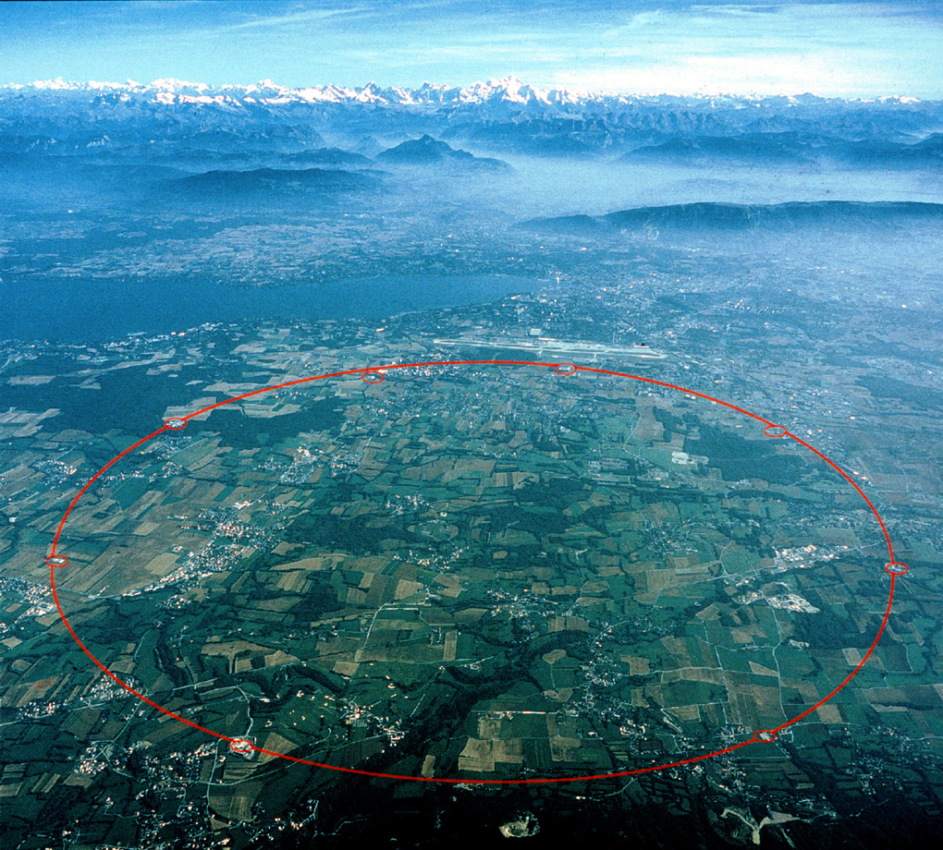
Outline
ATLAS and the LHC
Higgs physics at the LHC
ZH/WH H➝bb in ATLAS
Event selection
Backgrounds
Systematic errors
Results
Boosted VH
Summary and Outlook

Slide 3
ATLAS and the LHC

Slide 4
Muon Spectrometer: |η|<2.7
Air-core toroids and gas-based muon chambers
σ/p_{T} = 2% @ 50GeV to 10% @ 1TeV (ID+MS)
EM calorimeter: |η|<3.2
Pb-LAr Accordion
σ/E = 10%/√E ⊕ 0.7%
Hadronic calorimeter:
|η|<1.7 Fe/scintillator
1.3<|η|<4.9 Cu/W-Lar
σ/E_{jet}= 50%/√E ⊕ 3%
JINST (2008) 3 S08003
L = 44 m, ∅ ≈ 25 m
7000 tonnes
≈10⁸ electronic channels
3-level trigger reducing 40 MHz collision rate to 200 Hz of events to tape
Inner Tracker: |η|<2.5, B=2T
Si pixels/strips and Trans. Rad. Det.
σ/p_{T} = 0.05% p_{T} (GeV) ⊕ 1%

Slide 5
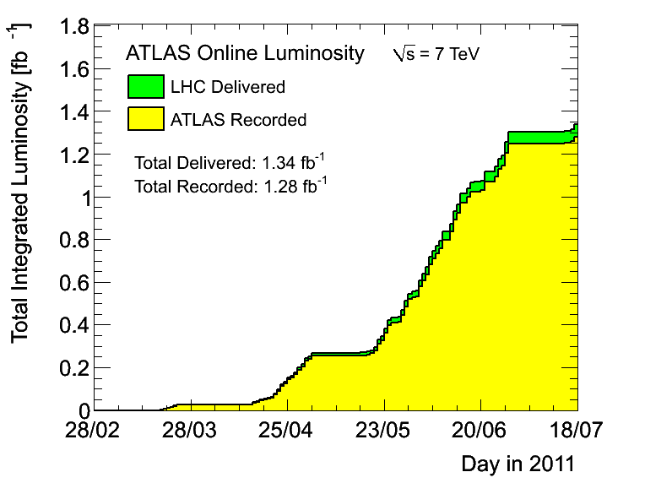
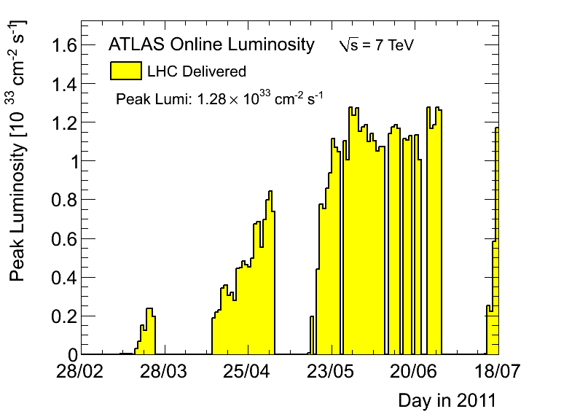
Very successful operation in 2011!
Running @ √s = 7TeV and 50ns bunch crossing
Peak instantaneous luminosity 1.28x10³³cm⁻²s⁻¹
Average pileup <μ> ≈ 6 but peak up to 14
Collected 20 – 60 pb⁻¹ per day before tech. stop
Continue run until end of 2012
Then shutdown and upgrade to higher √s
Light aircraft carrier (10,000 tonne) traveling at 30km/h

Slide 6
Higgs Physics at the LHC

Slide 7
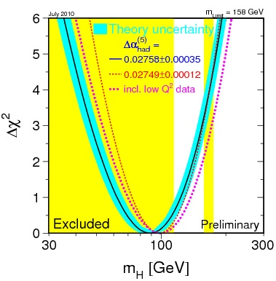
The simplest model of electroweak symmetry breaking predicts one Higgs scalar
The Higgs boson mass is the only free parameter
Current mass limits:
LEP excluded mass range below 114.4 GeV/c²
EW fit: m_{H} = 89⁺³⁵₋₂₆ GeV/c² (July 2010)
Including LEP: m_{H} < 185 GeV/c² (July 2010)
Tevatron excluded range of 158 – 173 GeV/c²
http://lepewwg.web.cern.ch/LEPEWWG/
March 2011
July 2010
http://tevnphwg.fnal.gov/
http://tevnphwg.fnal.gov/

Slide 8
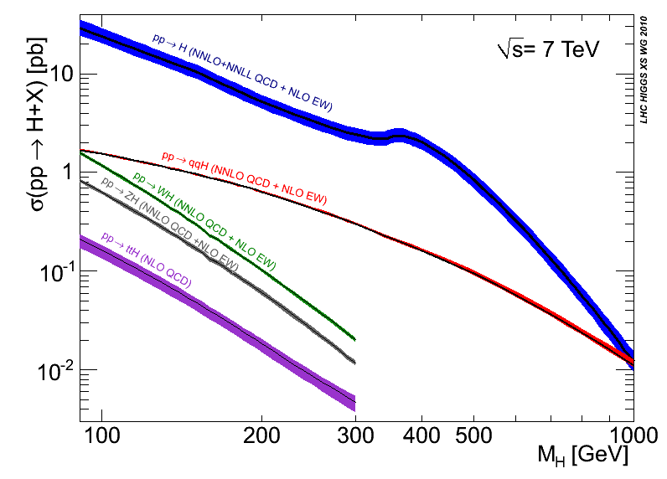
CERN-2011-002; arXiv:1101.0593
Notes:
Main production channels: gluon fusion, Vector Boson Fusion, associated production with vector bosons, associated production with ttbar pair
Animation

Slide 9
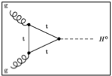
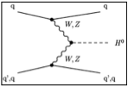
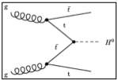
CERN-2011-002; arXiv:1101.0593
Notes:
Main production channels: gluon fusion, Vector Boson Fusion, associated production with vector bosons, associated production with ttbar pair
Animation

Slide 10
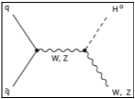
CERN-2011-002; arXiv:1101.0593
Notes:
Main production channels: gluon fusion, Vector Boson Fusion, associated production with vector bosons, associated production with ttbar pair
Animation

Slide 11
CERN-2011-002; arXiv:1101.0593
Disfavoured by EW precision fits
Excluded by LEP
Excluded by Tevatron
Notes:
Main production channels: gluon fusion, Vector Boson Fusion, associated production with vector bosons, associated production with ttbar pair
Animation

Slide 12
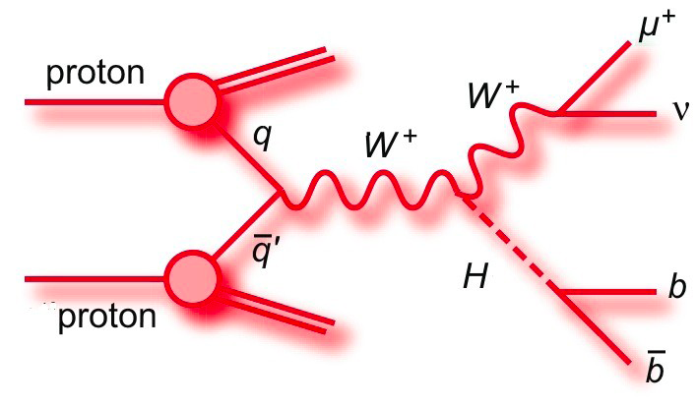
H➝bb Searches in ZH/WH production

Slide 13
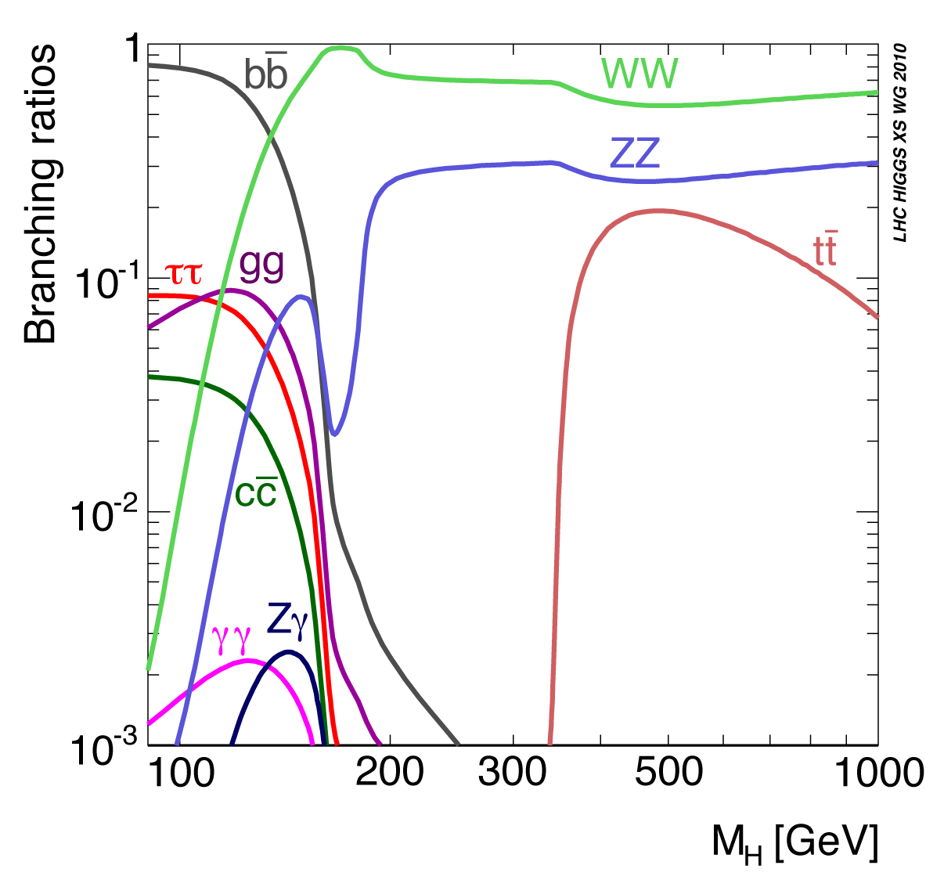
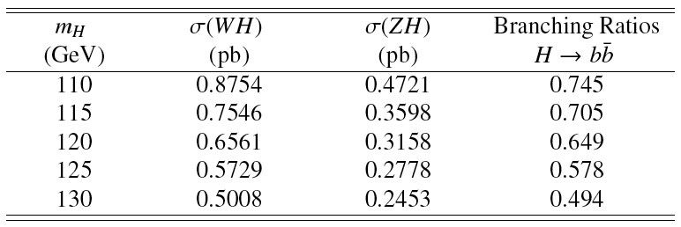
CERN-2011-002; arXiv:1101.0593
This talk: ZH➝llbb and WH➝lνbb
1.04 fb⁻¹ analyzed
H->bb dominant at low mass
WH cross section factor ≈2x higher than ZH, but important top background
ZH less affected by top background
Simple, robust cut-based analysis for first LHC direct search for H➝bb(*)
Select Z or W and search for 2 additional b jets
Search Higgs in m_{bb} spectrum
(*) Using newly commissioned advanced taggers. See posters by Kirika Uchida and Nicolas Bousson on b-tagging

Slide 14
ZH➝llbb Selection
Trigger:
e (p_{T}^{e}>20GeV) or μ (p_{T}^{μ}>18GeV)
2e/2μ trigger (p_{T}>12GeV)
Exactly 2 leptons p_{T} > 20GeV
Opposite charge for μ
Z mass cut: 76 < m_{ll} < 106 GeV
E_{T}^{miss} < 50GeV
Two leading jets b tagged

Slide 15
ZH➝llbb Backgrounds
Z + b(bb ̄) dominates:
Shape from MC
Normalization from sideband (m_{bb} < 80GeV);
Cross check in single-b control region m_{bj}
Top:
From MC
Cross check in m_{ll} control regions: [60GeV, 76GeV] or [106GeV, 150GeV]
Multijet:
e channel: multijet sample from reverting electron quality cuts
μ channel: negligible (from MC)
Diboson ZZ, WZ: from MC

Slide 16
WH➝lνbb Selection
Trigger: e (p_{T}^{e}>20GeV) or μ (p_{T}^{μ}>18GeV)
Exactly 1 lepton – p_{T} > 25GeV
M_{T} = √2p_{T}^{l}p_{T}^{ν}(1 - cos Δφ_{lν} ) > 40 GeV
E_{T}^{miss} > 25GeV
Exactly 2 jets (anti-k_{T} 0.4; E_{T} > 25GeV) to reduce top background
Both jets b tagged

Slide 17
WH➝lνbb Backgrounds
W+jets and top dominant:
W+jets important at low m_{bb}:
Use m_{jj} from data as template
Top dominant at high m_{bb}:
Describe shape with MC
Cross check m_{bb} in 3-jet bin
Normalisation from m_{bb} sidebands [40GeV, 80 GeV] and [140GeV, 250GeV]
Z+jets: use same normalisation of MC as measured in ZH
Multijet Data templates from QCD enhanced samples (anti-isolation)
Diboson WW , WZ from Monte Carlo

Slide 18
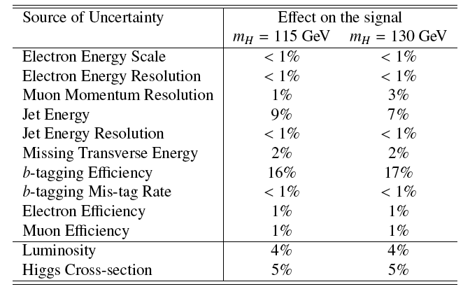
Systematic Uncertainties
Dominant systematic errors from b-tagging efficiency in both analyses
Followed by jet energy scale
Points at the next things things to improve!
ZH➝llbb
WH➝lνbb

Slide 19
H➝bb Analysis Results

Slide 20
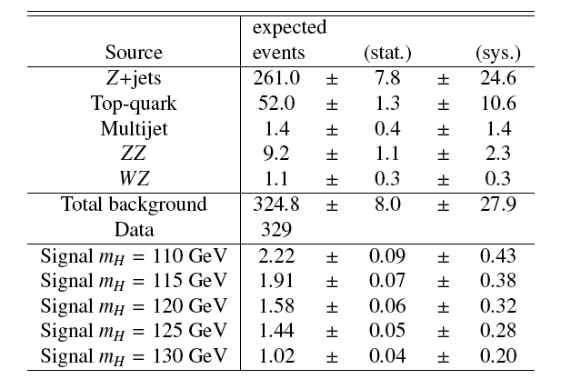
ZH➝llbb
Good description of the background
No excess observed
Single-channel exclusion of ≈20x Standard Model

Slide 21
ZH➝llbb
Good description of the background
No excess observed
Single-channel exclusion of ≈20x Standard Model

Slide 22
ZH➝llbb
Good description of the background
No excess observed
Single-channel exclusion of ≈20x Standard Model

Slide 23
ZH➝llbb
Good description of the background
No excess observed
Single-channel exclusion of ≈20x Standard Model

Slide 24
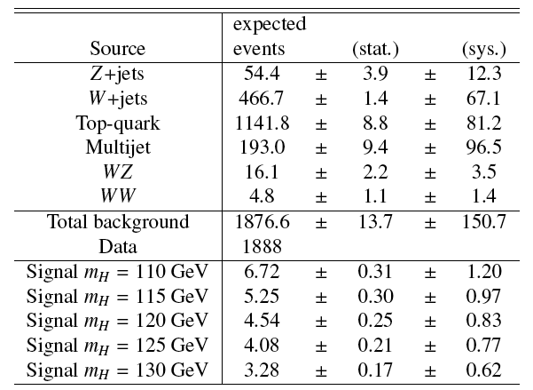
WH➝lνbb
Good description of the background
No excess observed
Single-channel exclusion of ≈20-30x Standard Model

Slide 25
Boosted VH with H➝bb

Slide 26
Alternative to inclusive channels: search for high-pT Higgs to bb:
J. M. Butterworth, A. R. Davison, M. Rubin, and G. P. Salam, Phys. Rev. Lett. 100 (2008) 242001, arXiv:0802.2470 [hep-ph]
p_{T}^{H} > 200GeV ≈ 5% of inclusive cross section but improved significance
Select W➝lν events and search for a H➝bb jet
Search for high-p_{T} jet (Cambridge-Aachen algorithm, R=1.2)
Search jet clustering history in reverse and look for large mass drop
Re-cluster with small R parameter to find sub jets
Peak consistent with W➝jj in tt events
Proof of principle for future analysis
See talk by D.Miller in QCD yesterday

Slide 27
Conclusions & Outlook

Slide 28
First direct search for H➝bb at the LHC in WH and ZH channels
Combined sensitivity to ≈10-20x Standard Model
Room for improvement!
Reduce systematics
New channels to explore
Multivariate analyses
Lots of data expected!
Proof of principle for boosted Higgs analysis
Watch this space!
Ref.: ATLAS-CONF-2011-103

Slide 29
Backup

Slide 30
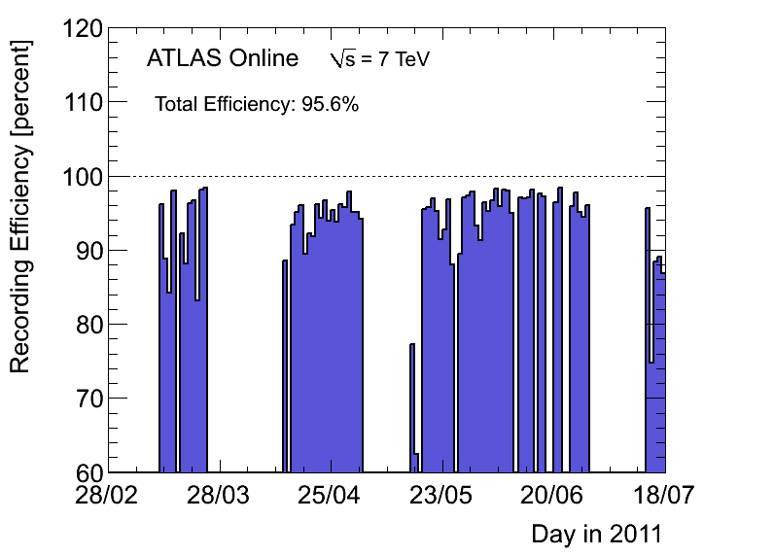
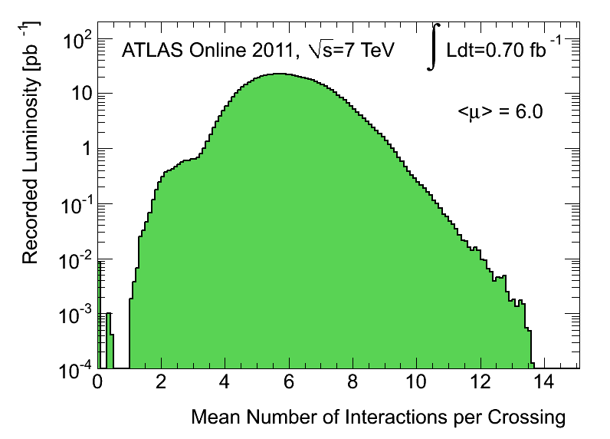
ATLAS & LHC: Efficiency and Pileup
Very good ATLAS performance
Data-taking efficiency above 95%
Luminosity-weighted distribution of the mean number of interactions per crossing for 2011
Calculated from the instantaneous luminosity as:
μ=L x σ_{inel} / (n_{bunch} x f_{r})
L: instantaneous luminosity
σ_{inel} : inelastic cross section (71.5 mb)
n_{bunch}: number of colliding bunches
f_{r}: LHC revolution frequency
Entries at μ≈0 from pilot bunches
See: arXiv:1101.2185

Slide 31
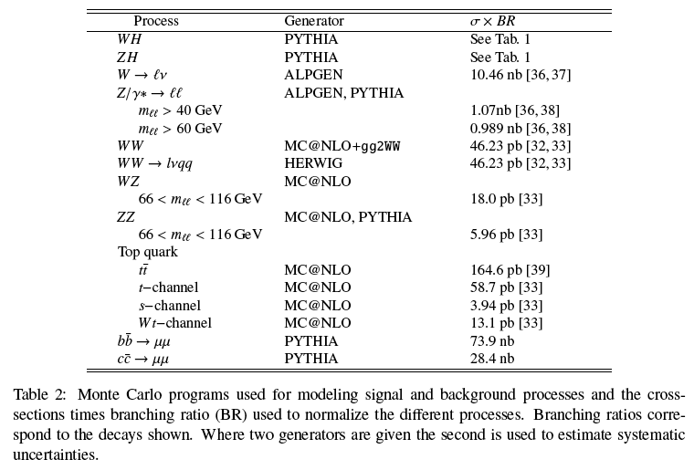
Monte Carlo Samples

Slide 32
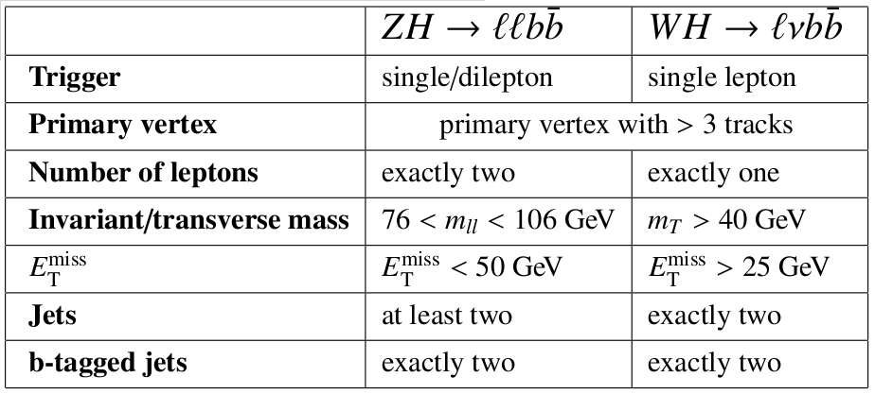
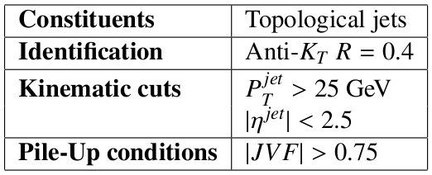
Common event selection:
Lepton Identification:
Jet reconstruction:

Slide 33
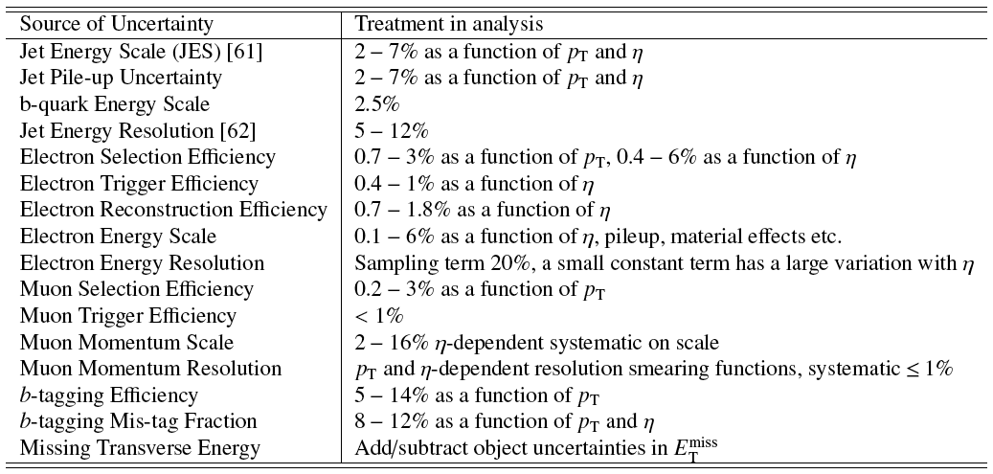
Detector related uncertainties

Slide 34
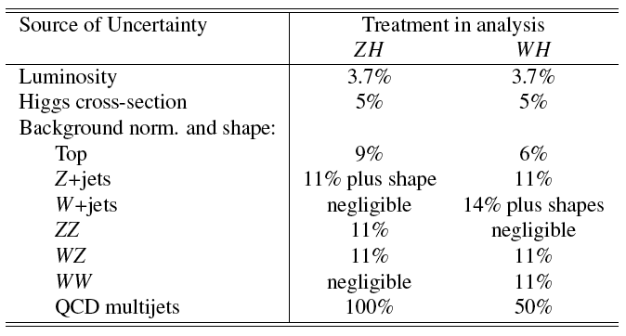
Normalization Systematic Uncertainties

