Slide 1
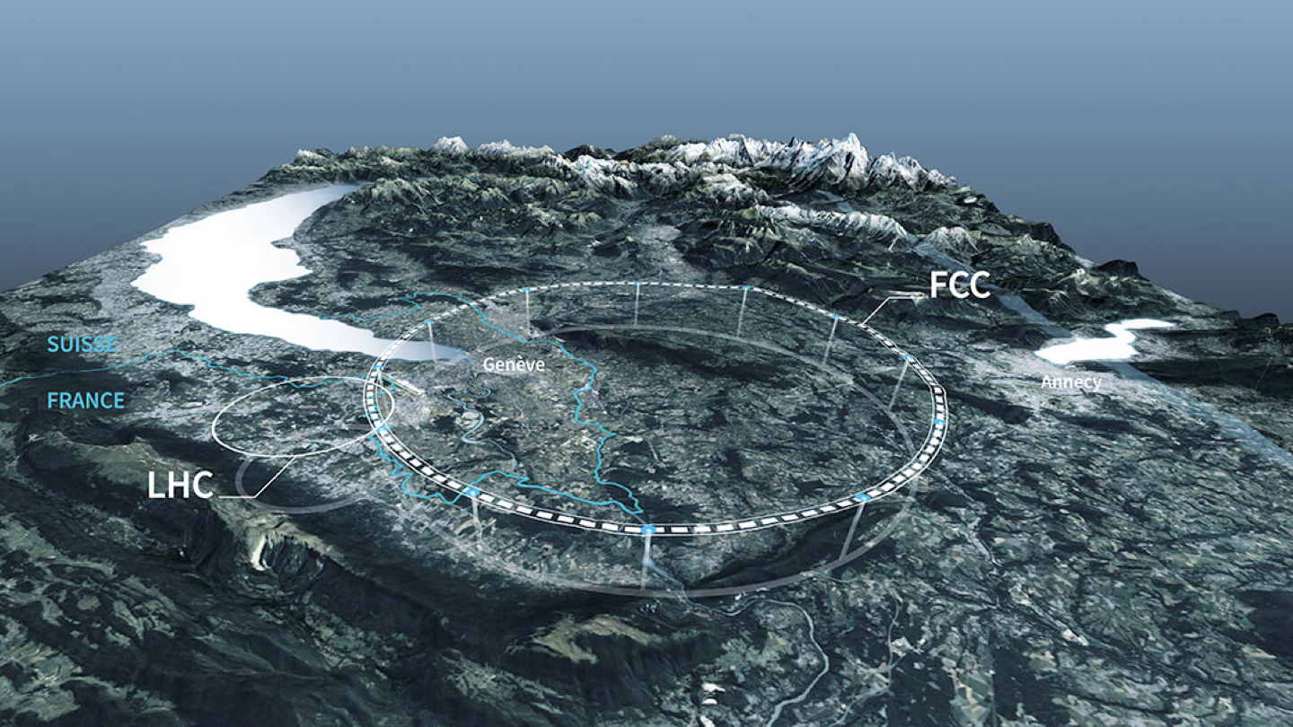
LHC Upgrades and Future Accelerators
R. Gonçalo (UC/LIP)
RECFA Visit to Portugal
Biblioteca Nacional de Portugal, Lisbon – 15 Sep. 2023

Slide 2
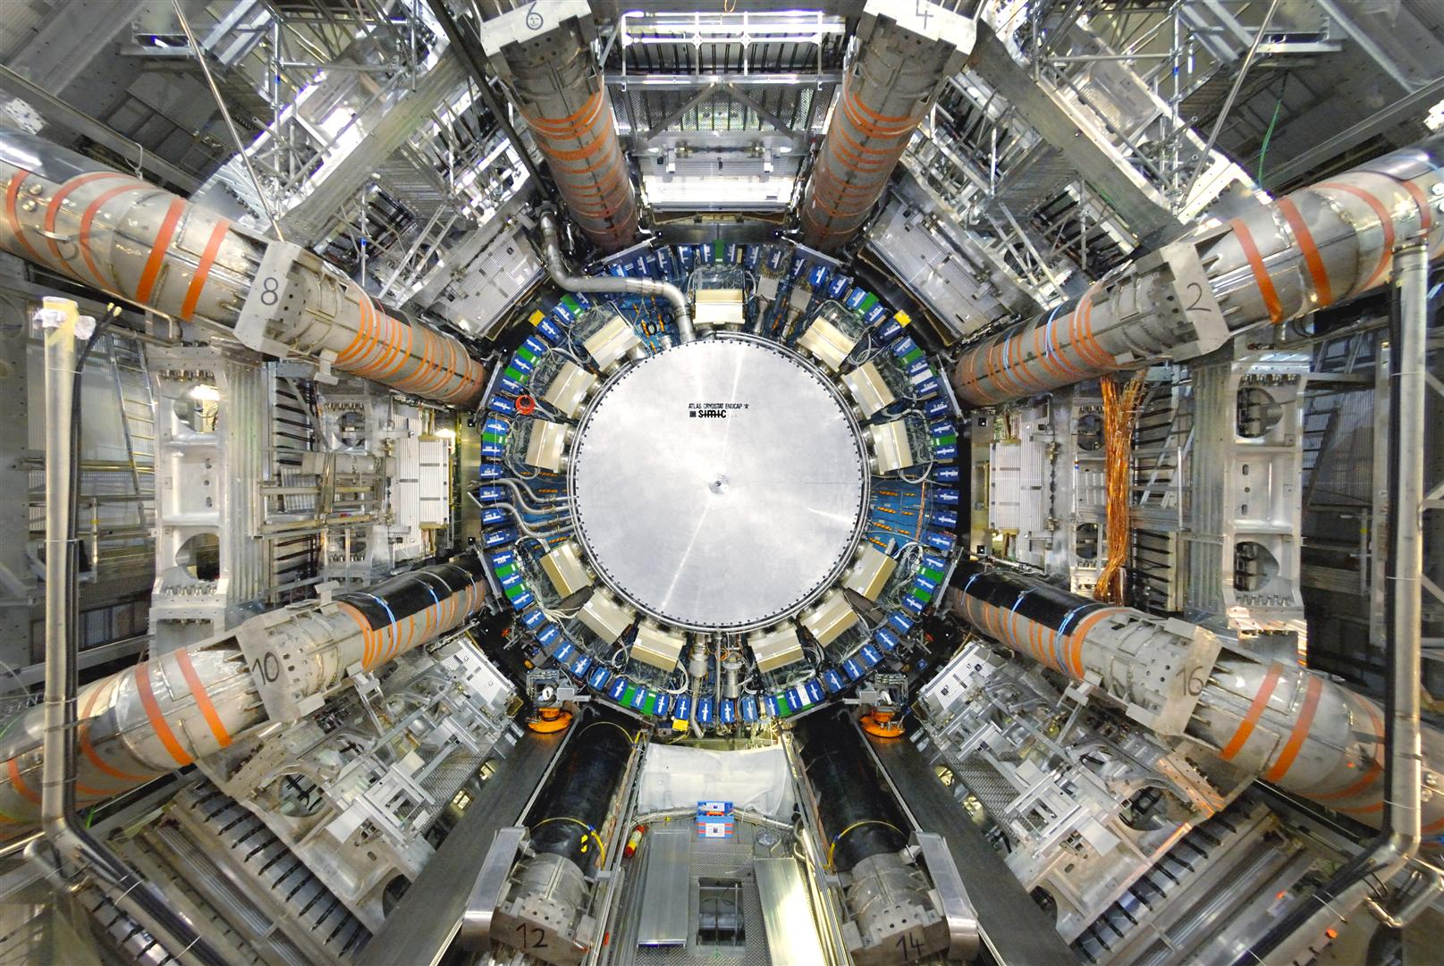
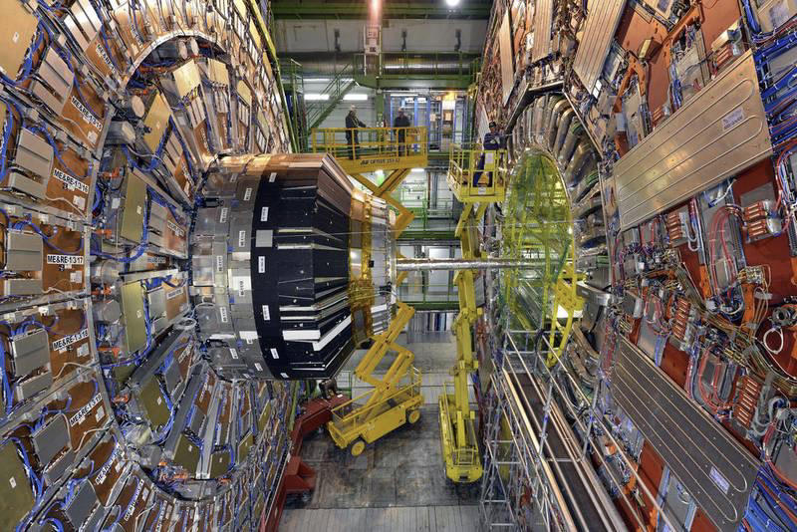
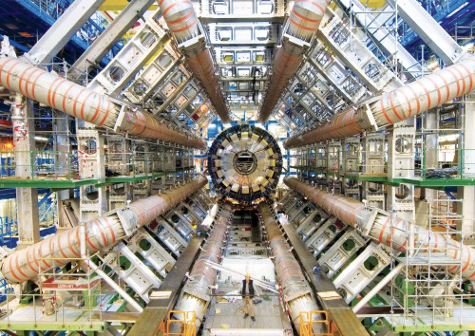
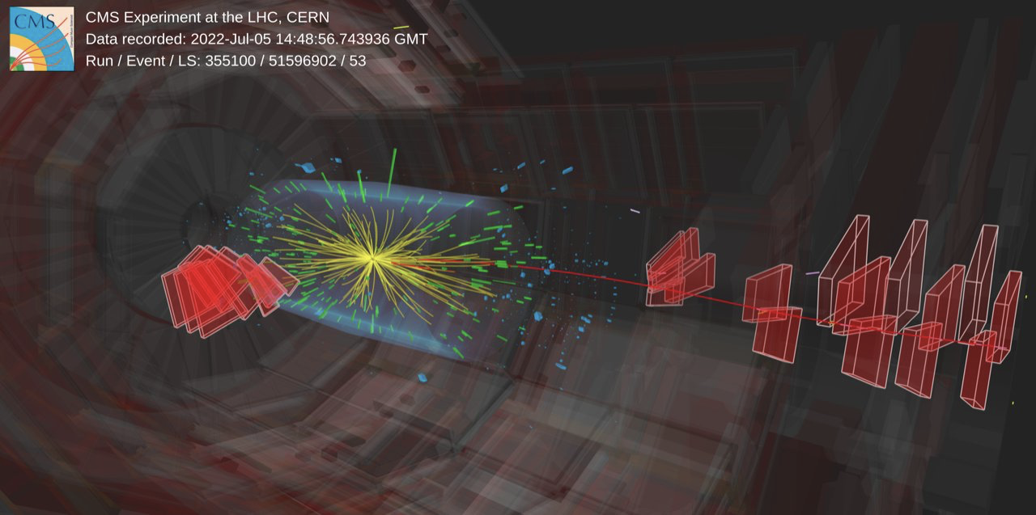
LHC Upgrades and Future Accelerators
LHC Phase II Upgrade
ATLAS Upgrades: TileCal, HGTD , HTT…
CMS Upgrades: MTD, PPS, ECAL, HGCAL
Future Colliders:
FCC activities in Portugal
Detector R&D Collaborations

Slide 3
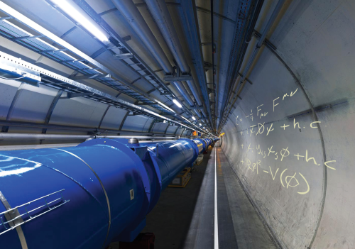
LHC Upgrades

Slide 4
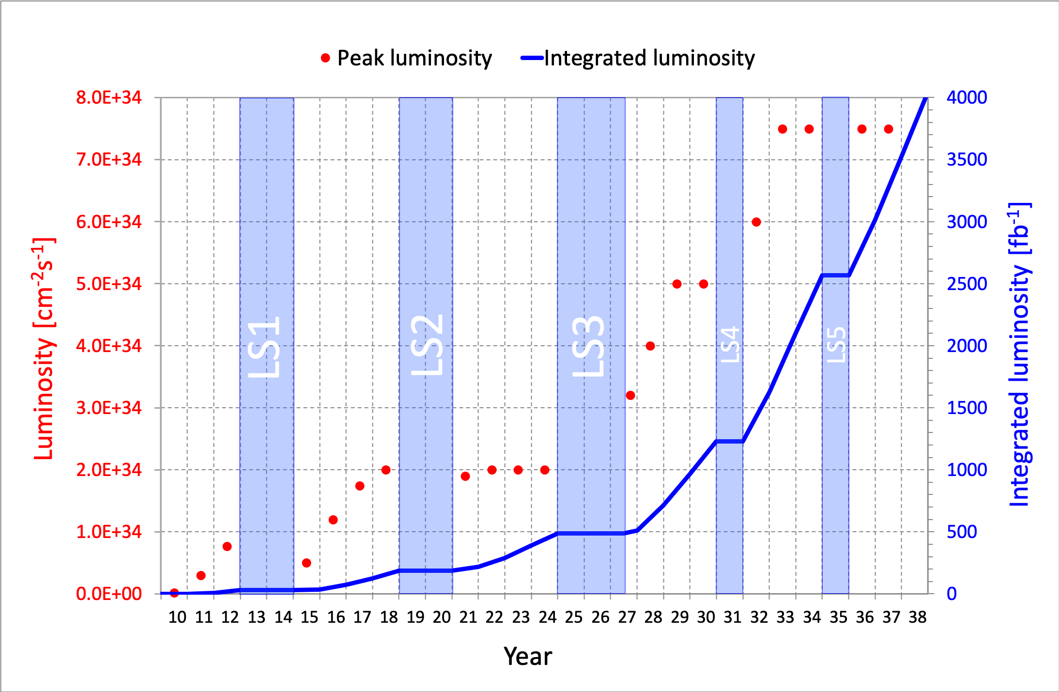
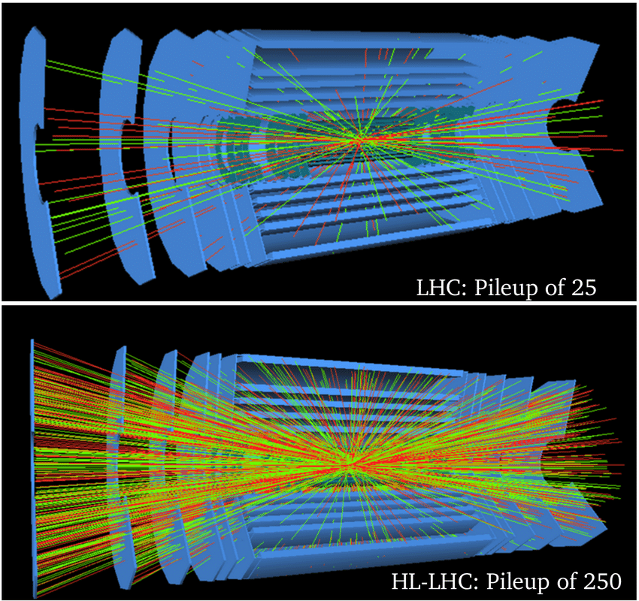
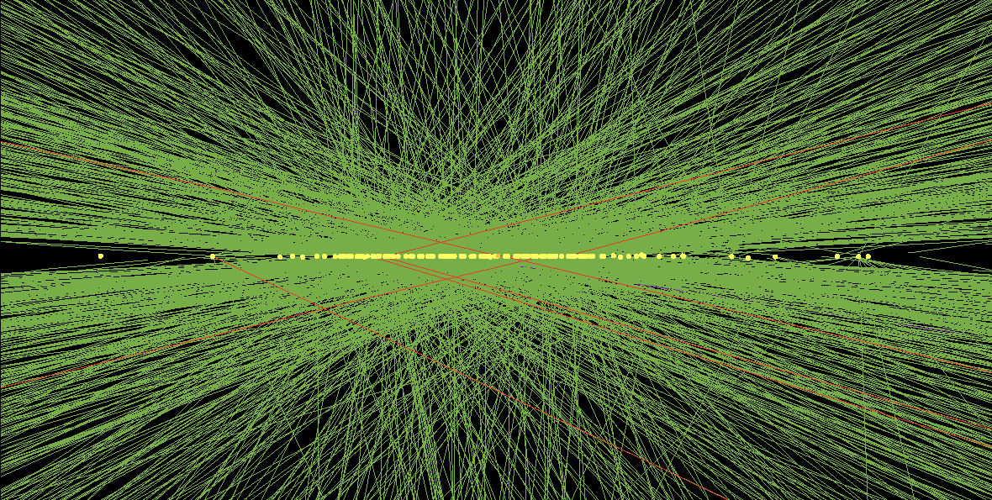
LHC Upgrades
200 simultaneous proton collisions
≈1.8 collisions/mm
≈ 10 cm

Slide 6
LHC Upgrades for Phase II: ATLAS

Slide 7
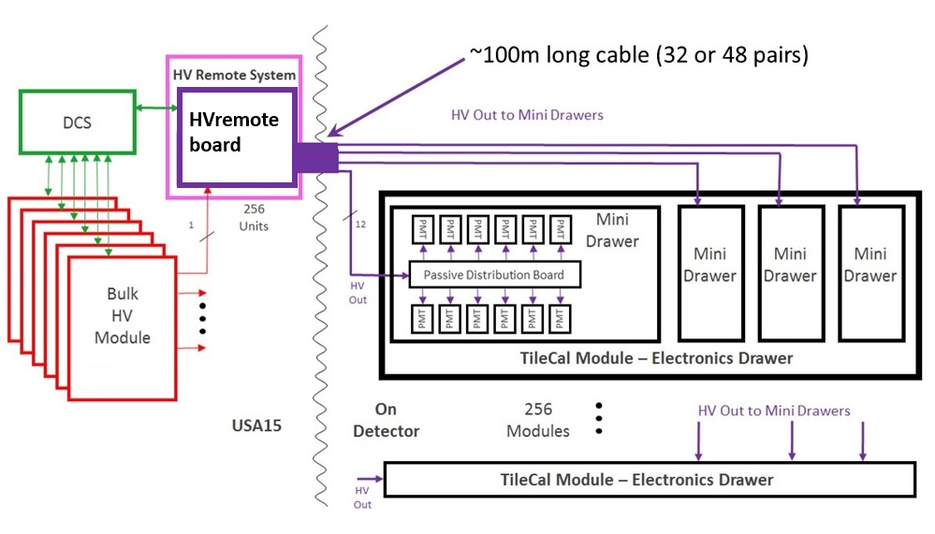
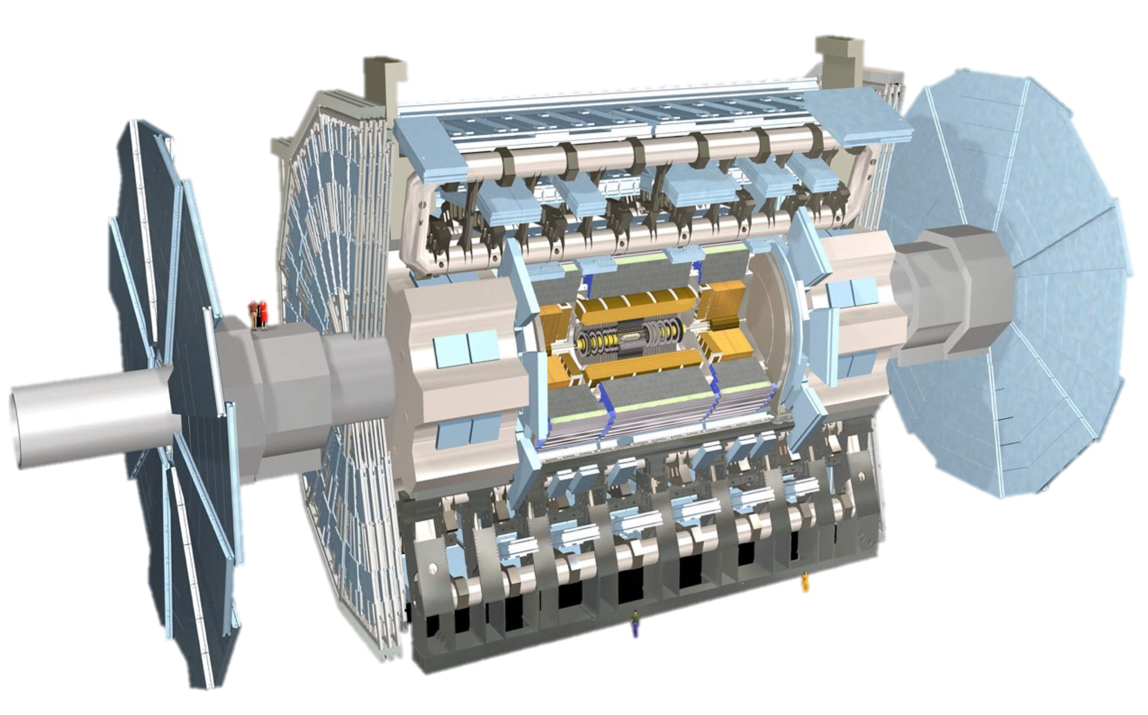
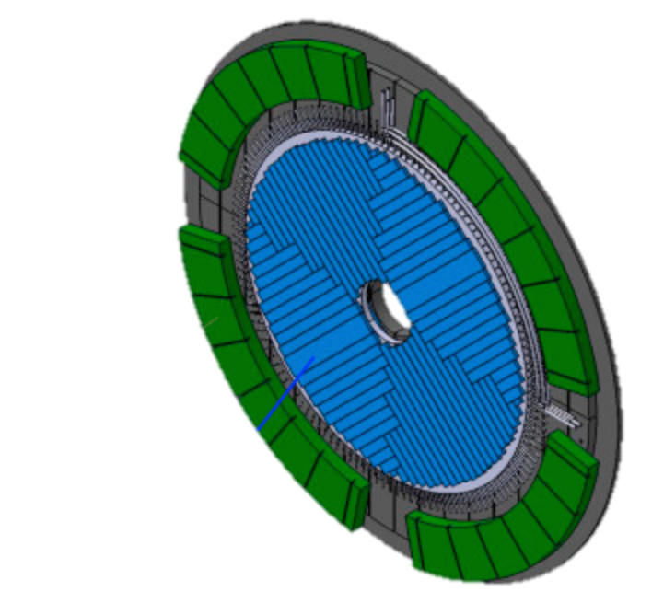
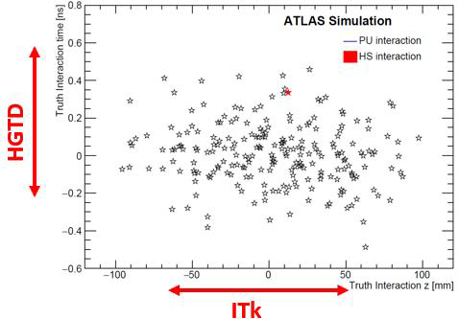
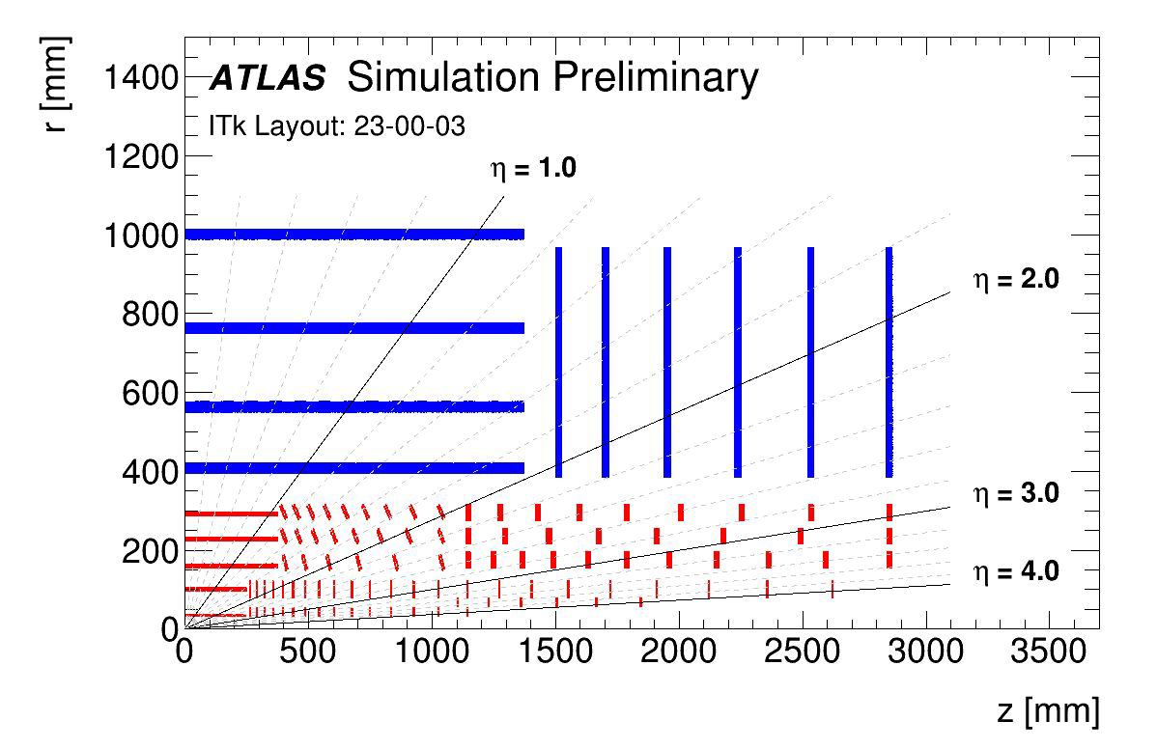
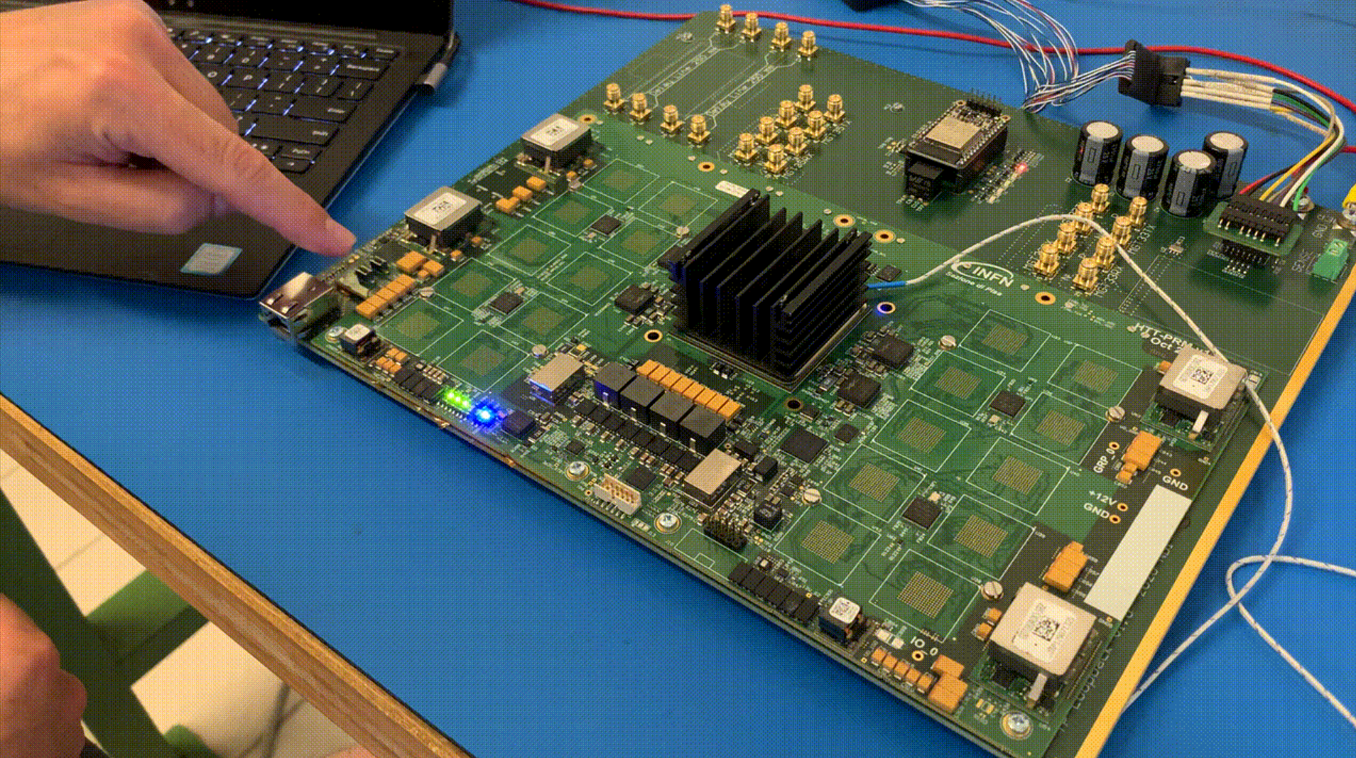
ATLAS Upgrade @ LIP
New Tile Calorimeter High-Voltage system
High Granularity Timing Detector
(30-50 ps/track)
Track reconstruction for New Inner Tracker (ITk)
R&D on hardware acceleration for trigger
Previously: Hardware Tracking for the Trigger (HTT) – abandoned

Slide 8
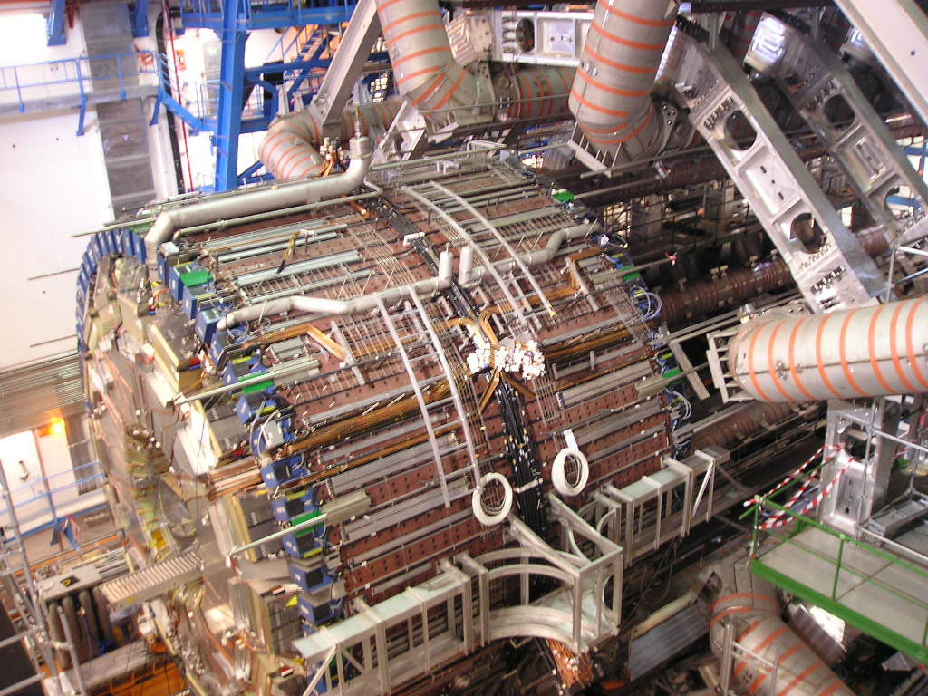
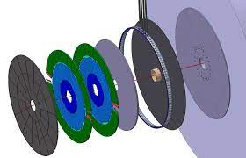
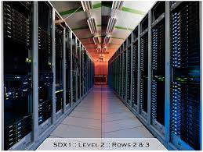
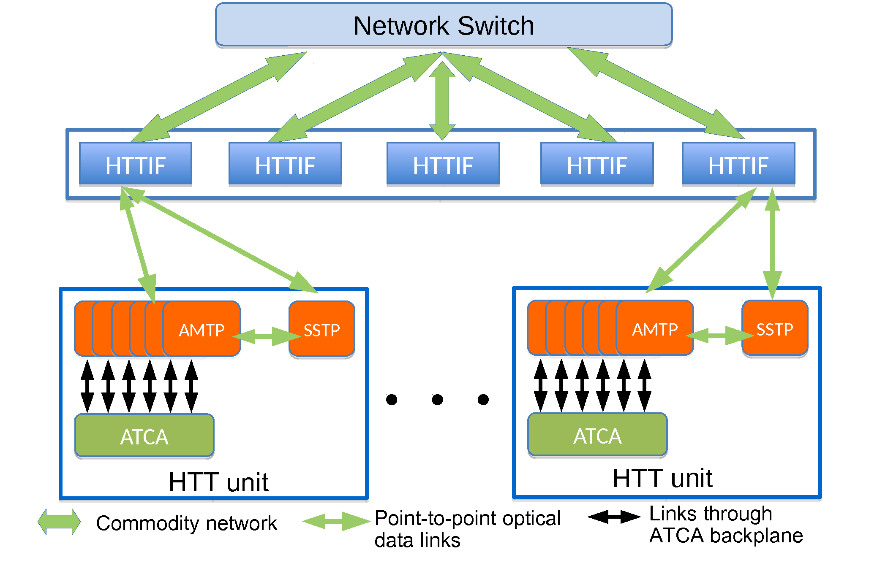
LHC Upgrades for Phase II: ATLAS
Tile calorimeter (TileCal) High Voltage system – PT contribution: 1 M€
Large team effort and entirely under LIP’s responsibility
Team: 4 senior researchers/academics; 3 engineers; 2 PhD students; 4 MSc students
Close collaboration with LIP Electronics Lab
High Granularity Timing Detector (HGTD) – PT contribution: 400 k€
Contributions to readout ASIC development, DCS and Interlock systems, High Voltage
Team: 3 researchers/academics; 2 engineers; 2 MSc students
Close collaboration with LIP Detector and Electronics Labs
TDAQ Phase-II upgrade – PT contribution: 200 k€
Contribution to High-Level Trigger computing farm
Event Filter software: GPU acceleration for Trigger calorimeter reconstruction
Team: 1 academic, 1 PhD student; collaboration with INESC-ID Computing group
Formerly: Hardware Tracking for the Trigger – planned PT contribution 600 k€
Team: 2 researchers/academics; 2 engineers; 1 PhD student; 1 MSc student
Solution abandoned by ATLAS in favor of a software-based solution

Slide 9
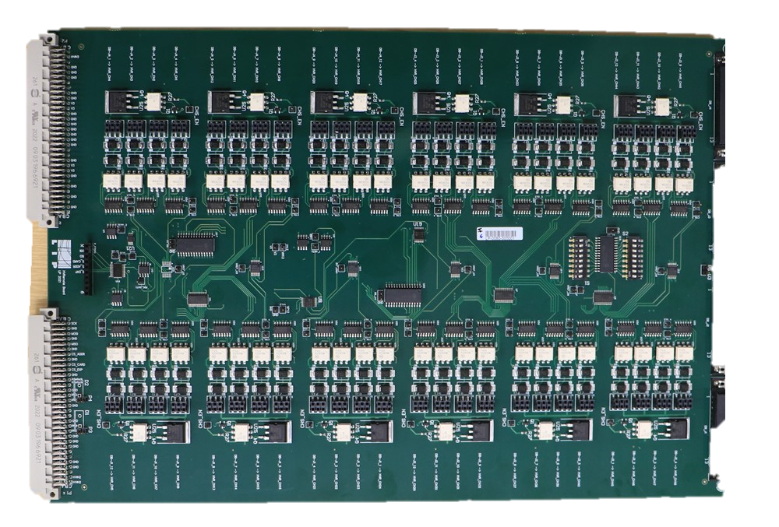
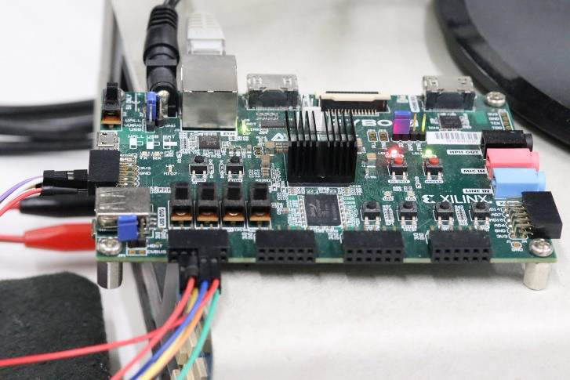
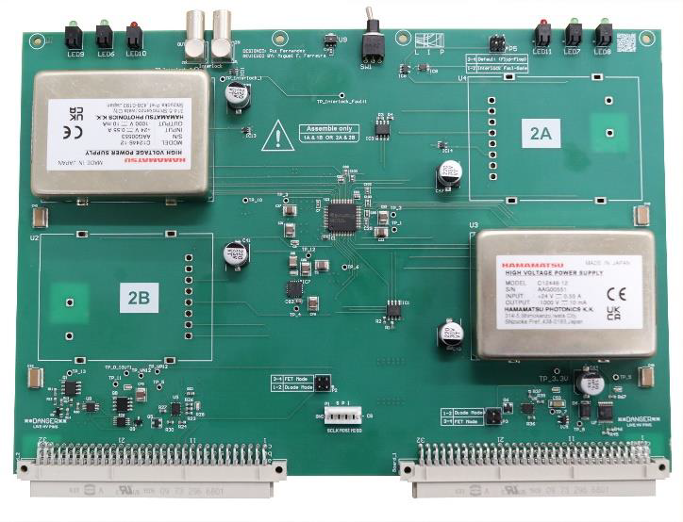
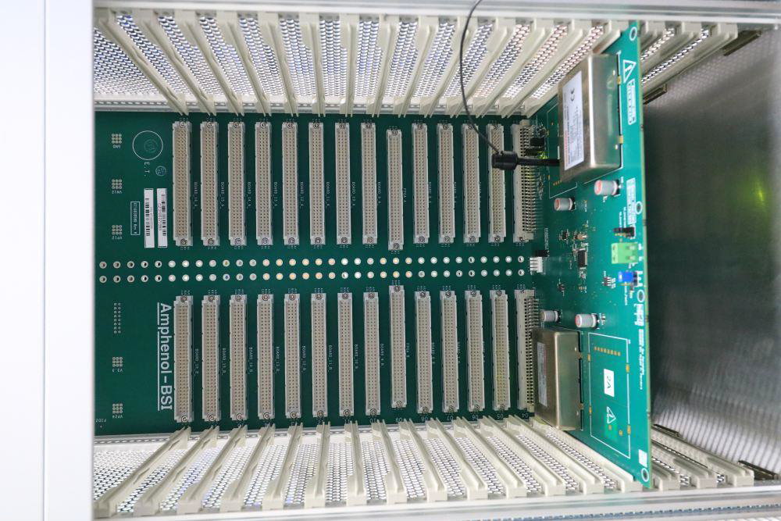
ATLAS: TileCal High-Voltage System (LIP)
DCS system: SoC board for High Voltage monitoring & control
HVRemote boards - Regulation and control system off detector at USA15 (256 boards)
HVSupplies provide primary High Voltage
(256 boards)
>100m long cables
from service cavern
16 crates in service cavern
System parameters:
10000 Photomultipliers
High Voltage < 950 V – so far used ≈750 V
Individual currents < 400 μA
High Voltage stability < 0.5 V rms
HVBus – passive distribution board distributes HV to PMTs (1024 boards)

Slide 10
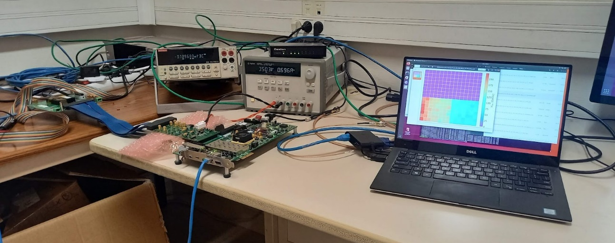
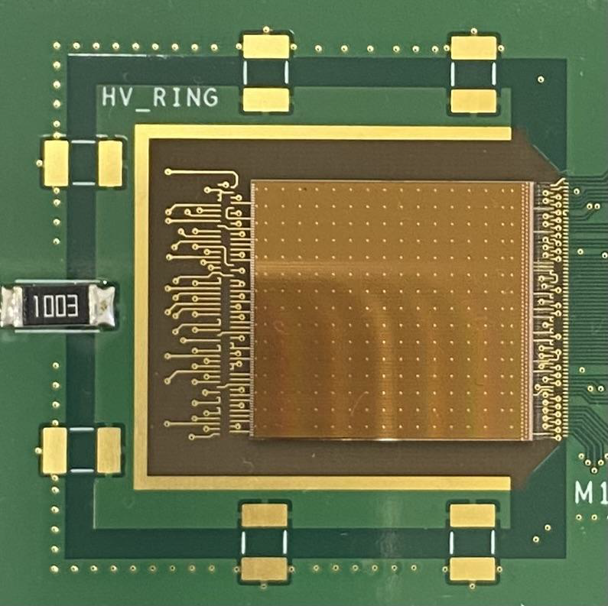
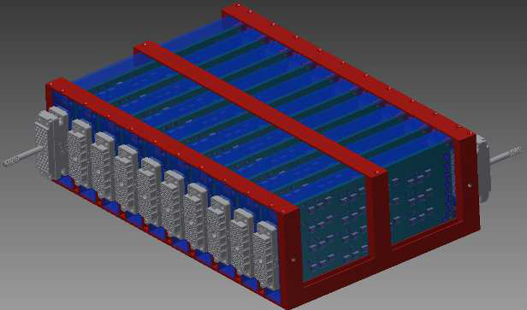
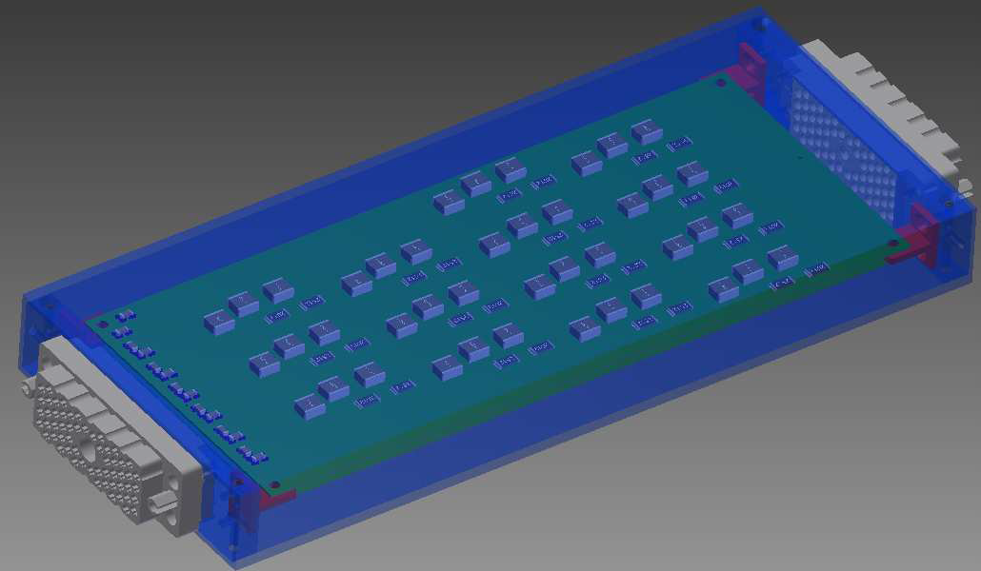
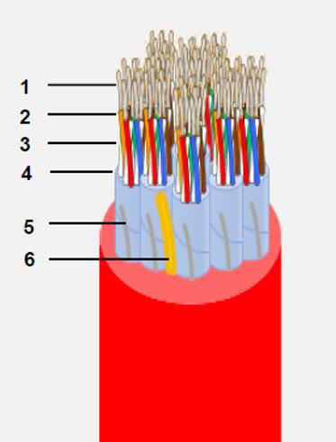
ATLAS: High Granularity Timing Detector
Based on novel Low Gain Avalanche Detectors
Good timing resolution: 30 – 50 ps/track
LIP’s contributions:
Development of front-end ASIC (ALTIROC)
Functionality and radiation hardness tests
High voltage infrastructure:
Coordinating High Voltage filters and patch panels
Also cables, pigtail connectors, etc
Detector Control System (DCS) and Interlock:
Coordinating Interlock system
In charge of interlock Transfer Module board
DCS: monitoring of high voltage and CO₂ cooling
Strong expertise in DCS and Interlock systems

Slide 11
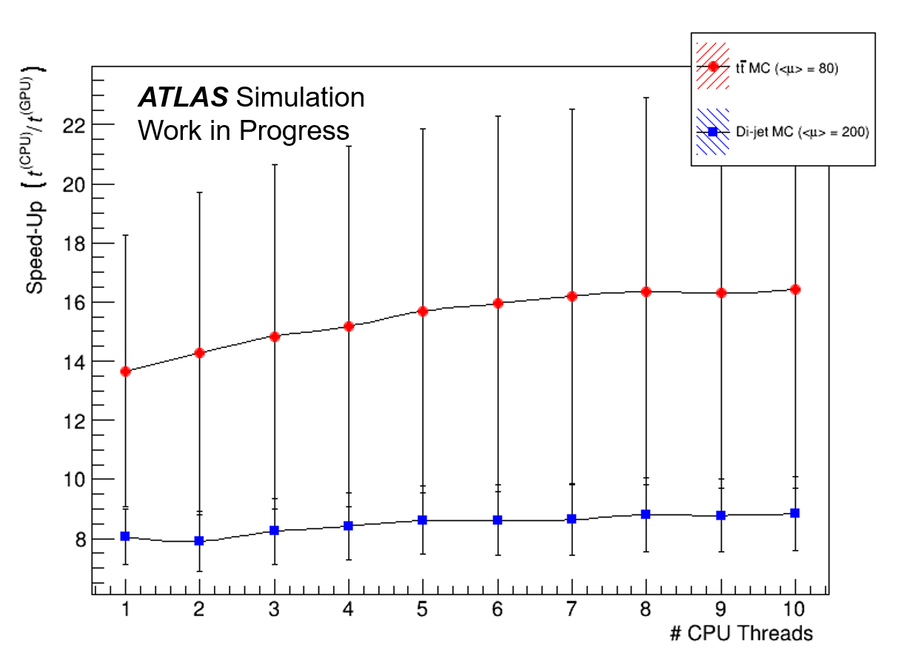
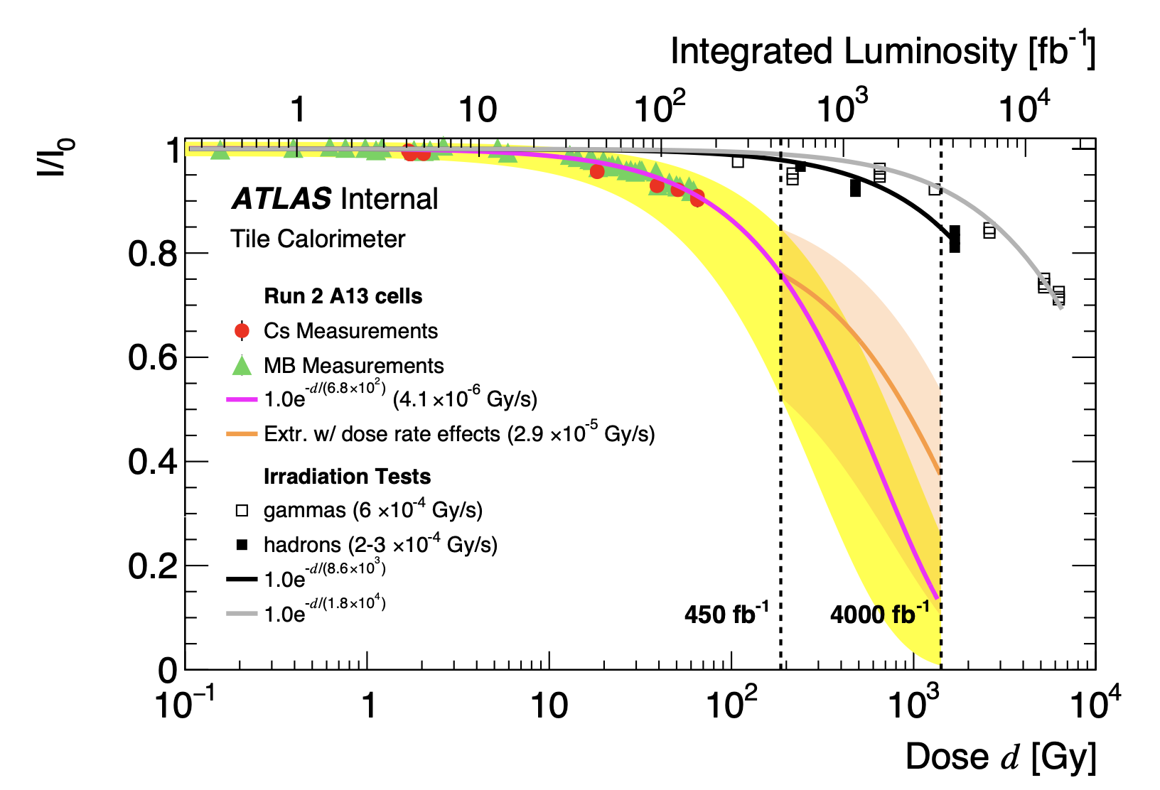
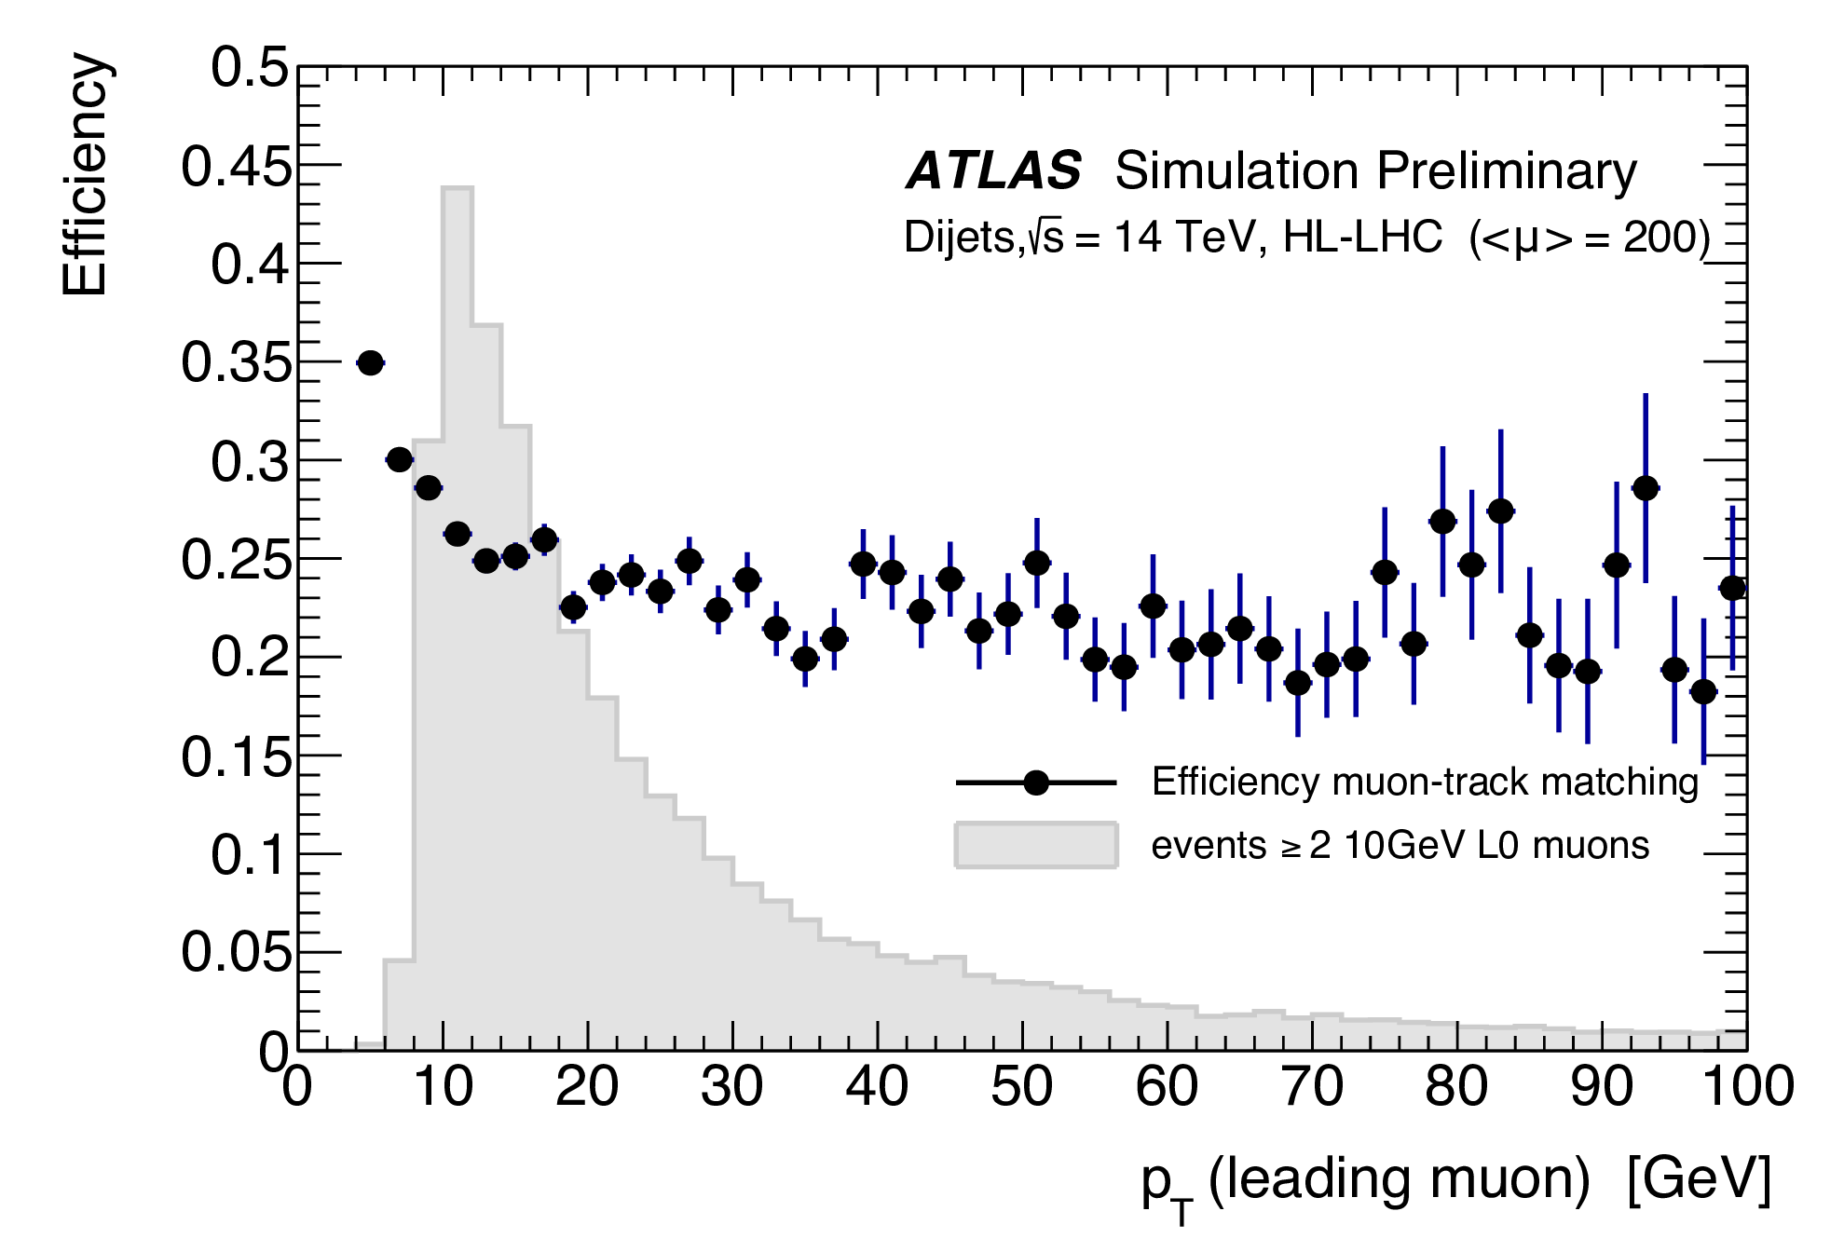
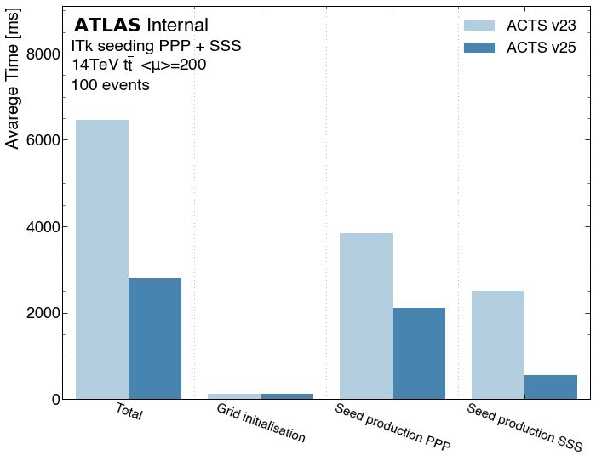
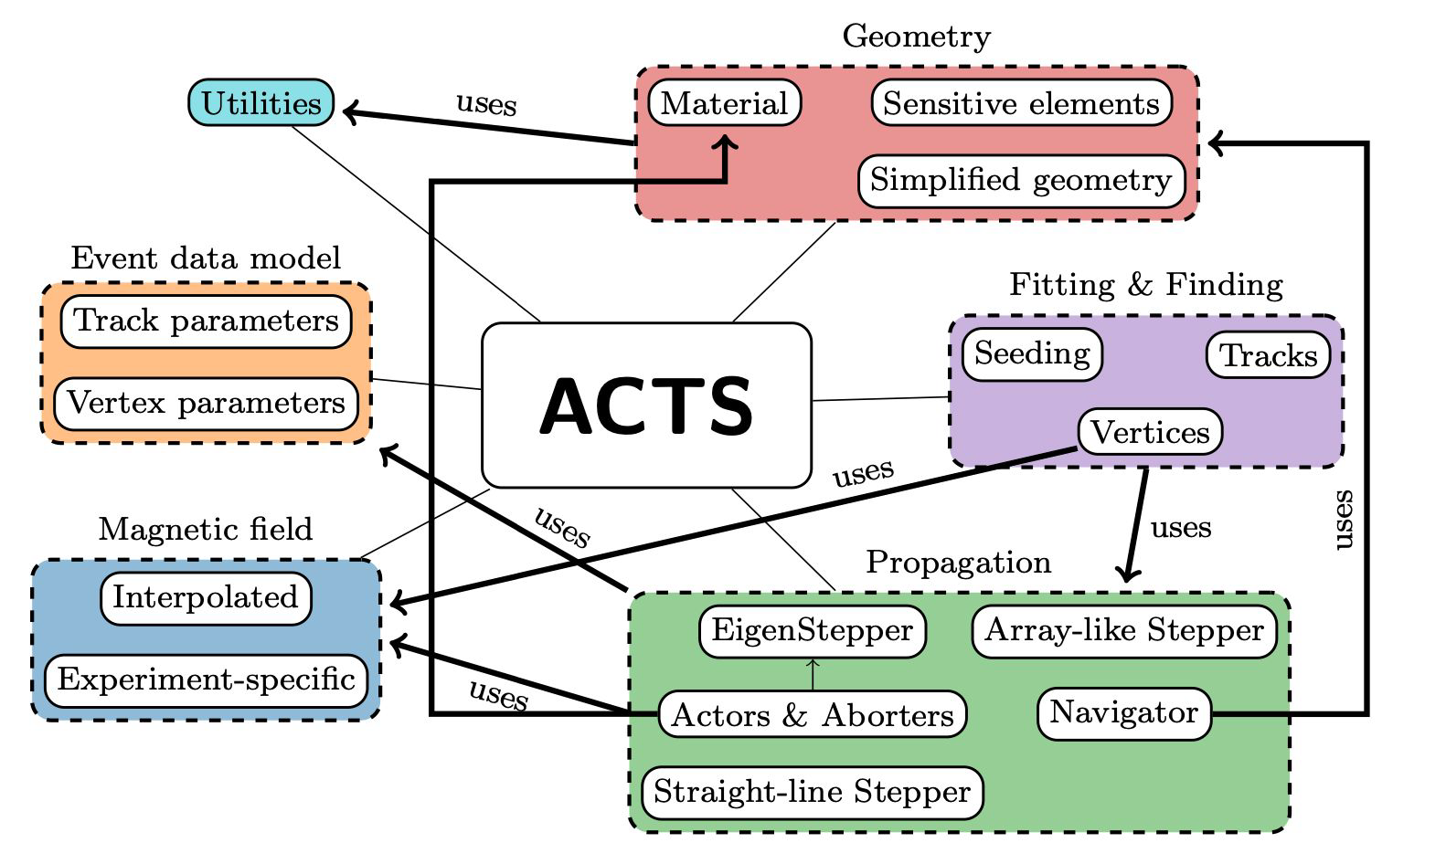
ATLAS: Trigger/DAQ, Performance, and Tracking
Trigger and data acquisition
Development of GPU-based algorithms for acceleration of high level filter calorimeter reconstruction
Demonstrated important improvement factor over CPU algorithm: J. Phys.: Conf. Ser. 2438 012044
TileCal radiation hardness for HL-LHC
Monitoring of optics light response versus radiation dose using calibration systems
Modelling and extrapolation to future conditions essential to predict detector behaviour
Contributed to former project on Hardware Tracking for the Trigger
Simulation and performance studies
ATL-DAQ-PUB-2023-001
Tracking software development for HL-LHC
PhD student at CERN working on optimization of common tracking package for HL-LHC
HTT

Slide 12
LHC Upgrades for Phase II: CMS

Slide 13
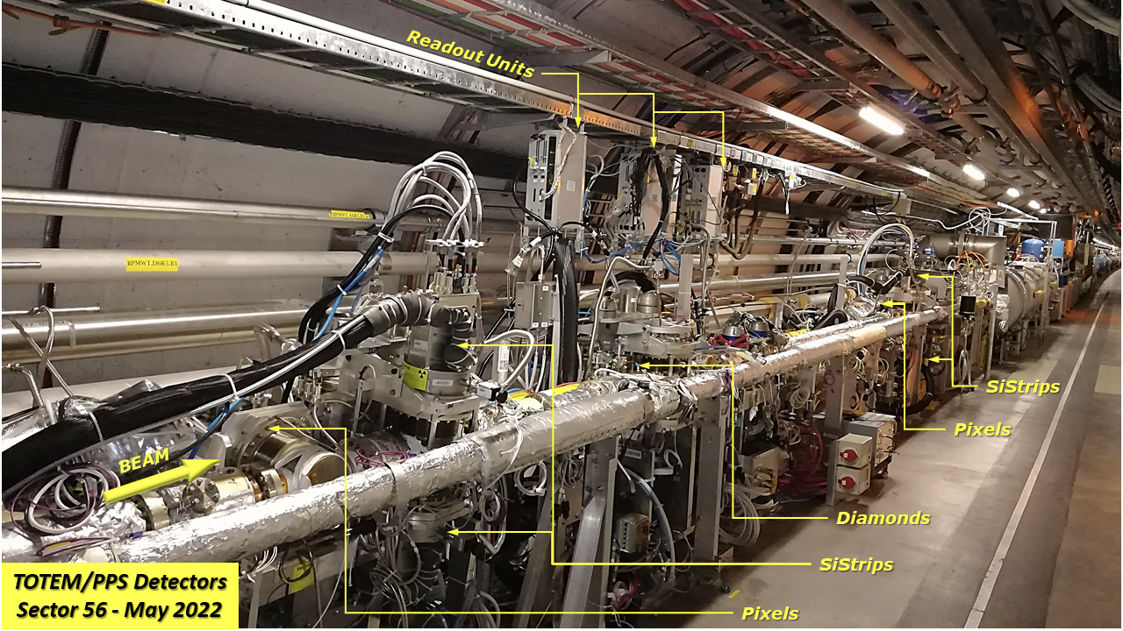
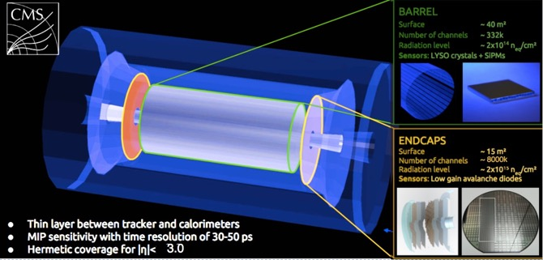
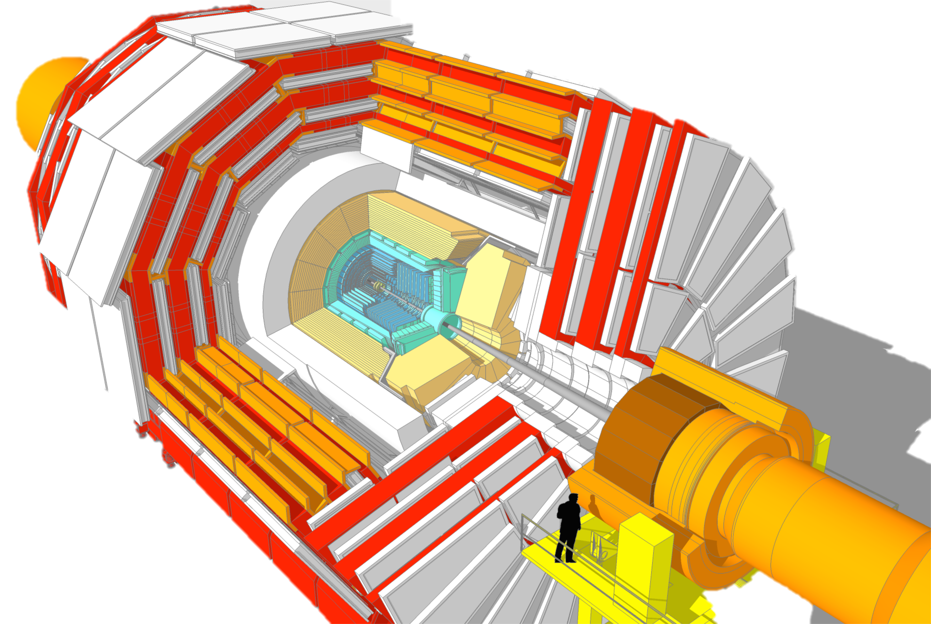
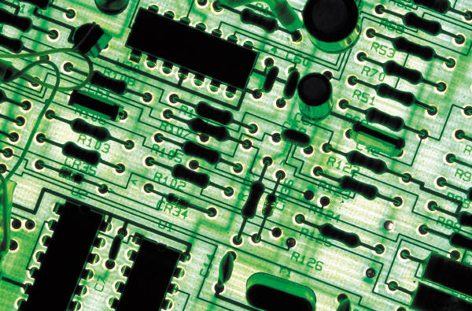
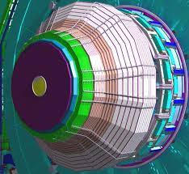
Barrel Timing Layer (BTL)
Upgrade of Precision Proton Spectrometer (PPS)
Electronics for Electromagnetic calorimeter
High Granularity Calorimeter (HGCAL)
Notes:
Add timing information to reject pileup: need O(mm) resolution => ~10ps
Add spacial granularity to separate close tracks
Rad.hard technology
Add tracking solid angle (b-tagging, vertex ident. Etc)

Slide 14
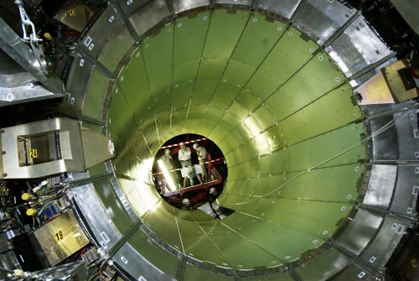
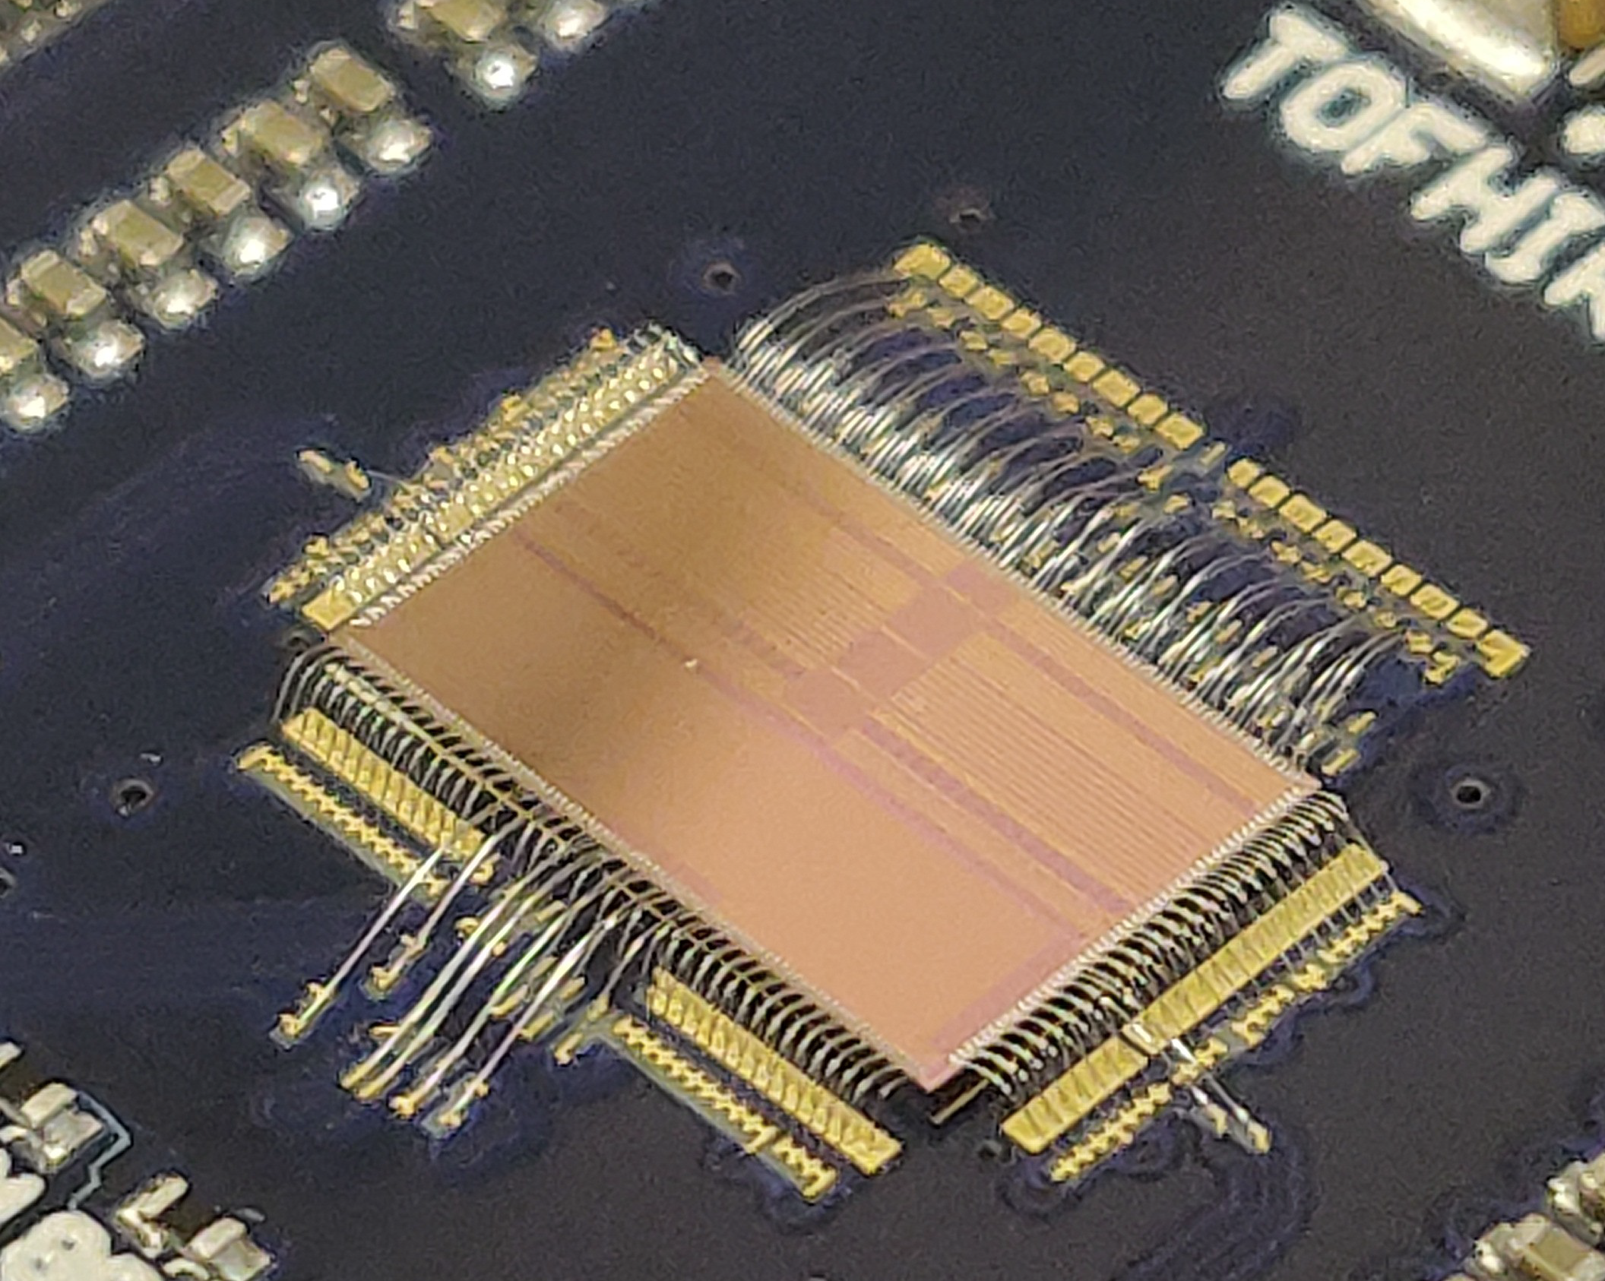
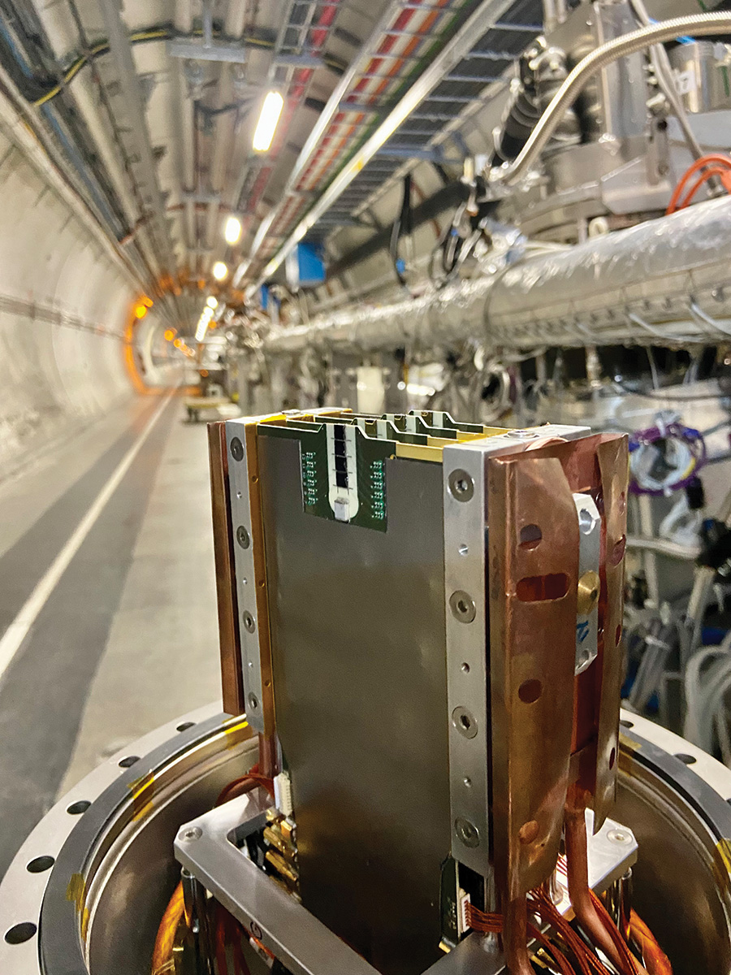
LHC Upgrades for Phase II: CMS
MIP Timing Detector – PT contribution: 1070 k€
Barrel: Full responsibility for TOFHIR ASIC and front-end cards
Budget 790 k€, Executed 1070 k€
Team: 3 senior researchers/academics; 2 engineers; 2 PhD students
MTD/BTL electronics coordination (J. Varela)
Precision Proton Spectrometer (Phase II program under approval)
Project manager (J.Hollar) – Level 1 position
Team: 4 senior researchers/academics; 1 engineer; 3 PhD students;
HGCAL calorimeter – PT contribution: 290 k€
Rad tolerant regulator ASIC in collaboration with CERN
Budget: 360 k€, Executed 240 k€
Team: 1 senior researchers/academics; 1 engineer
ECAL calorimeter – PT contribution: 400 k€
Frontend ADC ASIC in collaboration with Torino/Italy
Budget: 400 k€, Executed 325 k€
Team: 1 senior researchers/academics; 1 engineer
Missing Funds: 200 k€

Slide 15
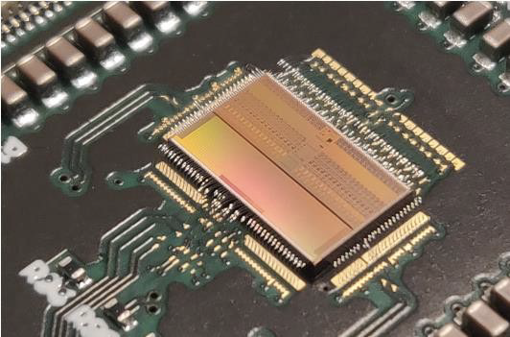
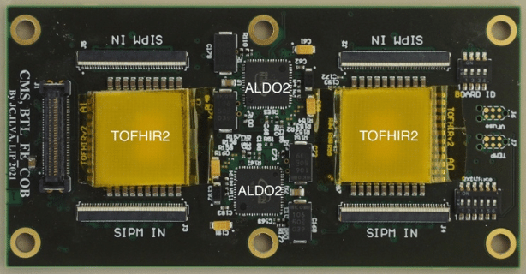
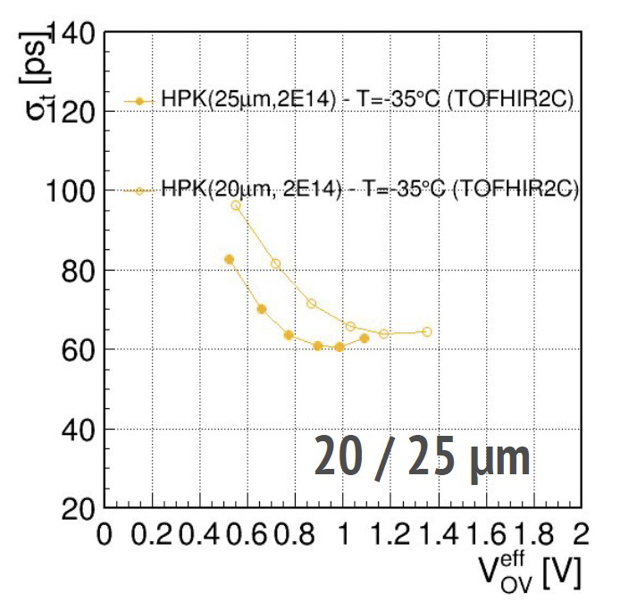
CMS: MIP Timing Layer
Very good time resolution!
30 ps at Beginning of Operation
Degrades to 60 ps at End of Operation due to radiation damage of SiPMs
Suppress pileup and increase physics reach in vertex reconstruction precision
Impact on: long-lived/stable particle searches, di-Higgs, b-tagging, PID for heavy ions/flavor physics, etc…
Barrel Timing Layer (BTL, |η| < 1.5):
TOFHIR2 readout ASIC (15k chips)
Front-end cards (5500 cards)
Developing TOFHIR ASIC together with the PETSYS Portuguese company – a major endeavour!
Test beam results
with TOFHIR2 and modules irradiated to 2×10¹⁴ neq/cm²
(End of Operation)

Slide 16
CMS: Precision Proton Spectrometer
Forward proton spectrometer
Tracking and timing detectors very close to beam
≈200 m from the CMS interaction point
In Roman Pots with vertical movement: mitigate radiation damage
Good spatial and time resolution (goal is 50 ps)
For HL-LHC: upgrade to run at high luminosity
Challenge: huge flux and highly non-uniform irradiation profile
Use LGADs and adapt solutions developed for Endcap Timing Layer
LIP contributing strongly to detector preparation, test beam activity, detector R&D and characterization, silicon sensor studies, simulation, DAQ, etc.
EoI: arXiv:2103.02752

Slide 17
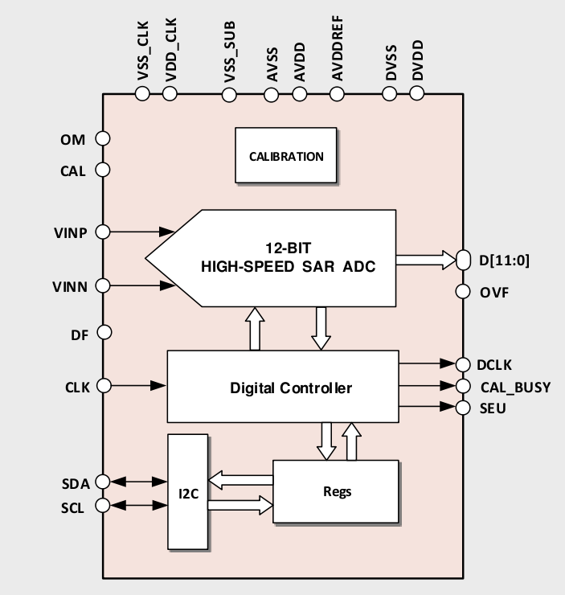
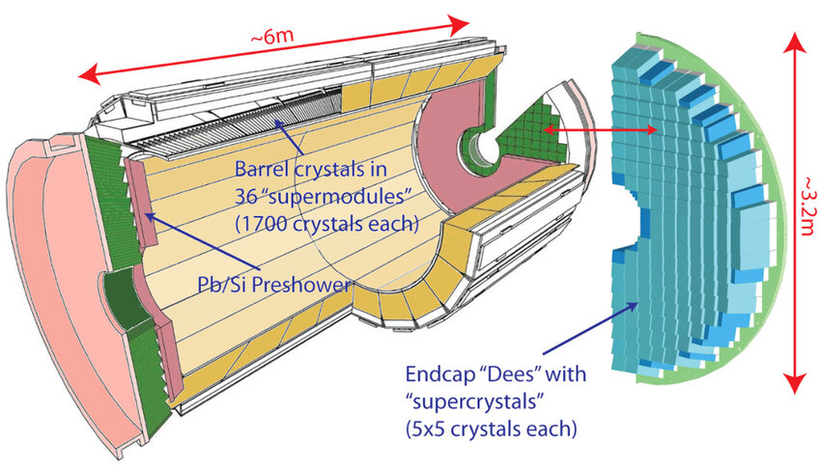
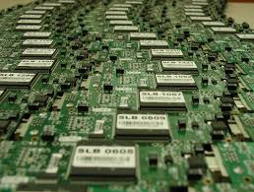
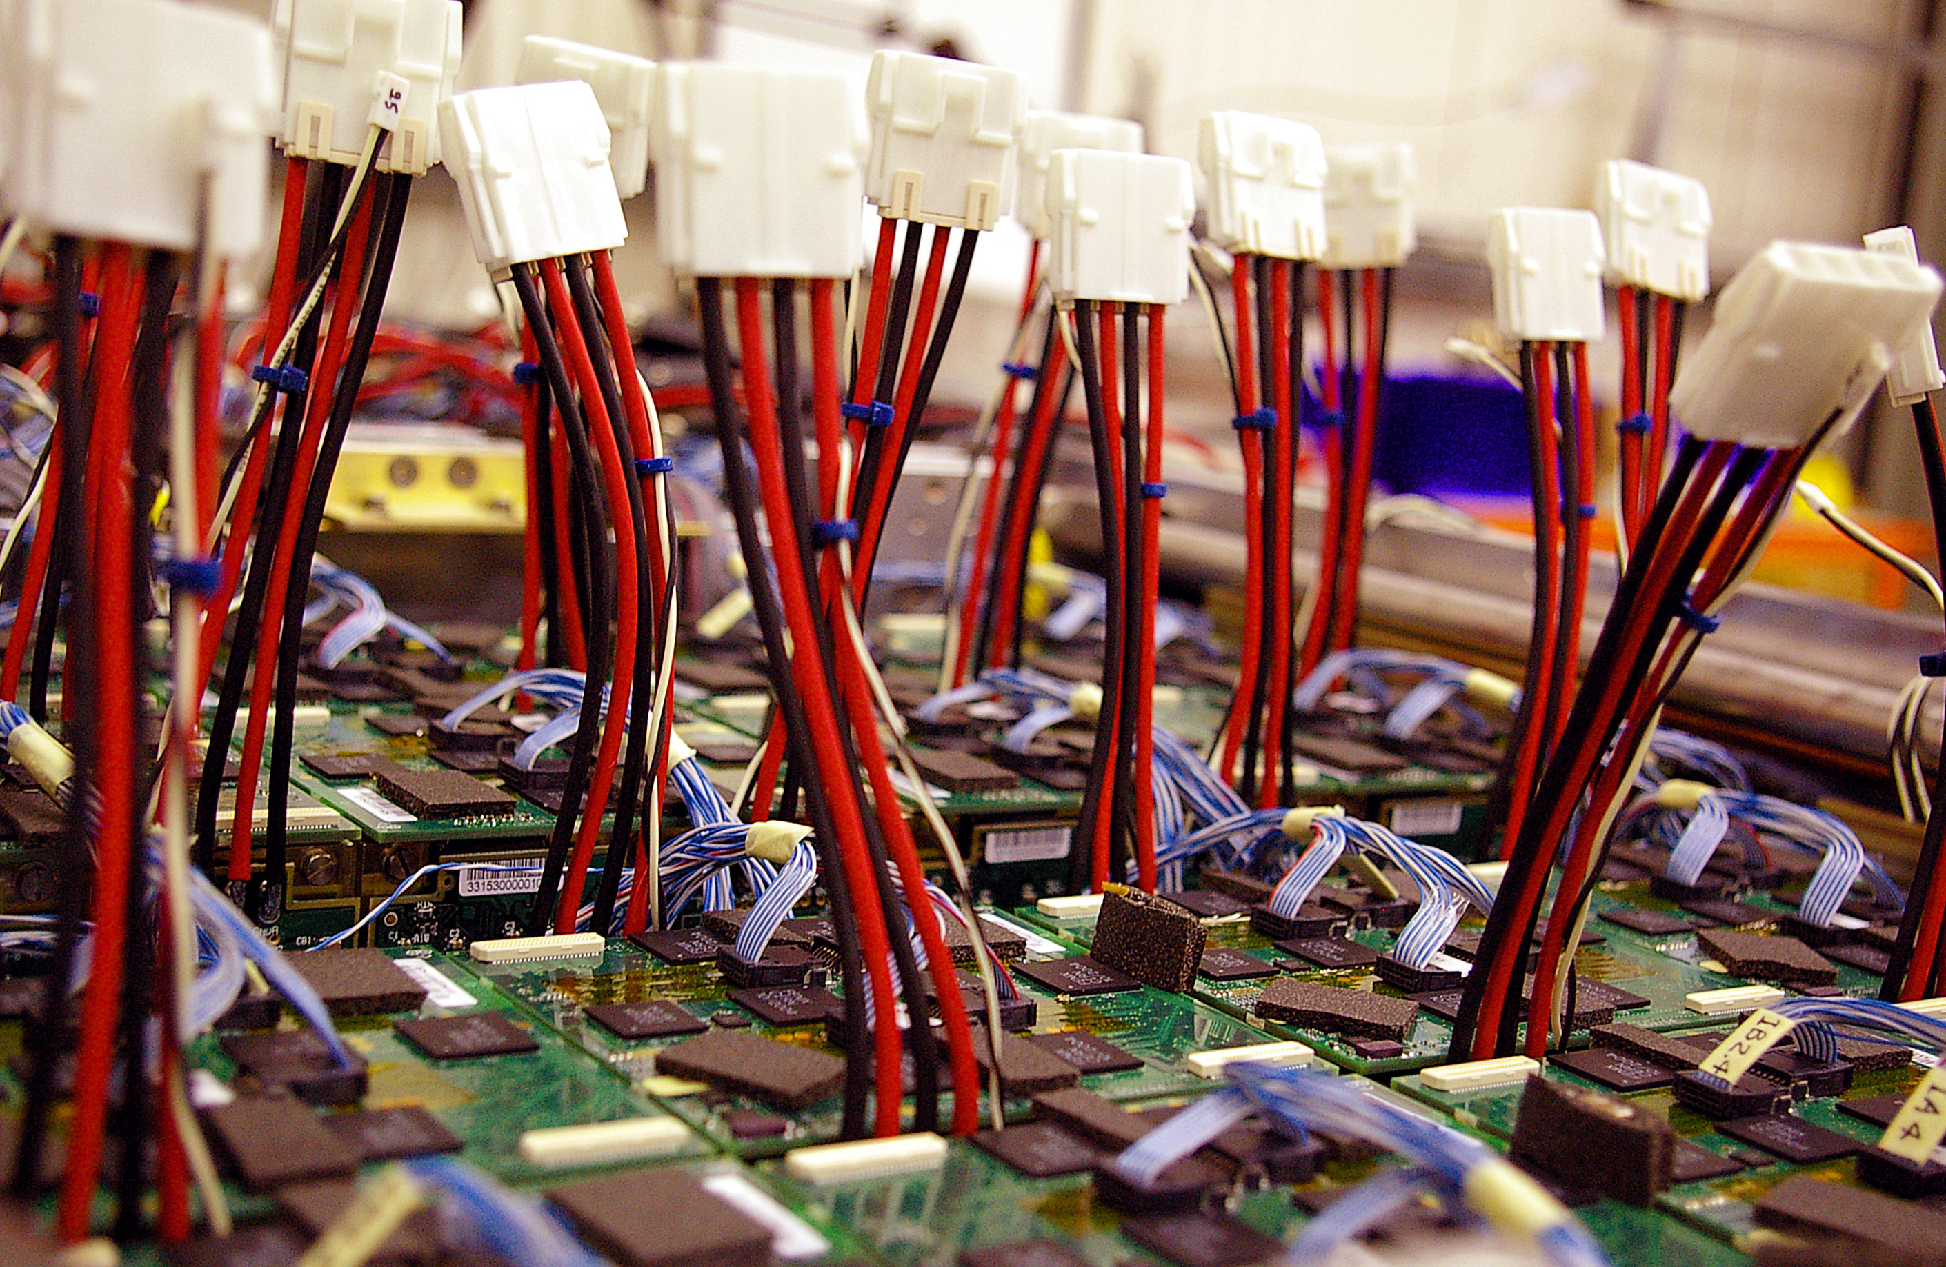
CMS: Electromagnetic Calorimeter (ECAL)
LIP responsible for ECAL back-end electronics for many years
For HL-LHC:
Full replacement of electronics, to meet pileup/rate requirements
LIP contribution: collaboration with Portuguese industry to develop new low-power ADC ASIC
12-bit resolution, with 160 MS/s sampling rate

Slide 18
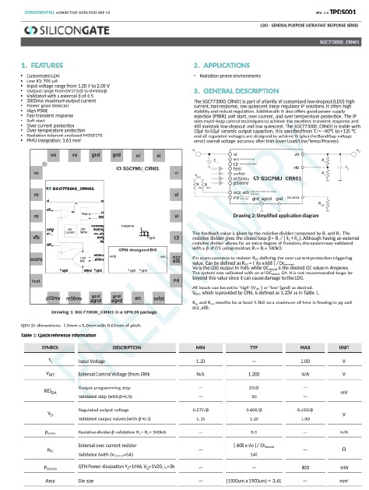
CMS: HGCAL
New High Granularity Endcap Calorimeter (HGCAL)
State of the art in electromagnetic and hadronic Calorimetry for proton colliders
Very challenging project
LIP contribution
A new high current (3A); <200 mV dropout, radiation-tolerant; adjustable linear voltage regulator
Developed by Portuguese company Silicon Gate
Used extensively in the HGCAL front-end electronics
Chip production and testing organized by CERN

Slide 19
Coordination roles in HL-LHC upgrade projects
ATLAS:
Agostinho Gomes (Tile Calorimeter, since 2018):
Phase-II Upgrade Power Supplies Coordinator
High-Voltage Power Supply Regulation Board Production Coord.
Calorimeter High-Voltage Power Supply System Responsible
High-Voltage Bulk Power Supply Installation Coordinator
High-Voltage Power Supply Cables Production Coordinator
High-Voltage Power Supply Bus Board Production Coordinator
Rute Pedro:
TileCal Phase II Software and Performance group (>2023)
Helena Santos:
HGTD Interlock Coordinator (> 2022)
Ricardo Gonçalo:
HGTD Patch Panels Coordinator (> 2022)
Member of HGTD Speakers Committee (> 2023)
CMS:
J.Varela:
MTD/BTL electronics systems coordinator (> 2018)
ECAL, MTD, HGCAL Institution Boards
MTD Steering Committee
M.Gallinaro:
PPS Institution Board
J.C.Silva:
MTD/BTL front-end electronics coordinator (2018-2023)
J.Hollar:
Level-1 role: PPS Deputy Coordinator (2018-22)
Level-1 role: PPS Project Manager (> 2022)

Slide 20
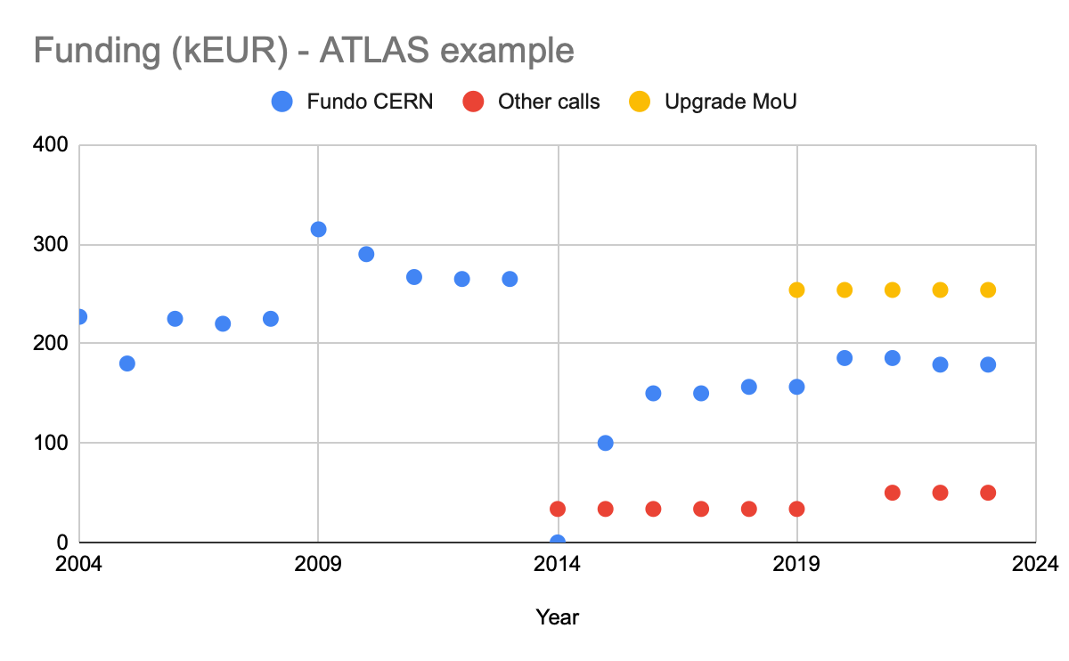
LHC Upgrades for Phase II: Funding
Portuguese investment in HL-LHC:
MoUs signed by FCT funding agency and experiments
ATLAS: 1.6 M€ / 6 years
CMS: 1.6 M€ / 6 years
Fund experiments directly
Normally accompanied by similar funds for R&D, prototypes and human resources in the country, but not in our case
R&D funds through “Fundo CERN” competitive calls
Essential funds to capitalize on MoU investment
Both scientifically and in industrial return
Construction
M&O+Physics
M&O+Physics+Phase I+PhaseII
Last ECFA visit
Crossing of the desert

Slide 21
Future Acceleratos

Slide 22
Future Circular Collider and ECFA Roadmap
FCC proposal for a 100 km collider at CERN
FCC-ee (e⁺e⁻, 90 – 365 GeV) followed by FCC-hh 100 TeV pp collider
New group at LIP
Joined FCC Collaboration in 2022
9 academics/researchers; 1 PhD student; 2 MSc students
Small research projects funding this activity:
15 k€ to fund initial activity of FCC group
50 k€ exploratory project to develop radiation-hard scintillators
ECFA Detector Roadmap:
Detector R&D (DRD) Collaborations ramping up now
Long history of excellent detector research in Portugal - talk by A.Blanco
Can make a difference in Detector R&D: DRD1 (gaseous detectors); DRD 2 (liquid); DRD 3 (Solid state); DRD 6 (calorimetry)
Great opportunity to make leading contributions to these collaborations
Long-term planned funding is crucial
Fundo CERN is essential first step towards this!

Slide 23
Future Circular Collider ongoing activity
Hadronic calorimeter simulation for FCC-ee detector concept
Co-proponent of scintillator+Fe/Pb HCAL concept (DRD6)
Optimizing geometry, material, granularity, depth, compensation etc, including with Machine Learning
R&D for novel radiation-hard scintillator development
Variety of PET/PEN samples being produced and tested
Exploratory R&D project (50 k€) in collaboration with IPC/UM polymer group
Theory & Phenomenology:
Prepare measurement of 𝛂_{s} at ‰ accuracy at FCC-ee
Phenomenological study of Higgs production: triple-Higgs coupling in FCC-ee
PEN
PET

Slide 24
Conclusions
Both ATLAS and CMS groups strongly involved in HL-LHC effort
Important Portuguese investment in this programme and occupying key positions
Essential that R&D funds allow us to capitalize on investment and effort
Preparing the future beyond the LHC
Main activity so far on FCC activity – soon also ECFA DRD collaborations
Still subsidiary to HL-LHC activity, but producing first results
Concerns:
PhD grant programmes and scientific employment essential to all this! No people means no future!
MoU budgets are fixed: no means to account for increased prices since COVID and war in Ukraine
Stability of funding is essential for very long-term international scientific endeavours

Slide 25
Thank you!
LET’S INSPIRE PEOPLE
jgoncalo@lip.pt
Notes:
https://docs.google.com/forms/d/1mYM3yW3vMMPyp9cSqKTQqStZdBoxiNMYR1FkCO48zpI/edit

Slide 26
Future Circular Collider: Timeline
F.Gianotti, FCC Week 2023

Slide 27
ECFA Detector R&D Roadmap

Slide 28
Novel Rad-Hard Scintillators
Primary goal is to develop and characterize new rad-hard scintillating plastics: focus on PEN (Polyethylene Naphthalate) and PET (Polyethylene Terephthalate) polymers
Collaboration with Institute for Polymers and Composites of the University of Minho (IPC/UMinho)
Samples (3cm x 3cm x 2mm) produced with various compositions through:
Injection Moulding
Extrusion
Crucial parameters:
Dosage; injection speed; pressure; cooling time; cooling temperature ; melting temperature; mold Polishing
PEN
PET
Notes:
R&D in Lisbon

Slide 29
ATLAS: TileCal radiation hardness for HL-LHC
Monitoring of light response of TileCal optical components using calibration systems
Modelling and extrapolation to future conditions essential to predict detector behaviour
Dedicated publication being prepared

Slide 30
ATLAS: Trigger/DAQ and Tracking
Trigger and data acquisition
Development of GPU-based algorithms for acceleration of high level filter calorimeter reconstruction
Demonstrated important improvement factor over CPU algorithm: J. Phys.: Conf. Ser. 2438 012044
Contributed to former project on Hardware Tracking for the Trigger
Simulation and performance studies
ATL-DAQ-PUB-2023-001
Tracking software development for HL-LHC
PhD student at CERN working on optimization of common tracking package for HL-LHC
HTT

