Slide 1
Higgs Boson Searches with ATLAS
Ricardo Gonçalo
Royal Holloway, University of London
On behalf of the ATLAS Collaboration
DISCRETE 2012
Third Symposium on Prospects in the Physics of Discrete Symmetries
3-7 December 2012 – CFTP, Instituto Superior Técnico

Slide 2
Outline
After the discovery
SM Higgs News:
H➞WW➞lνlν
H➞ττ
H➞bb
Signal strength
See ATLAS overview in Patricia Conde-Muiño’s plenary talk

Slide 3
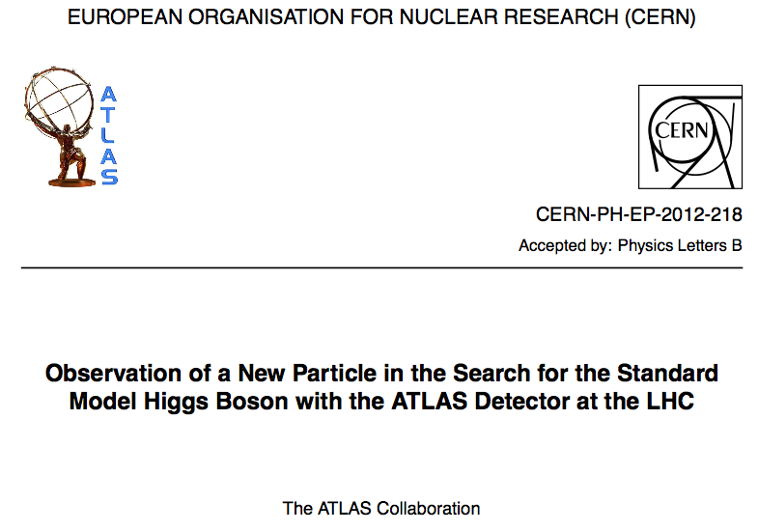
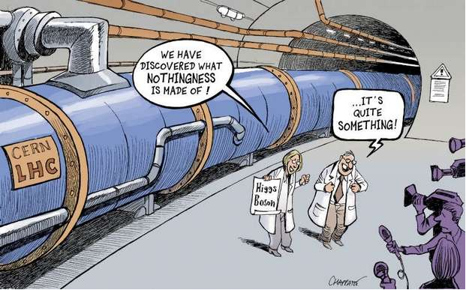
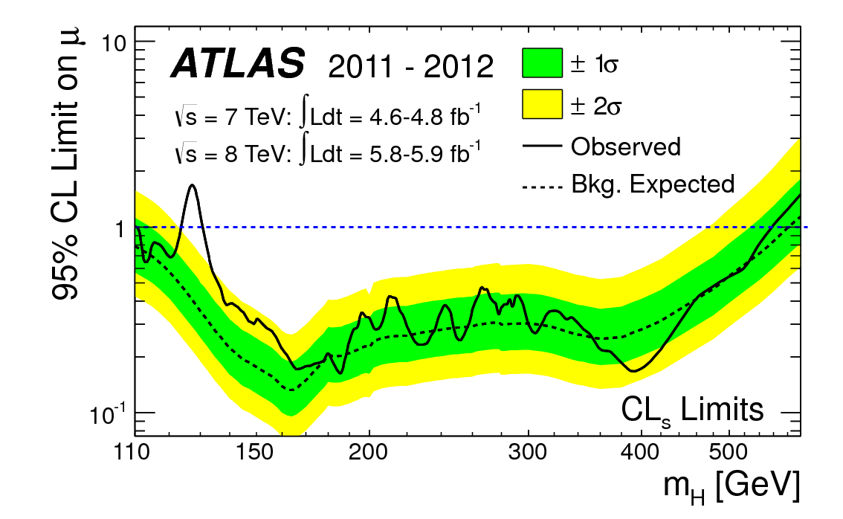
The story so far… we found a Higgs-like boson! ☺

Slide 4
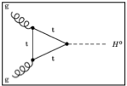
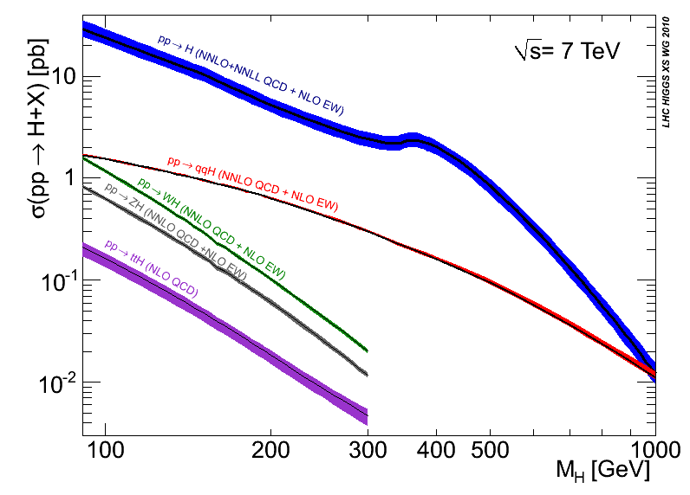
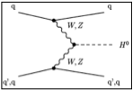
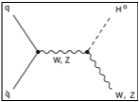
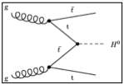
6 months ago: ICHEP 2012
1 ½ year ago: EPS 2011
CERN-2011-002; arXiv:1101.0593
Disfavoured by EW precision fits
Disfavoured by EW precision fits
Excluded by LHC
Excluded by LHC
Excluded by LEP
Excluded by Tevatron
Notes:
Main production channels: gluon fusion, Vector Boson Fusion, associated production with vector bosons, associated production with ttbar pair
Animation

Slide 5
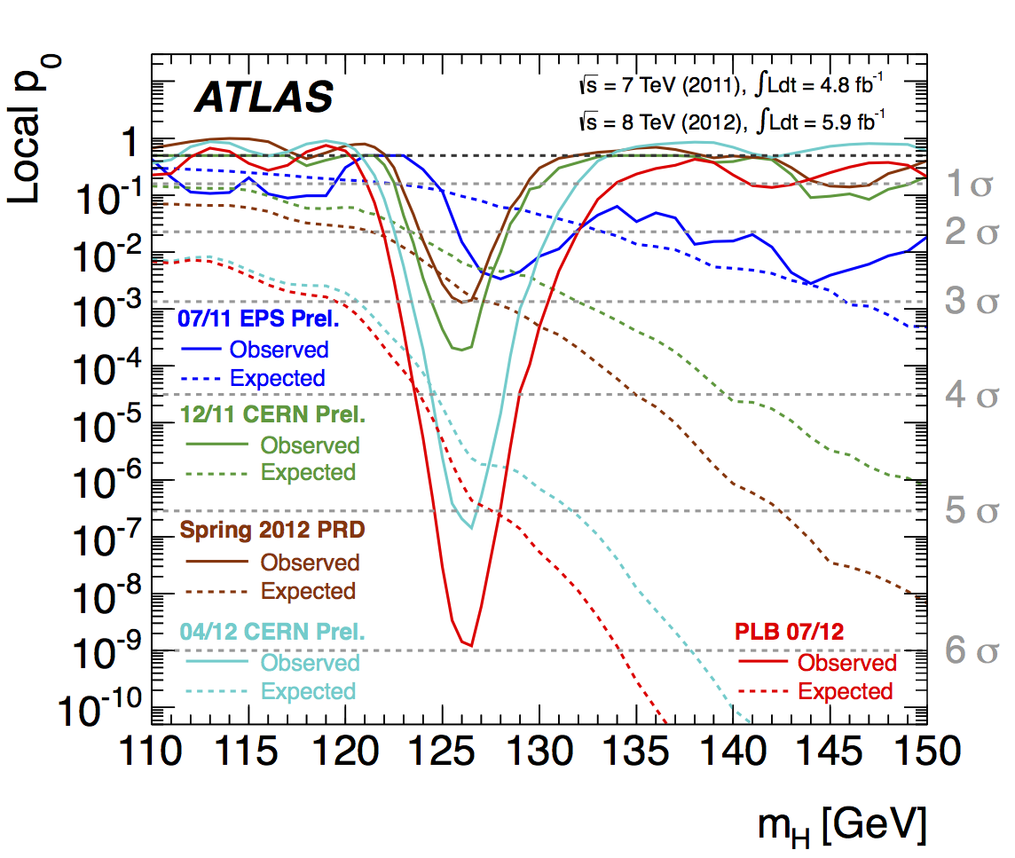
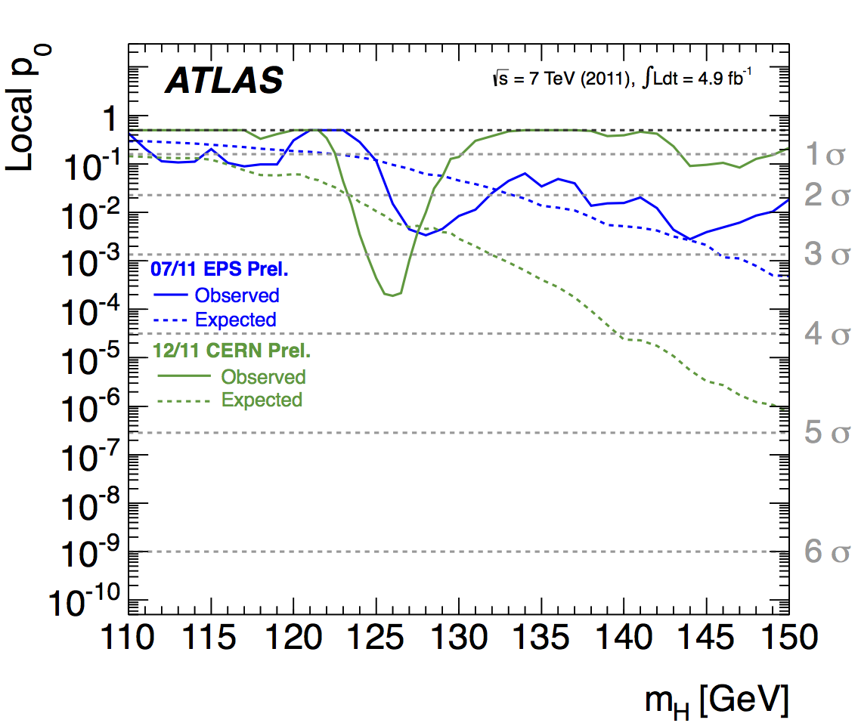
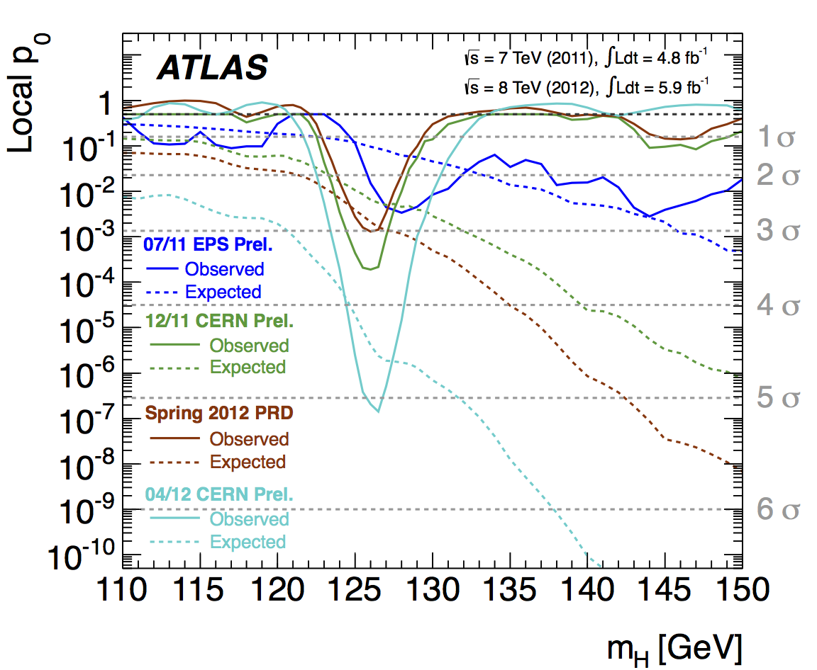
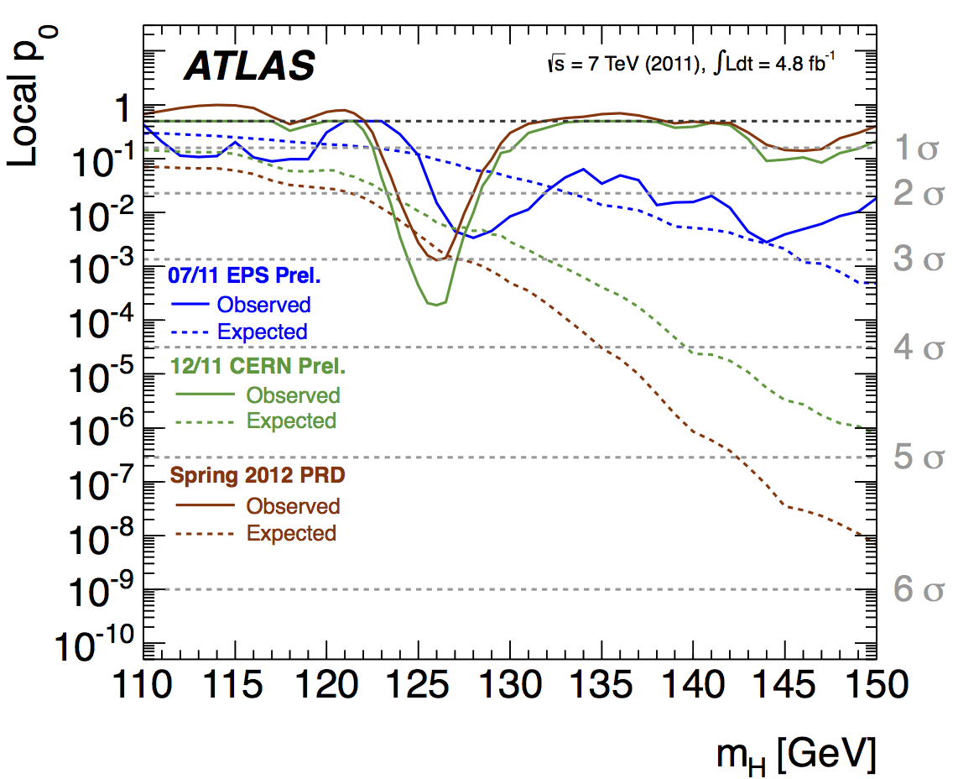
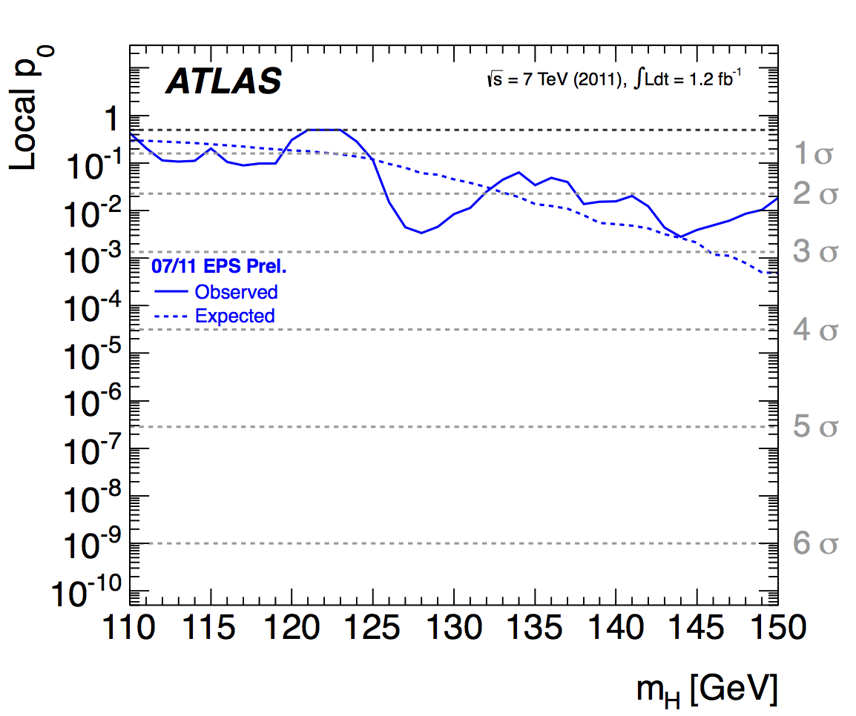
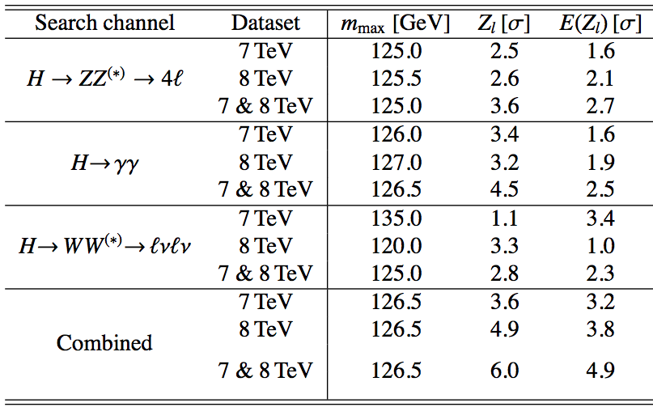
5σ announced on 4th of July independently by ATLAS and CMS!! ≈6σ with ATLAS H->WW
Data analysed:
4.8 fb⁻¹ @7TeV & 5.6 fb⁻¹ @8TeV
Clear excess only in bosonic decay channels:
H➞ZZ, H➞γγ, H➞WW
Hints of H➞ττ from LHC and evidence from Tevatron for H➞bb and hints from CMS
Need to keep looking!
SM Higgs search is a great way to search new physics!
The 6 billion Swiss Franc question (+ M&O):
Is it THE Standard Model Higgs?
More details of LHC Higgs implications in Abdelhak Djouadi‘s talk in Monday Plenary session

Slide 6
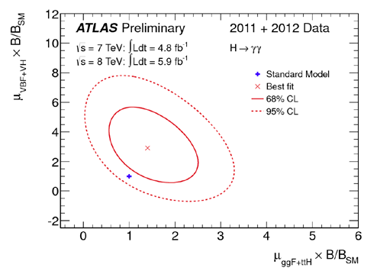
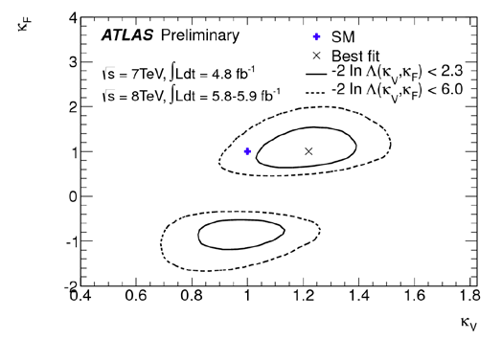
What do we know about the new particle?
Mass ≈ 126 GeV
Electric charge = 0 (neutral final state)
Unknown/incomplete knowledge:
Spin (J) = 0, 1, 2, ... ? J=1 disfavored (Landau-Yang theorem and observation in H➞γγ)
Charge-conjugation, parity (CP)
Couplings?
September analysis used same data as July 2012 observation paper
ATLAS-CONF-2012-127: https://cdsweb.cern.ch/record/1476765?ln=en
Fit data to estimate factors κ multiplying coupling in each SM production and decay mode
Signal strength for the γγ final state (gluon fusion vs VBF+VH)
κ_{V} versus κ_{F} – assume a single κ_{F} factor for all fermions t, b, τ and a single factor κ_{V} for vector
Sign comes from interference between t and W loops in H➞γγ

Slide 7
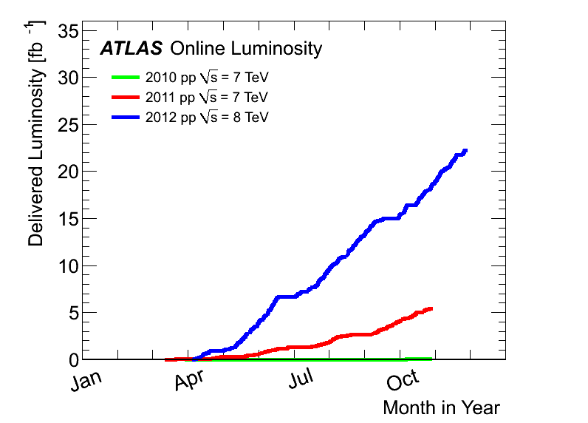
Latest Results
And more
Today’s results
4.8fb⁻¹ @ 7TeV+
13fb⁻¹ @ 8TeV
4th July discovery
4.8fb⁻¹ @ 7TeV + 5.6fb⁻¹ @ 8TeV

Slide 8
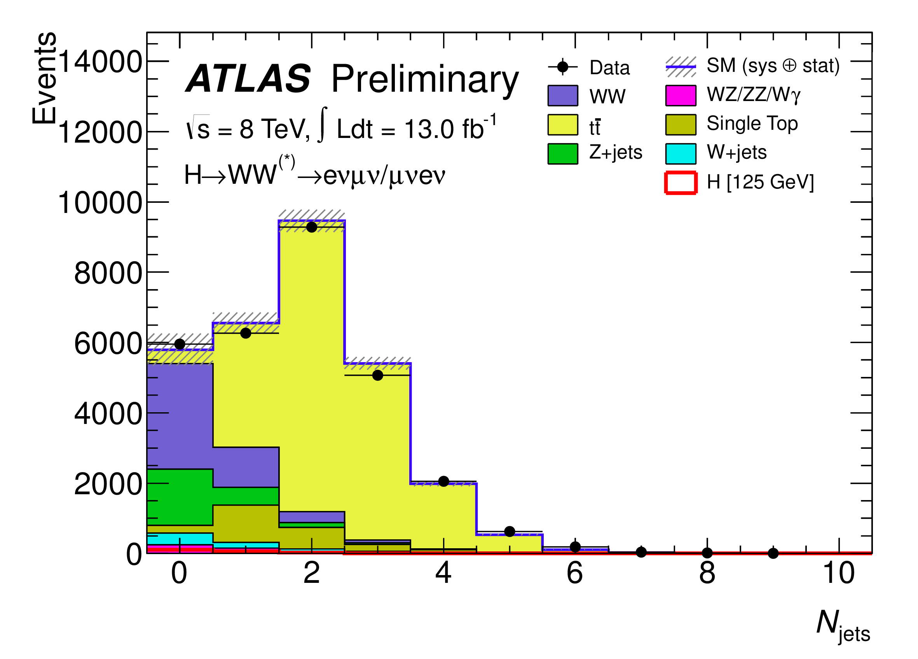
H➞WW^{(*)} ➞eνμν
13 fb⁻¹ of 8 TeV data
ATLAS-CONF-2012-158:
http://cdsweb.cern.ch/record/1493601
Signature:
Increased pileup in 2012
Degraded E_{T}^{miss} resolution
Poor Z/γ^{(*)} rejection
Used e + μ + E_{T}^{miss} only
Good sensitivity
Z/γ^{(*)} contamination suppressed
Backgrounds:
WW
Top: tt+single top
W+jets, Z/γ^{(*)}, W+γ^{(*)}
Split into categories:
0-/1-jet (<2 jets to reject top)
μe /eμ (first lepton has higher p_{T})
Νeutrinos => use transverse mass
Coarse m_{T} resolution
=> broad Higgs signal
=> Low sensitivity to Higgs mass
Search for Higgs in m_{T} distribution
Signal region blinded until backgrounds well understood in control regions:
Blind region: 93.75 < m_{T} < 125 GeV

Slide 9
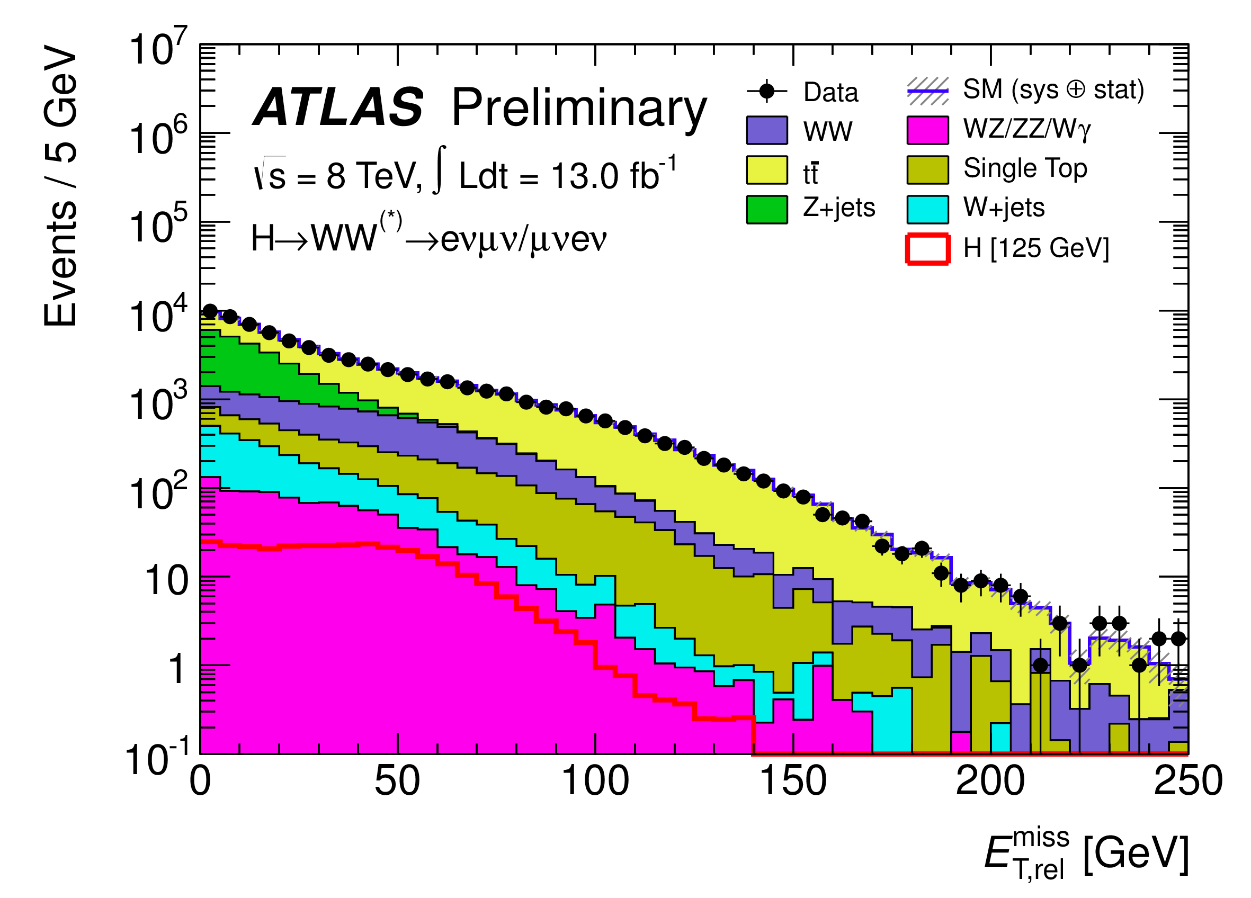
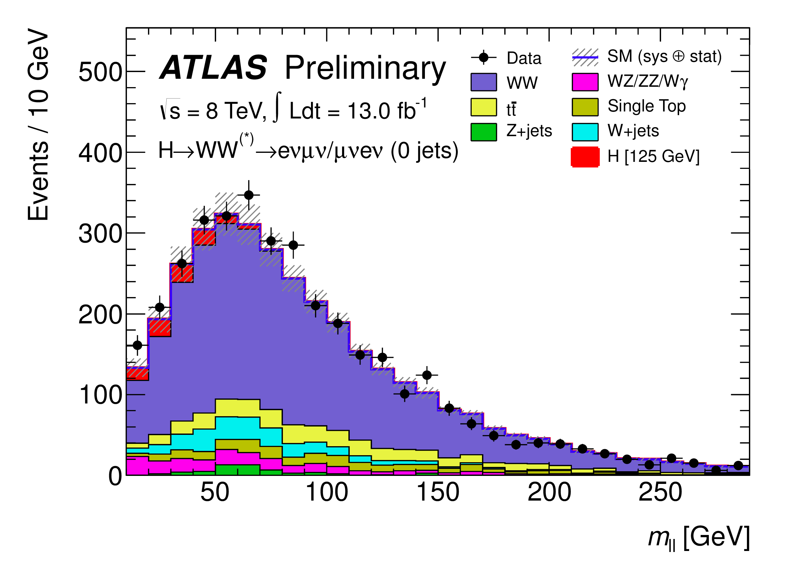
Event Selection:
E_{T,rel}^{miss} > 25 GeV to remove Z➞ττ and fake E_{T}^{miss}
Scalar Higgs means leptons have preferentially small separation
Small azimuthal separation
small invariant mass: m(ll) < 50 GeV
dilepton recoiling against ν’s:
Δφ(ll) < 1.8
Also (0-jet analysis):
Δφ(ll, E_{T}^{miss}) > π/2
p_{T}(ll) > 30 GeV
Dedicated Z➞ττ veto |m_{ττ} – m_{Z}|>25 GeV in 1-jet category
Veto events containing b-jets to reject top
H
W⁺
W⁺
μ⁺
W⁻
ν_{μ}
W⁻
e⁻
ν_{e}

Slide 10
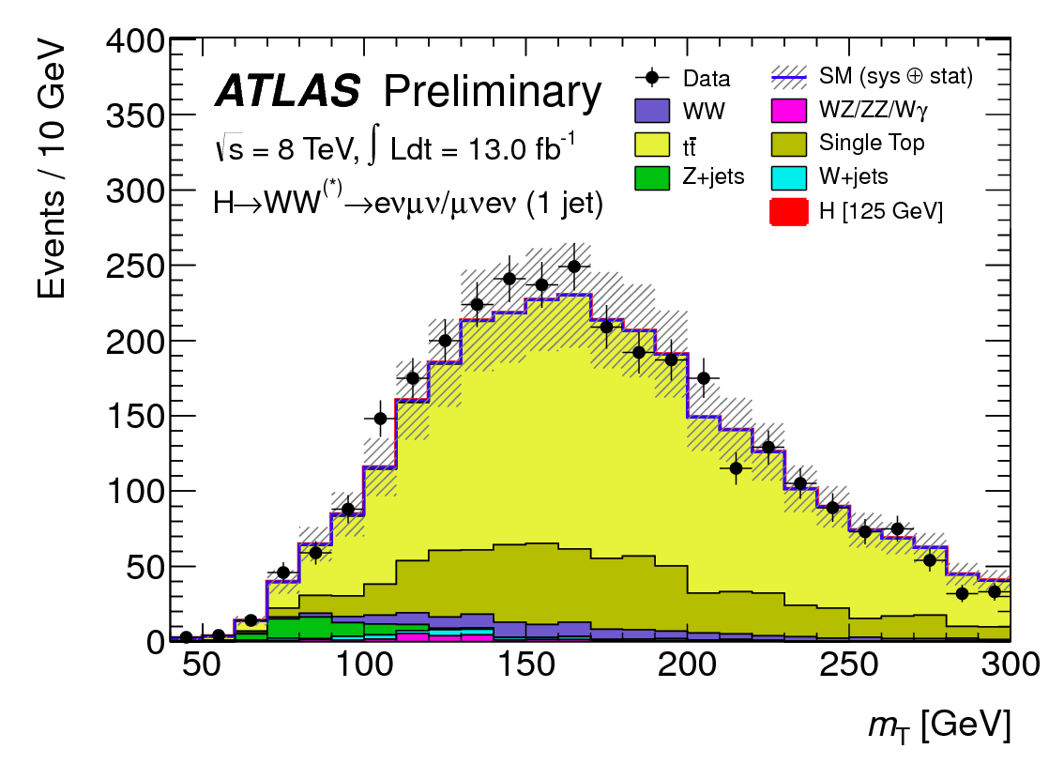
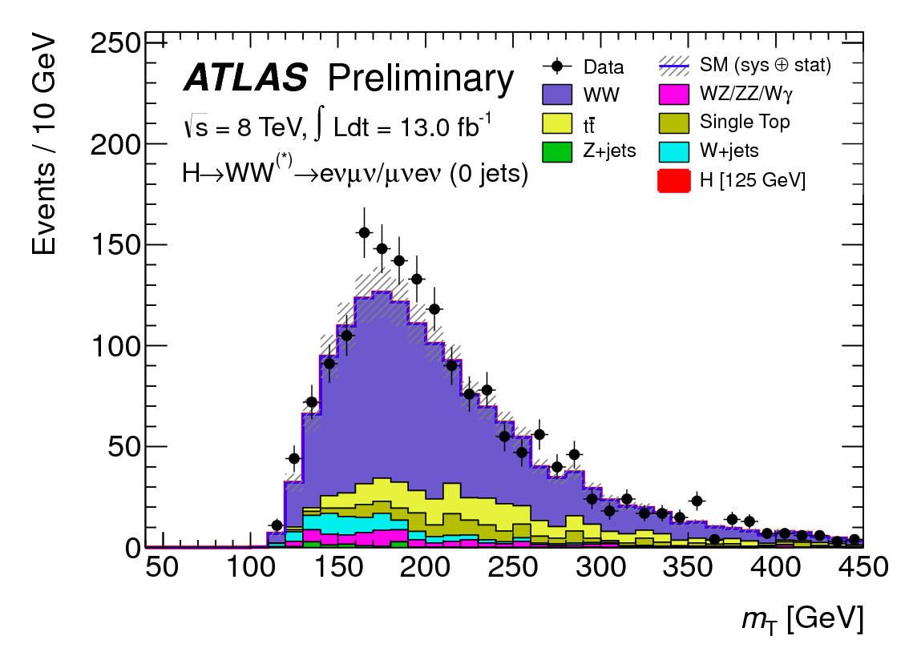
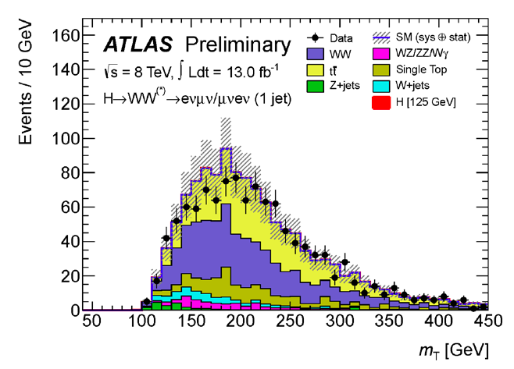
Background
W+jets:
Control sample: one loosely identified lepton failing tight selection
Transfer shape to signal region using fake factor evaluated with inclusive di-jet data sample (50% syst. from fake factor)
Top:
Control samples:
0 jet: loosen N_{jet} cut, remove m(ll) and Δφ(ll) cuts
1 jet: reverse b-jet veto (I.e. require a b-tagged jet)
Correction factors applied to MC prediction: 1.040.14 (stat+syst), 1.030.37 (stat+syst) for the 0-,1-jet analysis
WW:
Remove _{ll} cut, change m_{ll} cut to m_{ll} > 80 GeV
Normalization factors: 1.13±13% (0-jet), 0.84±54% (1-jet)
top 1-jet control region
WW 1-jet control region
WW 0-jet control region

Slide 11
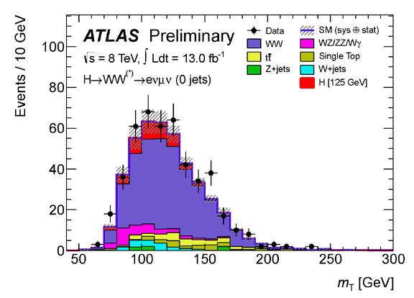
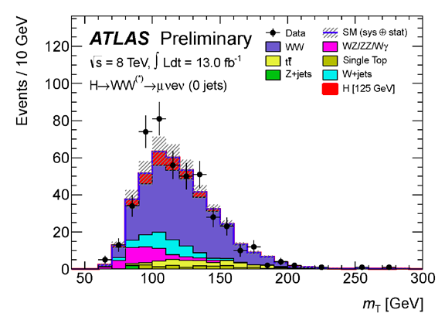
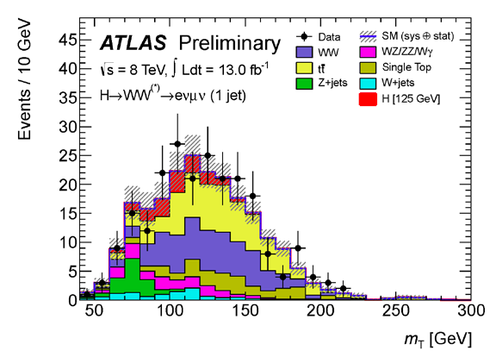
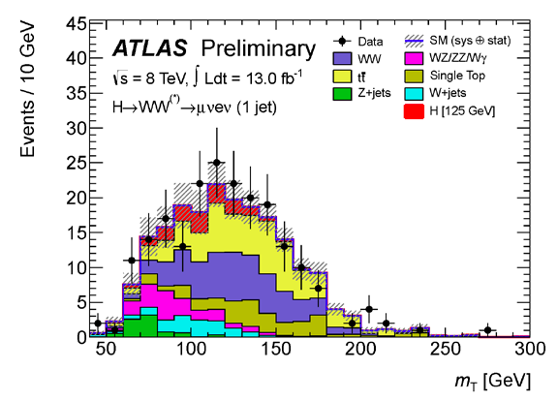
Results – I
Leading e
Leading μ
m_{T} in 4 analysis categories
Used in statistical analysis
S/B:
≈13-16%
Note: 2012 data (13fb⁻¹@8TeV)
0 jet
1 jet
After m_{T} cut: 94 < m_{T} < 125GeV

Slide 12
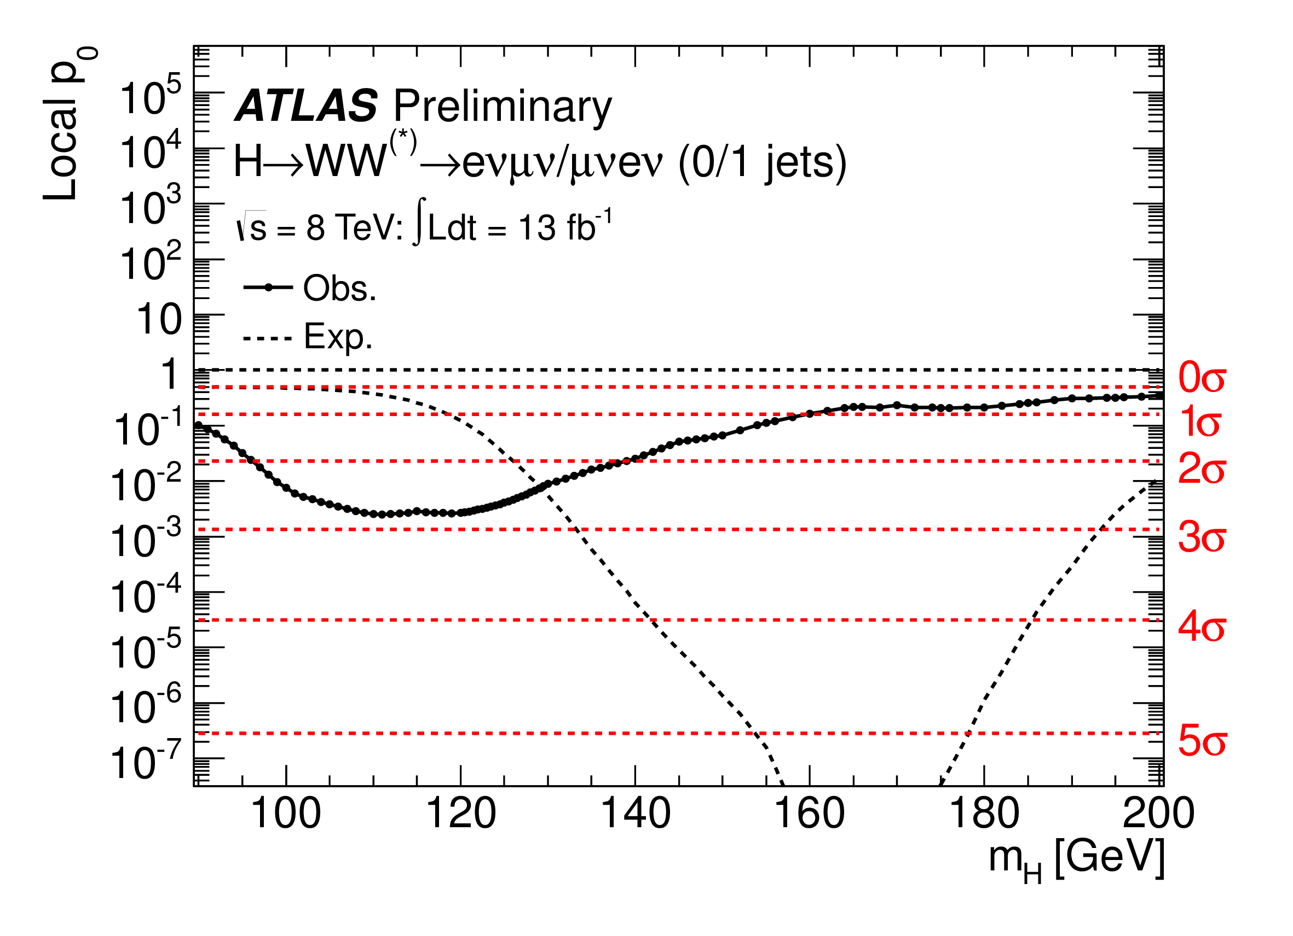
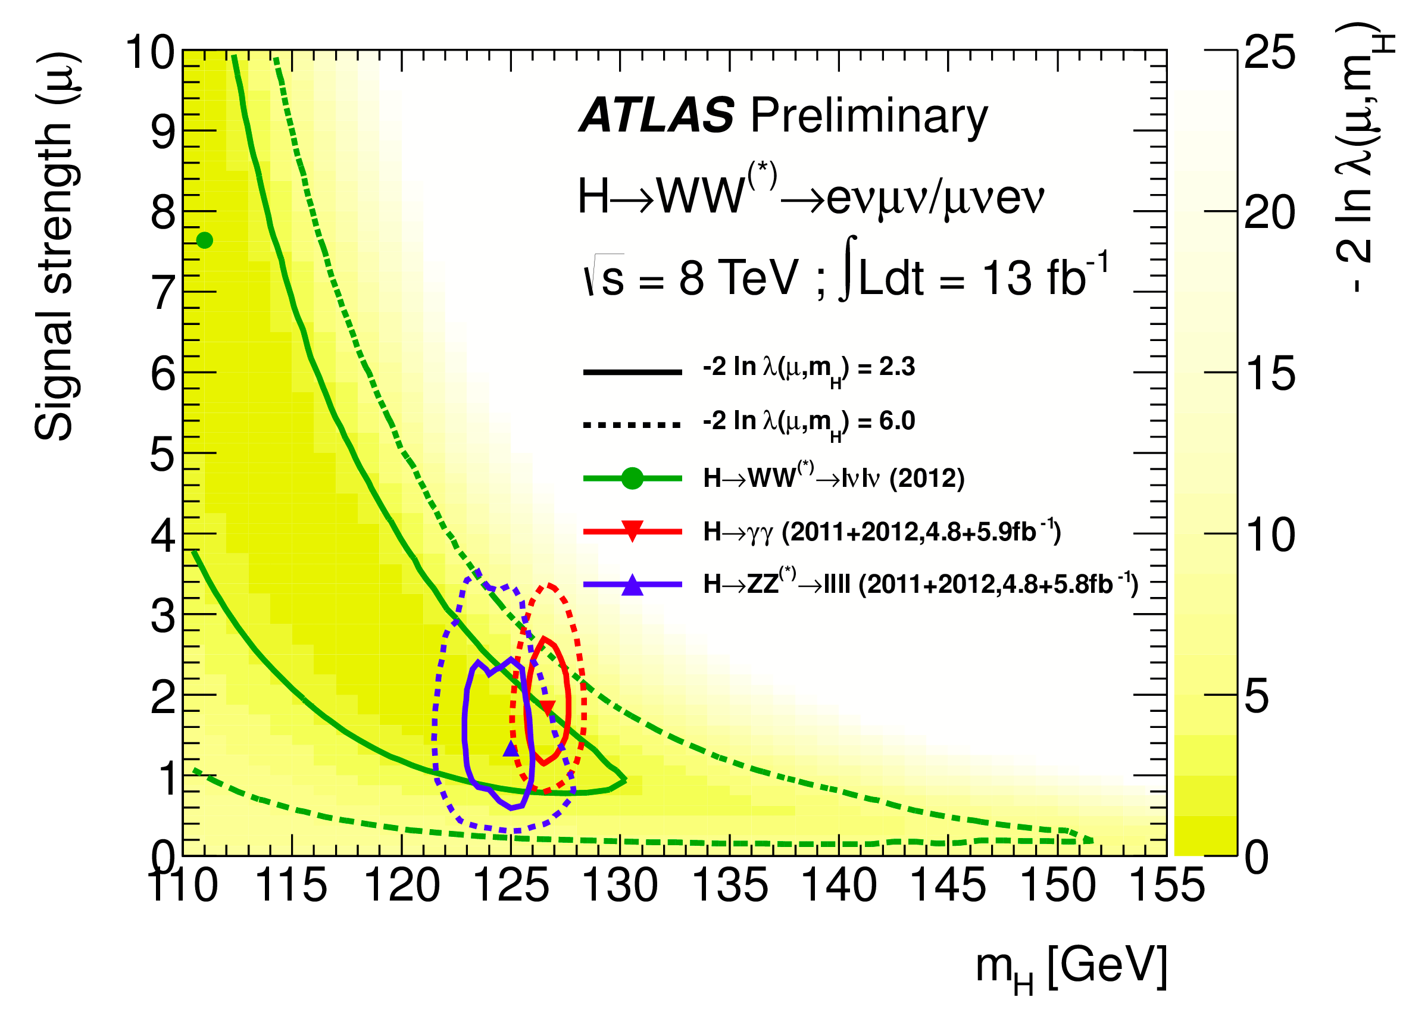
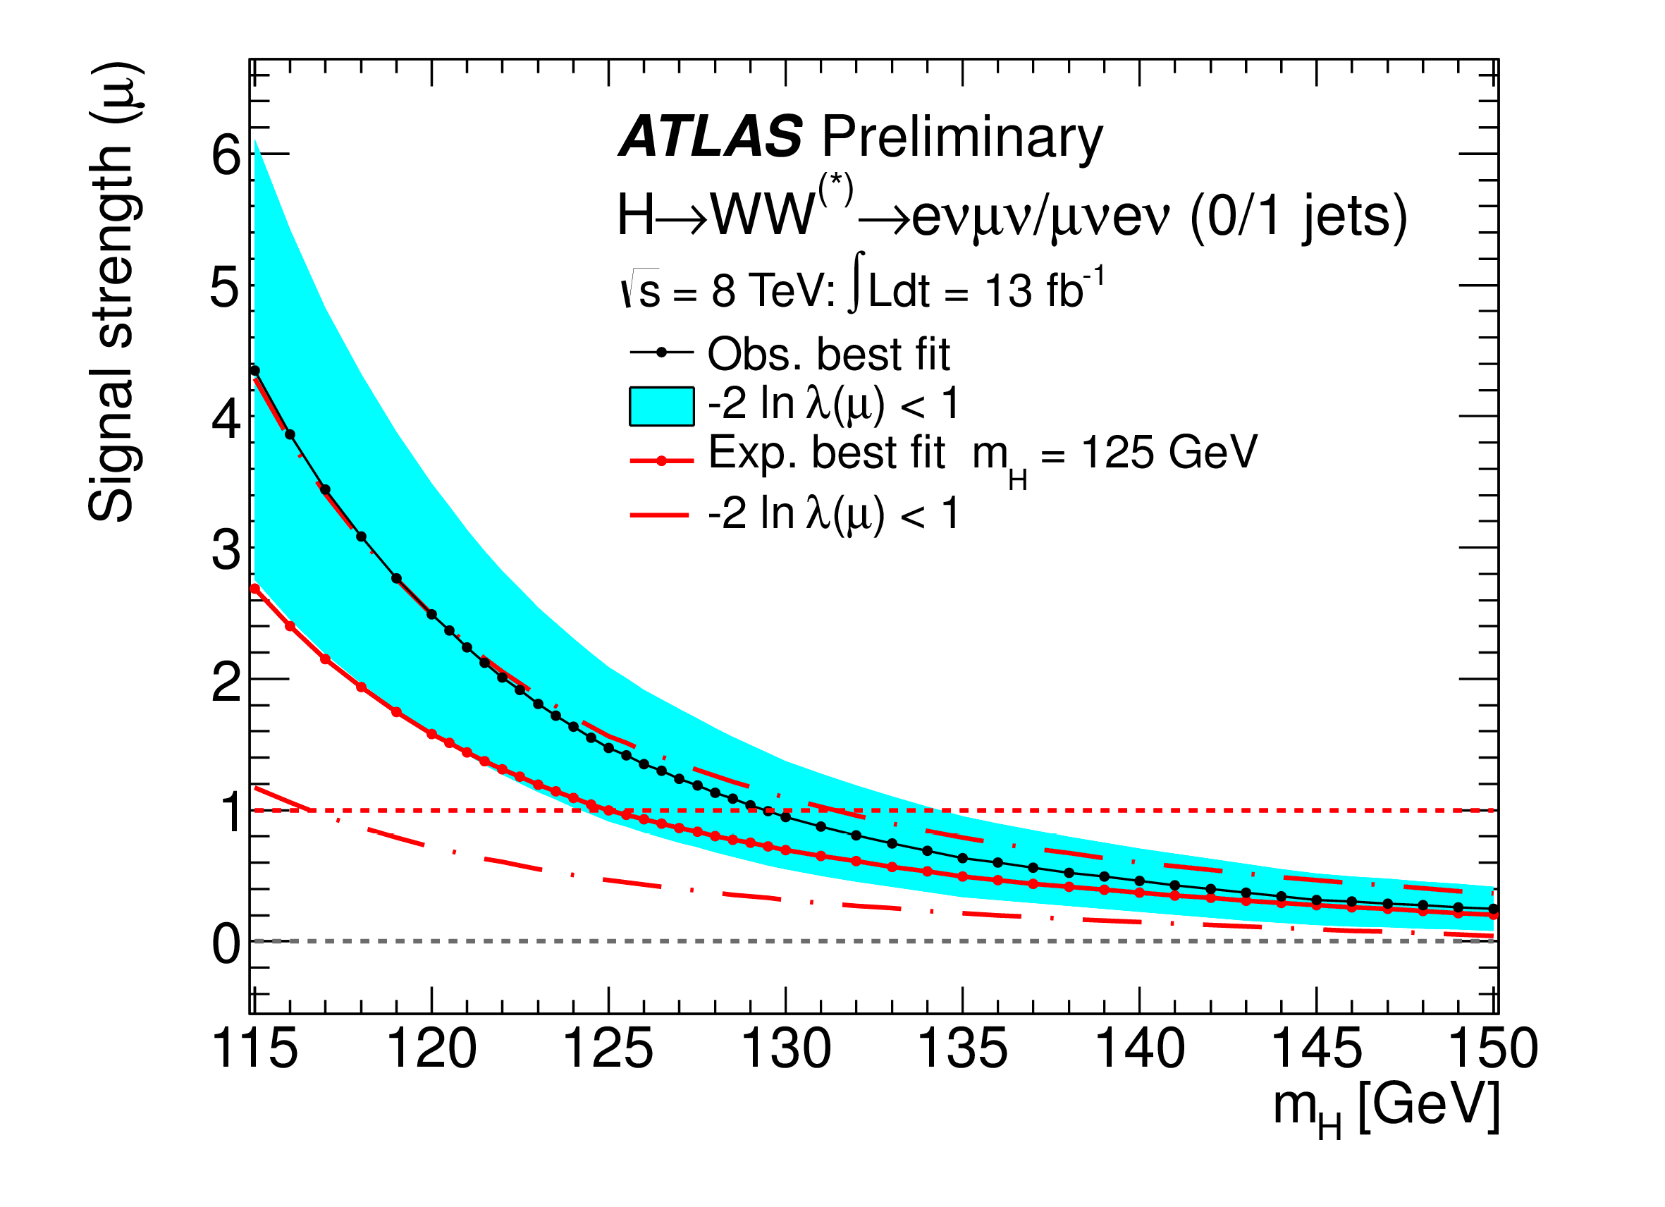
Results – II (note: 2012 data only)
At m_{H}=125GeV:
Signal significance: 2.6σ (expected 1.9σ)
Signal strength (ratio to SM rate): μ = 1.5 ± 0.6
Assuming SM ratio of production mechanisms:
SM expectation:

Slide 13
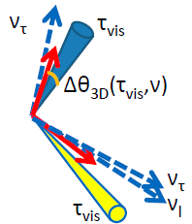
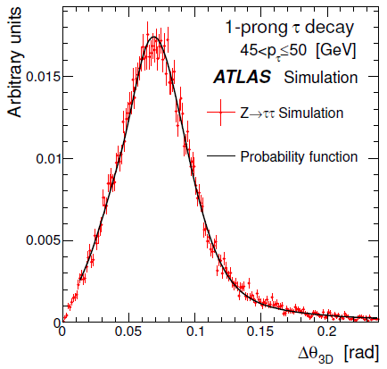
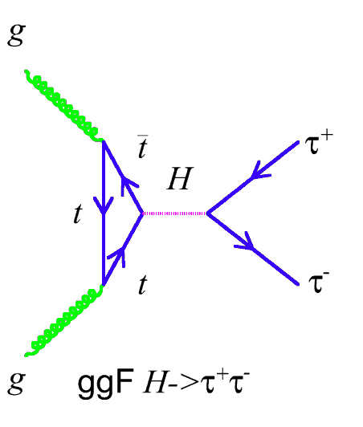
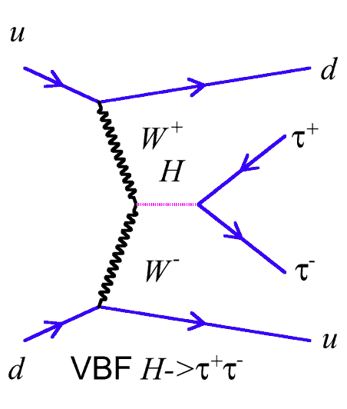
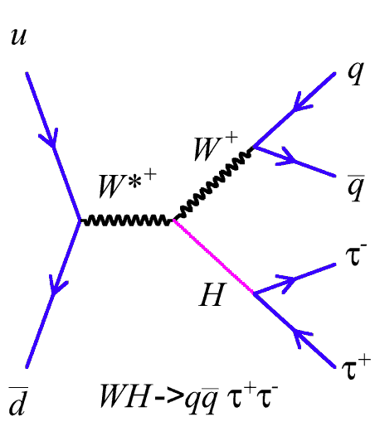
H➞ττ analysis
Analysed 4.6fb⁻¹ (7TeV) + 13fb⁻¹ (8TeV)
ATLAS-CONF-2012-160: https://cdsweb.cern.ch/record/1493624
Three ττ decay modes:
“lep-lep”: ll4ν; “lep-had”: lτ_{had}3ν; “had-had”: τ_{had}τ_{had}νν (l=e/μ)
Three production channels:
gluon fusion, Vector boson fusion (VBF), WH/ZH production
τ identification: BDT based on calorimeter and tracking
m_{ττ} reconstructed with Missing Mass Calculator (MMC)
Kinematic fit to τ, E_{T}^{miss} in Δφ(τ_{vis},ν) parameter space using Δθ_{3D}(τ_{vis},ν) template from simulation as PDF
Mass resolution from 13% to 20% depending on kinematics and decay mode

Slide 14
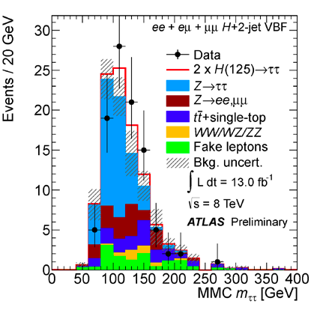
H➞ττ➞ll4ν (lep-lep)
BR(H➞ττ➞ll4ν) = 12.4%
5 mutually exclusive categories (all using b-jet veto):
2-jet VBF: P_{T}(j) > 25 GeV, Δη(jj) > 3.0, m(jj) > 400 GeV
Boosted: NOT 2-jet VBF, P_{T}(ττ) > 100 GeV
2-jet VH: NOT Boosted and Δη(jj) < 2.0, 30 GeV < m(jj) < 160 GeV
1-jet: NOT 2-jet VBF, Boosted, or 2-jet VH, and m(ττj) > 225 GeV
0-jet: oppositely charged leptons, 30 < m(ll) < 100 GeV, P_{T}(ll) > 35 GeV, Δφ(ll) > 2.5 (not used at 8 TeV)
Backgrounds:
Dominant: Z ➞ ττ
Z ➞ ττ estimated using “embedding”: replace mu in real Z➞μμ events with simulated τ's of same momentum
Z ➞ ee/μμ backgrounds determined from data: simulations normalized to control regions
Fake leptons: determined from data using templates, fitted in control regions with relaxed lepton identification criteria

Slide 15
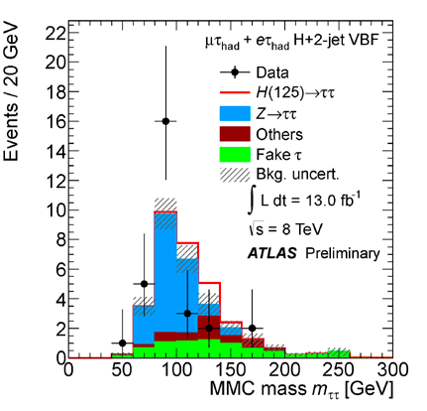
H➞ττ➞lτ_{had}3ν (lep-had)
BR(H➞ττ➞lτ_{had}3) = 45.6%
4 exclusive categories (here for 8 TeV):
2-jet VBF: P_{T}(jet) > 40/30 GeV, Δη(jj) > 3.0, m(jj) > 500 GeV, m_{T} < 50 GeV
Boosted: NOT 2-jet VBF, and PT(ττ) > 100 GeV, mT < 50 GeV
1-jet: NOT 2-jet VBF or boosted, and P_{T}(jet) > 30 GeV, m_{T} < 50 GeV
0-jet: No jets with P_{T}(jet) > 30 GeV
Backgrounds:
Dominant: Z ➞ ττ
Non-VBF categories:
Multijets: Estimated from same lepton sign events
VBF category:
Modeled by simulation normalized in data Z -> ee/μμ events with VBF-like cuts
Multi-jet and W+jet backgrounds normalised in control regions after relaxed lepton ID criteria and scaled to signal region

Slide 16
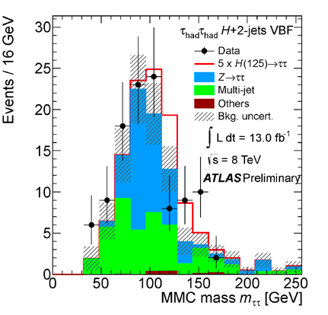
H➞ττ➞τ_{had}τ_{had}νν (had-had)
BR(H➞ττ➞τ_{had}τ_{had}νν) = 42%
2 mutually exclusive categories:
2-jet VBF:
P_{T}(jet) > 50/30 GeV, Δη(jj) > 2.6, m(jj) > 350 GeV, τ between “tag” jets in η
Boosted:
NOT 2-jet VBF, PT(τ) > 70 (50) GeV for 2012 (2011), ΔR(τ₁, τ₂) < 1.9.
Backgrounds:
Multijet background:
Broad track multiplicity, τ mostly 1 or 3
From same-sign events using 2D templates of N_{tracks} for each τ to fit track multiplicity to data
Dominant Z -> ττ – embedding technique
2D template fit to track multiplicity for the two hadronic taus
Normalize in region 60 < m_{ττ} < 108 GeV to exclude possible Higgs signal
Other EWK backgrounds small – taken directly from MC

Slide 17
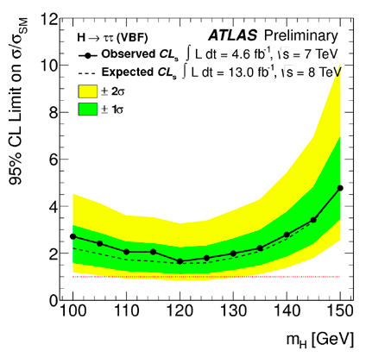
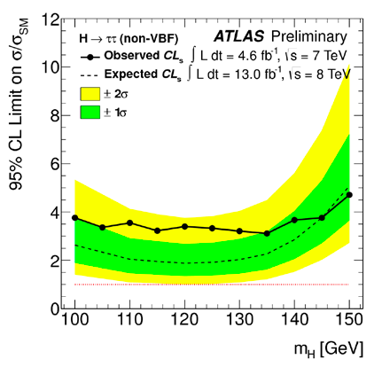
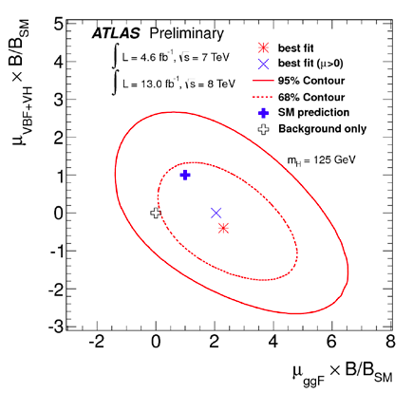
H➞ττ results
Total of 25 channels combined (13 for 7TeV, 12 for 8TeV)
Small excess, consistent with SM Higgs hypothesis (and to lesser extent, with background-only)
Best-fit signal strength μ value at 125 GeV is μ = 0.7 ± 0.7
Combined local significance for m_{H} = 125 GeV is 1.1σ observed (1.7σ expected)
Observed (expected) exclusion is 1.9 (1.2) times the SM predicted value (μ=1)
Separating out VBF categories broad excess seen in non-VBF categories
VBF
Non-VBF

Slide 18
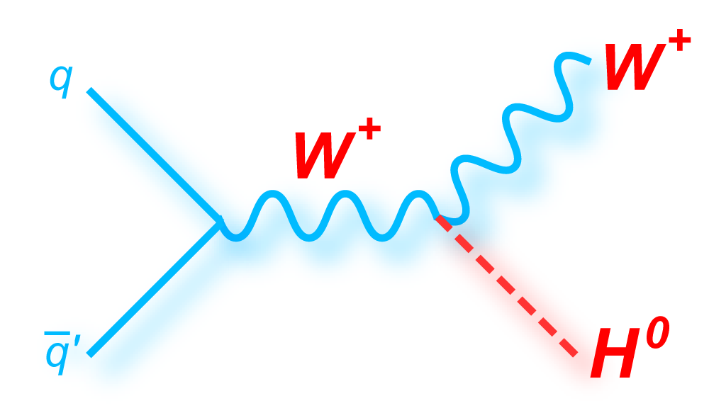
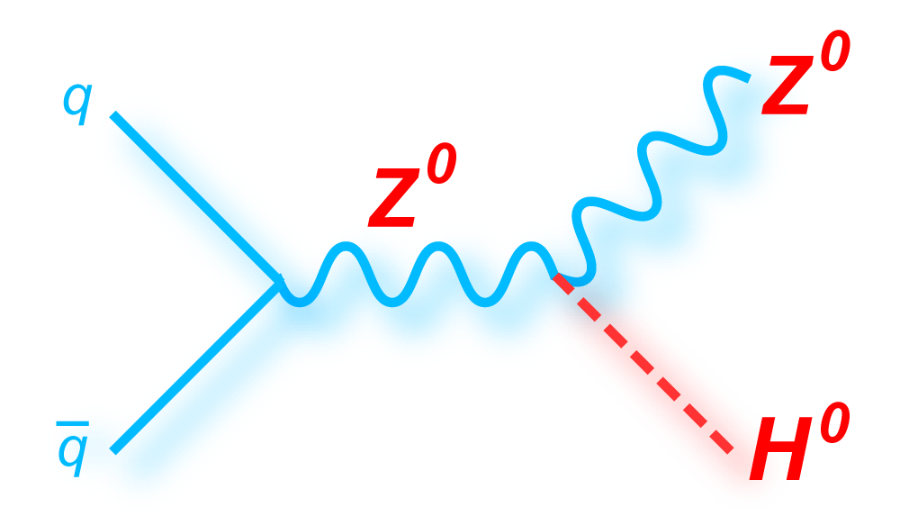
WH/ZH, H➞bb
This analysis: 4.7fb⁻¹ √s = 7 TeV & 13fb⁻¹ √s = 8 TeV
ATLAS-CONF-2012-161: http://cdsweb.cern.ch/record/1493625
Analysis divided into three channels
Two (llbb), one (lνbb) or zero (ννbb) leptons (l=e,μ)
Cuts common to all channels
Two or three jets: 1st jet p_{T} > 45 & other jets > 20 GeV
Two b-tags: 70% efficiency per tag; mistag rate: c-jet ≈20%; light-jet ≈0.7%
16 categories determined by p_{T}^{V} and N_{leptons}:
0-lepton: E_{T}^{miss} [120-160] [160-200] [>200] GeV x (2 or 3 jets)
1 & 2 lep: p_{T}^{W/Z} [0-50] [50,100] [100-150] [150-200] [>200] GeV
Two lepton
One lepton
Zero lepton
ZH ➞ llbb
No additional leptons
E_{T}^{miss} < 60 GeV
83 < m_{ll} < 99 GeV
WH ➞ lνbb
No additional leptons
E_{T}^{miss} > 25 GeV
40 < M_{T}^{W} < 120 GeV
ZH ➞ ννbb
No leptons
E_{T}^{miss} > 120 GeV
E_{T}^{miss} trigger

Slide 19
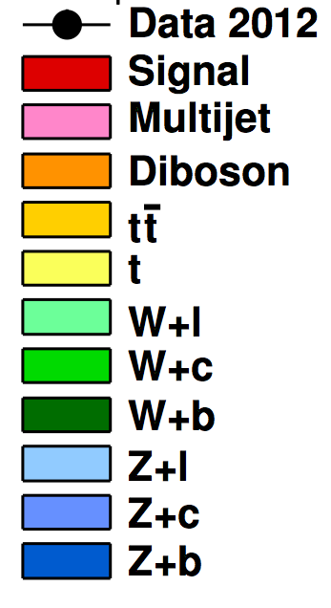
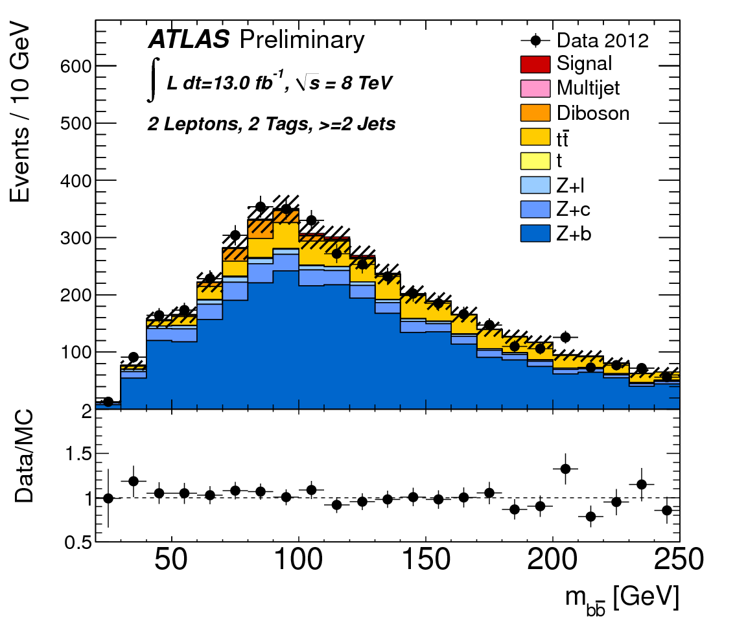
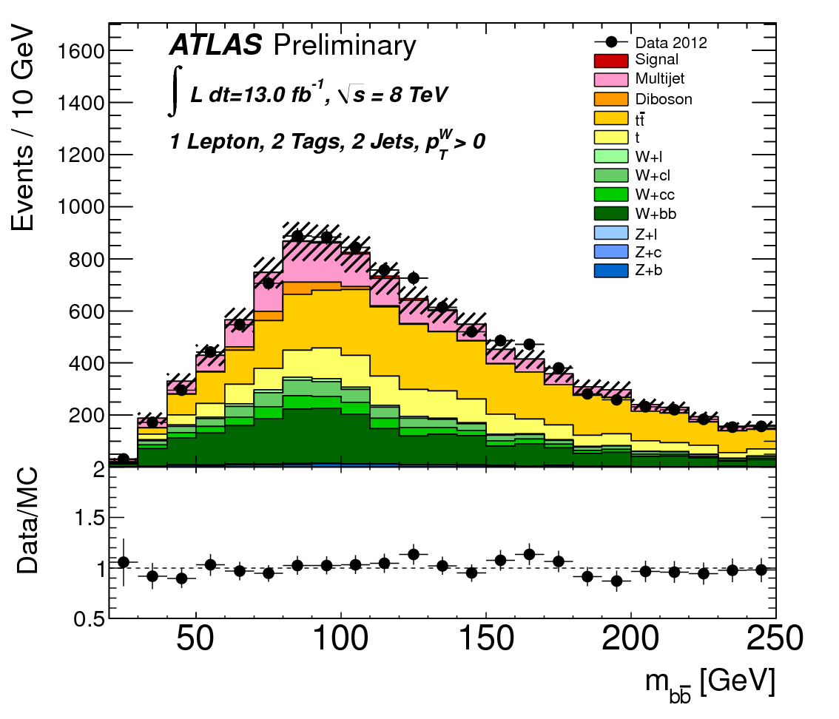
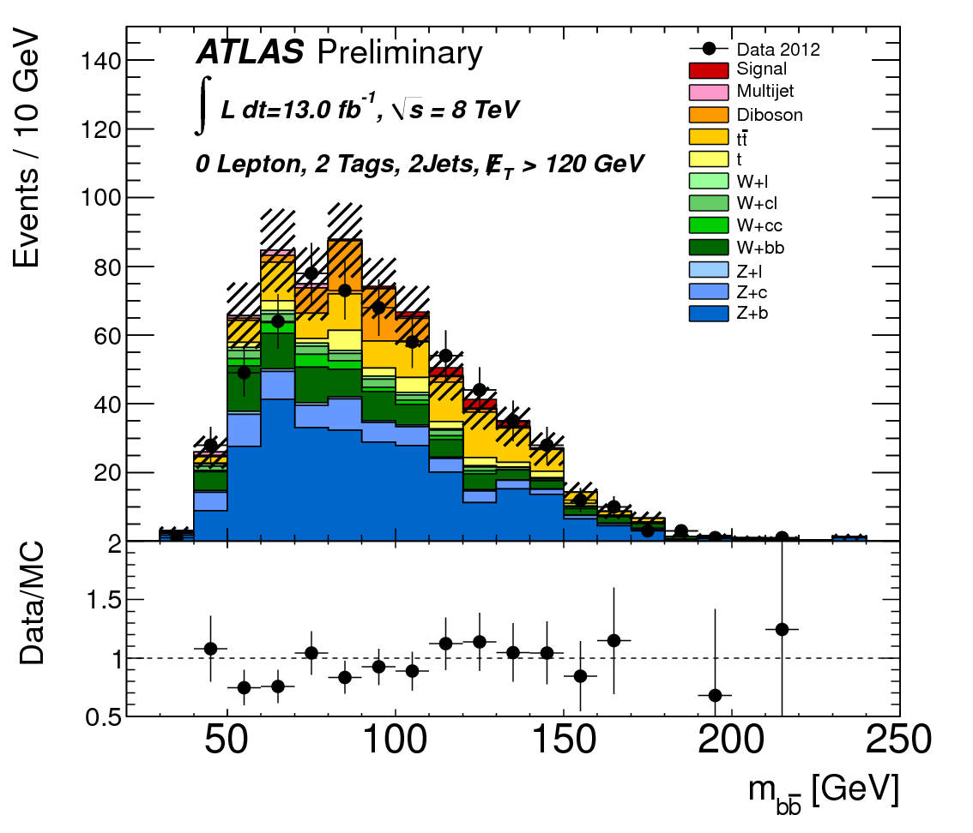
Backgrounds and MC
Signal: WH/ZH Pythia6/8
Diboson WW/WZ/ZZ Herwig
Multijet: Data driven
ttbar: MC@NLO
Single Top Acer/MC@NLO
W+b Powheg
W+c/light-jets Alpgen
Z+ b/c/light-jets Alpgen/Sherpa
Background shapes from simulation and normalised using flavour & data fit
Multi-jet bkg determined by data-driven techniques
WZ(Z➞bb) & ZZ(Z➞bb) resonant bkg normalisation and shape from simulation
2 lepton
1 lepton
0 lepton
Z+jets
Top/W+jets/Multijet
Z+jets/W+jets/Top

Slide 20
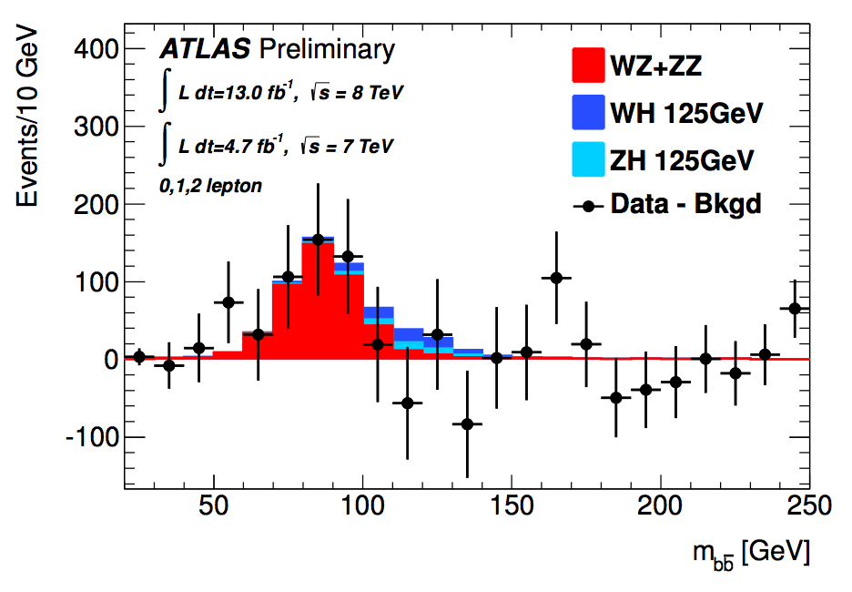
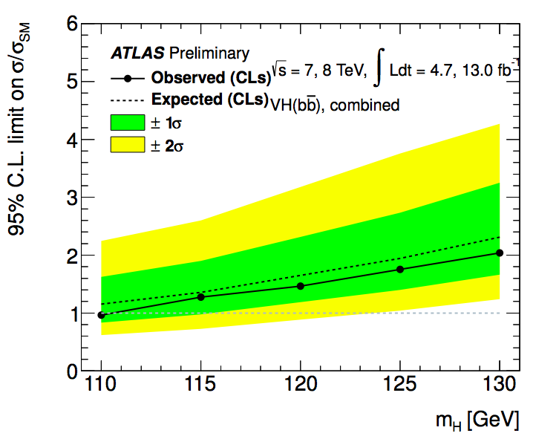
WH/ZH, H➞bb results
Dibosons:
WZ & ZZ production with Z➞bb
Similar signature, but 5 times larger cross-section
Clear excess is observed in data at expected mass
Perform separate fit for Z➞bb to validate H➞bb analysis:
σ/σ_{SM} = μ_{D} = 1.05 ± 0.32
Significance = 4.0 σ
In agreement with Standard Model!
WH/ZH, H➞bb:
Some excess in 2012 data but deficit from 2011 re-analysis
Results:
Limit: 1.8 (1.9)
p0 value 0.64 (0.15)
σ/σ_{SM} = μ = −0.4 ± 0.7(stat.) ± 0.8(syst.)
Exclusion at m_{H} ≈ 110 GeV
Note: CMS observed broad 2.2σ excess

Slide 21
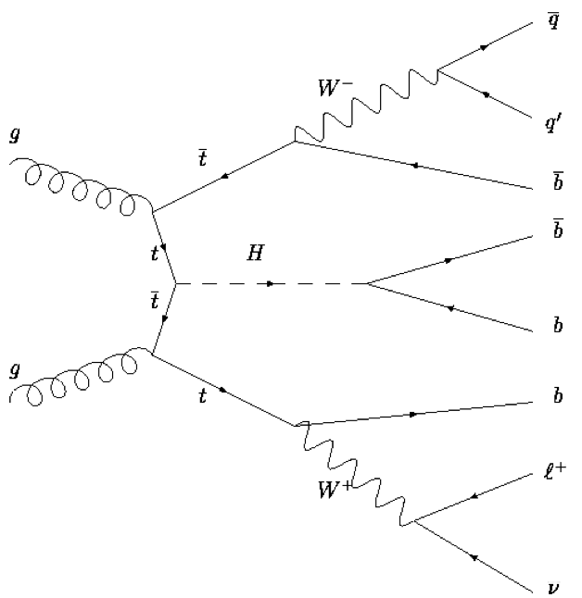
ttH, H->bb Analysis
Challenging analysis!
High combinatorial background
Small signal cross section
Important for top Yukawa coupling!
Data: 4.7fb⁻¹ at √s = 7 TeV (2011)
ATLAS-CONF-2012-135: https://cdsweb.cern.ch/record/1478423
9 categories based on jet & b-tag multiplicity
Signal enriched: (5 jets, ≥6 jets) x (3,≥4 b-tag)
Other categories are background enriched to constrain those backgrounds
Final discriminants
m_{bb} for ≥6 jets and (≥3 b-tag) categories
Do kinematic fit to reconstruct tt+H➞bb
H_{T}^{had} (∑p_{T,jet}) for other categories
Backgrounds constrained in limits fit by profiling nuisance parameters
To check fit control regions are used
2 light jets (mostly)
Up to 4 b-tags
e or μ, E_{T}^{miss} , M_{T}^{W}
 | 0 b-tags | 1 b-tag | 2 b-tags | 3 b-tags | ≥4 b-tags
4 jets | H_{T}^{had} | H_{T}^{had} | H_{T}^{had}
5 jets | H_{T}^{had} | H_{T}^{had} | H_{T}^{had} | H_{T}^{had} | H_{T}^{had}
≥6 jets | H_{T}^{had} | H_{T}^{had} | H_{T}^{had} | m_{bb} | m_{bb}
Signal
Background
Control regions

Slide 22
ttH, H->bb Analysis
Poor theory constraints on ttbb/ttjj ratio – interaction with theory community important!
Large impact of systematic uncertainties
…but we can do it! ☺
m_{H} (GeV) | Obs. limit | Exp. limit | Stat.-only
110 | 7.0 | 6.0 | 3.5
115 | 8.7 | 6.9 | 4.0
120 | 10.4 | 8.5 | 4.9
125 | 13.1 | 10.5 | 6.1
130 | 16.4 | 13.0 | 7.8
140 | 33.0 | 23.2 | 14.2

Slide 23
Updated signal strength
Previous combined signal strength result: μ = 1.4 ± 0.3
2011 analyses of ττ and bb, July analyses for γγ, 4-lepton, and WW
New result using analysis shown today: μ = 1.3 ± 0.3
Compatibility with SM μ=1 with observed measurement is 23%.
July 2012 results
New result including updates shown

Slide 24
Summary & Outlook
New boson looks SM-like so far…
Wishlist for 2011+2012 data
≈25 – 30 fb⁻¹/experiment
Clear observation of H➞ττ and H➞bb – sensitive to fermion and lepton couplings
Sensitivity to Higgs spin and CP!
Beyond 2014… increase statistics!
Essential to observe a signal in remaining SM Higgs decay modes!
Measure precisely new particle properties
ATL-PHYS-PUB-2012-004: http://cdsweb.cern.ch/record/1484890
Couplings: 20 – 30% with 300fb⁻¹ & 5 – 25% with 3ab⁻¹ at 14 TeV
Spin/CP determined with > 5σ with 300fb⁻¹
3σ Self-coupling observation with 3ab⁻¹

Slide 25
Bonus slides

Slide 26
PDG 2009 Review

Slide 27
Muon Spectrometer: |η|<2.7
Air-core toroids and gas-based muon chambers
σ/p_{T} = 2% @ 50GeV to 10% @ 1TeV (ID+MS)
EM calorimeter: |η|<3.2
Pb-LAr Accordion
σ/E = 10%/√E ⊕ 0.7%
Hadronic calorimeter:
|η|<1.7 Fe/scintillator
1.3<|η|<4.9 Cu/W-Lar
σ/E_{jet}= 50%/√E ⊕ 3%
JINST (2008) 3 S08003
L = 44 m, ∅ ≈ 25 m
7000 tonnes
≈10⁸ electronic channels
3-level trigger reducing 40 MHz collision rate to 200 Hz of events to tape
Inner Tracker: |η|<2.5, B=2T
Si pixels/strips and Trans. Rad. Det.
σ/p_{T} = 0.05% p_{T} (GeV) ⊕ 1%

Slide 28
Today’s results
Discovery

Slide 29
H➞WW^{(*)} ➞eνμν Event Selection
Exactly one e and one μ
Of opposite charge
p_{T1} > 25, p_{T2} > 15 GeV;
|η| < 2.5 (μ) / < 2.47 (e)
Isolated (calorimeter & tracking)
0 or 1 Jet (anti-k_{t}, R=0.4):
|η| < 2.5: p_{T} > 25 GeV
2.5 < |η| < 4.5: p_{T} > 15 GeV
>50% Σp_{T}^{trk} from primary vertex
Veto events containing b-tagged jets (ε≈85%)
0-jet category:
Δφ(ll, E_{T}^{miss}) > π/2
p_{T}(ll) > 30 GeV
m(ll) < 50 GeV
Δφ(ll) < 1.8
1-jet category:
Z➞ττ veto |m_{ττ} – m_{Z}|>25 GeV
m(ll) < 50 GeV, Δφ(ll) < 1.8

Slide 30
H➞WW^{(*)} ➞eνμν
Uncertainties on expected yields
Uncertainties on μ

Slide 31
H➞ττ
Systematic uncertainties for Z➞ττ background and Signal.
Dominant systematics are Embedding, Tau Energy Scale and Jet Energy Scale. Both Shape and Normalization variation are taken into account.

Slide 32
H➞ττ➞lep-lep Selection

Slide 33
H➞ττ➞lep-had selection

Slide 34
H➞ττ➞had-had selection

Slide 35
Details of VH, H➞bb event selection
Basic event selection:
Tuned kinematic cuts to optimise sensitivity in each category:

Slide 36
QCD/multi-jet modelling
0 lepton
Use ABCD method
Regions defined by relative directions of MET/jets/pTmiss
Found to be small (~1%)
1 lepton
MET template by reverse isolation cuts
Normalised by fitting each WpT bin
Electroweak contamination removed from template
2 lepton
Template: reverse isolation/quality selection
Found to be small (<1%)
ABCD method
Use lack of correlation
Δϕ (Etmiss,pTmiss) vs
Δϕ (Etmiss,jets)
for multi-jet background estimation in signal region

Slide 37
Maximum likelihood Fits
First perform the flavour ML fit
Determined V+light and V+c scale factors
Z+c factor changes due to MC treatment
Improved understanding of bkg V pT
Using the high statistics at 8 TeV we discovered that the V pT spectrum
falls more rapidly in data than expected from MC ☺
W + jets and Z + jets: 5-10 % correction required
Top background: 15 % correction required
Using corrections & scale factors get good MC/data agreement
Binned profile likelihood fit to 16 signal regions & top control regions
W+b, Z+b and top bkg are floated
Rescaling factors from the fit ➠
L(μ,θ) fit to signal strength μ (= σ/σ_{SM})
Nuisance parameters θ for systematics
CL_{S} used to determine limits

Slide 38
Background estimation
Most background shapes are taken from simulation and normalised using data control regions
Multi-jet background determined entirely from data-driven techniques
WZ(bb) & ZZ(bb) resonant bkg normalisation and shape from simulation
Main control regions
Z + jets: Pre-tag and 1 b-tag
W + jets: Pre-tag and 1 b-tag
Top:
0 & 1 lepton channel: + 1jet
2-lepton channel: veto(83< m_{ll}< 99)
MET > 60)
Dominant backgrounds
Z + jets
2-lepton
channel
0-lepton
W + jets
1-lepton
channel
Top
Multi-jet
Small (except for 1-lepton)
Key validation
Diboson
Interesting signal present in all channels
⇒ separate combined search to validate analysis

Slide 39
Systematic Uncertainties
Experimental uncertainties
b-tagging and jet energy dominate
Jets: components (7 JES, 1 p_{T}^{Reco}, resol.)
E_{T}^{miss} – scale and resolution of soft components. Data/MC for E_{T}^{miss} trigger
bTagging – light, c & 6 p_{T} bins for b-jet efficiency
Lepton – energy, resolution, efficiency
Multijet / diboson / Luminosity / MC stats
Theoretical uncertainties
BR(H➞bb) @ mH=125 GeV (3.3%)
W/Z+jet m_{bb} (20%) and V pT (5-10%)
Single top/top normalisation (15%)
W+c/W+jets (30%), Z+c/Z+jets (30%)
Diboson (11%)
Background systematics
Uncertainties given are after full cuts (pre-fit)
Signal systematics

Slide 40
VH, H->bb Results: Exp. S+B & Obs. events
8TeV analysis:

Slide 41
WH/ZH, H➞bb results
2011
2012
Observed (expected) values at m_{H} =125 GeV
Limits: 1.8 (3.3) & 3.4 (2.5) on μ = σ/σ_{SM}
p₀ values: 0.97 (0.26) & 0.17 (0.20)
σ/σ_{SM}:
μ=−2.7±1.1(stat)±1.1(sys) & μ=1.0±0.9(stat)±1.1(sys)
Combined (2011+2012)
Limit: 1.8 (1.9)
p0 value 0.64 (0.15)
σ/σ_{SM} = μ = −0.4 ± 0.7(stat.) ± 0.8(syst.)
Exclusion at m_{H} ≈ 110 GeV
Note: CMS observed broad 2.2σ excess
2011+2012

Slide 42
ttH Samples & Yields for ≥ 6 jets ≥ 4 b’s
Signal: 2.3 events
PYTHIA 6.425, m_{t} = 172.5 GeV. Charged lepton filter: p_{T} > 5, |η| < 5
Backgrounds:
Dominant are tt+jets (16.4 events) and ttbb (26.5 events):
ALPGEN 2.13+HERWIG 6.520 HFOR overlap removal.
tt+jets: Npartons = 0−5, σ=73.08pb, K=1.755;
ttbb : σ = 0.856 pb, K=1.687 (biggest sys.)
Multijets (data-driven): 6.22 events (5.67 e channel; 0.55 μ channel)
ttV: 2.2 events
Madgraph 4 + PYTHIA 6.425 σ_{ttW}= 0.12pb, σ_{ttZ} = 0.096pb
Single Top: 1.28 events
s-channel (1.5 pb) and Wt (15.74 pb): MC@NLO 4.01 with HERWIG 6.520 and Jimmy 4.31.
t-channel (20.92 pb, K=0.866): AcerMC 3.8 with PYTHIA 6.425
W+jets: 0.54 events
ALPGEN 2.13+HERWIG 6.520: Wbb, Wcc, Wc, Z → ll, W → lν; HFOR overlap removal
Uses data to normalize and change mix of heavy flavours
Minor backgrounds: 0.2 events
Dibosons and Z + jets;
Dibosons: HERWIG 6.520 and JIMMY 4.31; charged lepton filter p_{T} > 10GeV, |η| < 2.8.

Slide 43
ATLAS Analysis

Slide 44
Pre-fit
Post-fit

