Slide 1
ttH(H->bb) searches in ATLAS and CMS
Ricardo Gonçalo
Collider Cross Talk, 18 October 2012

Slide 2
Why?
If particle X is the Standard Model Higgs, then we need to see fermionic couplings
ttH, H->bb depends on couplings to two heaviest fermions in SM – large mass => large coupling
Clear interest in measuring top Yukawa couplings at tree level, with no additional assumptions
Can only be done in ttH
Can access ttH, H→anything given enough lumi - Foremost is ttH, H→bb

Slide 3
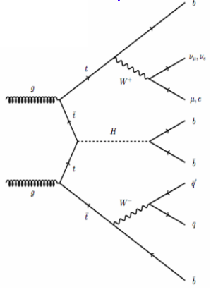
Early LHC ttH analyses: A yes we can! channel
First LHC results shown by CMS at ICHEP
CMS-PAS-HIG-12-025: https://cdsweb.cern.ch/record/1460423/
Single-lepton and di-lepton modes
2011 data (5fb⁻¹)
ATLAS released ttH analysis a few weeks ago
ATLAS-CONF-2012-135: https://cdsweb.cern.ch/record/1478423
Single-lepton mode
4.7fb⁻¹ of 2011 data

Slide 4
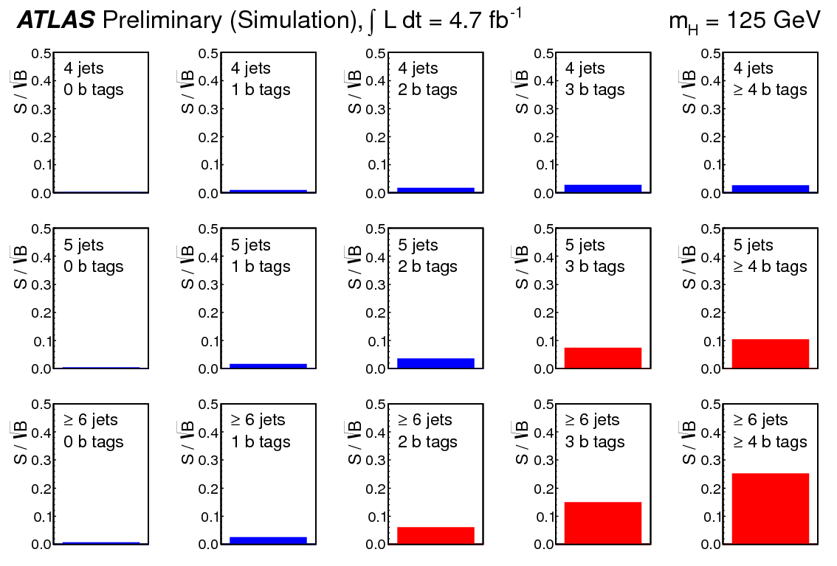

Slide 5
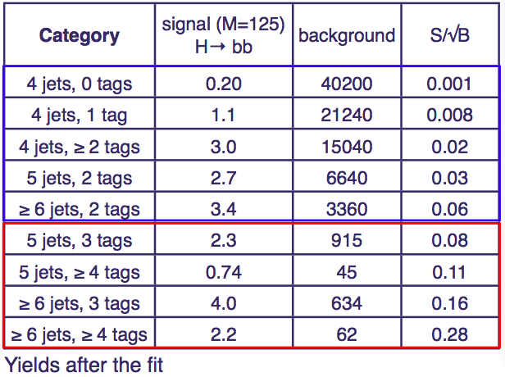
Thanks Sarah Boutle for this table

Slide 6
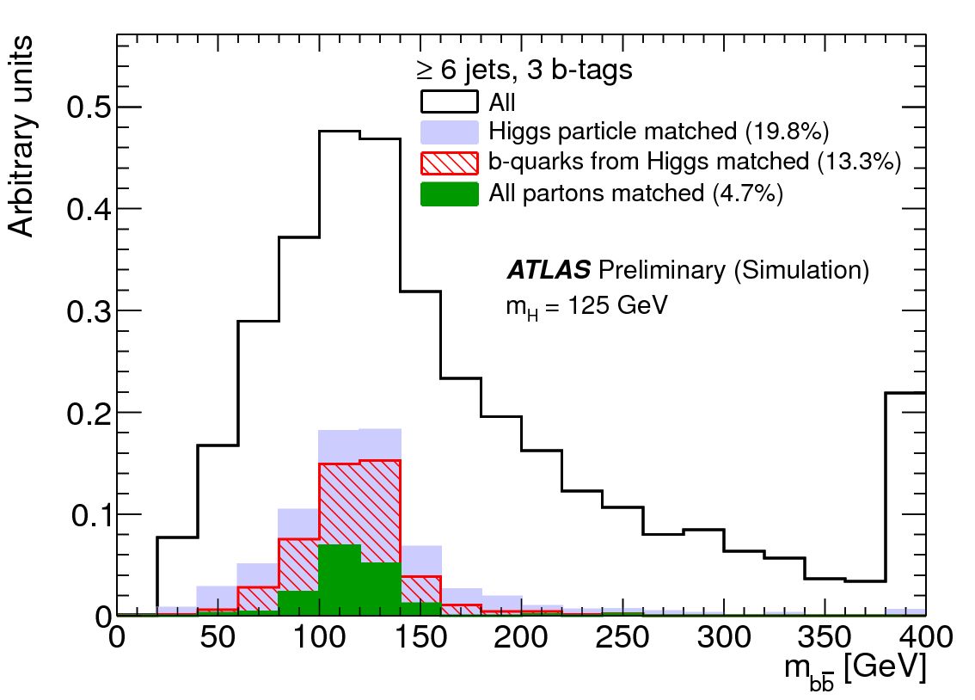
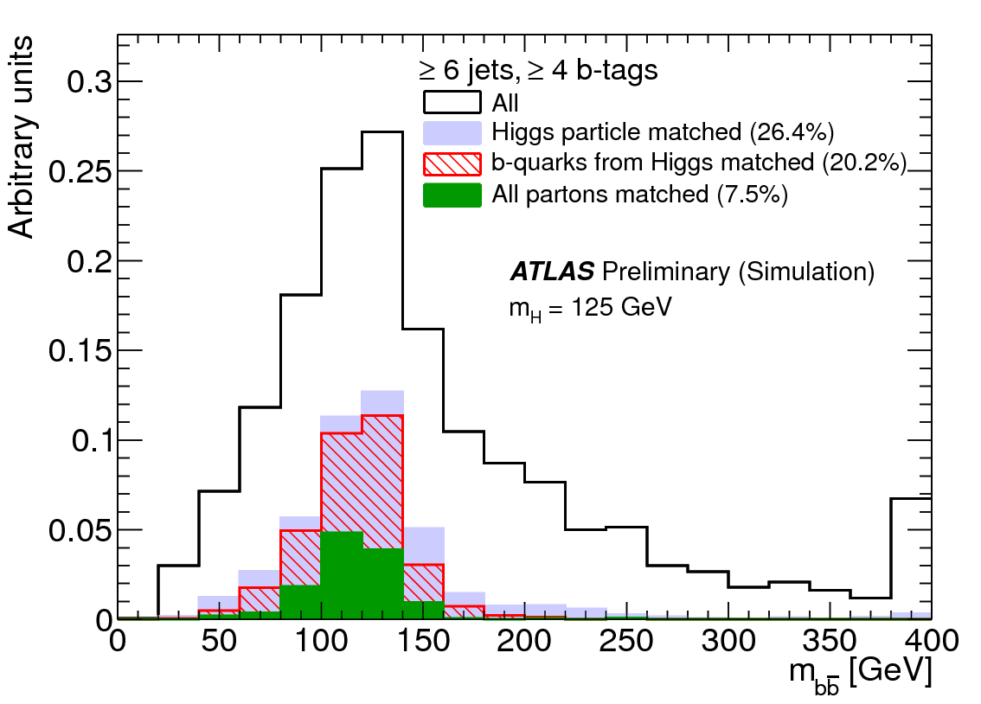

Slide 7
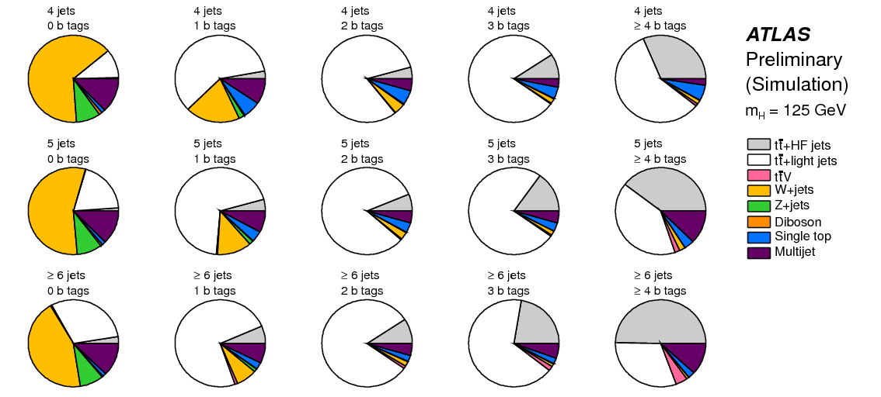
ATLAS Analysis

Slide 8
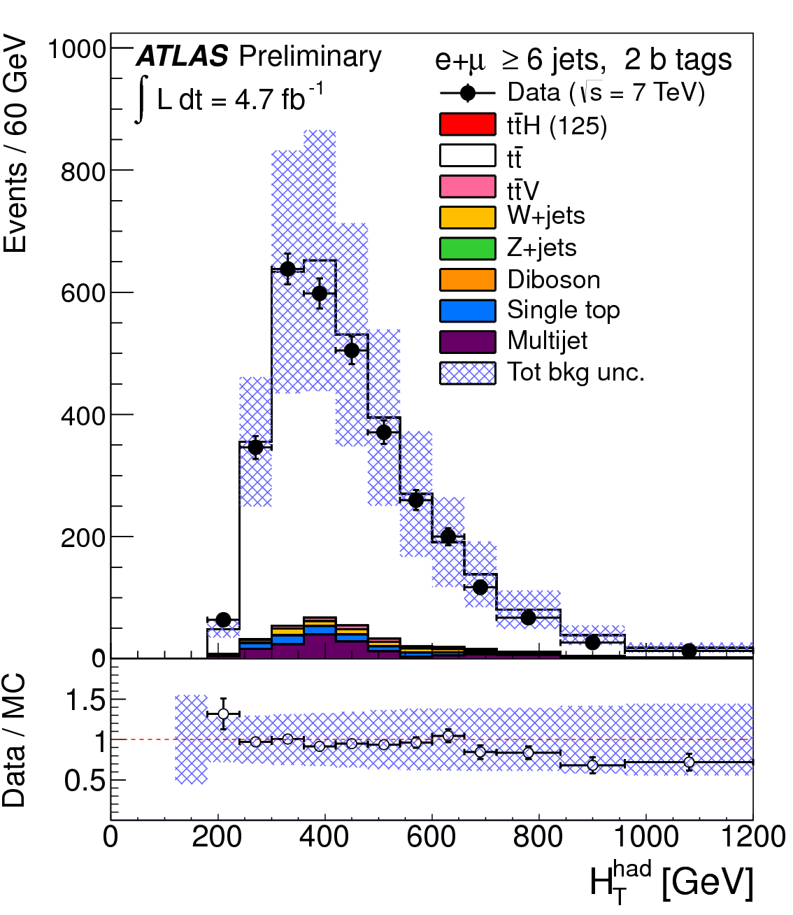
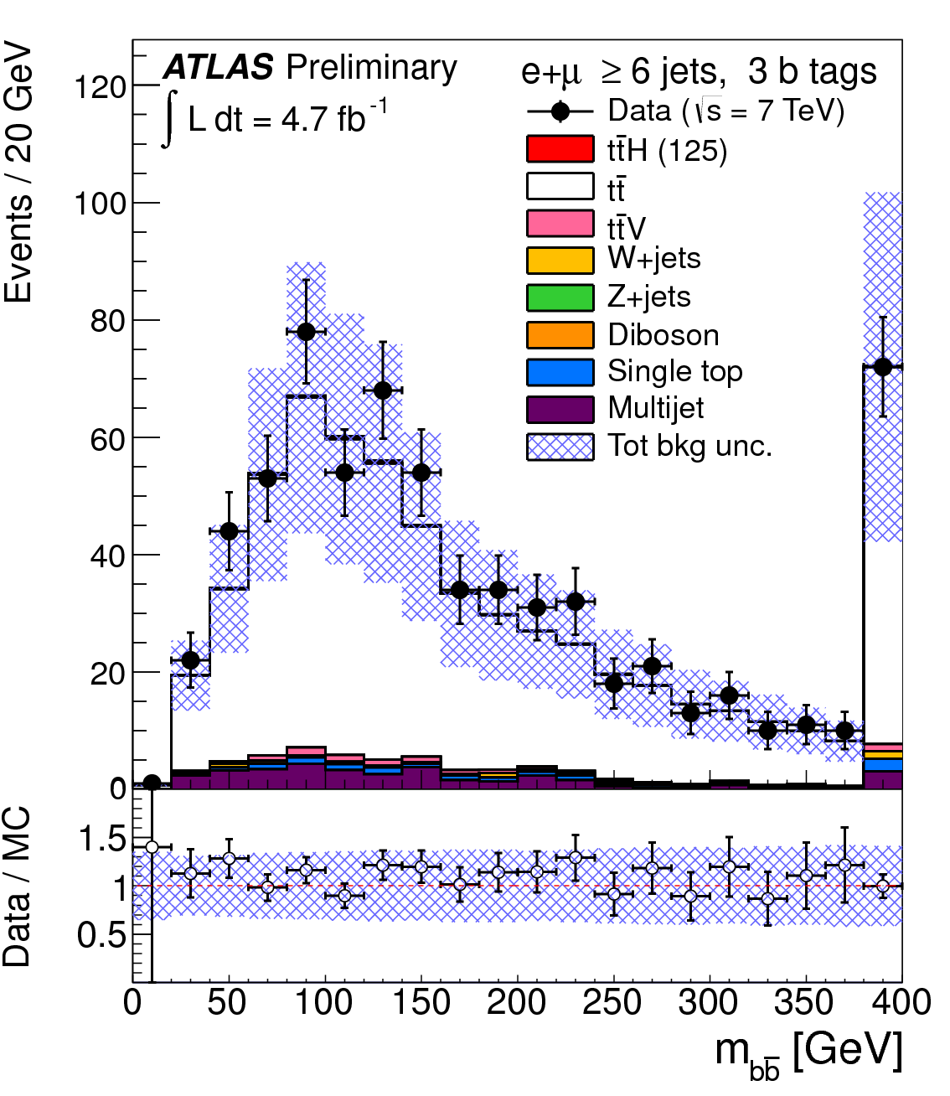
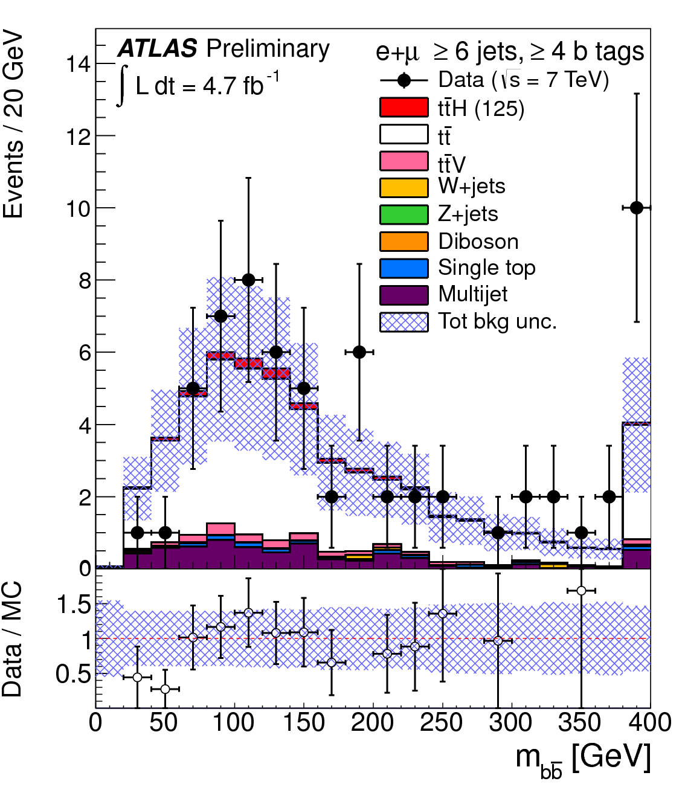
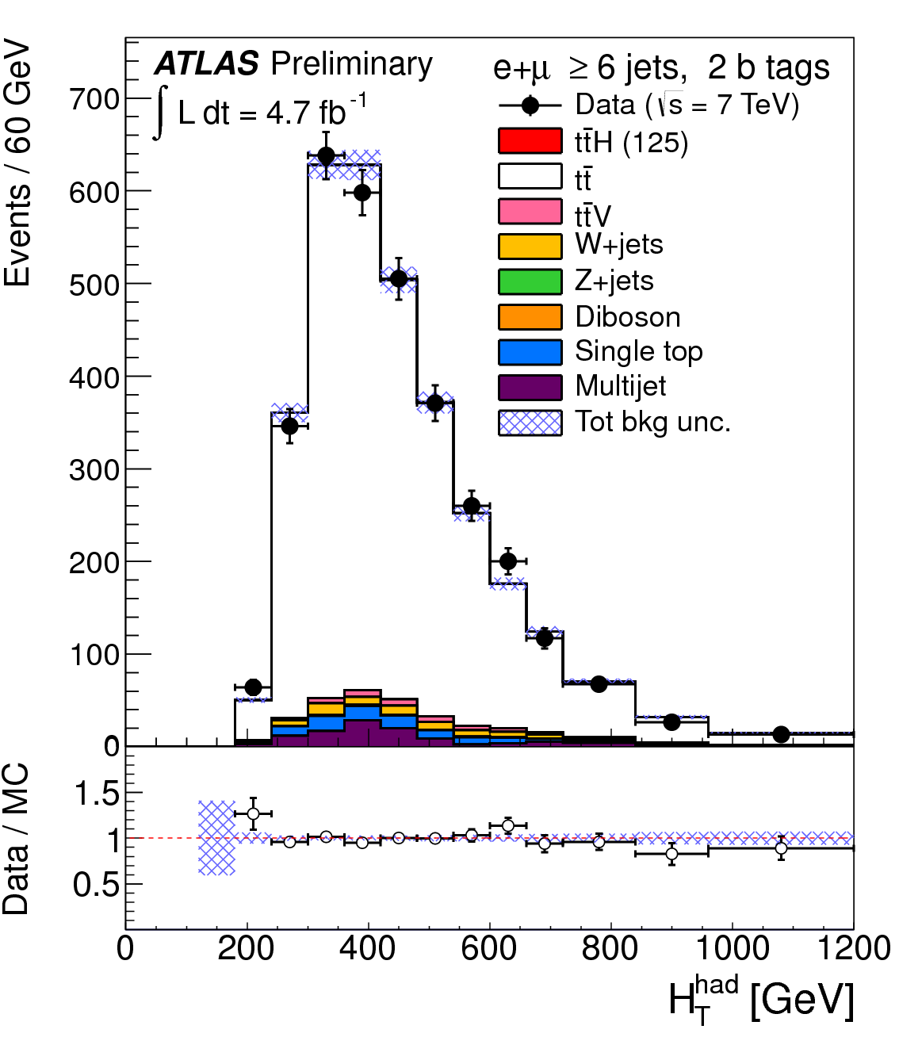
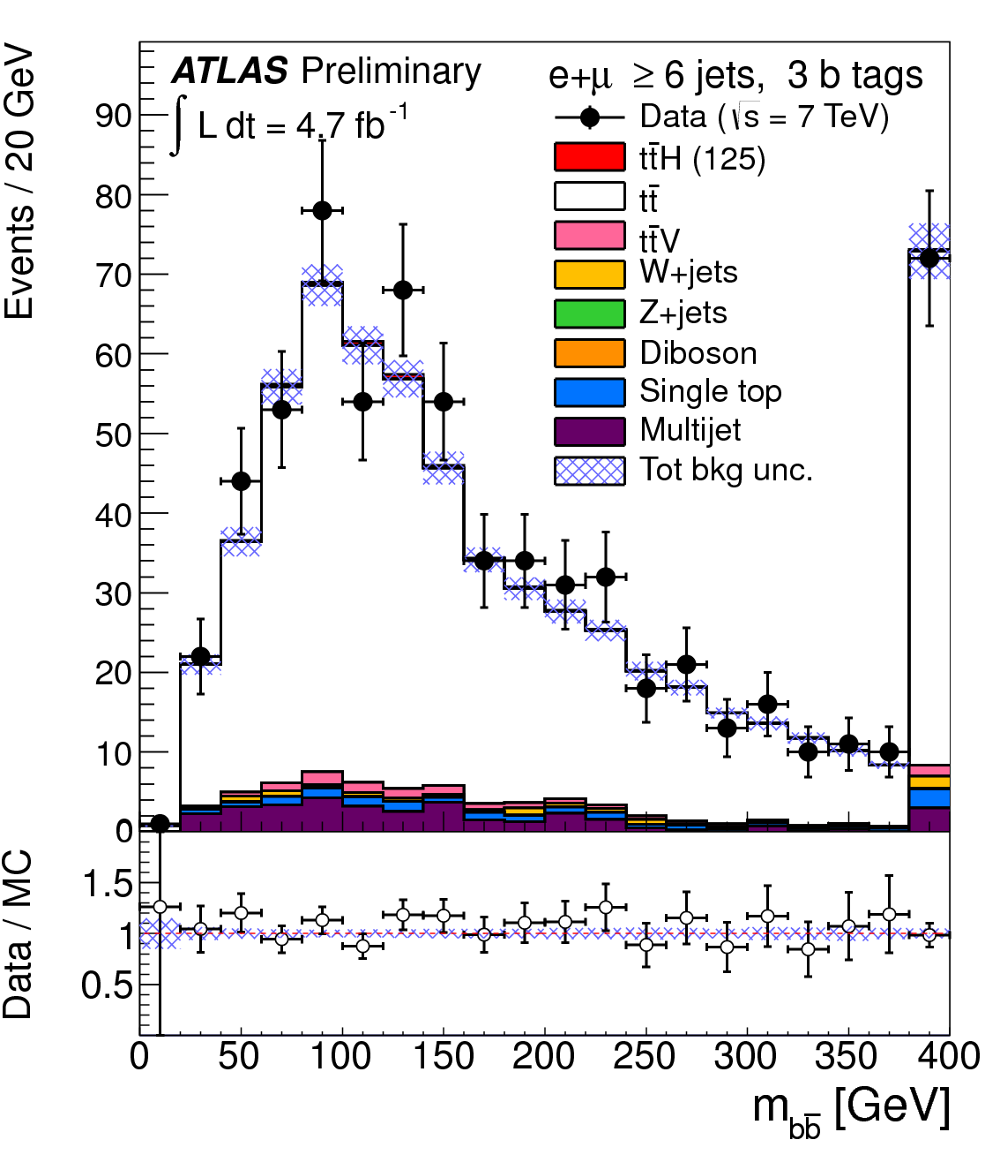
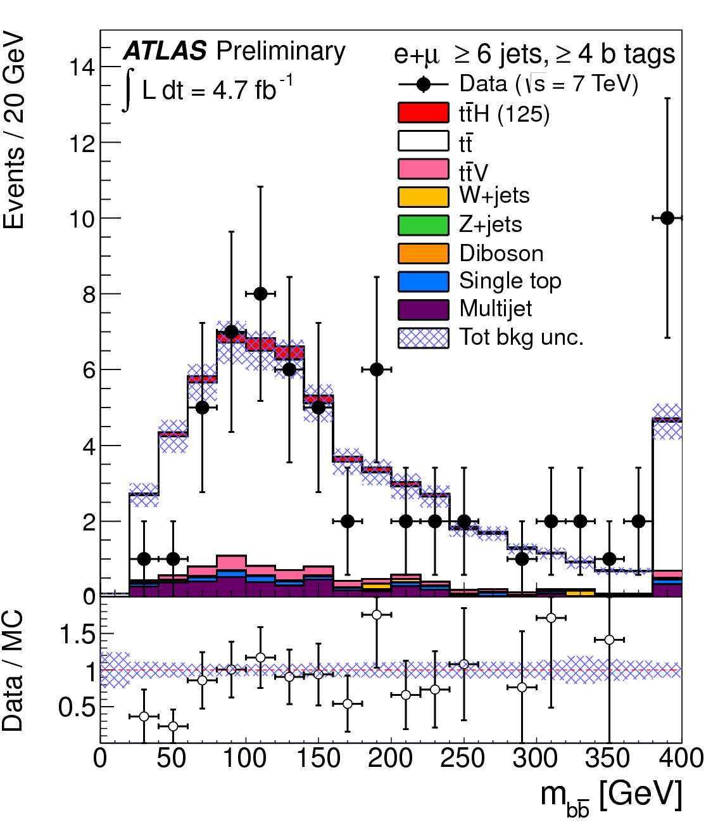
Pre-fit
Post-fit

Slide 9
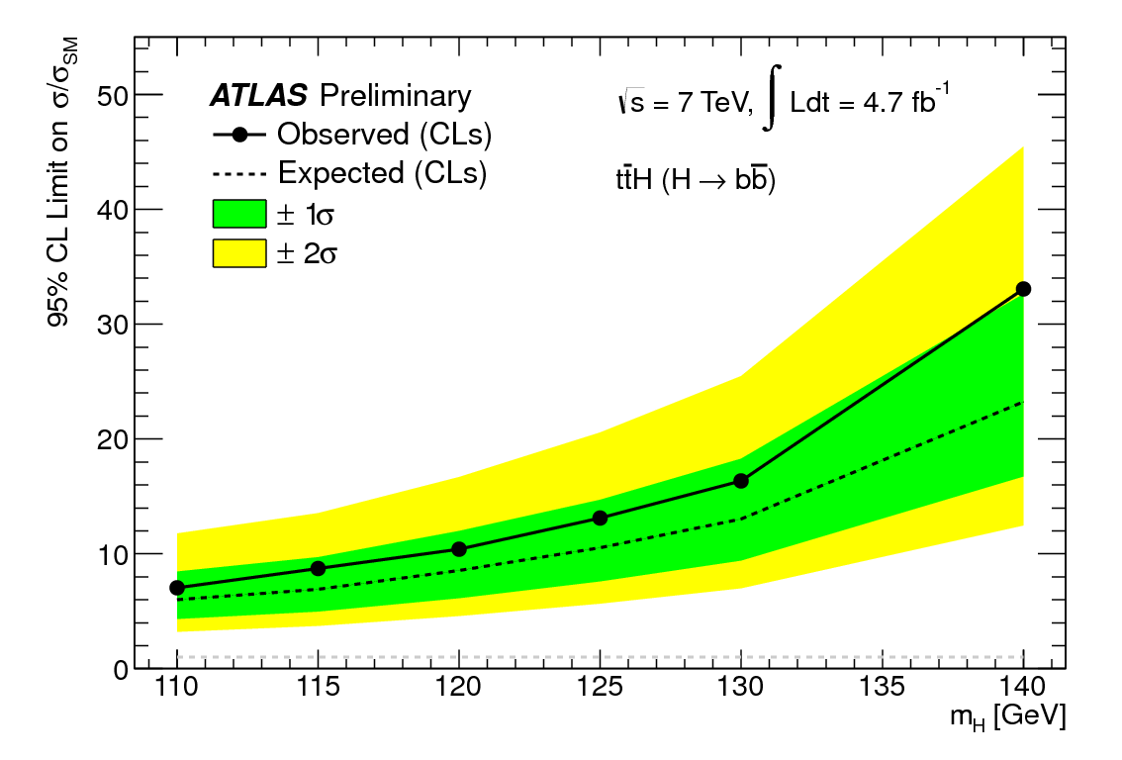
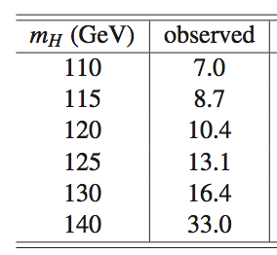
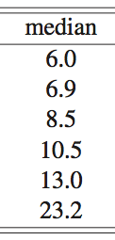
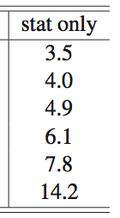
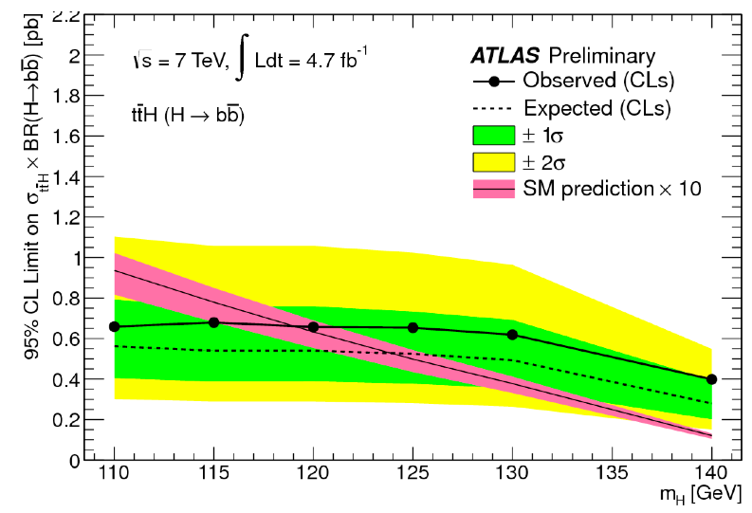

Slide 10
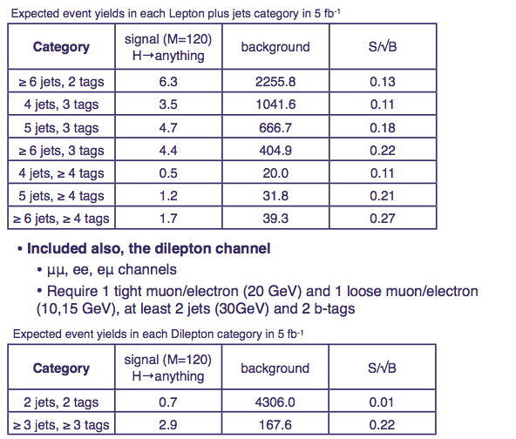
Thanks Sarah Boutle

Slide 11
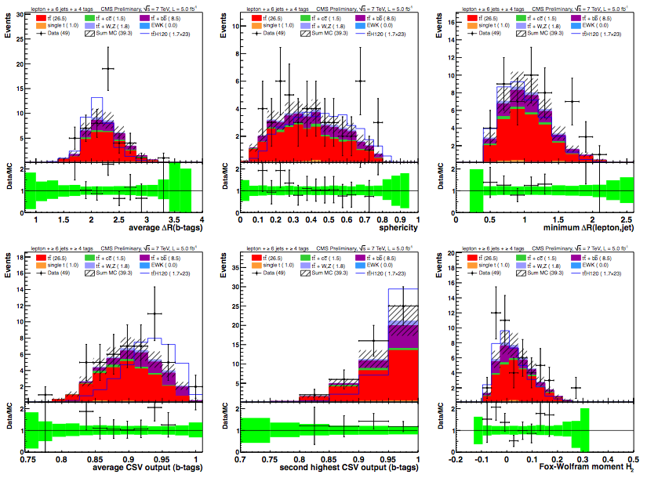
CMS Analysis
Neural-net based analysis of 2011 data
Separate events into categories of #jets and #b-tagged jets
10 best kinematic/event shape/b-tagging variables chosen from “pool of candidates”
Optimized for each #jets/#b-tags category
Simultaneous fit for S and B on NN output distributions
≥6 jets, ≥4 b-tags

Slide 12
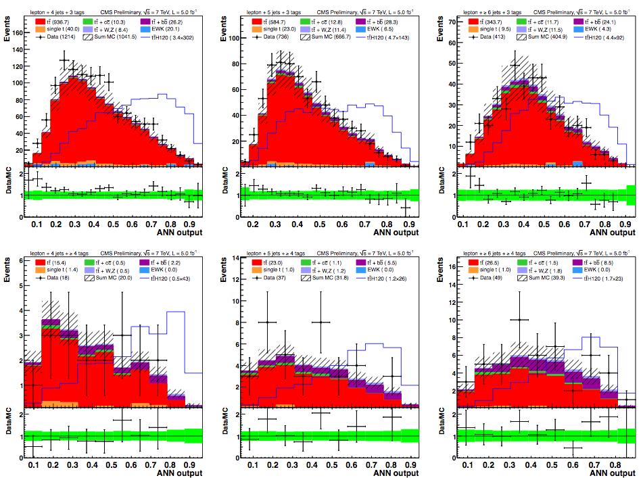
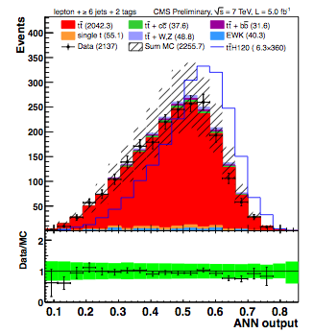
CMS Analysis: Neural Net Output
4j, 3b
5j, 3b
6j, 3b
6j, 2b
4j, 4b
5j, ≥4b
6j, ≥4b

Slide 13
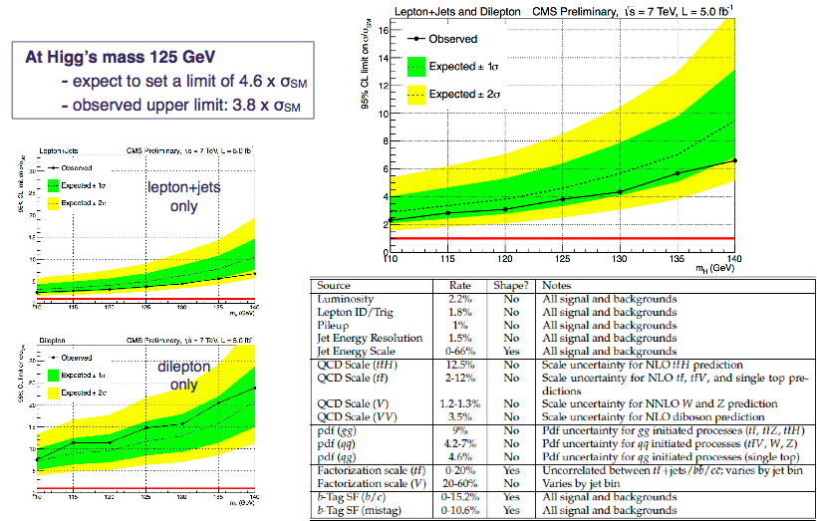

Slide 14
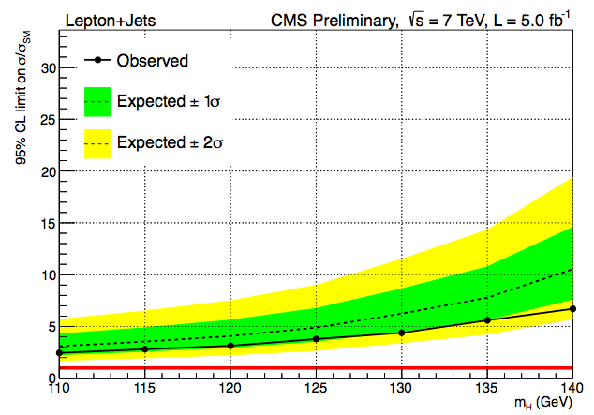
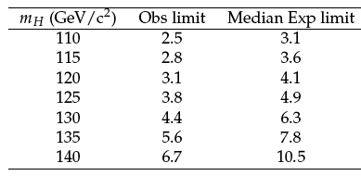
CMS
Lepton+jets mode
ATLAS
Very big difference!...

Slide 15
Bonus slides

Slide 16
ATLAS & CMS Selection (l+jets)
ATLAS | CMS
e: p_{T}>25GeV |η|<2.5 | e: p_{T}>30GeV |η|<2.5
μ: p_{T}>20GeV |η|<2.5 | μ: p_{T}>30GeV |η|<2.1
jets: (0.4): p_{T}>30GeV / 40GeV | Jets (0.5): p_{T}>30/40GeV |η|<2.4
B-tag: 70% (b) 20% (c) 0.8% (lite) | B-tag: 70% (b) 20% (c) 2% (lite)
e ch.: E_{T}^{miss} > 30 GeV M_{T}^{W} > 30GeV
μ ch.: E_{T}^{miss}> 20GeV E_{T}^{miss}+M_{T}^{W} > 60GeV

Slide 17
Data-driven background detemination

Slide 19
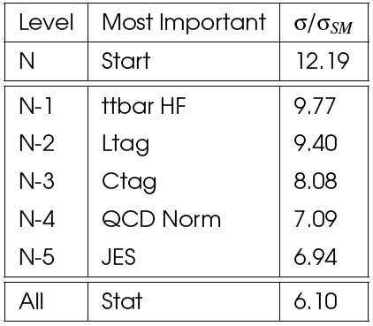
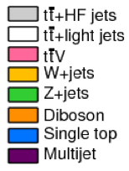
Profiling
Parameters strongly constrained:
W+jets and QCD normalization, tt , b-tag:
4 jet channels
W+jet and tt:
4 jet 0b (W+jet), 4 jet 1b and 2b
b tagging:
4 jet evolution across the number of b-tags
tt modelling and rate uncertainties:
4, 5 and 6 jets with 2 b-tags
tt+HF fraction:
5 channels with 3 and 4 b-tags
Ordered nuisance parameters:
Number of b-tags ➔
Effect of each systematic uncertainty evaluated with “N-1” test (and “N-m”):
Remove one, put back, remove next…
Largest impact: freeze (parameter set to the best fitted value) and repeat
⬅ Number of jets

Slide 20
Systematic Uncertainties
tt+heavy-flavour fractions: Vary by 50% - theory studies suggest cross section uncertainty is 75% ; should be weighted down by the fraction of this background. Fit puts it at 30%.
tt modeling (Alpgen):
Qfac: (±2.3%) The factorization scale for the hard scatter is varied by a factor of two up and down relative to the original scale, Q² = Σ_{partons}m²+ p²_{T}
kTfac: (±9.2%) The renormalisation scale associated with the evaluation of α_{s} at each local vertex in the matrix element calculation is varied by a factor of two up and down relative to the original scale, k_{T} , between two partons.
Functional form of the factorization scale (iqopt2): (± 13%) Default choice (=1) for dynamic factorization scale, Q² = Σ_{partons}m²+ p²_{T}, changed to Q² = x₁x₂s. This has an order of magnitude larger effect than Qfac.

Slide 21
tt cross section: +9.9 -10.7% using NNLO Hathor.
Jet Energy scale: 16 eigenvectors recommended by the jet/ETmiss group are varied.
b, c and light tagging: 9 (btag),5(ctag) eigenvectors recommended by b-tagging group are varied for heavy flavours and the one value for light flavours.
QCD Multijets: Mostly in the electron channel. Correlated 50% uncertainty plus uncorrelated statistical estimate in each channel (66% in 6 jet 4 b-tag)
ttH parton shower modelling: 1-5% effect at mH = 120 GeV

Slide 22
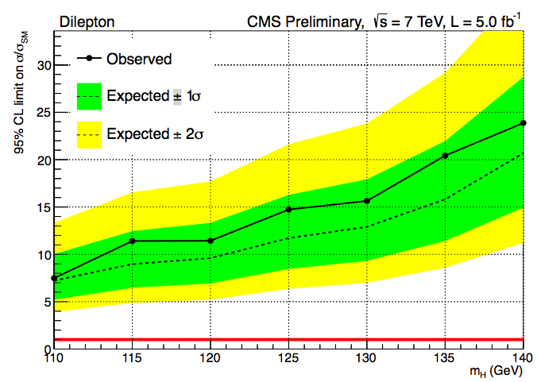
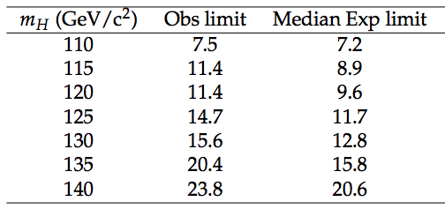
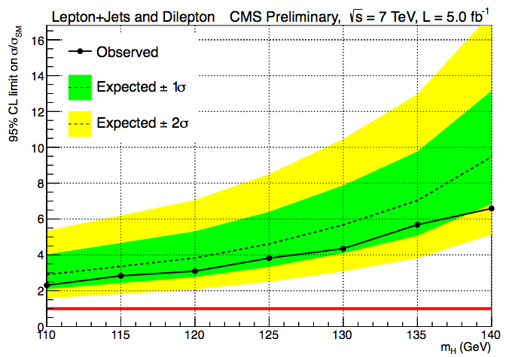
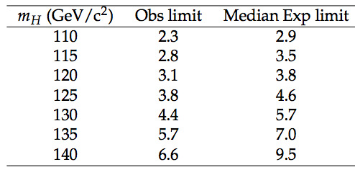
Di-lepton channel
Single-lepton + Di-lepton channels combined
(di-lepton improves expected limit by 6.5%)

Slide 23
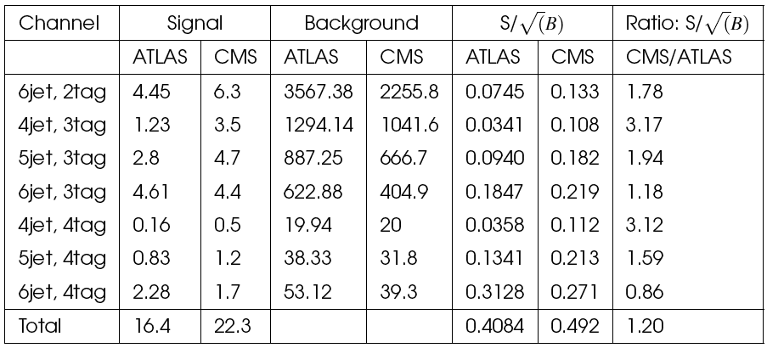
ATLAS/CMS differences
Systematics:
No QCD systematics (no QCD background?!)
No ttH modeling
No W+jets/HF systematic
No JVF systematic (pileup suppression)
Different treatment of Jet Energy Scale (ATLAS 16 NP), b-tag sys. (ATLAS 9 NP) and c-tag sys (ATLAS 5 NP): CMS one Nuis. Par.
b and c tagging correlated
One tt systematic uncertainty (ATLAS 3 NP)
ttbar+HF 20% instead of 50% uncertainty
Cuts:
Electrons and muon:
ATLAS p_{T}>20/25GeV
CMS p_{T} > 30 GeV
Jets:
ATLAS pT>25GeV
CMS 3 leading jets pt > 40 GeV (otherwise 30 GeV)
More signal and higher cuts. Not clear what signal sources are used
Summary:
ATLAS using CMS systematics: 35% better
20% improvement from more signal
Remaining improvement from use of Multivariate analysis (22%)
In numbers:
σ/σ_{SM} = 10.5 -> 7.8 from systematics
Take 22% improvement from MVA: -> 6.1
Take 20% additional signal: σ/σ_{SM} -> 5.1 (expect)
CMS: 4.9 (expected)

