Slide 1




H➞bb Searches in ATLAS
BANG
Ricardo Gonçalo – Royal Holloway
Chicago 2012 Workshop of LHC Physics in the Higgs Era
University of Chicago
14th November 2012

Slide 2
Introduction
The 6 billion Swiss Franc question (plus M&O): Is it THE Higgs?
H ➞ bb is important to answer it!
  Direct sensitivity to Higgs couplings to fermions
  Largest SM Higgs BR (58% at ≈125GeV) – help constrain total width
  Measure top Yukawa coupling directly – largest in SM
  Challenging backgrounds: use associated production with W, Z, tt
This talk: new VH results from 7 and 8 TeV and ttH for 7TeV

Slide 3
New WH/ZH analysis of
7 and 8 TeV data

Slide 4
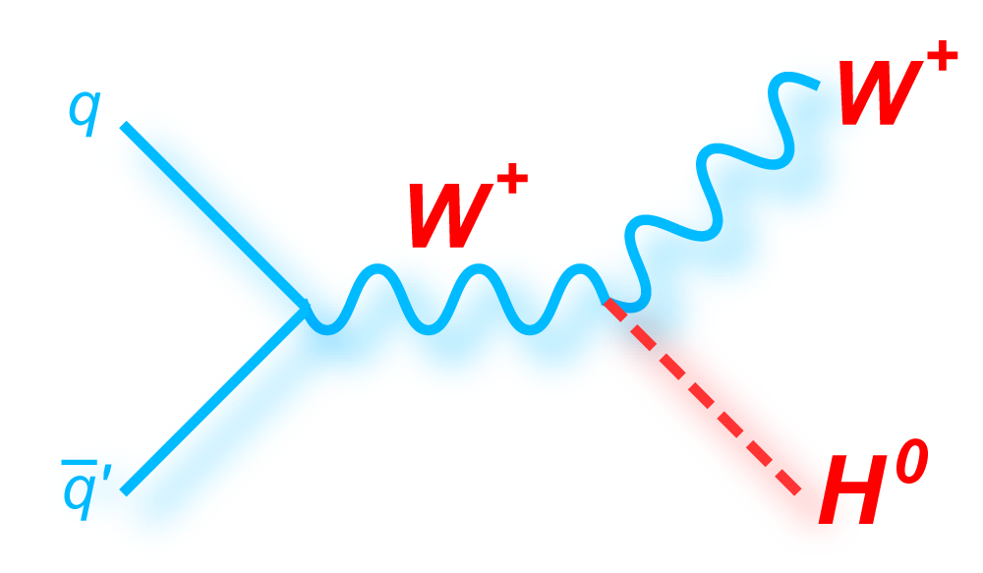
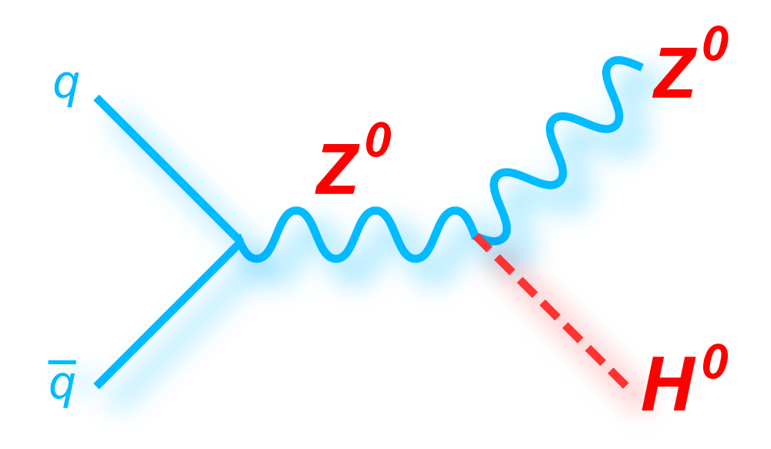
Search Strategy
Search for Higgs decaying to pair of b-quarks
  Associated production to reduce backgrounds
The analysis is divided into three channels
  Two (llbb), one (lνbb) or zero (ννbb),) (l=e,μ)
Cuts common to all channels
  Two or three jets: 1st jet p_{T} > 45 & other jets > 20 GeV
  Two b-tags: 70% efficiency per tag
    c-jet rejection factor ≈5
    Light-jet rejection factor ≈150
Two lepton
One lepton
Zero lepton
ZH ➞ llbb
No additional leptons
E_{T}^{miss} < 60 GeV
83 < m_{Z} < 99 GeV
Single & di-lepton trigger
WH ➞ lνbb
No additional leptons
E_{T}^{miss} > 25 GeV
40 < M_{T}^{W} < 120 GeV
Single lepton trigger
ZH ➞ ννbb
No leptons
E_{T}^{miss} > 120 GeV
E_{T}^{miss} trigger

Slide 5
Analysis Overview
  Previous publication: 4.7 fb⁻¹ √s=7 TeV http://arxiv.org/abs/1207.0210
This analysis: 4.7fb⁻¹ √s = 7 TeV & 13fb⁻¹ √s = 8 TeV
  S/B is not large, but increases as p_{T}^{bb} increases
  Therefore analysis broken into different p_{T} bins (use p_{T}^{V} of W or Z)
  Not yet enough ∫Ldt to use jet substructure techniques
Various substantial improvements wrt previous analysis
  The analysis is divided into 16 categories using p_{T}^{V}
    0-lepton: E_{T}^{miss} [120-160] [160-200] [>200] GeV x (2 jets or 3 jets)
    1 & 2 lepton: p_{T}^{W/Z} [0-50],[50,100],[100-150],[150-200] [>200] GeV
  Cuts are optimised for each category (~30% increase in sensitivity)
  Muon energy (p_{T}>4 GeV) added for b-jets (~10% resolution improve/)
  Additional ttbar based b-tagging calibration (~50% reduction in b-tagging systematic uncertainty)

Slide 6
Analysis Overview
  Previous publication: 4.7 fb⁻¹ √s=7 TeV http://arxiv.org/abs/1207.0210
This analysis: 4.7fb⁻¹ √s = 7 TeV & 13fb⁻¹ √s = 8 TeV
  S/B is not large, but increases as p_{T}^{bb} increases
  Therefore analysis broken into different p_{T} bins (use p_{T}^{V} of W or Z)
  Not yet enough ∫Ldt to use jet substructure techniques
Various substantial improvements wrt previous analysis
  The analysis is divided into 16 categories using p_{T}^{V}
    0-lepton: E_{T}^{miss} [120-160] [160-200] [>200] GeV x (2 jets or 3 jets)
    1 & 2 lepton: p_{T}^{W/Z} [0-50],[50,100],[100-150],[150-200] [>200] GeV
  Cuts are optimised for each category (~30% increase in sensitivity)
  Muon energy (p_{T}>4 GeV) added for b-jets (~10% resolution improve/)
  Additional ttbar based b-tagging calibration (~50% reduction in b-tagging systematic uncertainty)

Slide 7
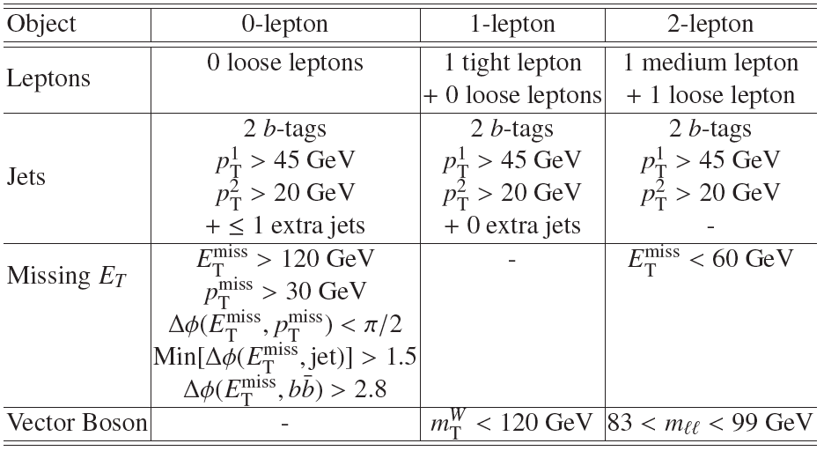
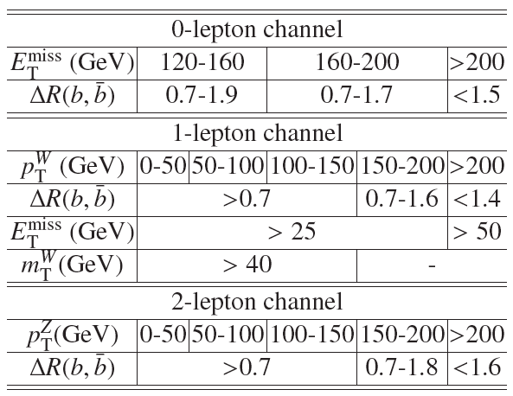
Details of event selection
Basic event selection:
Tuned kinematic cuts to optimise sensitivity in each category:

Slide 8
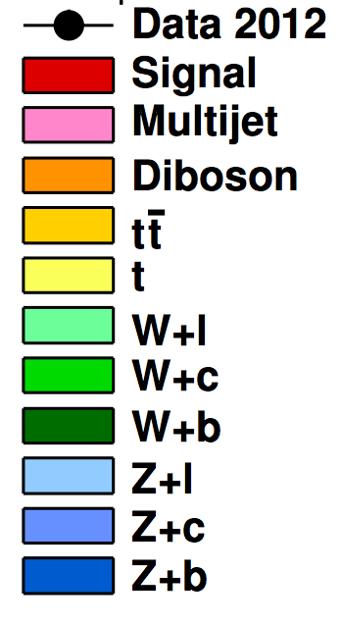
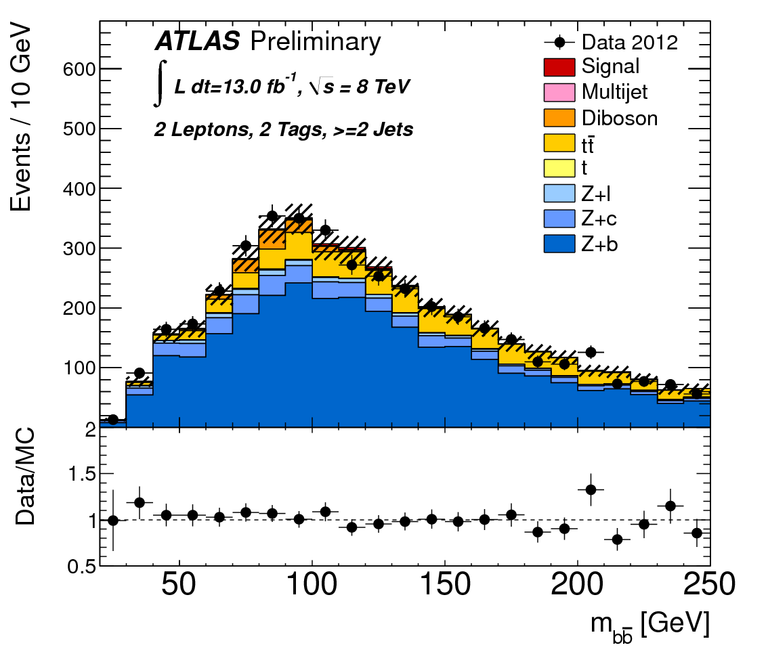
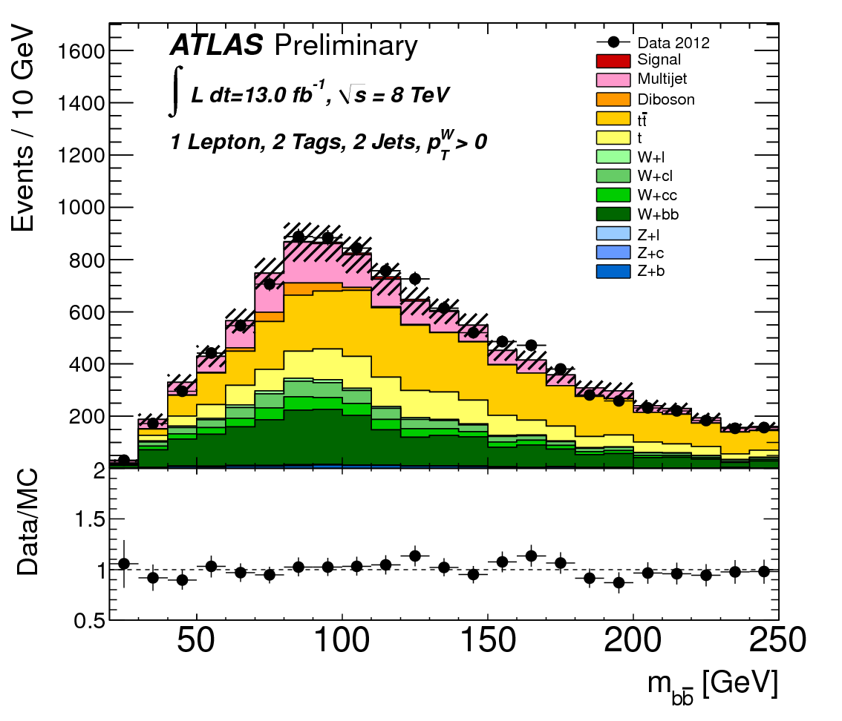
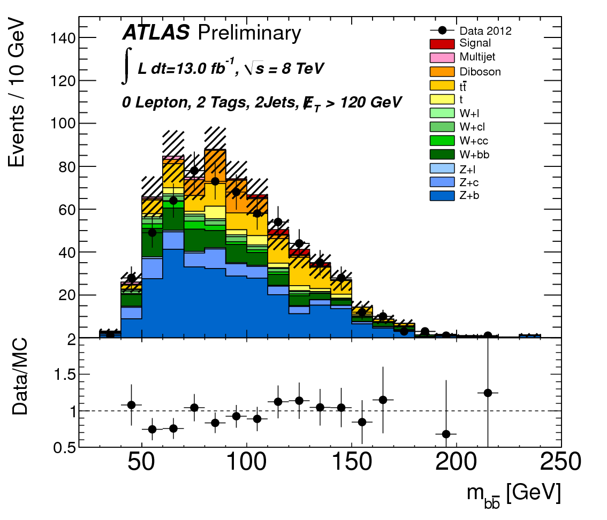
Backgrounds and MC
Signal: WH/ZH Pythia6/8
Diboson WW/WZ/ZZ Herwig
Multijet: Data driven
ttbar: MC@NLO
Single Top Acer/MC@NLO
W+b Powheg
W+c/light-jets Alpgen
Z+ b/c/light-jets Alpgen/Sherpa
Background shapes from simulation and normalised using flavour & data fit
Multi-jet bkg determined by data-driven techniques
WZ(Z➞bb) & ZZ(Z➞bb) resonant bkg normalisation and shape from simulation
2 lepton
1 lepton
0 lepton
Z+jets
Top/W+jets
Z+jets/W+jets/Top

Slide 9
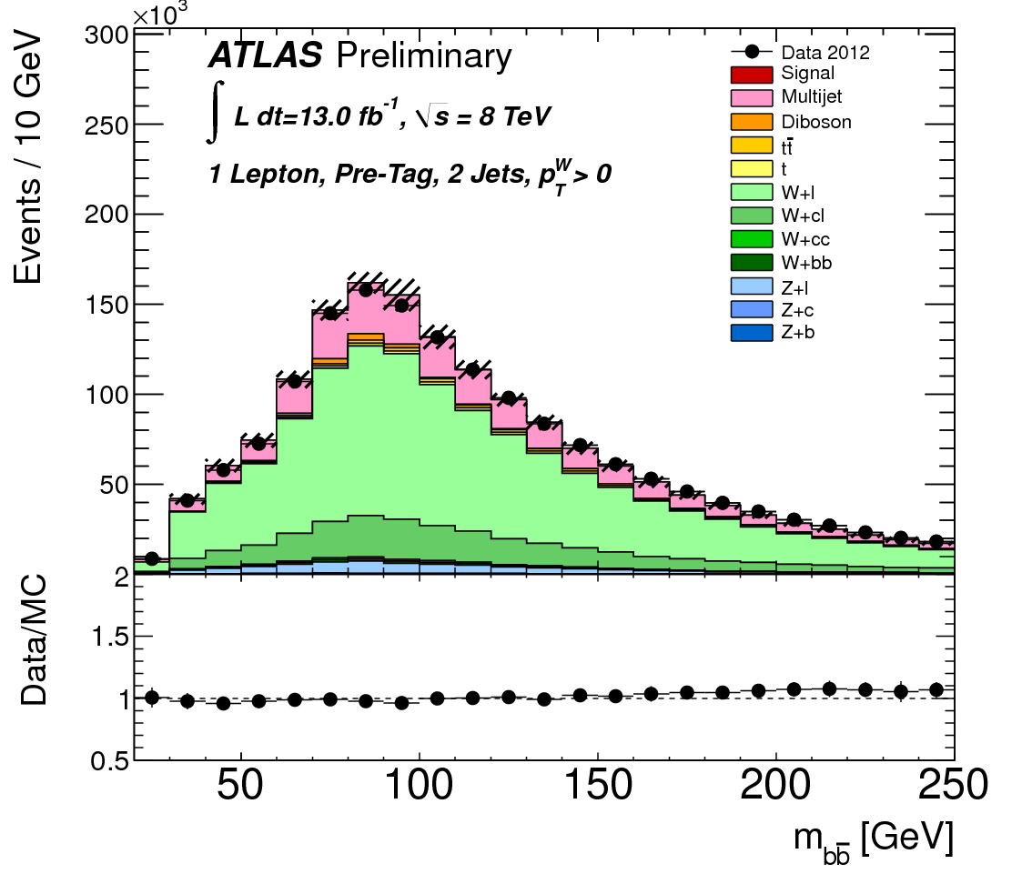

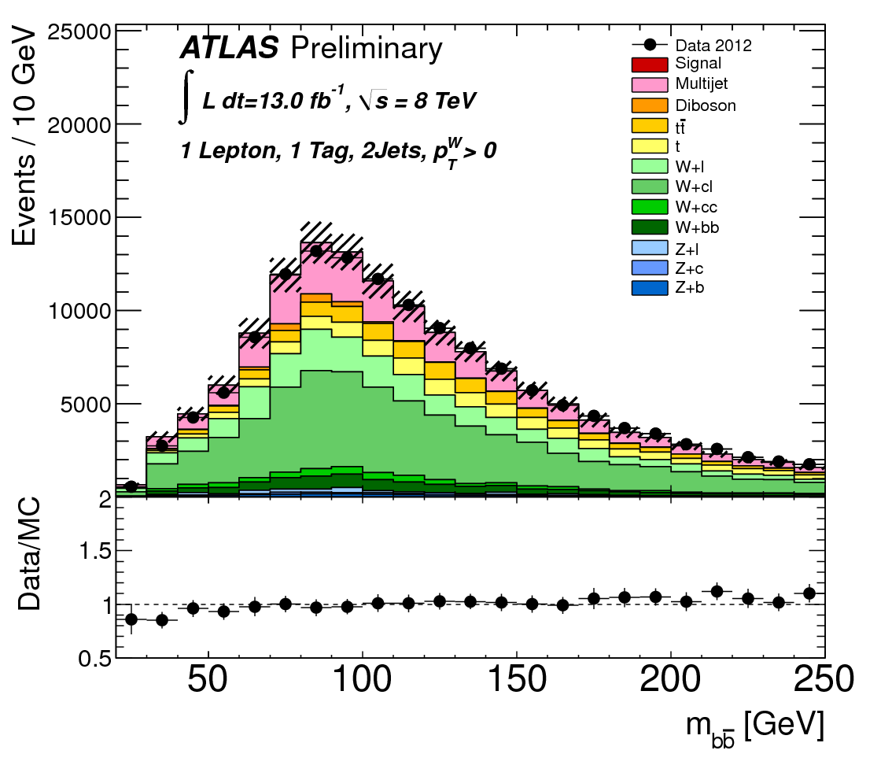
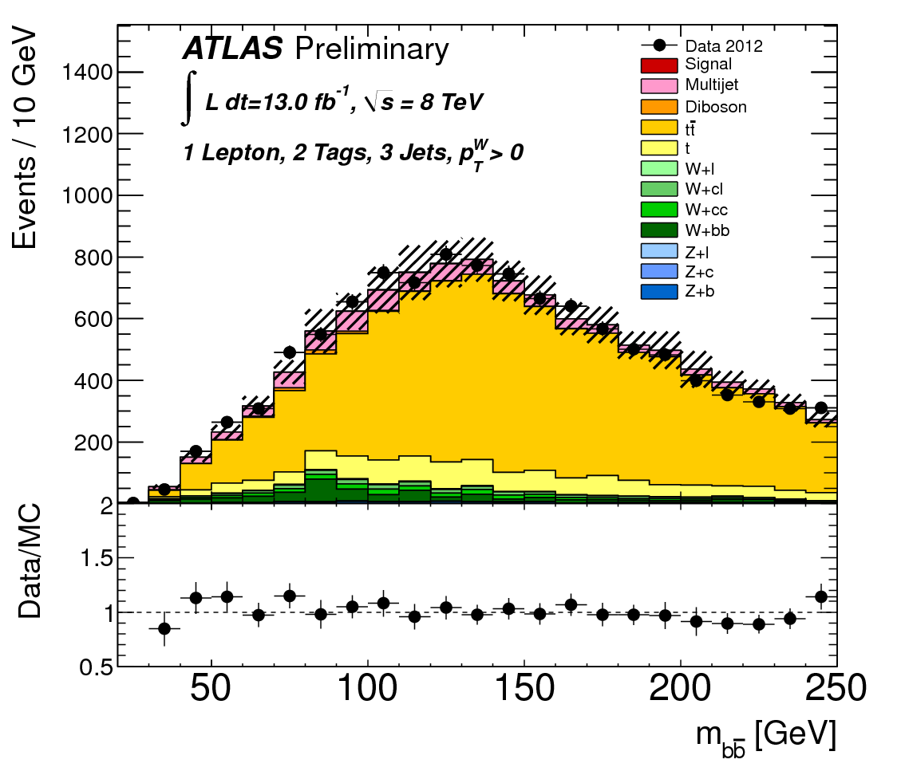


Control regions:
Pre b-tag: rich in V+light jets
1 b-tag: V+light, V+c, V+b etc
Top:
  1-lepton: ≥3-jet region;
  2-lepton: m(ll) sidebands of m_{Z}
Pre b-tag
enriched
1 b-tag
+ 1 jet
enriched
enriched

Slide 10
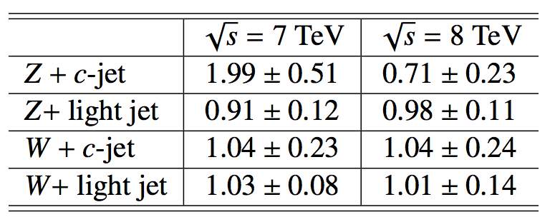
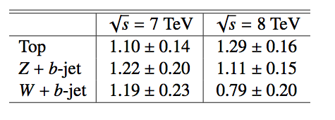
Maximum likelihood Fits
First perform the flavour ML fit
  Determined V+light and V+c scale factors
  Z+c factor changes due to MC treatment
  Improved understanding of bkg V pT
    Using the high statistics at 8 TeV we discovered that the V pT spectrum
    falls more rapidly in data than expected from MC ☺
  W + jets and Z + jets: 5-10 % correction required
  Top background: 15 % correction required
Using corrections & scale factors get good MC/data agreement
Binned profile likelihood fit to 16 signal regions & top control regions
  W+b, Z+b and top bkg are floated
  Rescaling factors from the fit ➠
L(μ,θ) fit to signal strength μ (= σ/σ_{SM})
Nuisance parameters θ for systematics
CL_{S} used to determine limits

Slide 11
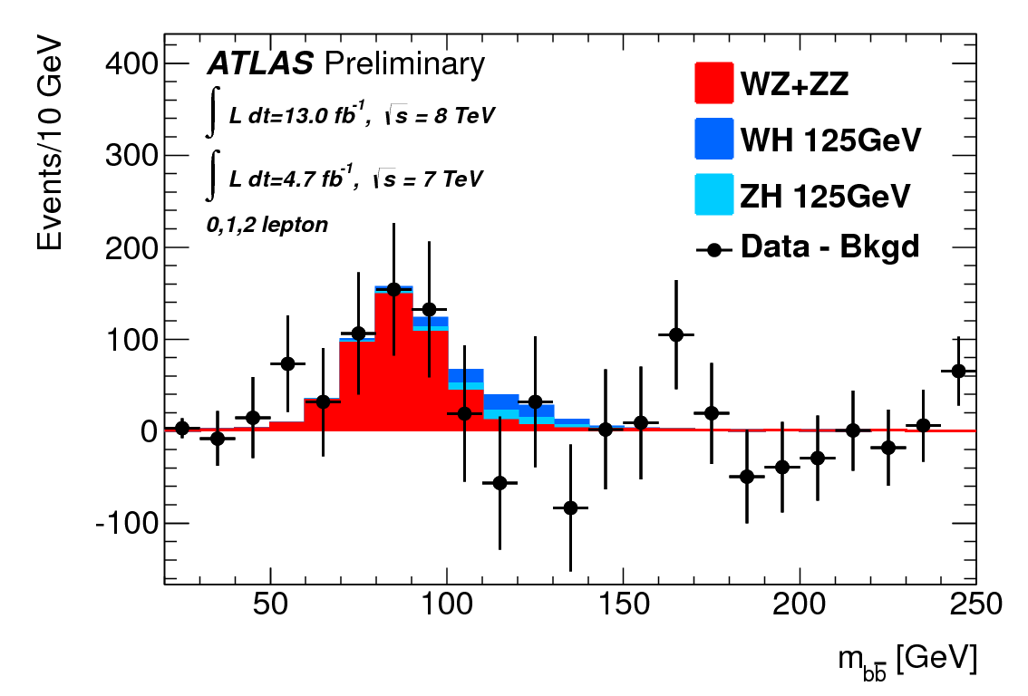
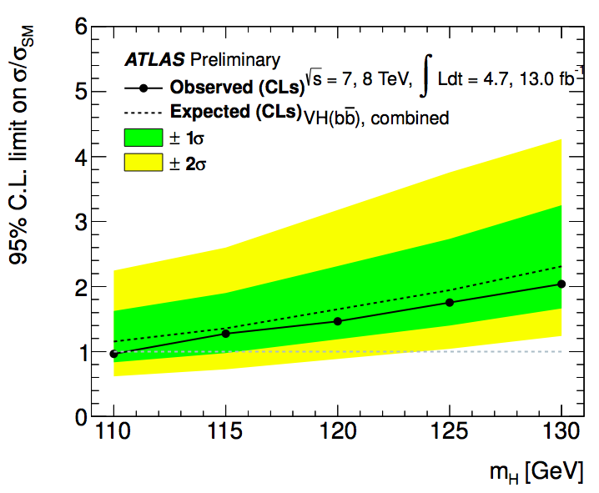
Analysis
Event selection:
0 lepton
1 lepton
2 lepton
Data-driven corrections:
Pre-tag
top CR (3/4j)
p_{T}^{V} correction of W+jets, Z+jets and top
MC
data
Flavour fit (V+c, V+light):
Use different b/c/light content to get correction to flavour fractions
Pre-tag
1 b-tag
2 b-tag
top CR (3/4j)
Fix Higgs to SM and fit to get diboson significance:
Fix diboson to SM and do fit to extract final background normalizations and limits:

Slide 12
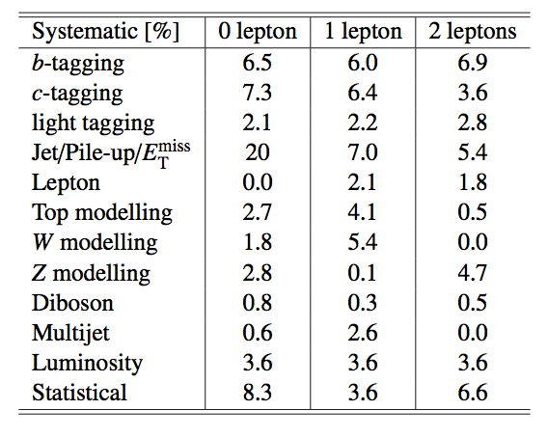
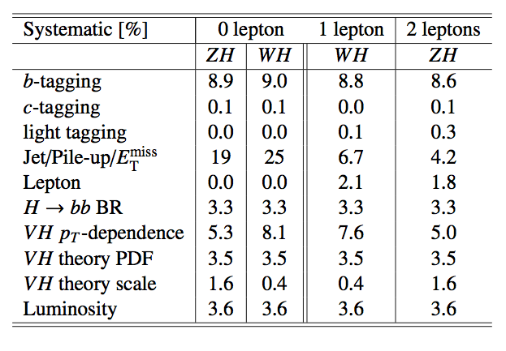
Systematic Uncertainties
Experimental uncertainties
  b-tagging and jet energy dominate
  Jets: components (7 JES, 1 p_{T}^{Reco}, resol.)
  E_{T}^{miss} – scale and resolution of soft components. Data/MC for E_{T}^{miss} trigger
  bTagging – light, c & 6 p_{T} bins for b-jet efficiency
  Lepton – energy, resolution, efficiency
  Multijet / diboson / Luminosity / MC stats
Theoretical uncertainties
  BR(H➞bb) @ mH=125 GeV (3.3%)
  W/Z+jet m_{bb} (20%) and V pT (5-10%)
  Single top/top normalisation (15%)
  W+c/W+jets (30%), Z+c/Z+jets (30%)
  Diboson (11%)
Background systematics
Uncertainties given are after full cuts (pre-fit)
Signal systematics

Slide 13
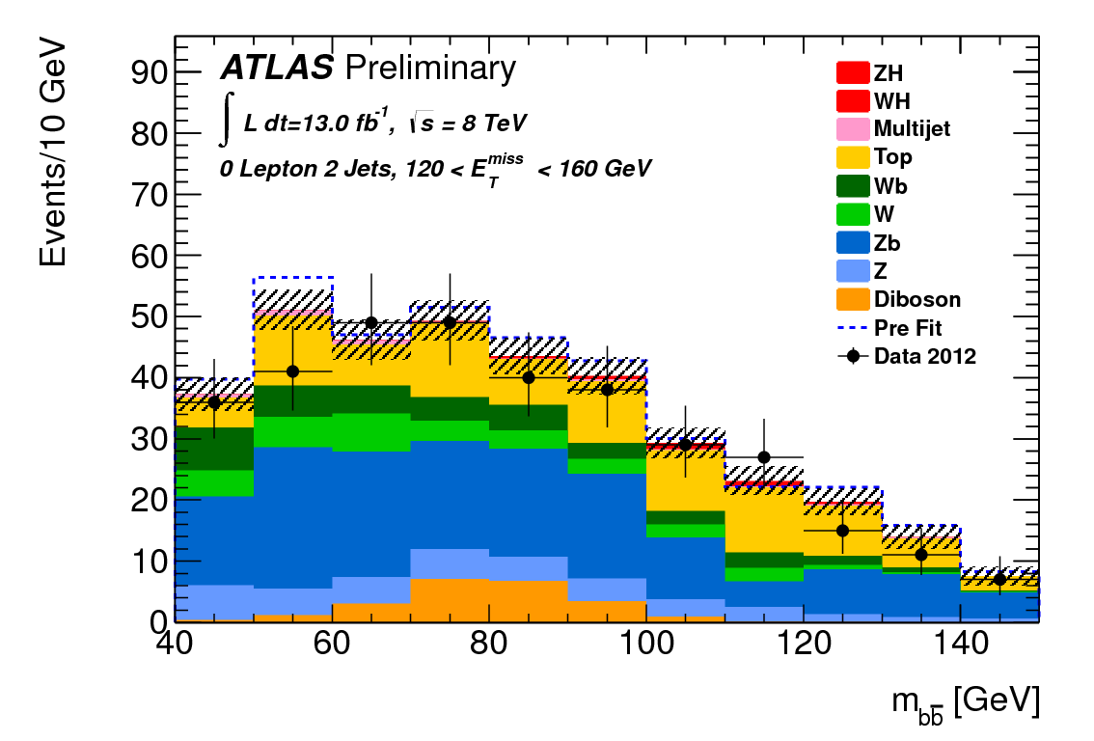
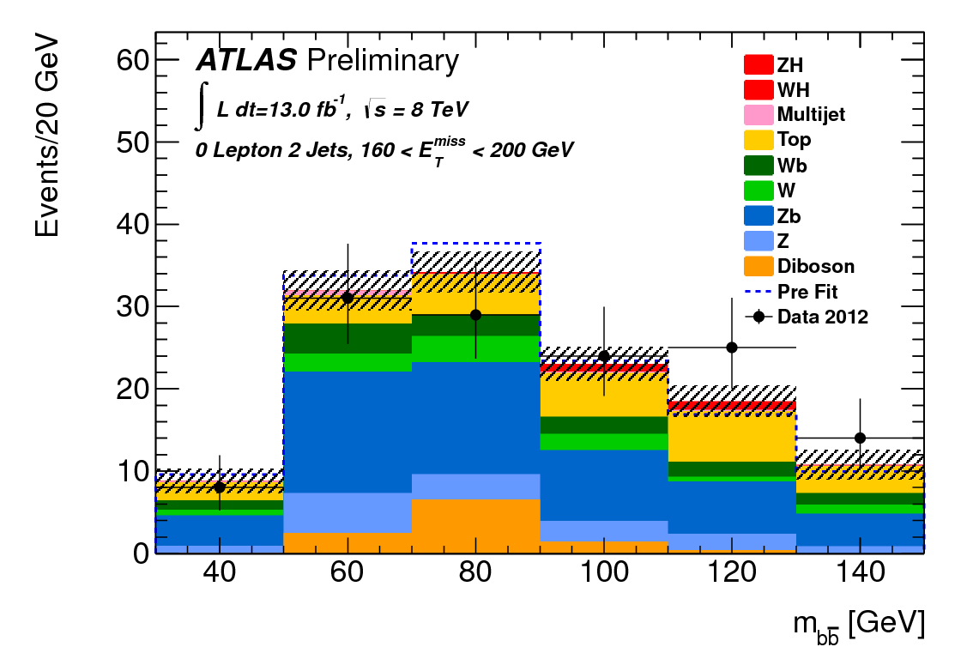
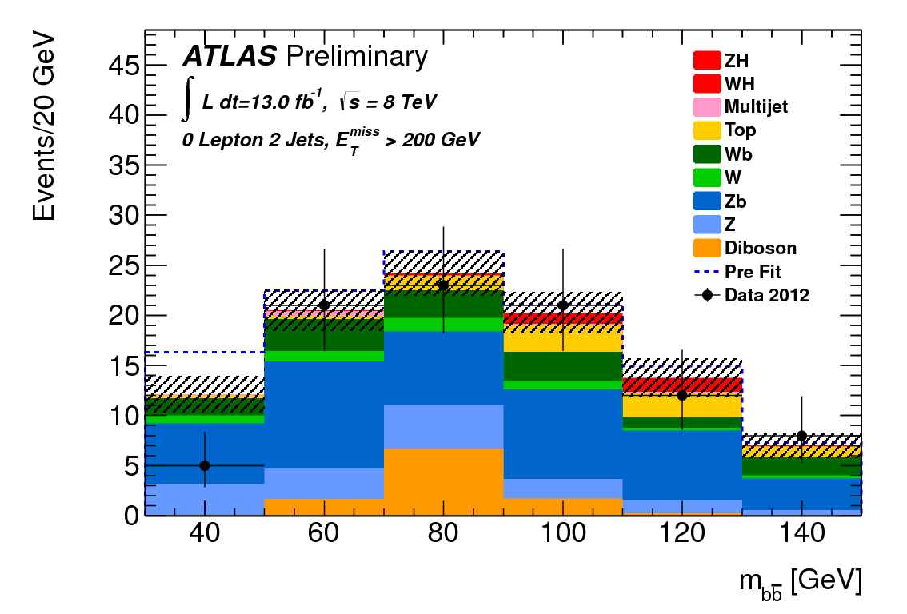
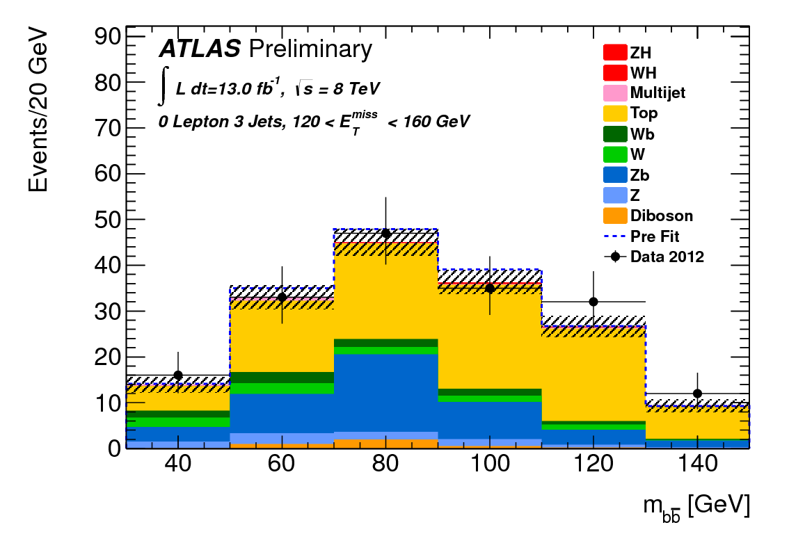
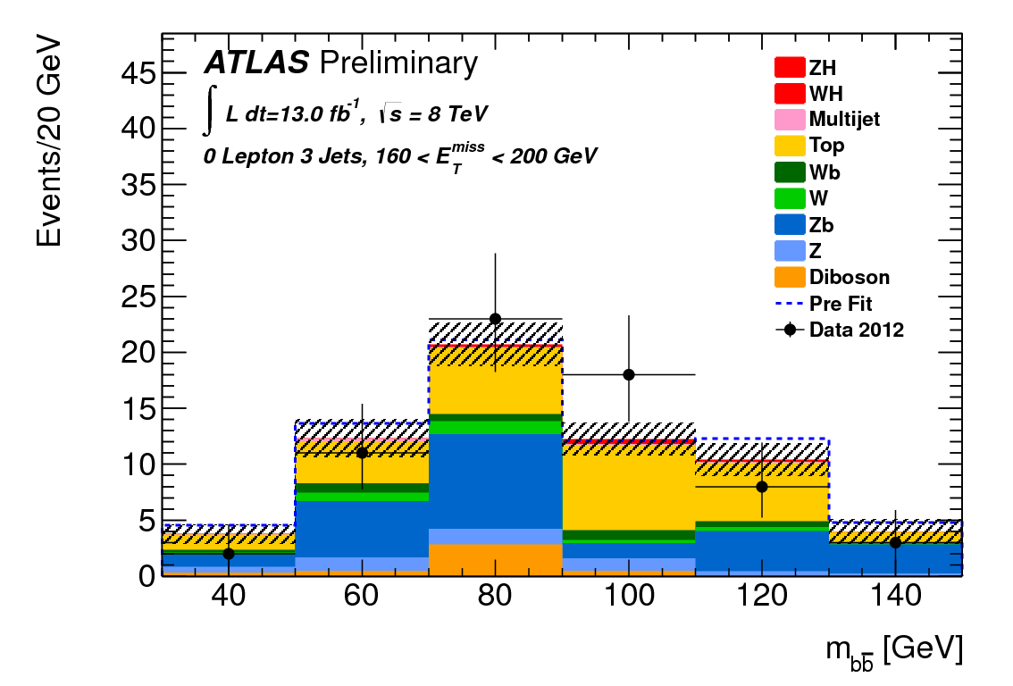
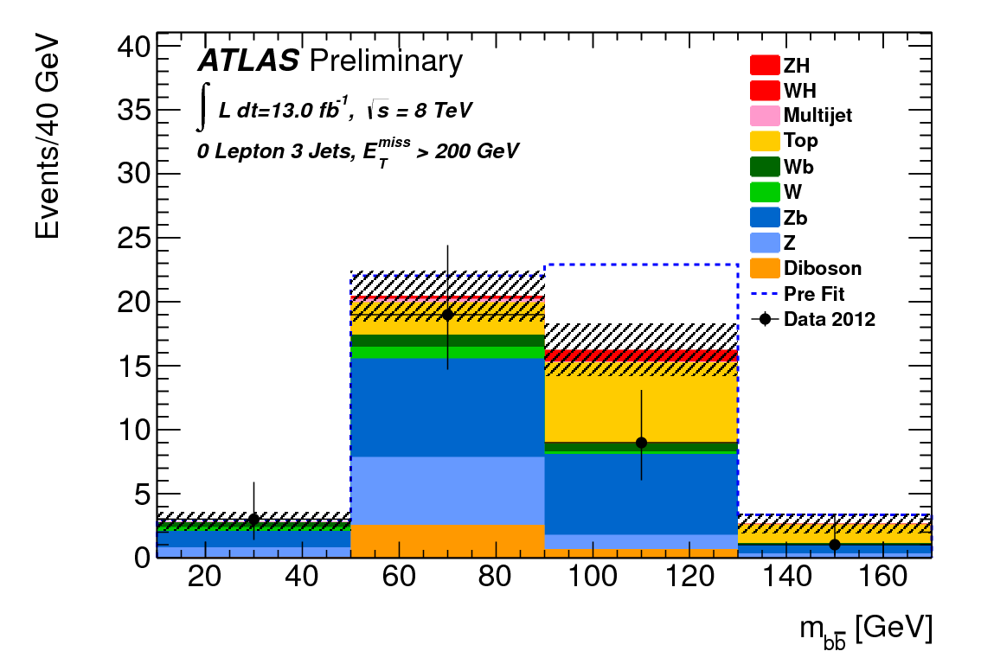
M_{bb} distribution (0-lepton, 8TeV)
2-jet categories
3-jet categories
120 < E_{T}^{miss} < 160 GeV
160 < E_{T}^{miss} < 200 GeV
160 < E_{T}^{miss} < 200 GeV

Slide 14
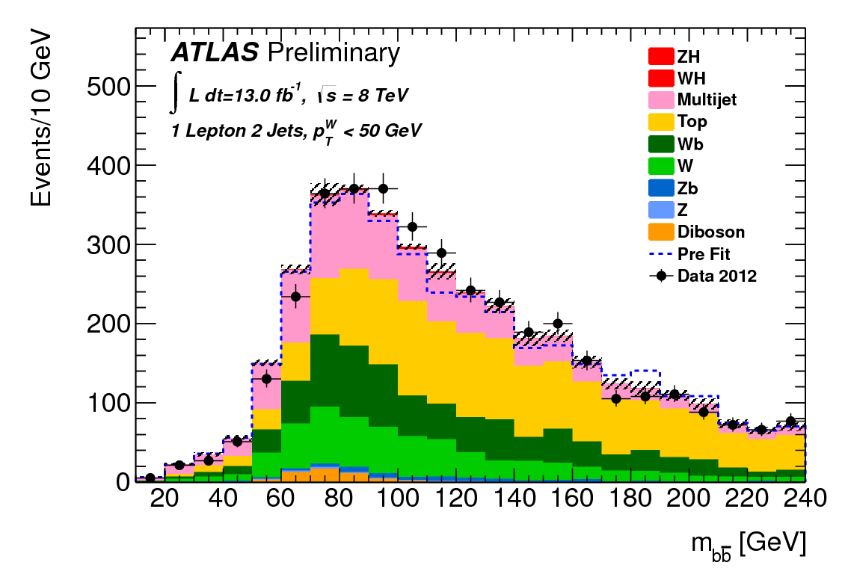
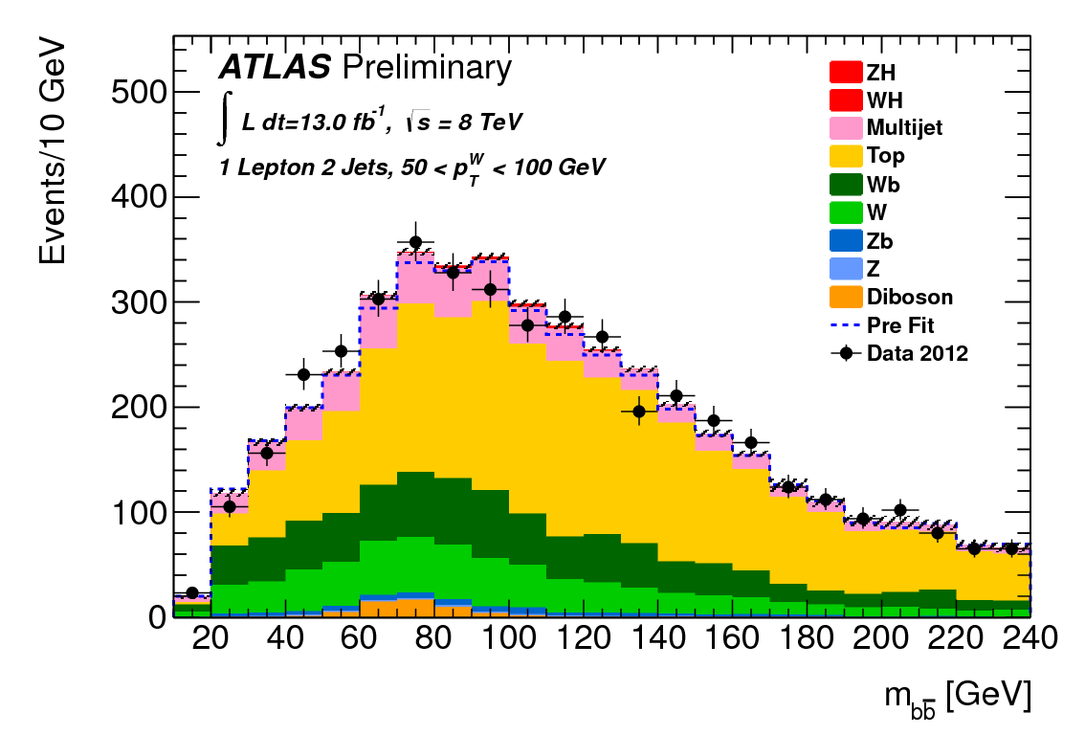
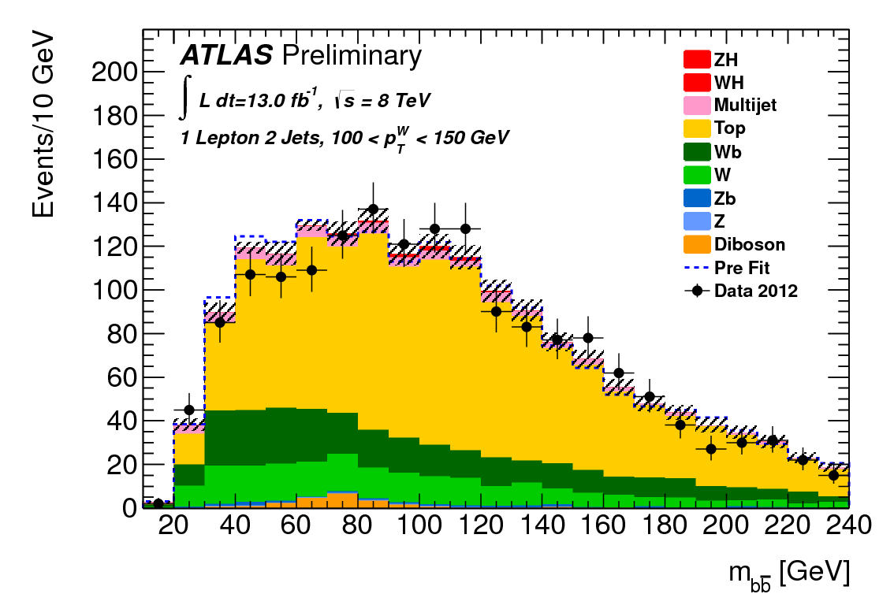
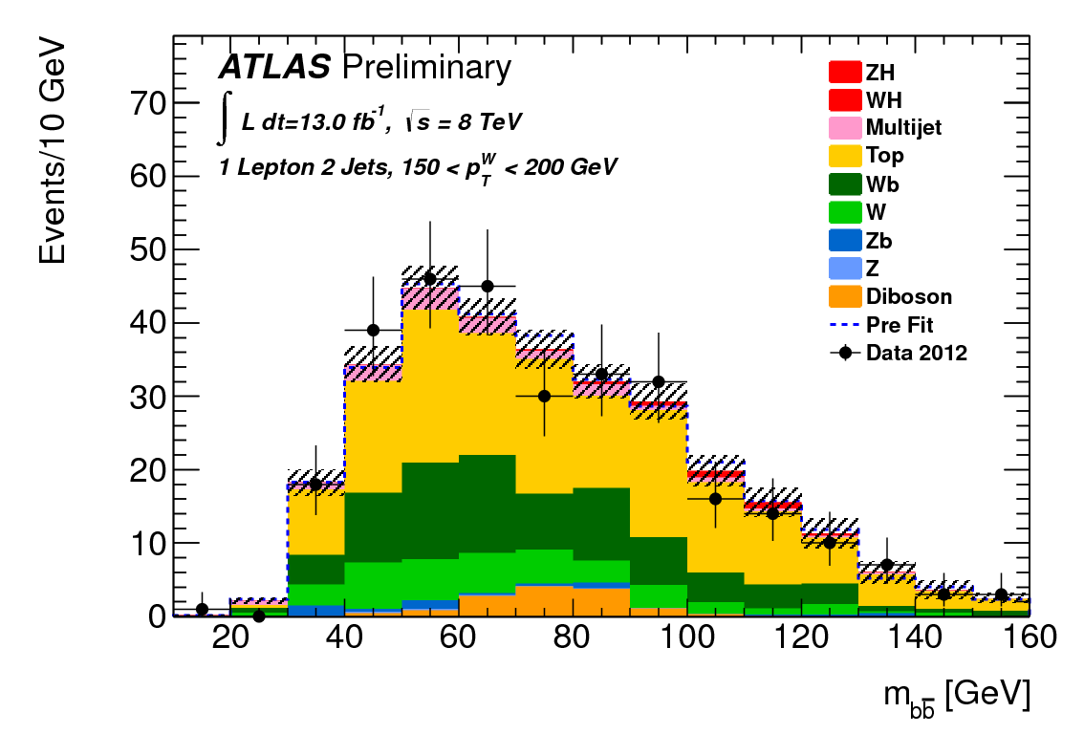
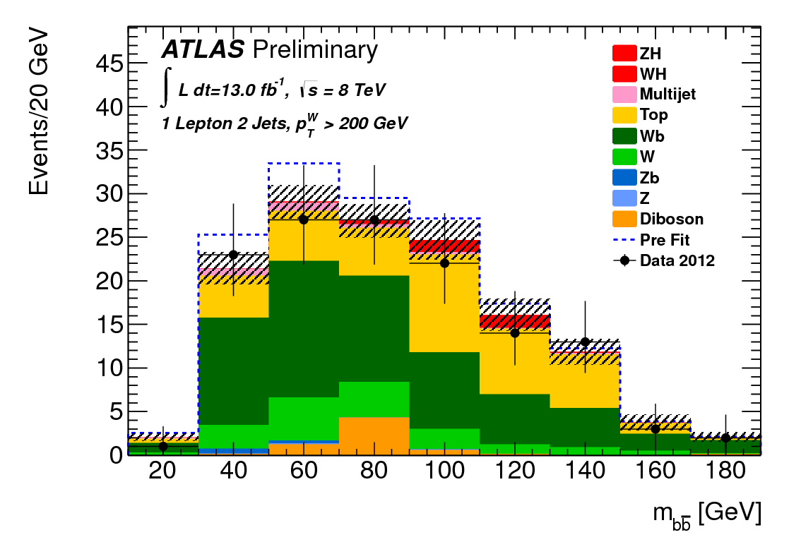
M_{bb} distribution (1-lepton, 8TeV)
p_{T}^{W} < 50 GeV
50 < p_{T}^{W} < 100 GeV
100 < p_{T}^{W} < 150 GeV
150 < p_{T}^{W} < 200 GeV
p_{T}^{W} > 200 GeV

Slide 15
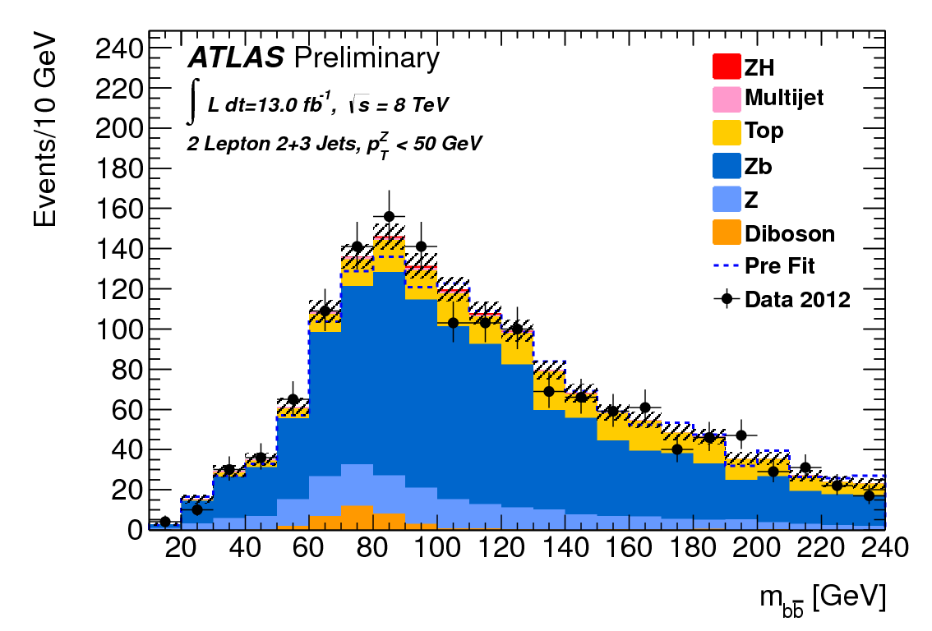
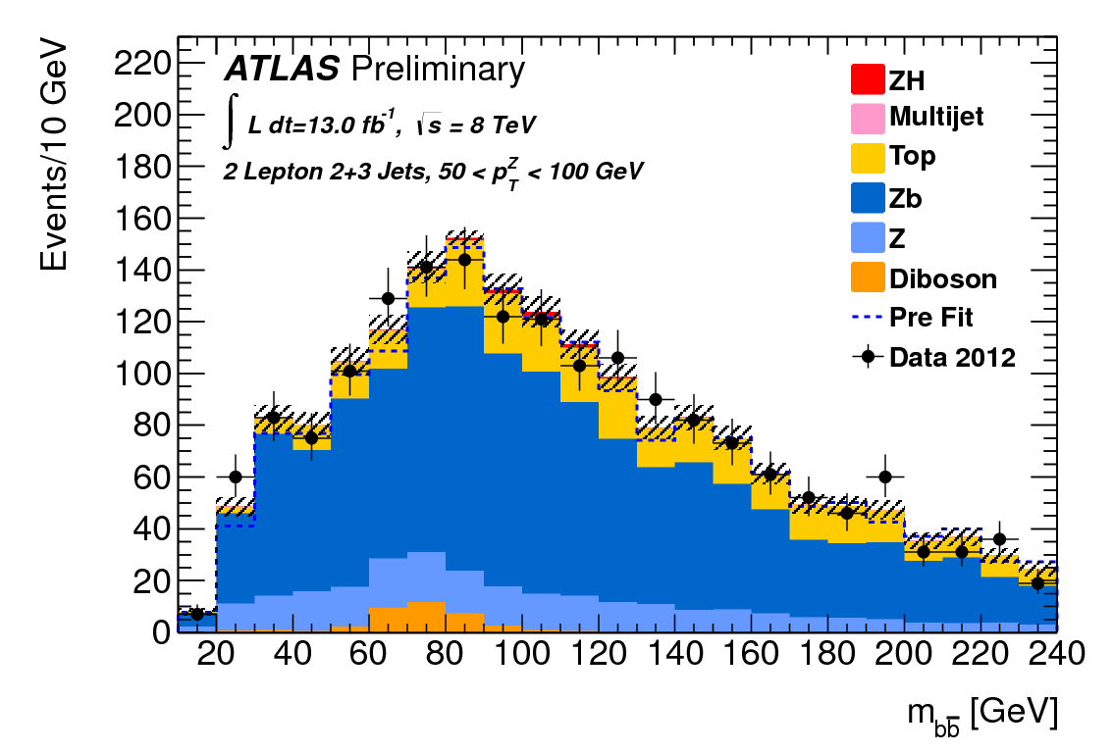
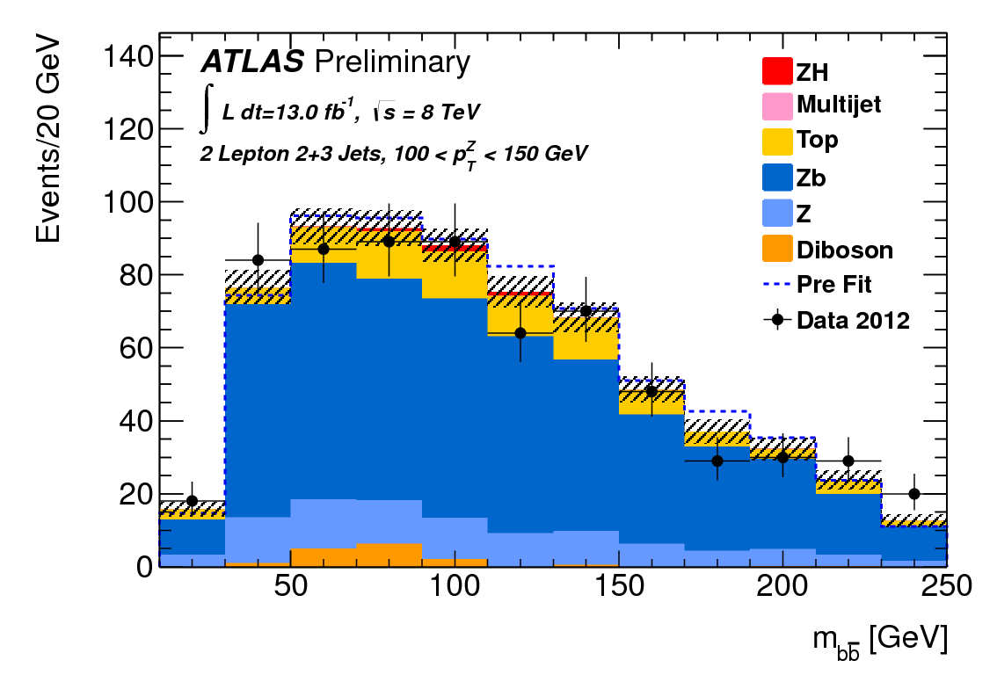
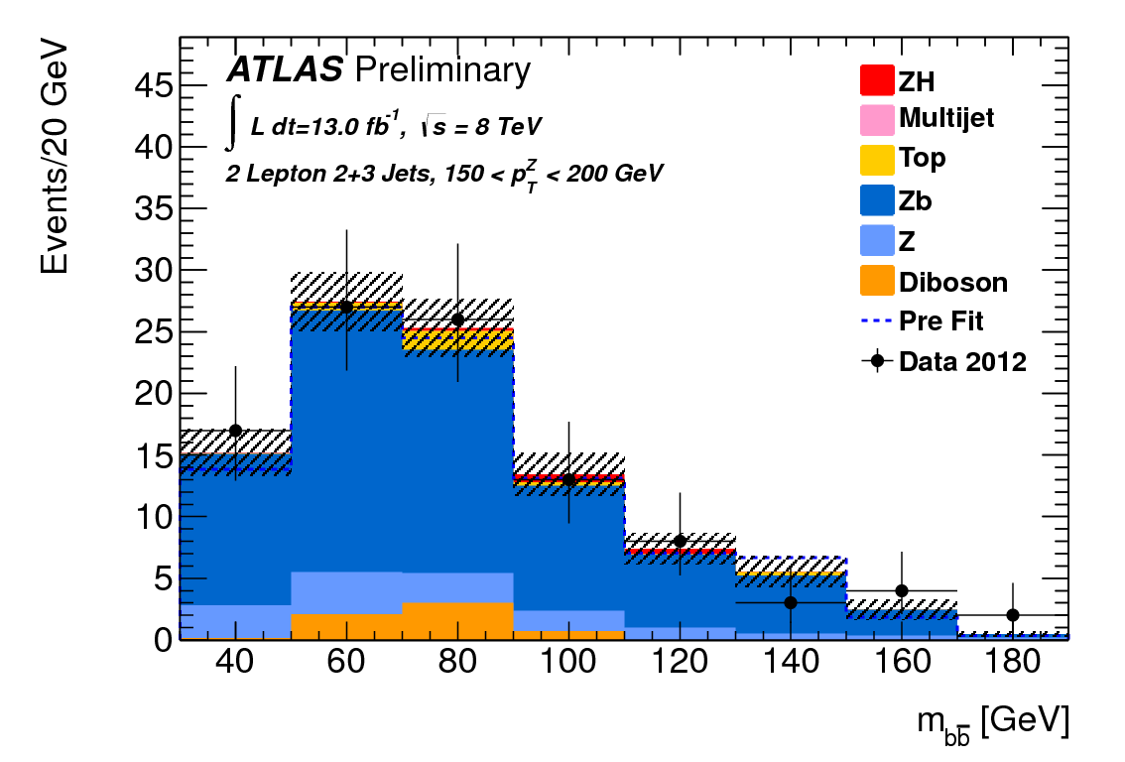
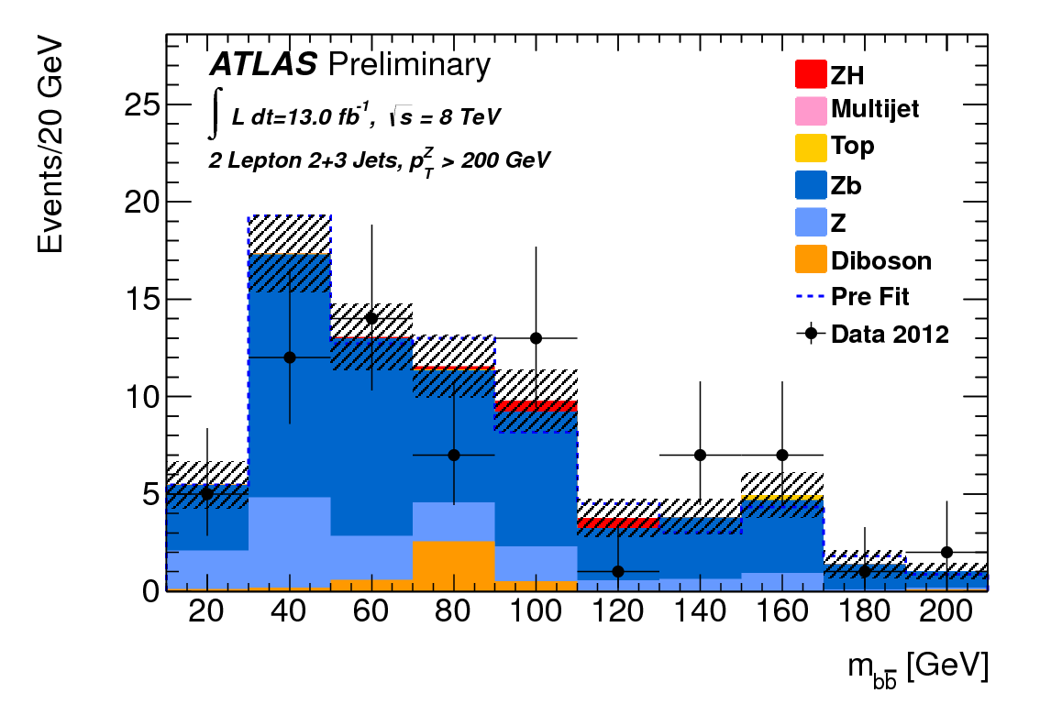
M_{bb} distribution (2-lepton, 8TeV)
p_{T}^{Z} < 50 GeV
50 < p_{T}^{Z} < 100 GeV
100 < p_{T}^{Z} < 150 GeV
150 < p_{T}^{Z} < 200 GeV
p_{T}^{Z} > 200 GeV

Slide 16
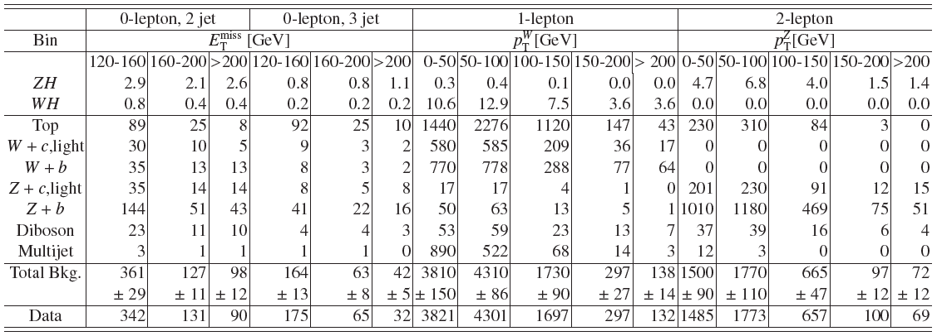
Results: Exp. S+B & Obs. events
8TeV analysis:

Slide 17
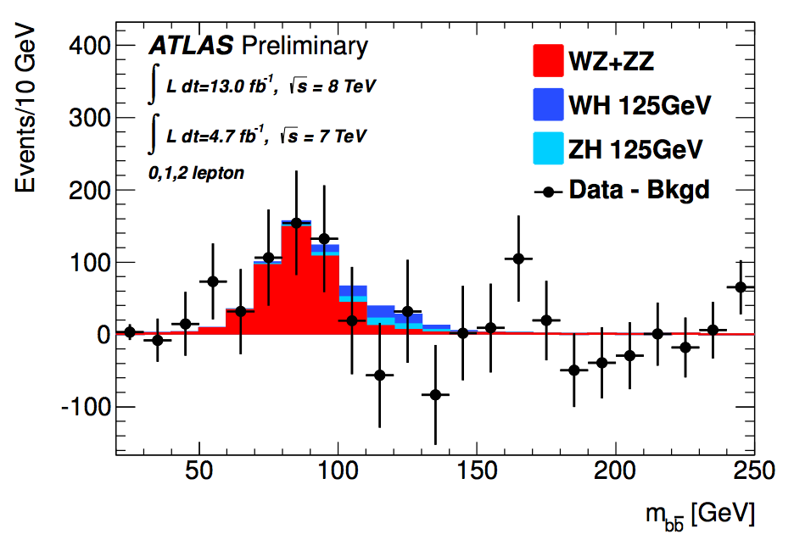
Diboson production
WZ & ZZ production with Z→bb
  Similar signature, but 5 times larger cross-section
Perform a separate fit for this to validate the analysis procedure
  Profile likelihood fit performed (with systematics)
  All bkgs (except diboson) subtracted
Clear excess is observed in data at the expected mass
0,1 and 2- lepton channels combined
2011 & 2012 data combined
Full systematics are applied
Results
  σ/σ_{SM} = μ_{D}= 1.05 ± 0.32
  Significance = 4.0 σ
In agreement with Standard Model
For the Higgs analysis the diboson contribution is fixed to its SM expectation in the likelihood profile, with an uncertainty of 11%

Slide 18
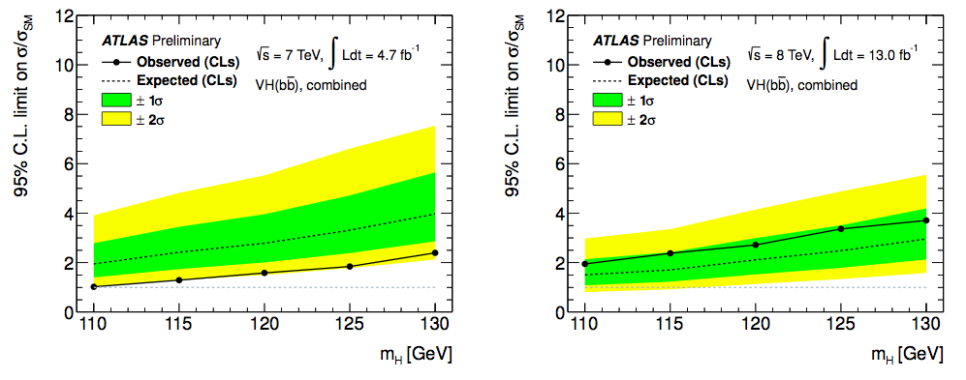
CL_{S} limit results
2011
2012
Observed & expected CL_{S} limit on normalised signal strength as function of Higgs Boson mass (0,1,2 lepton combined)
Observed (expected) values at m_{H} =125 GeV
  Limits 1.8 (3.3) & 3.4 (2.5) times the Standard Model
  p₀ values: 0.97 (0.26) & 0.17 (0.20)
  σ/σ_{SM}: μ = −2.7 ± 1.1(stat.) ± 1.1(syst.) & μ = 1.0 ± 0.9(stat.) ± 1.1(syst.)

Slide 19
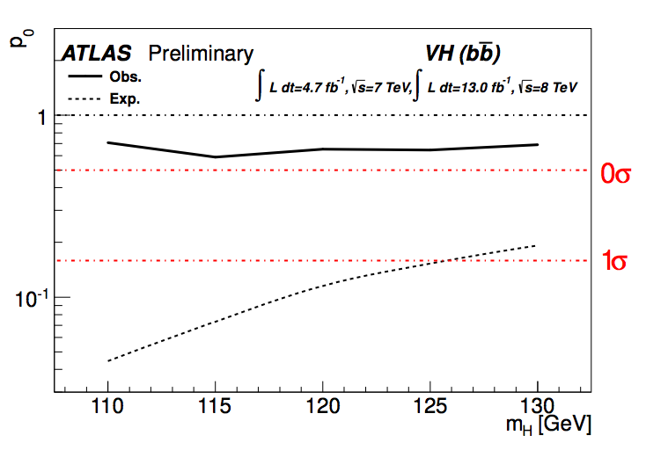
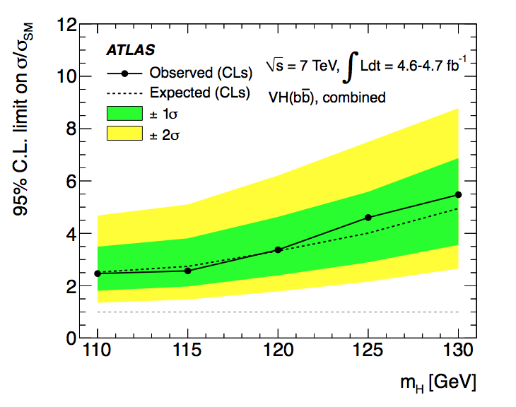
Combined (2011 & 2012) result
Previous publication
Observed (expected) limit at m_{H} =125 GeV
  1.8 (1.9) x SM prediction
Observed (expected) p₀ value 0.64 (0.15)
σ/σ_{SM} = μ = −0.4 ± 0.7(stat.) ± 0.8(syst.)
Exclusion at m_{H} ~ 110 GeV
More than doubled the analysis sensitivity ➠

Slide 20
ttH analysis of
7 TeV data

Slide 21

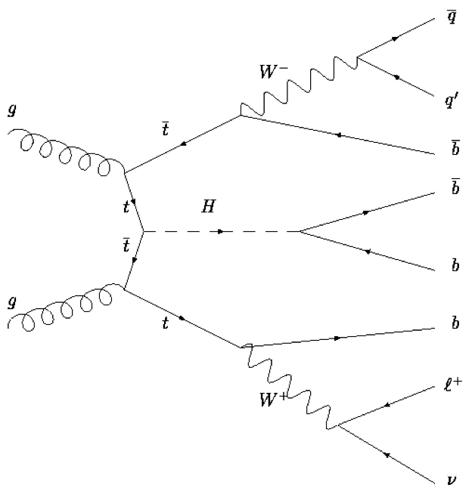
ttH, H->bb analysis
A yes we can! channel
  ATLAS-CONF-2012-135: https://cdsweb.cern.ch/record/1478423
Data: 4.7fb⁻¹ at √s = 7 TeV (2011)
9 categories based on jet & b-tag multiplicity
  Signal enriched (5 jets, ≥6 jets) x (3,≥4 b-tag)
  Other are background enriched
Final discriminants
  m_{bb} for ≥6 jets and (≥3 b-tag) samples
  H_{t}^{had} (∑p_{T,jet}) for other samples
To check fit control regions are used
2 light jets (mostly)
Up to 4 b-tags
 | 0 b-tags | 1 b-tag | 2 b-tags | 3 b-tags | ≥4 b-tags
4 jets | H_{T}^{had} | H_{T}^{had} | H_{T}^{had}
5 jets | H_{T}^{had} | H_{T}^{had} | H_{T}^{had} | H_{T}^{had} | H_{T}^{had}
≥6 jets | H_{T}^{had} | H_{T}^{had} | H_{T}^{had} | m_{bb} | m_{bb}
e or μ, E_{T}^{miss} , M_{T}^{W}
Signal
Background
Control regions

Slide 22
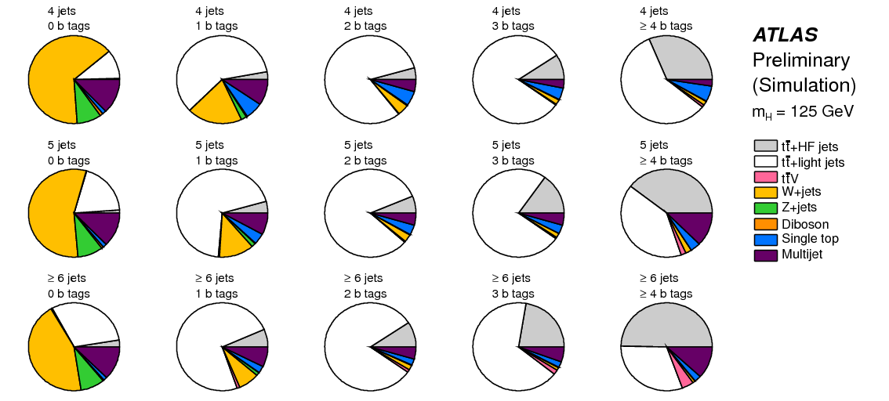
ATLAS Analysis

Slide 23
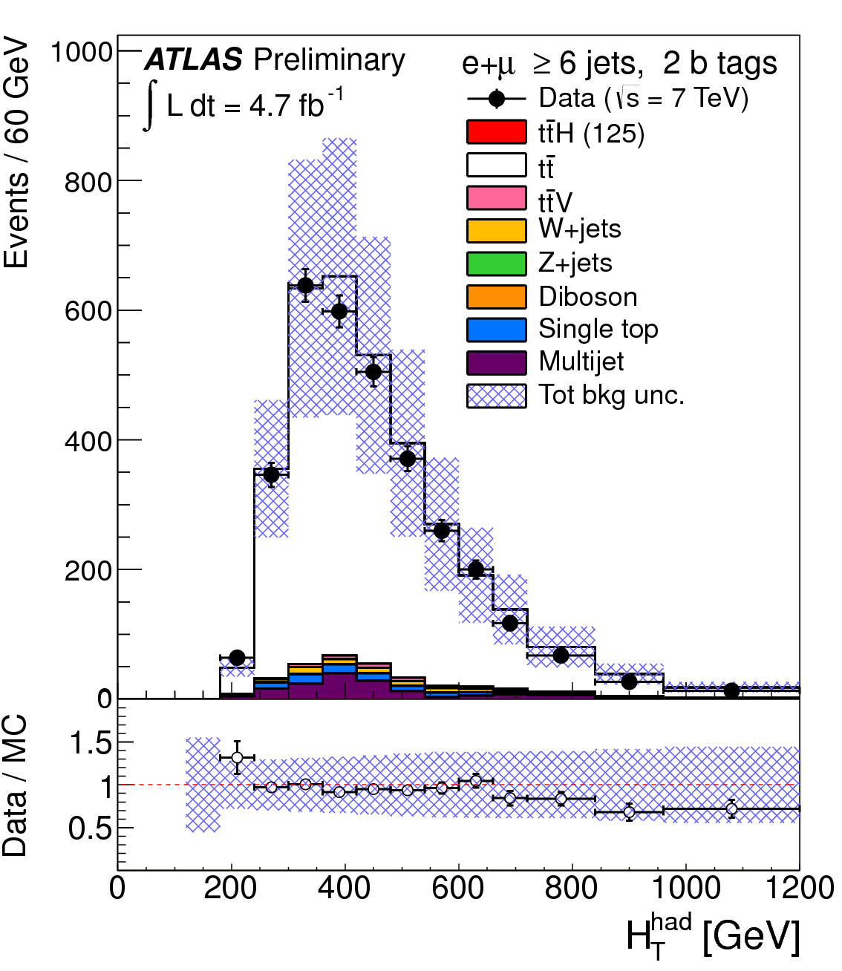
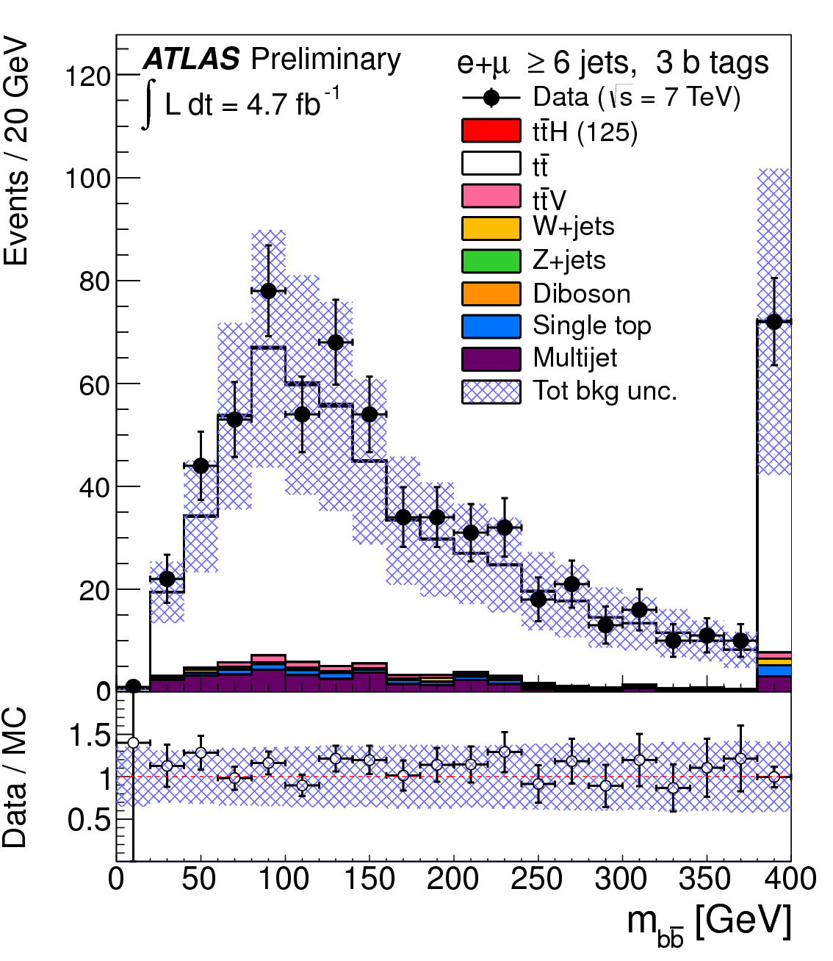
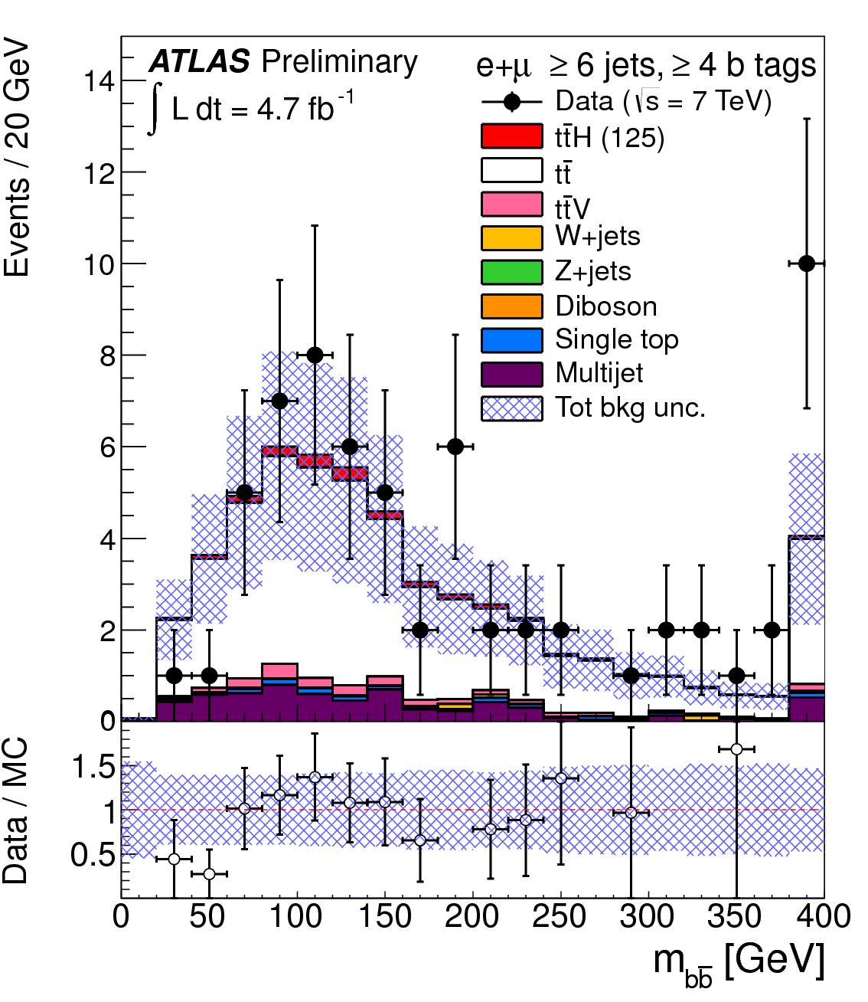
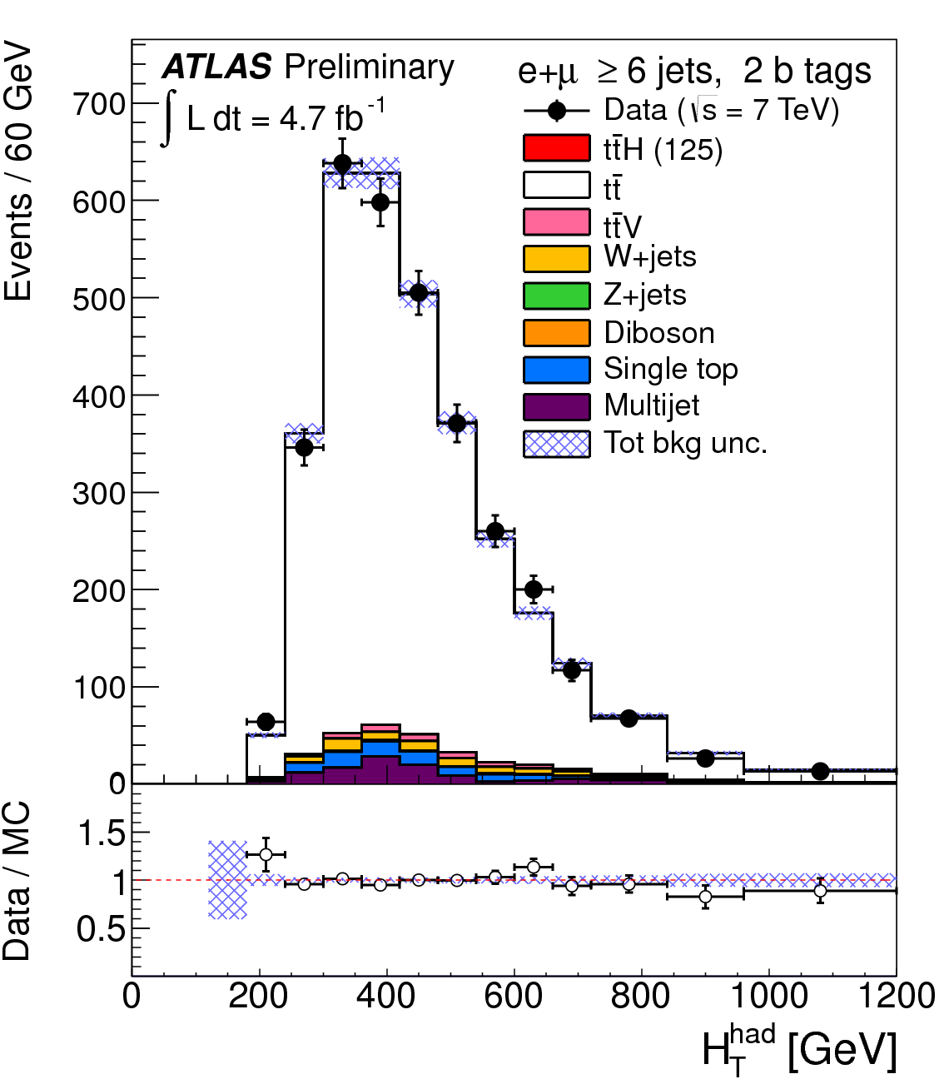
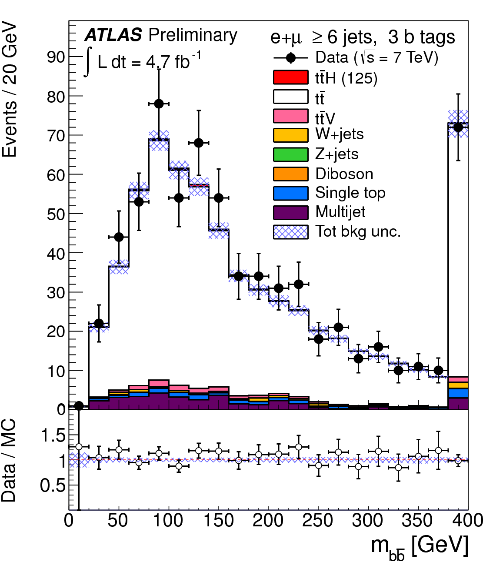
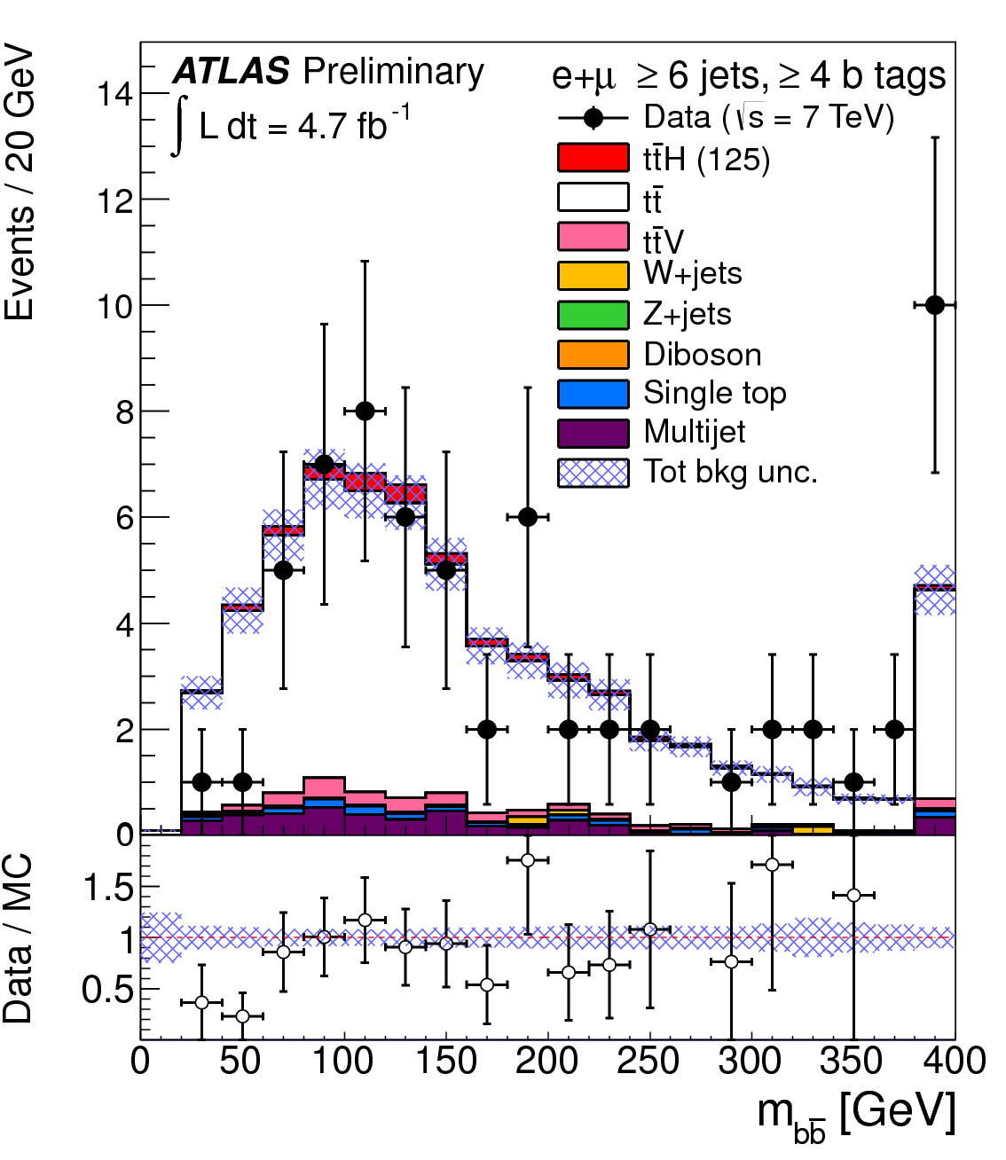
Pre-fit
Post-fit

Slide 24
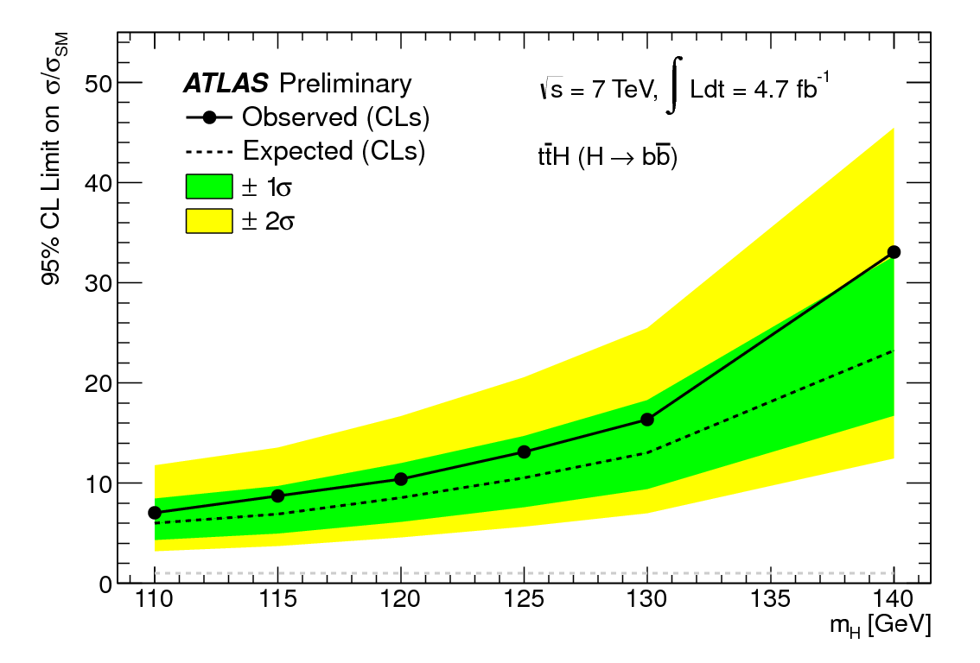
ATLAS ttH, H->bb Analysis
Very challenging analysis!
  High combinatorial background, small signal cross section
  Difficult to describe backgrounds appropriately – data-driven constraints on background normalization and shape
  Important for the measurement of top Yukawa couplings!
First ATLAS results: ATLAS-CONF-2012-135 (September 2012): https://cdsweb.cern.ch/record/1478423
m_{H} (GeV) | Obs | Exp | Stat
110 | 7.0 | 6.0 | 3.5
115 | 8.7 | 6.9 | 4.0
120 | 10.4 | 8.5 | 4.9
125 | 13.1 | 10.5 | 6.1
130 | 16.4 | 13.0 | 7.8
140 | 33.0 | 23.2 | 14.2

Slide 25
Conclusions
First combined 2011 & 2012 VH analysis in H->bb channel
  Using 4.7fb⁻¹ (2011) and 13fb⁻¹ (2012) data
  Significant improvements to all aspects of the analysis
  Excellent data/MC agreement across all channels/control regions
  Observed (exp.) limits are 1.8 (1.9) x SM at m_{H} = 125
  Individual limits for 2011 & 2012: 1.8 (3.3) 3.4 (2.5) at m_{H} = 125
Large improvement in sensitivity, previous results were 4.6 (4.0)
Clear di-boson signal measured
  μ_{Diboson} = 1.05 ± 0.32
  Significance = 3.9σ
Further plans
  To simultaneously fit control regions
  for W+light and W+c
  Update ttH with 2012 data for Moriond
No observation and no surprises… but watch this space!

Slide 26

Bonus slides

Slide 27
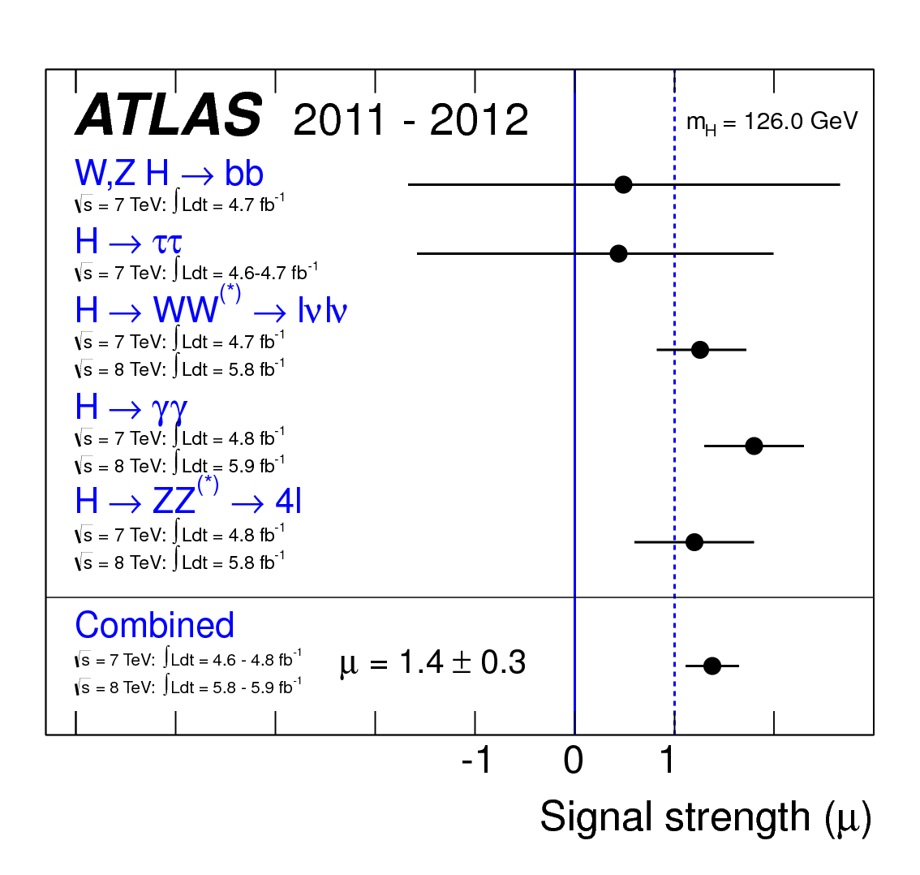
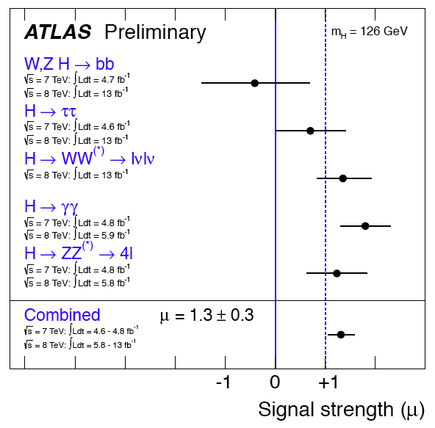

Slide 28
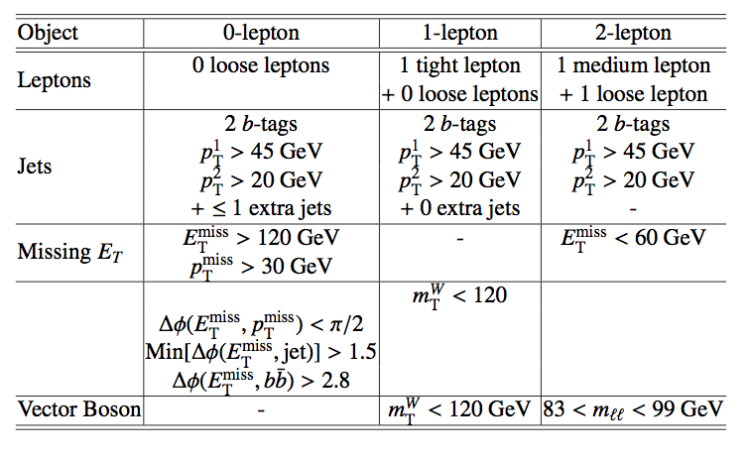
Selection cuts

Slide 29

Further topological cuts
Specific cuts for 0, 1 & 2-lepton channels in p_{T}^{W} / p_{T}^{Z} intervals

Slide 30


QCD/multi-jet modelling
0 lepton
  Use ABCD method
  Regions defined by relative directions of MET/jets/pTmiss
  Found to be small (~1%)
1 lepton
  MET template by reverse isolation cuts
  Normalised by fitting each WpT bin
  Electroweak contamination removed from template
2 lepton
  Template: reverse isolation/quality selection
  Found to be small (<1%)
ABCD method
Use lack of correlation
Δϕ (Etmiss,pTmiss) vs
Δϕ (Etmiss,jets)
for multi-jet background estimation in signal region

Slide 31

B-tagging

Slide 32

Mbb distributions (0-lep, 7TeV)

Slide 33

Mbb distributions (1-lep, 7TeV)

Slide 34

Mbb distributions (2-l, 7TeV)

Slide 35
V+light & V+c flavour fit
0 lepton
1 lepton
2 lepton
0 b-tag
0 b-tag
0 b-tag
1 b-tag
1 b-tag
1 b-tag

Slide 36


Flavour fit results (2-lepton)
0 b-tag
1 b-tag
top ctrl
2 b-tags

Slide 37
Background estimation
Most background shapes are taken from simulation and normalised using data control regions
Multi-jet background determined entirely from data-driven techniques
WZ(bb) & ZZ(bb) resonant bkg normalisation and shape from simulation
Main control regions
Z + jets: Pre-tag and 1 b-tag
W + jets: Pre-tag and 1 b-tag
Top:
0 & 1 lepton channel: + 1jet
2-lepton channel: veto(83< m_{ll}< 99)
  MET > 60)
Dominant backgrounds
Z + jets
2-lepton
channel
0-lepton
W + jets
1-lepton
channel
Top
Multi-jet
Small (except for 1-lepton)
Key validation
Diboson
Interesting signal present in all channels
⇒ separate combined search to validate analysis

Slide 38
Samples & Yields for ≥ 6 jets ≥ 4 b’s
Signal: 2.3 events
PYTHIA 6.425, m_{t} = 172.5 GeV. Charged lepton filter: p_{T} > 5, |η| < 5
Backgrounds:
Dominant are tt+jets (16.4 events) and ttbb (26.5 events):
  ALPGEN 2.13+HERWIG 6.520 HFOR overlap removal.
  tt+jets: Npartons = 0−5, σ=73.08pb, K=1.755;
  ttbb : σ = 0.856 pb, K=1.687 (biggest sys.)
Multijets (data-driven): 6.22 events (5.67 e channel; 0.55 μ channel)
ttV: 2.2 events
  Madgraph 4 + PYTHIA 6.425 σ_{ttW}= 0.12pb, σ_{ttZ} = 0.096pb
Single Top: 1.28 events
  s-channel (1.5 pb) and Wt (15.74 pb): MC@NLO 4.01 with HERWIG 6.520 and Jimmy 4.31.
  t-channel (20.92 pb, K=0.866): AcerMC 3.8 with PYTHIA 6.425
W+jets: 0.54 events
  ALPGEN 2.13+HERWIG 6.520: Wbb, Wcc, Wc, Z → ll, W → lν; HFOR overlap removal
  Uses data to normalize and change mix of heavy flavours
Minor backgrounds: 0.2 events
  Dibosons and Z + jets;
  Dibosons: HERWIG 6.520 and JIMMY 4.31; charged lepton filter p_{T} > 10GeV, |η| < 2.8.

Slide 39





CMS
Lepton+jets mode
ATLAS
Very big difference!...

Slide 40
ttH Systematic Uncertainties
tt+heavy-flavour fractions: vary by 50% - theory studies suggest cross section uncertainty is 75% ; should be weighted down by the fraction of this background. Fit puts it at 30%.
tt modeling (Alpgen):
  Qfac: (±2.3%) The factorization scale for the hard scatter is varied by a factor of two up and down relative to the original scale, Q² = Σ_{partons}m²+ p²_{T}
  kTfac: (±9.2%) The renormalisation scale associated with the evaluation of α_{s} at each local vertex in the matrix element calculation is varied by a factor of two up and down relative to the original scale, k_{T} , between two partons.
  Functional form of the factorization scale (iqopt2): (± 13%) Default choice (=1) for dynamic factorization scale, Q² = Σ_{partons}m²+ p²_{T}, changed to Q² = x₁x₂s. This has an order of magnitude larger effect than Qfac.

Slide 41
tt cross section: +9.9 -10.7% using NNLO Hathor.
Jet Energy scale: 16 eigenvectors recommended by the jet/ETmiss group are varied.
b, c and light tagging: 9 (btag),5(ctag) eigenvectors recommended by b-tagging group are varied for heavy flavours and the one value for light flavours.
QCD Multijets: Mostly in the electron channel. Correlated 50% uncertainty plus uncorrelated statistical estimate in each channel (66% in 6 jet 4 b-tag)
ttH parton shower modelling: 1-5% effect at mH = 120 GeV

Slide 42

ATLAS/CMS differences
Systematics:
No QCD systematics (no QCD background?!)
No ttH modeling
No W+jets/HF systematic
No JVF systematic (pileup suppression)
Different treatment of Jet Energy Scale (ATLAS 16 NP), b-tag sys. (ATLAS 9 NP) and c-tag sys (ATLAS 5 NP): CMS one Nuis. Par.
b and c tagging correlated
One tt systematic uncertainty (ATLAS 3 NP)
ttbar+HF 20% instead of 50% uncertainty
Cuts:
Electrons and muon:
  ATLAS p_{T}>20/25GeV
  CMS p_{T} > 30 GeV
Jets:
  ATLAS pT>25GeV
  CMS 3 leading jets pt > 40 GeV (otherwise 30 GeV)
More signal and higher cuts. Not clear what signal sources are used
Summary:
ATLAS using CMS systematics: 35% better
20% improvement from more signal
Remaining improvement from use of Multivariate analysis (22%)
In numbers:
σ/σ_{SM} = 10.5 -> 7.8 from systematics
Take 22% improvement from MVA: -> 6.1
Take 20% additional signal: σ/σ_{SM} -> 5.1 (expect)
CMS: 4.9 (expected)

Slide 43

The ATLAS detector

Slide 44

DIBOSON

Slide 45


