Slide 1
Here is the key to your office. Good luck!
Ricardo Gonçalo (FCTUC/LIP)
CNaPPES.22 – 14 e 15 de Julho 2022
Escola Superior de Enfermagem de Coimbra

Slide 5
This Study
Not a proper study!
Asked a few friends and collaborators from around the world what their experiences had been upon starting
The (biased and non-homogeneous!) sample:
STEM subjects: Physics, Engineering, Biology/Medicine
4 women; 8 men
Ages: between 35 and 52
Teaching experience: from 3 to 10 years
Posts: Assistant (2), Associate (8) and to Full Professor (2)

Slide 6
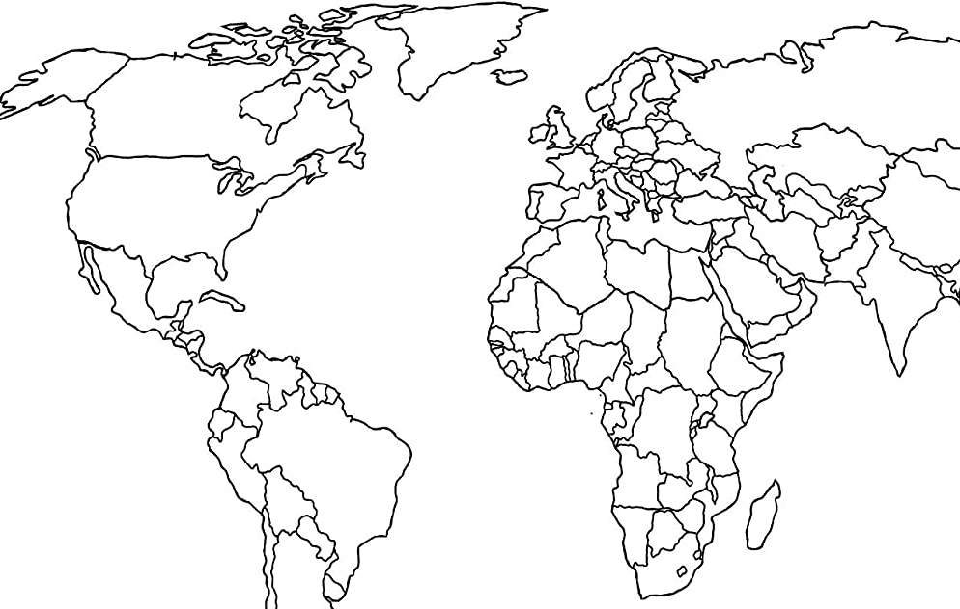
Portugal:
Universidade do Minho
Universidade de Coimbra
Instituto Superior Técnico
Europa:
Uppsala
Copenhaga
Liverpool
Birmingham
Londres
Genebra
Santiago de Compostela
EUA:
Yale
Northern Illinois
New York

Slide 7
The questions
Please give a brief informal description of the training you received as you have started at university
Did you receive any training? And if so:
Was it a formal course?
How long was it?
Any particular focus?
Was it informal or self-taught?
What are the benefits and faults that you perceive in the training you had or action you took?

Slide 8
Overview of responses
Overall 12 responses – interpreted qualitatively
Pedagogical training:
7 formal training (from isolated sessions to year-long course)
2 informal training (support group, self-taught)
3 no training / 1 no interest
Slight correlation (ρ=0.62) with university ranking in THE(2022)*
Mandatory (formal or informal training) in 4 cases – tied to success in probation period
Perceived benefit and problems of training:
Very useful or essential in 8 cases / no interest in 1 case
Department-specific training most useful – 3 mentions
Load should be carefully balanced or tied to reduced teaching time – 3 mentions
More women follow pedagogy training if not mandatory – 1 mention
(*) Times Higher Education 2022 teaching classification

Slide 9
Hopefully useful references:
Richard M. Felder, Rebecca Brent, “Teaching and Learning STEM: A Practical Guide”, Jossey-Bass / John Wiley & Sons, 2016, San Francisco, US
Randall Knight, “Five Easy Lessons : Strategies for Successful Physics Teaching”, Pearson Education, 2003, US
Eric Mazur, “Peer Instruction: A User's Manual”, Pearson Educational Innovation: Instructor Resources for Physics, 1996, US

