Slide 1
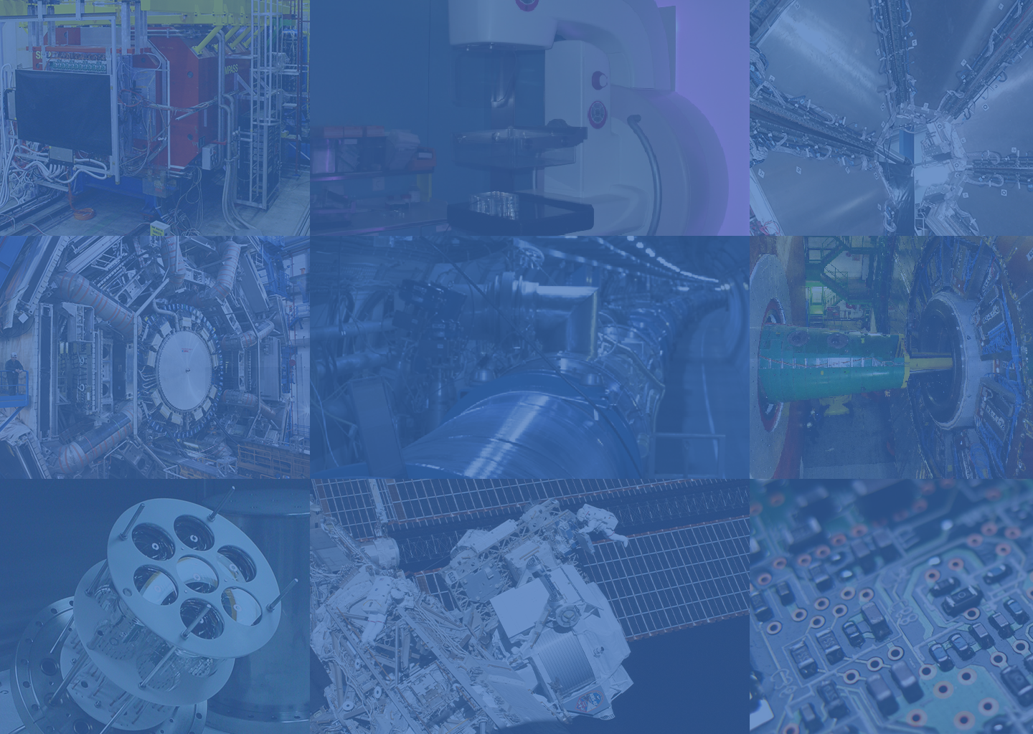
LIP – Laboratory for Instrumentation and Experimental Particle Physics
From Fundamental Physics to the Space Frontier
Ricardo Gonçalo (FCTUC & LIP)

Slide 2
Notes:
Apresentação geral do LIP

Slide 3
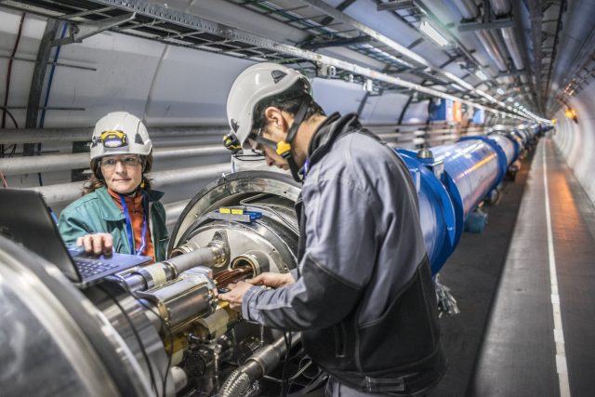
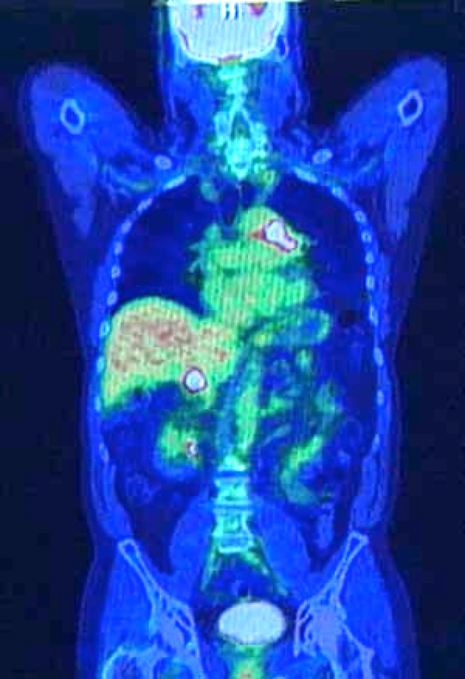
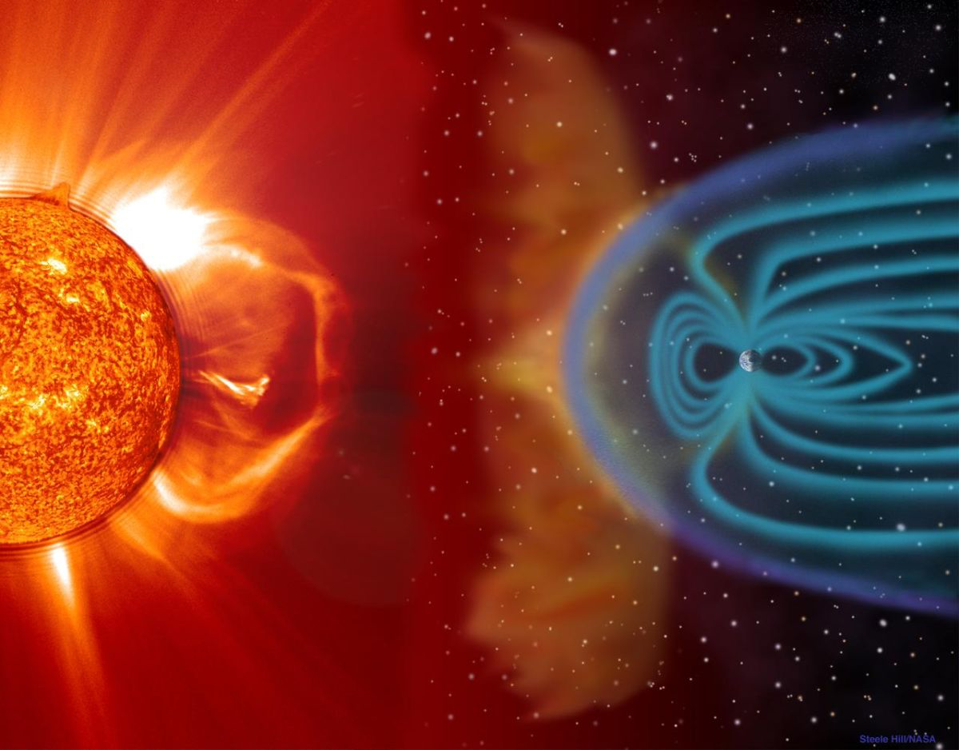
Particle Physics Technologies
Radiation Detetors
Particle Accelerators
Electronics and Instrumentation
Software:
Large-scale data analysis
Large experimental control systems
Detector/radiation simulation

Slide 4
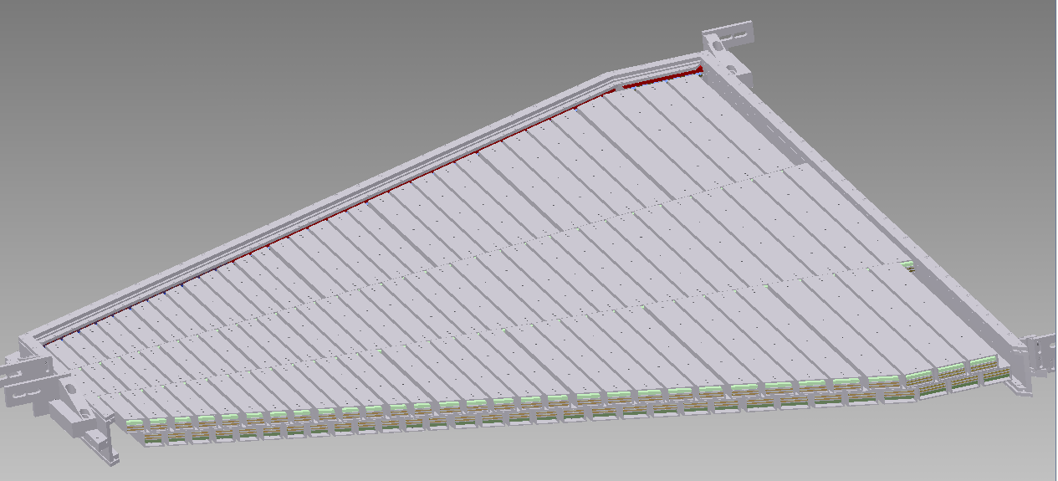
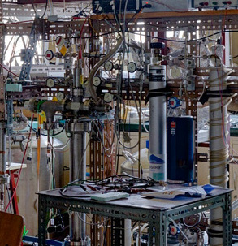
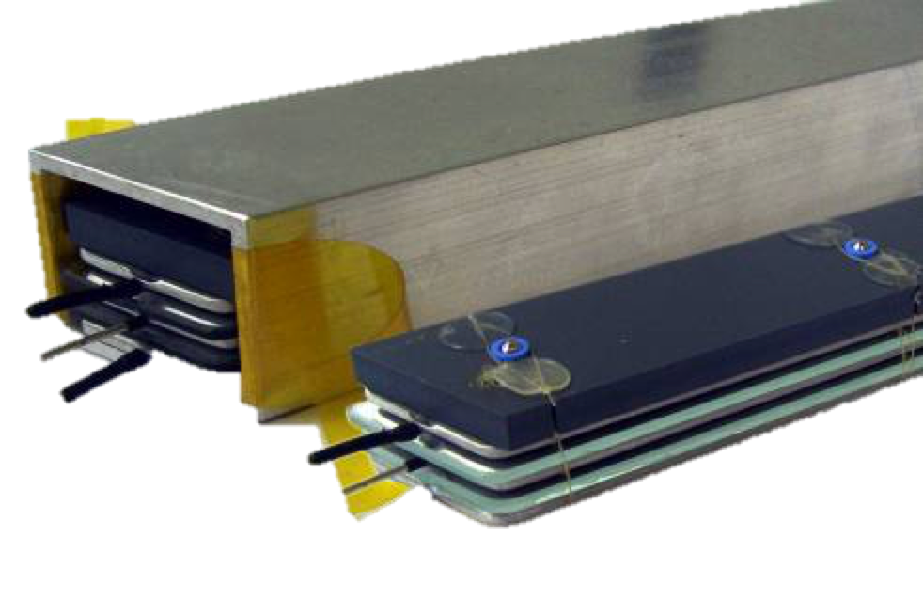
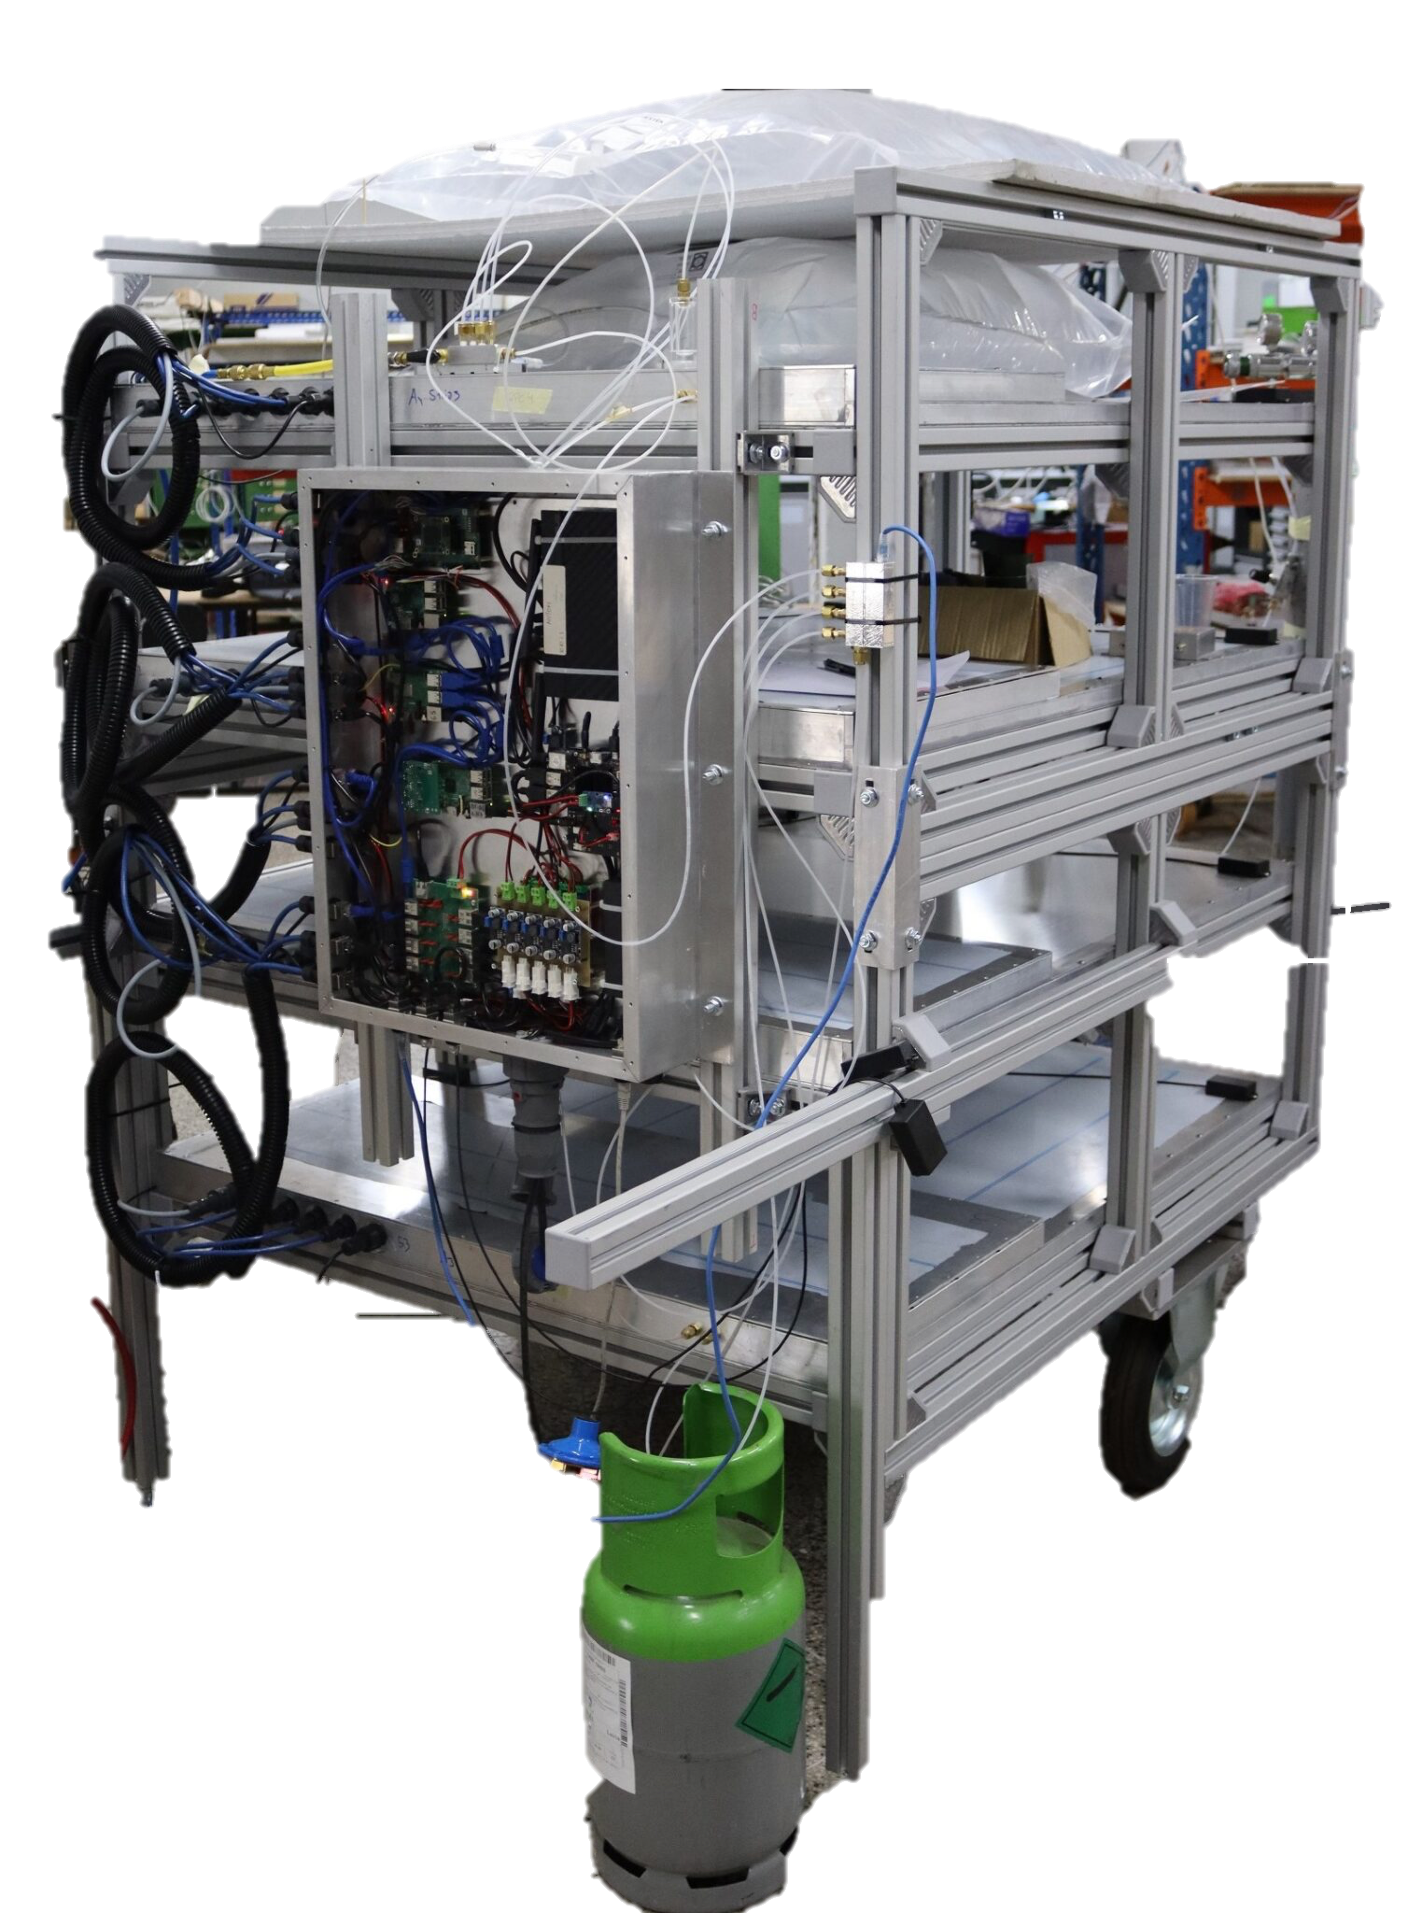
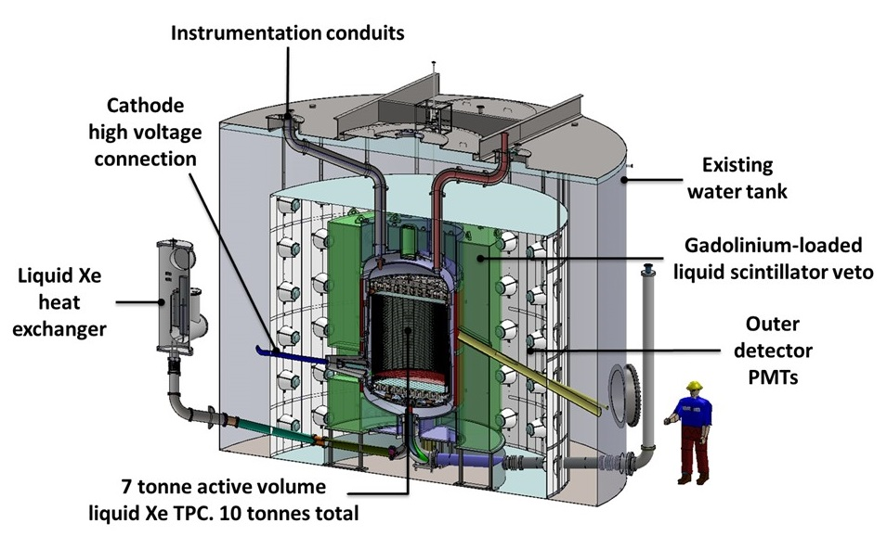
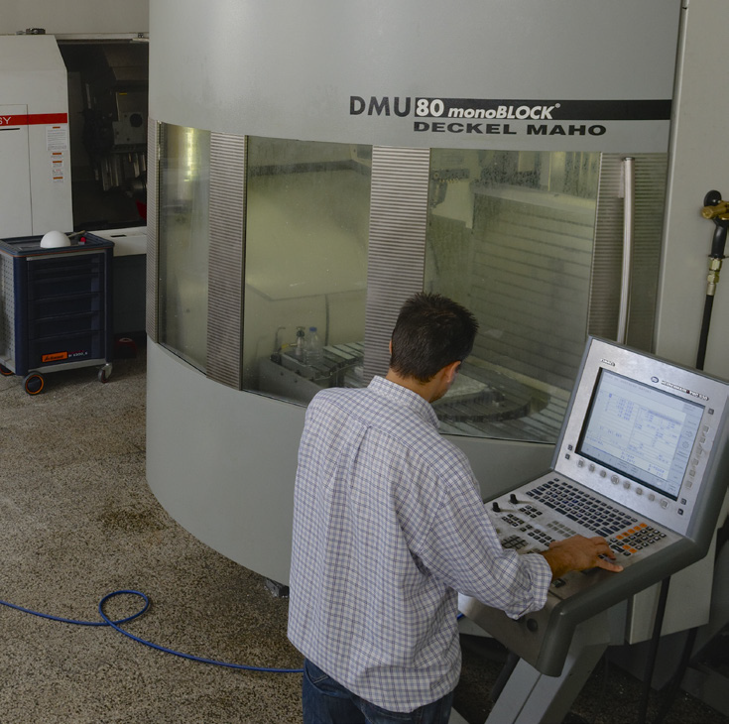
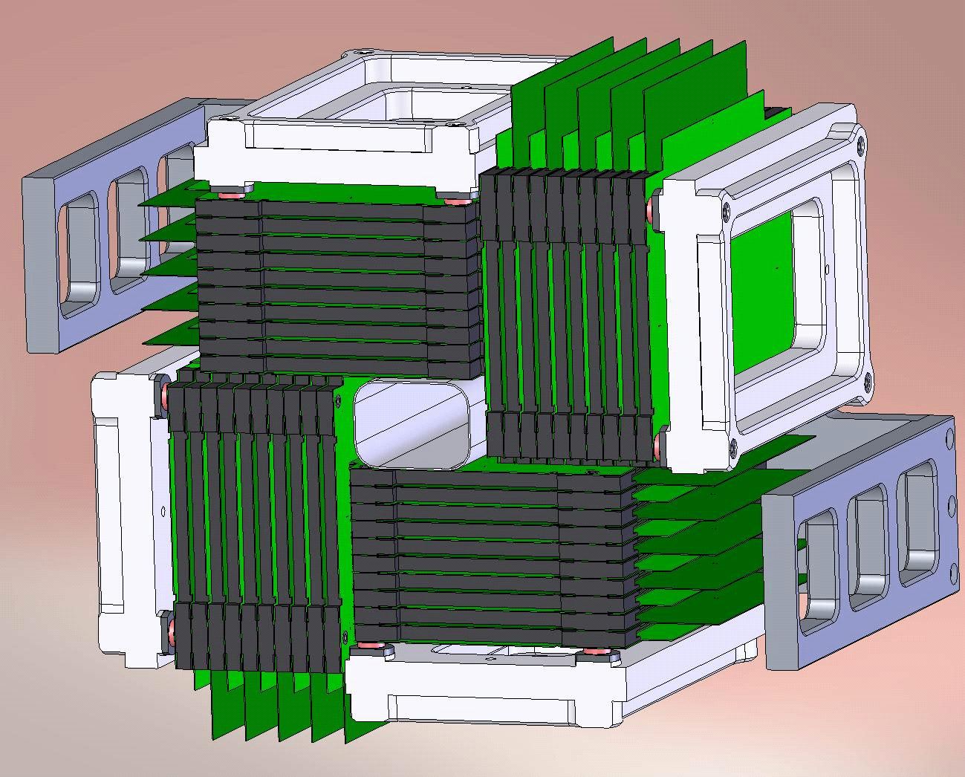
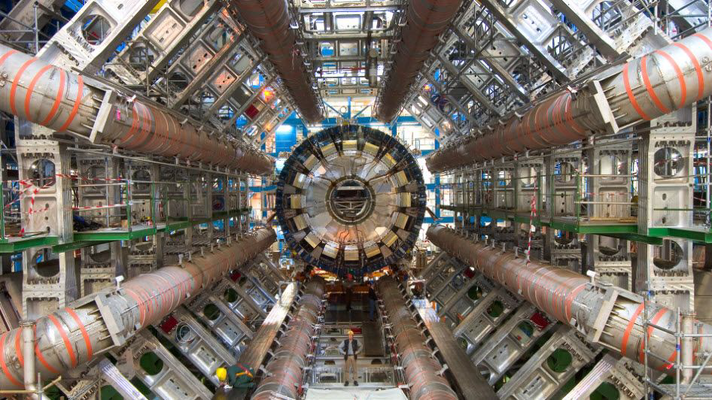
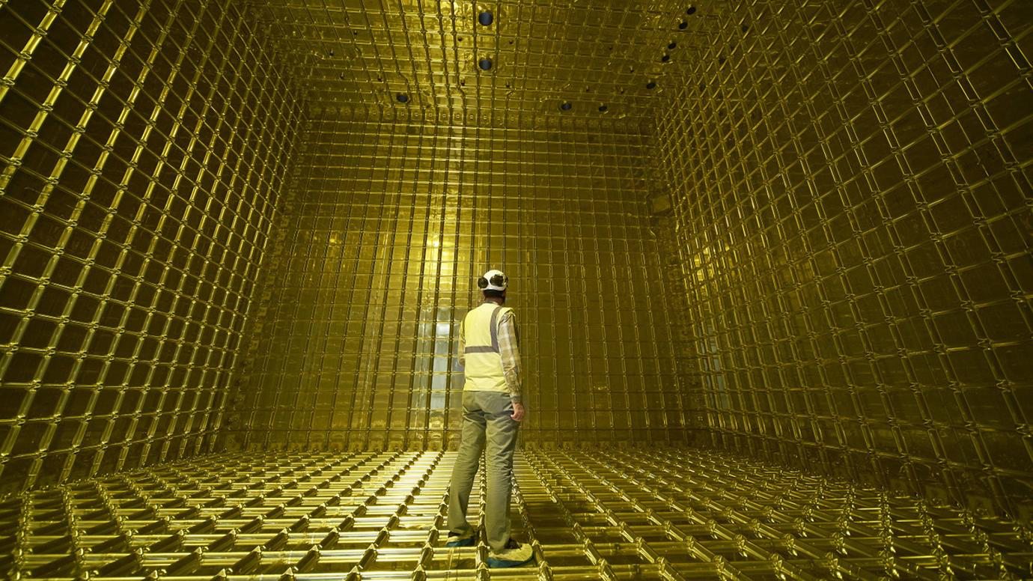
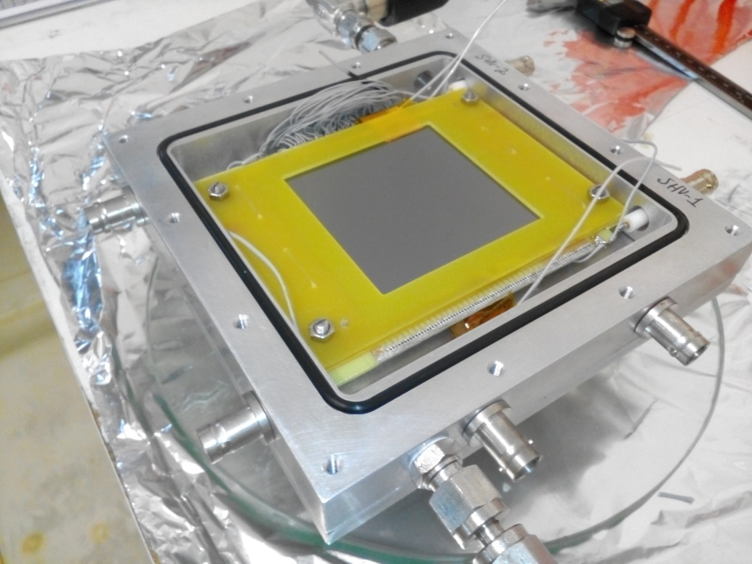
Detector Laboratory
Muons
Radiation Detectors
Automation and control
Dark matter
Space
Neutrinos
Precision mechanical workshop
Thermal Neutrons
Health
CERN
Notes:
Em Coimbra em particular

Slide 5
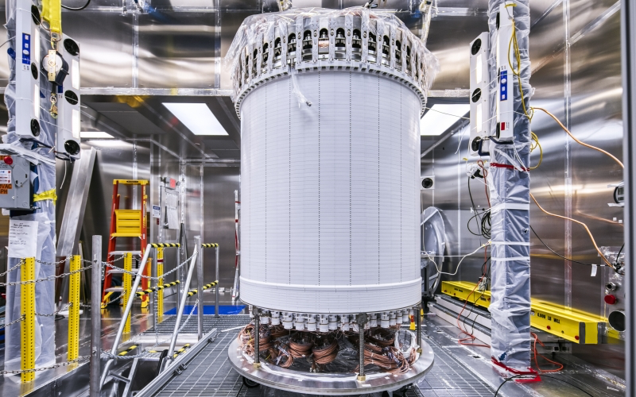
Particle and Astroparticle Physics
LHC (CERN) – ATLAS experiment
Higgs boson, top quark, exotics, etc
Lux and LZ experiments (US):
Dark Matter direct search
DUNE experimente (US):
Next generation neutrino oscillation experiment

Slide 6
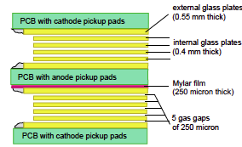
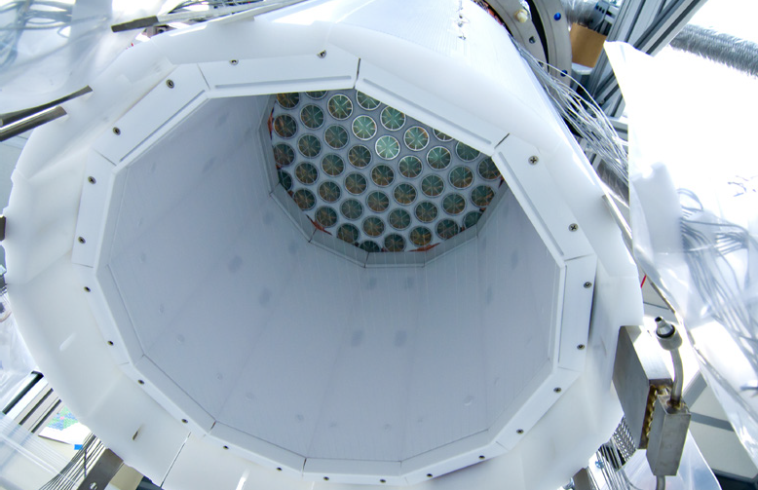
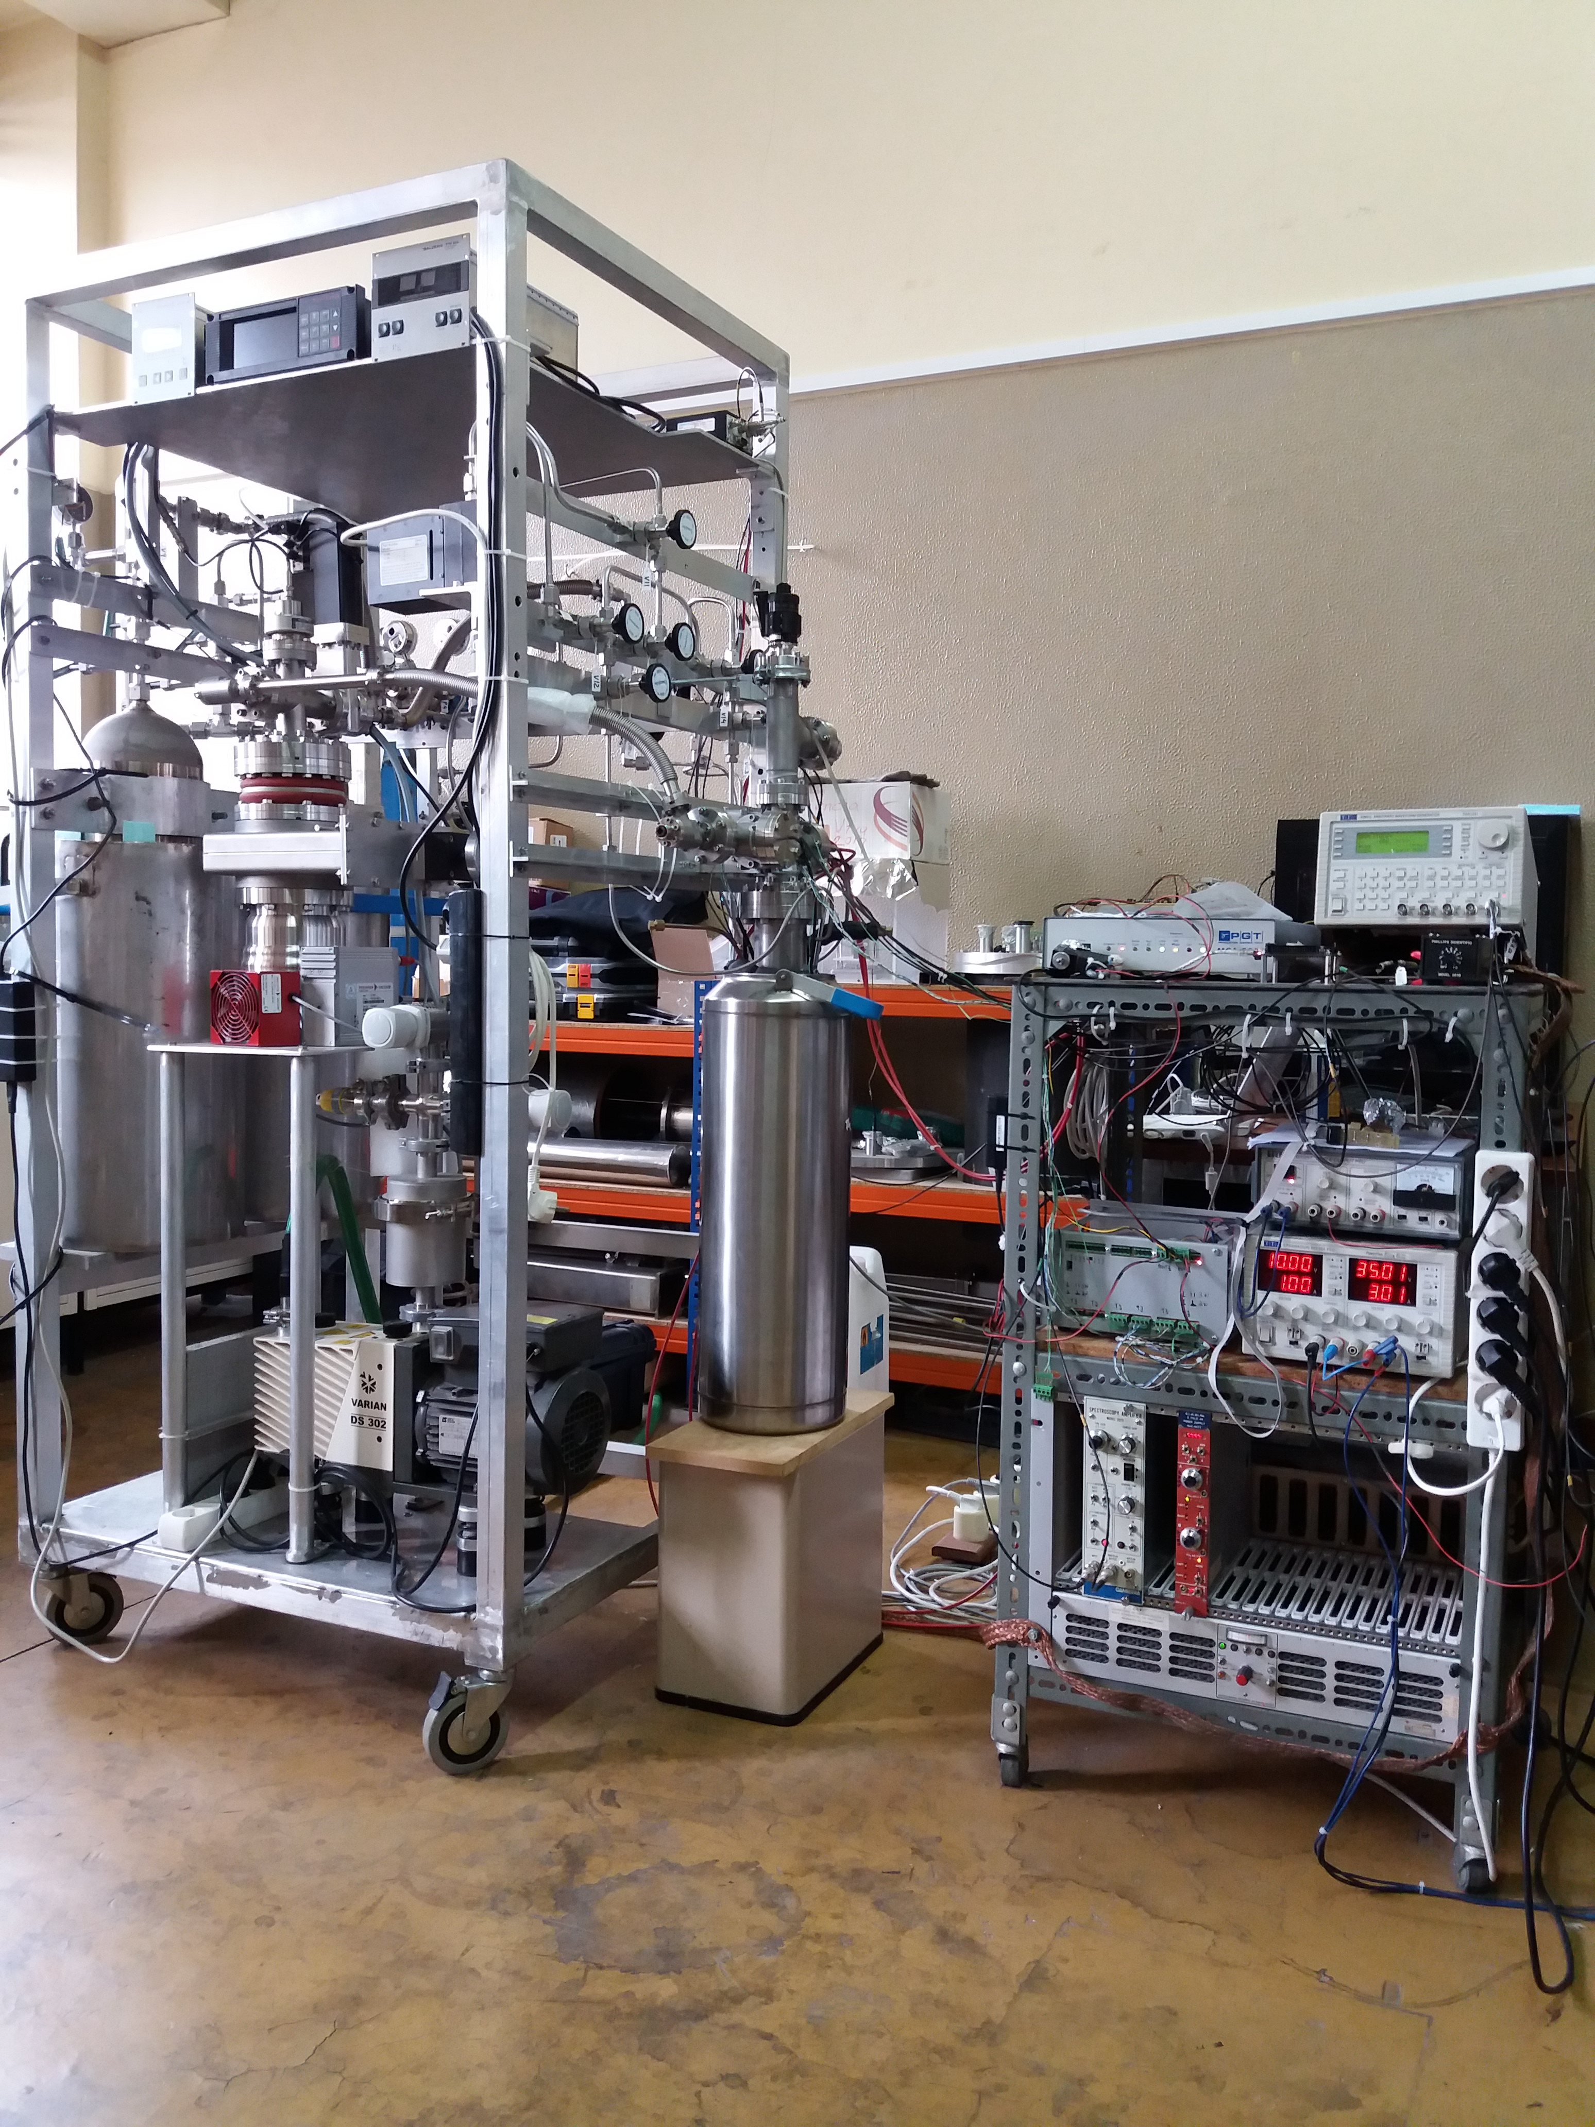
Particle Detector development
Resistive Plate Chambers
Intrinsically fast, excellent spatial resolution
Noble liquid detectors
Neutrino and Dark Matter experiments
Gaseous detectors
Study of electron and ion mobility in gases

Slide 7
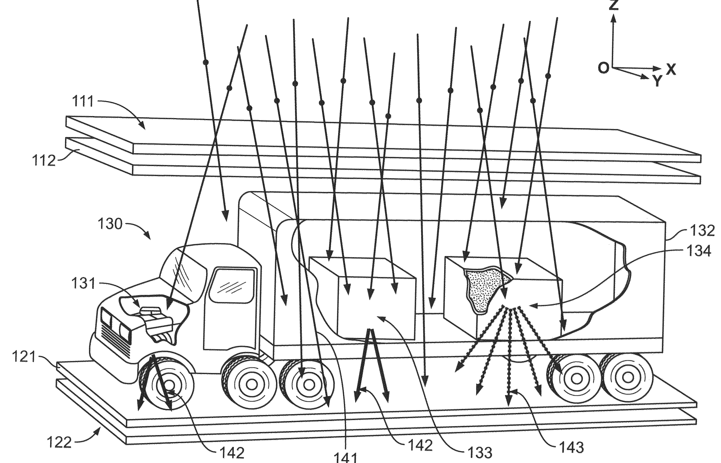
Some Applications
Brain-PET prototype with sub-mm resolution
Under tests in radiation therapy centre (ICNAS)
Radio- and proto-therapy instrumentation
Thermal neutron detectors
European Spallation Source
Muography for National Security
Tecnologia para o Astrofísica e Espaço
CdZnTe sensors for X-ray polarimetry

Slide 8
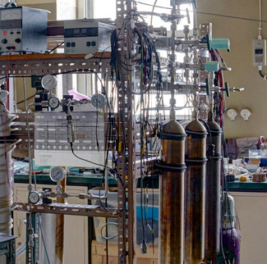
Infrastructures in Coimbra
Detector Development Laboratory:
Design and construction of radiation detetor systems
Monitoring and Control Competence Centre:
Experimental control and safety systems
Precision Mechanical Workshop:
Design and execution of precision mechanics; ideal for prototypes and small series

Slide 9
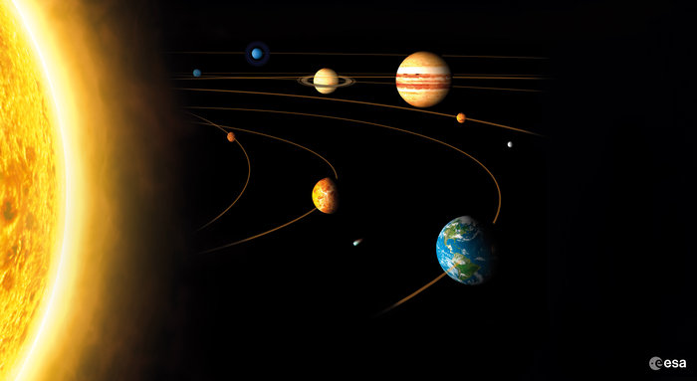
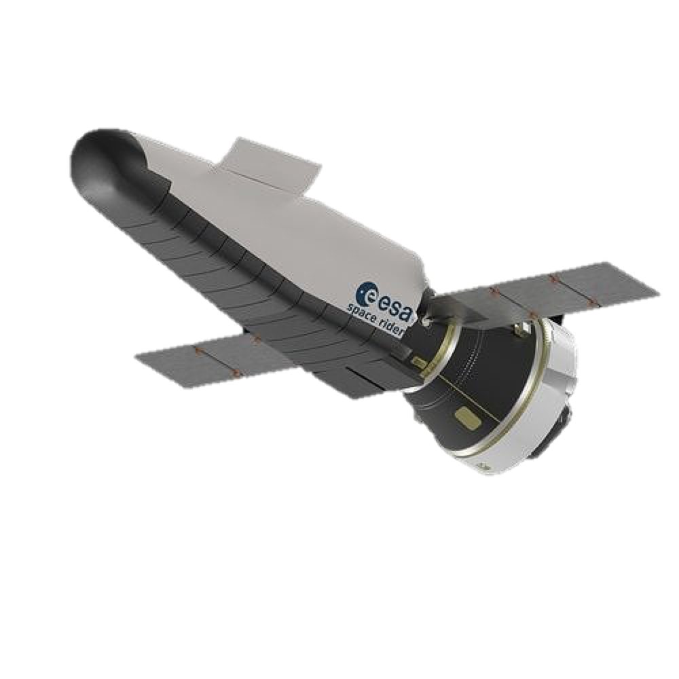
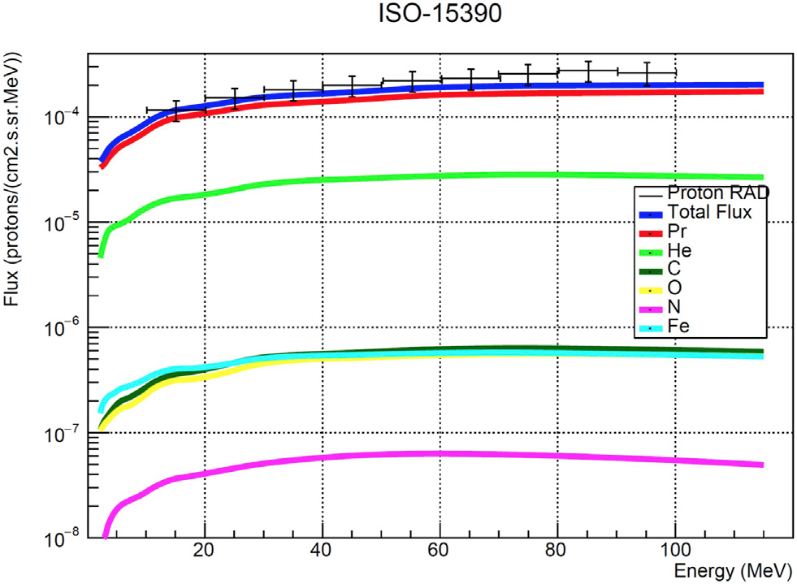
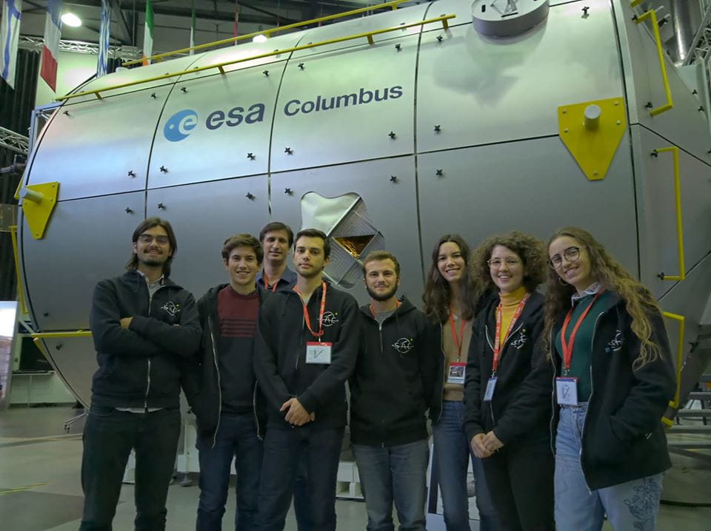
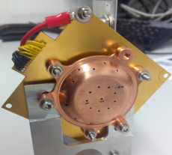
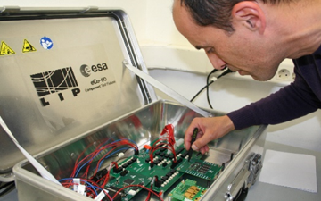
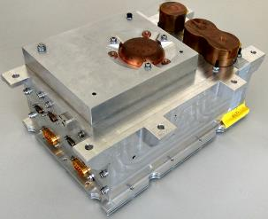
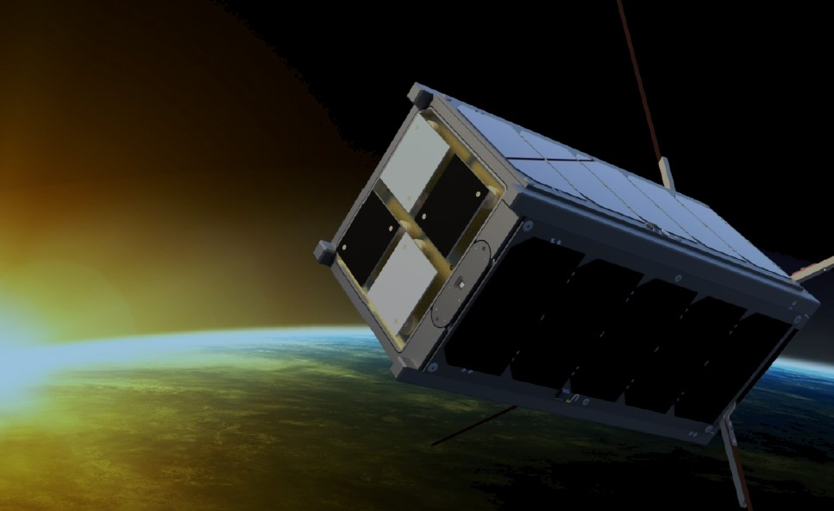
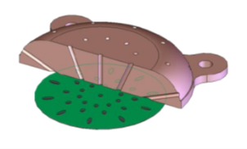
Radiation technology in the space frontier
Missão JUICE (ESA, EFACEC, PSI, IDEAS)
RADEM – Rad. Hard Electron Mon.
EEE component testing for the Jupiter radiation environment
Projeto MarsREM – Mars Energetic Radiation Environment Models (ESA)
Projeto BERM (ESA/JAXA)
Radiation monitor de for Bepi-Colombo mission (Mercury)
Efeitos da radiação espacial:
EEE component testing (Technology Test Bed)
CdZnTe sensor ageing for space (GLOSS, ESA/CNES)
Gamma ray polarimetry, Earth observation:
COMcube (ESA); AMEGO (NASA)
STRATOSPOLCA (ESA)
THOR - Space Rider: Terrestrial Gamma Flashes (Active Space, Advacam, ESA)
Notes:
Expert support for RADEM
GLOSS: Gamma-ray Laue Optics and Solid State detectors (ESA/CNES Euro Ageing Materials)

Slide 10
Partners
ESA
NASA
Active Space
EFACEC
Advacam (Chzechia)
Ideas (Norway)
PSI (Switzerland)
...
http://www.lip.pt/

Slide 11
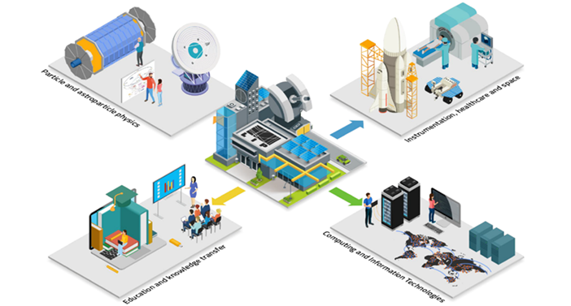
http://www.lip.pt/

