Slide 1






LHC highlights in top and Higgs physics
Ricardo Gonçalo
Laboratório de Instrumentação e Física Experimental de Partículas
BEACH 2018 – Peniche, Portugal

Slide 2

Outlook
...so I’ll show what I like instead ☺
  ATLAS, CMS and the LHC
  Quick word on W mass
  Top physics
  Higgs physics
See also: next talk by Eliza Melo da Costa on Z,H decays to quarkonia

Slide 3
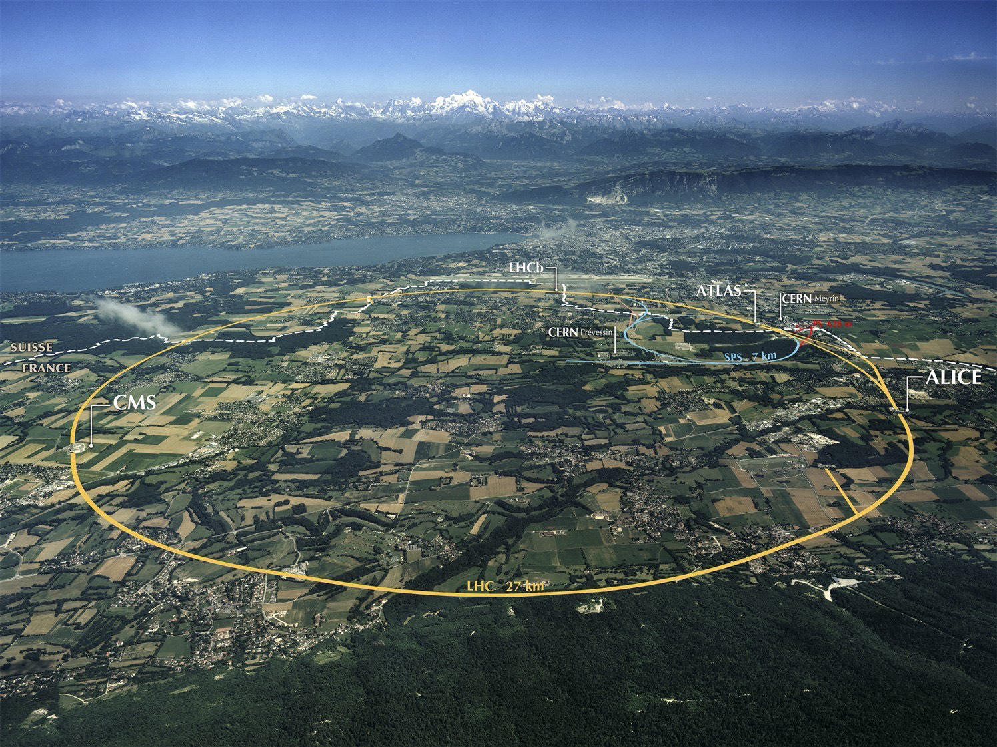
Design (p-p run):
√s = 14 TeV (design)
N_{p} = 1.2 x 10¹¹ p/bunch
2780 bunches
Peak L = 1 x 10³⁴ cm⁻²s⁻¹ (design)
β* = 55 cm
Run 1: 2009 – 2013 √s = 7/8 TeV
Run 2: 2015 – 2018 √s = 13 TeV
Mont Blanc
ATLAS
CMS
Notes:
LHC Running at 2x design luminosity
Expect 150/pb by end of this year

Slide 4
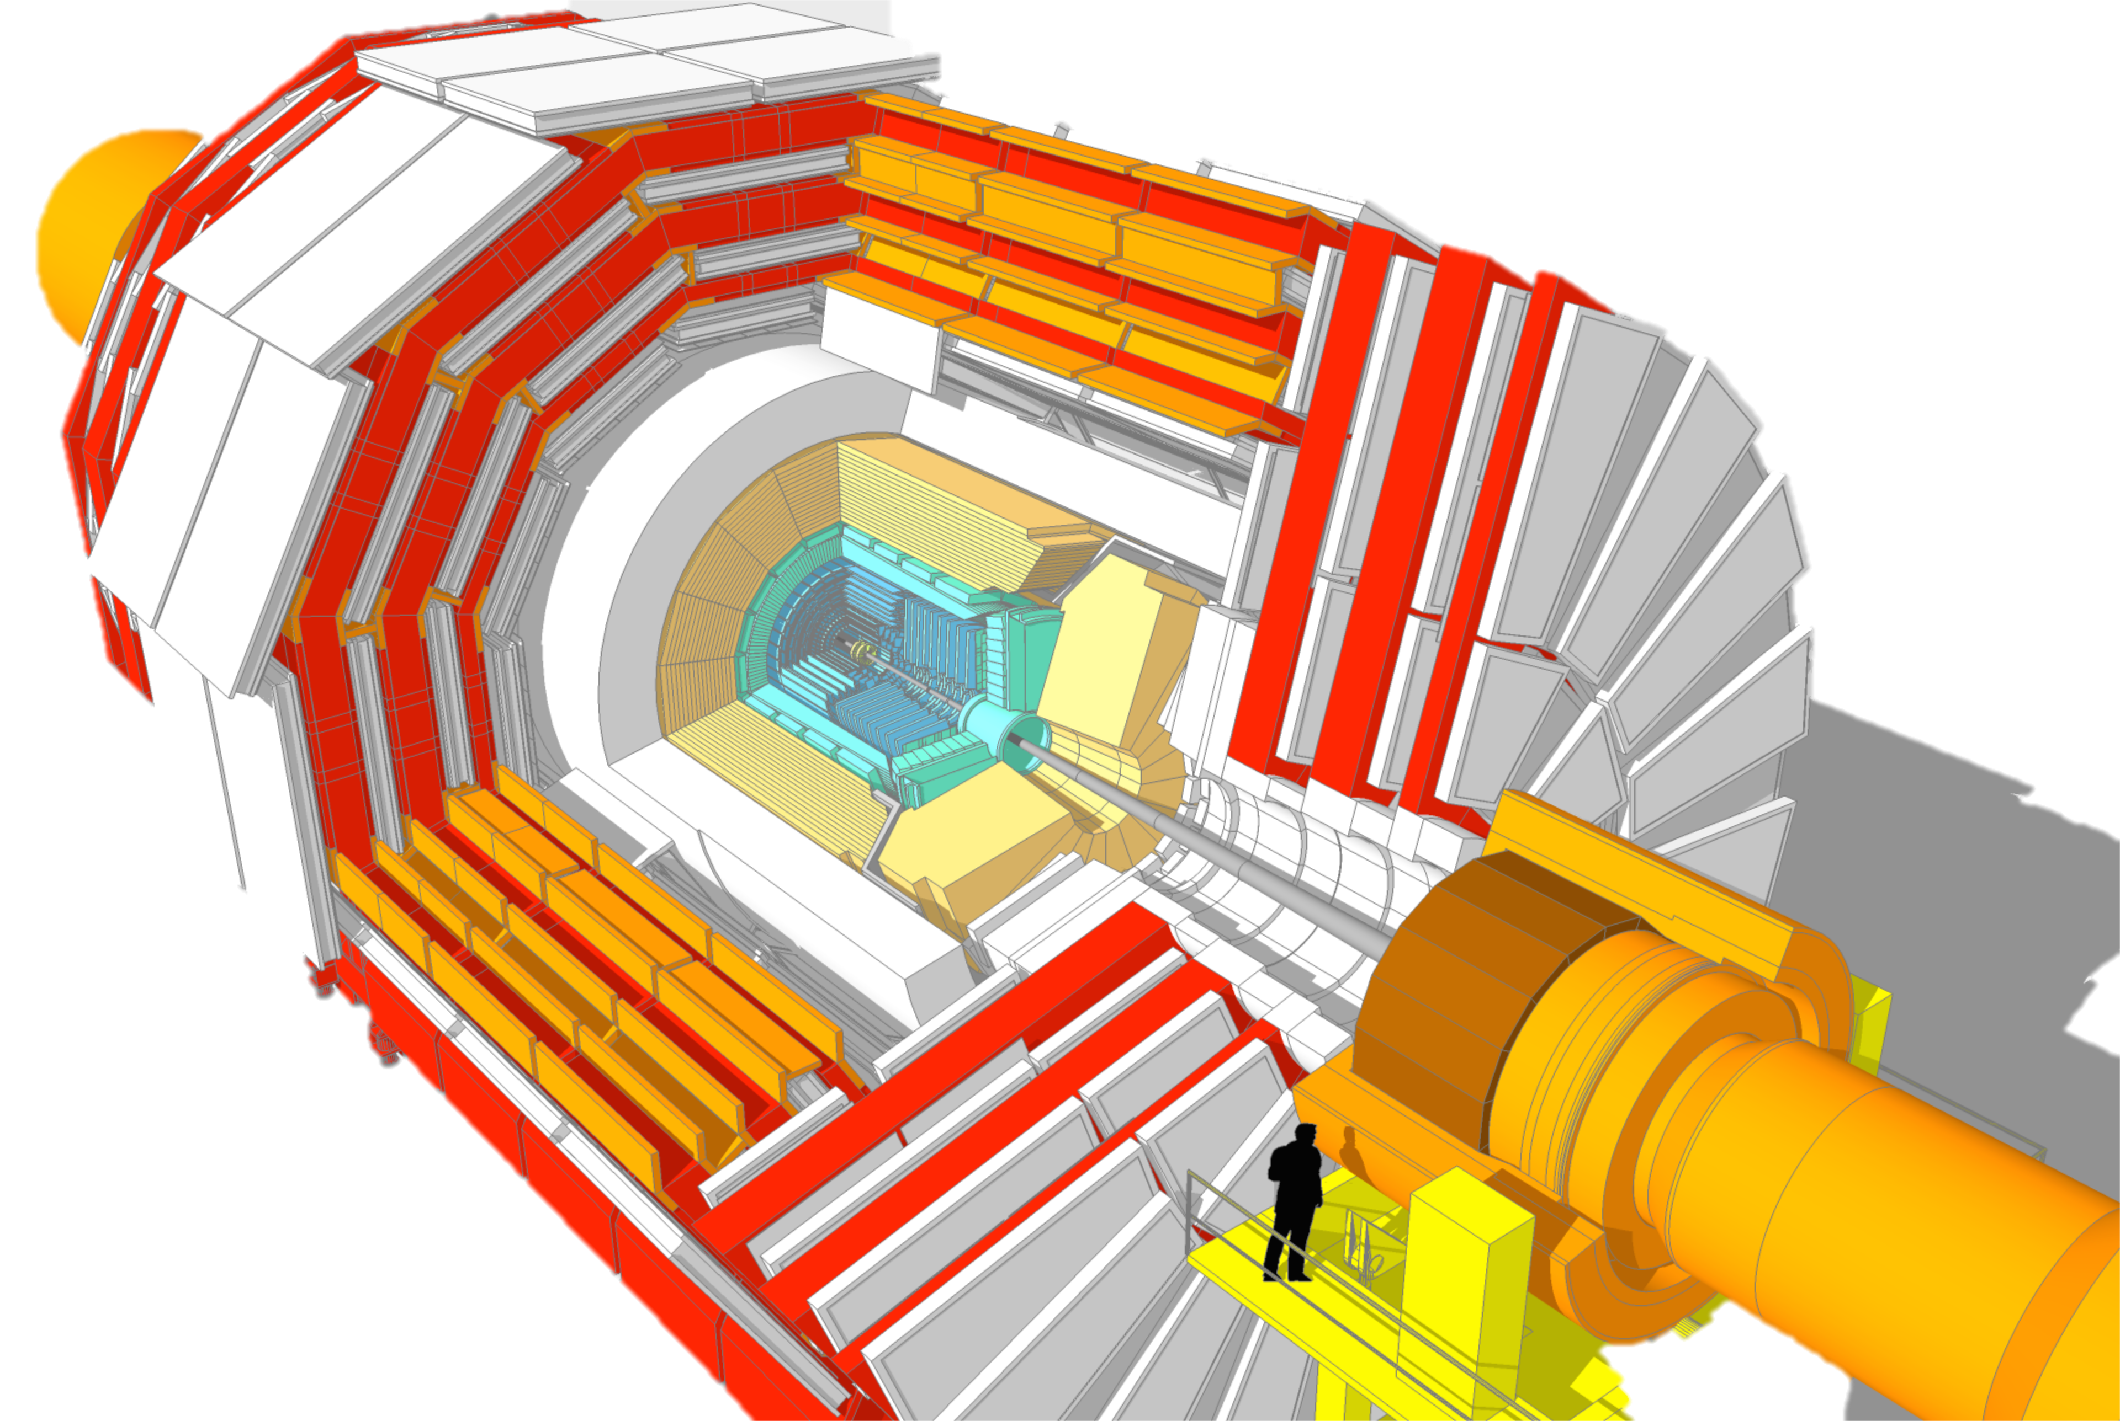
Muon Spectrometer:
Steel return yoke and gas-based muon chambers
σ/p_{T} = 1% @ 50GeV to 5% @ 1TeV (ID+MS)
EM calorimeter:
PbWO₄ crystals homogen.
σ/E = 2-5%/√E ⊕ 0.005
Hadronic calorimeter:
Brass+scint./Steel+quartz
σ/E_{jet}= 100%/√E ⊕ 0.05
Solenoid: B = 4 T
Inner Tracker:
Si pixels/strips
σ/p_{T} = 0.02% p_{T} (GeV) ⊕ 0.005

Slide 5
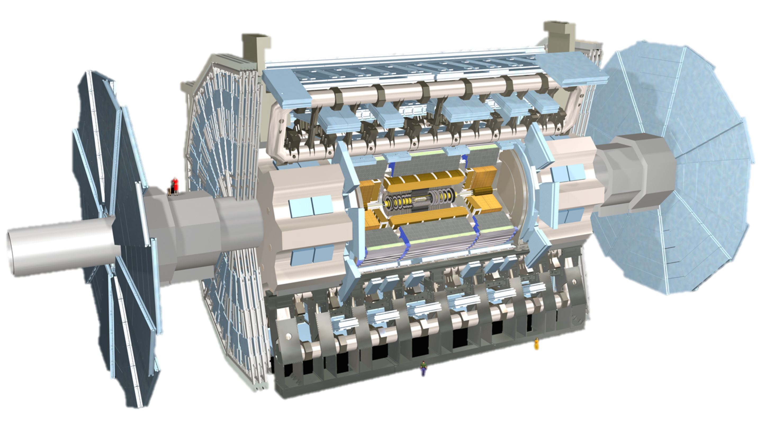
Muon Spectrometer: |η| < 2.7
Air-core toroid + gas-based muon chambers
σ/p_{T} = 2% @ 50GeV to 10% @ 1TeV (ID+MS)
EM calorimeter: |η| < 2.5 (3.2)
Pb-LAr accordion sampling
σ/E = 10%/√E ⊕ 0.7%
L = 44 m, ∅ ≈ 25 m
7000 tonnes
≈10⁸ electronic channels
2-level trigger reducing 40 MHz collision rate to 1 kHz of events to tape
Hadronic calorimeter:
Fe/scintillator / Cu/W-LAr
σ/E_{jet}= 50%/√E ⊕ 3%
Solenoid: B = 2 T
Inner Tracker: |η| < 2.5
Si pixels/strips and Trans. Rad. Det.
σ/p_{T} = 0.05% p_{T} (GeV) ⊕ 1%

Slide 6
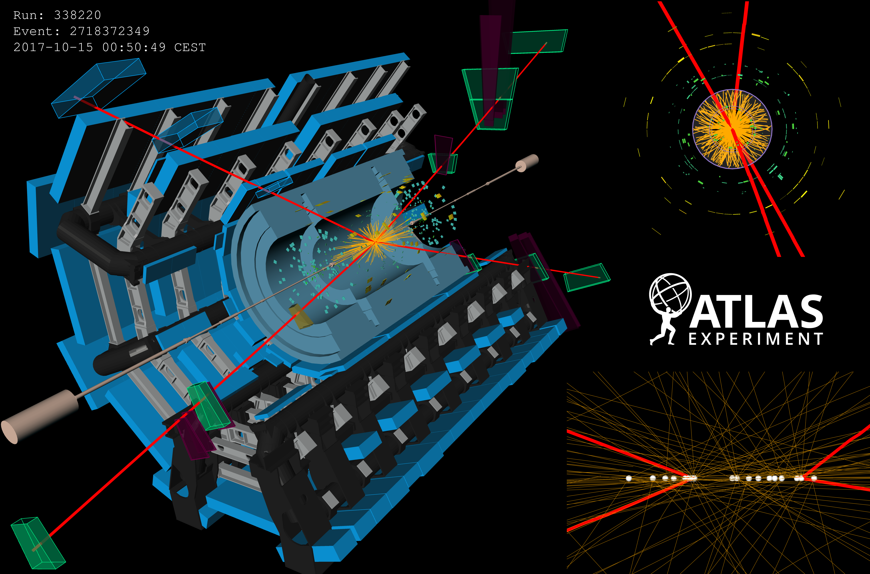
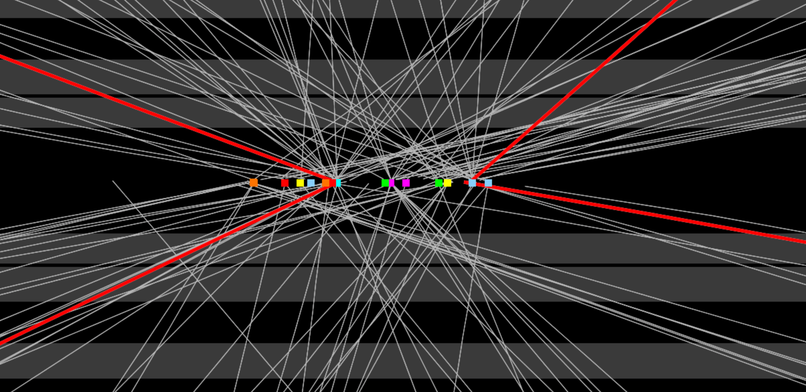

Slide 7
Notes:
https://twiki.cern.ch/twiki/bin/view/CMSPublic/PhysicsResultsCombined

Slide 8
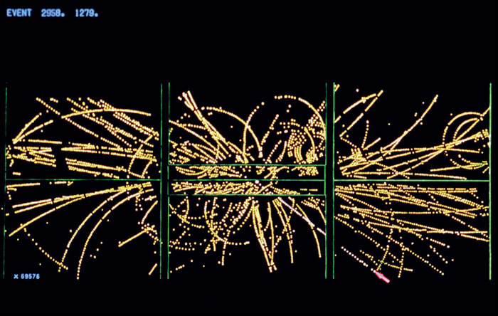
W boson mass
a
W candidate, UA1, 1982

Slide 9

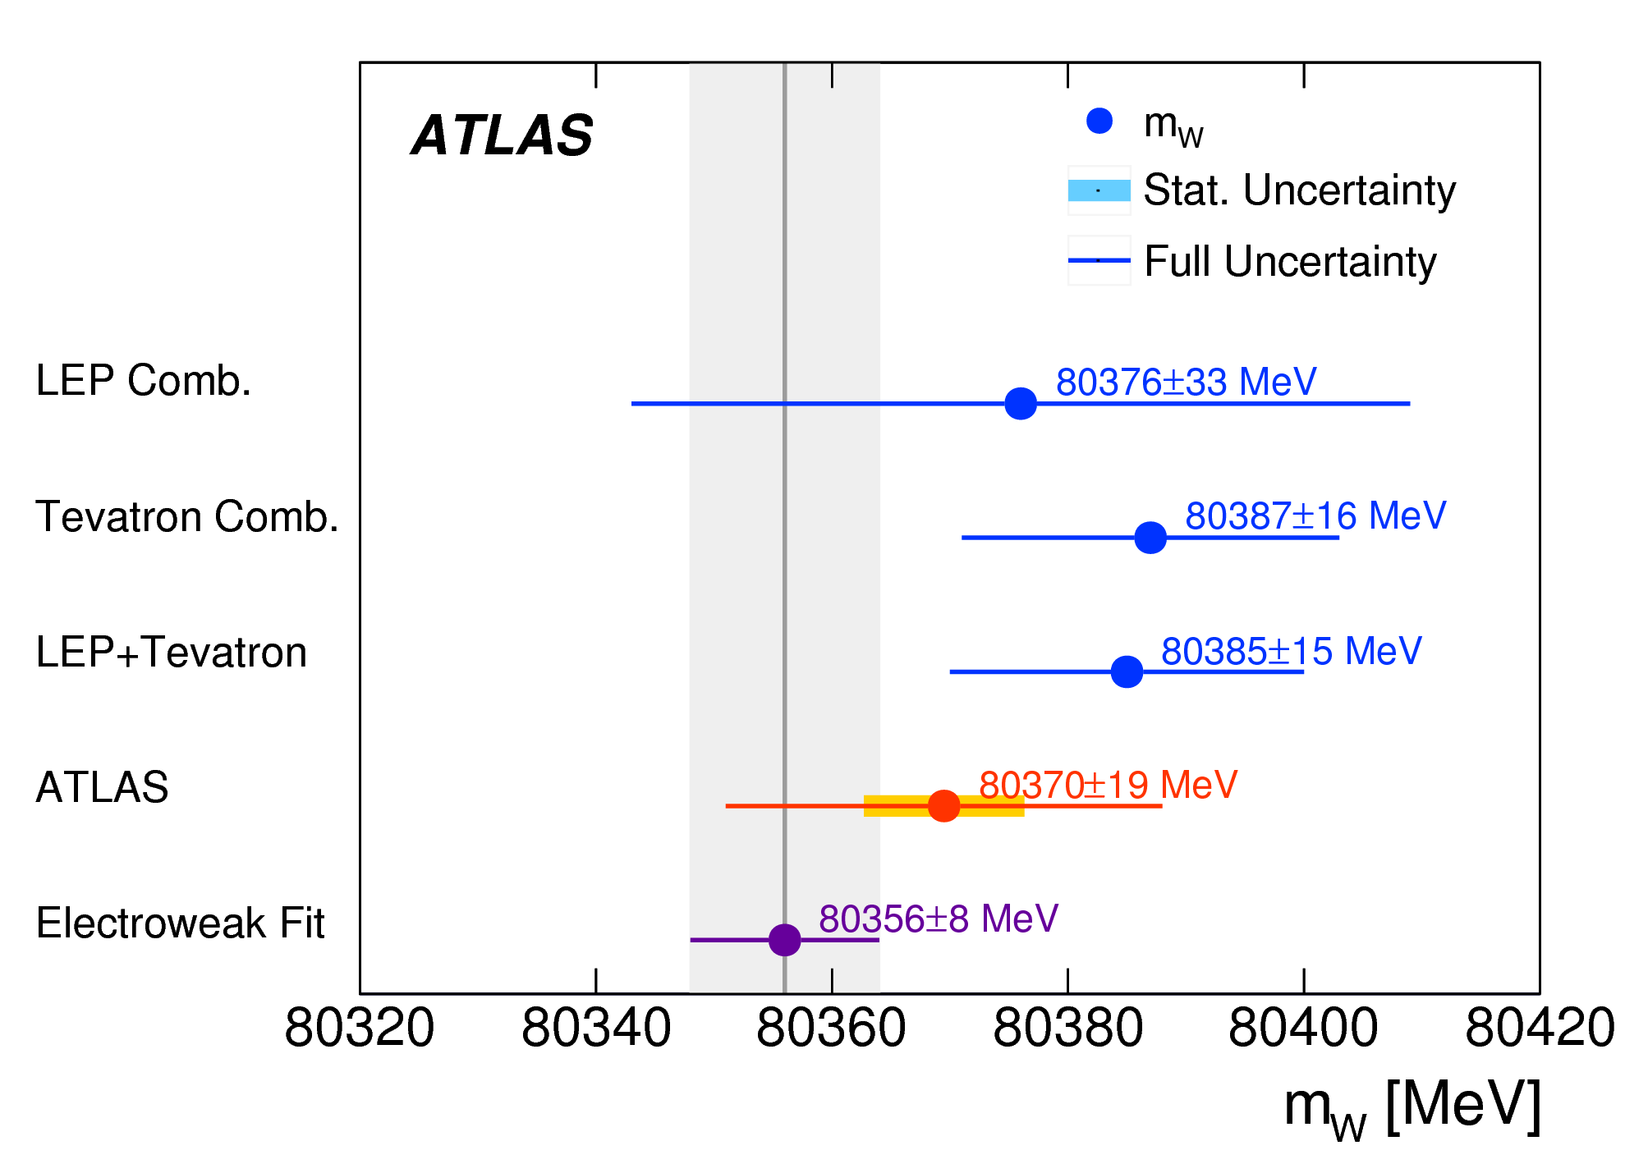
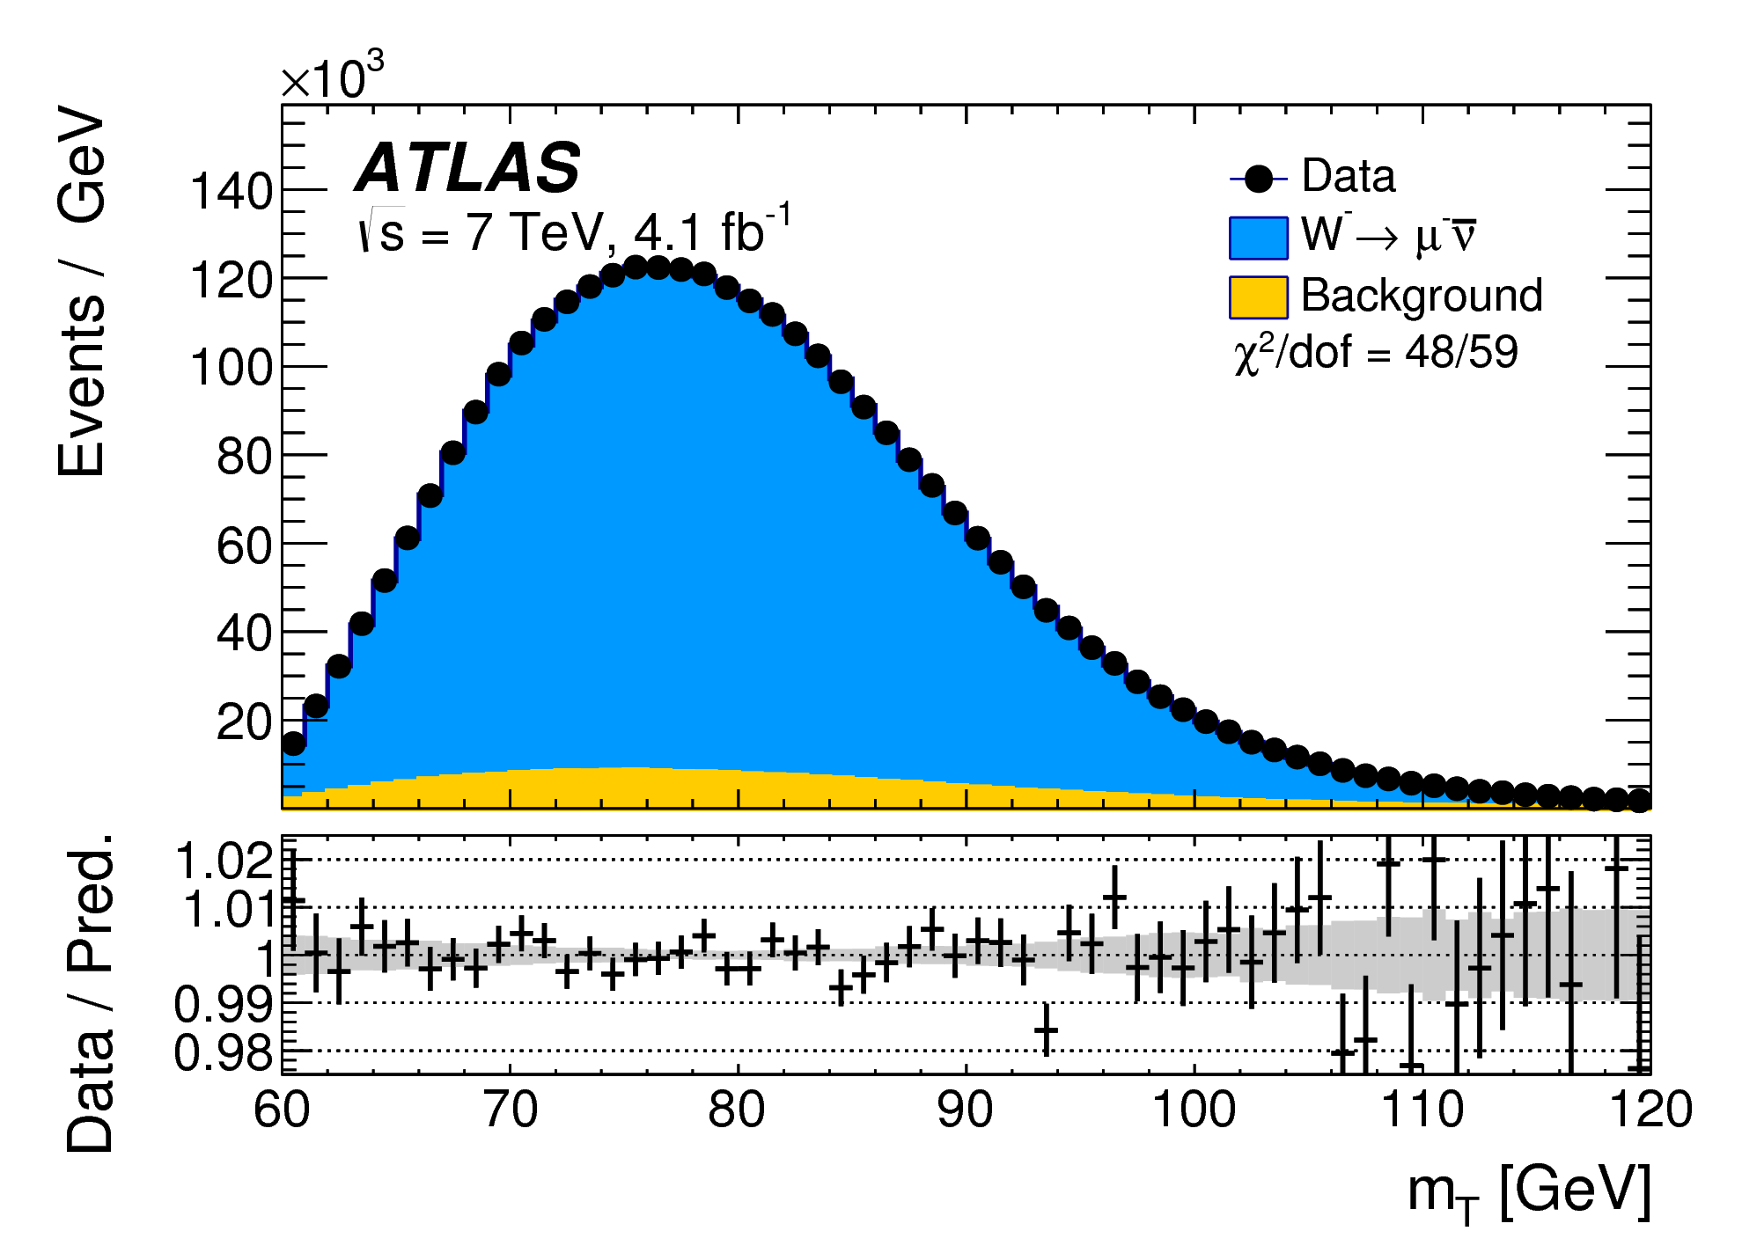
W boson mass
Eur. Phys. J. C 78 (2018) 110
Based on low-pileup 2011 data: √s = 7 TeV, 4.6 fb⁻¹
Detailed precision analysis and huge amount of work to understand detector response and modelling of kinematic quantities
Result (0.2 per mille!) competitive with LEP and Tevatron measurements:
m_{W} = 80 370 ± 7 (stat.) ± 11 syst. ± 14 modeling MeV
To be followed up at with special low-pileup runs
Notes:
Eur. Phys. J. C 78 (2018) 110; arXiv:1701.07240
https://atlas.web.cern.ch/Atlas/GROUPS/PHYSICS/PAPERS/STDM-2014-18/

Slide 10

Probing the top quark
Fermilab news 8 March 2013

Slide 11
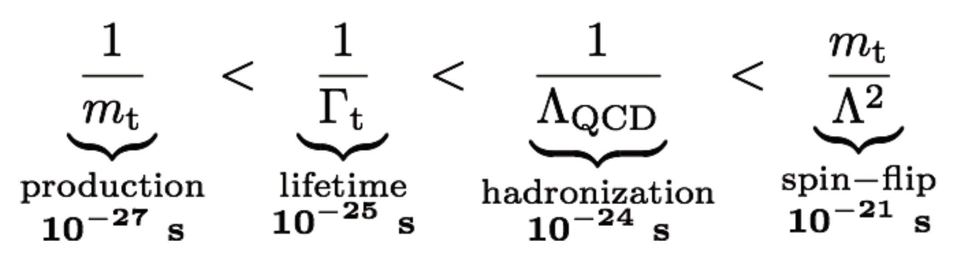
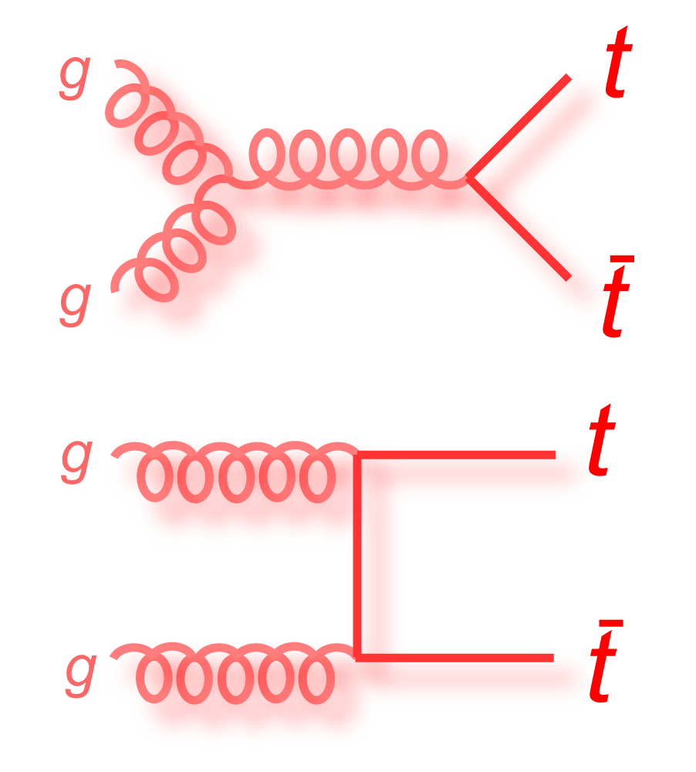
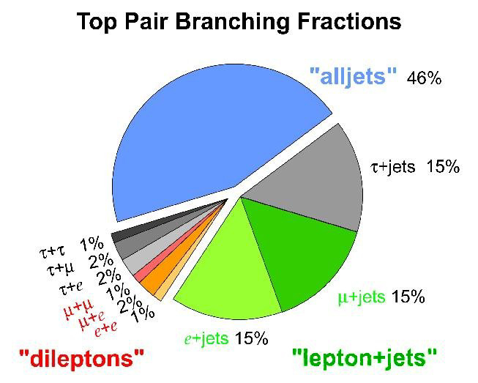
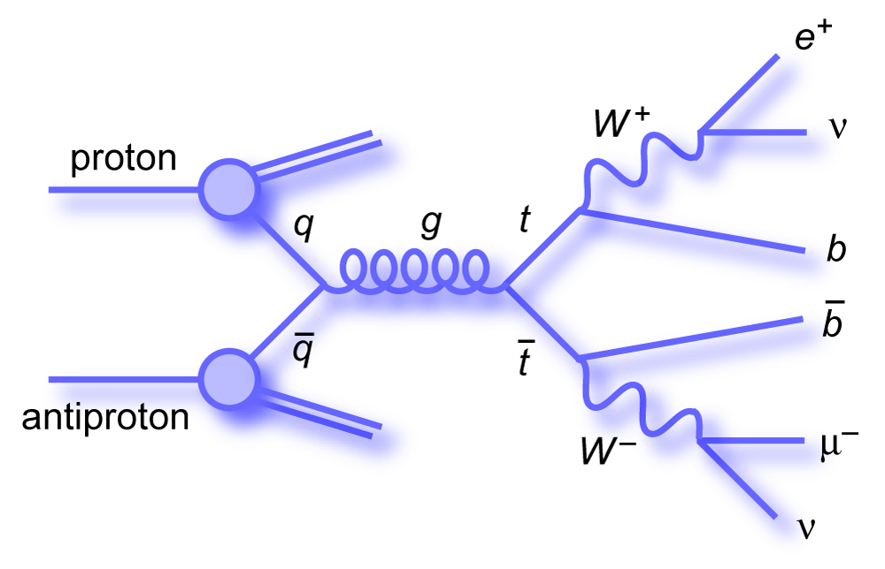
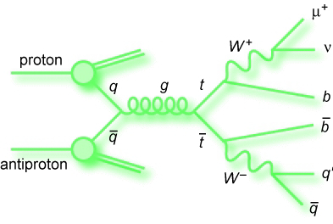
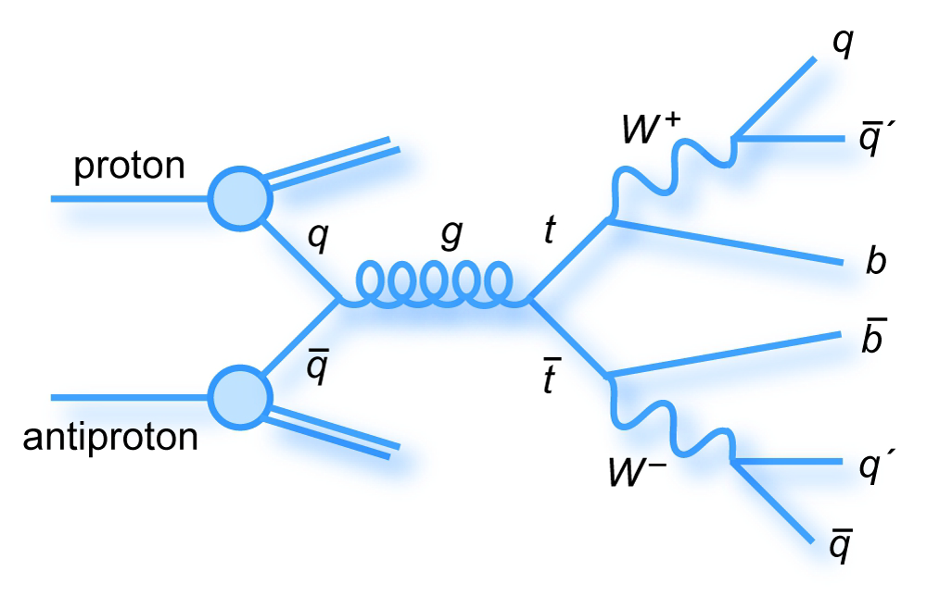
Top quarks at the LHC
The top is too heavy to form bound states
  Allows observation of bare quark properties!
Large Yukawa coupling to Higgs boson
  Special role in EW symmetry breaking?
  top decays almost always as t→bW
  |V_{tb}|>>|V_{ts}|>|V_{td}| => BR(t→bW) ≈ 1
The LHC is a top factory:
  A great laboratory for top measurements
  And background for everything else… ☺
  Dominated by top pair from gluon fusion

Slide 12
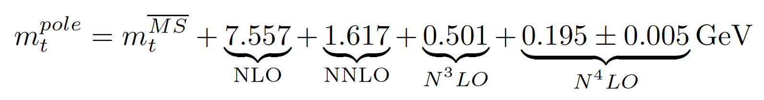
What we talk about when we talk about the top mass
The top quark mass is a key parameter of the Standard Model
  High m_{t} results in/comes from Yukawa coupling close to 1
  Results in important radiative corrections to Standard Model observables.
Theoretically:
  Beyond LO, m_{t} must be defined within a given renormalization scheme
  Pole mass scheme: conserves m_{t} at all perturbation orders
  MS scheme: m_{t} has different corrections at each order (differences of up to a few GeV!)
Experimentally:
  Direct measurements sensitive to “Monte Carlo mass” m_{t}^{MC}:
    Extracted from invariant mass of decay products (yes, including jets)
    Top mass unfolded from Monte Carlo simulation taking m_{t}^{MC} as input parameter
  Indirect measurements sensitive to pole mass m_{t}^{pole} from observables depending on m_{t}
    E.g. from σ^{meas} vs σ^{theory}(α_{s}, m_{t}, PDF, μ_{F}, μ_{R}, ...)
    Measurement made in a given renormalization scheme
O(GeV) difference between m_{t}^{MC} and m_{t}^{pole}
      See e.g. arXiv:1712.02796v3 [hep-ph] for an interesting discussion
Notes:
Top is coloured and decays to jets => cannot be unambiguously associated with a set of decay particles => cannot be unambiguously defined in terms of the decay products invariant mass
Lisa Shabalina dixit: “difference between MC mass and pole mass is now much better understood and what we measure is very close to pole mass”

Slide 13

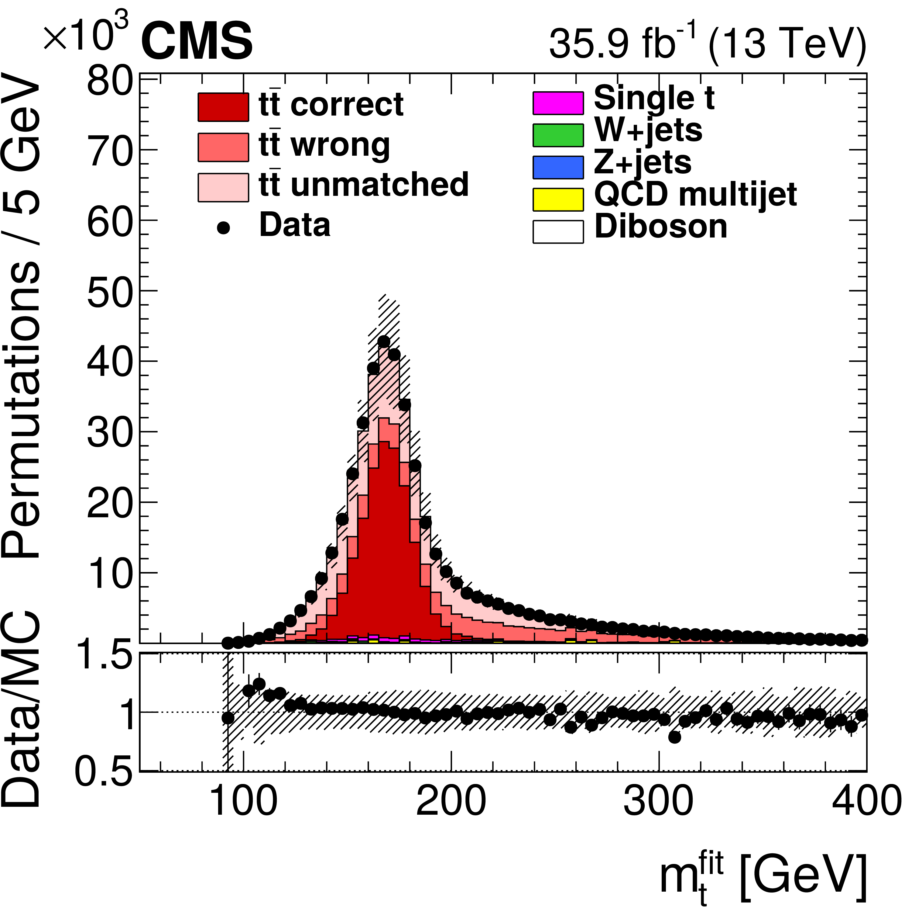

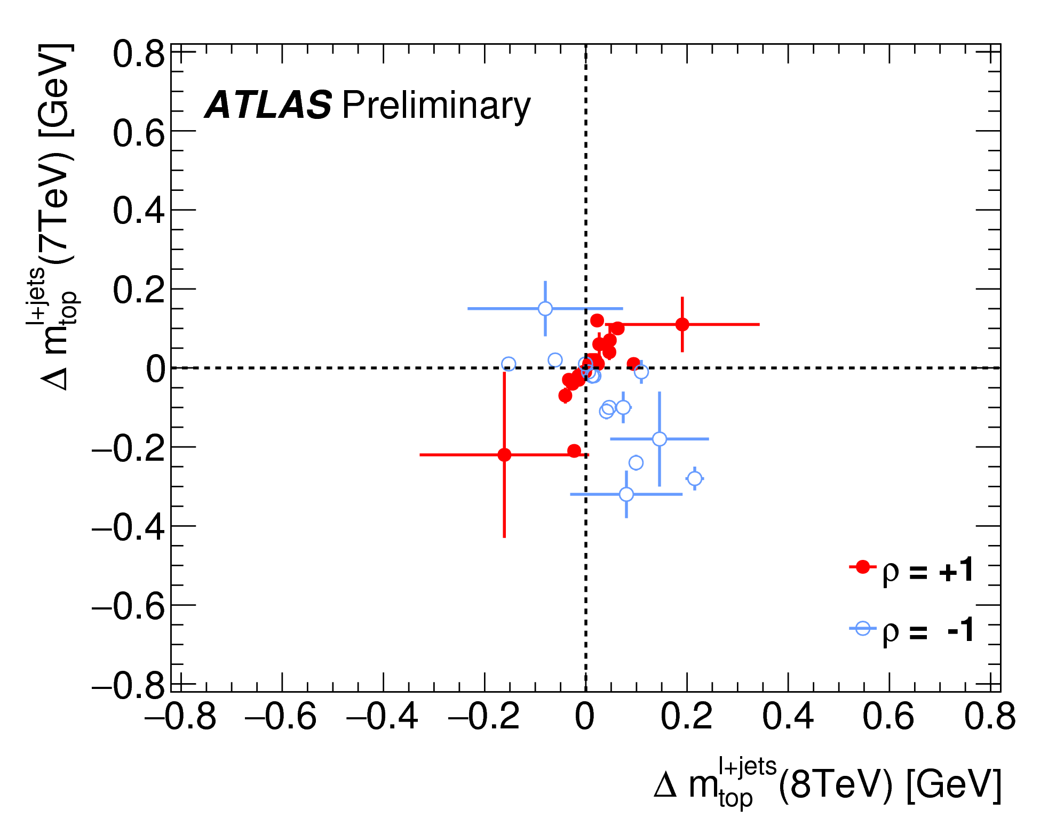
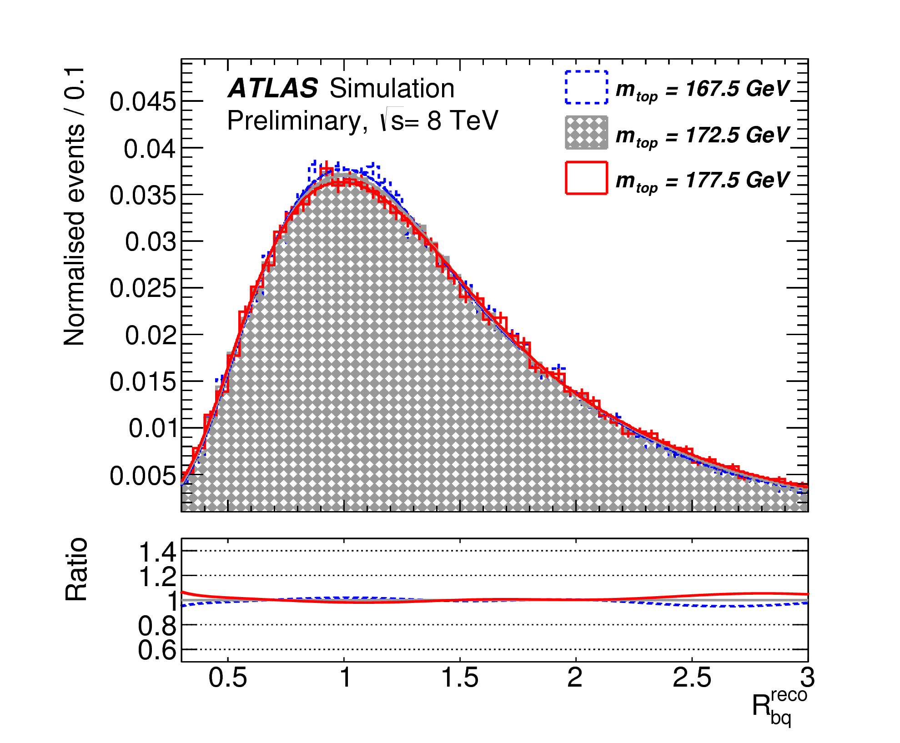
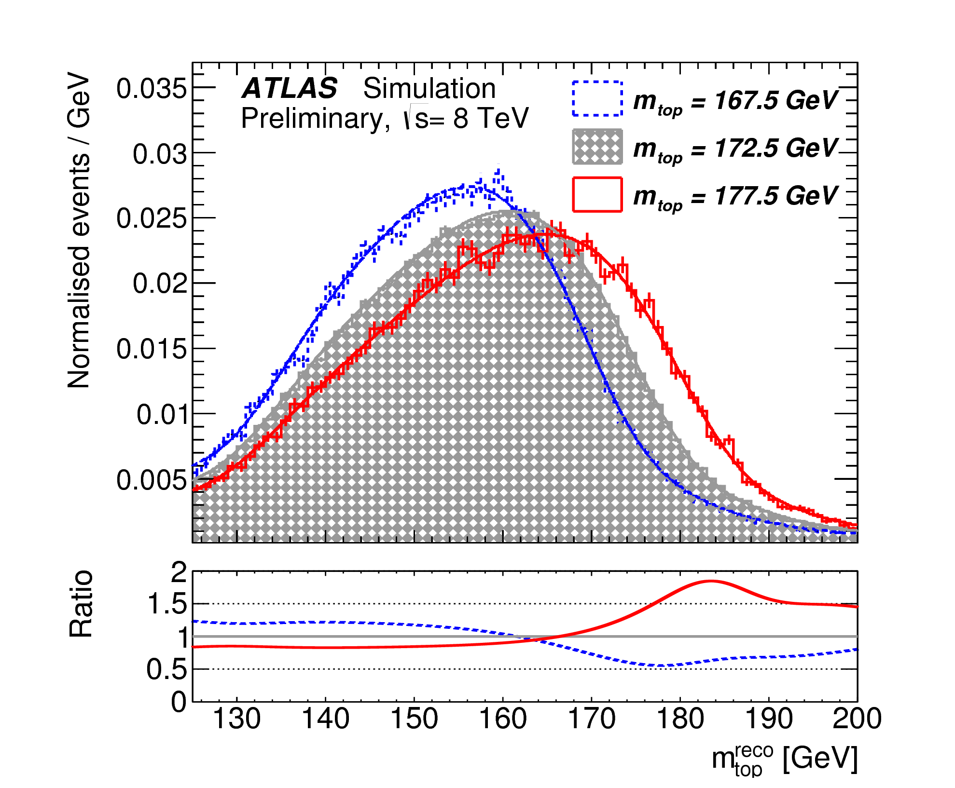
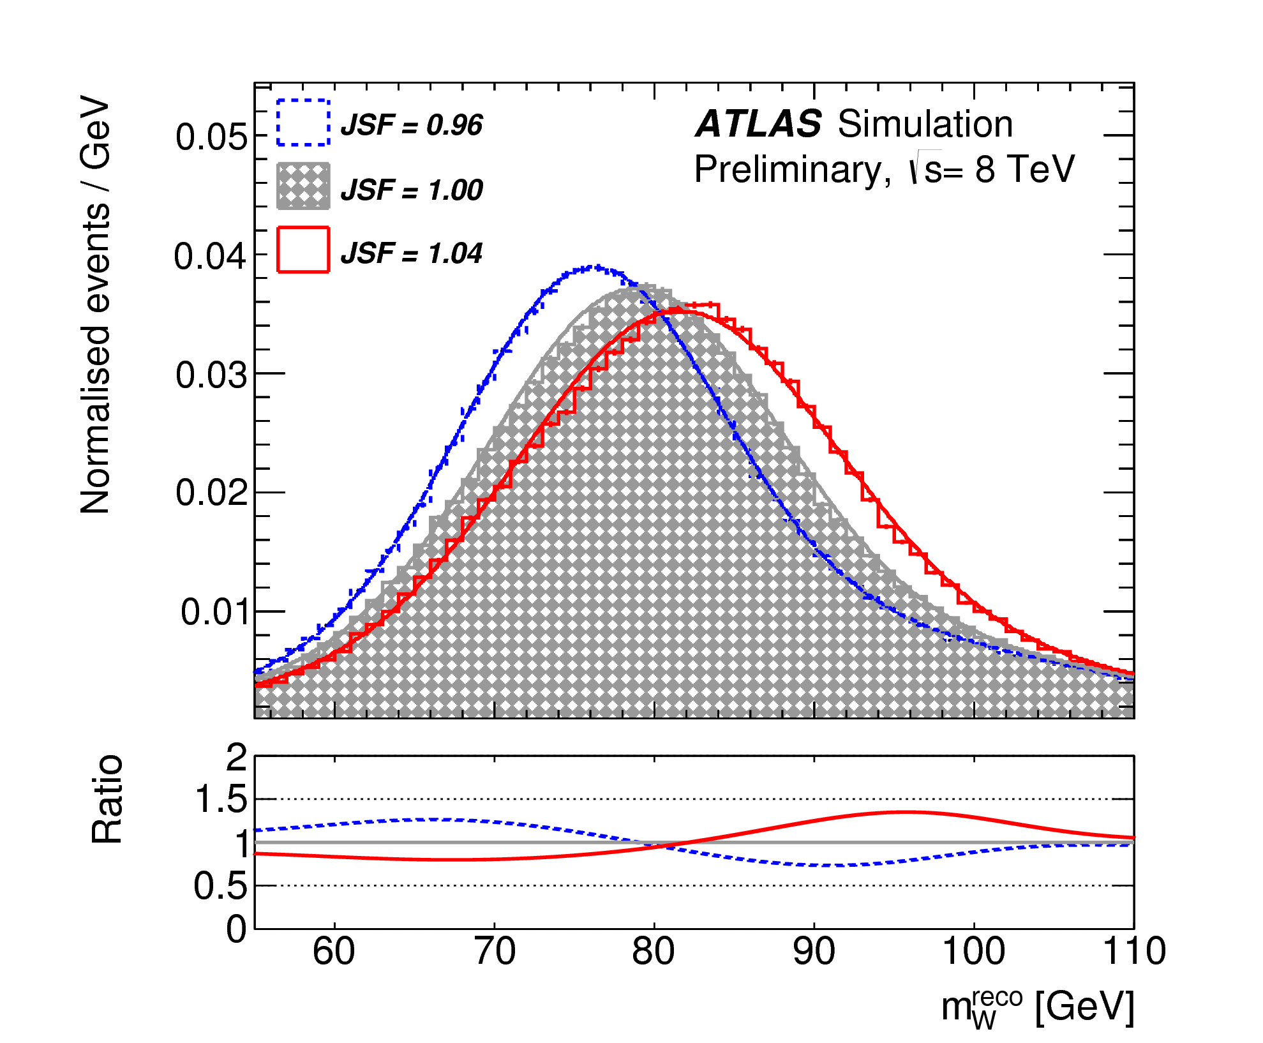
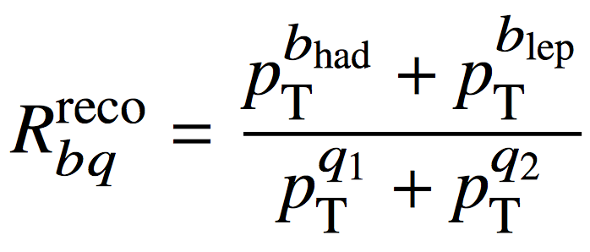
Direct m_{t} measurement : l+jets
CMS-PAS-TOP-17-007; ATLAS-CONF-2017-071
e/μ+≥4 jets (2 b-tagged)
Kinematic fit:
  Constraints: W mass, 2 same mass t tbar
CMS: 35.9 fb⁻¹ at √s = 13 TeV
  2D fit of m_{t} and m_{W}^{reco} ; extract JSF
  m_{t} = 172.25 ± 0.08 (stat+JSF) ± 0.62 (syst) GeV
ATLAS: 20.2 fb⁻¹ at √s = 8 TeV
  3D fit to: m_{top}^{reco}, m_{W}^{reco}, R_{bq}^{reco}
  Extract m_{t}, JSF, b-JSF
  m_{t} = 172.08 ± 0.39 (stat) ± 0.82 (syst) GeV
  Adding √s = 7 TeV data:
  m_{t} = 172.51 ± 0.27 (stat) ± 0.42 (syst) GeV
  (q1 and q2 light jets assigned to W)
Notes:
http://cms-results.web.cern.ch/cms-results/public-results/publications/TOP-17-007/index.html → 3 May 2018
https://atlas.web.cern.ch/Atlas/GROUPS/PHYSICS/CONFNOTES/ATLAS-CONF-2017-071/ → 18 September 2017
L.Shabalina: “stress that despite the fact that ATLAS individual measurement are less precise that CMS, the combination @8 TeV has similar precision because of the anti correlation of the systematics” → caused by the in-situ measurement of the jet energy scale factor (JSF) and relative b-to-light-jet energy scale factor (bJSF) in the three-dimensional tt ̄ → lepton + jets analysis

Slide 14
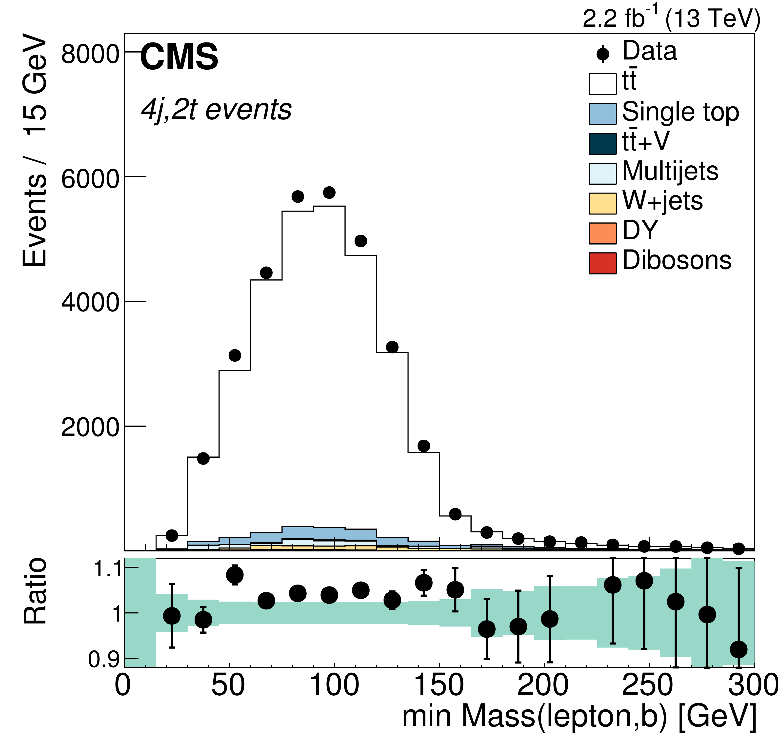
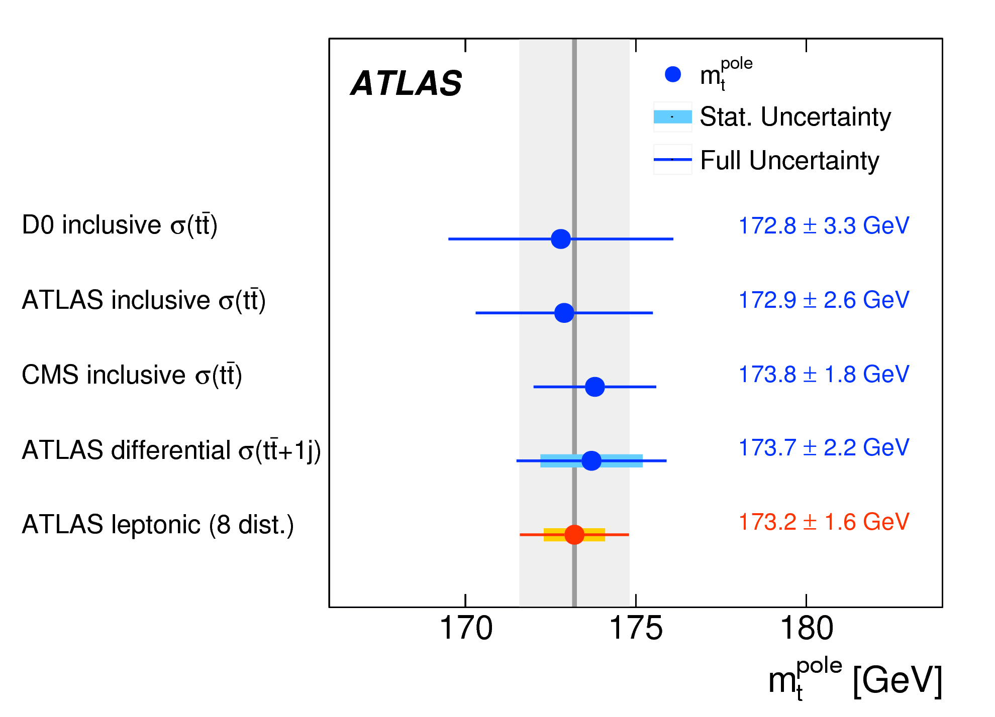
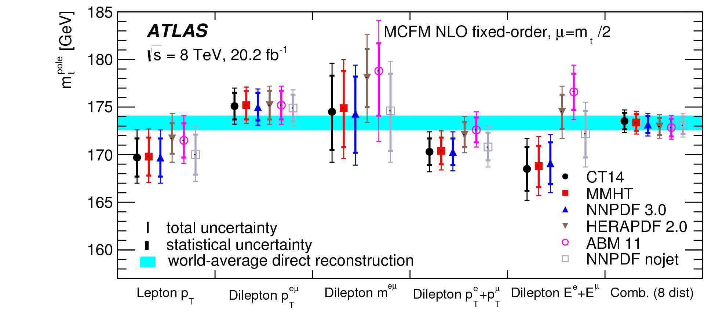
Indirect m_{t} measurement
JHEP 09 (2017) 051; EPJC77 (2017) 804
CMS: 13 TeV data, L = 2.2 fb⁻¹; lepton+jets final state
Measure differential cross section wrt min(m_{lb}) in categories of N_{jet} and N_{b-jet}:
  σ = 888 ± 2 (stat) ± 27(sys) ± 20 (lumi) pb
Extract pole mass from cross section:
  m_{t}^{pole} = 170.6 ± 2.7 (tot) ± 1.01 (syst.) GeV
ATLAS: 8 TeV data, L = 20.2 fb⁻¹, dilepton with 1 or 2 b-jets
8 differential fiductial cross sections measured:
  p_{T}^{l}, |ηl|, p^{eμ}, m^{eμ}, |y^{eμ}|, ∆φ^{eμ}, p_{T}^{e}+p_{T}^{μ}, E^{e}+E^{μ}
m_{t}^{pole} extracted from combined fit to templates or distribution moments
  m_{t}^{pole}= 173.2 ± 0.9 (stat) ± 0.8 (syst) ± 1.2 (theo) GeV
Notes:
http://cms-results.web.cern.ch/cms-results/public-results/publications/TOP-16-006/index.html → 22 January 2017
https://atlas.web.cern.ch/Atlas/GROUPS/PHYSICS/PAPERS/TOPQ-2015-02/ → 26 September 2017

Slide 15
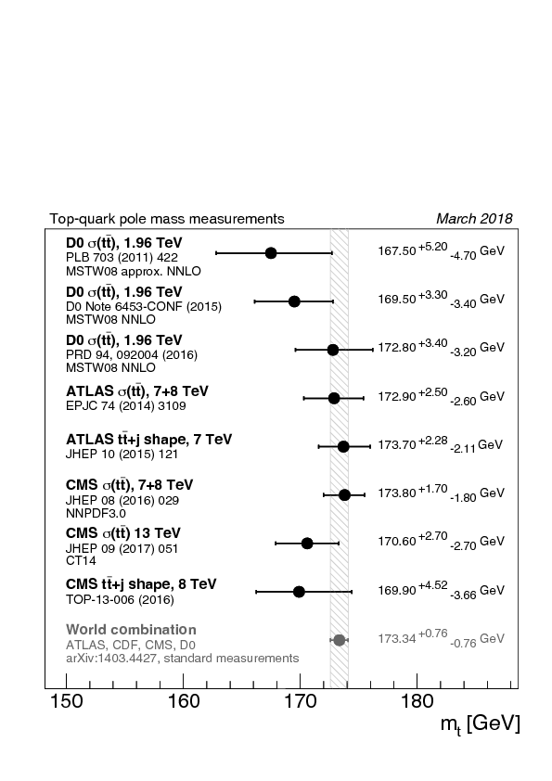
m_{t}: the story so far
https://twiki.cern.ch/twiki/bin/view/LHCPhysics/LHCTopWGSummaryPlots
Notes:
http://cms-results.web.cern.ch/cms-results/public-results/preliminary-results/TOP-15-012/index.html
https://atlas.web.cern.ch/Atlas/GROUPS/PHYSICS/CONFNOTES/ATLAS-CONF-2017-071/

Slide 16
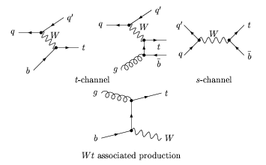
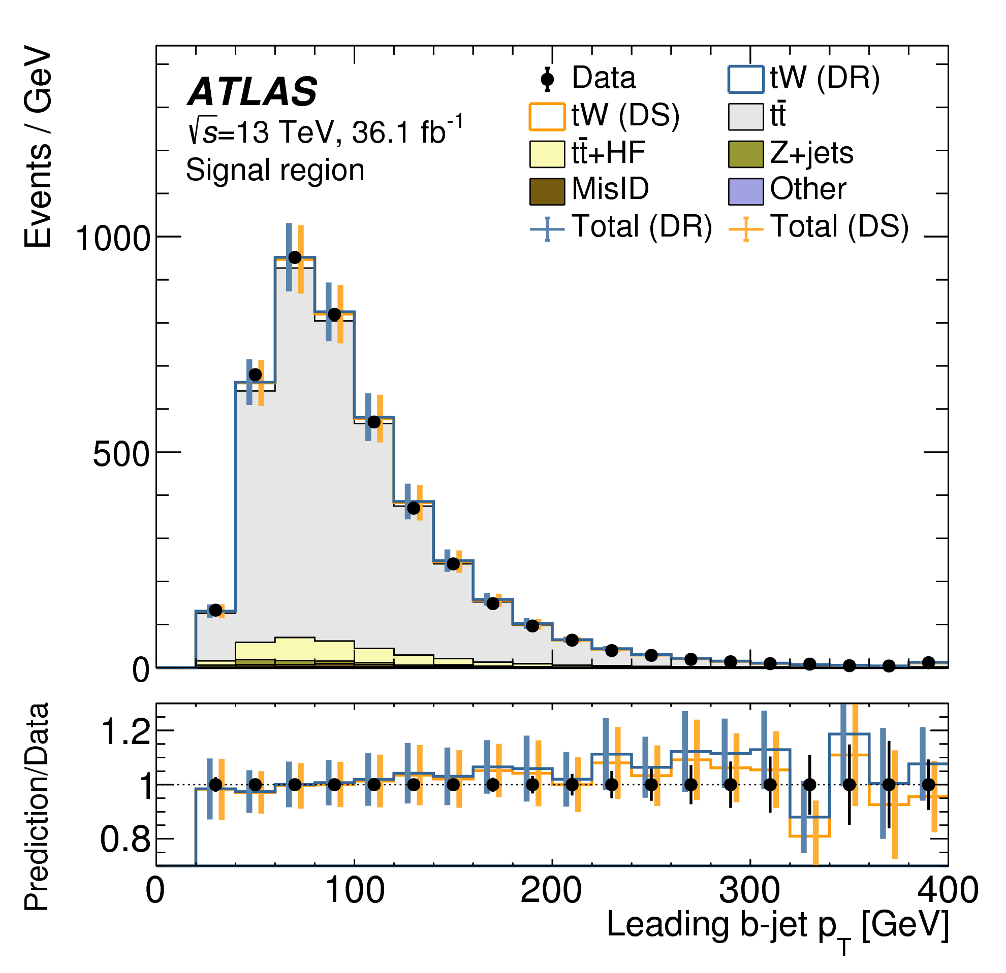
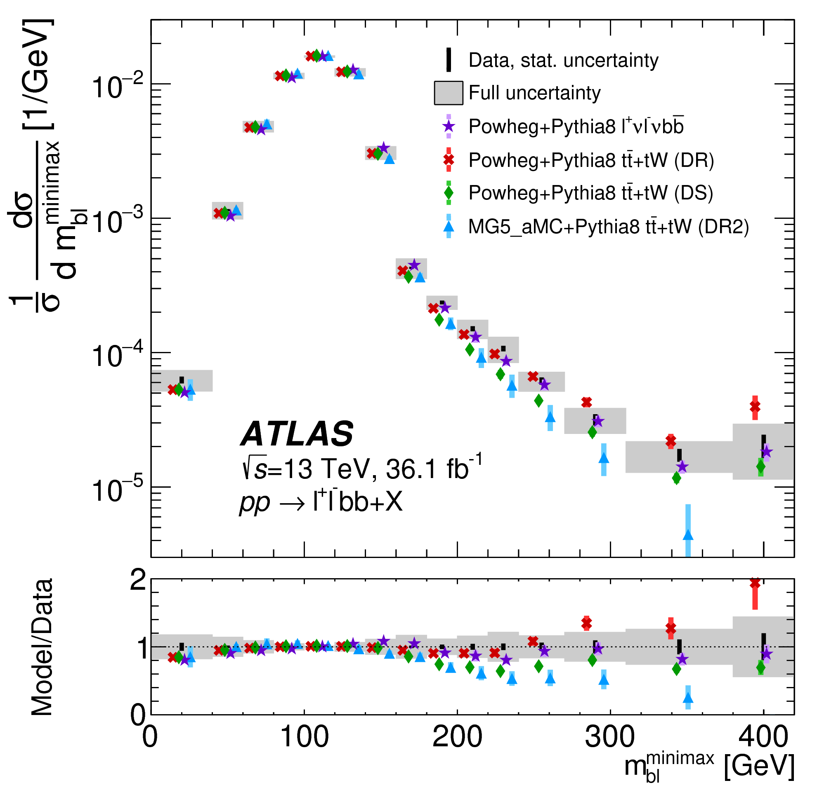
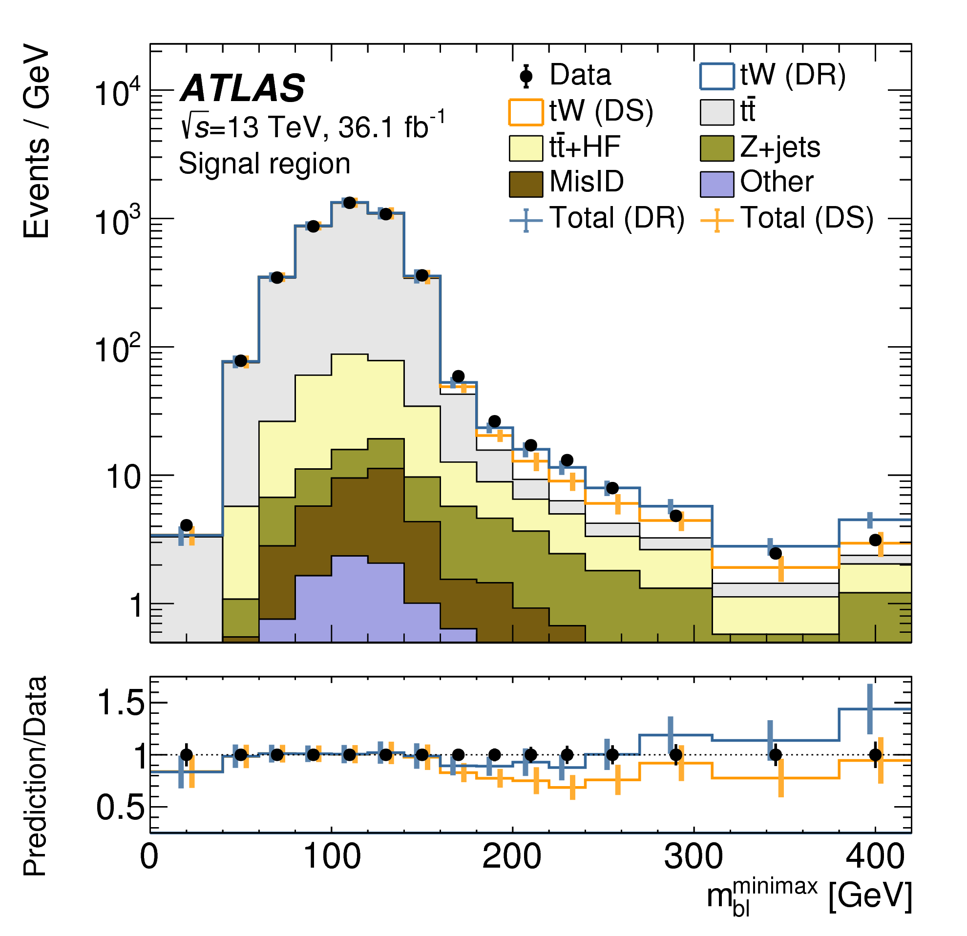
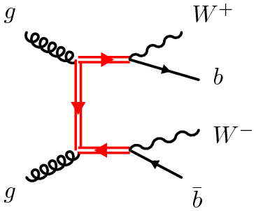
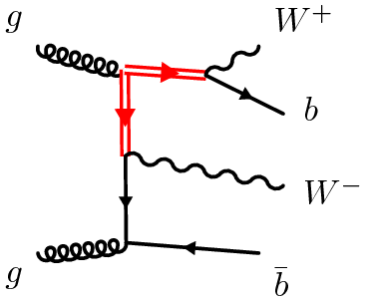
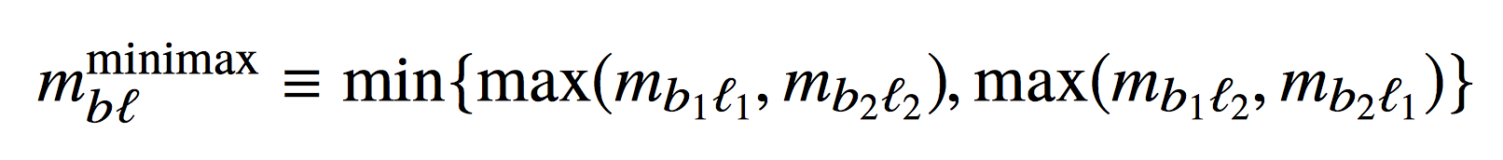
ATLAS measurement of quantum interference in single top production
arXiv:1806.04667 [hep-ex]
An NLO, top pair and single top (Wt) production have quantum interference
Ad hoc treatment of the Wt and tt combination is used in most analyses:
  Diagram removal (DR): remove doubly resonant diagrams from Wtb matrix element
  Diagram subtraction (DS): subtract gauge-invariant term from Wtb matrix element
  See review in arXiv:1607.05862 [hep-ph]
ATLAS measured differential cross section for tt/Wt production
  Focused on fiducial region with significant interference effects
Notes:
https://atlas.web.cern.ch/Atlas/GROUPS/PHYSICS/PAPERS/TOPQ-2017-05/fig_02.png→ 12 June 2018
asurement targets the dilepton final state, characterized by a pair of oppositely charged leptons (ee, μμ, or eμ) originating from W-boson decays,1 associated with jets containing b-hadrons (b-jets) and missing transverse momentum due to undetected neutrinos. The contributions from doubly and singly resonant amplitudes (and hence also their interference) to the combined cross-section depend on the invariant mass of the bW pairs in the event, mbW . In this analysis, the charged lepton is used as a proxy for the W boson and a differential cross-section is measured as a function of the invariant mass of a b-jet and a lepton.

Slide 17

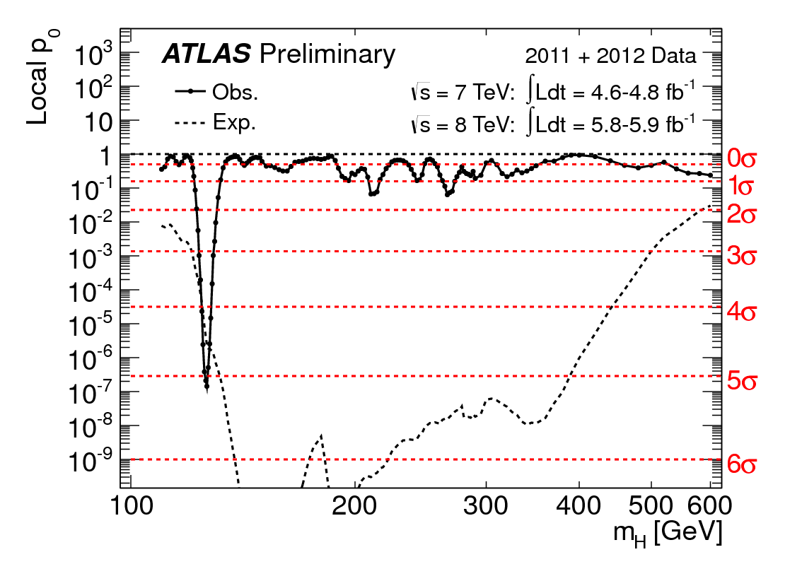
Higgs physics @ the LHC

Slide 18
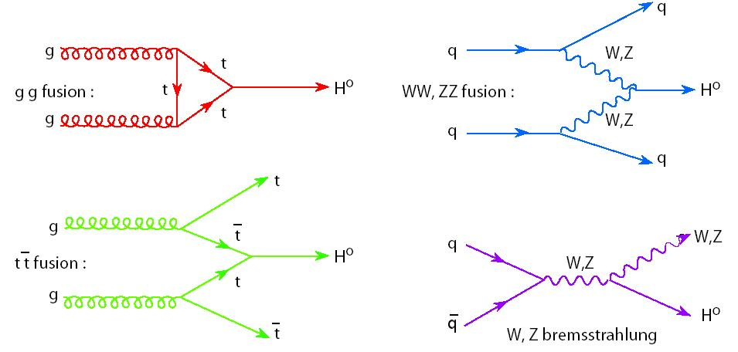
Higgs @ the LHC
Many different production and decay mechanisms
  Span 3 orders of magnitude in cross section and branching ratio
  Some very clean decays with low BR (γγ, 4l)
  Other very difficult with higher rates (bb, WW, ττ,...)
Access Higgs properties through combination of different channels
Enormous amount of progress since discovery 6 years ago!
Notes:
https://twiki.cern.ch/twiki/bin/view/LHCPhysics/LHCHXSWG#Latest_plots

Slide 19
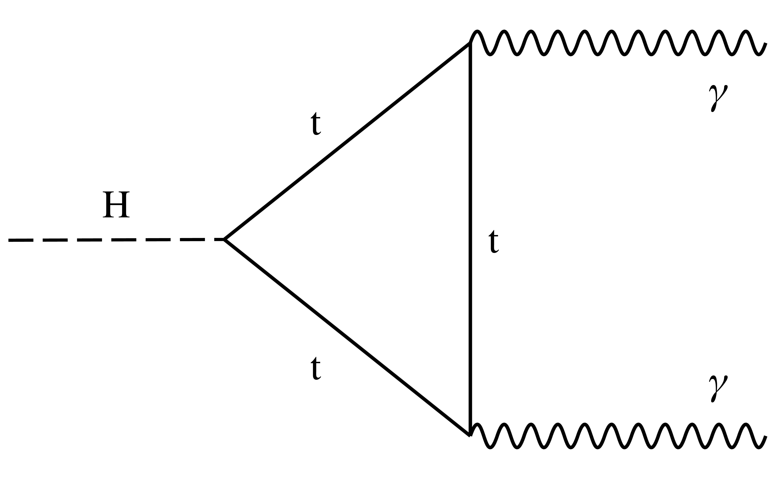
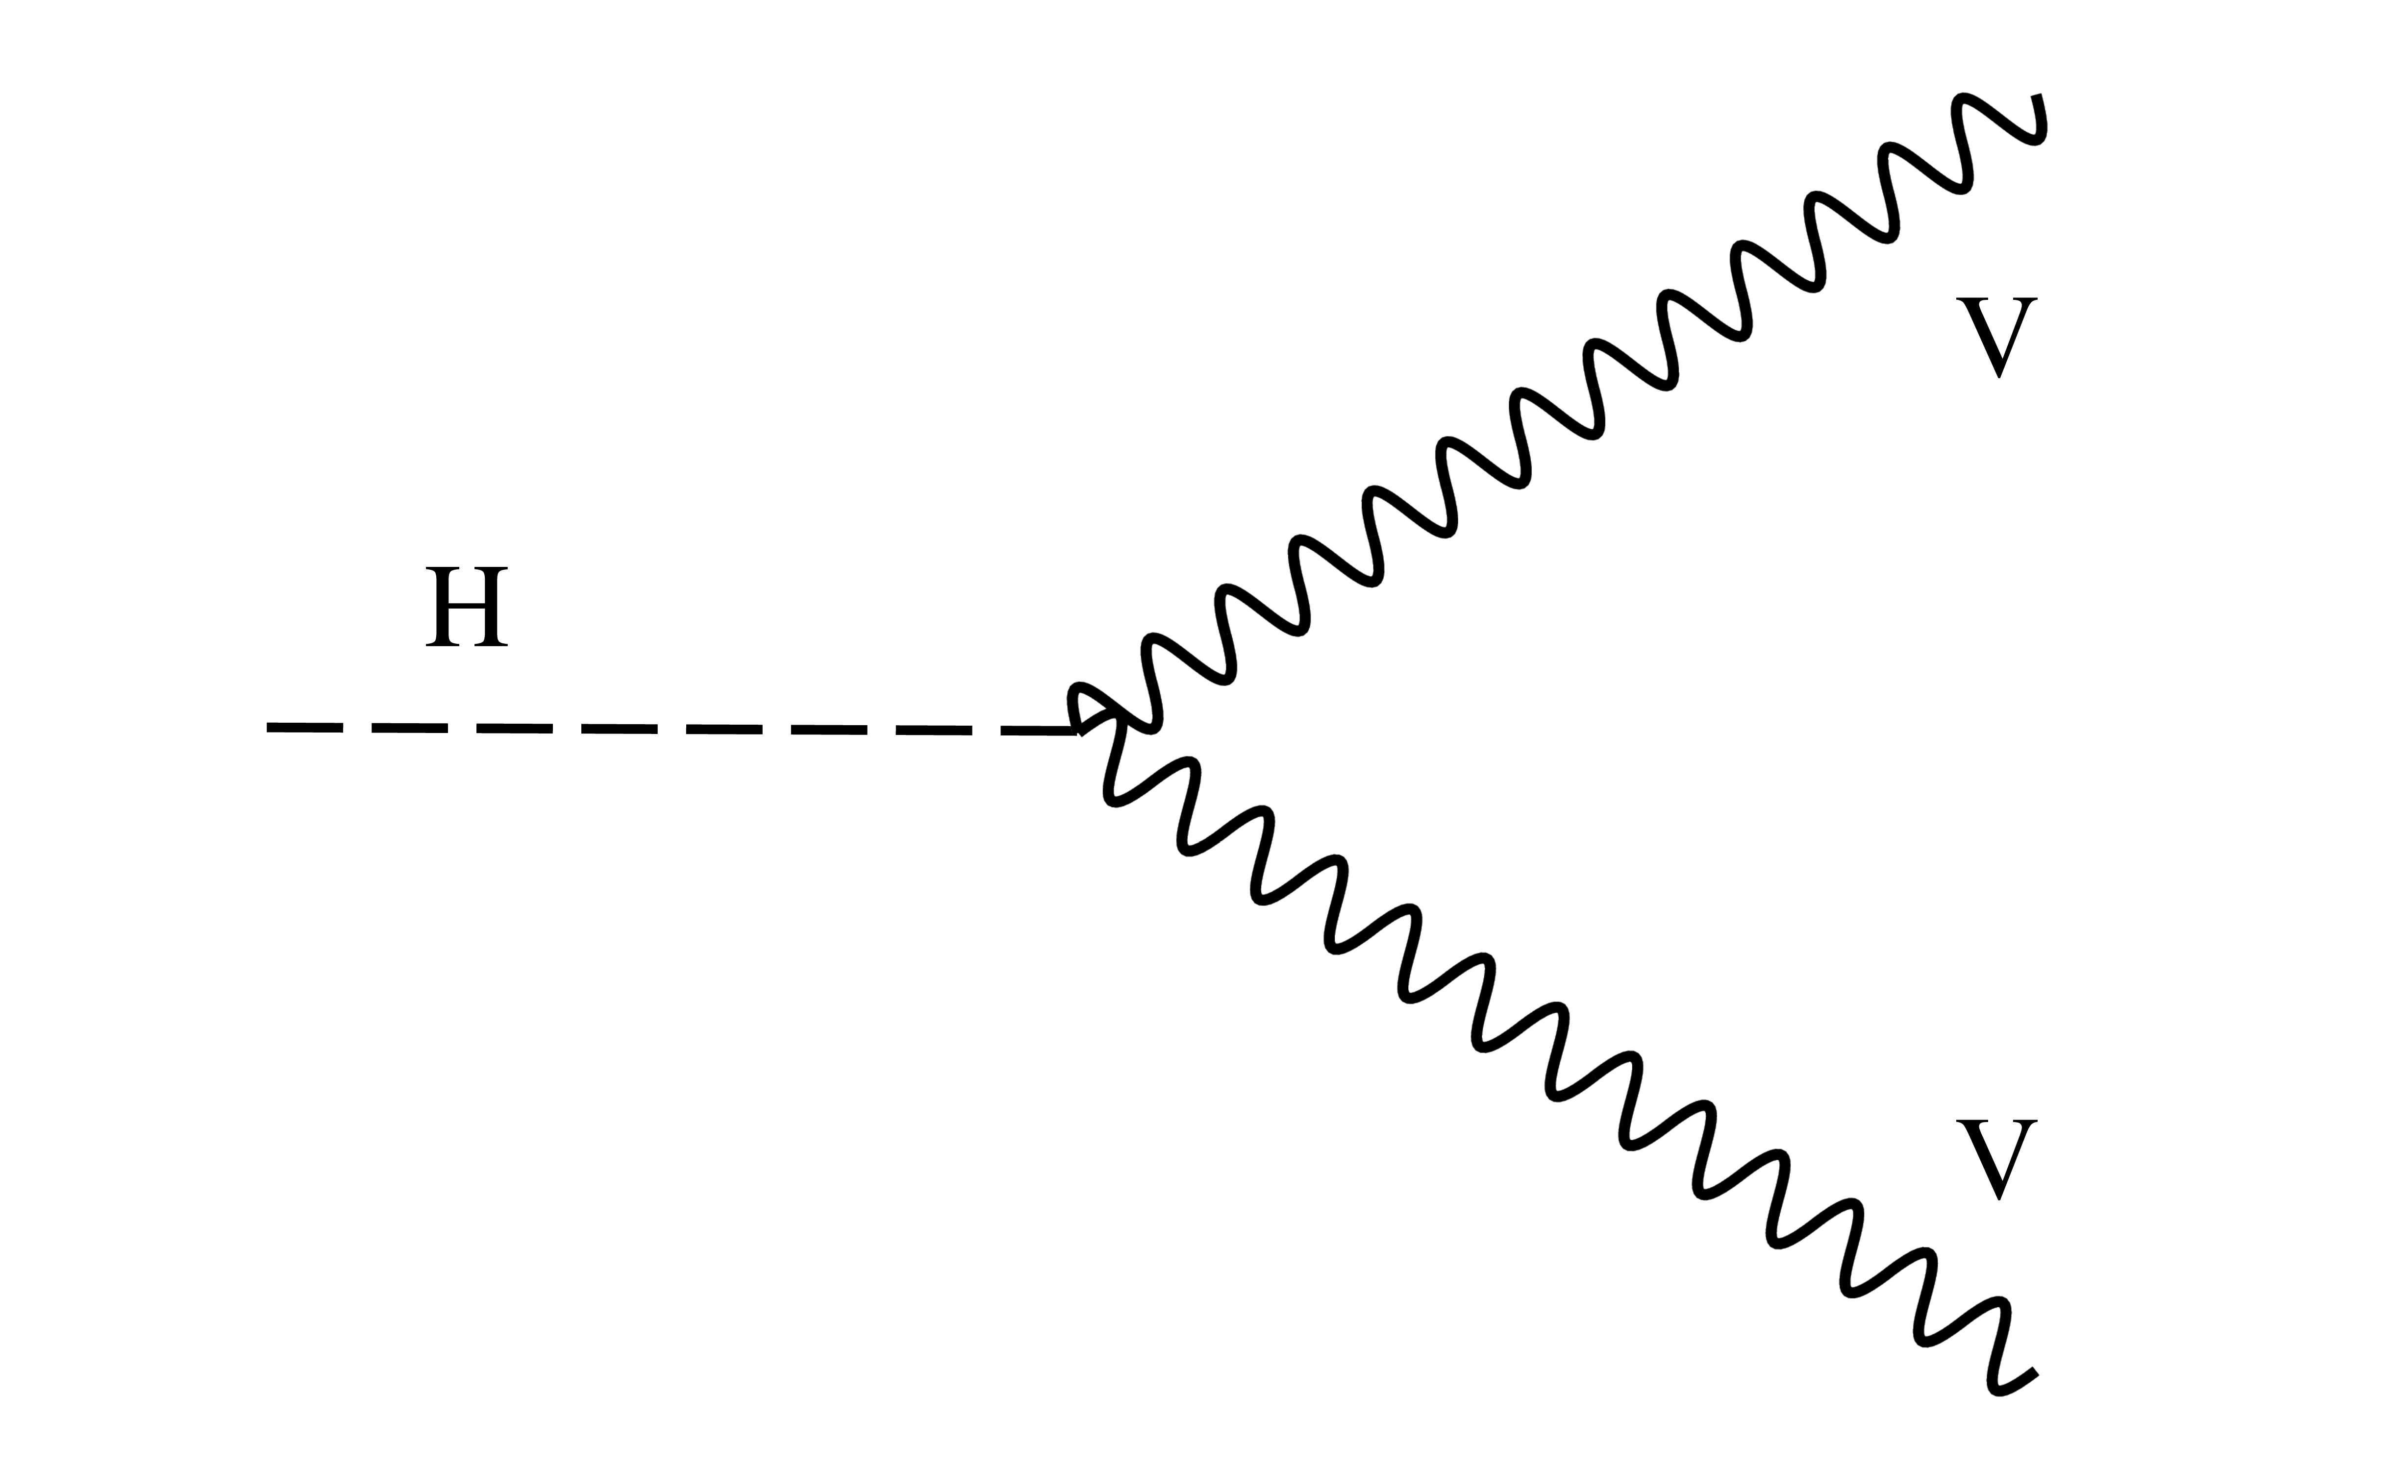
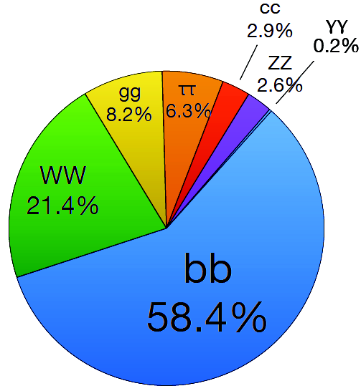
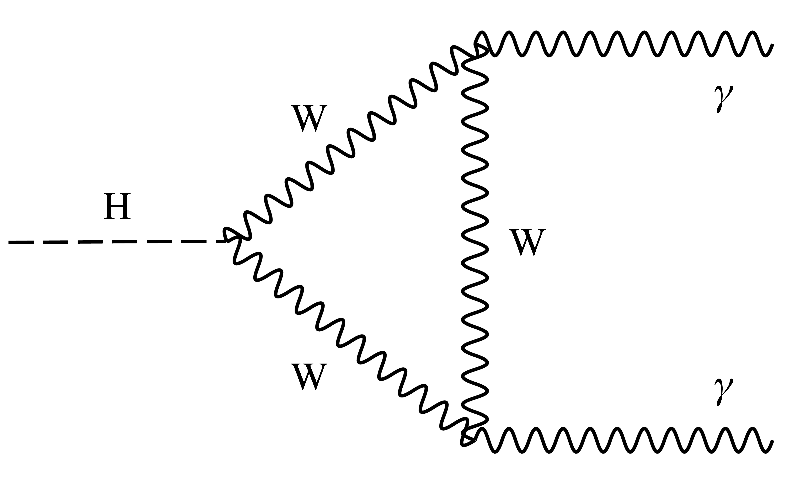
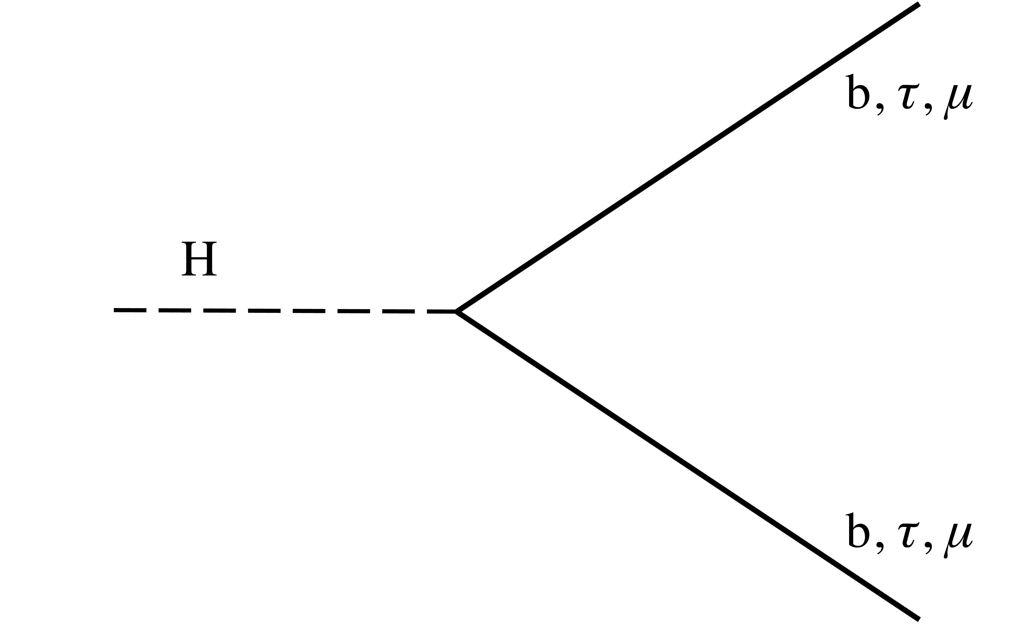
Higgs @ the LHC
Many different production and decay mechanisms
  Span 3 orders of magnitude in cross section and branching ratio
  Some very clean decays with low BR (γγ, 4l)
  Other very difficult with higher rates (bb, WW, ττ,...)
Access Higgs properties through combination of different channels
Enormous amount of progress since discovery 6 years ago!
Notes:
https://twiki.cern.ch/twiki/bin/view/LHCPhysics/LHCHXSWG#Latest_plots

Slide 20
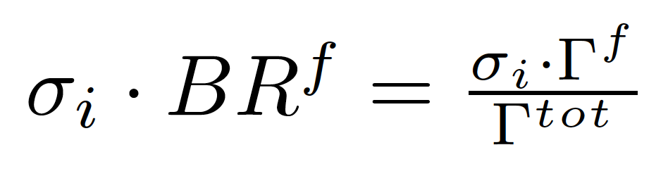
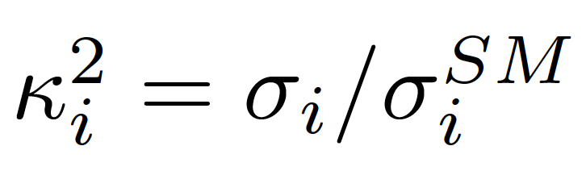
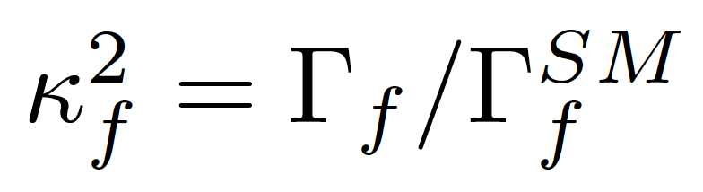
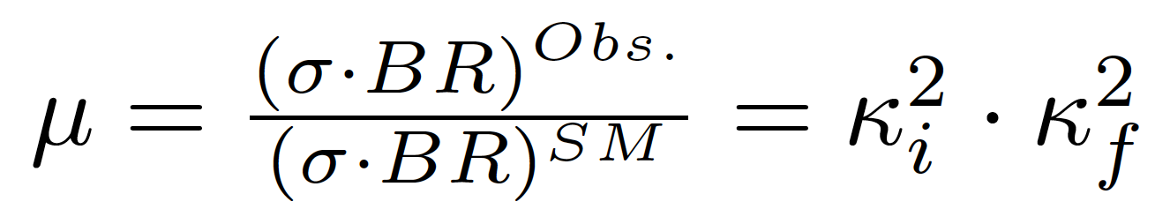
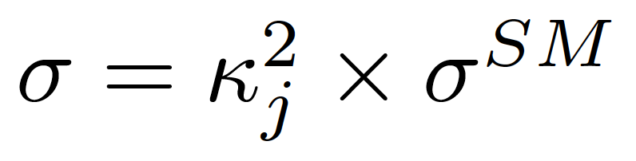
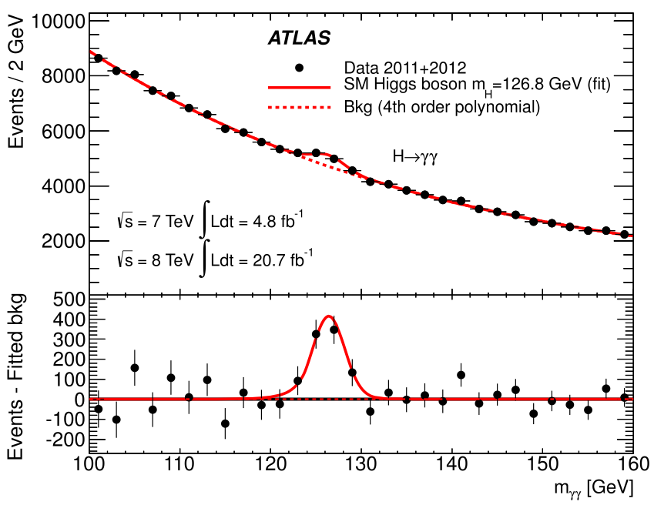
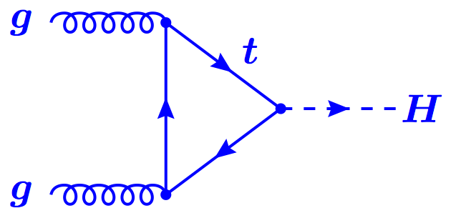
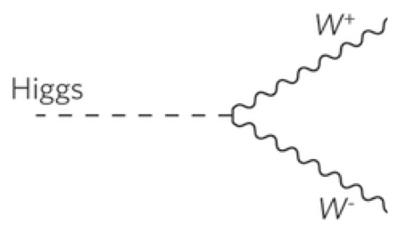
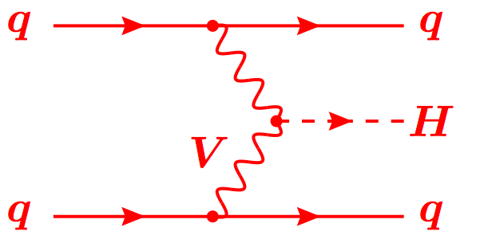
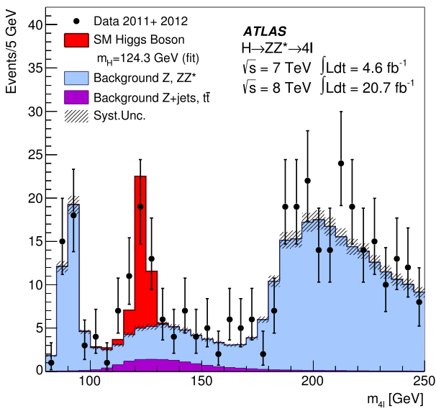

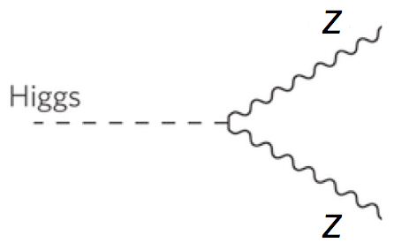






Production
Decay
FIT
H->γγ
×
H->ZZ
t
H->WW
t
Backgrounds +
t

Slide 21


The Run 1 legacy
Phys. Rev. Lett. 114 (2015) 191803
JHEP 08 (2016) 045
Mass – Higgs mass measured with 0.4% accuracy:
  m_{H} = 125.09 ± 0.21 (stat.) ± 0.11 (scale) ± 0.02 (other) ± 0.01 (theory) GeV
Couplings:
  ggF with H → ZZ,,WW observed by individual experiments
  VBF and H →  observed with >5σ significance by ATLAS+CMS combination
  ttH, VH production and H → bb not observed during Run1
Couplings compatible with SM:
  Signal strength: μ_{VBF+VH}/μ_{ggF+ttH} = 1.06 ^{+0.35} _{-0.27}
  Coupling modifiers broadly consistent with SM but large uncertainty
μ = (σ ×BR)_{Obs}/ (σ×BR)_{SM}
Significance (σ)
Prod. | Obs. | Expect.
VBF | 5.4 | 4.7
VH | 3.5 | 4.2
ttH | 4.4 | 2.0
Decay | Obs. | Expect.
H→ττ | 5.5 | 5.0
H→bb | 2.6 | 3.7
Notes:
https://atlas.web.cern.ch/Atlas/GROUPS/PHYSICS/PAPERS/HIGG-2015-07/
https://atlas.web.cern.ch/Atlas/GROUPS/PHYSICS/PAPERS/HIGG-2014-14/

Slide 22


The Run 1 legacy
Phys. Rev. Lett. 114 (2015) 191803
JHEP 08 (2016) 045
Mass – Higgs mass measured with 0.4% accuracy:
  m_{H} = 125.09 ± 0.21 (stat.) ± 0.11 (scale) ± 0.02 (other) ± 0.01 (theory) GeV
Couplings:
  ggF with H → ZZ,,WW observed by individual experiments
  VBF and H →  observed with >5σ significance by ATLAS+CMS combination
  ttH, VH production and H → bb not observed during Run1
Couplings compatible with SM:
  Signal strength: μ_{VBF+VH}/μ_{ggF+ttH} = 1.06 ^{+0.35} _{-0.27}
  Coupling modifiers broadly consistent with SM but still large uncertainty
μ = (σ ×BR)_{Obs}/ (σ×BR)_{SM}
Significance (σ)
Prod. | Obs. | Expect.
VBF | 5.4 | 4.7
VH | 3.5 | 4.2
ttH | 4.4 | 2.0
Decay | Obs. | Expect.
H→ττ | 5.5 | 5.0
H→bb | 2.6 | 3.7
Notes:
https://atlas.web.cern.ch/Atlas/GROUPS/PHYSICS/PAPERS/HIGG-2015-07/
https://atlas.web.cern.ch/Atlas/GROUPS/PHYSICS/PAPERS/HIGG-2014-14/

Slide 23




Run 2: Higgs boson mass
arXiv:1706.09936 [hep-ex]; arXiv:1806.00242 [hep-ex]
Mass measurement from CMS H→ZZ*→4l:
m_{H}^{ZZ*}= 125.26 ± 0.20 (stat) ± 0.08 (syst) GeV
New Measurements from ATLAS
  H→ γγ: m_{H}^{γγ} = 124.93 ± 0.40 GeV
  H→ZZ*→4l: m_{H}^{ZZ∗} = 124.79 ± 0.37 GeV
Run 1+2 combination from ATLAS:
  m_{H} = 124.97 ± 0.19 (stat) ± 0.13 (syst.) GeV
Notes:
https://atlas.web.cern.ch/Atlas/GROUPS/PHYSICS/PAPERS/HIGG-2016-33/ → 1 June 2018
http://cms-results.web.cern.ch/cms-results/public-results/publications/HIG-16-040/index.html → 8 April 2018
Both use 36.1 fb⁻¹ from 2015+2016

Slide 24




Differential Higgs boson cross sections
JHEP 11 (2017) 047; CMS-HIG-17-015; ATLAS-CONF-2018-002; ATLAS-CONF-2018-018
Reached a new phase in the exploration of the Higgs sector!
Differential cross sections:
  Higgs p_{T} sensitive to new physics in gluon-fusion loop
  Number of jets sensitive to modeling of radiation and different production modes
Notes:
https://atlas.web.cern.ch/Atlas/GROUPS/PHYSICS/PAPERS/HIGG-2017-11/ → 24 May 2018
https://atlas.web.cern.ch/Atlas/GROUPS/PHYSICS/CONFNOTES/ATLAS-CONF-2018-018/ → 04 Jun 2018
http://cms-results.web.cern.ch/cms-results/public-results/publications/HIG-16-041/ → 30 June 2017
http://cms-results.web.cern.ch/cms-results/public-results/preliminary-results/HIG-17-015/index.html → March 2017

Slide 25





arXiv:1802.04146; ATLAS-CONF-2017-047; CMS-PAS-HIG-18-001
Simplified template cross sections (STXS):
  Independent, simple fiducial region definitions for each Higgs production mode
  Common for ATLAS, CMS and theory
  Good balance between experimental precision and theory uncertainty
Notes:
http://atlas.web.cern.ch/Atlas/GROUPS/PHYSICS/PAPERS/HIGG-2016-21/ → 13 February 2018
https://atlas.web.cern.ch/Atlas/GROUPS/PHYSICS/CONFNOTES/ATLAS-CONF-2017-047/ → combination 5 July 2017
ATLAS: H→γγ and H→ZZ→4l cross section in 31 fiducial regions 36.1 fb⁻¹, 13 TeV used to measure

Slide 26






Evidence for H→bb
JHEP 12 (2017) 024; Phys. Lett. B 780 (2018) 501
Largest branching fraction (58.4%) but huge background from heavy flavour production
Must use associated production: WH/ZH
  Require 2 b jets + 0 (Z→𝜈𝜈), 1 (W→ℓ𝜈) or 2 (Z→ℓℓ) leptons
Largest backgrounds:
  Z+heavy flavour (0- and 2-lepton) and tt (1-lepton)
  Irreducible background from VZ with Z→bb
Significance:
  ATLAS: observed (expected) of 3.5𝝈 (3.0𝝈)
  CMS: observed (expected) of 3.3𝝈 (2.8𝝈) – 3.8𝝈(3.8𝝈) with Run 1
Notes:
http://cms-results.web.cern.ch/cms-results/public-results/publications/HIG-16-044/index.html → 21 September 2017
https://atlas.web.cern.ch/Atlas/GROUPS/PHYSICS/PAPERS/HIGG-2016-29/ → 10 August 2017

Slide 27



CMS observation of H→ττ
Phys. Lett. B 779 (2018) 283
Combine all final: 𝝉_{had}𝝉_{had}, 𝝉_{lep}𝝉_{had}, 𝝉_{lep}𝝉_{lep}
3 categories: 0-jet, VBF and boosted (mostly ggF)
35.9 fb-1 of 13 TeV data
2D likelihood fit using m_{𝜏𝜏}, m_{jj} or p_{T}^{𝜏𝜏}
Observed (expected) significance of 4.9𝝈 (4.7𝝈)
Combining with Run 1:
  36 fb-1 of 13 TeV data: 4.9 𝝈 observed; 4.7 𝝈 expected
  Combining with Run 1: 5.9 𝝈 observed; 5.9 𝝈 expected
  𝝁 = 0.98 ± 0.18
Notes:
http://cms-results.web.cern.ch/cms-results/public-results/publications/HIG-16-043/index.html → 1 August 2017

Slide 28



ATLAS observation of H→ττ
ATLAS-CONF-2018-021
Combine all final: 𝝉_{had}𝝉_{had}, 𝝉_{lep}𝝉_{had}, 𝝉_{lep}𝝉_{lep}
Categories targeting boosted Higgs (mostly ggF) and VBF (additional jets)
Dominant backgrounds from Z→𝝉𝝉 and jets faking taus
Cut-based analysis using fit to m𝜏𝜏 distribution in 13 signal regions
Largest uncertainties: data and MC statistics, signal modelling and jets
Cross section measurement (13 TeV):
𝝈^{ggF} = 3.0 ± 1.0 (stat.) ^{+1.6}_{-1.2} (syst.) pb; 𝝈^{VBF} = 0.28 ± 0.09 (stat.) ± 0.10 (syst.) pb
Significance:
  36 fb⁻¹ of 13 TeV data: 4.4 𝝈 observed; 4.1 𝝈 expected
  Combining with 7 and 8 TeV data: 6.4 𝝈 observed; 5.4 𝝈 expected
Notes:
https://atlas.web.cern.ch/Atlas/GROUPS/PHYSICS/CONFNOTES/ATLAS-CONF-2018-021/ → 3 June 2018

Slide 29




Observation of ttH production
arXiv:1806.00425 [hep-ex]
arXiv:1804.02610 [hep-ex]
24/12/2017 – Evidence from ATLAS:
  36.1 fb-1 in ttH(ττ, γγ, bb, VV): 4.2 σ observed, 3.8 σ expected
08/04/2018 – Observation in CMS:
  5.1 (7 TeV), 19.7 (8TeV), and 35.9 (13 TeV) fb-1:
  5.2 σ observed, 4.2 σ expected
01/06/2018 – Observation in ATLAS:
  79.8 fb⁻¹ for ttH(γγ, ZZ→4l) and with 36.1 fb-1 in ttH(bb) (13 TeV): 5.2 σ observed, 4.9 σ expected
  Adding 4.5 fb-1 (7 TeV) and 20.3 fb-1 (8 TeV): 6.3 σ observed, 5.1 σ expected
Direct access to top Yukawa coupling
Experimental tour-de-force!
  Complex final states
  Large irreducible backgrounds
  Small cross sections: O(0.5)pb @ 13 TeV
Use all available final states:
  H→bb: high stats but low purity BR≈58%, S/B≈1-6%
  Multileptons: H→𝜏𝜏, H→WW*, H→ZZ* BR = 30%, S/B=4-34%
  H→𝛾𝛾: clean but low stats BR = 0.23%, S/B=5-200%
  H→ZZ*→4lep: clean but very low stats BR = 0.01%, S/B=50-500%
Notes:
http://cms-results.web.cern.ch/cms-results/public-results/publications/HIG-17-035/index.html → 8 April 2018
https://atlas.web.cern.ch/Atlas/GROUPS/PHYSICS/PAPERS/HIGG-2018-13/ → 1 June 2018
24/12/2017 – Evidence from ATLAS:
36.1 fb-1 in ttH(ττ, γγ, bb, VV): 4.2 σ observed, 3.8 σ expected
08/04/2018 – Observation in CMS:
5.1 (7 TeV), 19.7 (8TeV), and 35.9 (13 TeV) fb-1:
5.2 σ observed, 4.2 σ expected
01/06/2018 – Observation in ATLAS:
79.8 fb⁻¹ for ttH(γγ, ZZ→4l) and with 36.1 fb-1 in ttH(bb) (13 TeV): 5.2 σ observed, 4.9 σ expected
Adding 4.5 fb-1 (7 TeV) and 20.3 fb-1 (8 TeV): 6.3 σ observed, 5.1 σ expected

Slide 30






ttH observation: bb and Multileptons
ttH(ML) Phys. Rev. D 97 (2018) 072003; arXiv:1803.05485 [hep-ex]
ttH(bb) Phys. Rev. D 97 (2018) 072016; JHEP 01 (2018) 054
ttH(H→leptons)
Sensitive to: H→𝜏𝜏, H→WW* and H→ZZ*
Event categories according to number of light charged leptons and hadronic 𝜏 decays
Backgrounds: ttW/ttZ, non-prompt leptons and jets faking taus
Main uncertainties: signal modelling, jet energy scale and non-prompt lepton estimate
ATLAS: 4.1𝝈 observed; 2.8𝝈 expected
CMS: 3.2𝝈 observed; 2.8𝝈 expected
ttH(H→bb):
Profit from large H→bb branching ratio (58.4%)
But challenging final state: large ttbb irreducible background, theory uncertainties, combinatorics...
Event categories according to number of light and b jets
Main uncertainties: tt+heavy flavours, b tagging, jet calibration
ATLAS: 1.2𝝈 observed; 1.6𝝈 expected
CMS: 1.6𝝈 observed; 2.2𝝈 expected
For both channels:
Intensive use of dedicated machine learning (neural nets, boosted decision trees) and matrix element method to discriminate against fake leptons, reconstruct events, flavour tagging, and to enhance signal/background separation
Notes:
ttH(ML) → http://cms-results.web.cern.ch/cms-results/public-results/publications/HIG-17-018/ → 14 March 2018
https://atlas.web.cern.ch/Atlas/GROUPS/PHYSICS/PAPERS/HIGG-2017-02/ → 24 December 2017
ttH(bb) → http://atlas.web.cern.ch/Atlas/GROUPS/PHYSICS/PAPERS/HIGG-2017-03/ → 24 December 2017
http://cms-results.web.cern.ch/cms-results/public-results/publications/HIG-17-006/index.htm → 14 August 2017

Slide 31






ttH observation
arXiv:1806.00425 [hep-ex]; arXiv:1804.02610 [hep-ex]
CMS:
Combined Run 1 + 36.1 fb⁻¹ Run 2:
5.2 σ observed, 4.2 σ expected
ATLAS:
ttH(H→𝛾𝛾):
  New signal categories from BDT discriminant
  Sensitivity increased by 50%
Run 2 data from 2015+2016+2017 (𝛾𝛾/ZZ): 79.8 fb⁻¹
  5.2 σ observed, 4.9 σ expected
Adding Run 1: 6.3 σ observed, 5.1 σ expected
Measured production cross section at 13 TeV:
  670 ± 90 (stat.) +110−100 (syst.) fb
Notes:
http://cms-results.web.cern.ch/cms-results/public-results/publications/HIG-17-035/index.html → 8 Abril 2018
http://atlas.web.cern.ch/Atlas/GROUPS/PHYSICS/PAPERS/HIGG-2018-13/ → 1 Jun 2018

Slide 32

Notes:
http://atlas.web.cern.ch/Atlas/GROUPS/PHYSICS/PAPERS/HIGG-2018-13/
data event from the tt̄H(γγ) Had BDT bin with the largest signal over background ratio. The event contains two photon candidates, with a diphoton mass of 125.4 GeV. In addition, six jets are reconstructed using the anti-k_{t} algorithm and R=0.4, including one jet that is b-tagged using a 77% efficiency working point. The photons correspond to the green towers in the electromagnetic calorimeter, while the jets (b-jets) are shown as yellow (blue) cones.

Slide 33

Summary
I could only show a few highlights of the ATLAS and CMS top and Higgs physics (a personal choice...)
What I have left out (LOTS!):
Top cross section measurements, BSM, FCNC searches, etc
Searches for 2nd generation fermion Higgs couplings, double-Higgs production, extended Higgs sector, etc
Analysis details showing their huge sophistication
Performance studies/improvements which make it all possible
Projections for future LHC/HL-LHC running
arXiv:1803.01853
Notes:
Gavin Salam (LHCP’18) “The >5σ observations of ttH and H → ττ, independently by ATLAS and CMS, firmly establish the existence of a new kind of fundamental interaction,
Yukawa interactions.”
(Hbb, Htt, etc.): not a gauge interaction, and unlike anything we’ve probed before

Slide 34

Summary
I could only show a few highlights of the ATLAS and CMS top and Higgs physics (a personal choice...)
What I have left out (LOTS!):
Top cross section measurements, BSM, FCNC searches, etc
Searches for 2nd generation fermion Higgs couplings, double-Higgs production, extended Higgs sector, etc
Analysis details showing their huge sophistication
Performance studies/improvements which make it all possible
Projections for future LHC/HL-LHC running
Overall highlight (personal bias):
“The >5σ observations of ttH and H → ττ, independently by ATLAS and CMS, firmly establish the existence of a new kind of fundamental interaction, Yukawa interactions.”
Gavin Salam (LHCP’18)
Notes:
Gavin Salam (LHCP’18) “The >5σ observations of ttH and H → ττ, independently by ATLAS and CMS, firmly establish the existence of a new kind of fundamental interaction,
Yukawa interactions.”
(Hbb, Htt, etc.): not a gauge interaction, and unlike anything we’ve probed before

Slide 35




Summary
I could only show a few highlights of the ATLAS and CMS top and Higgs physics (a personal choice...)
In conclusion:
Higgs and top results probe deeply into our understanding of Nature
So far, the SM holds
So we must look closer!
Because the truth New Physics is out there!
See here for more: ATLAS Public results page and CMS Publications page

Slide 36

Bonus slides
a

Slide 37


ATLAS, CMS and the LHC
Run 1: 2009 – 2013; ≈ 5 fb⁻¹ at √s = 7 and ≈ 20 fb⁻¹ at 8 TeV per experiment
Run 2: 2013 – 2018; expect > 150 fb⁻¹ at √s = 13 TeV by the end of run
Instantaneous luminosity of 2 x 10³⁴ cm⁻²s⁻¹ in 2017 (2x design!)
  Downside is pileup => experimental challenge!
  Multiple vertices, large occupancy, degraded reconstruction resolution, etc
  LHC breaking new ground to go around this: leveling!
R. Steerenberg (CERN), LHCC 30 May 2018

Slide 38


Leveling by beam offset
Anti-leveling: crossing angle
Anti-leveling: β* reduction
Eckhard Elsen, LHCP’18
β* reduction
crossing angle reduction steps

Slide 39
Exploring the electroweak scale
Precision measurements of m_{W}, m_{t}, m_{H} are stringent tests of the SM at the EW scale
  E.g. excluding measured m_{H}, global EW fit gives m_{H} = 90 ± 21 GeV (1.7 σ tension) driven in part by m_{top}
arXiv:1803.01853

Slide 40



Direct m_{t} measurement: single top
EPJC 77 (2017) 354
Focus on (electroweak) single-top production
First measurement not in tt pair!
  Independent sample
  Systematic uncertainties partially uncorrelated with other channels
L = 19.7 fb⁻¹ at √s = 8 TeV
Small xsec: σ(t/t) = 55/30 pb
Top reconstructed with kinematic fit assuming on-shell W
m_{t} = 172.95 ± 0.77 (stat) ^{+0.97}_{-0.93} (sys) GeV
Notes:
http://cms-results.web.cern.ch/cms-results/public-results/publications/TOP-15-001/index.html → 7 March 2017

Slide 41

Top quark width
Eur. Phys. J. C 78 (2018) 129
NNLO calculation gives Γ_{t} = 1.322 GeV for m_{t} = 172.5 GeV
  A clear deviation would indicate BSM physics
Data:
20.2 fb⁻¹ at √s = 8 TeV
Lepton+jets tt final state
Hadronic top reconstructed with kinematic fit
Γ_{t} extracted from template fit to m_{lb} and R_{min}(j,b) distributions
Coll. | Γ_{t} [GeV] | Ref.
D0 | 2.00 ^{+0.47}_{-0.43} | PRD85 (2012) 091104
CMS | 1.36 ± 0.02 (stat.) ^{+0.14}_{-0.11} | PLB736 (2014) 33
ATLAS | 1.76 ± 0.33 (stat.) ^{+0.79}_{-0.68} | EPJC78 (2018) 2, 129
Notes:
The measurement is performed using two observables sensitive to Γt: mlb, which is the reconstructed invariant mass of the system formed by the b-jet and the charged lepton l from the semileptonic top- quark decay, and ∆Rmin(jb, jl), defined as the angular distance1 between the b-jet jb associated with the hadronic top-quark decay and the closest light jet jl from the hadronically decaying W boson

Slide 42

LHC and HL-LHC timeline

