Slide 1
Trigger (& some DAQ basics) tutorial
Alessandro Cerri (CERN), Ricardo Goncalo (Royal Holloway)

Slide 2
The plan
Aim: give you enough familiarity with the ATLAS trigger and related EDM components
Target: people with limited or no knowledge of trigger, tools and their effects/features
Part I
  How does ATLAS data get out of Point 1
  Why do I care?
  What do I need to know?
  …linguistics
Part II
  Hands-on tutorial based on toy analyses

Slide 3
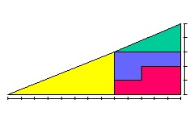
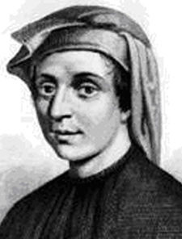
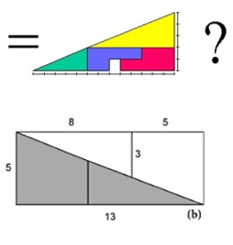
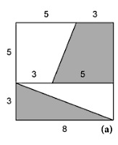
If you know all this…
The ‘celt stone’: parity violation in classical mechanics?
1, 1, 2, 3, 5, 8, 13, 21, 34…

Slide 4
Part I

Slide 5
Outline
Trigger & DAQ in ATLAS
Trigger
  Overall structure, capabilities & limitations
  Streams, overlaps
  Luminosity, live time, dead time
  LVL1
    primitives
  HLT
    Algorithms, chains, sequences
    EDM ‘remnants’ of trigger processing
    HLT menu
Trigger configuration
  Menus, Prescales
Conditions
  TriggerTool, TriggerDB, menu keys [supermaster, HLT, LVL1], prescale sets

Slide 6
ATLAS TDAQ

Slide 7
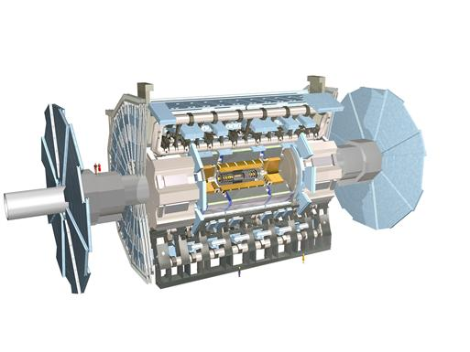

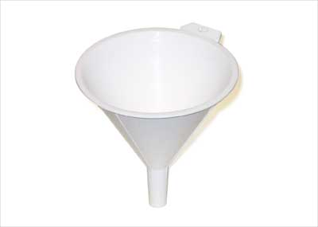
Introduction
TDAQ is the funnel that conveys data from ATLAS to CASTOR
Data needs to be:
  Compressed
  Skimmed
  Recorded
…all in real time!
X 4x10⁷ / s
X ~200 / s
(27 CD/min, 7km/yr)

Slide 8
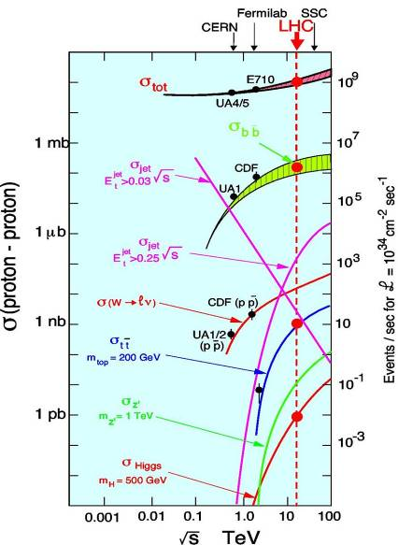
Challenges faced by the ATLAS TDAQ system
Much of ATLAS physics means cross sections at least ~10⁶ times smaller than total cross section
25ns “bunch crossing” interval (40 MHz)
Event size 1.5 MB (x 40 MHz = 60 TB/s)
Offline storing/processing: ~200 Hz
  ~5 events per million crossings!
In one second at design luminosity:
  O(40 000 000) bunch crossings
  ~2000 W events
  ~500 Z events
  ~10 top events
  ~0.1 Higgs events?
  200 events written out
We’d like the right 200 events to be written out!...

Slide 9
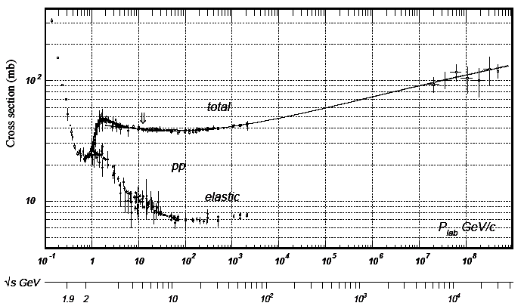
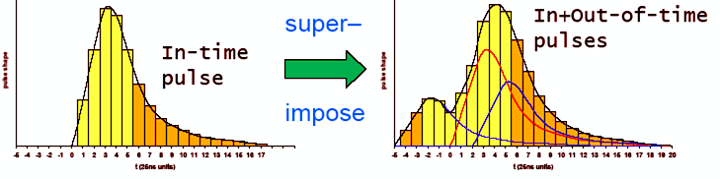
Challenges faced by the ATLAS trigger
L = 10³⁴ cm⁻²s⁻¹ = 10⁷mb⁻¹Hz
σ = 70 mb
=> Rate = 70x10⁷Hz
Δt = 25ns = 25x10⁻⁹ Hz⁻¹
=> Events/25ns = 70x25x10⁻² = 17.5
Not all bunches full (2835/3564)
22 events/crossing
Detector response time varies from a few ns to e.g. ~700 ns for MDT chambers
=> Pileup not only from the same crossing

Slide 10
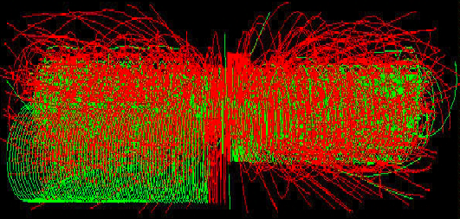
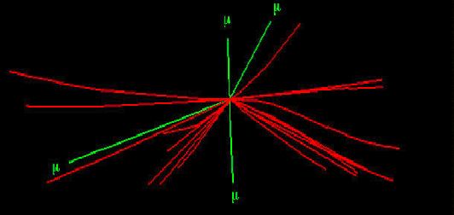
H->4μ

Slide 11
Trigger: levels
Choice is between
  Coarse & fast
  Precise & slow
We combine both:
  Three stages (“levels”) going from coarser to more precise and from real time (ns/event) to ‘slow’ (seconds/event)
  Events are skimmed to lower rates at each level, giving the next level ‘more time to think about them’
  Pipelined structure
“deadtimeless”

Slide 12
Trigger: dead time
How is dead time generated?
  Detector readout
  Excessive processing time
  “Backpressure”
How do we account for it?
  1st order (average user): luminosity in data is corrected by luminosity group
  2nd order (some special cases): more detailed insight may be needed
  See luminosity-group twiki

Slide 13
Trigger & DAQ: luminosity & conditions
Luminosity is uniquely defined only for fixed detector & selection configuration
This is never exactly true:
  Detector conditions vary without control (trips etc.)
  DAQ & selection criteria change (e.g. with luminosity, presence of noisy channels, readout problems etc.)
ATLAS data taking runs planned to last 10ths of hours
Luminosity blocks: our best approximation of periods with ‘constant data taking conditions’
  Passively defined (start-stop transitions, detector trips, slow control issues, machine conditions etc.)
  Actively enforced (trigger configuration changes, operator intervention etc.)
  Data quality flags, luminosity etc. are defined with this granularity
  Data itself (with few special exceptions) is handled in minimal units of ‘lumiblocks’

Slide 14
The ATLAS trigger
Three trigger levels:
Level 1:
  Hardware based (FPGA/ASIC)
  Coarse granularity detector data
  Calorimeter and muon spectrometer only
  Latency 2.5 μs (buffer length)
  Output rate ~75 kHz (limit ~100 kHz)
Level 2:
  Software based
  Only detector sub-regions processed (Regions of Interest) seeded by level 1
  Full detector granularity in RoIs
  Fast tracking and calorimetry
  Average execution time ~40 ms
  Output rate ~1 kHz
Event Filter (EF):
  Seeded by level 2
  Full detector granularity
  Potential full event access
  Offline algorithms
  Average execution time ~1 s
  Output rate ~200 Hz
High-Level Trigger

Slide 15
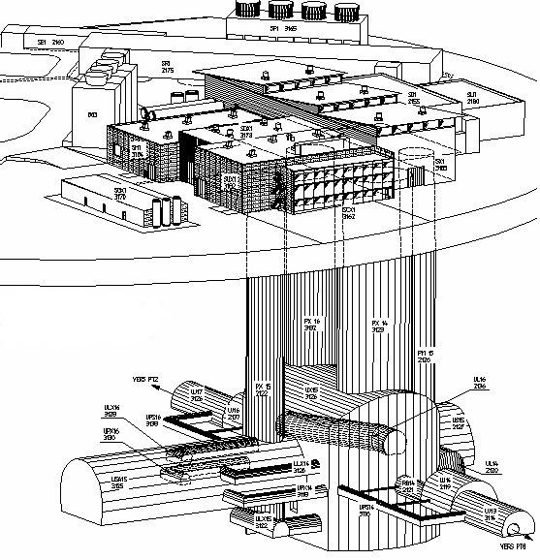
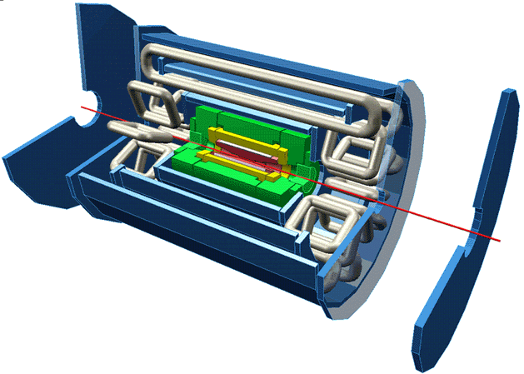
Trigger / DAQ architecture
CERN
computer
centre
4-code dual-socket nodes
6
~1600
~100
~ 500
Event rate
~ 200 Hz
Local
Storage
SubFarm
Outputs
(SFOs)
Event
Filter
(EF)
Event
Builder
SubFarm
Inputs
(SFIs)
LVL2
farm
Second-
level
trigger
Data
storage
DataFlow
Manager
Network
switches
pROS
stores
LVL2
output
Network switches
LVL2
Super-
visor
Gigabit Ethernet
Event data requests
Delete commands
Event data
pulled:
partial events
@ ≤ 100 kHz,
full events
@ ~ 3 kHz
Event size
~1.5MB
Requested event data
Regions Of Interest
Data of events accepted
by first-level trigger
~150
PCs
1600
Read-
Out
Links
VME
Dedicated links
Read-Out
Subsystems
(ROSs)
Read-
Out
Drivers
(RODs)
RoI
Builder
First-
level
trigger
Timing Trigger Control (TTC)
Event data pushed @ ≤ 100 kHz,
1600 fragments of ~ 1 kByte each

Slide 16
Streams and Overlaps
Multiple event selection schemes are implemented at once (e.g. ‘dimuon’ events, muon+jet, muon+Met etc.)
For data handling purposes written in different file sets (‘streams’), in files closed at lumiblock boundaries
Inclusive or exclusive approach possible
ATLAS chose inclusive streaming: the same event can end up in multiple streams…
  We waste some bandwith in favor of simpler data handling
  We must design our streams wisely
What happens with overlaps?

Slide 17
Prescales & passthroughs
Relative abundance of physics in pp collisions is defined by nature
We want to pick & choose
  We rank physics in our minds (…and different people have different ranks in their mind)
  Selections are the realization of our ranking (e.g. we raise the Pt threshold in single-muon triggers to suit our bandwidth desires)
  We want to sample also events below threshold, for several reasons:
    Understand our selection biases
    Provide calibration samples
    Debug trigger/DAQ
  ..this is implemented in the Trigger flexibility with two mechanisms:
Prescales: throw away N events every M being selected by a given criteria
  independent parameters at each level
  Independent parameters across selection criteria
  …what happens when I use events from several selection criteria which have different prescales in one analysis?
Passthroughs: skip a given selection at a given trigger stage and impose the decision

Slide 18
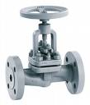
LVL1 Passthrough
LVL1 Prescale
LVL2 Prescale
LVL2 Passthrough
EF Passthrough
EF Prescale

Slide 19
Trigger decision
As part of event payload we store whether a given trigger strategy accepted that event: ‘trigger decision for each level’
Prescales complicate the picture:
  Decision before prescale
  Decision after prescale
REM: a single ‘stream’ contains multiple sources of trigger decision, with potentially different prescales
Q: How do we evaluate integrated luminosity if we use a logical combination of several selections with different prescales?

Slide 20
Trigger-DAQ role in analyses
A blessing, but also a curse
  Biases
    Physics content: Trigger selection
    …but not only: Readout (errors?)
Ideally you want to:
  Optimize event selection for your specific channel
  Account for it in your analysis
    Tighter offline selection
    Looser offline selection

Slide 21
LVL1 flexibility
256 different selection criteria can be implemented, choosing and partly) combining:
  ‘muon’ triggers (6 Pt thresholds)
  ‘calorimetry’ triggers ( [EM,J,TAU] 3x8 + 4 [forward] + 8 [global: Et etc.])
  MBTS, ZDC, Lucid
  ‘special’ triggers:
    RNDM
    Calibration
    Cosmic specific (scintillators, TRT etc.)
    Bunch groups (signals synchronous with the bunch structures in LHC)

Slide 22
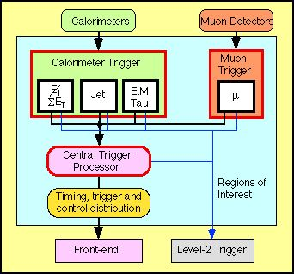
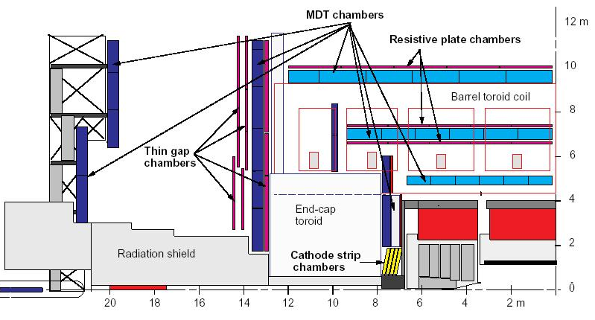
Level 1 architecture
Level 1 uses calorimeter and muon systems only
Muon spectrometer:
  Dedicated (fast) trigger chambers
    Thin Gap Chambers – TGC
    Resistive Plate Chambers – RPC
Calorimeter:
  Based on Trigger Towers: analog sum of calorimeter cells with coarse granularity
  Separate from precision readout
Identify regions of interest (RoI) and classify them as MU, EM/TAU, JET
On L1 accept, pass to level 2:
  RoI type
  E_{T} threshold passed
  Location in η and ϕ
calorimeter

Slide 23
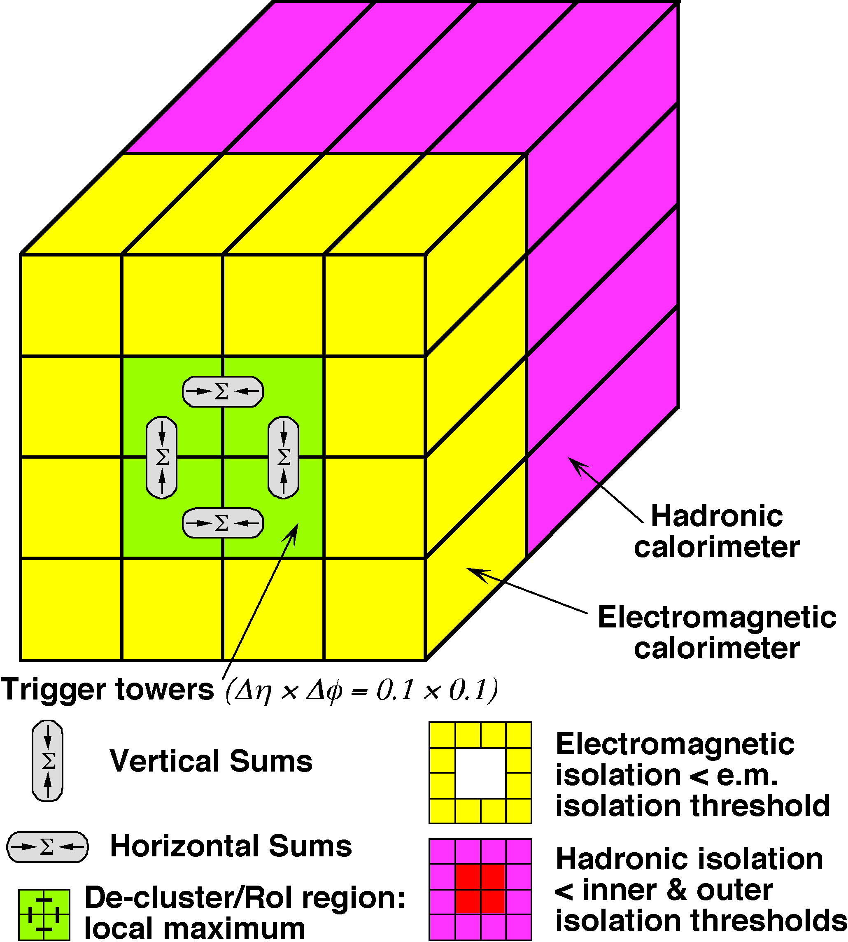
Level 1: Calorimeter Trigger
e/γ trigger
Coarse granularity trigger towers
  Δη×Δϕ = 0.1×0.1 for e, γ, τ up to |η|<2.5
  Δη×Δϕ = 0.2×0.2 for jets, up to |η|<3.2
Search calorimeter for physical objects (sliding window)
  e/γ: isolated electromagnetic clusters
  τ/hadrons: isolated hadronic clusters
  Jets: local E_{T} maximum in programmable 2x2, 3x3 or 4x4 tower sliding window
  Extended to η=4.9 wit low granularity (FCAL)
  ΣE_{T}^{em,had}, ΣE_{T}^{jets} and E_{t}^{miss} with jet granularity, up to η=4.9
Analog sum of calorimeter cells; separate from precision readout
  Separate for EM and hadronic towers

Slide 24
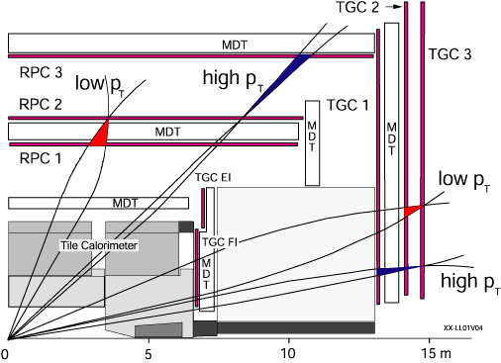
Level 1: Muon trigger
Uses dedicated trigger chambers with fast response (RPC, TGC)
Searches for coincidence hits in different chamber double-layers
  Starting on pivot plan (RPC2, TGC2)
Example:
Low-p_{T} threshold (>6GeV) look for 3 hits out of 4 planes
High-p_{T} threshold (>20GeV) look for 3 hits out of 4 planes + 1 out of 2 in outer layer
Algorithm is programmable and coincidence window is p_{T}-dependent
Toroid

Slide 26
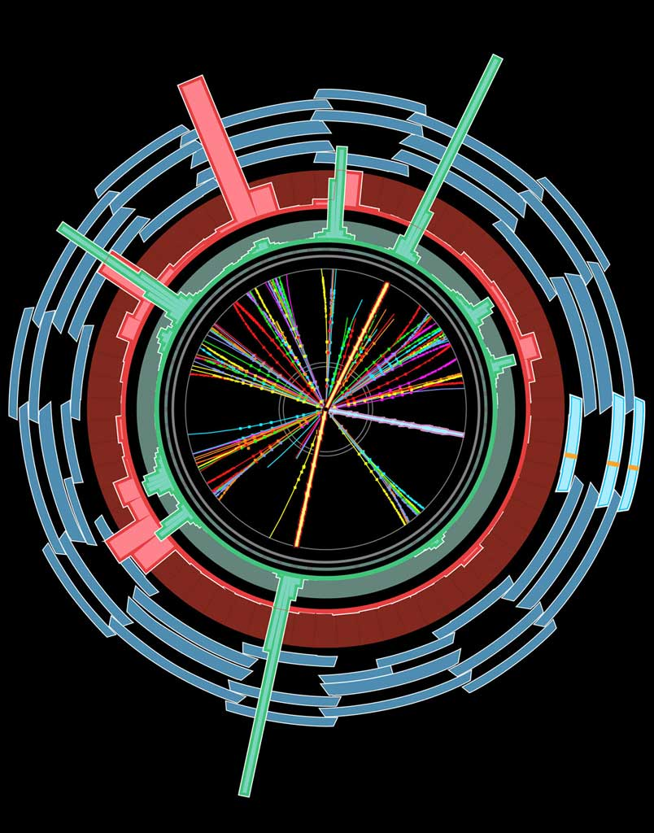
Selection method
Level1 Region of Interest is found and threshold/position in EM calorimeter are passed to Level 2
EMROI
L2 calorim.
Event rejection possible at each step
cluster?
Electromagnetic
clusters
Level 2 seeded by Level 1
Fast reconstruction algorithms
Reconstruction within RoI
L2 tracking
track?
match?
E.F.calorim.
E.F.tracking
Ev.Filter seeded by Level 2
Offline reconstruction algorithms
Refined alignment and calibration
track?
e/γ reconst.
e/γ OK?

Slide 27
High Level Trigger architecture
Basic idea:
Seeded and Stepwise Reconstruction
Regions of Interest (RoI) “seed” trigger reconstruction chains
Reconstruction (“Feature Extraction”) in steps
  One or more algorithms per step
Validate step-by-step in “Hypothesis” algorithms
  Check intermediate signatures
Early rejection: rejects hypotheses as early as possible to save time/resources
Note:
Level 2 usually accesses only a small fraction of the full event (about 2%)
  Depends on number and kind of Level 1 RoI’s
  “Full-scan” is possible but too costly for normal running
Event Filter runs after event building and may analyse full event
  But will normally run in seeded mode, with some exceptions (e.g. E_{T}^{miss} triggers)

Slide 28
Trigger Algorithm Steering
One top algorithm (Steering) manages the HLT algorithms:
  Determines from trigger Menu what chains of algorithms exist
  Instantiates and calls each of the algorithms in the right sequence
  Provides a way (the Navigation) for each algorithm to pass data to the next one in the chain
Feature caching
  Physical objects (tracks etc) are reconstructed once and cached for repeated use
Steering applies prescales
  Take 1 in N accepted events
And passthrough factors
  Take 1 in N events
More technical details:
  Possible to re-run hypothesis algorithms offline – study working point for each trigger
  Possible to re-run prescaled-out chains for accepted events (tricky…for expert studies)

Slide 29
Trigger algorithms
High-Level Trigger algorithms organised in groups (“slices”):
  Minimum bias, e/γ, τ, μ, jets, B physics, B tagging, E_{T}^{miss}, cosmics, plus combined-slice algorithms (e.g. e+E_{t}^{miss})
Level 2 algorithms:
  Fast algorithms – make the best of the available time
  Minimize data access – to save time and minimize network use
Event Filter algorithms:
  Offline reconstruction software wrapped to be run by Steering algorithm in RoI mode
  More precise and much slower than L2
  Optimise re-use and maintenability of reconstruction algorithms
  Ease analysis of trigger data and comparison with offline (same event data model)
  Downside can be a lower flexibility in software development (different set of people/requirements)
Different algorithm instances created for different configurations
  E.g. track reconstruction may be optimized differently for B-tagging and muon finding
All algorithms running in ATLAS software framework ATHENA
  No need to emulate the high-level trigger software
  In development: run MC production from Trigger configuration database
  Only Level 1 needs to be emulated

Slide 30
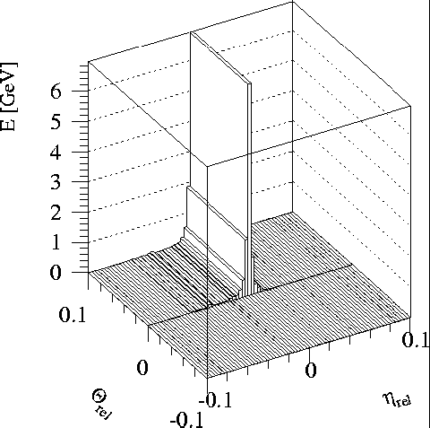
Example: level 2 e/γ calorimeter reconstruction
Full granularity but short time and only rough calibration
Reconstruction steps:
  LAr sample 2; cluster position and size (E in 3x3 cells/E in 7x7 cells)
  LAr sample 1; look for second maxima in strip couples (most likely from π⁰→γγ, etc)
  Total cluster energy measured in all samplings; include calibration
  Longitudinal isolation (leakage into hadronic calorimeter)
Produce a level 2 EM cluster object
π⁰
γ

Slide 32
FEX
FEature eXtraction algos produce
Features on which selection in
HYPOthesis algos is based
EMROI
features
L2 calorim.
L2 calorim.
HYPO
TrigEMCluster
T.E.
OK?
OK?
Chain:
  Started, if seed has fired and chain is not prescaled
  Stopped at step, if a HYPO is not passed
  Last HYPO passed → chain passed
Event:
  Passed, if at least one EF chain is passed
  Put into all streams that are associated with any passed EF chain
Trigger information in
  Trigger Decision +
  Trigger features +
  Trigger Navigation +
  Configuration
L2 tracking
TrigInDetTracks
T.E.
match?
E.F.calorim.
E.F.calorim.
CaloCluster
T.E.
E.F.tracking
track?
ESD
AOD
DPD
TAG
e/γ reconst.
e/γ reconst.
decision
egamma
T.E.
features
γ OK?
e± OK?
T.E.
passed e/γ trigger

Slide 33
What’s there? – Features
Features can be retrieved through the “TriggerNavigation” using the TrigDecisionTool
Features are created by FEX algorithms. They appear in StoreGate in containers according to FEX name. A FEX also creates a “TriggerElement” (TE)
  A TE is used as handle to the feature
  A TE has a pass/fail state set by the HYPO corresponding to the FEX
So the navigation can give you the TE’s for all the FEX that run in a chain
  Or just those that passed the last step in the chain
  From there you get the features (type templated)
  This is the correct way to retrieve the features for each RoI
TrigEMCluster
T.E.
TrigInDetTrack
T.E.
CaloCluster
T.E.
egamma
T.E.

Slide 35
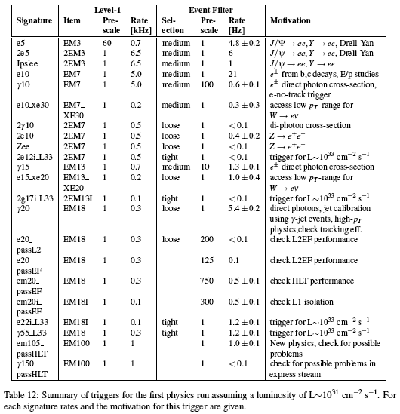
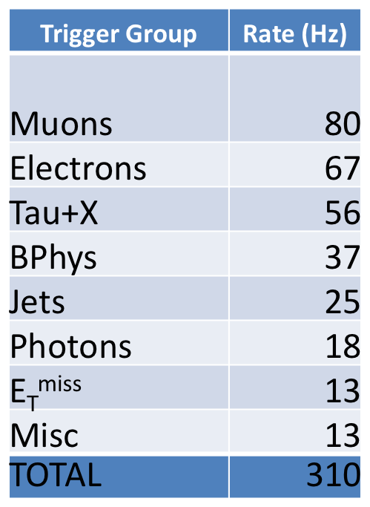
Trigger Menu
(just an example, definitely obsolete)
Complex menu, includes triggers for:
  Physics
  Detector calibration
  Minimum bias
  Efficiency measurement
Offline data streams based on trigger
Draft e/γ menu for L=10³¹cm⁻²s⁻¹
250Hz plus overlaps

Slide 36
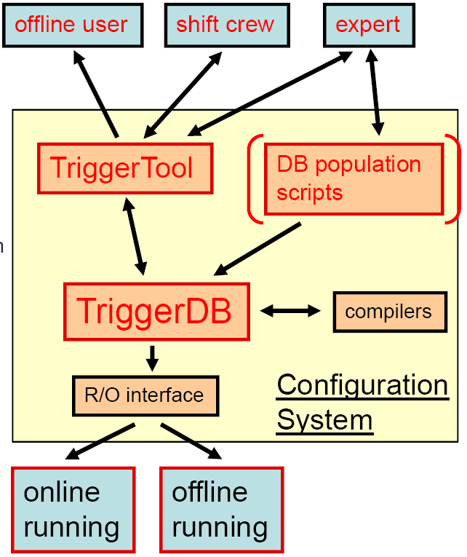
Configuration
Trigger configuration:
  Active triggers
  Their parameters
  Prescale factors
  Passthrough fractions
  Consistent over three trigger levels
Needed for:
  Online running
  Event simulation
  Offline analysis
Relational Database (TriggerDB) for online running
  User interface (TriggerTool)
  Browse trigger list (menu) through key
  Read and write menu into XML format
  Menu consistency checks
After run, configuration becomes conditions data (Conditions Database)
  For use in simulation & analysis

Slide 37
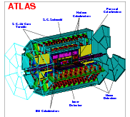
Configuration Data Flow
TriggerDB
All configuration data
Preparation
Configures
Stores
decoded Trigger Menu
Data
taking
Online
Conditions
Database
Encoded trigger decision
(trigger result from all 3 levels )
Decoded Trigger Menu
Trigger Result
passed?, passed through?, prescaled?, last successful step in trigger execution?
Trigger EDM
Trigger objects for trigger selection studies
Trigger Configuration
Trigger names (version), prescales, pass throughs
Data formats:
ESD
Reconstruction/
Trigger aware
analysis
AOD
With decreasing
amount of detail
DPD
TAG

Slide 38
How do I figure out how the trigger was configured…
Break down your sample by:
  Stream
  Lumiblock
Figure out how HLT/L1 were configured:
  By run number/interval:
http://atlas-service-db-runlist.web.cern.ch/
  Complex queries (search for a consistent set of detector/TDAQ conditions:
http://atlas-runquery.cern.ch/

Slide 39
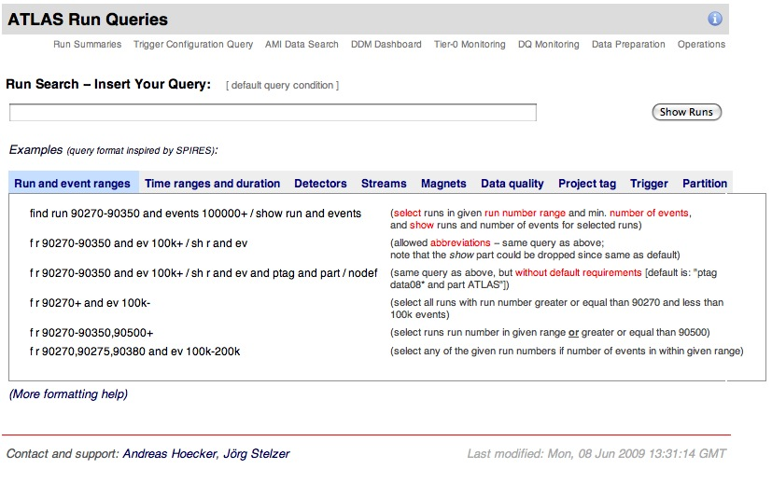
Run Query Page

Slide 40
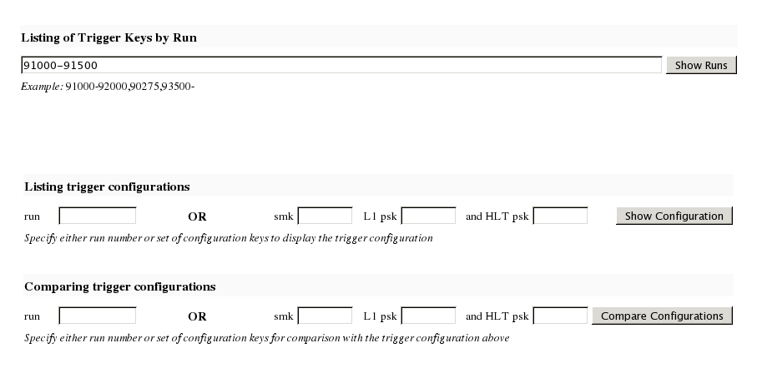
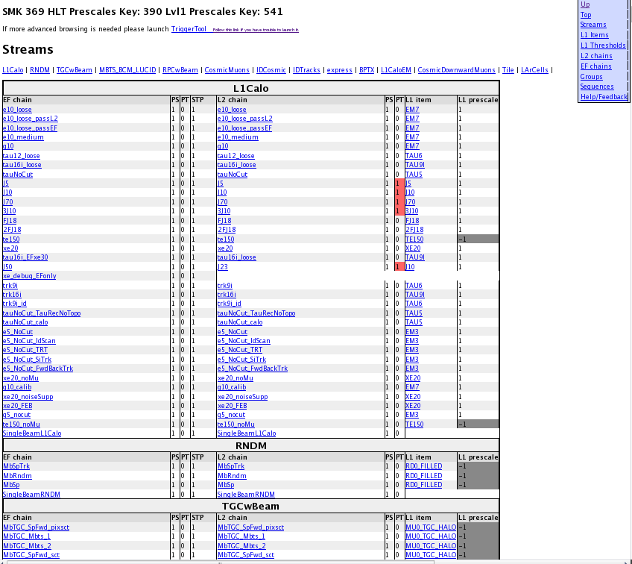
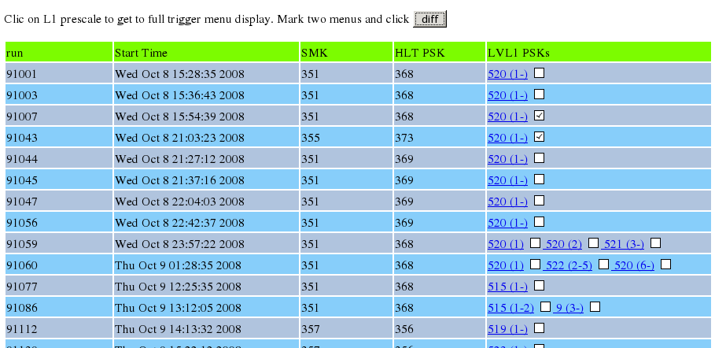
Web Interface to COOL and the TriggerDB
Web interface http://trigconf.cern.ch
  Runs TriggerTool on the server, result presented as dynamic html pages
1. Search
run-range
3. Trigger configuration (browsable)
(definition, algorithms, selection cuts)
2. Run list
Also with simple comparison functionality

Slide 41
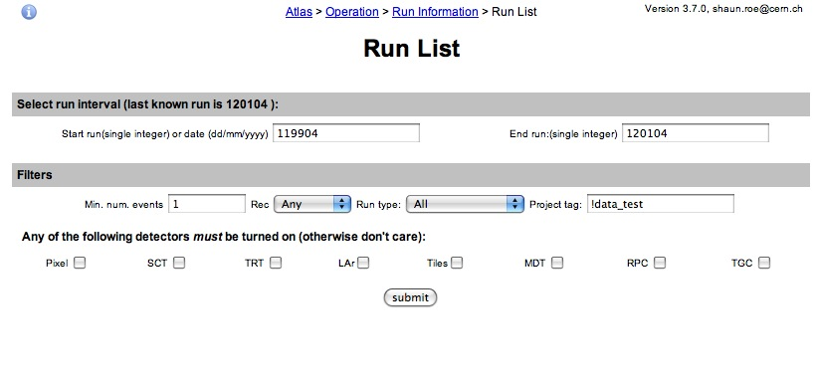
Run List Webpage

Slide 42
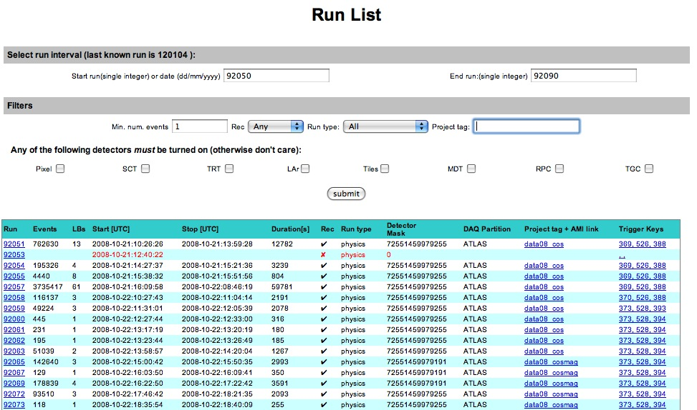
Run List: a query

Slide 43
Trigger Keys
Pointers to tables a special trigger conditions database (TriggerDB)
Trigger menu configuration
  One single number combining: L1+HLT
  Cannot change for a given run
Prescale values
  Separate L1 & HLT tables
  Can change along a run, in different lumiblocks

Slide 44
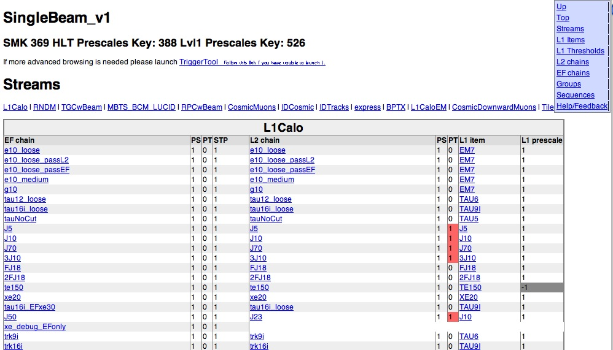
Trigger Menu page
(from trigger keys link)

Slide 45
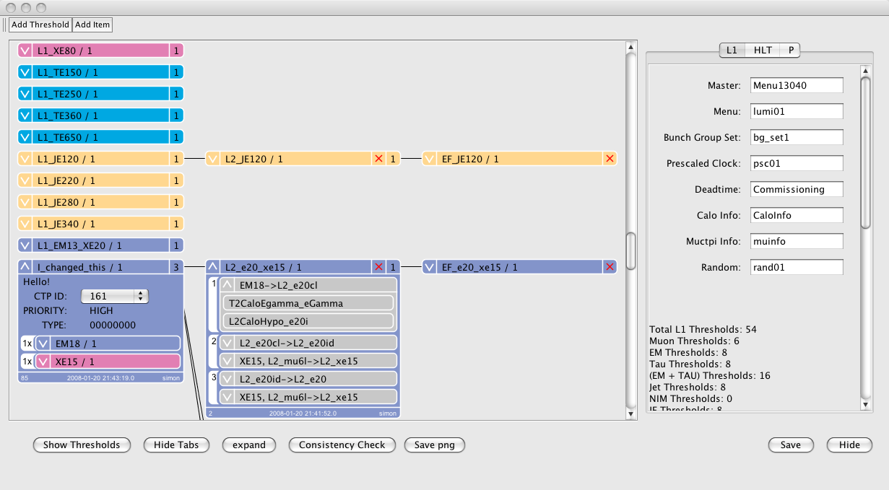
Viewing and Modifying a Menu
L1 Items in menu
L2 chains in menu
EF chains in menu
Record names
Menu can be edited by clicking the object
Some useful statistics
L1 Threshold
Steps
Input / Output Trigger Elements
Algorithms

Slide 46
What’s there? – Configuration Data
L1 Items: name, version, CTP-Id, prescale
HLT Chains: name, version, level, counter, prescale, trigger elements
Streams: chains feeding into each stream
Chain-groups: chains belonging to each group
Bunch-groups: name of each of the 8 BG

Slide 47
Trigger Menu Listing
Triger Menu and L1 rates stored in COOL, HLT rates coming. Quick access via
  Run summary pages (WEB based)
  http://atlas-service-db-runlist.web.cern.ch/atlas-service-db-runlist/query.html
    Trigger names, rates
  AtlCoolTrigger.py (command line tool)
    AtlCoolTrigger –r 91000‐99000 (many run summary)
    AtlCoolTrigger –v –m –r 90272 (single run menu)
    Prints keys, trigger menus, streams, allows diff‐ing of menus in different runs

Slide 48
Trigger-aware analysis
Analysis based on single trigger chain or an ‘OR’ of a few chains
Chain definition – algorithms, cuts, multiplicities – do not change during a run, but can change between runs
  Important for analysis on DPD, where multiple runs are merged
Prescales at LVL1 or at HLT can change between luminosity blocks
  A negative prescale means that this trigger is off. This is important for calculating the integrated luminosity

