Slide 1
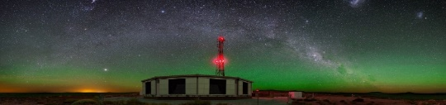

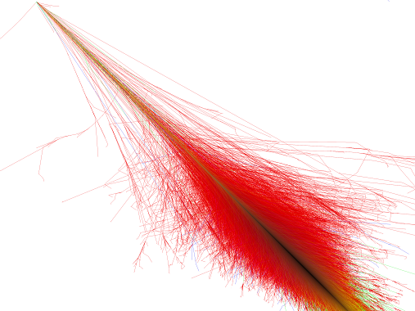

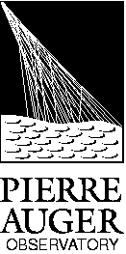

Study of the longitudinal and transverse cosmic ray shower profiles at the Pierre Auger Observatory
PhD Thesis in Physics
Supervisor: Mário Pimenta
Jury:
Doctor Sofia Andringa Dias
Doctor Glennys R. Farrar
Doctor Patrícia Carla Serrano Gonçalves
Doctor Mário João Martins Pimenta
Doctor Jan Řídký
Doctor Jorge Crispim Romão
João Pedro Canhoto Espadanal
Notes:
Good morning,
The title of my thesis is
the Study of the longitudinal and transverse cosmic ray shower profiles at the Pierre Auger Observatory

Slide 2
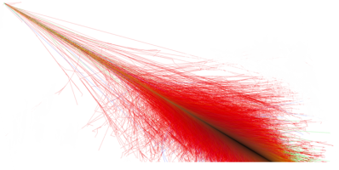
1. Physics Review
2. 3D Simulation
3. SD Energy Calibration with electromagnetic signal
4. Studies at MARTA
Notes:
I will begin by doing a first review of the physics of cosmic rays and the Pierre auger observatory

Slide 3
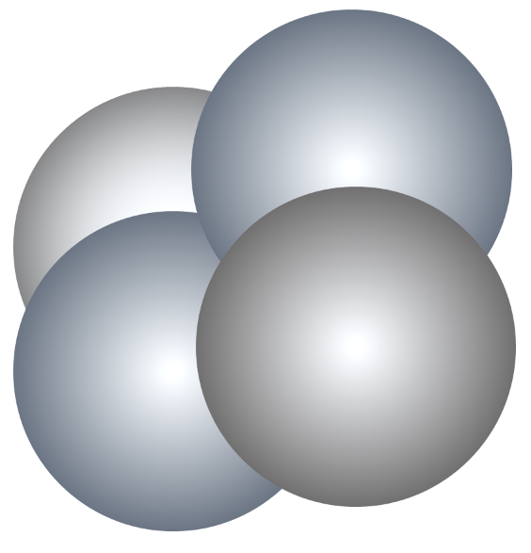
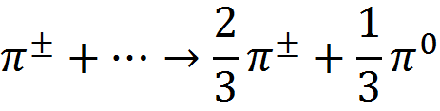
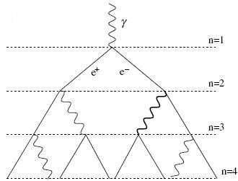


















Extensive Air Shower
Cosmic rays constantly hit the Earth (In Auger $E≳{10}^{18}$ eV and very small fluxes)
What is an Extensive Air Shower (EAS)?
Hadronic component
Cosmic Ray??
(p, Fe, ɣ ... )
The hadronic interactions produce
p n π⁰ + π⁺ + π ⁻
+ К Λ η Ω Σ …
Electromagnetic Component
$$π^{0}$$
$$π^{+}$$
Produced mainly by
π⁰ → ɣ ɣ
$$γ$$
$$π^{−}$$
$$e^{−}$$
Bremsstrahlung
Pair production
…
$$e^{+}$$
$$π^{0}$$
$$π^{+}$$
$$π^{−}$$
High energy pions
$$ν_{μ}$$
$$μ^{+}$$
$$ν_{μ}$$
Muonic Component
$$\overline{ν_{μ}}$$
$$μ^{−}$$
$$μ^{+}$$
Produced mainly by
electromagnetic
hadronic
muonic
Low energy pions can decay
Notes:
The Earth is constantly hit by extra-terrestrial particles.
But at the energies above 10^18 that we want to study at auger,
the CR fluxes are very small and we cannot detect them directly,
so there many unknowns
What is the composition of cosmic rays?
What is the origin of these extremely energetic particles?
And what kind of interactions occurs at those energies?
Since we cannot build a huge detector in space, We use the atmosphere as the detector.
So, when a cosmic ray enters the atmosphere, it will interact with the air nuclei, in an hadronic interaction, producing many of particles.
Many hadrons are produced, mostly pions with a fraction of 1/3 neutral pi and 2/3 charged pions.
These charge pions can interact again producing more particles
Which is usually called the hadronic component and is close to the axis.
The neutral pions, have a very small lifetime, so they decay almost immediately.
And they decay into two photons.
These photons produces e-e+ pairs
which will again produce more photons and in several processes and so on
. Creating the electromagnetic cascade.
When the charge pions losses most of their energy, they will not have time to interact,
And they will decay into muons and neutrinos producing the muon component.

Slide 4
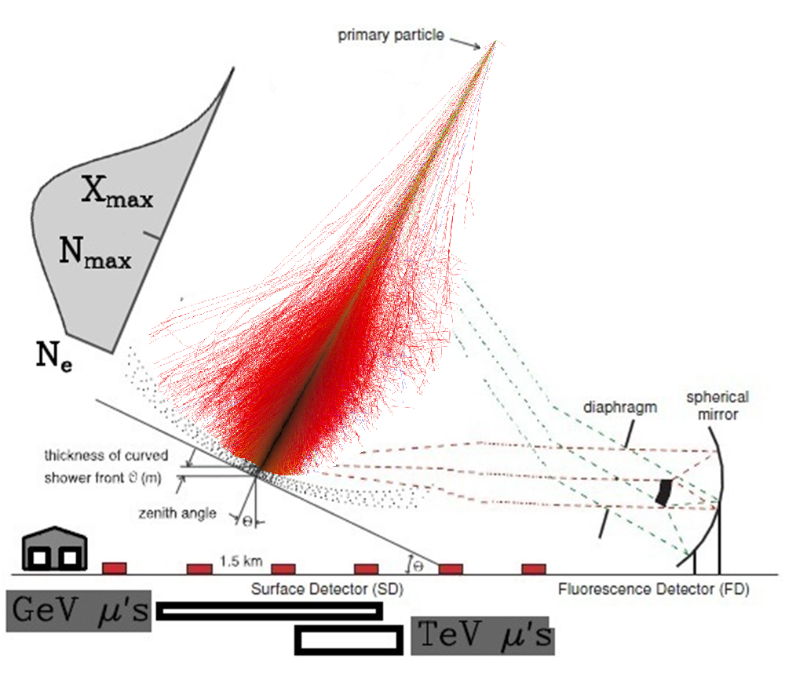
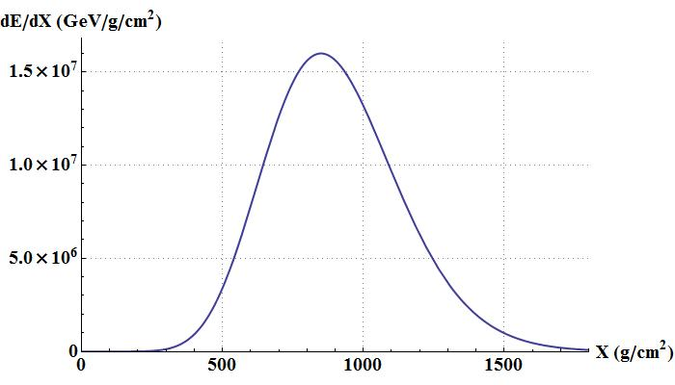
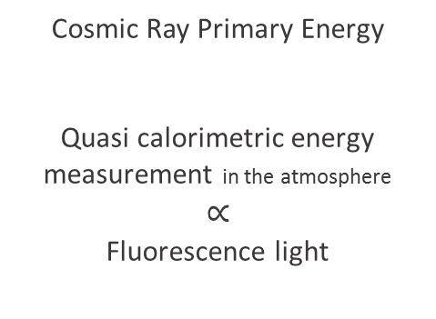
How to detect the Extensive air showers?
Through the emitted light with telescopes
From electromagnetic component
1. Cherenkov Light
2. Fluorescence Light in Nitrogen
Cherenkov
Light
Fluorescence Light
Through particles that reach the ground with surface detectors
  Electromagnetic component
  PLUS Muonic component
Longitudinal development: Deposited Energy
Cosmic Ray Primary Energy
Quasi calorimetric energy measurement in the atmosphere
$$∝$$
Fluorescence light
(dE/dX)max
Xmax
g/cm² of crossed atmosphere
Notes:
How can we detect those shower of particles?
When that cascade of particles pass through the air, they ionize and excite the nitrogen.
when the nitrogen return to the ground state, it emits light fluorescence.
Besides that, since those particles are relativistic particle they will emit Cherenkov light.
In this way we can be detect the fluorescence and Cherenkov light, simply by using telescopes.
the number of fluorescence photons are proportional to the energy deposited by the particles of the shower,
then, summing all the fluorescence light, we can obtain a longitudinal profile of the energy deposit in the atmosphere.
The integral of this curve will be basically/proportional to the energy of the cosmic ray,
and the atmosphere works like a calorimetry
This point with the bigger energy deposited is known as the xmax of the longitudinal development.
Moreover, that we can also detect the particles that reach the ground with surface detectors.
But here, we detect both electromagnetic and muon particles, while on the longitudinal it comes mainly from the electromagnetic component.

Slide 5
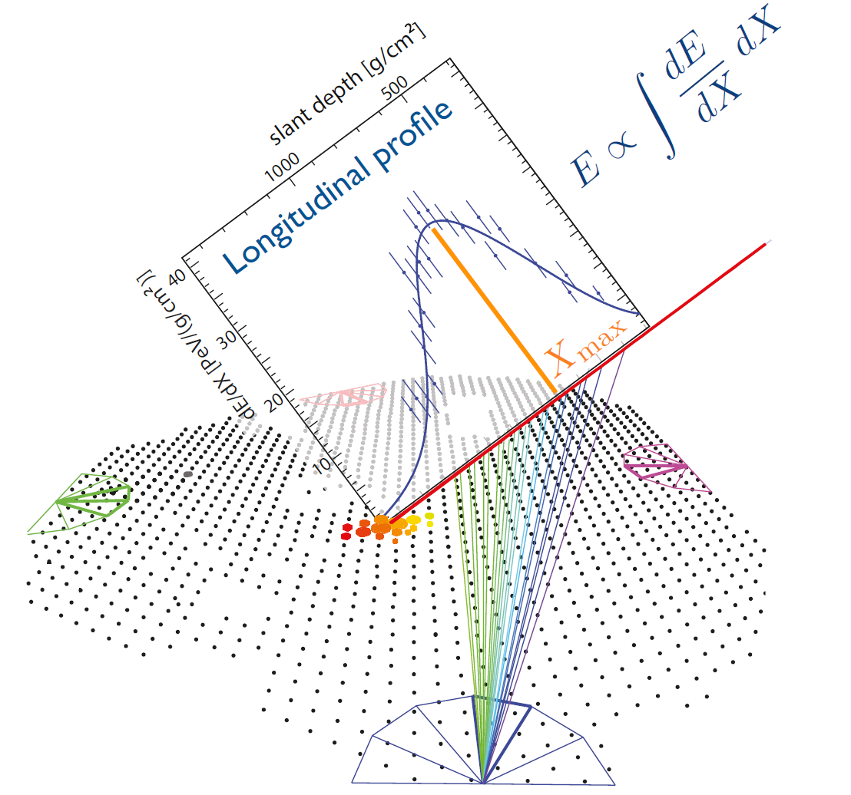
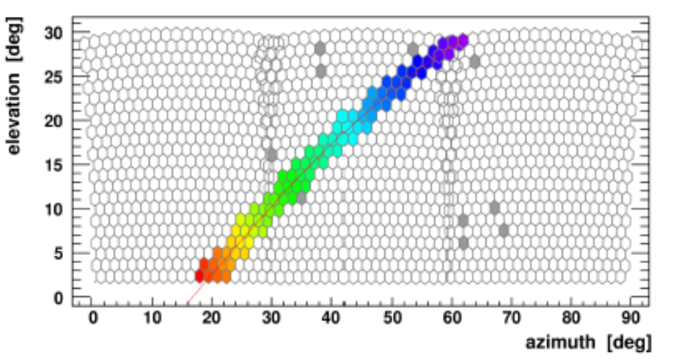
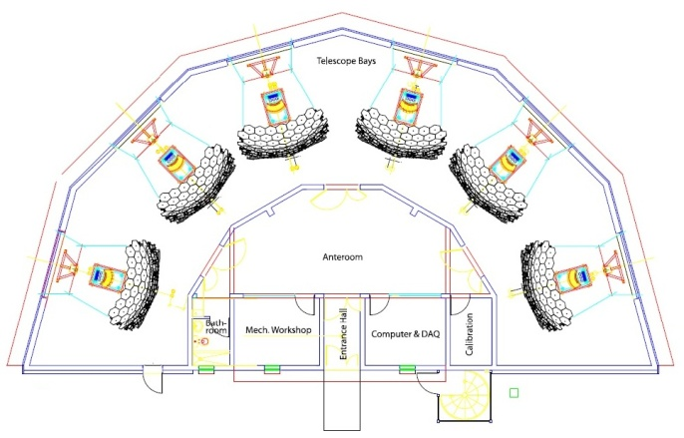
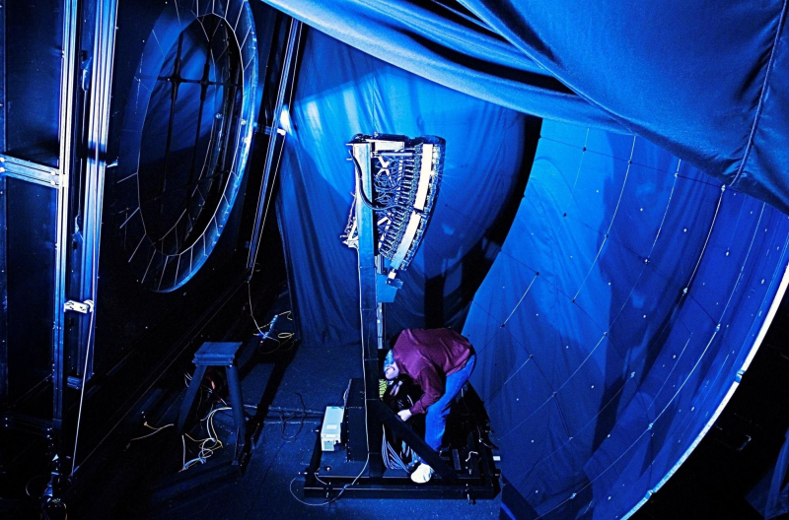
The Pierre Auger Observatory
Fluorescence detector
Loma Amarilla: E>1018 eV
Coihueco
Los Morados
Los Leones
HEAT: E>1017 eV
Pierre Auger Observatory
The Pierre Auger Observatory (PAO) was completed in May 2008 (3000km², 1600 Cherenkov tanks and 4 FD facilities, ...)
Surface detector array
1500 m: E>1018.5 eV
750 m (AMIGA): E>1017.5 eV
Radio detection
AERA (MHz)
EASIER (MHz, GHz)
MIDAS (GHz)
XLF
CLF
Calibration detectors
Lasers: Clf, Xlf
Lidar, Raman
Weather stations, IR camera
Atmospheric monitoring
Lasers: CLF, XLF
Lidar, Raman
Weather stations,
IR camera
Notes:
This is the map of the Pierre Auger observatory located at Mallargue Argentina,
it covers about 3000km^2.
To detect the shower light, we have 4 building, each one with 6 telescopes, in blue
and here is a representation of the building and a photo of one telescope.
There are also several atmospheric monitoring systems to control the systematic errors
This is an example of one event with 3 telescopes and the recovered longitudinal development with respective Xmax
This is the camera picture of the shower which contain some 3D shower information.

Slide 6
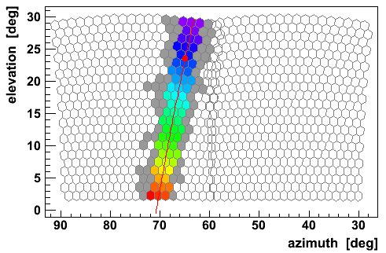


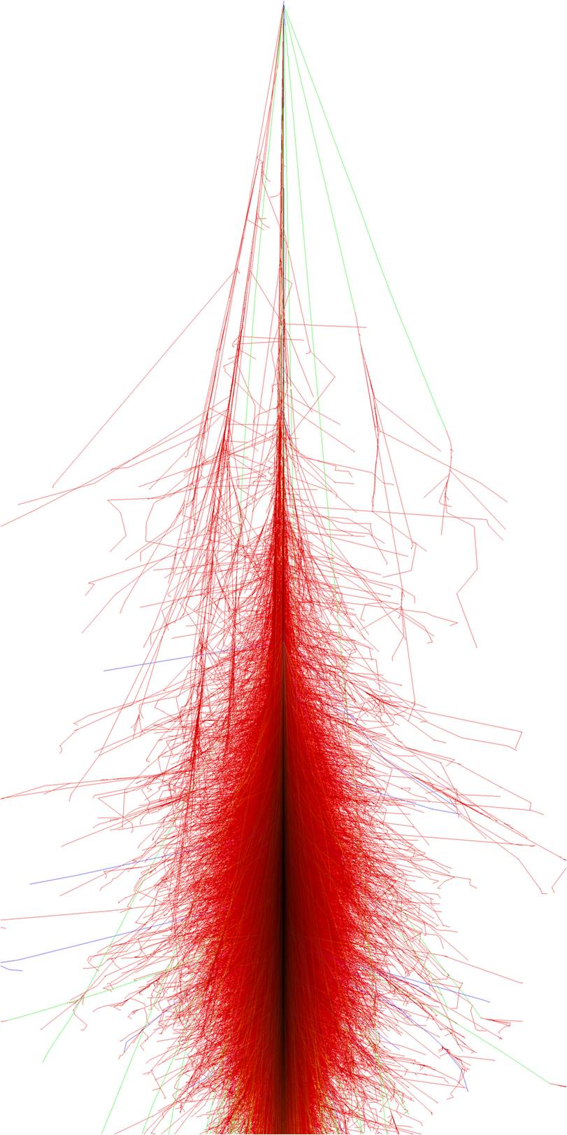

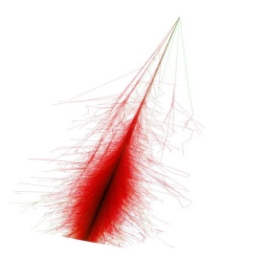
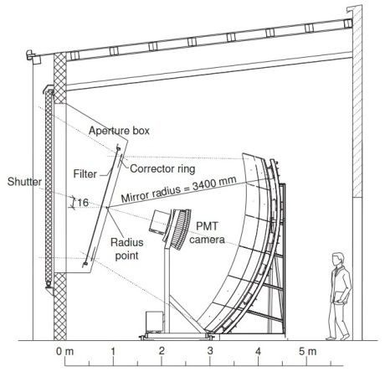
3D Shower shape
SDId 3599086
Energy = 1.58x10¹⁹
Distance _{to eye}= 3.87 km
Shower Image width
Detector
Atmosphere
Shower intrinsic width
Multiple Scattering
Light aberration
Internal reflections
Reflections and detections efficiencies
Notes:
This is another example of one event.
As you can see we have some lateral width.
Where this Shower Image width come from?
->Part of the shower width come from the intrinsic shower width. From the cascade evolution.
->Nevertheless, We have the atmosphere, which is good because is our calorimetry. However, now when the shower light propagates we will have multi-scattering that spreads the light, and we will see an increase in the width of the shower, an attenuation of the amount of light, So the shower image will get blurred.
Here for example, we can see some Cherenkov scattered even without detect Cherenkov light directly.
In this way we need to understand the atmosphere very carefully , since the amount of multi-scattering depends on the composition of the atmosphere
-> we also have the detector, which are telescopes. they will produce distortions on the real image of the shower. We will have light aberration from the optics, internal reflection, transmissions and efficiencies that change our 3D image of a shower.
So the shower image we see, is a convolution of the real shower with the detector plus the atmospheric effects. And we need to understand each step in it.

Slide 7
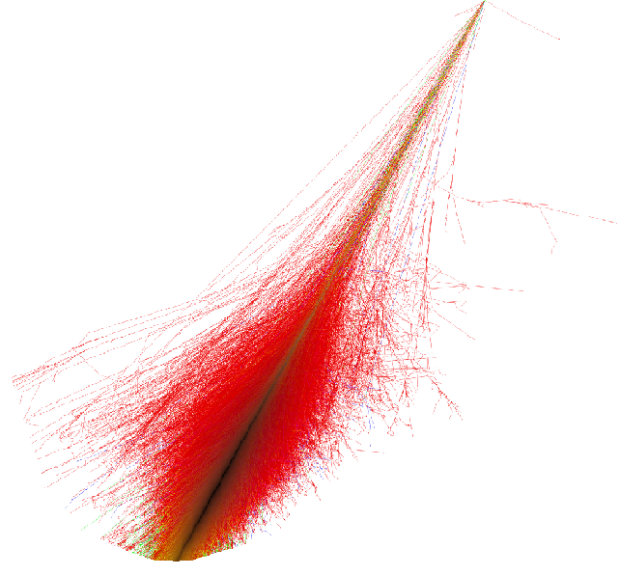
3D Shower shape
Shower Image width
Detector
Atmosphere
Shower intrinsic width
We should have a 3D simulation of the shower
Separate the several effects on the camera image
It is a fundamental step to implement a
full 3D reconstruction
(2nd part of the presentation)
In the standard Auger framework
(for simulation and reconstruction)
We generate the air showers
(CORSIKA, SENECA…)
All information
is projected into a line
The 3D shape is recovered in the simulation using average lateral profiles
Longitudinal
profiles
Notes:
We know that we have several effects on the shower shape,
and we need to have a good description of the shower 3D shape to understand all the image on the detectors.
In the standard simulation, when we simulate a shower,
we first generate the event in CORSIKA for example
and we project all the information into a line, in longitudinal profiles
So we will lose the 3D information. Which is latter recovered using average profiles
But we lose the information lateral information shower to shower.
We lose possible fluctuations and differences that could be present on the data.
There are other problems, For example, If we are close to the shower
we lose much information by looking for the longitudinal developments
In this way, we are developing a 3D simulation of the showers.
It is a fundamental step to implement a full 3D reconstruction

Slide 8
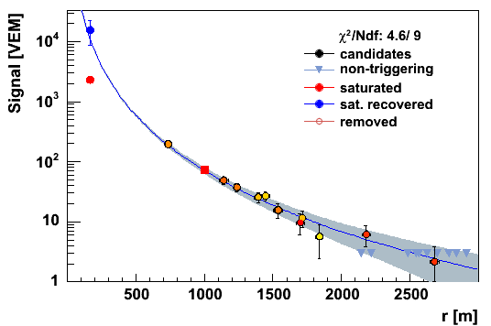
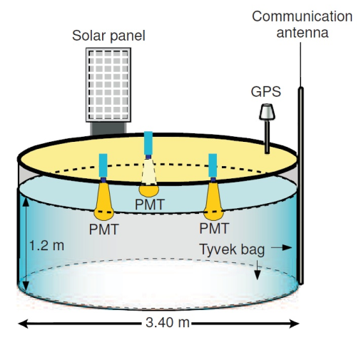
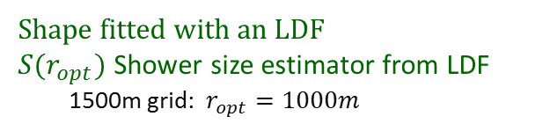
Auger Surface Detectors
Lateral distribution of particles
Shape fitted with an LDF
$S(r_{opt})$ Shower size estimator from LDF
1500m grid: $r_{opt}=1000m$
Model, data-based
Both muonic and electromagnetic component measured simultaneously
Notes:
On the surface of the observatory, we have 1600 tanks,
With the surface detectors, so we can sample the lateral distribution of particles.
This is an example of one event.
The absolute signal should be proportional to the energy
And the signal obtain at 1000 m should be used to estimate the energy
However, remember that we measure both muons and electromagnetic particles

Slide 9


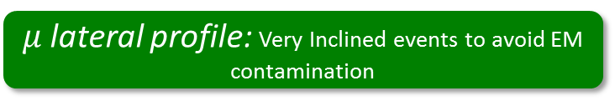

Muons results in Auger not consistent with models
$μ$ lateral profile: Very Inclined events to avoid EM contamination
$R_{μ}$ with energy
$$S_{1000}∝R_{μ}$$
Electromagnetic and muonic sectors
Inconsistency! In cosmic ray composition! Between muons and em!
$$X_{max}^{μ}$$
Muons
electromagentic
Notes:
But the muons in auger are not consistent with the models
If we are in very inclined events, the EM component was almost completely attenuated by the atmosphere
So the signal at 1000m is basically the number of muons
This is the auger result with the number of muons as a function of the energy
There are much more muons than predicted by the models
If we renormalize the same plot we can see the big difference in the data
In inclined events we can also indirectly estimate the the xmax of the muons
And if we compare the composition from the muons and electromagnetic sectors they are not consistent

Slide 10
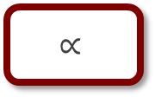
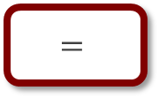
Problems in SD
FD Energy
(from telescopes)
Electromagnetic development
(atmospheric calorimetry)
$$∝$$
SD calibration with
FD energy
(from surface detectors)
SD = electromagnetic +
muonic signal
$$=$$
Muons in data
not consistent with models
Muons measurement
correlated with energy
Calibrate the SD energy
using only the
SD electromagnetic signal
(Part 3 of this presentation)
Have a detector to measure the muon sector directly
(Part 4 of this presentation)
Notes:
The FD energy is proportional to the electromagnetic development
However the signal used to calibrate the surface detectors, measures both electromagnetic and muonic component
Nevertheless, the muons are not consistent with the data
and the energy will be correlated with the energy
In conlusion,
We need to have a detector for muons only
And we should calibrate the energy in the SD with the electromagnetic signal

Slide 11
1. Physics Review
2. 3D Simulation
3. SD Energy Calibration with electromagnetic signal
4. Studies at MARTA
We should build a framework to perform
the 3D simulation
Notes:
We built a framework to perform the 3D simulation

Slide 12
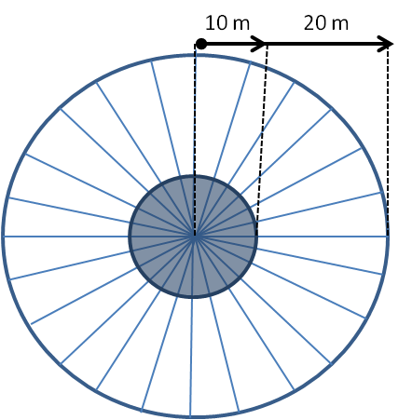
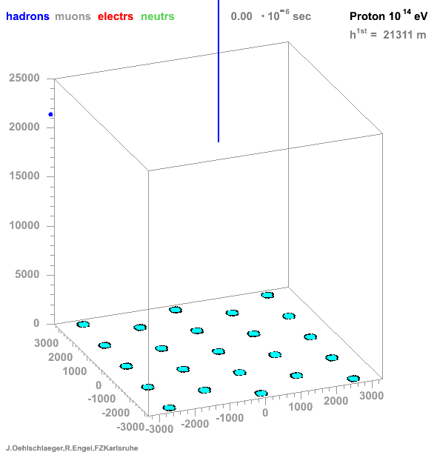
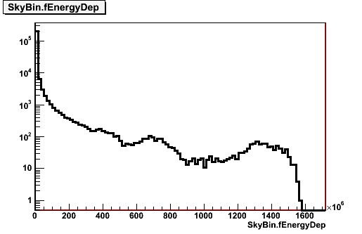

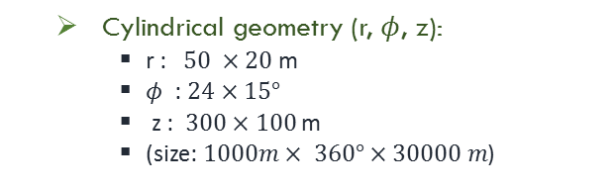
BinTheSky Framework and Fluorescence emission
BinTheSky Framework (ROOT structure)
At generator level!!!
  In CORSIKA (wrapped with C++ code)
    The energy deposited and other relevant
    variables are saved for each Skybin
100 m
  Cylindrical geometry (r, $φ$, z):
    r : $50 ×20$ m
    $φ$ : $24×15°$
    z : $300×100$ m
    (size: $1000m× 360°×30000 m$)
Shower axis
Fluorescence emission
  Energy Deposit in each SkyBin
  for fluorescence emission
  Isotropic emission
Skybin
$$E_{dep}+Yield_{fluor}→n_{ph}$$
Notes:
We developed a new framework
Basically, we divide the sky in cylindrical bins around the shower axis, and
at the generator level, inside corsika we save the information needed to simulate the shower.
These is the picture of the framework, where the bins close to the shower axis have higher particle densities and smaller volumes.
The fluorescence emission is the easier to implement
We just need to save the energy deposited in the box
And the number of fluorescence photons is proportional to the energy
As I said before

Slide 13









Direct Cherenkov emission
Information for Cherenkov depends on the particle directions
$l_{φ′}$ length travelled by particles in SkyBin in $φ′$ direction
Atmosphere
$$t_{0}$$
$$l_{φ}$$
$l_{α}$ length travelled by particles in SkyBin in $α$ direction
$$φ′$$
Shower axis
$$n_{ch,α}$$
$e^{−}$ direction
$$l_{α}$$
$$α$$
eye
ground
$N_{ph}=n_{particles}∙l_{α}\frac{l_{φ}}{l_{Total}}c_{k}\left(1−\frac{1}{n^{2}}\right)\left(\frac{1}{λ_{2}}−\frac{1}{λ_{1}}\right)$
$$core$$
Notes:
But we should proceed to emit the direct Cherenkov?
Each particle will emit Cherenkov in a cone with different directions.
But we have too many electrons and positron producing Cherenkov and we can not save and follow the direction of all them.
So we don’t save the directions of all of them
Therefore in each binthesky box, we discretize the directions of the electrons
We save the distribution of the particles direction in delta psi. By delta psi I mean the angular direction in relation to the psi of box. The phi distribution should look more or less the same for all box.
But we also need the alpha direction and we do the same in alpha, we discretize the alphas.
So in the end we save the alpha and phi distributions and the length traveled by those electrons.
We are using a bin of 1 degree for alpha and psi.
To know the number of photons emitted we simply say that we have nelectrons on alpha, that travel some lengh in that alpha and them multiply it by the weight lpsi over l total. Times the normal calculations.

Slide 14




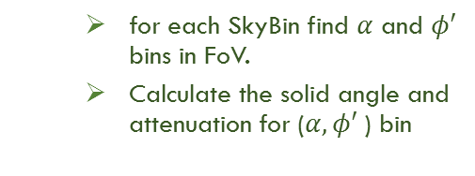


BinTheSky in the Auger Offline Framework
  for each SkyBin find $α$ and $φ′$ bins in FoV.
  Calculate the solid angle and attenuation for ($α,φ′$) bin
BinTheSky is embodied in the Auger Offline Framework
(Auger Simulation and reconstruction software)
Atmosphere
$$t_{0}$$
New Offline Module: ShowerSimulatorLX
Propagation
time
  Produce photons
    Fluorescence and Cherenkov emission
  Propagate Photons to detector
    solid angle; emission angle; distance to telescope
  Attenuate and scatter photons
    Attenuations due to Mie and Rayleigh
    Cherenkov scattered and Multiple-scattering
    (not yet implemented)
Emission
time
$$φ′$$
Skybin
  Plus time:
    Time= propagation time +
    emission time
𝚫𝝓’ bin = 1º
$$α$$
eye
$α$ bin = 1º
1bin in $α$
and 𝝓’
$$t_{core}$$
Notes:
This was at the generator level,
To simulate the shower at auger site we need to change the auger offline framework
So we built a new module called showersimulationLX to simulate the shower with the Binthesky framework
Basically, we need to find all boxes in the filed of view, find all alpha and phi direction that points to the telescopes, and produce the fluorescence and Cherenkov.
We propagate the photons to the detector and calculate the respective Attenuations and solid angles.
The time of the photons is just the propagation time until the plane shower front plus the emission time from the box to the telescope
for each SkyBin find $α$ and $φ′$ bins in FoV.
Calculate the solid angle and attenuation for ($α,φ′$) bin

Slide 15



Validation with real Data
Shower axis
Select the 2 sample of events
In DATA
Generate those showers in CORSIKA
(fill the BinTheSky framework)
Atmosphere
$$t_{0}$$
Fluorescence photons
Direct Cherenkov photons
Simulate in The Auger
Offline Framework
(3D and standard simulation)
+
Reconstruction
(the same for 3D, standard and data)
eye
$${\vec{n}}_{eye}$$
eye
ground
Rayleight Scattering
Mie Scattering
$$t_{core}$$
Compare the 3D simulation
Standard simulation
and DATA
1st sample: fluorescence rich events
with some scattered Cherenkov on data (<10% Cherenkov)
Scattering off
2nd sample: Cherenkov
rich events
with some scattered Cherenkov on data (>75%)
Notes:
To validate both emission
we choose two sample of real data events
One sample rich fluorescence.
For that the choose configurations with the shower going away from the telescopes.
------------
Other sample rich in Cherenkov, and for that we choose configuration with the telescopes in the front of the shower,
Since the Cherenkov is emitted close to the shower axis.
But there are also scattered light from Cherenkov that contaminates the fluorescence sample
Then, we reproduce these real events on the generators,
This case corsika
------------
Then we simulated the showers with the standard simulation and the 3D simulation
Currently the scattering is not implemented
And do the same reconstruction for both simulation and data
In the end we compare the simulations with the data

Slide 16
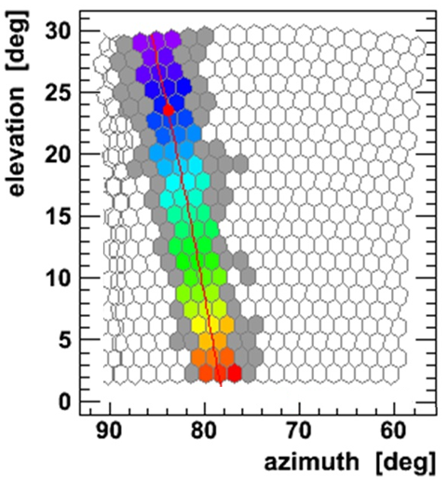
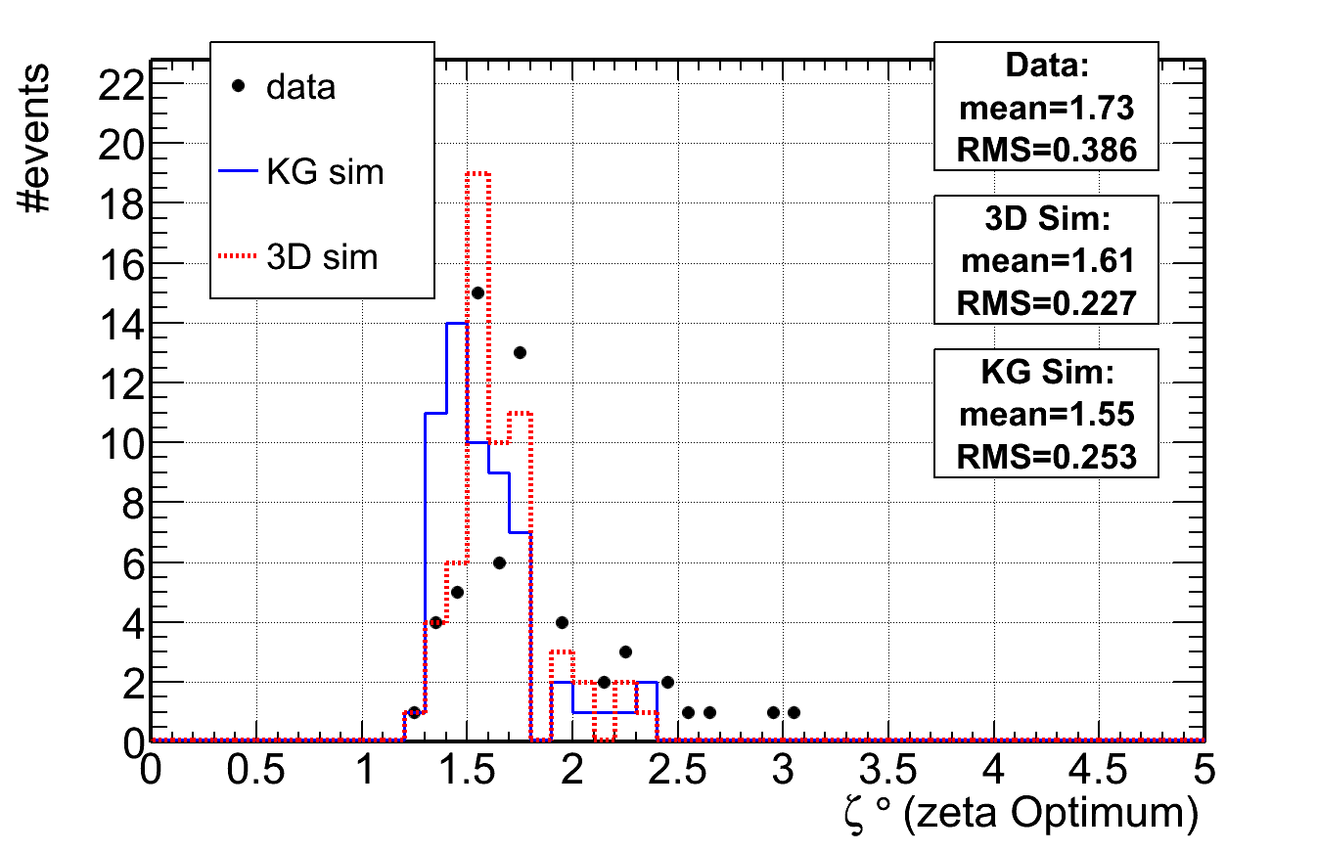
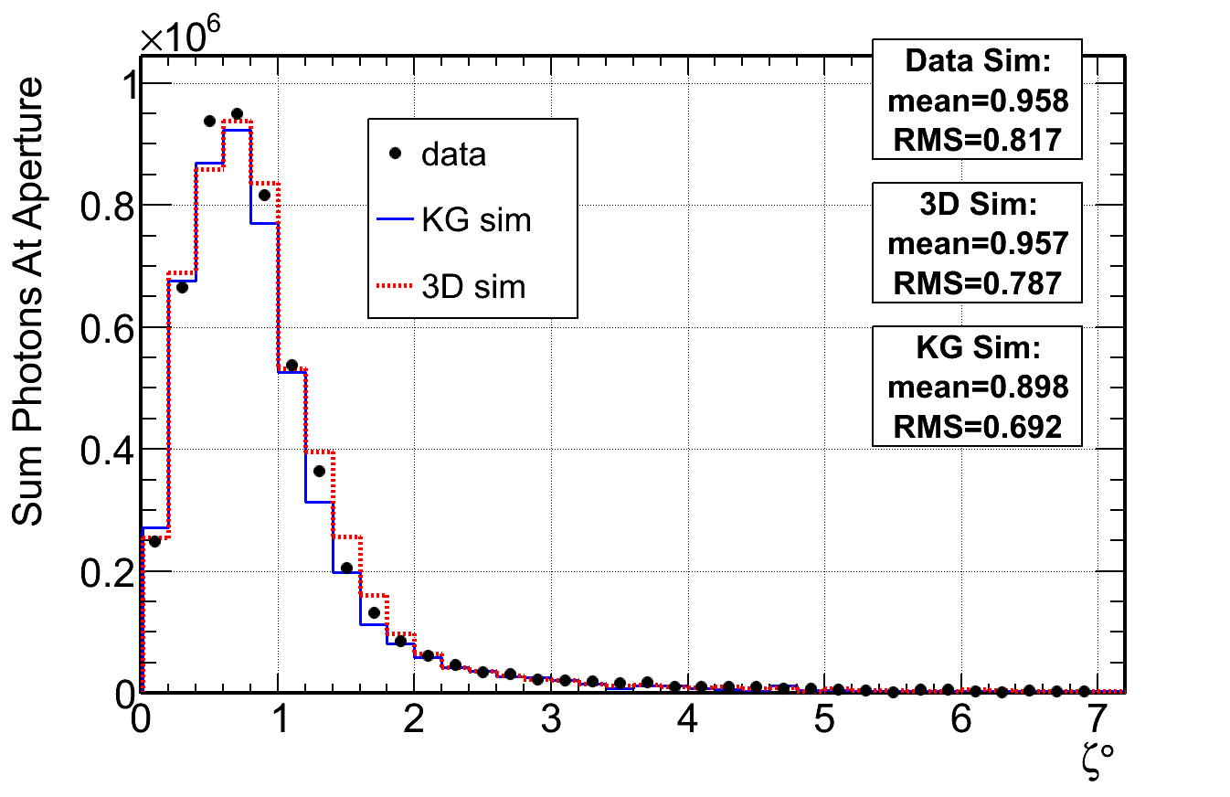


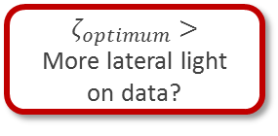
Fluorescence emission: Validation with data
Longitudinal Light at diaphragm
Time at diaphragm
+ Rayleigh and Mie scattering on standard simulation
$$ζ_{optimum}$$
Transversal/Lateral Light at diaphragm
$$ζ_{optimum}>$$
More lateral light
on data?
$$ζ_{optimum}$$
Notes:
The first thing to look is the light measured at the telescopes
We can plot the light longitudinal development of the shower
Which mean to sum the light as function of the time at the telescopes
We can see that the 3D simulation is similar to the standard simulation
However it is missing light with respect to the data
This light comes mainly from the scattered light
If we simulate the standard simulation with the scattering light we can see that some light is missing
The standard simulation uses longitudinal information's, so both simulations should be similar.
------------
Consequently, we should look at the lateral profiles of the light
So we defined the angular distance zeta, in white, and the distance from the light detected at a pixel and the position were the shower should be
This is the light as function the angular distance zeta
And you can see that the 3D simulation and data are larger then the standard simulation
------
There is also another important step in the reconstruction,
If you look at the camera we should sum the light until what angular distance?
That distance is called zeta optimum
And here we can see that the reconstruction is in the data and 3D simulation uses more lateral light than the standard simulation

Slide 17
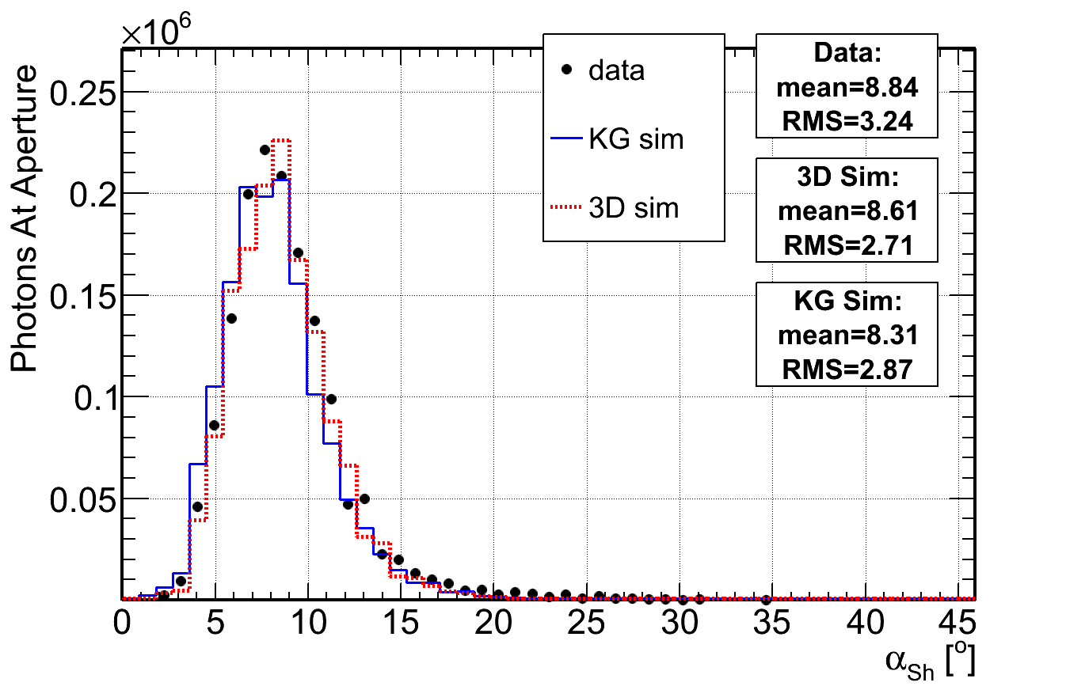


Direct Cherenkov emission: Validation with data
Longitudinal Light at diaphragm
Transversal/Lateral Light at diaphragm
Light at diaphragm with $α_{sh}$
Shower axis
$$α_{sh}$$
eye
ground
Notes:
We can do the same plot for the Cherenkov emission
-------
This is the longitudinal light
Very peaked due to the Cherenkov light
But simulation and data are consistent
-------
On the transverse light they are also similar except for higher angle where the data have more photons
These is the multiple-scattering not yet implemented.
On the fluorescence sample configuration the scattering is lower
------
But in the cherekov there is a very important parameter
The Cherenkov depend mainly on the angle alpha
And this is used on the reconstruction
So we should look at the light as function of the alpha_shower
We can see that the light in the 3D simulation and data is a little shifted with respect to the standard simulation

Slide 18


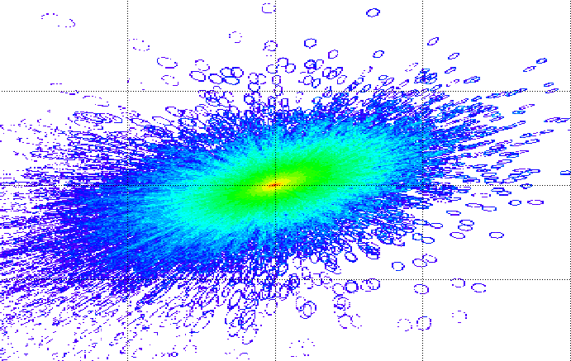



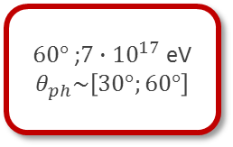


Cherenkov Pool: pattern on the ground
Example of two events:
Density of Cherenkov on the ground
Vertical Shower ${10}^{18}$ eV
$$θ_{sh}$$
$60°$ ;$7∙{10}^{17}$ eV
$$θ_{ph}\sim \left[60°;90°\right]$$
Shower $60°$ and $7∙{10}^{17}$ eV
$60°$ ;$7∙{10}^{17}$ eV
$$θ_{ph}\sim \left[30°;60°\right]$$
Notes:
But we can also use this framework in other context
For example, we can obtain the Cherenkov light density on the ground
-----
This is an example, of the Cherenkov pattern on the ground, for a vertical shower with 10tothe18 ev
----
Another example is for a shower with 60º
These are the density of photos for all possible photons directions
But, we can also see the Cherenkov parttern depending on the photon directions
This the same event but for photons with 60 -90º inclination
And this is for photons between 30 and 60
-------------
-------------
The Cherenkov light is not symmetric but
With this framework, we could also obtain the lateral distribution of Cherenkov, but only in vertical events

Slide 19

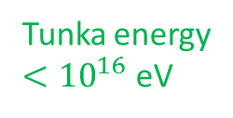


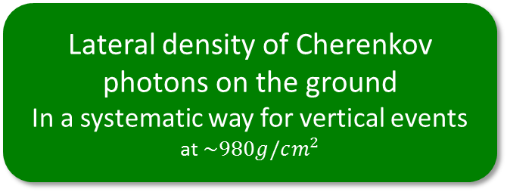
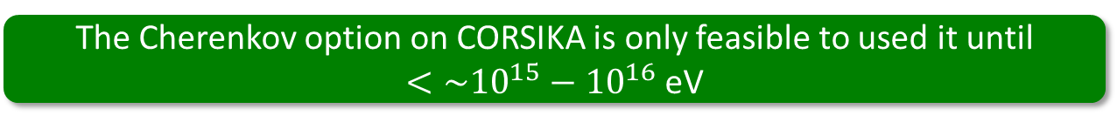


Cherenkov Pool: Lateral density
Lateral density of Cherenkov photons on the ground
In a systematic way for vertical events
at $\sim 980g/cm^{2}$
$$0°−40°$$
Tunka FoV
Tunka energy
$<{10}^{16}$ eV
  Cherenkov photons on the ground for different photon directions
3D Cherenkov and Tunka ($θ_{ph}\sim \left[0,40°\right]$)
3D Cherenkov and simulation at Chacaltaya
  ${10}^{19}$eV
  ${10}^{16}$eV
  ${10}^{16}$eV
  ${10}^{17}$eV
The Cherenkov option on CORSIKA is only feasible to used it until
$<\sim {10}^{15}−{10}^{16}$ eV
Notes:
Now we can obtain the Lateral density of Cherenkov photons on the ground for vertical events
Note that, The Cherenkov option on CORSIKA is only feasible to used it until $\sim {10}^{15}−{10}^{16}$ eV
But with the Binthesky framework we can obtain the Cherenkov for example at 10^18 eV
In balck is the density for all photon
And with the coloer for different photons angles
We can also use the framework to others experiments
Tunka for example as a field of view around 0 to 40º and energy until 10^16 eV
At 10^16 eV the framework is in agreement with tunka
But the tunka extrapolation for higher energies is completely wrong

Slide 20
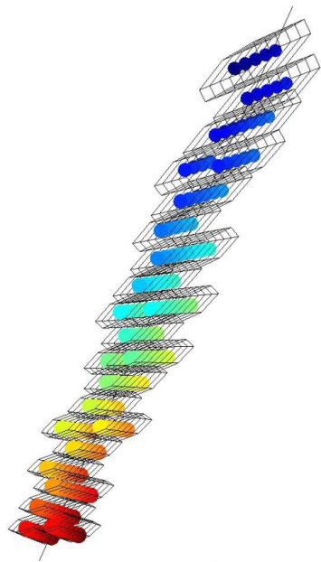
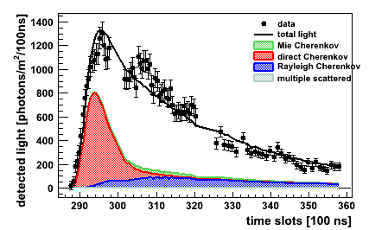
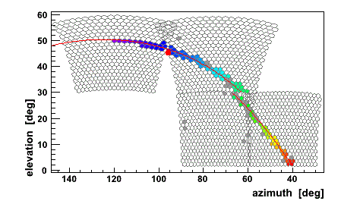
3D simulation summary
  The Fluorescence and Cherenkov emissions were validated with the standard simulation and data
  The BinTheSky framework is good to obtain the Cherenkov on the ground.
    Easy to implement in different experiment configuration
    while directly in CORSIKA it consumes a lot of time and disk space
    Validated with Tunka experiment and Chacaltaya simulations.
  BinTheSky framework is easy to used in the calibration task to simulate the laser and first scatterings
Pixels Time information perpendicular to the camera
Lateral width in the camera
3D reconstruction
  Scatter Cherenkov and multi-scattering not yet implemented
  The first step to further implement a
  3D reconstruction method
Notes:
To summarize this part,
The fluorescence and Cherenkov light have been implemented and validated
The binthesky framework is easy to use different experiments configurations
and could also be used in the calibration task
This is the first step to further implement a 3D reconstruction method
Using the lateral width on the camera and the time information perpendicular to the camera

Slide 21
1. Physics Review
2. 3D Simulation
3. SD Energy Calibration with electromagnetic signal
4. Studies at MARTA
With a new detector for muons
We can recover the electromagnetic signal
Notes:
With a new detector for muons we can recover the electromagnetic signal and calibrate the SD energy using the SD electromagnetic signal

Slide 22
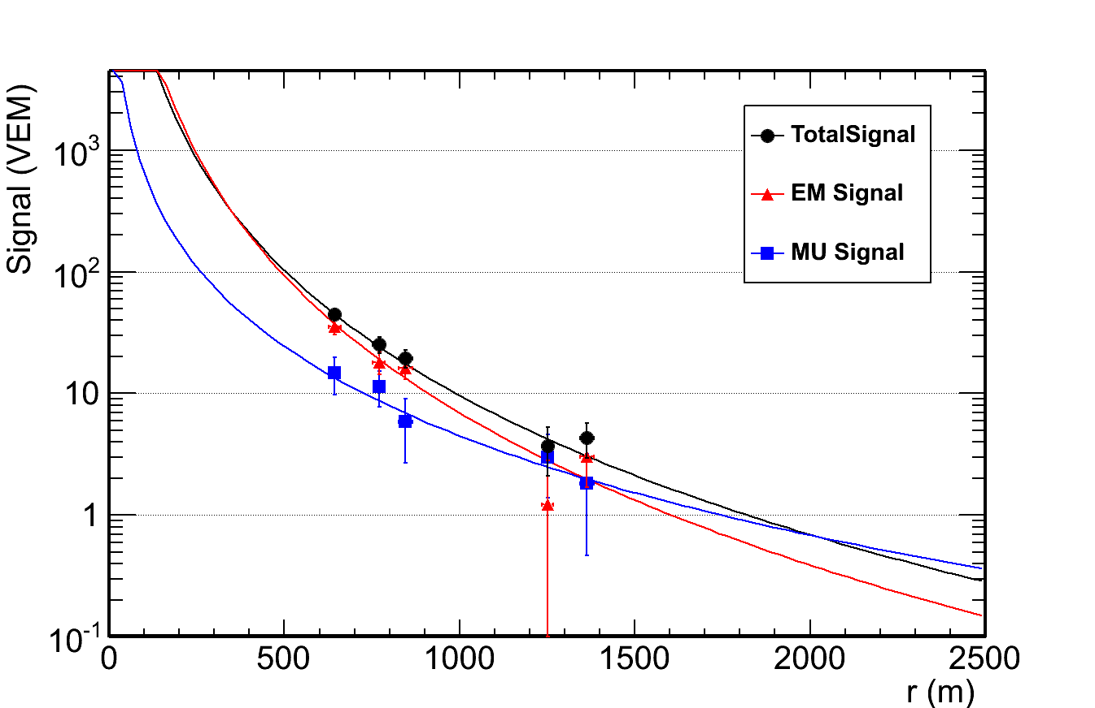
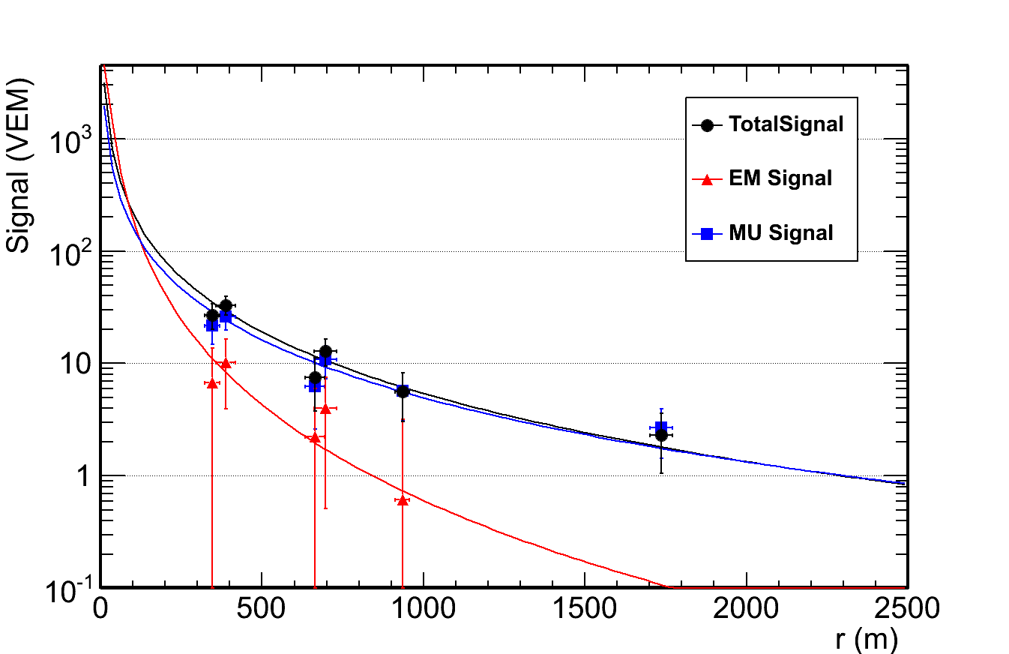
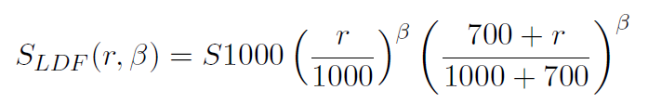








Energy Calibration on SD, separating each component
Two events from our sample
Slope $β$ was parametrized
$$θ={21}^{∘}$$
$β$ from Total Signal
$$0^{∘}$$
$$θ={60}^{∘}$$
$${60}^{∘}$$
$β$ from EM Signal
$β$ from MU Signal
Fits were done using a Likelihood base on the NKG equation
Notes:
These are two events Fitted with the LDF
Before continuing we should parametrize the slope beta event by event
----------
This is the slope beta parametrization for the total signal
For the em
And for muonic signal
The muon have the lower slope and the em part has the higher slope
Currently, on data we can only measure the total signal

Slide 23
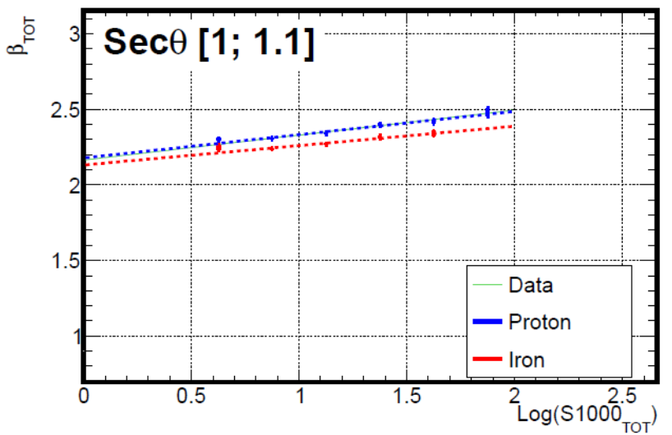

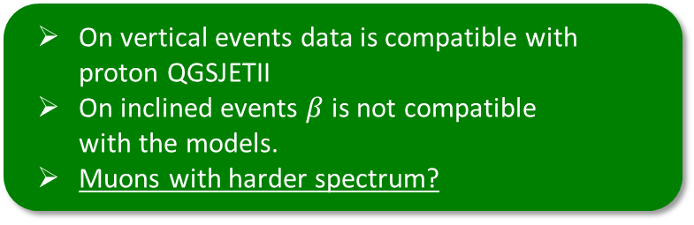

Slope $β$ comparison with Data
  On vertical events data is compatible with proton QGSJETII
  On inclined events $β$ is not compatible
  with the models.
  Muons with harder spectrum?
Vertical events
Electromagnetic plus Muons
Horizontal events $≤60°$
Dominated by muons
Notes:
Now,
The total slope for proton and iron have a little shift, since the iron shower have more muons
And in vertical events the data is consistent with protons
However,
In horizontal events the data is not consistent with the models
The slope is higher where it should be similar to the muonic slope
Since in vertical events the slope is consistent,
than the muonic LDF should be different in the data
And a possibility is that the muons could have an harder spectrum

Slide 24







Attenuation Curves: with CIC method
$S_{1000}$ is not constant with zenith angle
It is not a good energy estimator
Vertical Showers
Inclined Showers
Total Component and data
$$S_{1000}$$
Ground
Proton
EM Component
MU Component
Iron
Total Component
Data
Proton
Proton
Proton
Iron
Iron
Iron
$${60}^{∘}$$
$$S_{1000}= S_{38}×CIC(θ)$$
$$0^{∘}$$
Notes:
Now
We are going to calibrated the SD energy with the electromagnetic signal and the others
But, we can not use the signal at 1000 m directly because it is attenuated in the atmosphere
At the same energy, in vertical event we would measure a signal and at horizontal events we would have a much smaller signal
So we need to determine the attenuation curves
-------
These are the attenuation curves for the electromagnetic component
The horizontal events have around 14% of the signal in vertical events
And the rion and proton curves are slightly different here
------
The muonic attenuation is basically constant because the muons are much less attenuated in the atmosphere
------
The total curves are something between
-------
With the attenuation curves we covert the signal to the signal at 38 deg
-----
And now we can compare the total attenuations with the data
The data is compatible with protons, but not far from iron

Slide 25






Energy estimator
Total Signal
$S_{38}$ Is used as energy estimator
  $S_{1000}$ is converted to $S_{38}$
  $S_{38}$ is calibrated with energy
MU
$$B$$
$$S_{38}=S_{1000}/CIC(θ)$$
EM
$$\log_{10}{S_{38}}=A+B\log_{10}{E}$$
Energy resolution
Proton
Iron
Resolution
Total $\sim 14.8\%$
EM $\sim 17.2\%$
MU $\sim 18.0\%$
Resolution
Total $\sim 8.4\%$
EM $\sim 11.6\%$
MU $\sim 11.0\%$
Notes:
Finally we can calibrate the energy on SD with the S38
These are the calibration curves for the total signal, em and mu
What are the energy resolution of each component?
Thisis is the energy resolution for proton and iron
For example:
In the proton case
The total resolution is about 15 % while the em is 17%
This seems against our idea to improve the calibration
But first of all, remember that the FD energy and the electromagnetic component on the ground are correlated

Slide 26

Energy calibrations: resolutions
MU Signal
EM Signal
  The electromagnetic signal can be used to calibrate the SD energy with better resolution below $\sim 40°$
Proton
Iron
Since the electromagnetic changes with zenith angle $→$ calibrate the $S_{38}$ in smaller zenith intervals
Notes:
But more important!
The em component is very very attenuated
So, we should look at the resolutions as function of the angle
This is the resolution performed in different zenith intervals
We can see the em resolution get much worst for horizontal events
But at vertical events it is better than the total compoenent
-----
The muonic resolution is almost contant since they don’t have atmospheric attenuations
------
This is the same picture for the iron sample
-----
We can see that at least below 40deg we can use the em signal to calibrate the energy of the surface detectors

Slide 27







Comparison with data: S38 calibration
$S_{38}$ is calibrated by:
$$B$$
$$\log_{10}{S_{38}}=A+B\log_{10}{En}$$
Total signal
Sim Proton: $A=−15.74±0.03$; $B=0.91±0.002$
Sim Iron: $A=−15.74±0.03$ $B=0.91±0.002$
Data: $A=−16.86±0.12$ $B=0.97±0.007$
$$B$$
MU signal with $R_{μ}$(inclined data)
Sim Proton/Proton: $B=0.84±0.002$
Data: $B=1.03±0.05$
Notes:
We can compare the calibration of the total signal with the data,
And we found that the data is higher, consistent with a change in the compostion
In the case o the muons,
We can also compare the simulations with the very inclined events calibration
And the data slope is also much higher
But here the em composition wasn’t enough to justified the difference

Slide 28


Energy Calibration summary
  The SD energy can be estimated using the $S_{38}$ from the electromagnetic signal, with better resolution than the total signal for angle $θ∈\left[0°,\sim 40°\right]$
    Total signal RMS=$9.6\%$ and $6.3\%$ for pr and ir, for $θ∈\left[0°,\sim 29°\right]$
    EM signal RMS=$8.5\%$ and $5.3\%$ for pr and ir , for $θ∈\left[0°,\sim 29°\right]$
    Total signal RMS=$15\%$ and $9\%$ for pr and ir, for $θ∈\left[0°,\sim 60°\right]$
    EM signal RMS=$17\%$ and $12\%$ for pr and ir , for $θ∈\left[0°,\sim 60°\right]$
    electromagnetic signal was highly attenuated (inclined events is 14% of the value for vertical events at the same energy)
  Muons could be measured indirectly from the energy calibration.
  Mixture of composition would bias the energy of each primary type.
  The $β$ parametrization from the model, at higher angles, is not compatible with data. Muons problems, harder spectrum?
  SD calibration with total and muonic signal not compatible with model for pr and ir. Composition change in data!
  (CIC compatible)
Notes:
To summarize
The SD can be calibrated using the em signal with a better resolution than the total signal below 40º
Muons could be measured indirectly from the energy calibration.
And we saw that the muons don’t seem compatible with models
The slope beta is different and the energy calibration

Slide 29
1. Physics Review
2. 3D Simulation
3. SD Energy Calibration with electromagnetic signal
4. Studies at MARTA
A new detector for muons
Could be MARTA
(Muon Auger RPC for the Tank Array)
Notes:
A detector for muons could be MARTA Array

Slide 30




LDFs with MARTA (Muon Auger RPC for the Tank Array)
MARTA: Muon Auger RPC for the Tank Array
Is it possible to use the LDF parameter as composition estimators????
$$ρ\left(r\right)=ρ_{1000}{\left(\frac{r}{1000}\right)}^{β}{\left(\frac{700+r}{1000+700}\right)}^{β}$$
$$ρ\left(r\right)=ρ_{1000}{\left(\frac{r}{1000}\right)}^{β}{\left(\frac{700+r}{1000+700}\right)}^{β}$$
MARTA -> allow to separate EM and MU components in the tanks
SD energy can be calibrated with the electromagnetic signal
Average LDF FROM MARTA ONLY
Notes:
The marta project consist in place RPC detectors below the normal tank
The tanks would absorb the electromagnetic component and
MARTA would detect the muons
So combining both, we could separate the muon and em signal and calibrate the sd energy with the electromagnetic signal
And
We can obtain the muonic average lateral profile
Parametrized by this ldf
And the question now is if it possible to use the size parameter and the slope to estimate the composition

Slide 31










LDFs with MARTA: $β_{\left\langle LDF\right\rangle }$ vs ${\left\langle β\right\rangle }_{event−by−event}$
There are two possible ways:
Toy Model
$β$ generated
$β_{\left\langle LDF\right\rangle }$
average profile
$$\left\langle β\right\rangle$$
event-by-event
  $\left\langle β\right\rangle$
  event-by-event
  good for the energy evolution (calibration)
  $β_{\left\langle LDF\right\rangle }$
  average profile
  good for composition estimator
Hadronic component
There are two possible way:
  Using the average $\left\langle β\right\rangle$ event-by-event
  Using the $β$ from average $\left\langle LDF\right\rangle$
Simulation $\left\langle β\right\rangle$ event-by-event
Simulation $β_{\left\langle LDF\right\rangle }$
$$\left[19.65−19.75\right]$$
  $\left\langle β\right\rangle$ event-by-event good for the energy evolution (calibration)
  $β_{\left\langle LDF\right\rangle }$ good for composition estimator
$$\left[18.95−19.05\right]$$
Notes:
There are two possible ways
We can use the determine the average beta event by event
Like we did before
But the color are mixed, so the composition are not separated
This beta is not good for a composition estimator but is dependent on the energy
The other possibility is to use the beta from the average LDF
Here we can see that the compositions are separated and this could be used as composition estimator
But how many event we should use in the average LDF profile?
We made a toy model with a known beta and fit it to find out
In black is the original beta
And in green is the beta from the average LDF, around 300 events we are already close to the real one
In red is the event by event which have a bias in the result due to the definition of the likelihood

Slide 32











LDFs with MARTA: $ρ_{1000}$ vs $β_{\left\langle LDF\right\rangle }$
  $ρ_{1000}$ vs $β$ from $\left\langle LDF\right\rangle$
  are good composition estimators
$$ρ\left(r\right)=ρ_{1000}{\left(\frac{r}{1000}\right)}^{β}{\left(\frac{700+r}{1000+700}\right)}^{β}$$
Vertical events
Horizontal events
$$\left[19.65−19.75\right]$$
$$\left[18.95−19.05\right]$$
$$β_{\left\langle LDF\right\rangle }$$
Differences around $\sim 3σ$ to $\sim 8σ$
$$β_{\left\langle LDF\right\rangle }+ρ_{1000}$$
100 events at $\left[19.65−19.75\right]$
300 events at $\left[18.95−19.05\right]$
$$β_{\left\langle LDF\right\rangle }+X_{max}$$
$$β_{\left\langle LDF\right\rangle }+N_{μ}$$
Proton
Iron
Notes:
Lets see the separation we could obtain combining the size parameter and the slope beta from the average ldf
In vertical events
We can see that the proton in blue and iron in red are well separated
And a similar feature in horizontal events
Combining the beta parameter with other parameters, we can obtain separations around 3 to 8 sigmas

Slide 33




Xmax from MARTA
  The electromagnetic $X_{max}$ can be obtained from the fraction $\frac{S_{1000, EM}}{S_{1000, MU}}$
  $X_{max}$ Resolution
Proton
$$X_{max}=b+m(θ)\frac{S_{1000, EM}}{S_{1000, MU}}$$
$$m\left(θ\right)=m_{0}+m_{1}\sec\left(θ\right)+m_{2}\sec^{2}{(θ)}$$
Iron
Proton
Iron
Notes:
Since we can separate the em and muonic signal, we can use that information to recover the electromagnetic xmax
We saw that the electromagnetic signal is attenuated in the atmosphere and so it is very dependent to the distance of the xmax to the ground,
The muonic component is not much attenuated, so it give the xmax evolution with energy
This is the calibration of the sample and the iron
We can obtain a resolution around 45 g/cm2 in the proton
And 23 g/cm2 for irons
Currently the muonic xmax has a resolution between 100 to 55 g/cm2
And a new method from the rise time has a resolution around 55 g/cm2

Slide 34






$X_{max}$ and $X_{max}^{μ}$ (from MPD)
  Electromagnetic $\left\langle X_{max}\right\rangle$ from FD data
  Muonic $\left\langle X_{max}^{μ}\right\rangle$ from SD data
  MARTA would allow to recover:
    the electromagnetic $X_{max}$ from SD
    The muonic $X_{max}^{μ}$
  With much more statistics
  The electromagnetic and muonic development could be studied simultaneously
  Longitudinal EM width $L$
  $\left\langle X_{max}\right\rangle$ - $\left\langle X_{max}^{μ}\right\rangle$
  The muonic development is closely related to the pion production and could be compared to the width of the electromagnetic development
Notes:
This is the electromagnetic xmax from the telescopes
And this is the muonic xmax from the very inclined events in SD
A detector like marta would allow to obtain both xmax with much higher statistics and
A larger energy range
So we could compare the electromagnetic and muonic developments
And the consistency of the models since the xmax differences are related to the pions shower
And related to the width of the electromagnetic development

Slide 35


Studies at MARTA summary
  A muon detector (like MARTA) would allow detect the muons on the ground.
  The average muonic Lateral profile (LDF) on MARTA can be used to estimate the composition
    The slope $β$ of the average muonic LDF is a good estimator
    together with the LDF size parameter $ρ_{1000}$ , or $X_{max}$ or $N_{μ}$
  EPOS-LHC and QGSJET-II04 gives similar result in $β$ and $ρ_{1000}$
  A muon detector would allow to disentangle the muonic and electromagnetic signal in the tank.
  The electromagnetic $X_{max}$ can be recovered using the $\frac{S_{1000, EM}}{S_{1000, MU}}$, from the tanks.
  The electromagnetic and muonic development could be studied simultaneously
Notes:
To summarize
The average muonic Lateral profile (LDF) on MARTA can be used to estimate the composition
With a new detector able to separate muons and electromagnetic particles
We could recover the electromagnetic xmax from the sd
And the electromagnetic and muon sectors studied simultaneously

Slide 36



Final Summary and Conclusions
A framework was built to simulate the fluorescence and Cherenkov emission – the BinTheSky
    The Cherenkov distribution on the ground can be obtained quickly for different experiments
    Cherenkov was compared with auger and Tunka experiment
The muons on data, show a different behavior in the slope of the LDF and in the energy calibration
    Muons problems, harder spectrum? Different $β$ parametrization and energy calibration
A muon detector would allow to Separate the muonic and electromagnetic component on the ground (SD)
    The electromagnetic signal can be used as the SD energy estimator with better resolution than the total signal, at lower zenith angles.
    Recover the electromagnetic $X_{max}$ from the $\frac{S_{1000, EM}}{S_{1000, MU}}$, from the tanks
    Mixture of composition would bias the energy of each primary type.
MARTA Array would allow to directly measure the muons lateral distribution
    Use the slope parameter $β$ and $ρ_{1000}$ as composition estimators
  The electromagnetic and muonic development could be studied simultaneously
Notes:
The final summary
A new framework was built to simulate the fluorescence and Cherenkov light
And it can be use to simulate the Cherenkov light in different configuration in a easiest way than corsika alone
And it was compared to the tunka results
We saw that there are some problems with the muons in the LDF and calibration with energy
A new detector for muons would allow to separate the electromagnetic and muonic particles
So the sd can be calibrated with better resolution than the total signal below 40º
Separating the single would also allow to recover the xmax from the SD
And using marta
We could use new parameters to estimate the cosmic ray compostion

Slide 37

Thank you
  END

Slide 39
Backup Slides

Slide 40

Study of the longitudinal and transverse cosmic ray shower profiles at the Pierre Auger observatory
João Espadanal
Phd Thesis in Physics
Supervisor: Mário Pimenta
2nd July 2015

Slide 41
Backup: Auger Data

Slide 42
The Energy Scale of the Pierre Auger Observatory
  FD energy uncertainty
  SD energy uncertainty

Slide 43
About 1/4 of the collected air showers have zenith angles exceeding 60◦.

Slide 44
Notes:
P(hybrid) -> To avoid a possible mass-composition bias due to the different trigger probabilities for proton- and iron-induced showers, events are only accepted if the average expected SD trigger probability is larger than 95%. The probability is estimated for each event given its energy, core location and zenith angle (cf. [75]). This cut removes about 5% of events, mainly at low energies.
Xmax -> Xmax is within the observed profile range. Events where only the rising and/or falling edge of the profile has been observed are discarded, since in such cases the position of Xmax cannot be reliably estimated
Quality -> expected precision of the Xmax -> which is calculated in a semianalytic approach by expanding the Gaisser-Hillas function around Xmax and then using this linearized version to propagate the statistical uncertainties of the number of photoelectrons at the PMT to an uncertainty of Xmax. Only showers with ˆσ < 40 g=cm2
-> We studied the behavior of <Xmax> as a function of the minimum observation angle , αmin, and found systematic deviations below αmin ¼ 20°,
Fiducial cuts -> The aim of this selection is to minimize the influence of the effective field of view on the Xmax distribution by selecting only type (C) geometries
Profile cuts -> events with gaps in the profile that are longer than 20% of its total observed length are excluded.
-> standard-normal transformation to the χ2 of the profile fit, z = ( chi^2-ndf)/sqr(2ndf) and reject showers in the non-Gaussian tail at > 2.2σ.
-> minimum observed track length of > 300 g=cm2 is required

Slide 46

Auger Exposure
Annual Exposure $\sim 5370km^{2} sr yr$
ICRC2011
Exposure $\left[km^{2}sr yr\right]$ 01/2004 and 12/2010 $→20905 km^{2} sr yr$
ICRC2013
Notes:
[18.45-18.55] -> 6200 ~ (5E37/(1E18.5)^3)*5370*( 1E18.55 - 1E18.45 )
[18.95-19.05] -> 620 ~ (5E37/(1E19)^3)*5370*( 1E19.05 - 1E18.95 )
[19.65-19.75] -> 20 ~ (4E37/(1E19.7)^3)*5370*( 1E19.75 - 1E19.65 )
integral 5E37/x^3 dx from 1E18.3 to 1E19.5 = 6.25472
N = 6.25472 * 5370 = 33562.5
[18.5,19.5] N = 2.475*5370 = 13290.75

Slide 47
the SD 750 m spectrum had to be scaled up
by 2%, the inclined spectrum up by 5% and the hybrid down by 6%

Slide 49
FD Calibration

Slide 50
Backup: quick review

Slide 51

  3D simulation:
  1 step to implement the 3D reconstruction
  Improve the reconstruction of the Cherenkov events
  and increase the data selection efficiency
  The Cherenkov on the ground is
  Easy to implement in different experiment configuration
  while directly in CORSIKA it consumes a lot of time and disk space
  Calibration task $⟶$ implement the first light scattering in lasers and use the same procedure in the showers

Slide 52
Scattering light with the 3D simulation
BinTheSky
Framework
Shower axis
  Multiple and first scattering with the current 3D simulation approach:
Just 1 skybin!!!!!!
Same FoV
Different propagation times
Scattering light in the FoV of one pixel
eye
Fluorescence
Shower axis
Cherenkov
Different emisson times

Slide 53

Scattering light with the 3D simulation
  Multiple and first scattering with the current 3D simulation approach:
  Standard offline
Attenutations calculated
And accumulated
in 1d steps
Fluorescence
Just 1 skybin!!!!!!
Or Cherenkov
Same FoV
Scaterring light
Scattering light in the FoV of one pixel
eye
1 dimensional
Scattering light
Fluorescence
Shower axis
Cherenkov
Lateral shape is latter added on the camera using parametrization
accordingly with shower age and geometry
Shower axis

Slide 54





Fluorescence and Cherenkov light
  Fluorescence emission:
$$\# λ_{fluor}=34$$
$λ_{fluor}∈\left[296.2;427.8\right]$ nm
$λ_{fluor}=\text{296.2 ; 297.7 ; 302 ; 308 ; 311.7 ; 313.6 ; 315.9 ; 317.7 ; 326.8 ; 328.5 ; 330.9 ; 333.9 ; 337.1 ; 346.3 ; 350 ; 353.7 ; 357.7 ; 366.1 ; 367.2 ; 371.1 ; 375.6 ; 380.5 ; 385.8 ; 387.7 ; 388.5 ; 391.4 ; 394.3 ; 399.8 ; 405 ; 414.1 ; 420 ; 423.6 ; 427 ; 427.8}$ nm
Telescopes detection calibration efficiency
Relatively to 375nm
From Airfly collaboration
and Nagano et all
  Cherenkov emission:
Example of Cherenkov absorption
$$\# λ_{Ckov}=18$$
$λ_{Ckov}∈\left[280;433\right]$ nm
$λ_{Ckov}=\text{ 280 ; 289 ; 298 ; 307 ; 316 ; 325 ; 334 ; 343 ; 352 ; 361 ; 370 ; 379 ; 388 ; 397 ; 406 ; 415 ; 424 ; 433}$ nm
Emitted light
Detected light at $\sim$2km

Slide 55
Rayleigh and Mie Scattering
  Rayleigh scattering
  Mie scattering
Mainly driven forward

Slide 56


$$n_{air}=1.0003 →v=0.9997c→E_{th}\sim 20.35 MeV$$
I considered $β≈1$
the Cherenkov flux saturates quickly with the electron energy,
I considered $β≈1$
the Cherenkov flux saturates quickly with the electron energy, reaching ∼90% of its maximum value at $E\sim 3E_{thr}$ , where $k_{ch}=172$ photons/(g cm⁻²) in the (300–400) nm wavelength band.
Notes:
the Cherenkov flux saturates quickly with the electron energy, reaching ∼90% of its maximum value at $E\sim 3E_{thr}$ , where $k_{ch}=172$ photons/(g cm⁻²) in the (300–400) nm wavelength band.

Slide 57







Light Detected in the Telescope
2. Extensive Air Showers structure
One typical event:
Time signal in one pixel
Shower Length in Time
Fluorescence rich event
Cherenkov rich event

Slide 58
FD event

Slide 59

  SD calibration with electromagnetic signal
  FD energy directly correlated with the electromagnetic signal
  Better resolution in the energy estimator (with the electromagnetic component.
  Energy evolution independent from muons
  Recover Xmax from $\frac{S_{1000, EM}}{S_{1000, MU}}$ with resolution $\sim 43$g/cm²
  Mixture of 50% proton/iron
    Total signal: energy-> proton underestimated by $\sim 9\%$
    iron overestimated by $\sim 9\%$
    EM signal -> proton underestimated by $\sim 2\%$
    iron overestimated by $\sim 3\%$
    It increases the separation in the Xmax,
    increase the measure RMS
    but reduce the separation in the Nmu

Slide 60
  Muon detector
  Distinguish the muonic and electromagnetic component
  Reduce the invisible energy
  (currently 1.5% for SD and 3% in FD)
  Used the muons to test the hadronic models
    Composition estimators
    …
  Test the electromagnetic and muonic sectors

Slide 61





$β$ parameterization event-by-event for the total signal
Total signal
  $β_{EM}$ > $β_{μ}$
  In data there are more muons than expected by the models
Electromagnetic signal
  So $β_{data}→β_{MU}<β_{tot, models}$
Vertical events
Horizontal events $\sim 60°$
Muonic signal

Slide 62




Vertical events
$$β_{μ}\text{> }\text{is} \text{higher}\text{?!}$$
Or
$β_{EM<}$ is smaller?!
If $X_{max}^{μ}$ is higher $⟹$ $β_{μ}$ < (opposite direction)
The ground is far from the core -> more spreading of the particles
Horizontal events $\sim 60°$
$β_{μ}>$ $⇒$ muons closer to axis
$⟶$ pions/muons with harder spectrum?

Slide 63















$X_{max}$ and $X_{max}^{μ}$
Inflection point
$$L$$
$$X_{max}$$
$$X_{max}^{π^{0}}$$
$$π^{0}$$
$$X_{max}^{μ}$$
$$μ$$
$$X_{max}^{π^{±}}$$
$$X_{max}^{μ}$$
$$π^{±}$$
$$μ$$
$$X_{max}^{π^{±}}$$
$$X_{max}^{μ}$$
$$π^{±}$$
$μ$ with higher energy

Slide 64


LDFs with MARTA: $ρ_{1000}$ vs $β_{\left\langle LDF\right\rangle }$ for models
  $ρ_{1000}$ vs $β$ :
  EPOS-LHC and QGSJET-II04 compatible

Slide 65
Notes:
the electrons and gammas are completely converted while vertical muons deposit approximately
240 MeV of energy

Slide 66
Heitler model
Electromagnetic part

Slide 67
Modied Heitler model
Pion part

Slide 68



Electrons with matter:
Ionisation and excitation
Bremsstrahlung
Cherenkov radiation
Transition radiation
Cherenkov radiation
Photons with matter:
Photoelectric effect < few MeV
Compton scattering < few MeV
pair production > few MeV

Slide 69


  $X_{max}$ and $σ(X_{max})$
  $X_{max}$
  $σ(X_{max})$

Slide 71
$$X_{max}^{μ}$$

Slide 74



Muonic contribution in hybrid events
We don’t have the expected signal on the ground (LDF-Lateral distribution Function)
From hybrid events:
Longitudinal Profile ($\sim Calorimetry$)
Lateral Profile (LDF)
Atmosphere -> FD -> Longitudinal Profile
Choose an Energy bin ${10}^{18.8}<E<{10}^{19.2} eV$
$$E_{lab}=10EeV → E_{CM}=137 TeV$$
Cosmic ray inclination $0°<θ<60°$
Ground -> SD ->LDF (Lateral distribution Function)
Idea: Re-simulate measured hybrid events(FD+SD)
● Match longitudinal FD light profile
● Rescale ground signal to match SD data
● Contributions of EM and muon component vary with zenith angle
$$S_{resc}=R_{E}S_{EM}+ R_{E}^{α}R_{μ}S_{μ}$$
G. Farrar ICRC2013 arXiv:1307.5059v1

Slide 75

Muonic contribution in hybrid events
Ground Signal from MC
have different EM/muon component
$$S_{resc}=R_{E}S_{EM}+ R_{E}^{α}R_{μ}S_{μ}$$
Muon number in simulations is too low by at least a factor of 1.3
Beware: Fixing models with two factors is probably not the end of story
Energy Rescaling ⬄ EM rescaling:
G. Farrar ICRC2013 arXiv:1307.5059v1

Slide 76
Muon counting: Muon scale from very inclined air showers
Rμ = Nμ(event) / (E/10^19)
N19
N19
Very inclined air showers
● Long distance to ground, only muons survive
● First and most direct measurement of muon scale
I. Valino ICRC2013 arXiv:1307.5059v1

Slide 77
Muon counting: Muon fraction from signal shape
Multivariate Method
$f_{μ}=S_{μ}/S$
$$f_{μ}=a+bθ+cf_{0.5}^{2}+d θ P_{0}+e r$$
Squared threshold normalized total signal
$$f_{0.5}^{2}=\frac{{\left(\sum_{j=1}^{N}{x_{j}}∥\left\{x_{j}>0.5\right\}\right)}^{2}}{{\left(\sum_{j=1}^{N}{x_{j}}\right)}^{2}}$$
Normalized zero-frequency component
$$P_{0}=\frac{{\left(\sum_{j=1}^{N}{x_{j}}\right)}^{2}}{N\sum_{j=1}^{N}{x_{j}^{2}}}=\frac{{\left\langle x\right\rangle }^{2}}{\left\langle x^{2}\right\rangle }$$
B. Kegl ICRC2013 arXiv:1307.5059v1

Slide 78

Muon counting: Muon fraction from signal shape
Total Signal Corrected for the center of the bin in radius and energy
$f_{μ}=S_{μ}/S$
$$S\left(1000\right)=S\frac{LDF(1000m)}{LDF(r)}$$
While the measured angular dependence of the muonic signal is found to be similar to the prediction obtained for proton showers and QGSJETII.04, the magnitude of the muonic signal is comparable to the predictions for iron showers.
$$S_{19}=S\left(1000\right)×C(E)$$
Zenith angle $θ<60°$
Energy $E∈[{10}^{18.98},{10}^{19.02}]$
Surface Detector distance
$r∈\left[950,1050\right]m$
B. Kegl ICRC2013 arXiv:1307.5059v1

Slide 79

Muon counting: Muon fraction from signal shape
$$+$$
Energy ${10}^{19}eV$
$$S_{μ19}\left(1000\right)=f_{μ}×S_{19}(1000)$$
$1.33±0.02(stat.)±0.05(sys.)$(multivariate)
$1.31±0.02(stat.)±0.09(sys.)$(smoothing)
B. Kegl ICRC2013 arXiv:1307.5059v1

Slide 80

How to detect the Extensive air showers?
Through the emitted light with telescopes
From electromagnetic component
1. Cherenkov Light
2. Fluorescence Light in Nitrogen
Cherenkov
Light
Fluorescence Light
Longitudinal development: Deposited Energy
(dE/dX)max
Cosmic Ray Primary Energy
Quasi calorimetric energy measurement
Through particles that reach the ground with surface detectors
  Electromagnetic component
  PLUS Muonic component
Xmax
g/cm² of crossed atmosphere
Notes:
How can we detect those shower of particles?
When that cascade of particles pass through the air, they ionize and excite the nitrogen.
when the nitrogen return to the ground state, it emits light fluorescence.
Besides that, since those particles are relativistic particle they will emit Cherenkov light.
In this way we can be detect the fluorescence and Cherenkov light, simply by using telescopes.
the number of fluorescence photons are proportional to the energy deposited by the particles of the shower,
then, summing all the fluorescence light, we can obtain a longitudinal profile of the energy deposit in the atmosphere.
The integral of this curve will be basically/proportional to the energy of the cosmic ray,
and the atmosphere works like a calorimetry
This point with the bigger energy deposited is known as the xmax of the longitudinal development.
Moreover, that we can also detect the particles that reach the ground with surface detectors.
But here, we detect both electromagnetic and muon particles, while on the longitudinal it comes mainly from the electromagnetic component.

Slide 81




Cherenkov Pool: Lateral density
Lateral density of Cherenkov photons on the ground
In a systematic way for vertical events
at $\sim 980g/cm^{2}$
3D Cherenkov and Tunka ($θ_{ph}\sim \left[0,40°\right]$)
  ${10}^{19}$eV
  ${10}^{16}$eV
  Cherenkov photons on the ground for different photon directions
3D Cherenkov and simulation at Chacaltaya
  ${10}^{16}$eV
  ${10}^{17}$eV

Slide 82









L width
Parameterized by Gaisser-Hillas function:
R ~ Rotation
L ~ Width

Slide 84
Backup: 3D Simulation

Slide 85
3D Shower shape
Shower in 3D space:
  Shower intrinsic width
Shower Image width
Shower intrinsic width
Atmosphere
Detector
  Atmospheric effects
  Detector effects
Light aberration
Internal reflections
Reflections and detections efficiencies
SDId 3599086
Energy = 1.58x10¹⁹
Distance _{to eye}= 3.87 km
Multi Scattering
Notes:
how we see the Shower in the space? This is another event. As you can see we have some lateral width.
Where this Shower Image width come from?
->Part of the shower width come from the intrinsic shower width.
->Nevertheless, We have the atmosphere, which is good because is our calorimetry. However, now when the shower light propagates we will have multiscattering that spreads the light, and we will see an increase in the width of the shower, an attenuation of the amount of light, So the shower image will get blurred.
Here for example, we can see some Cherenkov scattered even without detect Cherenkov light directly.
In this way we need to understand the atmosphere very carefully , since the amount of multiscaterring depends on the composition of the atmosphere
-> we also have the detector, which are telescopes. they will produce distortions on the real image of the shower. We will have light aberration from the optics, internal reflection, transmissions and efficiencies that change our 3D image of a shower.
So the shower image we see, is a convolution of the real shower with the detector plus the atmosphere effects. And we need to understand each step in it.

Slide 86

3D Simulation vs standard Offline simulation
We generate the air showers
All information
is projected into a line
Longitudinal
profiles
Is Better
to have
To study interesting lateral information we need to have a 3D simulation, instead of having the information projected into a line
( at the generator level)
To study interesting lateral information we need to have a 3D simulation, instead of having the information projected into a line
( at the generator level)
Notes:
We need to have a good description of the shower 3D shape to understand all the image on the detectors.
In the standard simulation, simulate a shower, when we simulate a shower, we generate the event and we project all the information into a line, in longitudinal profiles and we will lose the 3D information. It is latter recovered using average profiles
But we lose the information lateral information shower to shower.
In this way we are developing a 3D simulation of the showers.
So we divide the sky in cylindrical bins around the shower axis and save the relevant information at the generator level

Slide 87











Direct Cherenkov emission
Information for Cherenkov depends on the particle directions
$l_{φ′}$ length travelled by particles in SkyBin in $φ′$ direction
$$l_{φ}$$
$$Δφ$$
$l_{α}$ length travelled by particles in SkyBin in $α$ direction
$$φ′$$
x_{sh}
$$φ_{i}$$
$e^{−}$direction
Shower direction
$$n_{ch,α}$$
$$l_{α}$$
SkyBin i
$$α$$
y_{sh}
$$Δφ$$
Top View
x_{sh}
Shower axis
$N_{ph}=n_{particles}∙l_{α}\frac{l_{φ}}{l_{Total}}c_{k}\left(1−\frac{1}{n^{2}}\right)\left(\frac{1}{λ_{2}}−\frac{1}{λ_{1}}\right)$
$$φ$$
y_{sh}

Slide 88




BinTheSky: In Auger Offline Framework
3. 3D Simulation Method
BinTheSky is embodied in the Auger Offline Framework
(Auger Simulation and reconstruction software)
New Offline Module: ShowerSimulatorLX
Propagation
time
  Produce photons
    Fluorescence and Cherenkov emission
  Propagate Photons to detector
    solid angle; emission angle; distance to telescope
  Attenuate and scatter photons
    Attenuations due to Mie and Rayleigh
    Cherenkov scattered and Multiple-scattering
    (not yet implemented)
SkyBin
$$φ′$$
Emission
time
𝚫𝝓 bin = 1º
$$α$$
  for each SkyBin find $α$ and $φ′$ bins in FoV.
  Calculate the solid angle and attenuation for ($α,φ′$) bin
$α$ bin = 1º
1bin in $α$
and 𝚫𝝓

Slide 89
3D Simulation
Select a sample of events
Produce electrons in CORSIKA
Fluorescence Light
Save 3D information
(ROOT file)
Cherenkov
Light
Simulate in The Auger
Offline Framework
Rayleight Scattering
Mie Scattering
Compare the 3D simulation
Standard simulation
And data
1st sample: fluorescence rich events
with some scattered Cherenkov (<10% Cherenkov)
2nd sample: Cherekov
rich events
with some scattered Cherenkov (>75%)

Slide 90
3D vs standard simulation
Standard simulation
3D simulation
emissions
Times…

Slide 91
3D vs standard simulation
Select data
Events
Generate those events in CORSIKA
With BinTheSky Framework
3D Simulation in offline
KG Simulation in offline
Offline
Reconstruction
Offline
Reconstruction
Compare

Slide 92
Backup Fluorescence emission: sample

Slide 93




Backup Fluorescence emission: geometry
Azimuth
Zenith
Geometry
Light at diaphragm

Slide 94






Backup Fluorescence emission: reconstruction…
Energy
$$ζ_{optimum}$$
$$X_{max}$$

Slide 95








Backup Fluorescence emission: dEdXmax, USP, L
$${dE}/{dX_{max}}$$
$${dE}/{dX_{max}}$$
USP in ${dE}/{dX}$
$L$ from GH

Slide 96





Backup Fluorescence emission: zeta, eta
Light in $ζ$ at diaphragm
Light in $η$ at diaphragm

Slide 98



Backup Cherenkov emission: sample

Slide 99




Backup Cherenkov emission: geometry
Azimuth
Zenith
Geometry
Light at diaphragm

Slide 100





Backup Cherenkov emission: reconstruction…
Energy
$$ζ_{optimum}$$
$$X_{max}$$

Slide 101



Backup Cherenkov emission: alpha shower
Light at diaphragm with $α_{sh}$
Shower axis
Fluorescence rich event
$$α_{sh}$$
eye
ground
Cherenkov rich event

Slide 102




Backup Cherenkov emission: dEdXmax, USP, L
$${dE}/{dX_{max}}$$
$${dE}/{dX_{max}}$$
USP in ${dE}/{dX}$
$L$ from GH

Slide 103




Backup Cherenkov emission: zeta, eta
Light in $ζ$ at diaphragm
Light in $η$ at diaphragm

Slide 104
Backup Cherenkov emission

Slide 105










Backup Cherenkov Pool:
Density of Cherenkov on the ground
Vertical Shower ${10}^{18}$ eV
Telescopes FoV
$$θ_{ph}\sim \left[0°;30°\right]$$
HEAT FoV
$$θ_{ph}\sim \left[30°;60°\right]$$
Shower $60°$ and $7∙{10}^{17}$ eV

Slide 106








Backup: Cherenkov Pool

Slide 107






Backup: Cherenkov Pool
KG simulation
Tunka
Chacaltaya

Slide 108






Backup: Cherenkov Pool

Slide 109
GAP2014_085 - Asymmetry of the angular distribution of Cherenkov photons - implementation in Offline
GAP2013_023 – New implementation of the Fluorescence Yield calculation in the Offline
On the thesis I used Airfly (latest fluorescence measurements.
Currently is also possible to use the option AirFluorescence combining the most important results
GAP2014_111 – Multiple scattering of light in atmosphere - implementation in Offline simulations
was implemented as a simple function, but there are any study about is effect.

Slide 110
Backup Energy Calibration

Slide 111

A New detector for Muons is very important
We have an excess of muons in our data that is not understood
Currently from SD Signal:
We determine the energy
We estimate the number of muons
MARTA: Muon Auger RPC for the Tank Array
number of muons
Energy
Are correlated
(more or less according to Shower angle
and on SD only Analysis)
Combining MARTA with the tank:
Is possible to estimate the electromagnetic signal and calibrate the energy with it
We can measure the muon number independently

Slide 112
Likelihood

Slide 113

$β$ parametrization
Proton
Iron
Proton
Iron

Slide 114
$β$ parametrization

Slide 115

$β$ parametrization Ir/Pr , sigma S1000

Slide 116

$β$ parametrization and data
Proton

Slide 117
$β$ parametrization and data

Slide 118
$β$ parametrization Ir/Pr , sigma S1000

Slide 119
CIC: event frequency

Slide 120




Constante Intensity Cut method: Intensity curves
Total signal
For each Cos²θ bin, we make an intensity plot (dif colors)
The intensity in each S1000 point will be the sum of all events with S1000 higher than the S1000 of the bin:
$$I\left(S_{1000},θ\right)=\#events_{S_{1000}−S_{1000}∗}=\sum{N_{θ}\left[S_{1000}−S_{1000}∗\right]}$$
If we cut in Intensity=85, we are choosing the 85 most energetic events in each Cos2 θ bin.
Since the bins have the same statistics, we obtain the S1000 evolution with zenith θ, for the same primary energy
Electromagnetic signal
Muonic signal
I=600
I=340
I=170
I= 85

Slide 121
Constante Intensity Cut method: Intensity plots I
Proton
Iron
Total signal
Electromagnetic signal
Muonic signal

Slide 122



CIC method: CIC curves
Total signal
Constant Intensity Cut (CIC) is fitted to polynomial in Cos²θ (3rd degree for muonic CIC only)
The different intensity CIC should differ only in the normalization
Total CIC is dominated by MU in high zenith angles, and dominated by EM at low zenith angles.
With the CIC curve we obtain the S38 for all events
Electromagnetic signal
Muonic signal
I= 85
I=170
I=340
I=600

Slide 123
Attenuation Curves: with CIC method
$S_{1000}$ is not constant with zenith angle
It is not a good energy estimator
Vertical Showers
Inclined Showers
$$S_{1000}$$
Ground
Total Component
EM Component
MU Component
$${60}^{∘}$$
$$0^{∘}$$

Slide 124

Attenuation Curves and Data
CIC function (it is normalized to $S_{38}$)
Total Component
The Muonic CIC for proton and iron are basically the same.
The difference between each one comes from the electromagnetic CIC
Proton
Iron
Data
Proton
Iron
MU Component
EM Component
Proton
Iron

Slide 125


CIC for Proton and Iron
Total Component
EM Component
$${60}^{∘}$$
$$0^{∘}$$
MU Component
Proton
Iron

Slide 126
CIC method: CIC curves

Slide 127

Energy estimator
Total Signal
$S_{38}$ Is used as energy estimator
  $S_{1000}$ is converted to $S_{38}$
  $S_{38}$ is calibrated with energy
MU
$$S_{38}=S_{1000}/CIC(θ)$$
EM

Slide 128
Energy resolution for proton and iron
Energy resolution
Proton
Iron

Slide 129
Systematic errors vs energy
Proton
Iron
Total signal
Proton
EM signal
Iron
Muonic signal

Slide 130

Systematic errors vs $cos^{2}(θ)$
Proton
Iron
Total signal
Proton
EM signal
Iron
Muonic signal

Slide 131


Energy resolution for vertical and inclined events
$$θ∈\left[0°,29°\right]$$
$$θ∈\left[48°,60°\right]$$
Proton
Iron

Slide 132
Energy calibrations: resolutions vs theta
Proton
Iron

Slide 133
Mixture Composition (50%/50% iron proton): CIC curves

Slide 134
Mixture Composition (50%/50% iron proton): Energy calibration

Slide 135
Mixture Composition (50%/50% iron proton): energy resolutions

Slide 136



Mixture Composition (50%/50% iron proton): energy resolutions for $θ∈\left[0,\sim 30°\right]$
Total signal
Electromagnetic signal
Muonic signal

Slide 137

Energy calibration vs data $S_{1000}^{total}$

Slide 138

Energy calibration vs data $S_{1000}^{μ}$

Slide 139
Backup MARTA

Slide 140
LDFs with MARTA: Toy model

Slide 141


LDFs with MARTA: $β_{\left\langle LDF\right\rangle }$ vs ${\left\langle β\right\rangle }_{event−by−event}$
There are two possible way:
  Using the average $\left\langle β\right\rangle$ event-by-event
  Using the $β$ from average $\left\langle LDF\right\rangle$
Toy Model
Hadronic component
  $\left\langle β\right\rangle$ event-by-event good for the energy evolution (calibration)
  $β_{\left\langle LDF\right\rangle }$ good for composition estimator
Simulation $\left\langle β\right\rangle$ event-by-event
Simulation $β_{\left\langle LDF\right\rangle }$

Slide 142




LDFs with MARTA: $β_{\left\langle LDF\right\rangle }$ vs ${\left\langle β\right\rangle }_{event−by−event}$ Fixed [Energy, θ]
Simulation $\left\langle β\right\rangle$ event-by-event
Simulation $β_{\left\langle LDF\right\rangle }$
$$ρ\left(r\right)=ρ_{1000}{\left(\frac{r}{1000}\right)}^{β}{\left(\frac{700+r}{1000+700}\right)}^{β}$$

Slide 143




LDFs with MARTA: $ρ_{1000}$ , $X_{max}$, $N_{μ}$ Fixed [Energy, θ]
$ρ_{100}$ vs $β_{\left\langle LDF\right\rangle }$
$X_{max}$ vs $β_{\left\langle LDF\right\rangle }$
$N_{μ}$ vs $β_{\left\langle LDF\right\rangle }$

Slide 144


LDFs with MARTA: $ρ_{1000}$ vs $β$ models Fixed [Energy, θ]
  $ρ_{1000}$ vs $β$ :
  EPOS-LHC and QGSJET-II04 compatible

Slide 145



LDFs with MARTA: $β_{\left\langle LDF\right\rangle }$ vs ${\left\langle β\right\rangle }_{event−by−event}$ Continuous [Energy, θ]
Simulation $\left\langle β\right\rangle$ event-by-event
Simulation $β_{\left\langle LDF\right\rangle }$

Slide 146



LDFs with MARTA: $ρ_{1000}$, $X_{max}$ Continuous [Energy, θ]
$ρ_{1000}$ vs $β_{\left\langle LDF\right\rangle }$
$X_{max}$ vs $β_{\left\langle LDF\right\rangle }$

Slide 147


LDFs with MARTA: $N_{μ}$ Continuous [Energy, θ]
$N_{μ}$ vs $β_{\left\langle LDF\right\rangle }$

Slide 148
LDFs with MARTA: with and without Silent stations Fixed [Energy, θ]
Examples
Without silent st
With silent st

Slide 149
LDFs with Tanks: with and without Silent stations Fixed [Energy, θ]
Examples
Without silent st
With silent st

Slide 150

$X_{max}$ from MARTA
  The electromagnetic $X_{max}$ can be obtained from the fraction $\frac{S_{1000, EM}}{S_{1000, MU}}$
Proton
$$X_{max}=b+m(θ)\frac{S_{1000, EM}}{S_{1000, MU}}$$
$$m\left(θ\right)=m_{0}+m_{1}\sec\left(θ\right)+m_{2}\sec^{2}{(θ)}$$
Iron

Slide 151


$X_{max}$ from MARTA
  $X_{max}$ Resolution
  Misture $50\%/50\%$ proton iron
Proton
parametrization
Iron
resolution

Slide 152
MARTA (Muon Auger RPC for the Tank Array)
  MARTA
  RPC - Resistive Plate Chambers
  Signals on RPC

Slide 153
Notes:
The total tank response in black, events with single hit (in one RPC pad) in
red and one single hit in a pad in a central region of the RPCs (radius r < 0:5 m) in blue.

Slide 154




Slide 155




A few Results
SDiD: 9721432
3D
Data
KG

Slide 156





SDiD: 9721432
SDiD: 9721432
3D
Data
KG

Slide 157



SDiD: 9721432
Data
3D
KG

Slide 158



SDiD: 9721432
Data
3D
KG

