Slide 1
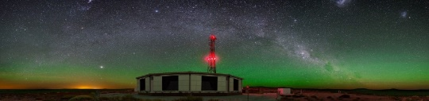

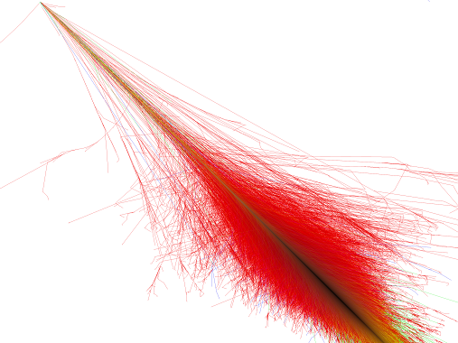

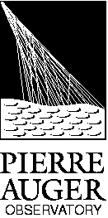

Cosmic Rays Anisotropies and
Point Sources at Pierre Auger Observatory
ENAA 2015
João Pedro Canhoto Espadanal
Notes:
Good morning,
The title of my thesis is
the Study of the longitudinal and transverse cosmic ray shower profiles at the Pierre Auger Observatory

Slide 2
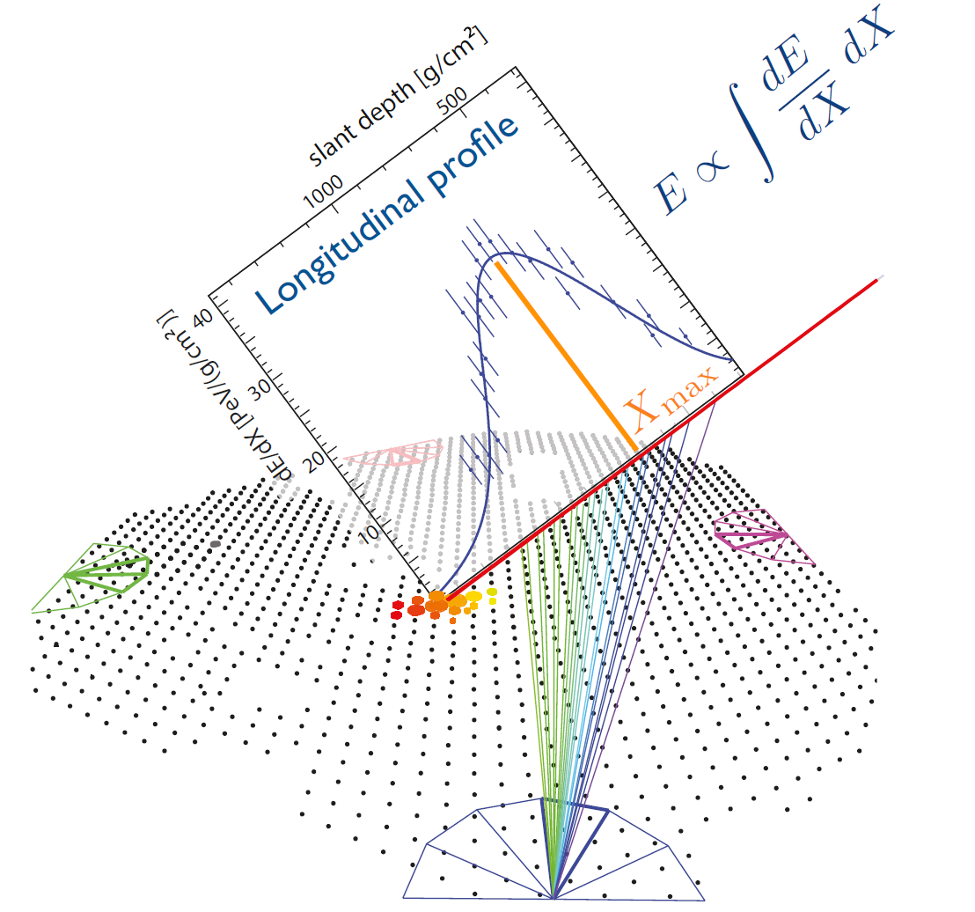
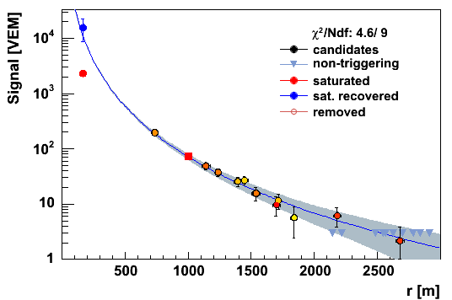
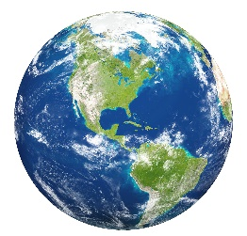
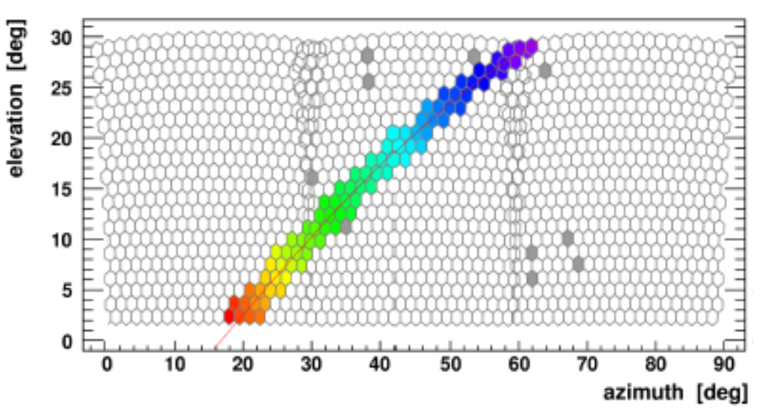
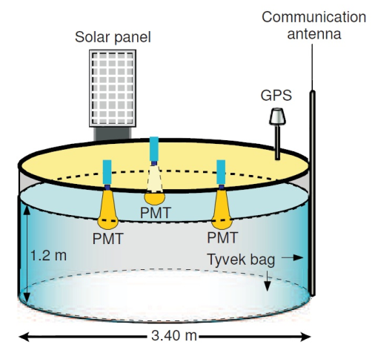
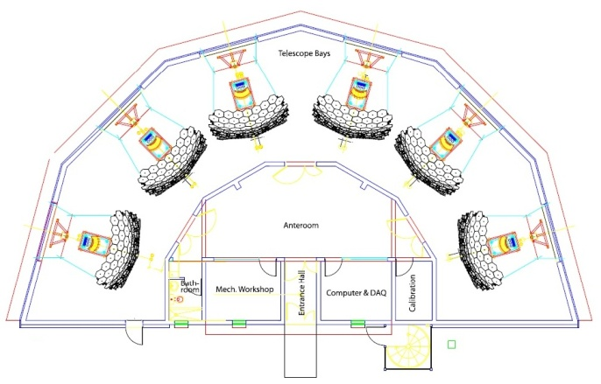
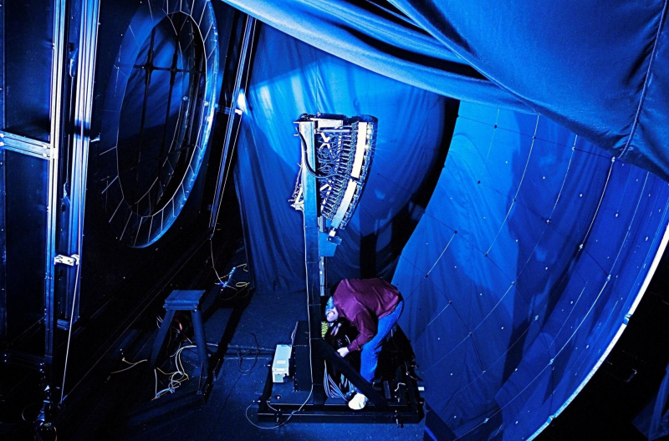
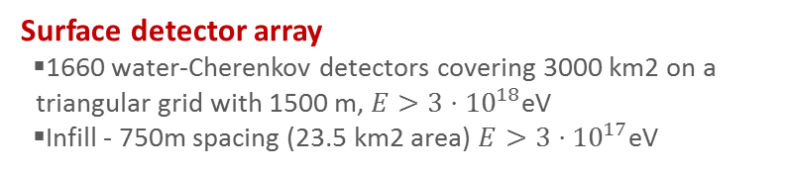

The Pierre Auger Observatory
Pierre Auger Observatory
The world’s largest cosmic ray observatory
In Argentina with $∼$3000km²
Fluorescence detector FD
fluorescence telescopes at 4 sites overlooking the SD array
Surface detector array
1660 water-Cherenkov detectors covering 3000 km2 on a triangular grid with 1500 m, $E>3⋅{10}^{18}$eV
Infill - 750m spacing (23.5 km2 area) $E>3⋅{10}^{17}$eV
Notes:
This is the map of the Pierre Auger observatory located at Mallargue Argentina,
it covers about 3000km^2.
To detect the shower light, we have 4 building, each one with 6 telescopes, in blue
and here is a representation of the building and a photo of one telescope.
There are also several atmospheric monitoring systems to control the systematic errors
This is an example of one event with 3 telescopes and the recovered longitudinal development with respective Xmax
This is the camera picture of the shower which contain some 3D shower information.

Slide 3
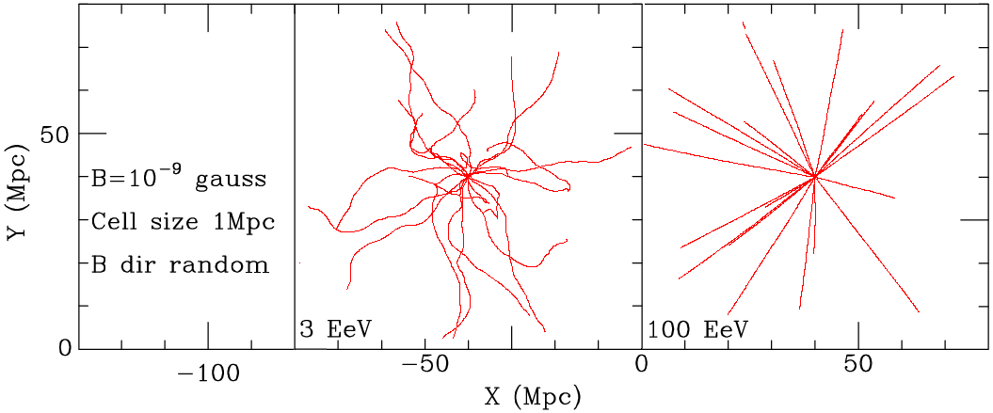

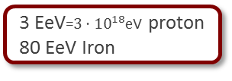
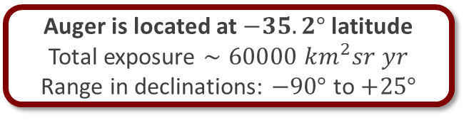
The Pierre Auger spectrum
Energy spectrum:
Propagation:
3 EeV=$3⋅{10}^{18}$eV proton
80 EeV Iron
100 EeV proton
2000 EeV Iron
Auger is located at $−35.2°$latitude
Total exposure $∼60000 km^{2}sr yr$
Range in declinations: $−90°$ to $+25°$
Anisotropies in the arrival directions for very high energies? $E≳40$ EeV
Large scale anisotropies around
$20EeV≳ E≳0.1 EeV$?
GMF, composition, distrib. of sources
Neutrino and photons fluxes?
Cosmic ray production mechanism
Where are the point sources?
Are there large scale anisotropies?
Lower Energy
Higher Energy

Slide 4
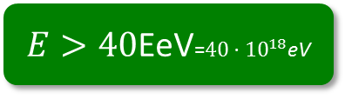
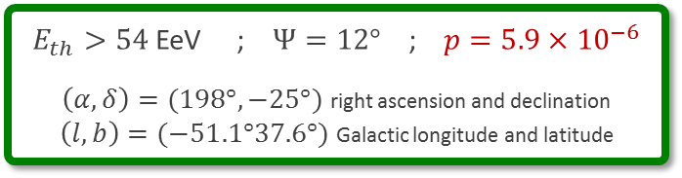

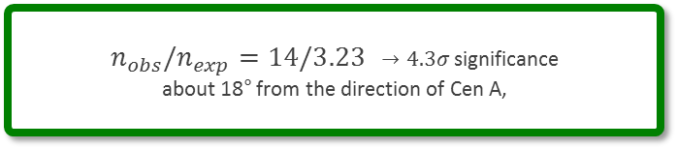
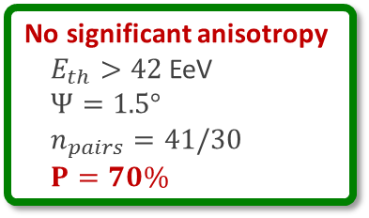
Anisotropies in the arrival directions for very high energies
$E>40$EeV=$40⋅{10}^{18}$eV
Were the most energetic Cosmic rays come from? $E>40$EeV
  Look for excesses over the visible sky
Galactic Coord.
  sample the exposed sky:
    using circular windows
  Scan in:
    circular windows, from 1° up to 30°, in 1° steps
    Events energy threshold, from 40 EeV up to 80 EeV in steps of 1 EeV.
    Calculate binomial probability:
    Isotropic flux to produce n equal, or larger, number of events than that found in the data
clustering of arrival directions
$E_{th}>54$ EeV ; $Ψ=12°$ ; $p=5.9×{10}^{−6}$
$\left(α,δ\right)=(198°,−25°)$ right ascension and declination
$\left(l,b\right)=(−51.1°37.6°)$ Galactic longitude and latitude
No significant anisotropy
$E_{th}>42$ EeV
$Ψ=1.5°$
$n_{pairs}=41/30$
$P=70\%$
$n_{obs}/n_{exp}=14/3.23$ $→4.3σ$ significance
about 18° from the direction of Cen A,

Slide 5
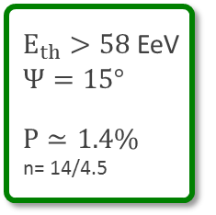
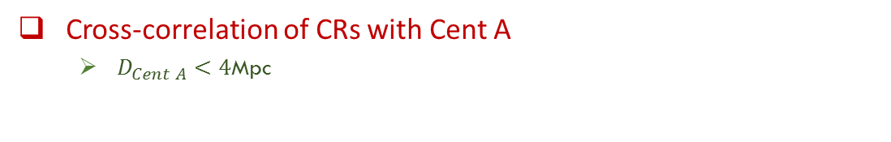
Anisotropies in the arrival directions: excess around Cen A
Cross-correlation of CRs with Cent A
  $D_{Cent A}<4$Mpc
$E_{th}>58$ EeV
$Ψ=15°$
$P≃1.4\%$
n= 14/4.5
Excess around Centaurus A
with 1.4 % prob from isotropic distribution
These results could be understood:
as due to the large deflections caused by the intervening magnetic fields if a large fraction of the CRs in this energy range were heavy,
the number of individual sources

Slide 6
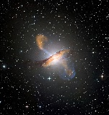
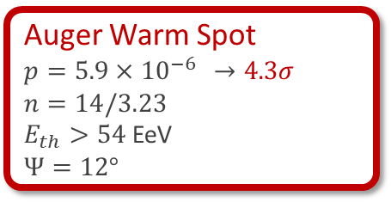

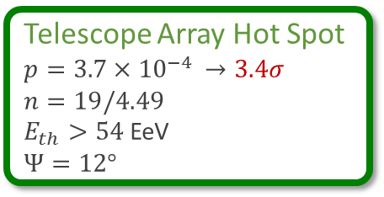

Anisotropies in the arrival directions: Full-Sky
Full-Sky: Auger +Telescope Array
Auger spot
Auger Warm Spot
$p=5.9×{10}^{−6}$ $→4.3σ$
$n=14/3.23$
$E_{th}>54$ EeV
$Ψ=12°$
TA spot
$\left(α,δ\right)=(198°,−25°)$ equatorial coord.
$\left(l,b\right)=(−51.1°37.6°)$ Galactic coord.
Galactic Coord.
TA spot
Telescope Array Hot Spot
$p=3.7×{10}^{−4}$ $→3.4σ$
$n=19/4.49$
$E_{th}>54$ EeV
$Ψ=12°$
$\left(α,δ\right)=(146.7°,43.2°)$ equatorial coord.
$\left(l,b\right)=(177.4°,50.2°)$ Galactic coord.
Auger spot
Equatorial Coord.

Slide 7
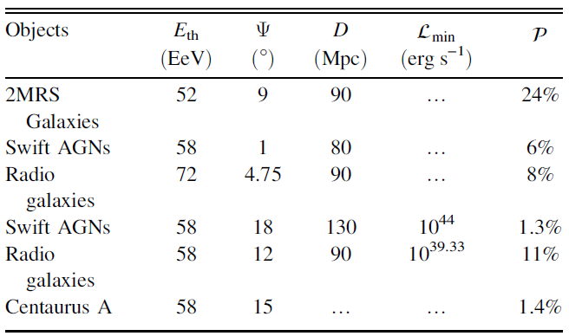

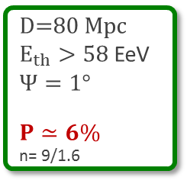
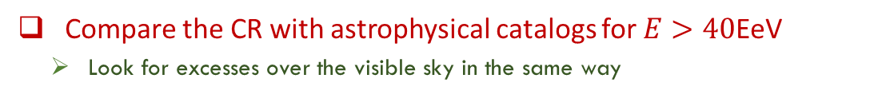
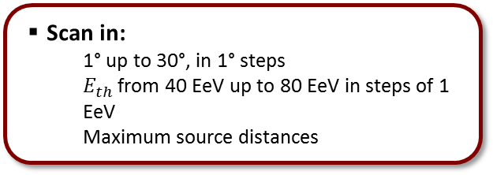
Anisotropies in the arrival directions for very high energies
$E>40$EeV=$40⋅{10}^{18}$eV
Compare the CR with astrophysical catalogs for $E>40$EeV
  Look for excesses over the visible sky in the same way
  Scan in:
    1° up to 30°, in 1° steps
    $E_{th}$ from 40 EeV up to 80 EeV in steps of 1 EeV
    Maximum source distances
  Example: Cross-correlation with the AGNs in the Swift-BAT catalog
D=80 Mpc
$E_{th}>58$ EeV
$Ψ=1°$
$P≃6\%$
n= 9/1.6
No significant deviations from isotropic distributions!
Galactic Coord.

Slide 8
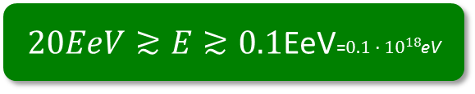
Large Scale anisotropies
Large Scale anisotropies with two analysis
$20EeV≳E≳0.1$EeV=$0.1⋅{10}^{18}$eV
  2D Harmonic analysis in right ascension
    E > 1 EeV: Rayleigh weighted for exposure
    E < 1 EeV: East – West: independent of detector and atmospheric effects, but with reduced sensitivity
  3D: Spherical harmonic analysis

Slide 9
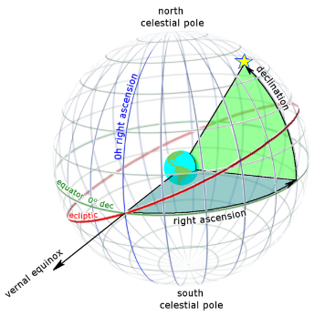
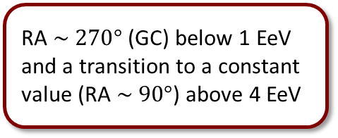
Large Scale anisotropies in right ascension
Dipole amplitude
  2D Harmonic analysis
  in right ascension
3 bins above 1 EeV
have isotropic probability < 1%
3 bins above 1 EeV have isotropic probability < 1%
Dipole amplitude
Dipole phase
RA $\sim 270°$(GC) below 1 EeV and a transition to a constant value (RA $\sim 90°$) above 4 EeV
dipole rising
from ~1% @ 1 EeV
to few % @ 10 EeV
Notes:
A/S: EeV CRs are galactic, their escape from the galaxy by diffusion/drift causes the anisotropies. A/S = antisymm./symm. halo field
Gal: CRs are galactic up to the highest energies, anisotropy caused by diffusive motion due to the turbulent component of the GMF
C-G Xgal: Compton-Getting effect for extragal. CRs due to the motion of our galaxy wrt the frame of extragal. isotropy (= CMB)

Slide 10
Large Scale anisotropies with Spherical harmonic At Auger
  3D: Spherical harmonic analysis
Only dipole searches
Incomplete sky-coverage and non-uniform exposure
alignment of the phases in right ascension as a function of the energy, as the previous slide
Only dipole and quadrupole searches
Protons @ EeV energies from stationary galactic sources origin disfavoured
Considering a Galactic magnetic field:
Regular: disk field and halo field + Turbulent field
Notes:
Generic estimates of the amplitudes expected from stationary galactic sources
GMF = regular (BSS disk field and anti-symmetric halo field) + turbulent field (according
to a Kolmogorov power spectrum)
Unless the strength of the GMF is much higher than in the picture used here, the upper
limits on dipole and quadrupole amplitudes challenge an origin of CRs from galactic
stationary sources distributed in the disk and emitting predominantly light particles
in all directions at EeV energy ranges
BSS model: Symmetric with respect to the galactic plane (logarithmic spiral model with reversal direction in two arms)
+ Anti-symmetric with respect to the galactic plane and purely toroidal
+ Kolmogorov power spectrum

Slide 11
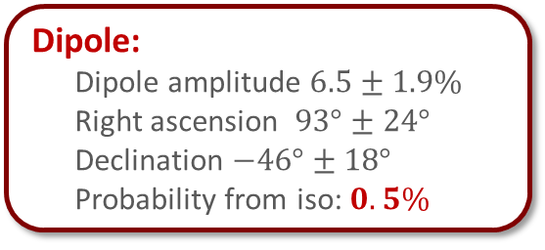
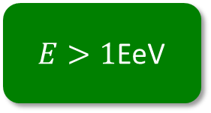
Large Scale anisotropies Spherical harmonic Full Sky
Full-Sky: Auger +Telescope Array
$E>1$EeV
Sky map with average flux
Dipole:
Dipole amplitude $6.5±1.9\%$
Right ascension $93°±24°$
Declination $−46°±18°$
Probability from iso: $0.5\%$
Multipoles amplitudes
Multipoles:
Quadrupole within statistical fluctuations expected from isotropic samples

Slide 12
Photons and neutrinos fluxes at Ultra High energy
Photon limits
Neutrino limits
  Photons flux strongly disfavour top-down model of CR acceleration
  E> 10 EeV start constraining the most optimistic predictions of cosmogenic photon fluxes in the assumption of a pure proton composition at the sources
  Neutrino flux disfavour, Waxman-Bahcall bound on neutrino production in optically thin sources and Some models of neutrino production in astrophysical sources such as Active Galactic Nuclei (AGN)
Notes:
Z-bursts: neutrinos coming from remote sources annihilate at the Z-resonance with relic background neutrinos. The Z bosons then decay, producing secondary protons, neutrinos and photons. The Z-resonance, which acts as a new cutoff, occurs when the energy of the incoming ν is $Eres =\frac{M_{Z}^{2}}{2}m_{ν}=4× {10}^{21}eV(eV/m_{ν})$
topological defects (necklaces) : GUT-scale mass particles, which in turn decay into quarks, leptons etc
super heavy dark matter particles (SHDM)
GZK photons
NEUTRINOS: The current Auger limit is approaching the fluxes predicted under a range of assumptions for the composition of the primary flux, source evolution and model for the transition from galactic to extragalactic cosmic-rays [18]. A 10-fold increase in the exposure will be needed to reach the most optimistic predictions in case of a pure iron composition at sources, out of the range of the current configuration of the observatory.
Bahcall and E. Waxman: the bound is valid for neutrinos produced either by p, γ reactions or by p − p ( n) reactions in sources which are optically thin for high energy protons to photomeson and nucleon-meson interactions.
-> high-energy neutrinos produced by photomeson interaction in sources of size not much larger than the proton photo-meson mean-free-path, e.g. AGN jets and GRBs
p, FRII & SFR : FRII=Radio galaxies - Fanaroff and Riley Class II
p, Fermi-LAT 99%: Cosmogenic neutrinos originate from photo-hadronic interactions of cosmic ray protons with the cosmic microwave background (CMB). a fit to the HiRes spectrum and Fermi-LAT measurements of the diffuse extragalactic γ-ray background

Slide 13
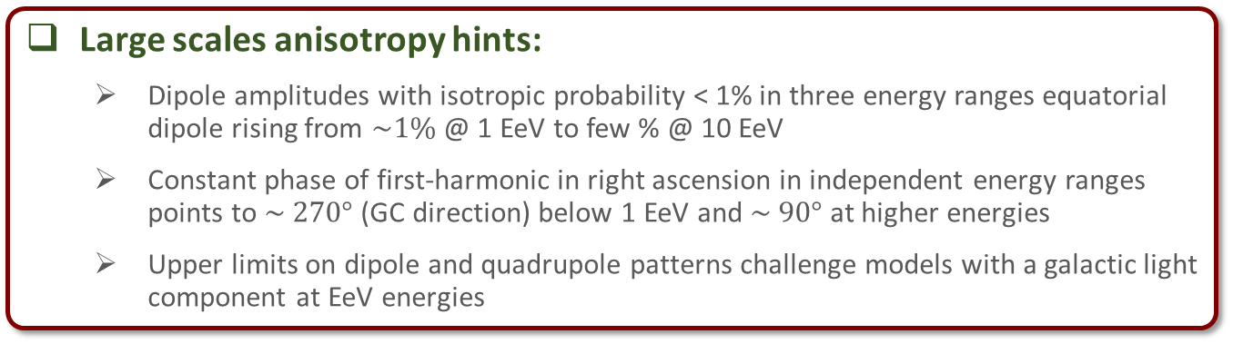
Summary
Arrival directions quite isotopically distributed
Large scales anisotropy hints:
  Dipole amplitudes with isotropic probability < 1% in three energy ranges equatorial dipole rising from $\sim 1\%$ @ 1 EeV to few % @ 10 EeV
  Constant phase of first-harmonic in right ascension in independent energy ranges points to $\sim 270°$ (GC direction) below 1 EeV and $\sim 90°$at higher energies
  Upper limits on dipole and quadrupole patterns challenge models with a galactic light component at EeV energies
Small angular scales:
  No clear evidence for anisotropy
  Excess near Cen A?
  No point-like (neutron) excess at 1 EeV
Neutrino and photon fluxes:
  Neutrino flux disfavour, Waxman-Bahcall bound on neutrino production in optically thin sources and Some models of neutrino production in astrophysical sources such as Active Galactic Nuclei (AGN)
  Photons flux strongly disfavour top-down model of CR acceleration

Slide 14
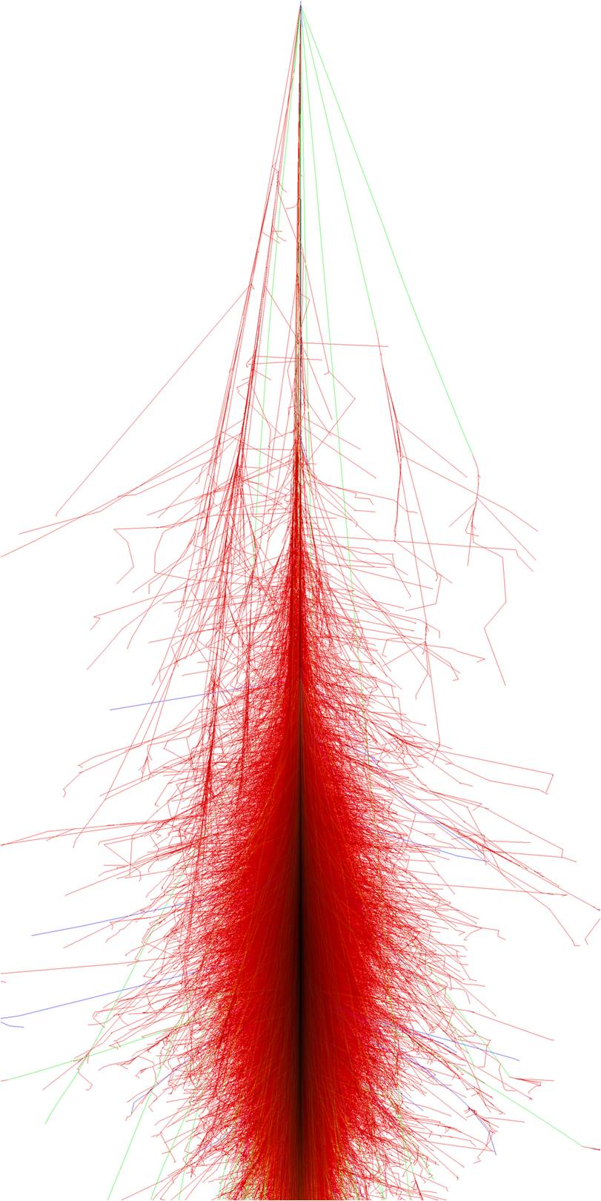

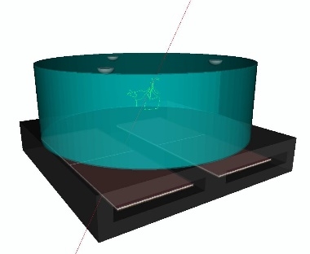
Thank you
  END

Slide 16
Backup Slides

Slide 17
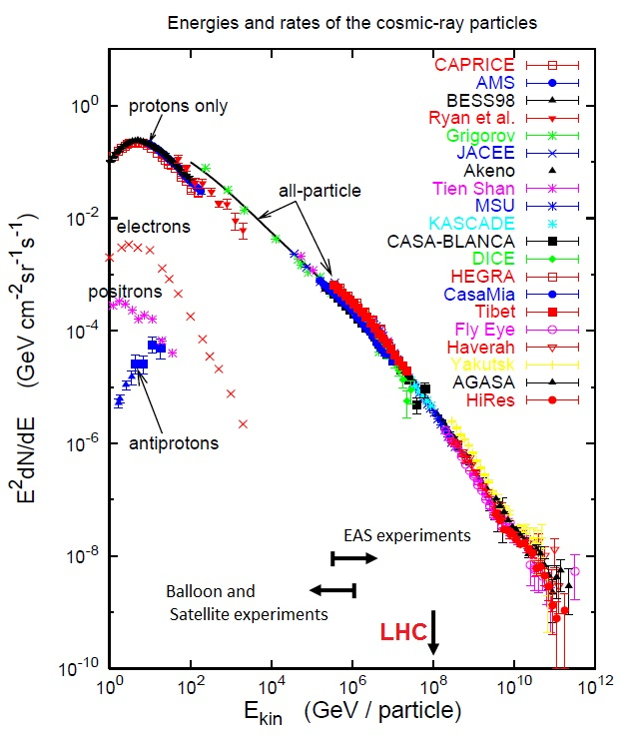
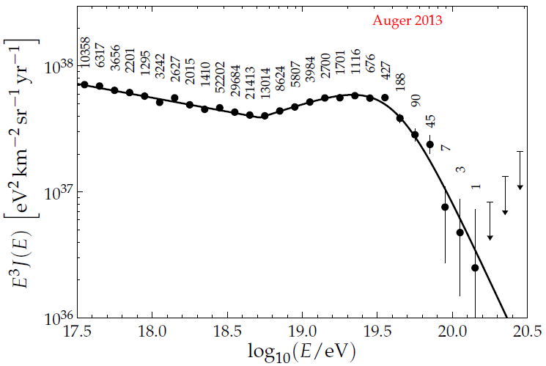
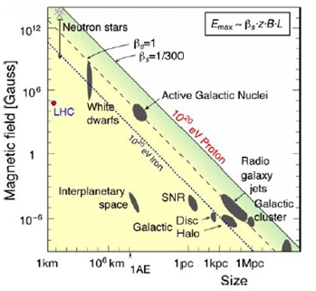
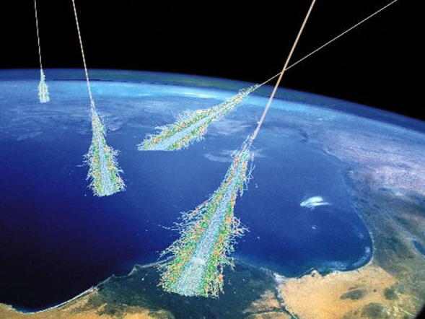
Cosmic Rays
Cosmic Rays
Extraterrestrial particles that hit the Earth
During early 20th century, most of the new particles were discovered in cosmic rays
Now, the most energetic particles we can access are cosmic rays
Recent Spectrum measure at Auger
Challenges:
  Small flux (difficult to detect directly)
  How to indirectly detect them?
  Which are their directions and sources?
  What is their composition?
  Are the interactions the same at those energies?
Cosmic Ray Suppression due to interaction with CMB?
Transition of cosmic rays origin from galactic to extragalactic?

Slide 18
The Pierre Auger Observatory
Pierre Auger Observatory
The world’s largest cosmic ray observatory
Radio detection
AERA (MHz)
EASIER (MHz, GHz)
MIDAS (GHz)
Atmospheric monitoring
Lasers: CLF, XLF
Lidar, Raman
Weather stations,
IR camera
Fluorescence detector
Loma Amarilla: E>1018 eV
Coihueco
Los Morados
Los Leones
HEAT: E>1017 eV
Calibration detectors
Lasers: Clf, Xlf
Lidar, Raman
Weather stations, IR camera
Surface detector array
1500 m: E>1018.5 eV
750 m (AMIGA): E>1017.5 eV
Notes:
This is the map of the Pierre Auger observatory located at Mallargue Argentina,
it covers about 3000km^2.
To detect the shower light, we have 4 building, each one with 6 telescopes, in blue
and here is a representation of the building and a photo of one telescope.
There are also several atmospheric monitoring systems to control the systematic errors
This is an example of one event with 3 telescopes and the recovered longitudinal development with respective Xmax
This is the camera picture of the shower which contain some 3D shower information.

Slide 19
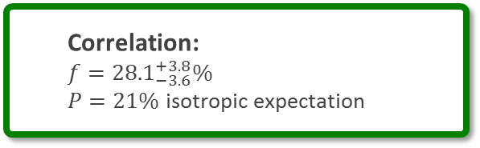
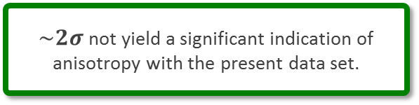
Nature update: Anisotropy test with the VCV Catalog
Update: Correlation of the highest energy cosmic rays with nearby extragalactic objects
Science 318 (2007) 938-943
Data set up to March 2014:
146 events above 53 EeV
41 events correlate with VCV catalog
Correlation:
$f={28.1}_{−3.6}^{+3.8}\%$
$P=21\%$ isotropic expectation
$\sim 2σ$ not yield a significant indication of anisotropy with the present data set.

Slide 20

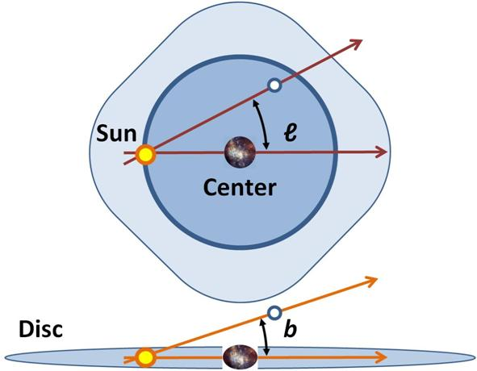
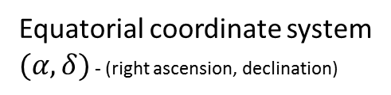
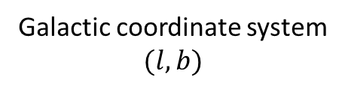
Equatorial coordinate system
$(α,δ)$ - (right ascension, declination)
Galactic coordinate system
$$(l,b)$$

Slide 21
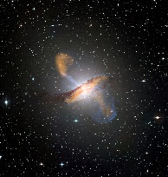
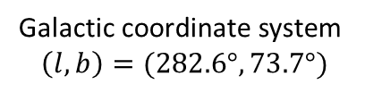

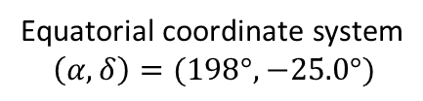

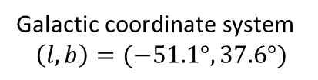
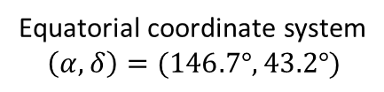




Centaurus A
Centaurus A
Auger Warm spot
Galactic coordinate system
$$\left(l,b\right)=(−50.5°,19.4°)$$
Galactic coordinate system
$$\left(l,b\right)=(−51.1°,37.6°)$$
Equatorial coordinate system
$$\left(α,δ\right)=(\text{201.2}5°,−43.0°)$$
Equatorial coordinate system
$$\left(α,δ\right)=(198°,−25.0°)$$
Ursa Major cluster
Galactic coordinate system
$$\left(l,b\right)=(282.6°,73.7°)$$
TA Hot spot
Equatorial coordinate system
$$\left(α,δ\right)=\sim (\text{18}0°,+50°)$$
Galactic coordinate system
$$\left(l,b\right)=(177.4°,50.2°)$$
Virgo cluster
Equatorial coordinate system
$$\left(α,δ\right)=(146.7°,43.2°)$$
Galactic coordinate system
$$\left(l,b\right)=(282.6°,73.7°)$$
Equatorial coordinate system
$$\left(α,δ\right)=(\text{186.5}°,+12°)$$

Slide 22
Map in Galactic coordinates of the arrival directions of the events with E ⩾ 52 EeV. The black (white) circles correspond to vertical (inclined) events. The size of each circle scales with the energy of the event. The color scale is proportional to the relative exposure

Slide 23
Li Ma
Li, T.-P., & Ma, Y.-Q. 1983, ApJ, 272, 317

Slide 24
Catalogs
2MRS - 2MASS Redshift Survey
2MASS (The Two Micron All Sky Survey)
Swift Gamma-Ray Burst Mission
Sky in n three infrared wavebands around 2 micrometres (μm): J (1.25 μm), H (1.65 μm), and Ks (2.17 μm)
Two 1.3 m equatorially mounted Cassegrain reflector telescopes:
Mt. Hopkins, Arizona for the Northern Hemisphere data
Cerro Tololo Inter-American Observatory, Chile, for the southern hemisphere
Three instruments work together to observe GRBs and their afterglows in the gamma-ray, X-ray, ultraviolet, and optical wavebands.
Swift/BAT: Energy range: 15–150 keV
The 70 Month Swift-BAT All-sky Hard X-Ray Survey, The Astrophysical Journal Supplement, V207, Issue 2, article id. 19, 2013.
J. Huchra , The 2MASS Redshift Survey - Description and Data Release, Astrophys. J. Suppl. 199, 2012
Compilation of radio galaxis
Van Velzen , Radio galaxies of the local universe: all-sky catalog, luminosity functions, and clustering, A&A 544, A18 (2012)

Slide 25


Search for a Localized Excess Flux over the Exposed Sky
Were Cosmic rays come from?
  Look for excesses over the visible sky
    sample the exposed sky:
    using circular windows with radii varying from 1° up to 30°, in 1° steps. The centers of the windows are taken on a 1° × 1° grid.
    energy threshold of the events used to build the maps is varied from 40 EeV up to 80 EeV in steps of 1 EeV.
    Calculate binomial probability:
    Isotropic flux to produce n equal, or larger, number of events than that found in the data
$p=5.9×{10}^{−6}$ ; $E_{th}>54$ EeV ; $Ψ=12°$
$\left(α,δ\right)=(198°,−25°)$ right ascension and declination
$\left(l,b\right)=(−51.1°37.6°)$ Galactic longitude and latitude
$n_{obs}/n_{exp}=14/3.23$ $→4.3σ$ significance
about 18° from the direction of Cen A,

Slide 26



Search for correlations with the galaxy and with the super-galactic plane
Galactiv Center
$E_{th}>60$ EeV
$b_{CG,max}=19°$
$n=12/5.6$
$P=29\%$
Galactic Plane
$E_{th}>$72 EeV
$b_{G,max}=30°$
$n=29/22.8$
$P=70\%$
Super Galactic Plane
$E_{th}>$53 EeV
$b_{SG,max}=19°$
$n=89/69.7$
$P=20\%$

Slide 27


Cross-correlation with Flux-limited Samples: 2MRS catalog
Scan:
$10<D<200$Mpc, 10Mpc steps
${40<E}_{th}>80$ EeV, in 1EeV steps
$1°<Ψ<30°$, in $1°$ steps
2MASS Redshift Survey
$D=90$ Mpc
$E_{th}>52$ EeV
$Ψ=9°$
$P=24\%$

Slide 28

Cross-correlation with Flux-limited Samples: with the AGNs in the Swift-BAT catalog
Scan:
$10<D<200$Mpc, 10Mpc steps
${40<E}_{th}>80$ EeV, in 1EeV steps
$1°<Ψ<30°$, in $1°$ steps
AGNs in the Swift-BAT
$D=80$ Mpc
$E_{th}>58$ EeV
$Ψ=1°$
$P=6\%$

Slide 29

Cross-correlation with Flux-limited Samples: with jetted radio galaxies
Scan:
$10<D<200$Mpc, 10Mpc steps
${40<E}_{th}>80$ EeV, in 1EeV steps
$1°<Ψ<30°$, in $1°$ steps
jetted radio galaxies
$D=90$ Mpc
$E_{th}>72$ EeV
$Ψ=4.75°$
$P=8\%$

Slide 30

Cross-correlation with Flux-limited Samples: with Bright AGNs from Swift AGNs
Scan:
$10<D<200$Mpc, 10Mpc steps
${40<E}_{th}>80$ EeV, in 1EeV steps
$1°<Ψ<30°$, in $1°$ steps
AGNs from Swift AGNs
$L>{10}^{44} erg.s^{−1}$
$D=130$ Mpc
$E_{th}>58$ EeV
$Ψ=18°$
$P=1.3\%$

Slide 31


Cross-correlation with Flux-limited Samples: with Bright AGNs from radio galaxies
Scan:
$10<D<200$Mpc, 10Mpc steps
${40<E}_{th}>80$ EeV, in 1EeV steps
$1°<Ψ<30°$, in $1°$ steps
AGNs from radio galaxies $L>{10}^{39.3} erg.s^{−1}$
$D=90$ Mpc
$E_{th}>72$ EeV
$Ψ=4.75°$
$P=8\%$
AGNs from radio galaxies $L>{10}^{40} erg.s^{−1}$
$D=90$ Mpc
$E_{th}>58$ EeV
$Ψ=12°$
$P=11\%$

Slide 32

Photon limits
Neutrino limits
Z-bursts: neutrinos coming from remote sources annihilate at the Z-resonance with relic background neutrinos. The Z bosons then decay, producing secondary protons, neutrinos and photons. The Z-resonance, which acts as a new cutoff, occurs when the energy of the incoming ν is $Eres =\frac{M_{Z}^{2}}{2}m_{ν}=4× {10}^{21}eV(eV/m_{ν})$
topological defects (necklaces) : GUT-scale mass particles, which in turn decay into quarks, leptons etc
super heavy dark matter particles (SHDM)
GZK photons
Bahcall and E. Waxman:
p, FRII & SFR : cosmogenic n models that assume a pure primary proton composition at the sources for strong evolution (FRII-type) of the sources
p, Fermi-LAT 99%:
G. Gelmini, O. Kalashev, D. Semikoz, JETP 106 (2008) 1061 [arXiv:astro-ph/0506128].
J. Ellis, V. E. Mayes, D. V. Nanopoulos, Phys. Rev. D 74 (2006) 115003 [arXiv:astro-ph/0512303].
J. Bahcall and E. Waxman, Phys. Rev. D 64 (2001) 023002 [arXiv:hep-ph/9902383].
M. Ahlers et al., Astropart. Phys. 34 (2010) 106 [arXiv:1005.2620].
K. -H. Kampert, M. Unger, Astropart. Phys. 35 (2012) 660 [arXiv:1201.0018].
Notes:
NEUTRINOS: The current Auger limit is approaching the fluxes predicted under a range of assumptions for the composition of the primary flux, source evolution and model for the transition from galactic to extragalactic cosmic-rays [18]. A 10-fold increase in the exposure will be needed to reach the most optimistic predictions in case of a pure iron composition at sources, out of the range of the current configuration of the observatory.
Bahcall and E. Waxman: the bound is valid for neutrinos produced either by p, γ reactions or by p − p ( n) reactions in sources which are optically thin for high energy protons to photomeson and nucleon-meson interactions.
-> high-energy neutrinos produced by photomeson interaction in sources of size not much larger than the proton photo-meson mean-free-path, e.g. AGN jets and GRBs
p, FRII & SFR : FRII=Radio galaxies - Fanaroff and Riley Class II
p, Fermi-LAT 99%: Cosmogenic neutrinos originate from photo-hadronic interactions of cosmic ray protons with the cosmic microwave background (CMB). a fit to the HiRes spectrum and Fermi-LAT measurements of the diffuse extragalactic γ-ray background

Slide 34





















Extensive Air Shower
Cosmic rays constantly hit the Earth (In Auger $E≳{10}^{18}$ eV and very small fluxes)
What is an Extensive Air Shower (EAS)?
Hadronic component
Cosmic Ray??
(p, Fe, ɣ ... )
The hadronic interactions produce
p n π⁰ + π⁺ + π ⁻
+ К Λ η Ω Σ …
Electromagnetic Component
$$π^{0}$$
$$π^{+}$$
Produced mainly by
π⁰ → ɣ ɣ
$$γ$$
$$π^{−}$$
$$e^{−}$$
Bremsstrahlung
Pair production
…
$$e^{+}$$
$$π^{0}$$
$$π^{+}$$
$$π^{−}$$
High energy pions
$$ν_{μ}$$
$$μ^{+}$$
$$ν_{μ}$$
Muonic Component
$$\overline{ν_{μ}}$$
$$μ^{−}$$
$$μ^{+}$$
Produced mainly by
electromagnetic
hadronic
muonic
Low energy pions can decay
Notes:
The Earth is constantly hit by extra-terrestrial particles.
But at the energies above 10^18 that we want to study at auger,
the CR fluxes are very small and we cannot detect them directly,
so there many unknowns
What is the composition of cosmic rays?
What is the origin of these extremely energetic particles?
And what kind of interactions occurs at those energies?
Since we cannot build a huge detector in space, We use the atmosphere as the detector.
So, when a cosmic ray enters the atmosphere, it will interact with the air nuclei, in an hadronic interaction, producing many of particles.
Many hadrons are produced, mostly pions with a fraction of 1/3 neutral pi and 2/3 charged pions.
These charge pions can interact again producing more particles
Which is usually called the hadronic component and is close to the axis.
The neutral pions, have a very small lifetime, so they decay almost immediately.
And they decay into two photons.
These photons produces e-e+ pairs
which will again produce more photons and in several processes and so on
. Creating the electromagnetic cascade.
When the charge pions losses most of their energy, they will not have time to interact,
And they will decay into muons and neutrinos producing the muon component.

Slide 35



How to detect the Extensive air showers?
Through the emitted light with telescopes
From electromagnetic component
1. Cherenkov Light
2. Fluorescence Light in Nitrogen
Cherenkov
Light
Fluorescence Light
Through particles that reach the ground with surface detectors
  Electromagnetic component
  PLUS Muonic component
Longitudinal development: Deposited Energy
Cosmic Ray Primary Energy
Quasi calorimetric energy measurement in the atmosphere
$$∝$$
Fluorescence light
(dE/dX)max
Xmax
g/cm² of crossed atmosphere
Notes:
How can we detect those shower of particles?
When that cascade of particles pass through the air, they ionize and excite the nitrogen.
when the nitrogen return to the ground state, it emits light fluorescence.
Besides that, since those particles are relativistic particle they will emit Cherenkov light.
In this way we can be detect the fluorescence and Cherenkov light, simply by using telescopes.
the number of fluorescence photons are proportional to the energy deposited by the particles of the shower,
then, summing all the fluorescence light, we can obtain a longitudinal profile of the energy deposit in the atmosphere.
The integral of this curve will be basically/proportional to the energy of the cosmic ray,
and the atmosphere works like a calorimetry
This point with the bigger energy deposited is known as the xmax of the longitudinal development.
Moreover, that we can also detect the particles that reach the ground with surface detectors.
But here, we detect both electromagnetic and muon particles, while on the longitudinal it comes mainly from the electromagnetic component.

Slide 36


  $X_{max}$ and $σ(X_{max})$
  $X_{max}$
  $σ(X_{max})$

Slide 38
$$X_{max}^{μ}$$

Slide 41




Muons results in Auger not consistent with models
$μ$ lateral profile: Very Inclined events to avoid EM contamination
$R_{μ}$ with energy
$$S_{1000}∝R_{μ}$$
Electromagnetic and muonic sectors
Inconsistency! In cosmic ray composition! Between muons and em!
$$X_{max}^{μ}$$
Muons
electromagentic
Notes:
But the muons in auger are not consistent with the models
If we are in very inclined events, the EM component was almost completely attenuated by the atmosphere
So the signal at 1000m is basically the number of muons
This is the auger result with the number of muons as a function of the energy
There are much more muons than predicted by the models
If we renormalize the same plot we can see the big difference in the data
In inclined events we can also indirectly estimate the the xmax of the muons
And if we compare the composition from the muons and electromagnetic sectors they are not consistent

Slide 43
The Energy Scale of the Pierre Auger Observatory
  FD energy uncertainty
  SD energy uncertainty

Slide 44
About 1/4 of the collected air showers have zenith angles exceeding 60◦.

Slide 45
Notes:
P(hybrid) -> To avoid a possible mass-composition bias due to the different trigger probabilities for proton- and iron-induced showers, events are only accepted if the average expected SD trigger probability is larger than 95%. The probability is estimated for each event given its energy, core location and zenith angle (cf. [75]). This cut removes about 5% of events, mainly at low energies.
Xmax -> Xmax is within the observed profile range. Events where only the rising and/or falling edge of the profile has been observed are discarded, since in such cases the position of Xmax cannot be reliably estimated
Quality -> expected precision of the Xmax -> which is calculated in a semianalytic approach by expanding the Gaisser-Hillas function around Xmax and then using this linearized version to propagate the statistical uncertainties of the number of photoelectrons at the PMT to an uncertainty of Xmax. Only showers with ˆσ < 40 g=cm2
-> We studied the behavior of <Xmax> as a function of the minimum observation angle , αmin, and found systematic deviations below αmin ¼ 20°,
Fiducial cuts -> The aim of this selection is to minimize the influence of the effective field of view on the Xmax distribution by selecting only type (C) geometries
Profile cuts -> events with gaps in the profile that are longer than 20% of its total observed length are excluded.
-> standard-normal transformation to the χ2 of the profile fit, z = ( chi^2-ndf)/sqr(2ndf) and reject showers in the non-Gaussian tail at > 2.2σ.
-> minimum observed track length of > 300 g=cm2 is required

Slide 47

Auger Exposure
Annual Exposure $\sim 5370km^{2} sr yr$
ICRC2011
Exposure $\left[km^{2}sr yr\right]$ 01/2004 and 12/2010 $→20905 km^{2} sr yr$
ICRC2013
Notes:
[18.45-18.55] -> 6200 ~ (5E37/(1E18.5)^3)*5370*( 1E18.55 - 1E18.45 )
[18.95-19.05] -> 620 ~ (5E37/(1E19)^3)*5370*( 1E19.05 - 1E18.95 )
[19.65-19.75] -> 20 ~ (4E37/(1E19.7)^3)*5370*( 1E19.75 - 1E19.65 )
integral 5E37/x^3 dx from 1E18.3 to 1E19.5 = 6.25472
N = 6.25472 * 5370 = 33562.5
[18.5,19.5] N = 2.475*5370 = 13290.75

Slide 48
the SD 750 m spectrum had to be scaled up
by 2%, the inclined spectrum up by 5% and the hybrid down by 6%

Slide 50
FD Calibration

Slide 51



Muonic contribution in hybrid events
We don’t have the expected signal on the ground (LDF-Lateral distribution Function)
From hybrid events:
Longitudinal Profile ($\sim Calorimetry$)
Lateral Profile (LDF)
Atmosphere -> FD -> Longitudinal Profile
Choose an Energy bin ${10}^{18.8}<E<{10}^{19.2} eV$
$$E_{lab}=10EeV → E_{CM}=137 TeV$$
Cosmic ray inclination $0°<θ<60°$
Ground -> SD ->LDF (Lateral distribution Function)
Idea: Re-simulate measured hybrid events(FD+SD)
● Match longitudinal FD light profile
● Rescale ground signal to match SD data
● Contributions of EM and muon component vary with zenith angle
$$S_{resc}=R_{E}S_{EM}+ R_{E}^{α}R_{μ}S_{μ}$$
G. Farrar ICRC2013 arXiv:1307.5059v1

Slide 52

Muonic contribution in hybrid events
Ground Signal from MC
have different EM/muon component
$$S_{resc}=R_{E}S_{EM}+ R_{E}^{α}R_{μ}S_{μ}$$
Muon number in simulations is too low by at least a factor of 1.3
Beware: Fixing models with two factors is probably not the end of story
Energy Rescaling ⬄ EM rescaling:
G. Farrar ICRC2013 arXiv:1307.5059v1

Slide 53
Muon counting: Muon scale from very inclined air showers
Rμ = Nμ(event) / (E/10^19)
N19
N19
Very inclined air showers
● Long distance to ground, only muons survive
● First and most direct measurement of muon scale
I. Valino ICRC2013 arXiv:1307.5059v1

Slide 54




Muon counting: Muon fraction from signal shape
Multivariate Method
$f_{μ}=S_{μ}/S$
$$f_{μ}=a+bθ+cf_{0.5}^{2}+d θ P_{0}+e r$$
Squared threshold normalized total signal
$$f_{0.5}^{2}=\frac{{\left(\sum_{j=1}^{N}{x_{j}}∥\left\{x_{j}>0.5\right\}\right)}^{2}}{{\left(\sum_{j=1}^{N}{x_{j}}\right)}^{2}}$$
Normalized zero-frequency component
$$P_{0}=\frac{{\left(\sum_{j=1}^{N}{x_{j}}\right)}^{2}}{N\sum_{j=1}^{N}{x_{j}^{2}}}=\frac{{\left\langle x\right\rangle }^{2}}{\left\langle x^{2}\right\rangle }$$
B. Kegl ICRC2013 arXiv:1307.5059v1

Slide 55




Muon counting: Muon fraction from signal shape
Total Signal Corrected for the center of the bin in radius and energy
$f_{μ}=S_{μ}/S$
$$S\left(1000\right)=S\frac{LDF(1000m)}{LDF(r)}$$
While the measured angular dependence of the muonic signal is found to be similar to the prediction obtained for proton showers and QGSJETII.04, the magnitude of the muonic signal is comparable to the predictions for iron showers.
$$S_{19}=S\left(1000\right)×C(E)$$
Zenith angle $θ<60°$
Energy $E∈[{10}^{18.98},{10}^{19.02}]$
Surface Detector distance
$r∈\left[950,1050\right]m$
B. Kegl ICRC2013 arXiv:1307.5059v1

Slide 56




Muon counting: Muon fraction from signal shape
$$+$$
Energy ${10}^{19}eV$
$$S_{μ19}\left(1000\right)=f_{μ}×S_{19}(1000)$$
$1.33±0.02(stat.)±0.05(sys.)$(multivariate)
$1.31±0.02(stat.)±0.09(sys.)$(smoothing)
B. Kegl ICRC2013 arXiv:1307.5059v1

Slide 57









L width
Parameterized by Gaisser-Hillas function:
R ~ Rotation
L ~ Width

Slide 58






3D Shower shape
Shower in 3D space:
  Shower intrinsic width
Shower Image width
Shower intrinsic width
Atmosphere
Detector
  Atmospheric effects
  Detector effects
Light aberration
Internal reflections
Reflections and detections efficiencies
SDId 3599086
Energy = 1.58x10¹⁹
Distance _{to eye}= 3.87 km
Multi Scattering
Notes:
how we see the Shower in the space? This is another event. As you can see we have some lateral width.
Where this Shower Image width come from?
->Part of the shower width come from the intrinsic shower width.
->Nevertheless, We have the atmosphere, which is good because is our calorimetry. However, now when the shower light propagates we will have multiscattering that spreads the light, and we will see an increase in the width of the shower, an attenuation of the amount of light, So the shower image will get blurred.
Here for example, we can see some Cherenkov scattered even without detect Cherenkov light directly.
In this way we need to understand the atmosphere very carefully , since the amount of multiscaterring depends on the composition of the atmosphere
-> we also have the detector, which are telescopes. they will produce distortions on the real image of the shower. We will have light aberration from the optics, internal reflection, transmissions and efficiencies that change our 3D image of a shower.
So the shower image we see, is a convolution of the real shower with the detector plus the atmosphere effects. And we need to understand each step in it.

Slide 59



3D Simulation vs standard Offline simulation
We generate the air showers
All information
is projected into a line
Longitudinal
profiles
Is Better
to have
To study interesting lateral information we need to have a 3D simulation, instead of having the information projected into a line
( at the generator level)
To study interesting lateral information we need to have a 3D simulation, instead of having the information projected into a line
( at the generator level)
Notes:
We need to have a good description of the shower 3D shape to understand all the image on the detectors.
In the standard simulation, simulate a shower, when we simulate a shower, we generate the event and we project all the information into a line, in longitudinal profiles and we will lose the 3D information. It is latter recovered using average profiles
But we lose the information lateral information shower to shower.
In this way we are developing a 3D simulation of the showers.
So we divide the sky in cylindrical bins around the shower axis and save the relevant information at the generator level

Slide 60












Direct Cherenkov emission
Information for Cherenkov depends on the particle directions
$l_{φ′}$ length travelled by particles in SkyBin in $φ′$ direction
$$l_{φ}$$
$$Δφ$$
$l_{α}$ length travelled by particles in SkyBin in $α$ direction
$$φ′$$
x_{sh}
$$φ_{i}$$
$e^{−}$direction
Shower direction
$$n_{ch,α}$$
$$l_{α}$$
SkyBin i
$$α$$
y_{sh}
$$Δφ$$
Top View
x_{sh}
Shower axis
$N_{ph}=n_{particles}∙l_{α}\frac{l_{φ}}{l_{Total}}c_{k}\left(1−\frac{1}{n^{2}}\right)\left(\frac{1}{λ_{2}}−\frac{1}{λ_{1}}\right)$
$$φ$$
y_{sh}

Slide 61




BinTheSky: In Auger Offline Framework
3. 3D Simulation Method
BinTheSky is embodied in the Auger Offline Framework
(Auger Simulation and reconstruction software)
New Offline Module: ShowerSimulatorLX
Propagation
time
  Produce photons
    Fluorescence and Cherenkov emission
  Propagate Photons to detector
    solid angle; emission angle; distance to telescope
  Attenuate and scatter photons
    Attenuations due to Mie and Rayleigh
    Cherenkov scattered and Multiple-scattering
    (not yet implemented)
SkyBin
$$φ′$$
Emission
time
𝚫𝝓 bin = 1º
$$α$$
  for each SkyBin find $α$ and $φ′$ bins in FoV.
  Calculate the solid angle and attenuation for ($α,φ′$) bin
$α$ bin = 1º
1bin in $α$
and 𝚫𝝓

Slide 62

3D Simulation
Select a sample of events
Produce electrons in CORSIKA
Fluorescence Light
Save 3D information
(ROOT file)
Cherenkov
Light
Simulate in The Auger
Offline Framework
Rayleight Scattering
Mie Scattering
Compare the 3D simulation
Standard simulation
And data
1st sample: fluorescence rich events
with some scattered Cherenkov (<10% Cherenkov)
2nd sample: Cherekov
rich events
with some scattered Cherenkov (>75%)

Slide 63
3D vs standard simulation
Standard simulation
3D simulation
emissions
Times…

